Slide 1
Periodicity
Periodicity is the repetitive pattern of a property for elements based on atomic number.
The following properties are discussed in this chapter:
Sizes of atoms and ions
Ionization energy
Electron affinity
Some group chemical property trends
First, we will discuss a fundamental property that leads to may of the trends, effective nuclear charge.

Slide 2
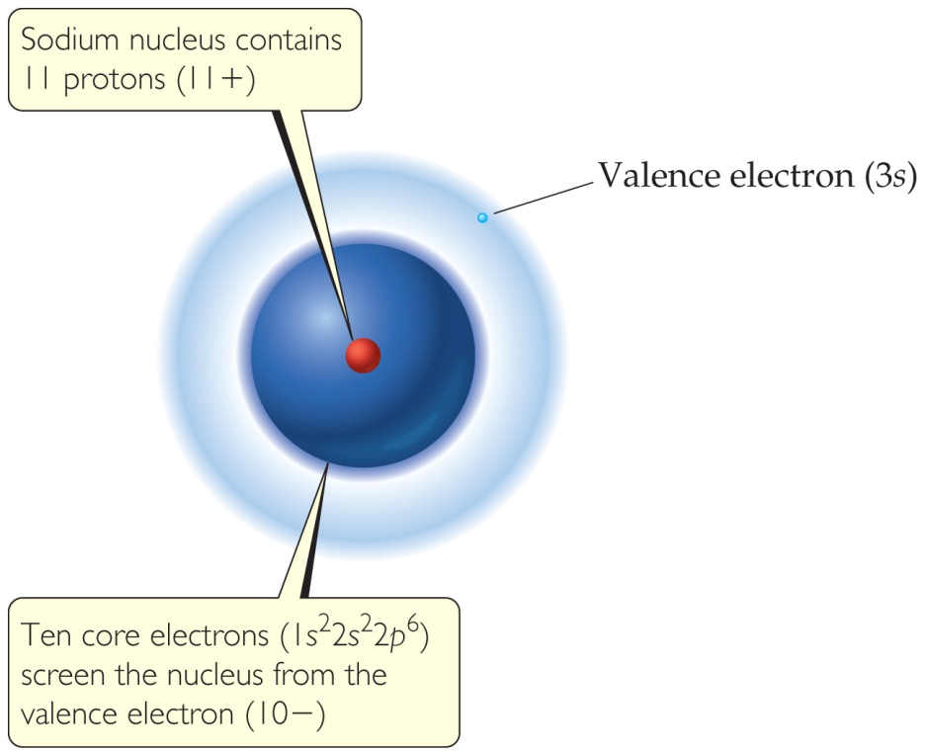
Effective Nuclear Charge
Many properties depend on attractions between valence electrons and the nucleus.
Electrons are both attracted to the nucleus and repelled by other electrons.
The forces an electron experiences depend on both factors.

Slide 3
Effective Nuclear Charge
The effective nuclear charge, Z_{eff}, is found this way:
Z_{eff} = Z − S
where Z is the atomic number and S is a screening constant, usually close to the number of inner electrons.
Effective nuclear charge is a periodic property:
It increases across a period.
It decreases down a group.

Slide 4
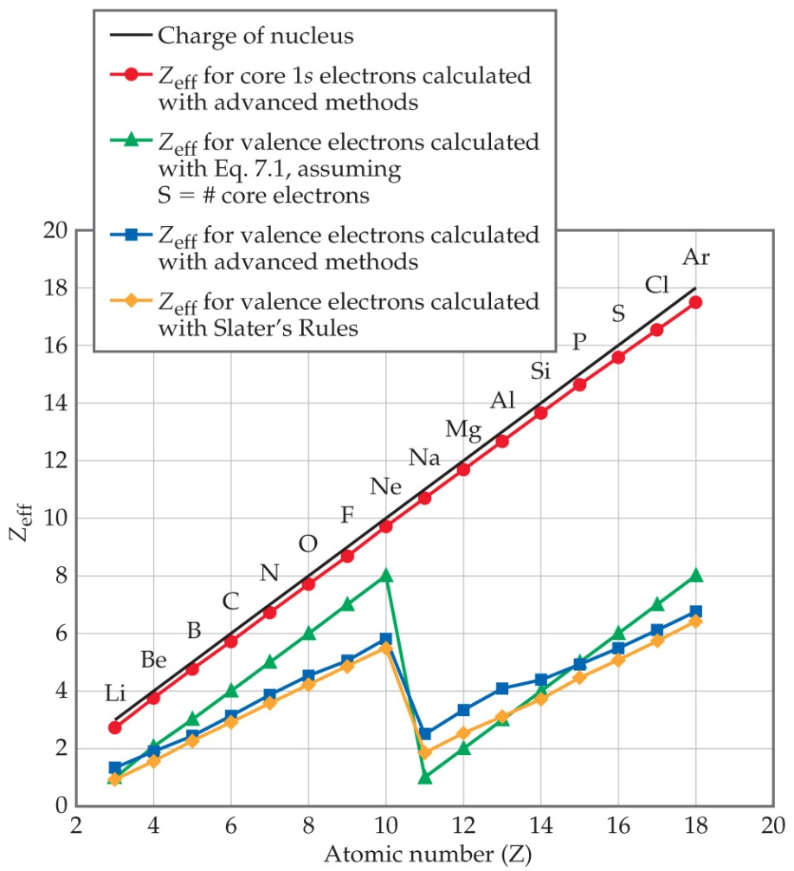
Effective Nuclear Charge Increases across a Period

Slide 5
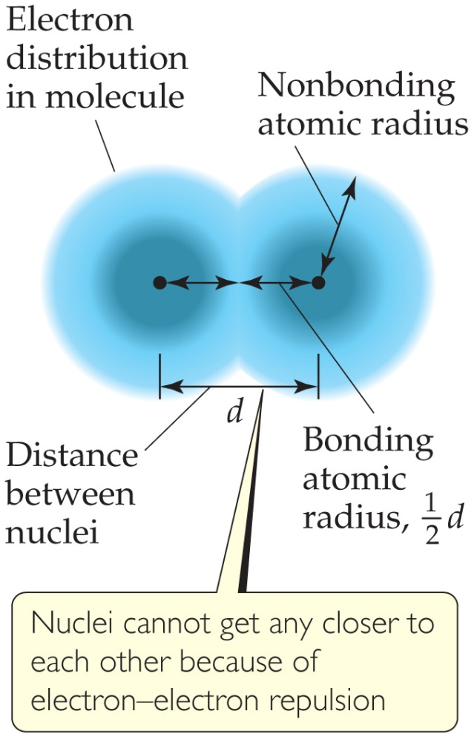
What Is the Size of an Atom?
The nonbonding atomic radius or van der Waals radius is half of the shortest distance separating two nuclei during a collision of atoms.

Slide 6
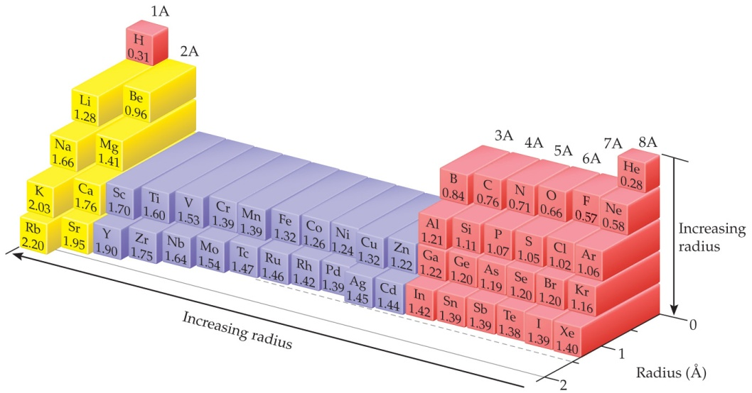
Sizes of Atoms
The bonding atomic radius is half the internuclear distance when atoms are bonded.
The bonding atomic radius tends to
— decrease from left to right across a period (Z_{eff} ↑).
— increase from top to bottom of a group (n ↑).

Slide 7
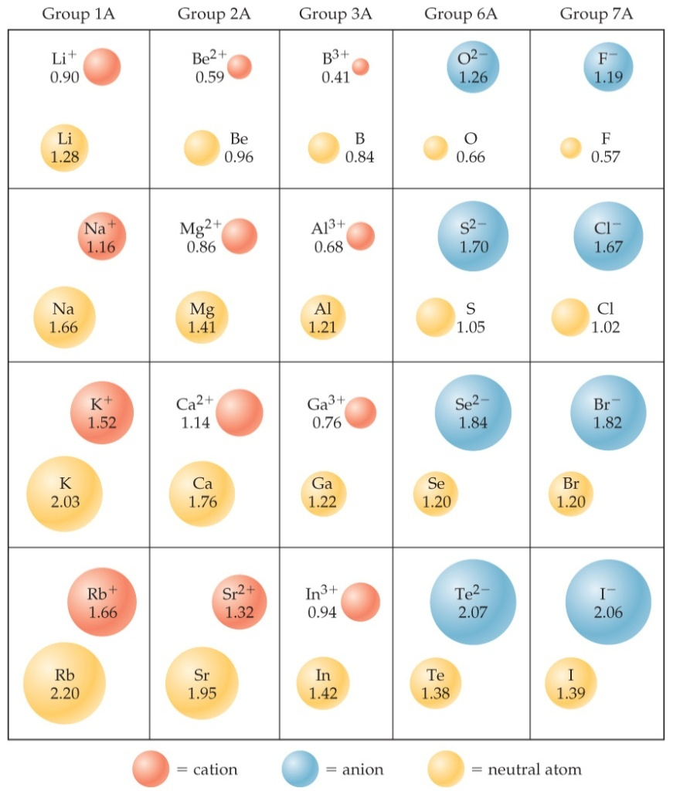
Sizes of Ions
Determined by interatomic distances in ionic compounds
Ionic size depends on
the nuclear charge.
the number of electrons.
the orbitals in which electrons reside.

Slide 8
Sizes of Ions
Cations are smaller than their parent atoms:
The outermost electron is removed and repulsions between electrons are reduced.
Anions are larger than their parent atoms:
Electrons are added and repulsions between electrons are increased.

Slide 9
Size of Ions— Isoelectronic Series
In an isoelectronic series, ions have the same number of electrons.
Ionic size decreases with an increasing nuclear charge.
An Isoelectronic Series (10 electrons)
Note increasing nuclear charge with decreasing ionic radius as atomic number increases
O^{2–} | F– | Na⁺ | Mg²⁺ | Al³⁺
1.26 Å | 1.19 Å | 1.16 Å | 0.86 Å | 0.68 Å

Slide 10
Ionization Energy (I)
The ionization energy is the minimum energy required to remove an electron from the ground state of a gaseous atom or ion.
The first ionization energy is that energy required to remove the first electron.
The second ionization energy is that energy required to remove the second electron, etc.
Note: the higher the ionization energy, the more difficult it is to remove an electron!

Slide 11
Ionization Energy
It requires more energy to remove each successive electron.
When all valence electrons have been removed, it takes a great deal more energy to remove the next electron.

Slide 12
Periodic Trends in First Ionization Energy (I₁)
I₁ generally increases across a period.
I₁ generally decreases down a group.
The s- and p-block elements show a larger range of values for I₁. (The d-block generally increases slowly across the period; the f-block elements show only small variations.)

Slide 13
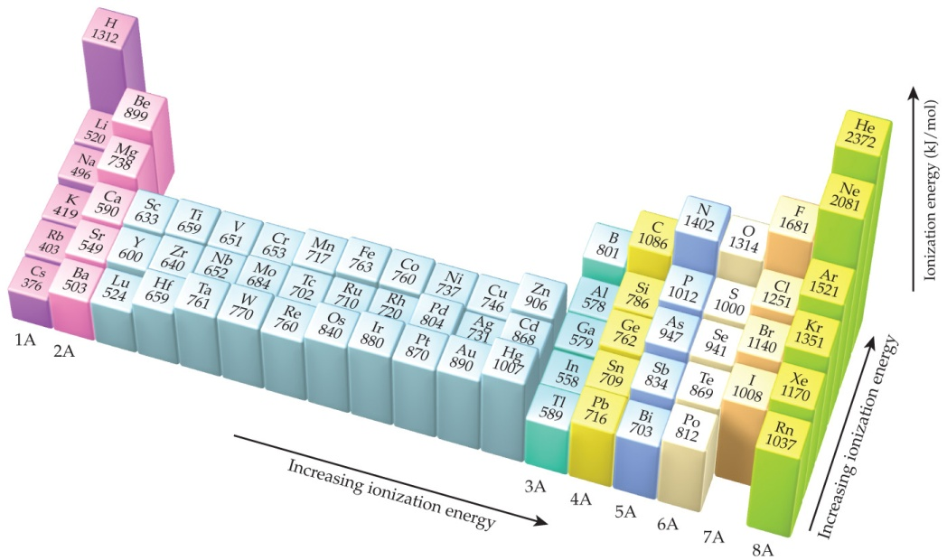
Factors that Influence Ionization Energy
Smaller atoms have higher I values.
I values depend on effective nuclear charge and average distance of the electron from the nucleus.

Slide 14
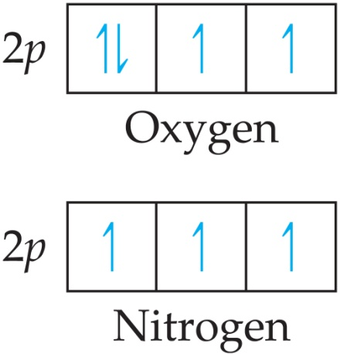
Irregularities in the General Trend
The trend is not followed when the added valence electron in the next element
enters a new sublevel (higher energy sublevel);
is the first electron to pair in one orbital of the sublevel (electron repulsions lower energy).

Slide 15
Electron Configurations of Ions
Cations: The electrons are lost from the highest energy level (n value).
Li⁺ is 1s² (losing a 2s electron).
Fe²⁺ is 1s²2s²2p⁶3s²3p⁶3d⁶ (losing two 4s electrons).
Anions: The electron configurations are filled to ns²np⁶; e.g., F– is 1s²2s²2p⁶ (gaining one electron in 2p).

Slide 16
Electron Affinity
Electron affinity is the energy change accompanying the addition of an electron to a gaseous atom:
Cl + e⁻ ⎯⎯→ Cl⁻
It is typically exothermic, so, for most elements, it is negative!

Slide 17
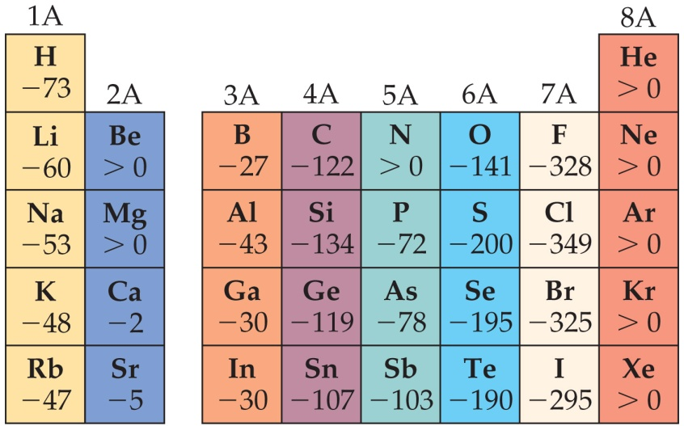
General Trend in Electron Affinity
Not much change in a group.
Across a period, it generally increases. Three notable exceptions include the following:
Group 2A: s sublevel is full!
Group 5A: p sublevel is half-full!
Group 8A: p sublevel is full!
Note: the electron affinity for many of these elements is positive (X– is unstable).

Slide 18
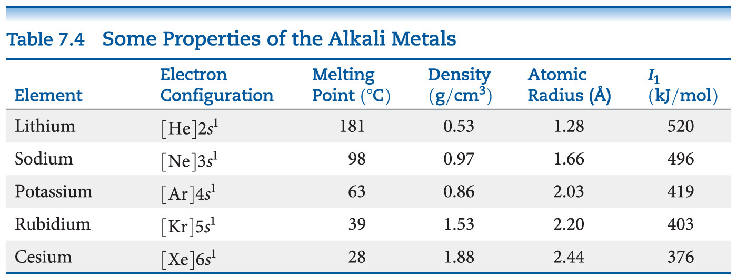
Alkali Metal Properties
They have low densities and melting points.
They also have low ionization energies.

Slide 19
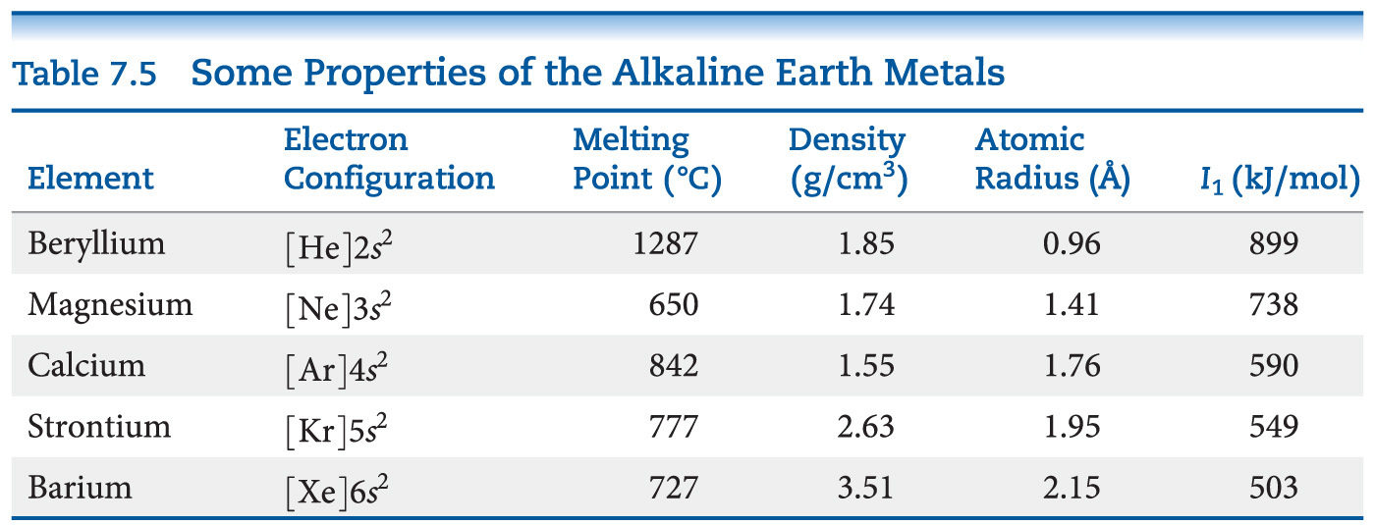
Alkaline Earth Metals—Compare to Alkali Metals
Alkaline earth metals have higher densities and melting points than alkali metals.
Their ionization energies are low, but not as low as those of alkali metals.

Slide 20
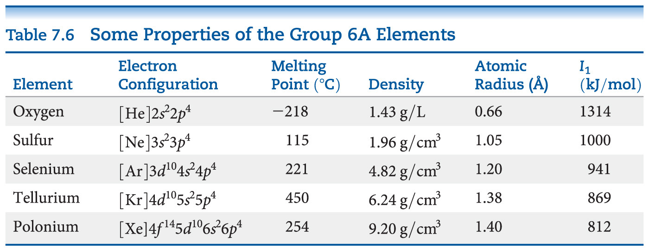
Group 6A—Increasing in Metallic Character down the Group
Oxygen, sulfur, and selenium are nonmetals.
Tellurium is a metalloid.
The radioactive polonium is a metal.

Slide 21
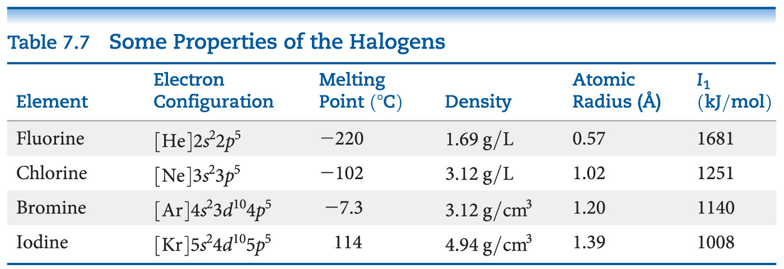
Group 7A—Halogens
The halogens are typical nonmetals.
They have highly negative electron affinities, so they exist as anions in nature.
They react directly with metals to form metal halides.

Slide 22
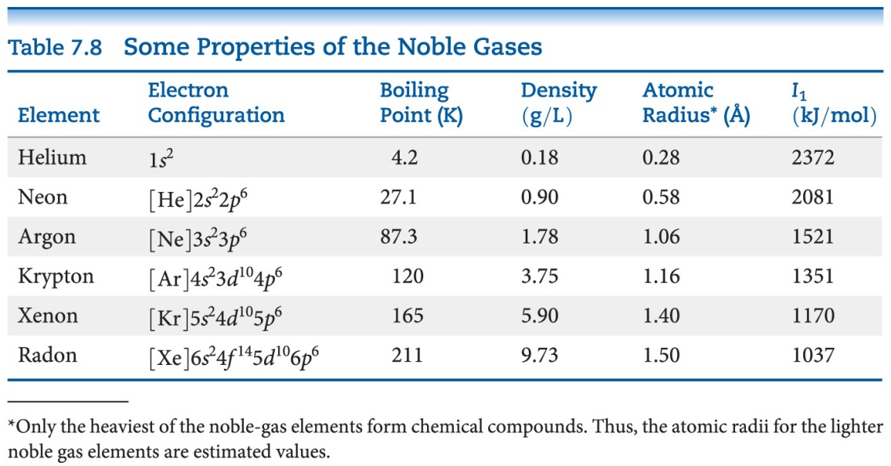
Group 8A—Noble Gases
The noble gases have very large ionization energies.
Their electron affinities are positive (can’t form stable anions).
Therefore, they are relatively unreactive.
They are found as monatomic gases.

