Slide 1
Graphing errors
What’s wrong with this picture

Slide 2
What makes a good graph
Good graphs give information about the experiment. A good graph revels trends that might not be visible looking at raw data.

Slide 3
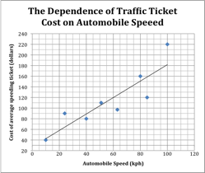
Here is a good graph

Slide 4
Why is this a good graph?
The graph has a descriptive title
The axes are labeled with quantities and units.
The scales are evenly spaced and follow the 1-2-5 rule
The graph is formatted such that the maximum area of paper is used with the 1-2-5 rule

Slide 5
And??
The graph is easy to read, neat, and without cross outs, blobs or other messes.
The label on the vertical axis is easy to read by turning the page one-quarter turn in the clockwise direction.
The correct variable was used on the correct axis.
Scale numbers are even, round numbers or values with decimals of 0.1, 0.2, or 0.5 when the numbers make sense.

Slide 6
Is there more? Why, yes! Thank you for asking.
Tick marks are carefully placed on the axis
Scale numbers are set on the heaviest lines are regular intervals at least two lines apart.
The data points are spread out and visible, and the curve is the best-fit straight line.
The line is drawn smoothly among the points, not zigzagged.

Slide 7
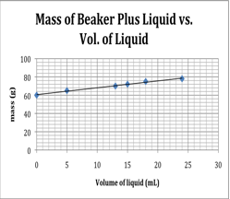
Now let’s look at some not so good graphs
The title is a repeat of the axes.
The graph should start closer to zero
The y-axis does not follow 1-2-5
The y-axis is labeled wrong
Notes:
Now lets look at a poor graph: At first glance, this graph seems reasonable. There is a title (not a good one). The axes look okay. The correct variable is on the correct axis-it is a density chart! The grapher seems to follow the rules. But on closer inspection, we see that the graph has some proble

Slide 8
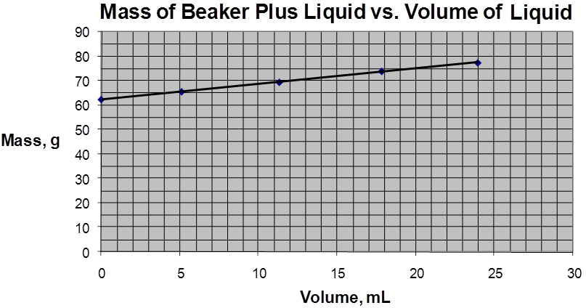
Is this graph correct?
Title?
Space Unused!!
There is no need to start at zero if your first point is far from it.
Notes:
The title does not contain enough information about the experiment. The student would be better served to start the graph at 50. Notice how the graph is cramped.

Slide 9
How would you fix these graphs
Part of creating a good graph is knowing how to fix errors in a poor graph
Each of these graphs have problems
How can they be fixed?

Slide 10
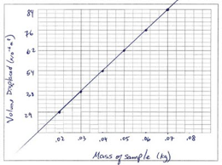
Density of an unknown liquid
Title
Axes are reversed
Scale
Y-axis

Slide 11
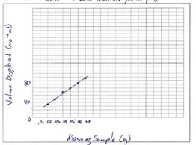
Another density graph

Slide 12
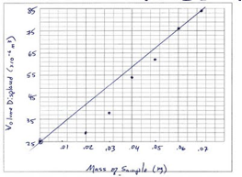
density
What do you see?

Slide 13
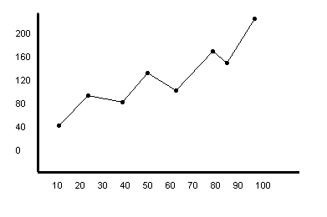
Problem Here?
This graph is useless!!
Title
Labels?
The dots are
connected!!

