Slide 1


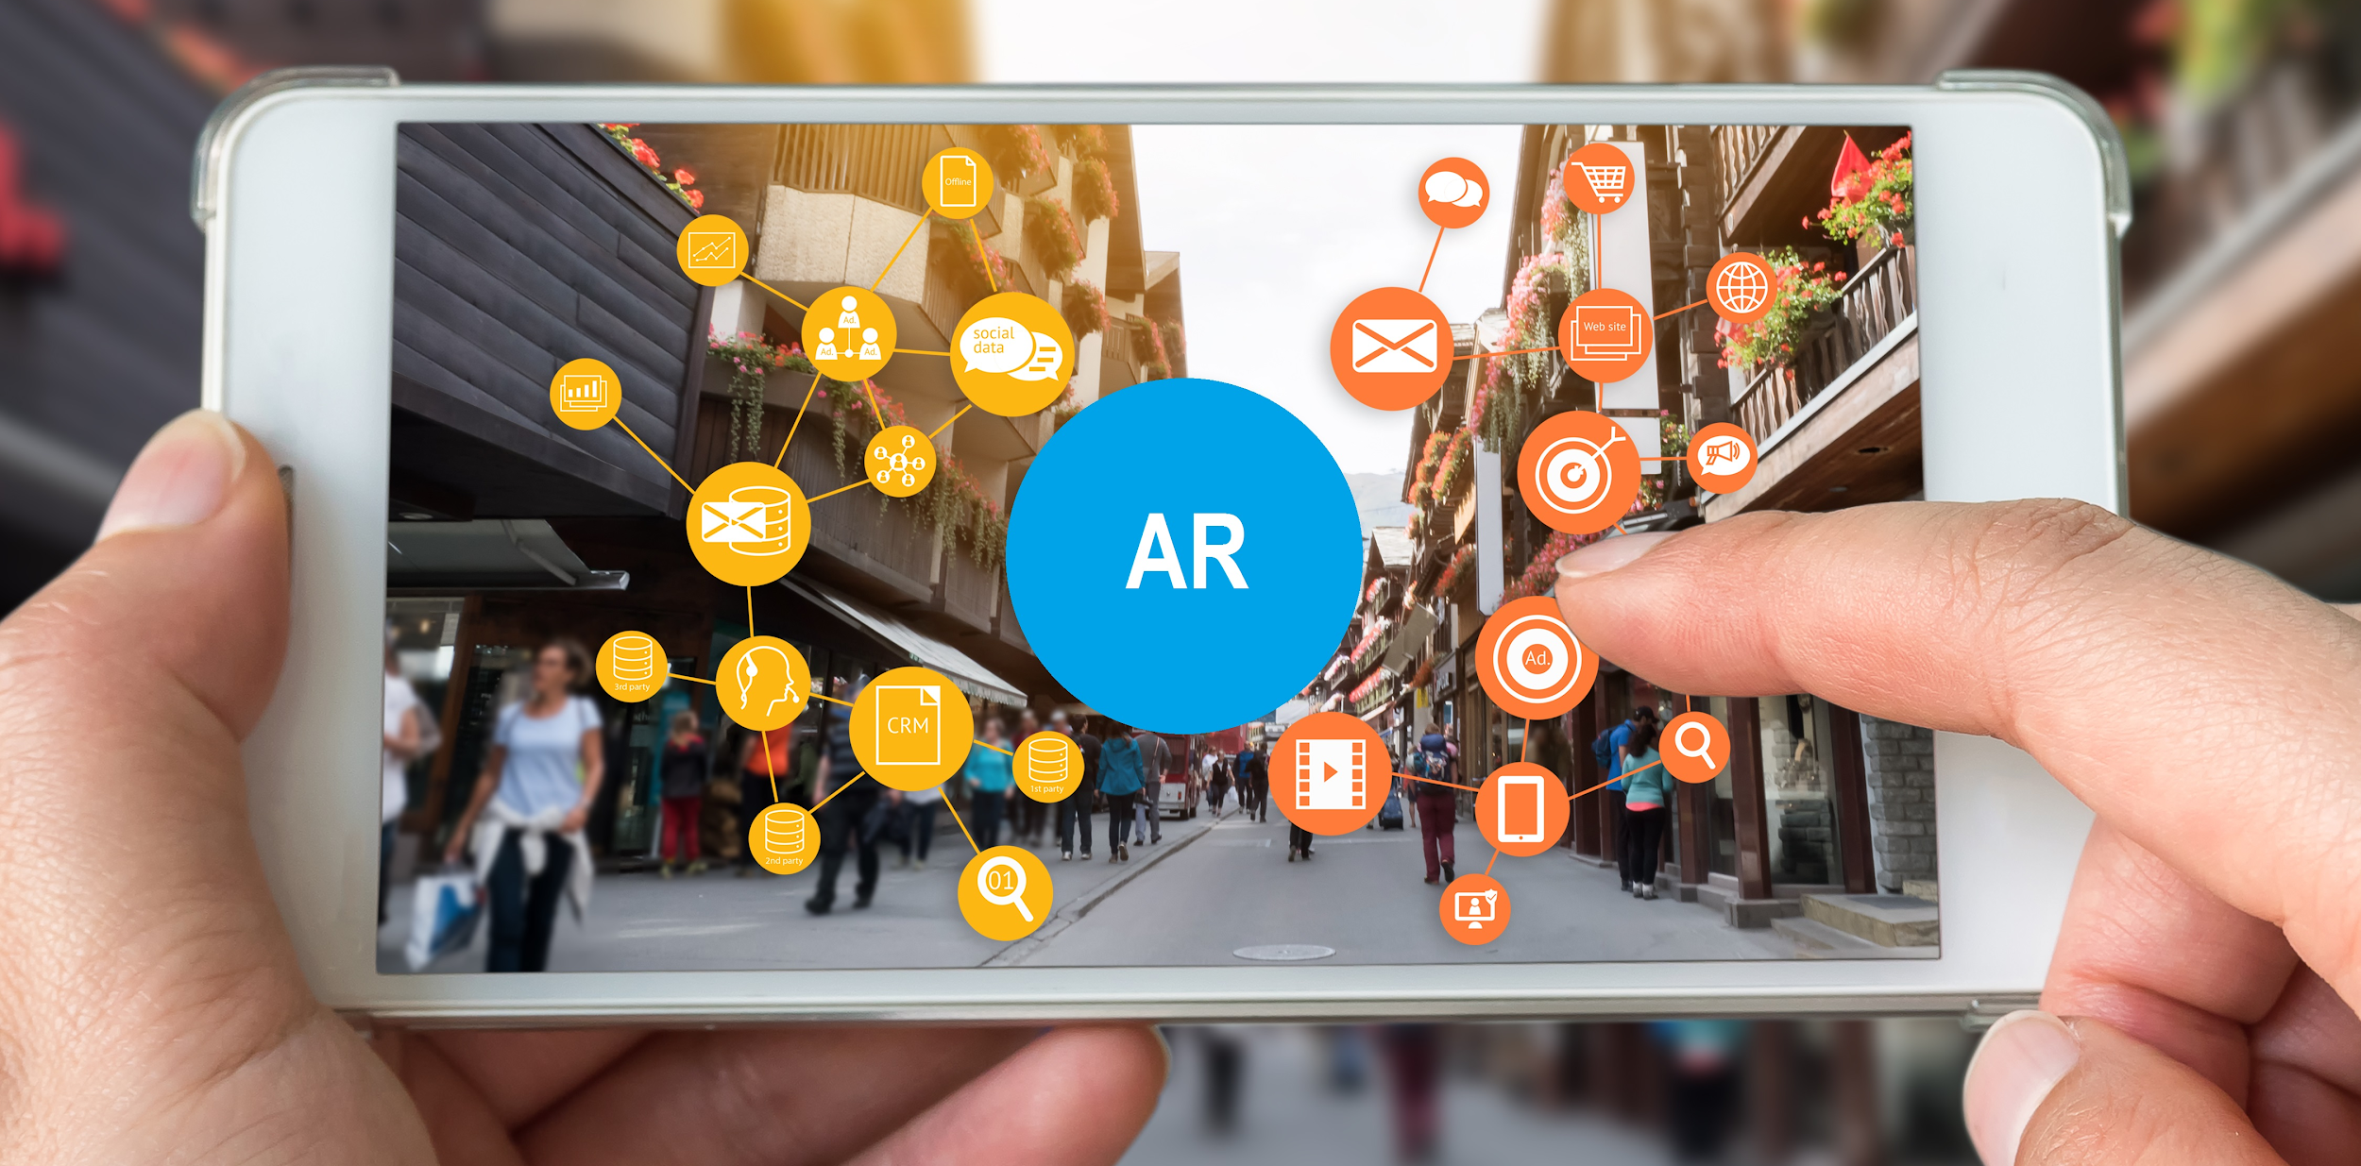

Unity and Pathstream partnered to build an
Immersive Design with VR/AR Certificate
to meet the fast-growing needs of employers and job seekers.
VR/AR Immersive Design Certificate
2 courses | 6 credit hours | No prerequisites
Preparing graduates for employability & career success with:
1
Virtual Reality Design Visualization
Foundational knowledge + applied digital skills
College or university degree
Tech skill from relevant software partner
2
Augmented Reality Design Visualization
Hands-on software training, including:
Mobile Augmented Reality
Demand for this skill is growing significantly:
There were ~350,000 job openings in 2018 for 3D Graphics jobs
Demand for 3D graphics skills are growing 40% faster than overall market job growth
20% of open positions are entry-level, providing a strong career launching opportunity
Salaries for 3D Graphics positions are over $70,000 on average
Real-time 3D skills (such as Unity) command an 18% salary premium to overall 3D Graphics positions
Through this program, students will:
Learn foundational Unity skills to create in a virtual space
Create highly realistic and immersive virtual scenes by adding and manipulating features, such as lighting, materials, textures, object animations, and post-processing effects
Incorporate interactable menus and media (audio, video, images) to the experience
Use these skills to create and deploy VR applications on OculusGO and AR application on mobile devices
Students will be able to:
Create immersive VR experiences and AR applications for real world use cases such as iterative design for automotive applications, architectural design visualizations, and remote assistance & training applications
Customize features such as lighting, media, and interactive elements to increase realism and practical functionality
Manage real workflows of importing virtual assets and CAD models

