Slide 1
Writing
Communication on Campus: Institutional Learning Outcome #1 Assessment Results and Discussion

Slide 2
Agenda
Introduction and purpose
Lunch
Preliminary Data – assessment of writing
Panel Discussion – strengths and problems in student writing
Brainstorm college-wide initiatives to help students write better
Existing resources

Slide 3
ILO #1 - Communication
ILO #1 Assessment Goal – assess communication in as many classes as possible.
Rubric Options: Writing, Oral Presentations, Media, Visual and Performing Arts

Slide 4
Purposes of this session
Find out about existing resources (on campus and online) to help students write more effectively.
Get feedback/suggestions from the college community on institution-wide initiatives to help students write better.
This semester, work on implementing an action plan: develop college-wide resources/initiatives and effectively use existing ones to help students write better.
Publicize these resources and initiatives.

Slide 5
Data - Writing
21 instructors participated (so far)
808 student writing samples assessed
Participating instructors were from Anthropology, Art, Asian/Asian American Studies, Biology, Chemistry, English, History, Political Science, Psychology

Slide 6
Note
Some instructors assessed ILO #1 via oral presentations or art (Sociology, Art departments)
We chose to focus on Writing for this discussion.

Slide 7
Rubric Categories (Writing)
Understanding of Assignment
Content/Support
Structural Organization
Grammar/Mechanics

Slide 8
Spreadsheet – Raw Data

Slide 9
Understanding of Assignment
Excellent | Good | Fair | Needs Work | Not done
33% | 31% | 14% | 7% | 15%

Slide 10
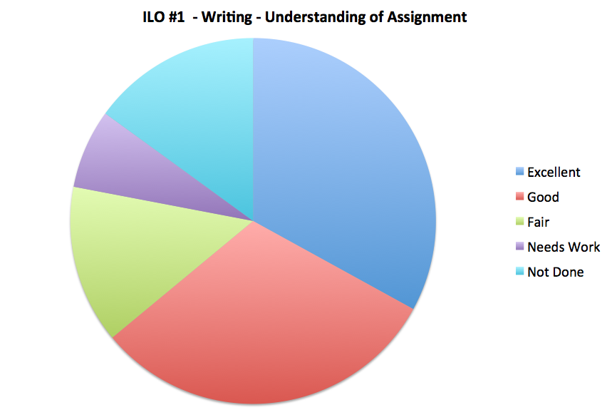

Slide 11
Content and Support
Excellent | Good | Fair | Needs Work | Not done
27% | 26% | 19% | 13% | 15%

Slide 12
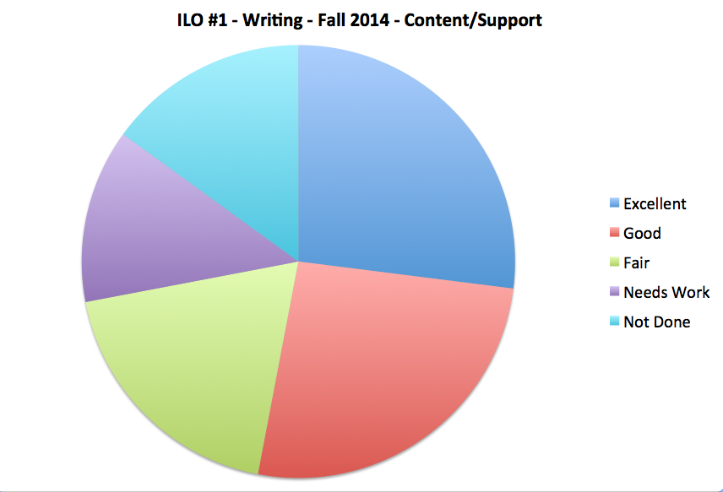

Slide 13
Structural Organization
Excellent | Good | Fair | Needs Work | Not done
28% | 27% | 19% | 11% | 15%

Slide 14
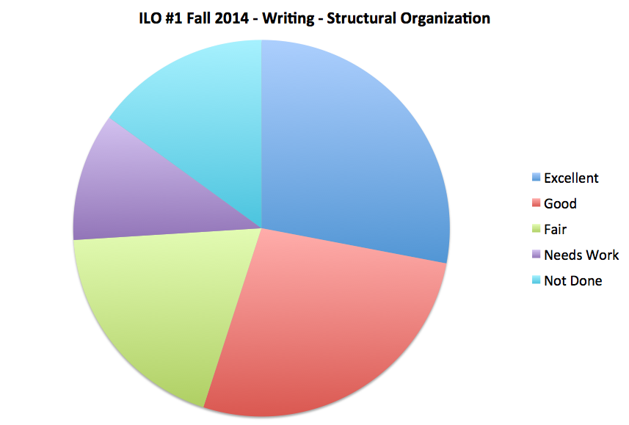

Slide 15
Grammar/Mechanics
Excellent | Good | Fair | Needs Work | Not done
20% | 30% | 24% | 13% | 14%

Slide 16
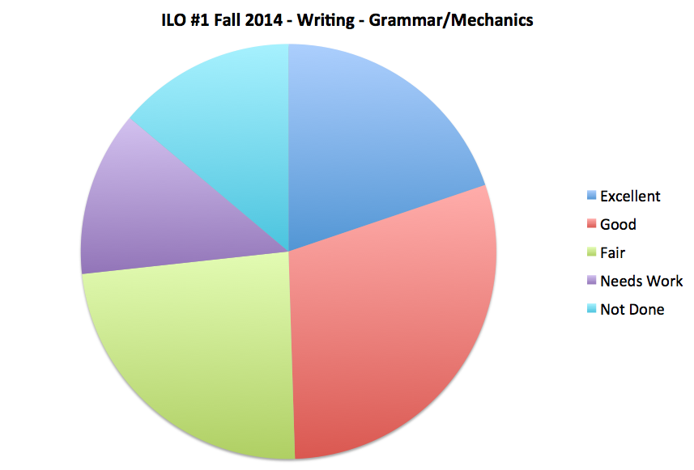

Slide 17
Panel/Audience
What strengths do you find when you evaluate your students’ written work? What are they good at?
What are the problem areas you’ve noticed in your students’ writing?

Slide 18
Ideas: College-Wide Initiatives
What suggestions do you have to improve students’ writing here at Laney? Can you think of any college-wide initiatives that could help students write better?

Slide 19
Existing Resources at Laney or Online
Suggestions from panel and from audience
Have you created anything that helps students write better? Are you willing to share?

Slide 20
Action Plan – Next Steps?
Further discussion
Publicizing resources

Slide 21
ILO Awareness Contest for students
Will be happening this semester
Different from last semester’s contest
Prizes: iPad Air 2 in gold, three $100 gift cards for the Laney bookstore, five 32 GB flash drives
Details coming in a few weeks – check your e-mail
Please encourage students to participate!

Slide 22
Winners from last semester
Winner of the iPad: Yvonne Henderson from Jacqueline Burgess’s class (Dance)
$100 bookstore gift card winners: Ning McKenzie (Runyon - Chem), Aaron Jones (Santos – Math), Linda Selph (Lepowsky – Math)
32GB Flash drive winners: Jacob Sultz (Martin – Culin), Xuan Mai Thi Do (Runyon – Chem), Mike Hernandez (Fossum- Chem), Judah Levenson (Burgess- Dance)

Slide 23
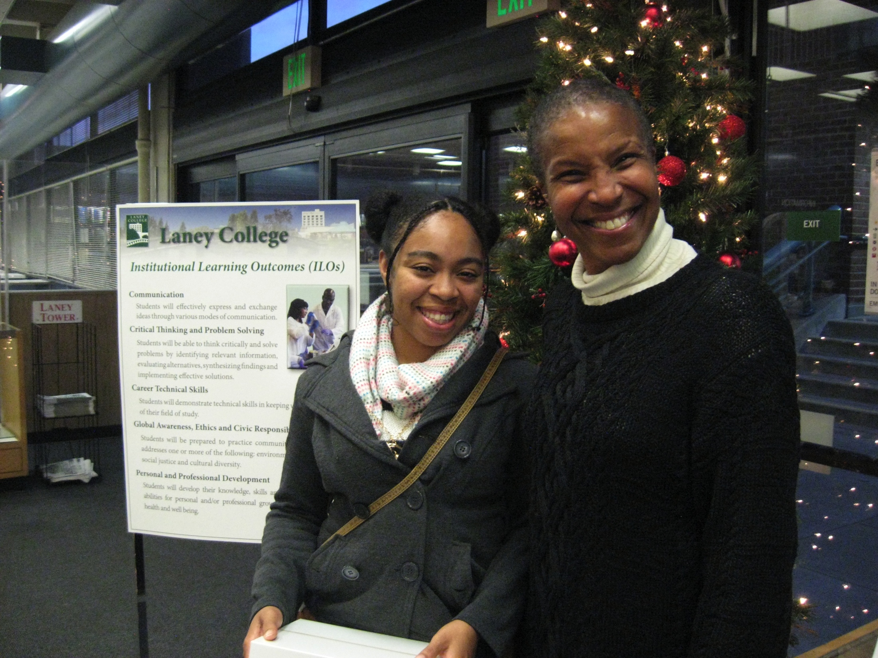

Slide 24
Please turn in questionnaires

