Slide 2
CengageNOW
PRESENTER
Getting Started
[Lynn Crossman]
[Instructor]

Slide 3
“I love the check your work option. Really, when you’re having a hard time figuring out an answer, sometimes working backwards is the best way to understand conceptually what you’re doing wrong.”
Brad Duncan
University of Utah
Have the tools you need to be successful
A variety of tools are available in CengageNOW, all combined in one easy-to-use resource designed to improve your grades. Some resources get you prepared for class and help you succeed on homework, and others show you specific areas where you can work to improve.
Notes:
Have the tools you need to be successful
A variety of tools are available in CengageNOW, all combined in one easy-to-use resource designed to improve your grades. Some resources get you prepared for class and help you succeed on homework, and others show you specific areas where you can work to improve.

Slide 4
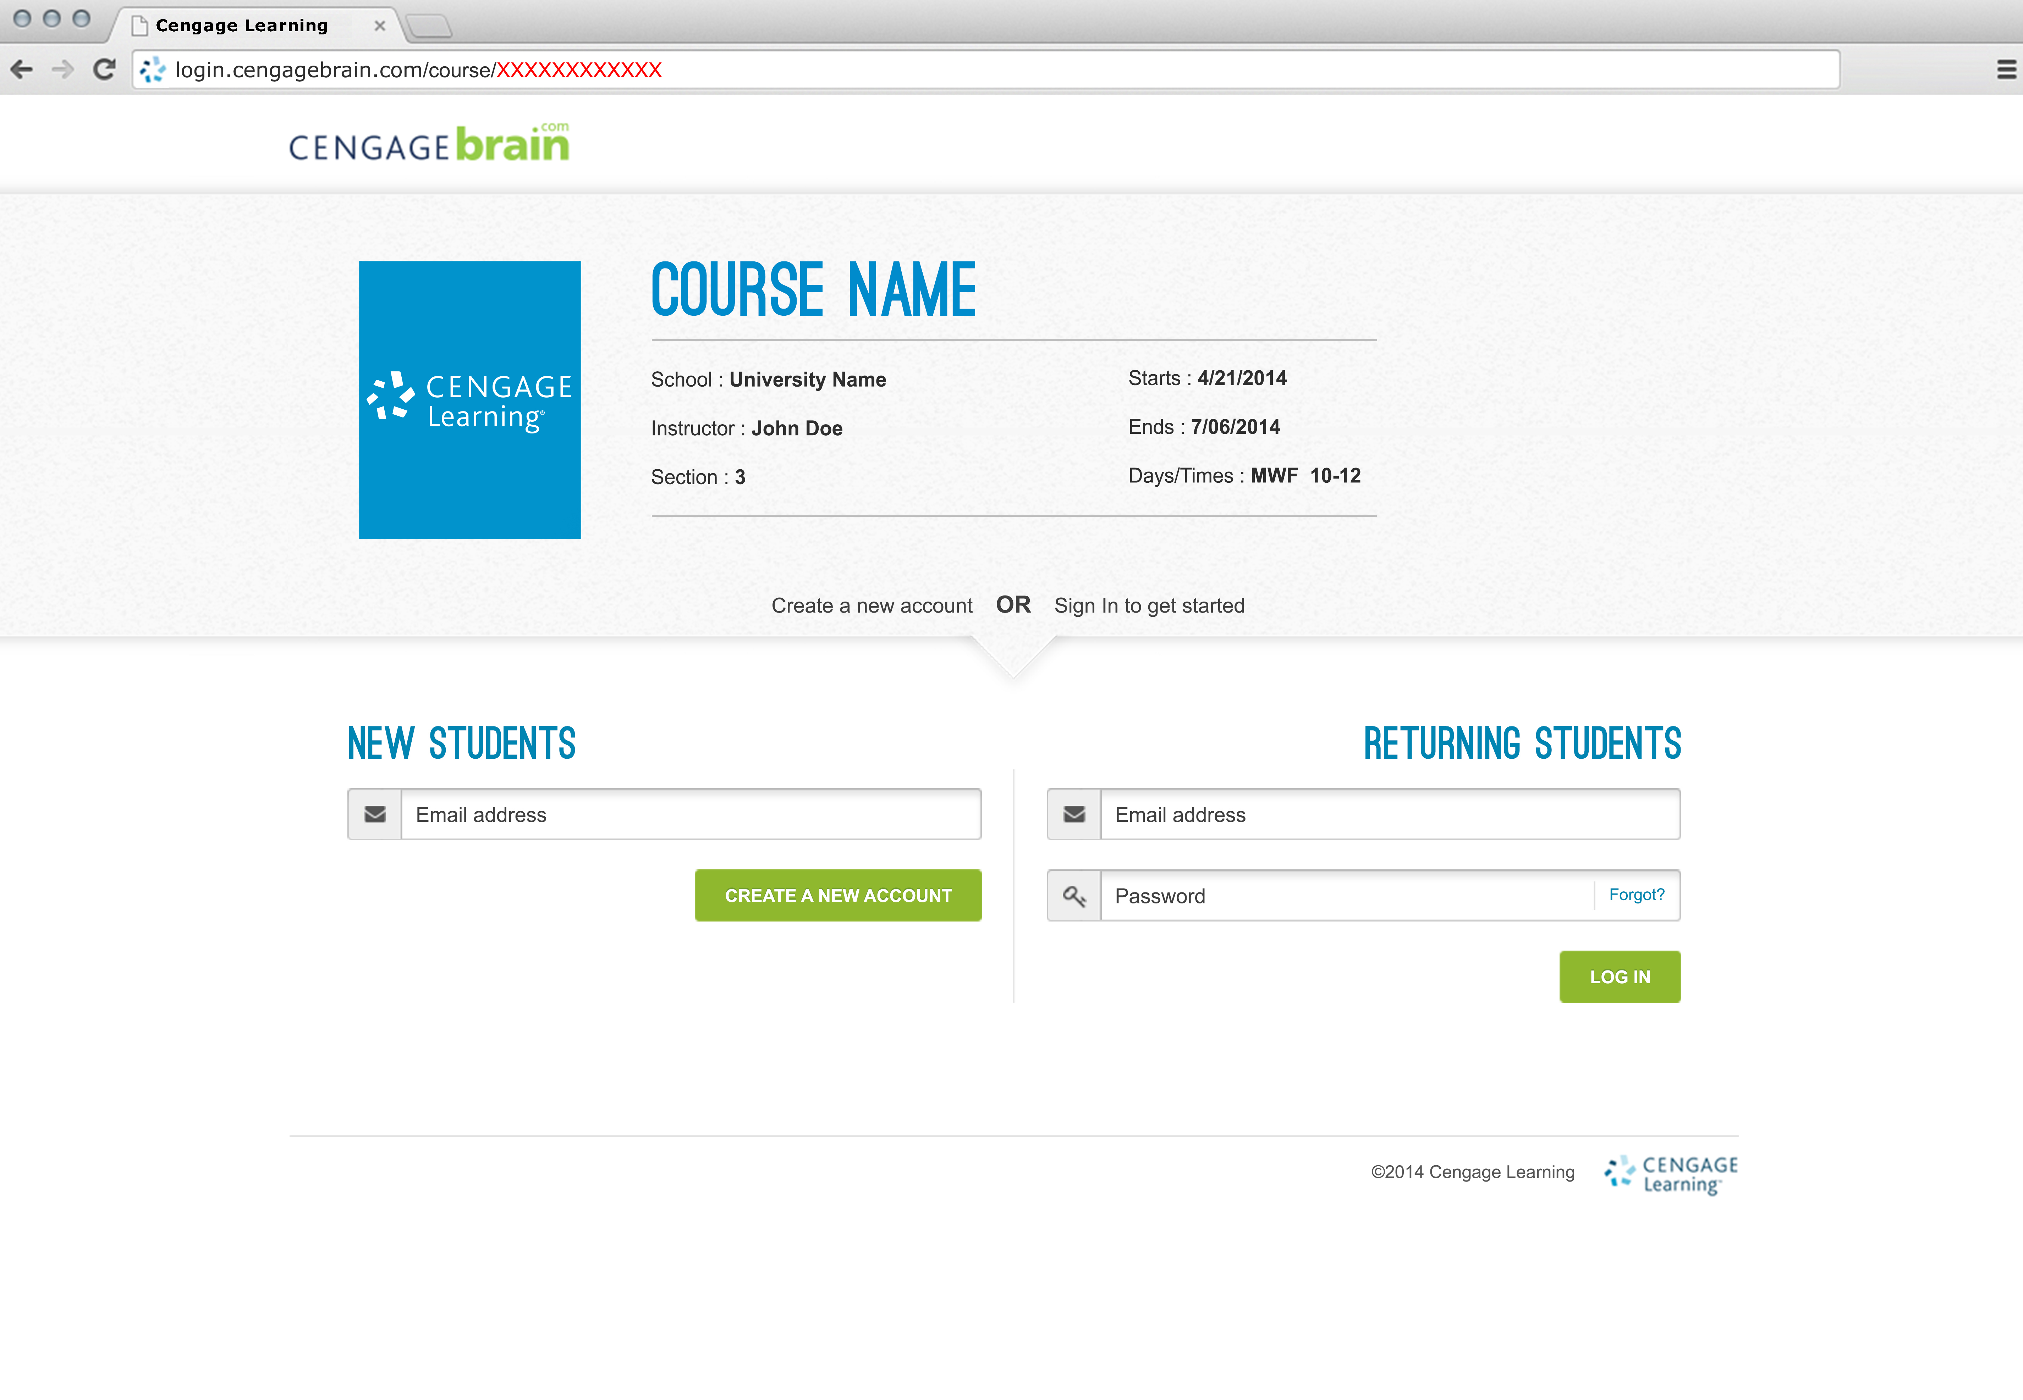
Access CengageNOW
1. Go to the course registration website provided by your instructor.
Or if you were given only the course key you can still use this new registration process by adding the course key (with dashes) to the end of this URL: login.cengagebrain.com/course/________
2. Either register as a new user or sign in if you already have a Cengage account
TIP: Only have the course key? Enter the following URL and replace the X’s with your course key (include the dashes).
login.cengagebrain.com/course/xxxx-xxxx-xxxx
1
2
Notes:
Your course materials can be purchased at your campus bookstore or by visiting www.cengagebrain.com and searching for your course materials by ISBN.

Slide 5
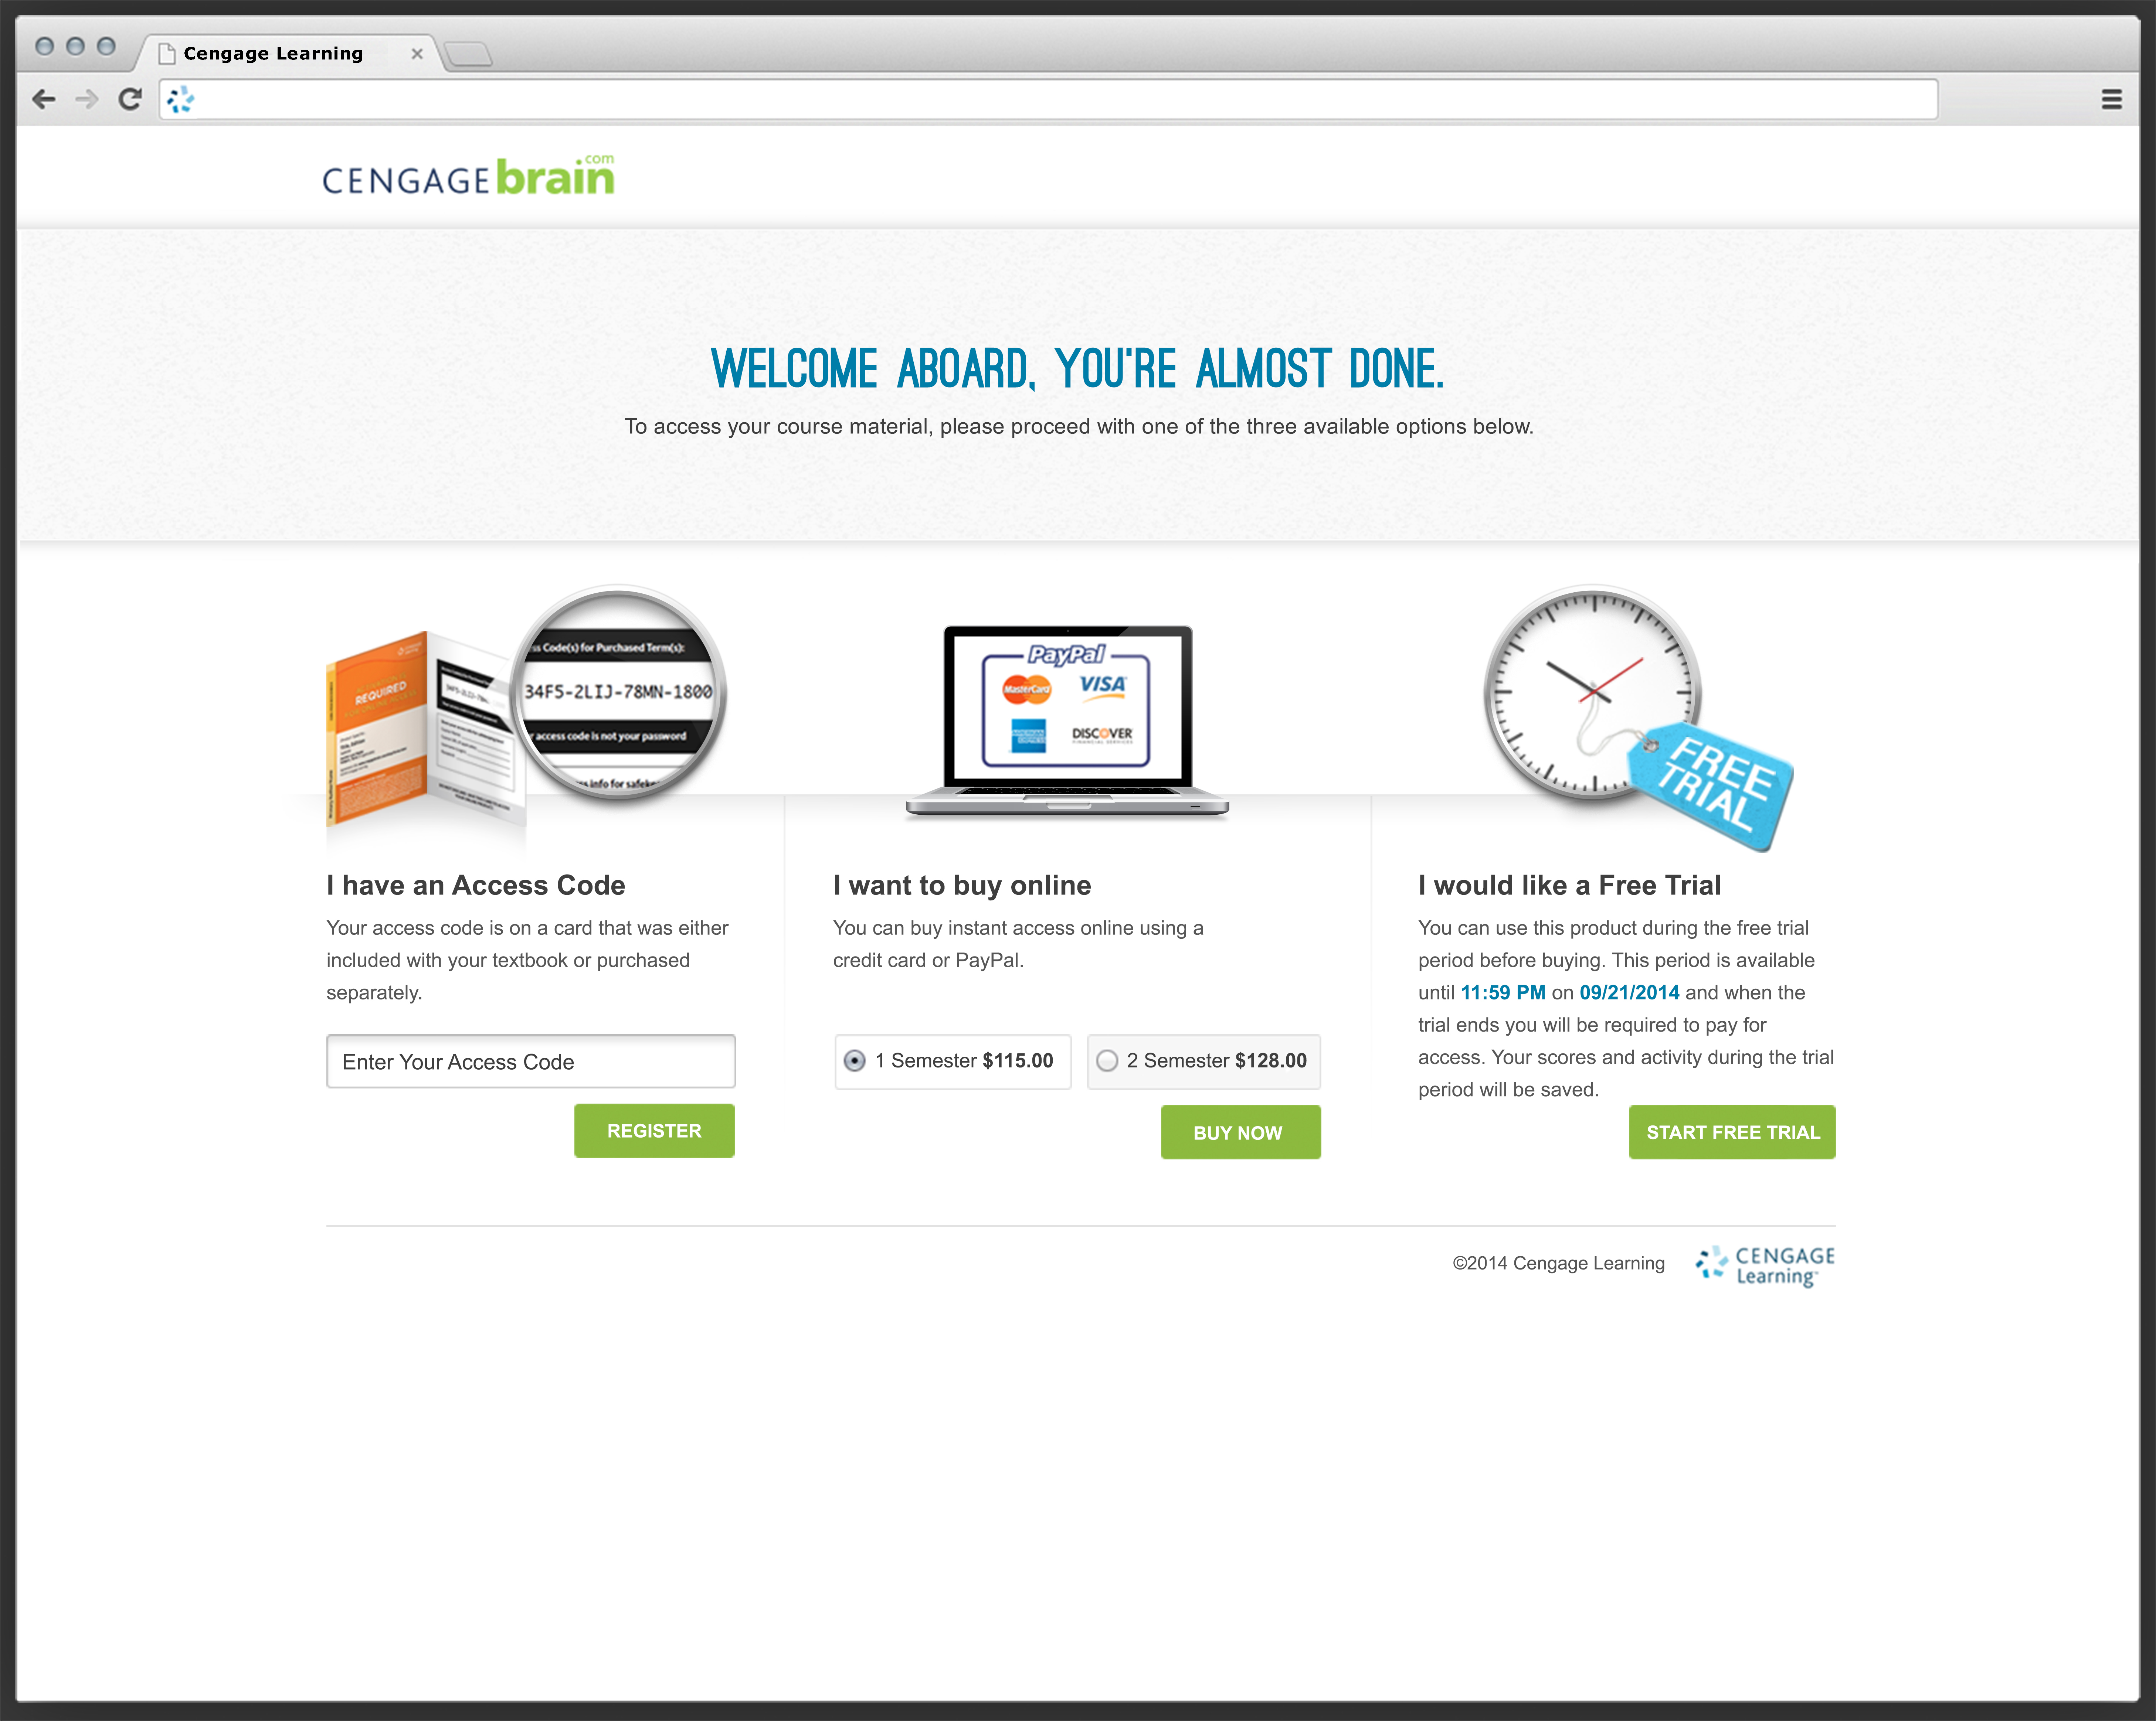
Purchase Options
3a. Already purchased an access code? Enter code here
3b. Or purchase online here
3c. Or buy later and start your trial access (available for limited time after class start date)
3a
3b
3c
Notes:
Your course materials can be purchased at your campus bookstore or by visiting www.cengagebrain.com and searching for your course materials by ISBN.

Slide 6
Returning to Access Course
4. To easily access your course each time you want to login bookmark this course website URL
5. Login as a Returning Student
4
5
Notes:
A. Whether you’re logging in for the first time or returning to your course, you will begin at the Cengage Brain website: https://login.cengagebrain.com
B. Click Create an Account. After you register the first time, you will click “Log in”

Slide 7
Have questions about your CengageBrain account?
Online:
Check the FAQs in the Support area of your CengageBrain home:
www.cengagebrain.com
Email:
Cengagebrain.support@cengage.com
Phone Support:
1.866.994.2427
Monday through Friday
8:00am to 6:00pm (EST)
Have questions about CengageNOW?
Online:
24/7 live chat!
www.cengage.com/support
Sign in using your CengageBrain credentials and create a case.
Once your case is submitted, you’ll receive access to 24/7 live chat! Or you can speak with an agent by calling the phone number provided upon your case submission.
Phone Support:
Monday through Thursday:
8:30am to 9:00pm (EST)
Friday: 8:30am to 6:00pm (EST)
Questions?
We’re Here to Help!
Notes:
If you have any further questions regarding logging in and accessing [insert digital solution] through CengageBrain, please contact us via email or phone using the information shown here.
If you have any questions while using (insert digital solution), please go to www.cengage.com/support and sign in using your cengagebrain credentials. You can then create a case and you’ll receive access to 24/7 live chat or you will have the option to speak to a live agent upon case submission.

