Slide 1
Organic Chemistry
Third Edition
David Klein
Chapter 1
A Review of General Chemistry: Electrons, Bonds, and Molecular Properties

Slide 2
1.1 Organic Chemistry
The study of carbon-containing molecules and their reactions
What happens to a molecule during a reaction?
  molecules collide
  bonds are broken and bonds are made
Why do reactions, like the one above, occur?
  We will need at least 2 semesters of your time to answer this question
  FOCUS ON THE ELECTRONS

Slide 3
1.1 Organic Chemistry
Why do we distinguish between organic and inorganic compounds?
Organic compounds contain carbon atoms
Why are organic compounds important? Organic compounds make up things like:
- Food
- Clothes
- Pharmaceuticals
- Plastics

Slide 4
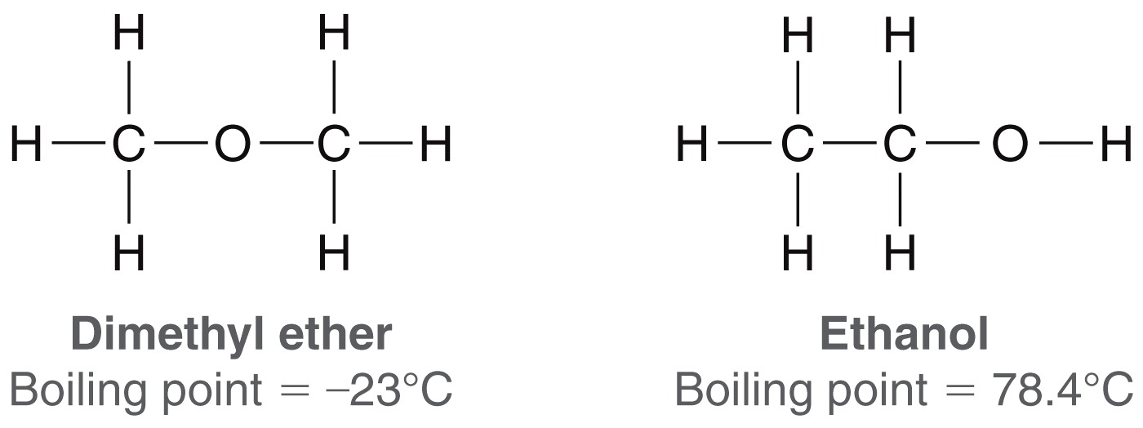
1.2 Structural Theory
In the mid 1800s, it was first suggested that substances are defined by a specific arrangement of atoms.
  Why is a compounds formula not adequate to define it?
  Because compounds differ in the specific ways in which atoms are bonded together
Compounds with the same molecular formula but different structures are constitutional isomers.

Slide 5
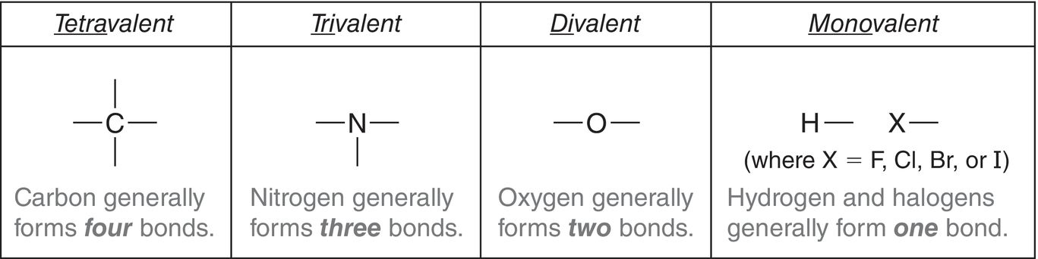
1.2 Structural Theory
Atoms that are most commonly bonded to carbon include N, O, H, and halides (F, Cl, Br, I).
With some exceptions, each element generally forms a specific number of bonds with other atoms
Practice with SkillBuilder 1.1

Slide 6

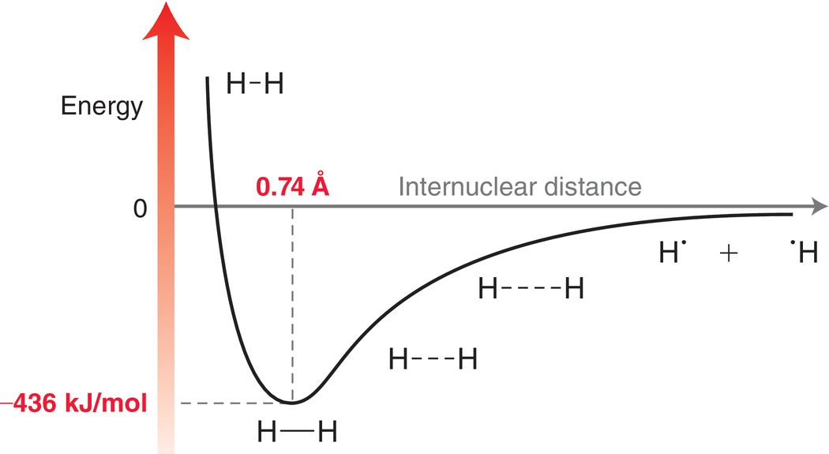
1.3 Covalent Bonding
A covalent bond is a PAIR of electrons shared between two atoms. For example…

Slide 7
1.3 Covalent Bonding
How do potential energy and stability relate?
What forces keep the bond at the optimal length?
- Attractive forces between positively charged nuclei and negatively charged electrons
- Repulsive forces between the two positively charged nuclei
- Repulsive forces between the two negatively charged electrons

Slide 8
1.3 Atomic Structure
A review from General Chemistry
  Protons (+1 charge) and neutrons (neutral) reside in the nucleus
  Electrons (-1 charge) reside in orbitals outside the nucleus.
  Valence electrons are the electrons in the outermost shell
  Look at carbon for example. Which electrons are the valence electrons?
  Valence electrons are our focus: because they involved in bonding!

Slide 9
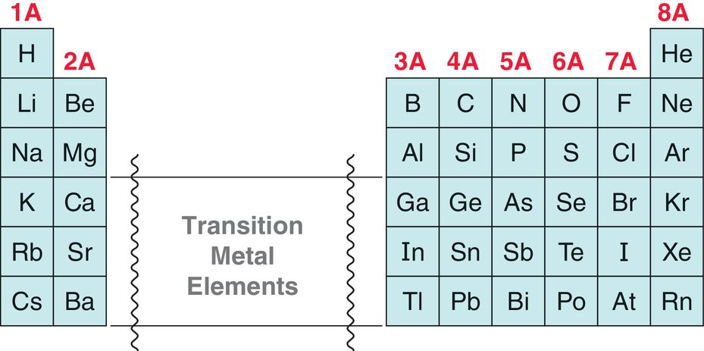
1.3 Counting Valence Electrons
You can always calculate the number of valence electrons by analyzing the e- configuration.
Or, for Group A elements only, just look at the Group number on the periodic table (Group number = # of valence electrons)
Practice with SkillBuilder 1.2

Slide 10


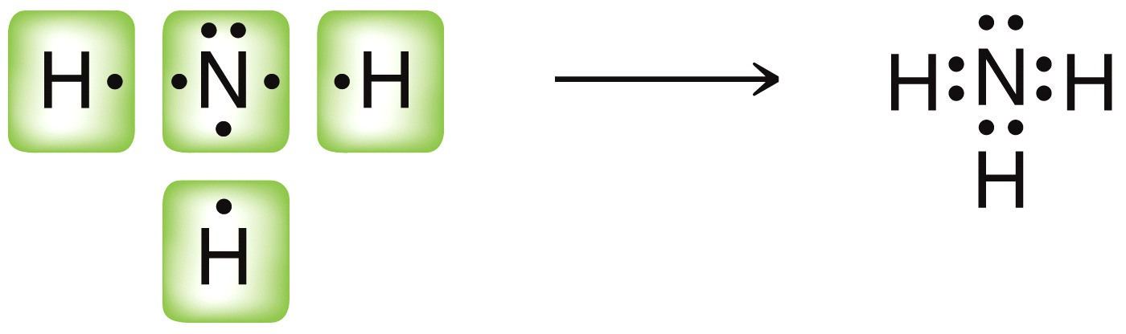
1.3 Simple Lewis Structures
For simple Lewis Structures…
  Draw the individual atoms using dots to represent the valence electrons.
  Put the atoms together so they share pairs of electrons to make complete octets.
Take NH₃, for example…
Note the nitrogen has a lone pair of electrons

Slide 11
1.3 Simple Lewis Structures
For simple Lewis Structures…
  Draw the individual atoms using dots to represent the valence electrons.
  Put the atoms together so they share pairs of electrons to make complete octets.
Skillbuilder 1.3: Try drawing a Lewis structure for CH₂O

Slide 12
1.4 Formal Charge
Recall the terms we use to describe atoms with an unbalanced or FORMAL charge.
  Anion = negatively charged atom
  Cation = positively charged atom
Atoms in molecules (sharing electrons) are typically neutral, but can also be anionic or cationic
To to determine the formal charge for an atom in a given molecule, compare the number of valence electrons that it owns (based on its bonding pattern) to the number of valence electrons that the atom needs to be neutral.

Slide 13
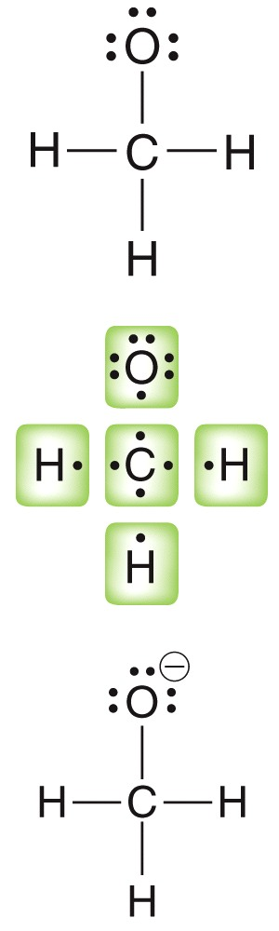
1.4 Formal Charge
Consider the formal charge on the atoms in the structure below, and determine if any of the atoms should have a formal charge
Carbon needs 4 valence electrons to be neutral (Group IV)
Carbon is surrounded by 8 electrons here, but it only owns 4 of them (1 from each of the bonds).
Since carbon owns 4 electrons, and needs 4 electrons to be neutral, it does not have a formal charge.

Slide 14
1.4 Formal Charge
Now determine if the oxygen atom has a formal charge here.
Oxygen needs 6 valence electrons to be neutral (Group VI)
Oxygen is surrounded by 8 electrons here, but it only owns 7 of them (1 from the bond, plus 3 lone pairs ).
Since oxygen owns 7 electrons here, and needs 6 electrons to be neutral, it has an extra electron, and therefore has a -1 charge.
Practice with SkillBuilder 1.4
We need to write a
negative charge next
to the oxygen atom

Slide 15
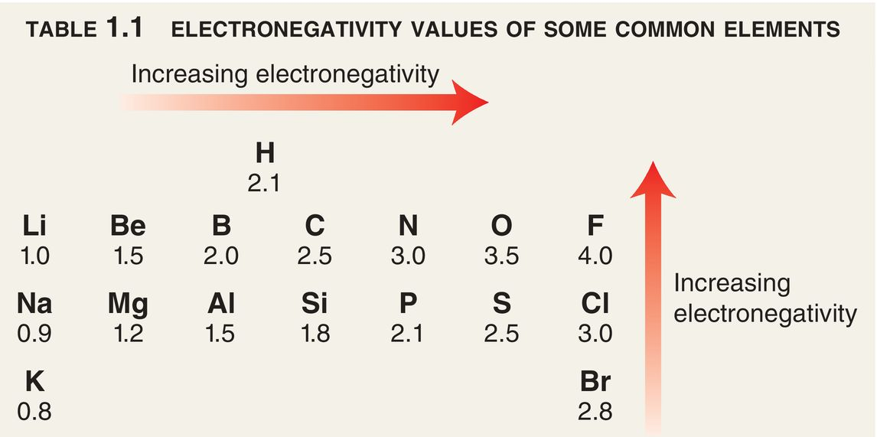
1.5 Polar Covalent Bonds
Electronegativity - how strongly an atom attracts shared electrons
If you remember that F is the most electronegative atom, then you can always remember the relative electronegativity of the atoms in the same column or the same row of the PTE

Slide 16


1.5 Polar Covalent Bonds
There are three types of bonds:
COVALENT BOND: electrons shared between two atoms, where electronegativity difference is less than 0.5
POLAR COVALENT BOND: electrons shared between two atoms with electronegativity difference between 0.5 and 1.7
IONIC BOND: the electrons are not really shared, the two atoms differ in electronegativity by more than 1.7, and so the more electronegative atom owns the electrons.

Slide 17

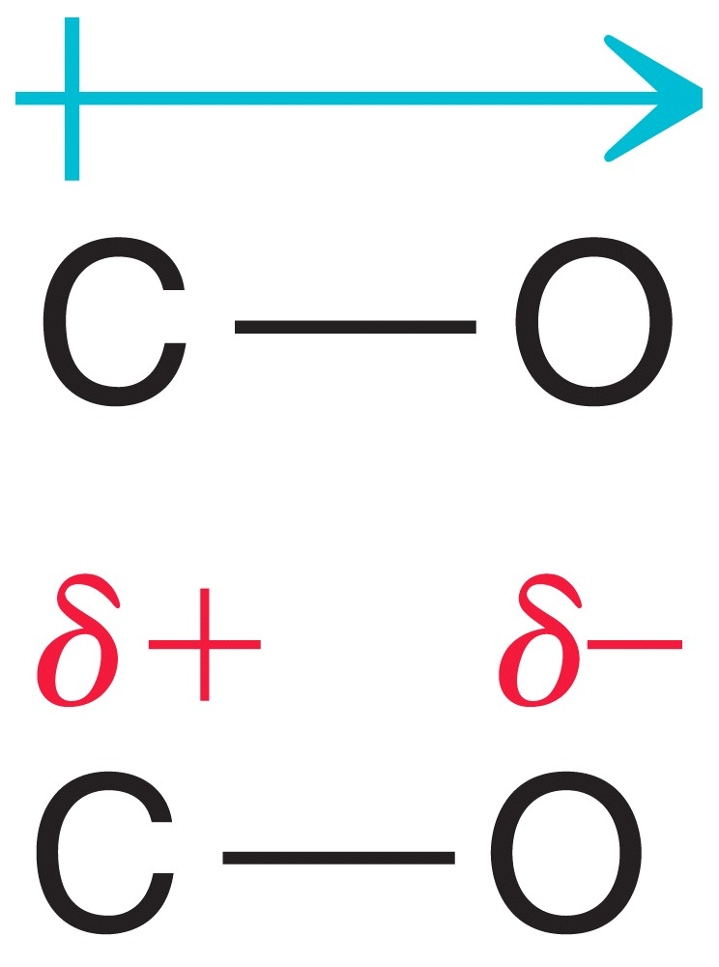
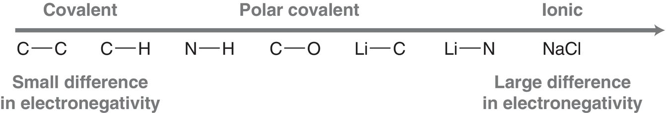
1.5 Polar Covalent Bonds
Electrons tend to shift away from lower electronegativity atoms to higher electronegativity atoms.
The greater the difference in electronegativity, the more polar the bond.

Slide 18
1.5 Polar Covalent Bonds
Some bonds are acceptable to write as a covalent bond or an ionic bond, as in the following example:
The electronegativity difference is 1.5, so it is on the cusp of polar covalent and ionic, according to just one method used for determining electronegativity values. So, the absolute difference in electronegativity is to be taken with a grain of salt.
Practice with SkillBuilder 1.5

Slide 19
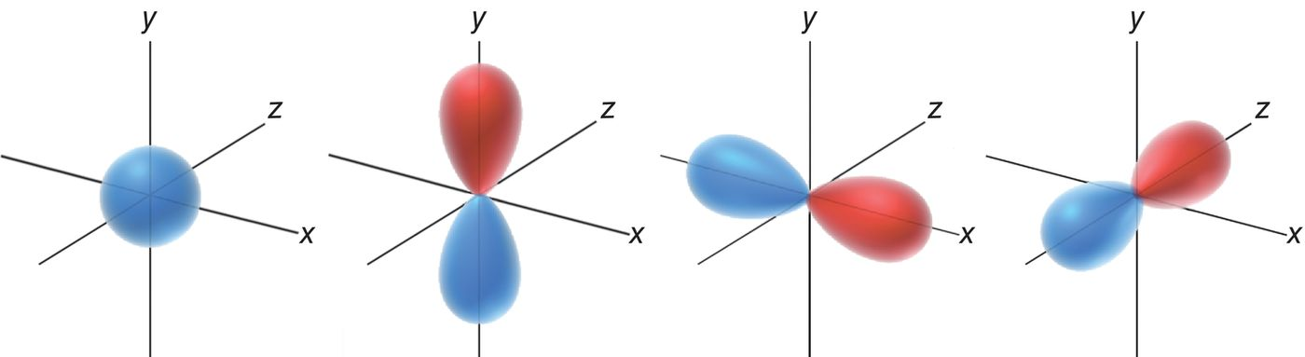
1.6 Atomic Orbitals
General Chemistry review
In the 1920s, Quantum Mechanics was established as a theory to explain the wave properties of electrons
The solution to wave equations are wave functions; The 3D plot of a (wave function)² gives an image of an atomic orbital

Slide 20
1.6 Atomic Orbitals = Electron Density
  The type of orbital is identified by its shape (s, p)
  Electron density: term used to refer to probability of finding an electron (the orbital shape is 90-95% of the space where an electron “probably” is)
We think of an atomic orbital as a cloud of electron density

Slide 21
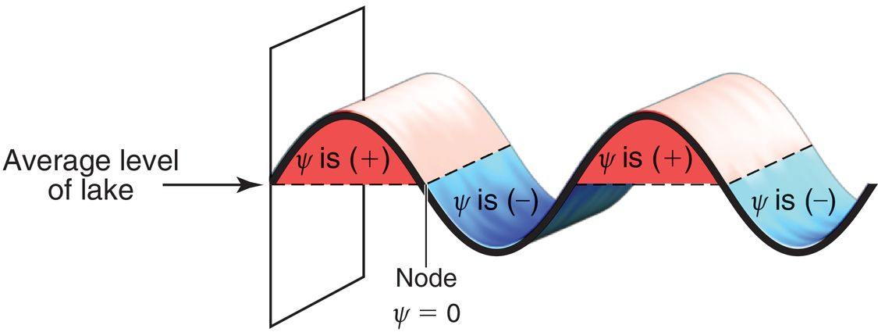
1.6 Phases of Atomic Orbitals
Electrons behave as both particles and waves. How can they be BOTH? Maybe the theory is not yet complete
The theory does match experimental data, and it has predictive capability.
  Like a wave on a lake, an electron’s wavefunction can have a positive (+) value, a negative (–) value, or zero (a node).

Slide 22
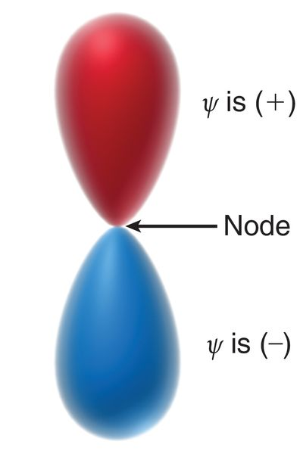
1.6 Atomic Orbitals
Because they are generated mathematically from wavefunctions, orbital regions can also be (–), (+), or ZERO
  The sign of the wave function has nothing to do with electrical charge.
In this p-orbital, there is a nodal plane. The sign of the wavefunction will be important when we look at orbital overlapping in bonds.

Slide 23
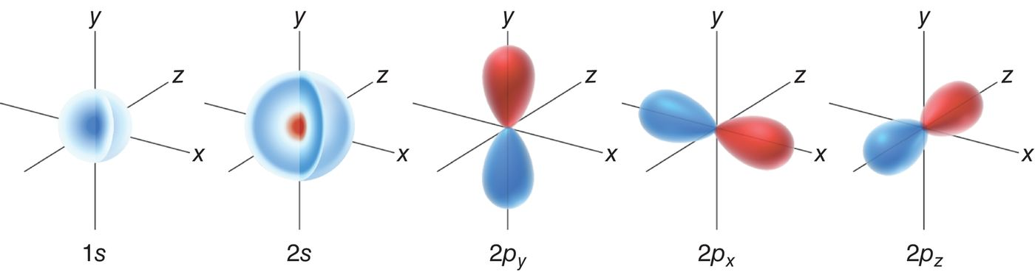
1.6 Atomic Orbitals
Electrons are most stable (lowest in energy) if they are in the 1s orbital?
The 1s orbital, like every atomic orbital, can have up to 2 electrons in it. If there are more electrons in the atom they fill up the 2s the 2p orbitals
The 2p orbitals are of equal energy, and thus are
degenerate orbitals

Slide 24
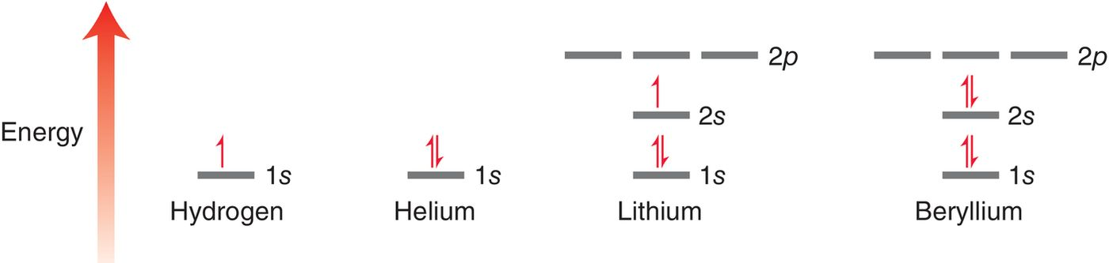
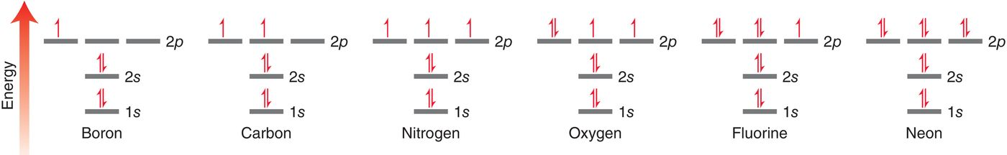
1.6 Atomic Orbitals
Common elements and their electron configurations
The placement of electrons are governed by the following: Aufbau principle, Pauli exclusion principle, and Hund’s Rule

Slide 25
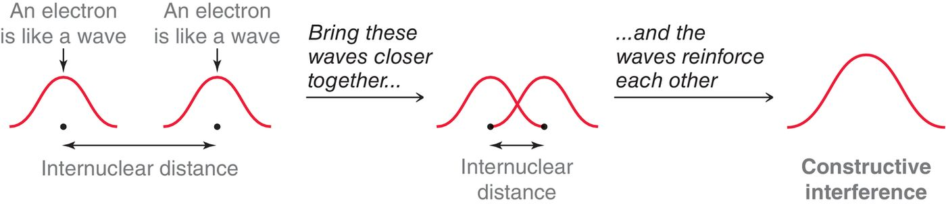
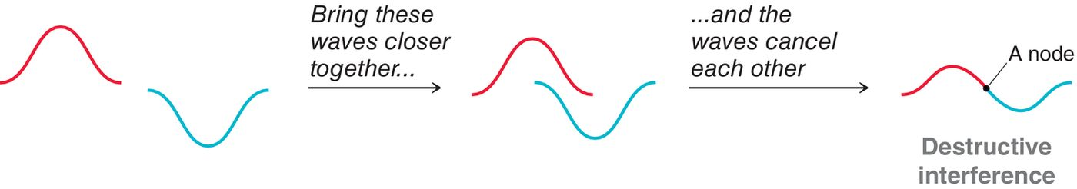
1.7 Valence Bond Theory
A bond occurs when atomic orbitals overlap. Overlapping orbitals is like overlapping waves
Only constructive interference results in a bond

Slide 26
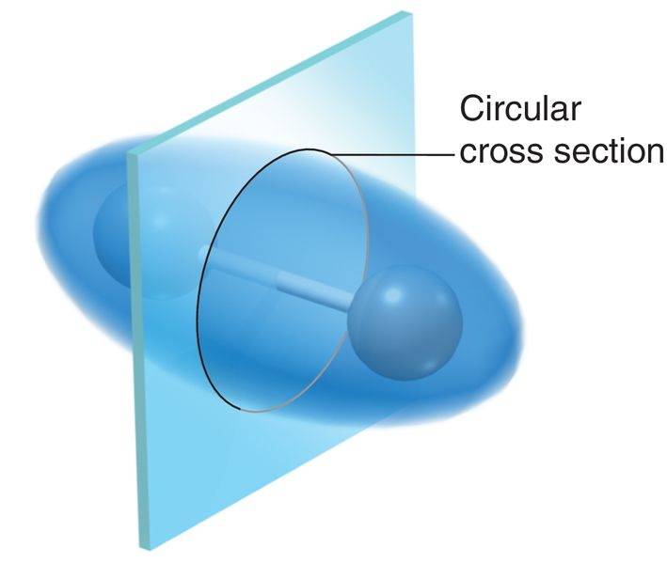
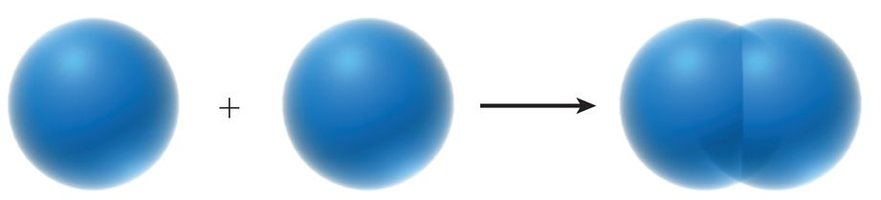

1.7 Valence Bond Theory
The bond for a H₂ molecule results from constructive interference
The bonded electrons spend most of their time in the overlapping atomic orbital space… which is called a sigma (σ) bond
direct overlap of orbitals
forms a sigma bond

Slide 27
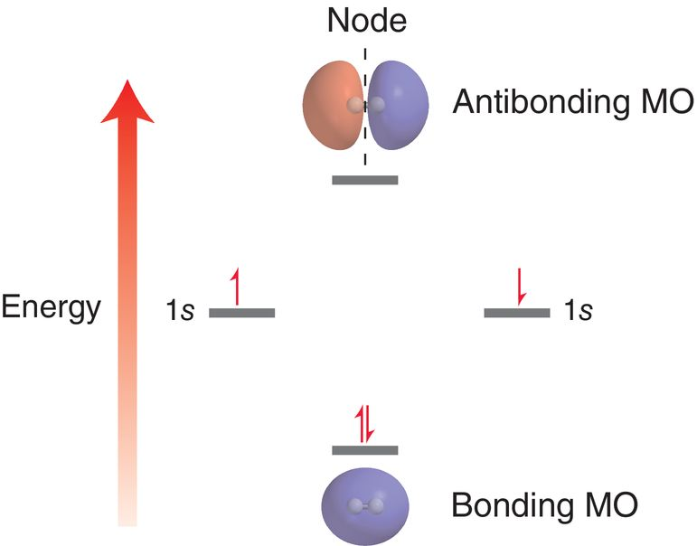
1.8 Molecular Orbital Theory
Atomic orbital wavefunctions overlap to form MOs that extend over the entire molecule.
MOs are a more complete analysis of bonds, because they include both constructive and destructive interference.
The number of MOs created must be equal to the number of AOs that were used.
Molecular Orbitals for H₂

Slide 28
1.8 Molecular Orbital Theory
The antibonding MO has higher energy because it has one node.
When the AOs overlap the electrons go into the bonding MO rather than the antibonding MO in order to achieve a lower energy state

Slide 29
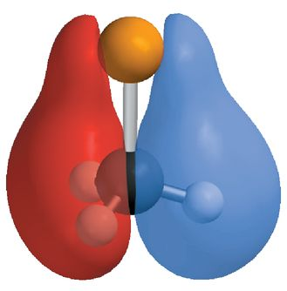
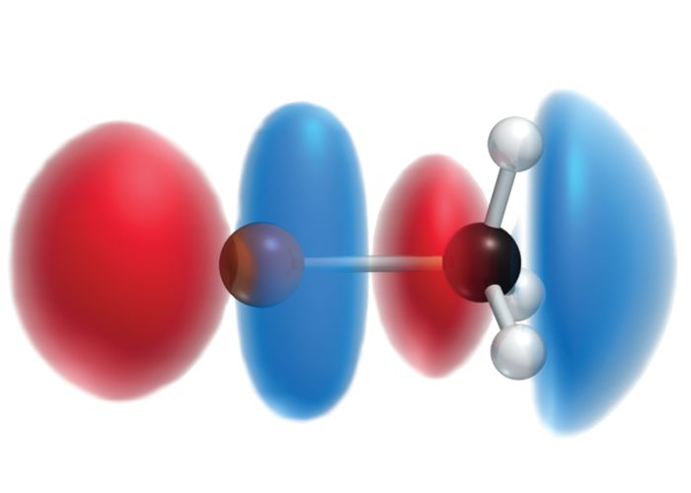
1.8 Molecular Orbital Theory
The are more than two MOs that exist for CH₃Br.. But let’s focus on only two of them here
  There are many areas of atomic orbital overlap, and nodes as well
  Notice how the MOs extend over the entire molecule

Slide 30
1.8 Molecular Orbital Theory
Each MO can hold two electrons?
In the ground state, electrons occupy lower energy MO’s while the higher energy ones remain unoccupied
These two MO’s here are the most important ones: The highest occupied MO (HOMO) and the lowest unoccupied MO (LUMO)
These are the MO’s in play when undergoing a chemical rxn

Slide 31
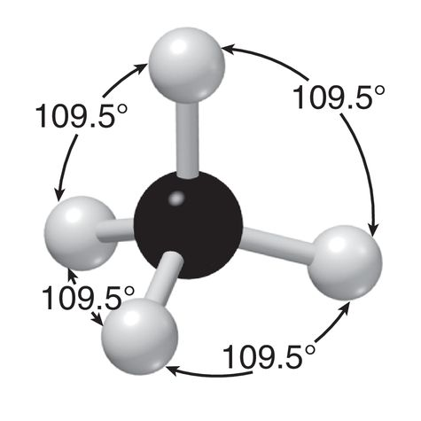
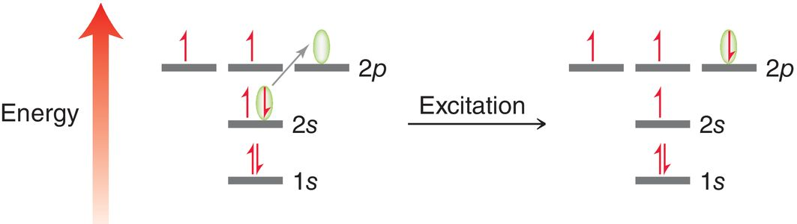
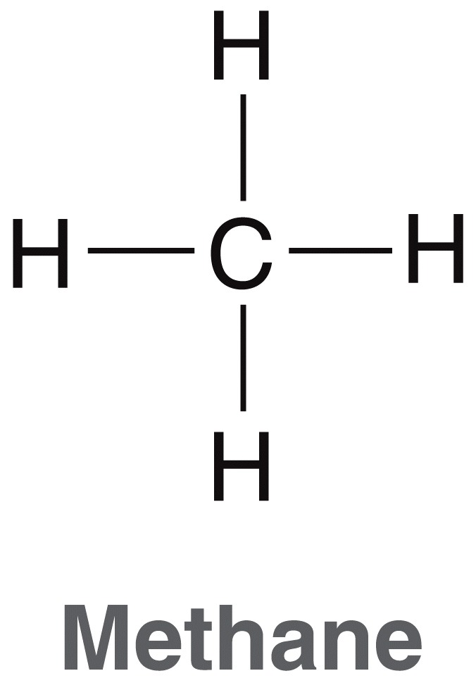
1.9 Hybridized Atomic Orbitals
the ground state electron configuration for carbon can’t explain how carbon makes four bonds
If considering the excited state, it still doesn’t explain how carbon makes 4 equivalent bonds, like the 4 bonds to H in a methane molecule
Only two orbitals have unpaired
electrons to be shared in the ground state
There are 4 unpaired electrons here, but 4 equal bonds cannot be made with two different
types of orbitals (s vs p)

Slide 32
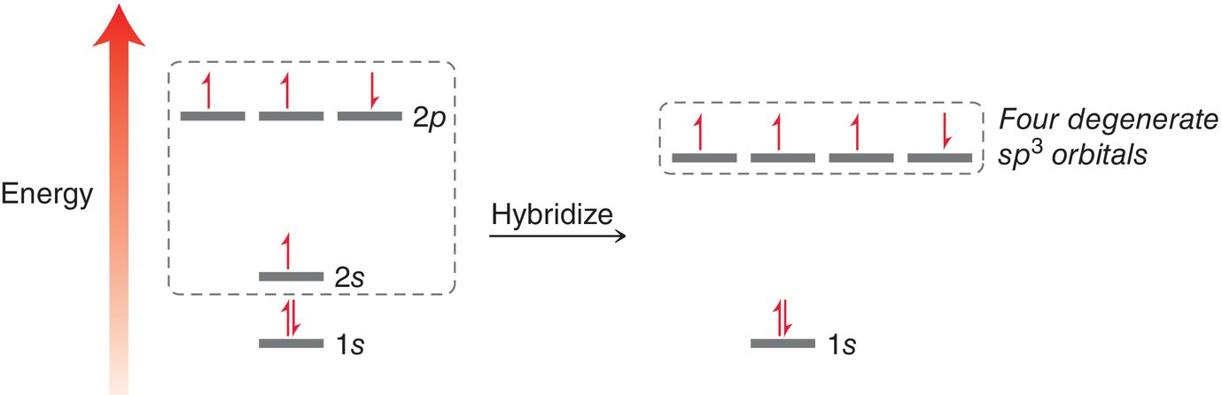
1.9 Hybridized Atomic Orbitals
The carbon must undergo hybridization to form 4 equal atomic orbitals, with symmetrical geometry
The atomic orbitals must be equal in energy to form four equal-energy symmetrical C-H bonds

Slide 33
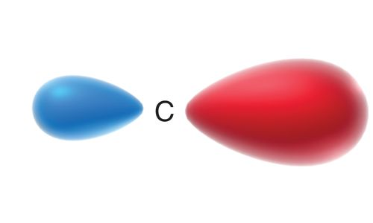
1.9 Hybridized Atomic Orbitals
the shape of an sp³ orbital results from have 25% s-character, and 75% p-character

Slide 34
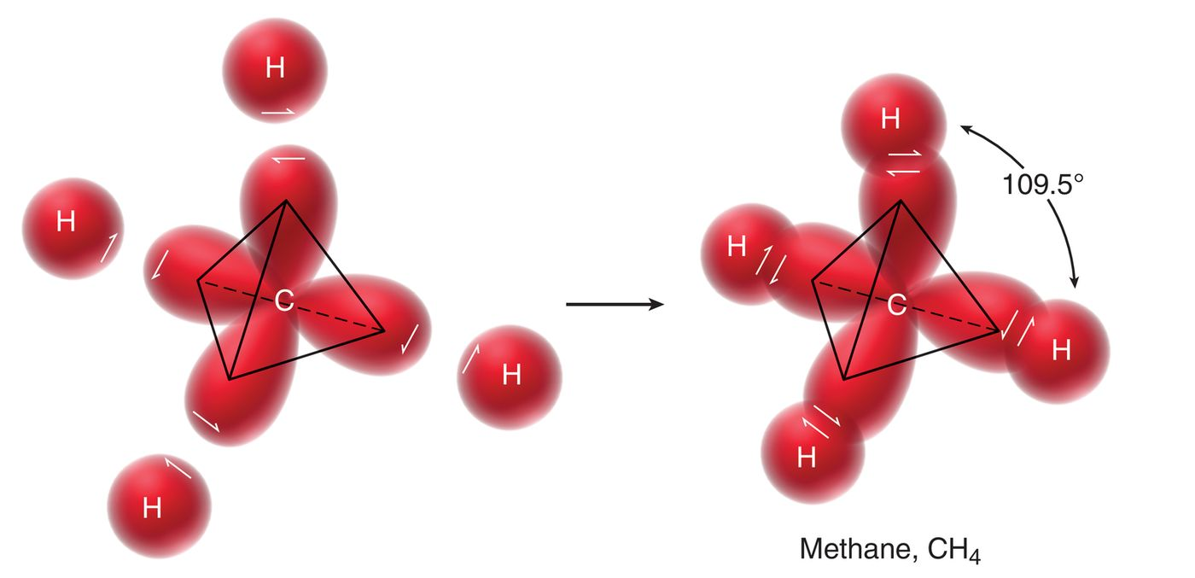
1.9 Hybridized Atomic Orbitals
To make CH₄, the 1s atomic orbitals of four H atoms will overlap with the four sp³ hybrid atomic orbitals of C

Slide 35
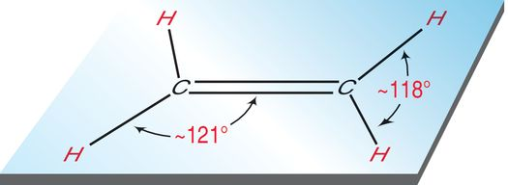
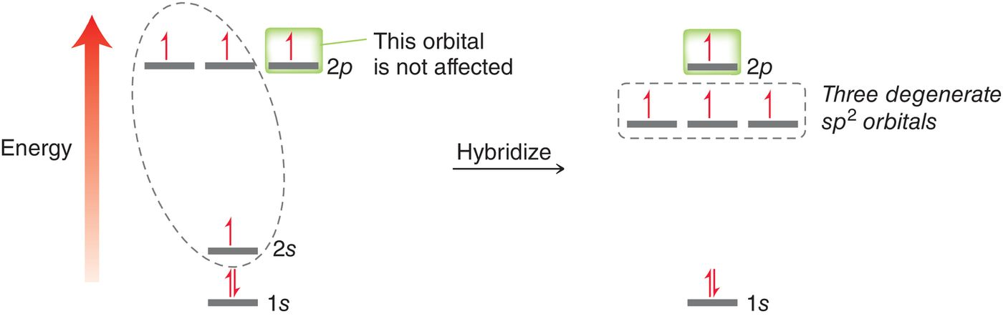
1.9 Hybridized Atomic Orbitals
Consider ethene (ethylene).
Each carbon in ethene must bond to three other atoms, so only three hybridized atomic orbitals are needed

Slide 36
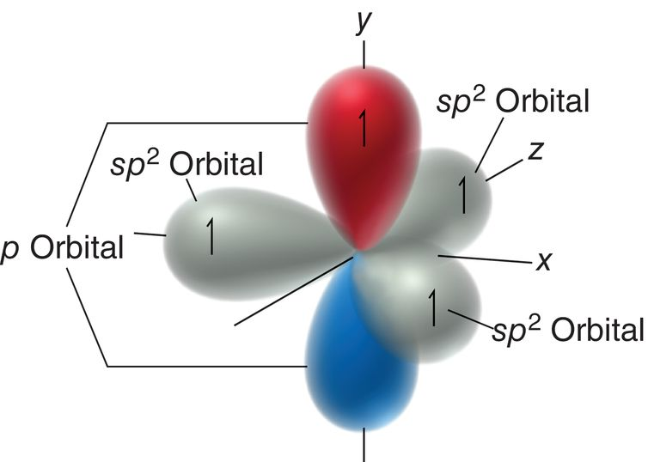
1.9 Hybridized Atomic Orbitals
An sp² hybridized carbon will have three equal-energy sp² orbitals and one unhybridized p orbital
the shape of an sp² orbital results from have 33% s-character, and 67% p-character

Slide 37
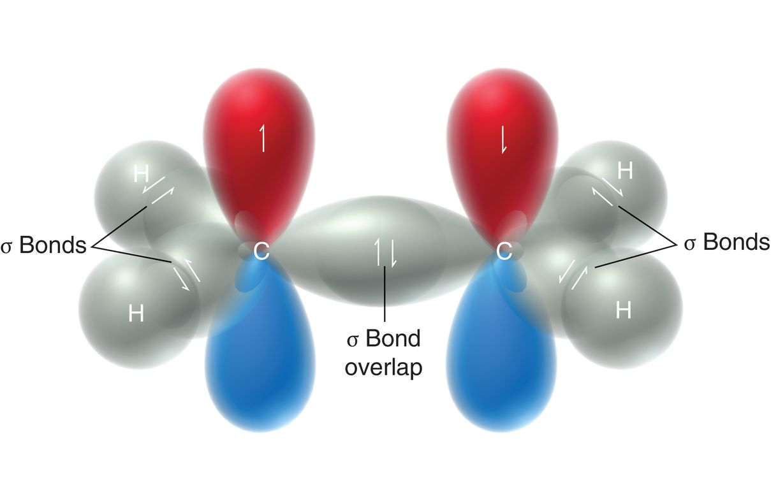
1.9 Hybridized Atomic Orbitals
The sp² atomic orbitals overlap to form sigma (σ) bonds
The p orbitals, here, overlap to form a pi bond

Slide 38
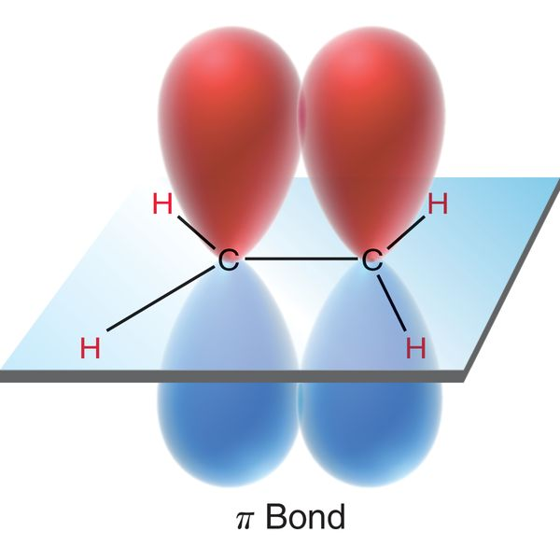
1.9 Hybridized Atomic Orbitals
The pi (π) bond is formed by SIDE-BY-SIDE overlap of the p orbitals. The electron density of the pi bond is spread out above and below the plane of the molecule, as shown below
Pi bonds are weaker than sigma bonds.

Slide 39
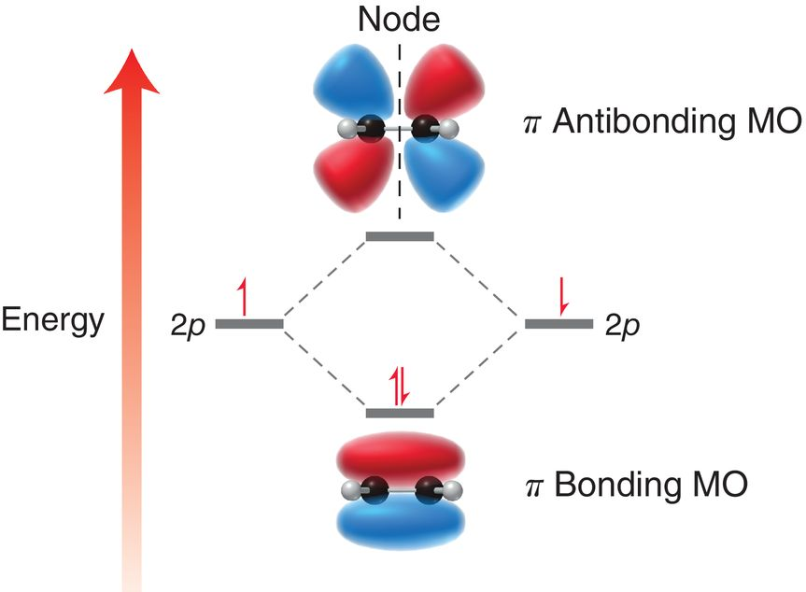
1.9 Hybridized Atomic Orbitals
The pi bond is described in a similar way according to MO theory.
Remember, red and blue regions are all part of the same orbital, but opposite
phases

Slide 40
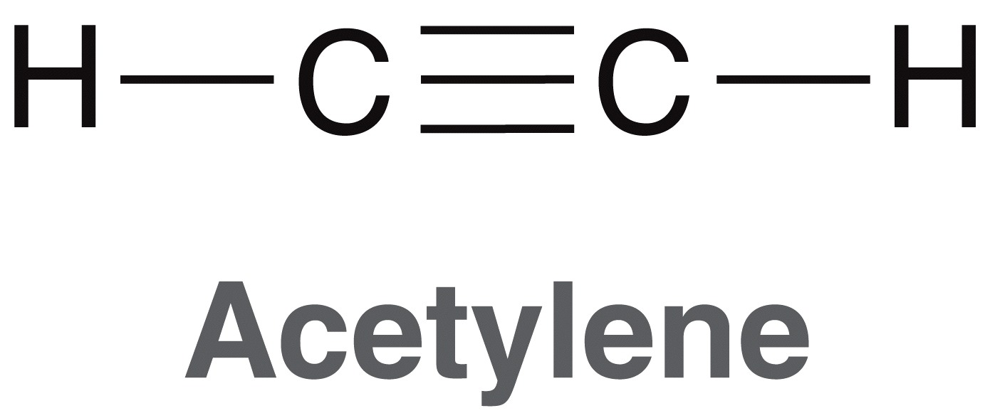
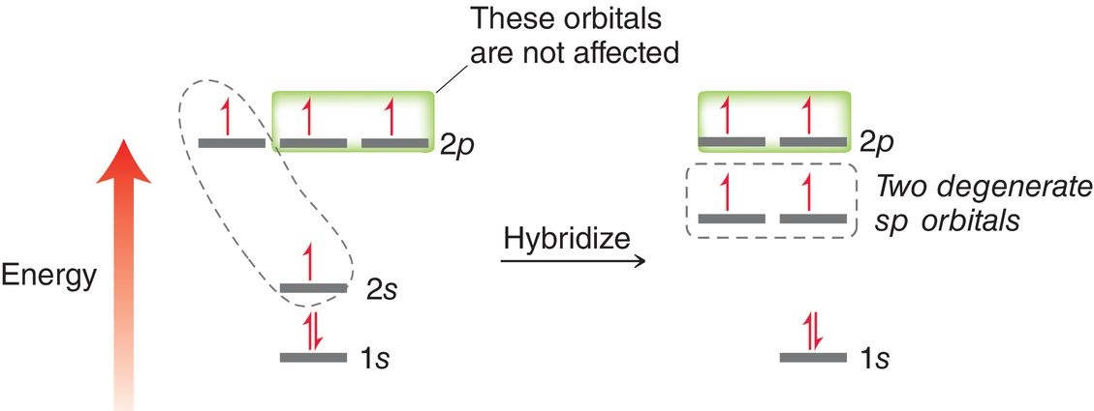
1.9 Hybridized Atomic Orbitals
Consider ethyne (acetylene).
Each carbon in ethyne must bond to two other atoms, so only two hybridized atomic orbitals are needed

Slide 41
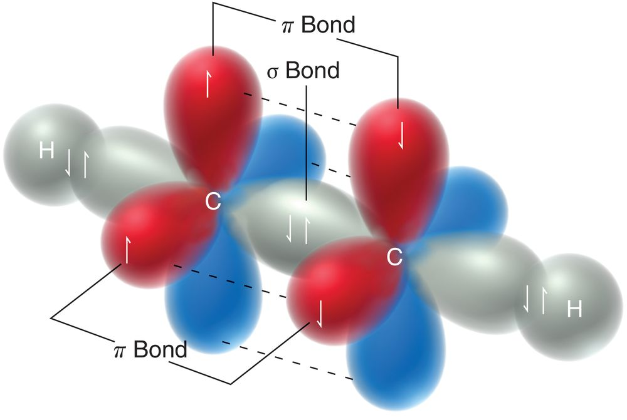
1.9 Hybridized Atomic Orbitals
The sp atomic orbitals overlap HEAD-ON to form sigma (σ) bonds while the unhybridized p orbitals overlap SIDE-BY-SIDE to form pi bonds
Practice with Skillbuilder 1.7

Slide 42
1.9 Bond Strength and Length
Which should be stronger, a pi bond or a sigma bond?
  The sigma bond is considered stronger as it requires almost twice the bond energy of a pi bond to break it
Which should be longer, an sp³ – sp³ sigma bond overlap or an sp – sp sigma bond overlap? Realize the more s-character in the orbitals, the shorter they will be
  sp³ bond lengths are the longest, followed by sp², and then sp bonds.

Slide 43
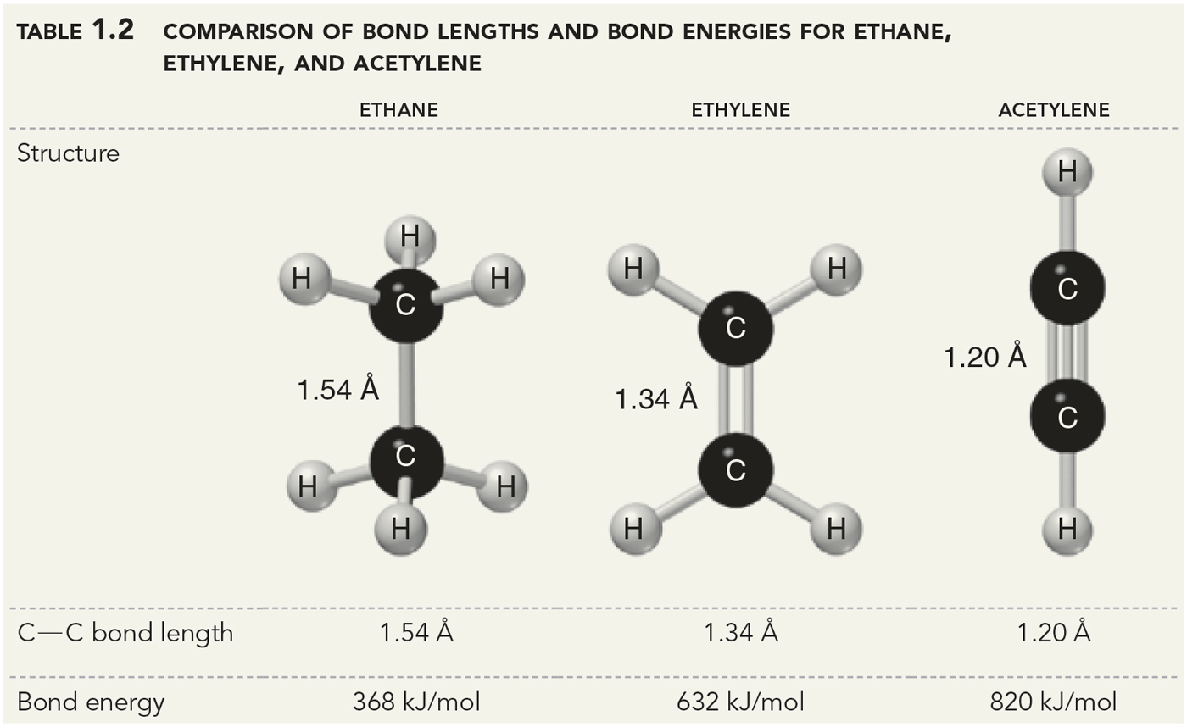
1.9 Bond Strength and Length
Rationalize the bond strengths and lengths below

Slide 44
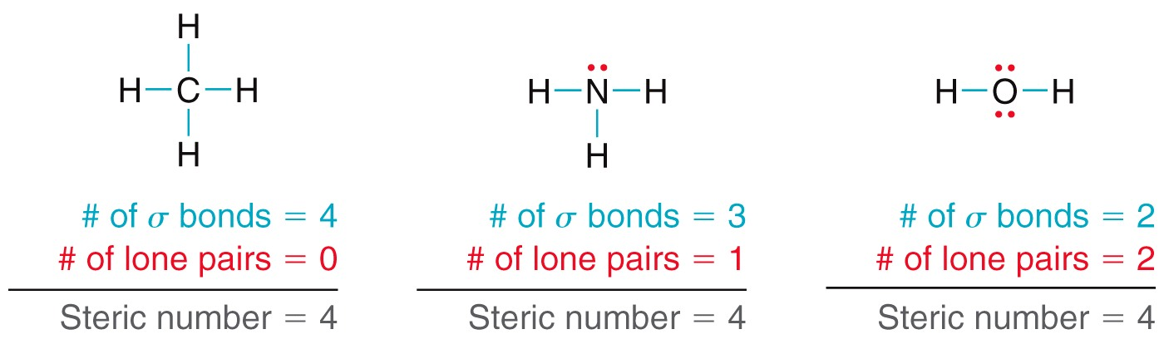
1.10 Molecular Geometry
Valence shell electron pair repulsion (VSEPR theory)
  Valence electrons (shared and lone pairs) repel each other
To determine molecular geometry, start with the steric number… which gives us a quick prediction

Slide 45
1.10 Molecular Geometry
The steric number translate to the hybridization of the central atom
    If the Steric number is 4, then it is sp³
    If the Steric number is 3, then it is sp²
    If the Steric number is 2, then it is sp

Slide 46
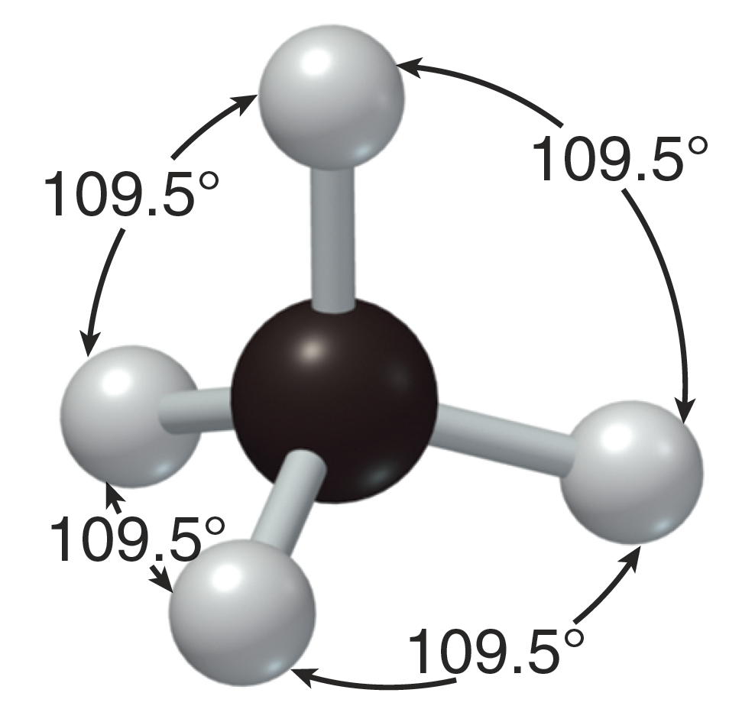
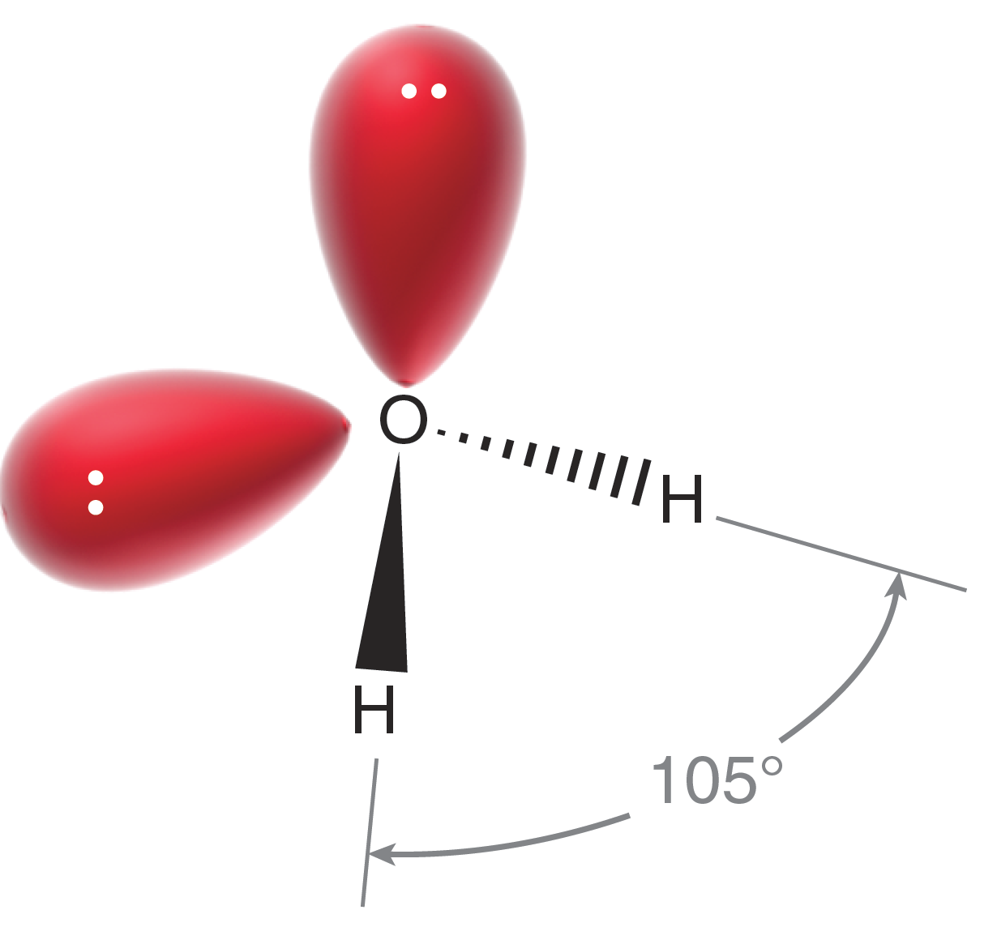
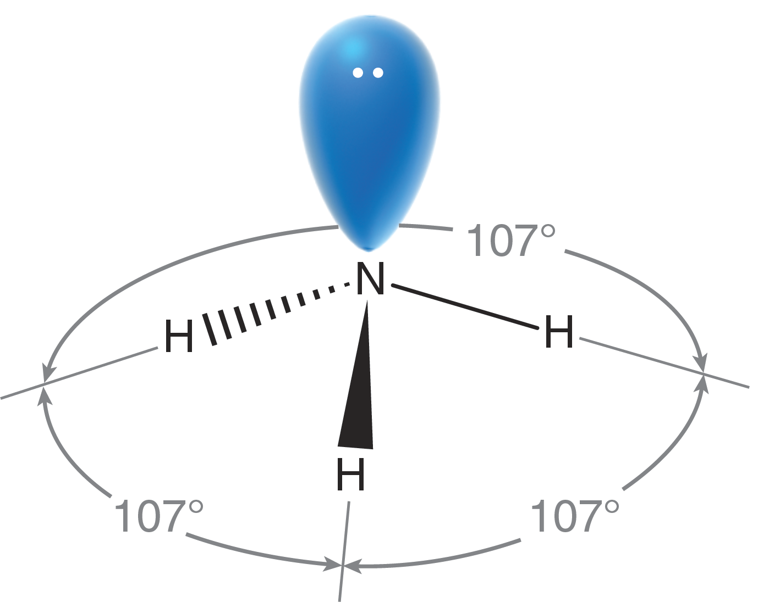
1.10 Molecular Geometry – sp³
For any sp³ hybridized atom, the 4 valence electron pairs will form a tetrahedral electron group geometry
Methane has 4 equal bonds, so the bond angles are equal
The bond angles in ammonia are a little smaller
The bond angles in oxygen are even smaller still

Slide 47
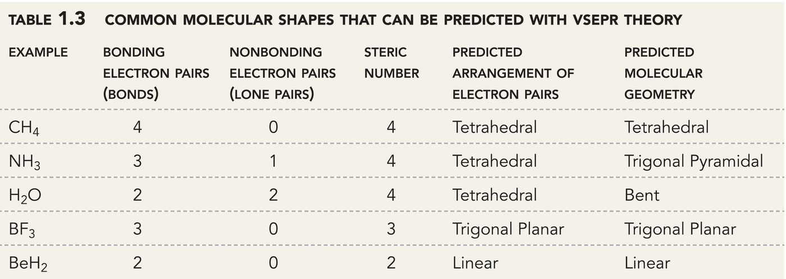
1.10 Molecular Geometry – sp³
The molecular geometry is described for only the atoms bonded to the central atom; electron group geometry includes lone pairs

Slide 48
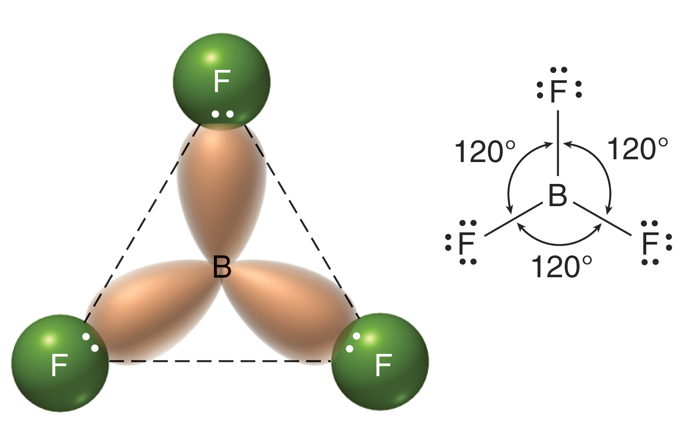
1.10 Molecular Geometry – sp²
Calculate the steric number for BF₃
The electron pairs in sp² hybridized orbitals (either bonded electrons or lone pairs) will form a trigonal planar electron group geometry (steric number = 3 = trigonal planar)

Slide 49
1.10 Molecular Geometry – sp²
Realize that the boron atom, in BF3, is sp2 hybridized. The three bonds are made with sp2 orbitals, and the unhybridized p orbital remains empty

Slide 50
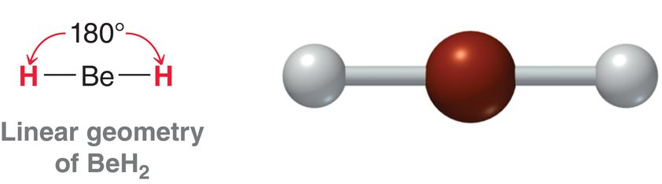
1.10 Molecular Geometry – sp
When steric number = 2, the geometry will be linear and the atom will be sp-hybridized
Consider BeH₂
Draw a Lewis structure for CO_{2.} Are the p orbitals on the C atom also empty in this compound, like they are with Be in the previous example?
the Be atom has two s bonds using sp orbitals, and two empty p orbitals

Slide 51
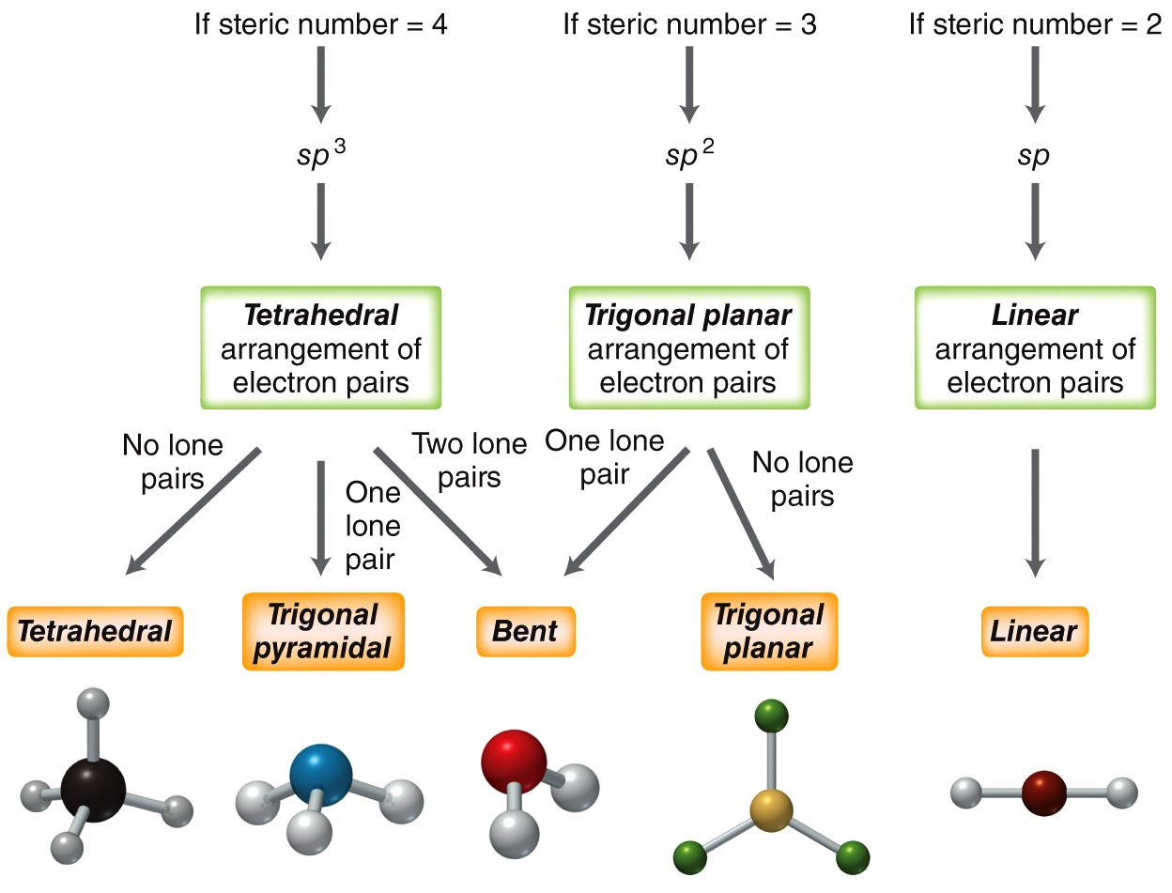
1.10 Molecular Geometry – Summary
Practice with SkillBuilder 1.8

Slide 52
1.11 Molecular Polarity & Dipoles
Electronegativity differences result in polar bonds
Induction (shifting of electrons within an orbital) results in a dipole moment.
Dipole moment = (the amount of partial charge) x (the distance the δ+ and δ- are separated)
Dipole moments are reported in units of debye (D)
1 debye = 10⁻¹⁸ esu ∙ cm

Slide 53
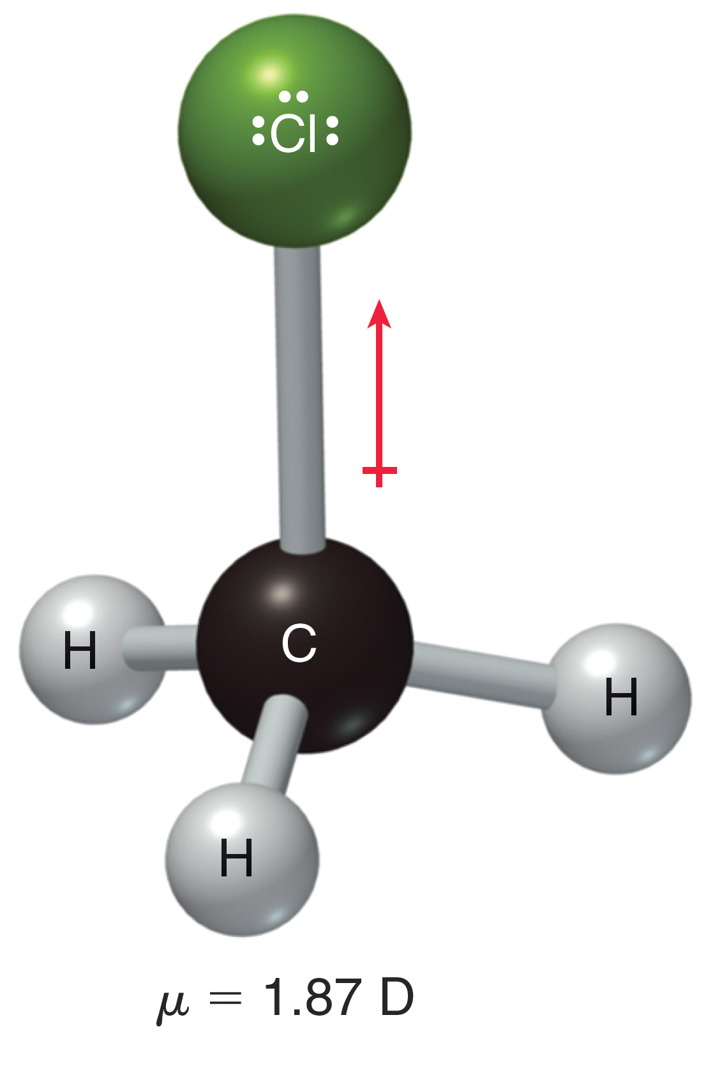
1.11 Molecular Polarity & Dipoles
Consider the dipole for CH₃Cl
Dipole moment (μ) = charge (e) x distance (d)
  Plug in the charge and distance
μ = (1.056 x 10⁻¹⁰ esu) x (1.772 x 10⁻⁸ cm)
  Note that the amount of charge separation is less than what it would be if it were a full charge separation (4.80 x 10⁻¹⁰ esu)
μ = 1.87 x 10⁻¹⁸ esu ∙ cm
  Convert to debye
μ = 1.87 D

Slide 54
1.11 Molecular Polarity & Dipoles
What would the dipole moment be if CH₃Cl were 100% ionic?
μ = charge (e) x distance (d)
  Plug in the charge and distance, using the full charge of an electron
μ = (4.80 x 10⁻¹⁰ esu) x (1.772 x 10⁻⁸ cm)
μ = 8.51 x 10⁻¹⁸ esu ∙ cm = 8.51 D
What % of the C-Cl bond is ionic?
22% ionic character means the C-Cl bond is mostly covalent

Slide 55
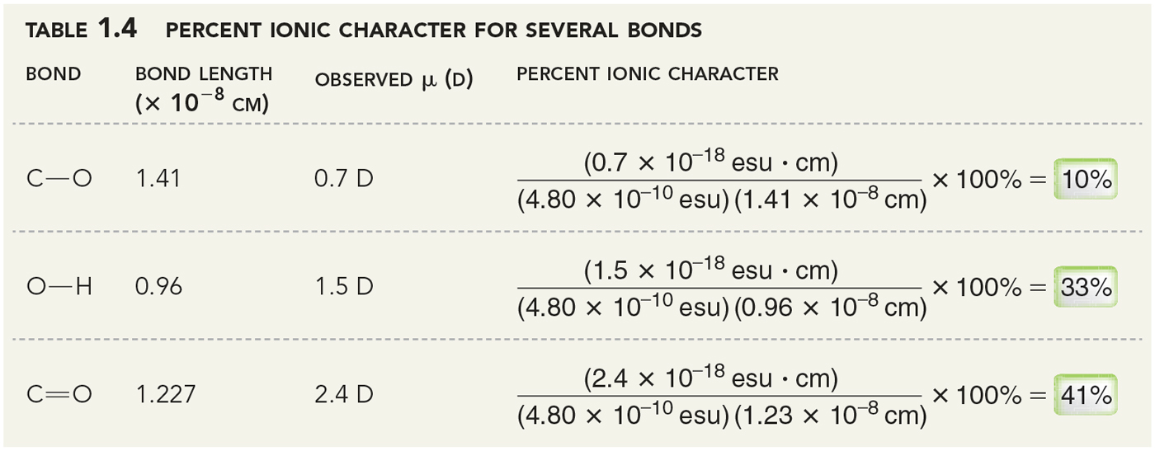
1.11 Molecular Polarity & Dipoles
The polarity of some other common bonds

Slide 56
1.11 Molecular Polarity & Dipoles
Why is the C=O double bond so much more polar than the C-O single bond?

Slide 57
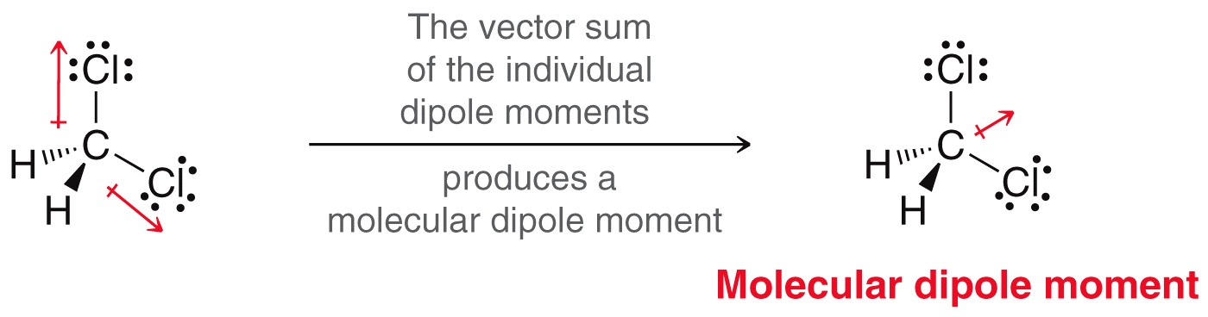
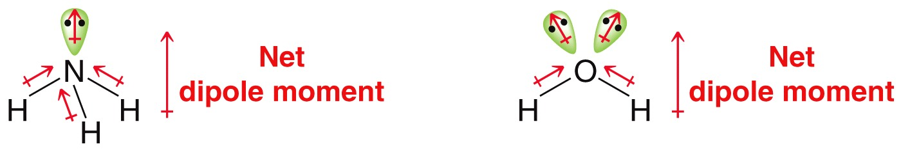
1.11 Molecular Polarity & Dipoles
For molecules with multiple polar bonds, the dipole moment is the vector sum of all of the individual bond dipoles

Slide 58
1.11 Molecular Polarity & Dipoles
you have to know the molecule’s geometry before analyzing its polarity
If you have not drawn the molecule with the proper geometry, it may cause you to assess the polarity wrong as well
Would water have a different dipole moment if it were linear instead of bent?

Slide 59

1.11 Molecular Polarity & Dipoles
Electrostatic potential maps are often used to give a visual depiction of polarity

Slide 60

1.11 Molecular Polarity & Dipoles
Practice with SkillBuilder 1.9

Slide 61
1.12 Intermolecular Forces
Many properties such as solubility, boiling point, density, state of matter, melting point, etc. are affected by the attractions between separate molecules
Neutral molecules (polar and nonpolar) are attracted to one another through…
  Dipole-dipole interactions
  Hydrogen bonding
  Dispersion forces (a.k.a. London forces or fleeting dipole-dipole forces)

Slide 62

1.12 Dipole-Dipole Attractions
Dipole-dipole forces result when polar molecules line up their opposite charges.
Note acetone’s permanent dipole results from the difference in electronegativity between C and O
The dipole-dipole attractions BETWEEN acetone molecules increases acetone’s boiling and melting points while similar molecules without dipole-dipole interactions, such as isobutylene, have lower boiling and melting points.

Slide 63

1.12 Dipole-Dipole Attractions
Isobutylene and acetone have such different MP and BPs because of dipole-dipole interactions. Isobutylene lacks a significant dipole moment.
isobutylene is less polar, has weaker dipole-dipole attractions
and therefore a lower BP
Acetone is more polar, and so it
has a higher BP

Slide 64

1.12 Hydrogen Bonding
Hydrogen bonds are an especially strong type of dipole-dipole attraction
Hydrogen bonds are strong because the partial + and – charges are relatively large
H-bonding is the attractive force between an H bonded to an electronegative atom (N, O and F) and a lone pair on another electronegative atom.

Slide 65

1.12 Hydrogen Bonding
Only when a hydrogen shares electrons with a highly electronegative atom (O, N, F) will it carry a large partial positive charge
The large δ+ on the H atom can attract large δ– charges on other molecules
Even with the large partial charges, H-bonds are still about 20 times weaker than covalent bonds

Slide 66
1.12 Hydrogen Bonding
Solvents that engage in H-bonding are called protic solvents. Solvents that do not H-bond are aprotic
acetic acid
(protic)
diethyl ether
(aprotic)
dimethylsulfoxide, called DMSO
(aprotic)

Slide 67

1.12 Hydrogen Bonding
Increasing the amount and extent of hydrogen bonding explains why the following isomers have different boiling points

Slide 68

1.12 Hydrogen Bonding
H-bonds are among the forces that cause DNA to form a double helix and some proteins to fold into an alpha-helix

Slide 69
1.12 London Dispersion Forces
If two molecules are nonpolar (dipole = 0 D), they still will have an attractive force between them
  This occurs due to an induced, transient dipole moment, called London Dispersion Forces
Nonpolar molecules normally have their electrons (–) spread out evenly around the nuclei (+) completely balancing the charge
However, the electrons are in constant random motion within their MOs

Slide 70

1.12 London Dispersion Forces
The constant random motion of the electrons in the molecule will sometimes produce an electron distribution that is NOT evenly balanced with the positive charge of the nuclei
Such uneven distribution produces a temporary dipole, which can induce a temporary dipole in a neighboring molecule

Slide 71
1.12 London Dispersion Forces
The result is a fleeting attraction between the two molecules
Such fleeting attractions are generally weak.
But like any weak attraction, if there are enough of them, they can add up to be significant

Slide 72

1.12 London Dispersion Forces
The greater the surface area of a molecule, the more temporary dipole attractions are possible
Consider the feet of Gecko. They have many flexible hairs on their feet that maximize surface contact
The resulting London dispersion forces are strong enough to support the weight of the Gecko

Slide 73

1.12 London Dispersion Forces
London dispersion forces are the reason why molecules with more mass generally have higher boiling points
Practice with SkillBuilder 1.10

Slide 74

1.12 London Dispersion Forces
The more branching in a molecule, the lower it’s surface area, and the weaker the London dispersion forces.

Slide 75
1.13 Solubility
As you learned in general chemistry, like-dissolves-like
Polar compounds generally mix well with other polar compounds
  If the compounds mixing are all capable of H-bonding and/or strong dipole-dipole, then there is no reason why they shouldn’t mix
Nonpolar compounds generally mix well with other nonpolar compounds
  If none of the compounds are capable of forming strong attractions, then no strong attractions would have to be broken to allow them to mix

Slide 76

1.13 Solubility
We know it is difficult to get a polar compound (like water) to mix with a nonpolar compound (like oil)
  We can’t use just water to wash oil off our dirty cloths
To remove nonpolar oils, and grease, and dirt… we need soap

Slide 77

1.13 Solubility
Soap molecules organize into micelles in water, which form a nonpolar interior to carry away dirt.

