Slide 1
Organic Chemistry
Third Edition
David Klein
Chapter 2
Molecular Representations

Slide 2
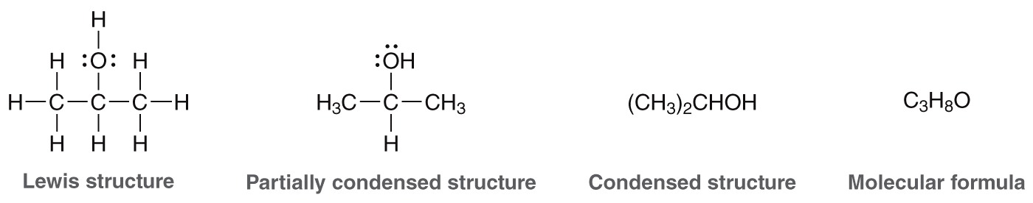
2.1 Representing Molecules
There are many ways to represent molecules
Consider what information is necessary to accurately describe a molecule.
Which representations are easiest to draw? Which ones give you more information about the molecule?

Slide 3
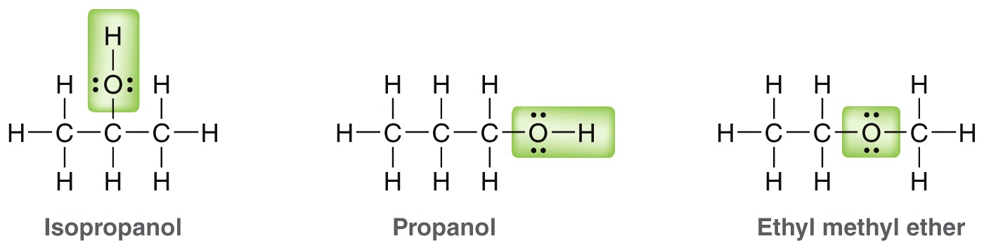
2.1 Representing Molecules
Notice that the molecular formula would be inadequate to distinguish between propanol and isopropanol.
Practice converting from one type of representation to another with Skillbuilder 2.1

Slide 4
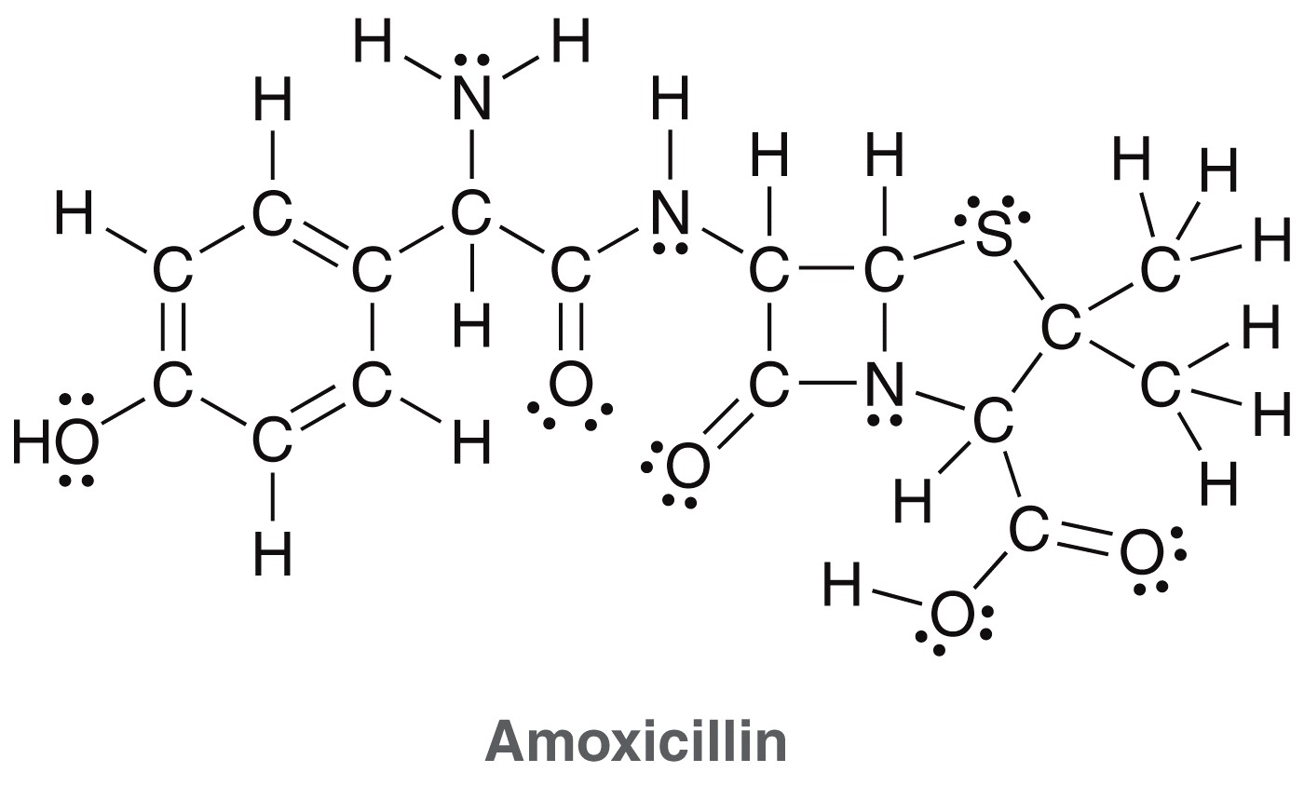
2.2 Bond-Line Structures
Lewis structures are too impractical to represent a compound like Amoxicillin, because of it’s size. But condensed formulas would tell very little about it’s shape.

Slide 5
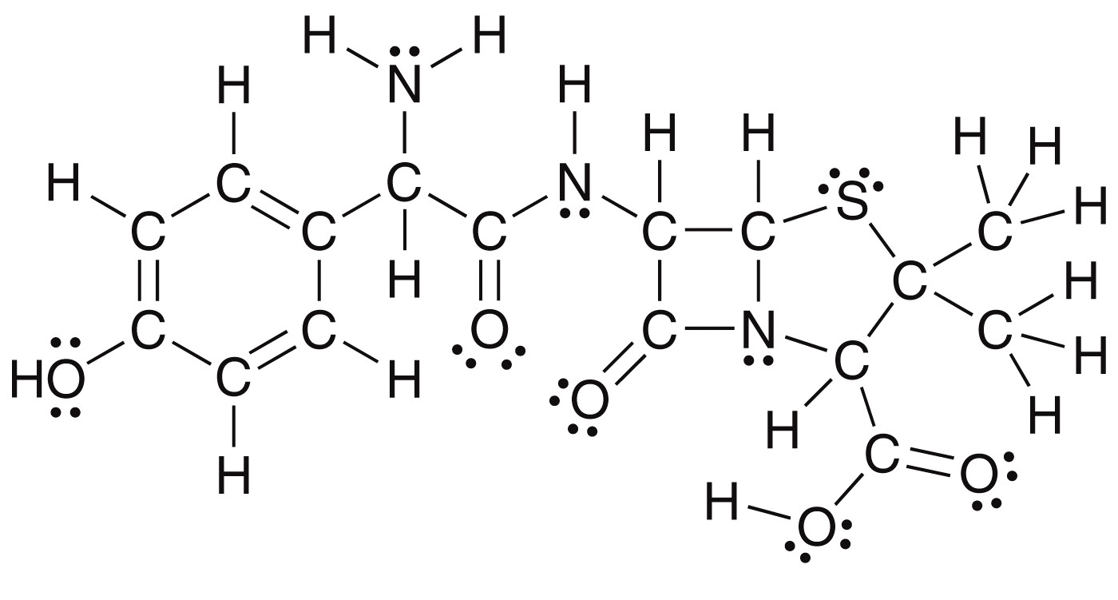
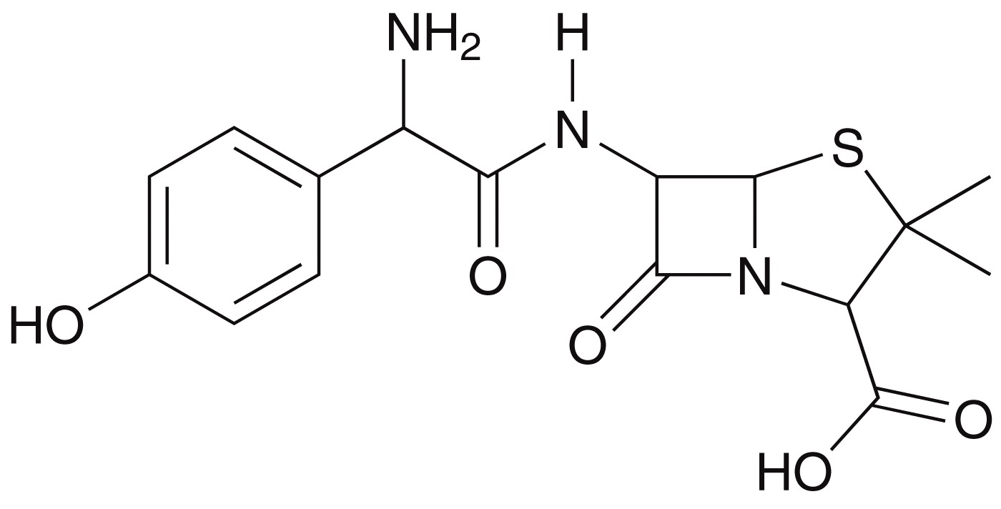
2.1 Representing Molecules
Lewis
structure
The Bond-line structure (also called a skeletal structure) is easier to read and to draw
bond-line
structure

Slide 6
2.1 Representing Molecules
Bond-line structures are the benchmark representations for organic compounds
It is critical to known how to draw these structures, for any compound, without difficulty, to succeed in any organic chemistry course.

Slide 7
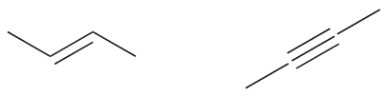
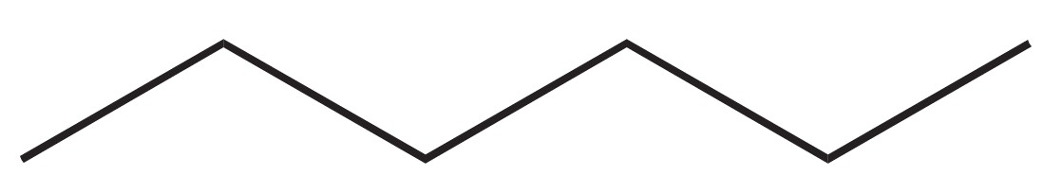
2.2 How to Read Bond-Line Structures
Each corner or endpoint represents a carbon atom. There are six carbon atoms in hexane and four in 2-butene and 2-butyne:
The zigzag format is fairly accurate in representing the bond angles for sp³ and sp² hybridized atoms
  Linear geometry is shown for sp-hybridized atoms?
Carbon atoms are not labeled, but a carbon is assumed to be located at every corner or endpoint on the zigzag.
H atoms bonded to carbon are not drawn
4
2
4
6
1
3
3
2
1
3
5
4
2
1

Slide 8
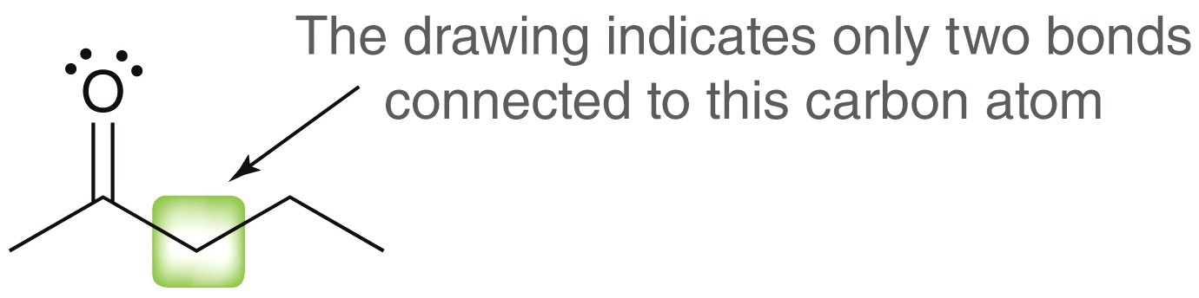
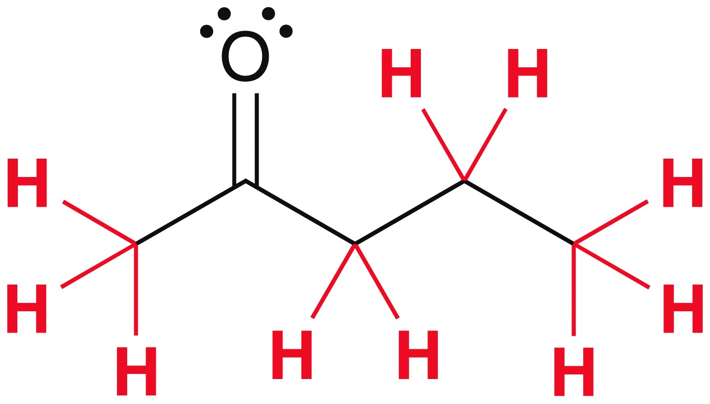
2.2 How to Read Bond-Line Structures
You must also be able to use the bond-line structure language to interpret the number and location of H atoms in a molecule
H atoms are not shown, but its assumed there are enough to complete the octet (4 bonds) for each carbon

Slide 9
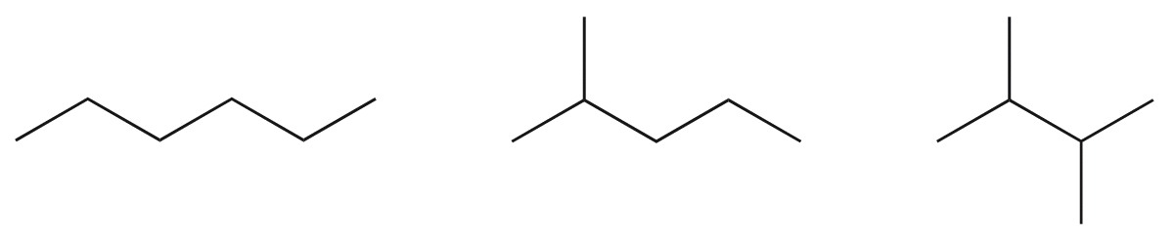
2.2 How to Read Bond-Line Structures
Practice identifying the location of carbons and hydrogens in a skeletal structure. In your mind’s eye you should see the hydrogens and where they are located.
Practice with Skillbuilder 2.2

Slide 10
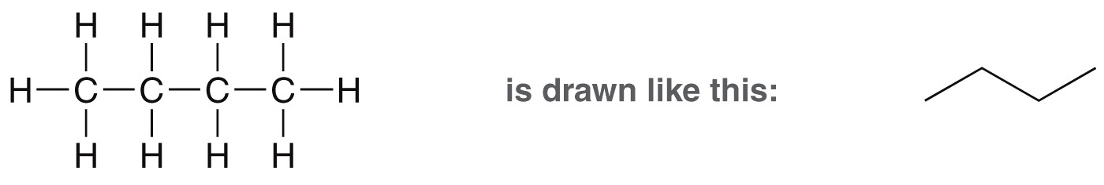
2.2 How to Draw Bond-Line Structures
If you are given a Lewis structure or condensed structure, you must also be able to draw the corresponding bond-line structure
Rule 1: sp2 and sp 3 hybridized atoms in a straight chain should be drawn in zigzag format

Slide 11
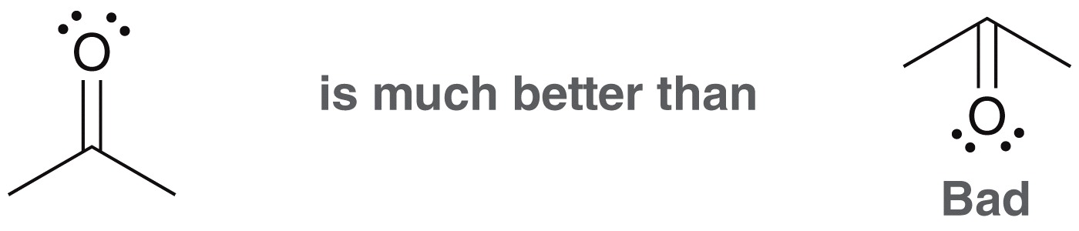
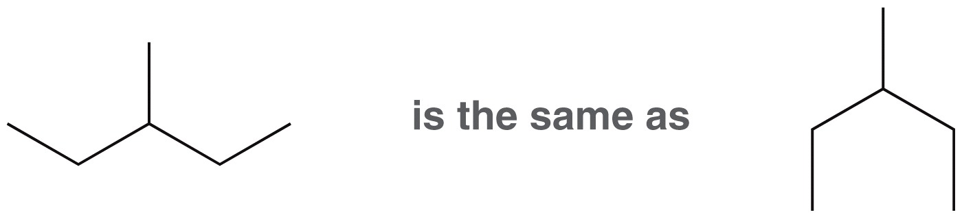
2.2 How to Draw Bond-Line Structures
  Rule 2: When drawing double bonds, draw all bonds as far apart as possible
  Rule 3: When drawing single bonds, the direction in which the bonds are drawn is irrelevant

Slide 12
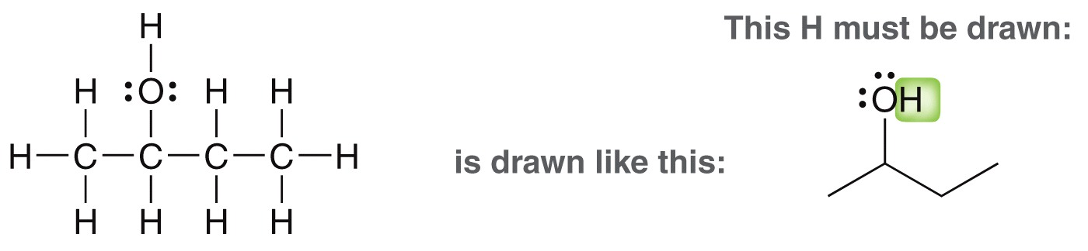
2.2 How to Draw Bond-Line Structures
Rule 4: All heteroatoms (other than carbon and hydrogen) must be drawn, as well as the H atoms attached to them.
Rule 5: The cardinal rule – Never draw more than four bonds to a carbon atom (recall the octet rule).
Practice with Skillbuilder 2.3

Slide 13
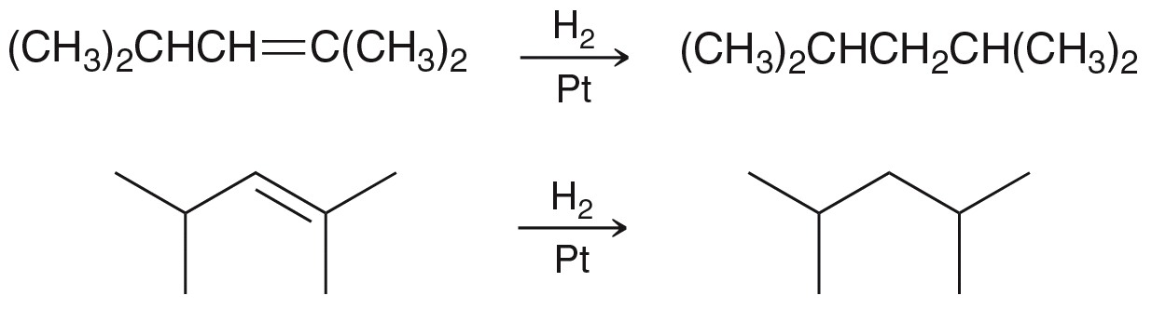
2.2 Identifying Functional Groups
Bond-line structures make it easier to see the bonds made/broken in a chemical reaction
Compare the condensed formula with the bond-line structure below for the same reaction
The bond-line structures make it more obvious to see the functional group transformation that takes place

Slide 14
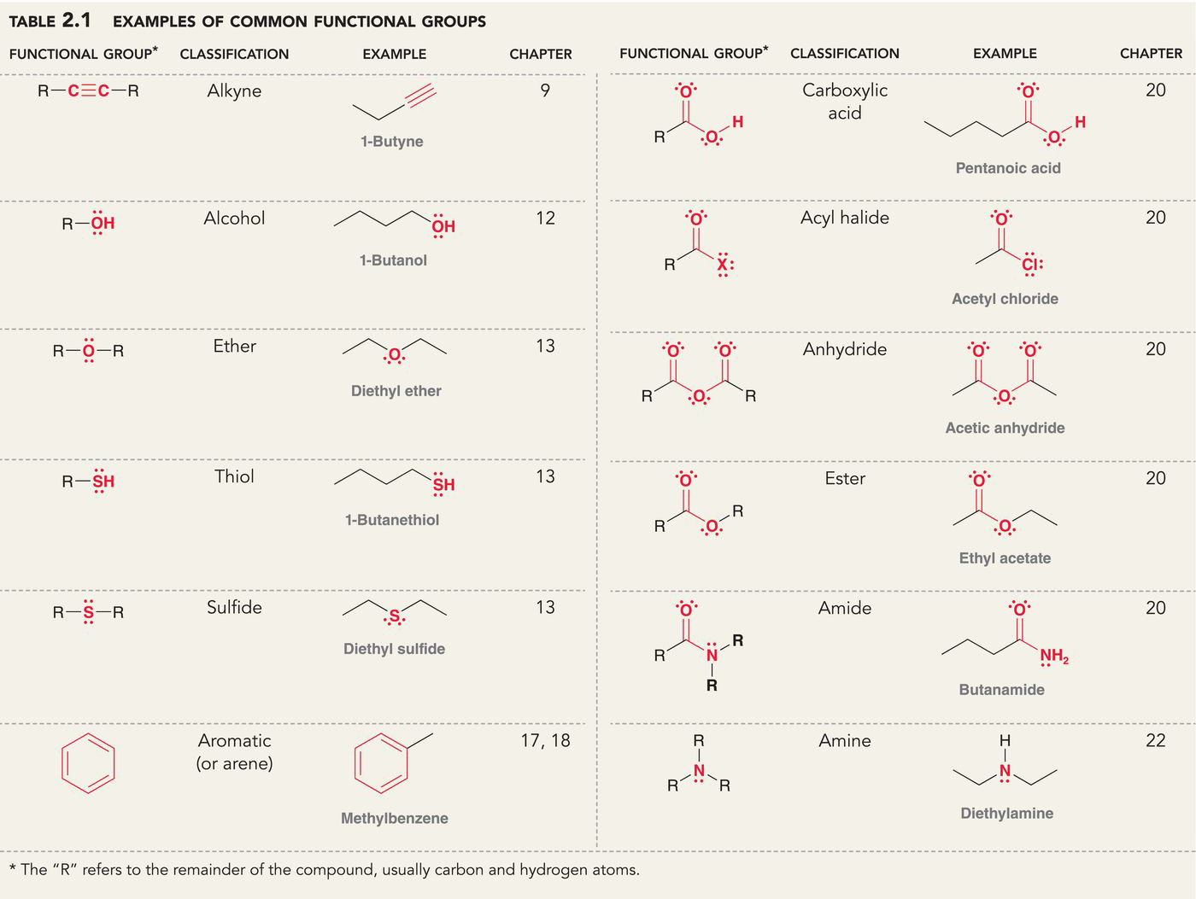
2.2 Identifying Functional Groups
When certain atoms are bonded together in specific arrangements, they undergo specific chemical reactions
These characteristic groups of atoms/bonds are called functional groups. Every chemistry student needs to learn the term for each functional group (Table 2.1)

Slide 15
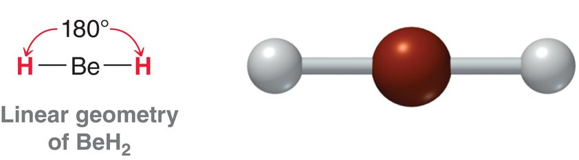
2.2 Identifying Functional Groups
Practice with conceptual checkpoint 2.7

Slide 16
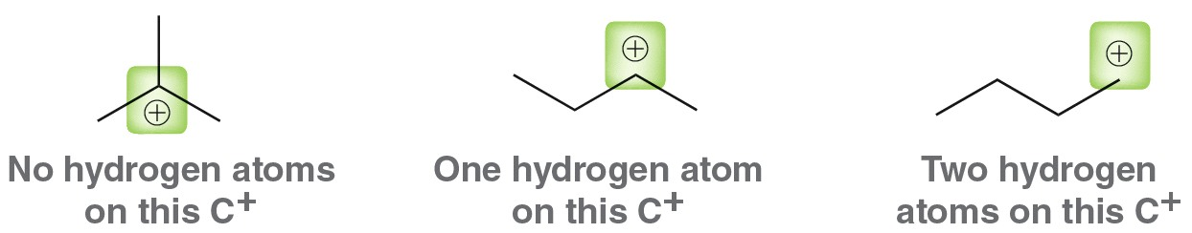
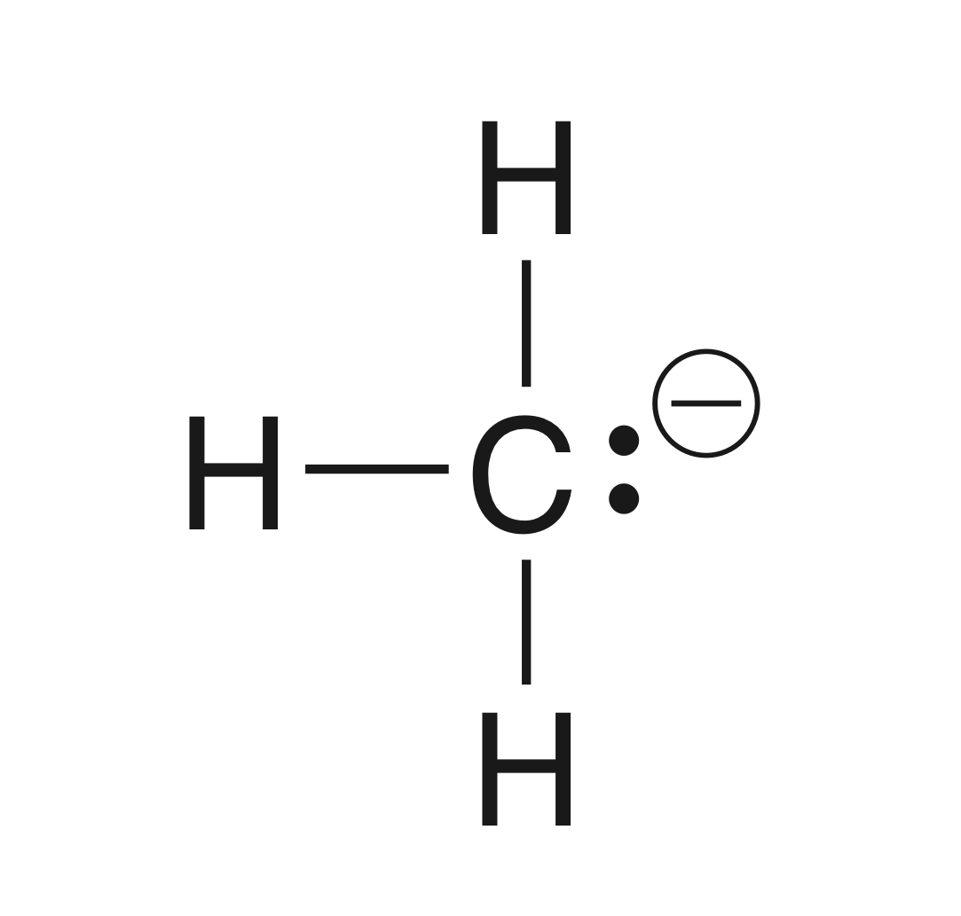
2.3 Carbon Atoms with Formal Charges
A carbon atom will have 4 bonds when it does not have a formal charge
When a carbon has a positive charge (carbocation), it will have a total of three bonds (and one empty orbital).
A carbanion will also have
three bonds, but also a lone pair.
(no empty orbitals)

Slide 17
2.3 Carbon Atoms with Formal Charges
Formal charge (section 1.4) affects the stability and reactivity of molecules, so you must be able to identify formal charges in bond-line representations
The following structure is incomplete, because it doesn’t have formal charges correctly indicated.
Formal charges must always
drawn. Fix the structure by
adding them
Practice with conceptual checkpoints
2.12 and 2.13

Slide 18
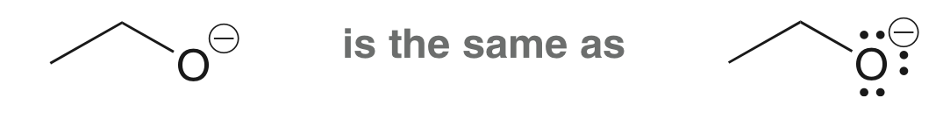
2.5 Bond-line structures: Identifying Lone Pairs
Formal charge must be drawn, always, but drawing lone pairs is optional and they are often not included.
By knowing the formal charge, the presence (or absence) of lone pairs is implied
Oxygen is in 6th group of PTE, needs 6 valence electrons to be neutral, so an oxygen anion has 7. The negatively charged oxygen has one bond, so it must have 6 unshared electrons to total 7.

Slide 19
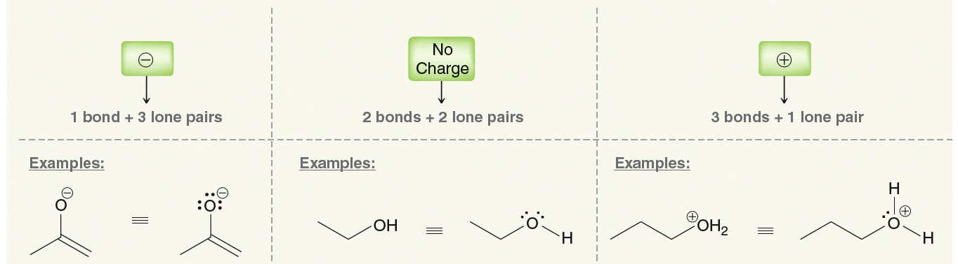
2.5 Bond-line structures: Identifying Lone Pairs
Oxygen has three possible bonding patterns (the same three patterns for any 2nd-row atom with 5, 6 or 7 valence electrons
Practice with SkillBuilder 2.4
when O has 7
valence e-
when O has 6
valence e-
when O has 5
valence e-

Slide 20
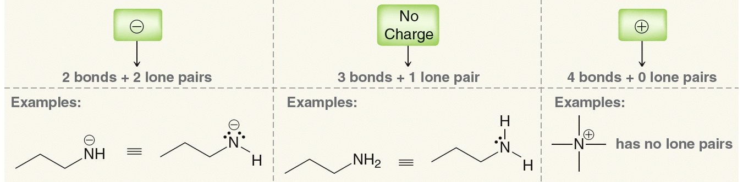
2.5 Bond-line structures: Identifying Lone Pairs
The formal charge on a N atoms can be calculated the same way or by matching its bonding pattern with its formal charge
Practice with SkillBuilder 2.5
When N has 6
valence e-
When N has 5
valence e-
When N has 4
valence e-

Slide 21
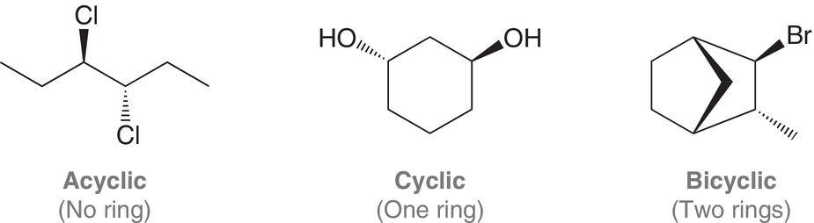
2.6 Bond-line Structures in 3-D
All molecules take up spaced in 3 dimensions, but it is difficult to represent a 3D molecule on a 2D piece of paper or blackboard
We will use dashed and solid wedges to show groups that point back into the paper or out of the paper

Slide 22
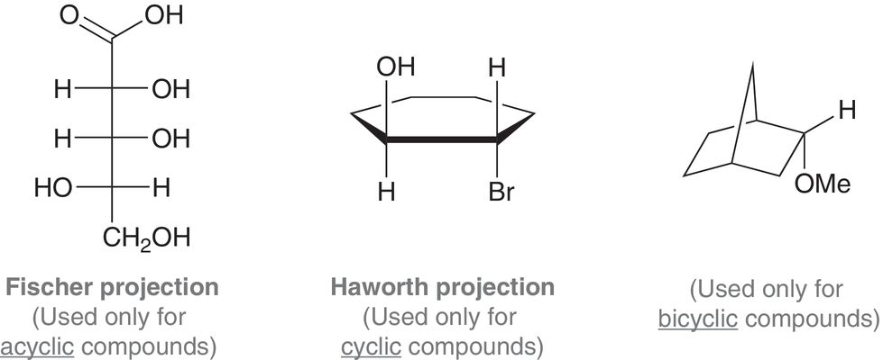
2.6 Bond-line Structures in 3-D
Other ways to show 3-D structure
The shape of a compound governs how it interacts biologically, and so it is important to accurately depict and interpret 3-D in bond-line structures.

Slide 23
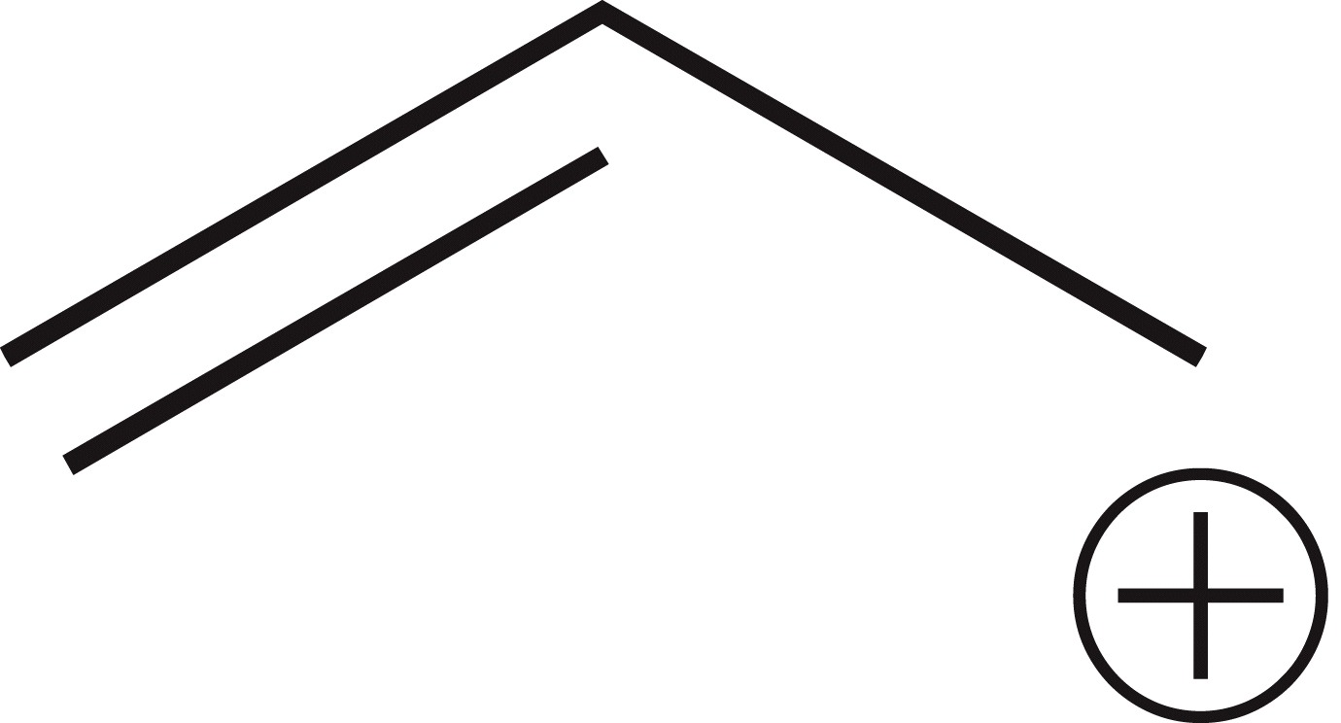
2.7 – Introduction to Resonance
Pi-bonds and/or formal charges are often more “spread out” than a bond-line structure can imply
Consider the allyl carbocation. In this case, the pi-bond and the positive are inadequately described by a bond-line structure.
There is a p-orbital on
carbon 1, 2 and 3…
… so the pi-bond is also delocalized
between carbons 2 and 3
2
1
3

Slide 24
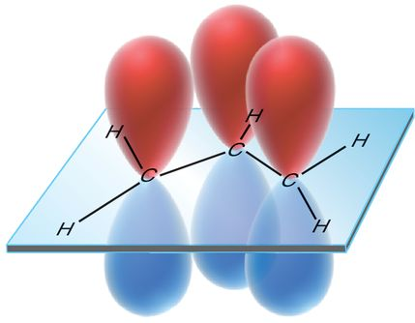
2.7 – Introduction to Resonance
If all of the carbons have unhybridized p orbitals, then all 3 of them overlap side-on-side, and
All three overlapping p orbitals allow the electrons to move throughout the overlapping area, and so we say the molecule has resonance (meaning it has delocalized electrons).

Slide 25
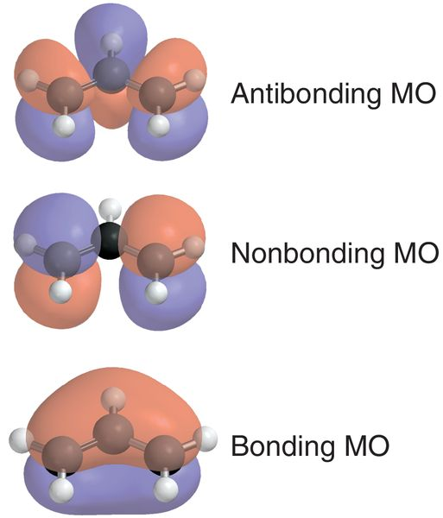
2.7 – Introduction to Resonance
From a molecular orbital point of view, the THREE unhybridized p-orbitals overlap to form THREE new MOs
The two pi-electrons occupy the lowest energy MO, which is the bonding MO

Slide 26
2.7 – Introduction to Resonance
The allyl carbocation has a charge of +1. If it gained an electron it would go to the non-bonding MO
The symmetry of the non bonding MO suggests the cationic charge is spread out to both ends of the 3 carbon chain (not just one carbon atom drawn with the positive charge)

Slide 27
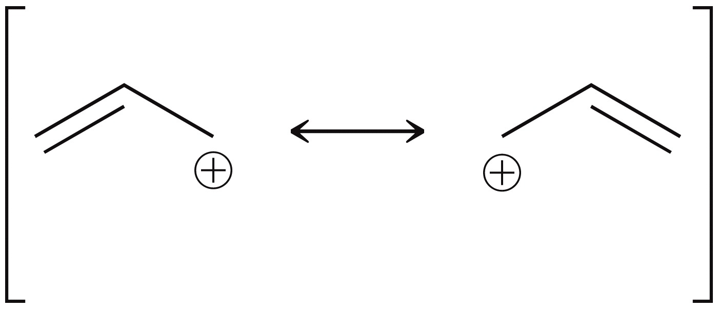
2.7 Resonance
So how can we use bond-line structures accurately describe the positive charge on the allyl carbocation?
The pi electrons can exist on both sides of the middle carbon, so we can draw two different resonance structures to represent the compound
The resonance arrow, and the brackets, indicate these structures
are describing one compound

Slide 28
2.7 Resonance
Because neither of the contributors exists (look at MOs), the average or hybrid is much more appropriate
vs.
The resonance structures are not switching back and forth!
Analogy: a nectarine is a hybrid formed by mixing a peach and a plum. A nectarine is does not switch back and forth between being a peach and a plum. It is simply a nectarine, all of the time
δ+
δ+
Two resonance contributors
one resonance hybrid

Slide 29
2.7 Resonance
Delocalized electrons are more spread out, thus lower energy, thus more stable. So resonance stabilizes a molecule
  Electrons exist in orbitals that span a greater distance giving the electrons more freedom minimizing repulsions
  Electrons spend time close to multiple nuclei all at once maximizing attractions
Delocalization of charge
  The charge is spread out over more than one atom. The resulting partial charges are more stable than a full +1 charge.
δ+ δ+

Slide 30
2.8 Curved Arrows
Throughout Organic Chemistry, we will be using curved arrows to show electron movement
The sooner you master this skill, the easier the course will be
  The arrow starts where the electrons are currently located
  The arrow ends where the electrons will end up after the electron movement
We will explore curved arrows to show other reactions in Chapter 3

Slide 31
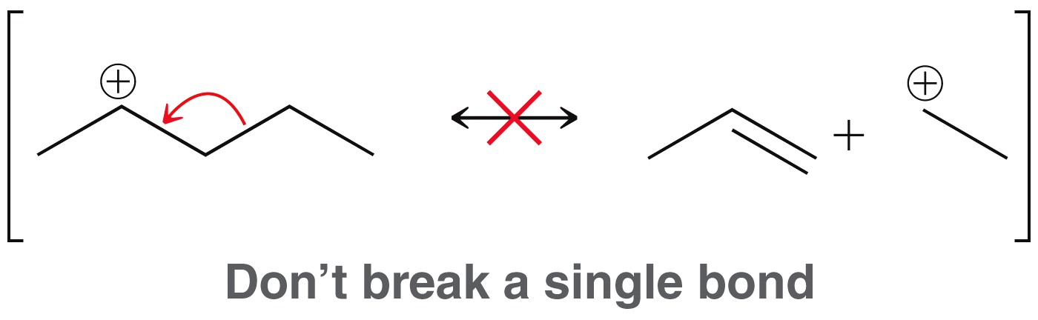
2.8 Curved Arrows
There specific rules for using curved arrows to describe electron delocalization (i.e. resonance)
Rule 1: Never show a single (sigma) bond as being delocalized
Single bonds break in a chemical reaction, not resonance.
Resonance occurs for electrons existing in overlapping p orbitals (pi-bonds and lone pairs… not sigma bonds)

Slide 32
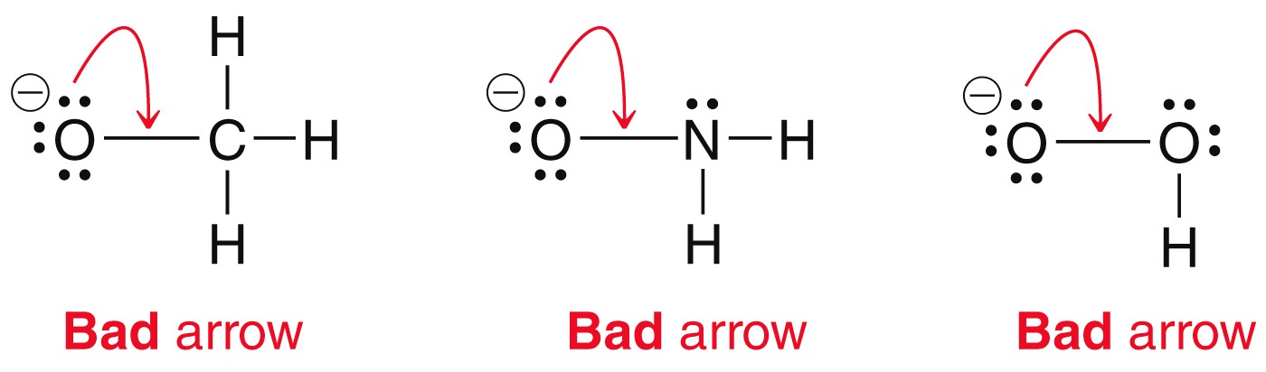
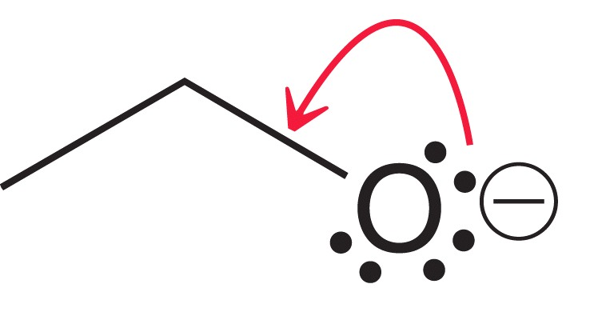
2.8 Curved Arrows
Rule 2: Never exceed an octet for 2nd row elements (B, C, N, O, F)
The valence shell of an atom in the 2nd row has only 4 orbitals, holding a max. of 8 electrons
These curved arrows violate rule 2.
Bad arrow

Slide 33
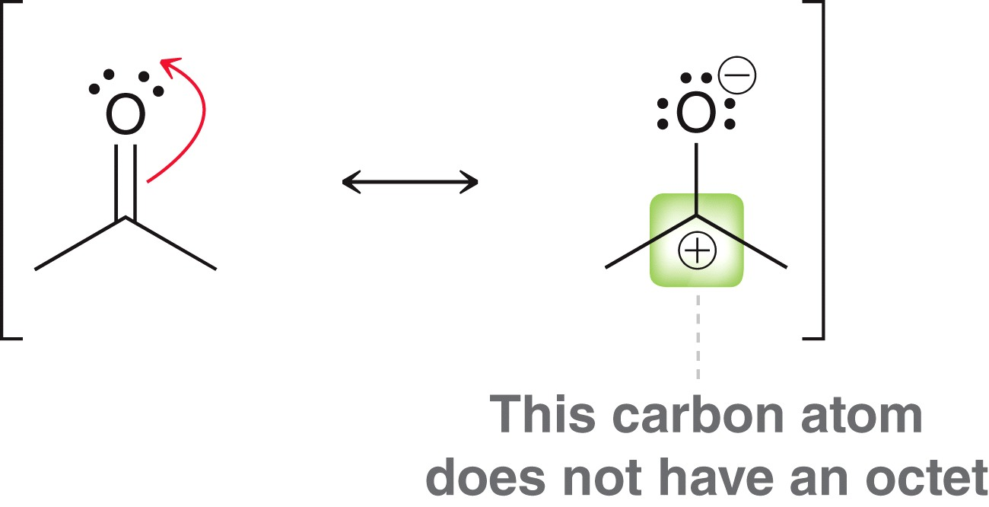
2.8 Curved Arrows
2nd row elements (B, C, N, O, F) will sometimes have LESS than an octet, just never more than an octet.
Practice with SkillBuilder 2.6

Slide 34
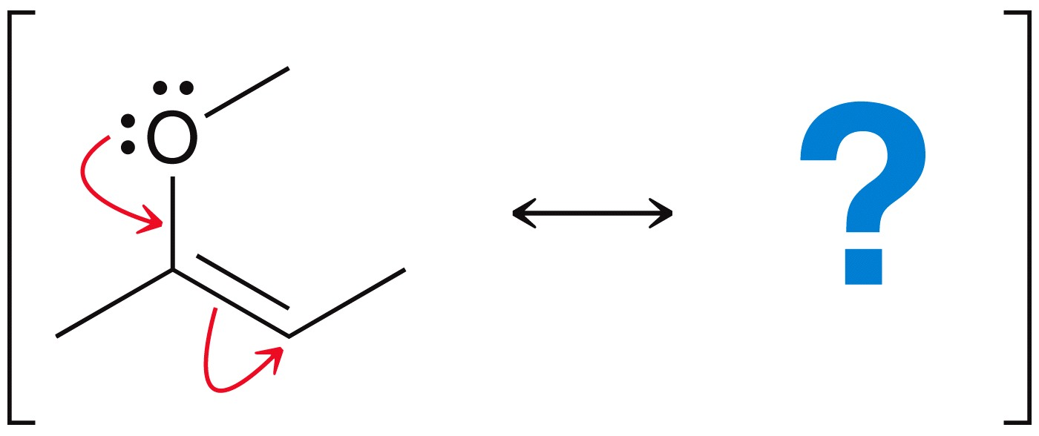
2.9 Formal Charges in Resonance
When using curved arrows to derive resonance structures, you will often have one or more formal charges to contend with.
You have to be able to indicate formal charge to draw a valid structure.
Consider the resonance structure derived from the curved arrows shown below:

Slide 35
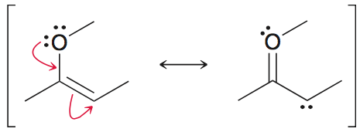
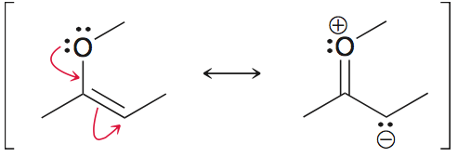
2.9 Formal Charges in Resonance
We can draw the other resonance structure by following the instructions provided by the curved arrows…
… but we have to show the formal charges to draw it correctly:
Do Skillbuilder 2.7 and Practice the Skill 2.15 and 2.16

Slide 36
2.10 Resonance Pattern Recognition
There are 5 general bonding patterns in which resonance occurs. Recognize these patterns to predict when resonance will occur
  Allylic lone pair
  Allylic carbocation
  Lone pair of electrons adjacent to a carbocation
  A pi bond between two atoms with different electronegativities
  Conjugated pi bonds in a ring
The only way to recognize these patterns is to do lots, and lots of practice problems and examples.

Slide 37
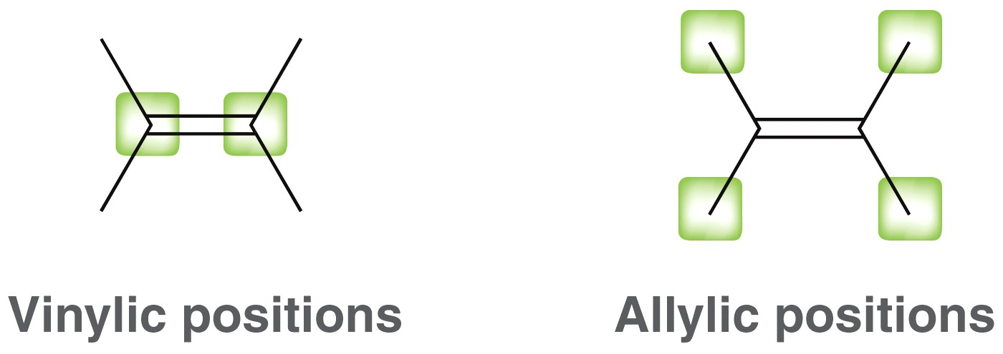
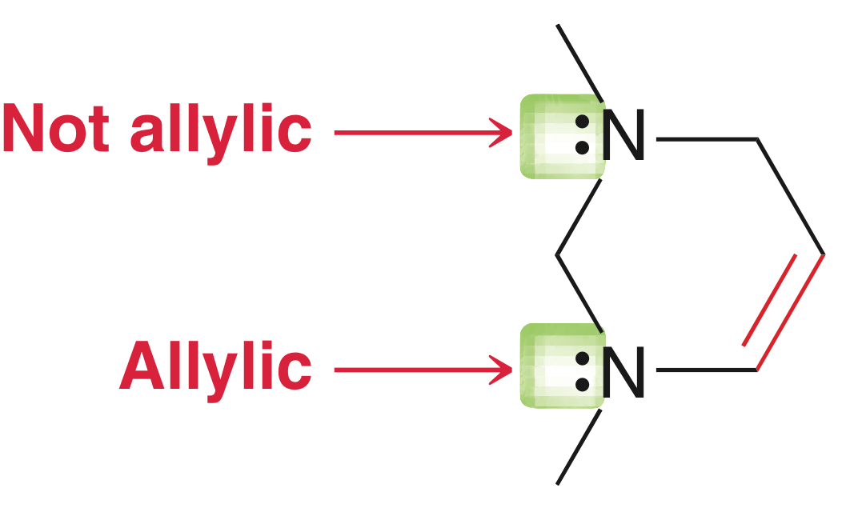
2.10 Resonance Pattern Recognition
pattern
#1
Vinyl and allyl refer to the atoms of the pi bond and next door to the C=C double bond, respectively
We look for allylic lone pairs because they will be resonance delocalized

Slide 38
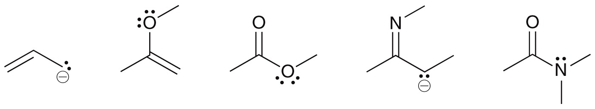
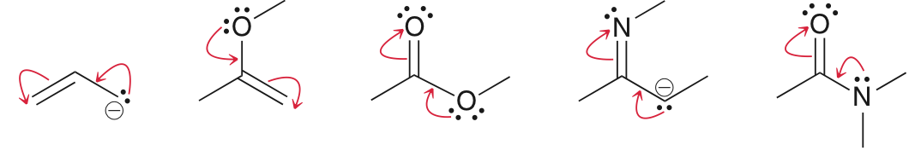
2.10 Resonance Pattern Recognition
pattern
#1
All of the lone pairs drawn in these examples are allylic
Two curved arrows must be used to show the delocalization of an allylic lone pair.

Slide 39
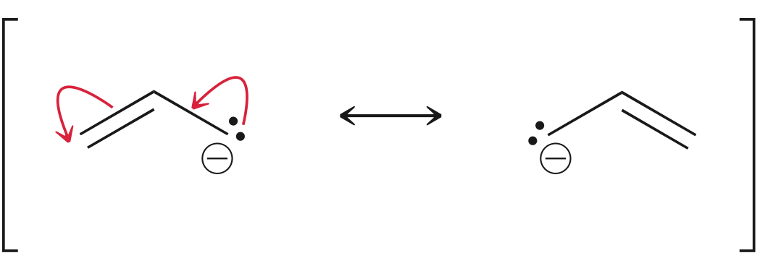
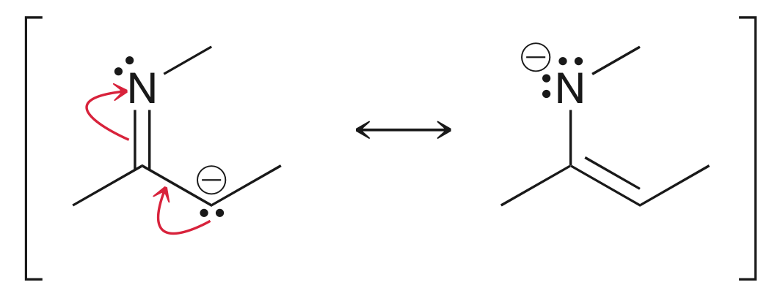
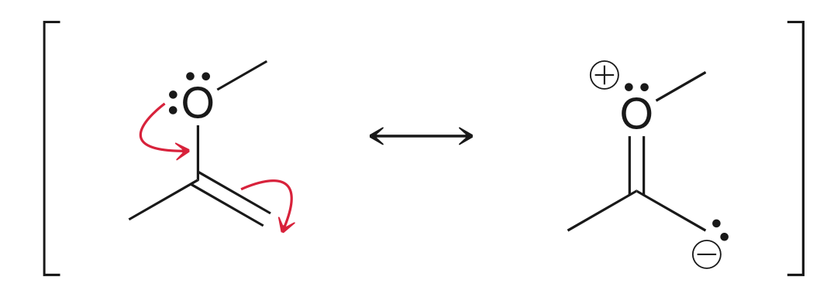
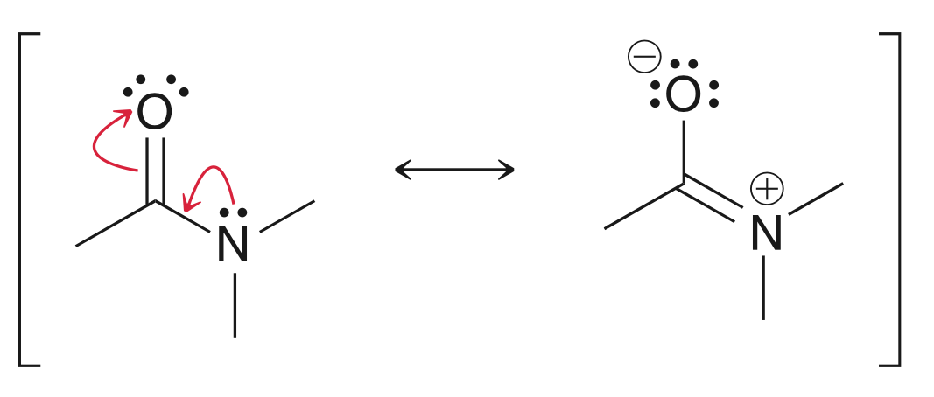
2.10 Resonance Pattern Recognition
pattern
#1
When the atom with the allylic lone pair has a negative charge, the charge is delocalized with the lone pair, shown here.
If the allylic atom is neutral, then it will become positive, and the atom receiving the lone pair will become negative.
Practice with Conceptual Checkpoint 2.18

Slide 40
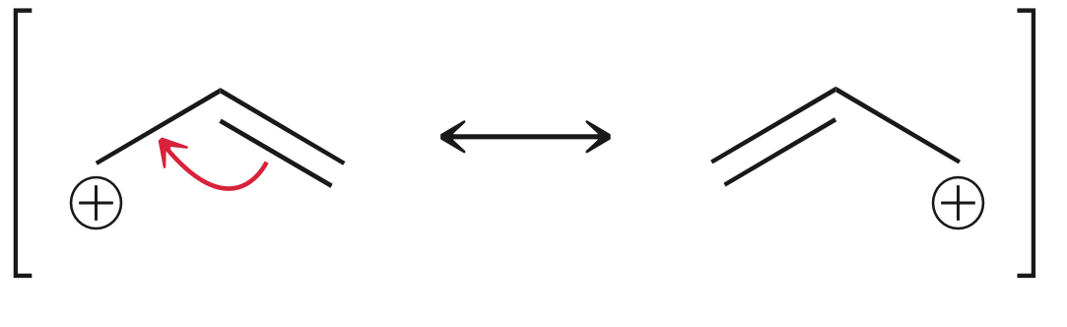
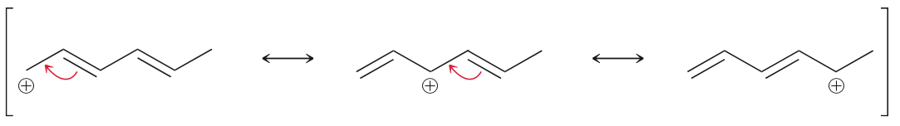
2.10 Resonance Pattern Recognition
pattern
#2
Allylic carbocations
Only one curved arrow is needed
to show resonance
If there are multiple double bonds (conjugated), then multiple contributors are possible. They are drawn by moving one electron pair at a time
Practice with Conceptual Checkpoint 2.19
A total of three resonance structure for this allylic carbocation

Slide 41
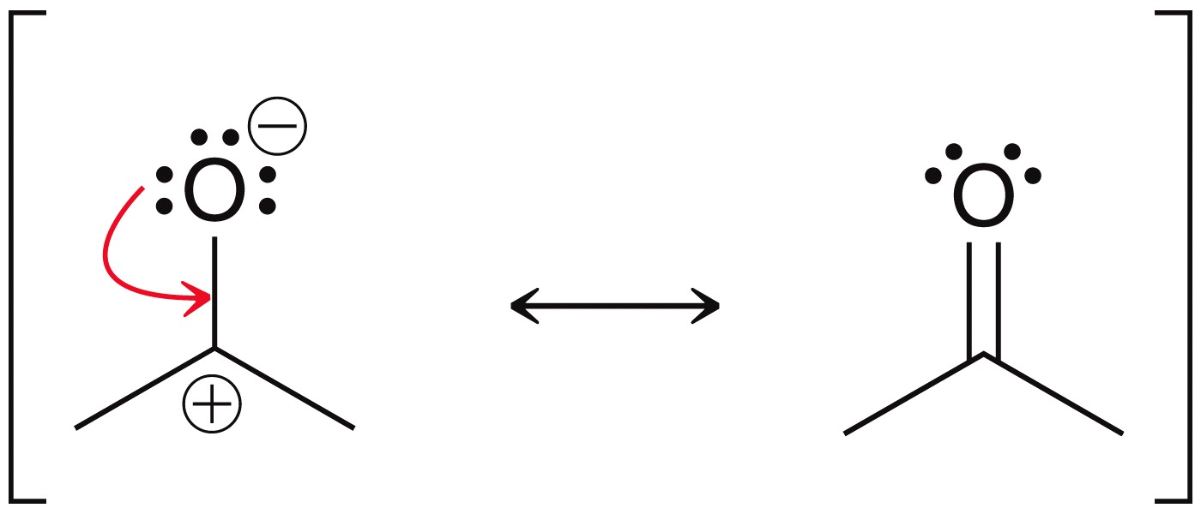
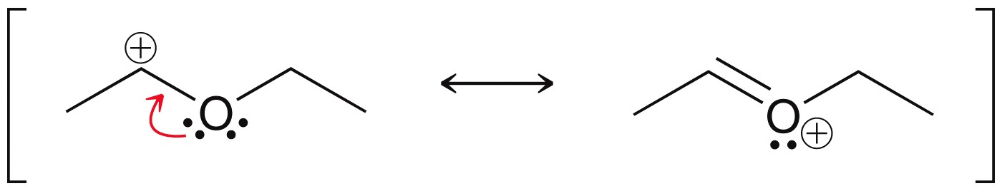
2.10 Resonance Pattern Recognition
pattern
#3
A lone pair adjacent to a carbocation
Only one arrow is needed
Recognize how the formal charges are affected by the electron movement in these two examples
Practice with Conceptual Checkpoint 2.20

Slide 42
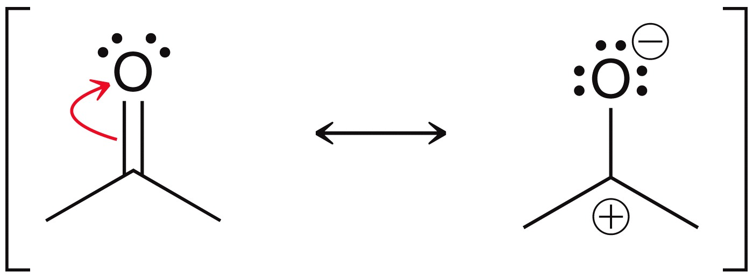
2.10 Resonance Pattern Recognition
pattern
#4
A pi bond between atoms of different electronegativity
The pi electrons will be more attracted to the more electronegative atom, causing the pi bond to be unequally shared
These two structure represent the “extreme” descriptions of the pi-bonded electrons (equally shared versus not shared). The actual compound is a hybrid of the two (unequally shared).
Practice with conceptual checkpoints 2.21-2.23

Slide 43
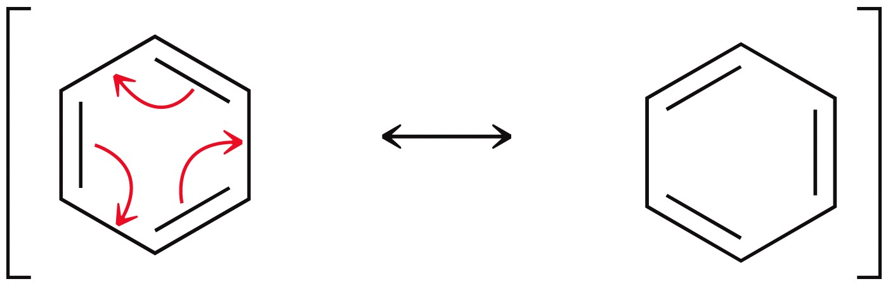
2.10 Resonance Pattern Recognition
pattern
#5
Conjugated pi bonds in a ring
Each atom in the ring has an unhybridized p orbital that can overlap with its neighbors
The pi bonds can be pushed over by one position (clockwise or counterclockwise, doesn’t matter, the result is the same).
Practice with conceptual checkpoint 2.24

Slide 44
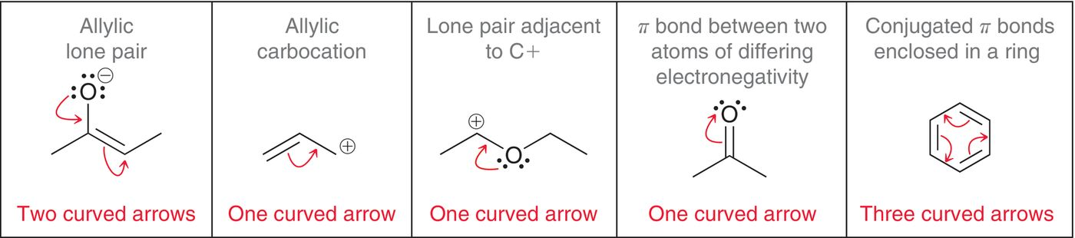
2.10 Resonance Pattern Recognition
Summary of the 5 main patterns
Practice with conceptual checkpoint 2.25

Slide 45
2.10 Resonance Pattern Recognition
Practice the act of recognizing the patterns of resonance and using curved arrows to push electrons and show their delocalization.

Slide 46
2.11 Assessing Resonance Structures
When multiple resonance structures can be drawn, we know a blend of all of them, the hybrid structure, is the actual structure of the compound
Typically, not all of the resonance structures will contribute equally to the hybrid.
The following rules, listed in order of importance, allow us to determine the most significant resonance form(s) for a given compound (i.e. the MAJOR resonance form)

Slide 47

2.11 Assessing Resonance Structures
  RULE 1: The most significant resonance forms have the greatest number of filled octets
Carbocation doesn’t have
a full octet
In this structure, all atoms
have an octet, so it is the major
resonance contributor

Slide 48
2.11 Stability of Contributors
  Rule 2: The structure with fewer formal charges is more significant
  The first two structures both have full octets, but the first one has fewest formal charges, so it is the most significant resonance contributor.

Slide 49
2.11 Stability of Contributors
  If the compound has an overall formal charge, focus only on drawing resonance forms that show the delocalization of the charge

Slide 50
2.11 Stability of Contributors
Rule 3: a structure with a negative charge on the more electronegative atom will be more significant, and vice versa
Practice these rules with Skillbuilder 2.8
We default to Rule 3 here
because more than one
structure has all atoms with
a full octet, and the same
number of formal charges

Slide 51
2.11 Stability of Contributors
Practice the Skill 2.26: Draw the significant resonance forms for each compound below, and indicate the major resonance form.

Slide 52
2.12 The Resonance Hybrid
The resonance hybrid represents the pi bond of an allylic carbocation as being delocalized over all three carbon atoms
This is consistent with MO theory, in that the pi electrons occupy the bonding MO, which has no nodes and is spread out across all three atoms.

Slide 53
2.13 Delocalized Lone Pairs
Localized electrons are NOT in resonance
Delocalized electrons ARE in resonance (and are more stable)
  To be delocalized, a lone pair of electrons must be adjacent to an atom with an unhybridized p orbital
The lone pair on the nitrogen is
delocalized because it is next door
to a carbon atom with a p-orbital

Slide 54

2.12 Delocalized Lone Pairs
In one structure, the N is sp³ hybridized, and the other indicates the N atom is sp² hybridized. So which is it?
The lone pair is delocalized, which is only possible through overlapping p-orbitals. So, the nitrogen must be sp² hybridized.
If a lone pair participates in
resonance, then it occupies a
p-orbital

Slide 55


2.12 Localized Lone Pairs
A lone pair does not participate in resonance if it cannot overlap with an adjacent p-orbital… it is a localized lone pair
The lone pair in pyridine cannot
Overlap with p-orbital on the
Adjacent atom

Slide 56

2.12 Localized Lone Pairs
Don’t assume a lone pair is delocalized just because it is next door to a pi bond.
As a general rule, you can assume that when an atom possesses a pi bond and a lone pair, they both will not participate in resonance.
And, as always, if there is no p-orbital next door to the lone pair, then it will be localized
localized
lone pair
delocalized
lone pair
localized
lone pair

