Slide 1
Organic Chemistry
Third Edition
David Klein
Chapter 3
Acids and Bases

Slide 2
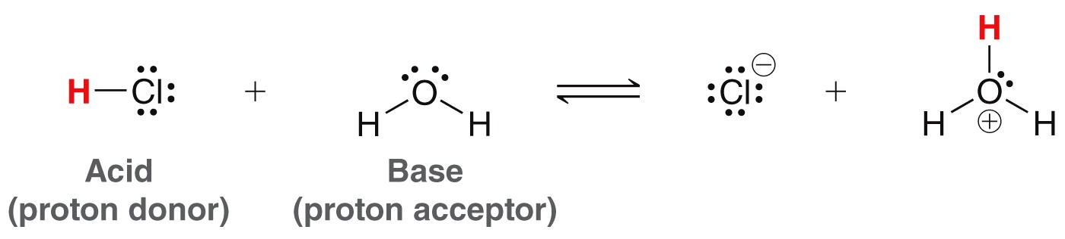
3.1 Bronsted-Lowry Acids and Bases
Brønsted-Lowry definition
  Acids donate a proton
  Bases accept a proton
Recall from General Chemistry this classic example
conjugate
base
conjugate
acid

Slide 3
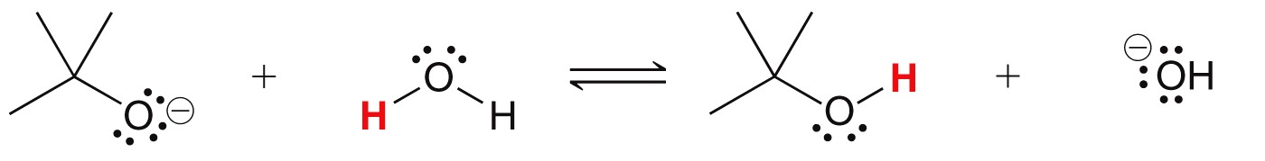
3.1 Conjugate Acids and Bases
Brønsted-Lowry definition
  A conjugate acid results when a base accepts a proton
  A conjugate base results when an acid gives up a proton
Label the acid, base, and the conjugates in the reaction below

Slide 4
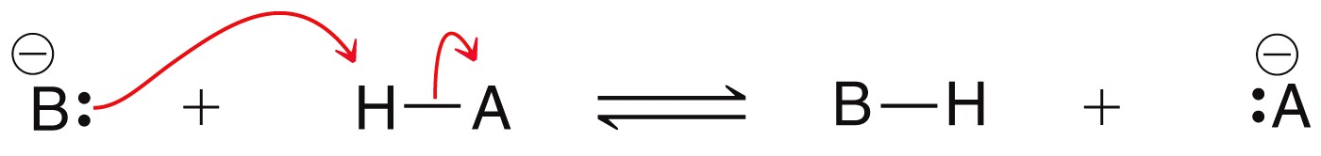
3.2 Curved Arrows in Reactions
The making and breaking of bonds involves electron movement
We use curved arrows to describe the flow of electron density
The are the same as curved arrows used to draw resonance structures, BUT…
… here, the curved arrows are actually describing the physical movement of electrons!!!
Learning to draw mechanisms is one of the most valuable skills in this class

Slide 5
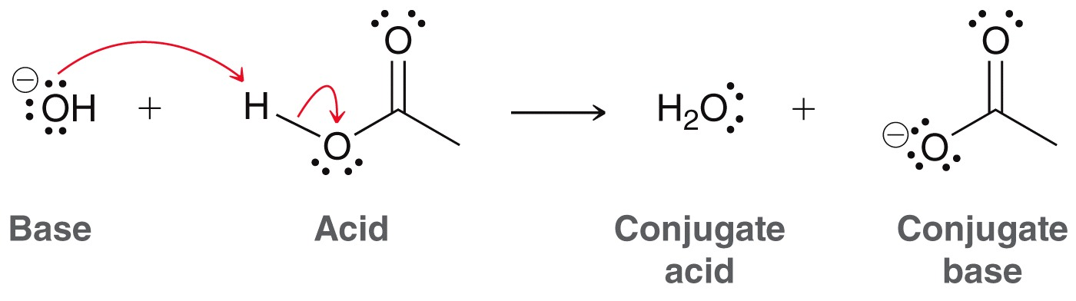
3.2 Curved Arrows in Reactions
Consider a specific acid/base example
The base “attacks” the acid, using a pair of electrons
The acid cannot lose its proton without the base taking it. All acid/base reactions occur in one step
The mechanism shows two arrows indicating that two pairs of electrons move simultaneously (one shows a bond breaking, the other shows the bond being made

Slide 6
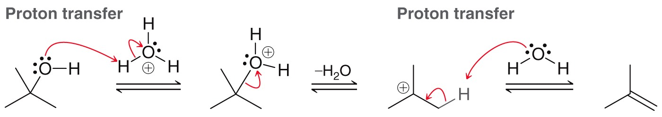
3.2 Curved Arrows in Reactions
A multistep reaction mechanism is shown below
Which steps below are proton transfers?
Before long, you will be drawing mechanisms like this one. For now, just worry about correctly using curved arrows to show acid-base reactions (i.e. proton transfers).
Practice with SkillBuilder 3.1

Slide 7
3.3 Quantifying Acidity
Recall from General Chemistry, how do “strong” acids/bases differ from “weak” acids/bases?
The strength of an acid or base is helpful to predict how reactions will progress
  We will learn to do Quantitative strength analysis – using pK_{a} values to compare the strengths of acids
  We will learn to do Qualitative strength analysis – comparing the general stability of structures.

Slide 8
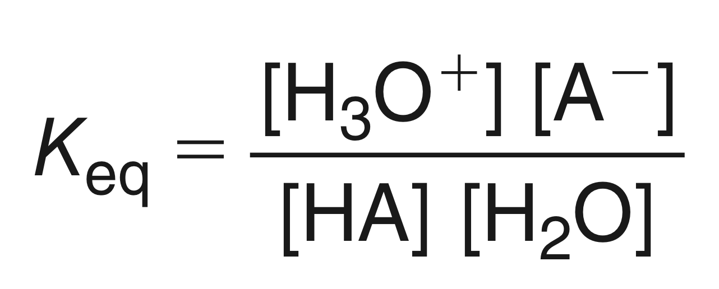
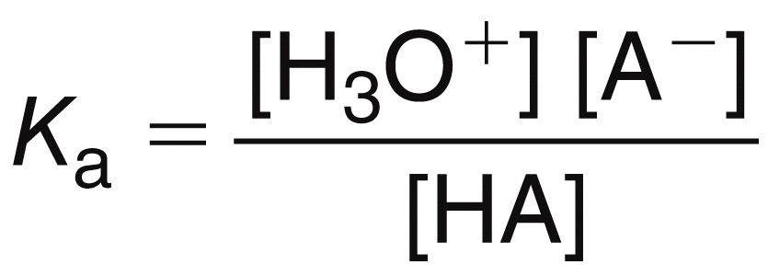
3.3 Quantifying Acidity
Quantitative strength analysis – using numerical data to compare how strong acids are.
K_{a} is the acid dissociation constant of an acid dissolved in water. It is the measurement of an acid’s strength what water is the base.
If the acid is strong, will K_{a} be bigger than 1, or smaller than 1?

Slide 9
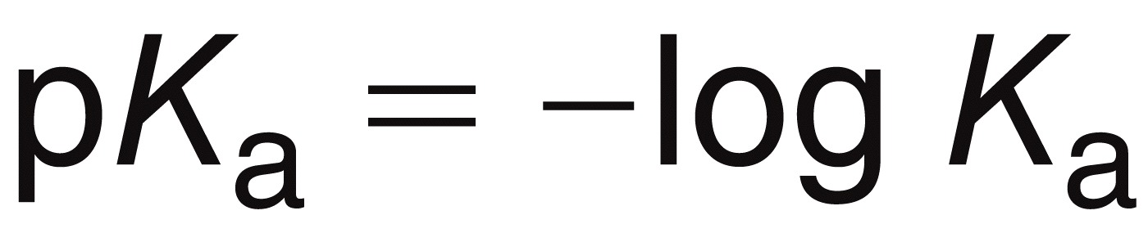
3.3 Quantifying Acidity
K_{a} values range from 10⁻⁵⁰ to 10¹⁰ and so the size of these numbers (very small or very big) are hard to work with.
If you take the -log of the K_{a}, that will focus you on the exponent of the K_{a} value, which ranges from -10 to 50
So, pKa values range from -10 to 50. Lower pka = stronger acid

Slide 10
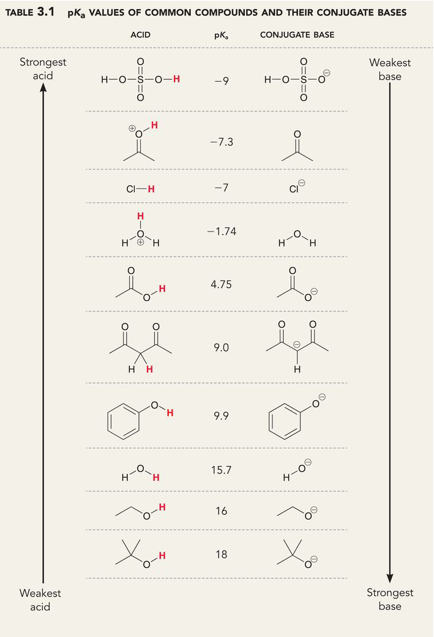
3.3 Quantifying Acidity
There are more acids and pK_{a} values in Table 3.1 and the inside cover of your textbook
Each pK_{a} unit represents an order of magnitude or a power of 10.
For example, H2SO4 (pKa = -9) is 100 times stronger acid than HCl (pKa = -7)
Practice with SkillBuilder 3.2

Slide 11
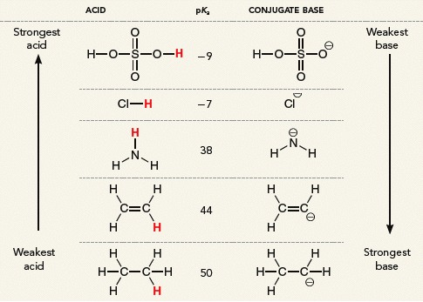
3.3 Quantifying Basicity
You can also use pK_{a} values to compare the strengths of bases because…
… The stronger an acid the weaker its conjugate base.
Practice with SkillBuilder 3.3

Slide 12
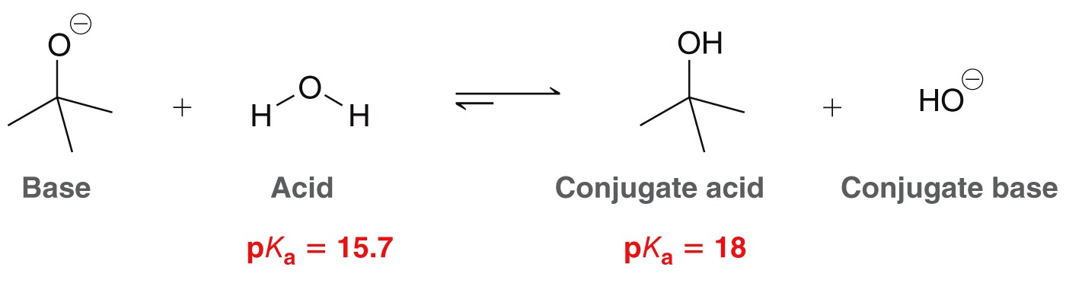
3.3 Using pK_{a} values to predict equilibria
With the relevant pK_{a} values, you can predict which direction an acid/base equilibrium will favor. Higher pKa = weaker acid
This reaction demonstrates what is ALWAYS true in an acid-base reaction: equilibrium favors the weaker acid and weaker base!!

Slide 13
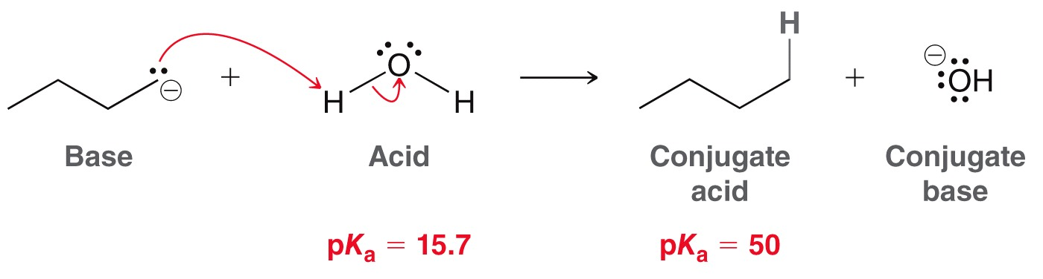
3.3 Using pK_{a}s to analyze Equilibria
Subtracting the pK_{a} values, (50 - 15.7 ≈ 34) also tells you that there will be ≈ 10³⁴ more products than reactants.
It’s not really much of an equilibrium, and more like an irreversible reaction
Practice with SkillBuilder 3.4 and checkpoint 3.12

Slide 14
3.4 Qualifying Acidity
to determine the relative strength of two acids, without knowing their pKa values, we compare the stability of their conjugate bases
The stronger the acid, the more stable it’s conjugate base!
When an acid loses a proton, it forms the conjugate base, which has a lone pair of electrons that resulted from the lose of H+
To determine the stability of a conjugate base, we are actually looking at the stability of the lone pair

Slide 15
3.4 Qualifying Acidity
The more effectively a conjugate base can stabilize its negative charge (i.e. lone pair), the stronger the acid
Four main factors affect the stability of a negative charge:
  The type of atom that carries the charge
  Resonance
  Induction
  The type of orbital where the charge resides
These factors can be remembered with the acronym, ARIO

Slide 16
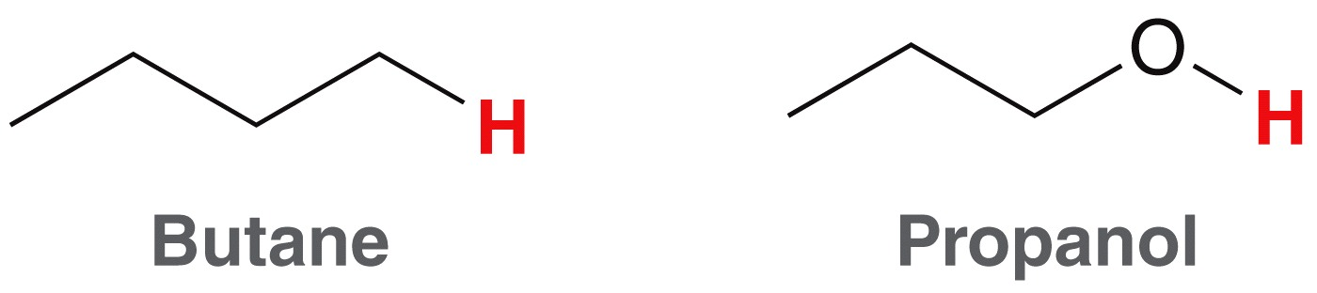
3.4 Qualifying Acidity
ARIO - The type of atom that carries the charge
  In order to compare the acidity of the two compounds below
  We need to draw and then analyze the stability of the negative charge on the conjugate bases

Slide 17
3.4 Qualifying Acidity
ARIO - The type of atom that carries the charge
  Here, we can determine whether an oxygen or a carbon will better stabilize a negative charge
  The larger the atom, the more stable a negative charge will be (size is the most important factor)
  Since C and O are in the same period, they are similar sizes. In this case, the more electronegative atom will better stabilize the negative charge
Less stable
More stable

Slide 18
3.4 Qualifying Acidity
ARIO - The type of atom that carries the charge
The relative stability of the bases tells us the relative strength of the acids
More stable
Less stable
Less acidic
MORE ACIDIC

Slide 19
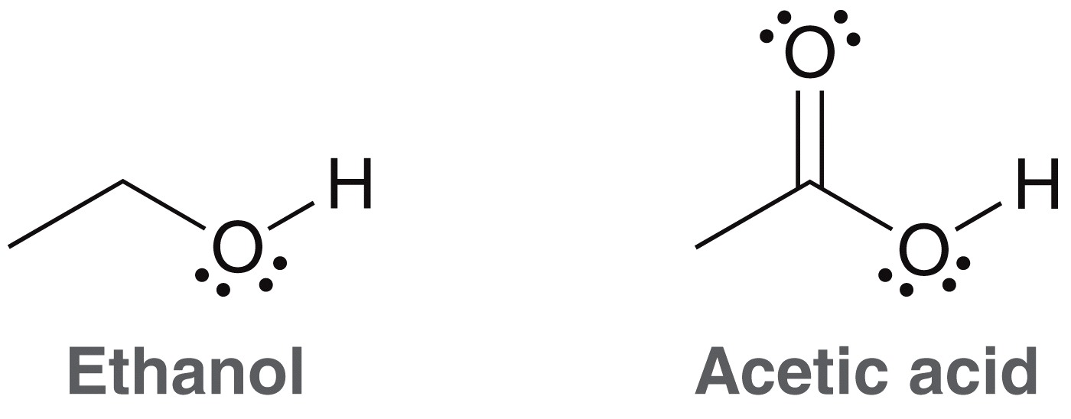
3.4 Qualifying Acidity
ARIO - Resonance stabilizes a negative charge (i.e. lone pair) by spreading it out across multiple atoms
Compare the acidity of the two compounds below by comparing the stabilities of their conjugate bases.

Slide 20
3.4 Qualifying Acidity
ARIO - Resonance
Compare the stability of these conjugate bases
versus
Now we know the relative stability of the acids (which can be confirmed by looking up their pKa values)
Practice with Skillbuilder 3.6
Less acidic
MORE ACIDIC

Slide 21
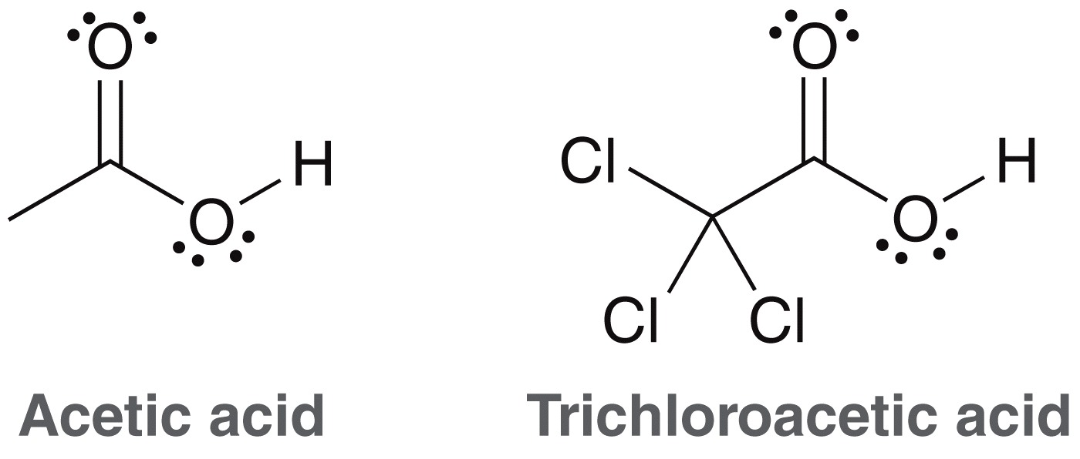
3.4 Qualifying Acidity
ARIO - Induction can also stabilize a formal negative charge by spreading it out. How is induction different from resonance?
Electron withdrawing atoms/groups inductively withdraw electron density from their surroundings, thus stabilizing a negative charge.
less acidic
more acidic

Slide 22
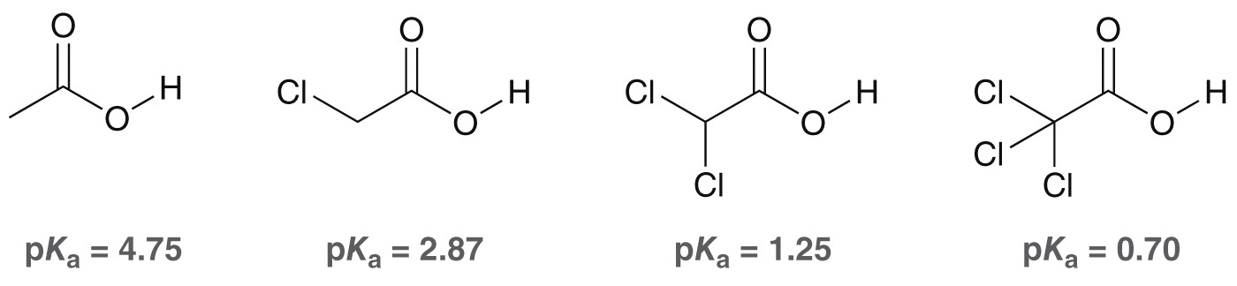
3.4 Qualifying Acidity
More electron withdrawing groups = more stable conjugate base
The closer the electron withdrawing groups to the negative charge = more stable the conjugate base
Practice with SkillBuilder 3.7

Slide 23
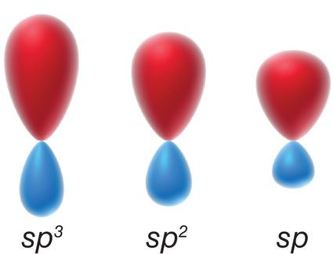
3.4 Qualifying Acidity
ARIO - The type of orbital also can affect the stability of a formal negative charge
The closer electrons are held to the nucleus, the the more stable they are.
The shorter the atomic orbital, the closer to the nucleus.

Slide 24
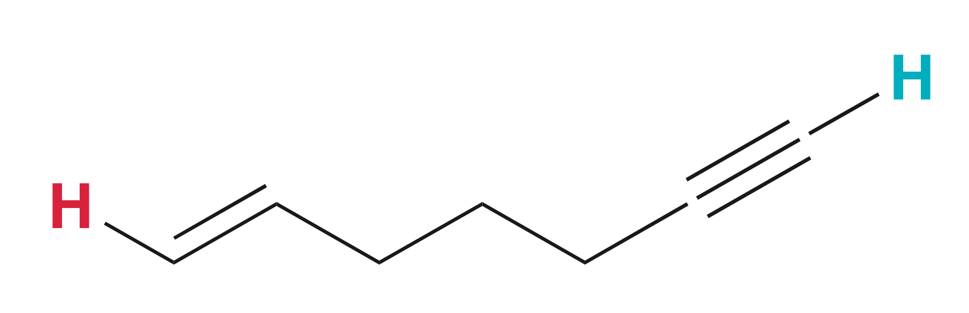
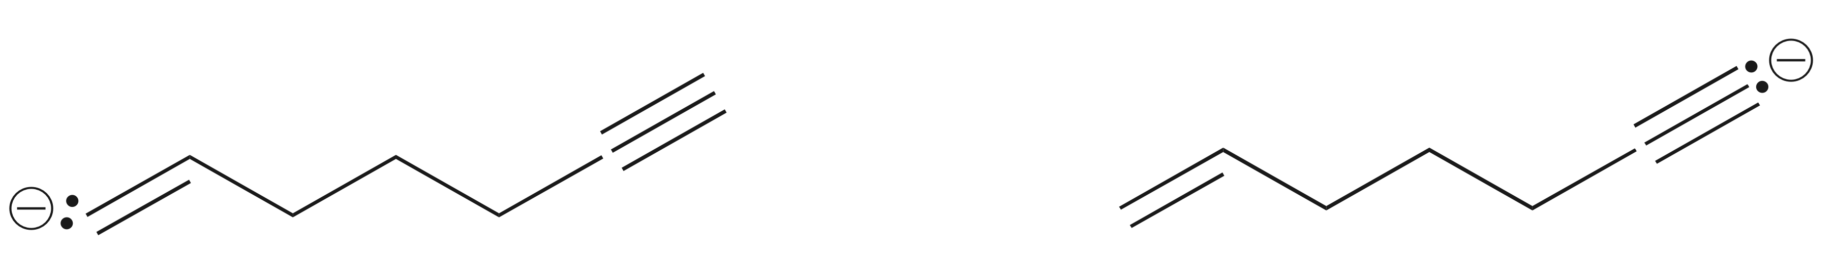
3.4 Qualifying Acidity
ARIO - The type of orbital also can affect the stability of a formal negative charge
Consider the relative stability of the H’s indicated below:
To predict which H is more acidic, we first have to draw the two possible conjugate bases
Which carbanion is more stable?
versus

Slide 25
3.4 Qualifying Acidity
ARIO - The type of orbital also can affect the stability of a negative charge. The more s-character in the orbital, the more stable the negative charge.
versus
Lone pair in a sp² orbital, not as close to the nucleus
LESS STABLE
Lone pair in a sp orbital, closer to the nucleus
MORE STABLE
less acidic
MORE ACIDIC

Slide 26
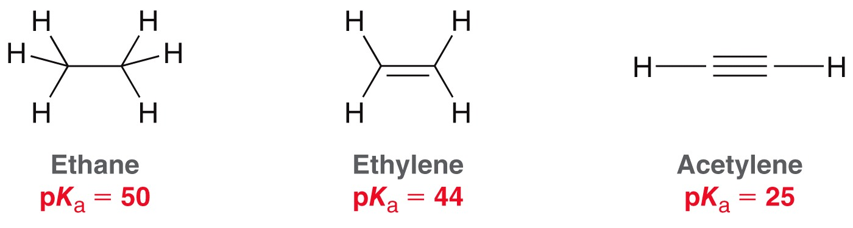
3.4 Qualifying Acidity
Compare the acidity of the compounds below by comparing the stabilities of their conjugate bases.
Practice with SkillBuilder 3.8

Slide 27
3.4 Qualifying Acidity
When assessing the acidity of protons, we generally use ARIO as the order of importance of these stabilizing effects.
  The type of atom that carries the charge
  Resonance
  Induction
  The type of orbital where the charge resides
It is typically helpful to use this order of priority when comparing the stability of conjugate bases, but it isn’t 100% reliable: there are exceptions

Slide 28
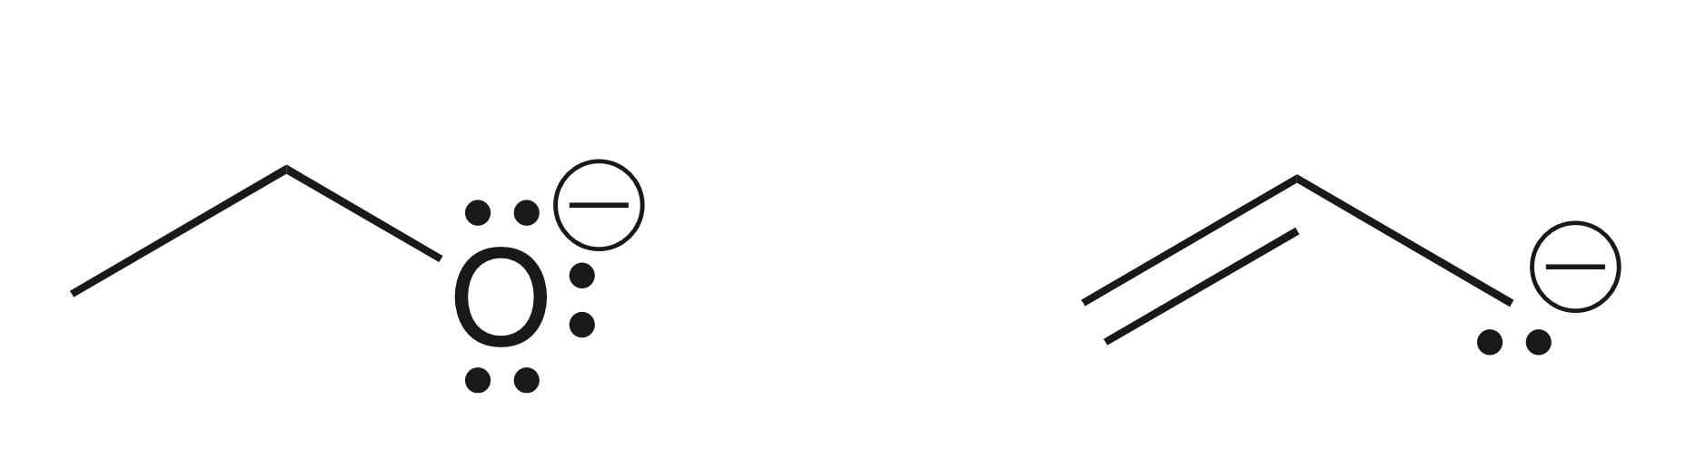
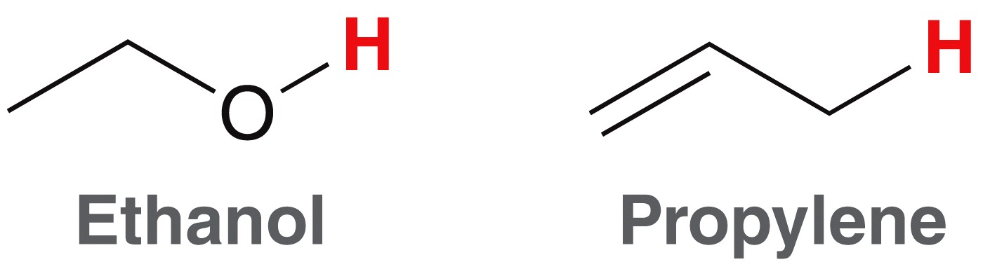
3.4 Qualifying Acidity
Ethanol is more acidic than propylene. Therefore, the conjugate base of ethanol must be more stable.
The type of atom (O vs. C) is consistent with this fact.
But, propylene’s conjugate base is resonance stabilized, which would suggest it is more stable
So, in this case, our order of priority (ARIO) is accurate.
pK_{a} = 16
pK_{a} = 43
More stable
Less stable

Slide 29
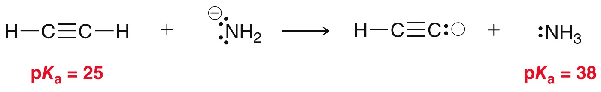
3.4 Qualifying Acidity
ARIO is only a guideline of priority… it sometimes fails
In this example, we know equilibrium lies to the right because we know the pka values
If we had judged the conjugate base stability, we would’ve concluded that negative charge on N is more stable than C, and predicted equilibrium to lie to the left, and we would’ve been wrong
Conclusion: for some acids, we simply need to know the pKa values because they are exceptions to the ARIO priority rule.

Slide 30
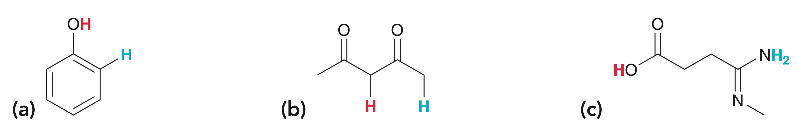
3.4 Qualifying Acidity
Practice the Skill 3.23 – Predict which proton (red vs. blue) is more acidic in each of these compounds.
Keep practicing with the other examples in Practice the Skill 3.23

Slide 31
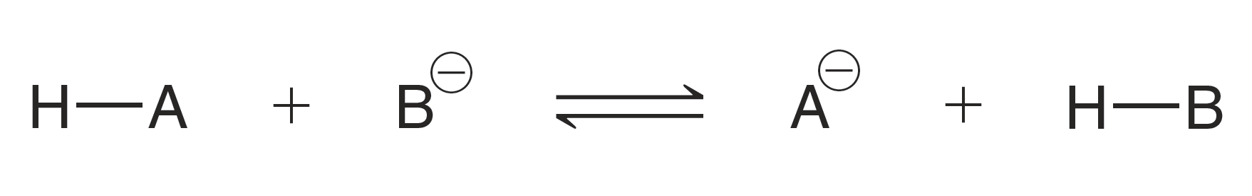
3.5 Predicting Equilibrium Position
Consider any acid base reaction:
There are two distinct ways to predict which side is favored at equilibrium
the pK_{a} values of H-A and H-B (the higher pKa will be favored)
The relative stability of the bases, B⁻ and A⁻
See Skillbuilder 3.10

Slide 32
3.5 Choosing a Reagent
Another important skill is to be able to choose an appropriate reagent for a acid/base reaction
Choose an acid from Table 3.1 that could effectively protonate each of the following molecules

Slide 33
3.6 Leveling Effect
Another important skill is to be able to choose an appropriate solvent for a acid/base reaction
The solvent should be able to surround the reactants and facilitate their collisions without itself reacting
Because water can act as an acid or a base, it has a leveling effect on strong acids and bases
  Acids stronger than H₃O⁺ can not be used in water.
  Bases stronger than OH⁻ can not be used in water. WHY? – see next few slides

Slide 34
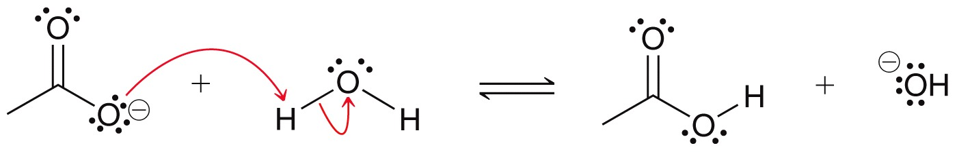
3.6 Leveling Effect
Appropriate use for water as a solvent – when the base is not stronger than hydroxide:
pK_{a} = 15.7 pK_{a}= 4.75
With water as the solvent, the CH₃CO₂– will react with the water, but the equilibrium greatly favors the left side, so water is an appropriate solvent

Slide 35
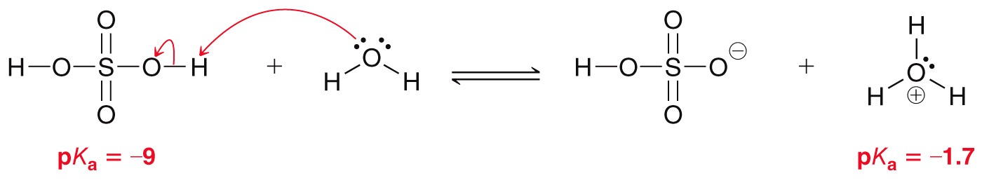
3.6 Leveling Effect
Because water can act as an acid or a base, it has a leveling effect on strong acids and bases
  Acids stronger than H₃O⁺ cannot be used in water. For example, water would react with sulfuric acid producing H₃O⁺. Virtually no sulfuric acid will remain if we wanted it to be available to react with another reagent

Slide 36
3.6 Leveling Effect
Because water can act as an acid or a base, it has a leveling effect on strong acids and bases
  Bases stronger than OH– can not be used in water. For example, we wouldn’t be able to perform the following acid-base reaction in water
  Which of the following solvents would be a better choice?

Slide 37
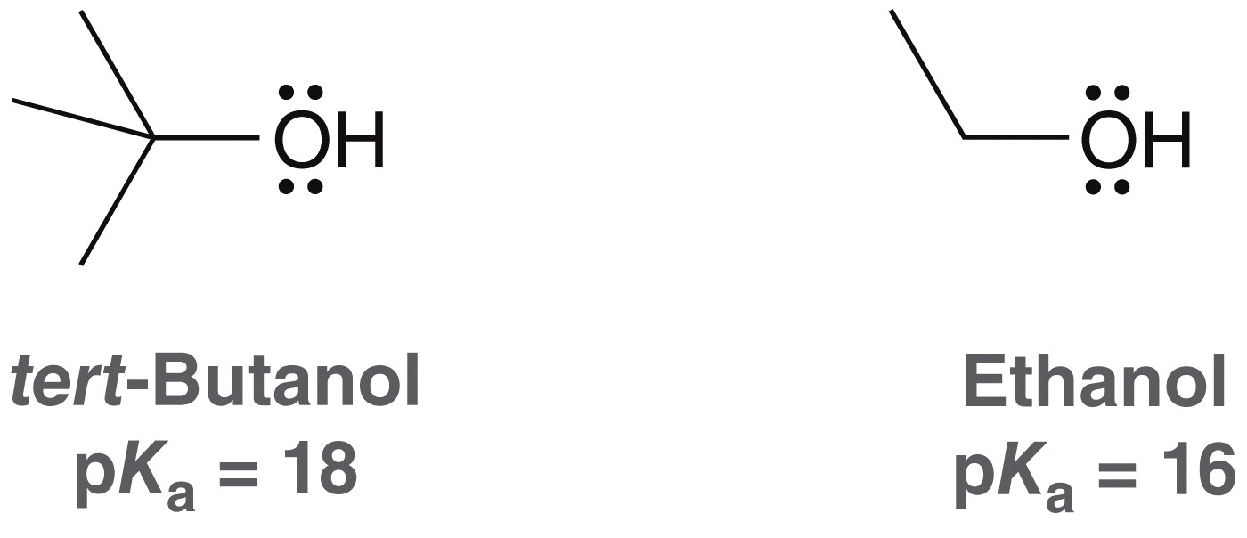
3.7 Solvating Effects
Because they are so similar, ARIO can not be used to explain the pK_{a} difference comparing ethanol and tert-Butanol
As with all acids, the difference in acidity is due to the relative stability of their conjugate bases.
The ability of the solvent to stabilize conjugates bases comes into play for this example

Slide 38
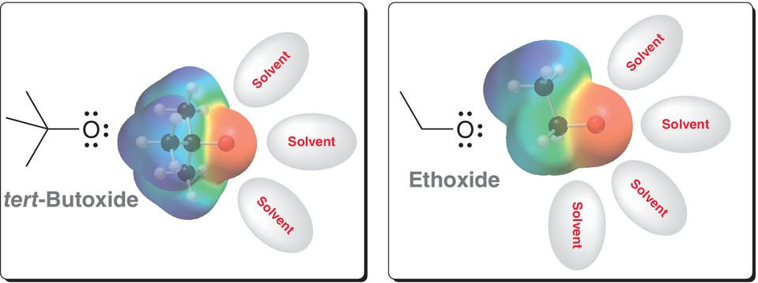
3.7 Solvating Effects
The solvent must form ion-dipole attractions to stabilize the formal negative charge
If the tert-Butoxide is sterically hindered, it won’t be as well solvated as the ethoxide. That is why t-butanol is not as acidic as ethanol

Slide 39
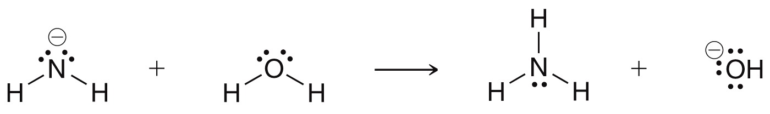
3.8 Counter Ions
Counterions are also known as spectator ions.
There are always present, because they are necessary to balance the overall charge of a solution
Full reaction. with counterion(s) included:
We often do not include the counter ions when writing the rxn:

Slide 40
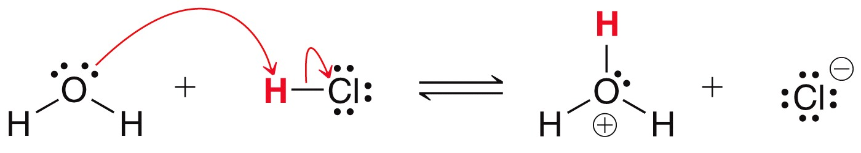
3.9 Lewis Acids and Bases
Lewis acid/base definition
  A Lewis acid accepts a pair of electrons
  A Lewis base donates a pair of electrons
Acids under the Brønsted-Lowry definition are also acids under the Lewis definition
Bases under the Brønsted-Lowry definition are also bases under the Lewis definition
this reaction fits both definitions

Slide 41
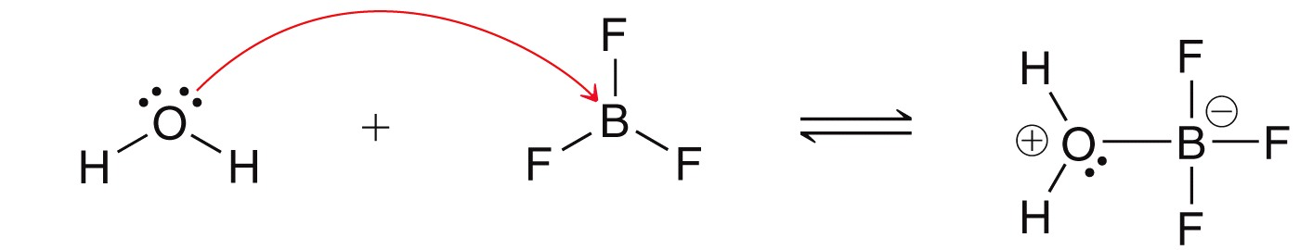
3.9 Lewis Acids and Bases
Lewis acid/base definition
  A Lewis acid accepts and shares a pair of electrons
  A Lewis base donates and shares a pair of electrons
Some Lewis acid/base reactions can not be classified using the Brønsted-Lowry definition
Explain how this reaction fits the Lewis definition but not the Brønsted-Lowry definition
Practice with SkillBuilder 3.12

