Slide 1
Organic Chemistry
Third Edition
David Klein
Chapter 4
Alkanes and Cycloalkanes

Slide 2
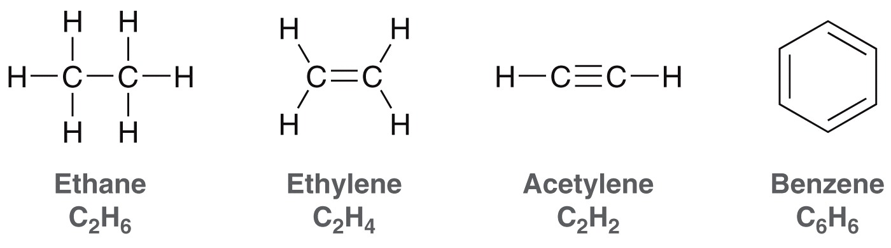
4.1 Alkanes
Hydrocarbons –composed of hydrogen and carbon
Hydrocarbons are saturated or unsaturated

Slide 3
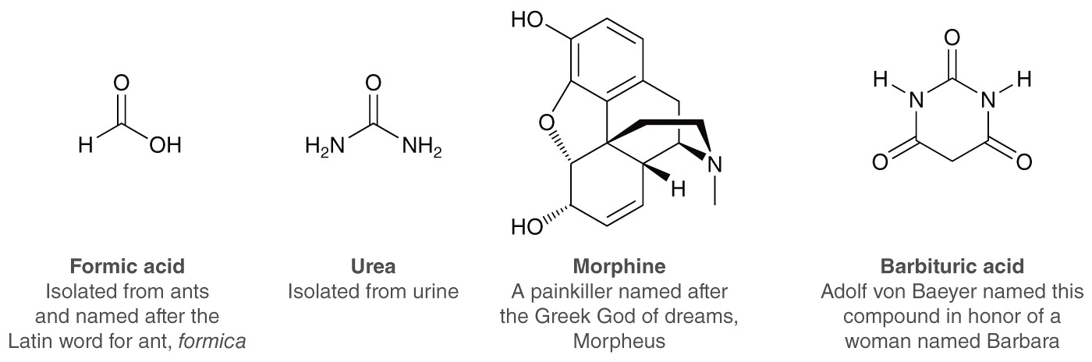
4.1 Naming Alkanes
Many organic compounds have “common” names

Slide 4
4.2 IUPAC Nomenclature - Alkanes
The IUPAC system – systematic naming of compounds
IUPAC name includes:
      Parent name (longest carbon chain)
      Names of substituents
      Location of substituents

Slide 5
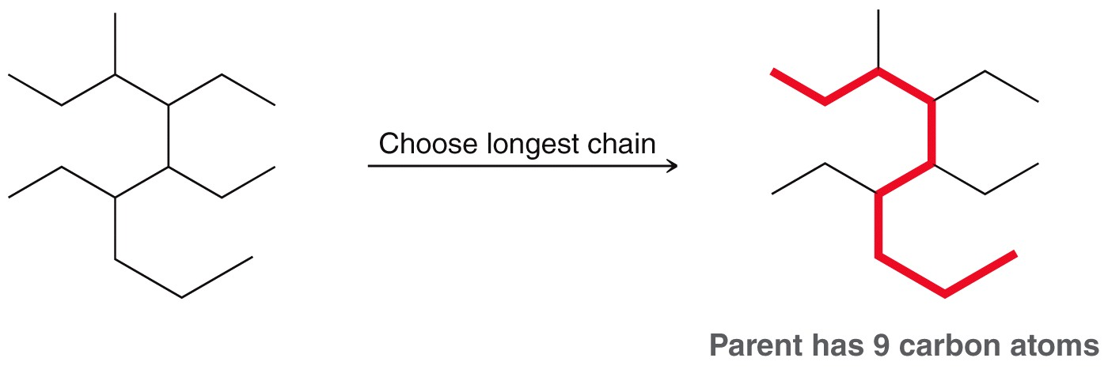
4.2 Selecting the Parent Chain
Identify the parent chain - the longest consecutive chain of carbons

Slide 6
4.2 Selecting the Parent Chain
Identify the parent chain - the longest consecutive chain of carbons
  If there is more than one possible parent chain, choose the one with the most substituents attached

Slide 7
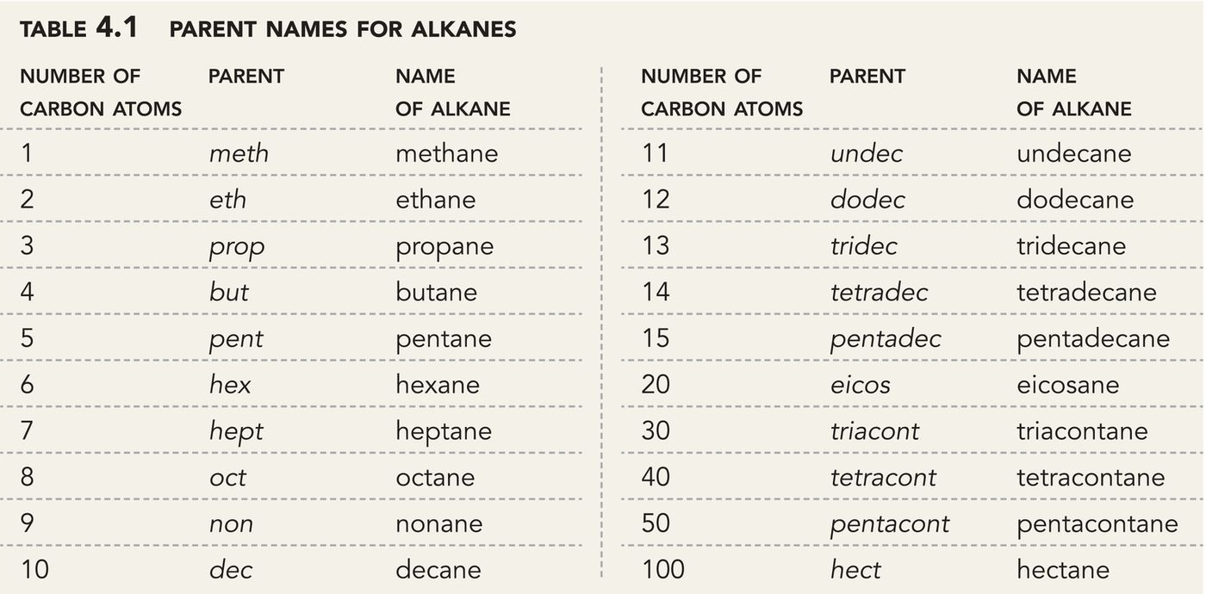
4.2 Selecting the Parent Chain

Slide 8
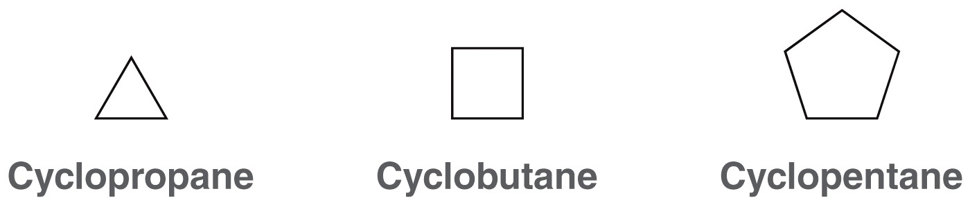
4.2 Selecting the Parent Chain
Identify the parent chain - the longest consecutive chain of carbons
  If the parent chain is cyclic, add the prefix “cyclo”
  Practice with Skillbuilder 4.1

Slide 9



4.2 Selecting the Parent Chain
  Practice the Skill 4.1 – Identify and name the parent in each of the following compounds

Slide 10
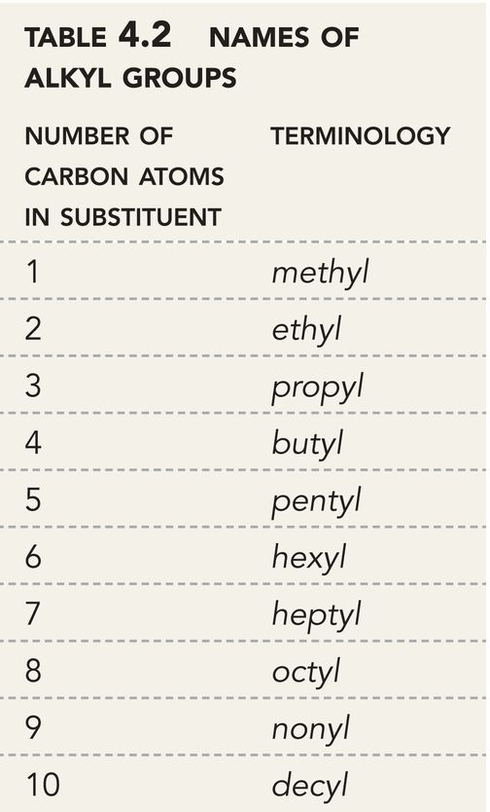
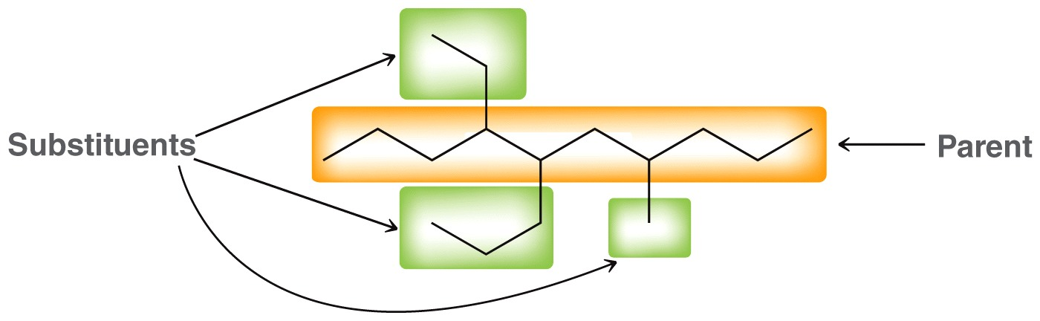
4.2 Naming Substituents
Identify and name the substituents

Slide 11
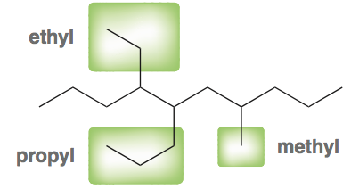
4.2 Naming Substituents
Identify and name the substituents
  Substituents end in yl instead of ane.

Slide 12
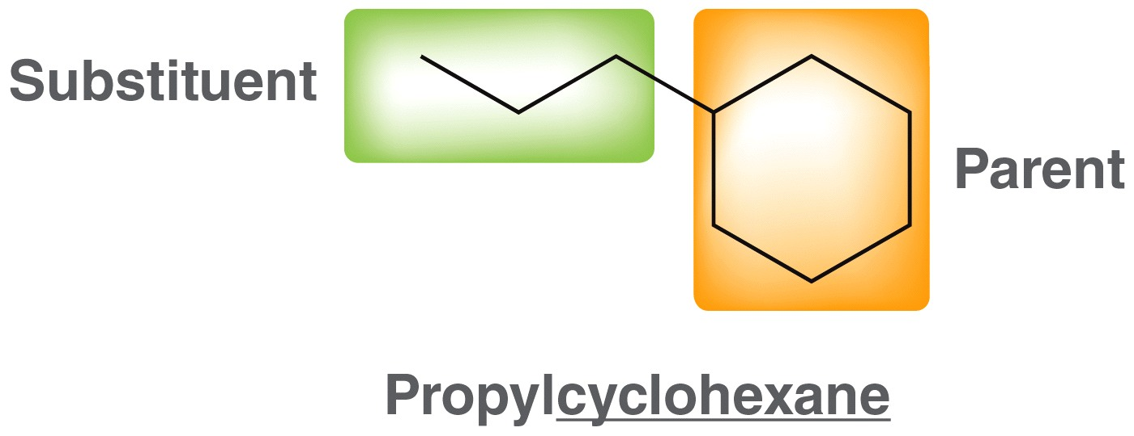
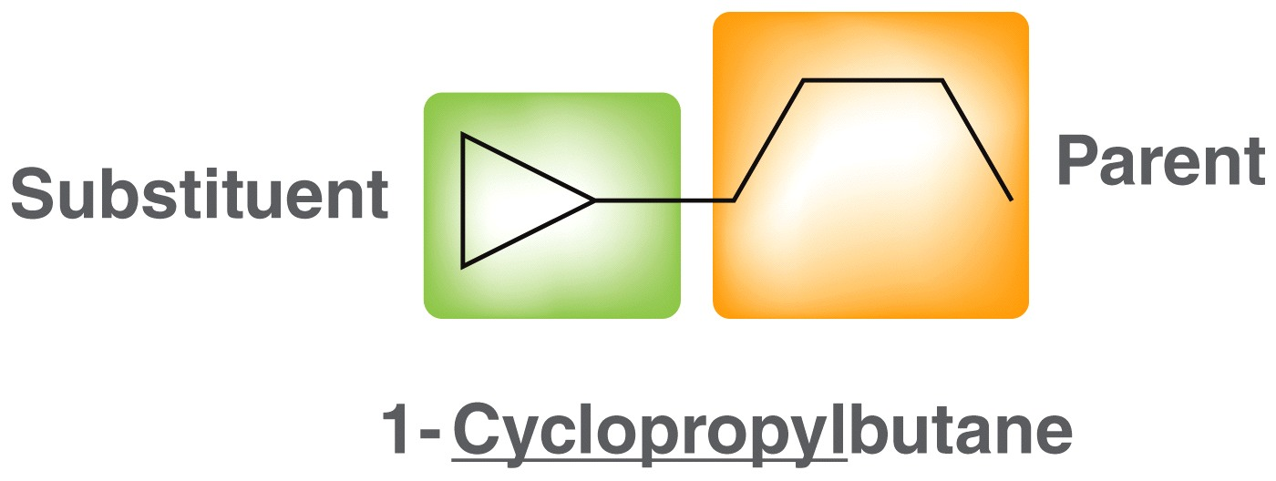
4.2 Naming Substituents
Identify and name the substituents
  A ring can be either a parent chain or a substituent depending on the number of carbons
  Practice with Skillbuilder 4.2

Slide 13
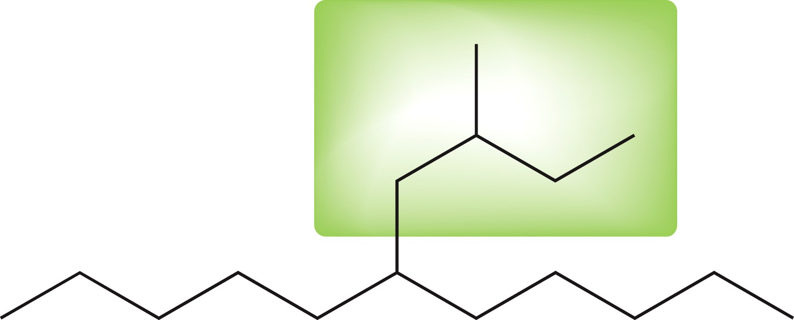
4.2 Naming Substituents
Identify and name the substituents
  For substituents with complex branches
  Number the longest carbon chain WITHIN the substituent. Start with the carbon attached to the parent chain
  Name the substituent (in this case butyl)
  Name and Number the substituent’s side group (in this case 2-methyl)
  The name of the substituent is (2-methylbutyl)
1
2
3
4

Slide 14
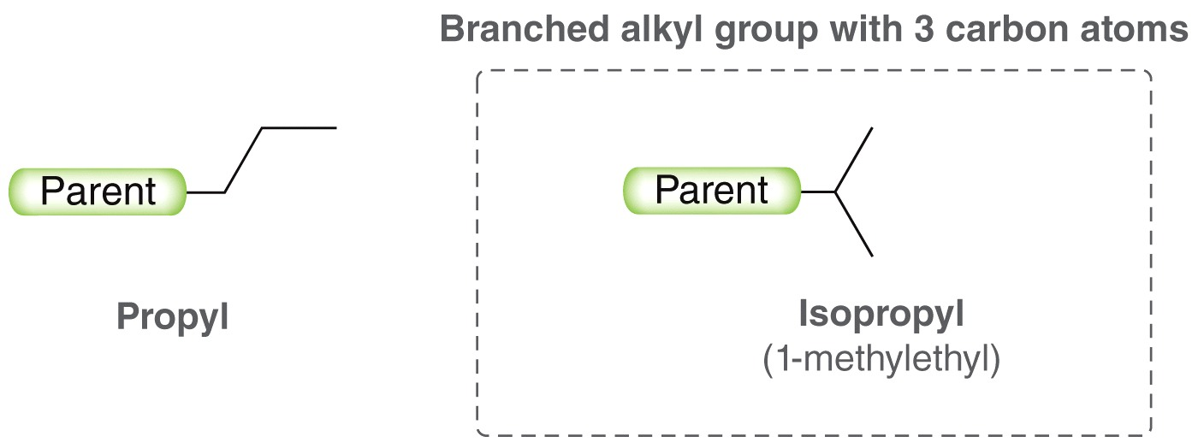
4.2 Naming Substituents
Identify and name the substituents
  Some branched substituents have common names
  Two types of propyl groups

Slide 15
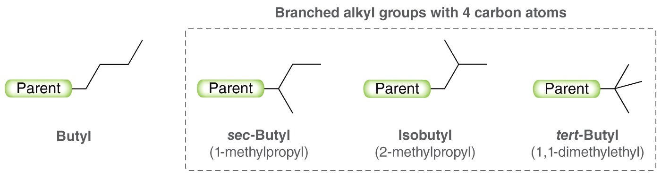
4.2 Naming Substituents
Identify and name the substituents
  Some branched substituents have common names
  Three types of butyl groups
  Practice with Skillbuilder 4.3

Slide 16
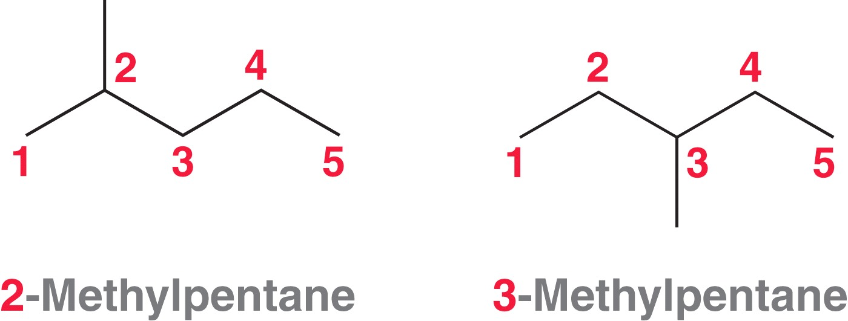
4.2 Assembling the IUPAC Name
Carbons in the parent chain have to be numbered
2-methylpentane means there is a methyl group on carbon #2 of the pentane chain

Slide 17
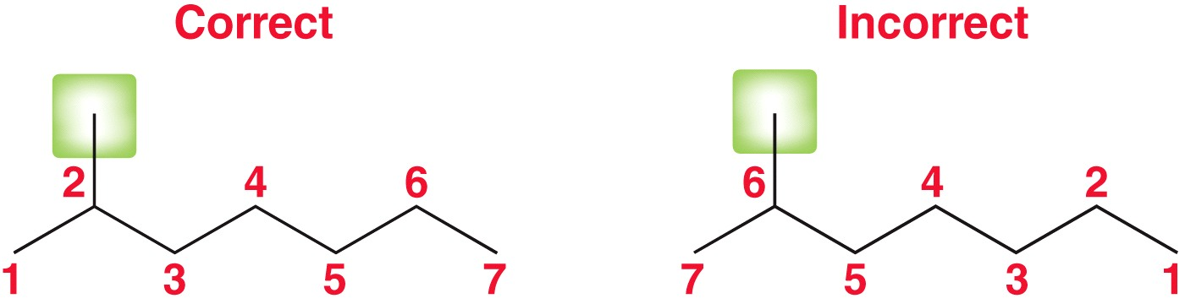
4.2 Assembling the IUPAC Name
Guidelines to follow when numbering the parent chain
  If ONE substituent is present, number the parent chain so that the substituent has the lowest number possible

Slide 18
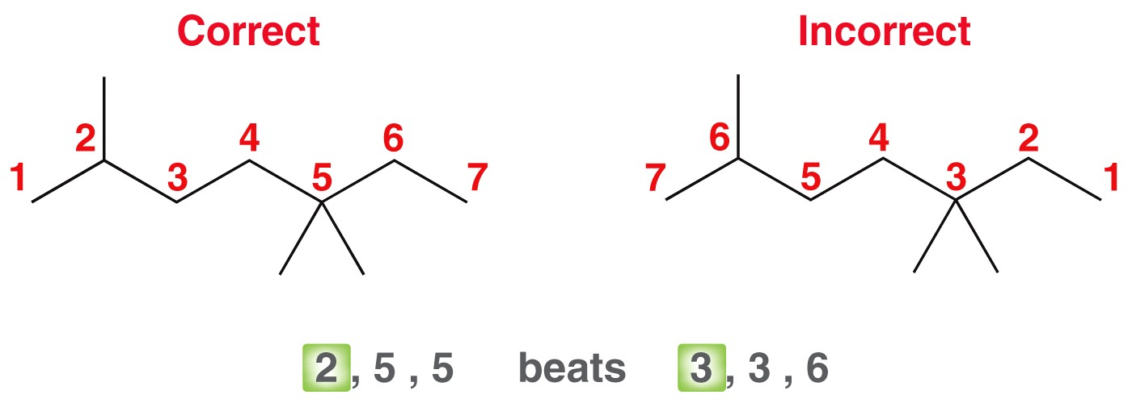
4.2 Assembling the IUPAC Name
Guidelines to follow when numbering the parent chain
  When multiple substituents are present, number the parent chain to give the first substituent the lowest number possible

Slide 19
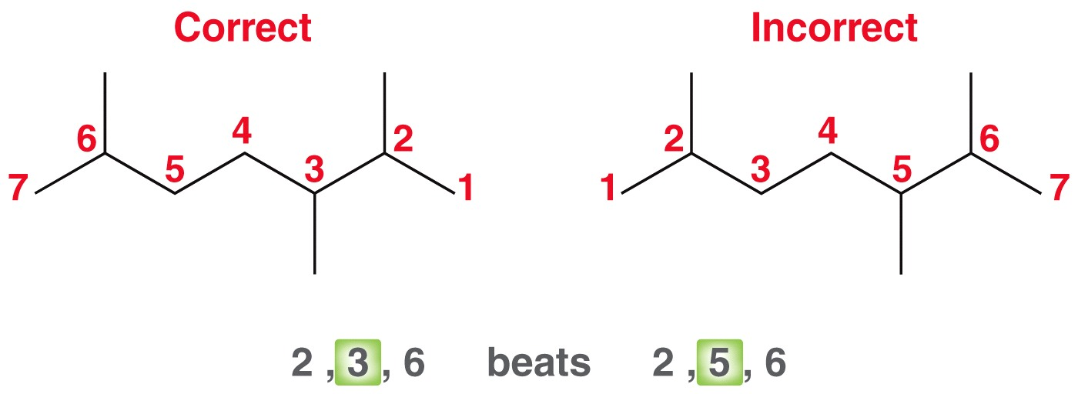
4.2 Assembling the IUPAC Name
Guidelines to follow when numbering the parent chain
  If there is a tie, then number the parent chain so that the second locant gets the lowest number possible

Slide 20
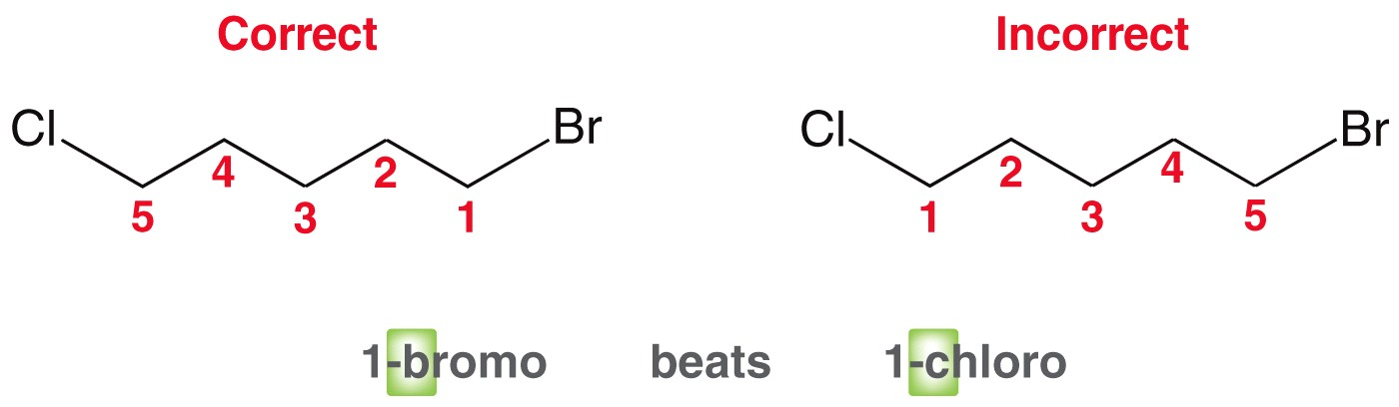
4.2 Assembling the IUPAC Name
Guidelines to follow when numbering the parent chain
  If there is no other tie-breaker, then assign the lowest number alphabetically

Slide 21
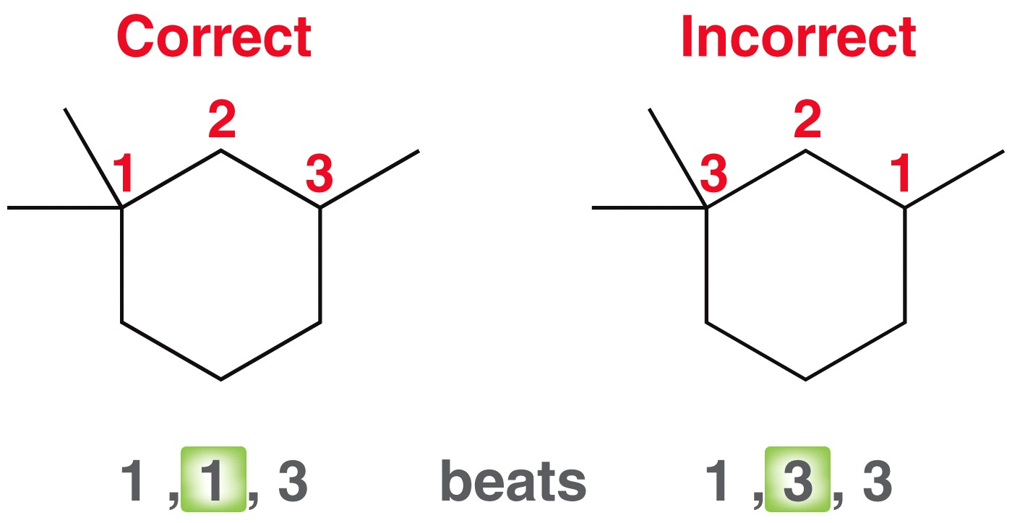
4.2 Assembling the IUPAC Name
Guidelines to follow when numbering the parent chain
  The same rules apply for cycloalkanes

Slide 22
4.2 Assembling the IUPAC Name
  To assemble the complete name:
  Put the # and name of each substituent before the parent chain name, in alphabetical order
  A prefix is used (di, tri, tetra, penta, etc.) if multiple substituents are identical.
  note: “di” or “tri” is ignored when alphabetizing the substituents

Slide 23
4.2 IUPAC Rules - Summary
Identify the parent chain
Identify and Name the substituents
Number the parent chain; assign a locant to each substituent
List the numbered substituents before the parent name in alphabetical order
Practice with SkillBuilder 4.4

Slide 24
4.2 IUPAC Rules - Summary
Following the rules, we can name the following compound:
1-tert-butyl-2-ethyl-4,4-dimethylcyclohexane
Parent name:
cyclohexane
Substituents:
1-tert-butyl
2-ethyl
4-methyl
4-methyl
4,4-dimethyl

Slide 25
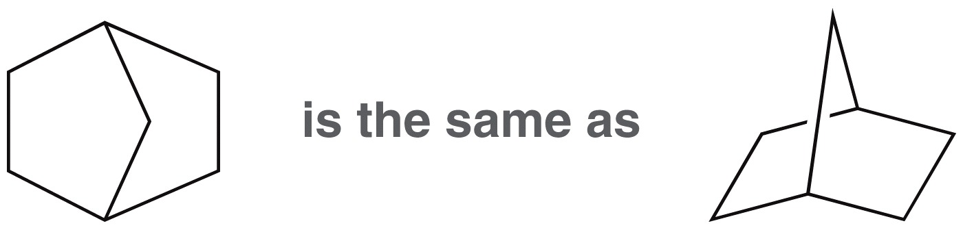
4.2 Naming Bicyclic Compounds
Bicyclic compound contains two fused rings.
To name a bicyclic compound, include the prefix bicyclo in front of the parent name

Slide 26
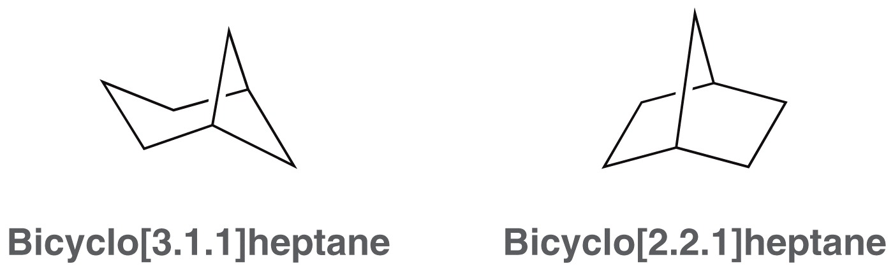
4.2 Naming Bicyclic Compounds
The two carbons where the rings are fused are bridgehead carbons
There are three “paths” connecting the bridgeheads. Count the number of carbons in each path to name the compound
Practice with Skillbuilder 4.5
1
1
2
1
1
1
3
1
2
2

Slide 27
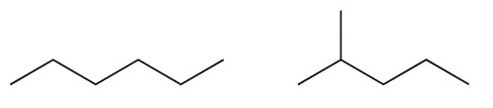
4.3 Constitutional Isomers
ISOMERS
  different structures, same molecular formula
CONSTITUTIONAL ISOMERS
  different connectivity of atoms

Slide 28
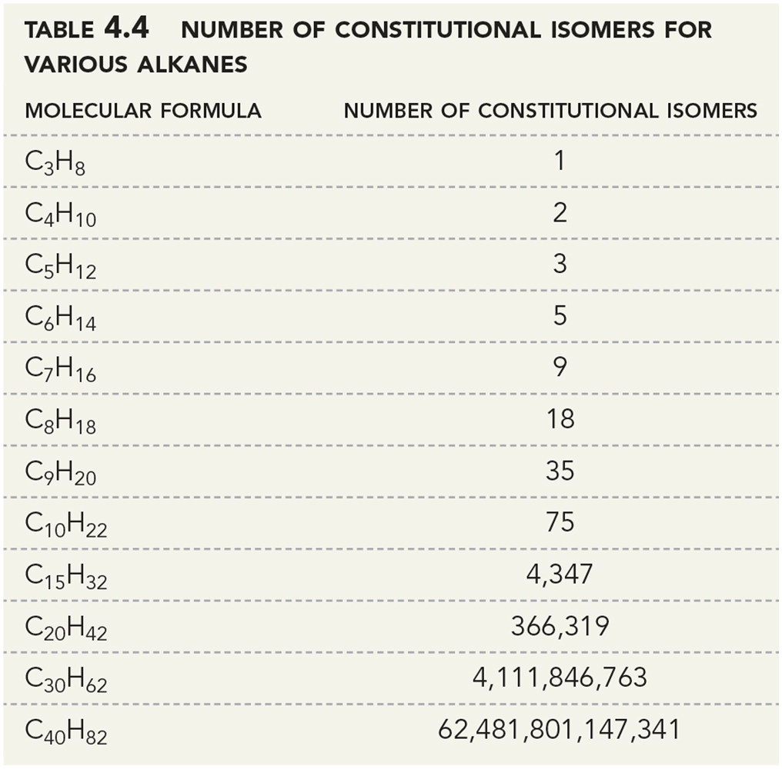
4.3 Constitutional Isomers
As the number of carbon atoms increases, the number of constitutional isomers increases

Slide 29
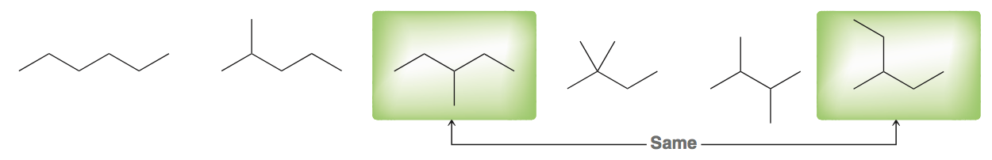
4.3 Constitutional Isomers
Be able to recognize different structures as either being isomers, or being the same compound.
You can test if structures are the same in two ways:
  Flip one of the molecules in 3D space and rotate around its single bonds until it is super-imposable on the other molecule
  Name them. If they have the same IUPAC name, they are the same compound

Slide 30
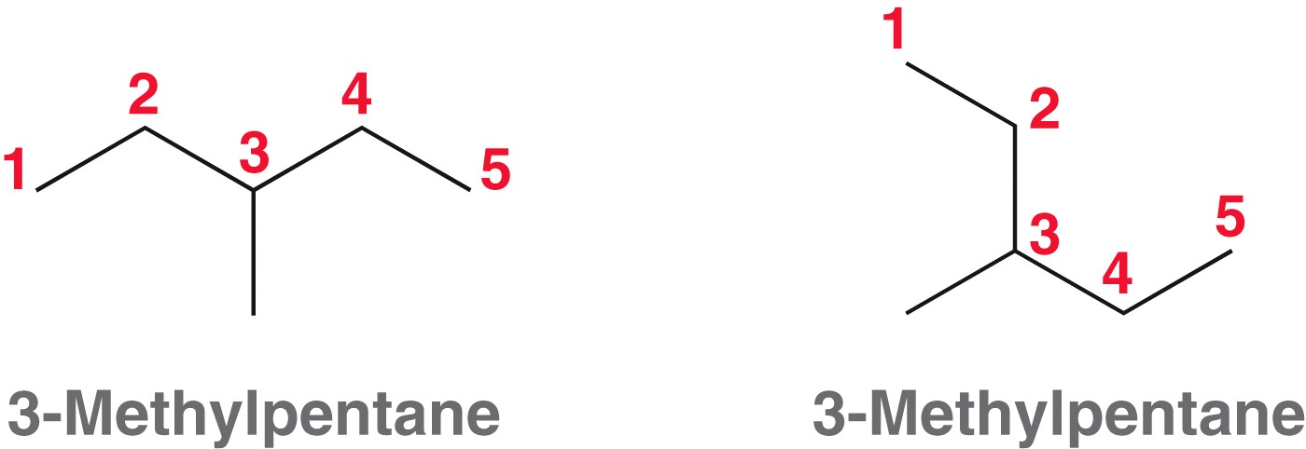
4.3 Constitutional Isomers
  180˚ rotation along the C3 – C4 bond would make it more obvious these two compounds are the same
Following IUPAC rules for naming yields the same name as well
Practice with SkillBuilder 4.6

Slide 31
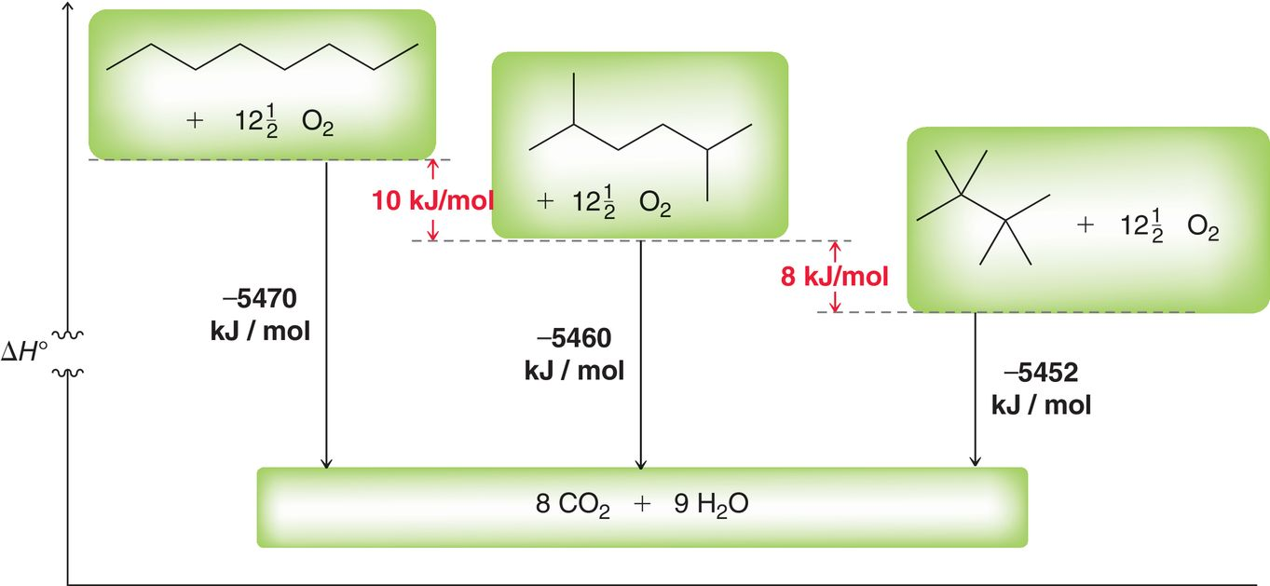
4.4 Relative Stability of Isomeric Alkanes
Relative stability of isomers can be determined by measuring heat of combustion

Slide 32
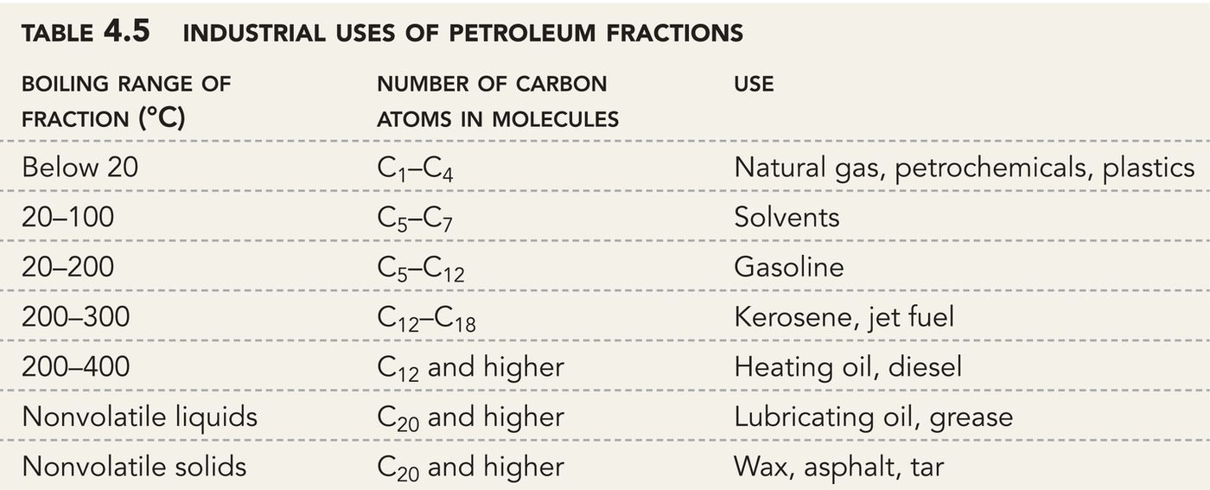
4.5 Sources and Uses of Alkanes
various components of petroleum are separated by distillation
The gasoline fraction of crude oil only makes up about 19%, which is not enough to meet demand

Slide 33
4.5 Sources and Uses of Alkanes
Gasoline is a mixture of straight, branched, and aromatic hydrocarbons (5-12 carbons in size)
Large alkanes can be broken down into smaller molecules by Cracking
Straight chain alkanes can be converted into branched alkanes and aromatic compounds through Reforming
After using these processes, the yield of gasoline is about 47% rather than 19%

Slide 34
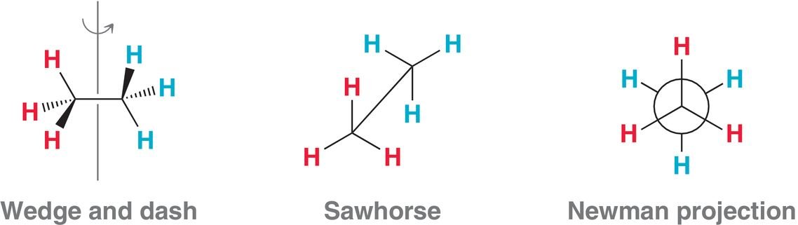
4.6 Drawing Newman Projections
Single bonds rotate, resulting in multiple 3-D shapes, called conformations
There are various ways to represent the 3-D shape of a compound
Newman projections are ideal for comparing the relative stability of possible conformations resulting from single bond rotation

Slide 35
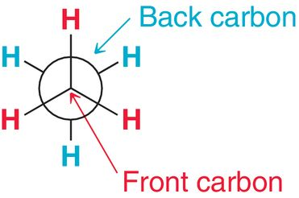
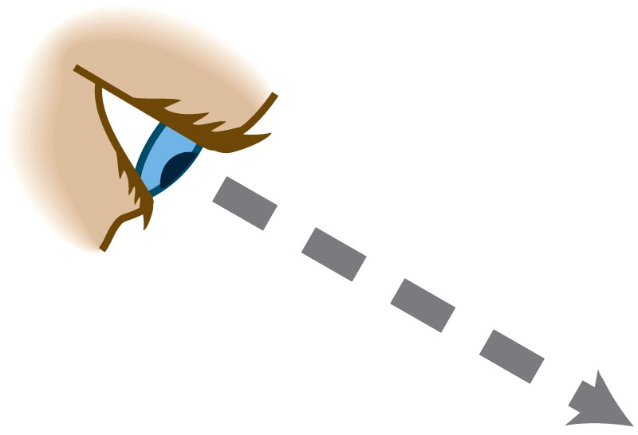
4.6 Drawing Newman Projections
A Newman projection is the perspective of looking straight down a particular C-C bond
Show the front carbon as a point and the back carbon as a large circle behind it
Practice with SkillBuilder 4.7

Slide 36
4.6 Drawing Newman Projections
Another example

Slide 37
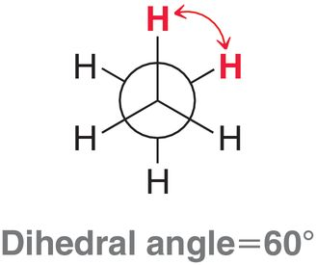
4.7 Conformational Analysis
The angle between atoms on adjacent carbons is called a dihedral angle or torsional angle. It is 60° in the molecule below

Slide 38
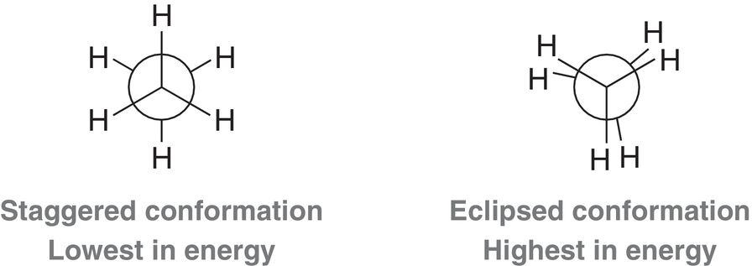
4.7 Conformational Analysis - Ethane
Staggered conformations are more stable (lower in energy) than eclipsed conformations
The difference in energy between these conformations is due to torsional strain. Here, the difference in energy is 12 kJ/mol

Slide 39
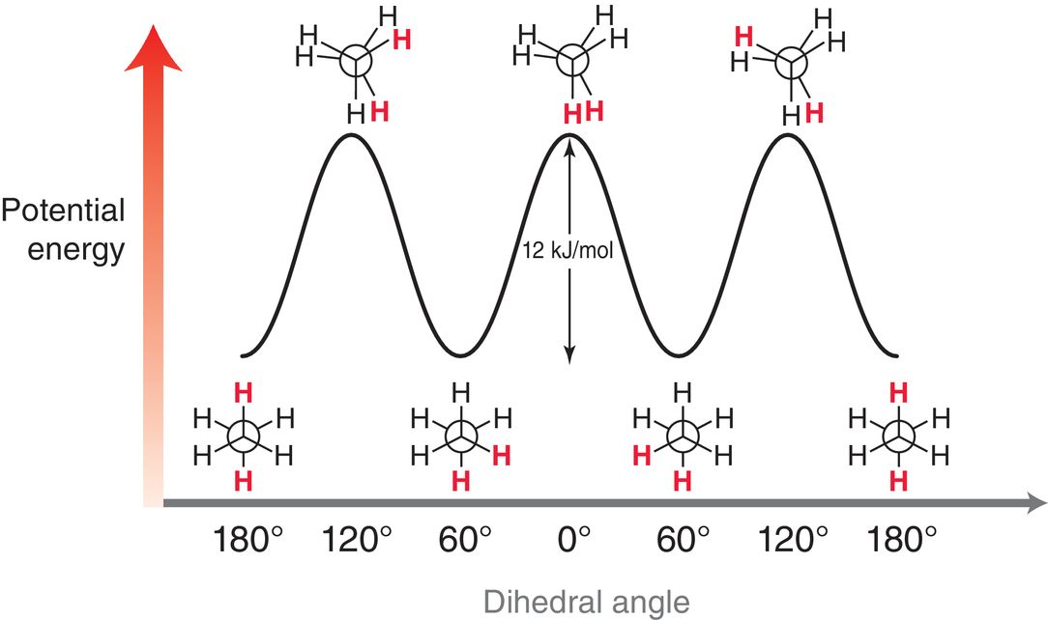
4.7 Conformational Analysis - Ethane

Slide 40
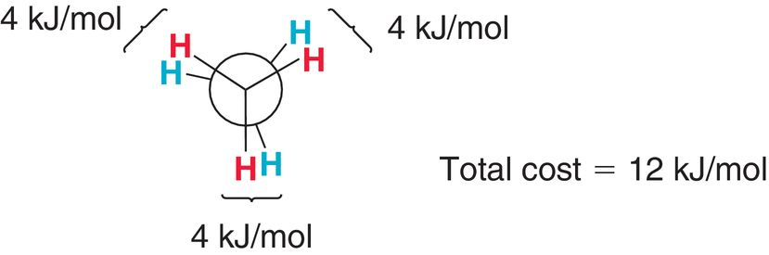
4.7 Conformational Analysis - Ethane
It’s possible the eclipsed conformation is 12 kJ/mol less stable because of electron pair repulsion between the eclipsing bonds (4 kJ/mol for each eclipsing interaction)
With a difference of 12 kJ/mol in stability, at room temperature, 99% of the molecules will be in the staggered conformation

Slide 41
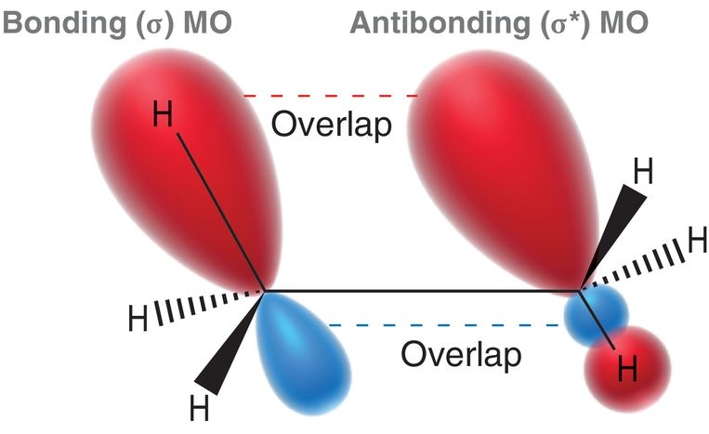
4.7 Conformational Analysis - Ethane
The difference in energy can also be rationalized by the presence of stabilizing interactions in the staggered conformation
A filled, bonding MO has side-on-side overlap with an empty anti-bonding MO.

Slide 42
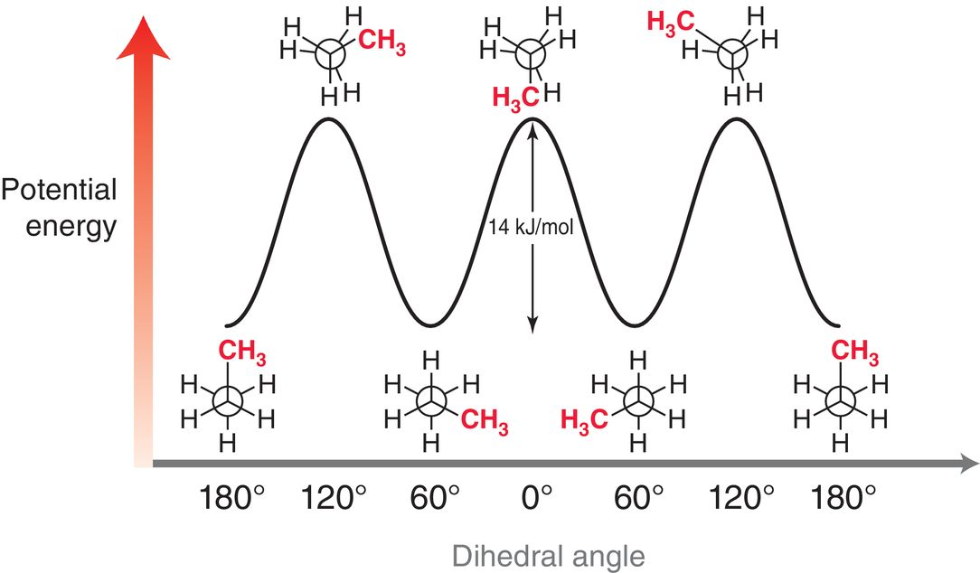
4.7 Conformational Analysis – Propane
The analysis of torsional strain for propane (below) is similar to ethane

Slide 43
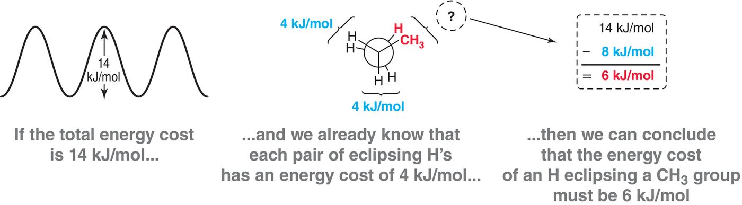
4.7 Conformational Analysis - Propane
The barrier to rotation for propane is 14 kJ/mol, which is 2 kJ/mol more than for ethane
If each H-----H eclipsing interaction costs 4 kJ/mol of stability, that total can be subtracted from the total 14 kJ/mol to calculate the contribution of a CH₃-----H eclipsing interaction
Practice with conceptual checkpoint 4.19

Slide 44
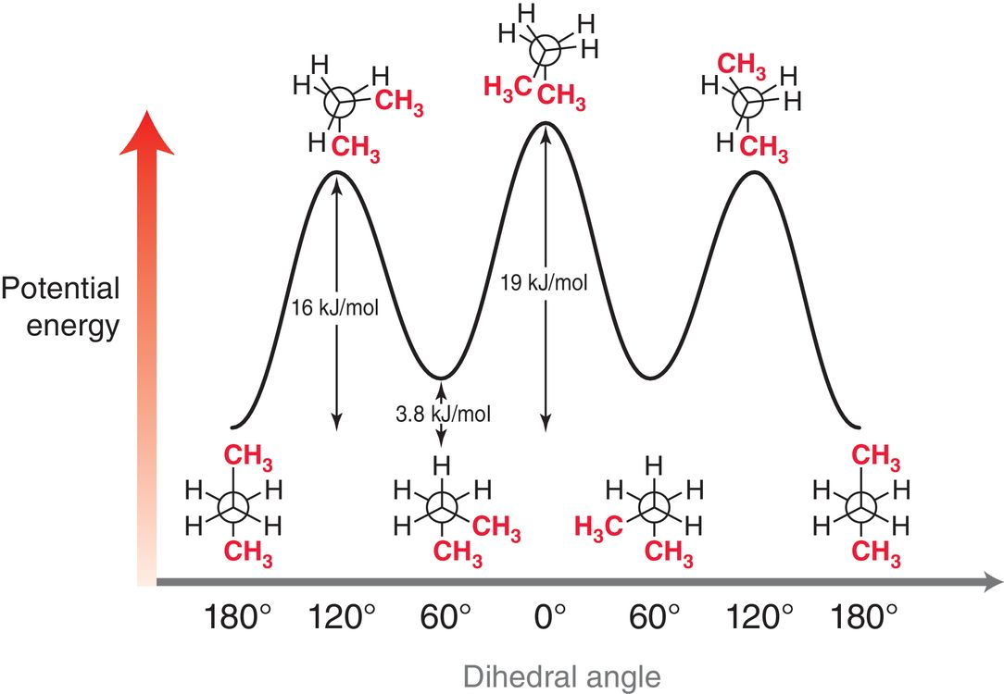
4.8 Conformational Analysis - Butane
The analysis of torsional strain for butane shows more variation
Note that there are multiple staggered conformations and multiple eclipsed conformations

Slide 45
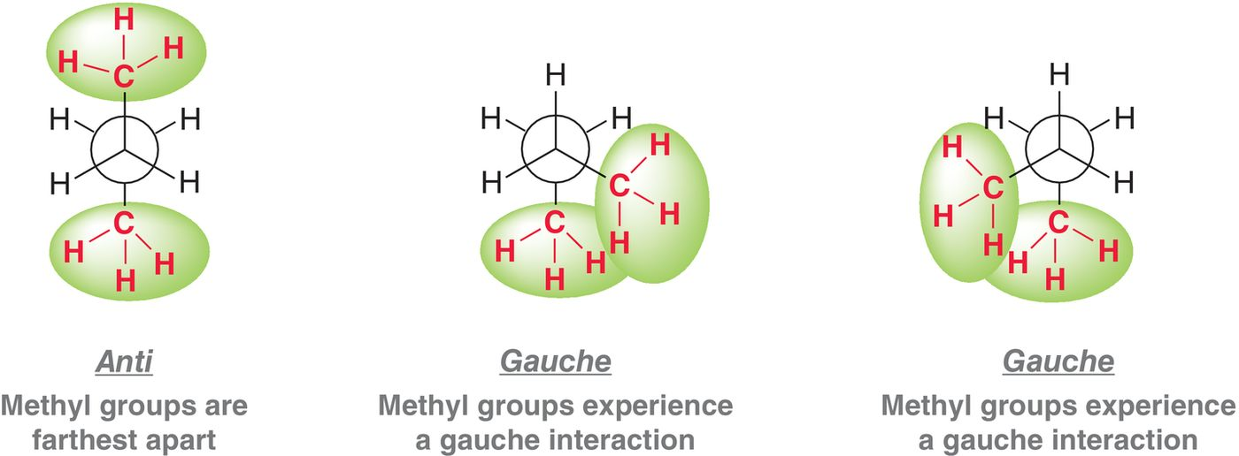
4.8 Conformational Analysis - Butane
The stability of the different staggered conformations differs by 3.8 kJ/mol
When the methyl groups are gauche to one another, there is steric strain, and a higher energy conformation than when they are anti to one another

Slide 46
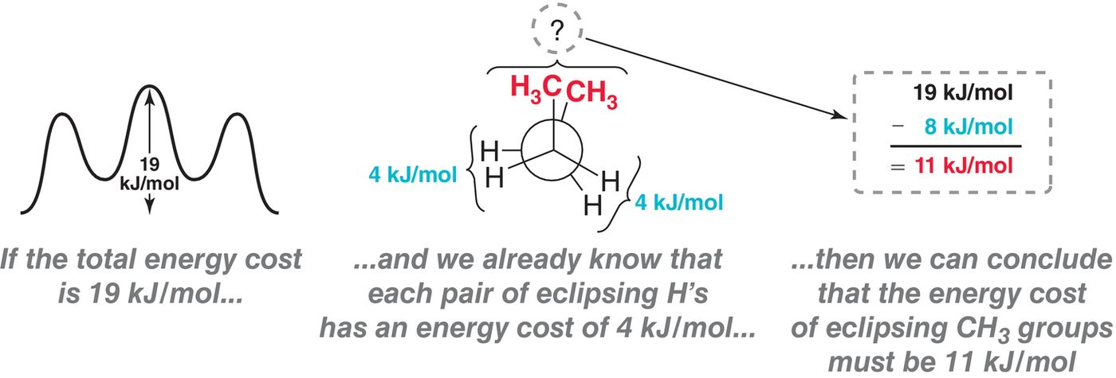
4.8 Conformational Analysis - Butane
The highest energy conformation for butane results when the methyl groups eclipse one another
Each CH₃-----CH₃ eclipsing interaction accounts for 11 kJ/mol of energy (torsional and steric strain).

Slide 47
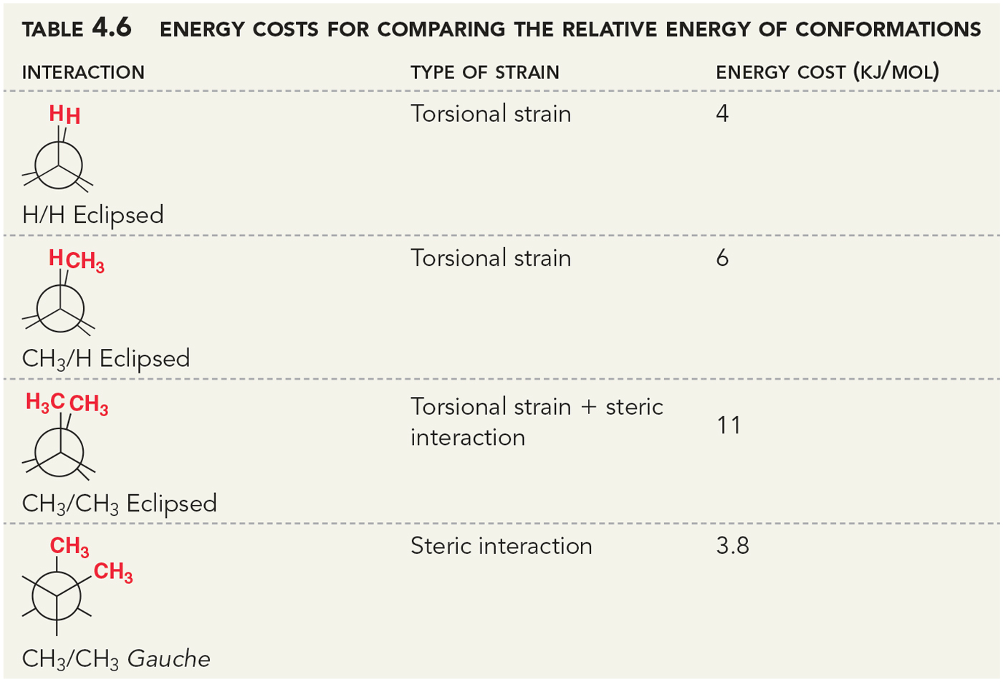
4.8 Conformational Analysis - Butane
The energy costs for eclipsing and gauche interactions can be used to approximate the energy of a given conformation
Practice with SkillBuilder 4.8

Slide 48
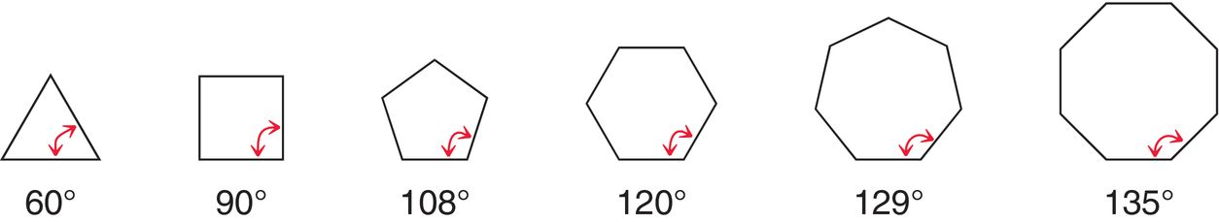
4.9 Cycloalkanes
Ideal bond angles for sp³ hybridized carbon is 109.5˚
If cycloalkanes were flat, each carbon in the ring would experience angle strain.
Also, if a ring was flat, then all the C-C bonds would be in eclipsing rotamers… causing considerable torsional strain.

Slide 49
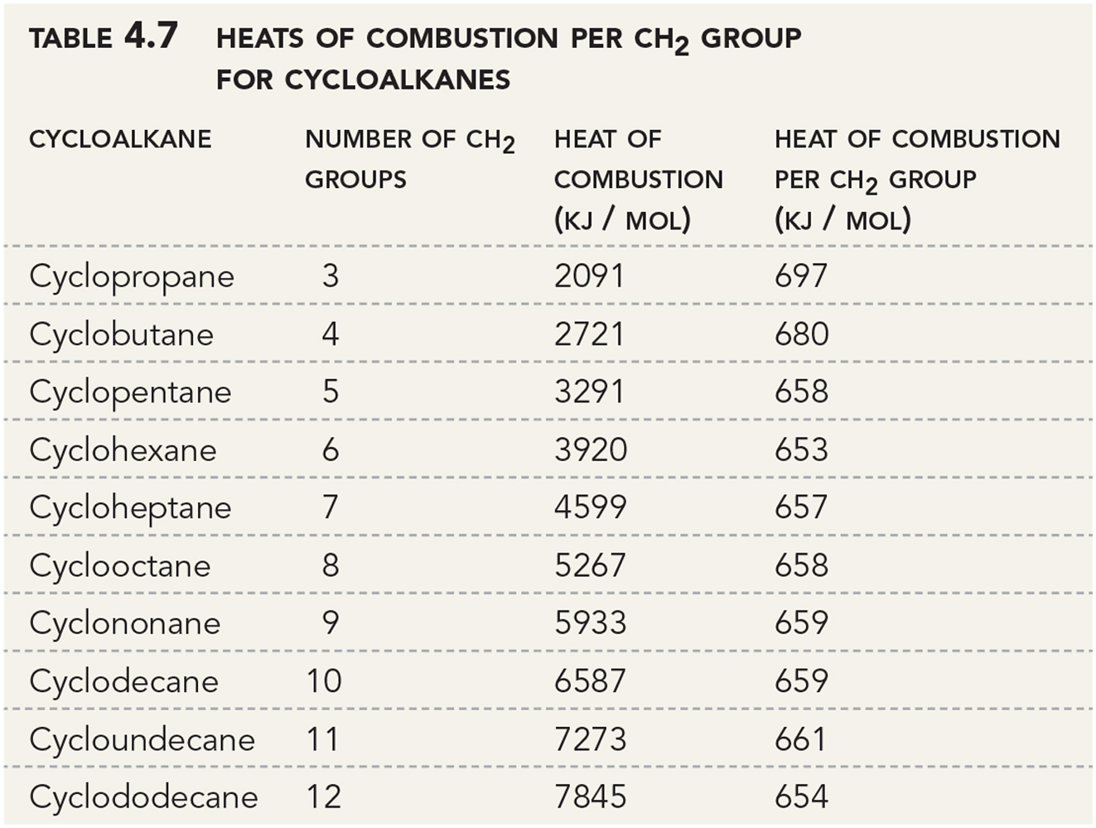
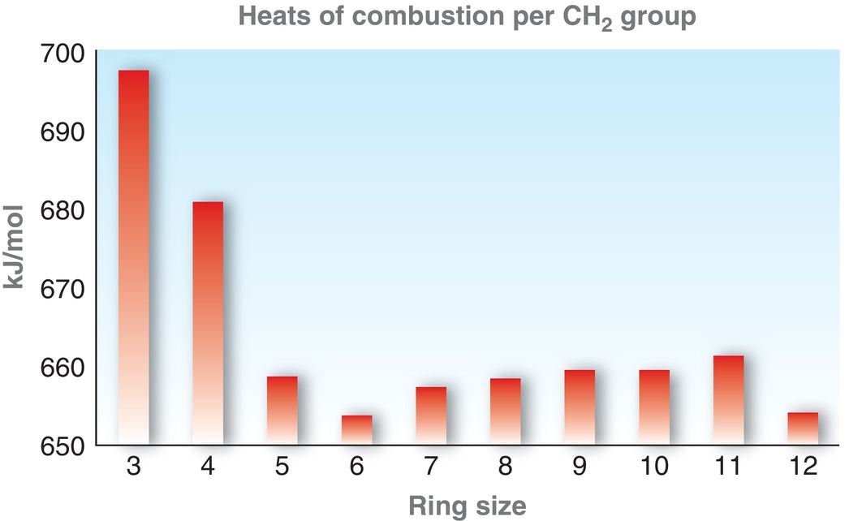
4.9 Cycloalkanes
The combustion data for cycloalkanes shows that a 6-member ring is the most most stable ring size (it is lowest in energy per CH₂ group)

Slide 50
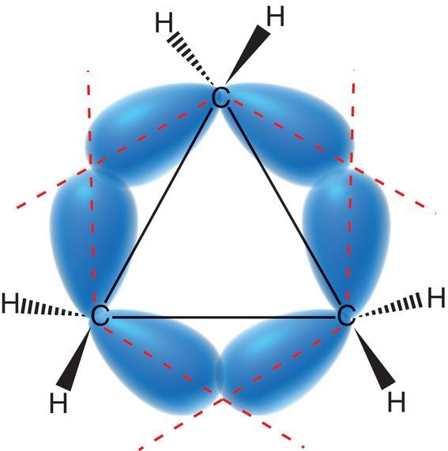
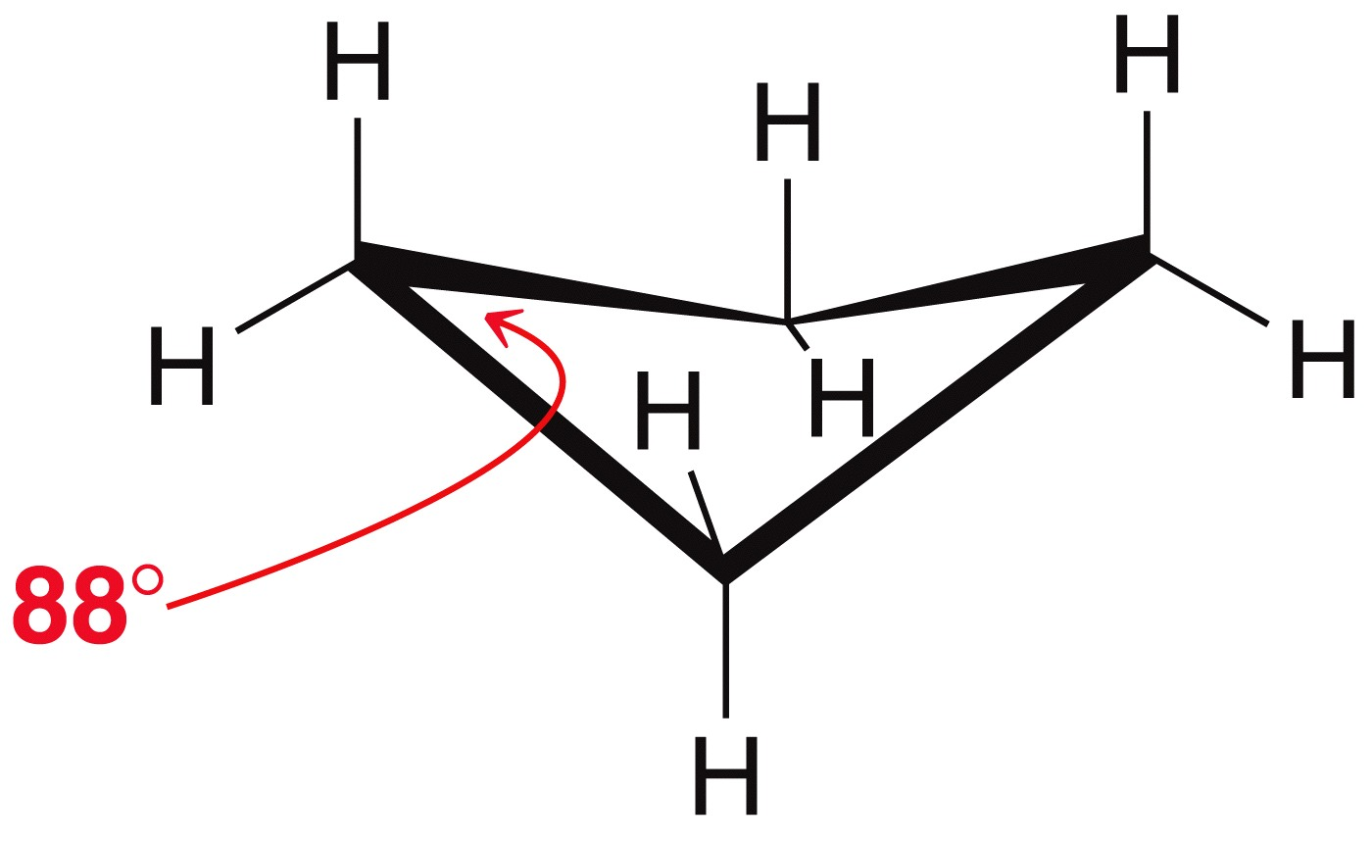
4.9 Cyclobutane
Cyclobutane is 27 kJ/mol less stable than cyclohexane per CH₂ group.
  Angle strain bond angles of 88°
  Slight torsional strain results because adjacent C-H bonds are neither fully eclipsed nor fully staggered
  Puckered conformation has less torsional strain than a flat conformation

Slide 51
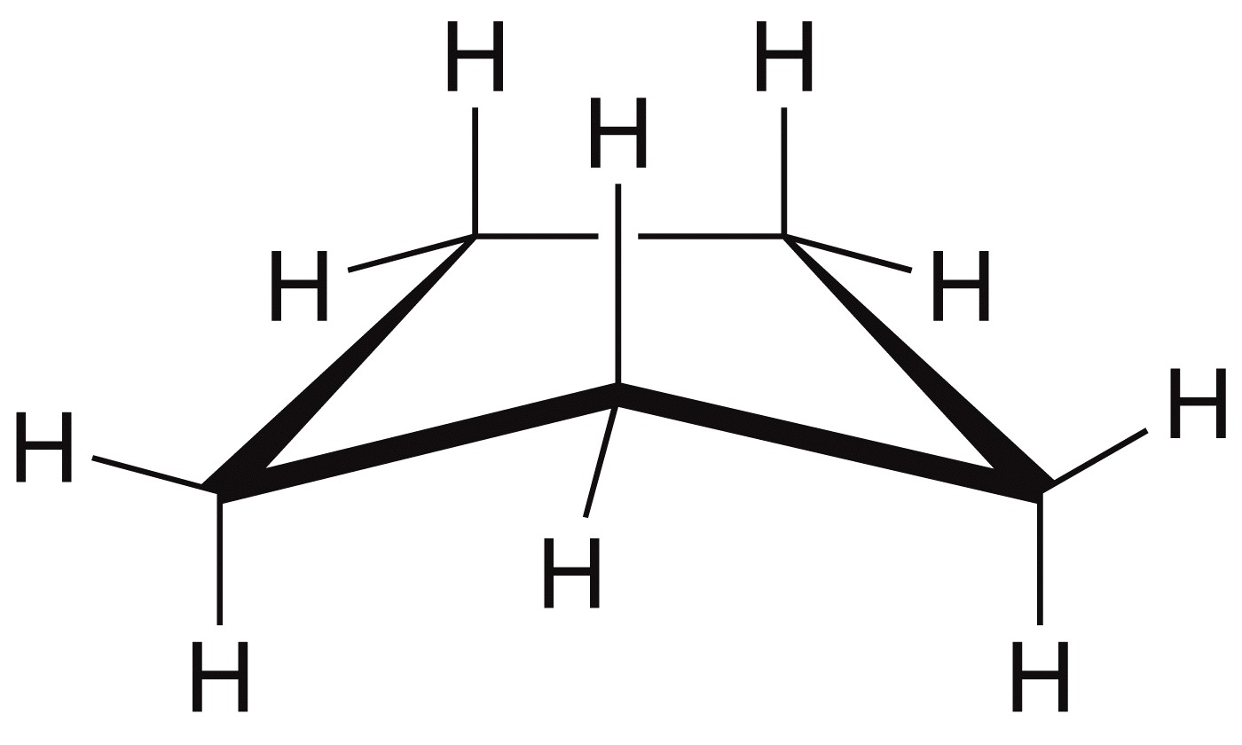
4.9 Cyclopentane
Cyclopentane is only 5 kJ/mol less stable than cyclohexane per CH₂ group
  Very little angle strain - bond angles are nearly 109.5˚
  Slight torsional strain – adopts an envelope conformation to avoid most of it

Slide 52
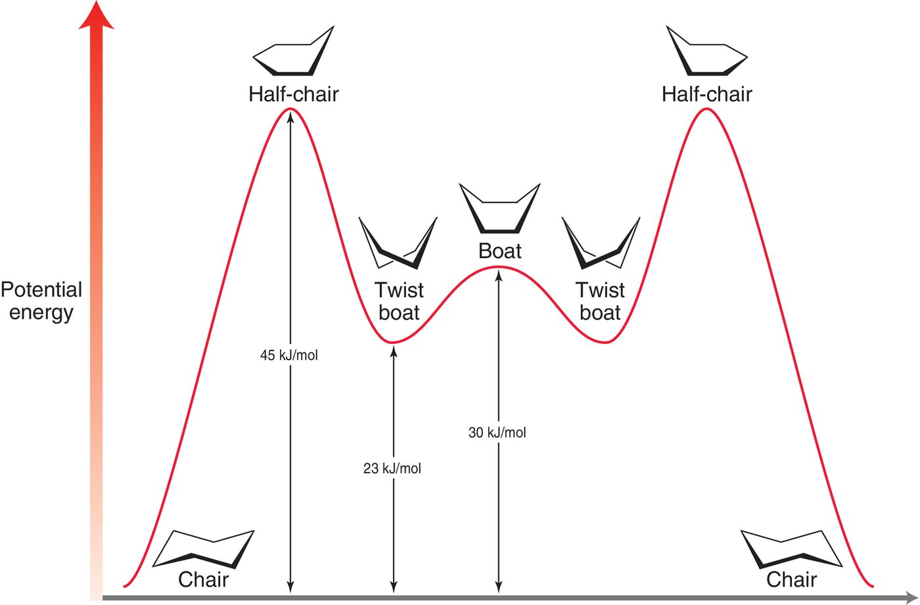
4.10 Conformations of Cyclohexane
Cyclohexane can adopt a variety of conformations, but it is the chair conformation that is the most stable

Slide 53
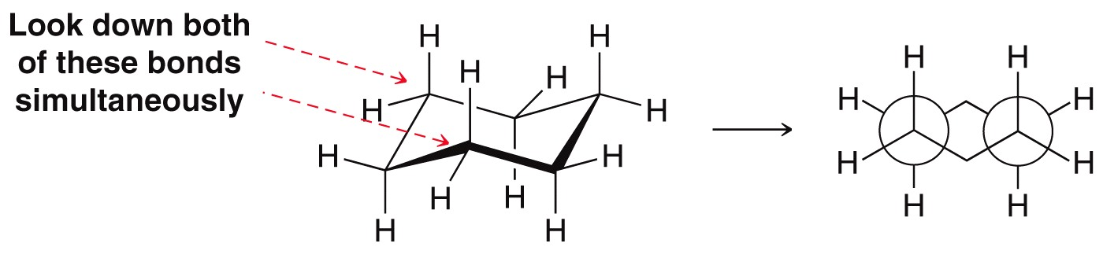
4.10 Conformations of Cyclohexane
Cyclohexane has no ring strain in a chair conformation
  No angle strain – beyond angles are 109.5°
  No torsional strain - all adjacent C-H bonds are staggered
  The other possible conformations of cyclohexane have some amount of angle and/or torsional strain (i.e. ring strain)

Slide 54
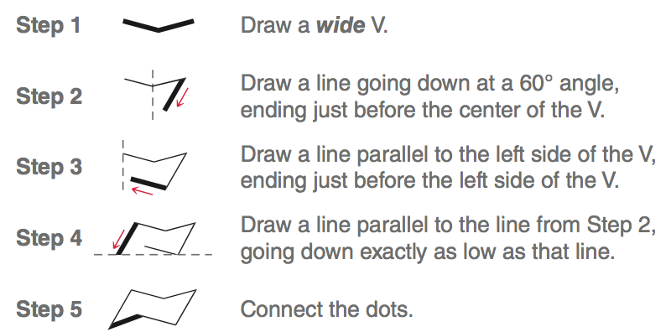
4.11 Drawing Chair Conformations
Drawing a chair conformation (SkillBuilder 4.9)

Slide 55

4.11 Drawing Chair Conformations
If drawn correctly, the chair should contain 3 sets of parallel lines
Each carbon in the ring has two substituents: one is in an axial position and the other in an equatorial position

Slide 56



4.11 Drawing Chair Conformations
Adding the axial substituents is easy, as they point straight up and down, alternating around the ring.
The equatorial groups are drawn off of the ring, and they run parallel to the lines in the chair

Slide 57


4.12 Monosubstituted Cyclohexane
When cyclohexane has one substituent, there are two possible chair conformations,
Ring flipping occurs by rotation of all the C-C bonds in the ring. Axial substituents become equatorial and vice versa.
ring flip

Slide 58

4.12 Monosubstituted Cyclohexane
Consider methylcyclohexane. The chair conformation where the methyl group is equatorial is the more stable chair
At room temperature, methylcyclohexane will be in the more stable chair 95% of the time.
In the axial position, the methyl group causes steric interactions that destabilize the conformation.

Slide 59



4.12 Monosubstituted Cyclohexane
The steric strain from a substituent being in the axial position is the result of 1,3-diaxial interactions
The 1,3-diaxial interactions are actually gauche interactions, which are not present when the methyl group is equatorial

Slide 60

4.12 Monosubstituted Cyclohexane
Larger groups will cause more steric crowding in the axial position.
Practice with Conceptual Checkpoint 4.27

Slide 61


4.13 Disubstituted Cyclohexane
With multiple substituents, solid or dashed wedges are used to show positioning of the groups on the ring
Realize the Cl group is UP in both possible chair conformations, and the methyl group is DOWN

Slide 62


4.13 Disubstituted Cyclohexane
Skillbuilder 4.12 - Draw both chair conformations for the following molecule
Draw the first chair by labeling the substituted carbons in the given structure, then translating to a chair:
On carbon 1 the ethyl group is
up, and on carbon 2 the methyl
group is down

Slide 63


4.13 Disubstituted Cyclohexane
To draw the other possible chair, we have to make sure that the ethyl group (pointed up) will be equatorial, and the methyl group (pointed down) will be axial
So the two conformations are:
Which chair is more stable?
What is your reasoning?

Slide 64

4.14 cis-trans Stereoisomerism
When naming a disubstituted cycloalkane, use the prefix cis when there are two groups on the same side of the ring, and trans when two substituents are on opposite sides of a ring
These two compounds are stereoisomers. Since they are 6-member rings, they are best represented as chair conformations

Slide 65

4.14 cis-trans Stereoisomerism
Each compound exists as two equilibrating chairs, spending more time in the more stable chair conformation
This is the lowest energy conformation for the cis isomer
This is the lowest energy conformation for the trans isomer

Slide 66


4.15 Polycyclic Systems
Decalin is two 6-member rings fused together
The decalin sub-structure is found in many naturally occurring compounds, such as steroids

Slide 67


4.15 Polycyclic Systems
There are many important structures that result when more than one ring is fused together (recall bicycloalkanes)
Camphor and Camphene are fragrant natural products isolated from evergreens

Slide 68

4.15 Polycyclic Systems
The structure of diamond is a network of 6-membered rings, fused together.

