Slide 1
Organic Chemistry
Third Edition
David Klein
Chapter 5
Stereoisomerism

Slide 2
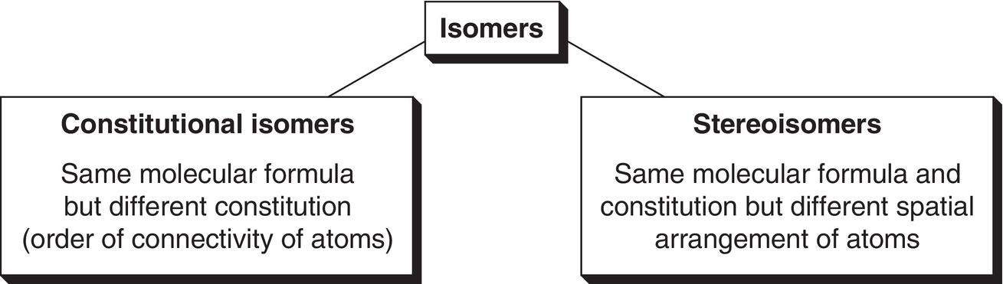
5.1 Isomers - Overview
Isomers are different compounds that have the same formula
There are two general types of isomers

Slide 3
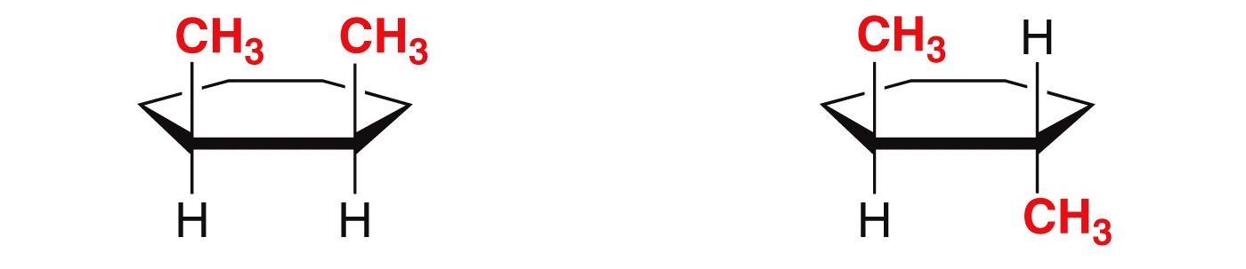
5.1 Isomers - Overview
Although the two molecules below have the same connectivity, they are NOT identical. So they are stereoisomers
In order to give these compounds unique IUPAC names, we use the cis and trans prefixes
cis-1,2-dimethylcyclohexane
(both groups in same side of ring)
trans-1,2-dimethylcyclohexane
(Both groups on opposite sides)

Slide 4
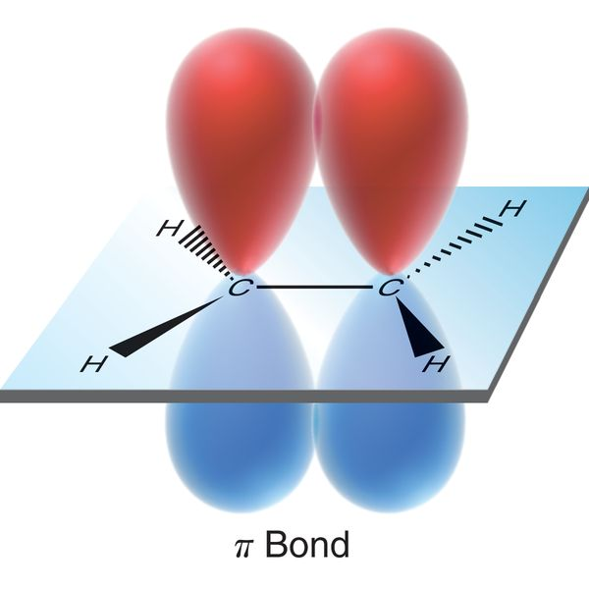
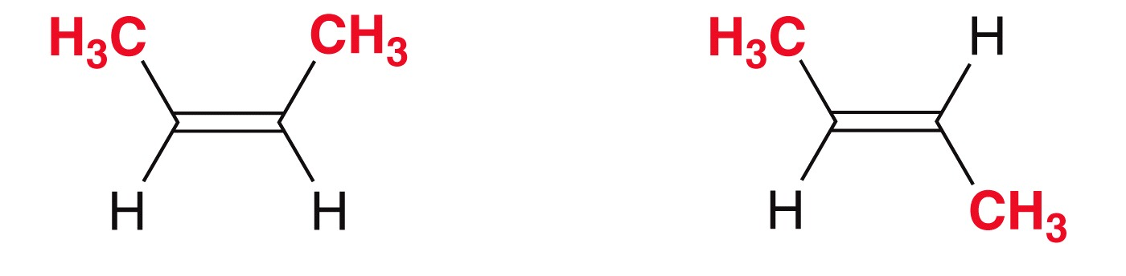
5.1 Isomers - Overview
To maintain orbital overlap in the pi bond, C=C double bonds can not freely rotate.
Although the two molecules below have the same connectivity, they are NOT identical… they are stereoisomers
cis-2-butene
Groups on same side of pi bond
trans-2-butene
Groups on opposite sides

Slide 5
5.1 Isomers - Overview
Identify the following pairs as either constitutional isomers, stereoisomers, or identical structures
                *Answers on the next slide*

Slide 6
5.1 Isomers - Overview
Identify the following pairs as either constitutional isomers, stereoisomers, or identical structures
identical
identical
stereoisomers
stereoisomers
Constitutional isomers

Slide 7
5.1 Isomers - Overview
Identify the following as either cis, trans, or neither.
*answers on next slide*

Slide 8
5.1 Isomers - Overview
Identify the following as either cis, trans, or neither.
trans
cis
cis
neither
trans

Slide 9
5.2 Stereoisomers
cis-trans isomerism is only one type… there are other important stereoisomeric relationships
To identify such stereoisomers, we must be able to identify chiral molecules
A chiral object is asymmetric, which means it is not the same as its mirror image (i.e. not superimposable on its mirror image)
You can test whether two objects are identical by seeing if they are superimposable.

Slide 10
5.2 Molecular Chirality
Chirality is important in molecules.
  Because two chiral molecules are mirror images, they will have many identical properties, but because they are not identical, their pharmacology may be very different
Visualizing mirror images of molecules and manipulating them in 3D space to see if they are superimposable can be VERY challenging, so…
…It is absolutely critical that you use handheld models as visual aids

Slide 11
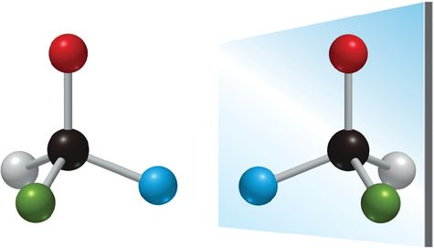
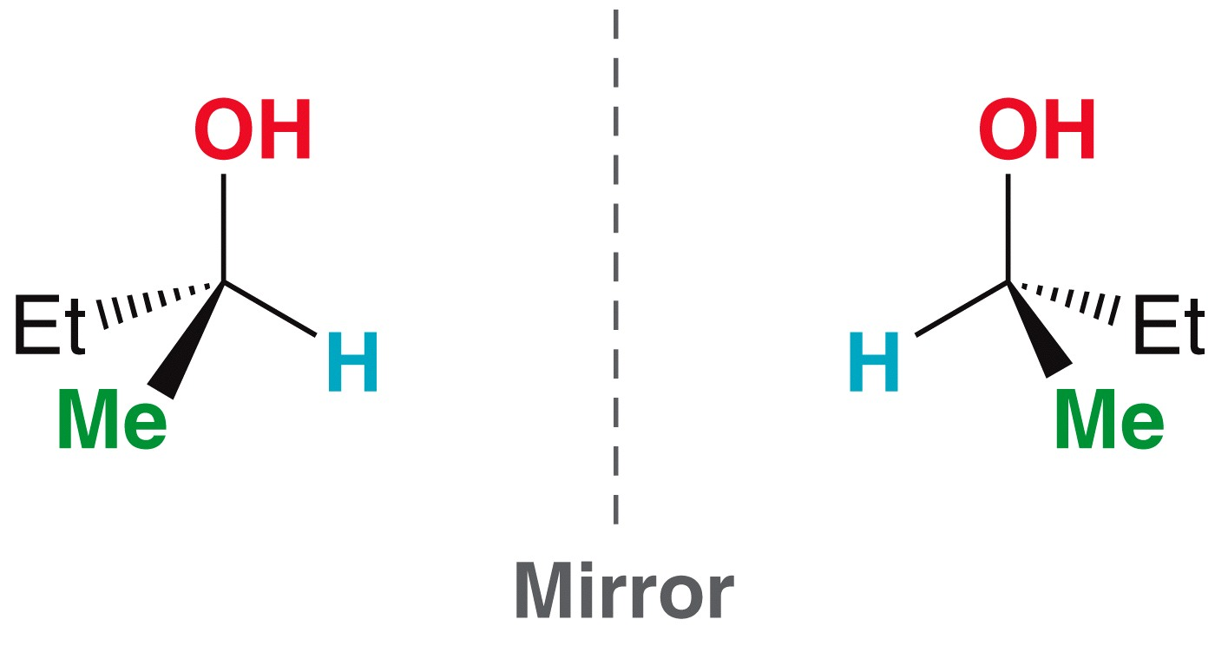
5.2 Stereoisomers
Chirality most often results when a carbon atom is bonded to 4 unique groups of atoms.
Make a handheld model to prove to yourself that they are NOT superimposable

Slide 12
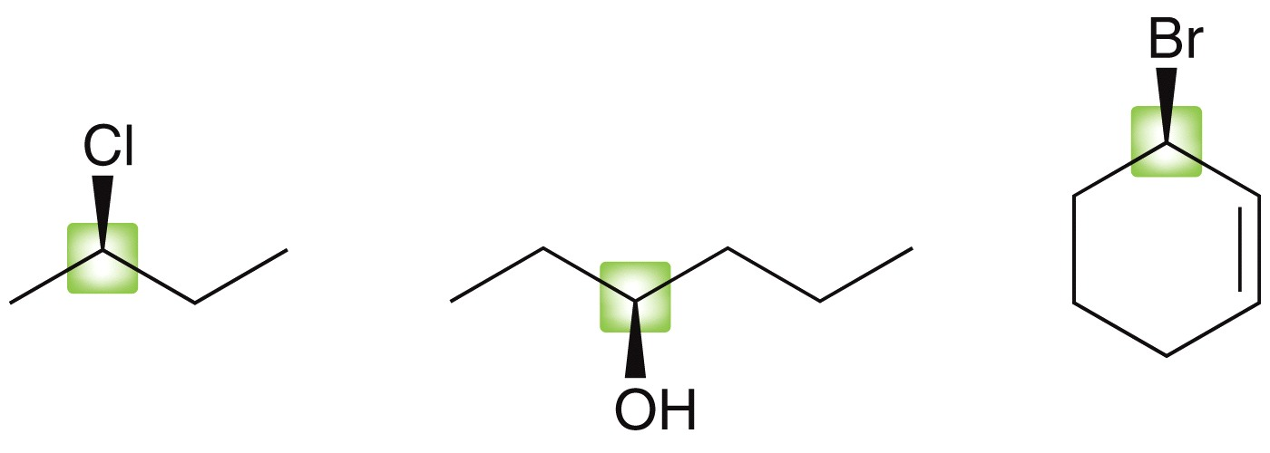
5.2 Stereoisomers
When an atom (like carbon) forms a tetrahedral center with 4 different groups attached to it, it is called a chirality center
Analyze the attachments for each chirality center below
Practice with SkillBuilder 5.1
each highlighted carbon
is bonded to 4 different
groups, and is a
chirality center

Slide 13
5.2 Stereoisomers
How many chirality centers are in each of the following compounds?
*answers on next slide*

Slide 14
5.2 Stereoisomers
How many chirality centers are in each of the following compounds?
no chirality centers
two chirality centers
two chirality centers
two chirality centers

Slide 15
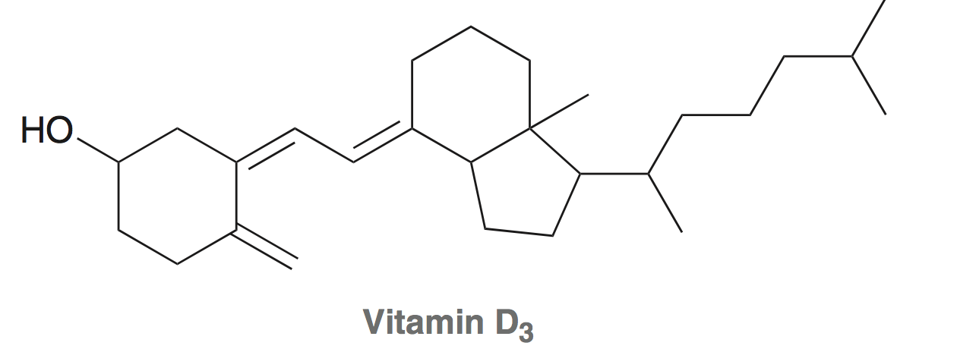
5.2 Stereoisomers
Practice the Skill 5.4 - Identify and label all the chirality centers in Vitamin D₃

Slide 16
5.2 Enantiomers
Some stereoisomers can also be classified as enantiomers
Enantiomers are TWO molecules that are MIRROR IMAGES but are not superimposable, therefore not identical
Only a chiral compound can have an enantiomer
this is a chiral compound…
… the mirror image will be its enantiomer

Slide 17
5.2 Enantiomers
Some stereoisomers can also be classified as enantiomers
Enantiomers are TWO molecules that are MIRROR IMAGES but are not superimposable, therefore not identical
Only a chiral compound can have an enantiomer
this is a chiral compound…
… the mirror image will be its enantiomer

Slide 18
5.2 Enantiomers
Another, often easier way to draw the enantiomer of a chiral compound is to invert the dashes and wedges of a chirality center
enantiomers
enantiomers
this is not a chiral compound, so inverting the
dashes/wedges provides an identical structure

Slide 19
5.3 Designating R vs S configuration
Enantiomers are different compounds, so they must not have identical names
They have opposite configuration at their chirality center(s)
We use the Cahn-Ingold-Prelog system to designate each chirality center as having either the “R” or “S” configuration.
If a compound has the “R” configuration at a chirality center, then the enantiomer will have the “S” configuration

Slide 20
5.3 Designating R vs S configuration
“R” or “S” is assigned to a chirality center using a stepwise procedure
  Using atomic numbers, prioritize the 4 groups attached to the chirality center (1, 2, 3 and 4)
  Arrange the molecule in space so the lowest priority group faces away from you
  Count the group priorities 1…2…3 to determine whether the order progresses in a clockwise or counterclockwise direction
  Clockwise = R and Counterclockwise = S
A handheld model can be very helpful visual aid for this process

Slide 21
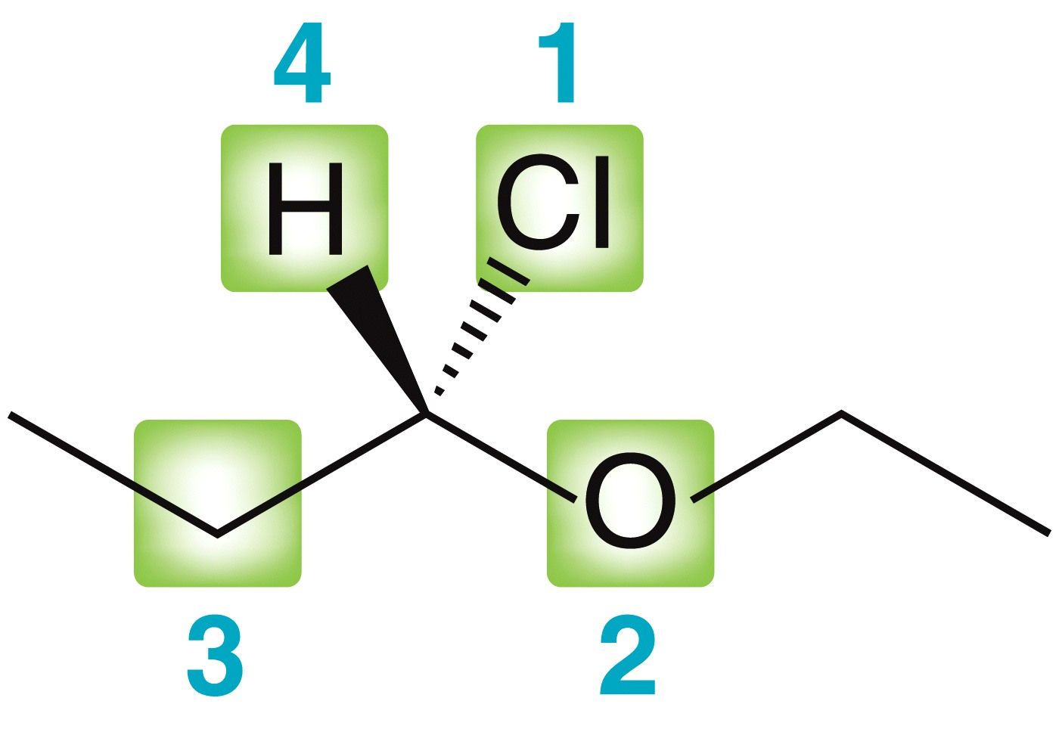
5.3 Designating R vs S configuration
The Cahn, Ingold and Prelog system
  Using atomic numbers, prioritize the 4 groups attached to the chirality center. The higher the atomic number, the higher the priority
  The atom with the largest atomic number is assigned the highest priority (1), and so on…

Slide 22
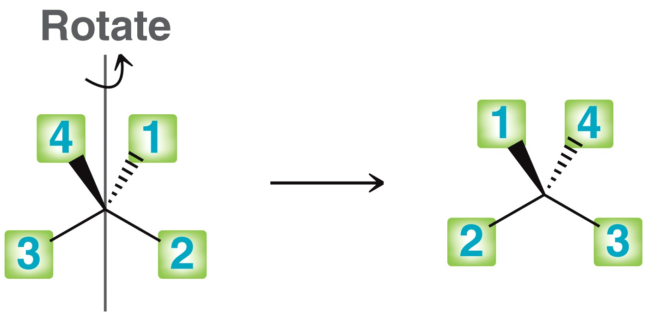
5.3 Designating R vs S configuration
The Cahn, Ingold and Prelog system
  Arrange the molecule in space so the lowest priority group faces away from you
  **This is the step where it is most helpful to have a handheld model

Slide 23
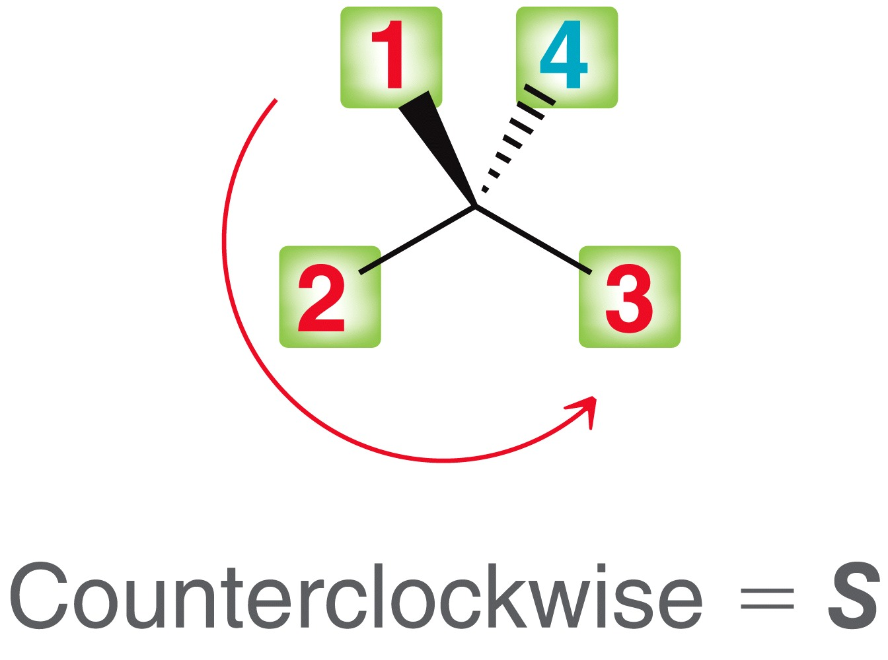
5.3 Designating R vs S configuration
The Cahn, Ingold and Prelog system
  Counting the other group priorities, 1…2…3, determine whether the order progresses in a clockwise or counterclockwise direction
  Clockwise = R and Counterclockwise = S
and so we just determined this chirality
Center has the (S) configuration

Slide 24
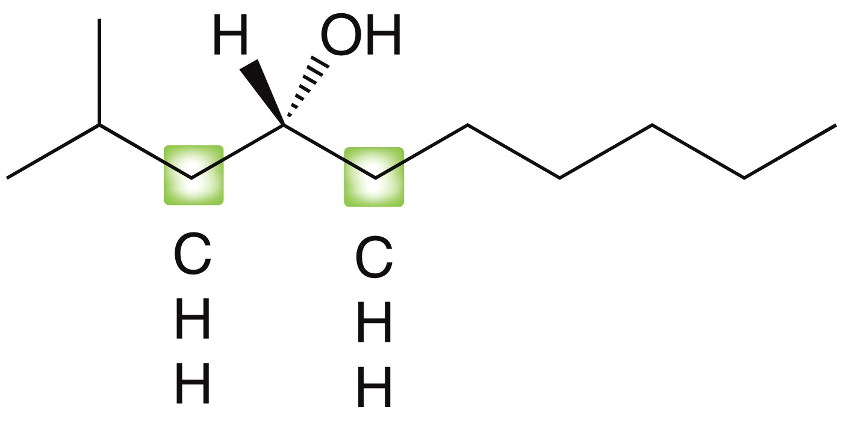
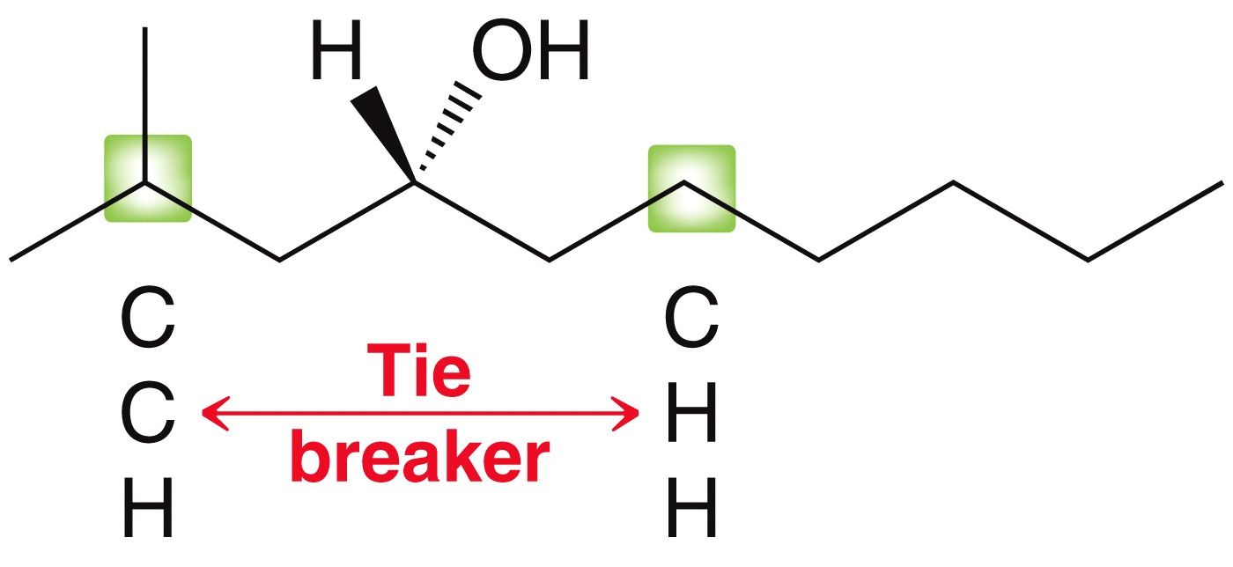
5.3 Designating R vs S configuration
When the groups attached to a chirality center are similar, it can be tricky to prioritize them
Analyze the atomic numbers one layer of atoms at a time
4
1
4
1
2
3
Tie
The 1 and 4 groups are obvious, but
there is a tie for priority 2 and 3
So we have to compare the atomic
weights of the atoms bonded to each
carbon to break the tie

Slide 25
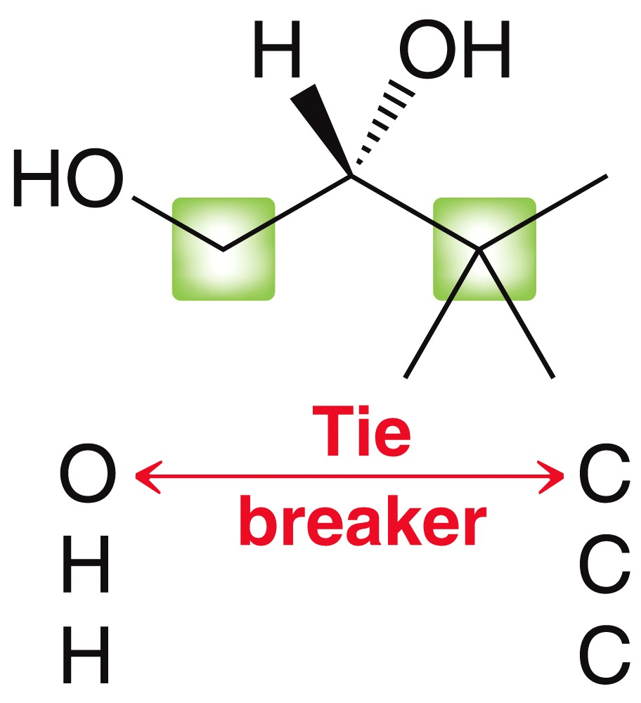
5.3 Designating R vs S configuration
Analyze the atomic numbers one layer of atoms at a time
First layer
Second layer
4
1
Tie
The priority is based on the first point of difference!
3
2

Slide 26
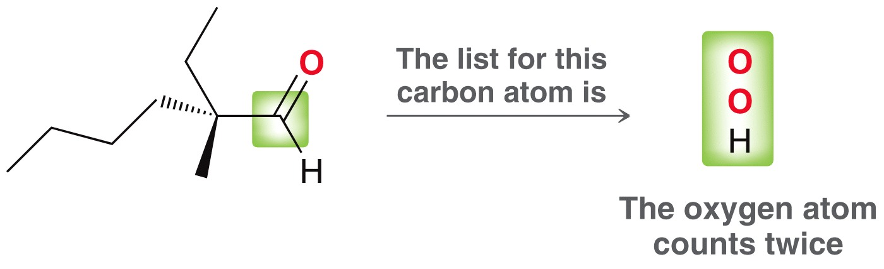
5.3 Designating R vs S configuration
When prioritizing for the Cahn, Ingold and Prelog system, double bonds count as two single bonds

Slide 27
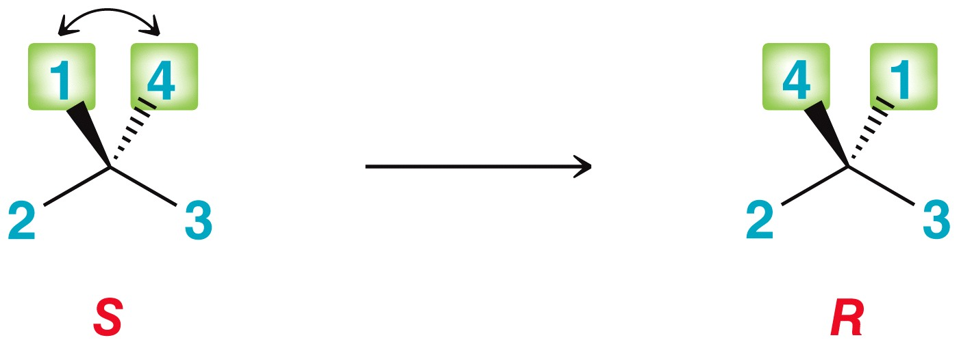
5.3 Rotating the Molecule
Handheld molecular models can be very helpful when arranging the molecule in space so the lowest priority group faces away from you
Here are some other tricks that can use
  Switching two groups on a chirality center will produce its opposite configuration

Slide 28
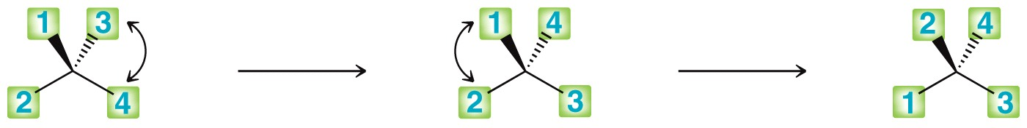
5.3 Rotating the Molecule
Switching two groups on a chirality center will produce its opposite configuration
You can use this trick to adjust a molecule so that the lowest priority group faces away from you
With the 4th priority group facing away, you can designate the configuration as R
Switching two of the groups, twice, returns the original configuration but allows us to put the 4 priority group pointing away.

Slide 29
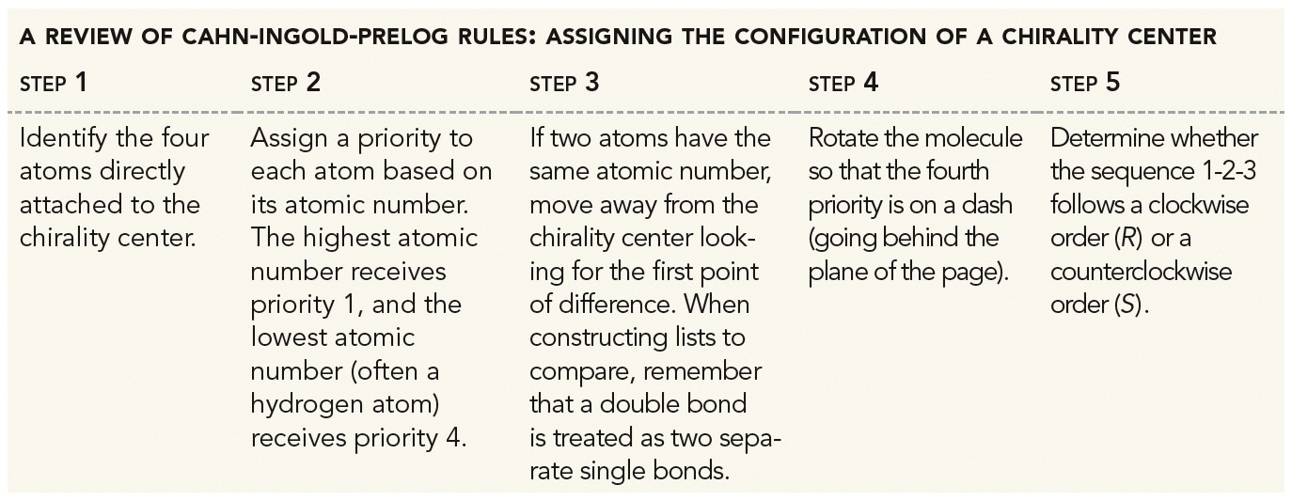
5.3 CIP Rules Summary

Slide 30
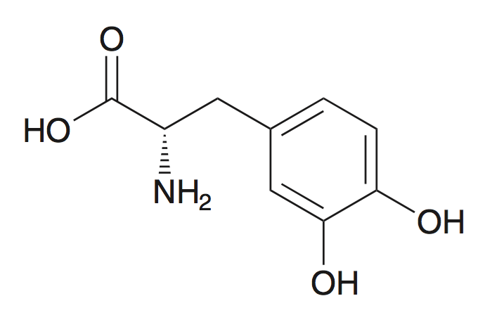
5.3 Designating R vs S configuration
Skillbuilder 5.3 – Assign the configuration of the chiral center in the following compound
Get additional practice with Practice the Skill 5.9

Slide 31
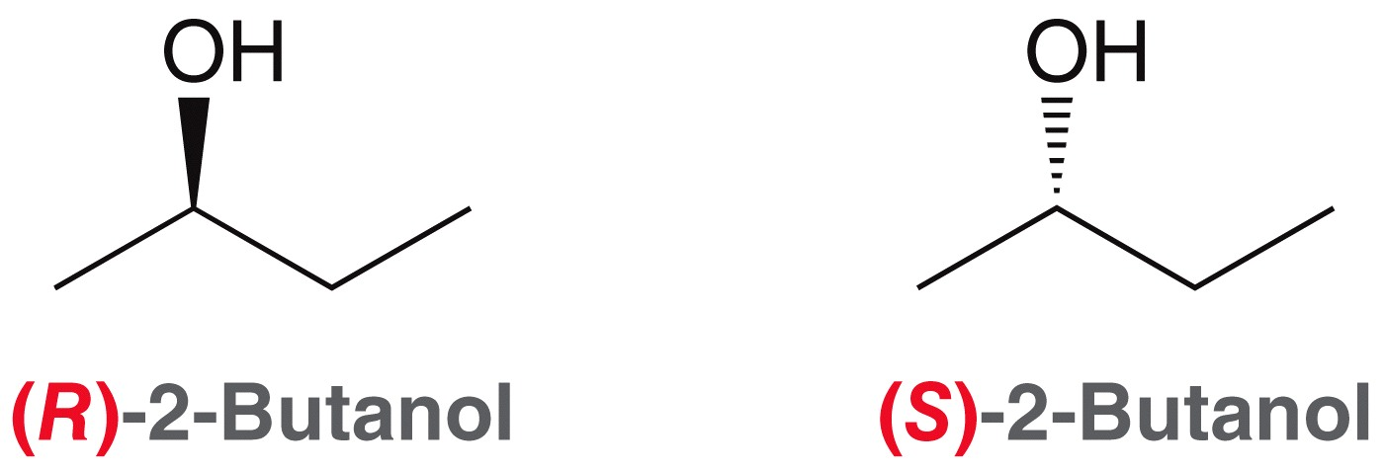
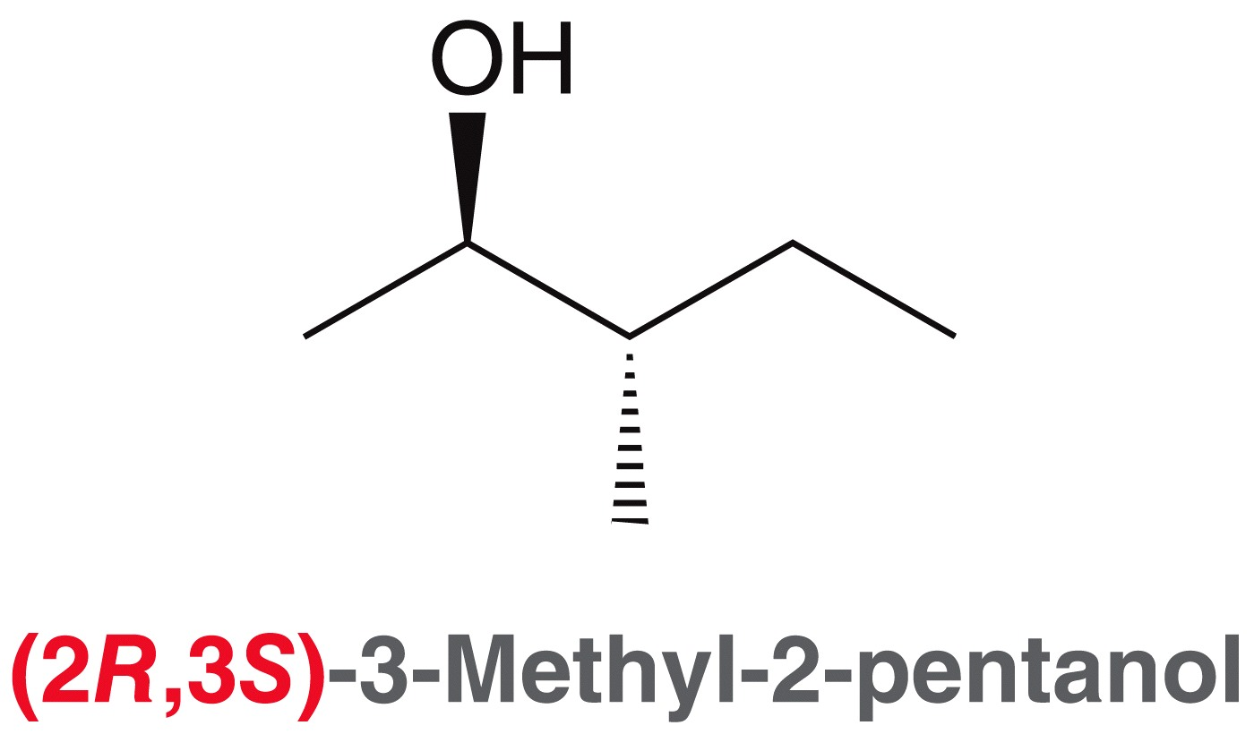
5.3 (R) and (S) in IUPAC Nomenclature
The (R) or (S) configuration is used in the IUPAC name for a compound to distinguish it from its enantiomer

Slide 32
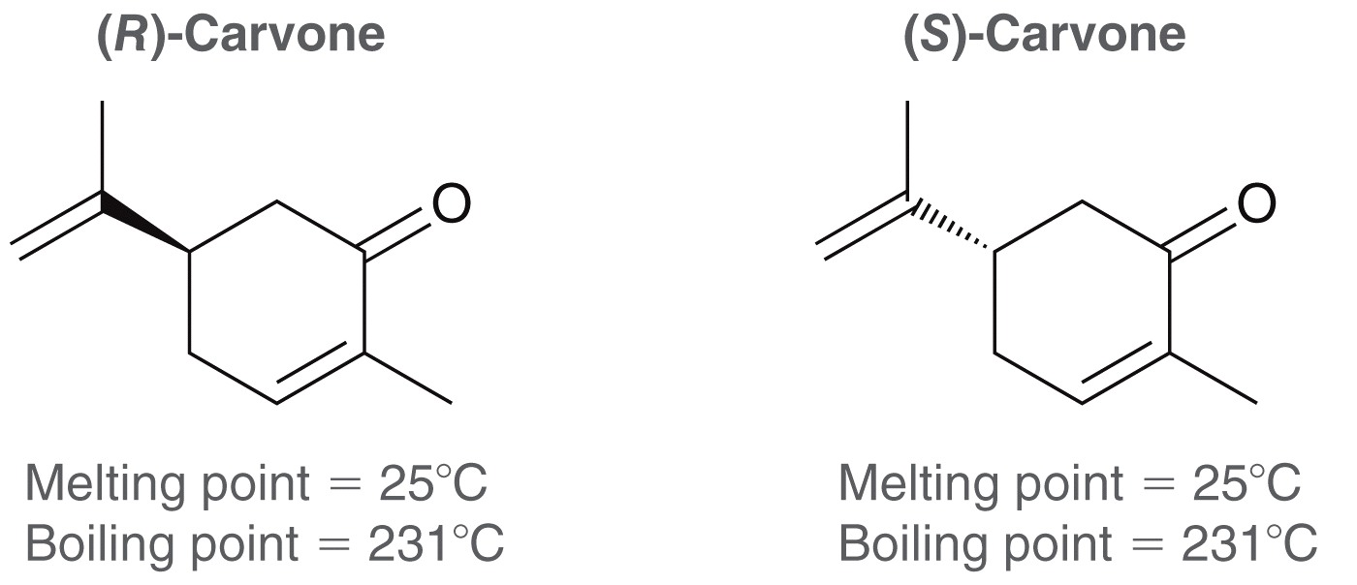
5.3 Optical Activity
Because the structures of enantiomers only differ in the same way your right hand differs from your left, they have the same physical properties.
Enantiomers only differ in (1) how they interact with other chiral compounds, and (2) their optical activity

Slide 33
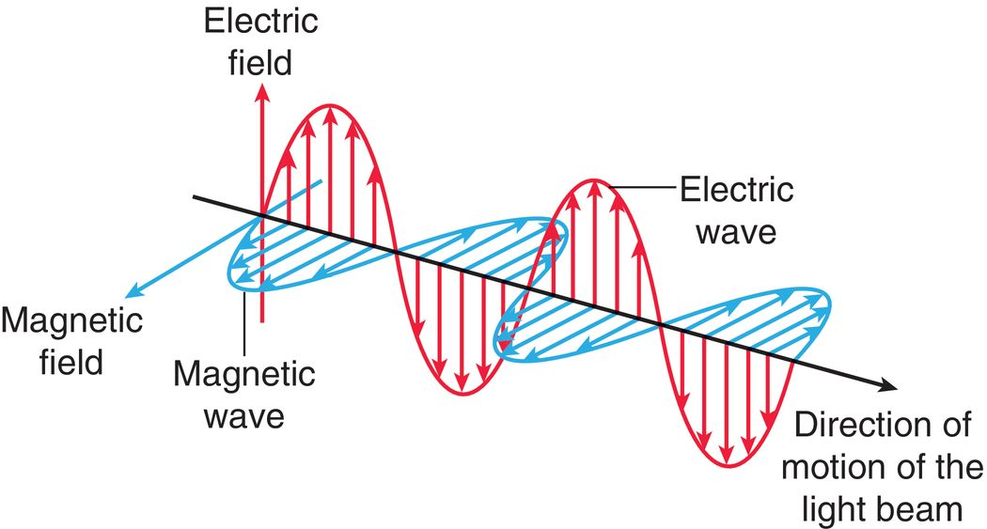
5.4 Optical Activity
Enantiomers have opposite configurations (R vs. S), and rotate plane-polarized light in opposite directions

Slide 34
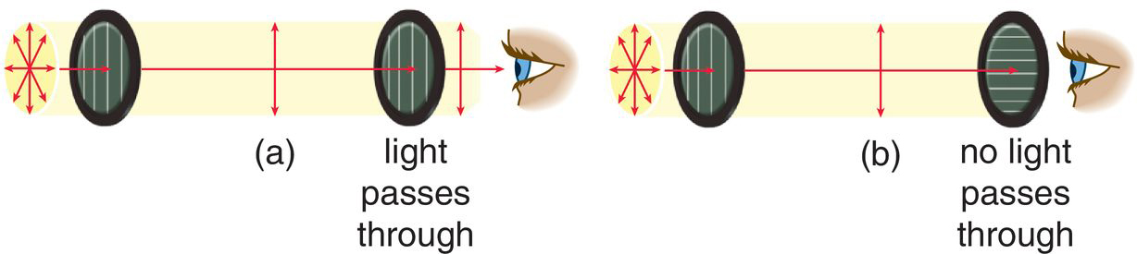
5.4 Optical Activity
To get light waves that travel in only one plane, light travels through a filter
When plane-polarized light is passed through a sample of chiral compound, the plane that the light travels on will rotate.
Compounds that can rotate plane-polarized light are optically active. Only chiral compounds are optically active

Slide 35
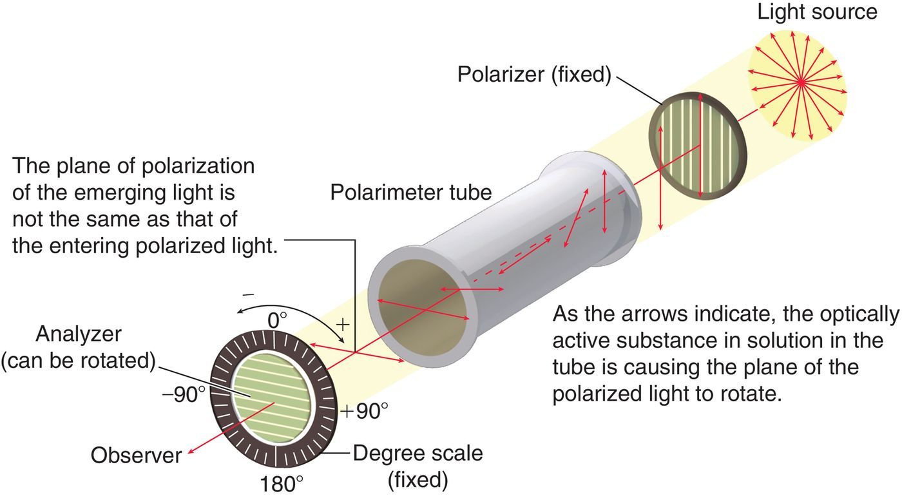
5.4 Optical Activity - Polarimeter

Slide 36
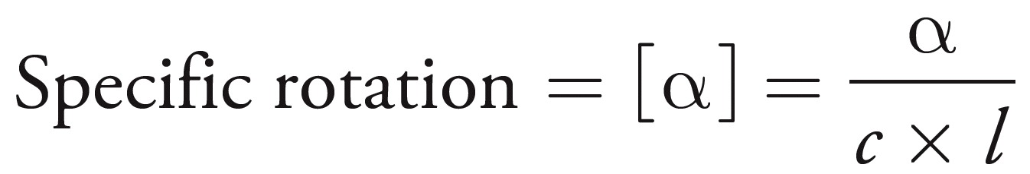
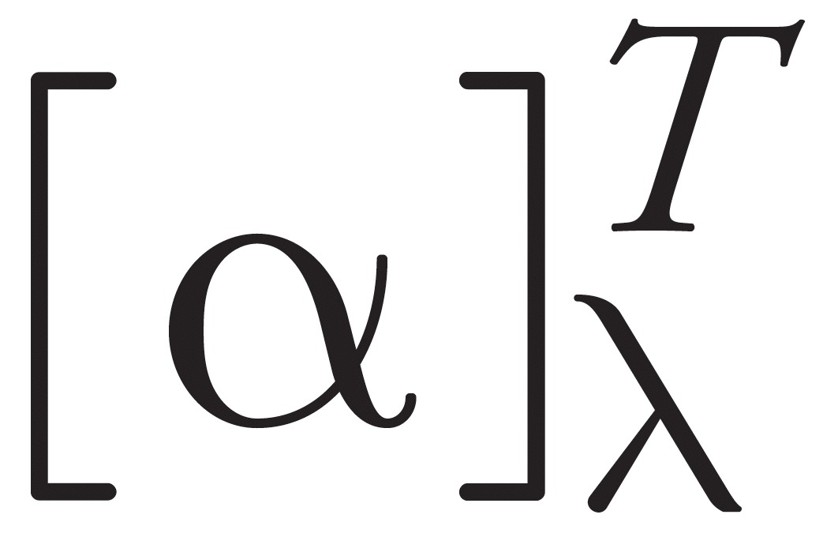
5.4 Optical Activity
Enantiomers will rotate the plane of the light to equal degrees but in opposite directions
The degree to which light is rotated depends on the sample concentration and the pathlength of the light
Standard optical rotation measurements are taken with 1 gram of compound dissolved in 1 mL of solution, and with a pathlength of 1 dm for the light
Temperature and the wavelength of light can also affect rotation and must be reported with measurements that are taken
temperature
wavelength

Slide 37
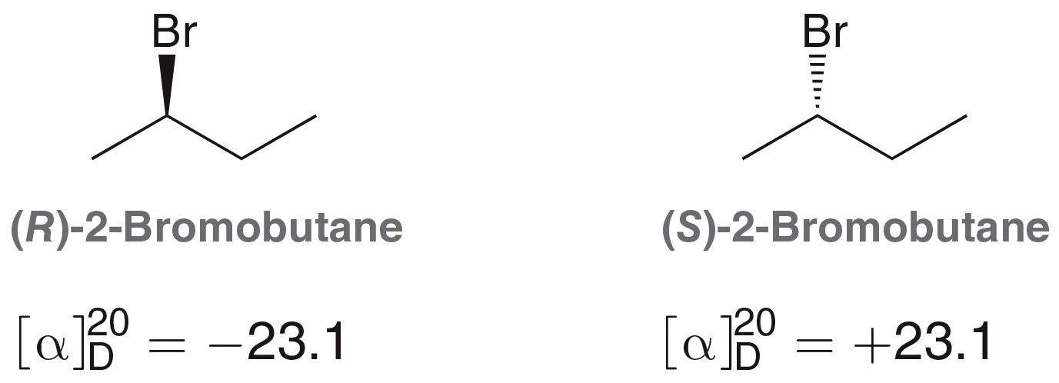
5.4 Optical Activity
Consider the enantiomers of 2-bromobutane
(R) and (S) refer to the configuration of the chirality center
(+) and (-) signs refer to the direction that the plane of light is rotated

Slide 38
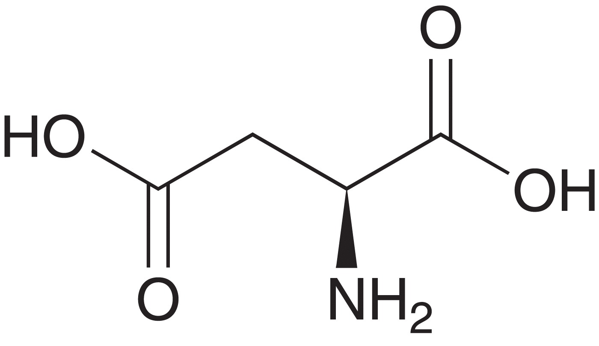
5.4 Optical Activity
(+) rotation is called dextrorotary, and (-) is levorotary
The compound below has the (S) configuration
Its optical rotation is levorotatory (-) at 20°C, but it is dextrorotatory (+) at 100°C
There is no correlation between R/S and +/-

Slide 39
5.4 Optical Activity
The magnitude and direction of optical rotation cannot be predicted, and has to be measured experimentally
However, we can predict the rotation of a racemic mixture to be 0˚ (the optical rotation of each enantiomer cancels each other).
    Racemic mixture: 50/50 mixture of two enantiomers
If one enantiomer is present in excess, relative to the other, then the mixture will have an optical rotation, but it will be less than the pure enantiomer.

Slide 40
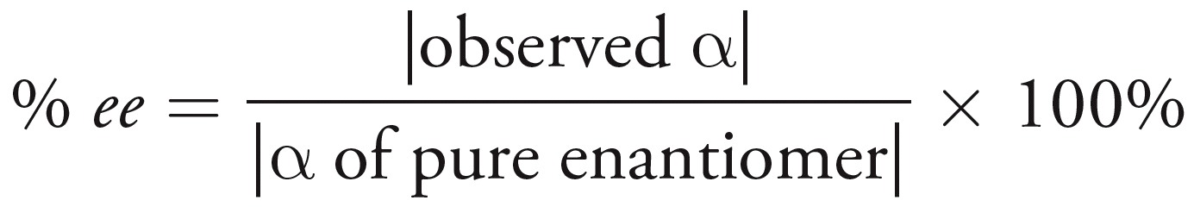
5.4 Enantiomeric Excess
For unequal amounts of enantiomers, the enantiomeric excess (% ee) can be determined from the optical rotation
Suppose a mixture of (R) and (S) 2-bromobutane has a specific rotation of -4.6 ˚. This allows us to determine the % ee
So, (-4.6) / (-23.1) x 100% = 20 % ee
Practice with SkillBuilder 5.5

Slide 41
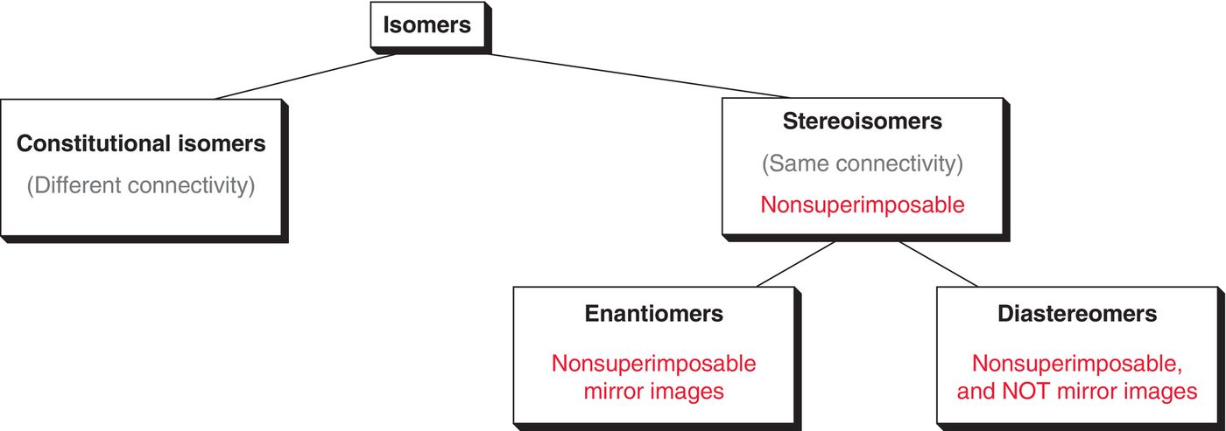
5.5 Enantiomers and Diastereomers
Categories of isomers
Enantiomers: stereoisomers that are mirror images
Diastereomers: stereoisomers that are not mirror images
* there are two sub-categories
of stereoisomers

Slide 42
5.5 Enantiomers and Diastereomers
Consider the structures of cis- and trans-2-butene
They are stereoisomers, but not mirror images of each other. So, they are diastereomers!
Recall that enantiomers have identical physical properties.
Diastereomers have different physical properties

Slide 43
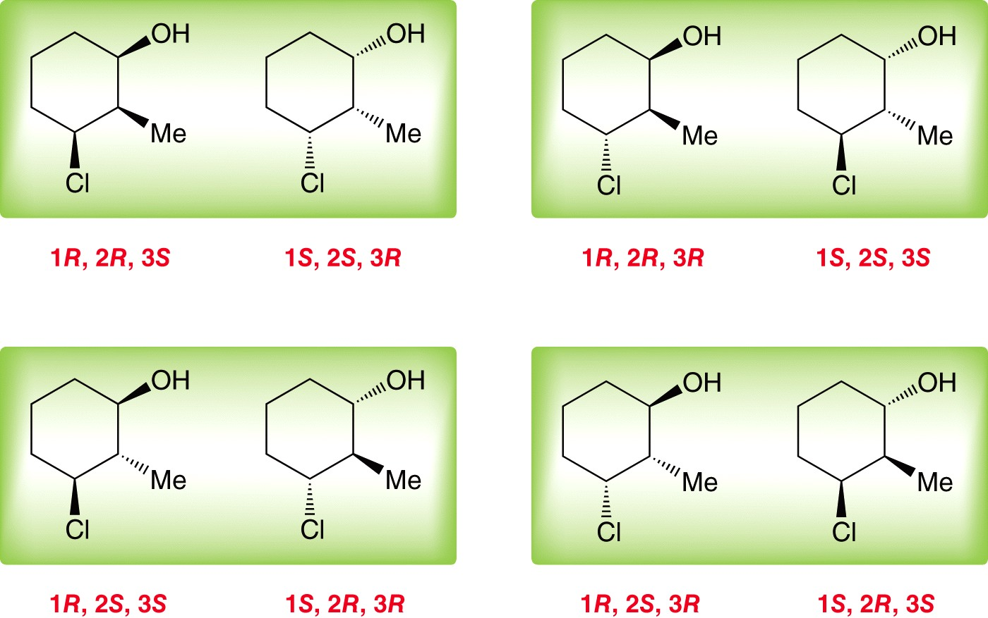
5.5 Stereoisomeric Relationships
Consider a cyclohexane with three substituents
There are three stereocenters here, and so there are 8 possible stereoisomers (all drawn above). Consider the relationship among them (enantiomers vs. diastereomers)

Slide 44
5.5 Stereoisomeric Relationships
Notice these 8 stereoisomers are comprised of 4 pairs of enantiomers
Can think of this as a family where there are 4 pairs of twins, for a total of 8 kids. Each kid has 7 siblings, where one of them is their twin (i.e. enantiomer) and the other 6 are diastereomers

Slide 45
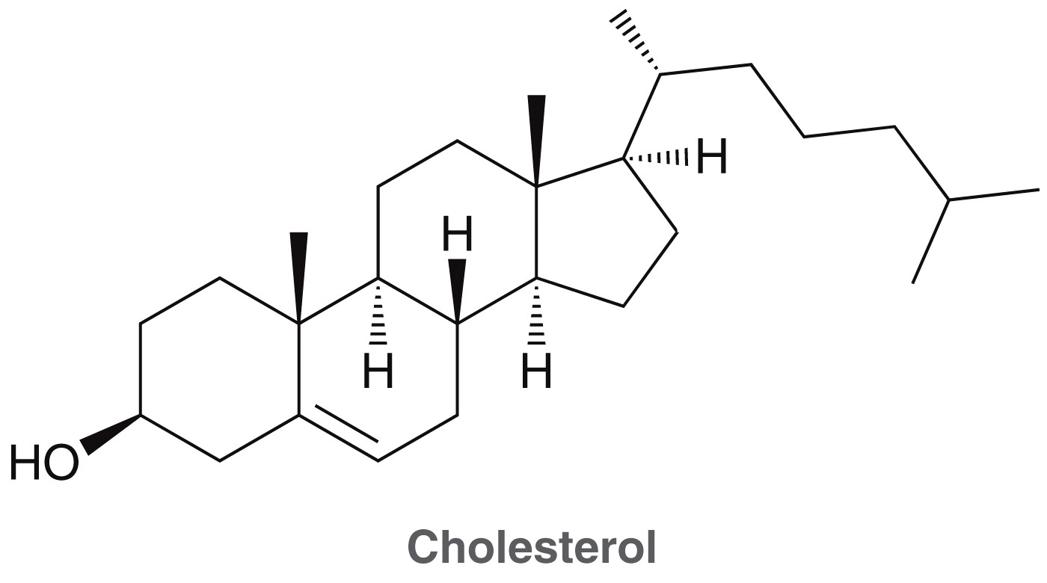
5.5 Stereoisomeric Relationships
The number of possible stereoisomers for a compound depends on the number of chirality centers (n) in the compound
What is the maximum number of possible cholesterol isomers?
Practice with SkillBuilder 5.6

Slide 46
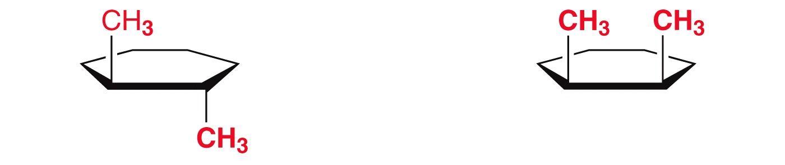
5.6 Symmetry and Chirality
Any compound with only ONE chirality center will be a chiral compound
With more than one chirality center, a compound may not be chiral; it may have a plane of symmetry
Consider the stereoisomers below, which possess TWO chirality centers:
trans-1,2-dimethylcyclohexane
cis-1,2-dimethylcyclohexane

Slide 47
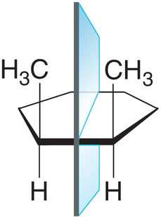
5.6 Symmetry and Chirality
The trans isomer is chiral, but the cis isomer is not (it is achiral)
If a molecule has a plane of symmetry, it will be achiral
The cis isomer has a plane of symmetry, which
means it will be superimposable on its
mirror image, and is not a chiral compound

Slide 48
5.6 Symmetry and Chirality
Molecules with an even number of chirality centers that have a plane of symmetry are called meso compounds
Another way to test if a compound is a meso compound is to see if it is identical to its mirror image
Draw the mirror image of the cis isomer and show that it can be superimposed on its mirror image
By definition, when a compound is identical to its mirror image, it is NOT chiral. It is achiral

Slide 49
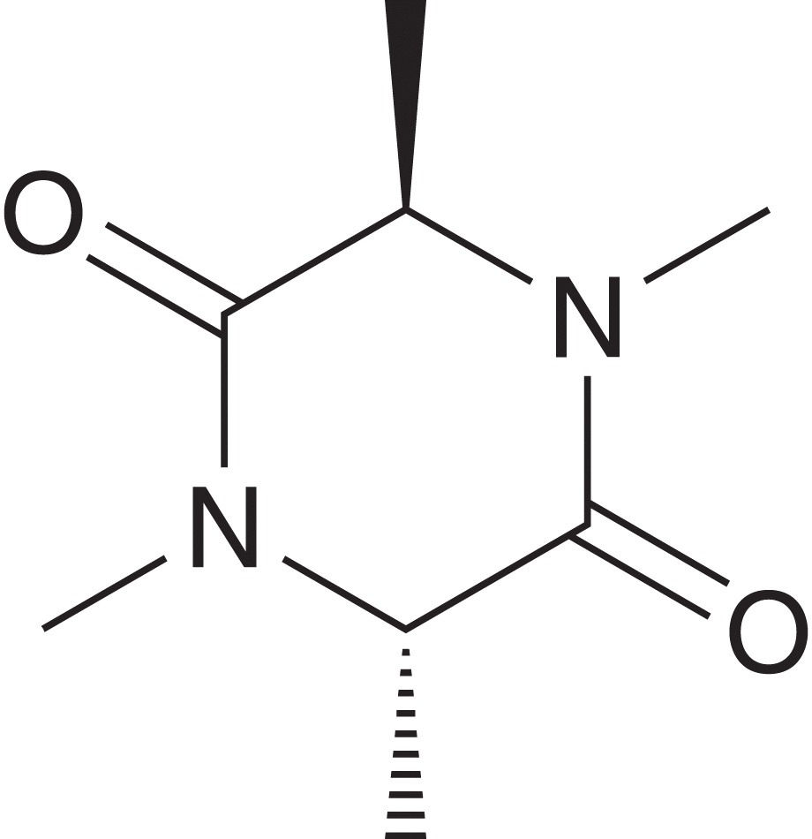
5.6 Symmetry and Chirality
If a compound has a plane of symmetry, it is ACHIRAL
But… a compound that lacks a plane of symmetry may still be an achiral compound… if it has an reflectional symmetry through inversion about a central point in the molecule
The molecule to the right has two chirality
centers, and no plane of symmetry, but it is
still achiral because of inversion

Slide 50
5.6 Symmetry and Chirality
OVERALL:
      The presence or absence of rotational symmetry is irrelevant to chirality
      A compound that has a plane of symmetry is achiral
      A compound without a plane of symmetry will usually be chiral, but there are exceptions (such as a compound with an inversion center).

Slide 51
5.6 Meso Compounds
A compound with chirality centers, but is achiral because of symmetry is called a meso compound
The molecules below are meso compounds:
meso compounds have less than the predicted number of stereoisomers based on the 2^{(n)} formula
Practice with Skillbuilder 5.7

Slide 52
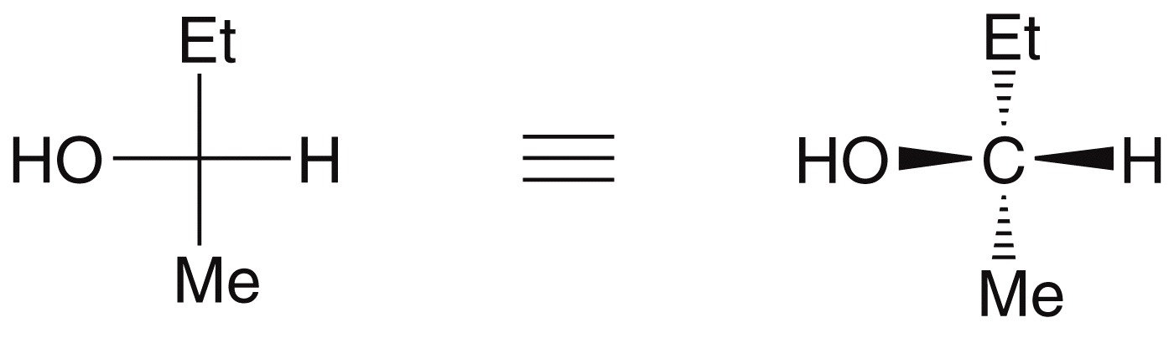
5.7 Fischer Projections
Fischer projections can also be used to represent molecules with chirality centers
Horizontal lines represent attachments coming out of the page
Vertical lines represent attachments going back into the page

Slide 53
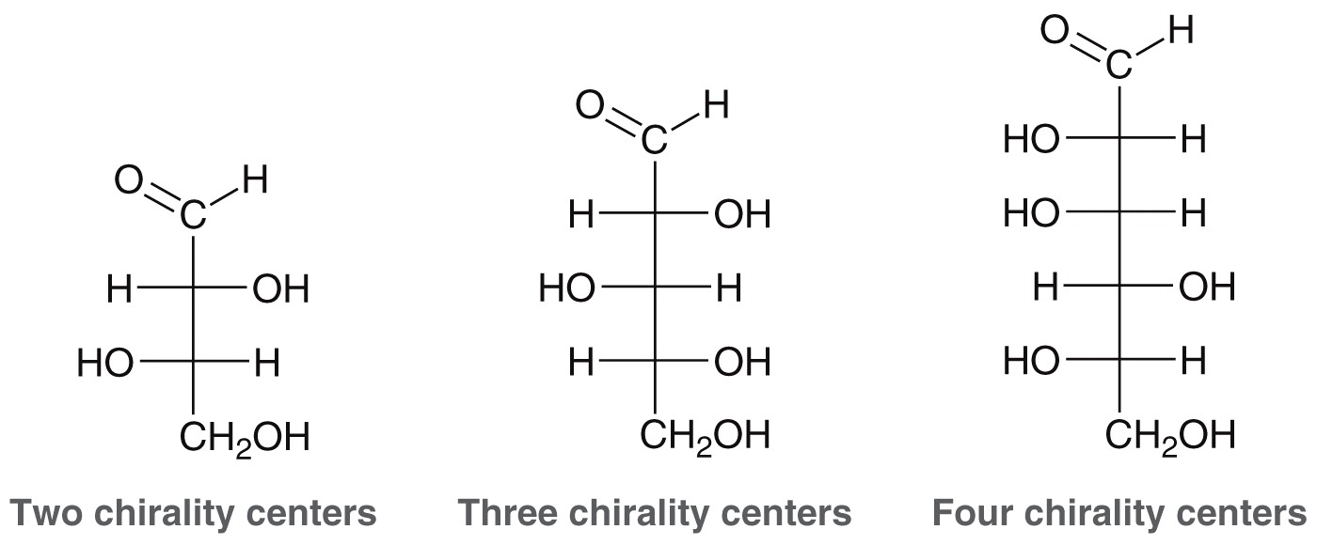
5.7 Fischer Projections
Fischer projections are most useful when drawing molecules having multiple chirality centers (like sugars, shown below).

Slide 54
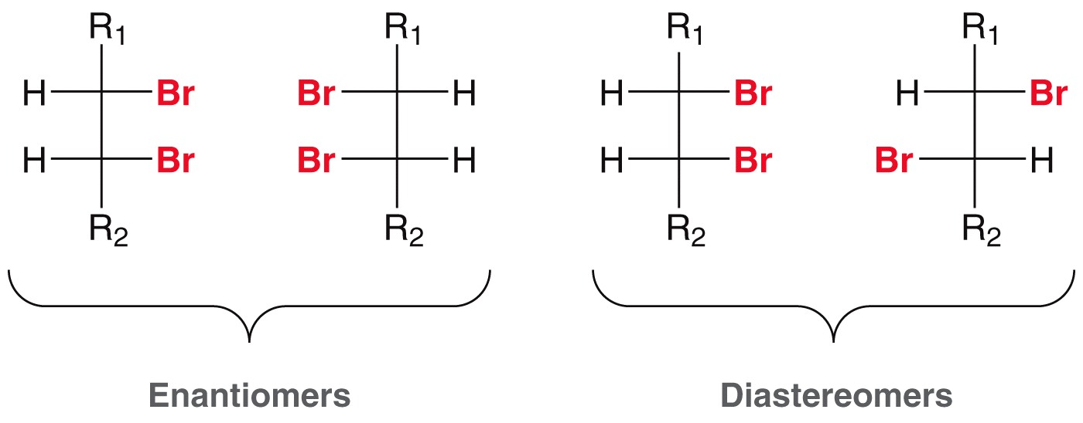
5.7 Fischer Projections
Fischer projections are also useful to quickly assess stereoisomeric relationships
Practice with SkillBuilder 5.8

Slide 55
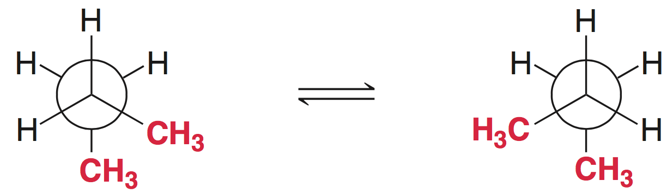
5.8 Conformationally Mobile Compounds
Molecules can rotate around single bonds.
Recall the gauche rotational conformations of butane
Realize that these conformations are chiral, and are actually enantiomeric
But, because these rotatomers are interchangeable via bond rotation, butane is not a chiral compound.

Slide 56
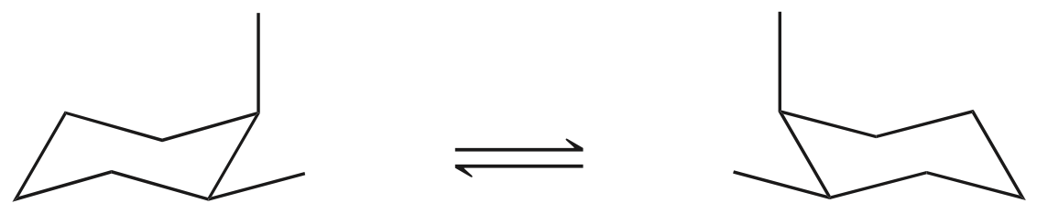
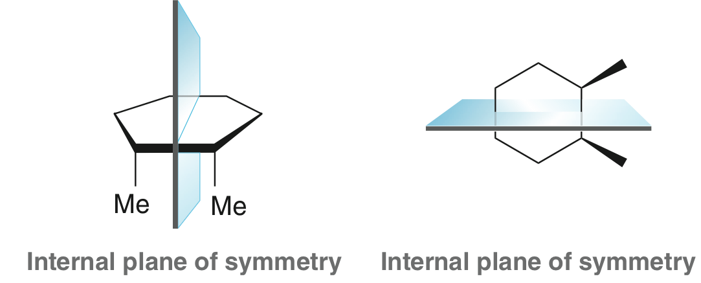
5.8 Interconverting Enantiomers
Compare both possible chair conformations of (cis)-1,2-dimethylcyclohexane
These conformations are chiral, and also enantiomeric
However, these conformations interconvert, and overall this is an achiral compound (possesses a plane of symmetry)

Slide 57
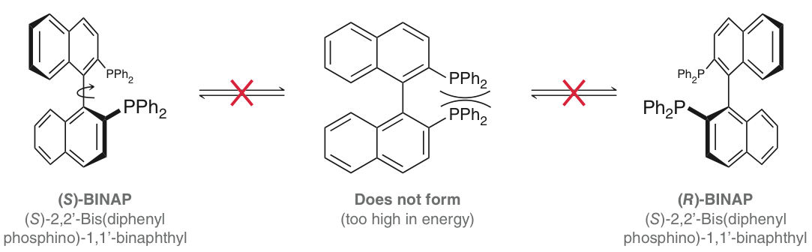
5.9 Chirality without Chirality Centers
ATROPISOMERS: stereoisomers that would be interchangeable through the rotation of a sigma bond, but because the bond is unable to rotate, the different conformations are “stuck” and not interchangeable.
(R) and (S)-BINAP are chiral, and enantiomers of one another, even though they do not have any chirality centers (they instead have an “axis of chirality.”

Slide 58
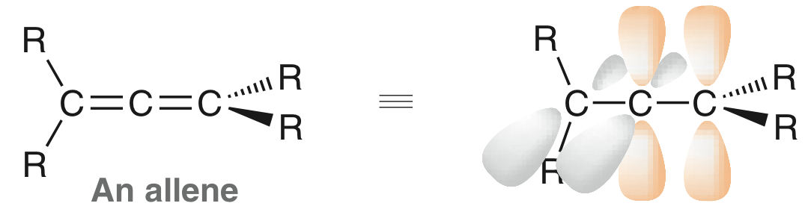
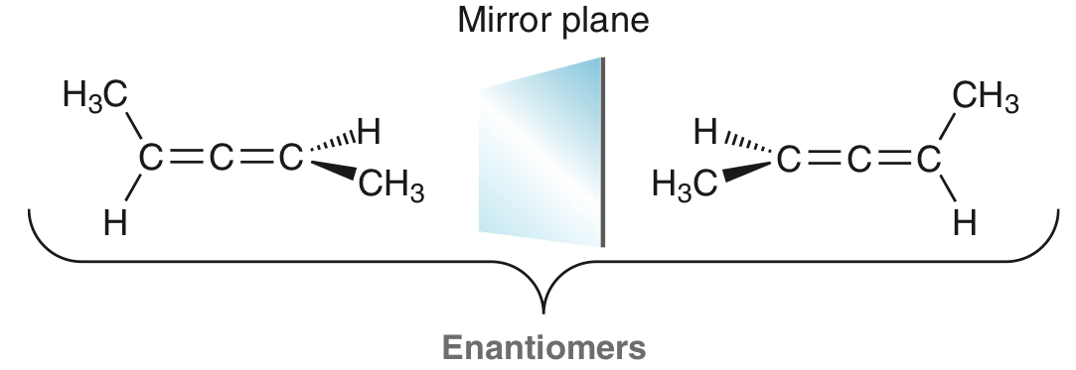
5.9 Chirality without Chirality Centers
ALLENES: compounds that possess two adjacent C=C double bonds. They may or may not be chiral depending on the substituents,
The the two groups on each end of the allene are different, than it will be a chiral compound

Slide 59
5.10 Resolution of Enantiomers
Most methods of separating compounds from one another take advantages of the compounds’ different physical properties
  Distillation – separates compounds with different boiling points
  Recrystallization – separates compounds with different solubilities
Such methods often don’t work to separate one enantiomer from its racemate, because they have identical physical properties/

Slide 60
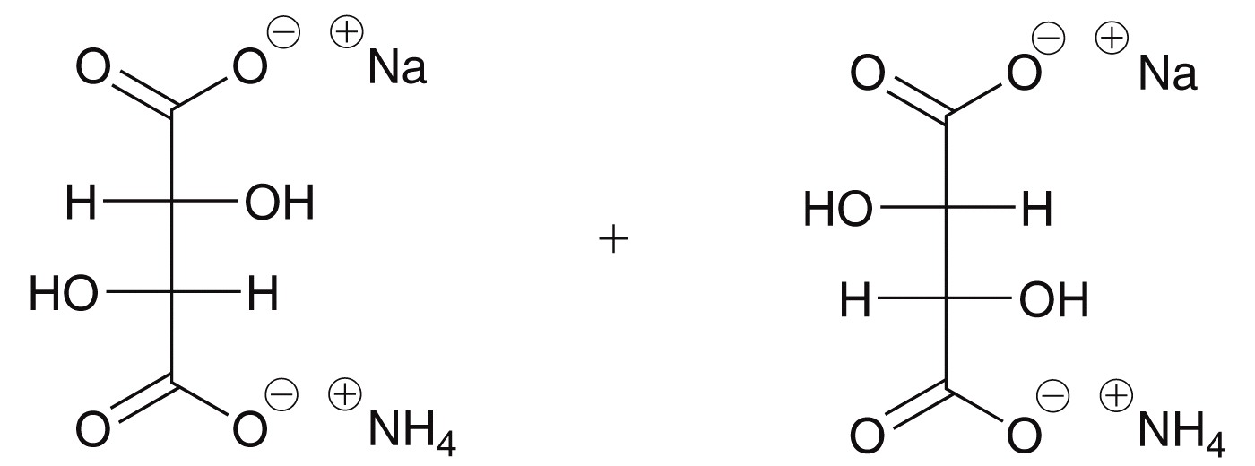
5.10 Resolution of Enantiomers
In 1847, Pasteur performed the first resolution of enantiomers from a racemic mixture of tartaric acid salts
The different enantiomers formed different shaped crystals that were separated by hand using tweezers
However, this method doesn’t work for most pairs of enantiomers

Slide 61
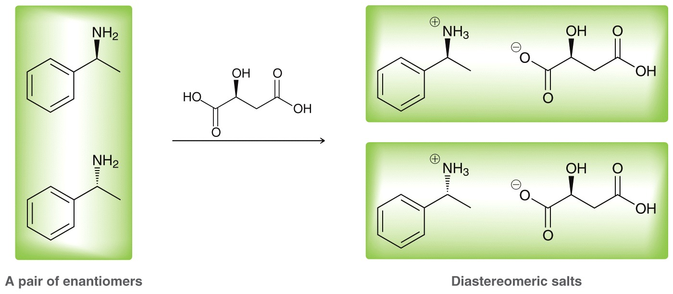
5.10 Resolution of Enantiomers
Another method is to use a chiral resolving agent
The differing physical properties of diastereomers allow them to be more easily separated

Slide 62
5.10 Resolution of Enantiomers
Affinity chromatography is often used to separate compounds
a glass column (or tube) is packed with a solid substance to act as an adsorbent, and a mixture is passed through it.
If a chiral adsorbent is used, then enantiomers will interact with it differently, and travel through the column at different rates, allowing for their individual collection (thus separation).
This is a very common way for resolving enantiomers

Slide 63
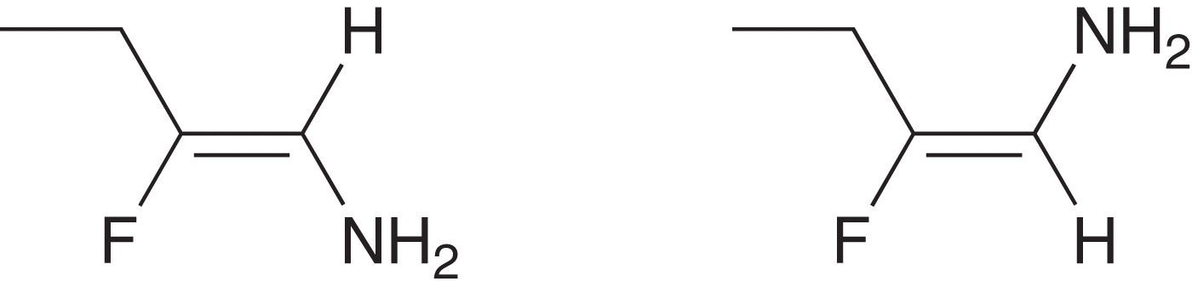
5.11 E and Z Designations for Alkenes
For molecules with different groups attached to the C=C double bond, the E/Z notation is used instead of cis/trans notation
cis and trans only works if there is a like group on each carbon of the alkene
Cis/trans isn’t adequate to differentiate between these two diastereomers

Slide 64
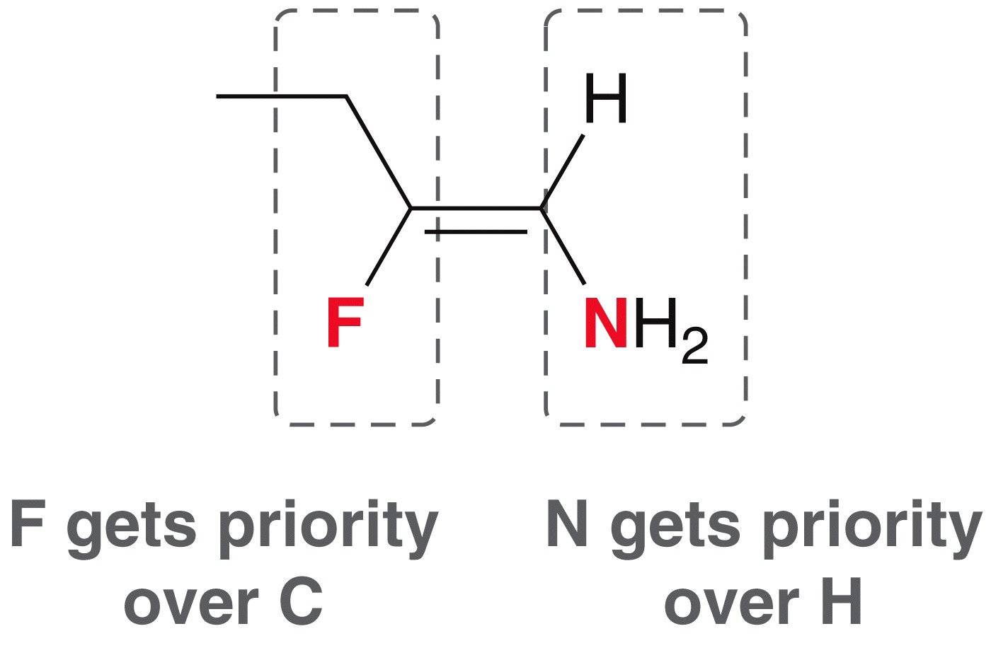
5.11 E and Z Designations for Alkenes
Assigning E or Z to a C=C double bond:
  prioritize the groups attached to the C=C double bond based on atomic number

Slide 65
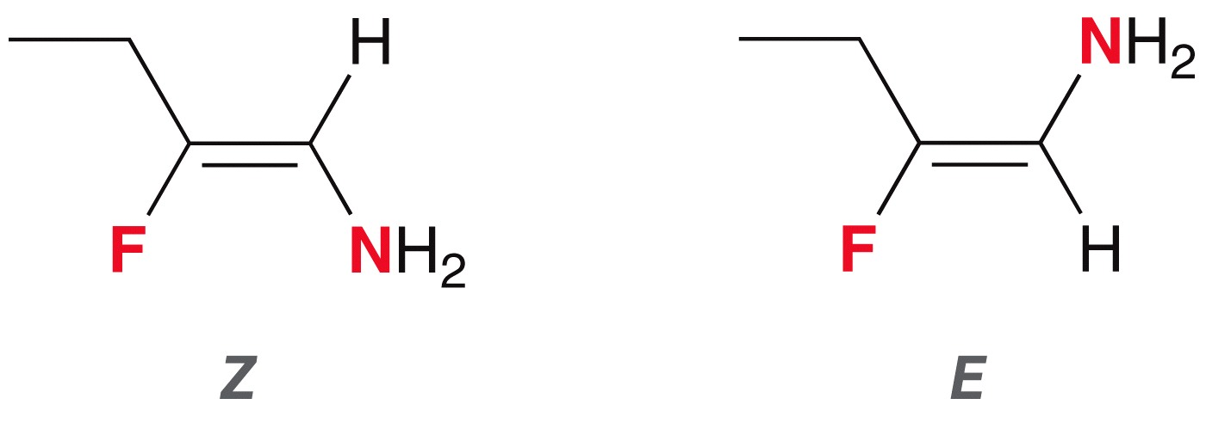
5.11 E and Z Designations for Alkenes
Assigning E or Z to a C=C double bond:
  prioritize the groups attached to the C=C double bond based on atomic number
  If the top priority groups are on the same side of the C=C double bond, it is Z (for zussamen, which means together)
  If the top priority groups are on opposite sides of the C=C double bond, it is E (for entgegen, which means opposite)
Practice with SkillBuilder 8.2

