Slide 1
Organic Chemistry
Third Edition
David Klein
Chapter 6
Chemical Reactivity and Mechanisms

Slide 2
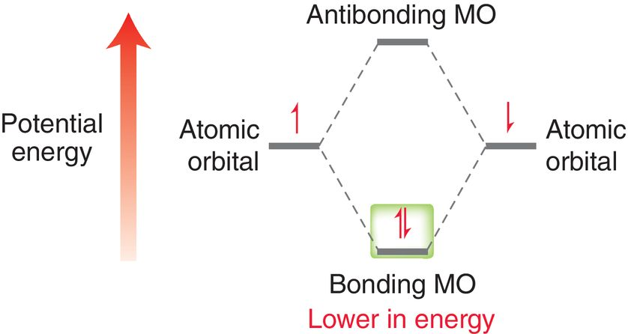
6.1 Enthalpy
Enthalpy (ΔH or q) is the heat energy exchange between the reaction and its surroundings
Breaking a bond requires the system to absorb energy
The electrons must absorb
Kinetic energy to overcome
the stability of the bond

Slide 3
6.1 Enthalpy (ΔH)
Bonds can break homolytically or heterolytically
Bond dissociation energy (BDE) or ΔH for bond breaking corresponds to homolytic bond cleavage

Slide 4
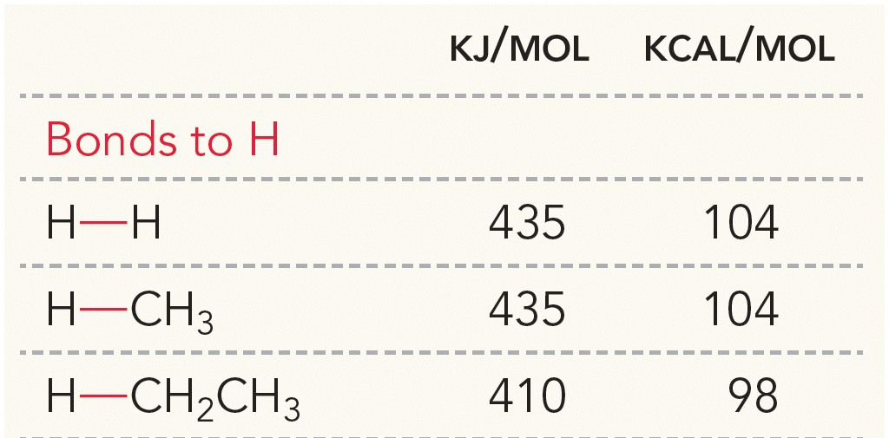
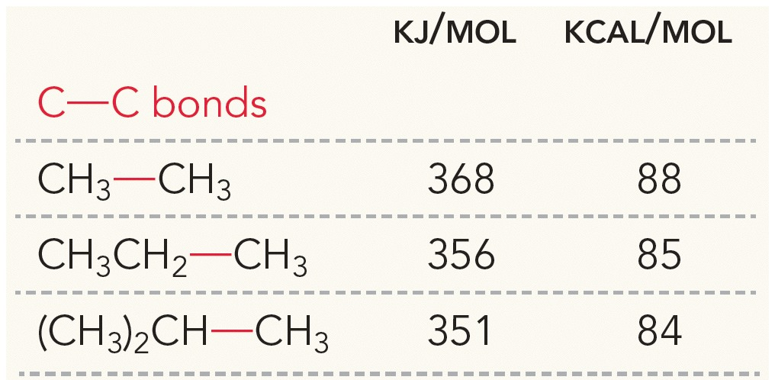
6.1 Bond Dissociation Energy
More BDEs can be found in table 6.1

Slide 5
6.1 Bond Dissociation Energy
Most reactions involve multiple bonds breaking and forming.
Exothermic reaction – The energy gained by bonds formed exceeds the energy needed for bonds broken
Products more stable than reactants
Endothermic reaction – Energy needed for bonds broken exceeds the stability gained by the bonds formed
Products less stable than reactants

Slide 6
6.1 Enthalpy (ΔH)
Energy diagrams for exothermic vs. endothermic reactions
• Products lower in energy
• Energy is released as heat
(PE converted to KE)
• ΔH˚ is negative
• Temp of surroundings increases
• Products higher in energy
• Energy is consumed
(KE converted to PE)
• ΔH˚ is positive
• Temp of surroundings consumed

Slide 7
6.1 Enthalpy (ΔH)
The sign (+/-) of ΔH indicates if the reaction is exothermic or endothermic.
An energy diagram is often used to describe the kinetics and thermodynamics of a chemical reaction
Potential energy (PE) is described by the y-axis
Reaction progress described by the x-axis (reaction coordinate)
Practice with SkillBuilder 6.1

Slide 8
6.1 Enthalpy (ΔH)
Practice the Skill 6.1 – Use BDE’s to determine if the following reaction is exothermic (+ΔH) or endothermic (-ΔH)
ΔH = BDE (bonds broken) – BDE(bonds formed)
Bonds broken = C-H (397 kJ/mol) and Br-Br (193 kJ/mol)
Bonds formed = C-Br (285 kJ/mol) and H-Br (368 kJ/mol)
ΔH = (397 + 193) – (285 + 368) = -63 kJ/mol
ΔH is negative, so the reaction is exothermic

Slide 9
6.2 Entropy (ΔS)
Exothermic and endothermic reactions can occur spontaneously (most reactions are exothermic though)
Enthalpy (ΔH) and entropy (ΔS) must both be considered when predicting whether a reaction will occur
Recall that entropy can be described as molecular disorder, randomness, or freedom
Entropy is actually the number of vibrational, rotational, and translational states the energy of a compound is distributed.

Slide 10
6.2 Entropy (ΔS)
Consider why a gas will expand and spread out into an empty container
The number of states the molecules spread across increases with increasing volume.
More volume for gas to occupy = greater entropy

Slide 11
6.2 Entropy (ΔS)
The total entropy change (ΔS_{tot}) will determine whether a process is spontaneous
For chemical reactions, we must consider the entropy change for both the system (the reaction) and the surroundings (the solvent usually)
If ΔS_{tot} is positive, the process is spontaneous.

Slide 12
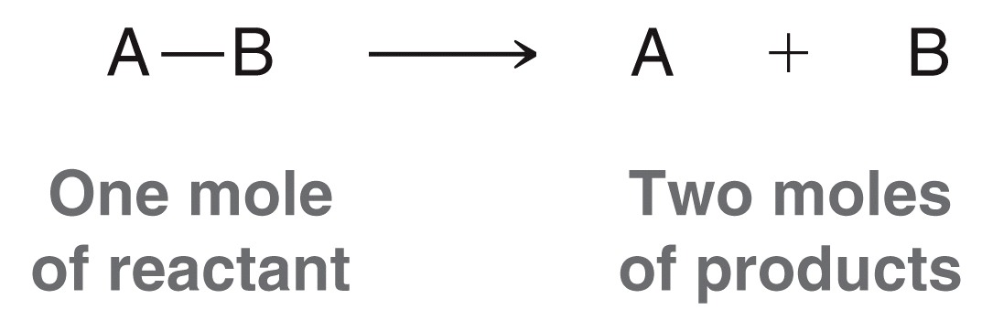
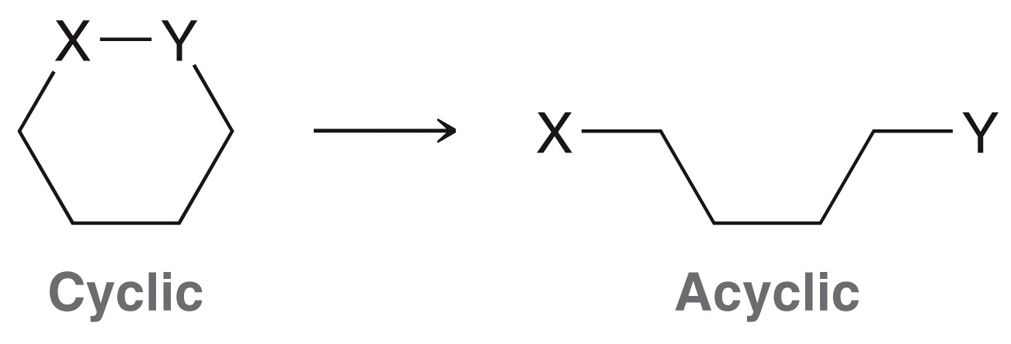
6.2 Entropy (ΔS)
ΔS_{sys} is affected most significantly by two factors, and will be positive…
When there are more moles of product than reactant
When a cyclic compound becomes acyclic
Practice with Conceptual Checkpoint 6.3

Slide 13
6.3 Gibbs Free Energy (ΔG)
Recall the spontaneity of a process depends only on ΔS_{tot}
ΔS_{surr} is actually a function of ΔH_{sys} and temperature (T)
which gives us a new equation for ΔS_{tot}

Slide 14
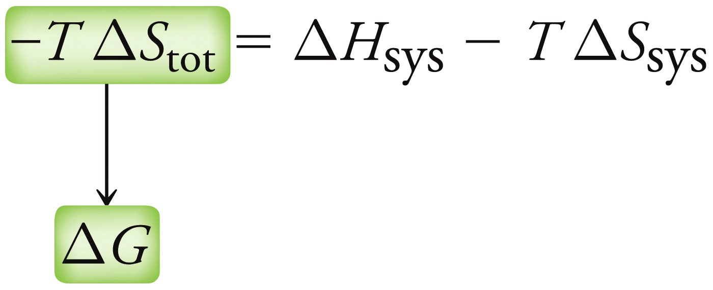
6.3 Gibbs Free Energy (ΔG)
Multiply both sides by temperature (T)
ΔG is the Gibbs Free Energy. A negative value of ΔG means the reaction is spontaneous, and a positive value is a nonspontaneous reaction.
ΔH is the change in the
Entropy of the surroundings
ΤΔS is the change in the
entropy of the system

Slide 15
6.3 Gibbs Free Energy (ΔG)
Consider the following reaction, which is spontaneous:
Since the reaction is spontaneous, ΔG must be negative
We also know that TΔS will be negative value because entropy is decreasing (2 molecules become 1).
So, it must be true that ΔH is a negative value, in order for ΔG to be negative overall.
In other words, the entropy of the surroundings is increasing more than the entropy of the system is increasing

Slide 16
6.3 Gibbs Free Energy (ΔG)
If a process has a negative ΔG, the process is spontaneous, and the process is exergonic
Notice that in this energy diagram, is is the free energy (G) is plotted rather than enthalpy (H)

Slide 17
6.3 Gibbs Free Energy (ΔG)
If a process has a positive ΔG, the process is nonspontaneous, and the process is endergonic
An endergonic reaction favors the reactants
Practice with conceptual checkpoint 6.4

Slide 18
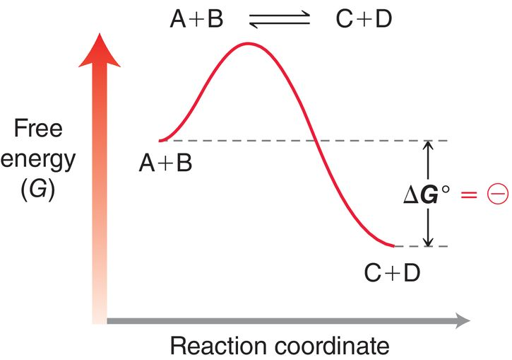
6.4 Equilibria
Consider an exergonic process with a (-) ΔG, which means the products are favored to form (spontaneous).
an equilibrium will eventually be reached
A spontaneous process means there will be more products than reactants
The greater the magnitude of a (-)ΔG, the greater the equilibrium concentration of products

Slide 19
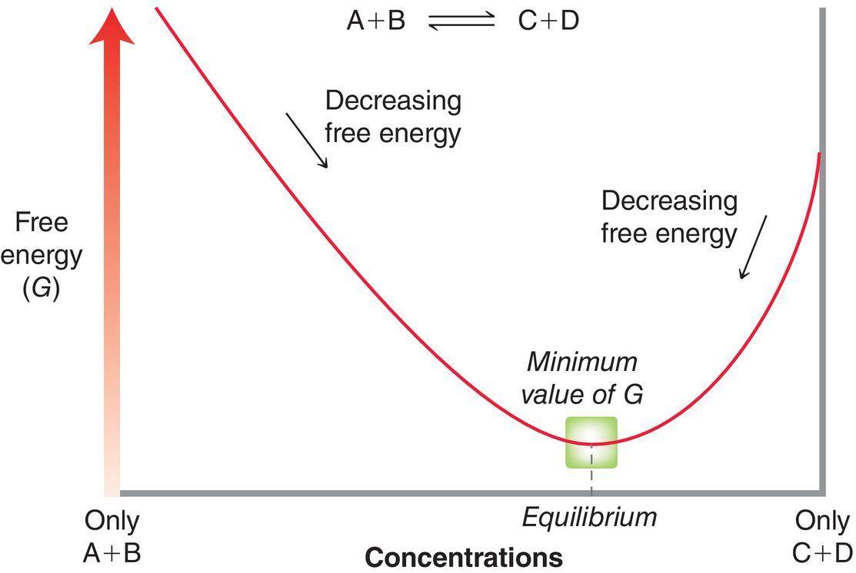
6.4 Equilibria
Why doesn’t an exergonic process react 100% to give products? Why will some reactants still remain at equilibrium?
As [A] and [B] decrease collisions between A and B will occur less often
As [C] and [D] increase, collisions between C and D will occur more often
Eventually the forward and reverse reaction rates will be equal

Slide 20
6.4 Equilibria
An equilibrium constant (K_{eq}) is used to show the degree to which a reaction is product or reactant favored
K_{eq}, ΔG, ΔH, and ΔS are thermodynamic terms. The only describe the relative stability of the products and reactants, but not the rate at which they are formed
Practice with checkpoint 6.6

Slide 21
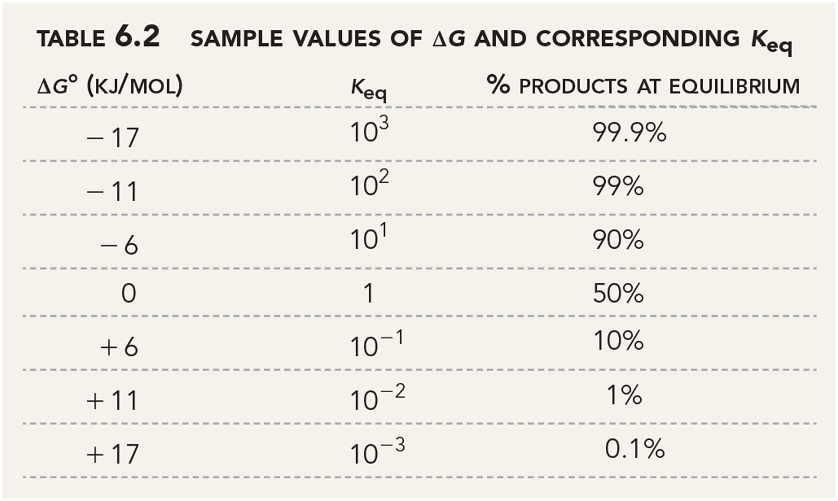
6.4 Equilibria
Notice that increasing (or decreasing) the value of DG by about 6 kJ/mol corresponds to a 10x change in the equilibrium constant

Slide 22
6.5 Kinetics
Recall that a (-) sign for ΔG tells us a process is product favored (spontaneous)
That does NOT tell us anything about the RATE or kinetics for the process.
In other words, ΔG says nothing about how fast a reaction will occur.
Some spontaneous processes are fast, such as explosions.
Some spontaneous processes are slow such as C (diamond) → C (graphite)… this takes millions of years, even though a spontaneous reaction

Slide 23
6.5 Kinetics
The reaction rate is a function of the number of molecular collisions that will occur in a given period of time, which is affected by the following factors:
The concentrations of the reactants
The Activation Energy
The Temperature
Geometry and Sterics
The presence of a catalyst

Slide 24
6.5 Rate Equations
Rate is determined using a Rate Law:
The rate depends on a rate constant, and the concentration of the reactant(s)
The degree to which a change in [reactant] will affect the rate is known as the order.

Slide 25
6.5 Kinetics
The order of a reaction is represented by x and y as follows
If [A] is doubled
rate is doubled
If [A] is doubled
rate is doubled
If [A] is doubled
rate is quadrupled

Slide 26
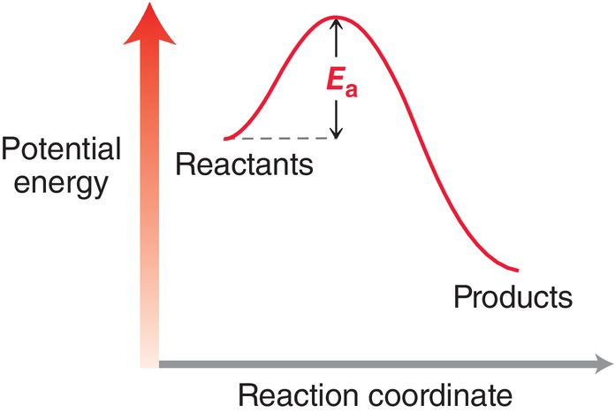
6.5 Factors Affecting the Rate Constant
Activation Energy (E_{a}) – The energy barrier between reactants and products
Free
energy
(G)
E_{a} is the minimum amt. of energy required for a molecular collision to result in a reaction

Slide 27
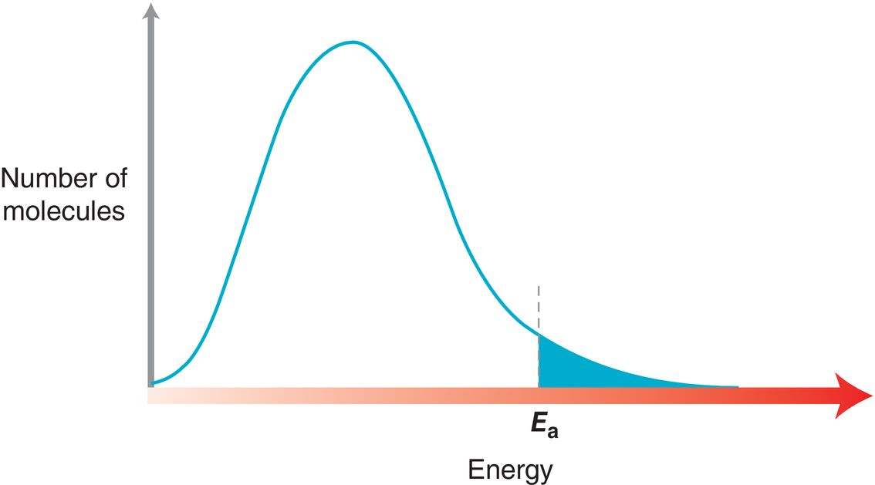
6.5 Factors Affecting the Rate Constant
Activation Energy (E_{a}) – The energy barrier between reactants and products
As Ea increases, the number of molecules possessing enough energy to react decreases…

Slide 28
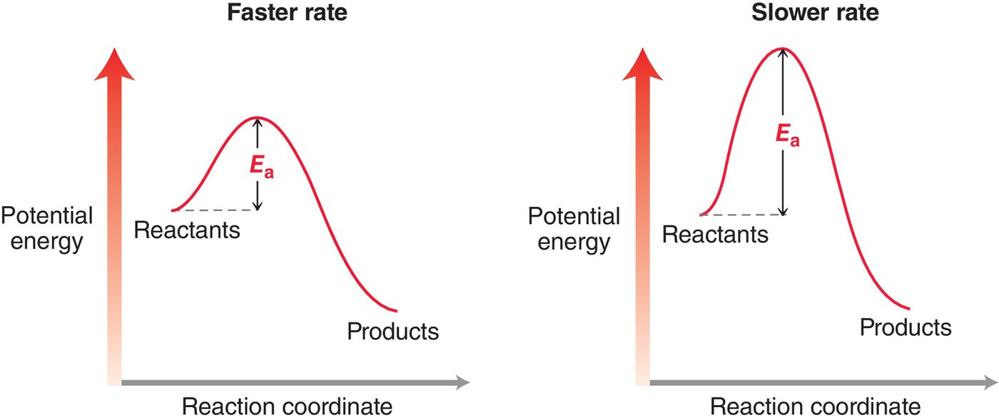
6.5 Factors Affecting the Rate Constant
Activation Energy (E_{a}) – The energy barrier between reactants and products
The lower the activation energy, the faster the rate

Slide 29
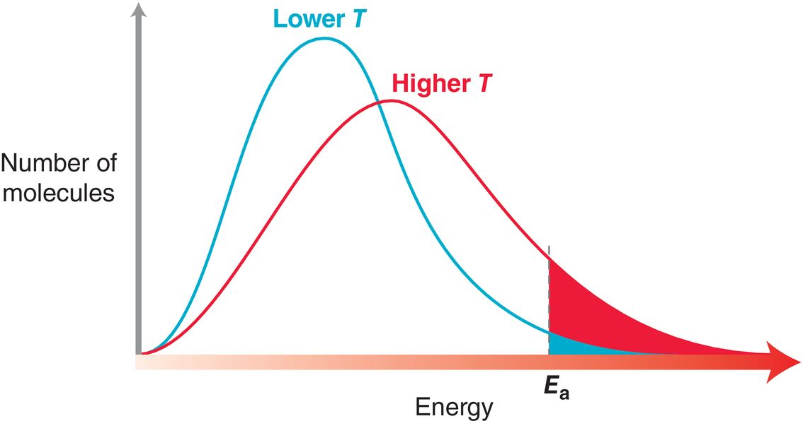
6.5 Factors Affecting the Rate Constant
Temperature (T) – Raising temperature will result in a faster rxn.
At higher T, molecules have more kinetic energy.
At higher T, more molecules will have enough energy to produce a reaction

Slide 30
6.5 Factors Affecting the Rate Constant
Steric Considerations – Steric hindrance, and the geometry of a compound, affects the rate of reaction
When molecules collide, they have to have the correct orientation for bonds to be made/broken.
If the reactive conformation of a compound is high energy, it will spend less time in that conformation, and so the probability of collision resulting in a reaction is low
This will be further explored in Chapter 7.

Slide 31
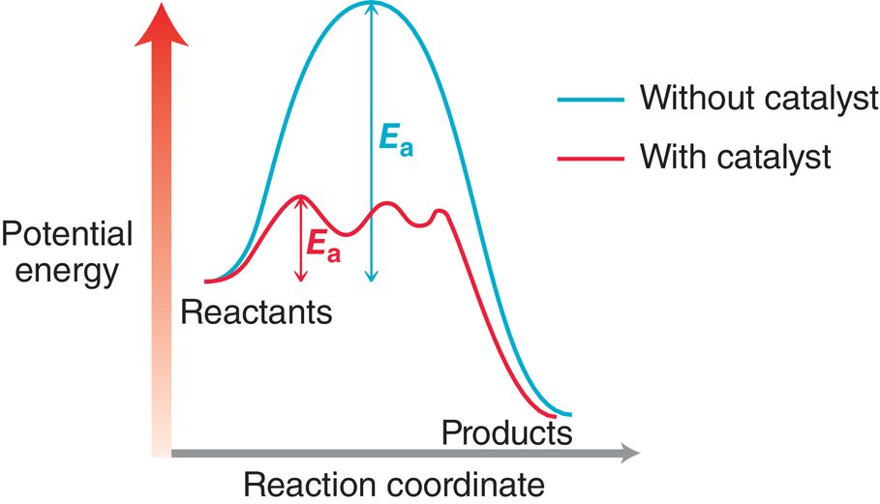
6.5 Catalysts and Enzymes
Catalyst – speeds up the rate of a reaction without being consumed
Enzymes are catalysts
Catalyst provides an alternate, and faster pathway of reaction
Catalysts lower the activation energy

Slide 32
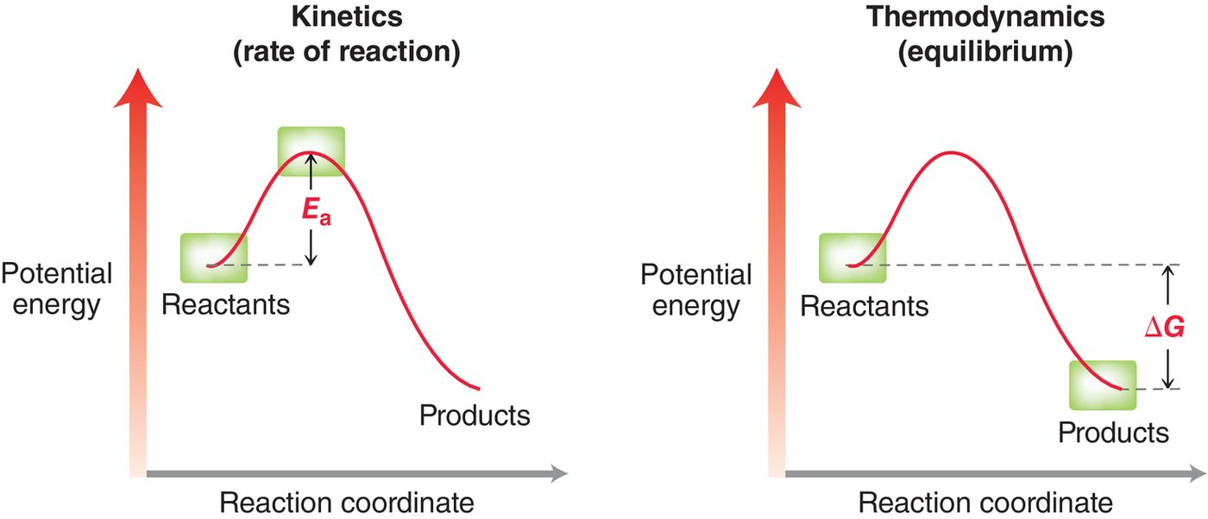
6.6 Reading Energy Diagrams
Recall that kinetics and thermodynamics are completely different concepts

Slide 33
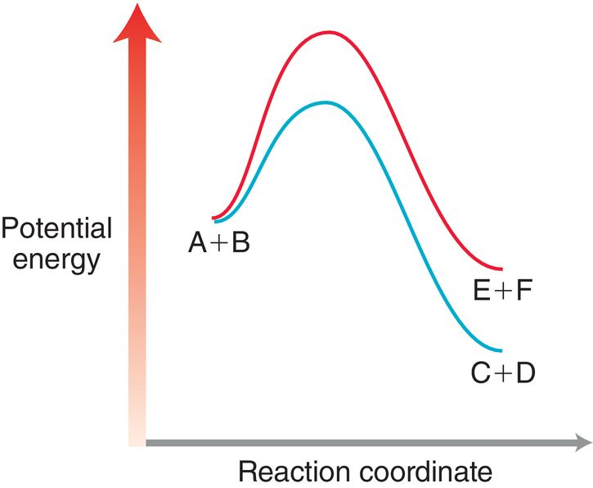
6.6 Kinetics vs. Thermodynamics
Consider the energy diagram below, which describes two possible reaction pathways of A+B:
The formation of C+D are kinetically and thermodynamically favored
The formation of products C+D has a lower E_{a}, and are lower in energy than E+F.
So products C+D form faster than E+F, and C+D are more stable than E+F

Slide 34
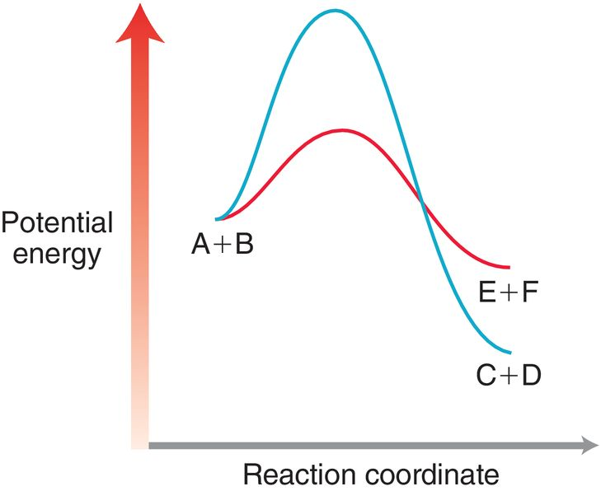
6.6 Kinetics vs. Thermodynamics
Now interpret the formation of E+F versus C+D according to the following energy diagram:
The formation of E+F is kinetically favored, but the formation of C+D is thermodynamically favored
The formation of products E+F has a lower E_{a}, and will form faster
The products C+D are lower in energy, thus more stable than E+F

Slide 35
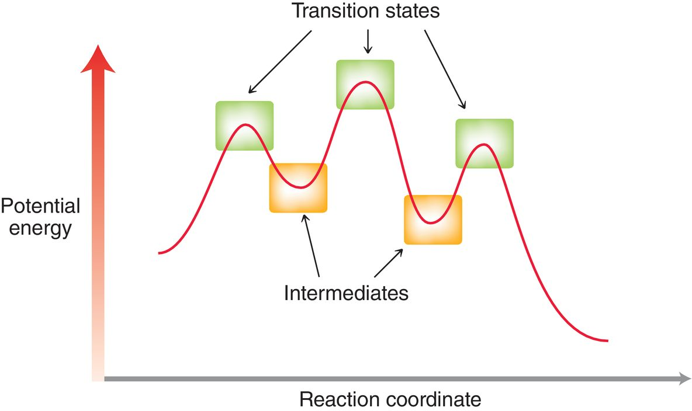
6.6 Transition States vs. Intermediates

Slide 36
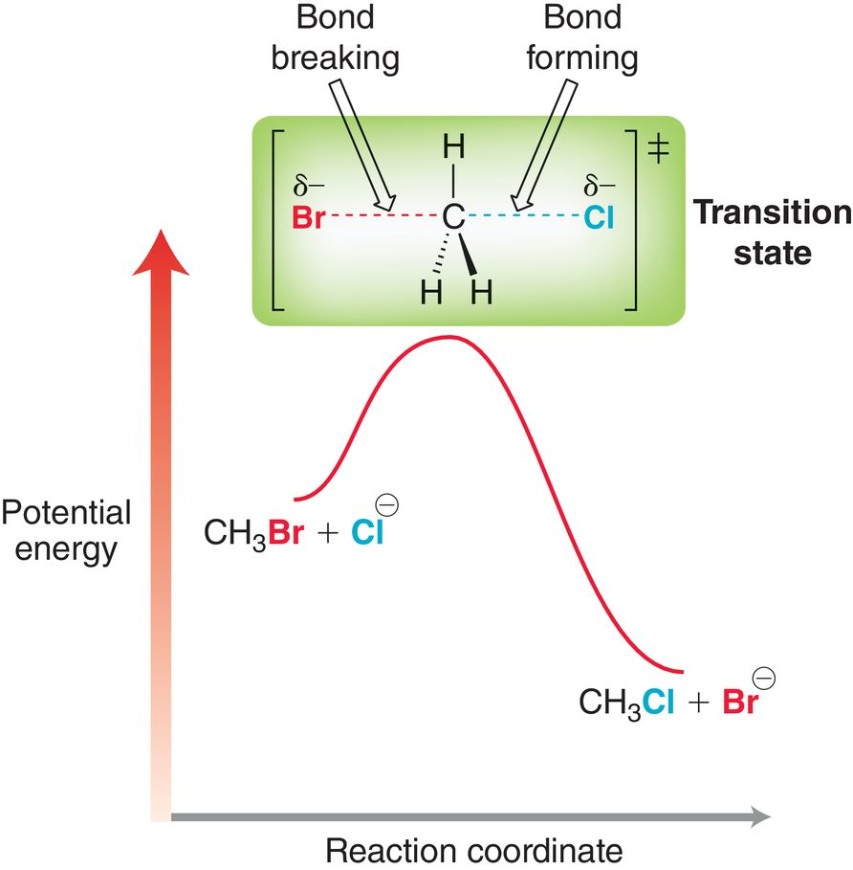
6.6 Transition States vs. Intermediates
A transition state is the high energy state a reaction passes through
Transition states are fleeting; they cannot be observed
On an energy diagram, transition states are energy maxima, and represent the transition as bonds are made and/or broken

Slide 37
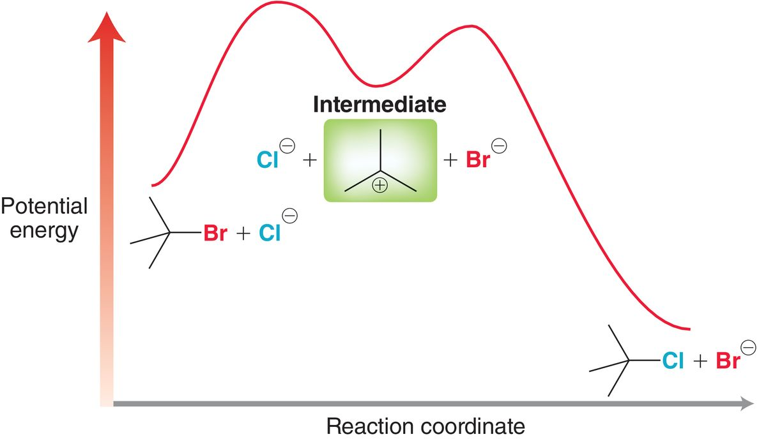
6.6 Transition States vs. Intermediates
An intermediate is an intermediate species formed during the course of a reaction. They are energy minima on the diagram.
Intermediates are observable. They are an actual chemical species that exists for a period of time before reacting further

Slide 38
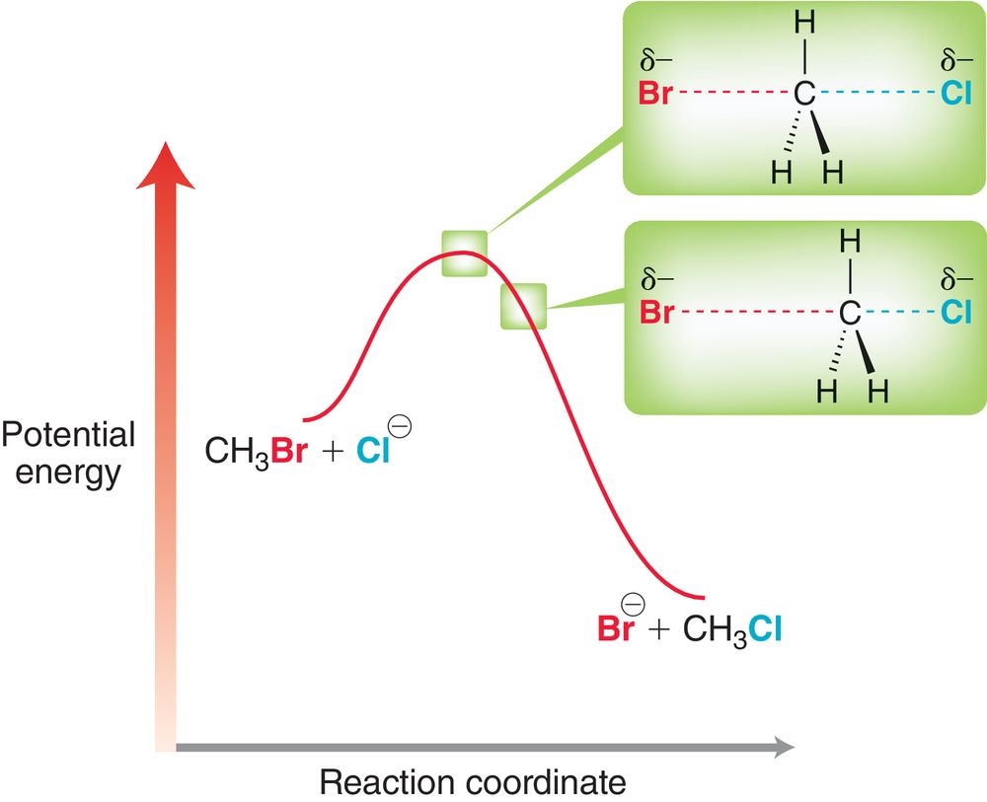
6.6 The Hammond Postulate
Two points on an energy diagram that are close in energy should be similar in structure
Based on this assumption, we can generalize the structure of a transition state, depending on whether the reaction is exothermic or endothermic

Slide 39
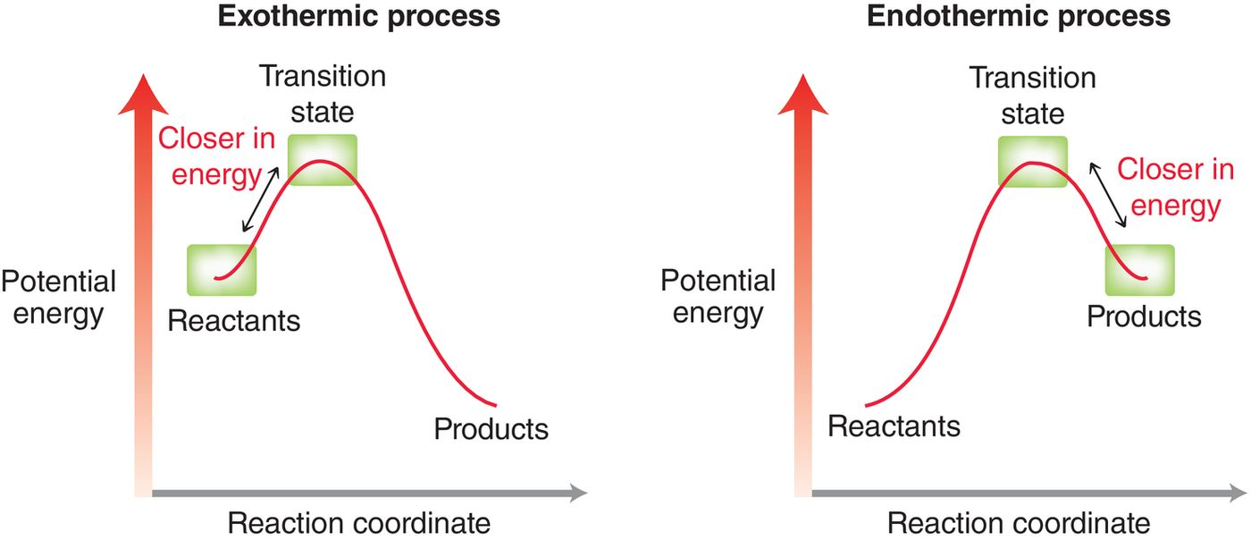
6.6 The Hammond Postulate
Exothermic rxn – transition states resembles reactant(s)
Endothermic rxn – transition state resembles product(s)
Practice with Conceptual Checkpoint 6.7

Slide 40
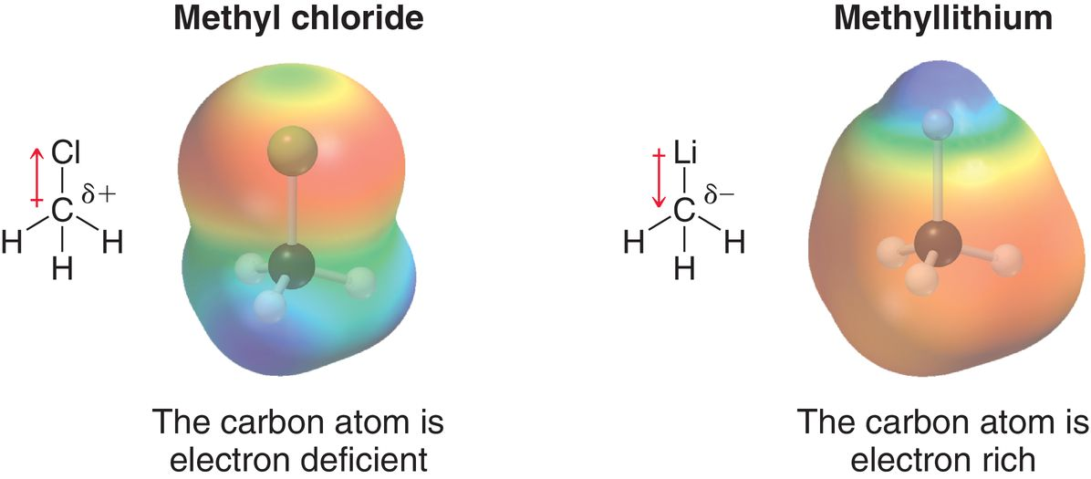
6.7 Nucleophiles & Electrophiles
Polar reactions – involve ions as reactants, intermediates, and/or products
Negative charges attracted to positive charges
Electron-rich species attracted to electron-deficient species
The carbon is
electrophilic
The carbon is
nucleophilic

Slide 41
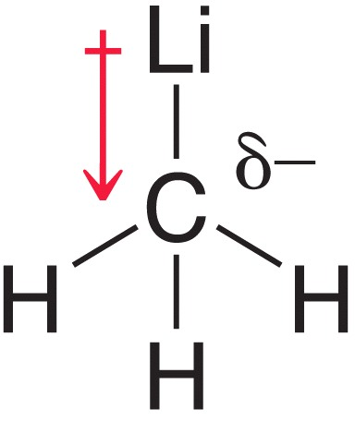
6.7 Nucleophiles
Nucleophile – electron rich species, can donate a pair of electrons
Nucleophiles are Lewis bases
More polarizable nucleophile = stronger nucleophile

Slide 42
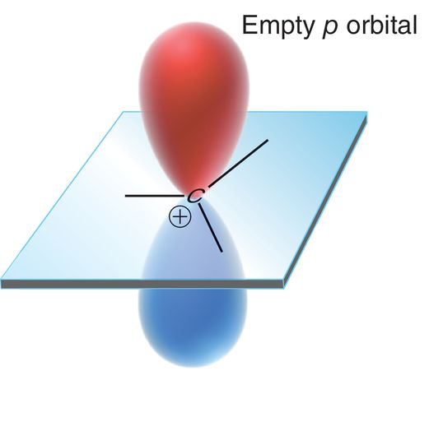
6.7 Electrophiles
Electrophile – electron deficient species, can accept a pair of electrons
Electrophiles are Lewis acids
Carbocations and partially-positive atoms are electrophilic
Practice with SkillBuilder 6.2

Slide 43
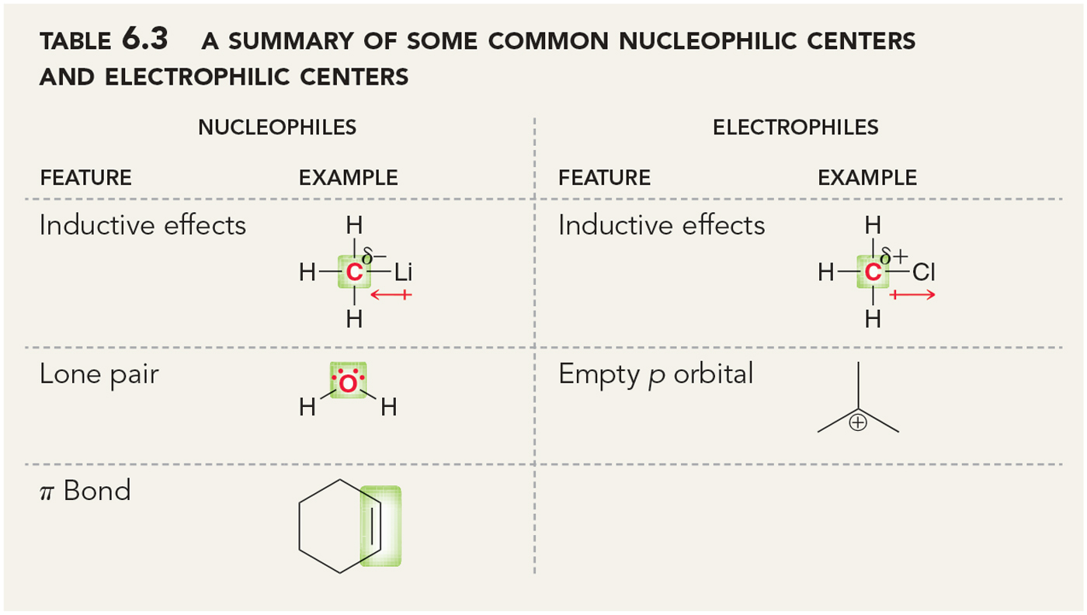
6.7 Nucleophiles & Electrophiles
Label all of the nucleophilic and electrophilic sites on the following molecule

Slide 44
6.8 Mechanisms and Arrow Pushing
Curved arrows are used to show how electrons move as bonds are breaking and/or forming
Recall their use in acid-base reactions
There are four main ways that electrons move in polar reactions
Nucleophilic Attack
Loss of a Leaving Group
Proton Transfers (Acid/Base)
Rearrangements

Slide 45
6.8 Nucleophilic Attack
Nucleophilic attack - nucleophile attacking an electrophile
The tail of the arrow starts on the electrons (- charge)
The head of the arrow ends on a nucleus (+ charge)
The electrons end up being sharing rather than transferred

Slide 46
6.8 Nucleophilic Attack
Nucleophilic attack may require more than one curved arrow
The alcohol (nucleophile) attacks a carbon with a δ+ charge.
The second arrow could be thought of as a resonance arrow.

Slide 47
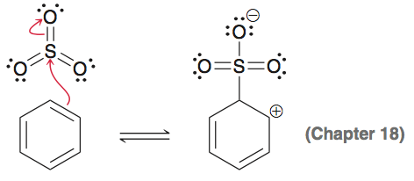
6.8 Nucleophilic Attack
Nucleophilic attack - Pi bonds can also act as a nucleophiles
Note that only one of the carbon atoms from the pi bond uses the pair of electrons (from the pi bond) to attack the electrophile

Slide 48
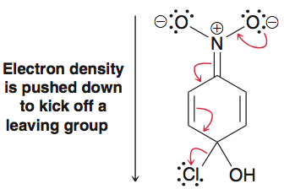
6.8 Loss of a Leaving Group
Loss of a leaving group – heterolytic bond cleavage, an atom or group takes the electron pair
It is common for more than one curved arrow be necessary to show the loss of a leaving group:

Slide 49
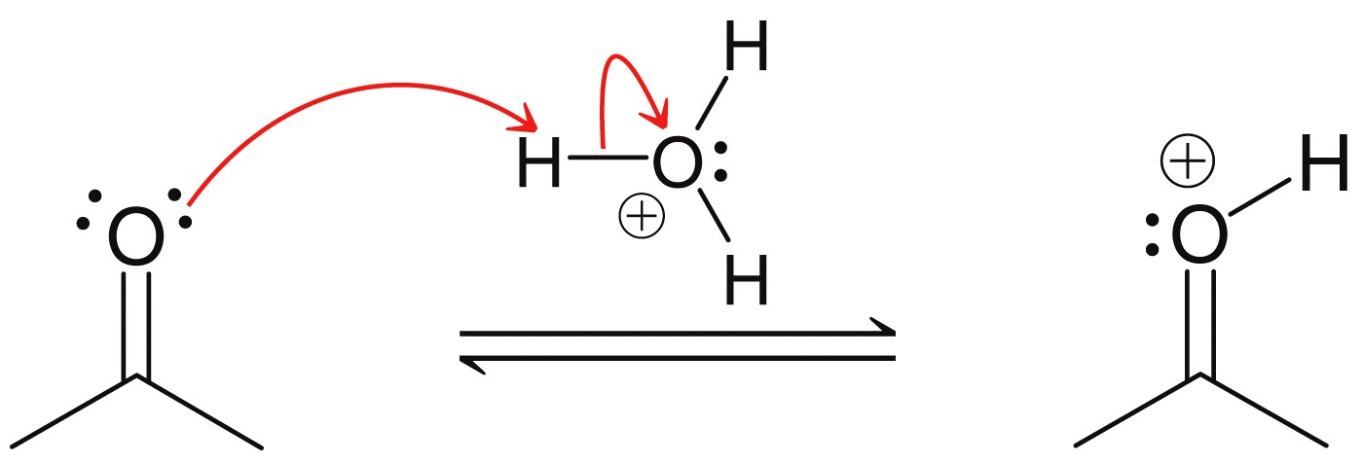
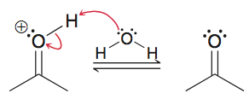
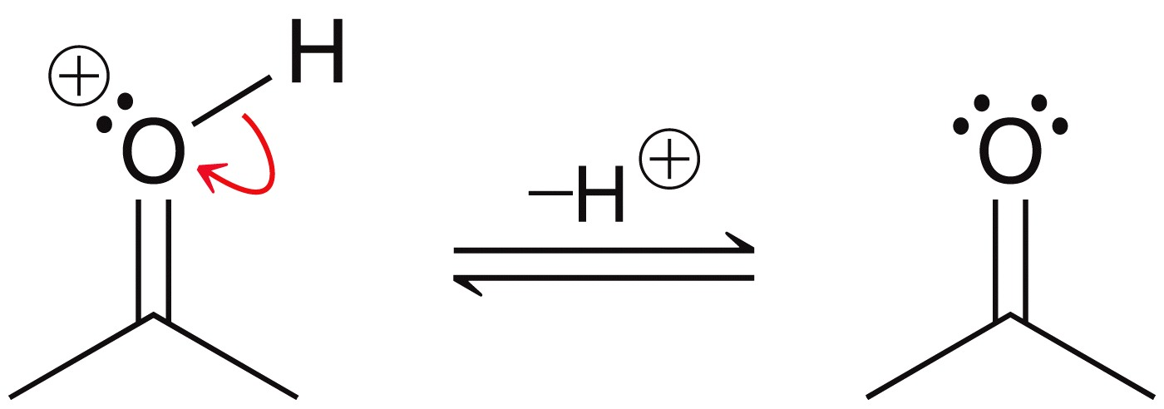
6.8 Proton Transfers
Proton transfer - Recall (from Chapter 3) that proton transfer requires two curved arrows
The deprotonation of a compound is sometimes shown with just a single arrow and “-H+” above the rxn arrow.
or

Slide 50
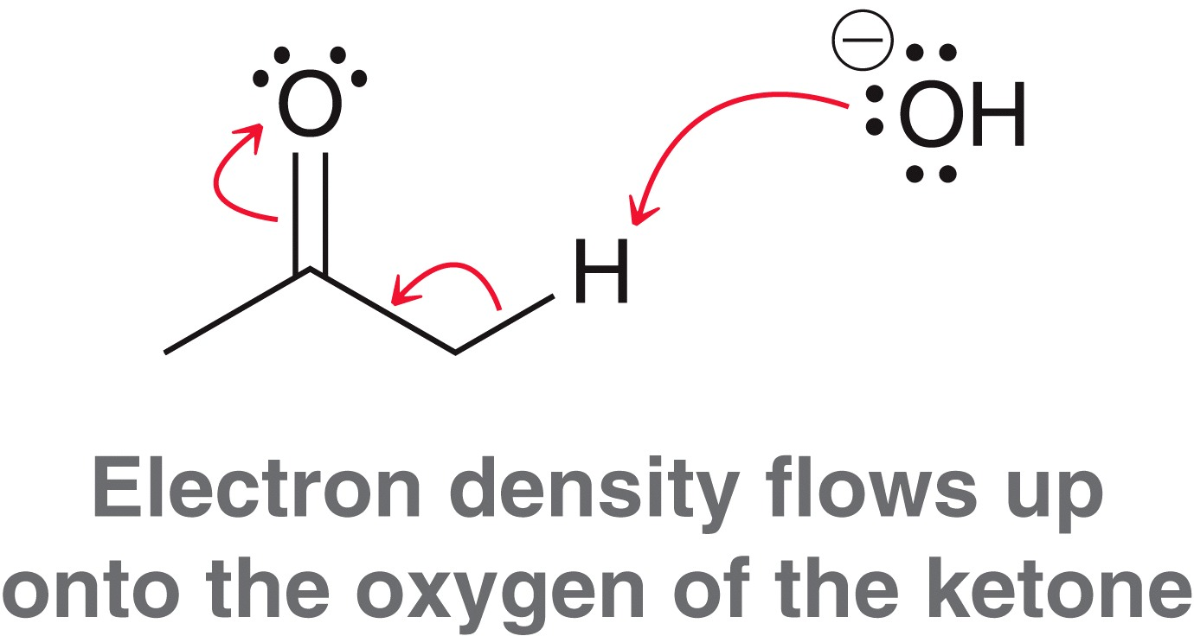
6.8 Proton Transfers
Multiple arrows may be necessary to show the complete electron flow when a proton is exchanged
Such electron flow can also be thought of as a proton transfer combined with resonance

Slide 51
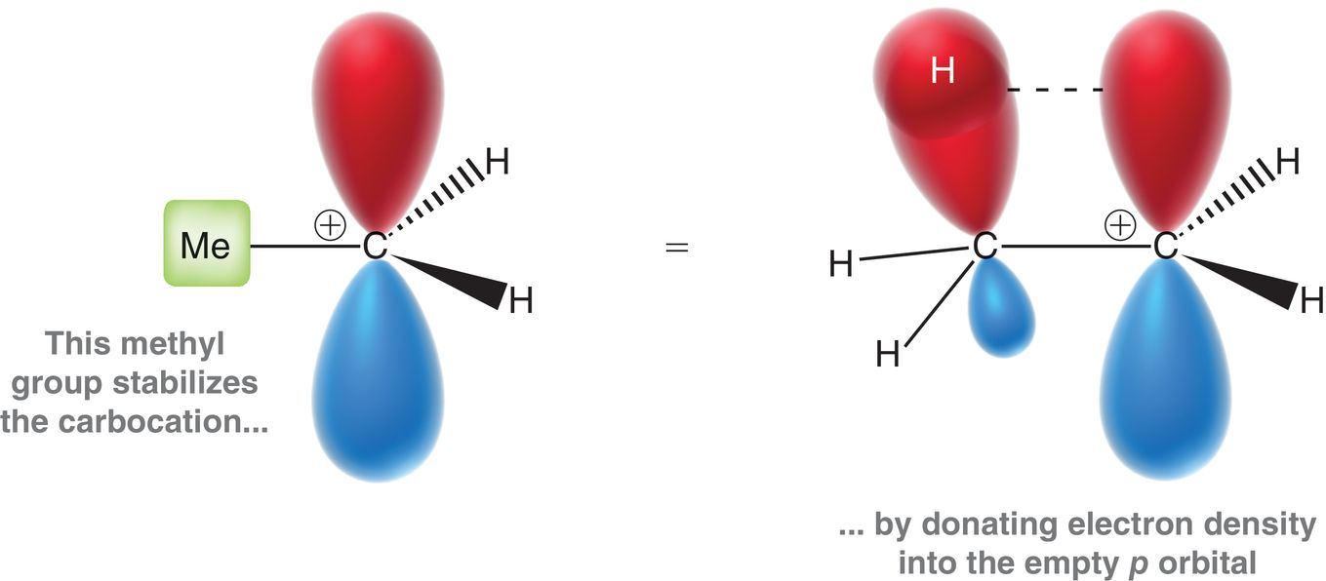
6.8 Rearrangements
Rearrangements - Carbocations can be stabilized by neighboring groups through slight orbital overlapping called hyperconjugation

Slide 52
6.8 Rearrangements
Hyperconjugation explains the carbocation stability trend below
Increasing the substitution increases the stability of a carbocation, due to the increasing number of adjacent sigma bonds aligned with the empty p-orbital.

Slide 53
6.8 Rearrangements
Rearrangements - Two types of carbocation rearrangement are common
1,2-hydride shift
1,2-methide shift
Shifts can only occur from an adjacent carbon.
Shifts only occur if a more stable carbocation results

Slide 54
6.9 Combining Patterns of Arrow Pushing
Multistep reaction mechanisms are simply a combination of one or more of the 4 patterns covered thus far:
Often two of the patterns occur in a single mechanistic step:
Nucleophilic attack and the loss
of a leaving group simultaneously

Slide 55
6.10 Drawing Curved Arrows
The curved arrow starts on a pair of electrons (a shared pair in a bond, or a lone pair)
The second arrow shown below is drawn incorrectly

Slide 56
6.10 Drawing Curved Arrows
The head of a curved arrow shows either the formation of a bond, or the formation of a lone pair
The head of a curved arrow can never show carbon forming more than 4 bonds

Slide 57
6.10 Drawing Curved Arrows
Any curved arrow drawn should describe one of the 4 patterns discussed thus far.
The arrow below is unreasonable. It violates the octet, and doesn’t match one of the 4 patterns
Practice with SkillBuilder 6.5

Slide 58
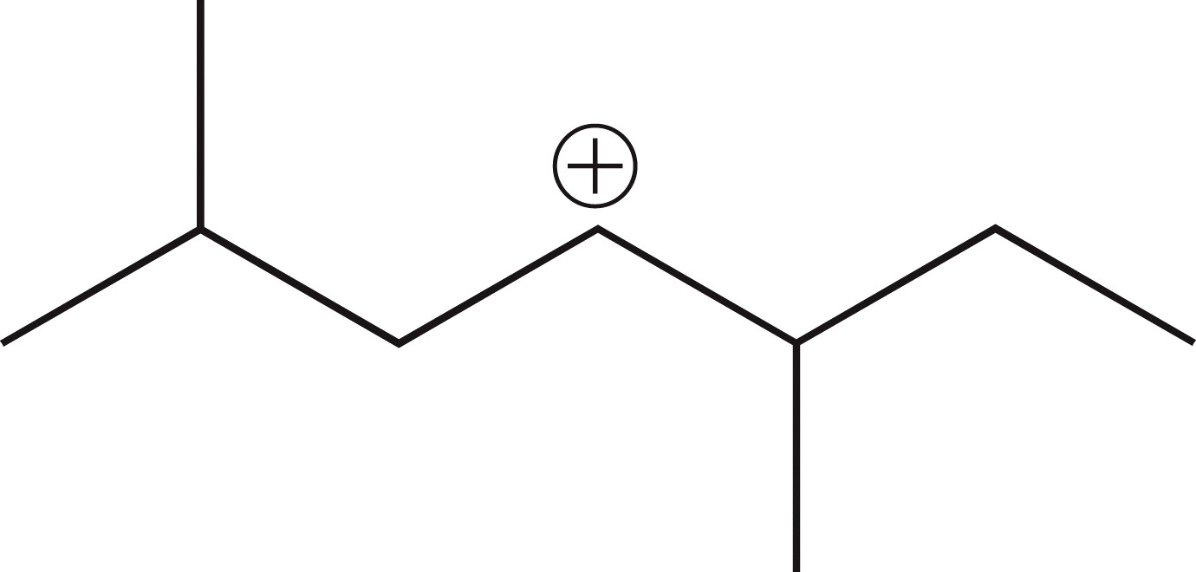
6.11 Carbocation Rearrangements
When you encounter a carbocation, you must consider if rearrangement (Hydride and methyl shift) could result in a more stable carbocation
This is a secondary carbocation. Could it rearrange to a more stable tertiary carbocation?

Slide 59
6.11 Carbocation Rearrangements
When you encounter a carbocation, you must consider if rearrangement will occur
Identify H atoms and/or methyl groups on neighboring carbon atoms
Determine if the shifting of one of these groups give a more stable carbocation
more stable, tertiary
carbocation can form

Slide 60
6.11 Carbocation Rearrangements
Tertiary carbocations typically will not rearrange unless a resonance stabilized cation is formed.
Here, an allylic carbocation if formed
Practice with SkillBuilder 6.6

Slide 61
6.12 Reversible and Irreversible Reaction Arrows
Some reactions are drawn as equilibria, and others are drawn as irreversible.
The question of reversibility is both a kinetic and a thermodynamic question.

Slide 62
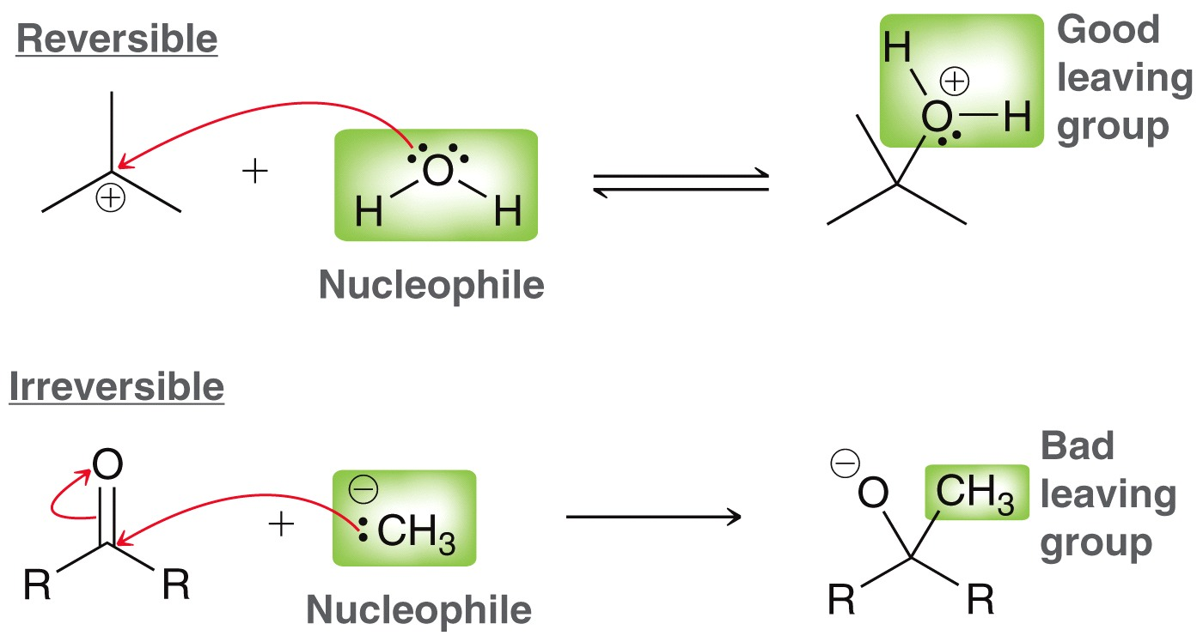
6.12 Reversible and Irreversible Reaction Arrows
If the attacking nucleophile is also a good leaving group, it will be a reversible attack
The reverse process occurs at an appreciable rate

Slide 63
6.12 Reversible and Irreversible Reaction Arrows
If the attacking nucleophile is a poor leaving group, it will essentially be an irreversible attack
The reverse reaction does not occur

Slide 64
6.12 Reversible and Irreversible Reaction Arrows
The loss of a leaving group is virtually always reversible
Most of the leaving groups encountered can act as nucleophiles

Slide 65
6.12 Reversible and Irreversible Reaction Arrows
All proton transfers are reversible.
But, if the pKa difference is 10 units or more, it can be considered irreversible

Slide 66
6.12 Reversible and Irreversible Reaction Arrows
Carbocation rearrangements are generally irreversible
Thermodynamically, there is no driving force for a more stable carbocation to rearrange to a less stable one.

Slide 67
6.12 Reversible and Irreversible Reaction Arrows
When considering thermodynamic equilibrium, in addition to comparing relative energies, Le Châtelier’s principle must also be considered.
One of the products (N₂) is a gas, and will escape the reaction mixture. It becomes impossible for the reaction to be reversible

