Slide 1
Organic Chemistry
Third Edition
David Klein
Chapter 7
Alkyl Halides: Nucleophilic Substitution and Elimination Reactions

Slide 2
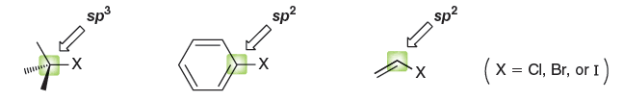
7.1 Introduction to Alkyl Halides
Alkyl halides undergo substitution and elimination rxns
  What is the hybridization of each highlighted carbon in the structures shown above?
  Which structure represents an alkyl halide?

Slide 3
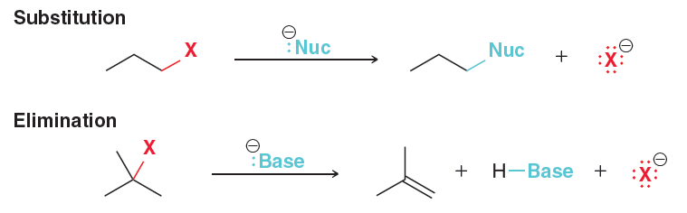
7.1 Substitution and Elimination Rxns
Alkyl Halides can undergo a substitution reaction when reacted with a nucleophile.
Alkyl Halides can undergo an elimination reaction when reacted with a base.
- what do “nucleophiles” and “bases” have in common?

Slide 4
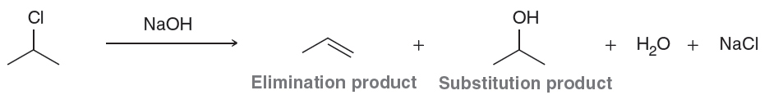
7.1 Substitution and Elimination Rxns
When the reagent can act as a nucleophile or a base, elimination and substitution will be competing reaction pathways
In the example above, which compound is the substrate?

Slide 5
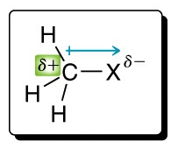
7.1 Substitution and Elimination Rxns
Two main reasons why alkyl halides undergo substitution and elimination reactions:
  The halogen is electron-withdrawing, creating a partial positive charge on the alpha carbon, making it susceptible to nucleophilic attack.
  The halogen acts as a leaving group, and for a substrate to undergo a substitution/elimination reaction, it must possess a good leaving group.

Slide 6
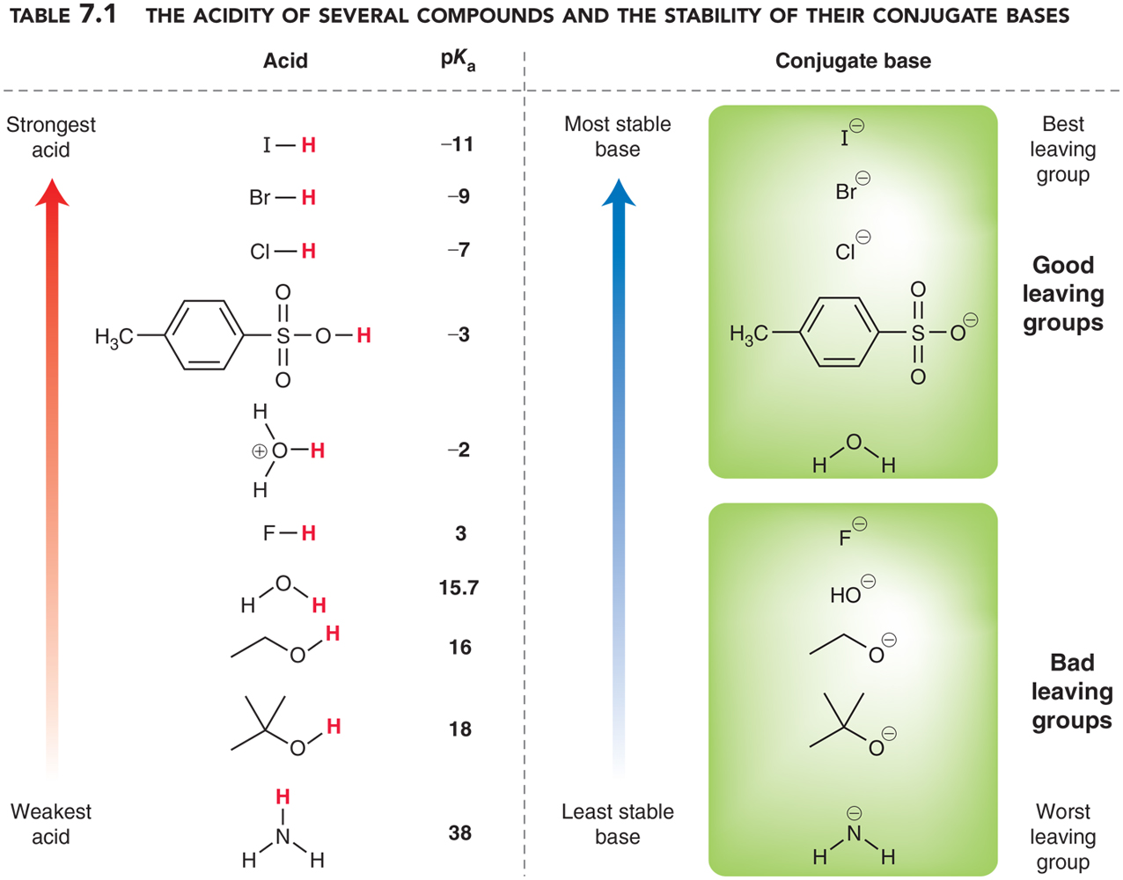
7.1 Leaving Groups
Good leaving groups are the conjugate bases of strong acids.

Slide 7
7.2 Alkyl Halides
Alkyl halides are compounds where a carbon group (alkyl) is bonded to a halide (F, Cl, Br, or I)
Recall from section 4.2 the steps we use to name a molecule
  Identify and name the parent chain
  Identify the name of the substituents
  Assign a locant (number) to each substituents
  Assemble the name alphabetically
The halide group is the key substituent we will name and locate

Slide 8
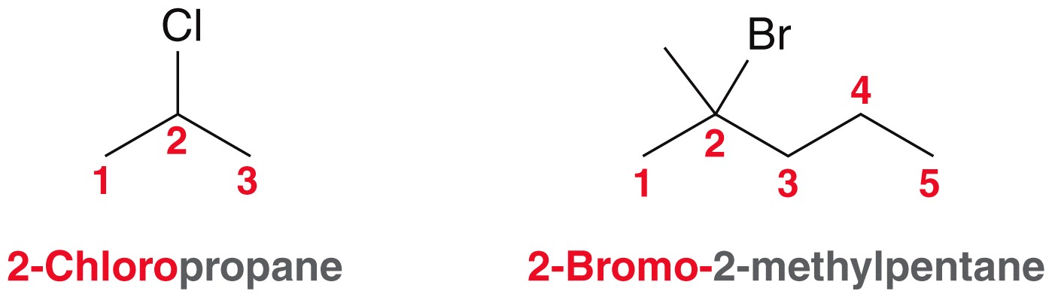
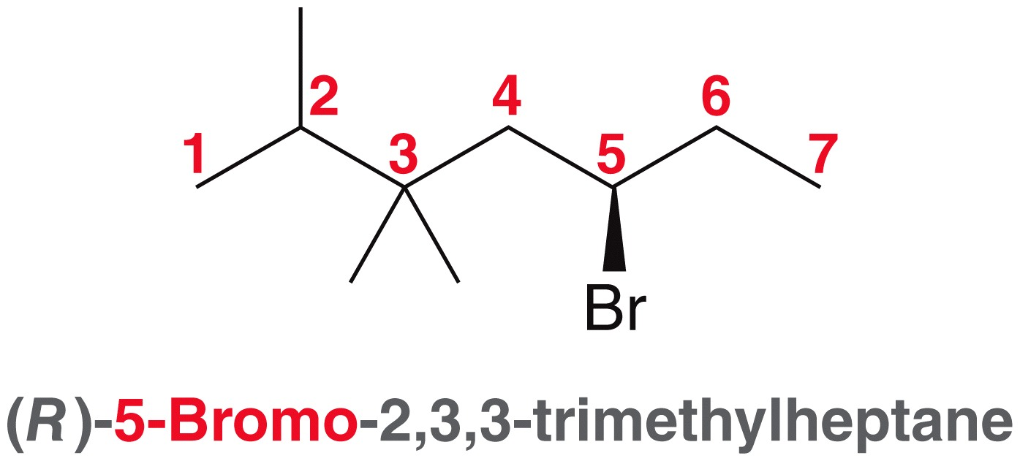
7.2 Alkyl Halide Nomenclature
For each of these examples, convince yourself that they are numbered in the most appropriate way.

Slide 9
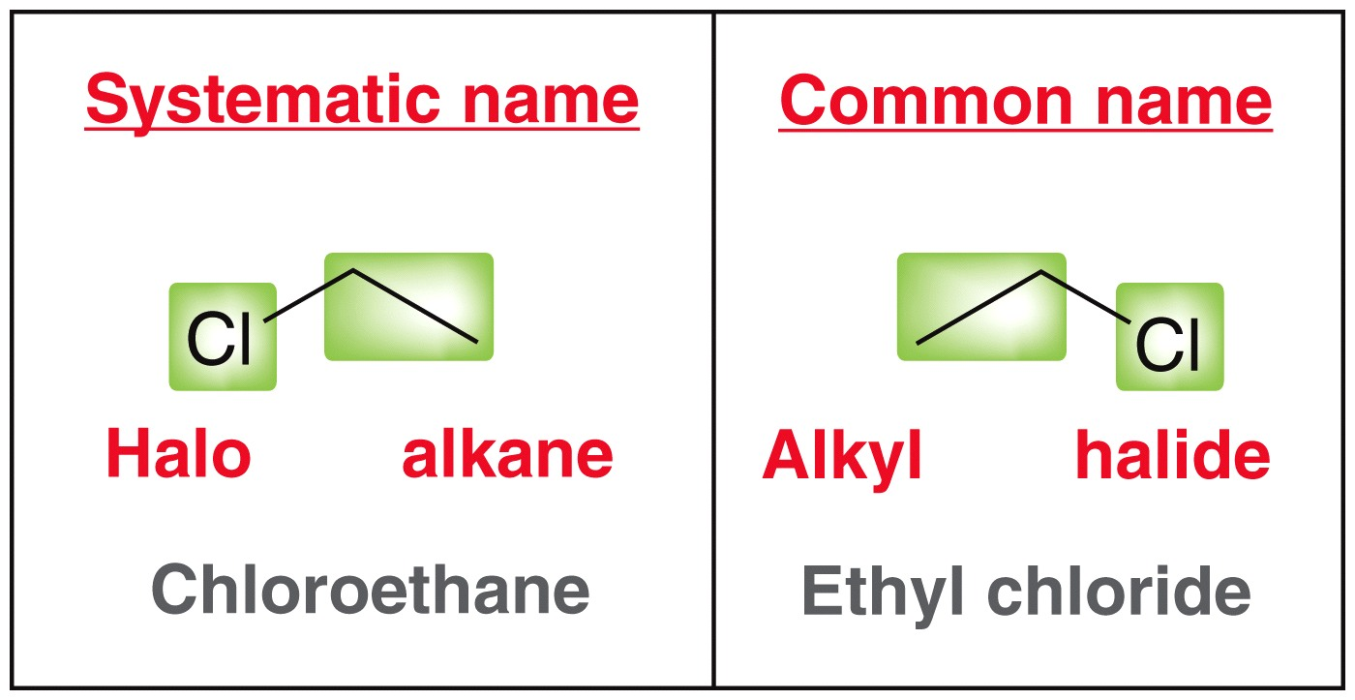
7.2 Alkyl Halide Nomenclature
Some simple molecules are also recognized by their common names.
  the alkyl group is named
  as the substituent, and
  the halide is treated as
  the parent name
  Methylene chloride is a commonly used organic solvent

Slide 10
7.2 Alkyl Halide Nomenclature
Give reasonable names for the following molecules
Try more examples with conceptual checkpoint 7.1

Slide 11
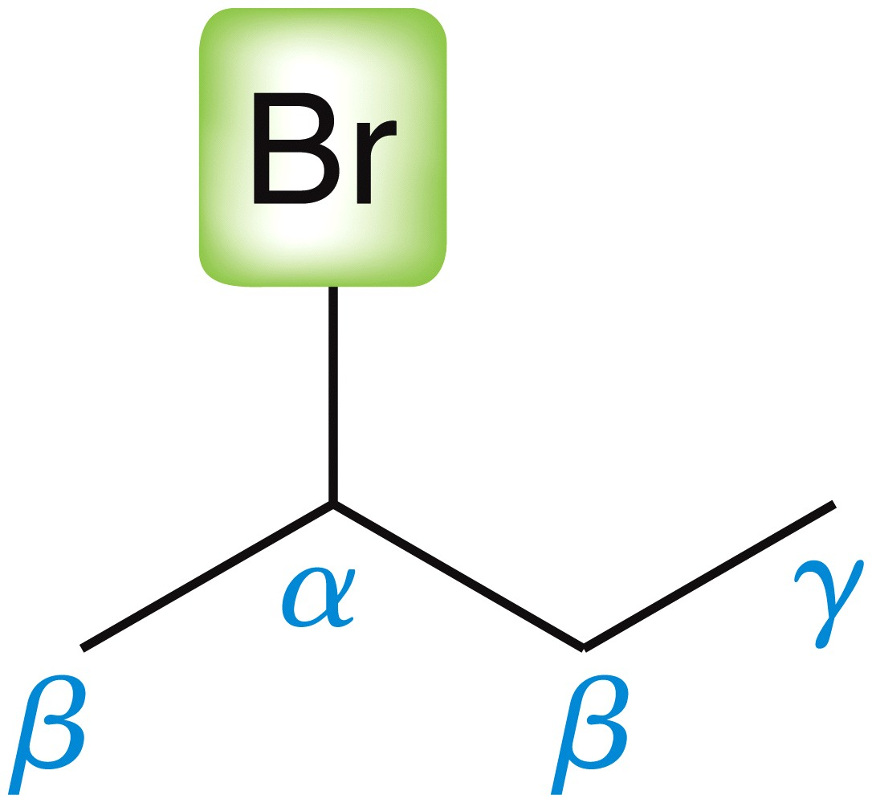
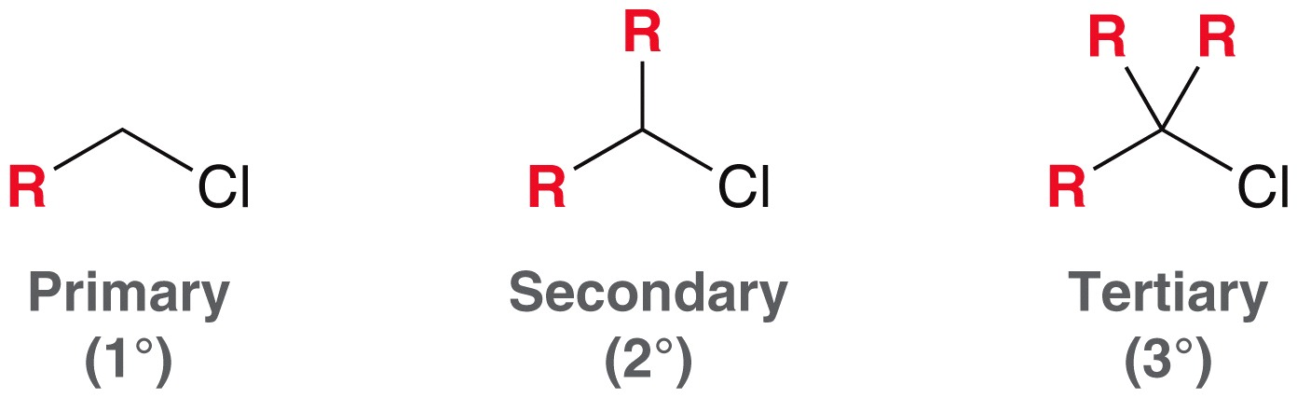
7.2 Alkyl Halide Structure
Greek letters are often used to label the carbons of the alkyl group attached to the halide
  Substitutions occur at the alpha carbon
  WHY?
The amount of branching at the alpha carbon affects the reaction mechanism. There are three types of alkyl halides

Slide 12
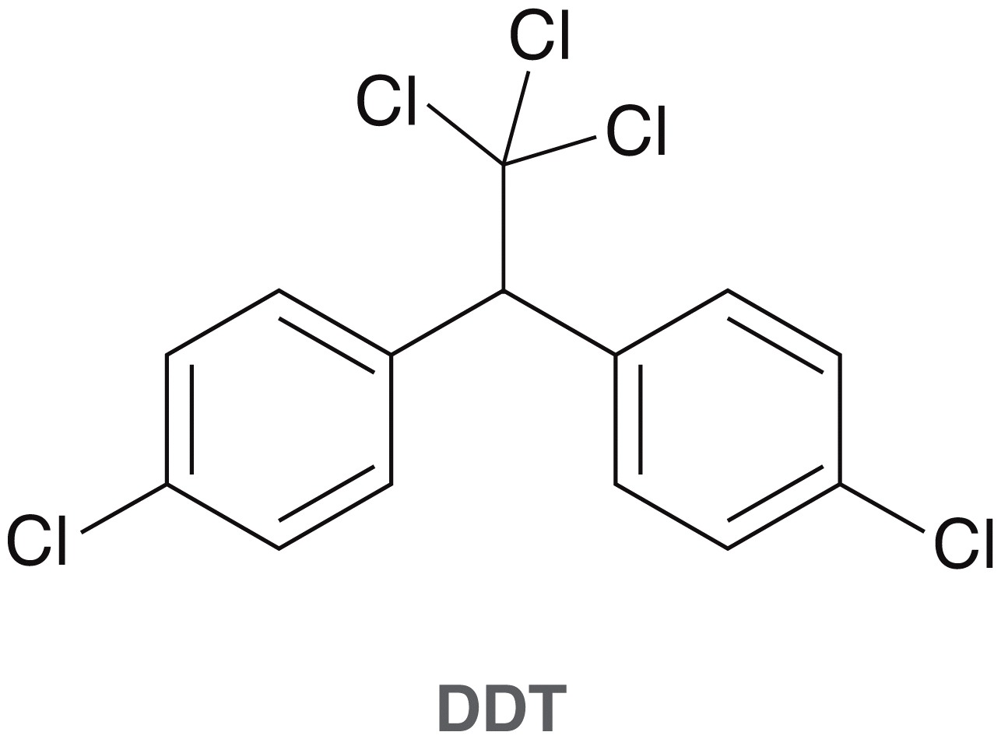
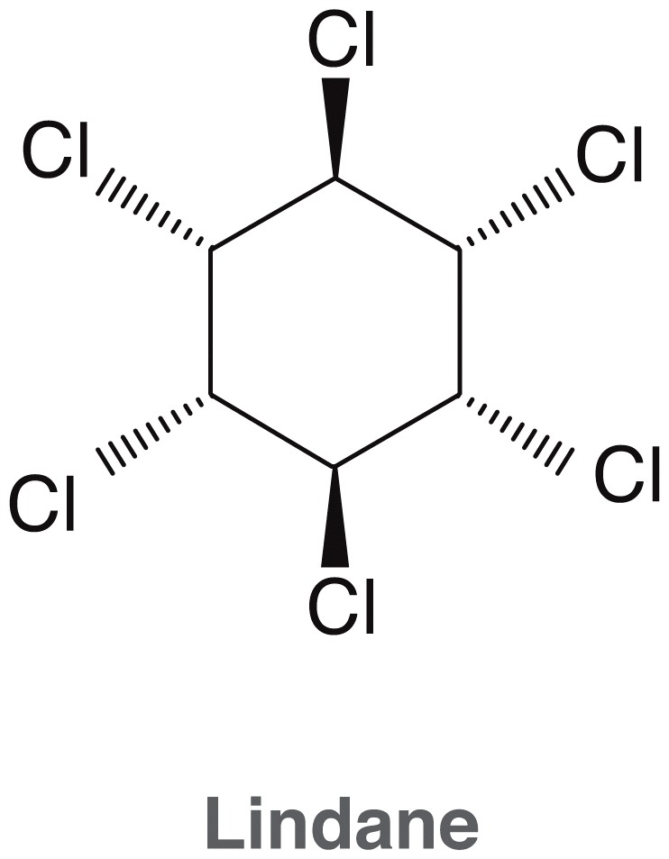
7.2 Alkyl Halide Structure
Some alkyl halides are used as insecticides. For the insecticides below…
  Label each halide as either primary, secondary, or tertiary
  For the circled atoms, label all of the alpha, beta, gamma, and delta carbons.

Slide 13
7.2 Uses of Organohalides
Halides appear in a wide variety of natural products and synthetic compounds
The structure of the molecule determines its function, and functions include…
  Insecticides (DDT, etc.)
  Dyes (tyrian purple, etc.)
  Drugs (anticancer, antidepressants, antimicrobial, etc.)
  Food additives (Splenda, etc.)
  Many more

Slide 14
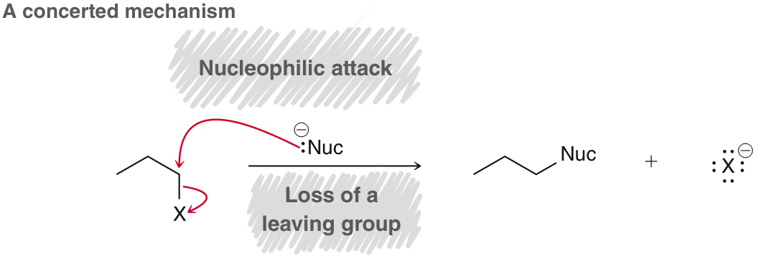
7.3 S_{N}2 Reactions
A substitution reaction requires the loss of a leaving group, and nucleophilic attack. There are two possible mechanisms: (1) concerted, and (2) stepwise.
The concerted mechanism involves breaking of the bond to the leaving group and making of the bond to the nucleophile at the same time

Slide 15
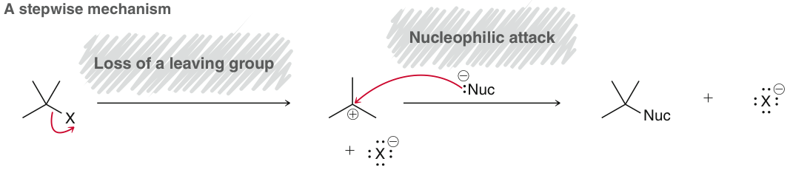
7.3 S_{N}2 Reactions
The stepwise mechanism the leaving groups leaves first, to give a carbocation intermediate, followed by nucleophilic attack
(The stepwise mechanism is covered in section 7.10)

Slide 16
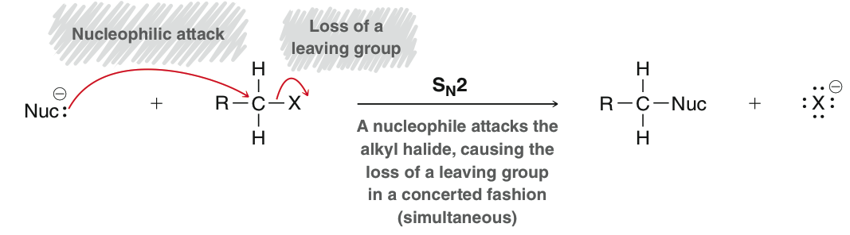
7.3 S_{N}2 – concerted substitution
What do S, _{N}, and 2 stand for in the S_{N}2 name
How might you write a rate law for this reaction?
How would you design a laboratory experiment to confirm this rate law? (Test yourself with conceptual checkpoint 7.2)

Slide 17
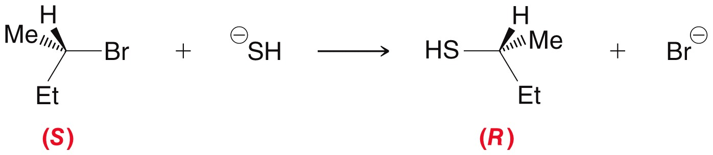
7.3 S_{N}2 – stereochemistry
How does the observed stereochemistry in the following reaction support an S_{N}2 mechanism?
Practice drawing the products of S_{N}2 reactions with SkillBuilder 7.1

Slide 18
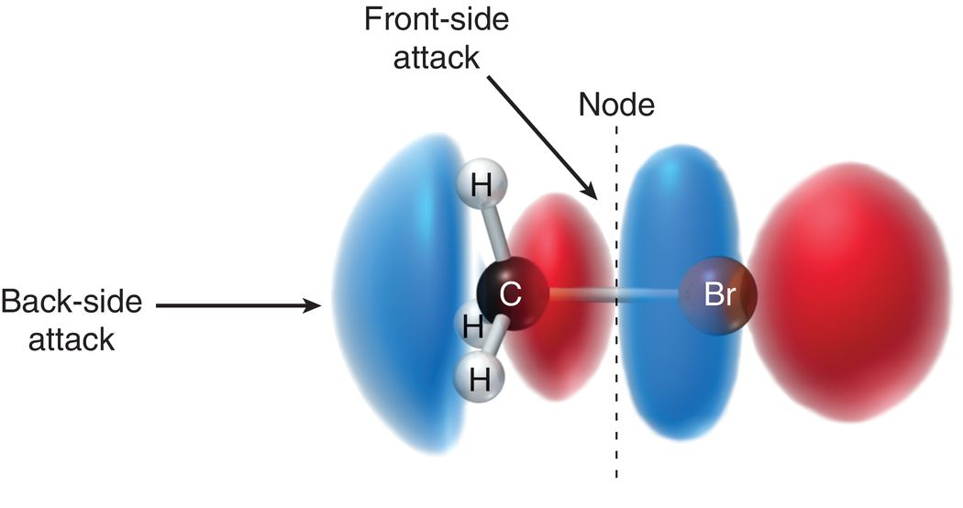
7.3 S_{N}2 – backside attack
The nucleophile attacks from the back-side
  Electron density repels the attacking nucleophile from the front-side
  The nucleophile must approach the back-side to allow electrons to flow from the HOMO of the nucleophile to the LUMO of the electrophile.
  Proper orbital overlap cannot occur with front-side attack
  because there is a node on the front-side of the LUMO

Slide 19
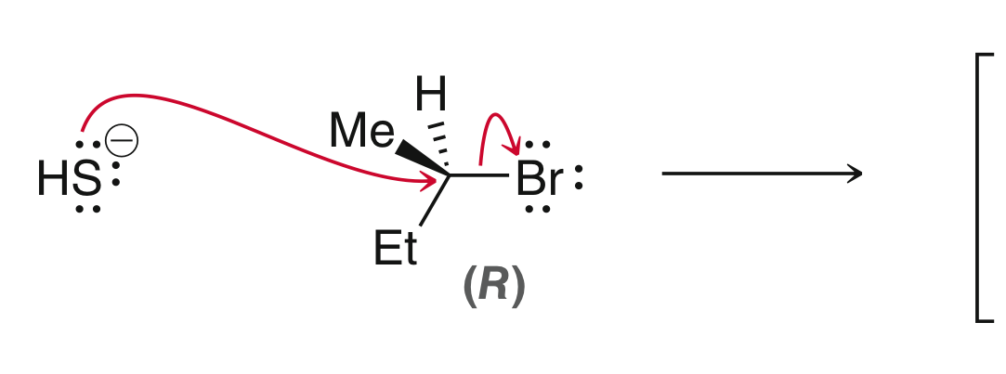
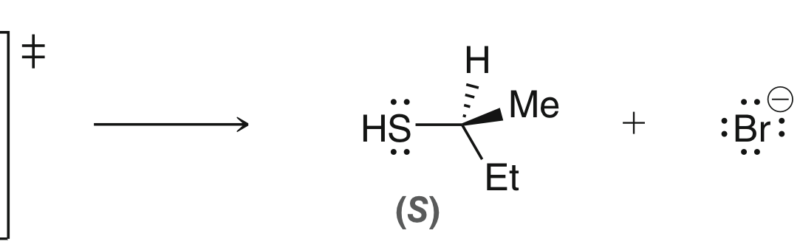
7.3 S_{N}2 – backside attack
Draw the transition state for the following reaction, which explains why S_{N}2 reactions proceed with inversion of configuration
Practice drawing transition states with SkillBuilder 7.2
Transition state symbol

Slide 20
7.3 S_{N}2- Kinetics
Less sterically hindered electrophiles react more readily under S_{N}2 conditions. Tertiary halides are too hindered to react via S_{N}2 mechanism.
To rationalize this trend, examine the
reaction coordinate diagram.

Slide 21
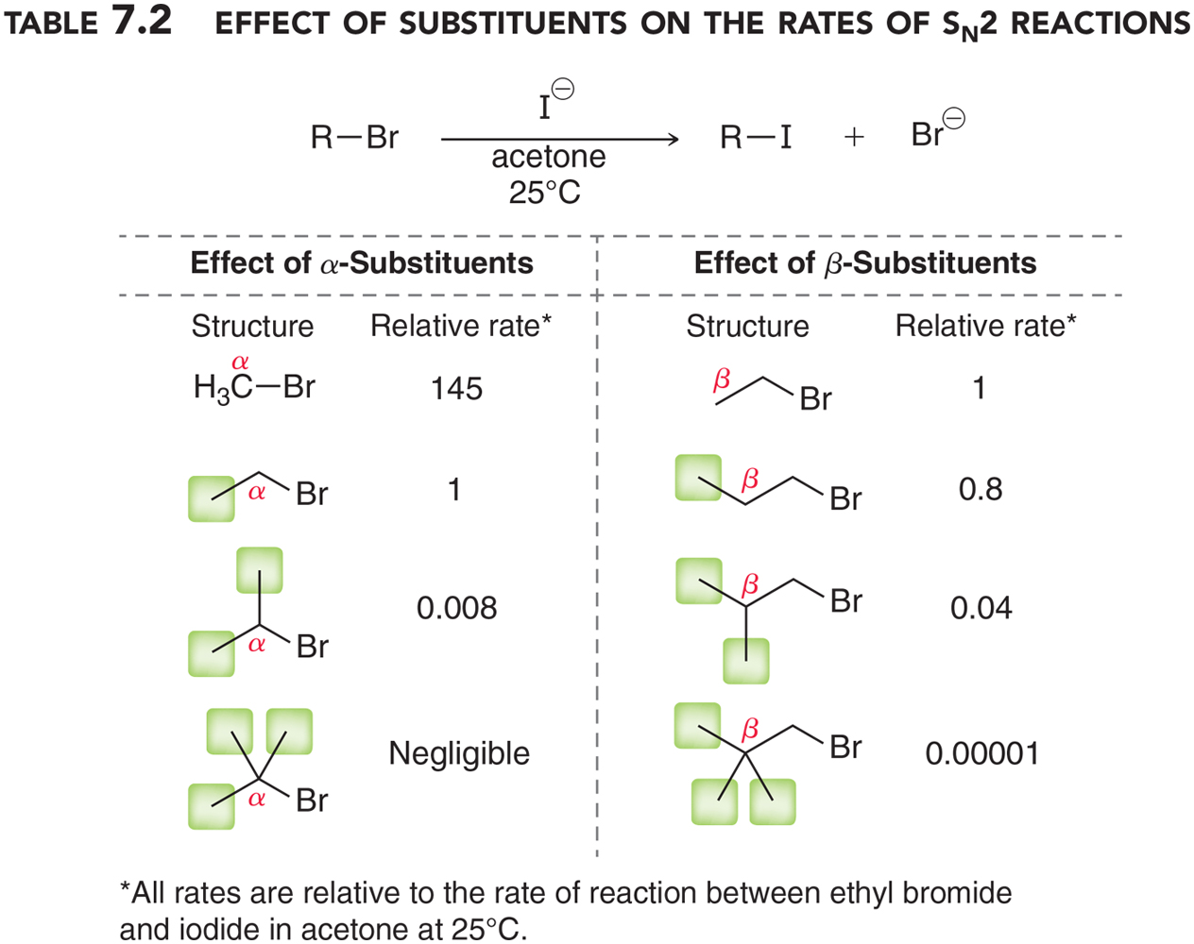
7.3 S_{N}2 - Kinetics
Alkyl groups branching from the α and β carbons hinder the backside attack of the nucleophile, resulting in a slower rate of reaction.
To rationalize this trend, we must examine the energy diagram

Slide 22
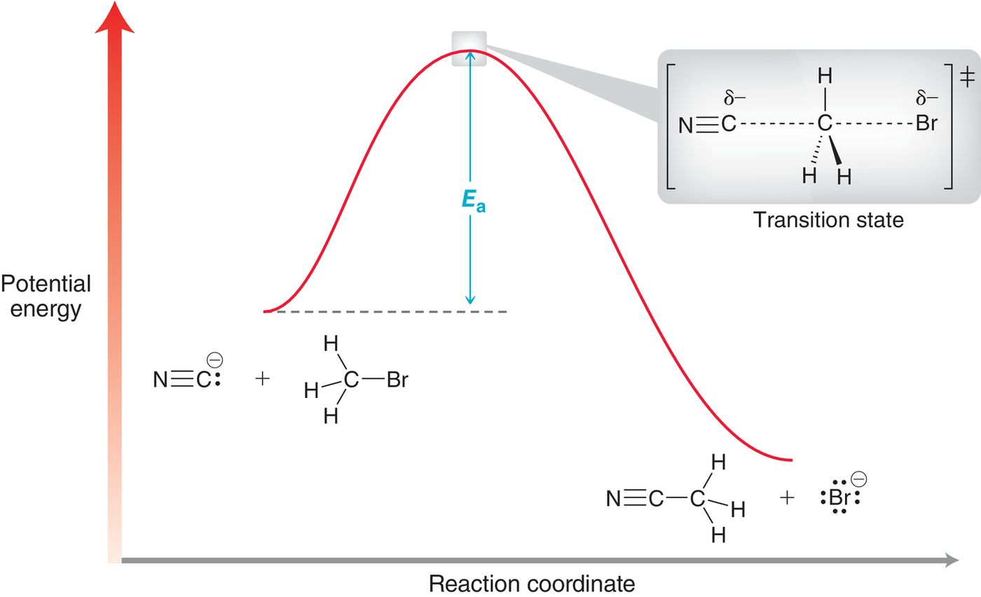
7.3 S_{N}2 – Rationalizing kinetic data
What feature of the diagram is relevant to rationalize the rate of reaction?
What feature is relevant to rationalize the thermodynamics of the reaction?

Slide 23
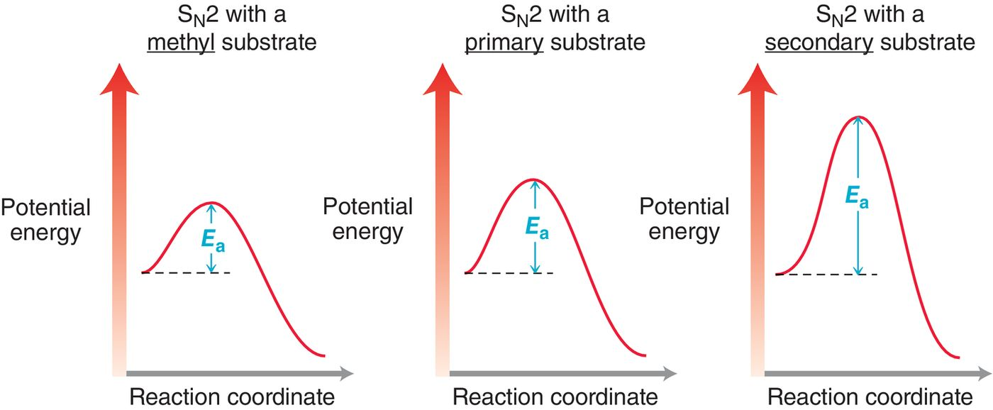
7.3 S_{N}2 – Rationalizing kinetic data
Which reaction will have the fastest rate of reaction?
WHY?
3° substrates react too slowly to measure.

Slide 24
7.3 S_{N}2 – Rationalizing kinetic data
An example to consider: neopentyl bromide
Draw the structure of neopentyl bromide
Is neopentyl bromide a primary, secondary, or tertiary alkyl bromide?
Should neopentyl bromide react by an S_{N}2 reaction relatively quickly or relatively slowly? WHY?

Slide 25
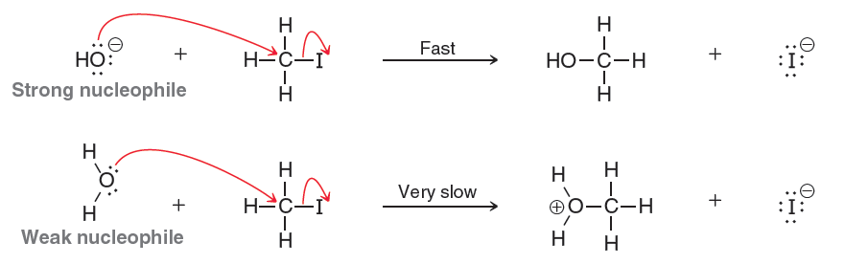
7.4 S_{N}2 – nucleophilicity
What are the factors that contribute to the strength of a nucleophile? (Review section 6.7)
A strong nucleophile is needed for an S_{N}2 rxn
Be able to recognize a given nucleophile as being strong or weak

Slide 26
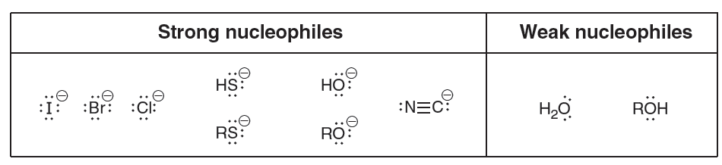
7.4 S_{N}2 – Nucleophilicity
Commonly nucleophiles used in substitution rxns:
You should be able to determine if a nucleophile is strong or weak. Which of the nucleophiles shown above would prefer S_{N}2?
In general, anions are strong nucleophiles
Polarizable atoms are good nucleophiles
The solvent affects nucleophilicity

Slide 27
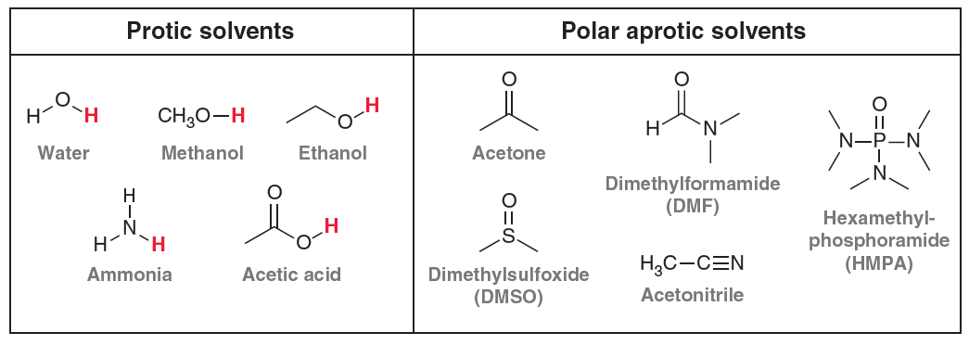
7.4 S_{N}2 – solvent effects
Need a polar aprotic solvent for S_{N}2 rxns
Protic solvents engage in H-bonding, and stabilize anionic species (such as good nucleophiles).
Aprotic solvents stabilize both cations and anions
How do these factors play into the strength of a nucleophile in protic versus aprotic solvent?

Slide 28
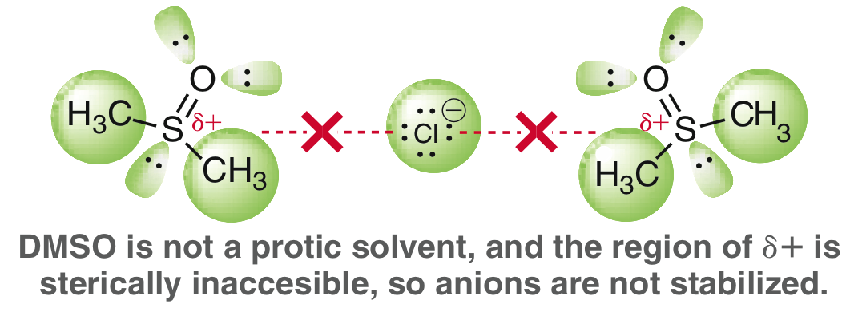
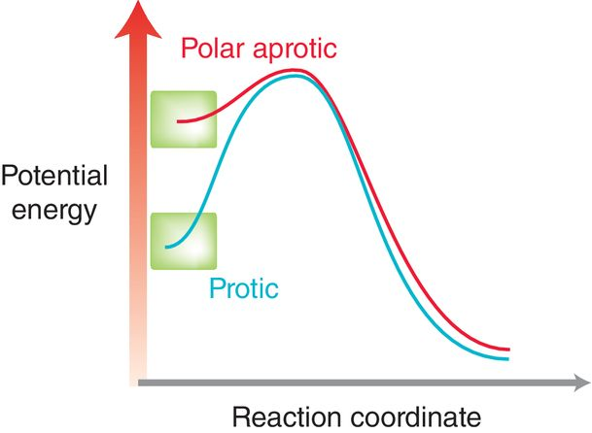
7.4 S_{N}2 – solvent effects
Nucleophiles are less stable, thus more reactive in aprotic solvent.
The activation energy will be lower and the reaction faster
Aprotic solvents are best for S_{N}2 reactions

Slide 29
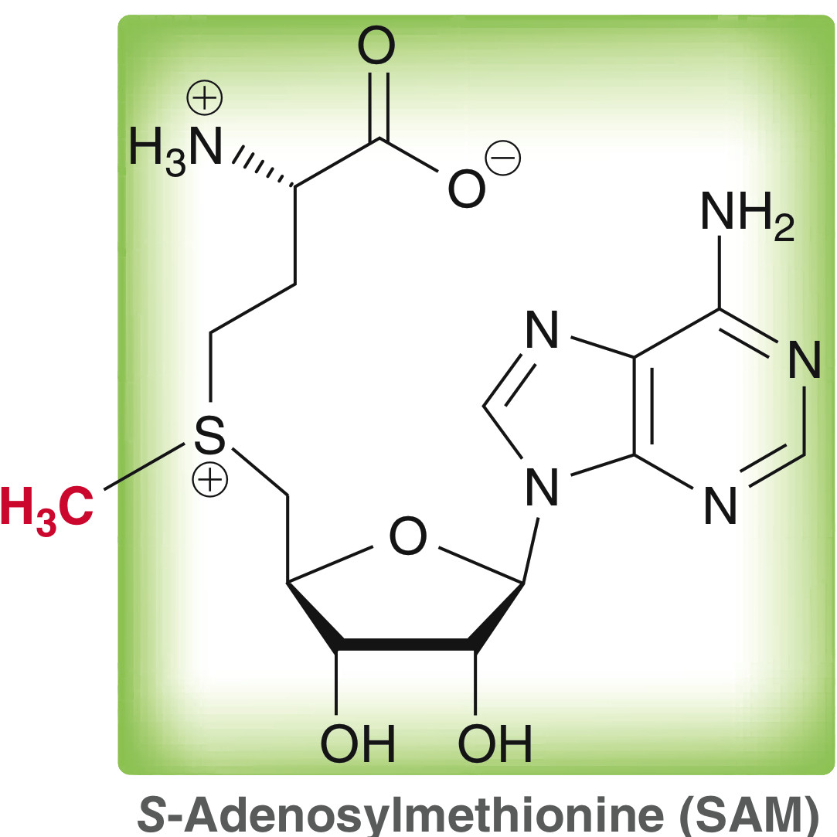
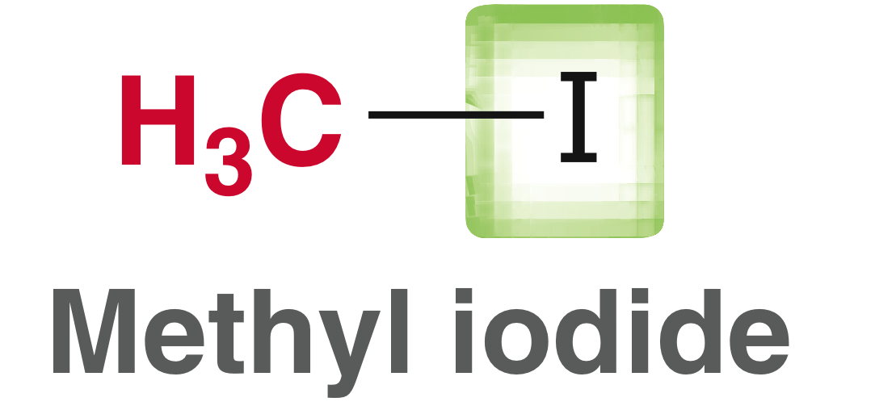
7.5 S_{N}2 – biological alkylation
Halides are common leaving groups for laboratory use, but are not common substrates in biological S_{N}2 rxns.
Both of these compounds are good methylating reagents: a good nucleophile will attack the CH₃ via an S_{N}2 mechanism.
Good leaving group
Good leaving group

Slide 30
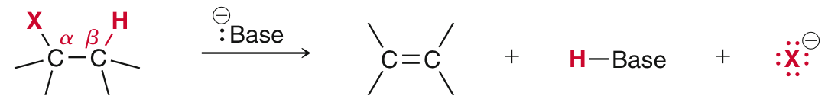
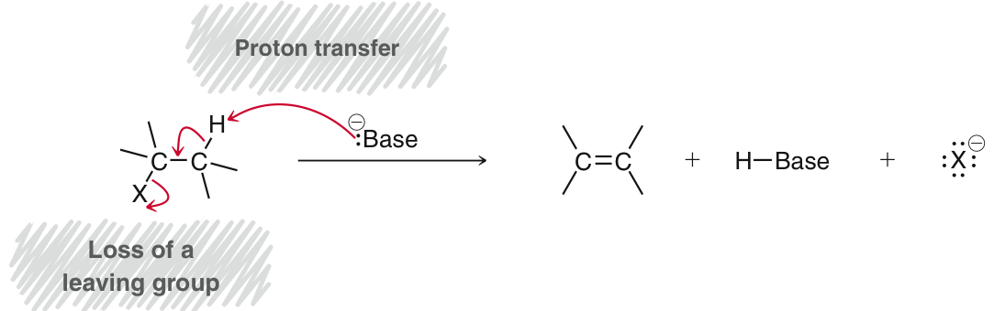
7.6 introduction to E2 rxns
When an alkyl halide is treated with a strong base, it can undergo beta elimination (1,2-elimination) to form an alkene:
A strong base will react in a concerted mechanism, called an E2 elimination.

Slide 31
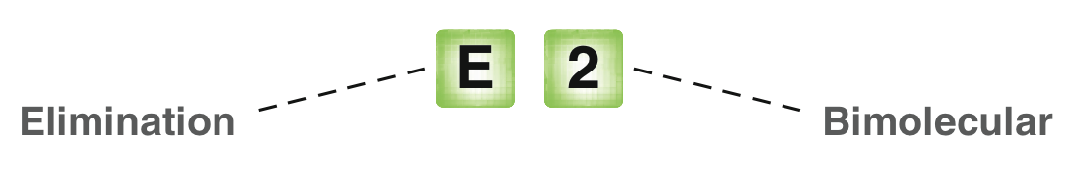
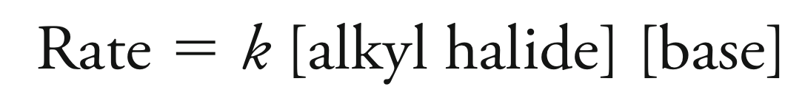
7.6 E2 - kinetics
E2 elimination is concerted, where the base removes a β-proton, causing the loss of the leaving group and the formation of the C=C bond. So, concerted elimination is bimolecular and follows second-order kinetics:
In what ways is E2 elimination similar to S_{N}2 substitution? What are the differences?

Slide 32
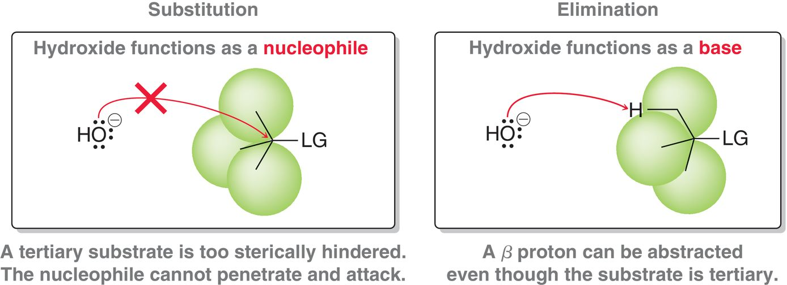
7.6 E2 – effect of the substrate
Consider a reagent such as NaOH, which is a strong nucleophile (S_{N}2) and a strong base (E2)…
… when the substrate is sterically hindered, E2 elimination will occur.

Slide 33
7.7 Alkene Nomenclature
Alkenes are given IUPAC names using the same procedure to name alkanes, with minor modifications
  Identify the parent chain, which includes the C=C double bond
  Identify and Name the substituents
  Assign a locant (and prefix if necessary) to each substituent. Give the C=C double bond the lowest number possible
  List the numbered substituents before the parent name in alphabetical order. Ignore prefixes (except iso) when ordering alphabetically
  The C=C double bond locant is placed either just before the parent name or just before the -ene suffix

Slide 34
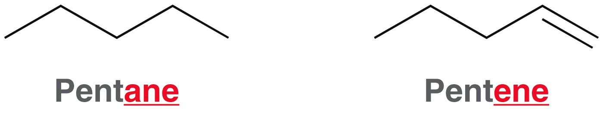
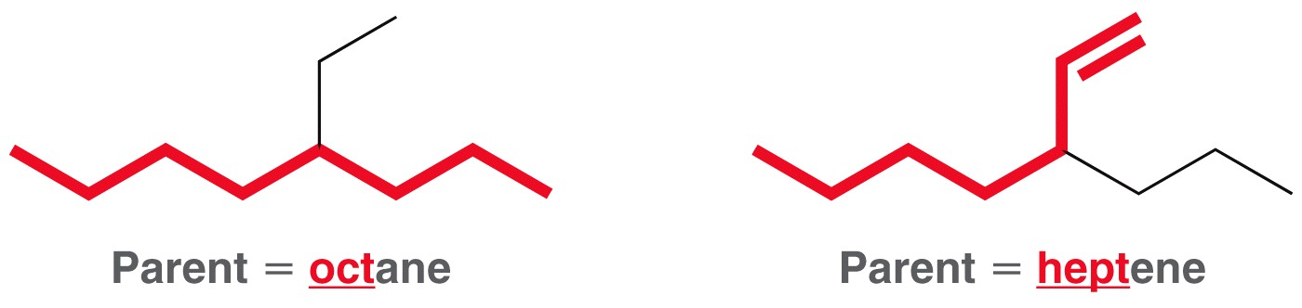
7.7 Alkene Nomenclature
Identify the parent chain, which should include the C=C double bond
The name of the parent chain should end in -ene rather than –ane
The parent chain should include the C=C double bond

Slide 35
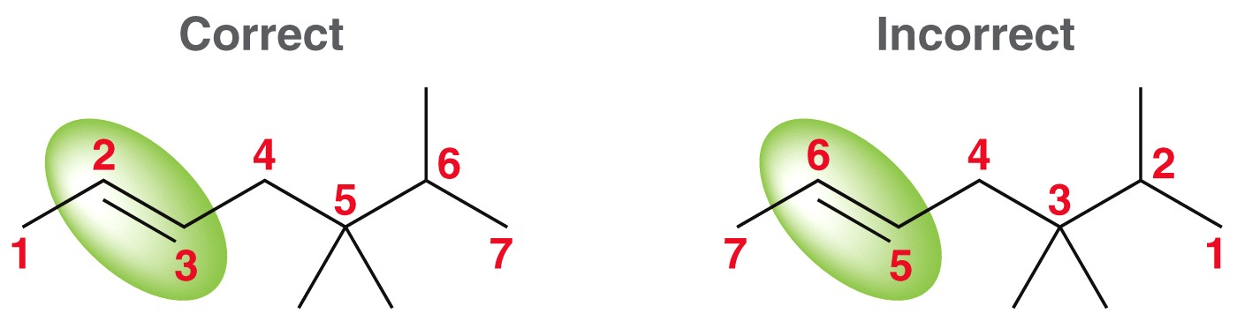
7.7 Alkene Nomenclature
Identify and Name the substituents
Assign a locant (and prefix if necessary) to each substituent. Give the C=C double bond the lowest number possible
  The locant of the double bond is a single number, and is the number indicating where the double bond starts. The alkene above is located at the “2” carbon.

Slide 36
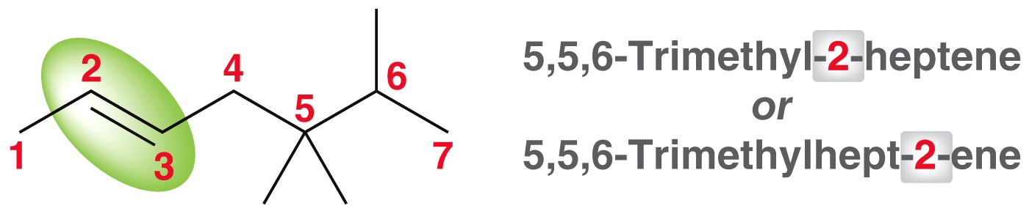
7.7 Alkene Nomenclature
List the numbered substituents before the parent name in alphabetical order. Ignore prefixes (except iso) when ordering alphabetically
The C=C double bond locant is placed either just before the parent name or just before the -ene suffix
Note: This alkene has the E configuration, which must be indicated in the name, in parentheses: (E)-5,5,6-trimethylhept-2-ene

Slide 37
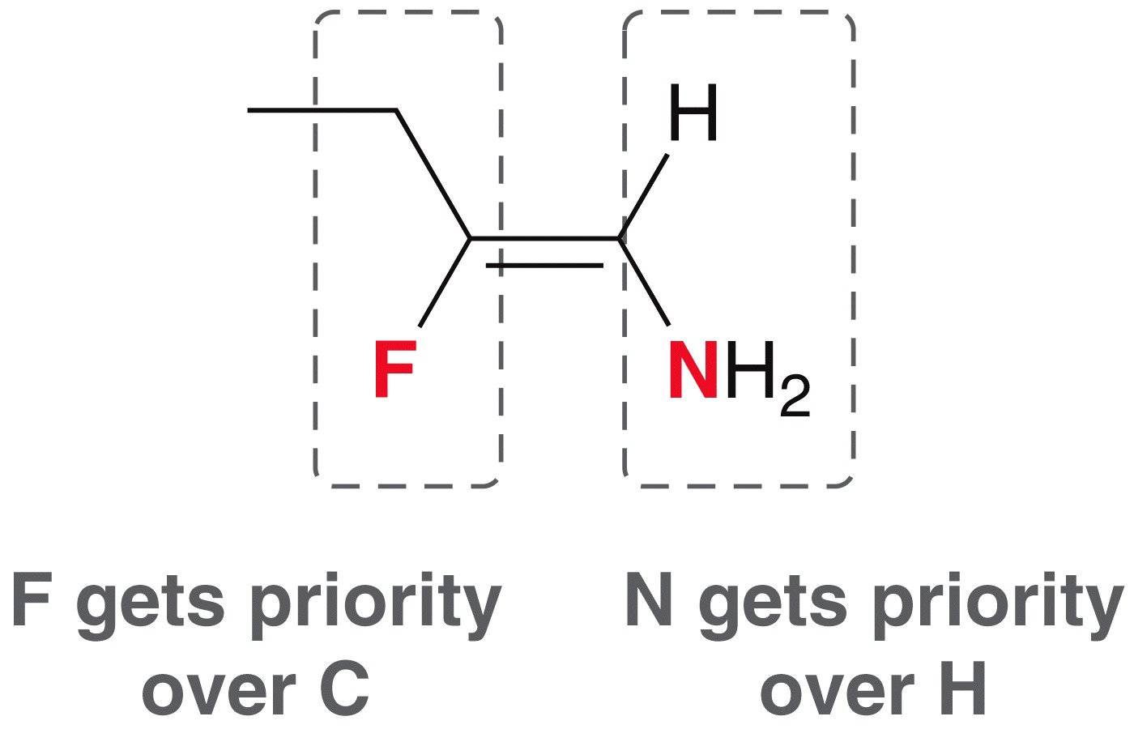
7.7 Alkene isomerism
Recall how to assign E or Z to alkene stereoisomers…
  First, prioritize the groups attached to the C=C double bond based on atomic number

Slide 38
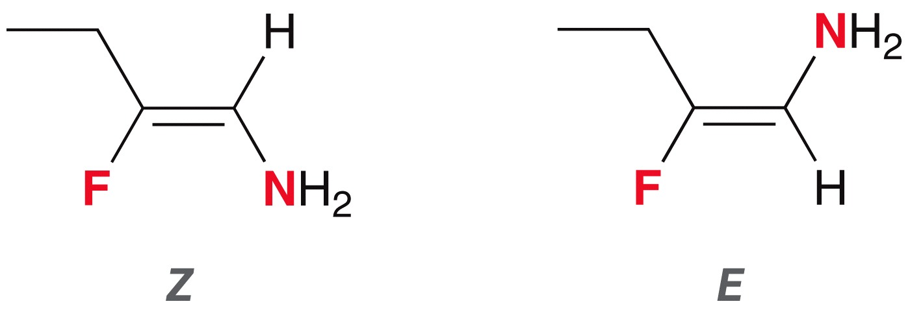
7.7 Alkene isomerism
  If the top priority groups are cis to each other, it is the
  Z isomer
  If the top priority groups are trans to each other, it is the
  E isomer

Slide 39
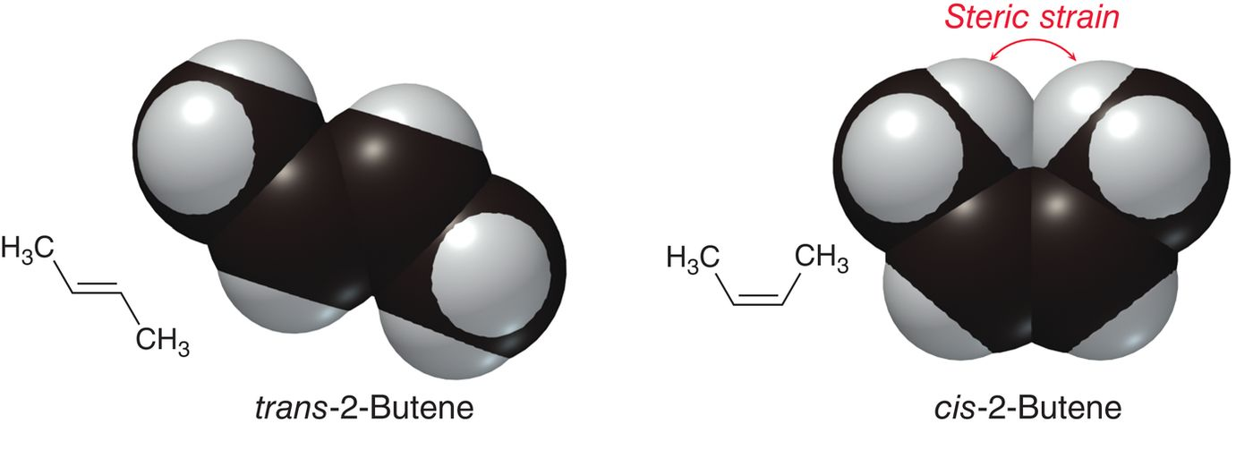
7.7 Alkene Stability
Because of steric strain, cis isomers are generally less stable than trans

Slide 40
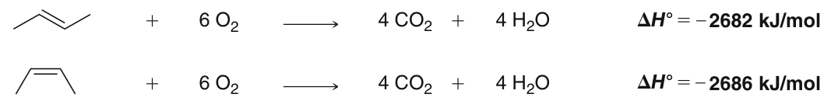
7.7 Alkene Stability
The difference in stability can be quantified by comparing the heats of combustion
Think about how the heats of combustion of the cis and trans isomers reveal their relative stability…

Slide 41
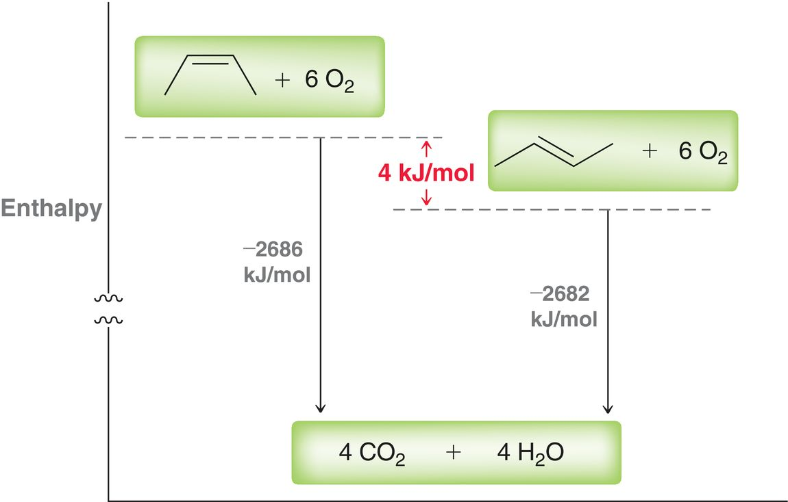
7.7 Alkene Stability

Slide 42
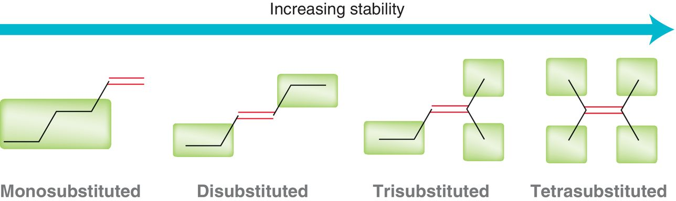
7.7 Alkene Stability
Alkyl groups stabilize the C=C pi bond via hyperconjugation.
Practice with Conceptual Checkpoint 7.16
More alkyl groups = more stable alkene

Slide 43
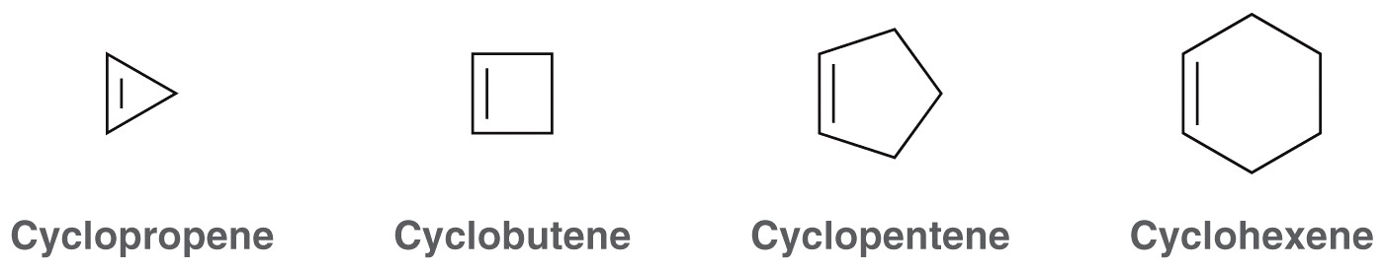
7.7 Cycloalkene stability
In cyclic alkenes with less than 7 carbons in the ring, only cis alkenes are stable. WHY?
So we do not need to indicate if the alkene is cis or trans unless the ring contains 8 carbons or more.
When applied to bridged bicycloakenes, this rule is called
Bredt’s rule

Slide 44
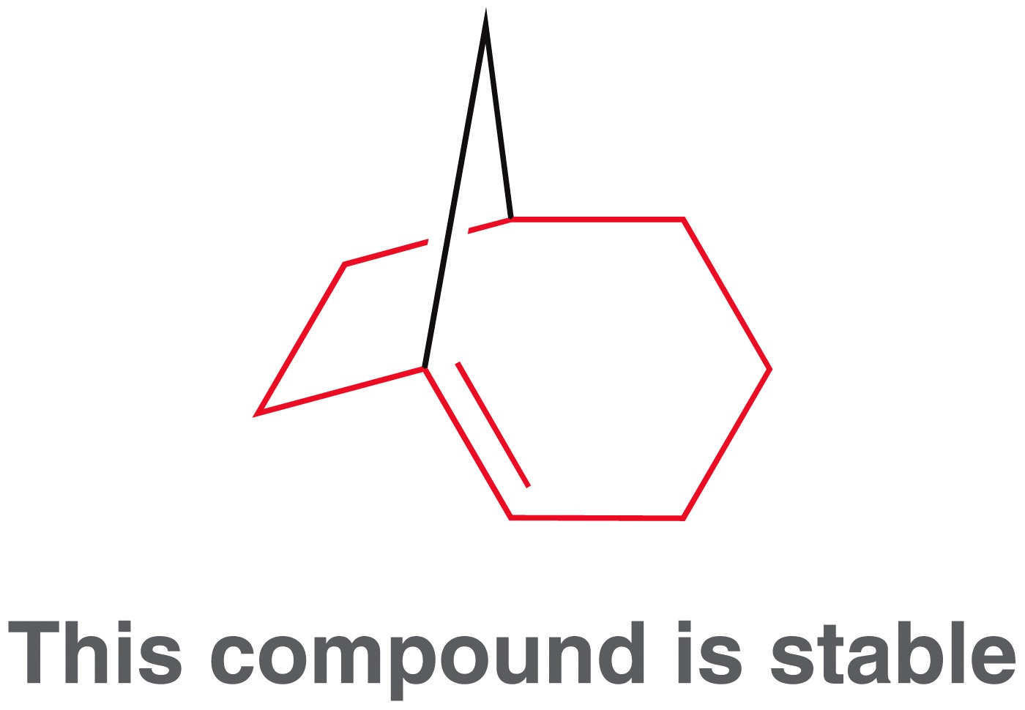
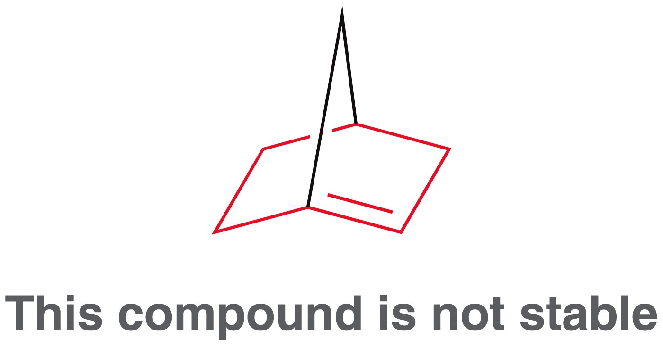
7.7 Alkene Isomerism
Apply Bredt’s rule to the compounds below
The bridgehead carbon cannot have a trans pi bond unless one of the rings has at least 8 carbons (otherwise the geometry of the bridgehead prevents parallel overlap of the p-orbitals)
Try building a handheld model of each compound shown above, and see, first-hand, the relative geometric strain of each

Slide 45
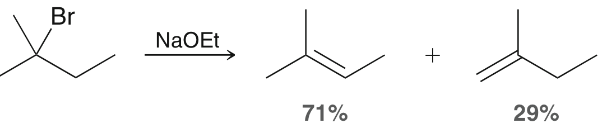
7.8 E2 regioselectivity
It is common for a substrate to have more than one β-carbon that can be deprotonated by a strong base, and so E2 elimination results in more than one alkene product.
When ethoxide is used as the strong base, 2-methyl-2-bromobutane gives two E2 products (shown above), with the more stable alkene (the Zaitsev product) produced as the major product, and the less substituted alkene (the Hofmann product) is the minor product.
Zaitsev product
Hofmann product

Slide 46
7.8 E2 regioselectivity
E2 elimination is a regioselective:
When constitutional isomers are formed as the products of a reaction, with one of them as the major product, the reaction is regioselective
The regioselectivity of an E2 reaction can be controlled by carefully choosing the strong base used.
Zaitsev product
Hofmann product

Slide 47
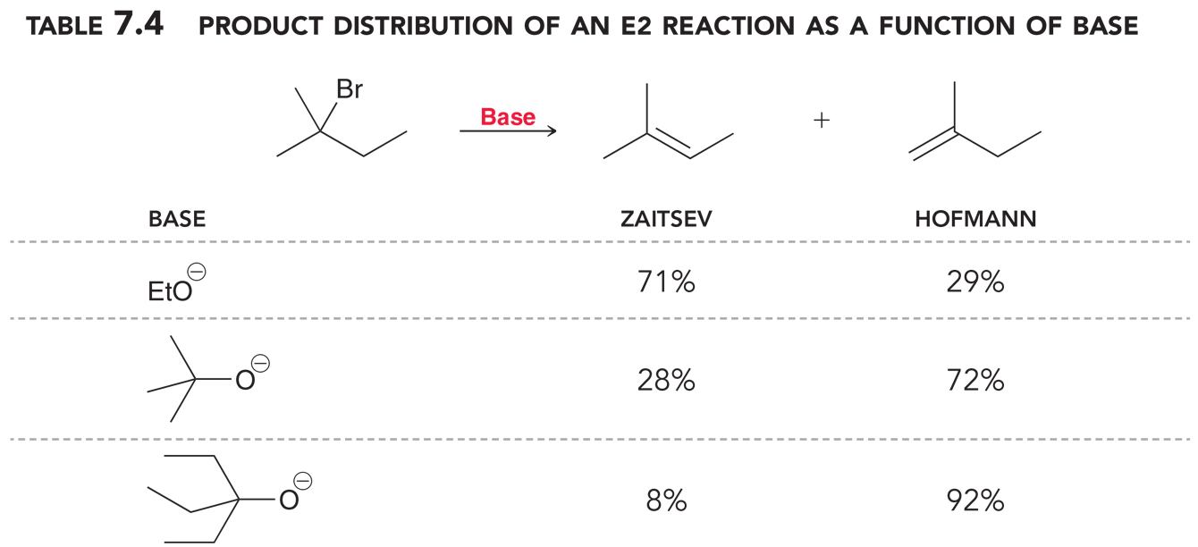
7.8 E2 regioselectivity
Experimental data indicates that a bulky, sterically hindered base will favor the formation of the Hofmann product, but an unhindered base (like ethoxide) will favor the Zaitsev product:

Slide 48
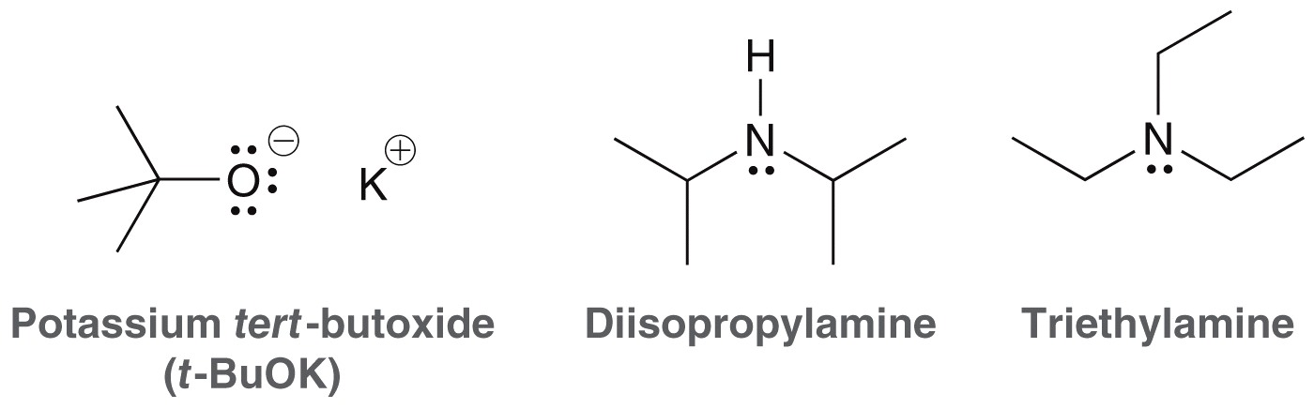
7.8 E2 regioselectivity
Why does a sterically hindered base favor the Hofmann product?
Sterically hindered bases (also called non-nucleophilic bases) are useful in many reactions
Practice with SkillBuilder 7.3

Slide 49



7.8 Regioselectivity of E2 rxns
Practice the Skill 7.18 predict the major and minor products for the following E2 reactions:

Slide 50


7.8 E2 stereoselectivity
Consider the dehydrohalogenation of 3-bromopentane, where two stereoisomers are possible products:
Use this energy diagram and the Hammond postulate to explain why the trans isomer is formed stereoselectively

Slide 51
7.8 Stereospecificity of E2
Consider dehydrohalogenation of the alkyl halide below:
There is only one
β-hydrogen to be removed
For E2 elimination to occur
You might imagine that it would be possible to form both the E and Z alkene products, but only the E isomer is formed
this isomer is
not formed
only product

Slide 52

7.8 Stereospecificity of E2
To rationalize the stereospecificity of the reaction, consider the transition state for the reaction
In the transition state, the C-H and C-Br bonds that are breaking must be rotated into the same plane as the pi bond that is forming
In other words, the β-hydrogen and the leaving group must be co-planar.

Slide 53
7.8 Stereospecificity of E2
There are two rotamers where the β-hydrogen and the leaving group are coplanar:
Since we are comparing two different rotamers, the Newman projections are a good tool to compare them

Slide 54
7.8 Stereospecificity of E2
The staggered rotamer, where the b-hydrogen and leaving group are anti-coplanar, is much lower energy than the eclipsed rotamer:
The product resulting from the anti-coplanar rotamer is formed
Lower energy
rotamer
High energy
rotamer

Slide 55
7.8 Stereospecificity of E2
Evidence suggests that a strict 180° angle is not necessary for E2 mechanisms.
Similar angles (175–179°) are sufficient
The term, anti-periplanar is generally used instead of anti-coplanar to account for slight deviations from coplanarity
Although the E isomer is usually more stable because it is less sterically hindered, the requirement for an anti-periplanar transition state can often lead to the less stable Z isomer

Slide 56

7.8 Stereospecificity of E2
Assuming they proceed through an anti-periplanar transition state, predict the products for the following reactions

Slide 57

7.8 Stereospecificity of E2
For the following substrate, the β-carbon has TWO β-hydrogens
There are two different rotamers where a β-hydrogen is anti-periplanar to the leaving group, and so two stereoisomers will be formed.
In this case, the reaction will be stereoselective, but not stereospecific. (see Skillbuilder 7.4)
E2 elimination will be stereospecific only when both the α and β carbons are stereocenters

Slide 58

7.8 stereospecific vs. stereoselective
It is very important to understand the difference between the terms stereospecific and stereoselective.
In a stereospecific rxn, the substrate is stereoisomeric and results in one stereoisomer as the product
In a stereoselective rxn, the substrate can produce two stereoisomers as products, where one is the major product.

Slide 59

7.8 Stereospecificity of E2
Consider the dehydrohalogenation of a cyclohexane derivative, where the leaving group is attached to the ring
Given the anti-periplanar requirement, E2 elimination can only occur when the leaving group is in the axial position.
E2 elimination
can occur in this
chair conformation
E2 elimination
cannot occur

Slide 60


7.8 Stereospecificity of E2
Which of the two molecules below will NOT be able to undergo an E2 elimination reaction? WHY?
It might be helpful to draw their chair structures and build a model

Slide 61
7.8 Stereospecificity of E2
Rationalize the product(s) formed in the following two reactions
One of the alkyl halides undergoes E2 elimination much faster than it’s diastereomer. Why is there a difference in their rxn rates?
Only one
product formed
(E2 rxn is slow)
Two products
formed
(E2 rxn is fast)

Slide 62
7.8 drawing products of E2 rxns
There are many factors to consider in order to correctly predict the product(s) of an E2 rxn and decide what the major product will be.
  Will the substrate react stereospecifically? or will it be a stereoselective E2 rxn?
  Will the substrate produce several regioisomeric alkenes? If so, what will be the major product, given the steric hindrance of the base that is used?
  The only way to master this material is to do lots of practice problems. Start with Skillbuilder 7.5, then go from there.

Slide 63
7.9 Unimolecular Rxns (S_{N}1 and E1)
Consider the following reaction, where a substitution and elimination products are formed when dissolving:
The substrate is 3˚, so S_{N}2 substitution is not possible. The reagent is EtOH, which is not a strong base, and so E2 elimination is unlikely.
It turns out the formation of the substitution and elimination products follow first-order kinetics, which confirms neither S_{N}2 nor E2 is occurring.

Slide 64
7.9 Unimolecular Rxns (S_{N}1 and E1)
The mechanisms of substitution and elimination in this case both start with the same step: ionization of the substrate
After the carbocation is formed, it will either undergo substitution or elimination, depending on how it reacts with the solvent (EtOH).
(S_{N}1)
(E1)
The leaving group leaves to form
a carbocation intermediate

Slide 65
7.9 S_{N}1 mechanism
The substitution rxn of a 3˚ substrate, in an alcohol solvent like EtOH, proceeds through a two-step (stepwise) mechanism
The entire mechanism is actually 3 steps, but the last step is just a proton transfer
This is called “solvolysis” because the nucleophile is also the solvent.
Loss of
leaving group
Nucleophilic
attack

Slide 66

7.9 S_{N}1 reaction coordinate
The highest energy transition state, in S_{N}1, is for the formation of the carbocation intermediate. So, formation of the carbocation is the rate determining step.

Slide 67

7.9 S_{N}1 kinetics
Since the formation of the carbocation requires only ionization of the substrate, the rate of it’s formation depends only on the substrate, and so the rxn follows first-order kinetics
Now it is clear that when substitution occurs via a carbocation intermediate, it is called “S_{N}1”
The rate of S_{N}1 substitution
depends only on the substrate

Slide 68

7.9 S_{N}1 mechanism
A substitution reaction that occurs stepwise, where the leaving group first leaves to form a carbocation intermediate, followed by nucleophilic attack is called S_{N}1 substitution.
Remember that when the nucleophile is a neutral species, such as an alcohol, there will be a proton transfer after nucleophilic attack

Slide 69

7.9 E1 mechanism
The elimination rxn of a 3˚ substrate, in an alcohol solvent like EtOH, proceeds through a two-step (stepwise) mechanism
Here, EtOH is serving as a base (not as a nucleophile) to deprotonate the carbocation and form an alkene
Like SN1, the E1 mechanism is unimolecular, and follows the same kinetics.
Loss of
leaving group
β-hydrogen
elimination

Slide 70


7.9 E1 kinetics
The rate of E1 is the same as for SN1: in both cases, the rate determining step is the formation of the carbocation intermediate
Both E1 and S_{N}1 share
The same rate determining step

Slide 71
7.9 S_{N}1/E1 rearrangements
Because SN1 and E1 rxns proceed through a carbocation intermediate, the carbocation may rearrange from 1,2-hydride or methide shifts.
S_{N}1 product
S_{N}1 product
after 1,2-hydride
shift
S_{N}1 product
S_{N}1 product
after 1,2-methide
shift

Slide 72

7.9 S_{N}1/E1 rearrangements
When a 1˚ substrate is reacted under solvolysis conditions, only the product resulting from rearrangement is observed
Remember 1˚ carbocations are too unstable to form. So, in this case the rearrangement occurs as the leaving group leaves
Only
S_{N}1 product
This product is
not observed
1,2-methide shift and
ionization is concerted,
3˚ carbocation is formed

Slide 73

7.9 S_{N}1/E1 solvent effects
Experimental data indicates SN1 and E1 reactions are faster in a polar protic solvent

Slide 74

7.9 solvent effects on substitution
Overall: For S_{N}2 rxns, a polar aprotic solvent is best
For S_{N}1 rxns, a polar protic solvent is best
aprotic solvents raise the energy
of the Nu⁻, which results in lower E_{a}
and a faster S_{N}2 reaction
protic solvents stabilize the carbocation
Intermediate, which results in lower E_{a}
and a faster S_{N}1 reaction

Slide 75

7.9 S_{N}1/E1 – the substrate
The better the leaving group, the faster the S_{N}1 or E1 rxn
Remember the rate-determining step for S_{N}1 and E1 of alkyl halides is the ionization step: the formation of a carbocation and a halide ion
So, the more stable the halide ion, the faster the ionization

Slide 76

7.9 S_{N}1/E1 – the substrate
The more stable the carbocation intermediate, the faster the S_{N}1 and E1 reactions will be.
Solvolysis rxns of 1˚ and 2˚ alkyl halides are often too slow to observe the formation of S_{N}1 and E1 products
However, 3˚ alkyl halides, as well as benzylic and allylic halides will undergo solvolysis at a practical rate thanks to the stability of the carbocation intermediates:
Recall that benzylic and allylic carbocations
are resonance stabilized

Slide 77

7.9 S_{N}1/E1 – the substrate
Be able to judge whether or not a given alkyl halide will undergo a solvolysis (S_{N}1 and/or E1) reaction.
In general, a 1˚ or 2˚ alkyl halide will only undergo solvolysis if rearrangement to a more stable carbocation is possible.
3˚, allylic and benzylic alkyl halides will undergo solvolysis to give a mixture of S_{N}1 and E1 products
Practice with Conceptual Checkpoints 7.30, 7.31 and 7.32
benzylic substrate
Mixture of S_{N}1 and E1 products
is observed

Slide 78

7.9 E1 – regioselectivity
Like we saw with E2 eliminations, it is possible for E1 elimination to yield more than one regioisomer, as in the following example:
E1 reactions will always give the most stable alkene as the major product, which will be the most substituted alkene
So E1 reactions are regioselective, but we cannot control the regioselectivity like we can with E2 reactions.
Major product
of E1 elimination

Slide 79

7.9 E1 – stereoselectivity
It is further possible to obtain several alkene stereoisomers in an E1 reaction, as in the following example:
It still holds true that the E1 reaction will give the most stable alkene as the major product. When two stereoisomers are obtained, the least sterically hindered isomer will be more stable.
So E1 reactions are stereoselective. But realize a mixture of all possible products is still obtained.
Major product
of E1 elimination

Slide 80

7.9 S_{N}1 – stereoselectivity
When the α-carbon in an S_{N}1 reaction is chiral, we obtain two substitution products that have opposite configurations at the reactive carbon:
Recall that in an S_{N}2 reaction, the Nuc does a backside attack, and only the inversion of configuration product is obtained.
The Nuc can attack
The carbocation from
either side

Slide 81

7.9 S_{N}1 – stereoselectivity
Even though a mixture of configurations is obtained in S_{N}1 substitution, typically more of the inversion product is observed
The leaving group
will form an ion-pair
with the carbocation,
making it more difficult
for the nucleophile
to attack from the
same side

Slide 82
7.10 Kinetic Isotope effects
As you learn all these mechanisms of substitution and elimination, you should appreciate how we have come to know how the mechanisms occur
One way we to study a mechanism is to see how replacing a hydrogen atom with it’s isotope, deuterium, affects the rate of a reaction. If the rate is affected, it is likely that particular H atom is involved in the rate determining step.
¹H is called hydrogen, abbreviated as “H”, and ²H is called deuterium, abbreviated as “D”
Deuterium (D) has the same chemical reactivity as hydrogen (H)

Slide 83


7.10 Kinetic Isotope effects
Consider the following reaction, where an alkyl halide undergoes elimination with a strong base (which you already know is called an E2 reaction).
When we replace the β-hydrogens with deuteriums, the reaction occurs at a slower rate. This is called the kinetic isotope effect

Slide 84
7.10 Kinetic Isotope effects
C – D bonds are stronger than C – H bonds. So, if replacing the b-hydrogens with deuteriums results in a slower rate by more than a factor of 5, then we can conclude the breaking of the C – H bond occurs during the rate determining step
The reaction above is nearly 7 times slower with β-deuteriums instead of β-hydrogens. This is one of the reasons why we know that E2 elimination is a concerted elimination

Slide 85

7.11 Predicting Products
By now, it should be clear that a number of factors affect the product(s) formed when reacting an alkyl halide with a nucleophile and/or base (the substrate, the reagent, and the solvent).
It should also be clear that in many cases, a mixture of substitution and/or elimination products will be obtained

Slide 86

7.11 Predicting Products
It is also possible, for a given substrate, that only one mechanism will occur
In order to understand how to use these reactions, to transform alkyl halides into a desired compound, one must be able to predict ALL the products that will form in a given reaction, as well as the major and minor product(s)

Slide 87
7.11 Predicting Products
To successfully predict the product(s) formed in a given reactions, we can follow a three-step analysis:
DETERMINE THE FUNCTION OF THE REAGENT
ANALYZE THE SUBSTRATE AND DETERMINE THE EXPECTED MECHANISM(S)
CONSIDER ANY RELEVANT REGIOCHEMICAL AND STEREOCHEMICAL REQUIREMENTS

Slide 88

7.11 Function of the reagent
STEP 1
Remember what kind of reagents promote S_{N}1, S_{N}2, E1 and E2
  S_{N}2 = strong nucleophile E2 = strong base
  S_{N}1 = weak nucleophile E1 = weak base
  The following table is a good resource for categorizing reagents and the mechanisms they will promote
E2
S_{N}2 and E2
S_{N}1 and S_{N}2
S_{N}1 and E1

Slide 89

7.11 Analyze the substrate
STEP 2
Once you determine what mechanism(s) will be favored by the reagent, analyze the substrate (is it to see which mechanism(s) will dominate… is the substrate 1˚, 2˚, or 3˚?

Slide 90
7.11 regioselectivity/stereoselectivity
STEP 3
After analyzing the reagent and the substrate, you can say which mechanism(s) will occur. Draw all the possible regio- and stereoisomers, then choose the major, using the guidelines you have learned.
For S_{N}2, you will observe a single product, which is inversion of configuration at the α-carbon

Slide 91

7.11 regioselectivity/stereoselectivity
STEP 3
For E2, draw all the possible alkene isomers. Only alkenes which result from a β-hydrogen anti-periplanar to the leaving group can form
- if a bulky base is used, the Hofmann product is the major
- if a non-bulky base is used, the most stable alkene is the major

Slide 92

7.11 regioselectivity/stereoselectivity
STEP 3
For S_{N}1, draw the carbocation intermediate, consider if it will rearrange. If not, then attach nucleophile to the carbocation. If it rearranges, draw the resulting carbocation, then attach the nucleophile to it.
- if a chiral carbon is formed by attack of the nucleophile, then
two products are formed (“R” and “S”). Draw them both.

Slide 93
7.11 regioselectivity/stereoselectivity
STEP 3
For E1, draw the carbocation formed from loss of the leaving group. If it will rearrange, draw the rearranged carbocation. Then, draw all possible alkene isomers resulting from elimination of a β-hydrogen. All possible alkene stereoisomers will form (E1 is not stereospecific).
- the major product will always be the most stable alkene.
PRACTICE THESE STEPS WITH SKILLBUILDER 7.7

Slide 94
7.11 Predict the products
Predict the product(s) of the following reaction, and label the major
product.
STEP 1: ANALYZE THE REAGENT(S). NaOH is a strong base, and a strong nucleophile, so SN2 and E2 will be favored
STEP 2: LOOK AT THE SUBSTRATE. It is a 2˚ halide, so SN2 and E2 will occur, but E2 will dominate (because 2˚ substrates are somewhat hindered, and backside attack is more difficult)

Slide 95
7.11 Predict the products
STEP 3: consider the regio- and stereochemical requirements.
For the S_{N}2 product, backside attack gives inversion of configuration
S_{N}2 product

Slide 96
7.11 Predict the products
STEP 3: consider the regiochemical and stereochemical requirements.
For the E2 product(s), draw all the β-hydrogens that can be anti-periplanar to the leaving group, then draw the resulting alkenes (use Newman projections if necessary)
elimination
of Hª
elimination
of H^{b}
elimination
of H^{c}

Slide 97
7.11 Predict the products
STEP 3: consider the regiochemical and stereochemical requirements.
Now we have all the products resulting from SN2 and E2. Now label the major product. E2 is major pathway, and the base is not hindered, so the Zaitsev product is the major.
Do more examples with
Practice the Skill 7.37
most stable
alkene
MAJOR

Slide 98
7.12 Other substrates
There are a variety of alternatives to alkyl halides for substitution and elimination reactions, such as alkyl sulfonates
Mesylates, tosylates, and triflates are excellent leaving groups. They are also quite large, and so we usually use abbreviations when drawing their structures (OMs, OTs, and OTf)

Slide 99
7.12 Alkyl sulfonates
Sulfonates are such good leaving groups because they are very stable (like halides, they are the conjugate bases of strong acids)
Based on pK_{a} values, which sulfonate is the best leaving group?
Sulfonate ions are
Resonance stabilized!

Slide 100


7.12 Alkyl sulfonates
Sulfonates are made from the corresponding alcohol
Realize we are just strapping the “Ts” group to the oxygen of the alcohol… no change in the carbon atom bearing the OH group occurs
Alcohols are not
good leaving groups
now we have a good
leaving group!

Slide 101

7.12 Alkyl sulfonates
To envision the compounds that can be synthesized from an alkyl tosylate, treat them the same as you would an alkyl halide
With a strong Nu/strong base, a 1˚ substrate
gives mostly S_{N}2, with a little E2
With a strong Nu/strong base, a 2˚ substrate
gives mostly E2, with a little S_{N}2

Slide 102


7.12 Alcohols
Alcohols can also be used in substitution and elimination reactions, and used as starting materials to make alkyl halides and alkenes.
We need strongly acidic conditions to do these reactions, because OH is a bad leaving group, but H₂O is a good leaving group
1˚ alcohol
1˚ bromide

Slide 103

7.12 Alcohols
The mechanism will be either SN1 or SN2, depending on the substrate. 1˚ alcohols react via S_{N}2, but 2˚ and 3˚ alcohols react via S_{N}1
Strongly acidic conditions are protic conditions, which would favor S_{N}1. But, since 1˚ carbocations are too unstable to form, 1˚ alcohols react via S_{N}2 mechanism
3˚ alcohol
3˚ bromide

Slide 104


7.12 Alcohols
Alcohols will undergo E1 elimination when reacted with H₂SO₄
Again, the strongly acidic conditions are protic conditions, which favors E1 for 2˚ and 3˚ substrates
3˚ alcohol
alkene
3˚ alcohol
E1 mechanism

Slide 105

7.13 Synthetic strategies
The whole point to organic synthesis is to make valuable, complex compounds from cheap and readily available starting materials
You now know how to make a variety of compounds starting with an alkyl halide.
1˚ halide

Slide 106

7.13 Synthetic strategies
In order to envision how a desired compound can be made, you need to be able to recall the reactions you can use (meaning you have to remember these reactions!!!)
3˚ halide

Slide 107
7.13 Synthetic strategies
When thinking about how to make something, we FIRST think about what the finished product will look.
If we were building a brick house, we would first imagine what the house will look like. THEN we would decide what bricks would be used to make it.
Organic synthesis is the same way: we first look at the desired product, and from there we decide what substrates and reactants we would need to use to make it
This approach is called retrosynthetic analysis

Slide 108

7.13 retrosynthetic analysis
Suppose we need to synthesize the following ether:
STEP 1: identify a bond in the target molecule that can be made using a reaction that you know.
STEP 2: draw the substrate and the nucleophile necessary to for the reaction.
We can make this bond by
S_{N}2 reaction between an
alkyl halide and an alkoxide
The retrosynthetic arrow is used to show
we are “thinking backwards” with regards
to the reaction we could do

Slide 109

7.13 retrosynthetic analysis
There are two C – O bonds in an ether, so we could also envision an alternative S_{N}2 reaction to make it:
You will find that when “thinking backwards” this way, more than one reaction will often come to mind to make a target compound
Alternatively, we could
make this bond via S_{N}2
These are the reactants we
would need

Slide 110
7.13 retrosynthetic analysis
STEP 3: verify that the reaction you have proposed is reasonable
STEP 4: draw the reaction in the forward direction
YES! We expect
this reaction to work
1˚ halide
(good substrate for S_{N}2)
Strong, unhindered Nu
(good for S_{N}2)
We are trying to do an S_{N}2 reaction,
So we might as well use an aprotic solvent, right?

Slide 111
7.13 retrosynthetic analysis
What reactants would you need in order to make the following compound as the product of a substitution reaction?
Try to do this on your own, and when you want to check your answer, or if you get completely stuck, refer to SkillBuilder 7.8

