Slide 1
Organic Chemistry
Third Edition
David Klein
Chapter 8
Addition Reactions and Alkenes

Slide 2

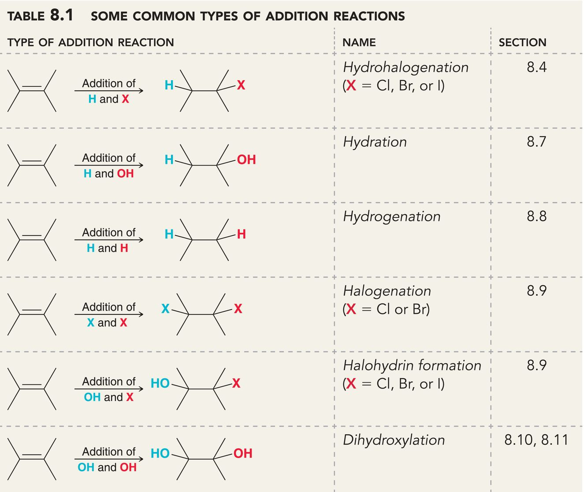
8.1 Introduction to Addition Reactions
Addition is the opposite of elimination
C=C π bond is converted to two new sigma bonds

Slide 3
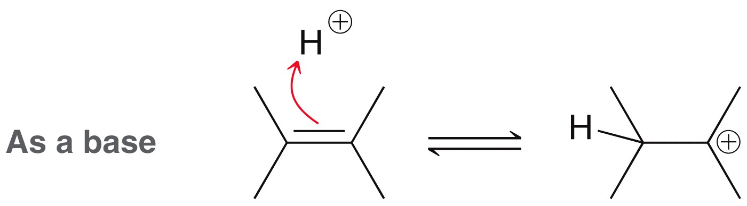
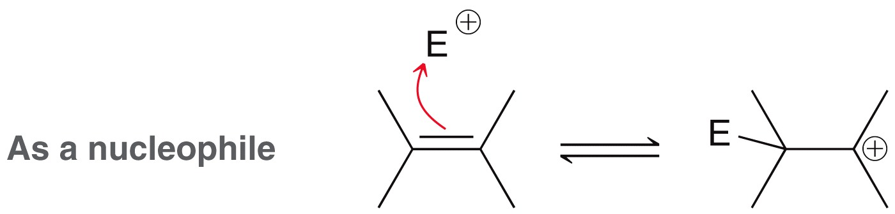
8.1 Introduction to Addition Reactions
The π bond is an electron-pair donor

Slide 4
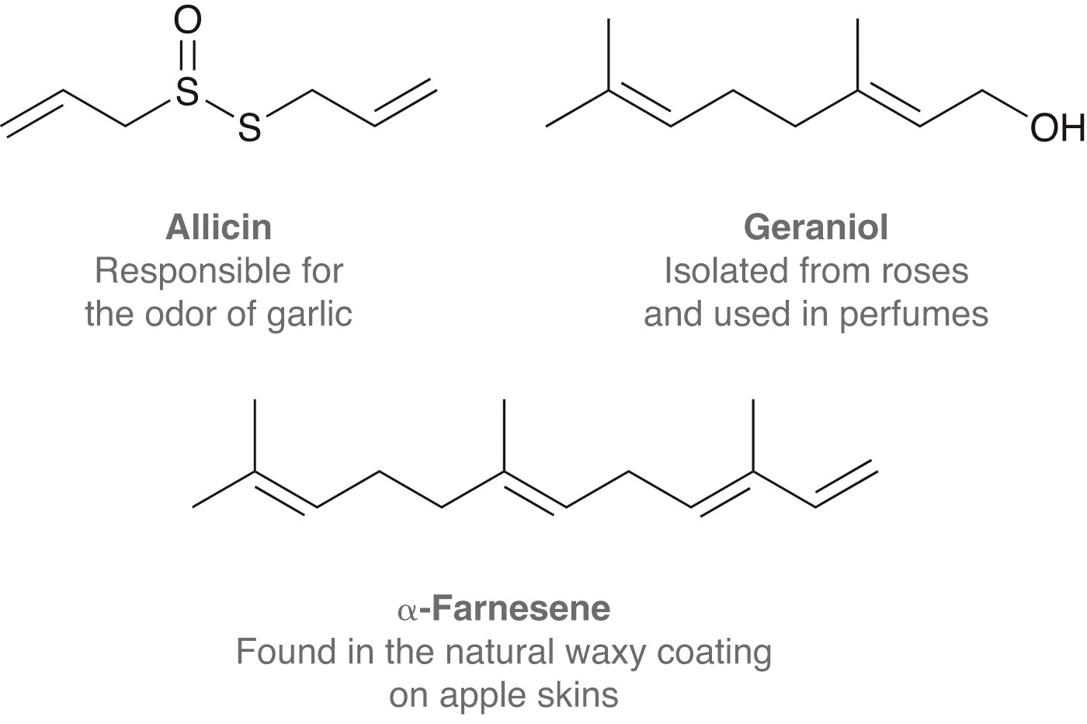
8.2 Alkenes in Nature and Industry
Naturally occurring, acyclic alkenes:

Slide 5
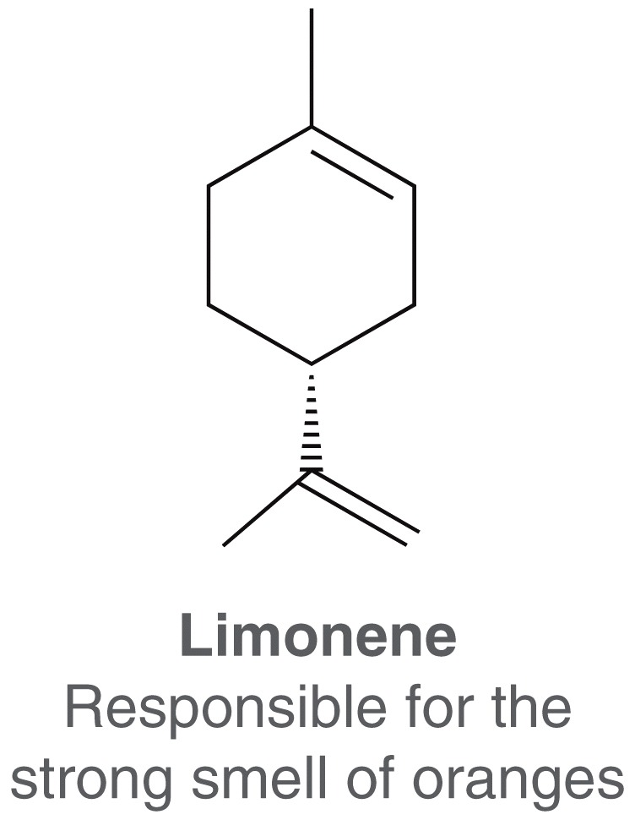
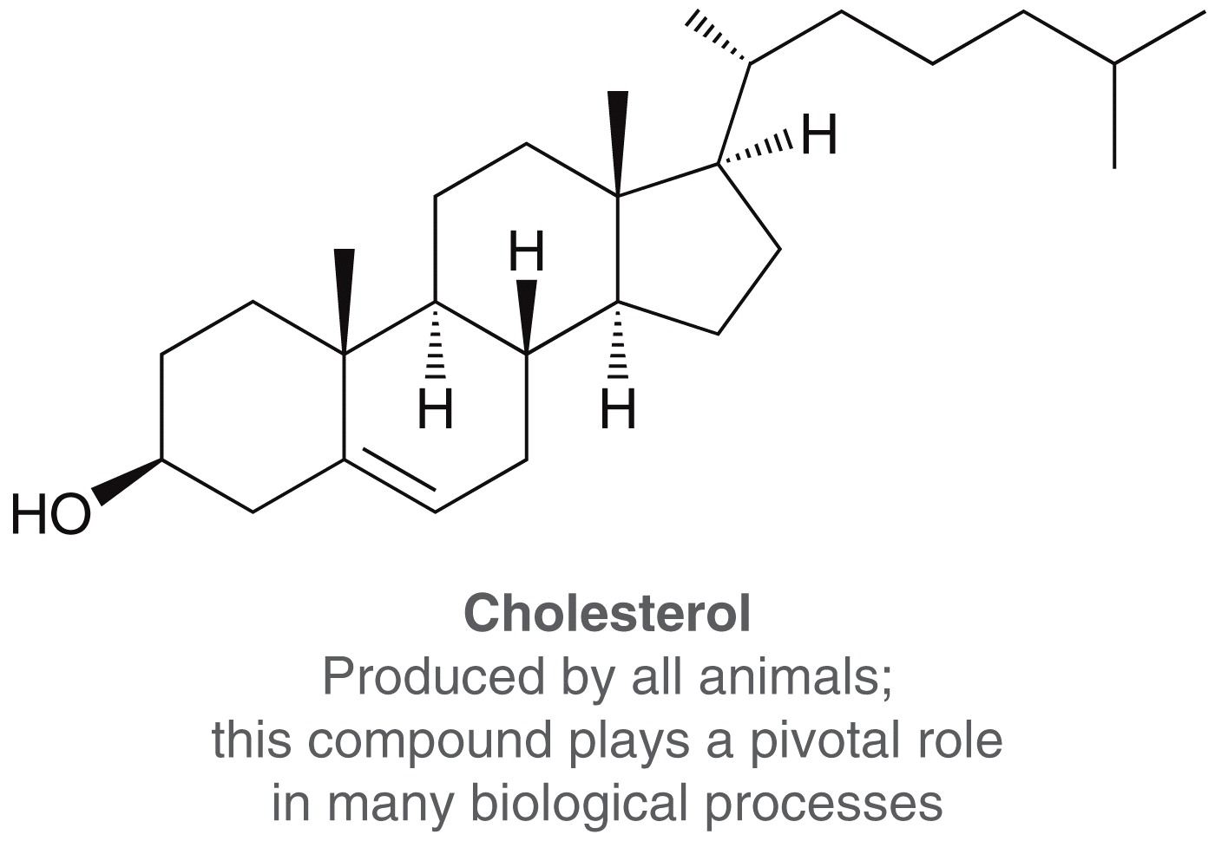
8.2 Alkenes in Nature and Industry
Cyclic and polycyclic alkenes:

Slide 6
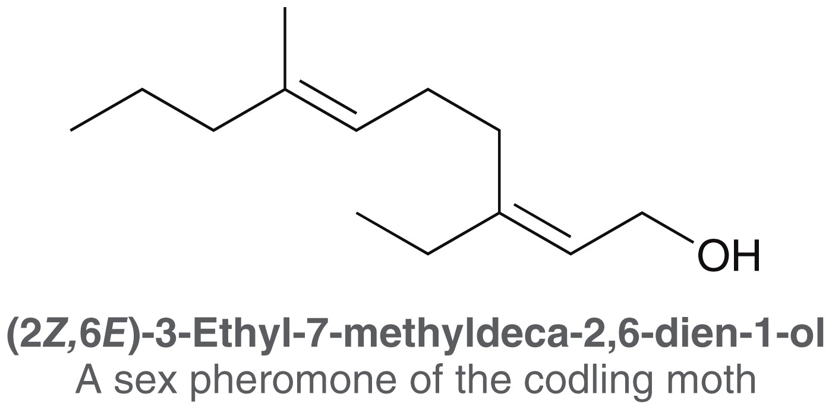
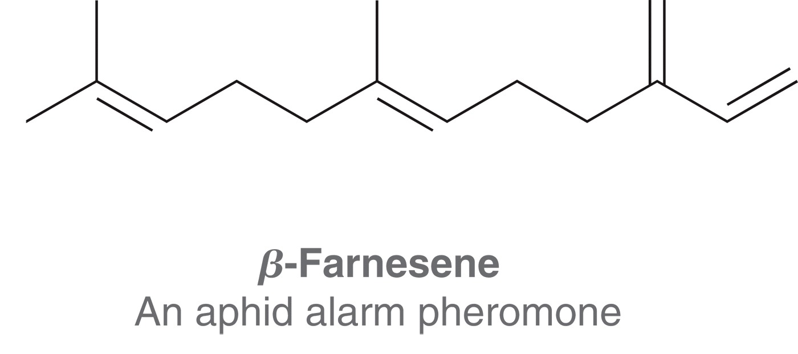
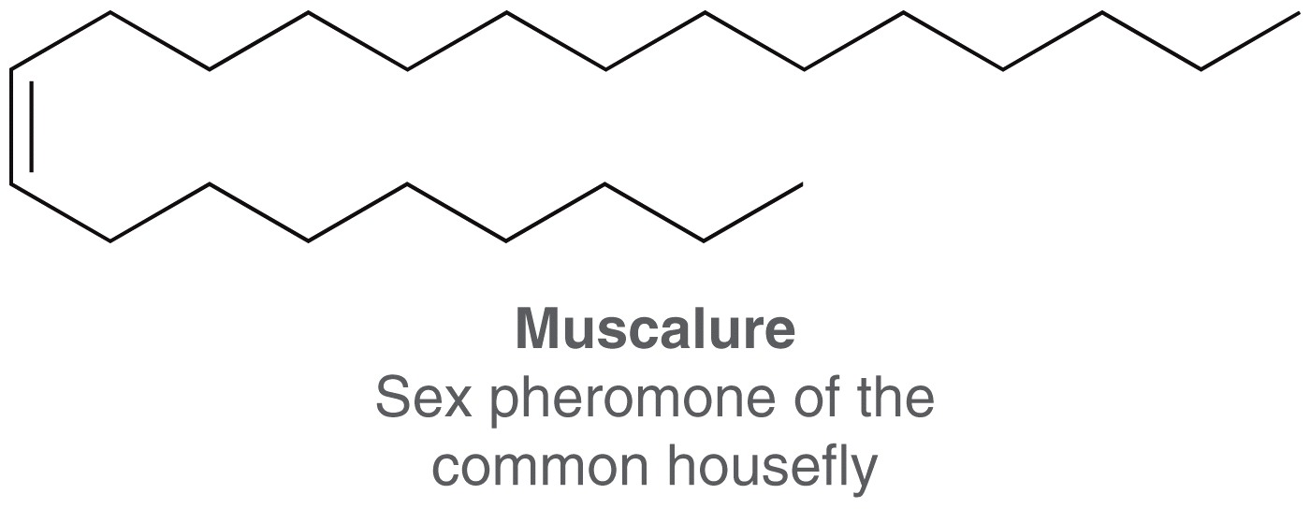
8.2 Alkenes in Nature and Industry
C=C double bonds often found in the structures of pheromones

Slide 7
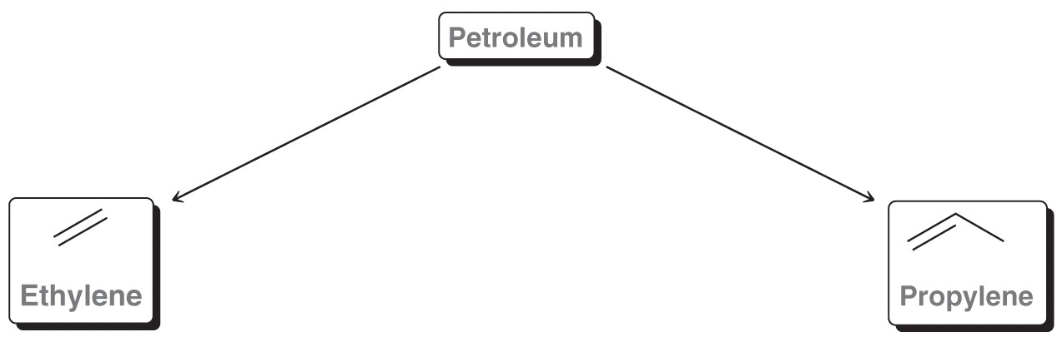
8.2 Alkenes in Nature and Industry
Alkenes are critical precursors in the chemical industry
70 billion pounds of propylene (propene) and 200 billion pounds of ethylene (ethene) are both made from cracking petroleum each year

Slide 8
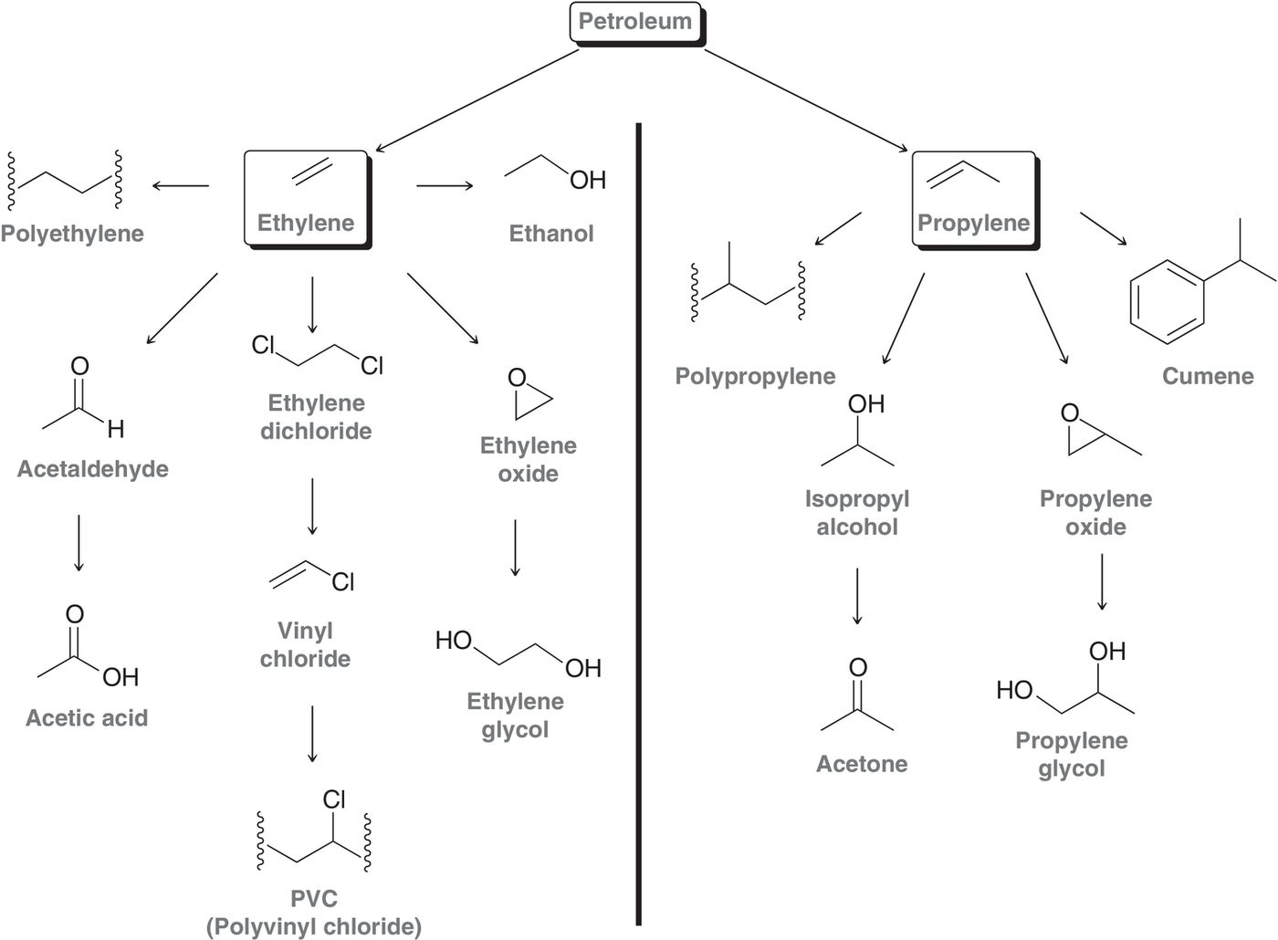
8.2 Alkenes in Nature and Industry

Slide 9
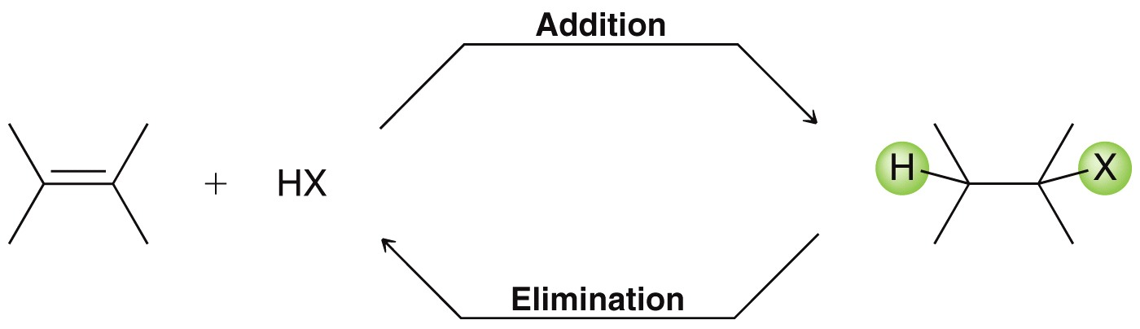
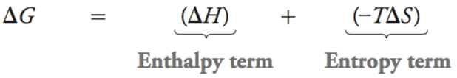
8.3 Addition vs. Elimination
Addition and elimination are equilibrating reactions:
  Which side is favored depends on temperature
  The higher the temperature, the more important entropy becomes:
Higher temp means
a bigger entropy term

Slide 10
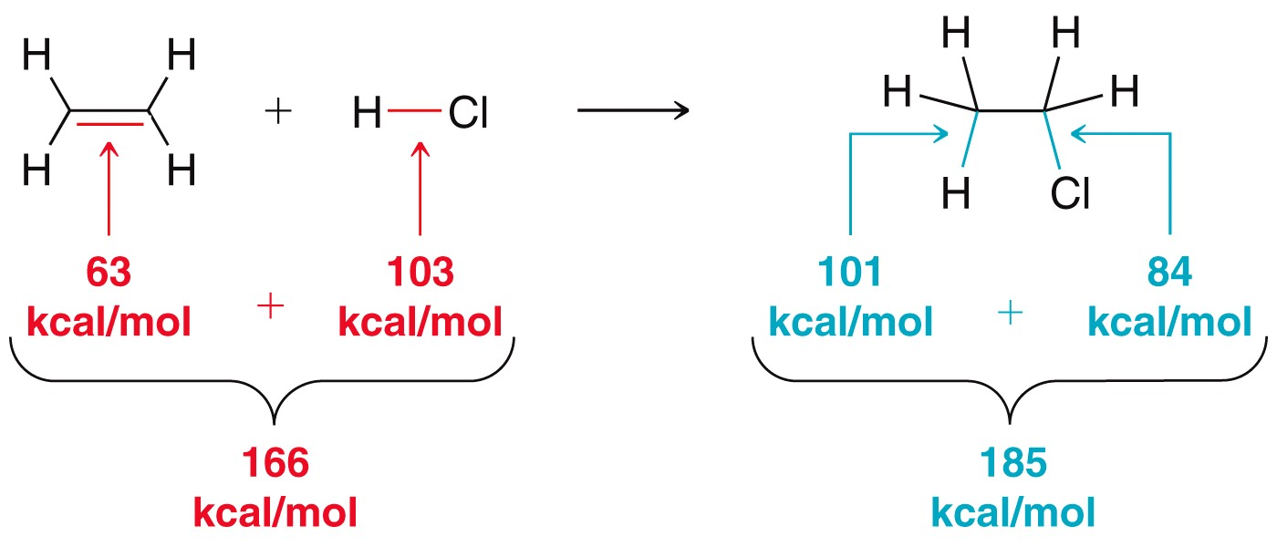
8.3 Addition vs. Elimination
Addition reactions are favored by enthalpy.
Sigma bonds are stronger (more stable) than π bonds
ΔH = Bonds broken – bonds formed
ΔH = 166 kcal/mol – 185 kcal/mol
ΔH = –19 kcal/mol

Slide 11
8.3 Addition vs. Elimination
Addition reactions are NOT favored by entropy.
Two molecules combine to form one product; entropy decreases
TWO reactants
ONE product

Slide 12
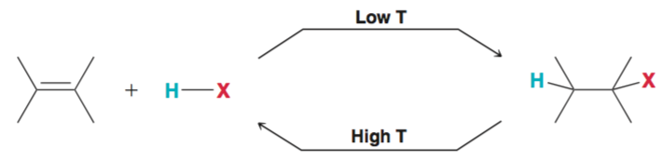
8.3 Addition vs. Elimination
At lower temps, enthalpy dominates, and addition reactions are favored
At higher temps, entropy dominates, and elimination reactions are favored
So, we use lower temperatures when doing an addition reaction

Slide 13
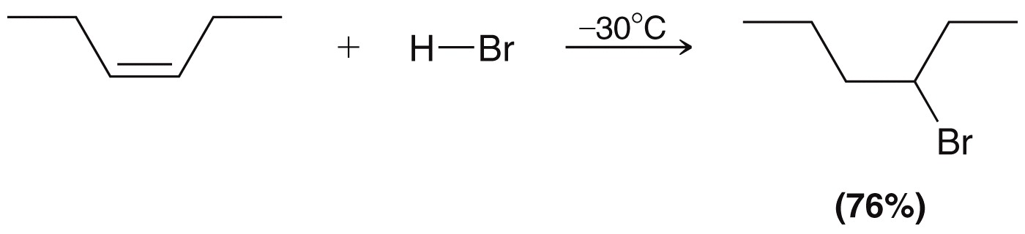
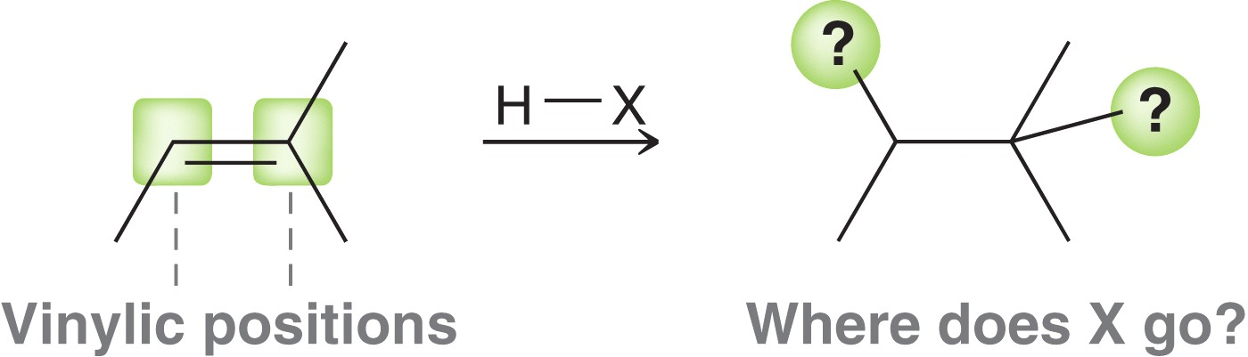
8.4 Hydrohalogenation
Hydrohalogenation: addition of H-X to an alkene
can use HCl, HBr, or HI
If the alkene is not symmetrical, then two regioisomers are possible, depending on which carbon gets the “H” and the “X”

Slide 14
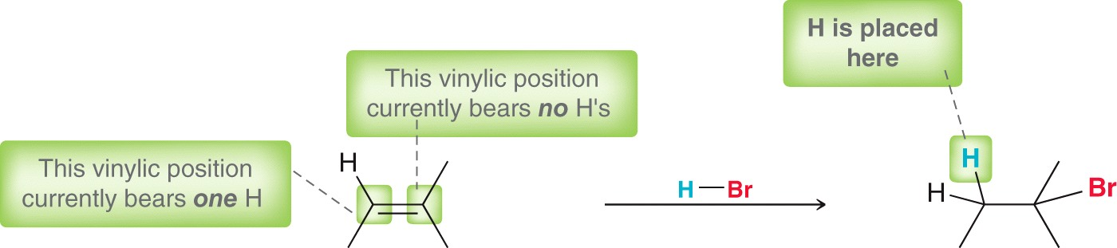
8.4 Hydrohalogenation - Regioselectivity
Hydrohalogenation is regioselective for Markovnikov addition
In 1869, Markovnikov observed the H atoms tend to add to the carbon already bearing more H atoms
The halogen is generally installed at the more substituted carbon

Slide 15
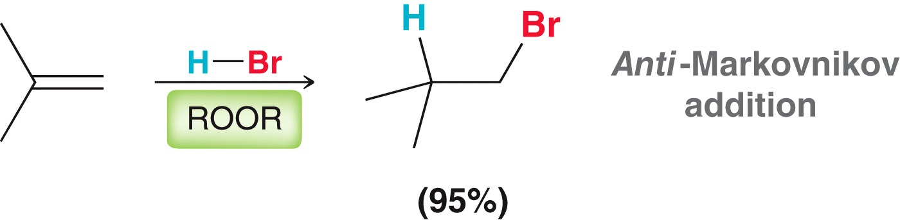
8.4 Hydrohalogenation - Regioselectivity
When peroxides are used with HBr, the opposite regioselectivity is observed.
The reaction mechanism must be different, when peroxides are present.

Slide 16
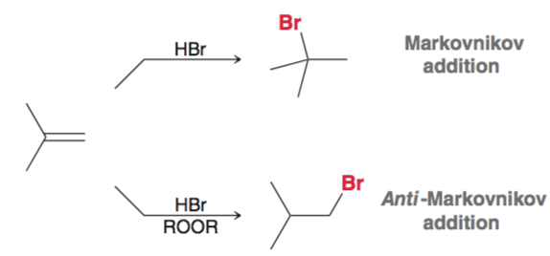
8.4 Hydrohalogenation - Regioselectivity
The important lesson here is that the regioselectivity of HBr addition can be controlled:

Slide 17


8.4 Hydrohalogenation - Regioselectivity
Conceptual Checkpoint 8.1 – Draw the expected major product for the following reactions

Slide 18
8.4 Hydrohalogenation - Regioselectivity
Conceptual Checkpoint 8.1 – Draw the expected major product for the following reactions
There are more practice problems in Checkpoint 8.1

Slide 19
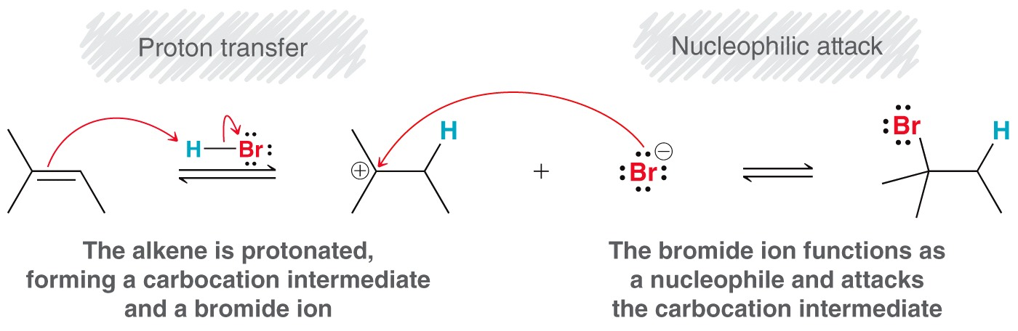
8.4 Hydrohalogenation - Mechanism
The mechanism is a two step process

Slide 20
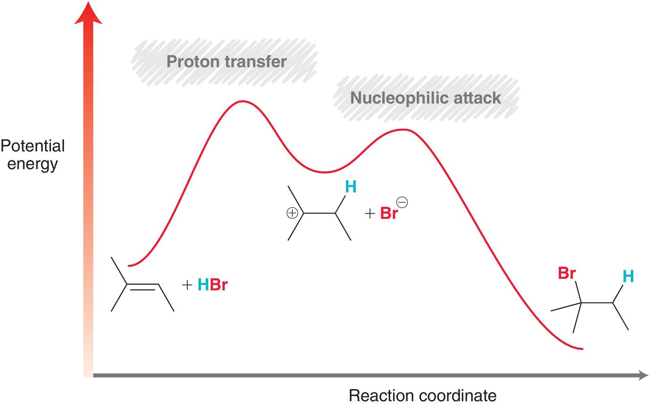
8.4 Hydrohalogenation - Mechanism
The step with the highest E_{a} is the rate determining step, which is the formation of the carbocation intermediate (the first step)

Slide 21
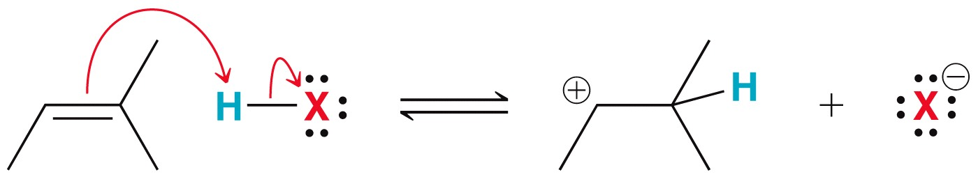
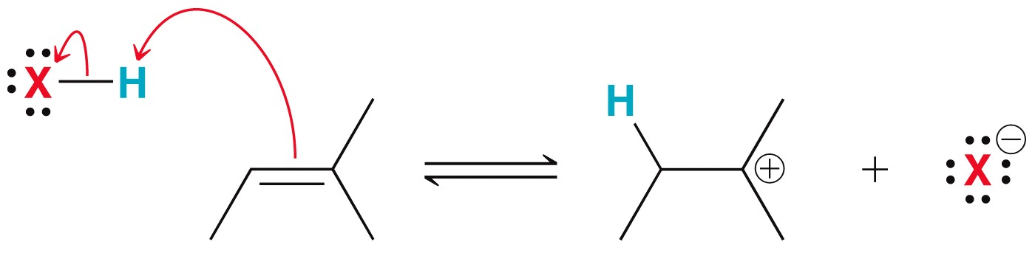
8.4 Hydrohalogenation - Mechanism
Recall that there are two possible products, Markovnikov and anti-Markovnikov
Markovnikov product is formed because of carbocation stability
2˚ carbocation
intermediate
anti Markovnikov
pathway
3˚ carbocation
intermediate
Markovnikov
pathway

Slide 22
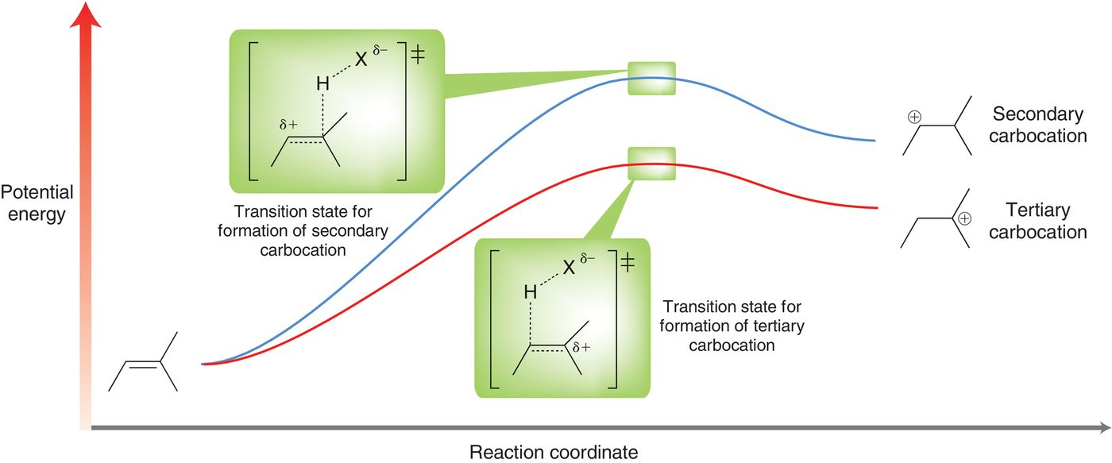

8.4 Hydrohalogenation - Mechanism
The Markovnikov product is formed through a lower energy (i.e. faster) transition state.
Practice with Skillbuilder 8.1

Slide 23
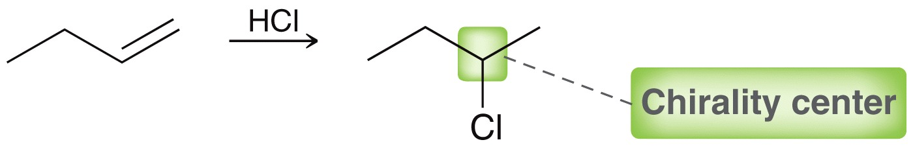
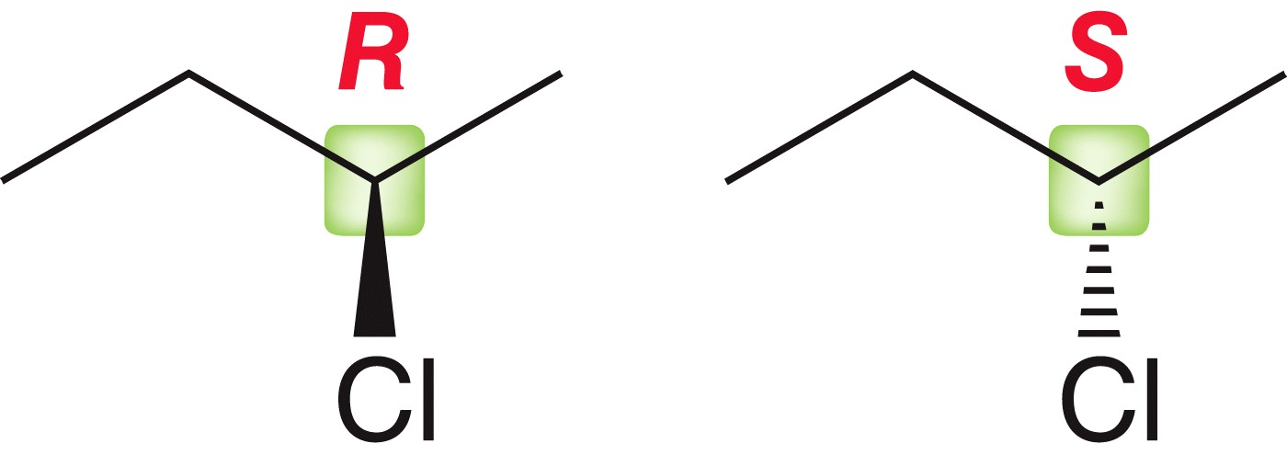
8.4 Hydrohalogenation - Stereochemistry
Hydrohalogenation may result in the formation of a chirality center
There are actually TWO Markovnikov products formed in this rxn
Two enantiomers are
formed in equal
amounts

Slide 24
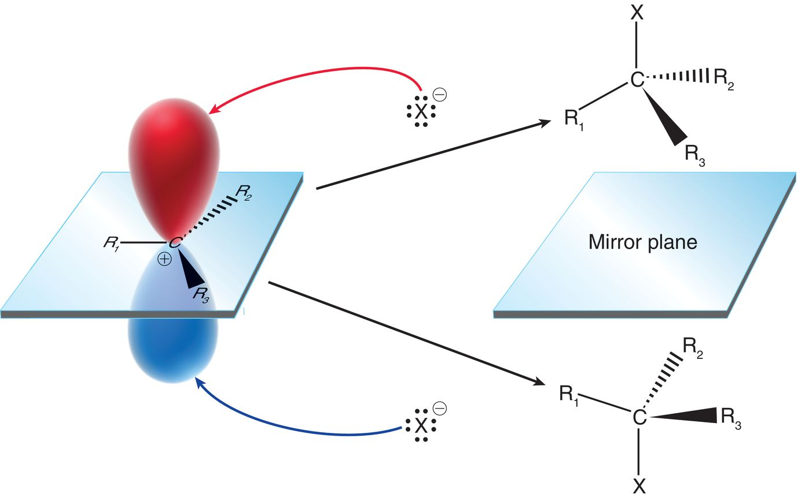
8.4 Hydrohalogenation - Stereochemistry
The carbocation intermediate can be attacked from either side of the empty p orbital, with equal probability
Practice with conceptual checkpoint 8.5

Slide 25
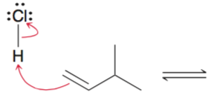
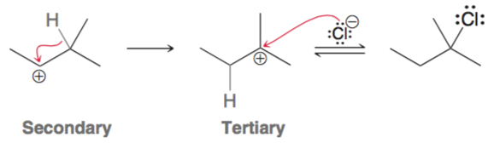
8.4 Hydrohalogenation - Rearrangements
Recall carbocations can rearrange (hydride or methide shift) if they can become more stable.
When this alkene undergoes hydrohalogenation, the 2˚ carbocation could rearrange to a more stable, 3˚ carbocation
1,2-hydride shift

Slide 26
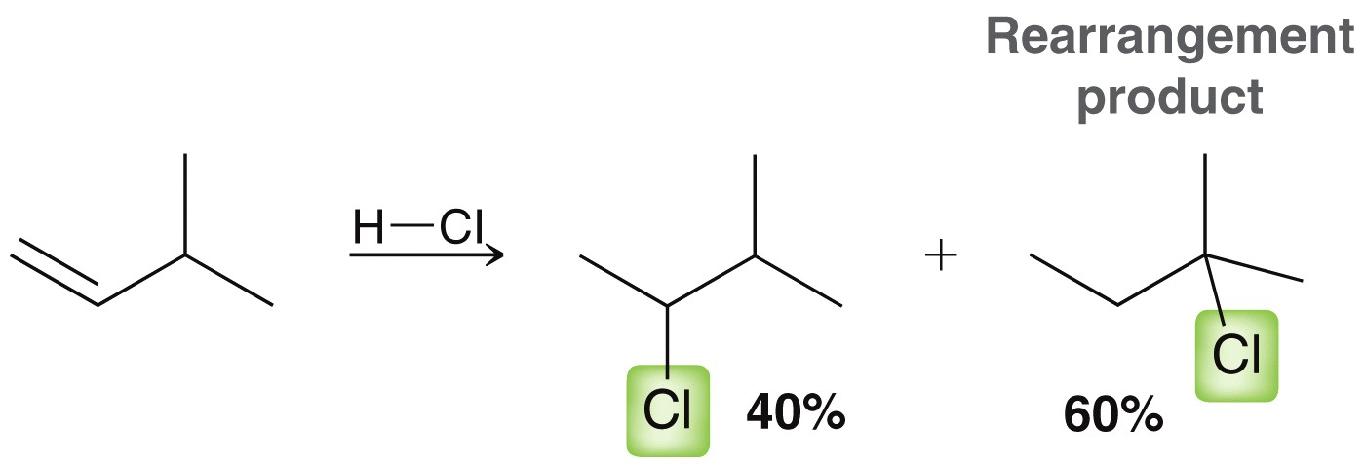
8.4 Hydrohalogenation - Rearrangements
Recall carbocations can rearrange (hydride or methide shift) if they can become more stable.
When carbocation rearrangements can occur, the DO occur
Practice with Skillbuilder 8.2

Slide 27
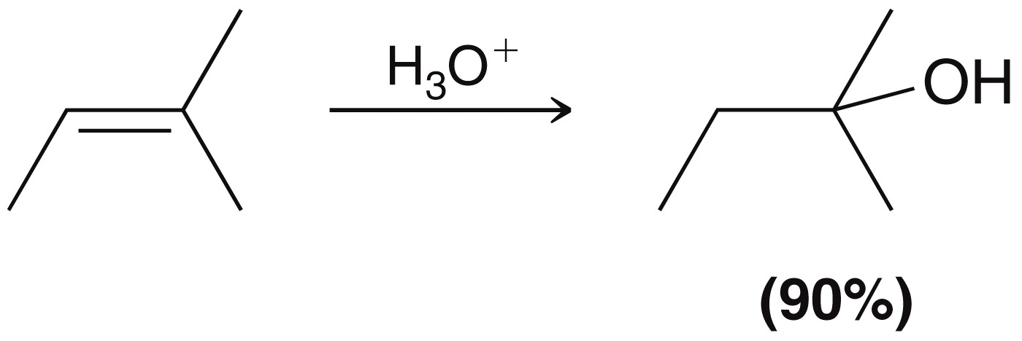
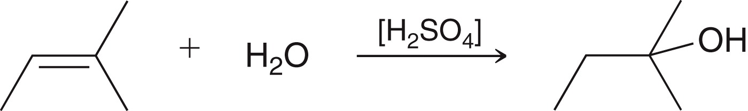
8.5 Acid-catalyzed Hydration
The components of water (H and OH) are added across the π bond
Acid-catalyzed hydration follows Markovnikov regeioselectivity
Sulfuric acid is typically the acid catalyst used

Slide 28
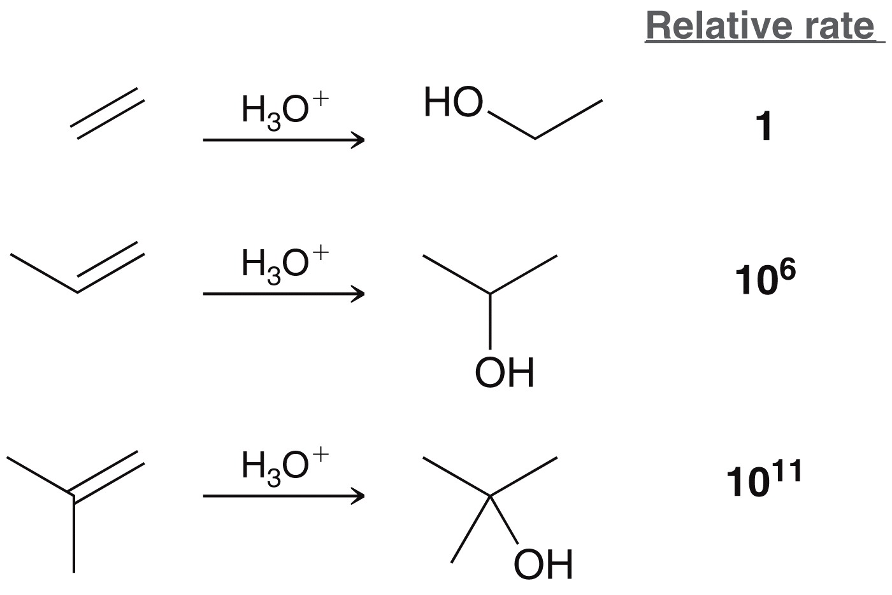
8.5 Acid-catalyzed Hydration
The OH is added to the more substituted carbon of the alkene
The more substituted the carbon atom is, the faster the reaction
this data is consistent
with a mechanism
that proceeds through
a carbocation
intermediate

Slide 29
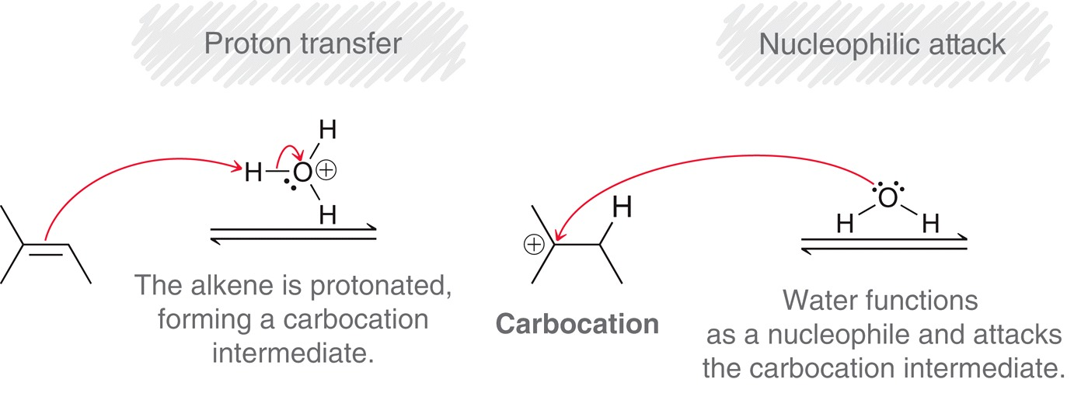
8.5 Hydration - Mechanism
The mechanism for acid-catalyzed hydration is essentially the same as hydrohalogenation:

Slide 30
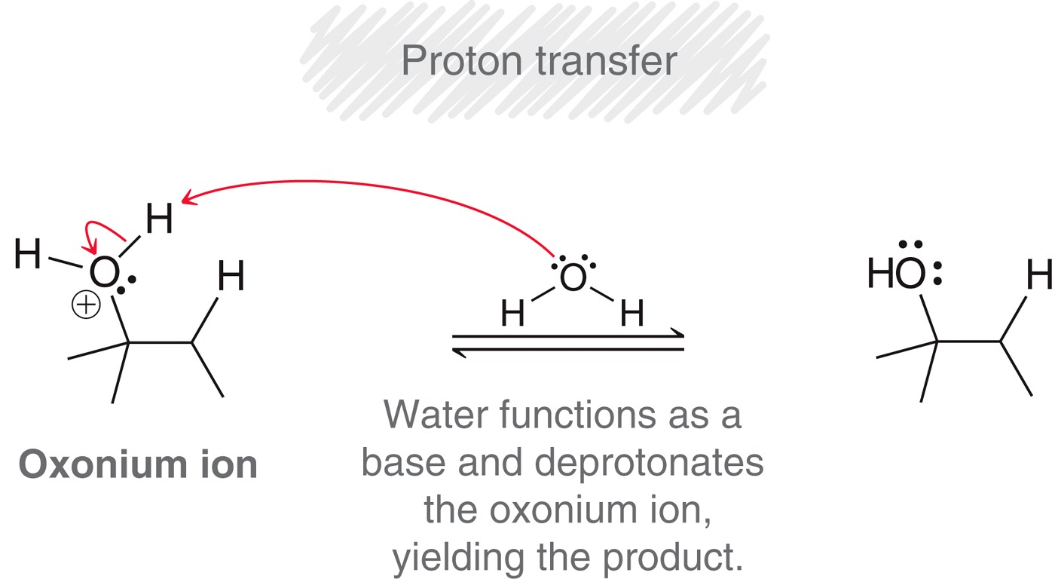
8.5 Hydration - Mechanism
The mechanism for acid-catalyzed hydration is essentially the same as hydrohalogenation:
But with hydration, nucleophilic attack produces an oxonium ion, which is deprotonated to afford the alcohol product:

Slide 31
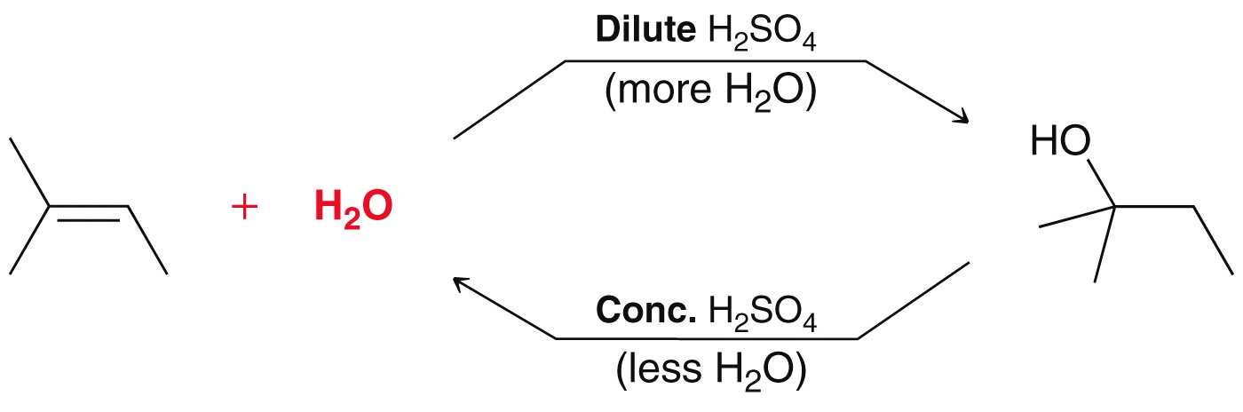
8.5 Hydration - Thermodynamics
The reactants and products of hydration are in equilibrium
We exploit La Chatelier’s principle to control the equilibrium
If we are synthesizing an alcohol from an alkene, we would use excess water
If we are synthesizing an alkene from an alcohol, we would only use acid, and not add water to the reaction

Slide 32
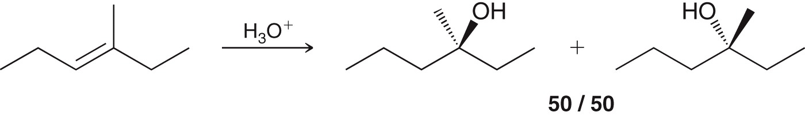
8.5 Hydration - Stereochemistry
The stereochemistry of hydration is analogous to hydration, for the same reason(s).
If a new chirality center is formed, a mixture of R and S is obtained
As always, if enantiomers are formed in a reaction, then a racemic mixture is obtained.
Practice with SkillBuilder 8.3

Slide 33
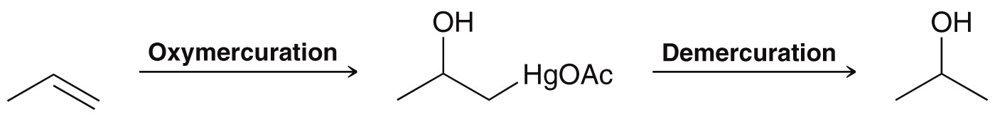
8.6 Oxymercuration-Demercuration
Markovnikov hydration (H₂O, H₂SO₄) has limited application… rearrangements often occur, giving mixture of products
Oxymercuration-demercuration is an alternative
  Markovnikov addition of H and OH
  No rearrangements occur

Slide 34
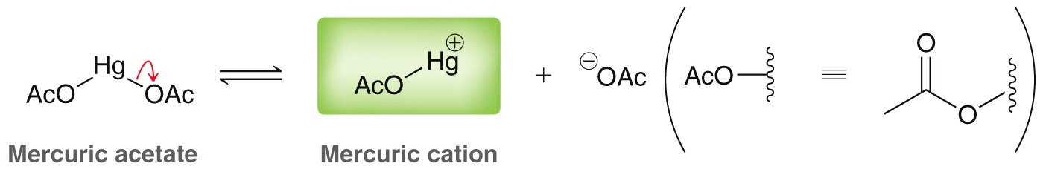
8.6 Oxymercuration-Demercuration
The mercuric cation is the (Lewis) acid in this reaction, instead of H⁺

Slide 35
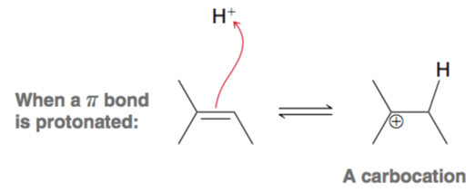
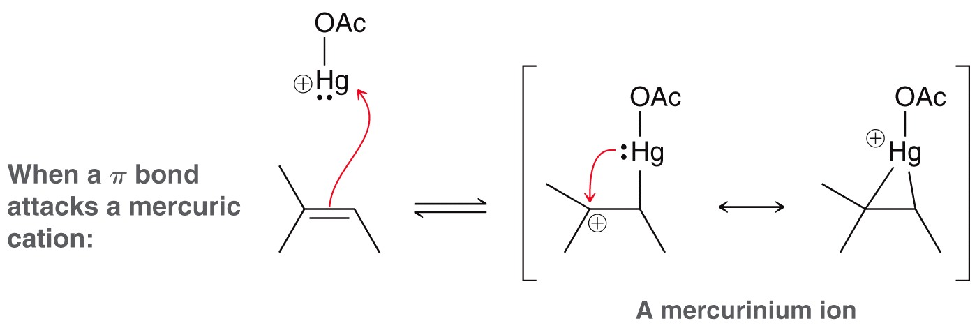
8.6 Oxymercuration-Demercuration
When the p bond attacks the mercuric cation, a stabilized cation is formed, and so it will not rearrange like carbocations do.
carbocations will
rearrange if they can
Mercurinium ions
will not rearrange

Slide 36
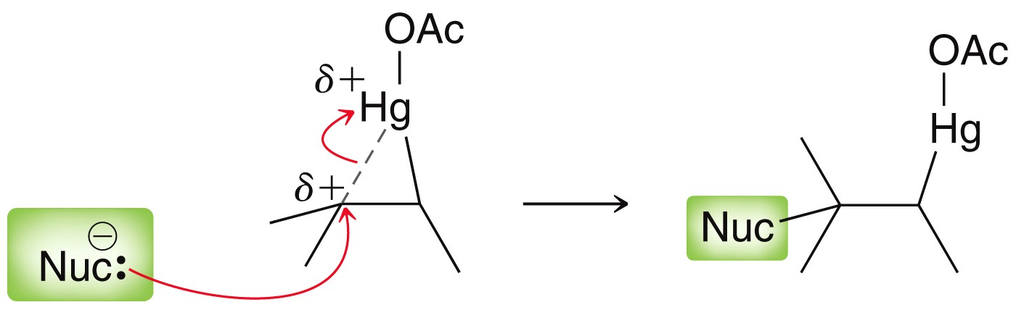
8.6 Oxymercuration-Demercuration
The mercurinium ion reacts with nucleophiles, and it can easily be attacked by a nucleophile
NaBH₄ is generally used to replace the –HgOAc group with a –H group via a free radical mechanism

Slide 37
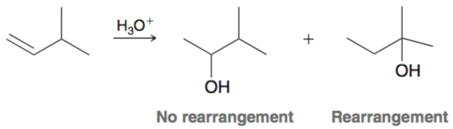
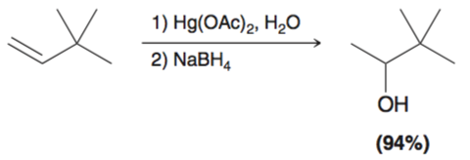
8.6 Oxymercuration-Demercuration
The two reaction sequence provides same product as acid-catalyzed hydration, but without rearrangement.
Practice with Conceptual Checkpoint 8.12
Mixture of products
formed due to a
rearranged product
A 1,2-methide shift would
occur if H₂O,H₂SO₄
was used

Slide 38
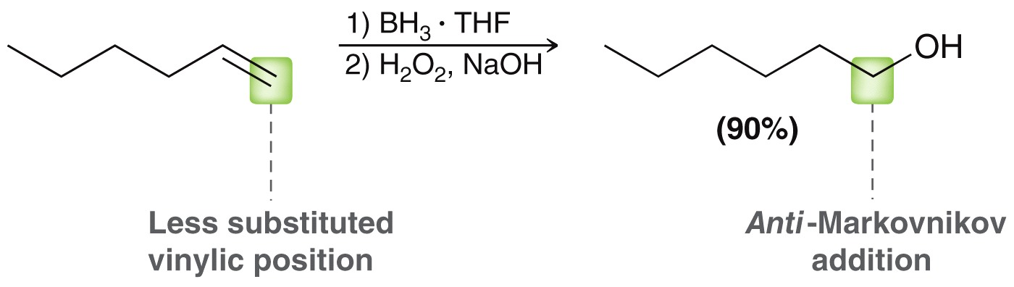
8.7 Hydroboration-Oxidation
Hydroboration-Oxidation adds H and OH with anti Markovnikov regioselectivity
Note that this is a two-reaction sequence

Slide 39
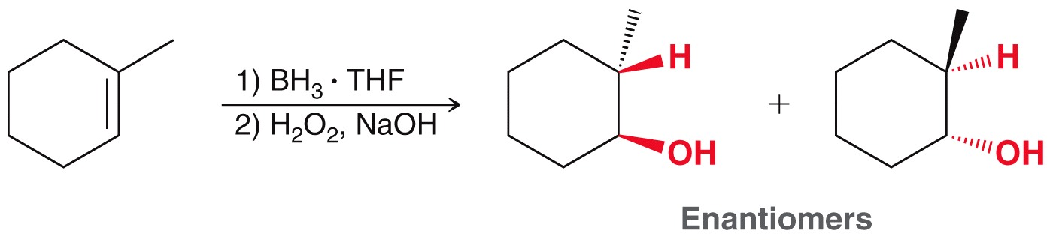
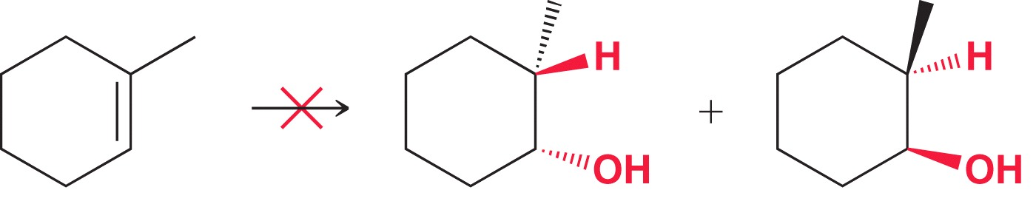
8.7 Hydroboration-Oxidation
Hydroboration-Oxidation is also stereoselective
  H and OH are added in a syn fashion
Anti addition is NOT observed

Slide 40
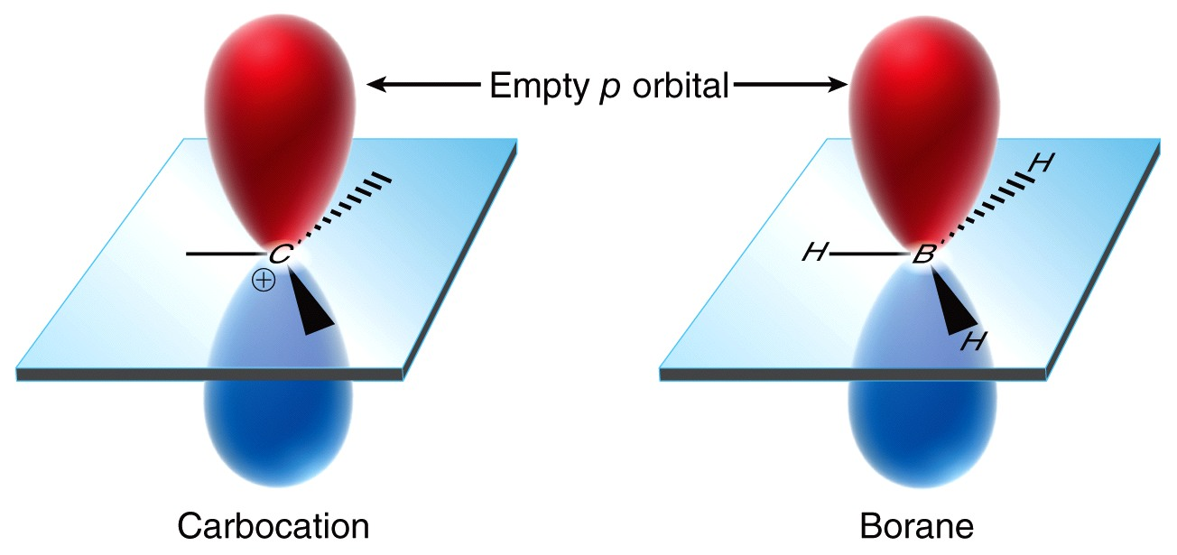
8.7 Hydroboration-Oxidation
Geometry/hybridization of BH₃ is analogous to a carbocation

Slide 41
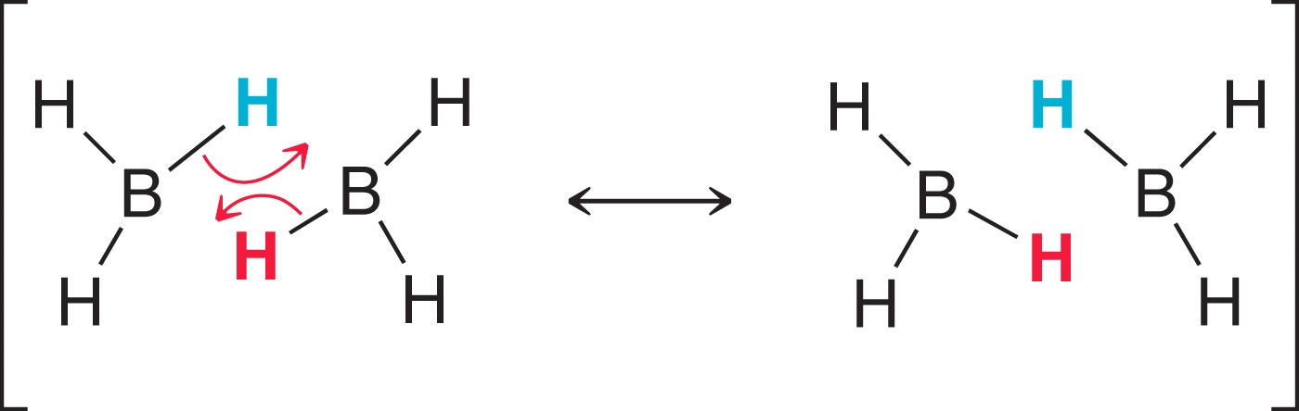

8.7 Hydroboration-Oxidation
The boron atom does not have an octet undergo intermolecular resonance to help fulfill their octets
The resonance hybrid reveals three-center, two-electron bonds

Slide 42

8.7 Hydroboration-Oxidation
B₂H₆ has to be stabilized in an ether solvent so that an appreciable amt of BH₃ is present
The active reagent is BH₃•THF

Slide 43


8.7 Hydroboration-Oxidation Mechanism
Hydroboration follows anti Markovnikov regioselectivity
The less substituted carbon attacks the boron, and the more substituted carbon develops a δ⁺ which triggers a hydride shift
One BH₃ reacts with three equivalents of alkene

Slide 44
8.7 Hydroboration-Oxidation Mechanism
Hydroboration follows anti Markovnikov regioselectivity
The less substituted carbon attacks the boron, and the more substituted carbon develops a δ⁺ which triggers a hydride shift
Recall that the more substituted carbon will be better at stabilizing a positive charge

Slide 45

8.7 Hydroboration-Oxidation Mechanism
Hydroboration follows anti Markovnikov regioselectivity
Sterics also influence the regioselectivity

Slide 46

8.7 Hydroboration-Oxidation Mechanism

Slide 47


8.7 Hydroboration-Oxidation selectivity
Hydroboration is stereospecific: only syn addition occurs
If only one chirality center is formed, a pair of enantiomers is formed by addition to either side of the alkene

Slide 48


8.7 Hydroboration-Oxidation
Hydroboration is stereospecific: only syn addition occurs
If two chirality centers are formed, again a pair of enantiomers is obtained

Slide 49
8.7 Hydroboration-Oxidation
Predict the product(s) of the following reaction:

Slide 50
8.7 Hydroboration-Oxidation
Predict the product(s) of the following reaction:
Two chirality centers are formed. Why do we not obtain a mixture of enantiomers?
Practice with SkillBuilder 8.4
In this case, a mixture
of diastereomers is obtained

Slide 51

8.8 Catalytic Hydrogenation
Hydrogenation - the addition of H₂ across a C=C double bond
Requires a metal catalyst
Alkene is converted to the corresponding alkane

Slide 52


8.8 Catalytic Hydrogenation selectivity
Hydrogenation - the addition of H₂ across a C=C double bond
Stereospecific – only syn addition is observed with hydrogenation
Two chirality centers are formed
only the stereoisomers resulting
from syn addition are obtained

Slide 53

8.8 Catalytic Hydrogenation
Without the metal catalyst, the addition of H₂ is too slow due to a very high activation energy (E_{a})

Slide 54

8.8 Catalytic Hydrogenation
The metal surface binds the H₂, and the alkene, which explains why H atoms are added syn across the π bond

Slide 55


8.8 Catalytic Hydrogenation
Syn addition of H2 to a symmetrical alkene will not produce a pair of enantiomers.
A meso compound will be produced instead
Practice with SkillBuilder 8.5

Slide 56


8.8 Catalytic Hydrogenation
Homogenous catalyst – does not dissolve in reaction medium, like Pt or Pd metal
Heterogenous catalyst – does dissolve in the reaction medium, accomplished by using a ligand with the metal
Wilkinson’s catalyst

Slide 57

8.8 Asymmetric Hydrogenation
Recall that the creation of one or two chiral centers results in a mixture of enantiomers (unless a meso compound is produced)

Slide 58


8.8 Asymmetric Hydrogenation
If a chiral catalyst is used, it is possible to synthesize only one enantiomer as the major product
This can be accomplished by replaced the phosphine ligands on the Wilkinson catalyst with chiral phosphine ligands

Slide 59

8.8 Asymmetric Hydrogenation
If a chiral catalyst is used, it is possible to synthesize only one enantiomer as the major product
William S. Knowles developed a synthesis of L-Dopa using a asymmetric hydrogenation as the key step
He later won the Nobel Prize in 2001

Slide 60

8.8 Asymmetric Hydrogenation
If a chiral catalyst is used, it is possible to synthesize only one enantiomer as the major product
Ryoji Noyori showed that the chiral ligand BINAP also affords one enantiomer with high selectivity
For his work, Noyori also won the Nobel Prize (with Knowles) in 2001

Slide 61


8.9 Halogenation
Halogenation – addition of two halogen atoms across a C=C double bond
Halogenation is a key step in the production of PVC

Slide 62

8.9 Halogenation
Halogenation only practical with Cl₂ and Br₂
halogenation with I₂ is poor; halogenation with F₂ is too violent
Regioselectivity – halogenation occurs with anti addition

Slide 63


8.9 Halogenation
Br₂ is nonpolar, but polarizable. Approach of a nucleophile will induce a dipole
Think of Br₂ as a bromine atom bonded to a good leaving group
The alkene acts as the nucleophile

Slide 64

8.9 Halogenation - stereoselectivity
Only anti addition is observed, so the mechanism is not consistent with a true carbocation intermediate
Syn addition doesn’t occur

Slide 65

8.9 Halogenation - mechanism
The formation of a bromomium ion intermediate is consistent with anti addition
This intermediate is similar to the mercurinium ion

Slide 66



8.9 Halogenation - mechanism
The formation of a bromomium ion intermediate is consistent with anti addition
Br- attacks backside (anti) to the bromonium ion

Slide 67

8.9 Halogenation - stereoselectivity
Halogenation is stereospecific, the stereochemistry of the starting alkene determines the stereochemistry of the product(s)
Practice with Conceptual Checkpoint 8.20

Slide 68

8.9 Halohydrin Formation
Halohydrins – formed when halogenation is conducted in water
Water acts as the nucleophile that attacks the bromonium ion
There are many more H₂O molecules compared to Br¹⁻ ions, so H₂O outcompetes Br¹⁻ for the bromonium ion

Slide 69


8.9 Halohydrin Formation
After water attacks, it is deprotonated to yield the neutral bromohydrin product
Here, the product is called
a chlorohydrin

Slide 70

8.9 Halohydrin Formation-Regioselectivity
Halohydrin Formation is regioselective
  The halide adds to the less substituted carbon
  The OH adds to the more substituted carbon

Slide 71

8.9 Halohydrin Formation-Regioselectivity
Regioselectivity results from H₂O attacking the more substituted carbon (faster than it attacks the less substituted one)

Slide 72


8.9 Halohydrin Formation-Regioselectivity
Regioselectivity results from H₂O attacking the more substituted carbon (faster than it attacks the less substituted one)
The more substituted carbon has more cationic character.
Practice with SkillBuilder 8.6
Transition state

Slide 73


8.10 Anti-Dihydroxylation
Dihydroxylation – addition of OH and OH across the π bond
Anti dihydroxylation of an alkene is a two-reaction process

Slide 74


8.10 Anti-Dihydroxylation
Conversion of alkene to an epoxide:
A peroxyacid is used as the reagent

Slide 75

8.10 Anti-Dihydroxylation - mechanism
Conversion of alkene to an epoxide:
The epoxide is reacted with H₂O and acid catalyst to form the anti diol.

Slide 76

8.10 Anti-Dihydroxylation
Note the similarities between these three key intermediates
Ring strain and a +1 formal charge makes these structures good electrophiles
They also each yield anti products, because the nucleophile must attack from the side opposite the leaving group
Practice with SkillBuilder 8.7

Slide 77


8.11 Syn Dihydroxylation
syn dihydroxylation – adds OH and OH across the p bond, in a concerted, syn fashion.

Slide 78

8.11 Syn Dihydroxylation
OsO₄ is expensive, and toxic.
NMO or an alkyl peroxide is used as an co-oxidant, so only a catalytic amount of OsO₄ is necessary.

Slide 79

8.11 Syn Dihydroxylation
Syn dihydroxylation can also be achieved with KMnO₄ but only under mild conditions (cold temperatures)
The synthetic utility of MnO₄¹⁻ is limited: it reacts with many other functional groups as well
Practice with Conceptual Checkpoint 8.27

Slide 80


8.12 Oxidative Cleavage
C=C double bonds are also reactive toward oxidative cleavage
Ozonolysis is one such process
Ozone exists as a resonance hybrid of two contributors

Slide 81


8.12 Oxidative Cleavage
Common reducing agents include dimethyl sulfide and Zn/H₂O. Practice with SkillBuilder 8.8

Slide 82
8.12 Oxidative Cleavage
Predict a bicyclic reactant used to form the product below

Slide 83
8.12 Oxidative Cleavage
Predict a bicyclic reactant used to form the product below

Slide 84
8.13 Predicting Products of Addition Rxns
Analyze the reagents used to determine what groups will be added across the C=C double bond
Determine the regioselectivity (Markovnikov or anti-Markovnikov)
Determine the stereospecificity (syn or anti addition)
  Each step can be achieved with minor reagent memorization and a firm grasp of the mechanistic rational
  The more familiar you are with the mechanisms, the easier predicting products will be
  Practice with SkillBuilder 8.9

Slide 85



8.14 One-Step Syntheses
To set up a synthesis, assess the reactants and products to see what changes need to be made
Addition rxn
Substitution rxn
Elimination rxn

Slide 86
8.14 One-Step Syntheses
To set up a synthesis, assess the reactants and products to see what changes need to be made
Give reagents and conditions for the following
Here, we need to do an
addition rxn, and add H
and OH, Markovnikov

Slide 87
8.14 One-Step Syntheses
To set up a synthesis, assess the reactants and products to see what changes need to be made
Give reagents and conditions for the following
Practice with the other examples in SkillBuilder 8.10
H₂O, H₂SO₄

Slide 88


8.14 Multi-step Syntheses
Changing the position of a Leaving Group:
The following transformation cannot be done with a single rxn
It can be accomplished in a two-rxn sequence:

Slide 89

8.14 Multi-step Syntheses
Changing the position of a Leaving Group:
To do the elimination reaction, the base needs to be carefully chosen:
This is the alkene we need,
so we use non-bulky base

Slide 90




8.14 Multi-step Syntheses
Changing the position of a Leaving Group:
Then we need to decide the reagents needed to add H and Br:
So, overall:
Markovnikov addition of
H and Br

Slide 91


8.14 Multi-step Syntheses
Consider the following transformation:
This is not a simple substitution, addition or elimination, so two processes must be combined

Slide 92

8.14 Multi-step Syntheses
The elimination must be done to give the Hofmann alkene, via an E2 elimination
The alcohol must be changed to a good leaving group so we can use a bulky base to afford the Hofmann product:

Slide 93

8.14 Multi-step Syntheses
The addition reaction must give anti Markovnikov addition of H and OH
So, overall:
Practice with SkillBuilder 8.11

Slide 94


8.14 Multi-step Syntheses
Changing the position of a π bond:
Again, two processes must be combined
anti Markovnikov
addition of H and Br
elimination to give
the Hofmann product

Slide 95
8.14 Multi-step Syntheses
Changing the position of a π bond:
Now recall the reagents needed for each reaction:
Practice with Skillbuilder 8.12
anti Markovnikov
addition of H and Br
elimination to give
the Hofmann product
HBr , ROOR
(anti Markovnikov)
t-BuOK
(bulky base)

Slide 96

8.14 Review of Addition Reactions
Ten reactions of alkenes covered in this chapter:

Slide 97

8.14 Review of Addition Reactions

