Slide 1
Organic Chemistry
Third Edition
David Klein
Chapter 10
Radical Reactions

Slide 2
10.1 Radicals - Introduction
Free radicals form when bonds break homolytically
Note the single-barbed or fishhook arrow used to show the electron movement

Slide 3
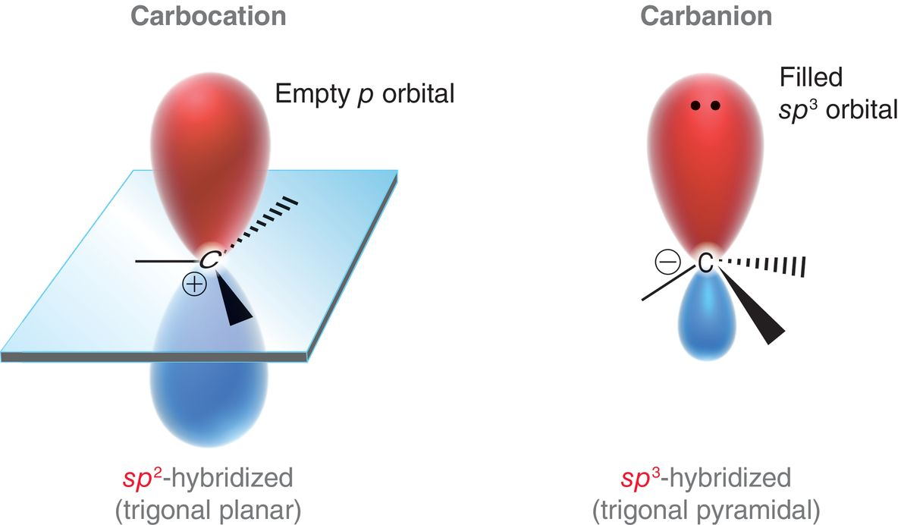
10.1 Radical Structure and Geometry
Recall the orbital hybridization in carbocations and carbanions

Slide 4
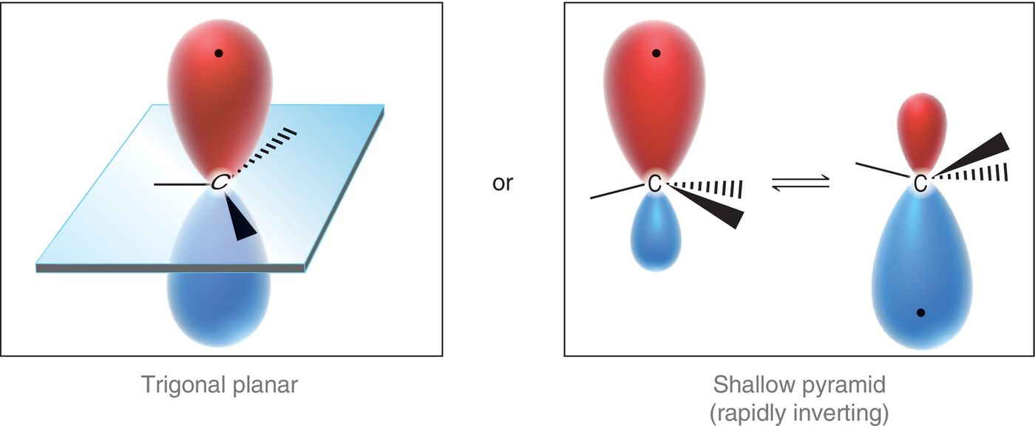
10.1 Radical Structure and Geometry
Radicals appear to be trigonal planar (sp² hybridized) or shallow trigonal planar (sp³ hybridized)
sp² hybridized

Slide 5
10.1 Free Radical Stability
Radicals are neutral (no formal charge) but still electron deficient (incomplete octet)
Radicals follow the same stability trend as carbocations, as they are both electron deficient species

Slide 6
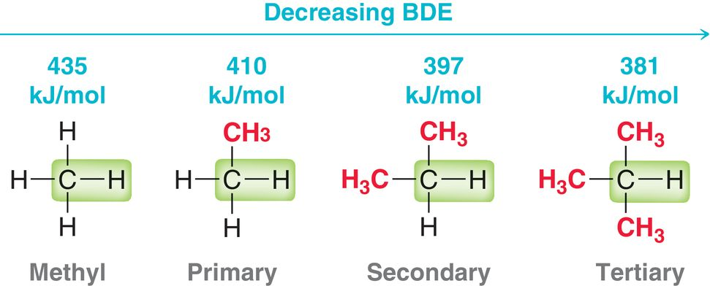
10.1 Free Radical Stability
Bond strength is inversely proportional to carbon radical stability.
The more stable the resulting radical(s), the weaker the bond
Practice with Conceptual Checkpoint 10.1

Slide 7
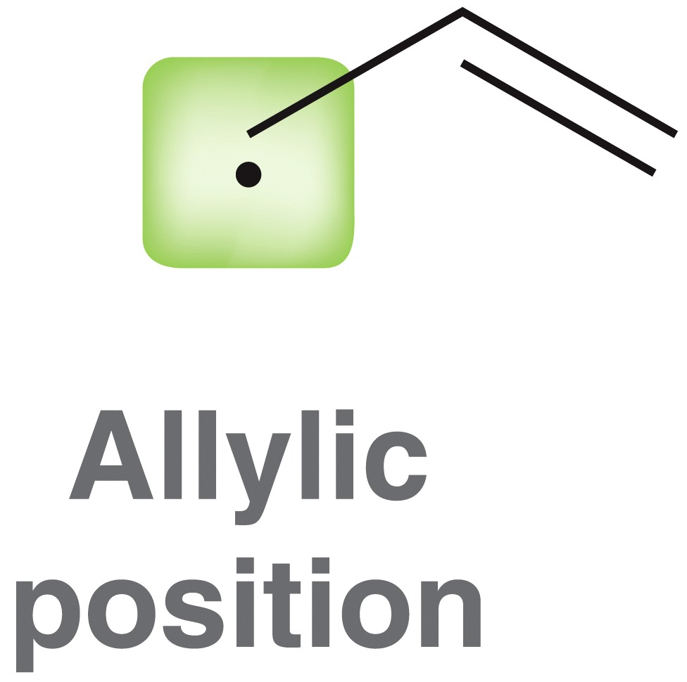
10.1 Free Radical Resonance
Radicals, like carbocations, are stabilized by resonance delocalization.
Fishhook arrows are used to present possible resonance forms

Slide 8
10.1 Free Radical Resonance
The more resonance delocalized a radical is, the more stable it is
Benzylic radicals are more stable than allylic radicals because the radical is delocalized over more carbon atoms

Slide 9
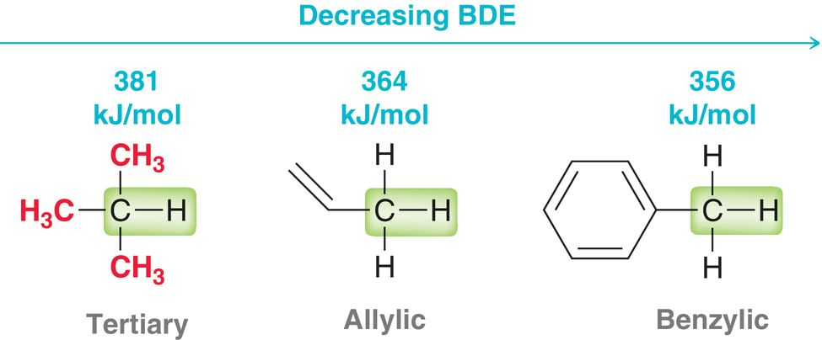
10.1 Resonance Stabilization
Resonance stabilized radicals are more stable than 3˚ radicals
Practice with SkillBuilder 10.1

Slide 10
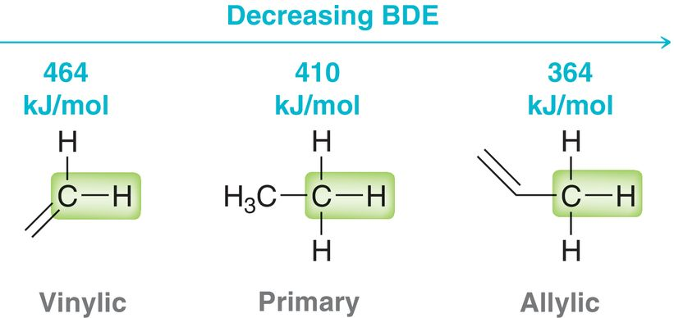
10.1 Radical Stability
Vinylic radicals are especially unstable (as with vinyl cations)
A radical in a sp² orbital is less stable than one in a sp³ orbital
Practice with SkillBuilder 10.2

Slide 11
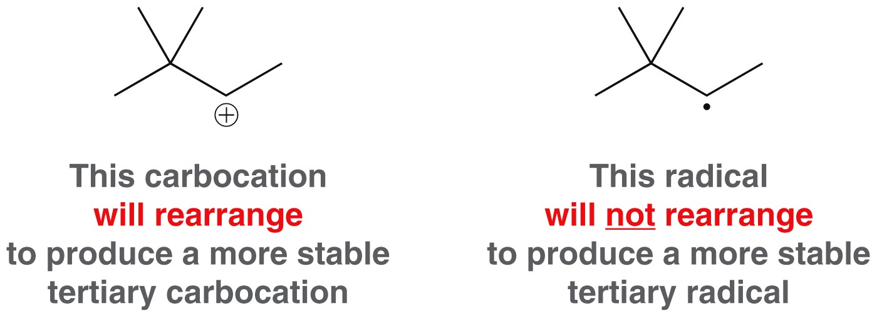
10.2 Patterns in Radical Mechanisms
Like ionic mechanisms, radical mechanisms follow patterns
But, radical mechanisms are distinctively different.
For example, radicals do not undergo rearrangement
Radical mechanisms follow SIX key arrow-pushing patterns

Slide 12
10.2 Patterns in Radical Mechanisms
Homolytic Cleavage: initiated by light or heat
Addition to a pi bond
Hydrogen abstraction: not the same as proton transfer
Halogen abstraction

Slide 13
10.2 Patterns in Radical Mechanisms
Elimination: The reverse of addition
the radical, on the α carbon is pushed toward the β carbon to eliminate a radical atom/group
Coupling: the reverse of homolytic cleavage

Slide 14
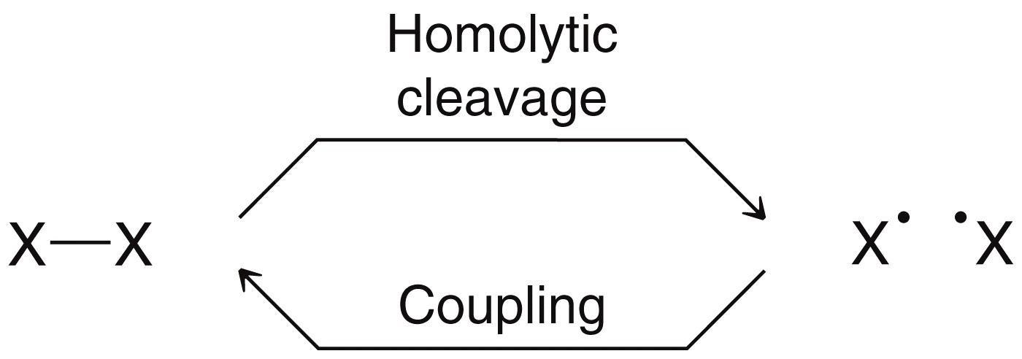
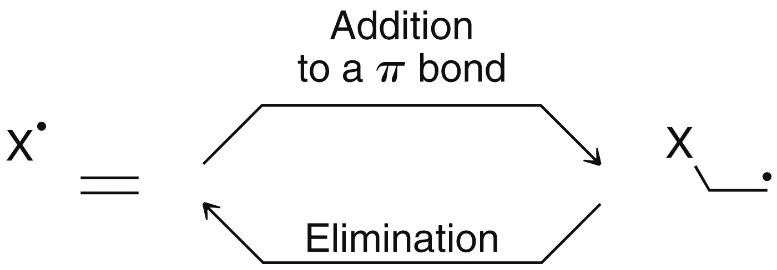
10.2 Patterns in Radical Mechanisms
Group the relationship(s) among these six patterns and you see there are only 3 processes, forward and backward
Practice with SkillBuilder 10.3

Slide 15
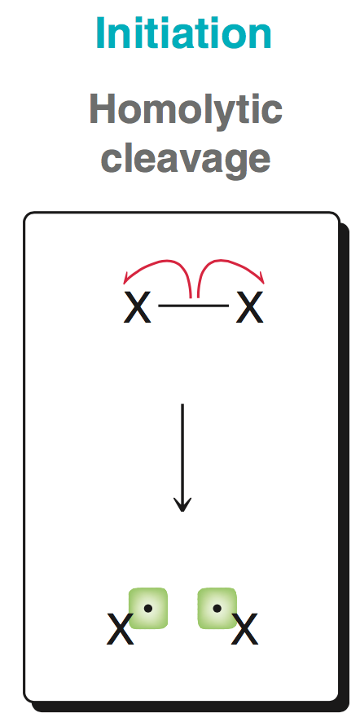
10.2 Patterns in Radical Mechanisms
The steps in a radical mechanism are classified as either initiation, termination, or propagation
An initiation step is one where
radical species are formed from
a non-radical species

Slide 16
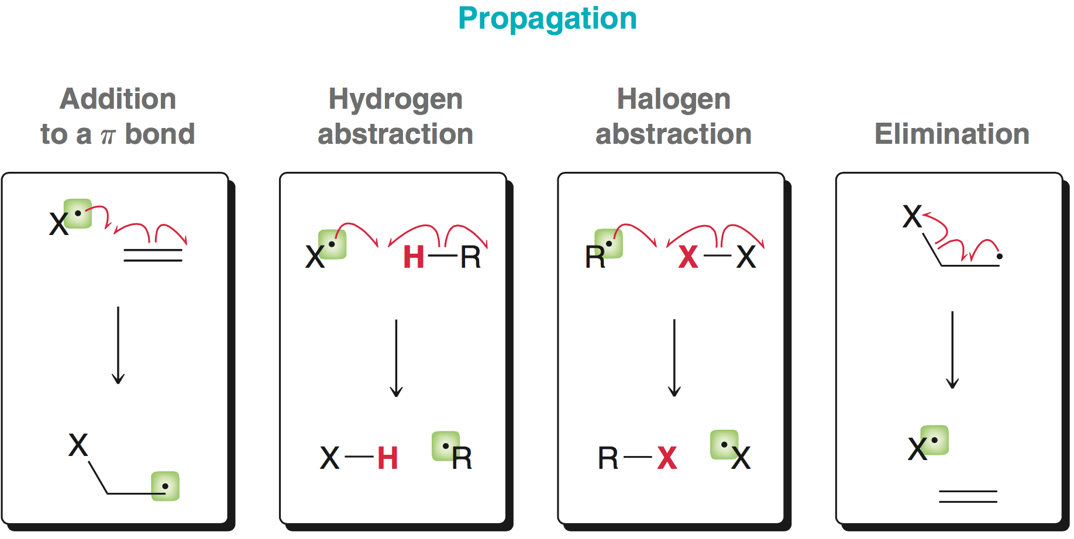
10.2 Patterns in Radical Mechanisms
Propagation occurs when radical reacts with a non-radical species, to form a new radical (and non-radical)

Slide 17
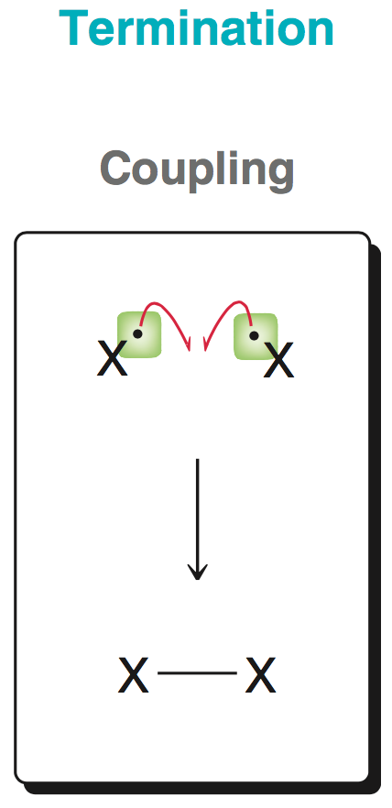
10.2 Patterns in Radical Mechanisms
Termination occurs when two radical species react to form a non-radical species
The complete definitions of
initiation, propagation and
termination will be discussed
later

Slide 18
10.3 Chlorination of Methane
Chlorination of methane follows a radical mechanism:
Radical mechanism consists of three distinct stages:
INITIATION: chlorine radicals are created

Slide 19
10.3 Chlorination of Methane
PROPAGATION: these steps are self-sustaining. The first propagation step consumes a Cl radical, and the second step produces one.

Slide 20
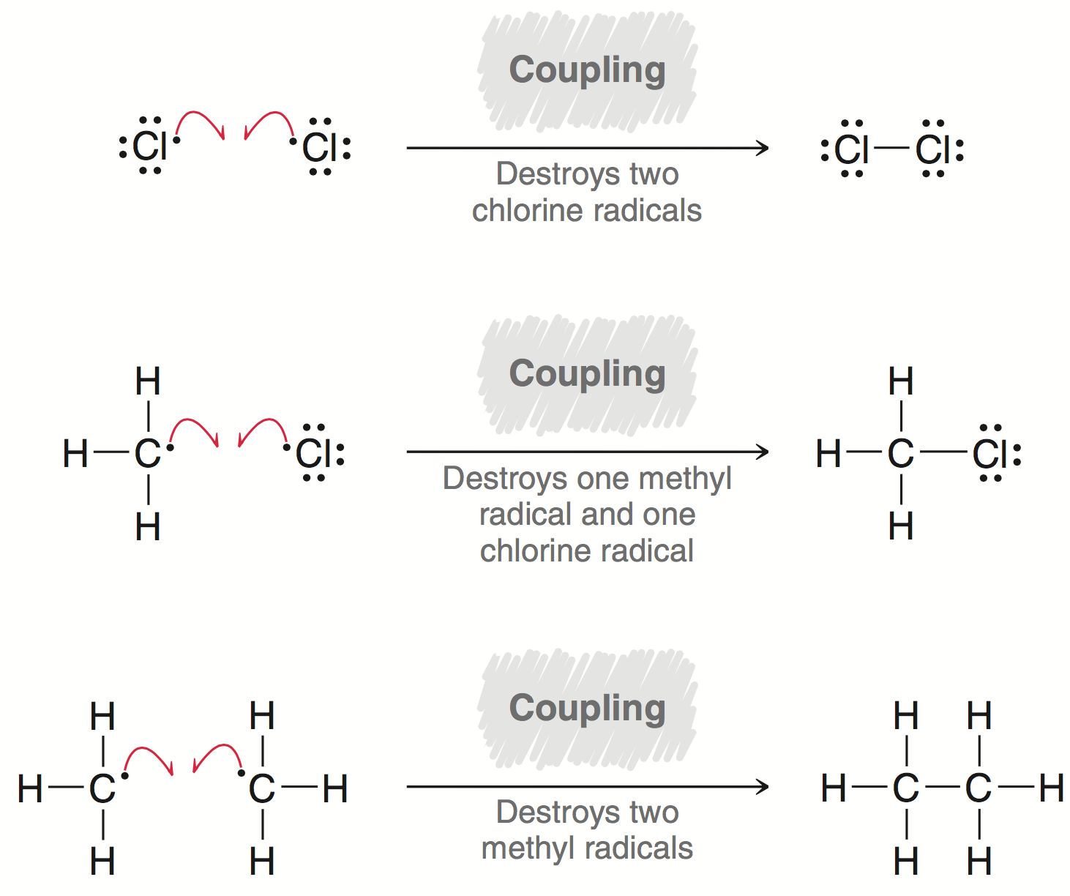
10.3 Chlorination of Methane
TERMINATION: occurs when radicals collide/couple.

Slide 21
10.3 Chlorination of Methane
The sum of the propagation steps gives the net reaction:
Propagation is a chain reaction: the product(s) for a later step serve as reactant(s) for an earlier step in the mechanism

Slide 22
10.3 Chlorination of Methane
Polychlorination is difficult to prevent
Methyl chloride is more reactive towards radical halogenation than methane
Need excess methane, relative to Cl2, for monochlorination to be the major product.
Practice with SkillBuilder 10.4

Slide 23
10.3 Radical Initiators
Radical initiator: possesses a weak bond that cleaves homolytically with heat or light
The acyl peroxide is most reactive, and is effective at 80 °C
dihalides
alkyl
peroxides
acyl
peroxides

Slide 24
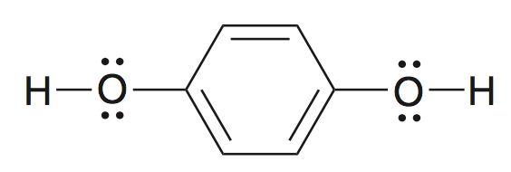
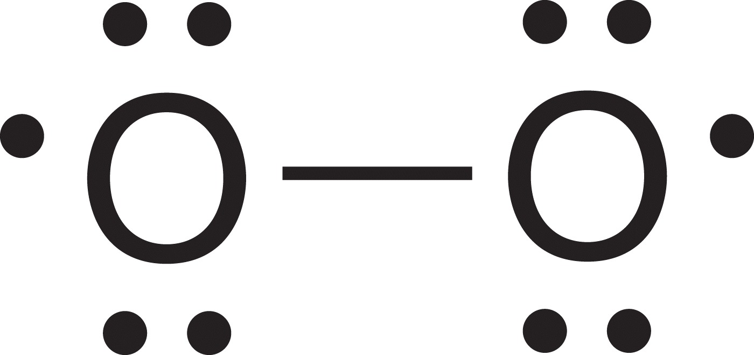
10.3 Radical Inhibitors
Radical inhibitors: react with radicals, and prevent a chain process from initiating or propagating
Stabilized radicals and compounds that easily form stabilized radicals are good inhibitors:
Radical reactions are very slow in the presence of oxygen
Oxygen is a diradical, and will react
with two other radicals
Hydroquinone will also react
with two radicals

Slide 25
10.3 Radical Inhibitors
Hydroquinone undergoes H-abstraction to form a resonance-stabilized radical

Slide 26
10.4 Halogenation Thermodynamics
If we want to determine whether a process is product favored, we must determine the sign (+/-) for ΔG
In a halogenation reaction, entropy is negligible.
# of reactants = # of products

Slide 27
10.4 Halogenation Thermodynamics
Can estimate the value of ΔH based on BDE’s for the bonds broken versus the bonds made in the reaction:

Slide 28
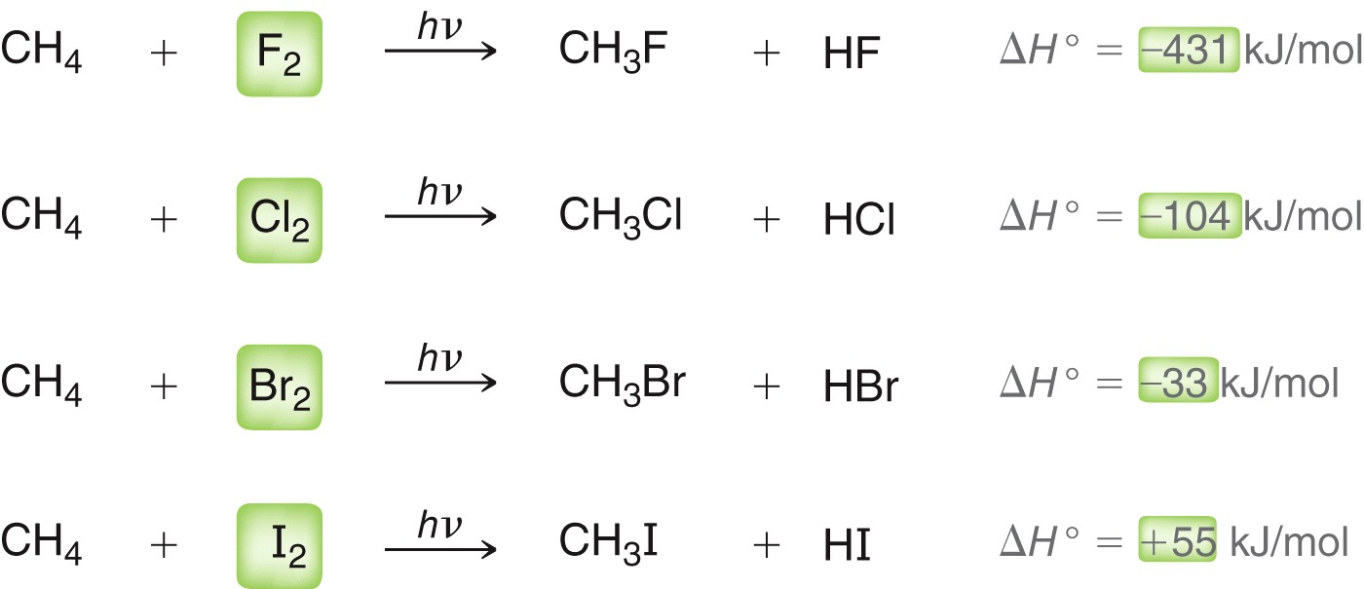
10.4 Halogenation Thermodynamics

Slide 29
10.4 Halogenation Thermodynamics
Fluorination is so exothermic, it is not practical (too violent)
Iodination is endothermic, not thermodynamically favored, and doesn’t occur
Only halogenation with Cl₂ and Br₂ are useful

Slide 30
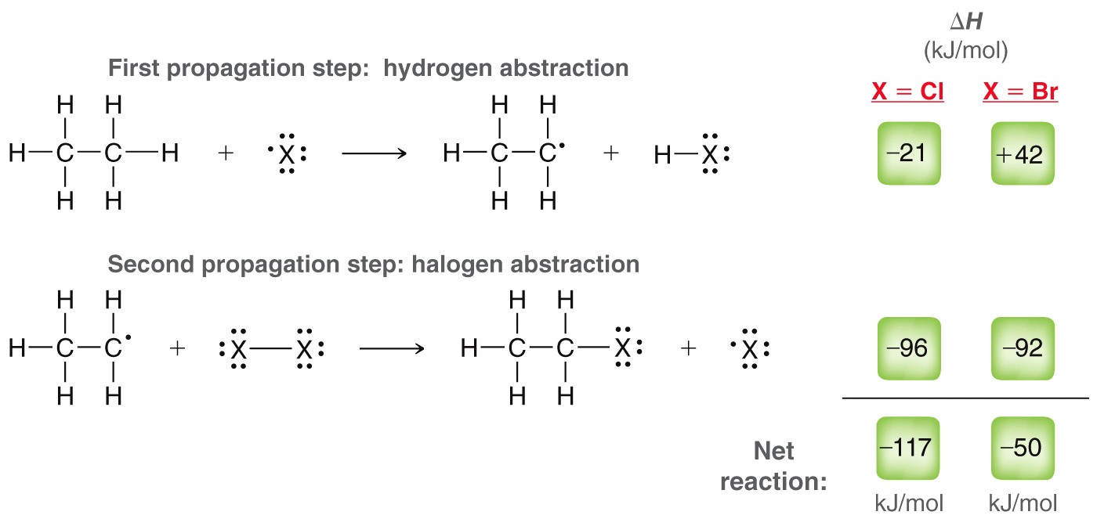
10.4 Halogenation Thermodynamics
Both chlorination and bromination are exothermic (favored).
But, ΔH for the first step of bromination is endothermic

Slide 31
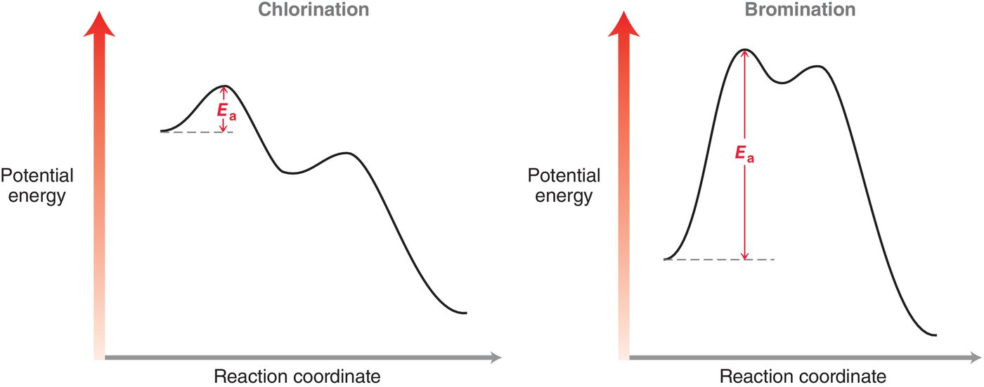
10.4 Halogenation Thermodynamics
So, bromination is much slower than chlorination
These means bromination is more selective.

Slide 32
10.5 Halogenation Regioselectivity
With substrates more complex than ethane, multiple monohalogenation products are possible
Chlorine is indiscriminant; significant amount of each product is formed
two monohalogenation products are possible for propane

Slide 33
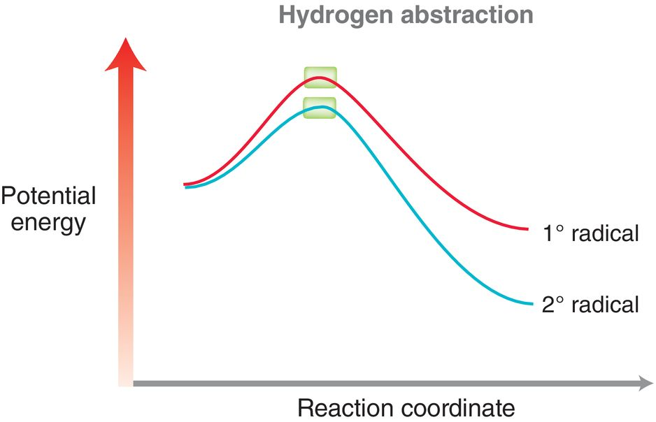
10.5 Halogenation Regioselectivity
But since 2˚ radicals are more stable than 1˚, the secondary halide is the major product
Hydrogen abstraction from a 2˚ carbon is faster than a 1˚ carbon

Slide 34
10.5 Halogenation Regioselectivity
Bromination is much slower, and so it is much more selective for the the more reactive 2˚ carbon:
The fact bromination is more regioselective than chlorination can be explained by the Hammond Postulate

Slide 35
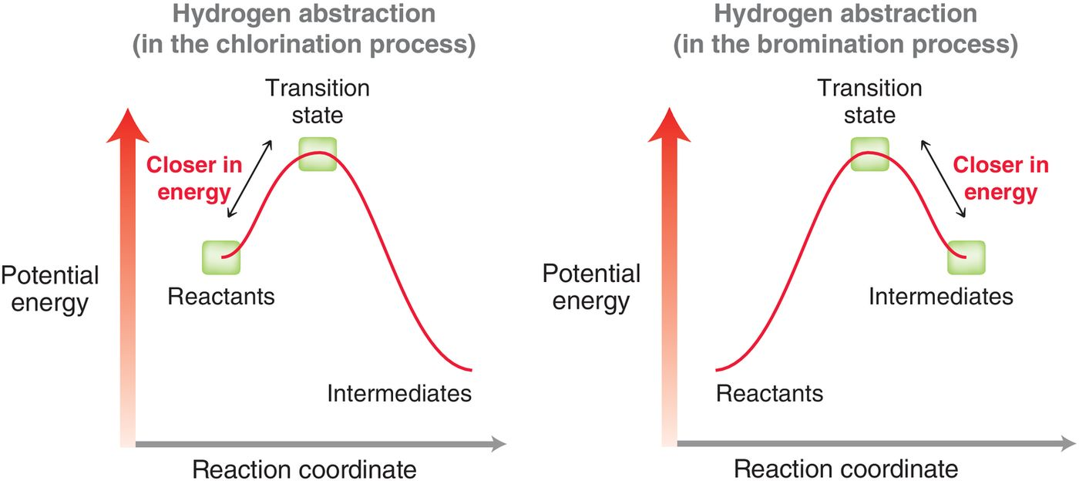
10.5 Halogenation Regioselectivity
Focus on the H abstraction (rate determining) step.
The transition state will be more like the reactants or more like the products, whichever is closer in energy
chlorination TS
resembles reactants
bromination TS
Resembles products

Slide 36
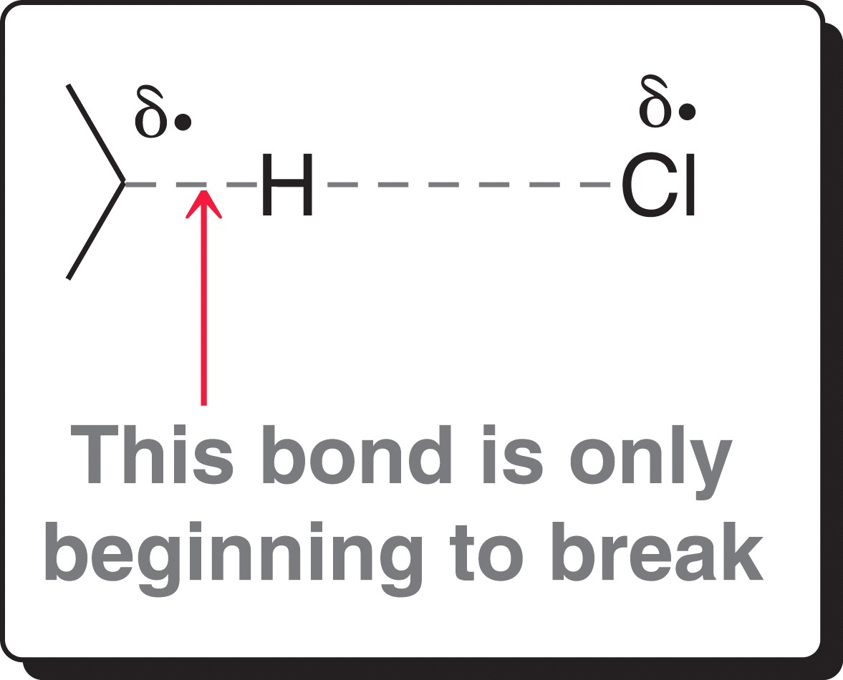
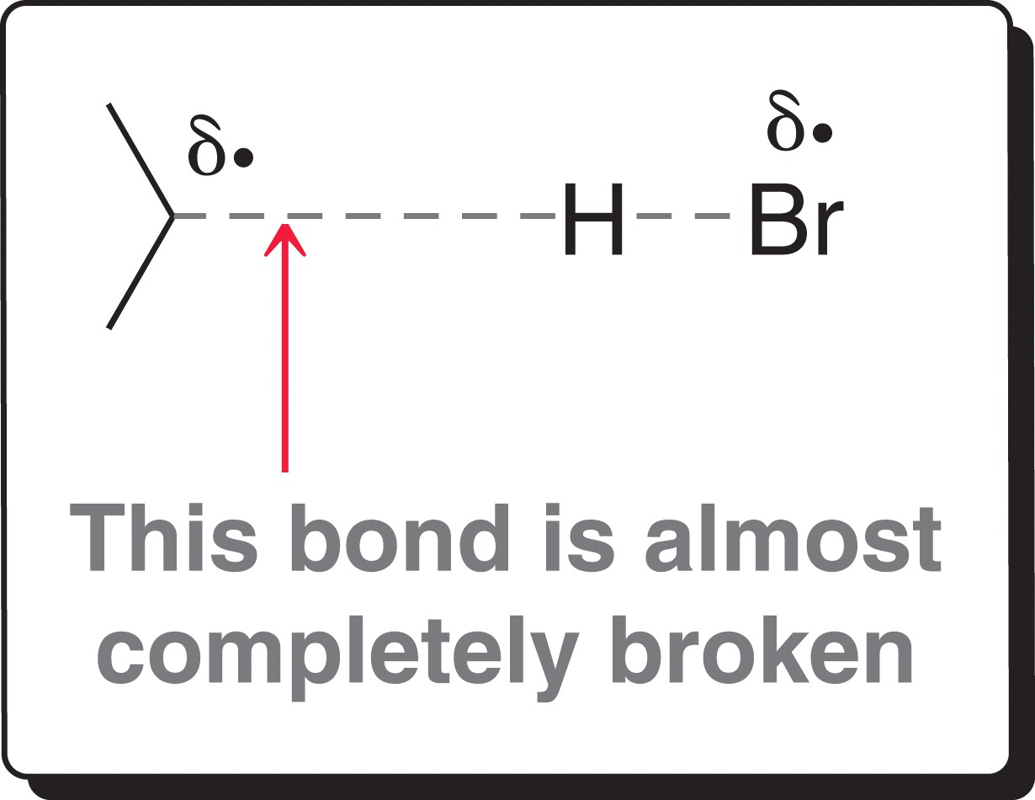
10.5 Halogenation Regioselectivity

Slide 37
10.5 Halogenation Regioselectivity
For bromination, the stability of the transition state largely depends on the stability of the resulting carbon radical
For chlorination, the stability of the transition state does not depend on the stability of the resulting carbon radical so much.

Slide 38
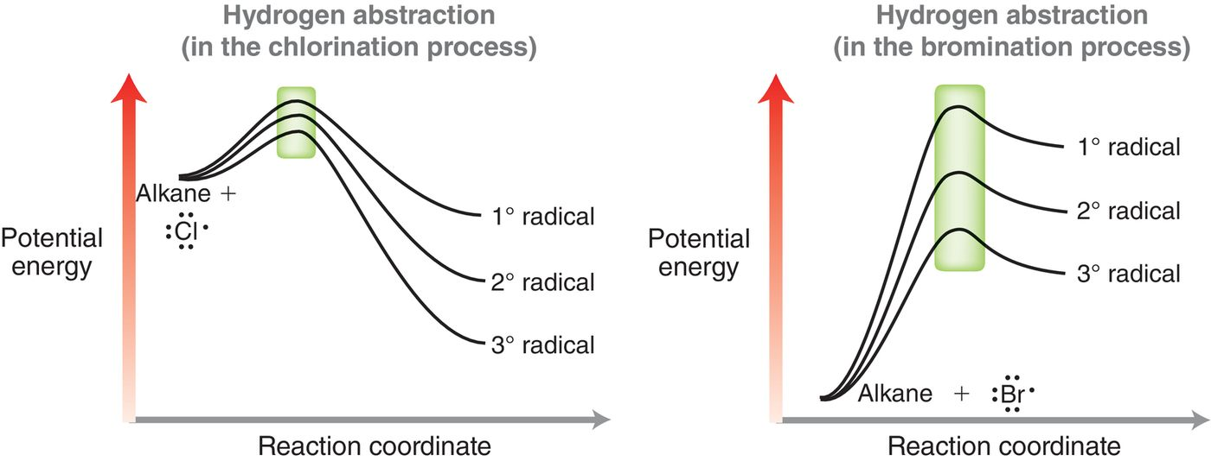
10.5 Halogenation Regioselectivity
In short, the difference in TS energies for the formation of a 1 vs. 2˚ vs 3˚ radicals is much bigger for bromination
Thus, bromination is more selective for the lower energy pathway

Slide 39
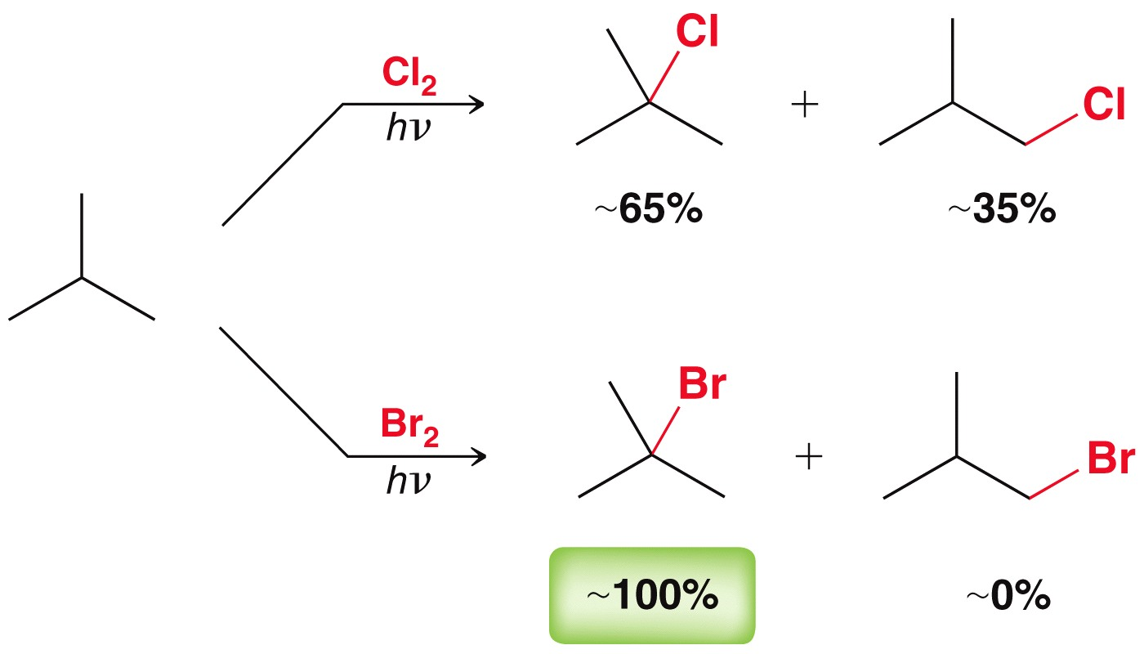
10.5 Halogenation Regioselectivity
Bromination at the 3° position happens 1600 times more often than at the 1° position

Slide 40
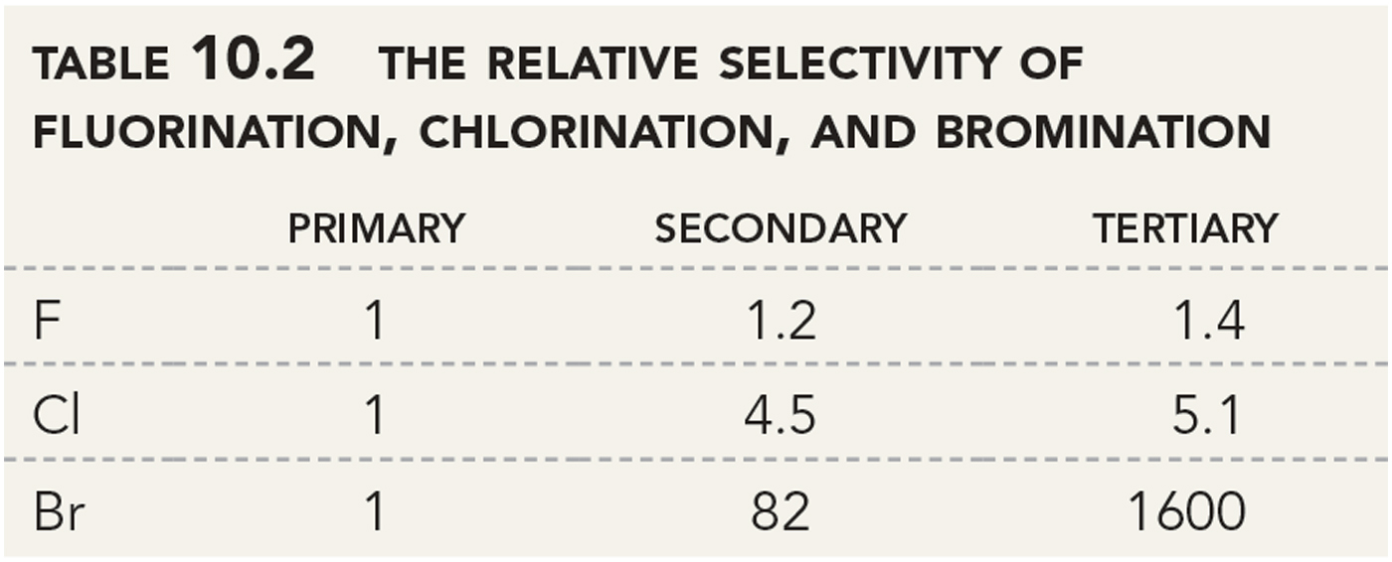
10.5 Halogenation Regioselectivity
Flourination is the fastest process, and thus the least selective
Practice with SkillBuilder 10.5

Slide 41
10.6 Halogenation Stereochemistry
The halogenation of butane or more complex alkanes forms a new chirality center
2-chlorobutane will form as a racemic mixture

Slide 42
10.6 Halogenation Stereochemistry
Whether the free radical carbon is sp² or a rapidly interconverting sp³, the halogen abstraction will occur on either side of the plane with equal probability
sp² hybridized

Slide 43
10.6 Halogenation Stereochemistry
There is actually a total of three monosubstituted products form in the halogenation of butane

Slide 44
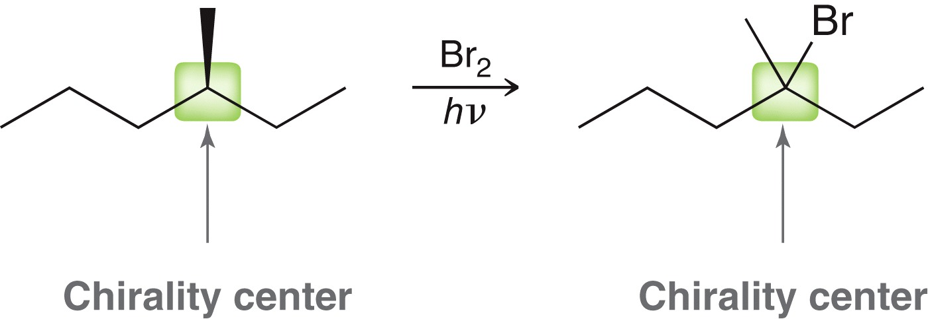
10.6 Halogenation Stereochemistry
In the halogenation of (S)-3-methylhexane, the chirality center is the most reactive carbon in the molecule.
The chirality center is a 3˚ carbon, and it has a weaker C-H bond than the 2˚ and 1˚ carbons
Practice with SkillBuilder 10.6
A racemic mixture will
be obtained

Slide 45
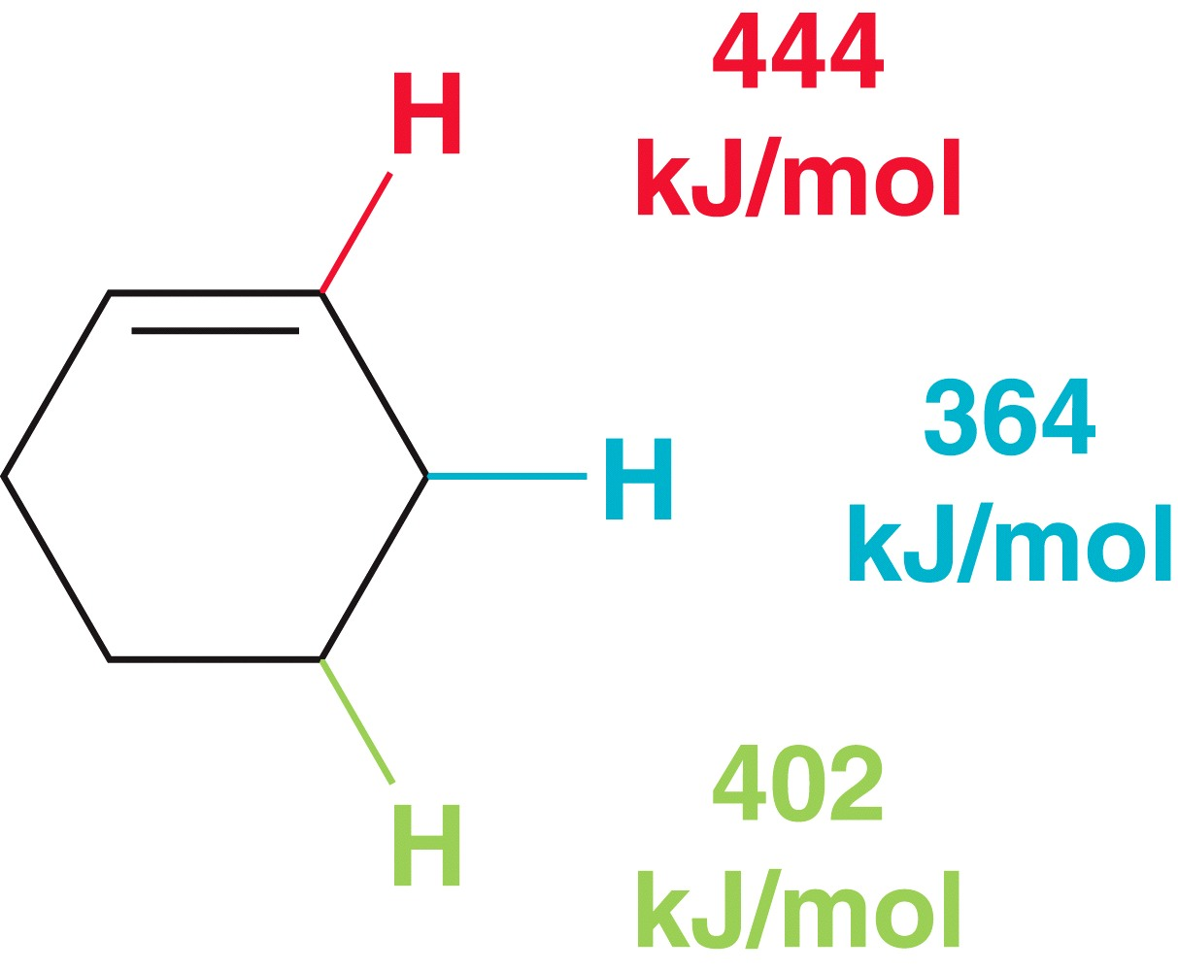
10.7 Allylic Halogenation
Recall the weakest C-H bond (lowest BDE) will undergo radical H-abstraction faster than the others.
Alkenes selectively undergo H-abstraction at the allylic carbon

Slide 46
10.7 Allylic Halogenation
H-abstraction of an allylic H results in a resonance-stabilized allylic radical:
So, bromination of an alkene is selective for the allylic carbon
But, addition of Br₂ to the alkene is a competing reaction…

Slide 47
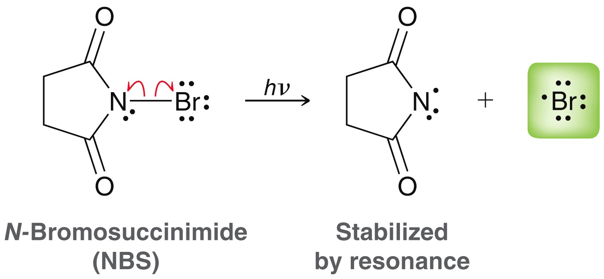
10.7 Allylic Halogenation with NBS
To avoid the competing alkene addition, NBS is used as a source of Br radicals (instead of using Br₂)
Using NBS keeps the concentration of HBr and Br₂ low, so competing addition reactions to the alkene are minimized

Slide 48
10.7 Allylic Halogenation with NBS
Propagation produces the allylic radical and HBr
The HBr produced reacts with NBS to form Br₂ … and this Br₂ then continues propagation and the formation of the product

Slide 49
10.7 Allylic Halogenation with NBS
With asymmetric alkenes, a mixture of isomeric products is often obtained
The radical is delocalized on two carbon atoms, and so halogenation occurs at either site
Practice with SkillBuilder 10.7

Slide 50
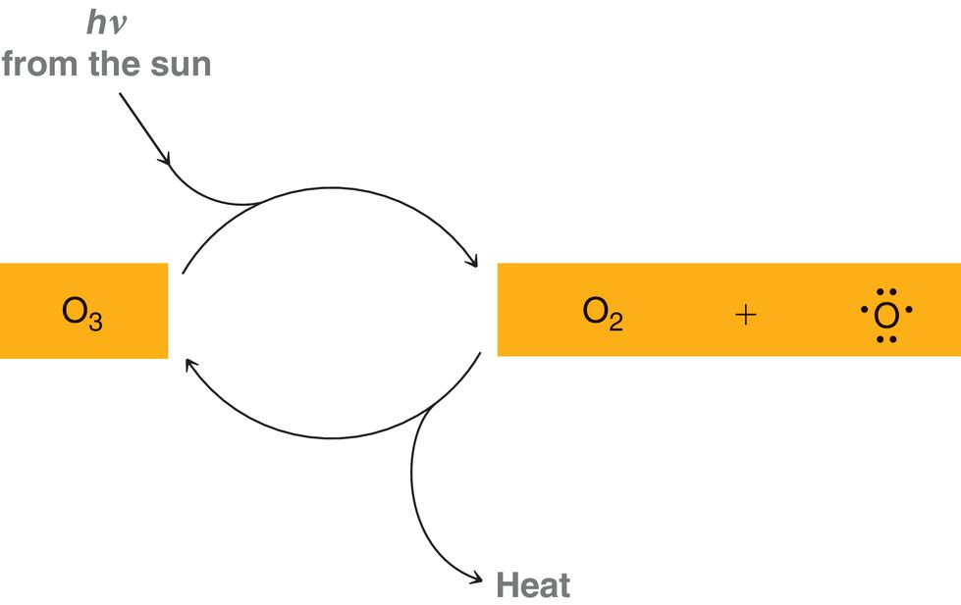
10.8 Atmospheric Chemistry and O₃
Ozone is both created and destroyed in the upper atmosphere
No net reaction is had overall, but UV radiation is converted to heat

Slide 51
10.8 Atmospheric Chemistry and O₃
Heat is a more disordered form of energy, compared to light
This process is spontaneous because entropy is increased

Slide 52
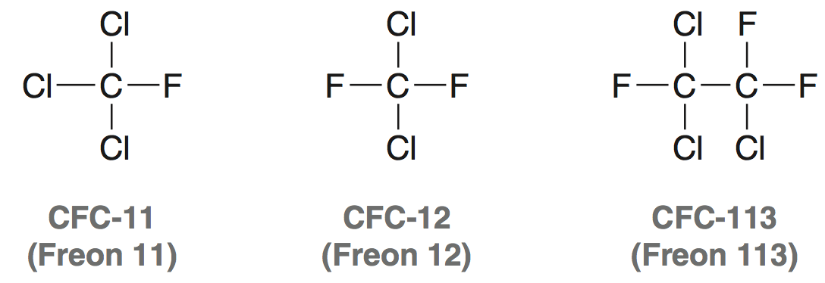
10.8 Atmospheric Chemistry and O₃
O₃ depletion is a serious health and environmental problem. Without it, harmful UV radiation penetrations the atmosphere.
Chlorofluorocarbons are believed to be the culprit
They reach the upper atmosphere, and react with UV light to form chlorine radicals

Slide 53
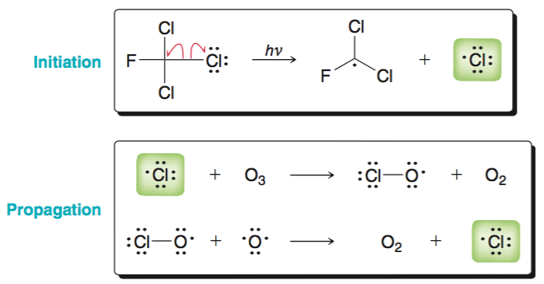
10.8 Atmospheric Chemistry and O₃
The Cl radicals destroy ozone by the following mechanism
Cl radicals are formed during propagation, and continue the destruction of ozone molecules

Slide 54
10.8 Atmospheric Chemistry and O₃
CFC’s have been replaced with hydrofluoroalkanes (HFA’s)
They are sometimes called hydrofluorocarbons (HFC’s)
They are not as harmful as CFC’s because they don’t produce chlorine radicals, but they still act as greenhouse gases

Slide 55
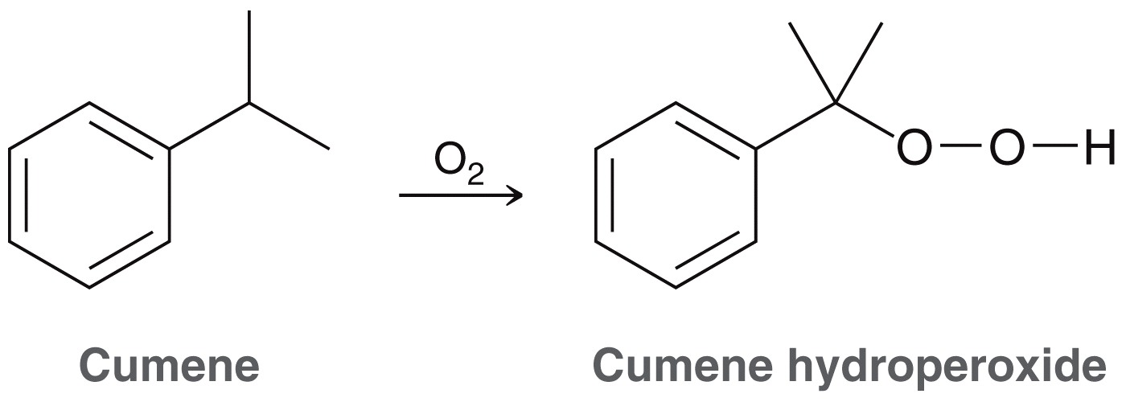
10.9 Autooxidation
Autooxidation is the process by which organic compounds react with atmospheric oxygen to form a hydroperoxide
The process is generally very slow

Slide 56
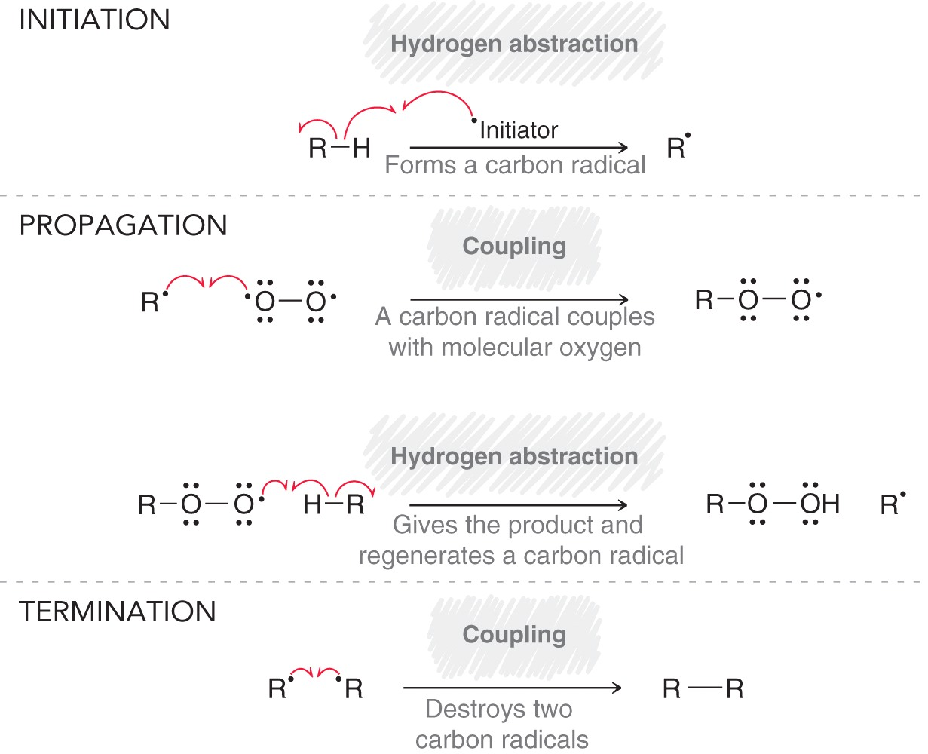
10.9 Autooxidation Mechanism
The initiation step is actually a propagation based on our earlier definitions…
…so the definitions need to be revised

Slide 57
10.9 Autooxidation Mechanism
Propagation steps can be more precisely defined as the steps that add together to give the net chemical equation
So initiation and termination steps are those that are not part of the net chemical equation

Slide 58
10.9 Autooxidation
Ethers are particularly susceptible to autooxidation
Hydroperoxides can be explosive, and so ether supplies cannot be stored for long periods of time.
Storing sensitive compounds in dark containers prevents light from accelerating the autooxidation process

Slide 59
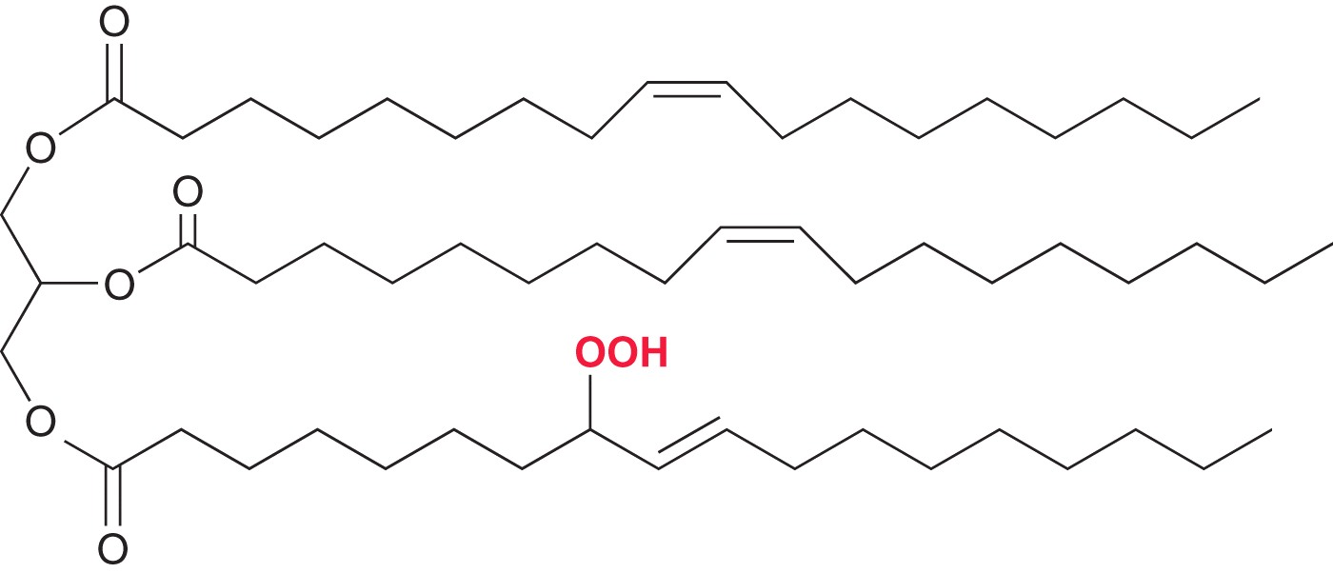
10.9 Antioxidants
Triglycerides are important to a healthy diet, but also susceptible to autooxidation (allylic carbons are especially reactive)
Autooxidation causes the food to become rancid and toxic

Slide 60
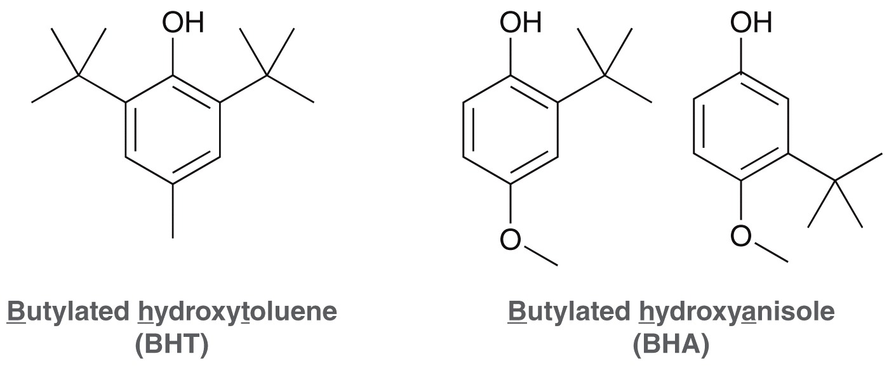
10.9 Antioxidants
Foods with unsaturated fatty acids have a short shelf life unless preservatives are used
These preservatives are radical inhibitors.

Slide 61
10.9 Antioxidants
One molecule of BHT can prevent thousands of autooxidation reactions
BHT can undergo H-abstraction to scavenge a radical that would otherwise initiate an autooxidation radical chain
So, inhibitors like BHT are often called antioxidants

Slide 62
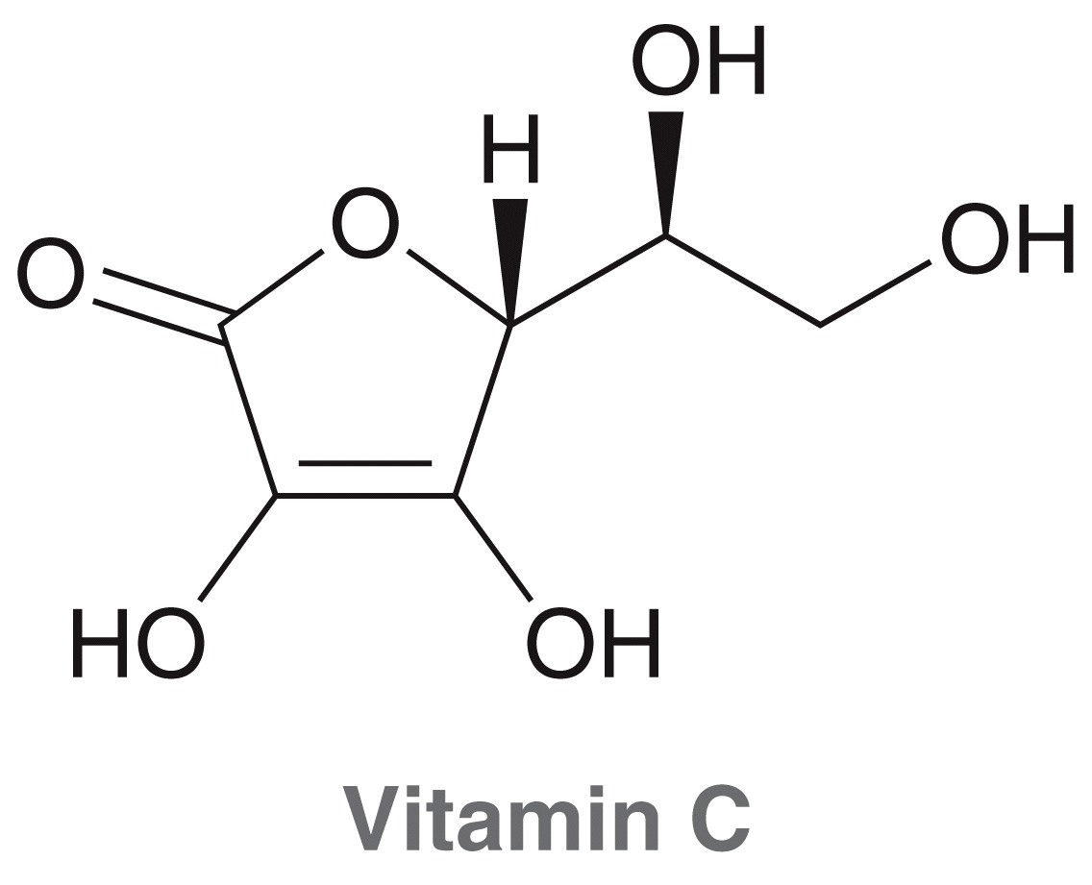
10.9 Natural Antioxidants
Natural antioxidants prevent the oxidation of cell membranes and other biologically important compounds
Vitamin E is hydrophobic, and finds it’s way
into cell membranes
Vitamin C is polar, and functions in polar
mediums, such as blood.

Slide 63
10.10 Radical Addition of HBr
We learned in chapter 9 that H-X will add across a C=C double bond with anti-Markovnikov regioselectivity when peroxides are present
The peroxides initiate a radical mechanism of addition.
(Different mechanism, different selectivity)
without
peroxides
with
peroxides

Slide 64
10.10 Anti Markovnikov Addition
The reaction is initiated by thermal homolysis of the peroxide, which initiates the formation of a Br radical from HBr.

Slide 65
10.10 Anti Markovnikov Addition
The Br radical then, in theory, could add to either side of the alkene:
But it will add to the side that generates the more stable carbon radical, as that will be a lower energy intermediate and thus a lower energy TS

Slide 66
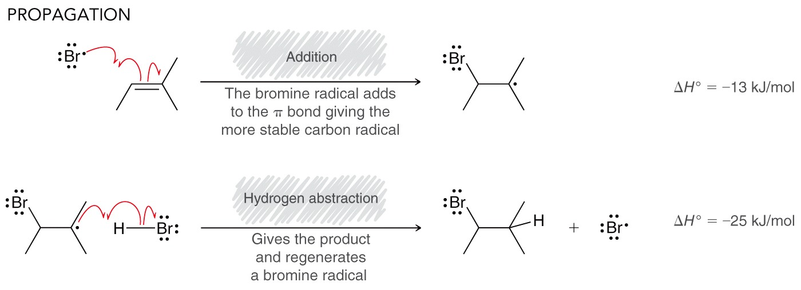
10.10 Anti Markovnikov Addition
The Br radical adds to the less substituted carbon of the alkene, generating the more stable (more substituted) carbon radical.
The carbon radical then abstracts an H to form the product and propagate the radical chain.

Slide 67
10.10 Anti Markovnikov Addition
Most of the radicals in solution at any given moment will be Br• radical, so combination of them is typically the termination step
But, the combination of any two radicals constitutes a terminationstep.

Slide 68
10.10 Addition Thermodynamics
Anti-Markovnikov radical addition of HBr is generally spontaneous (product favored)
radical addition of HCl and HI are generally nonspontaneous (reactant favored)
Consider the overall thermodynamics of each reaction to understand why

Slide 69
10.10 Addition Thermodynamics
Consider the halogen radical adding to the alkene:
The iodide radical is so much more stable than a carbon radical that it’s addition to an alkene is not thermodynamically favored.

Slide 70
10.10 Addition Thermodynamics
Now consider the product forming step:
Abstraction of H from HCl is not thermodynamically favored, because of the instability of the Cl radical.

Slide 71
10.10 Addition Stereochemistry
Recall that addition reactions often form a new chirality center
If the substrate is not chiral, then a racemic mixture will be obtained when one new chirality center is formed
If the starting alkene contains a stereocenter, then a mixture of diastereomers would be obtained.
Practice with SkillBuilder 10.8

Slide 72
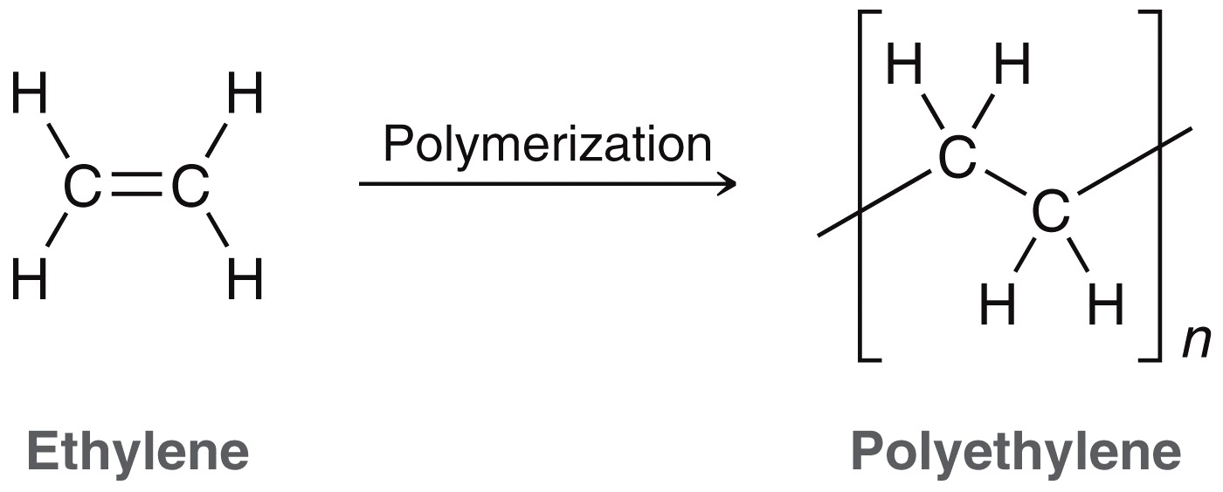
10.11 Radical Polymerization
Free radical conditions are also frequently used to form polymers
Recall that a polymerization process joins together many small units called monomers in a long chain
monomer
polymer

Slide 73
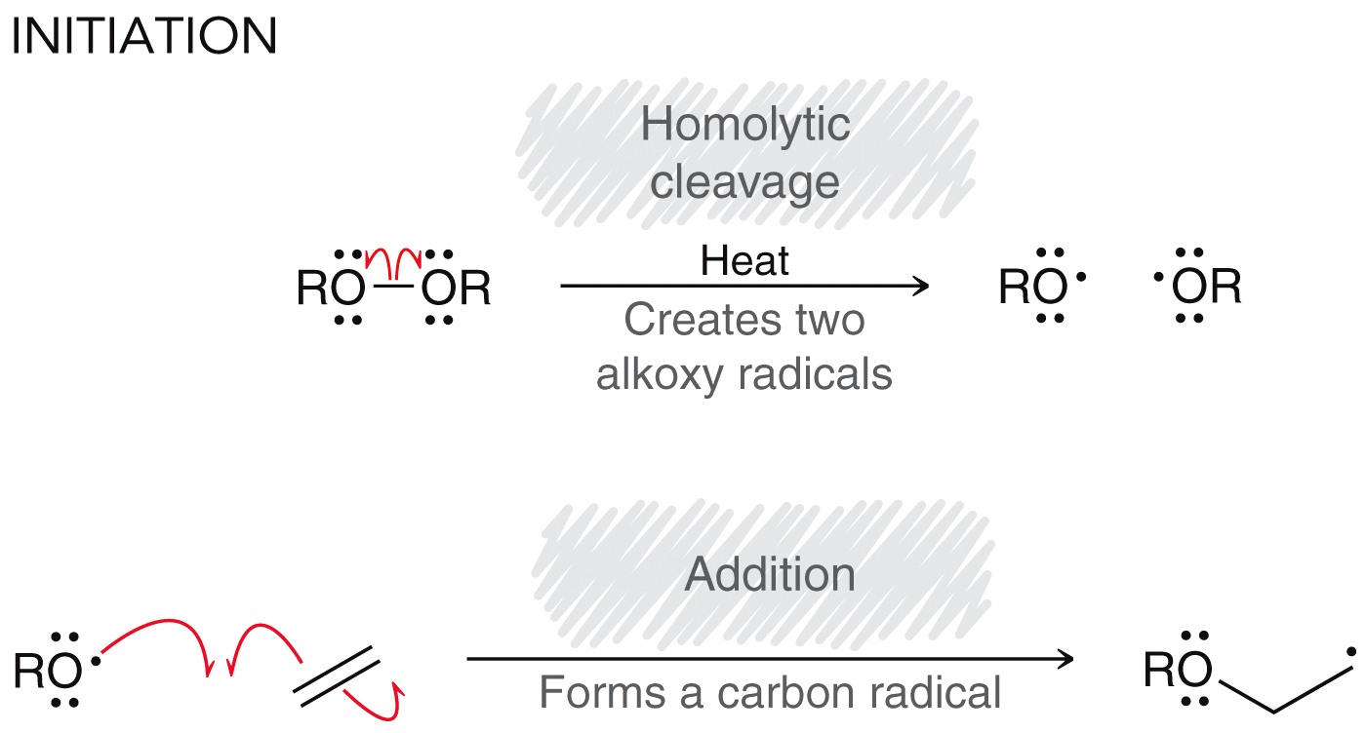
10.11 Radical Polymerization
Radical polymerizations generally proceed through radical chain mechanism:

Slide 74
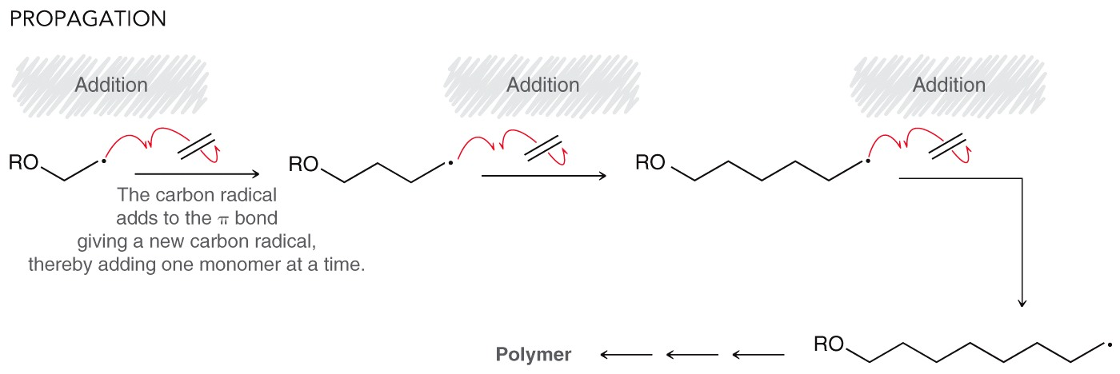
10.11 Radical Polymerization
Radical polymerizations generally proceed through radical chain mechanism:
The summation of the propogation steps gives the overall net reaction

Slide 75
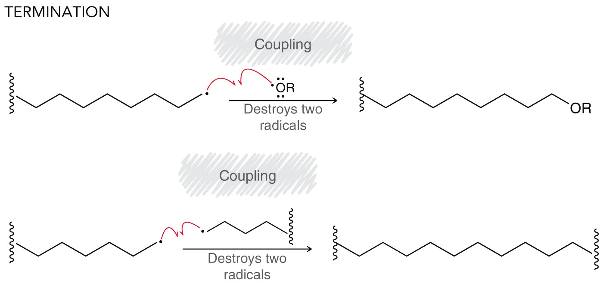
10.11 Radical Polymerization
Radical polymerizations generally proceed through radical chain mechanism:

Slide 76
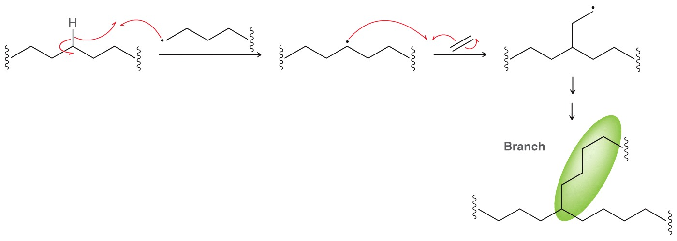
10.11 Radical Polymerization
Chain Branching is inevitable in this process, and occurs by the following mechanism
Highly branched polyethylene forms
flexible plastic (e.g. squeeze bottle)
Unbranched polyethylene is brittle and
rigid (like a plastic bottle cap)

Slide 77
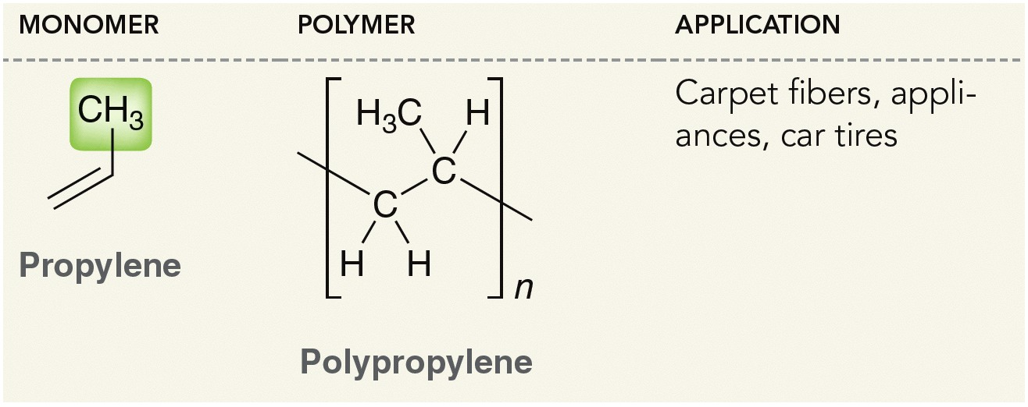
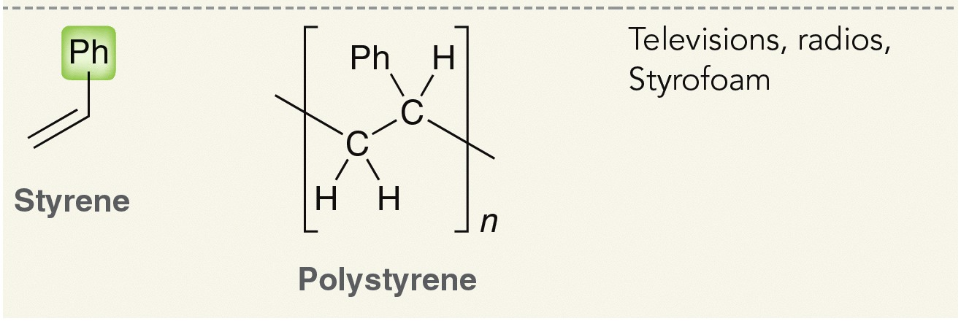
10.11 Radical Polymerization
Polymers with varying properties are obtained by polymerizing substituted ethylene derivatives:

Slide 78
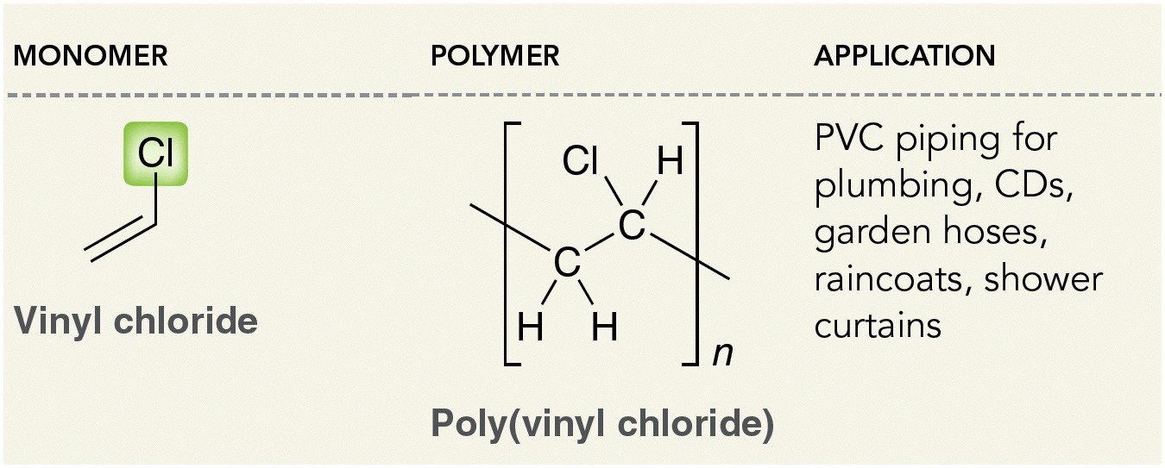
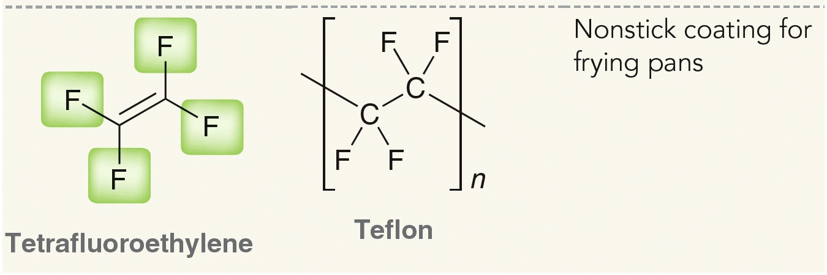
10.11 Radical Polymerization
Polymers with varying properties are obtained by polymerizing substituted ethylene derivatives:

Slide 79
10.12 Radical Petroleum Processes
Cracking of hydrocarbons produces smaller alkanes and alkenes
Hydrocracking is done in the presence of H2 gas, forming only alkane products
Reforming is also a radical process, producing branched alkanes

Slide 80
10.13 Synthetic Utility of Halogenation
Chlorination, to synthesize alkyl chlorides, is only useful when there is only one possible product
Bromination is slower, and more selective, and can be performed when several monohalogenation products are possible

Slide 81
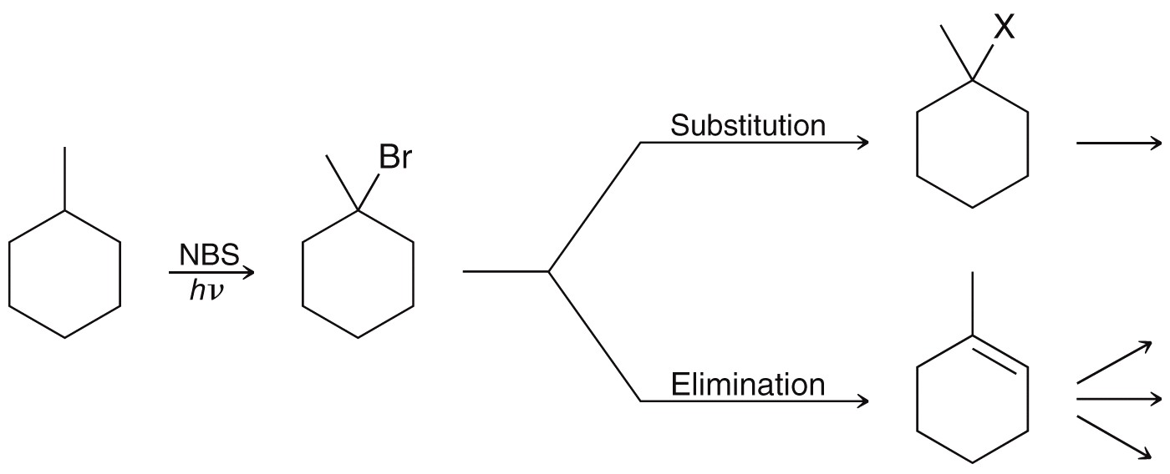
10.13 Synthetic Utility of Halogenation
Overall, the real advantage of halogenation is functionalizing an otherwise unreactive alkane, which can then be converted into other useful functional groups.

Slide 82
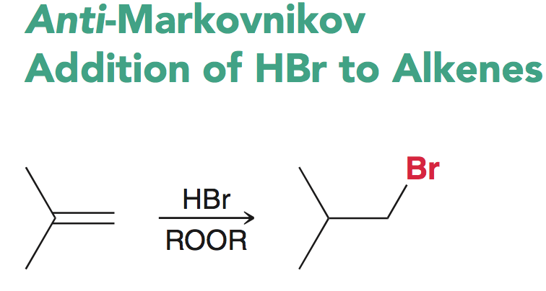
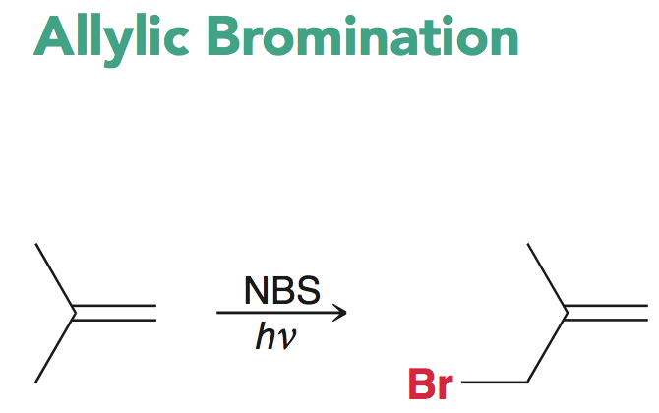
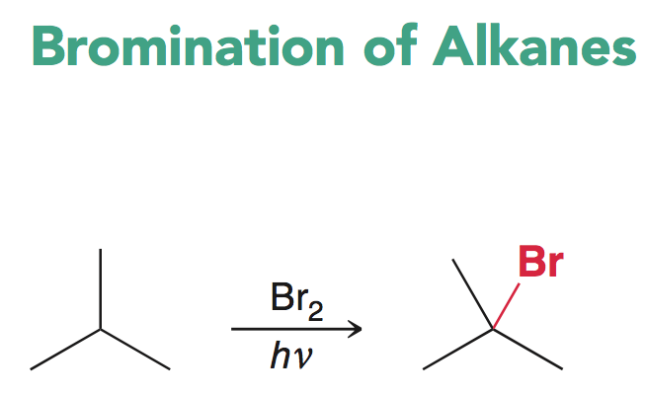
10.13 Review of Reactions
Radical reactions are synthetically useful, and will be applied to multistep syntheses throughout this text/course:

