Slide 1
Organic Chemistry
Third Edition
David Klein
Chapter 11
Synthesis

Slide 2
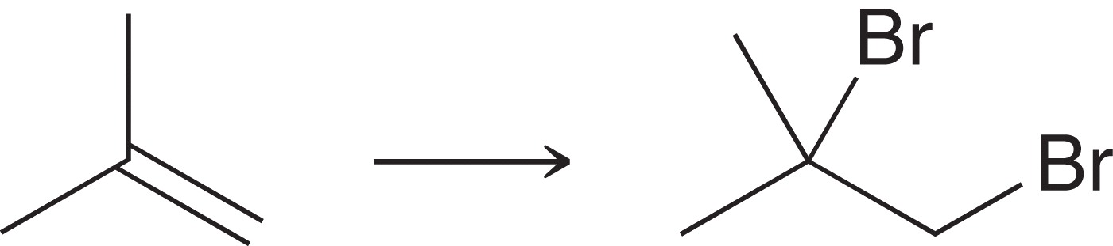
11.1 One-Step Syntheses
Solving a synthesis problem (i.e. “providing the reagents”) is straight-forward when only one reaction is needed:
Here, we would need Br2.
You have to master all the reactions, and the reagents required before tackling multi-step synthesis problems.
It is critical to work through Conceptual Checkpoint 11.1 and 11.2 before moving forward.

Slide 3
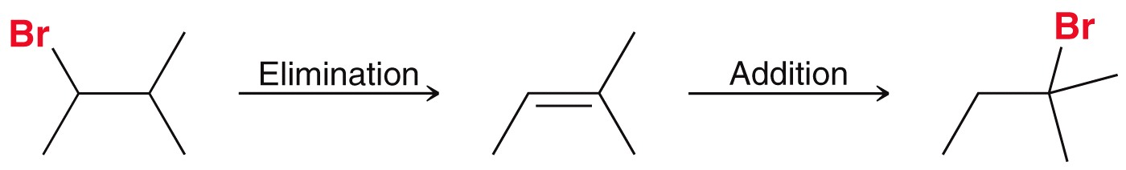
11.2 Functional Group Transformations
It’s logical to review the two-step synthesis strategies from previous chapters
Moving a functional group from one carbon to the next:
Here, we need to obtain the Zaitsev alkene, and choose the strong base used accordingly
The second step must be Markovnikov addition of HBr

Slide 4
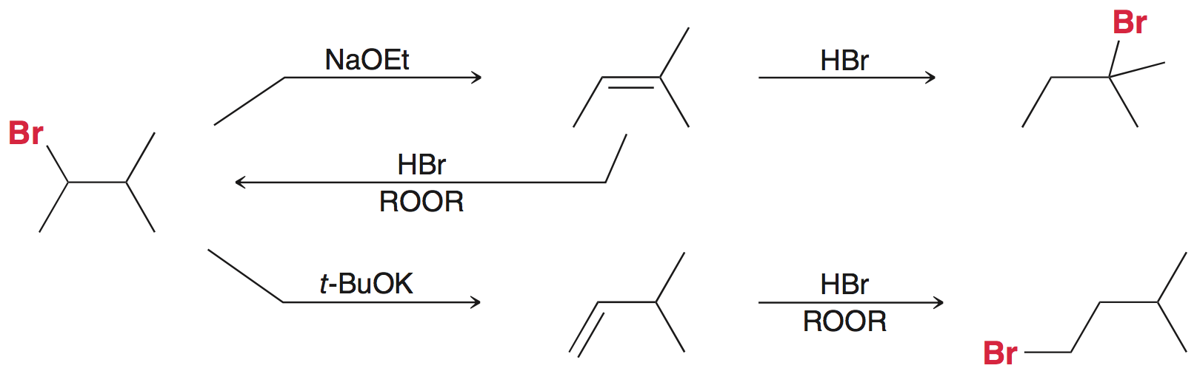
11.2 Functional Group Transformations
We can layout all the reactions we know where alkyl bromides and alkenes are concerned, and then choose the reagents needed to yield the correct regiochemistry:

Slide 5
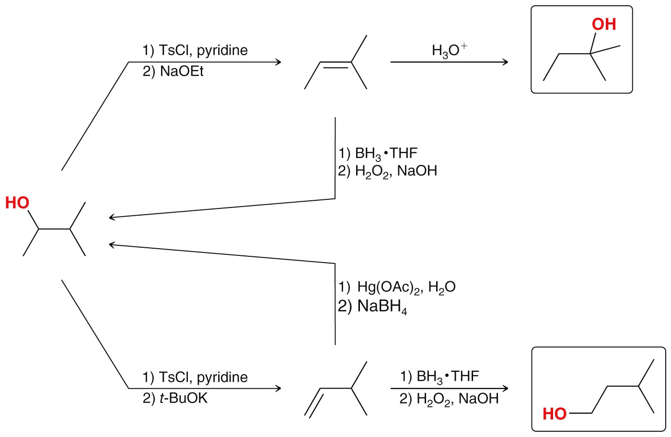
11.2 Functional Group Transformations
The approach must be modified for the analogous modification on an alcohol

Slide 6
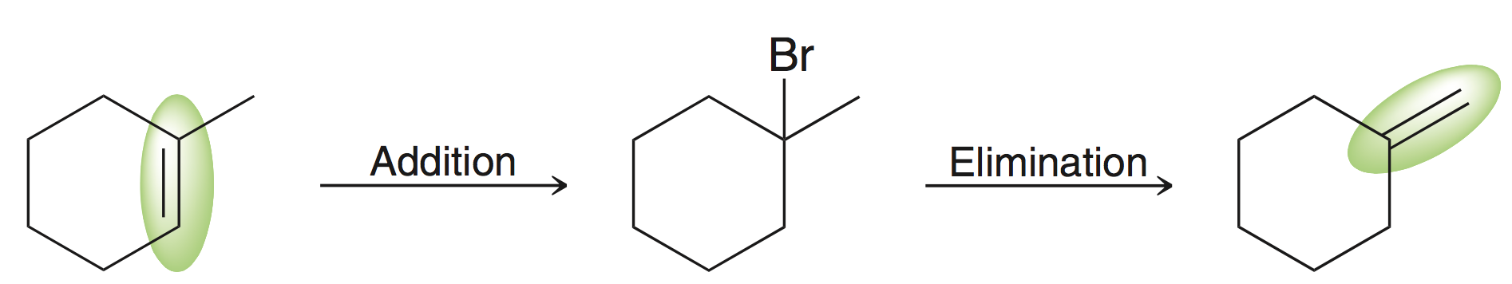
11.2 Functional Group Transformations
We also know how to apply a two-step strategy to move the position of a π bond in an alkene:
For the 1st reaction, we need to add H and Br to the alkene
For the 2nd reaction, we need to do an E2 elimination
Again, the reagents we choose depends on the regioselectivity we need

Slide 7
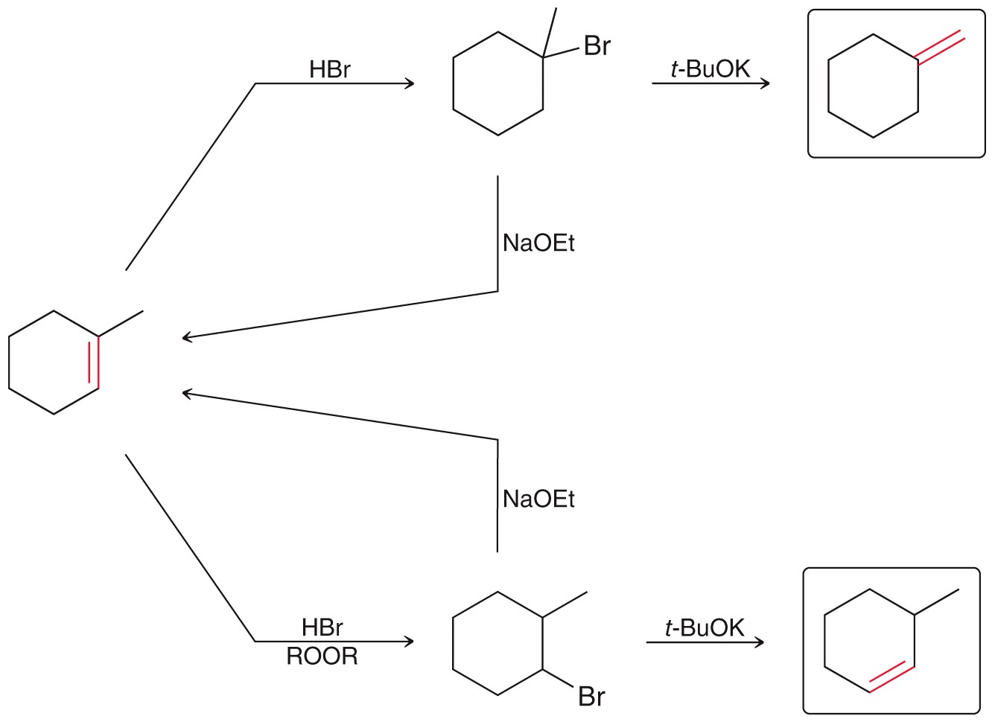
11.2 Functional Group Transformations
We have no chance to get this far unless we can easily recall all the possible reagents and reaction conditions first !!

Slide 8
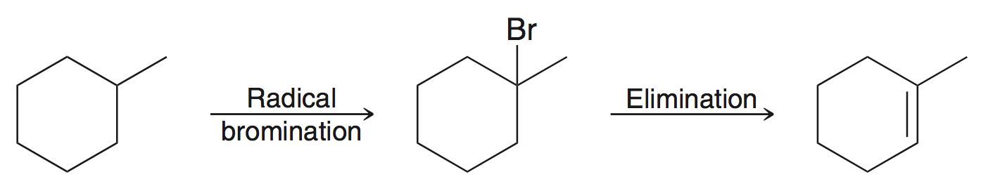
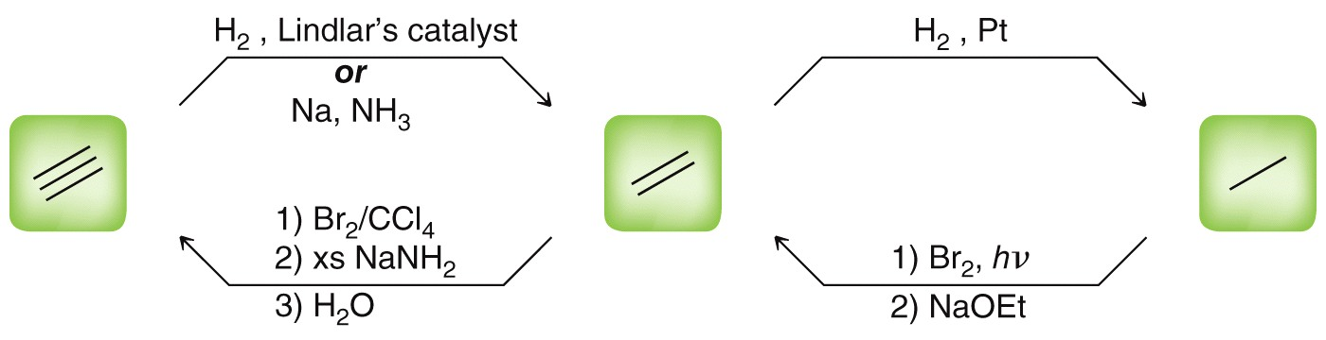
11.2 Functional Group Transformations
A two-step sequence is needed to convert an alkane to an alkene
We would then be able to convert the double bond to a single bond, or a triple bond
Practice with SkillBuilder 11.1

Slide 9
11.3 Changing the Carbon Skeleton
For some transformations, it may be necessary to tamper with the carbon skeleton (add or remove carbons)
When a synthesis requires the carbon skeleton to be altered, you need to be able to recall the reactions that add/remove carbons
Most reactions learned so far only change a functional group, or change the location of it.

Slide 10
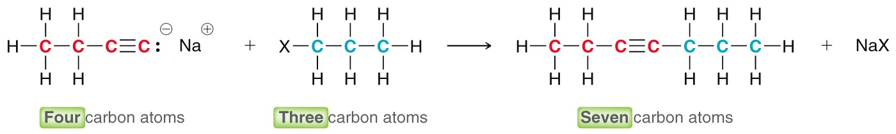
11.3 Changing the Carbon Skeleton
So far, we have learned only one transformation that increases the number of carbons in a molecule
For the time being, we know this reaction will have to be used when we need to add carbons to a compound

Slide 11
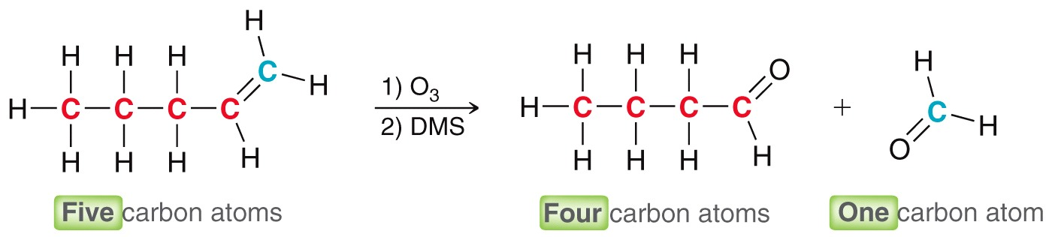
11.3 Changing the Carbon Skeleton
We have also learned a way to decrease the number of carbons in a molecule
In the future, we will discuss many more reactions that alter the carbon skeleton
Practice with SkillBuilder 11.2

Slide 12
11.4 How to Approach a Synthesis Problem
To approach any synthesis problem, first answer these two questions:
  Is there a change in the carbon skeleton? Is it gaining or losing carbons?
  Is there a change in the identity and/or location of the functional group?
  Solving a synthesis problem requires the recall of all the reactions learned, and working through many examples.

Slide 13
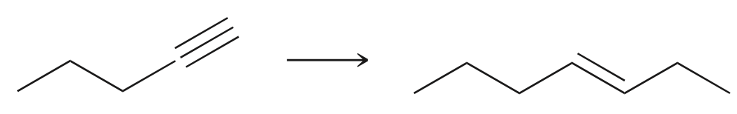
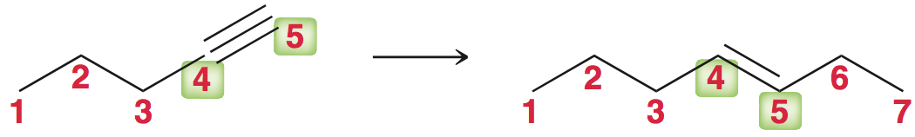
11.4 How to Approach a Synthesis Problem
SkillBuilder 11.3 – Propose an efficient synthesis for the following transformation
Is there a change in the carbon skeleton? YES. The starting compound has 5 carbons, the target compound has 7:

Slide 14
11.4 How to Approach a Synthesis Problem
Is there a change in the identify and/or location of the functional group? Alkyne changed to trans alkene, but the location hasn’t changed (remains between 4 and 5)
So the synthesis needs to accomplish the following:
• triple bond must be converted to trans alkene
• two additional carbon atoms must be installed
What reagents/reactions will accomplish these tasks?

Slide 15
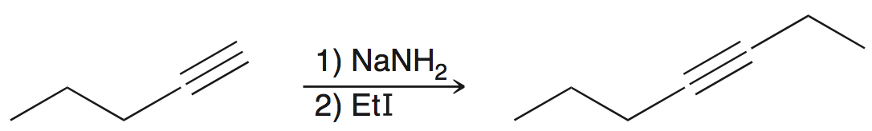
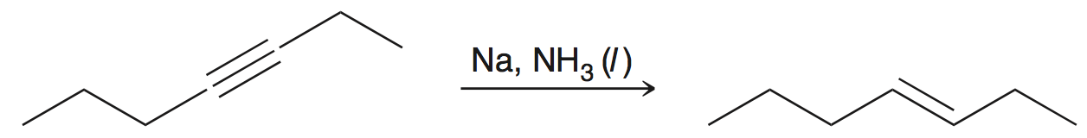
11.4 How to Approach a Synthesis Problem
  Two carbon atoms can be introduced by alkylating the starting alkyne, which gives the correct carbon skeleton:
  Dissolving metal reduction converts alkynes to trans alkenes:
  So it’s a two-step (actually 3 reactions) synthesis…

Slide 16
11.4 How to Approach a Synthesis Problem
  It’s extremely important to number each reaction in the multi-step synthesis. Merely listing all the reagents together is not sufficient
  There are more examples in Practice the Skill 11.7

Slide 17
11.5 Retrosynthetic Analysis
Retrosynthetic Analysis – simply put, this approach means we solve for the reaction sequence in reverse order
We begin by solving for the last step in the synthesis, first!
Still need to ask the same two questions before getting started:
  (1) is the carbon skeleton changing, and…
  (2) is the functional group changing and/or moving?
  Analyze the structure of the reactant and product. What functional groups are we dealing with?

Slide 18
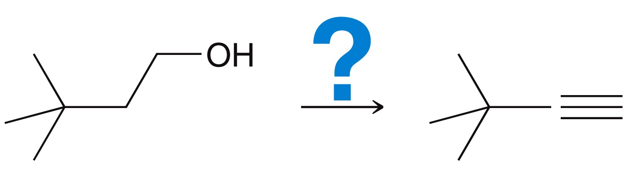
11.5 Retrosynthetic Analysis
Perform a retrosynthetic analysis for the following synthesis:
  Is there a change in the carbon skeleton? No, the carbon skeleton is not changing
  Is there a change in the identity of the functional group, and/or its location? Alcohol is converted to alkyne, but the position is unchanged.

Slide 19
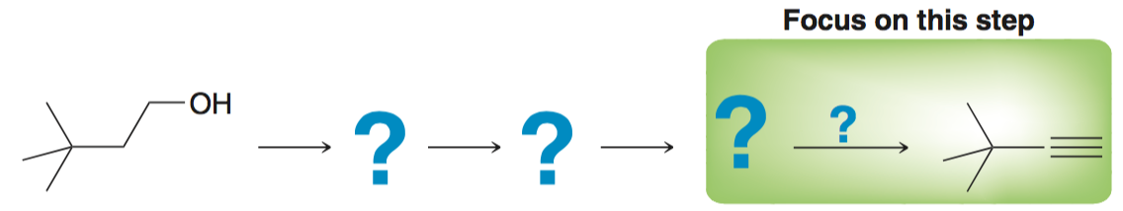
11.5 Retrosynthetic Analysis
Work backwards: focus on the last step in the synthesis
  What reactions do we know that can be used to make an alkyne?

Slide 20
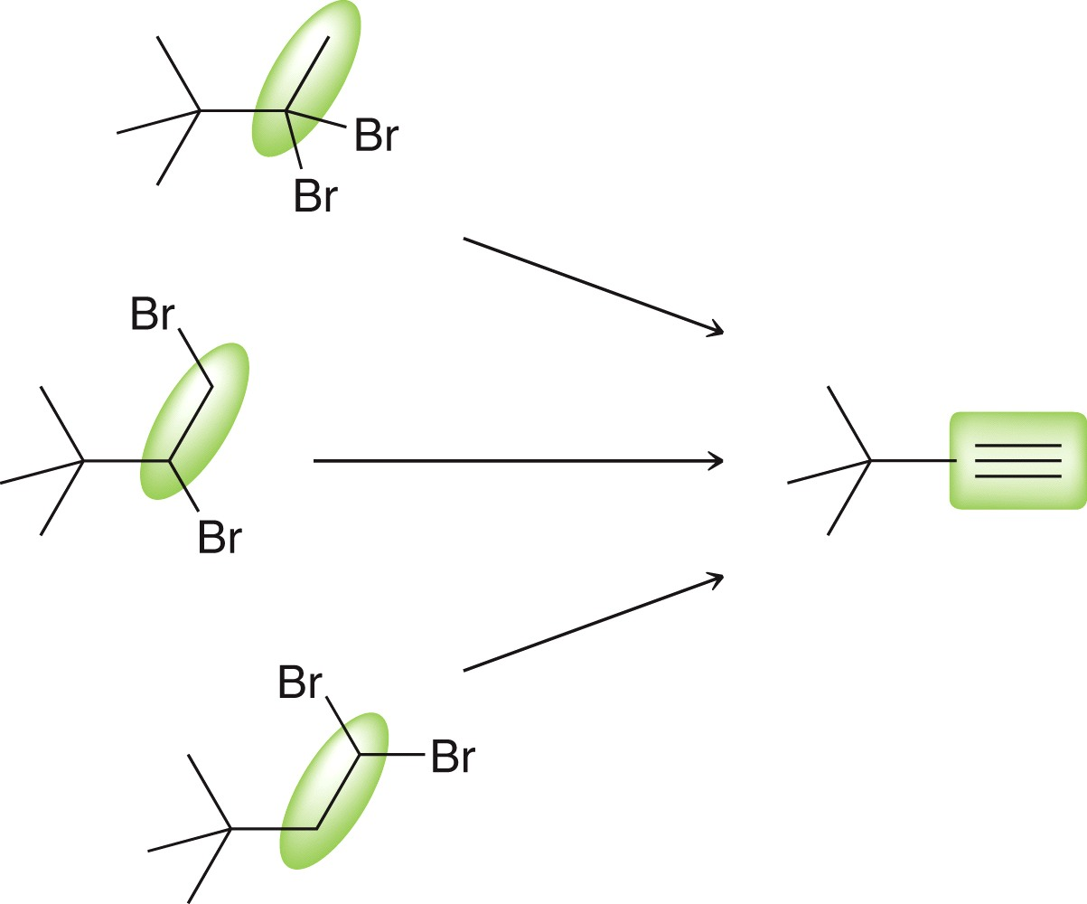
11.5 Retrosynthetic Analysis
An alkyne can be installed on this carbon skeleton by elimination of any of the following three dibromides:
This vicinal dihalide is
the only one we know
how to make

Slide 21
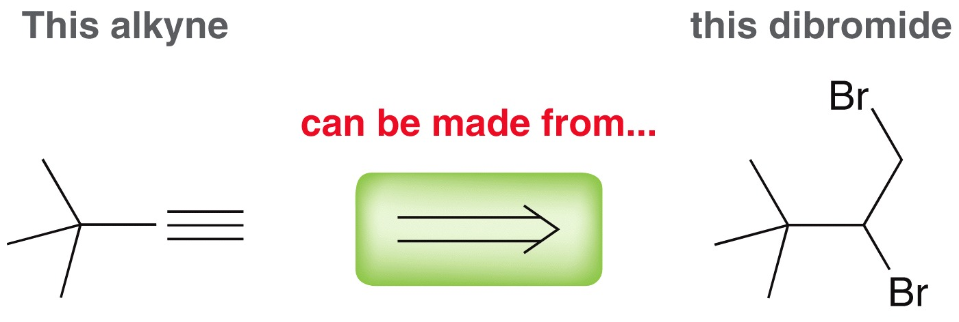
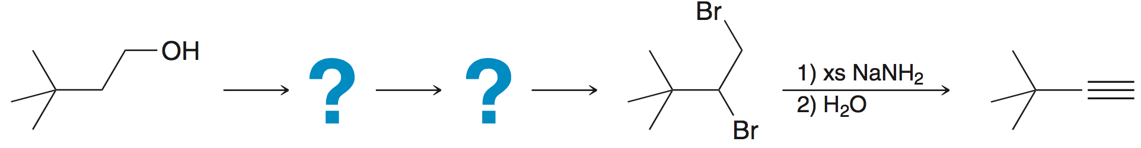

11.5 Retrosynthetic Analysis
Recall that a retrosynthetic arrow is used to indicate the type of “backward” thinking we used to solve for the last step:
So we have just solved for the last step in the synthesis by identifying a reactant we can use to produce the final product

Slide 22
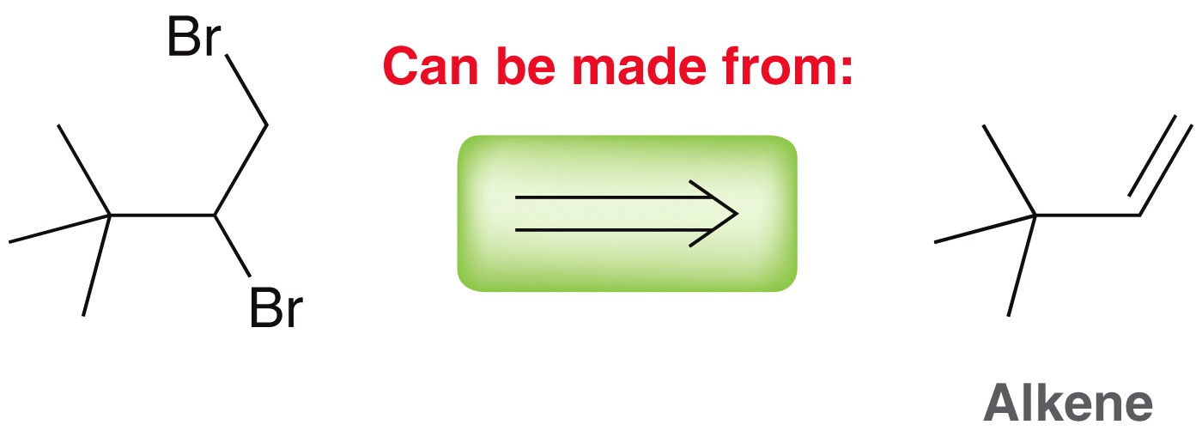
11.5 Retrosynthetic Analysis
Now we can continue to work backwards another step:
A vicinal dibromides are made by addition reaction to an alkene
  Recall Br₂ is needed as the reagent for this reaction
This is the alkene
we would need to
make the dibromide

Slide 23
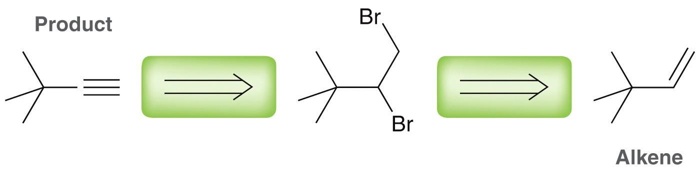
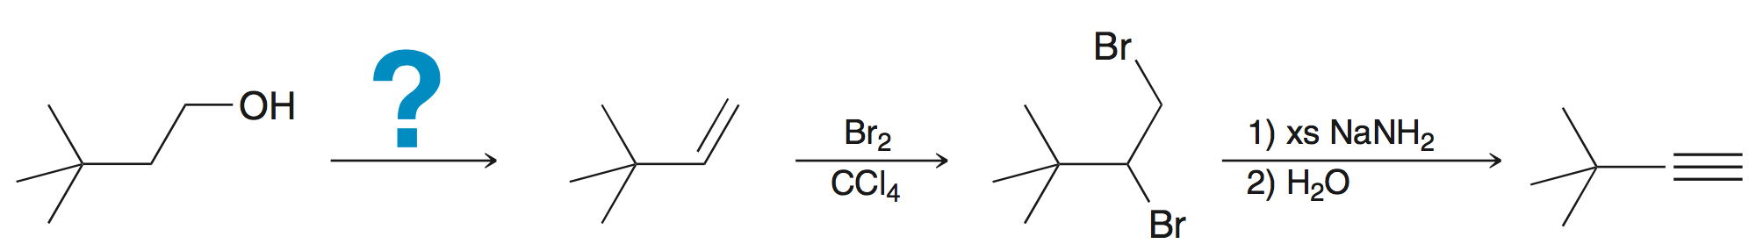
11.5 Retrosynthetic Analysis
So far, our retrosynthetic analysis looks like this:
REMEMBER: the arrows are pointing in the reverse direction, so the forward synthetic sequence looks like this:
We still need to
figure out this step

Slide 24
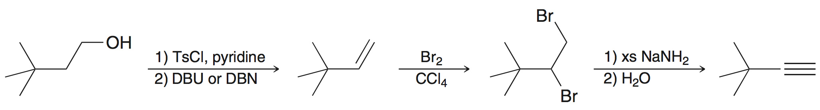
11.5 Retrosynthetic Analysis
At this point, we should recognize that an alcohol can be converted to an alkene via a dehydration (elimination) reaction:
We need to convert the alcohol to a tosylate, then eliminate with a non-nucleophilic base:

Slide 25
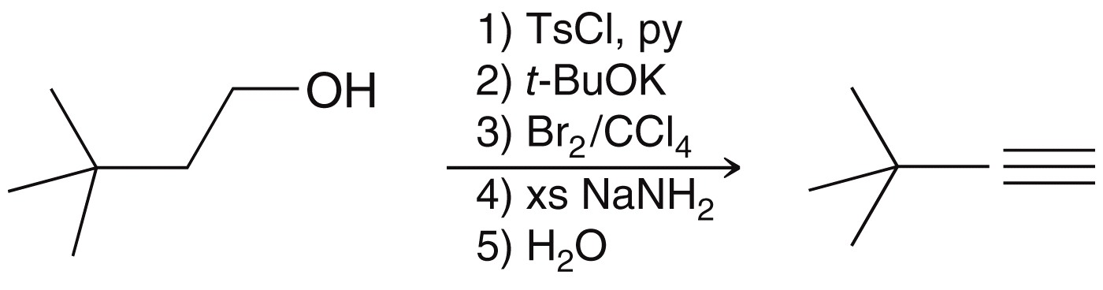
11.5 Retrosynthetic Analysis
  Overall, here is the multistep sequence:
  To ensure this is correct, we should work out each reaction and make sure the correct regio- and stereoselectivity
Practice with SkillBuilder 11.4

Slide 26
11.6 Green Chemistry
Green Chemistry – refers to reactions that are more environmentally friendly, and has 4 guiding principles:
Prevent waste.
Use less hazardous substances.
Use safer solvents – ones that are environmentally benign
Maximize atom economy - use reactions where all or most of the atoms from the reagents are incorporated into the product(s)

Slide 27
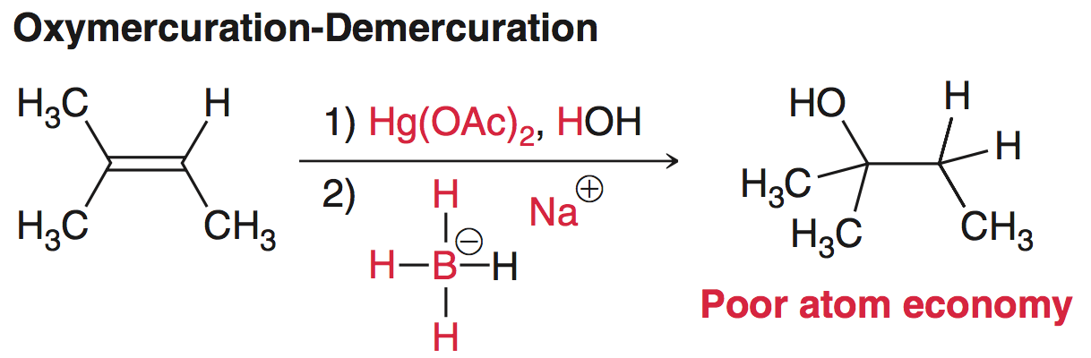
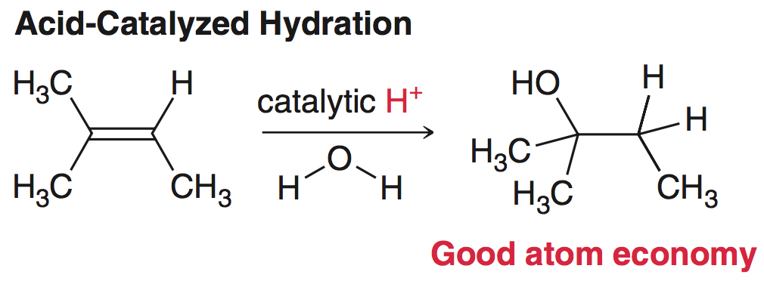
11.6 Green Chemistry
Consider two reactions to know (convert alkene to alcohol):
The atoms in red
are waste material
Only the H+ is waste
material, but it is only
needed in a
catalytic amount

Slide 28
11.6 Green Chemistry
Green Chemistry – refers to reactions that are more environmentally friendly, and has 4 guiding principles:
Use catalysts rather than stoichiometric reagents
Energy efficiency – reactions performed at room temperature more more efficient than those requiring heat
Renewable feedstocks – using sources such as grains, or corn, as a source of carbon as opposed to petroleum

Slide 29
11.7 Increasing Proficiency: Practical Tips
To build a molecule, you must be able to choose the right tools for the job
It is helpful to organize the reactions, as you learn them, into two sets of reactions:
  Reactions that alter the carbon skeleton
  Reactions that alter the functional groups
As more reactions are learned, add them to the appropriate list

Slide 30
11.7 Create Your Own Synthesis Problems
A great way to practice syntheses is to design your own problems
  Start with a relatively simple reactant compound
  Choose a reaction, write out the reagents then predict the structure of the product
  Repeat step 2 a few more times
  Take out all of the intermediates and reagents so you don’t give the answer away
  Swap problems with a classmate to practice more

Slide 31

11.7 Create Your Own Synthesis Problems
This process will help you to think about syntheses in new ways
Here’s an example, starting with acetylene:
  Choose a reaction for an alkyene, write out the reagents and predict (draw) the product
Rxn #1

Slide 32


11.7 Create Your Own Synthesis Problems
  Repeat step 2 a few more times
  Take out all of the intermediates and reagents so you don’t give the answer away
  Swap problems with a classmate
Rxn #2
Rxn #3

Slide 33
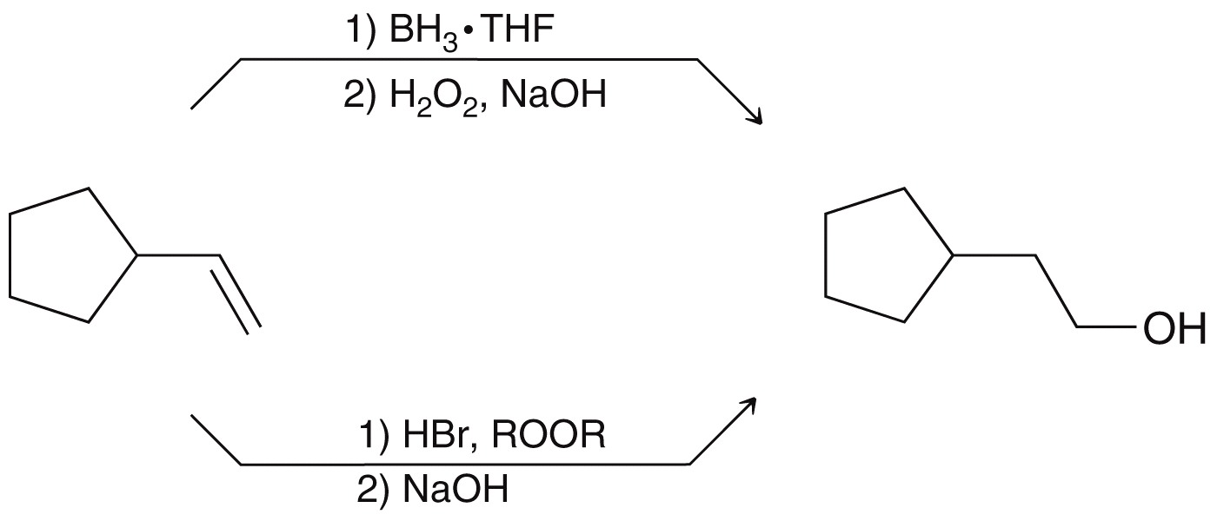
11.7 Multiple Correct Answers
There will often be more than one way to solve a synthesis problem
In general, a chemist’s goal is to find the most facile synthesis generally having the fewest steps

