Slide 1
Organic Chemistry
Second Edition
David Klein
Chapter 12
Alcohols and Phenols

Slide 2
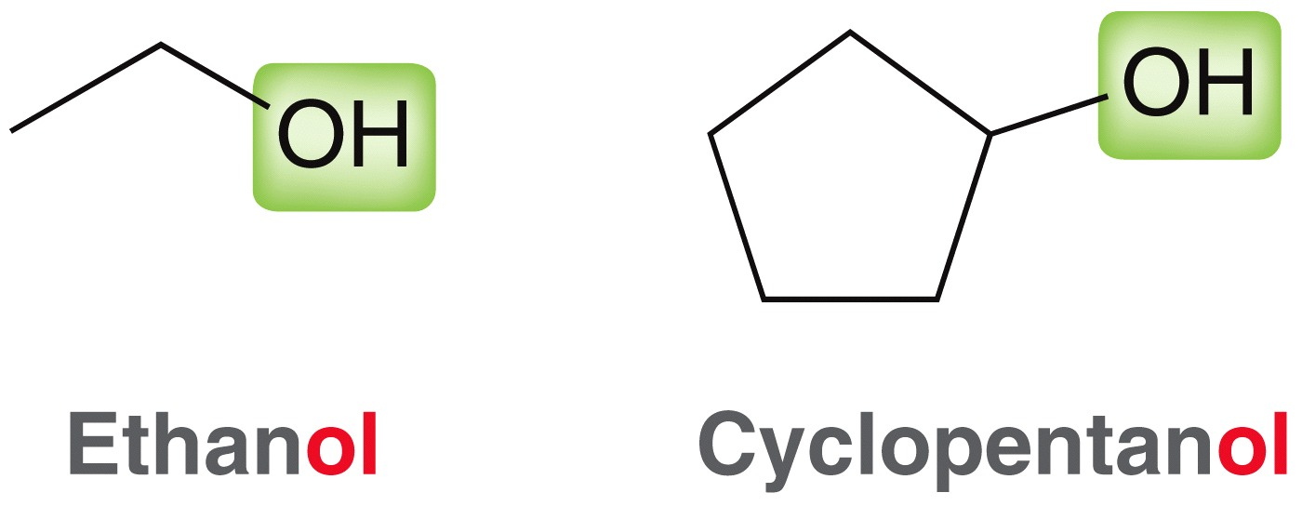
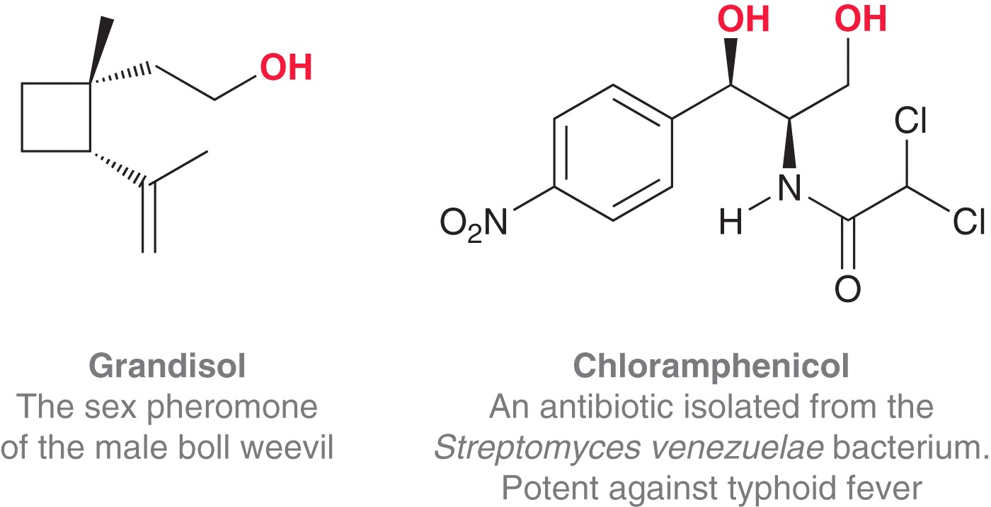
12.1 Alcohols and Phenols
Alcohols possess a hydroxyl group (-OH)
Hydroxyl groups are extremely common in natural compounds

Slide 3
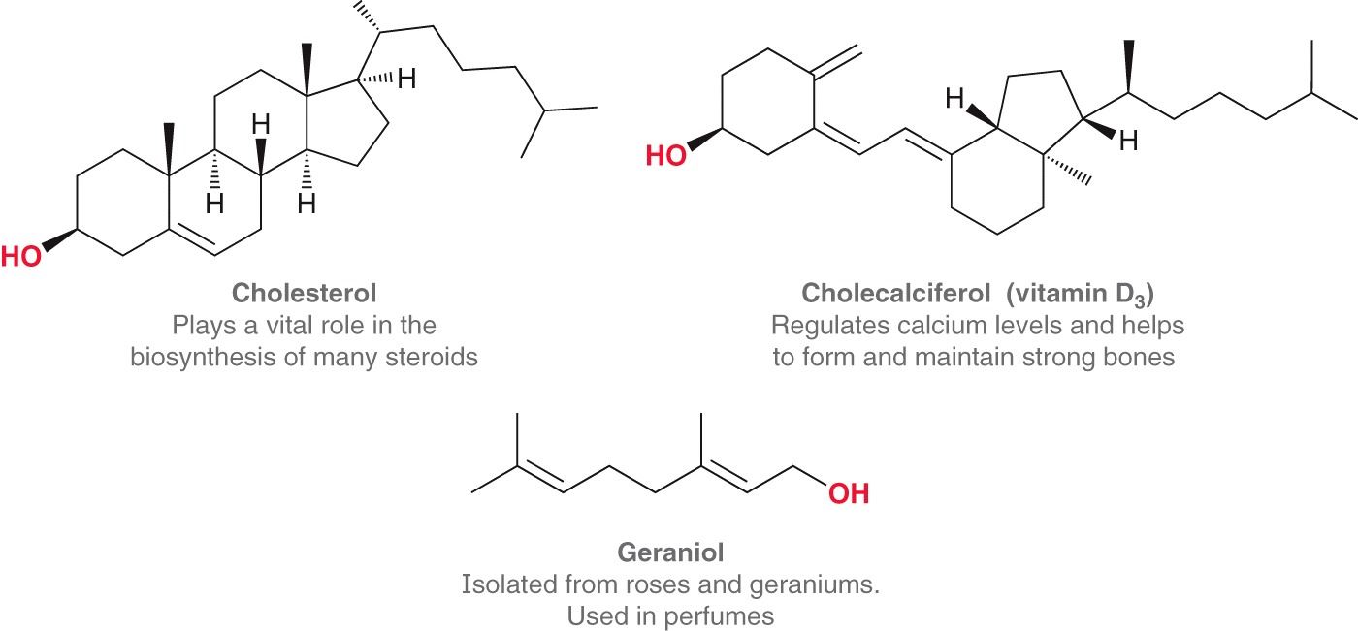
12.1 Alcohols and Phenols
Hydroxyl groups in natural compounds

Slide 4
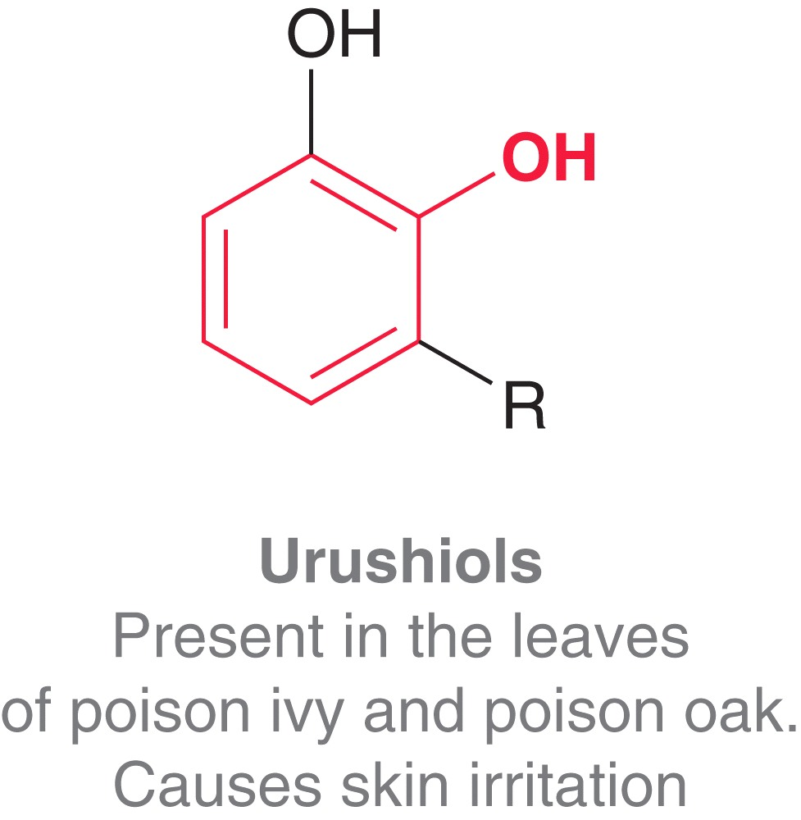
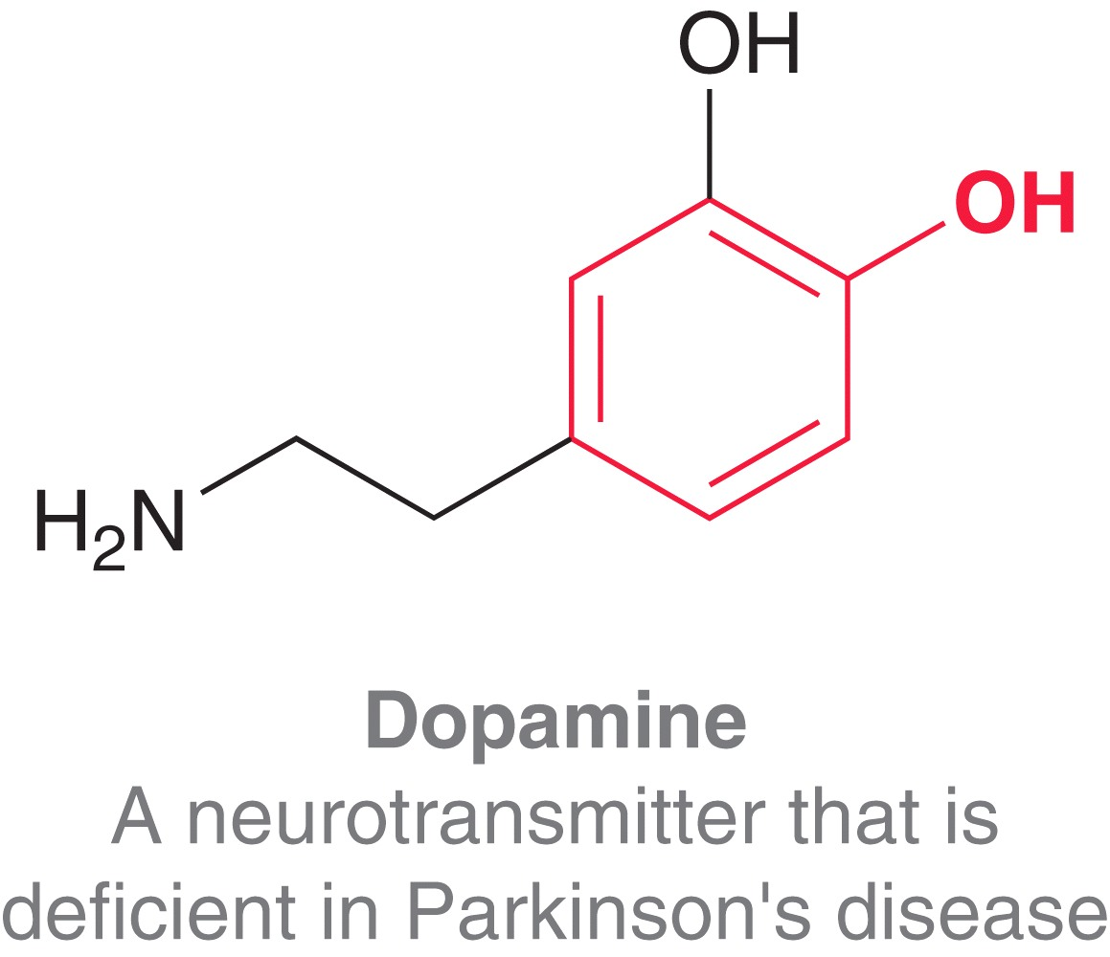
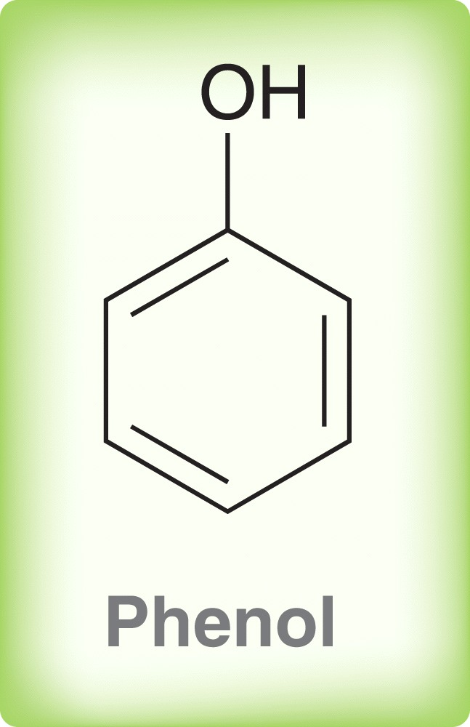
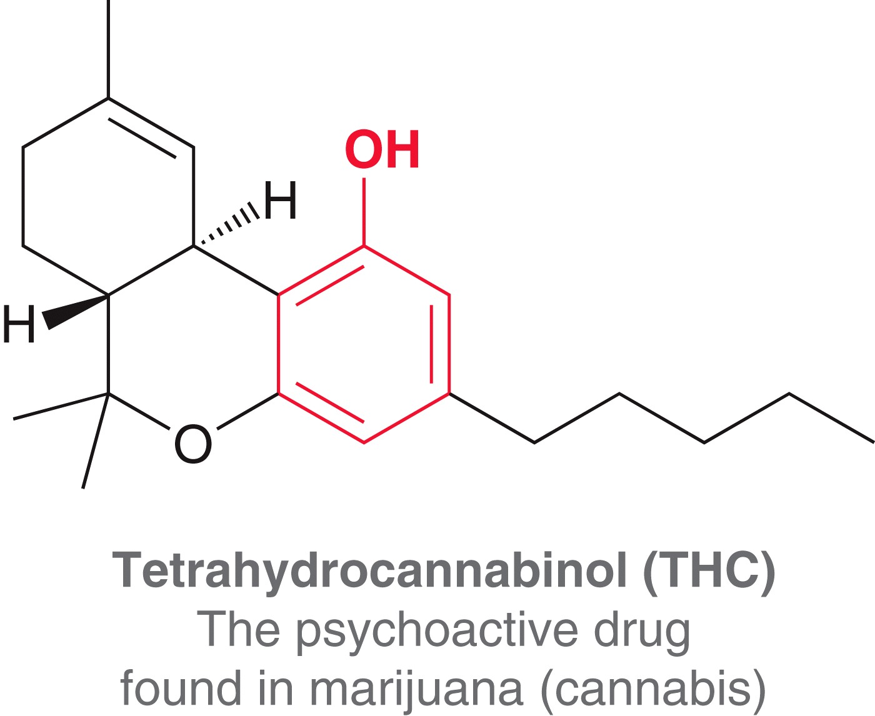
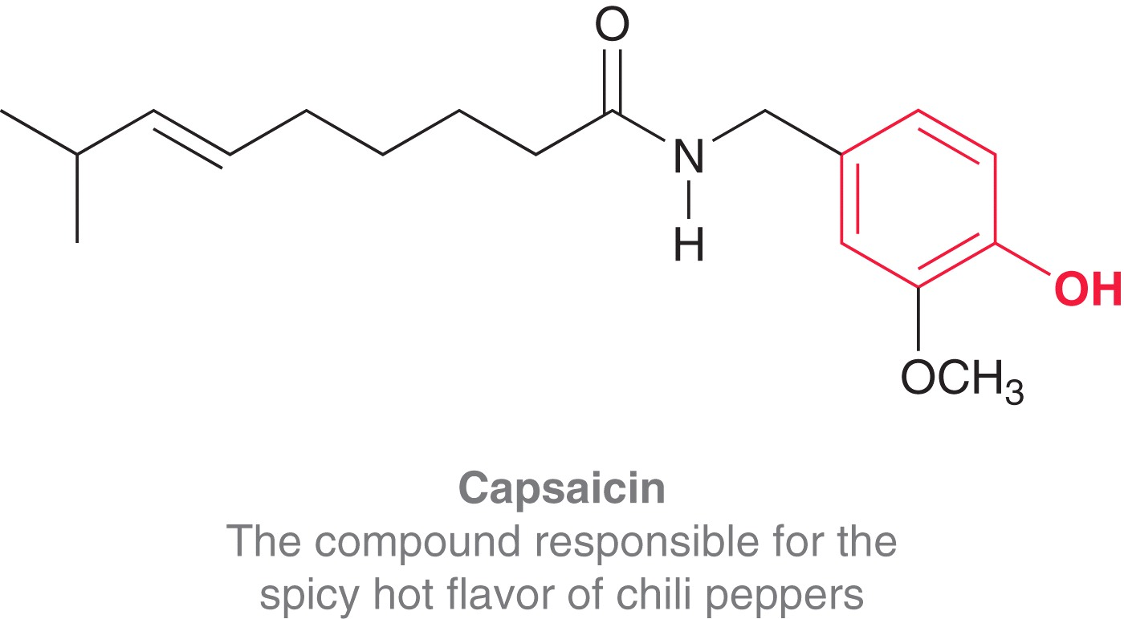
12.1 Alcohols and Phenols
Phenols possess a hydroxyl group directly attached to a benzene ring

Slide 5
12.1 Alcohol Nomenclature
Alcohols are named using the same procedure we used in Chapter 4 to name alkanes with minor modifications
  Identify the parent chain, which should include the carbon that the –OH is attached to
  Identify and Name the substituents
  Assign a locant (and prefix if necessary) to each substituent. Give the carbon that the –OH is attached to the lowest number possible
  List the numbered substituents before the parent name in alphabetical order. Ignore prefixes (except iso) when ordering alphabetically
  The –OH locant is placed either just before
  the parent name or just before the -ol suffix

Slide 6
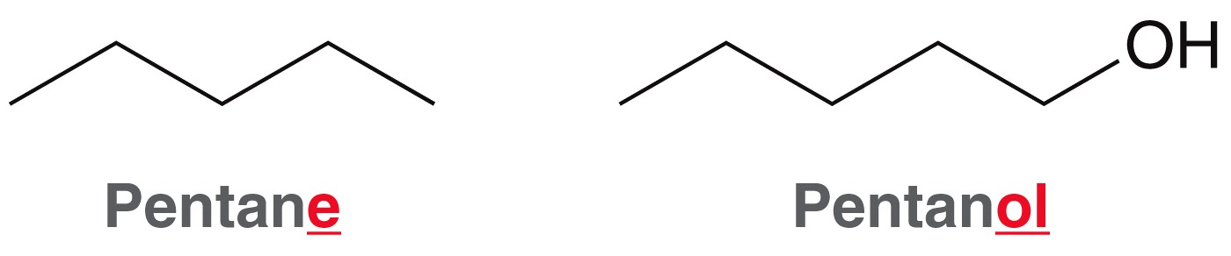
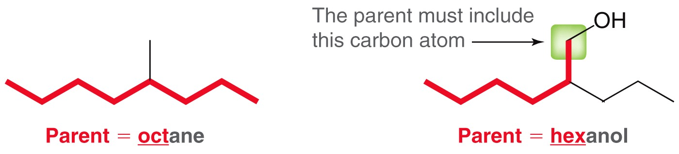
12.1 Alcohol Nomenclature
Alcohols are named using the same procedure we used in Chapter 4 to name alkanes with minor modifications
  Identify the parent chain

Slide 7
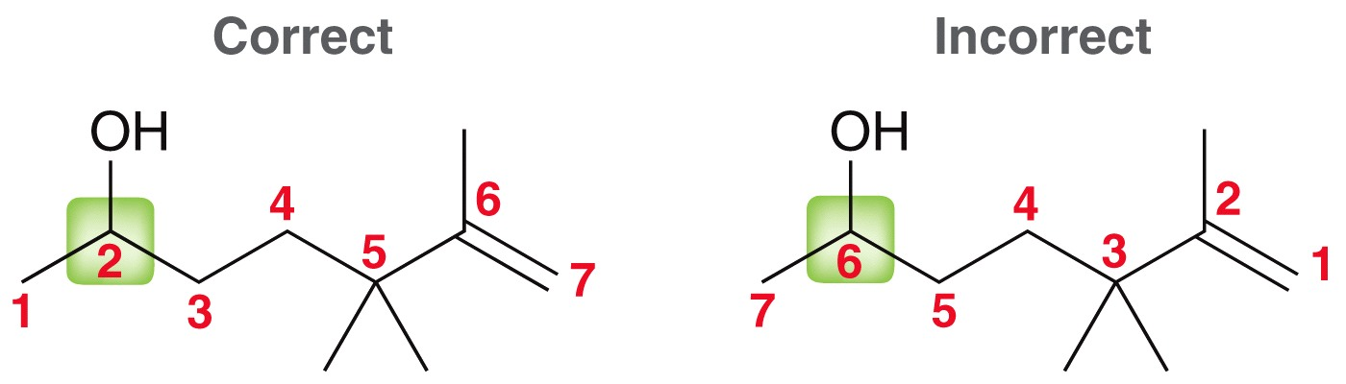
12.1 Alcohol Nomenclature
Alcohols are named using the same procedure we used in Chapter 4 to name alkanes with minor modifications
  Assign a locant (and prefix if necessary) to each substituent. Give the carbon that the –OH is attached to the lowest number

Slide 8
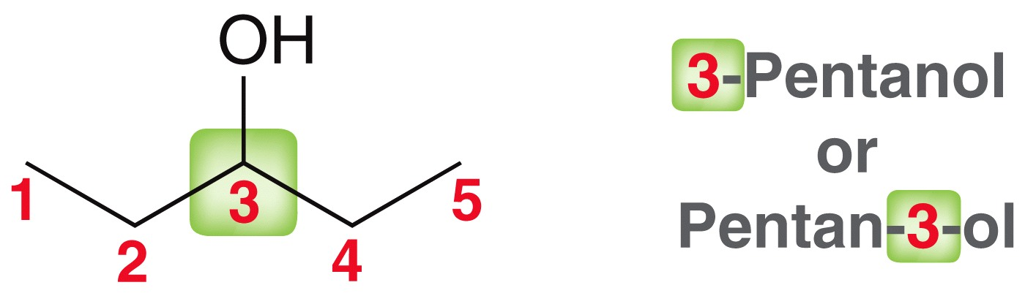
12.1 Alcohol Nomenclature
Alcohols are named using the same procedure we used in Chapter 4 to name alkanes with minor modifications
  The –OH locant is placed either just before the parent name or just before the -ol suffix

Slide 9
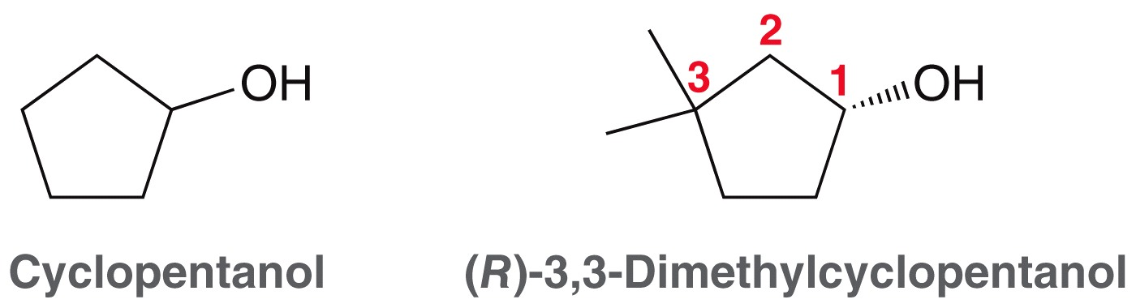
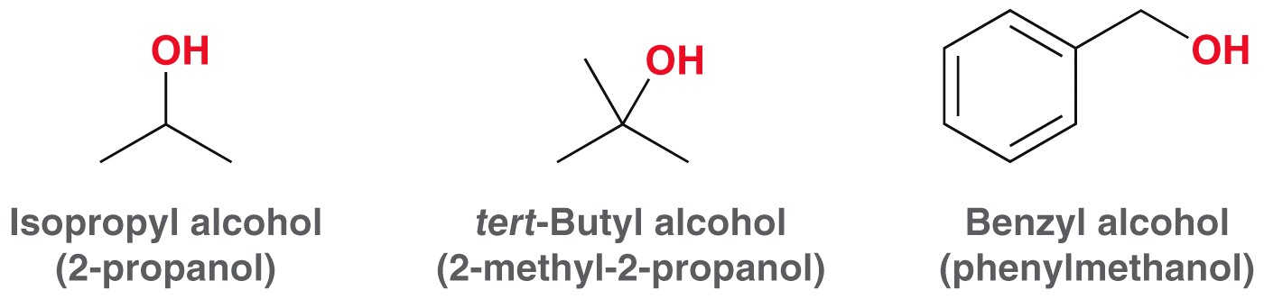
12.1 Alcohol Nomenclature
For cyclic alcohols, the –OH group is always carbon 1
Common names for some alcohols are also frequently used

Slide 10
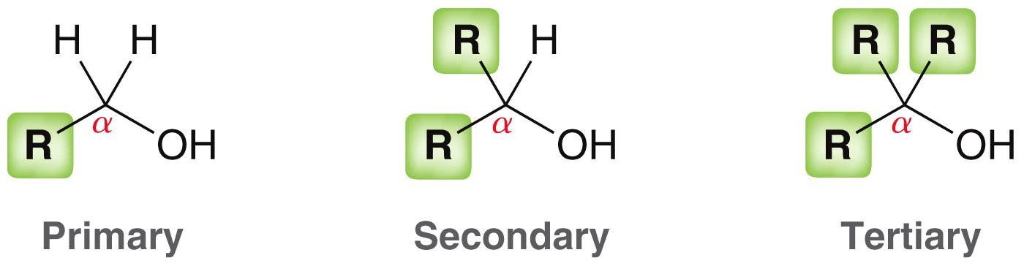
12.1 Alcohol Nomenclature
Like halides, alcohols are often classified by the type of carbon they are attached to

Slide 11
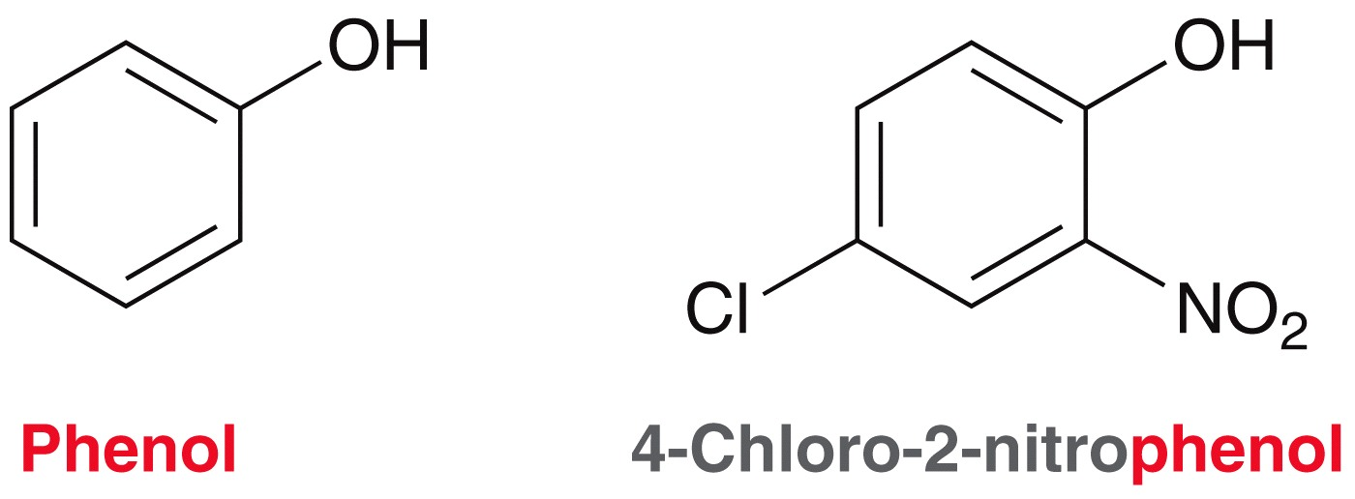
12.1 Alcohol Nomenclature
When an –OH group is attached to a benzene ring, the parent name is phenol
Practice with SkillBuilder 12.1

Slide 12
12.1 Commercially Important Alcohols
Methanol (CH₃OH) is the simplest alcohol
With a suitable catalyst, about 2 billion gallons of methanol is made industrially from CO₂ and H₂ every year
Methanol is poisonous, but it has many uses
  Solvent
  Precursor for chemical syntheses
  Fuel

Slide 13
12.1 Commercially Important Alcohols
Ethanol (CH₃CH₂OH), produced by fermentation of grains or fruits
Industrially, ethanol is made via acid-catalyzed hydration of ethylene (5 billion gallons/year in the U.S. alone)
Ethanol has many uses
  Solvent, precursor for chemical syntheses, fuel. Is denatured to avoid heavy taxes
  Human consumption – ethanol suitable for drinking, and is heavily taxed.

Slide 14
12.1 Commercially Important Alcohols
Isopropanol CH₃CH(OH)CH₃, a.k.a. rubbing alcohol.
Isopropanol is made industrially from the acid-catalyzed hydration of propylene
Isopropanol is poisonous, but it has many uses
  Industrial solvent
  Antiseptic
  Gasoline additive

Slide 15
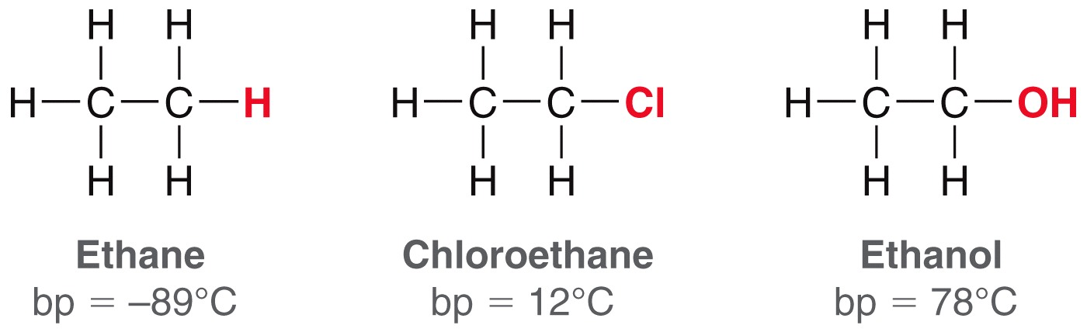
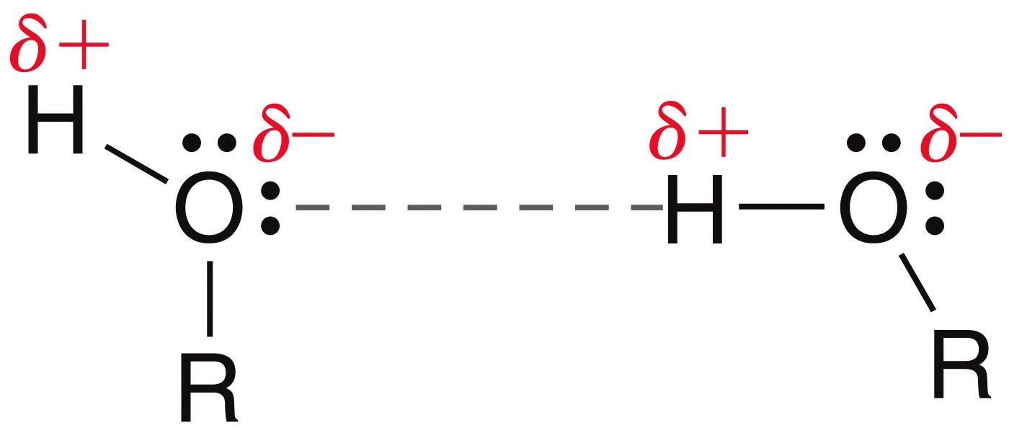
12.1 Physical Properties of Alcohols
The –OH of an alcohol has a big effect on its physical properties
Compare the boiling points below
Alcohols have much higher BP’s due to H-bonding

Slide 16
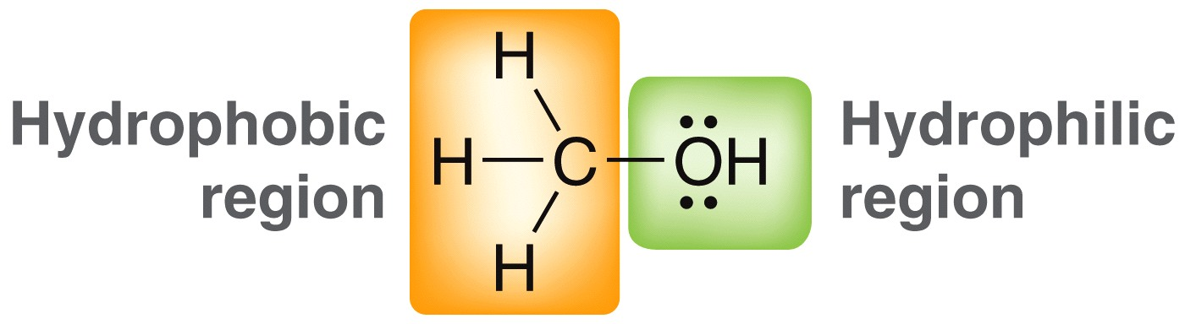
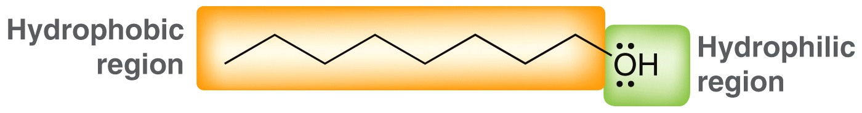
12.1 Physical Properties of Alcohols
Alcohols with 3 carbons or less are miscible in water
Alcohols with large carbon chains do not readily mix with water

Slide 17
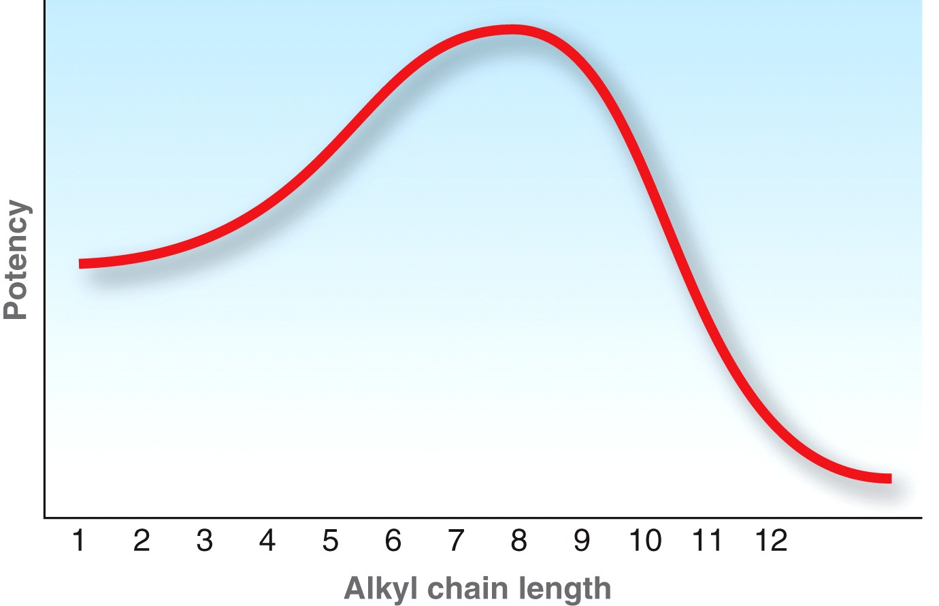
12.1 Physical Properties of Alcohols
An alcohol’s potency as an anti-bacterial agent depends on the size of the hydrophobic group
The alcohol needs some water solubility to travel through aqueous media
To kill a bacterium, the alcohol should have a significant hydrophobic region to penetrate microbial membranes

Slide 18
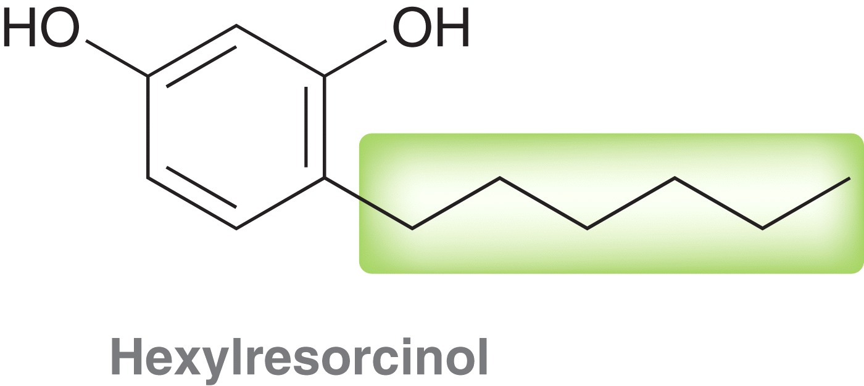
12.1 Physical Properties of Alcohols
Hexylresorcinol is used as an antibacterial and as an antifungal agent
It has a good combination of hydrophobic and hydrophilic regions
Practice with conceptual checkpoint 12.3

Slide 19
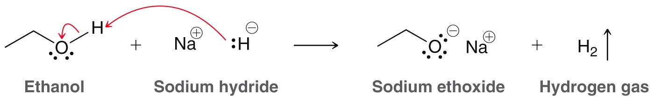
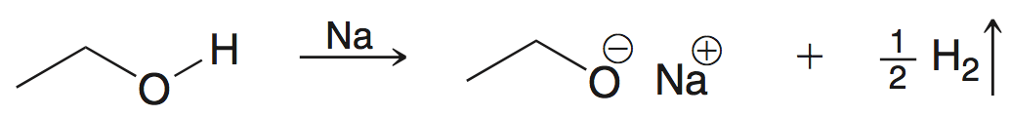
12.2 Acidity of Alcohols and Phenols
A strong base is necessary to deprotonate an alcohol. NaH is often used to generate the corresponding alkoxide:
Na, K, or Li metal is often used as well:
Practice with conceptual checkpoint 12.4

Slide 20
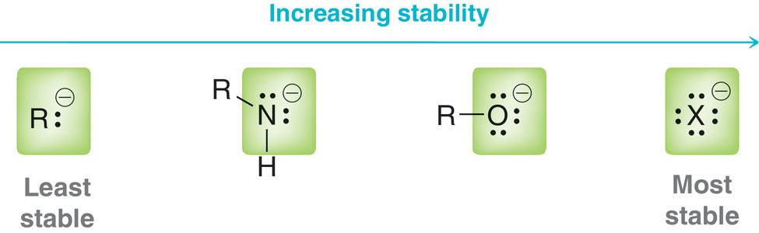
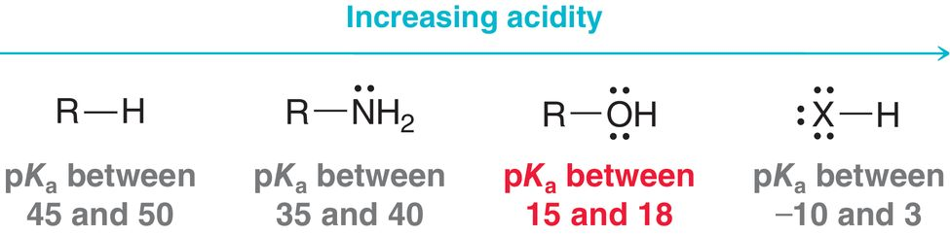
12.2 Acidity of Alcohols and Phenols
Alkoxide – conjugate base of an alcohol
Remember ARIO… to rationalize the relative acidity of an alcohol

Slide 21
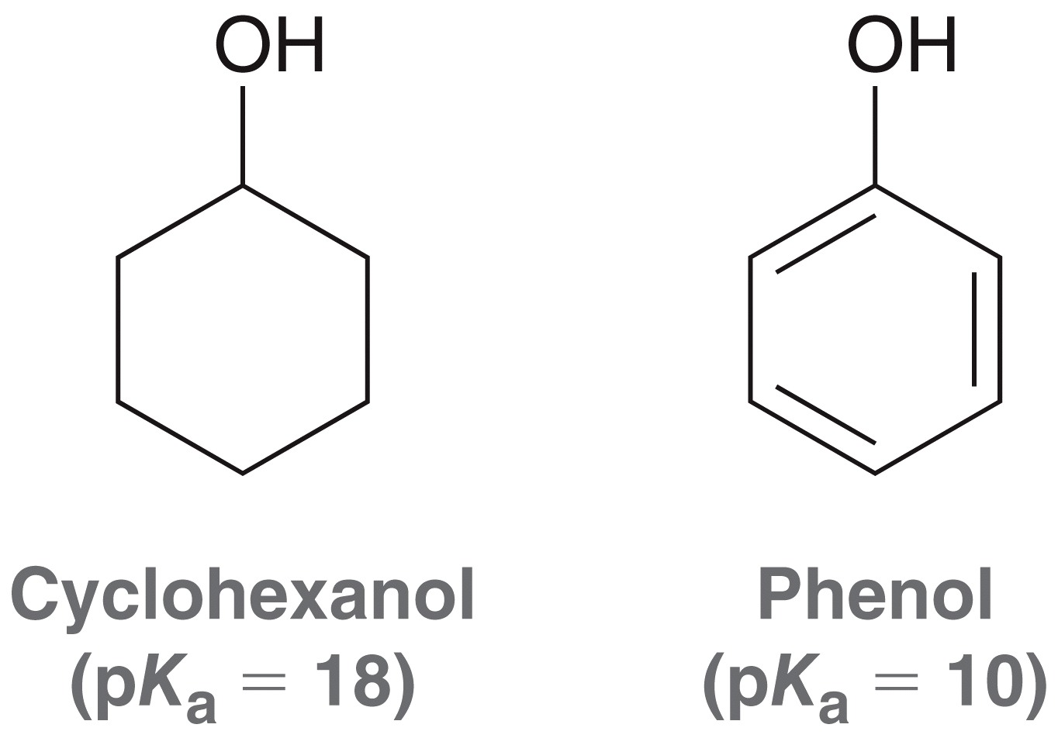
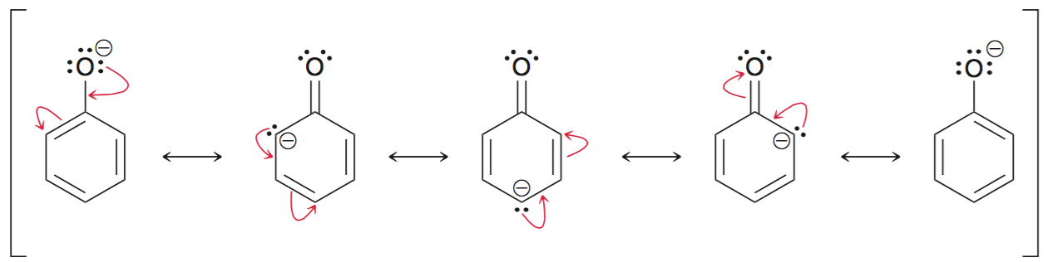
12.2 Acidity of Alcohols and Phenols
Recall the factors that affect the acidity of alcohols and phenols
Resonance – phenol is millions of
times more acidic because the
conjugate base, phenoxide,
is resonance stabilized

Slide 22
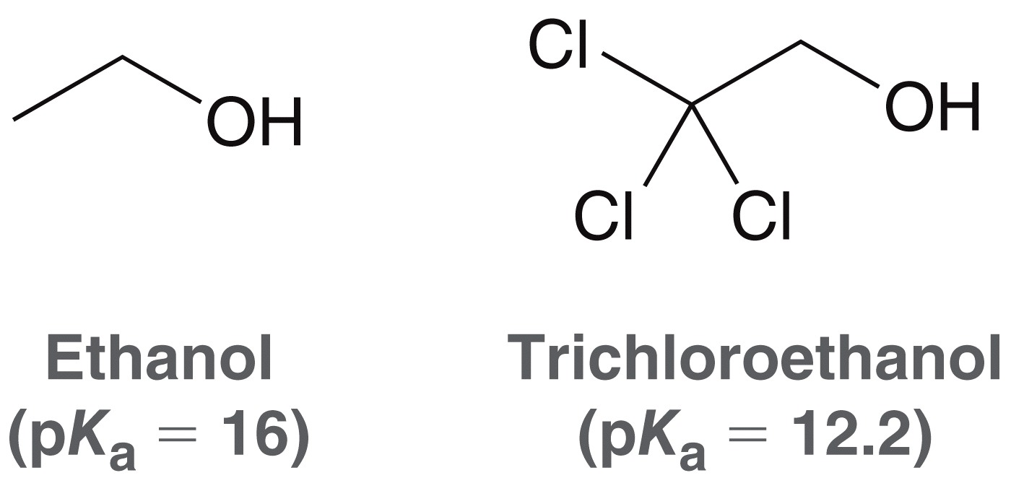
12.2 Acidity of Alcohols and Phenols
Recall the factors that affect the acidity of alcohols and phenols
Induction – presence of electron withdrawing groups increases the acidity of an alcohol or phenol

Slide 23
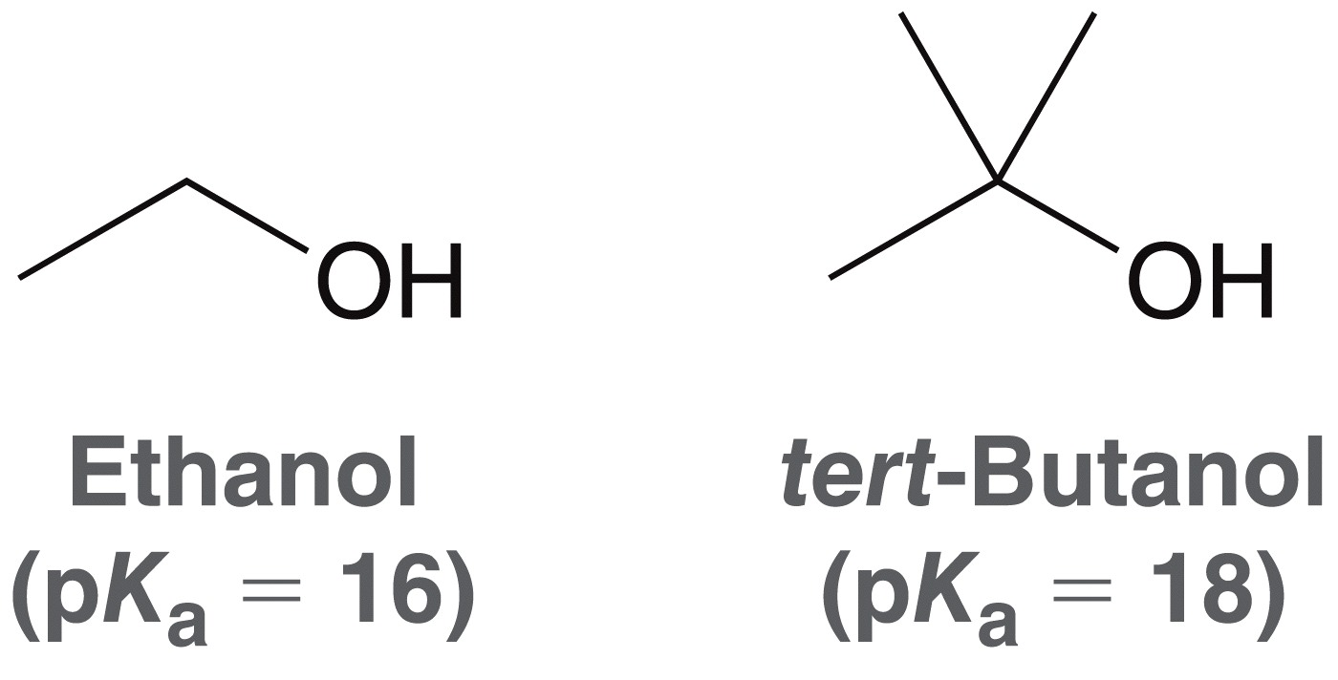
12.2 Acidity of Alcohols and Phenols
Recall the factors that affect the acidity of alcohols and phenols
Solvation Effects – The more poorly solvated a conjugate base, the less stable it is, and the less acidic it’s conjugate acid
The conjugate base of
tert-butanol is less stable
due to solvation effects

Slide 24
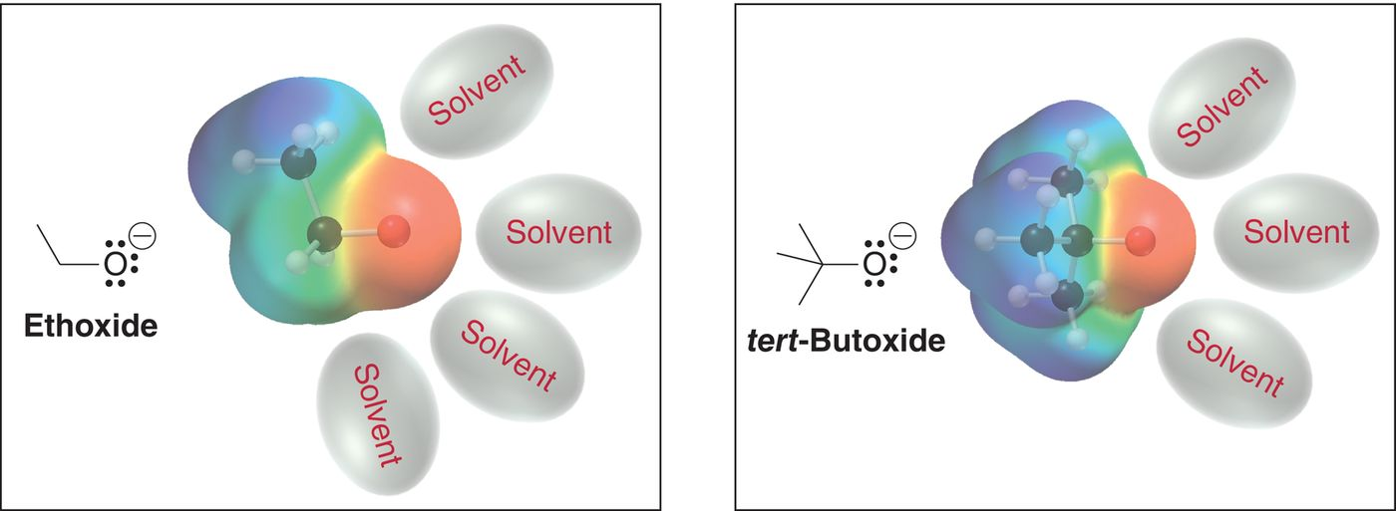
12.2 Acidity of Alcohols and Phenols
The tert-butoxide ion is sterically hindered, and not well solvated
Practice with SkillBuilder 12.2

Slide 25

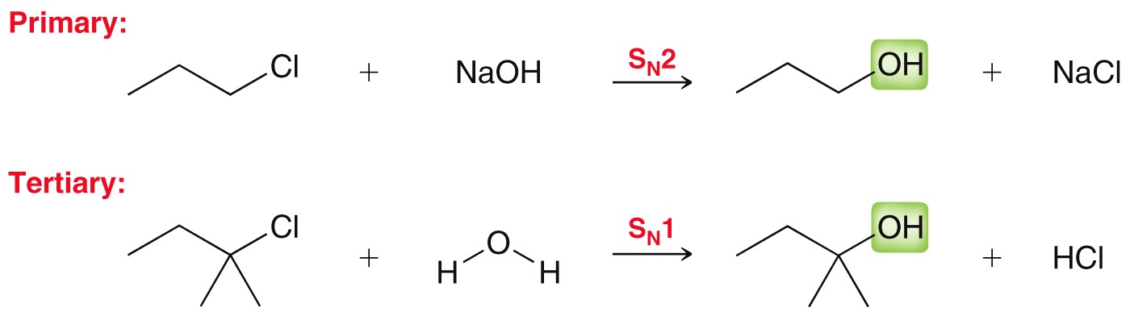
12.3 Preparation of Alcohols
Alcohols can be synthesized from alkyl halides via substitution:
The substitution occurs by S_{N}1 or S_{N}2, depending on the substrate:

Slide 26
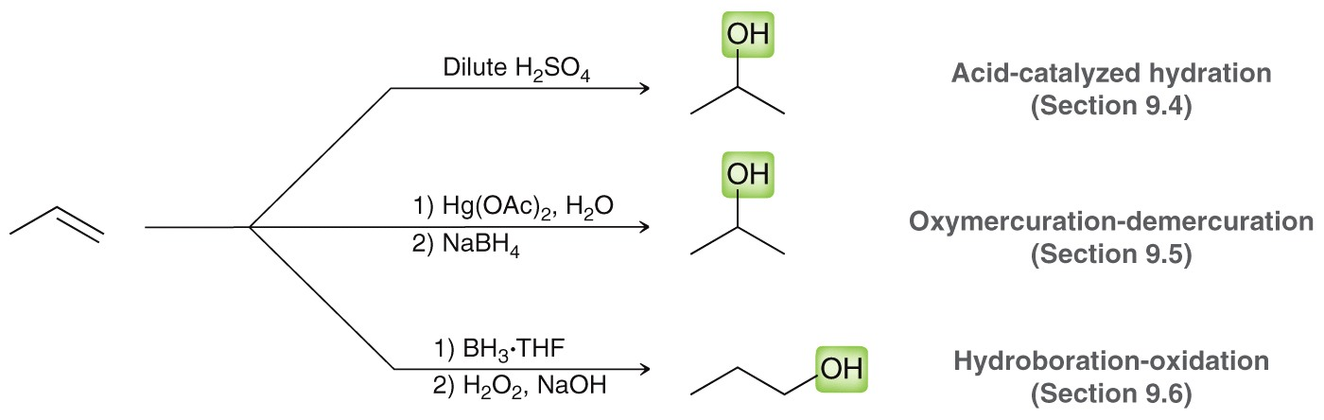
12.3 Preparation of Alcohols
Alcohols can by synthesized from alkenes via addition reactions:
Recall that acid-catalyzed hydration yield Markovnikov addition
Hydroboration-oxidation yields anti Markovnikov addition
Practice with Checkpoints 12.7 and 12.8

Slide 27
12.4 Prep. of Alcohols via Reduction
A third method to prepare alcohols is by the reduction of a carbonyl. What is a carbonyl?
Reductions involve a change in oxidation state
Oxidation state are a method of electron bookkeeping
Recall how we used formal charge as a method of electron bookkeeping
  Each atom is assigned half of the electrons it is sharing with another atom
  What is the formal charge on carbon in methanol?

Slide 28
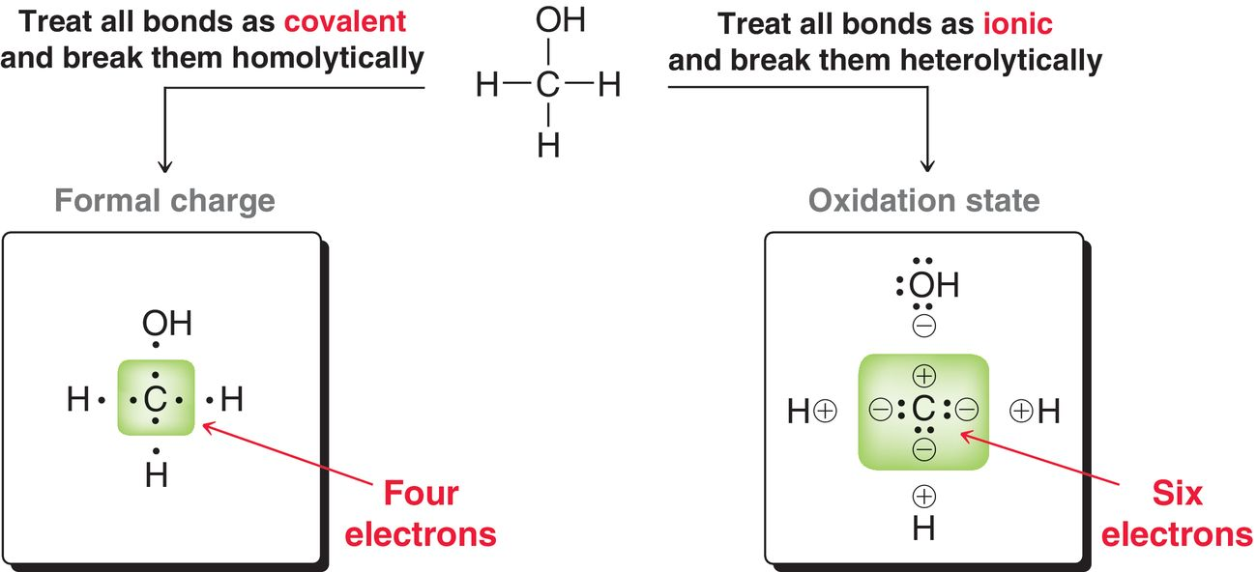
12.4 Prep. of Alcohols via Reduction
To determine the oxidation state of an atom, imagine the electrons in a bond as a lone pair on the more electronegative atom

Slide 29
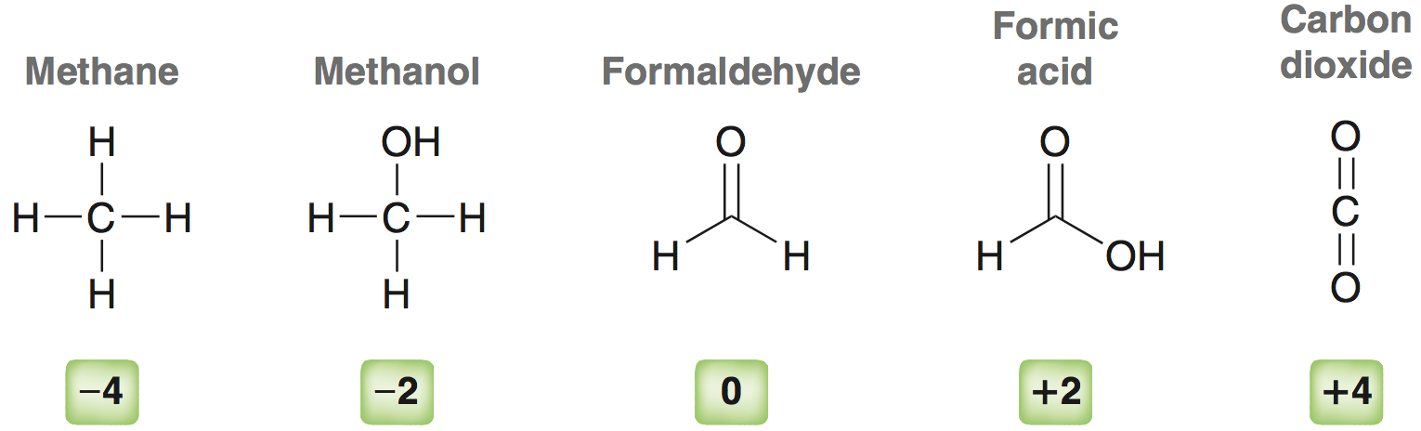
12.4 Prep. of Alcohols via Reduction
Oxidation states for carbon ranges from -4 to +4
Oxidation Rxn – carbon’s oxidation state is increased
Reduction Rxn – carbon’s oxidation state is decreased
Practice with SkillBuilder 12.3

Slide 30
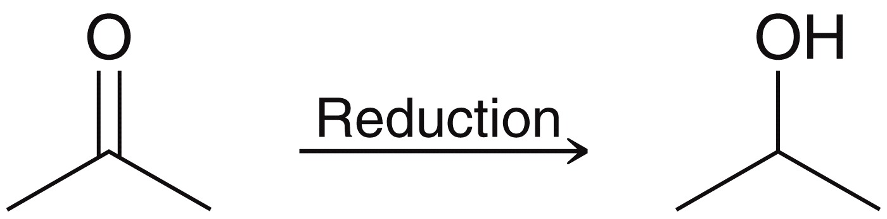
12.4 Prep. of Alcohols via Reduction
Converting a carbonyl to an alcohol requires a reducing agent
The reducing agent is then oxidized in the process, while the substrate (carbonyl is reduced)
The reduction of the carbonyl group, overall, results in the addition of H and H across the π bond

Slide 31
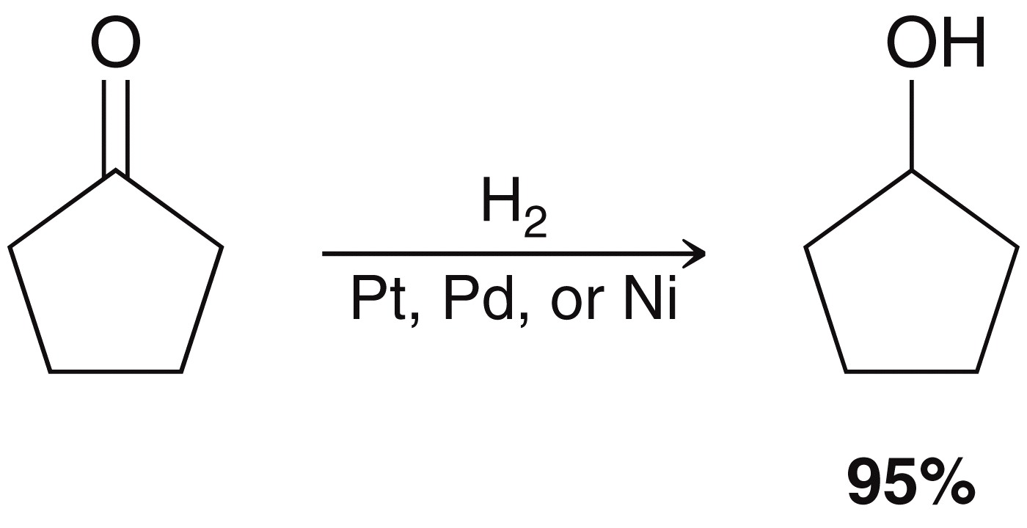
12.4 Prep. of Alcohols via Reduction
There are three reducing agents that can be used:
  Catalytic Hydrogenation:
  This method is rarely used; high temp and pressure is required

Slide 32
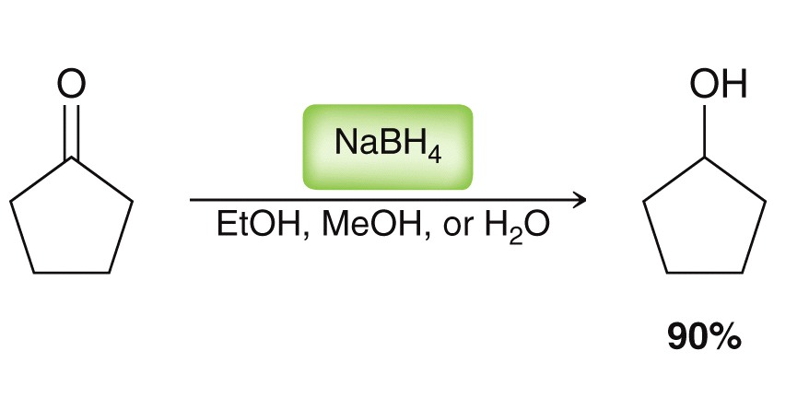
12.4 Prep. of Alcohols via Reduction
There are three reducing agents that can be used:
  Sodium Borohydride (NaBH₄) – common reducing agent for aldehydes and ketones

Slide 33
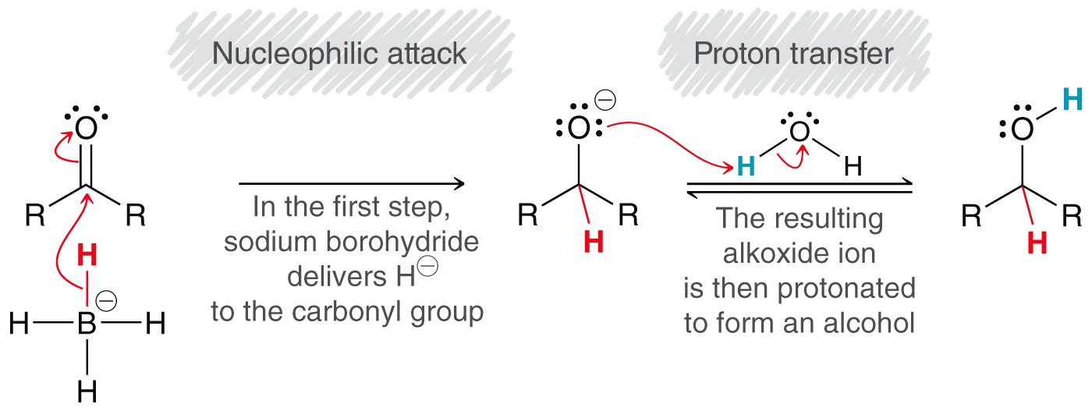
12.4 Prep. of Alcohols via Reduction
There are three reducing agents that can be used
NaBH₄ is a source of hydride (H⁻) which does nucleophilic addition to the carbonyl carbon, followed by proton transfer from the solvent:

Slide 34
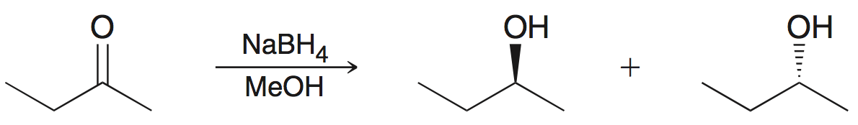
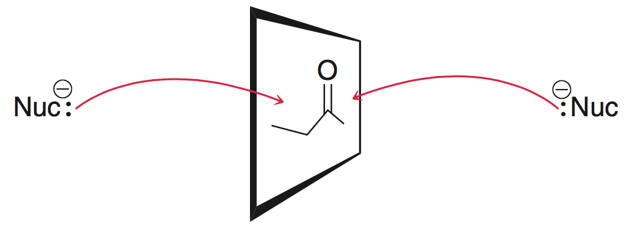
12.4 Prep. of Alcohols via Reduction
There are three reducing agents that can be used
When an unsymmetrical ketone is reduced, a new chiral center is created and a pair of stereoisomers is obtained
Unsymmetrical ketone
has two different R groups

Slide 35
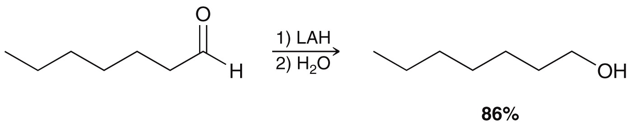
12.4 Prep. of Alcohols via Reduction
There are three reducing agents that can be used:
  Lithium Aluminum Hydride (LiAlH₄) – another common reducing agent for reducing carbonyl compounds
  Lithium Aluminum Hydride is often abbreviated as LAH

Slide 36
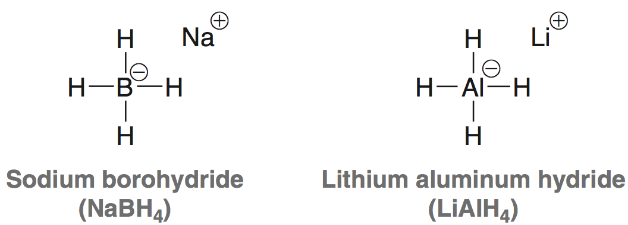
12.4 Prep. of Alcohols via Reduction
There are three reducing agents that can be used
LiAlH₄ and NaBH₄ are structurally similar hydride reagents
But, LAH is much more reactive than NaBH4

Slide 37
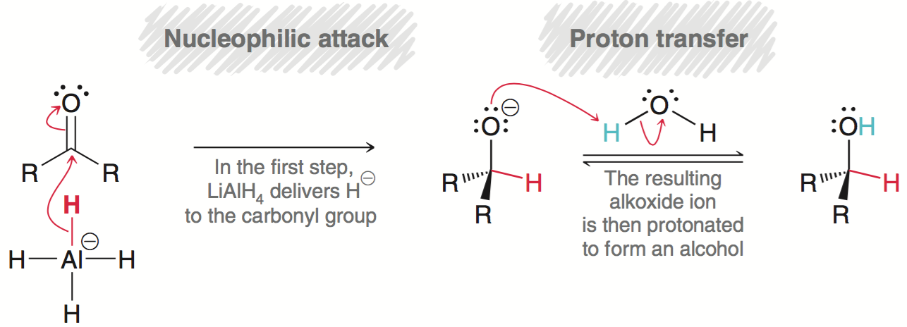
12.4 Prep. of Alcohols via Reduction
There are three reducing agents that can be used
LiAlH₄ is much more reactive and cannot be used in presence of a protic solvent. The proton source (H₂O) has to be added after carbonyl is reduced.

Slide 38
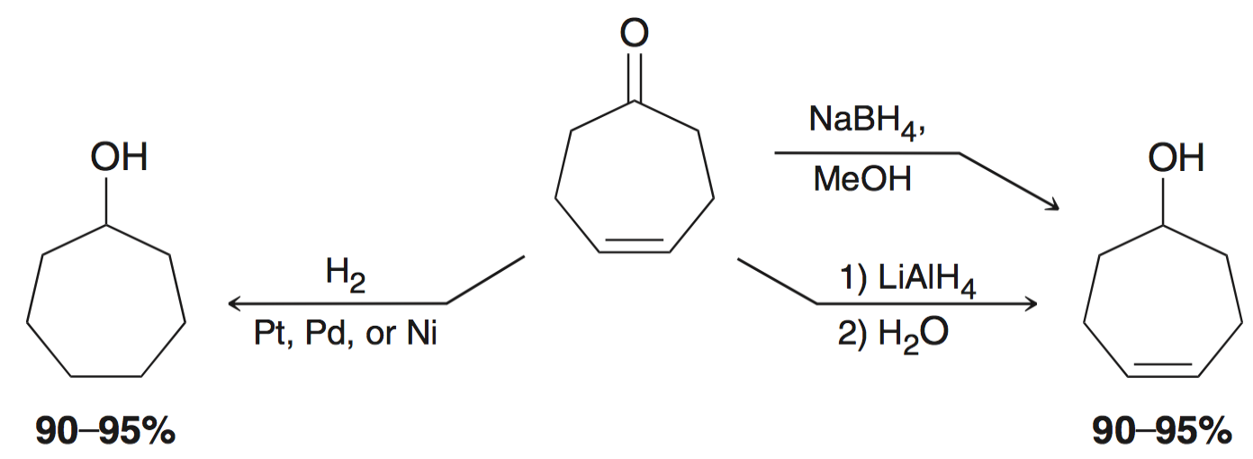
12.4 Prep. of Alcohols via Reduction
Hydride delivery agents are selective for the carbonyl group, whereas hydrogenation is not.
Catalytic hydrogenation reduces the carbonyl AND the alkene

Slide 39
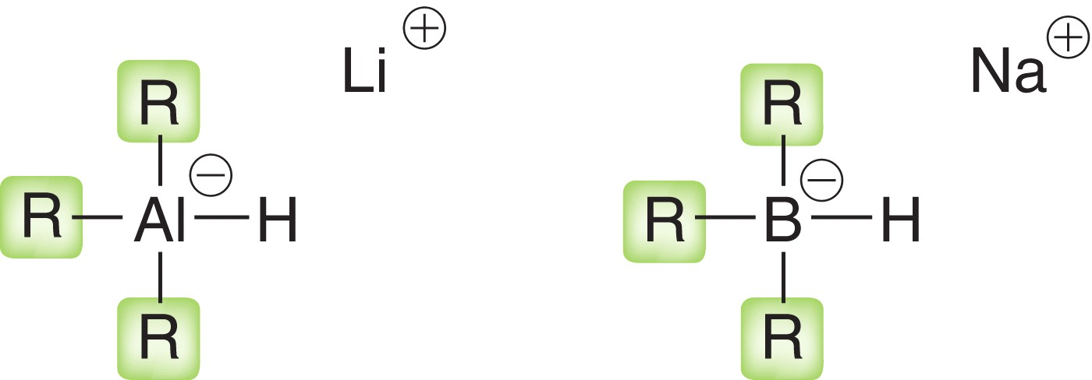
12.4 Prep. of Alcohols via Reduction
The reactivity of hydride delivery agents can be fine-tuned by using derivatives with varying R-groups
  Alkoxides
  Cyano
  Sterically hindered groups

Slide 40
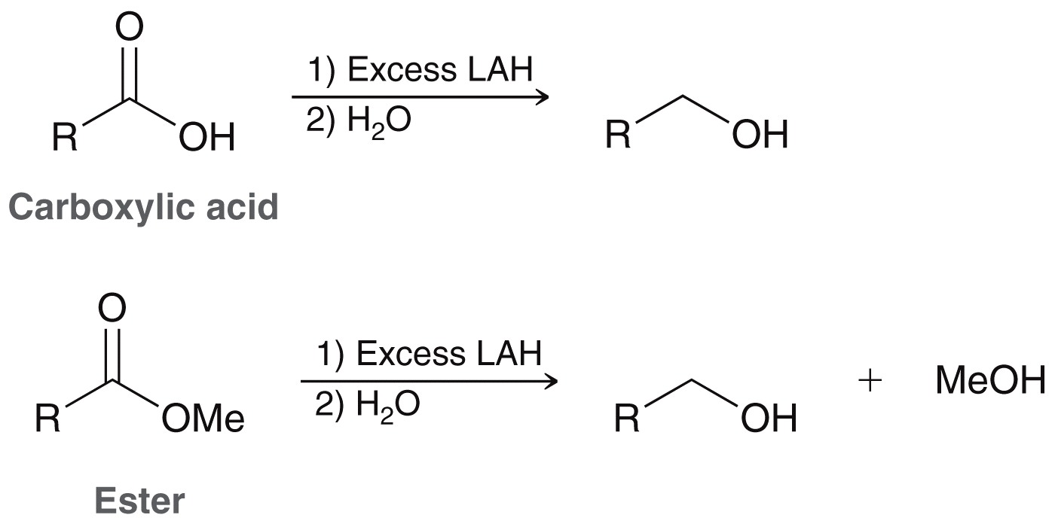
12.4 Prep. of Alcohols via Reduction
LAH is strong enough to also reduce esters and carboxylic acids, whereas NaBH₄ is generally not
Reduction of carboxylic acids & esters yield primary alcohols

Slide 41
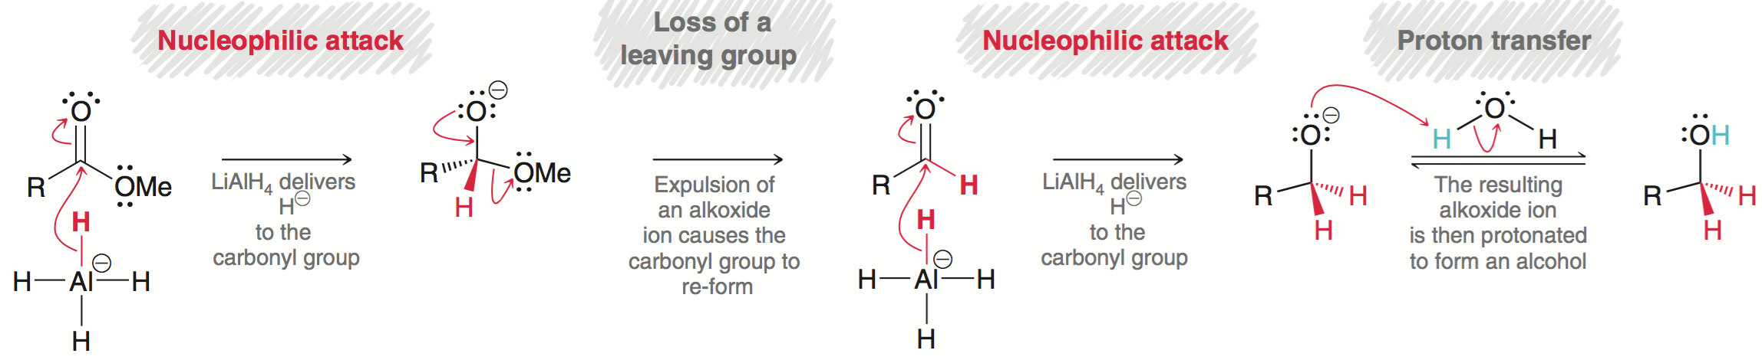
12.4 Prep. of Alcohols via Reduction
Reduction of an ester requires 2 equivalents of hydride
The first two steps result in formation of an aldehyde, which is then reduced to alcohol as previously discussed.
Methoxide is not a good leaving group, but acts like one here because the high energy intermediate becomes a stable aldehyde
Practice with SkillBuilder 12.4

Slide 42
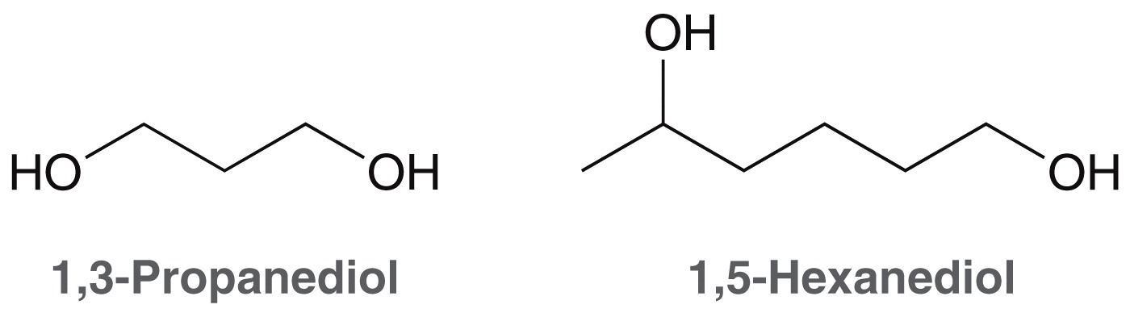
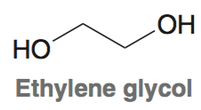
12.5 Preparation of Diols
Diols are named using the same method as alcohols, except the “e” is not dropped from the alkane name, and the suffix “diol” is used.
The term glycol is also used to describe
a compound with two hydroxyl groups

Slide 43

12.5 Preparation of Diols
Diols can be prepared from the reduction of diketones

Slide 44

12.5 Preparation of Diols
Recall the methods we discussed in chapter 9 to convert an alkene into a diol

Slide 45


12.6 Prep of Alcohols – Grignard Reagents
Grignard reagents are often used in the synthesis of alcohols
To form a Grignard, an alkyl halide is treated with Mg metal

Slide 46

12.6 Prep of Alcohols – Grignard Reagents
The electronegativity difference between C (2.5) and Mg (1.3) is great enough that the bond has significant ionic character
The carbon atom behaves like a carbon anion, and is a strong nucleophile, as well as a strong base

Slide 47


12.6 Prep of Alcohols – Grignard Reagents
Grignard reagents react like LAH, and will attack the carbonyl group of a ketone or an aldehyde
The key difference – Grignard reaction give a new C-C bond!

Slide 48

12.6 Prep of Alcohols – Grignard Reagents
Because the Grignard is both a strong base and a strong nucleophile, care must be taken to protect it from exposure to water or alcohols
Anhydrous ethers are usually used as solvents for Grignard reactions

Slide 49



12.6 Prep of Alcohols – Grignard Reagents
Grignard examples
Practice with SkillBuilder 12.5

Slide 50

12.7 Protection of Alcohols
Consider the reaction below.
The alcohol can act as an acid, so a Grignard reagents and alcohols are incompatible
The alcohol can be protected to prevent it from reacting

Slide 51

12.7 Protection of Alcohols
A three-step process is required to achieve the desired overall synthesis: (1) protect alcohol (2) perform Grignard reaction, then (3) deprotect

Slide 52


12.7 Protection of Alcohols
One such protecting group is trimethylsilyl (TMS)
The TMS protection step requires the presence of a base to neutralize the HCl byproduct

Slide 53

12.7 Protection of Alcohols
Evidence suggests that substitution at the Si atom occurs by an S_{N}2 mechanism
Because Si is much larger than C, it is more open to backside attack

Slide 54


12.7 Protection of Alcohols
The TMS group can later be removed with H₃O⁺ or F⁻
TBAF is often used to supply fluoride ions

Slide 55

12.7 Protection of Alcohols
The overall process is shown below:
Practice with Conceptual Checkpoint 12.16

Slide 56

12.8 Preparation of Phenols
2 million tons of phenol is produced industrially yearly
Acetone is a useful byproduct
Phenol is a precursor in many chemical syntheses
  Pharmaceuticals
  Polymers
  Adhesives
  Food preservatives, etc.

Slide 57


12.9 Reactions of Alcohols
3˚ alcohols area converted to alkyl halides with HX (S_{N}1 rxn)
For 1˚ or 2˚ alcohols, the reaction occurs via S_{N}2

Slide 58


12.9 Reactions of Alcohols
To make an alkyl chloride, ZnCl₂ must be used with HCl
The Zinc cation is required to make the –OH a better leaving group

Slide 59


12.9 Reactions of Alcohols
Recall the –OH group can be converted into a good leaving group, such as a tosyl group
The tosylate can then undergo
S_{N}2 substitution to obtain an
alkyl halide

Slide 60

12.9 Reactions of Alcohols
1˚ and 2˚ alcohols can also be converted to alkyl halides using SOCl₂ or PBr₃:

Slide 61

12.9 Reactions of Alcohols
SOCl₂ mechanism:

Slide 62

12.9 Reactions of Alcohols
PBr₃ mechanism:
Practice with SkillBuilder 12.6

Slide 63


12.9 Reactions of Alcohols
In section 7.12, we saw alcohols undergo elimination in acidic conditions:
3˚ follow an S_{N}1 mechanism under these conditions:

Slide 64

12.9 Reactions of Alcohols
Recall that E1 elimination generally favors the more substituted alkene.
The less substituted alkene could only be favored via E2 elimination using a strong bulky base.

Slide 65

12.9 Reactions of Alcohols
If the alcohol is converted into a better leaving group, then a strong base can be used to promote E2
E2 reactions generally preferred over E1 reactions. E2 pathway not susceptible to rearrangements, and regioselectivity can be controlled (Zaitsev vs. Hofmann)
Practice with Conceptual Checkpoint 12.19

Slide 66

12.10 Oxidation of Alcohols
We saw how alcohols can be formed by the reduction of a carbonyl
The reverse process, oxidation, is also possible:

Slide 67


12.10 Oxidation of Alcohols
Oxidation of primary alcohols proceed to an aldehyde, and then to the carboxylic acid
Oxidation of secondary alcohols produces a ketone

Slide 68

12.10 Oxidation of Alcohols
3˚ alcohols generally do not undergo oxidation because they do not have any protons at the α position:

Slide 69

12.10 Oxidation of Alcohols
There is a large number of oxidizing agents that can be used to oxidize an alcohol
The most common oxidizing agent is chromic acid; it is formed from either CrO₃ or Na₂Cr₂O₇ in aqueous acid:
Chromic acid
is also
called the
Jones Reagent

Slide 70

12.10 Oxidation of Alcohols
Oxidation of the alcohol with chromic acid involves (1) formation of a chromate ester, and (2) elimination to form the π bond

Slide 71

12.10 Oxidation of Alcohols
Chromic acid will oxidize a 1˚ alcohol to a carboxylic acid
PCC (pyridinium chlorochromate) can be used as the oxidant to produce an aldehyde
1˚ alcohol
aldehyde

Slide 72

12.10 Oxidation of Alcohols
Regardless of the oxidant used, either chromic acid or PCC will convert a 2˚ alcohol to a ketone:

Slide 73

12.10 Oxidation of Alcohols
Chromium reagents are toxic and horrible for the environment.
Alternatives have been developed, two of them are covered here:
Swern oxidation – dimethyl sulfoxide (DMSO) and oxalyl chloride form the active oxidant.
active
oxidant

Slide 74

12.10 Oxidation of Alcohols
The chlorodimethyl sulfonium ion (active oxidant) is attacked by the alcohol, and Et₃N facilitates elimination to form the π bond
2˚ alcohols are oxidized to ketones

Slide 75

12.10 Oxidation of Alcohols
Like PCC, the Swern oxidation converts 1˚ alcohols to aldehydes

Slide 76

12.10 Oxidation of Alcohols
Chromium reagents are toxic and horrible for the environment.
Alternatives have been developed, two of them are covered here:
Dess-Martin periodane oxidation (DMP) – yields analogous results as the Swern oxidation:

Slide 77

12.10 Oxidation of Alcohols
DMP oxidation is believed to proceed through a periodane intermediate:
DMP oxidation is non-acidic and doesn’t require high temps, but chromium oxidations do.

Slide 78
12.10 Oxidation of Alcohols
Predict the product for the following reaction

Slide 79
12.10 Oxidation of Alcohols
Predict the product for the following reaction
Practice with SkillBuilder 12.7
carboxylic
acid
2˚ alcohol
aldehyde
ketone
1˚ alcohol
carboxylic
acid

Slide 80

12.11 Biological Redox Reactions
Nature employs reducing and oxidizing agents
They are generally complex and selective.
NADH (below) is one such reducing agent

Slide 81

12.11 Biological Redox Reactions
The reactive site of NADH acts as a hydride delivery agent
This is one way nature
converts carbonyls into
alcohols

Slide 82


12.11 Biological Redox Reactions
NAD⁺ is an oxidant, and undergoes the reverse process:
The NADH / NAD⁺
interconversion plays a
key role in metabolism

Slide 83

12.11 Biological Redox Reactions
Recall that tertiary alcohols do not undergo oxidation, because they lack an alpha proton
You might expect phenol to be similarly unreactive
In reality, phenol is even more readily oxidized than primary or secondary alcohols

Slide 84

12.12 Oxidation of Phenol
Phenol oxidizes to form benzoquinone, which in turn can be reduced to hydroquinone
Quinones interconvert with hydroquinones, which is a key process in cellular respiration

Slide 85

12.12 Oxidation of Phenol
Ubiquinones act to catalyze the conversion of oxygen into water, and are found in all cells in nature

Slide 86

12.12 Oxidation of Phenol
Ubiquinone catalysis:

Slide 87

12.13 Synthesis Strategies
Recall that reactions fall into the category of (1) changing the carbon skeleton, or (2) changing a functional group
Some reactions covered so far:

Slide 88


12.13 Synthesis Strategies
Now we have reactions that interconvert 1˚ alcohols with aldehydes, and 2˚ alcohols with ketones:

Slide 89

12.13 Synthesis Strategies
These 6 functional groups can be grouped by oxidation state:

Slide 90

12.13 Synthesis Strategies
Practice with SkillBuilder 12.8

Slide 91


12.13 Synthesis Strategies
Recall the Grignard Reaction is a C-C bond forming reaction:

Slide 92


12.13 Synthesis Strategies
There is no one reaction that converts an aldehyde into a ketone, but with a Grignard reaction followed by oxidation, it can be accomplished in two:
Practice with conceptual checkpoint 12.24 and SkillBuilder 12.9

