Slide 1
Organic Chemistry
Third Edition
David Klein
Chapter 15
Nuclear Magnetic Resonance Spectroscopy

Slide 2
15.1 Intro to NMR Spectroscopy
Nuclear Magnetic Resonance (NMR) spectroscopy may be the most powerful method of gaining structural information about organic compounds
NMR involves an interaction between electromagnetic radiation (light) and the nucleus of an atom
We will focus on C and H nuclei for analysis of organic compounds, for obvious reasons
The structure (connectivity) of a molecule affects how the radiation interacts with each nucleus in the molecule

Slide 3
15.1 Intro to NMR Spectroscopy
Protons and neutrons in a nucleus behave as if they are spinning
If an atom has an odd number of protons and/or odd number of neutrons, it will have net nuclear spin
Examples:
The spinning charge in the nucleus creates a magnetic moment
Magnetic moment = magnetic field

Slide 4
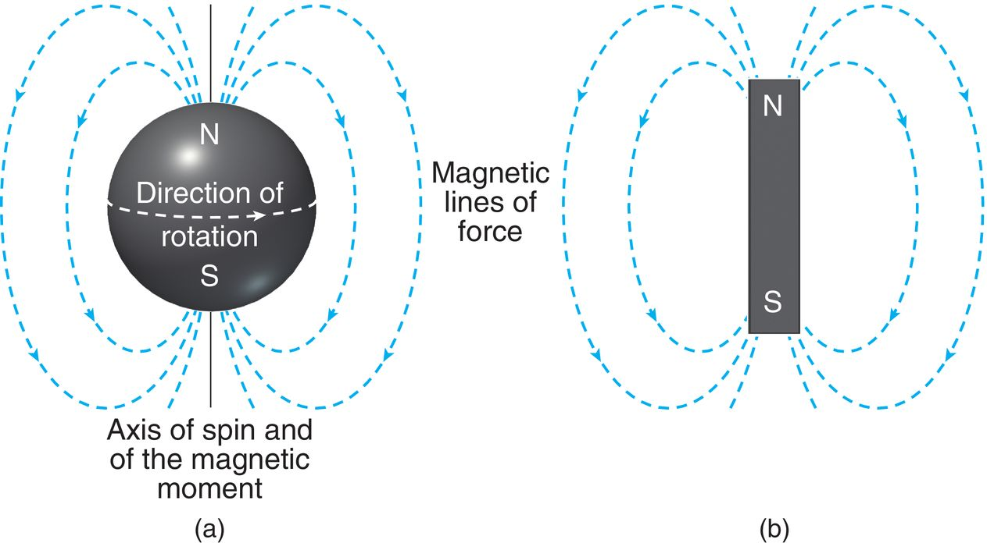
15.1 Intro to NMR Spectroscopy
The magnetic moment exists perpendicular to the axis of nuclear spin

Slide 5
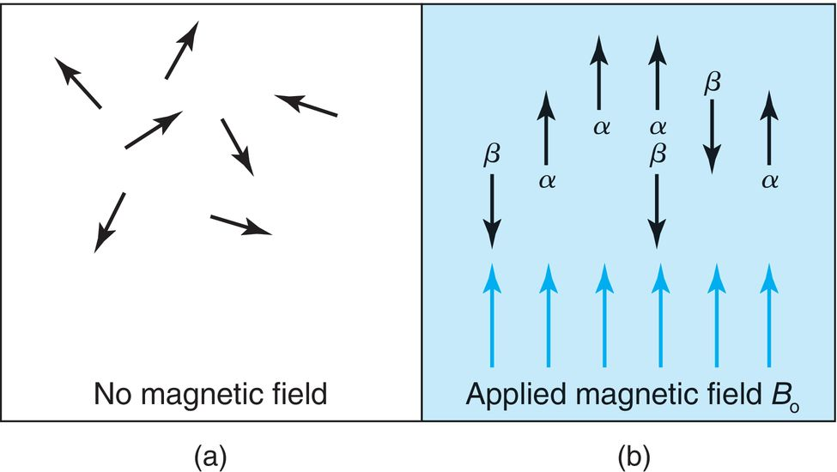
15.1 Intro to NMR Spectroscopy
If the normally disordered magnetic moments of atoms are exposed to an external magnetic field (B₀), their magnetic moments will align with the field, or against the field:

Slide 6
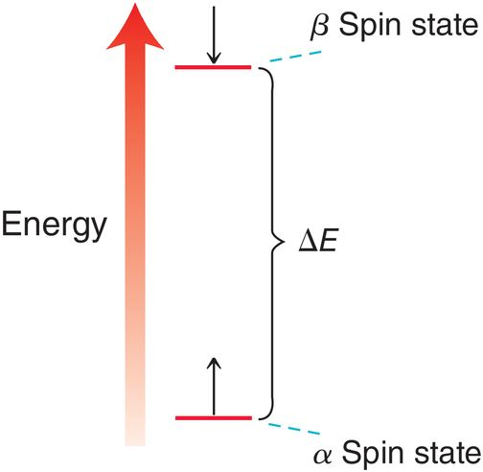
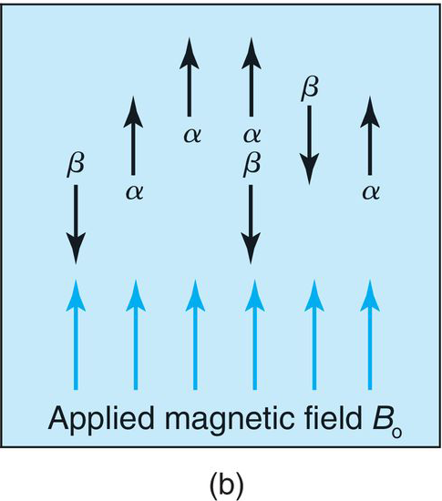
15.1 Intro to NMR Spectroscopy
β spin state = opposing B₀, higher energy spin state
α spin state = aligned with B₀, lower energy spin state

Slide 7
15.1 Intro to NMR Spectroscopy
When an atom with an α spin state is exposed to radio waves with just the right energy (ΔE), the photons are absorbed and spin flips to the β spin state
The stronger the magnetic field, the greater the energy gap

Slide 8
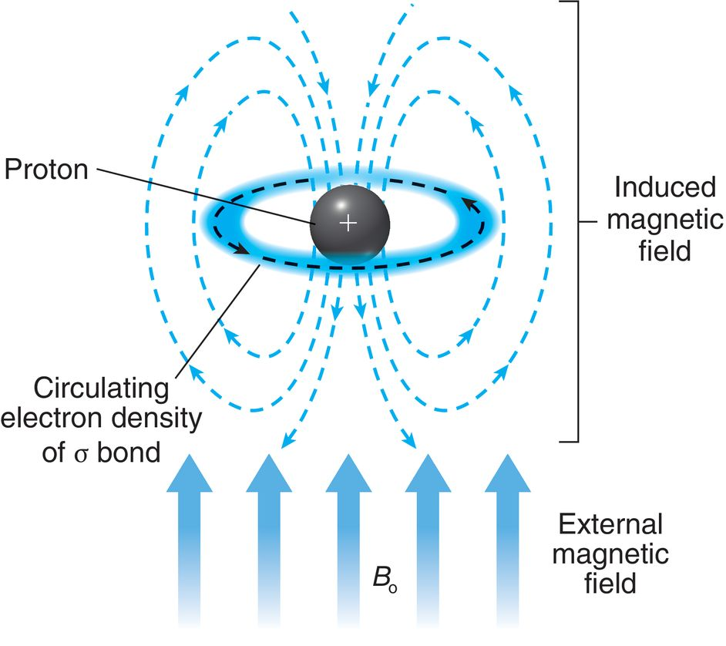
15.1 Intro to NMR Spectroscopy
B₀ causes electrons to circulate, inducing an opposing magnetic field (diamagnetism)
Nuclei then experience less B₀, and are said to be shielded, requiring less energy to spin flip
Nuclei surrounded by less electron density are said to be deshielded

Slide 9
15.1 Intro to NMR Spectroscopy
The amount of radio wave energy necessary for the α → β energy transition depends on the electronic environment for the atom
When the α spins are flipped to β spins, energy is absorbed, and the atoms are said to be in resonance
The use of the term, “resonance” here is totally different from when we are talking about electrons in molecular orbitals
The amount of energy required for each ¹H to spin flip tells us about it’s electronic environment, and thus the structure of the compound.

Slide 10
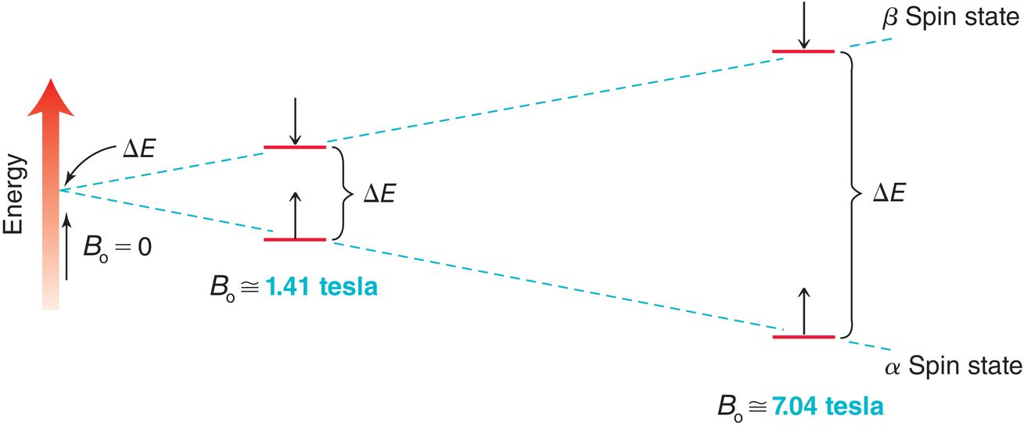
15.2 Acquiring a ¹H NMR Spectrum
NMR requires a strong magnetic field (B₀) and radio wave energy
The strength of the magnetic field affects the energy gap

Slide 11
15.2 Acquiring a ¹H NMR Spectrum
The strong magnetic field is created when a high current is passed through a superconducting material at extremely low temperature (≈4 Kelvin)
The greater the current, the greater the magnetic field
Pulsed Fourier-transform spectrometer: a brief pulse of radio energy (all relevant wavelengths) is used to excite the sample
Each of the atoms is excited and then relaxes, emitting energy
The emitted energy is recorded as a free induction decay (FID)

Slide 12
15.2 Acquiring a ¹H NMR Spectrum
The FID contains all of the information for each atom
A mathematical treatment called a Fourier-transform separates the signals so an individual signal can be observed for each atom that was excited
Often multiple FIDs are taken and averaged together
Before analysis, NMR samples must be prepared neat or in a liquid solution (deuterated solvent) and placed in a small NMR tube
The sample is placed into the magnetic field and the tube is spun at a high rate to average magnetic
field variations or tube imperfections

Slide 13
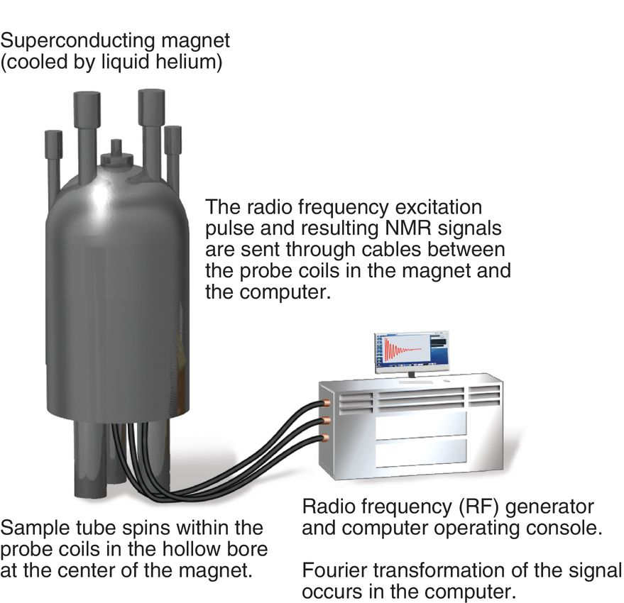
15.2 Acquiring a ¹H NMR Spectrum
Deuterated solvents must be used (no H’s)
the sample is generally at room temp when collecting the HNMR spectrum

Slide 14
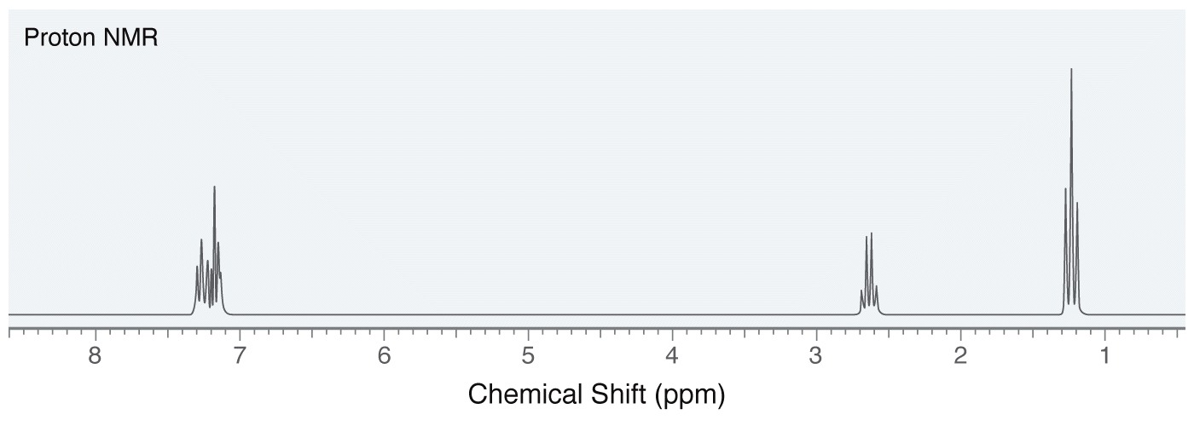
15.3 Characteristics of a ¹H NMR Spectrum
NMR spectra contain a lot of structural information
Number of signals
Signal location (chemical shift)
Signal intensity (area under the signal)
Signal shape (splitting pattern)

Slide 15
15.4 Number of Signals
The number of signals in a 1H NMR spectrum indicates the number of different kinds of protons in a compound
Identical protons are chemically equivalent. Such protons fall into the category of being either homotopic or enantiotopic
Homotopic protons: if the molecule has an axis of rotational symmetry that allows one proton to be rotated onto the other without changing the molecule

Slide 16
15.4 Number of Signals
Another test for homotopic protons is to replace the protons one at a time with another atom
If the resulting compounds are identical, then the protons that you replaced are homotopic

Slide 17
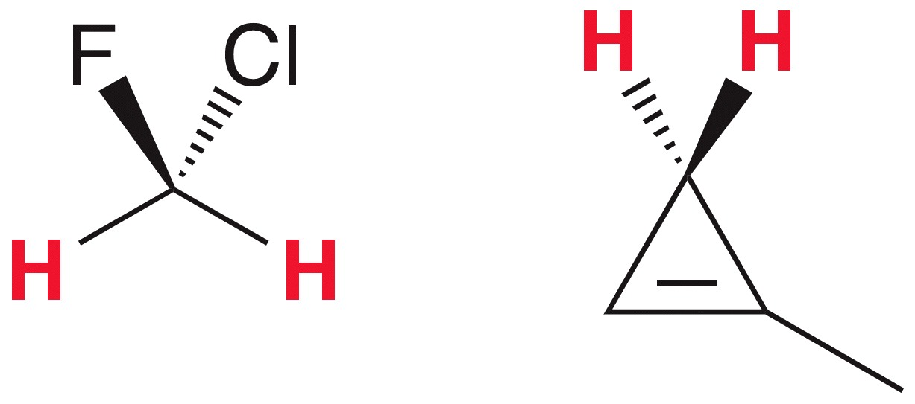
15.4 Number of Signals
Enantiotopic protons: if the molecule has a plane of reflection that makes one proton the mirror image of the other

Slide 18
15.4 Number of Signals
The replacement test is universal
It will work to identify any equivalents protons whether they are homotopic or enantiotopic
If the resulting compounds are enantiomers, then the protons that you replaced are enantiotopic

Slide 19
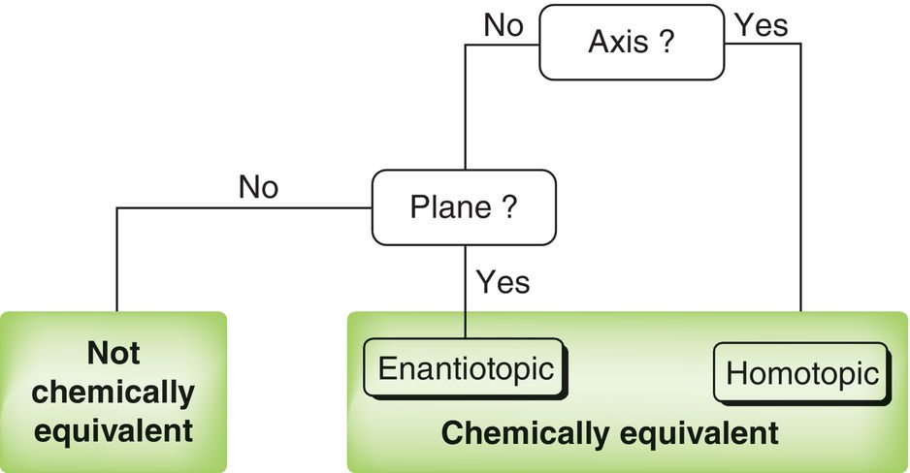
15.4 Number of Signals
To determine if protons are equivalent, look for rotational symmetry.
If none is found, then look for a plane of symmetry

Slide 20
15.4 Number of Signals
The replacement test produces diastereomers:
These protons are called diastereotopic, and not chemically equivalent
Practice with SkillBuilder 15.1

Slide 21
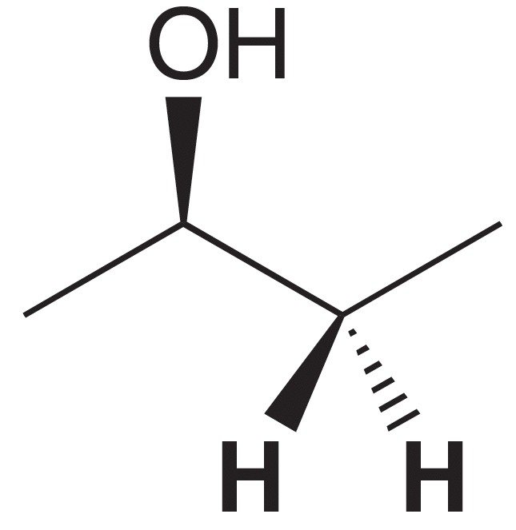
15.4 Number of Signals
If the protons are neither homotopic nor enantiotopic, then the are NOT chemically equivalent
Consider the indicated H’s below, in 2-butanol:
These protons cannot be interchanged by rotational symmetry or reflectional symmetry

Slide 22
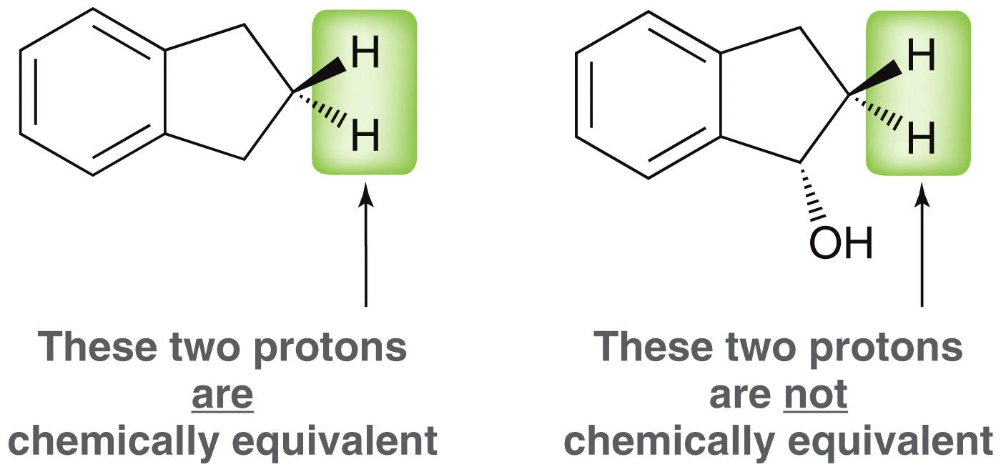
15.4 Number of Signals
There are some shortcuts you can take to identify how many signals you should see in the ¹H NMR
The 2 protons on a CH₂ group will be equivalent if there are NO chirality centers in the molecule
The 2 protons on a CH₂ group will NOT be equivalent if there is a chirality center in the molecule

Slide 23
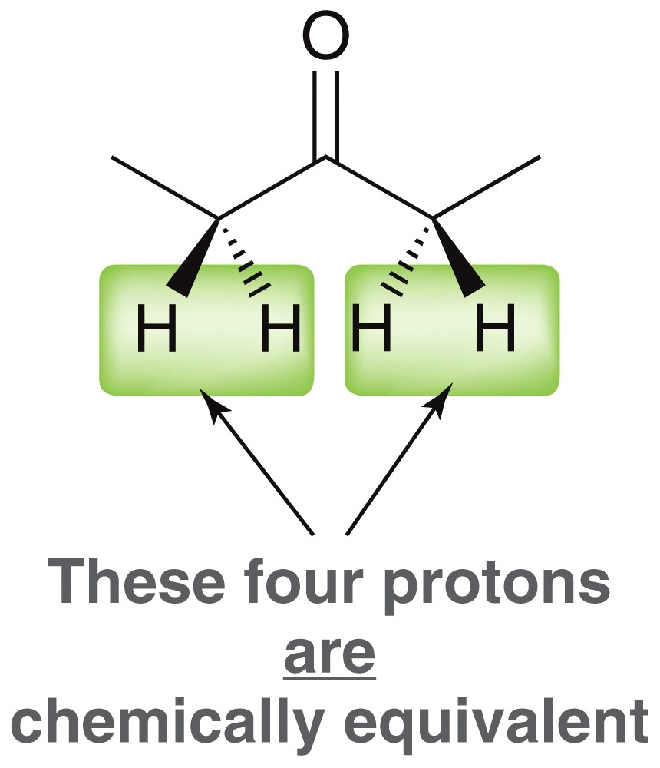
15.4 Number of Signals
There are some shortcuts you can take to identify how many signals you should see in the ¹H NMR
The 3 protons on any methyl group will always be equivalent to each other
Multiple protons are equivalent if they can be interchanged through either a rotation or mirror plane
Practice with SkillBuilder 15.2

Slide 24
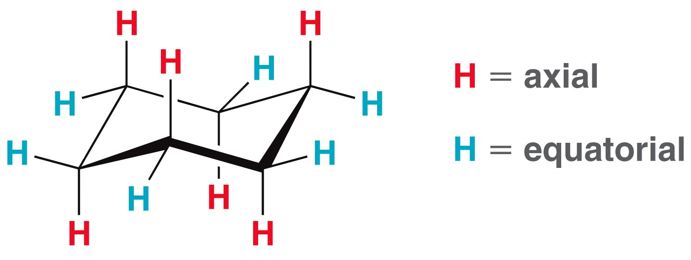
15.4 Variable Temperature NMR
Recall that cyclohexane chairs have 6 equatorial and 6 axial protons
the axial and equitorial protons have different electronic environments
Technically, there are two types of protons here, but only one signal is observed in the 1H NMR

Slide 25
15.4 Variable Temperature NMR
At room temperature, the chair interconversion occurs rapidly
The NMR is not fast enough to see the individual structures, so the average is observed (one signal)
If the temperature was reduced to -100 ˚C, ring flipping is slow enough to observe two signals

Slide 26
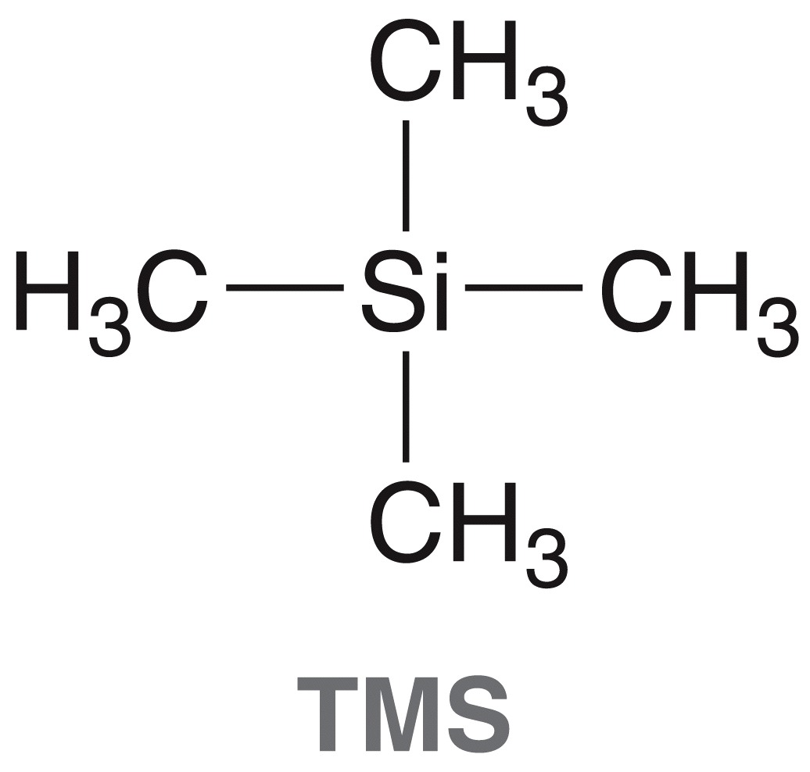
15.5 Chemical Shift
In many NMR solvents, 1% TMS is added as an internal standard. The frequency of the protons in TMS is lower than that observed for most organic compounds
The shift for a proton signal is calculated as a comparison to TMS
For benzene on a
300 MHz instrument

Slide 27
15.5 Chemical Shift
The shift for a proton signal is calculated as a comparison to TMS
For benzene on a 60 MHz instrument
The Hz of the signal is different in different instruments, but the shift relative to TMS (δ) is constant

Slide 28
15.5 Chemical Shift
The shift for a proton signal is calculated as a comparison to TMS
The shift relative to TMS (δ) is a dimensionless number, because the Hz units cancel out
Units for δ are often given as ppm (parts per million), which simply indicates that signals are reported as a fraction of the operating frequency of the spectrometer
Most ¹H signals appear between 0-10 ppm

Slide 29
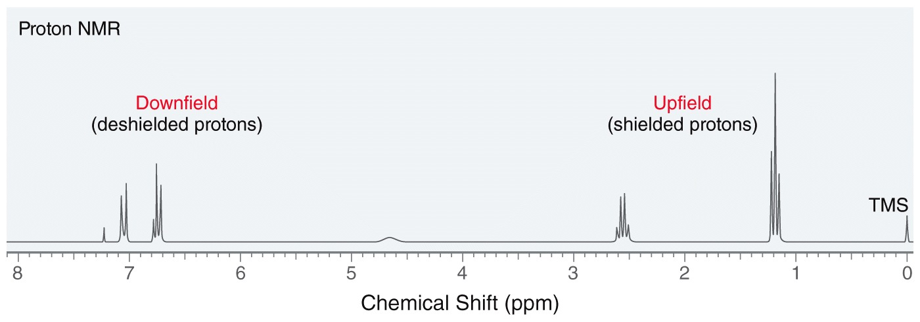
15.5 Chemical Shift
Early NMRs analyzed samples at a constant energy over a range of magnetic field strengths
low field strength = downfield
high field strength = upfield
Shielded protons required a stronger external magnetic field to be excited at the same energy as deshielded protons.

Slide 30
15.5 Chemical Shift
Current NMRs analyze samples at a constant field strength over a range of energies
Shielded protons have a smaller magnetic force acting on them, so they have smaller energy gaps and absorb lower energy radio waves
Higher Energy
Lower Energy

Slide 31
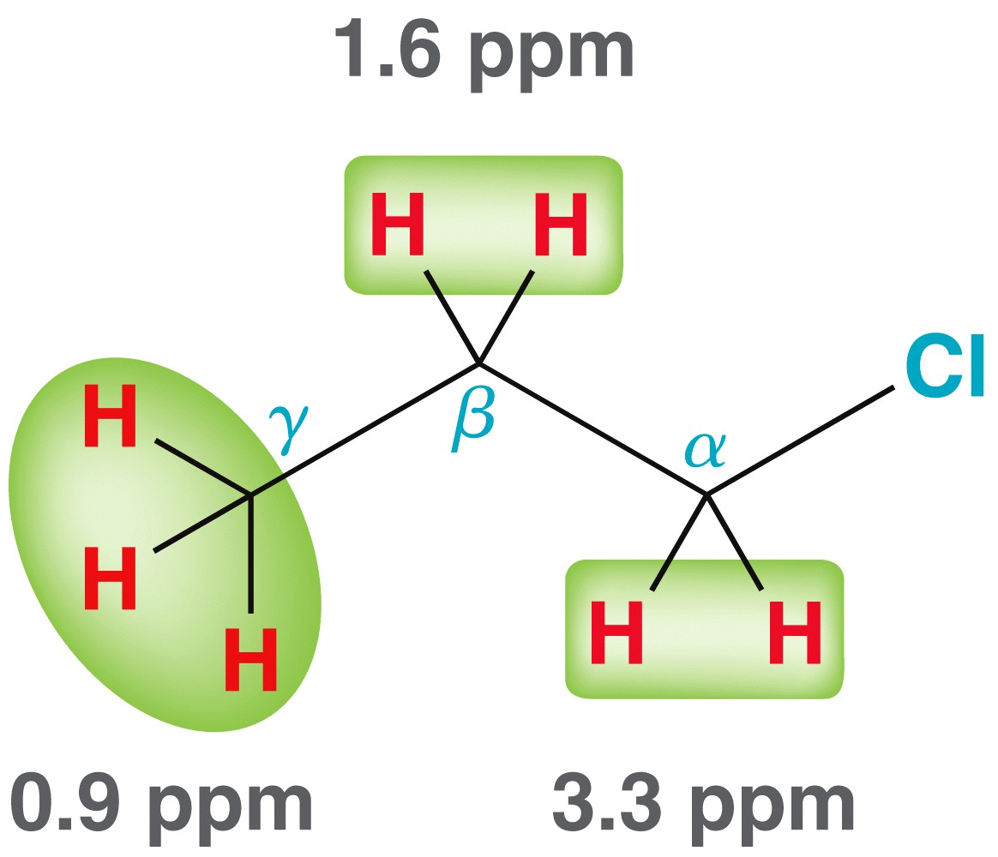
15.5 Chemical Shift
Alkane protons generally give signals around 1-2 ppm
Protons can be shifted downfield when nearby electronegative atoms cause deshielding.

Slide 32
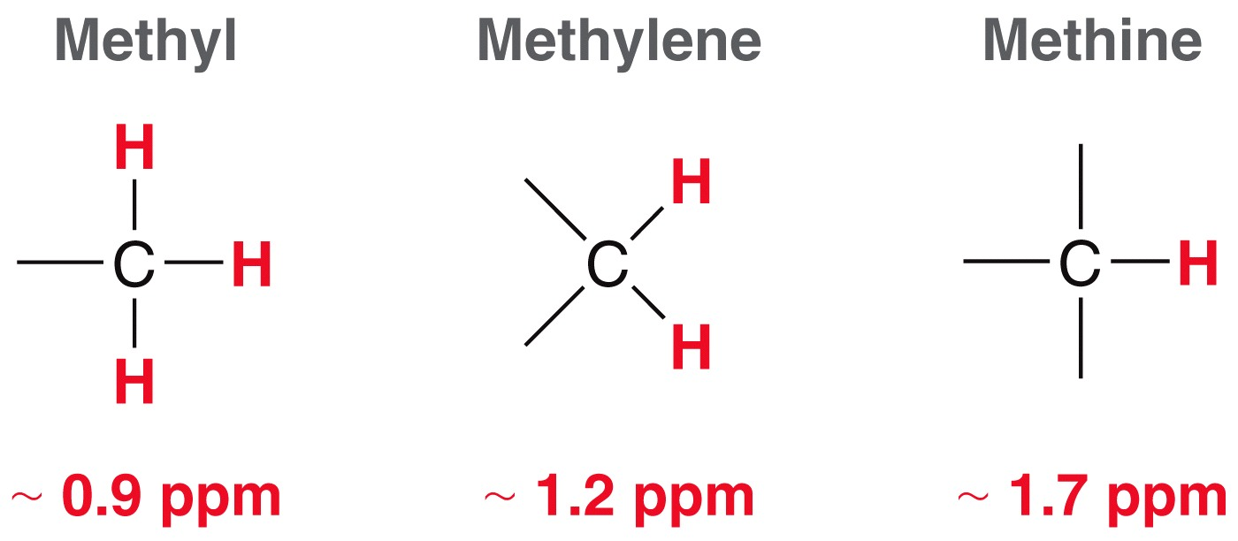
15.5 Chemical Shift
To predict chemical shifts, start with the standard ppm for the type of proton (methyl, methylene, or methine)
Use table 16.1 to adjust the ppm depending on proximity to certain function groups

Slide 33
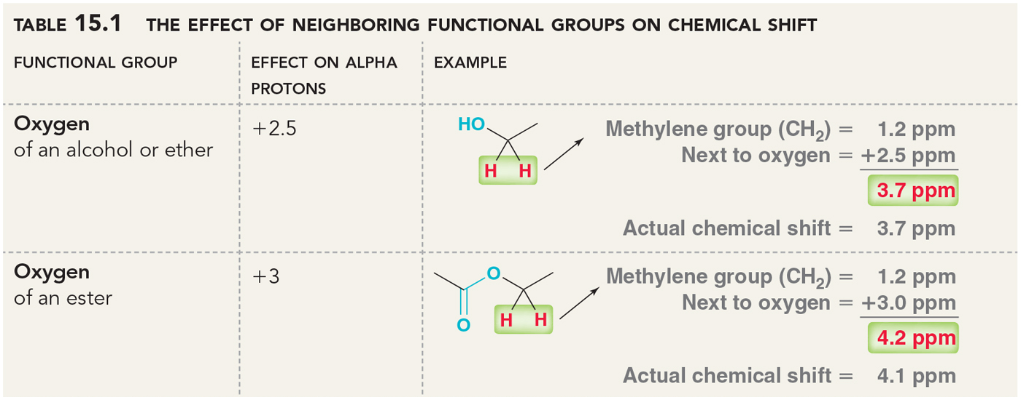
15.5 Chemical Shift
The effect on beta protons is about one-fifth the effect on alpha protons

Slide 34
15.5 Chemical Shift
Handbooks, or tables found online at credible websites, can be used for functional groups beyond table 15.1
Practice with SkillBuilder 15.3

Slide 35
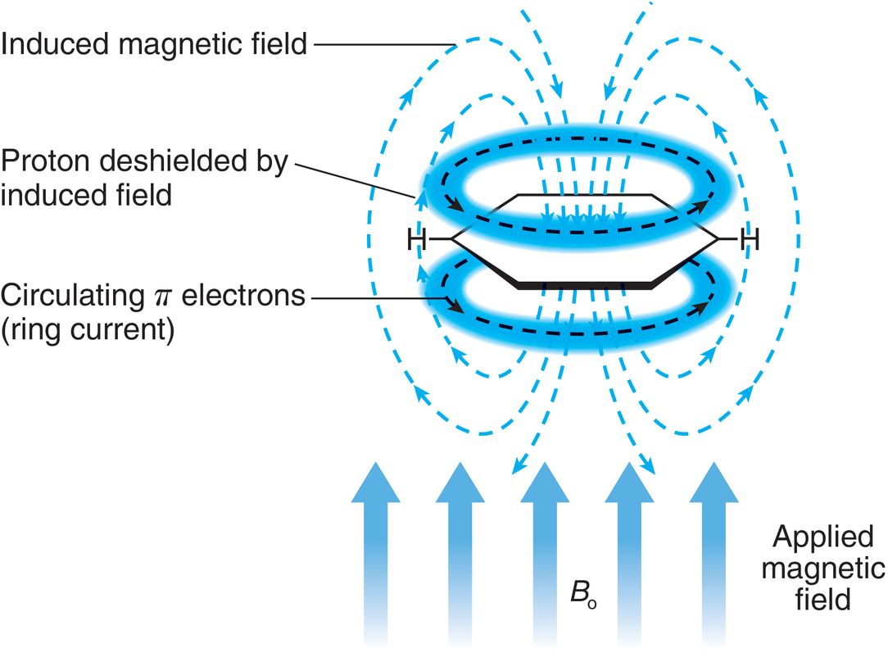
15.5 Chemical Shift – Anisotropic Effects
When the electrons in a pi system are subjected to an external magnetic field, they circulate and produce a magnetic field, causing diamagnetic anisotropy

Slide 36
15.5 Chemical Shift
Diamagnetic anisotropy means that different regions of localized space has different magnetic strengths
Regions outside
the ring have
increased magnetic
field

Slide 37
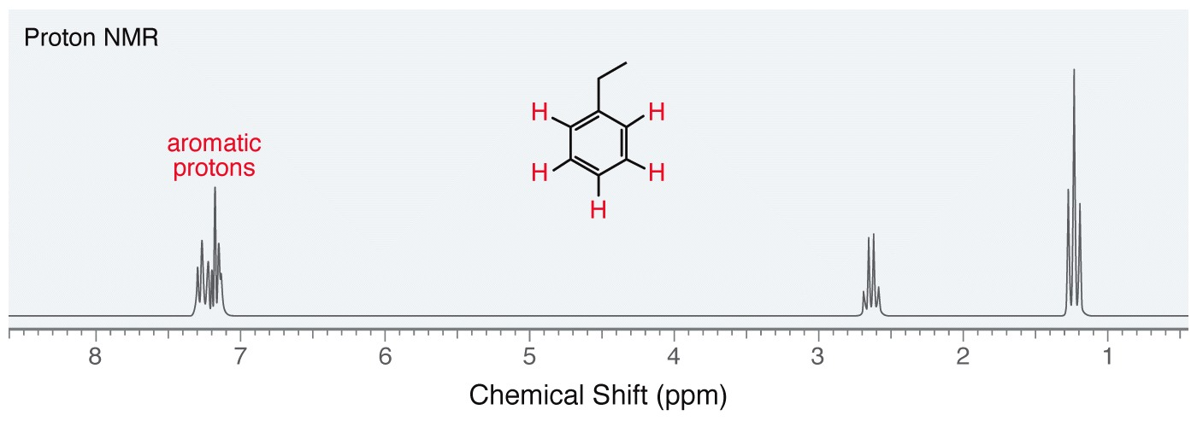
15.5 Chemical Shift
The result of the diamagnetic anisotropy effect is similar to deshielding for aromatic protons. More magnetic field means more energy required to spin-flip the proton(s)
Aromatic protons appear in the neighborhood of 7 ppm.

Slide 38
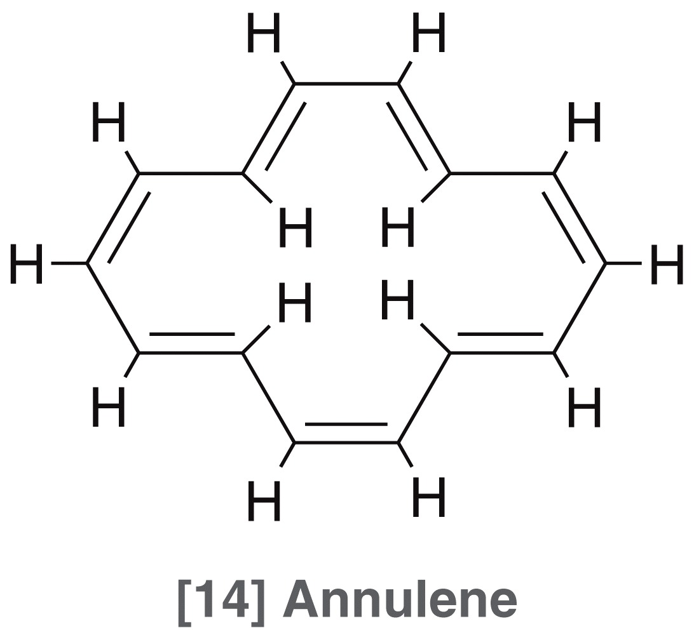
15.5 Chemical Shift
The result of the diamagnetic anisotropy effect is similar to shielding for protons on the inside of the pi system
protons outside the ring: appear at 8 ppm
Protons inside the ring: appear at -1 ppm.

Slide 39
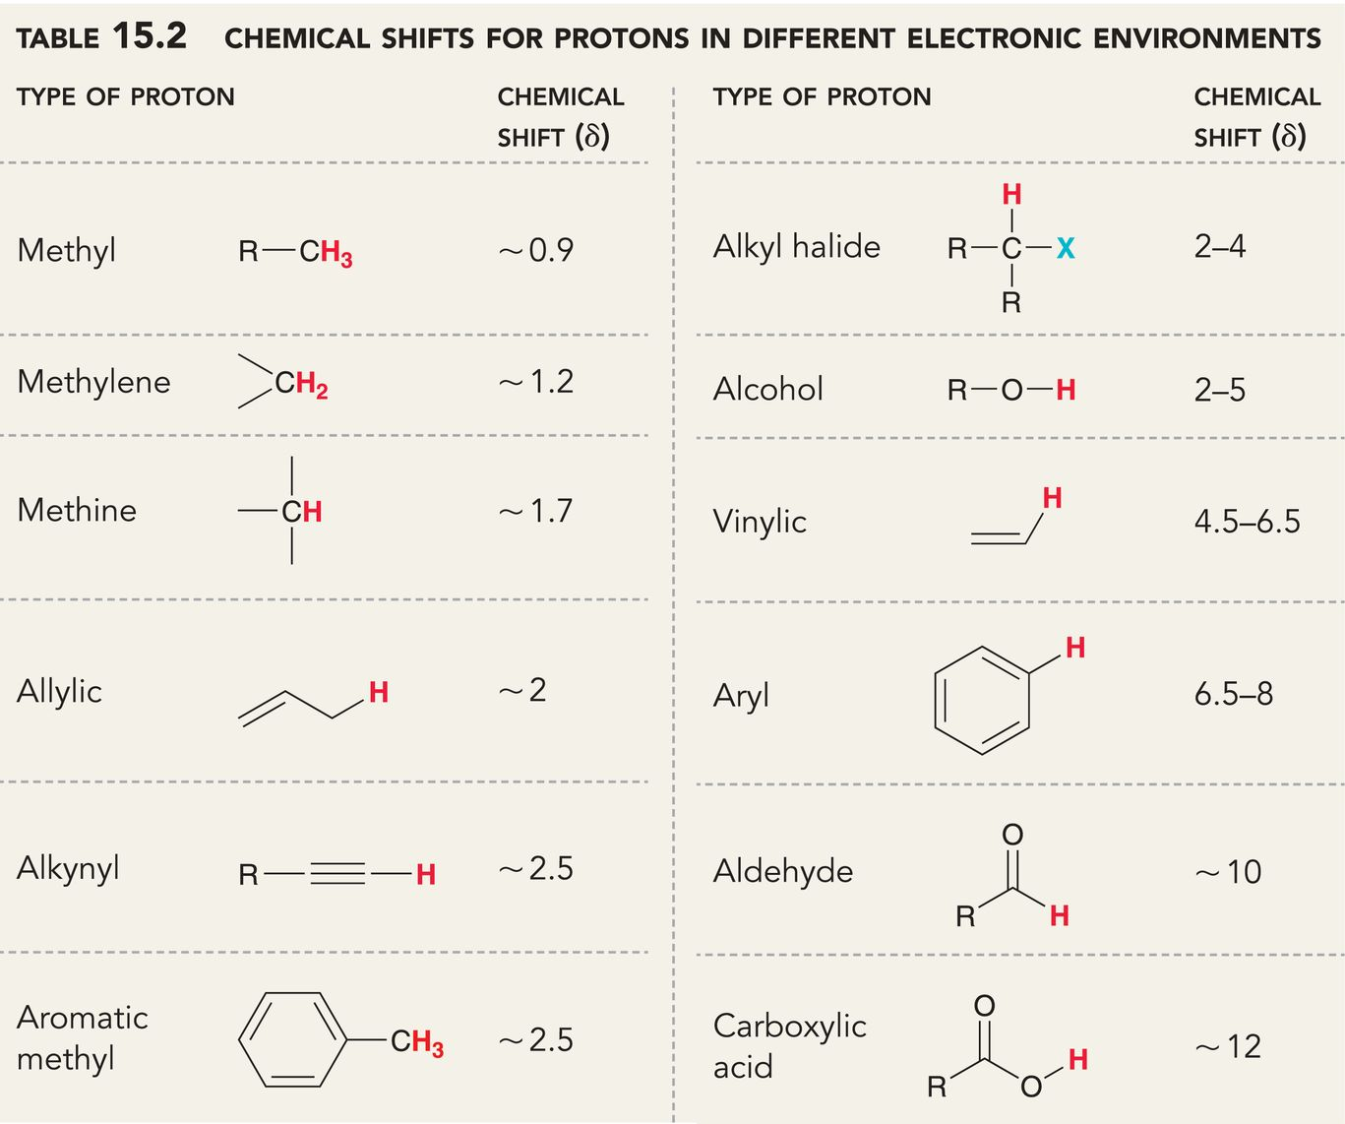
15.5 Chemical Shift
It is necessary to be familiar with the ppm values of these common types of protons
Practice with Conceptual Checkpoint 15.10

Slide 40
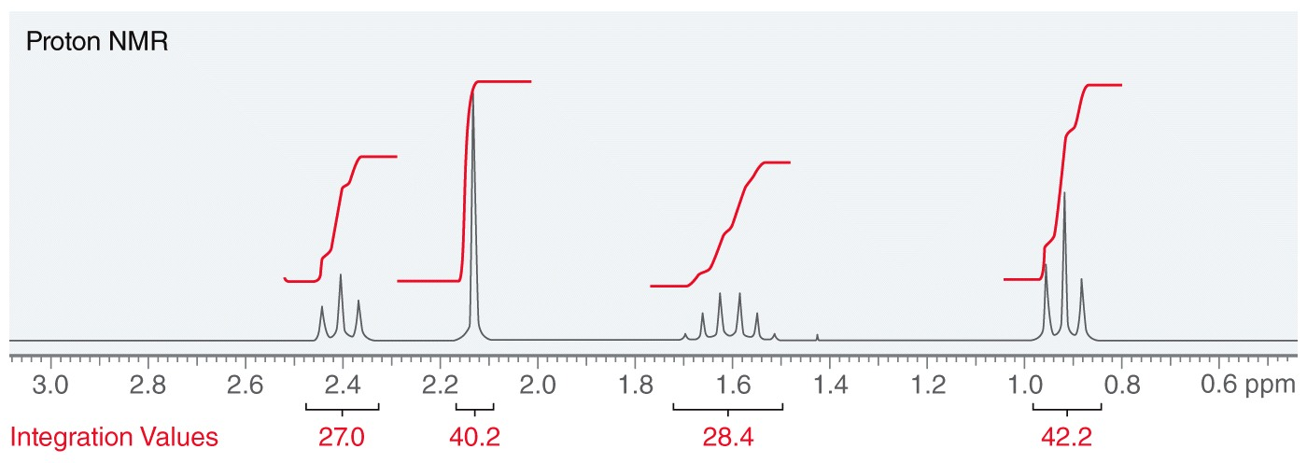
15.6 Integration
The integration (area) under the peak quantifies the relative number of protons giving rise to a signal
A computer will calculate the area of each peak representing that area with a step-curve
The curve height represents the integration

Slide 41
15.6 Integration
The computer operator sets one of the peaks to a whole number to let it represent a number of protons
The computer uses the integration ratios to set the values for the other peaks
1.48
1.56
1.00
1.05

Slide 42
15.6 Integration
Integrations represent numbers of protons, so you must adjust the values to whole numbers
If the integration of the first peak is doubled, the computer will adjust the others according to the ratio
2.96
3.12
2.00
2.10

Slide 43
15.6 Integration
The integrations are relative quantities rather than an absolute count of the number of protons
Symmetry can also affect integrations
3-pentanone has two kinds of protons. The relative integration value of the two signals would be 2:3

Slide 44
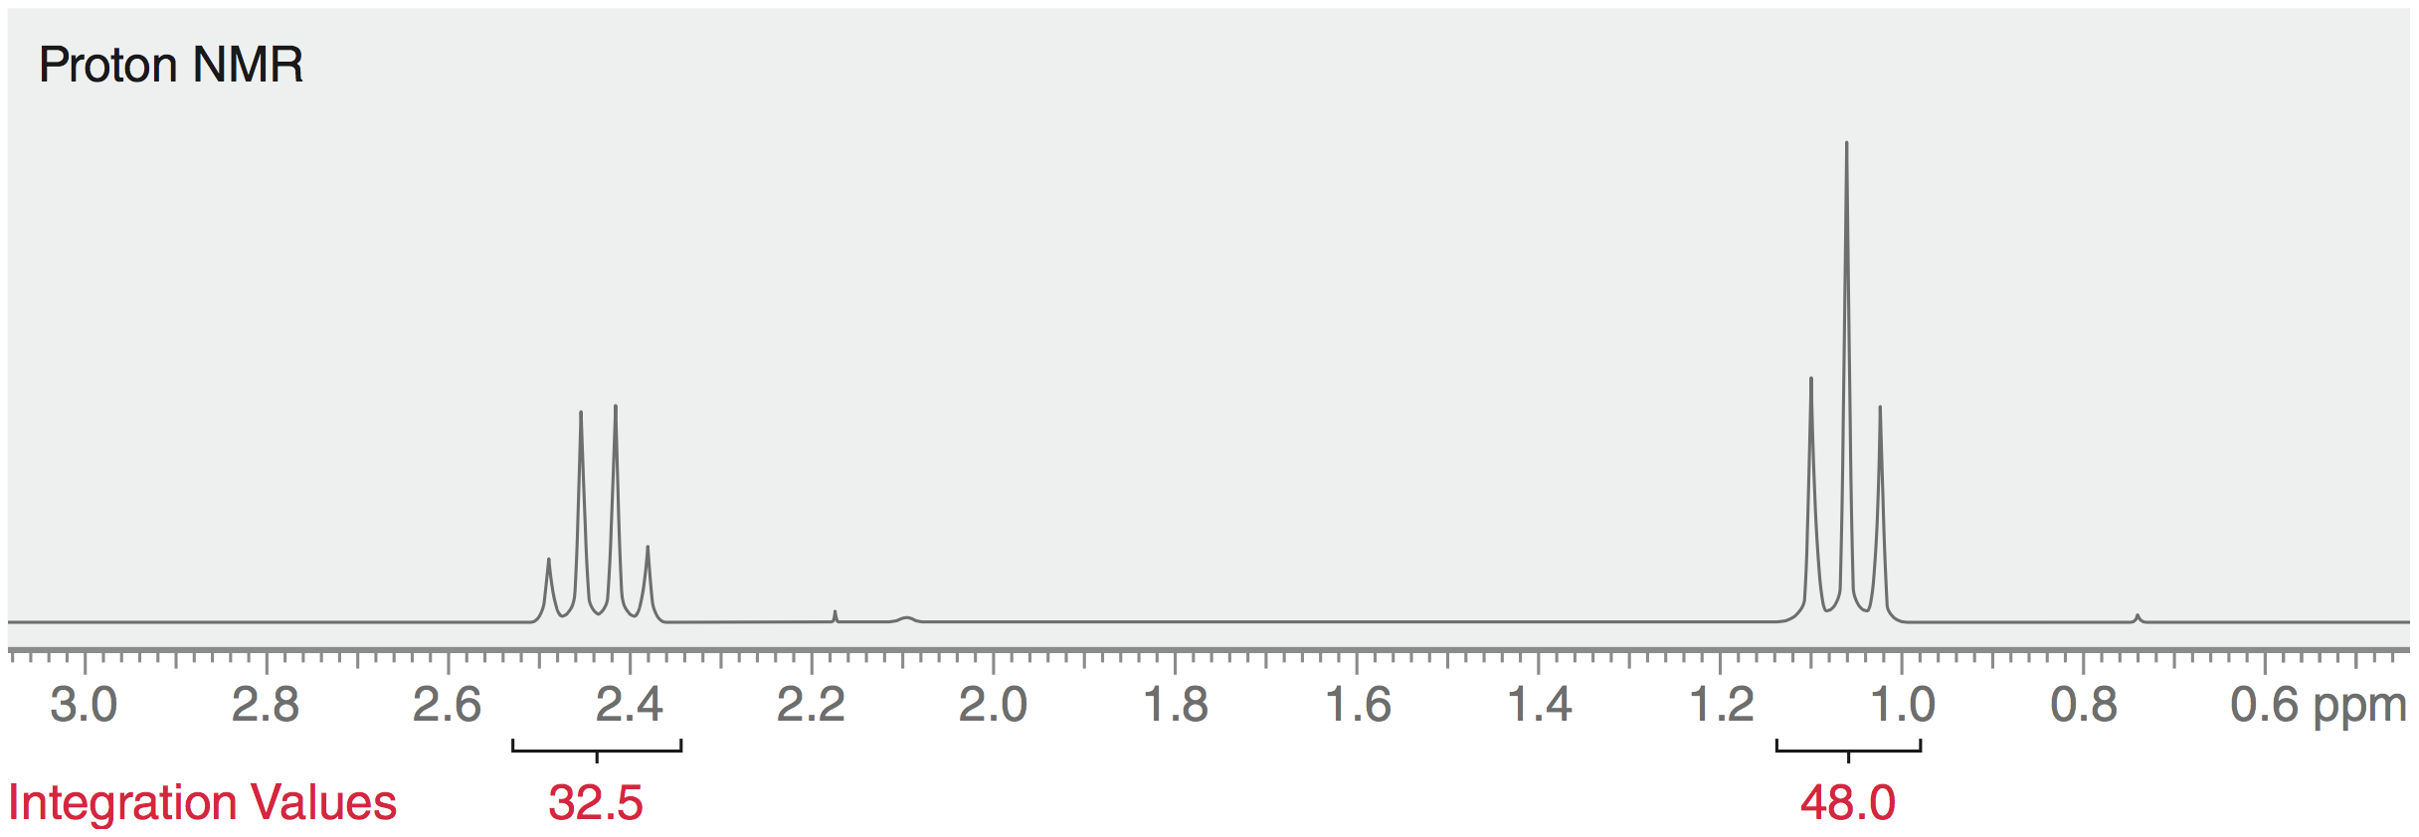
15.6 Integration
The molecular formula (C₅H₁₀O) must be known in order to know that the absolute ratio is actually 4:6, and not 2:3
Practice with SkillBuilder 15.4

Slide 45
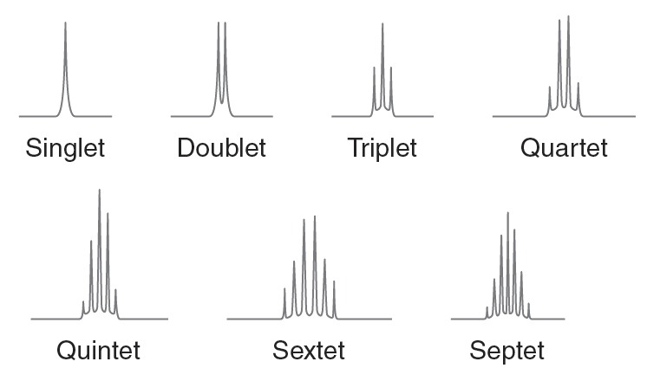
15.7 Multiplicity
Multiplicity (splitting pattern): the number of peaks in a given signal

Slide 46
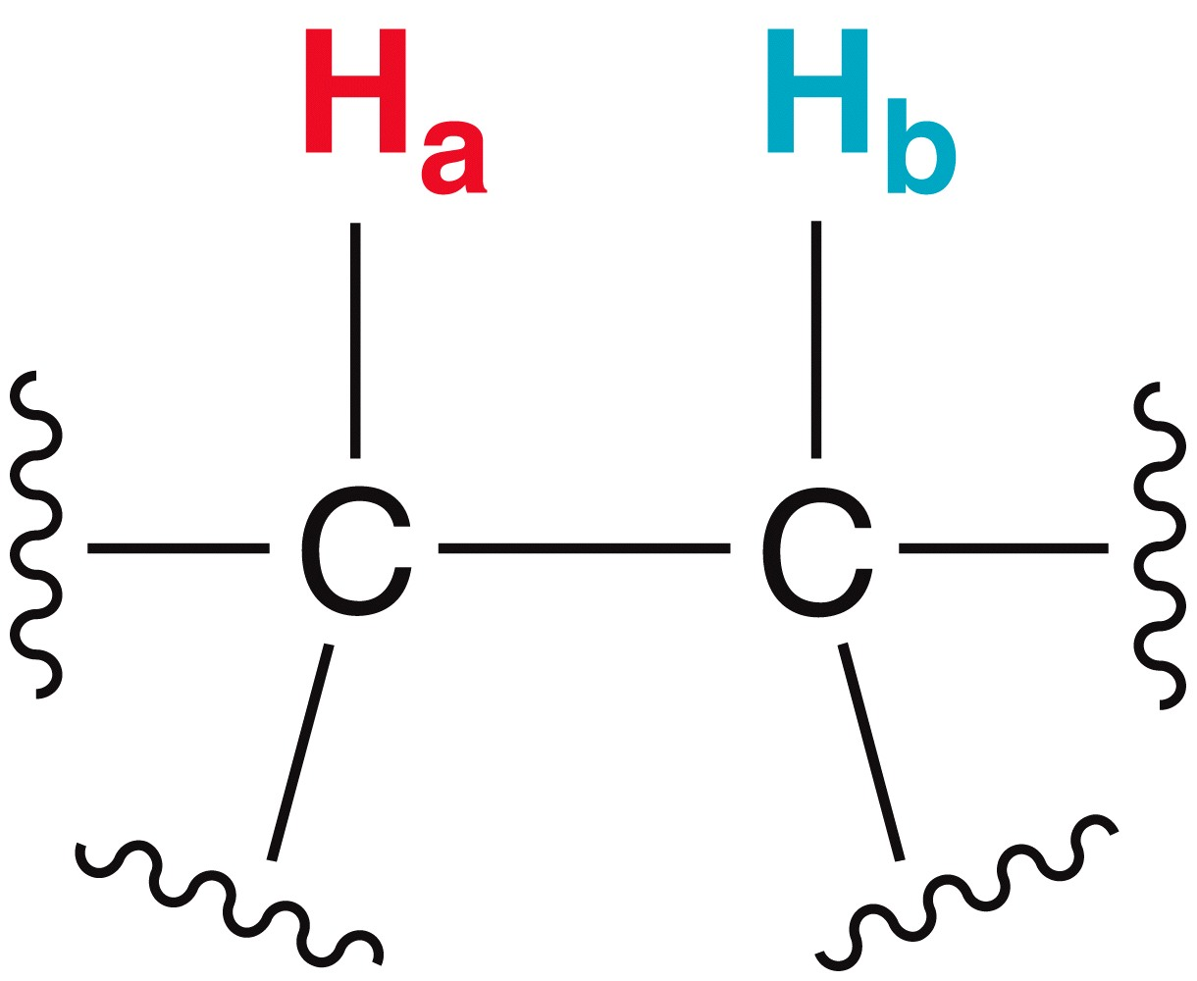
15.7 Multiplicity
Multiplicity results from magnetic affects that protons have on each other
Consider protons H_{a} and H_{b}
Since protons align with or against the external magnetic field, so there will be two different magnetic environments for H_{a} :

Slide 47
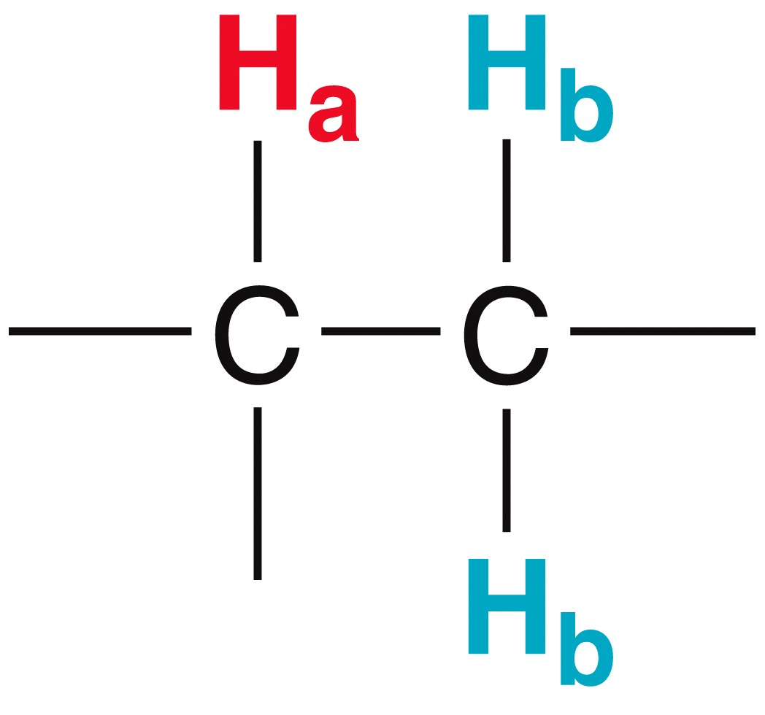
15.7 Multiplicity
Consider an example where there are two protons on the adjacent carbon
Here, there are three possible environments for H_{a}

Slide 48
15.7 Multiplicity
Now, consider a scenario where H_{a} is split by three neighboring H_{b} atoms:

Slide 49
15.7 Multiplicity
Table 15.3 shows how the multiplicity trend continues
By analyzing the splitting pattern of a signal in the ¹H NMR, you can determine the number of equivalent protons on adjacent carbons

Slide 50
15.7 Multiplicity
The trend in table 15.3 also allows us to predict splitting patterns
When there are “n” number of neighboring protons that are chemically equivalent, there will be how the n+1 peaks in the signal

Slide 51
15.7 Multiplicity
Remember three key rules for splitting:
Equivalent protons can not split one another
because they resonate together
To split each other, protons must be within a 2 or 3 bond distance

Slide 52
15.7 Multiplicity
Remember three key rules
The n+1 rule only applies to protons that are all equivalent
The splitting pattern observed for the proton shown below will be more complex than a simple triplet
Complex splitting will be discussed later in this section
Practice with SkillBuilder 15.5

Slide 53
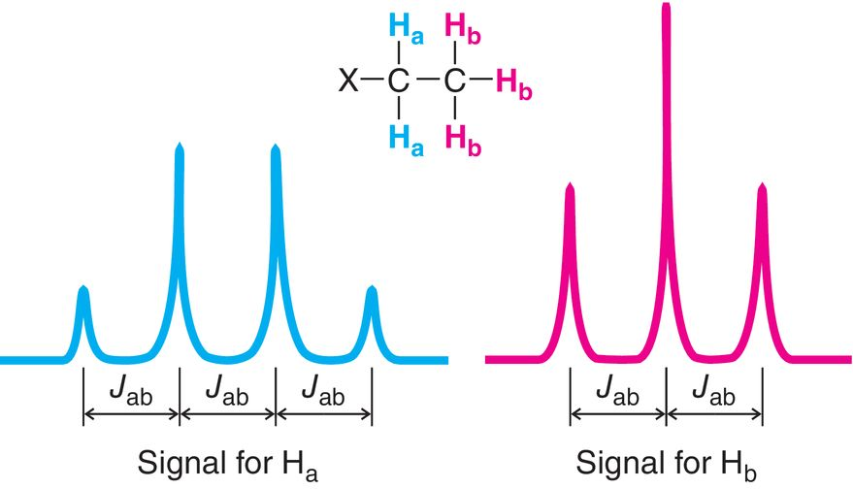
15.7 Multiplicity
The degree to which a neighboring proton will couple to its neighbor is called a coupling constant, or J value
The J value is the distance between peaks of a splitting pattern measured in units of Hz
protons splitting each other will have the same coupling constant
J_{ab} = J_{ba}

Slide 54
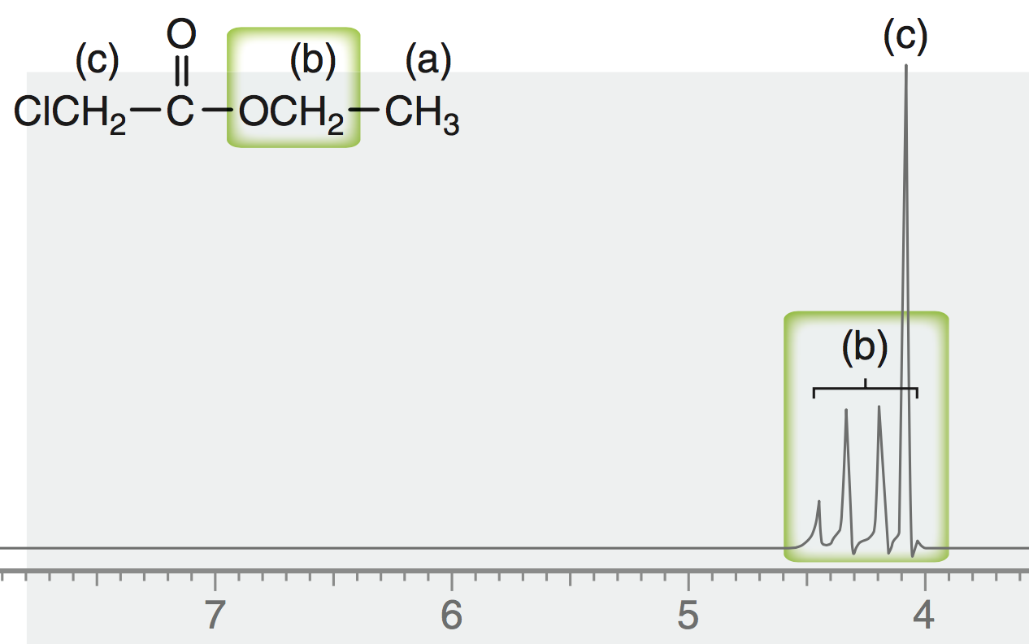
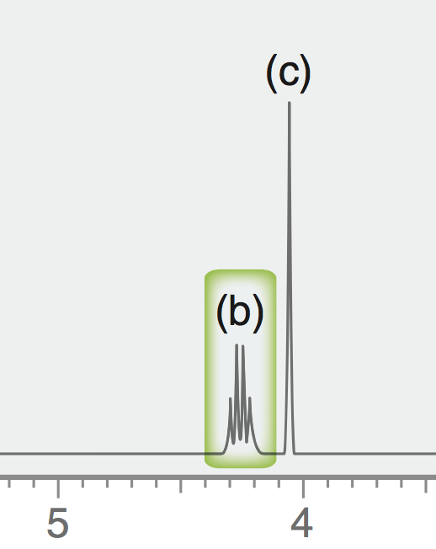
15.7 Multiplicity
Higher field strength instruments will give better resolution between peaks, because the coupling constant is a smaller percentage of the overall Hz available.
300 MHz spectrometer avoids overlapping of peaks (right), compared to the 60 MHz spectrometer (left)

Slide 55
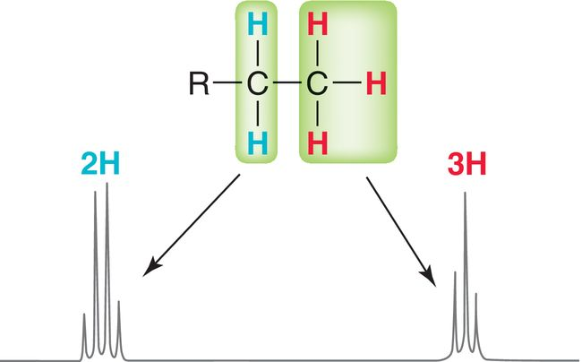
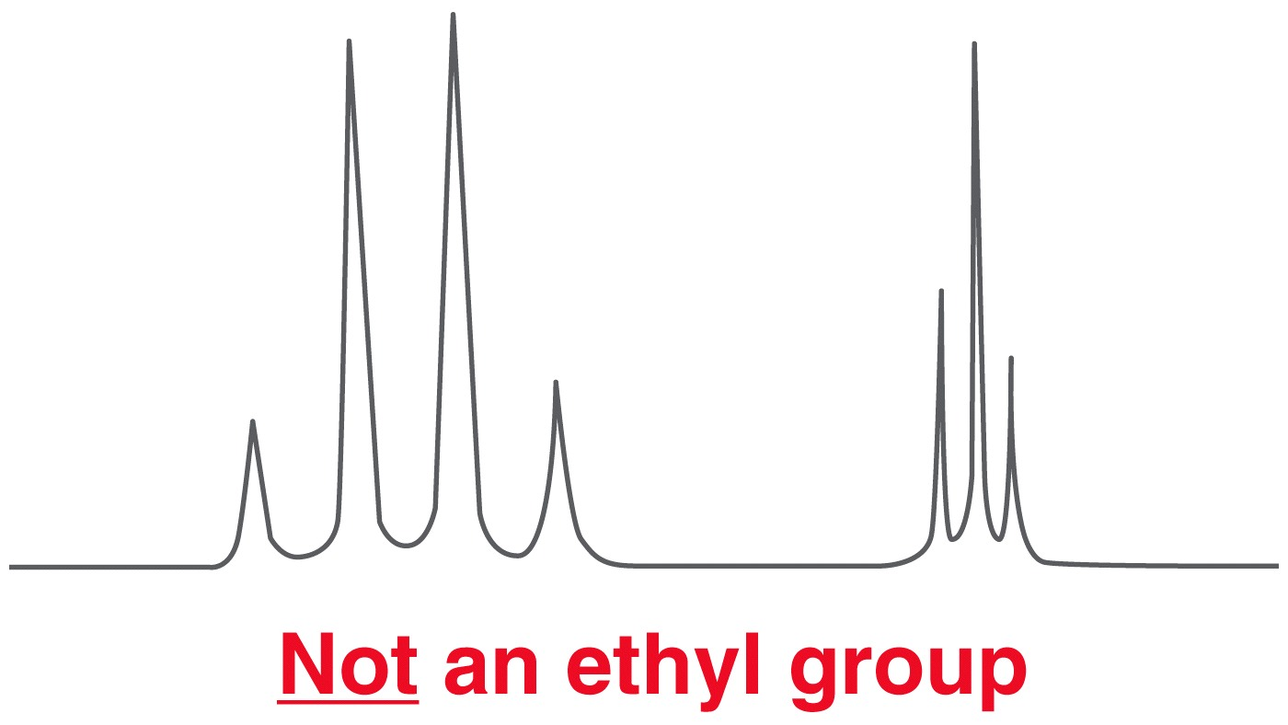
15.7 Multiplicity
Sometimes recognizable splitting patterns will stand out in a spectrum
An isolated ethyl group gives a triplet and a quartet
The triplet and quartet must have the same coupling constant if they are splitting each other

Slide 56
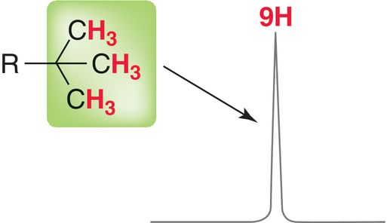
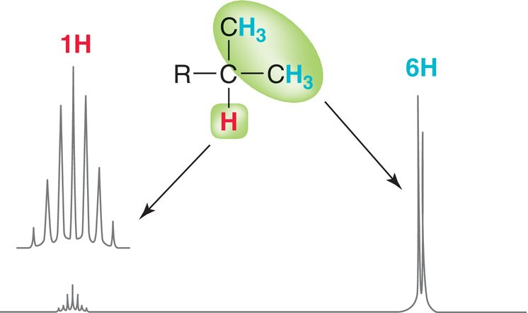
15.7 Multiplicity
A peak with an integration equal to 9 suggests the presence of a tert-butyl group
An isolated isopropyl group gives a doublet and a septet
Practice with conceptual checkpoint 15.17

Slide 57
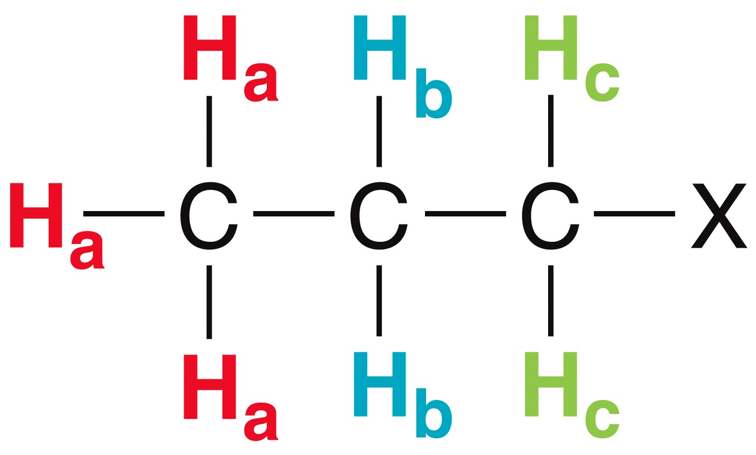
15.7 Multiplicity
Complex splitting results when a proton has two different kinds of neighboring protons
If J_{ab} is much greater than J_{bc} then the signal will appear as a quartet of triplets
In the molecule shown, H_{b} is split into a quartet by H_{a} and into a triplet by H_{c}

Slide 58
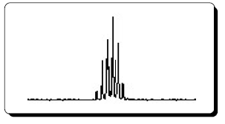
15.7 Multiplicity
Complex splitting results when a proton has two different kinds of neighboring protons
If J_{bc} is much greater than J_{ab}, the signal will appear as a triplet of quartets
If J_{bc} is similar to J_{ab}, then several lines may overlap, and the signal is called a multiplet

Slide 59
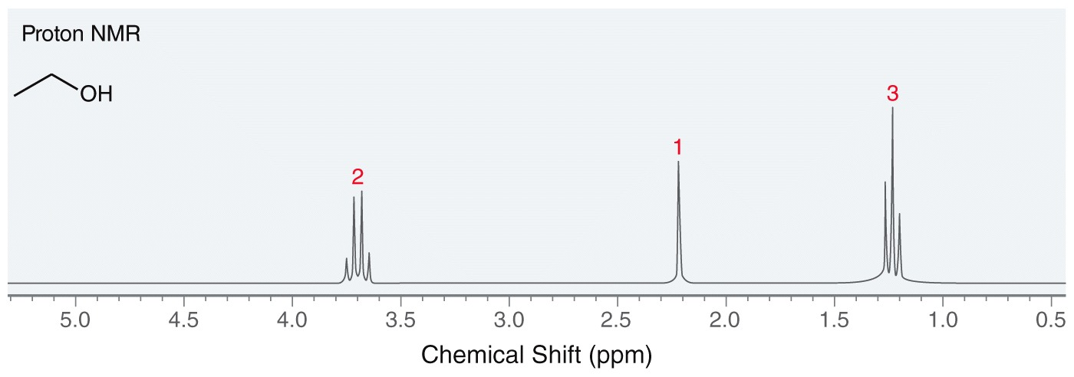
15.7 Multiplicity
Splitting is not observed for some protons. Consider ethanol
The protons bonded to carbon split each other, but the hydroxyl proton is not split

Slide 60
15.7 Multiplicity
The hydroxyl proton and other labile or exchangeable protons undergo rapid exchange with trace amounts of acid. Show a reasonable mechanism
Such exchange blurs the shielding/deshielding affect of the neighboring protons giving a singlet that is often broadened

Slide 61
15.9 Using ¹H NMR to Distinguish between Compounds
The three molecules below might be difficult to distinguish by IR of MS.
They are easily distinguished with ¹H NMR because they do not have the same # of protons.
Practice with SkillBuilder 15.7

Slide 62
15.10 Analyzing a ¹H NMR Spectrum
With a given formula and ¹H NMR spectrum, you can determine a molecule’s structure by a 5-step process
Calculate the degree of unsaturation or hydrogen deficiency index (HDI).
Consider the number of NMR signals and integration (gives clues about the symmetry in the molecule)
Analyze each signal, and draw fragments consistent with each signal
Assemble the fragments into a complete structure
Verify the proposed structure is consistent with all of the spectral data
Practice with SkillBuilder 15.8

Slide 63
15.11 Acquiring a ¹³C NMR Spectrum
Because ¹H is by far the most abundant isotope of hydrogen, ¹H NMR signals are generally strong
¹³C only accounts for about 1% of carbon atoms in nature, so a sensitive receiver coil and/or concentrated NMR sample is needed
In ¹H NMR, shift, splitting, and integration are important
In ¹³C NMR, only the number of signals and the chemical shift will be considered

Slide 64
15.11 Acquiring a ¹³C NMR Spectrum
In ¹³C NMR, the ¹H-¹³C splitting is often so complex that the spectrum is unreadable
To elucidate the ¹³C spectrum and make it easier to determine the total number of ¹³C signals, ¹³C NMR are generally decoupled
In the vast majority of ¹³C spectra, all of the signals are singlets

Slide 65
15.12 Chemical Shifts in ¹³C NMR
Compared to ¹H, ¹³C atoms require a different frequency of energy to excite (resonate)
Compared to the standard TMS, ¹³C NMR signals generally appear between 220 and 0 ppm
Each signal in a ¹³C NMR spectrum represents a unique type of carbon
Planes and axes of symmetry can cause carbon atoms to be electronically equivalent

Slide 66
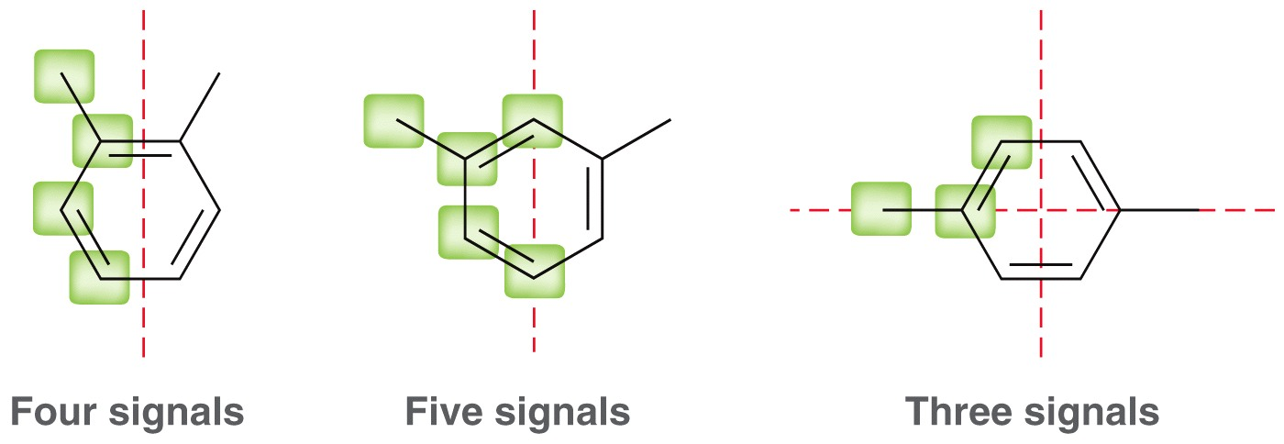
15.12 Chemical Shifts in ¹³C NMR
Note how symmetry affect the number of ¹³C signals for these compounds:

Slide 67
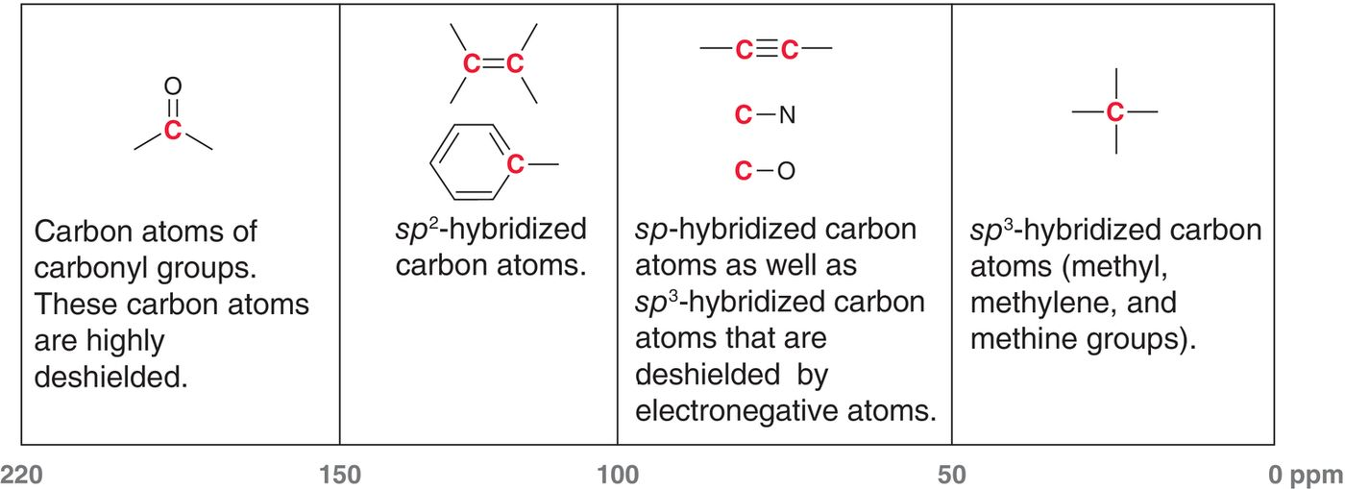
15.12 Chemical Shifts in ¹³C NMR
Like ¹H signals, chemical shifts for ¹³C signals are affected by shielding or deshielding
Practice with SkillBuilder 15.9

Slide 68
15.13 DEPT ¹³C NMR Spectroscopy
¹³C spectra generally give singlets that do not provide information about the number of hydrogen atoms attached to each carbon
Distortionless Enhancement by Polarization Transfer (DEPT) ¹³C NMR provides information the number of hydrogen atoms attached to each carbon
DEPT-90: Only CH signals appear
DEPT-135: CH₃ and CH give (+) signals, and CH₂ give (-) signals

Slide 69
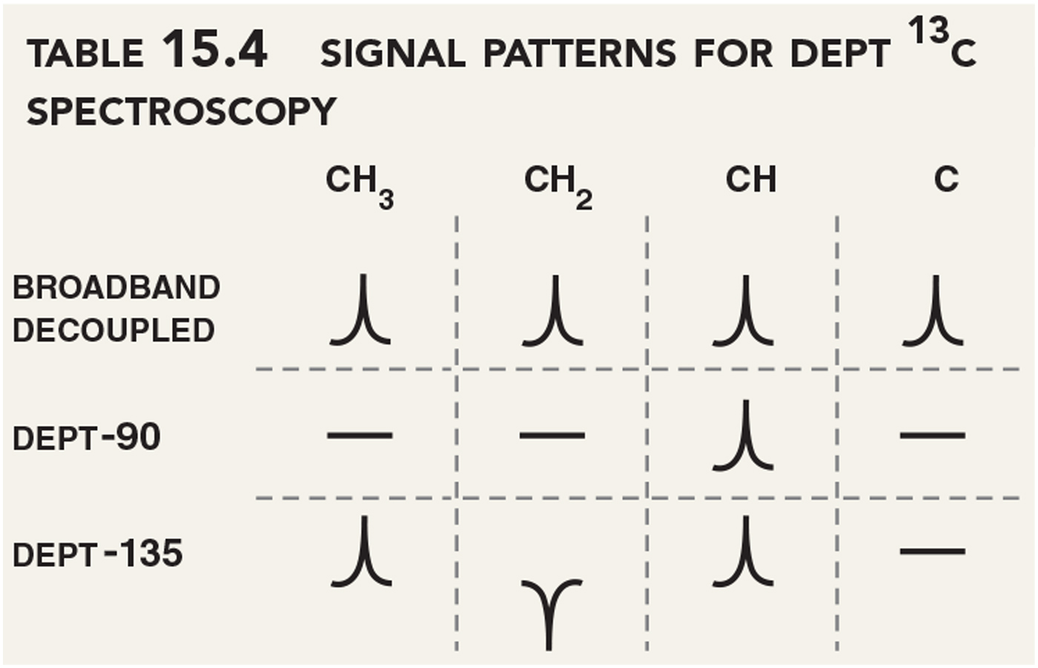
15.13 DEPT ¹³C NMR Spectroscopy
DEPT-90: Only CH signals appear
DEPT-135: CH₃ and CH = (+) signals, CH₂ = (-) signals
Practice with SkillBuilder 15.10

Slide 70
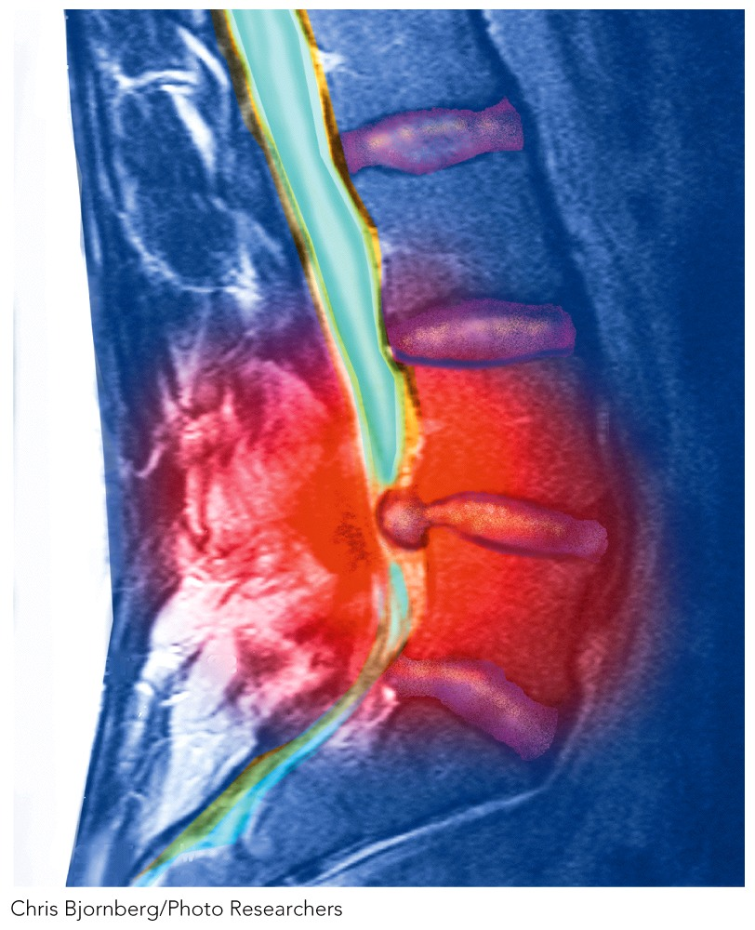
15.13 Magnetic Resonance Imaging (MRI)
MRI (Magnetic Resonance Imaging) instruments are essentially ¹H NMR spectrometers
The body is analyzed rather than a sample in an NMR tube
Different tissues have different concentrations of protons.
The MRI gives a 3D image of different tissues.
Radio waves and magnetic field are very mild, so no side effects are experienced

