Slide 1
Organic Chemistry
Third Edition
David Klein
Chapter 9
Alkynes

Slide 2
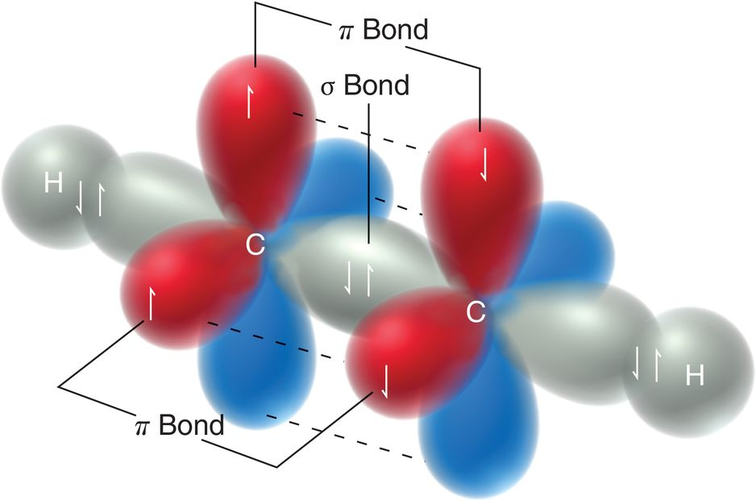
10.1 Alkynes
Alkynes are molecules that possess a C≡C triple bond

Slide 3
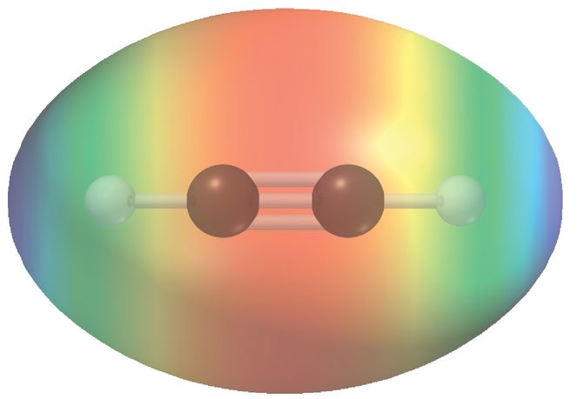
9.1 Alkynes
Given the presence of pi bonds, alkynes are similar to alkenes in their ability to act as a nucleophile
Many of the addition reactions of alkenes also work on alkynes

Slide 4
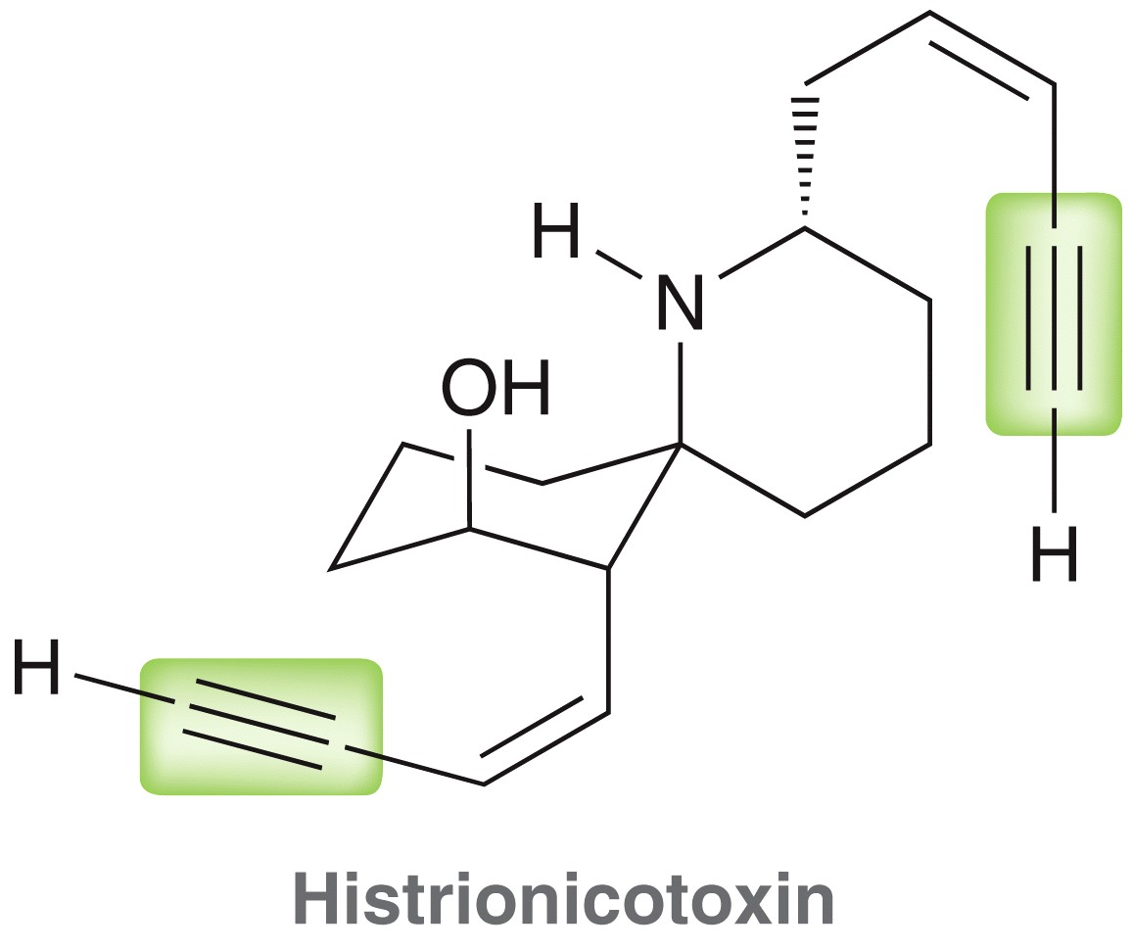
9.1 Alkynes in Industry and Nature
Acetylene is the simplest alkyne
It is used in blow torches and as a precursor for the synthesis of more complex alkynes
More than 1000 different alkyne natural products have been isolated

Slide 5
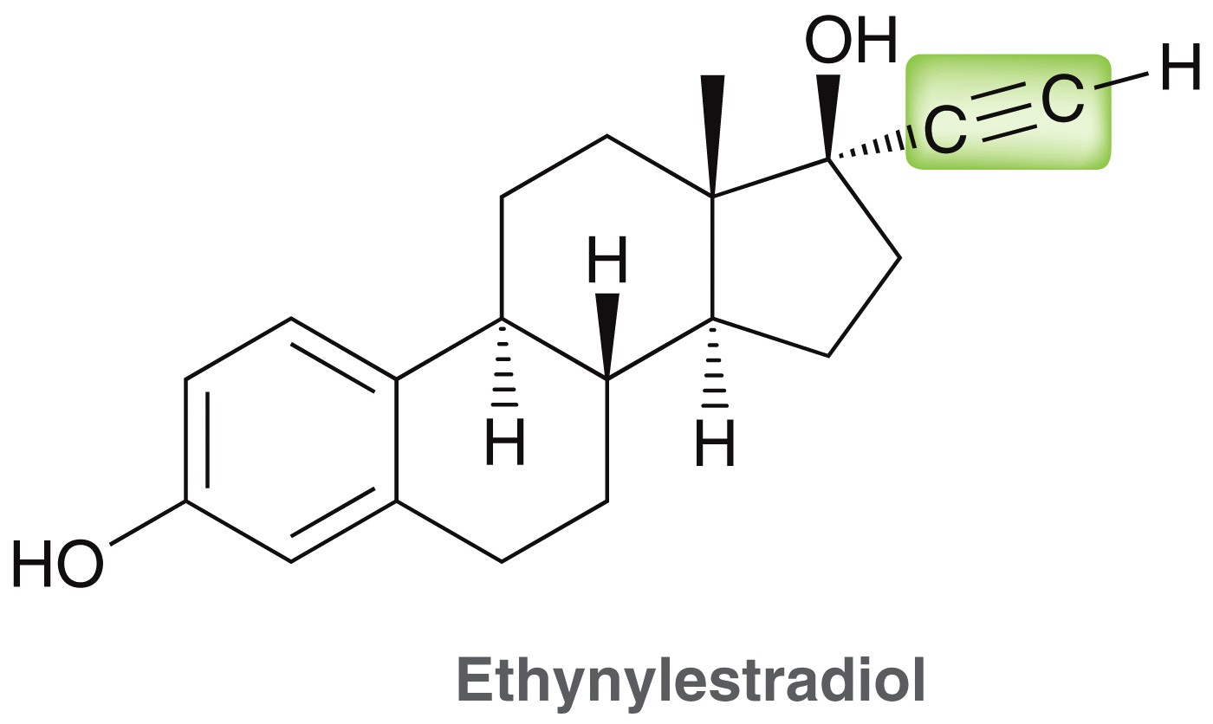
9.1 Alkynes
An example of a synthetic alkyne is ethynylestradiol
Ethynylestradiol is the active ingredient in many birth control pills

Slide 6
9.2 Nomenclature of Alkynes
Alkynes are named using the same procedure we used in Chapter 4 to name alkanes with minor modifications
  Identify the parent chain, which should include the C≡C triple bond
  Identify and Name the substituents
  Assign a locant (and prefix if necessary) to each substituent giving the C≡C triple bond the lowest number possible
  List the numbered substituents before the parent name in alphabetical order. Ignore prefixes (except iso) when ordering alphabetically
  The C≡C triple bond locant is placed either just before the parent name or just before the -yne suffix

Slide 7
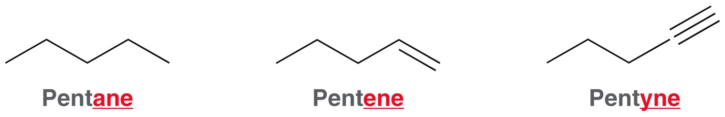
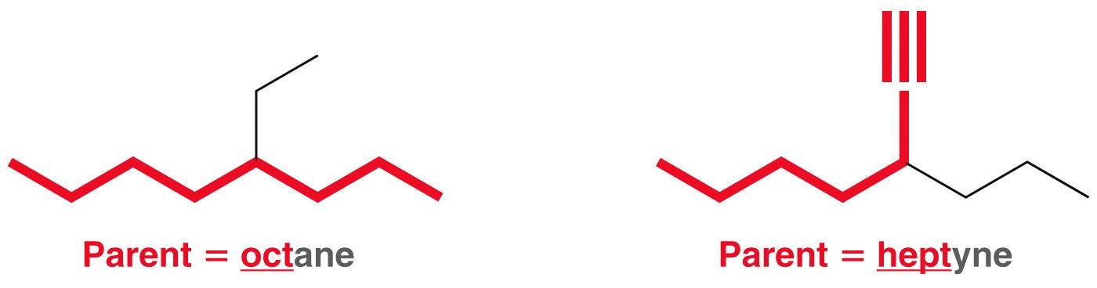
9.2 Nomenclature of Alkynes
Alkynes are named using the same procedure we used in Chapter 4 to name alkanes with minor modifications
  Identify the parent chain, which should include the C≡C triple bond
  Identify and name the substituents.

Slide 8
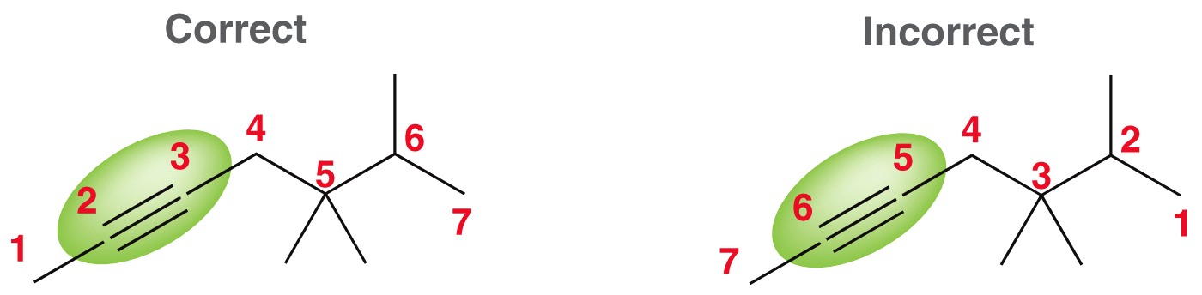
9.2 Nomenclature of Alkynes
Alkynes are named using the same procedure we used in Chapter 4 to name alkanes with minor modifications
  Assign a locant (and prefix if necessary) to each substituent giving the C≡C triple bond the lowest number possible
  The locant is ONE number, NOT two. Although the triple bond bridges carbons 2 and 3, the locant is the lower of those two numbers

Slide 9
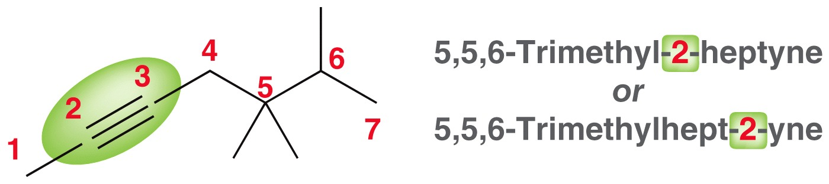
9.2 Nomenclature of Alkynes
Alkynes are named using the same procedure we used in Chapter 4 to name alkanes with minor modifications
  List the numbered substituents before the parent name in alphabetical order. Ignore prefixes (except iso) when ordering alphabetically
  The C≡C triple bond locant is placed either just before the parent name or just before the -yne suffix

Slide 10
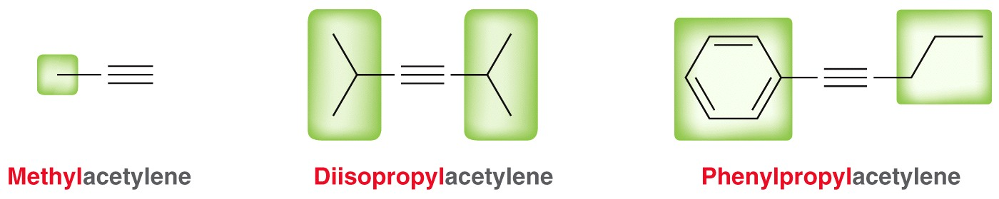
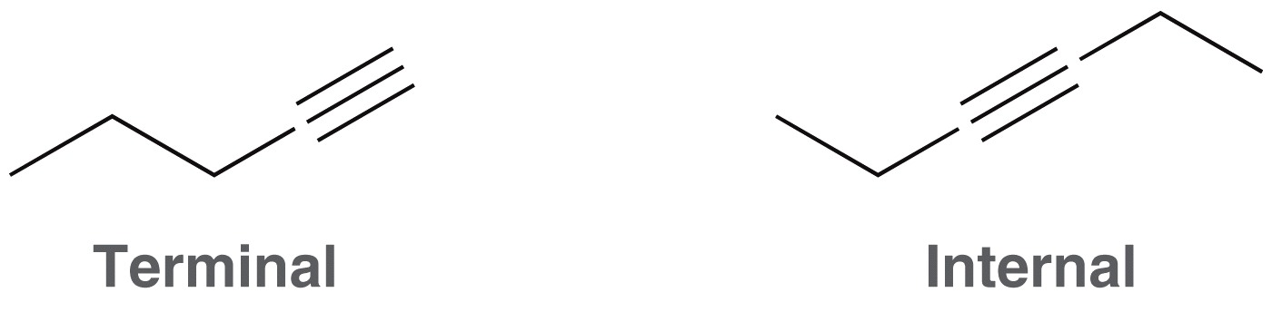
9.2 Nomenclature of Alkynes
common names derived from acetylene are often used as well
Alkynes are also classified as terminal or internal
Practice with SkillBuilder 9.1

Slide 11
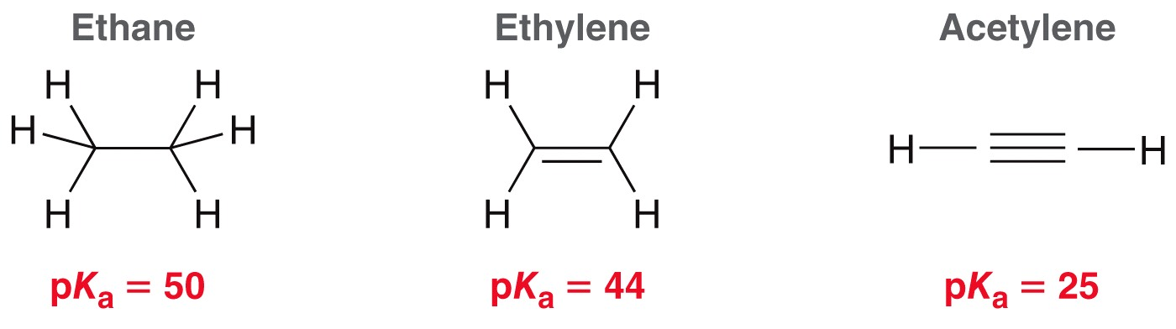
9.3 Acidity of Terminal Alkynes
Recall that terminal alkynes have a lower pK_{a} (i.e. more acidic) than other hydrocarbons
Acetylene is 19 pK_{a} units more acidic than ethylene, which is 10¹⁹ times stronger

Slide 12
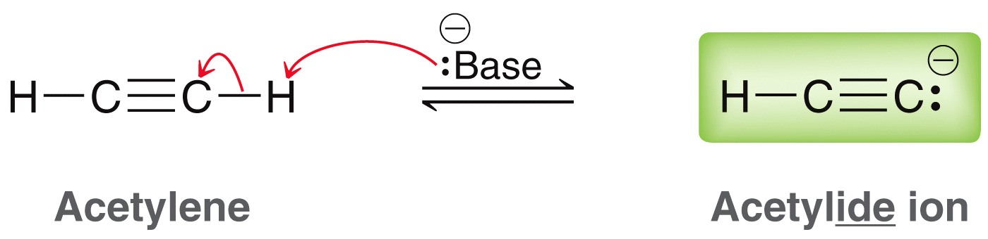
9.3 Acidity of Terminal Alkynes
Acetylene can be deprotonated by a strong based to form the conjugate base (acetylide ion).
Recall ARIO to explain why acetylene is a stronger acid than ethylene which is stronger than ethane

Slide 13
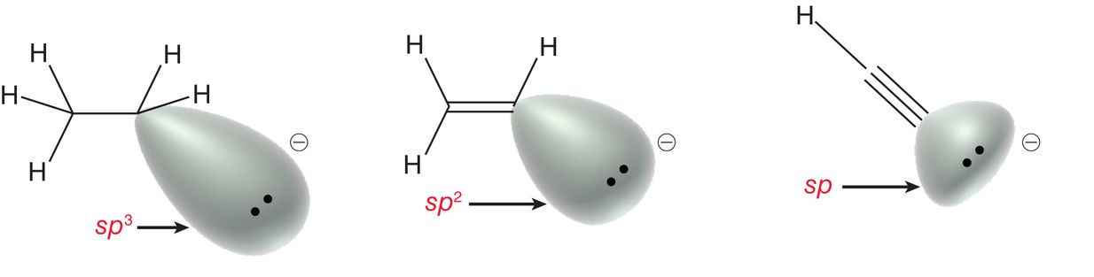
9.3 Acidity of Terminal Alkynes
Recall that terminal alkynes have a lower pK_{a} than other hydrocarbons
The acetylide ion is more stable because the lone pair occupies a sp orbital
Less stable
More stable

Slide 14
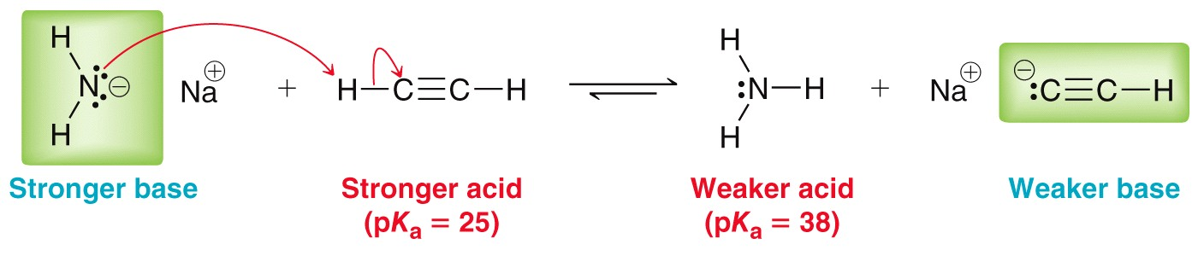
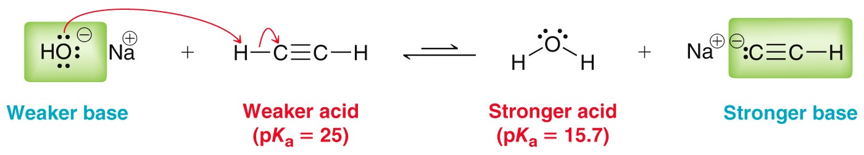
9.3 Acidity of Terminal Alkynes
A bases conjugate acid pK_{a} must be greater than 25 for it to be able to deprotonate a terminal alkyne

Slide 15
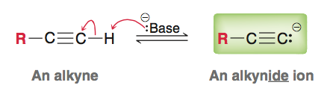
9.3 Acidity of Terminal Alkynes
Any terminal alkyne can be deprotonated by a suitable base
NaNH₂ is often used as the base, but others can be used as well

Slide 16
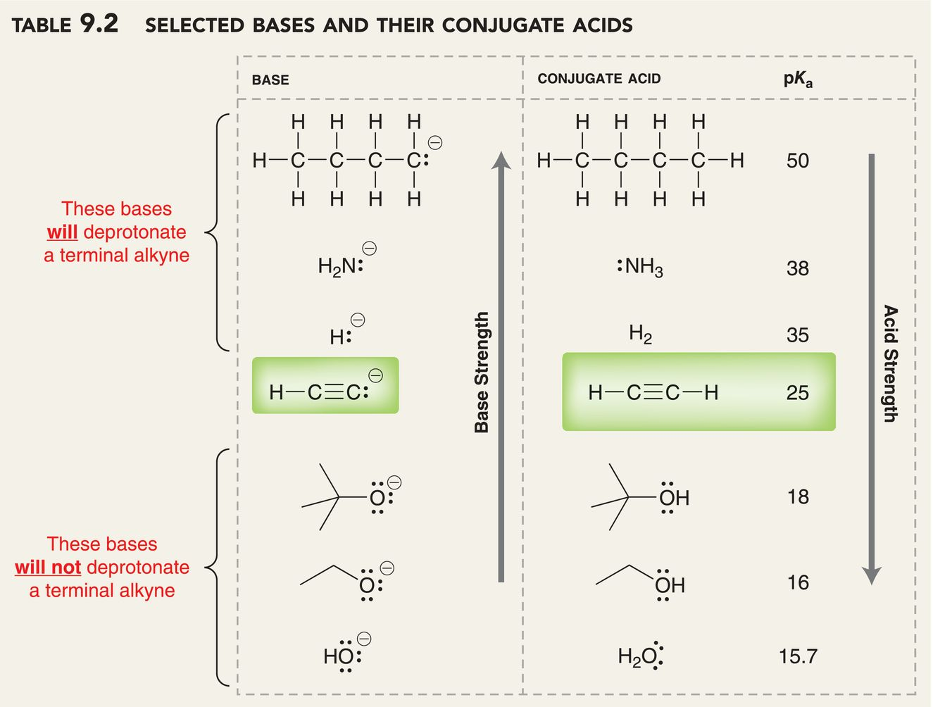
9.3 Acidity of Terminal Alkynes
Practice with SkillBuilder 9.2

Slide 17
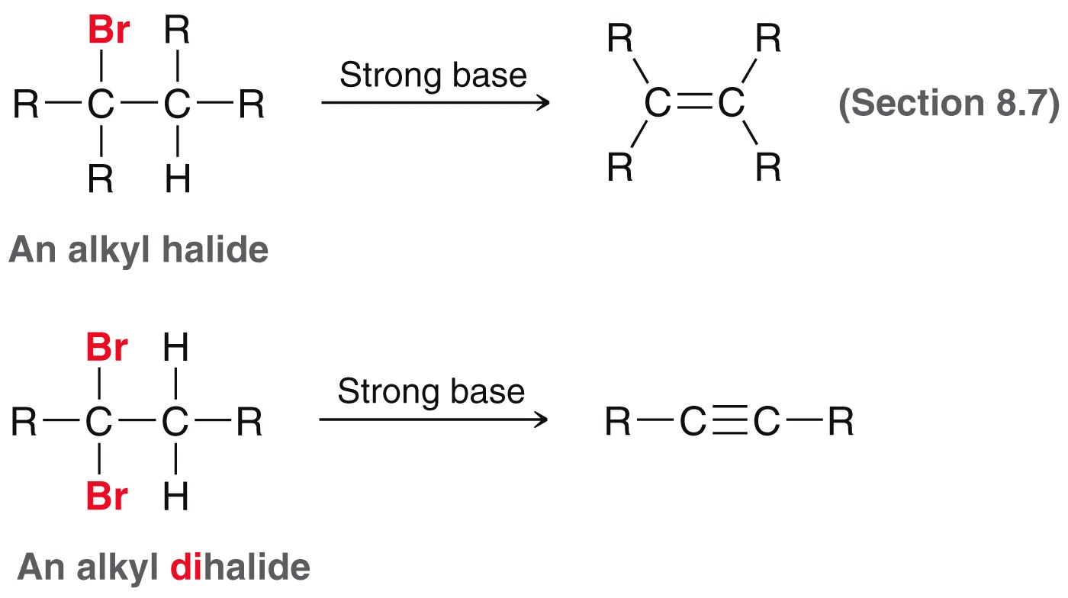
9.4 Preparation of Alkynes
Like alkenes, alkynes can also be prepared by elimination
Need a dihalide to make an alkyne

Slide 18
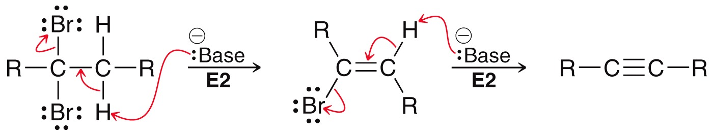
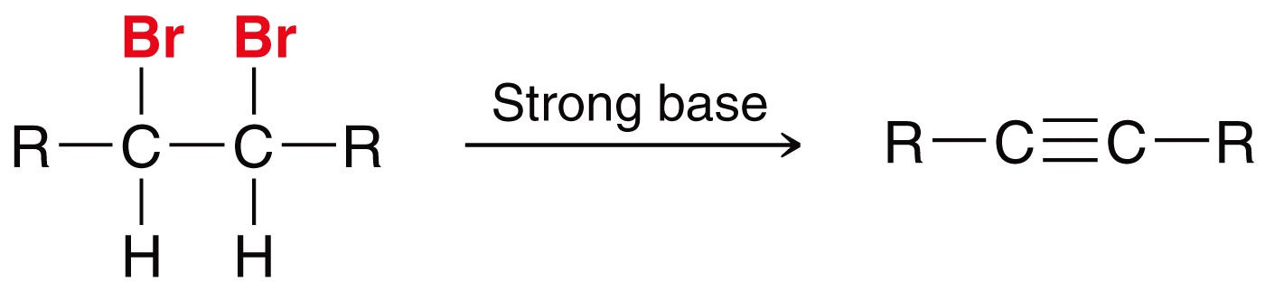
9.4 Preparation of Alkynes
Such eliminations usually occur via an E2 mechanism
Geminal or vicinal dihalides can be used
geminal
dihalide
vicinal
dihalide

Slide 19
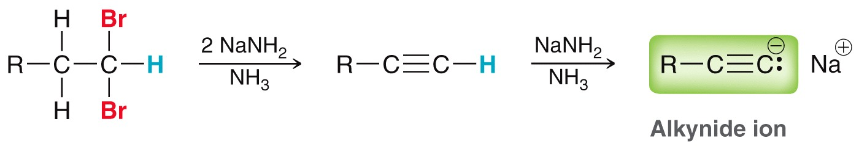
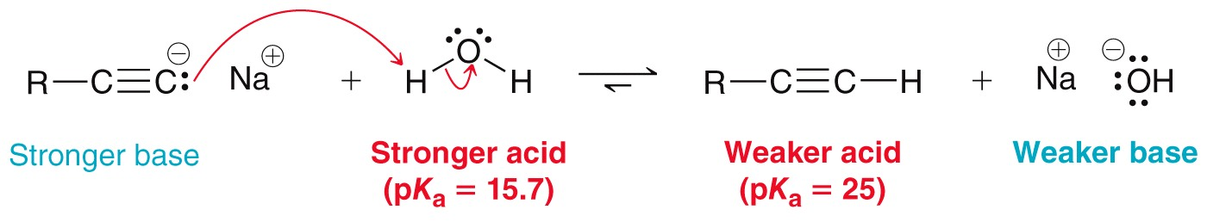
9.4 Preparation of Alkynes
excess equivalents of NaNH₂ are used to shift the equilibrium toward the elimination products
Aqueous workup is then needed to produce the neutral alkyne:

Slide 20
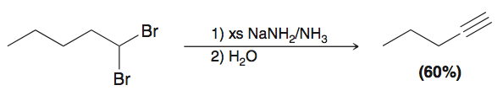
9.4 Preparation of Alkynes
Overall, a terminal alkyne is prepared by treating the dihalide with excess (xs) sodium amide, followed by water:
Practice with Conceptual Checkpoint 9.7

Slide 21
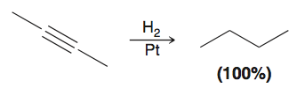
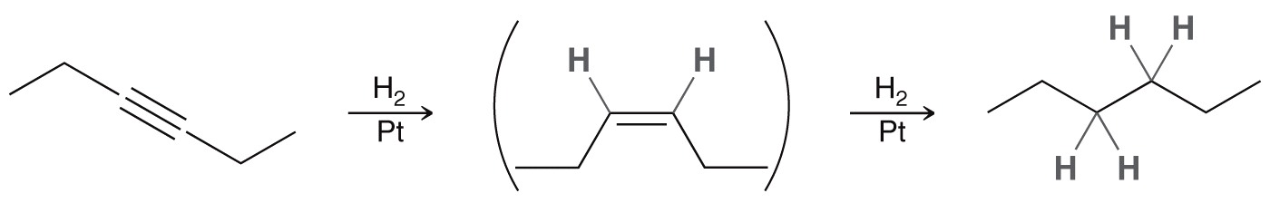
9.5 Reduction of Alkynes
Catalytic hydrogenation – alkyne is concerted to an alkane by addition of two equivalents of H2
The first addition produces a cis alkene (via syn addition) which then undergoes addition to yield the alkane

Slide 22
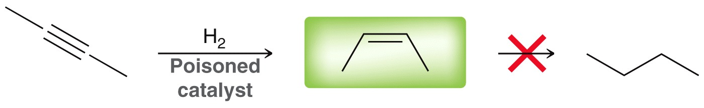
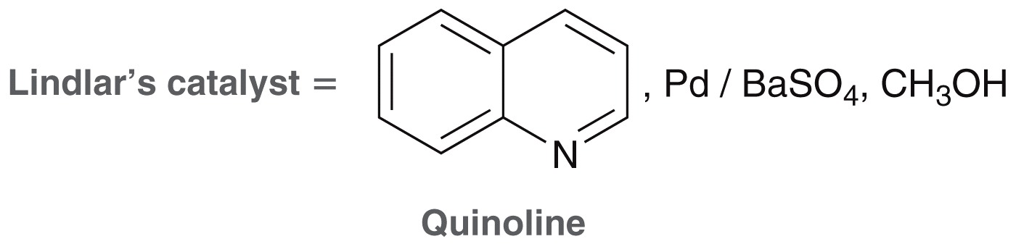
9.5 Reduction of Alkynes
A deactivated or poisoned catalyst can be used to stop the reaction at the cis alkene, without further reduction:
Lindlar’s catalyst and P-2 (Ni₂B complex) are common examples of a poisoned catalysts

Slide 23
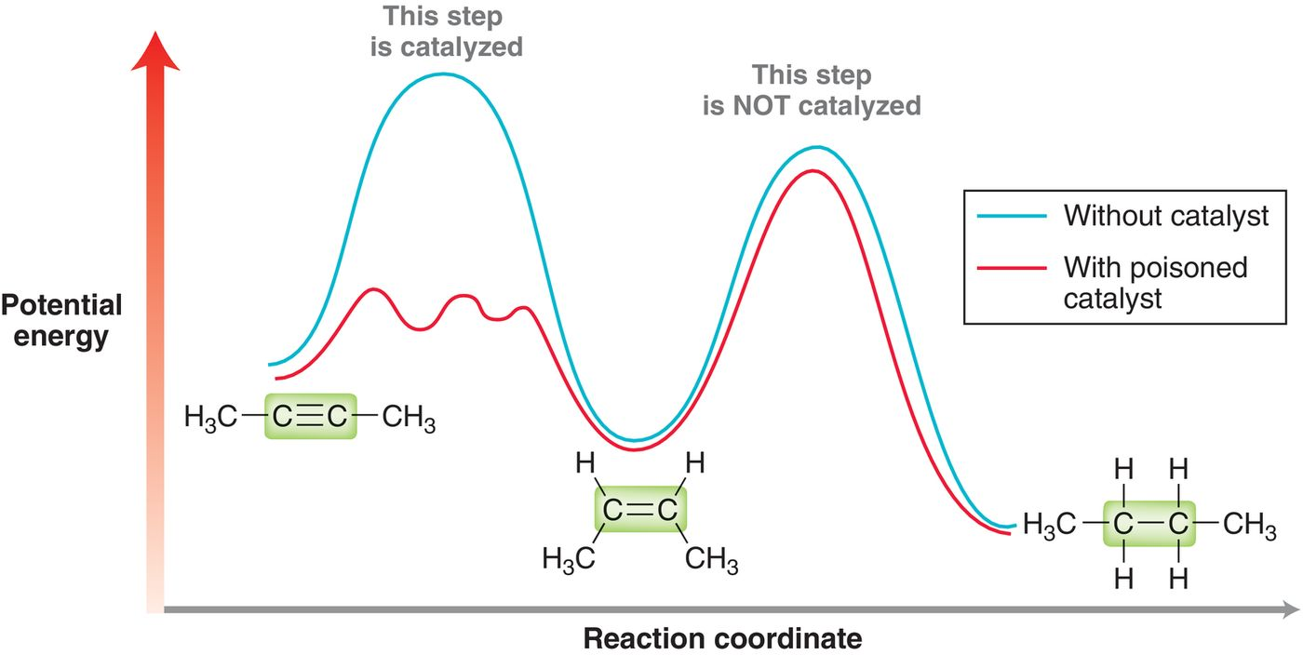
9.5 Reduction of Alkynes
The poisoned catalyst catalyzes the first addition of H₂, but not the second.
Practice with Conceptual Checkpoint 9.9

Slide 24
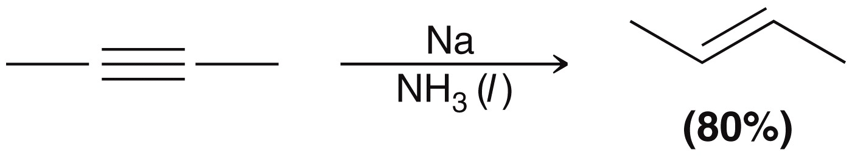
9.5 Reduction of Alkynes
Dissolving metal reduction – reduces an alkyne to a trans alkene using sodium metal and ammonia
This reaction is stereoselective for anti addition of H and H

Slide 25
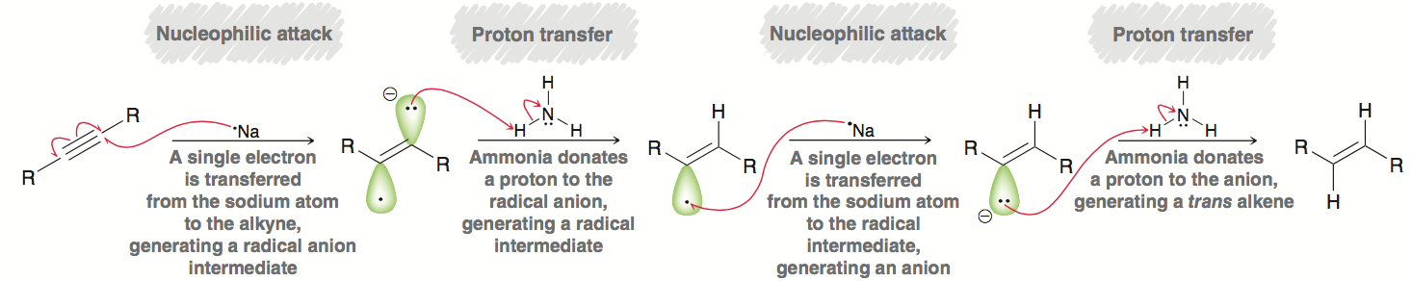
9.5 Reduction of Alkynes
Dissolving metal reduction – reduces an alkyne to a trans alkene using sodium metal and ammonia
The proposed mechanism is shown below (Mechanism 9.1)

Slide 26
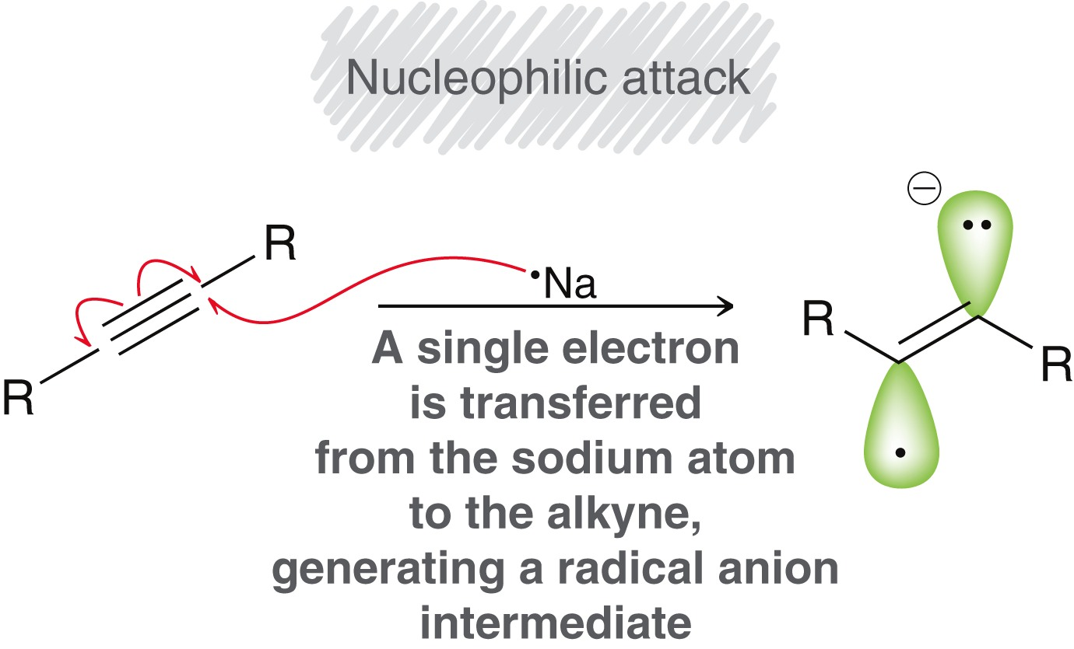
9.5 Reduction of Alkynes
Dissolving metal reduction – reduces an alkyne to a trans alkene using sodium metal and ammonia
Mechanism – Step 1
Na atom transfer an electron
to the alkyne, forming a
radical cation intermediate
Note the use of fishhook arrows to show single electron movement

Slide 27
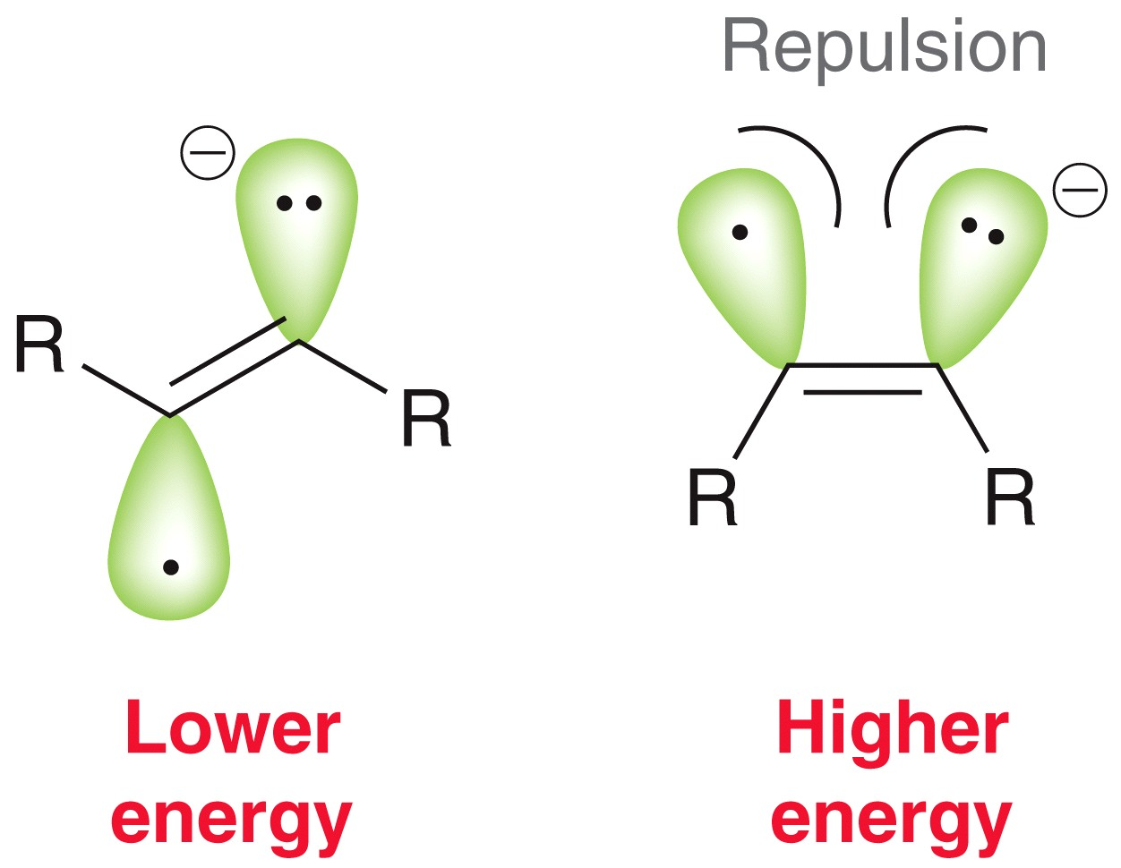
9.5 Reduction of Alkynes
Dissolving metal reduction – reduces an alkyne to a trans alkene using sodium metal and ammonia
Mechanism – Step 1
the paired electrons and the
single electron adopt an anti
geometry

Slide 28
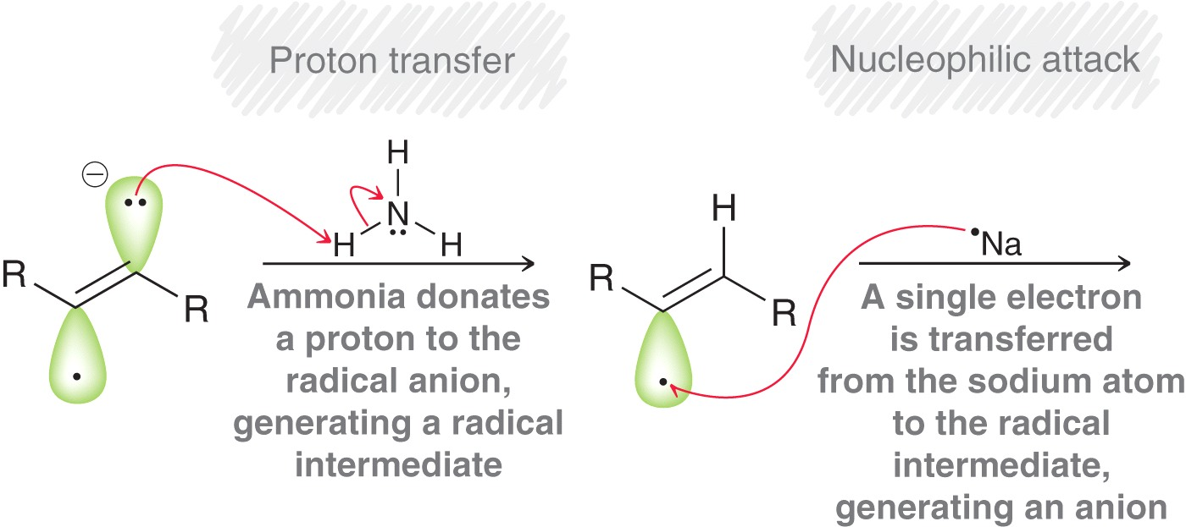
9.5 Reduction of Alkynes
Dissolving metal reduction – reduces an alkyne to a trans alkene using sodium metal and ammonia
Mechanism – Steps 2 and 3

Slide 29
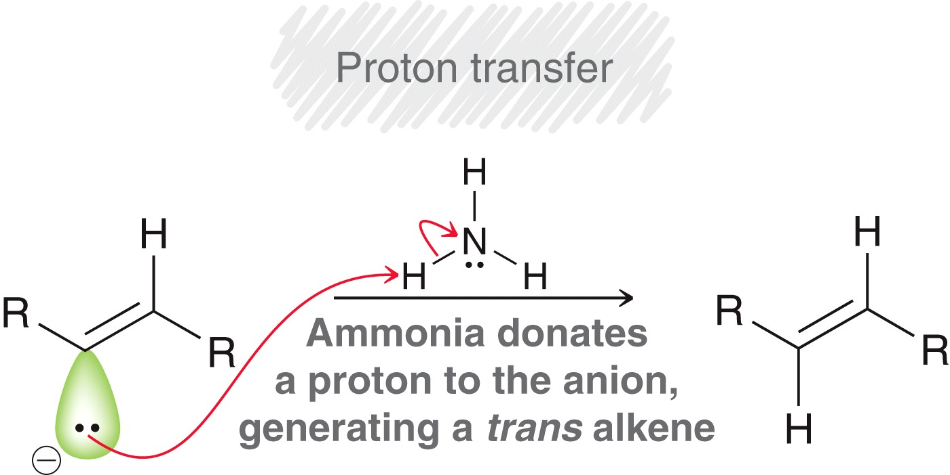

9.5 Reduction of Alkynes
Dissolving metal reduction – reduces an alkyne to a trans alkene using sodium metal and ammonia
Mechanism – Step 4
Practice with Conceptual Checkpoint 9.10

Slide 30
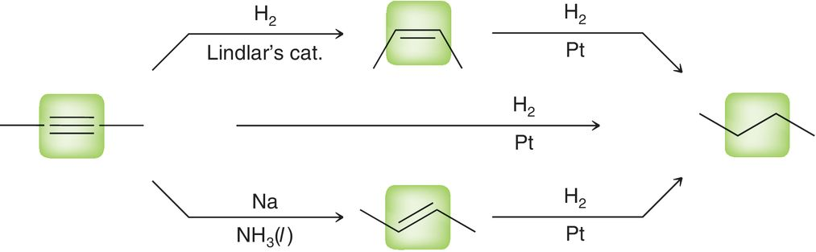
9.5 Reduction of Alkynes - Summary
Know the reagents needed to reduce an alkyne to an alkane, a cis alkene, or a trans alkene.
Practice with Conceptual Checkpoint 9.11

Slide 31
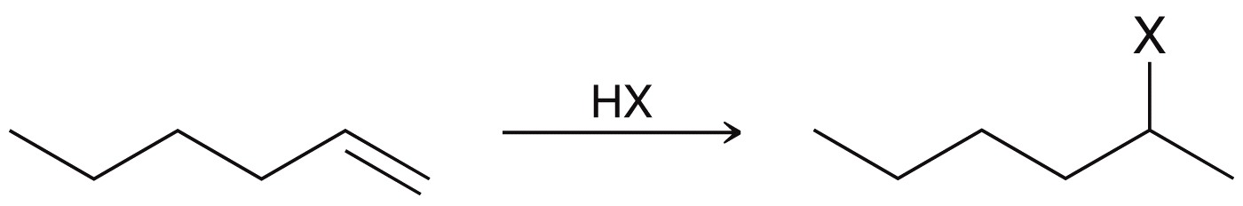
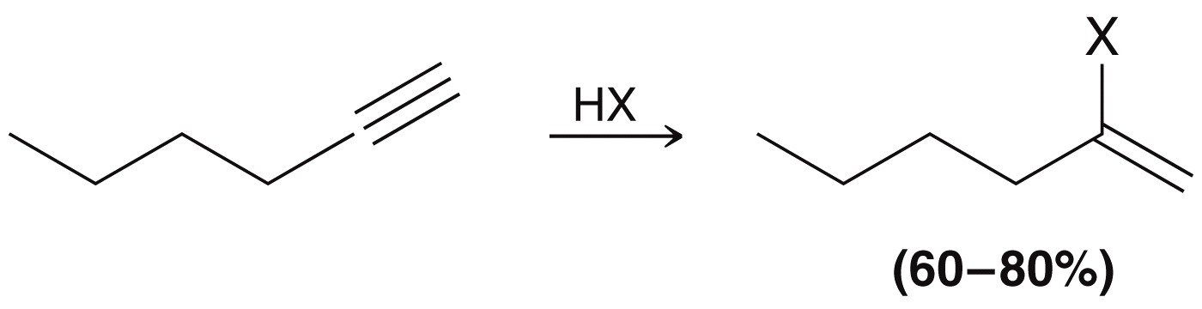

9.6 Hydrohalogenation of Alkynes
Hydrohalogenation affords Markovnikov addition of H and X to an alkyne, same as with an alkene.
Excess HX affords a geminal dihalide
addition to an alkene
addition to an alkyne
geminal dihalide

Slide 32
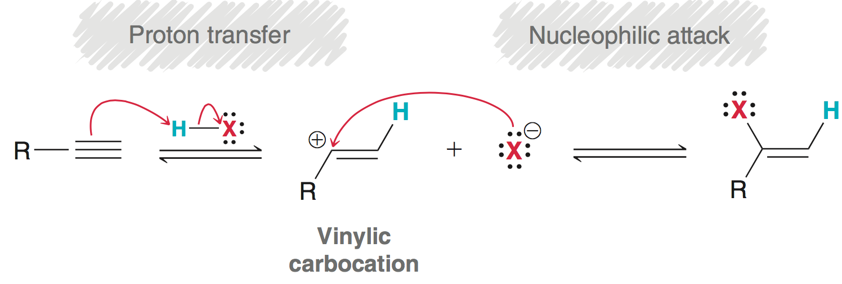
9.6 Hydrohalogenation of Alkynes
If the mechanism was analogous to HX addition to an alkene, it would require the formation of a vinyl carbocation:
Vinayl carbocations are extremely unstable, so this mechanism is unlikely
Kinetic data also suggests a different mechanism is in play

Slide 33
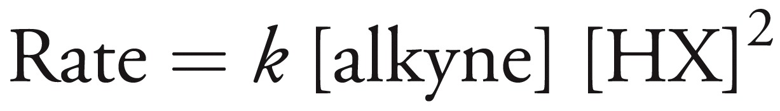
9.6 Hydrohalogenation of Alkynes
Kinetic studies suggest the rate law is 1st order with respect to the alkyne and 2nd order with respect to HX
The mechanism must be consistent with a termolecular process

Slide 34
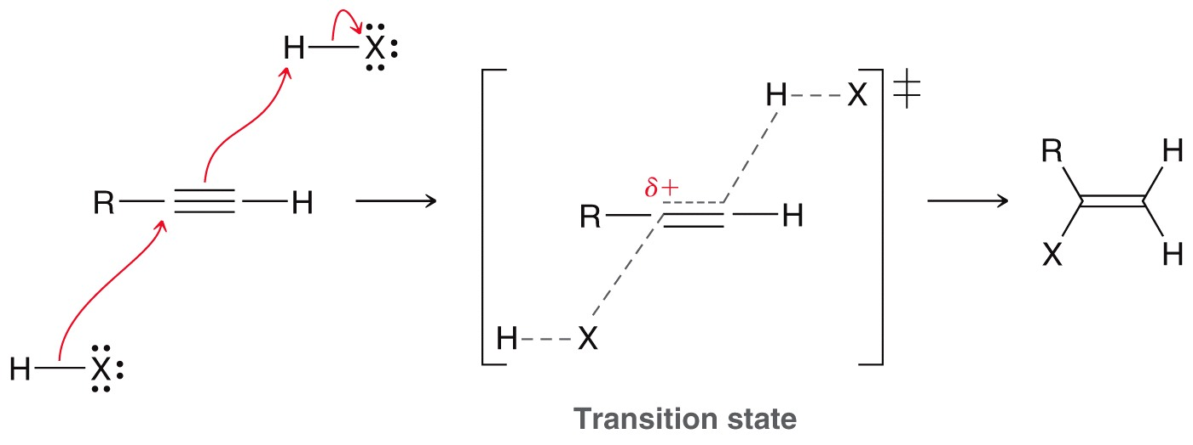
9.6 Hydrohalogenation of Alkynes
Proposed mechanism
Its possible several competing mechanisms are occurring.

Slide 35
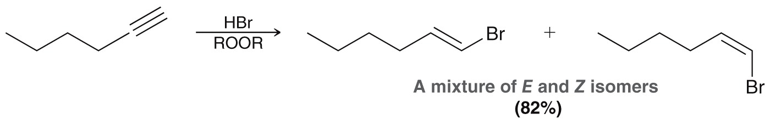
9.6 Hydrohalogenation of Alkynes
HBr with peroxides promotes anti-Markovnikov addition, just like with alkenes
This only works with HBr (not with HCl or HI)
This radical mechanism is covered in chapter 10

Slide 36
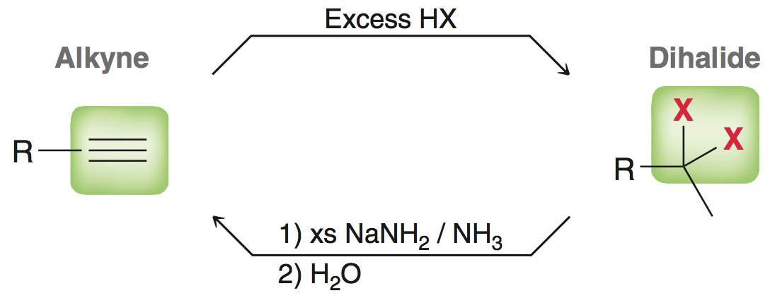
9.6 Dihalide/alkyne interconversion
Hydrohalogenation of alkynes, and elimination of dihalides represent complimentary reactions:
Practice with Conceptual Checkpoint 9.13 – 9.15

Slide 37
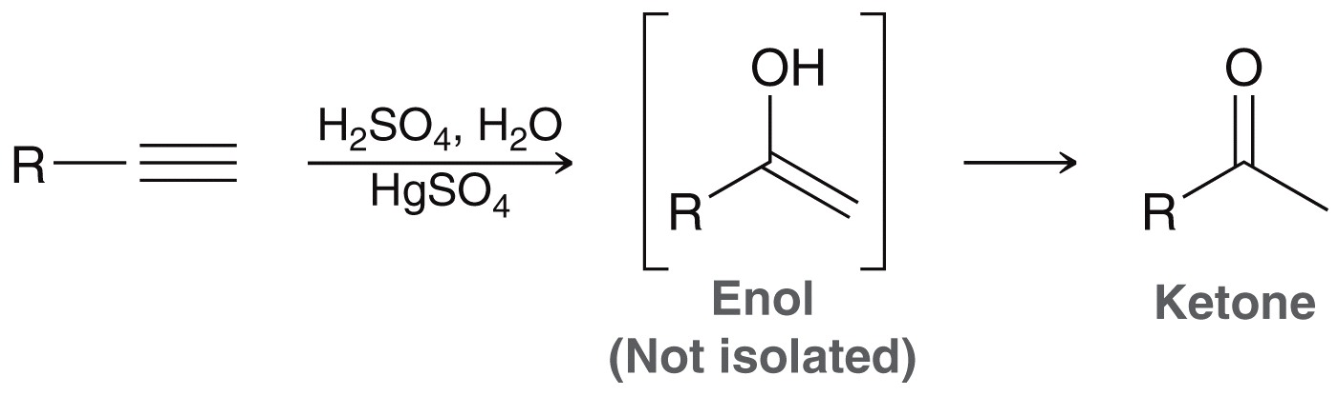
9.7 Hydration of Alkynes
Alkynes can also undergo acid catalyzed Markovnikov hydration
The process is generally catalyzed with HgSO₄ to compensate for the slow reaction rate that results from the formation of vinylic carbocation

Slide 38
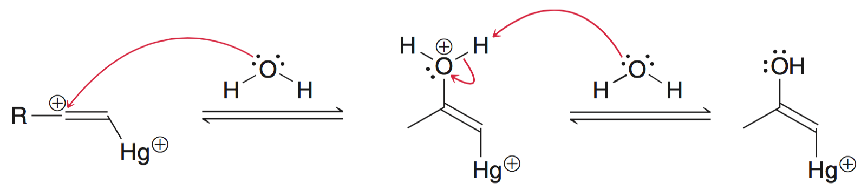
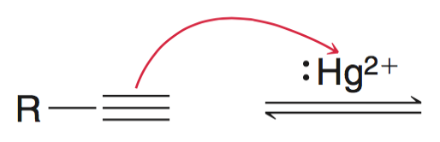
9.7 Hydration of Alkynes - mechanism
The alkyne attacks the mercury cation to form the mercurinium ion intermediate, which is attacked by water, followed by deprotonation

Slide 39
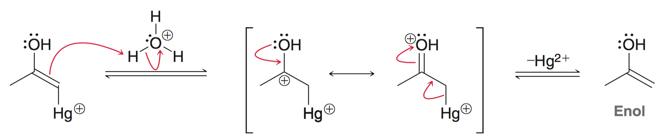
9.7 Hydration of Alkynes - mechanism
The alkyne attacks the mercury cation to form the mercurinium ion intermediate, which is attacked by water, followed by deprotonation
A proton then replaces the Hg²⁺ to form an enol intermediate

Slide 40
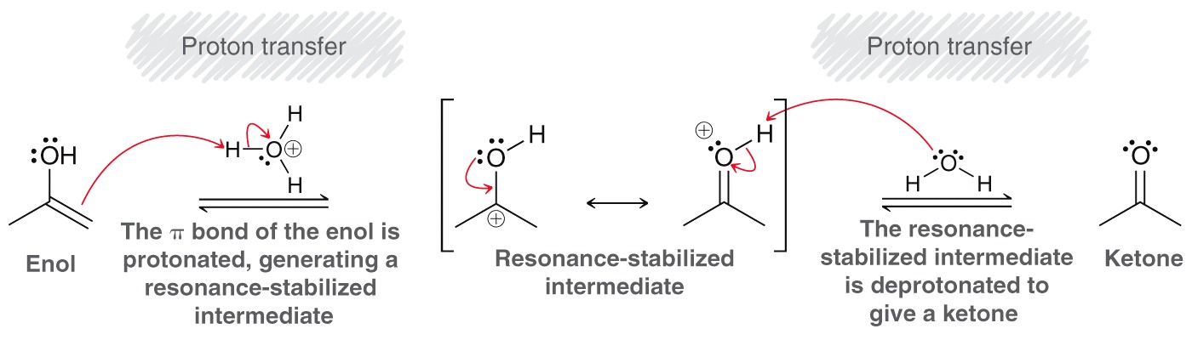
9.7 Hydration of Alkynes
The enol then tautomerizes to the ketone.
Process is called keto-enol tautomerization
The enol and the ketone are tautomers of one another
Equilibrium generally favors the ketone
Practice with SkillBuilder 9.3

Slide 41
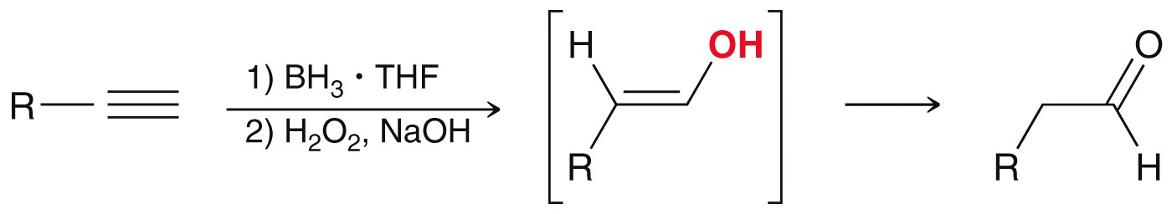
9.7 Hydroboration-Oxidation of Alkynes
Hydroboration-oxidation of alkynes is the same as for alkenes
Regioselective for anti-Markovnikov addition
It also produces an enol that tautomerizes to aldehyde
In this case, tautomerization is base-catalyzed (OH⁻)

Slide 42
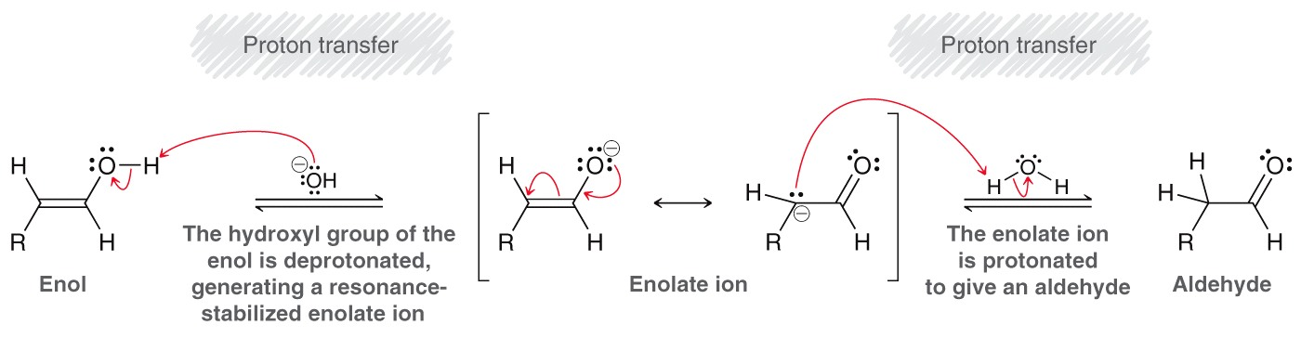
9.7 Hydroboration-Oxidation of Alkynes
Base-catalyzed tautomerization mechanism:
Enol is deprotonated to form an enolate, which is protonated at the carbon to produce the aldehyde.

Slide 43
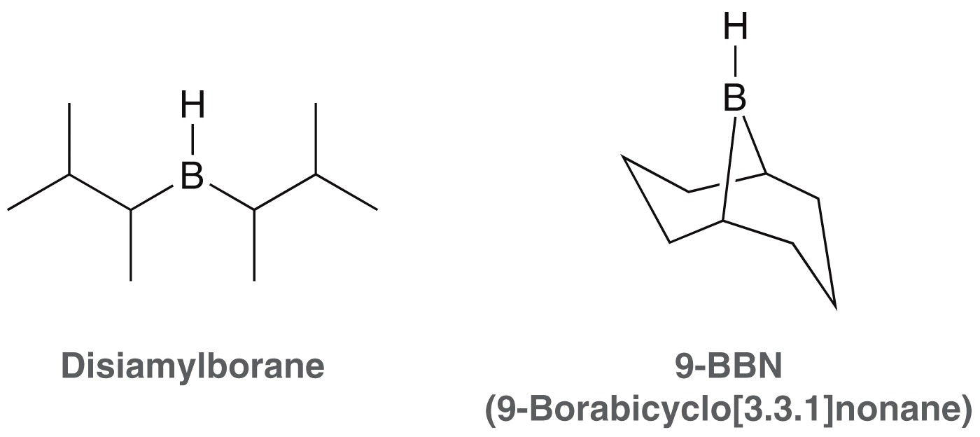
9.7 Hydroboration-Oxidation of Alkynes
If BH3 is used, then the alkyne can undergo two successive add’ns.
To prevent the second addition, a dialkyl borane is used (instead of BH₃)
The bulky alkyl groups
provide steric hindrance
to prevent a second
addition

Slide 44

9.7 Hydroboration-Oxidation of Alkynes
The modified borane reagents allow for conversion of a terminal alkyne to the corresponding aldehyde:
Practice with Conceptual Checkpoint 9.20

Slide 45

9.7 Controlling Hydration Regiochemistry
For a terminal alkyne:
  Markovnikov hydration yields a ketone
  Anti Markovnikov hydration yields an aldehyde
Practice with SkillBuilder 9.4

Slide 46

9.8 Halogenation of Alkynes
Halogenation of alkynes yields a tetrahalide
Two equivalents of halogen are added with excess X₂

Slide 47

9.8 Halogenation of Alkynes
When one equivalent of halogen is added to an alkyne, both anti and syn addition is observed
The mechanism for alkyne halogenation is not fully understood. If it was like halogenation of an alkene, only the anti product would be obtained.

Slide 48


9.9 Ozonolysis of Alkynes
Ozonolysis of an internal alkyne produces two carboxylic acids
Ozonolysis of a terminal alkyne yields a carboxylic acid and carbon dioxide.
Practice with Conceptual Checkpoint 9.24 – 9.26

Slide 49
9.9 Ozonolysis of Alkynes
Predict the product(s) for the following reaction

Slide 50
9.9 Ozonolysis of Alkynes
Predict the product(s) for the following reaction
Ozonolysis of symmetrical alkynes is particularly useful to prepare carboxylic acids: only one product is formed…. two equivalents of it

Slide 51


9.10 Alkylation of Terminal Alkynes
Recall that terminal alkynes are completely converted to an alkynide ion with NaNH₂
Alkynide ions are good nucleophiles
S_{N}2 reaction with alkyl halides
New C-C bond

Slide 52

9.10 Alkylation of Terminal Alkynes
Alkylation of an alkynide ion is S_{N}2 substitution, and so it works best with methyl and 1˚ halides
(E2 elimination dominates with 2˚/3˚ halides)
Acetylene can undergo two successive alkylations
New C-C bond

Slide 53
9.10 Alkylation of Terminal Alkynes
Note that that double alkylation of acetylene must be stepwise:
Complex target molecules can be made by building a carbon skeleton and converting functional groups
Practice with SkillBuilder 9.5

Slide 54

9.11 Synthesis Strategies
Recall the methods for converting triple bonds to double or single bonds
But, what if you want to reverse the process or decrease saturation?

Slide 55


9.11 Synthesis Strategies
Halogenation of an alkene followed by elimination yields an alkyne
These reactions give us a handle on interconverting single, double and triple bonds
Practice with SkillBuilder 9.6

Slide 56

9.11 Reactions of Alkynes - Summary
Review of Reactions

Slide 57

9.11 Reactions of Alkynes - Summary

