Slide 1
Organic Chemistry
Third Edition
David Klein
Chapter 13
Ethers and Epoxides; Thiols and Sulfides

Slide 2
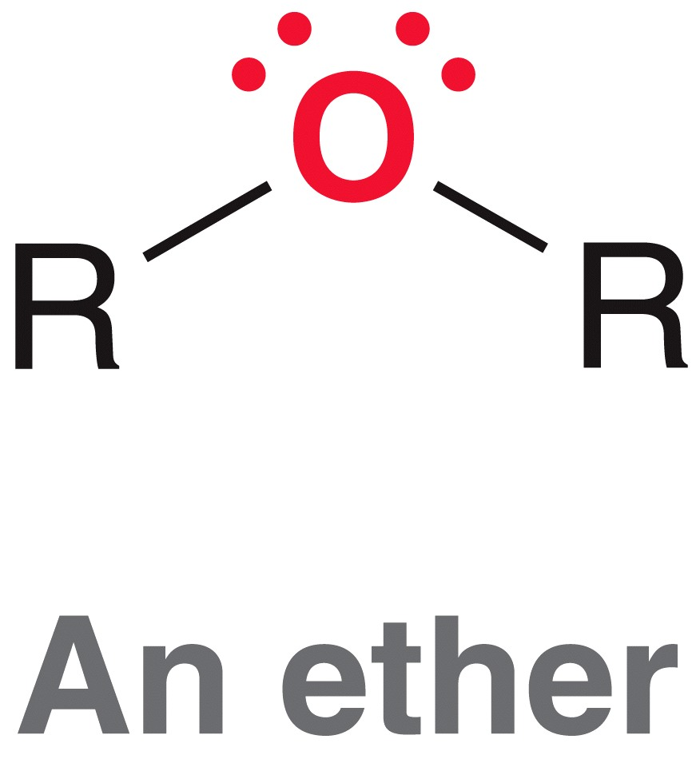
13.1 Introduction to Ethers
An ether group includes an oxygen atom that is bonded to two alkyl groups
-R groups can be alkyl, aryl, or vinyl groups (not acyl groups)
this is an ester,
(not an ether)

Slide 3
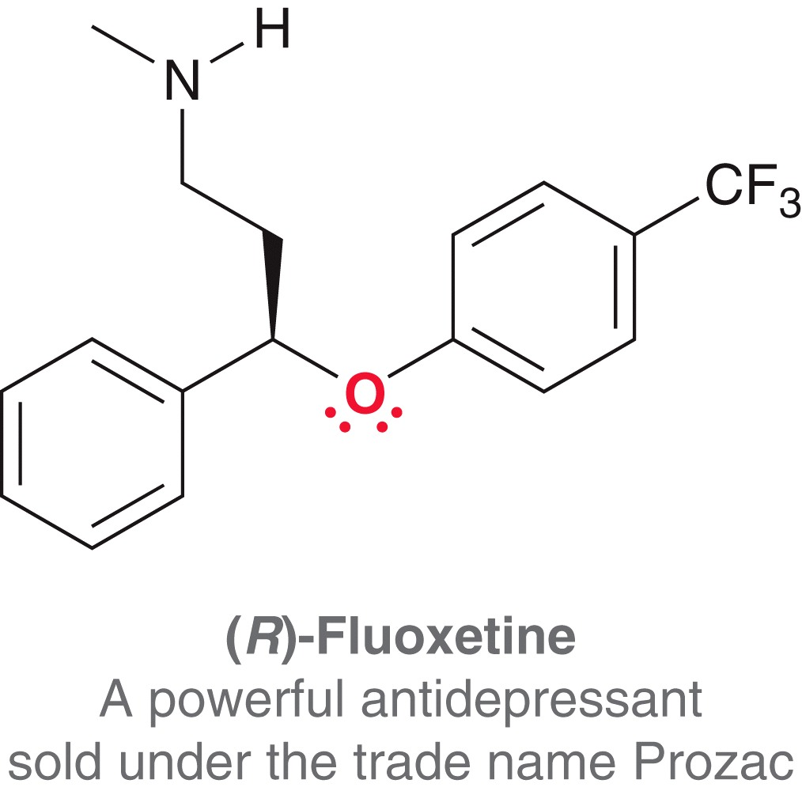
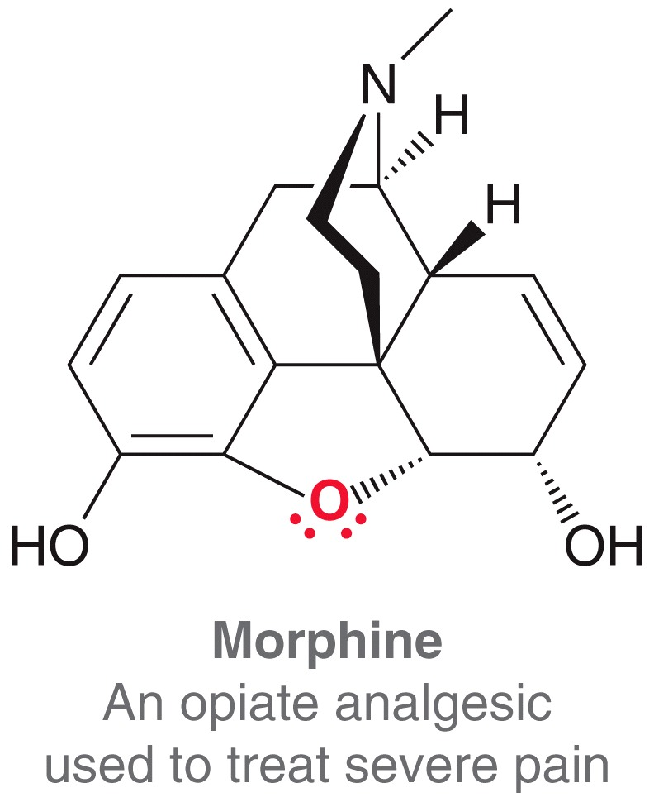
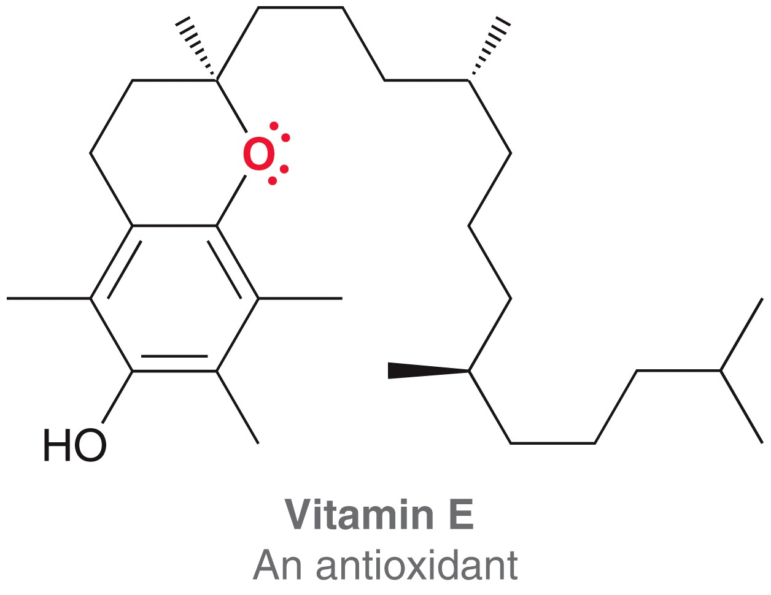
13.1 Introduction to Ethers
Ether is a common function group in many natural and synthetic compounds

Slide 4
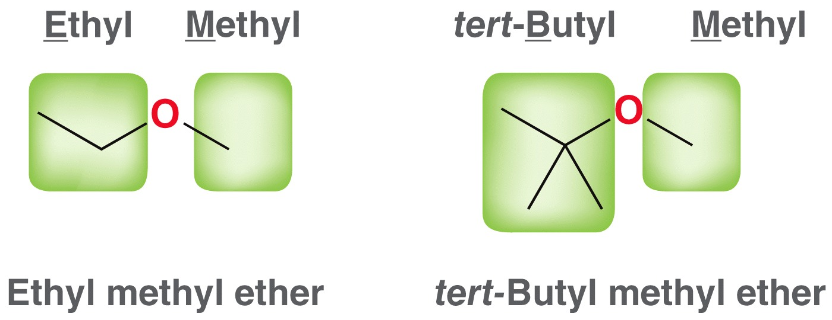
13.2 Naming Ethers
Common names are often used for ether:
  Name each –R group
  Arrange them alphabetically
  End with the word, “ether”

Slide 5
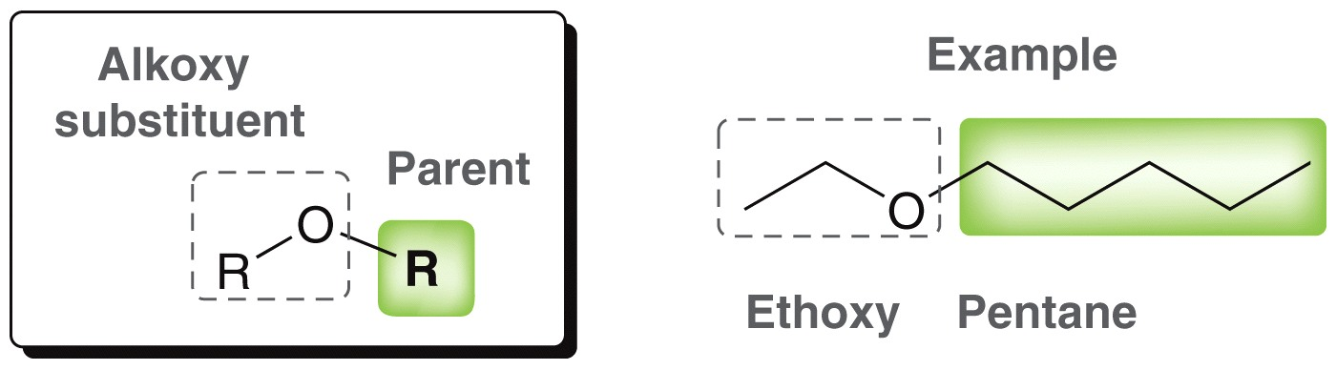
13.2 Naming Ethers
IUPAC systematic names:
  The larger –R group is the parent chain
  The smaller –R group is the alkoxy substituent
Practice with SkillBuilder 13.1

Slide 6
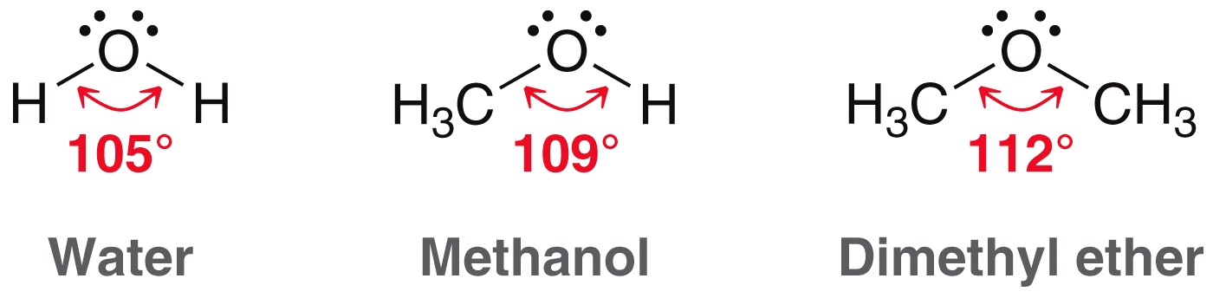
13.3 Structure and Properties of Ethers
The bond angle in ethers is very similar to that found in water and in alcohols
  The oxygen atom is sp³ hybridized
  The larger the –R group, the wider the bond angle

Slide 7
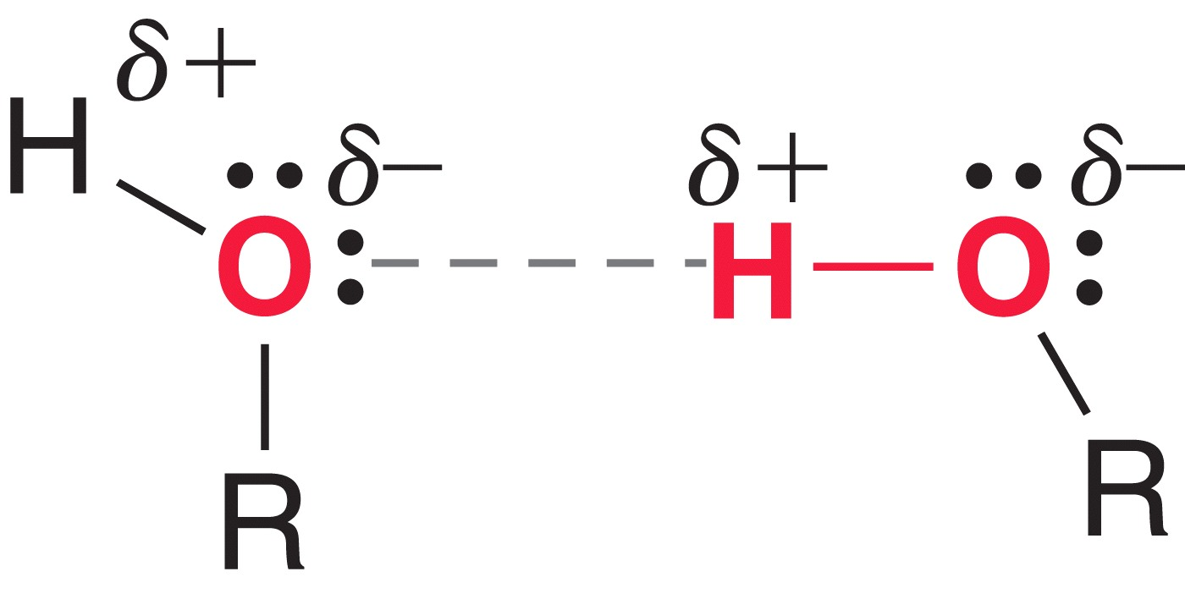
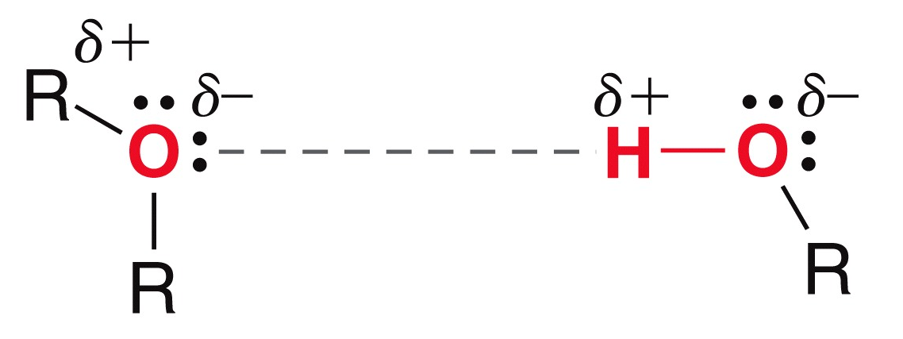
13.3 Structure and Properties of Ethers
Recall alcohols have relatively high boiling points, as a result of H-bonding
Ethers can act only as H-bond acceptors

Slide 8
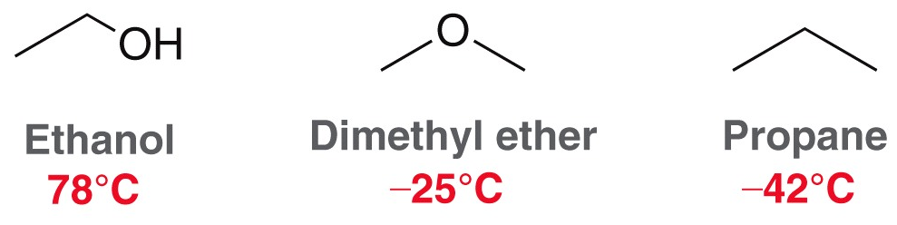
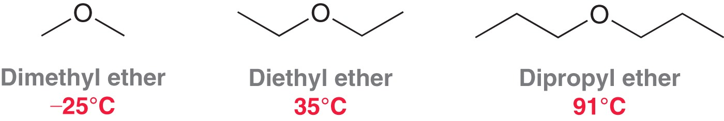
13.3 Structure and Properties of Ethers
Ethers cannot H-bond among themselves, and so their BP’s are much lower than alcohols of comparable size:
The larger the ether, the higher the BP (London dispersion forces)

Slide 9
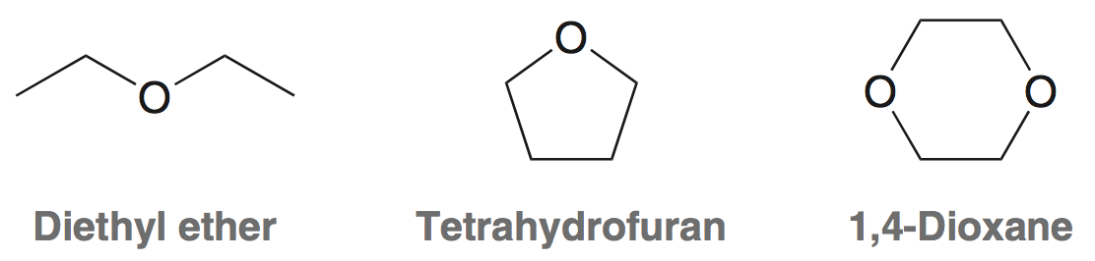
13.3 Structure and Properties of Ethers
Ethers are common solvents used for organic reactions:
  Relatively low boiling points (easily removed by evaporation)
  They are fairly unreactive

Slide 10
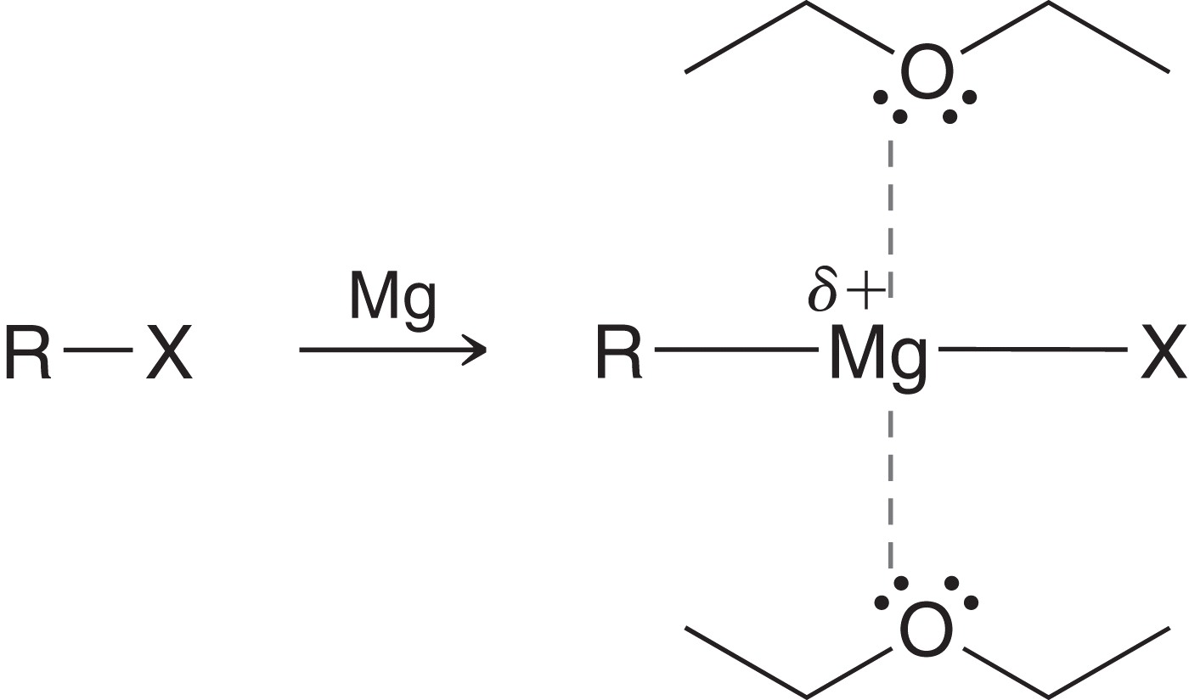
13.4 Crown Ethers
Metal atoms with a full or partial positive charge are stabilized by ether solvents
Ethers are used as solvents for
Grignard reactions because they
stabilize the Mg atom

Slide 11
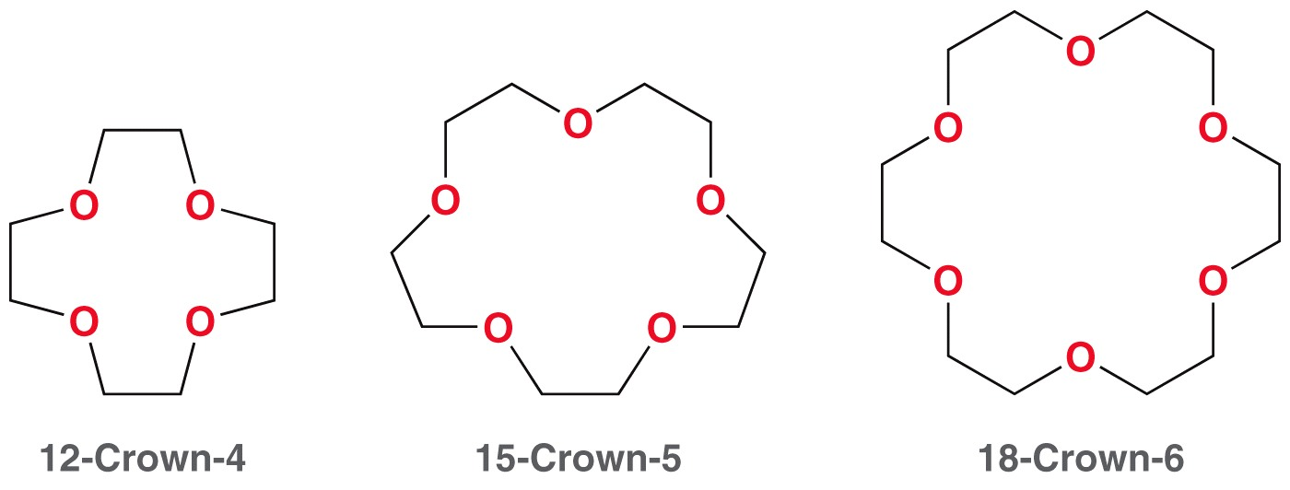
13.4 Crown Ethers
Crown ethers have been shown to form especially strong attractions to metal atoms.
The multiple ether groups result in stronger metal attraction
They #’s in their names refer to the total number of atoms, and the number of oxygens

Slide 12
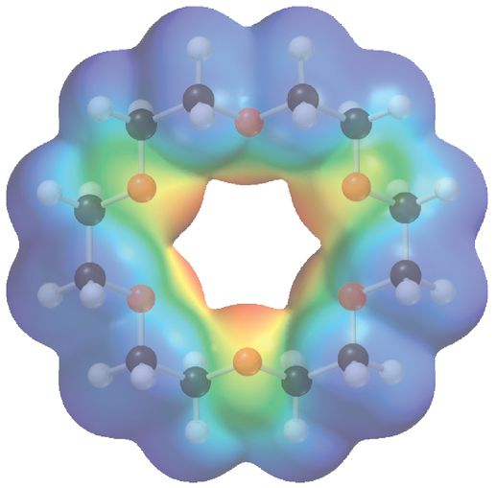
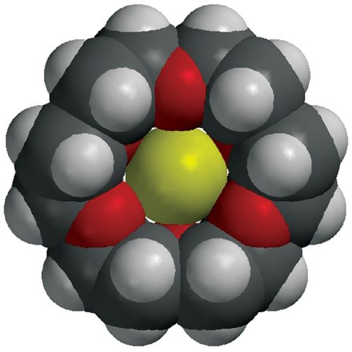
13.4 Crown Ethers
The size of the metal must match the size of the crown to form a strong attraction
18-crown-6 is the ideal size to trap a potassium cation

Slide 13
13.4 Crown Ethers
Metal ions are not soluble in low polarity solvents.
The crown ether complexes to the metal cation, and the resulting complex is soluble
Crown ethers are used to help ionic salts, needed for organic reactions, to dissolve in organic solvents

Slide 14
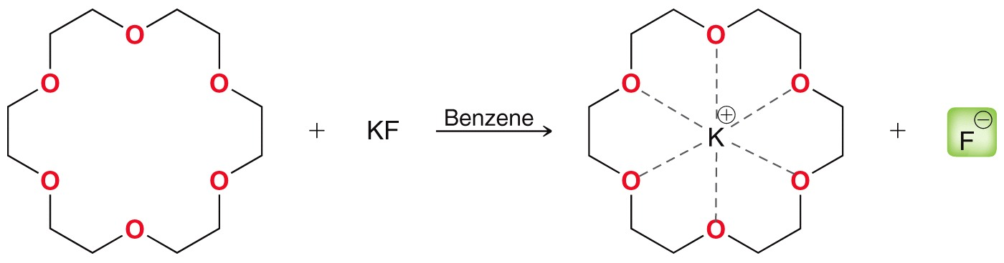
13.4 Crown Ethers
The F⁻ ion below is ready to react because the K⁺ ion is “hosted” by 18-crown-6
Without the crown ether, the solubility of KF in benzene is miniscule

Slide 15
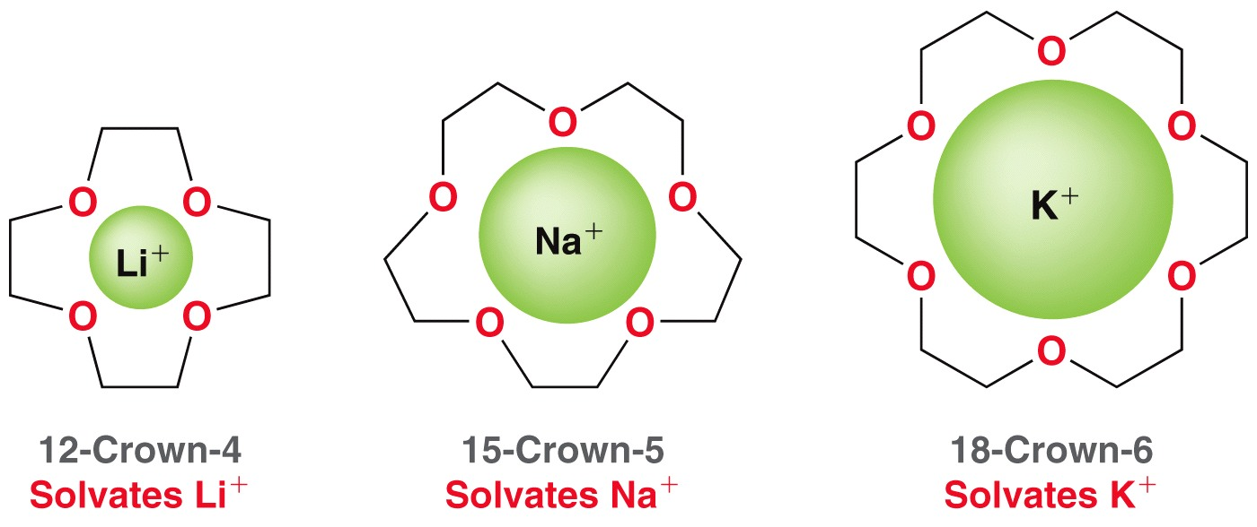
13.4 Crown Ethers
Choosing a crown ether depends on the metal cation present in a reaction:
Practice with Conceptual Checkpoint 13.4

Slide 16
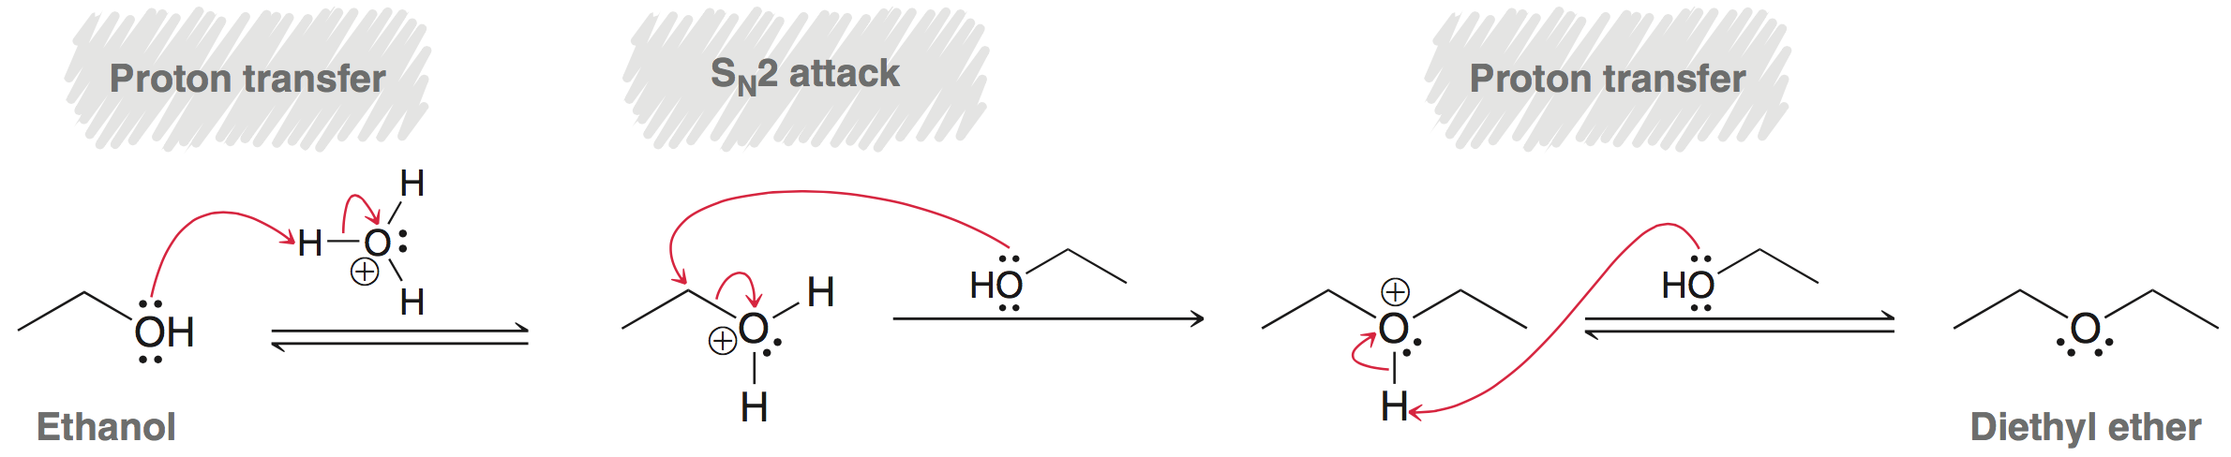
13.5 Preparation of Ethers
Industrially, diethyl ether is prepared by the acid-catalyzed dehydration of ethanol
Simple, symmetrical ethers can be prepared this way

Slide 17
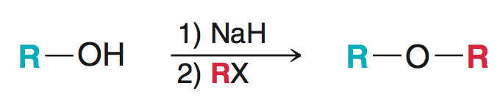
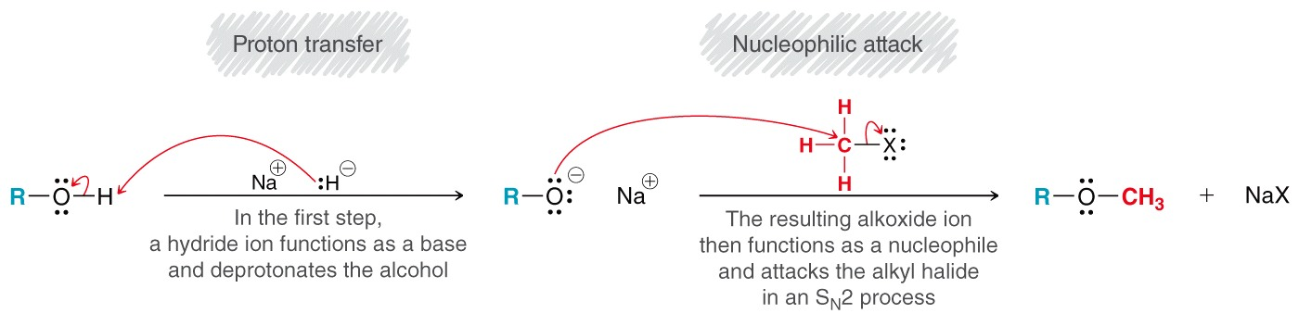
13.5 Preparation of Ethers
The Williamson ether synthesis is a viable approach for many asymmetrical ethers

Slide 18
13.5 Preparation of Ethers
The Williamson ether synthesis is a viable approach for many asymmetrical ethers
Since this is SN2 substitution, it only works well with unhindered (1˚ and methyl) alkyl halides

Slide 19
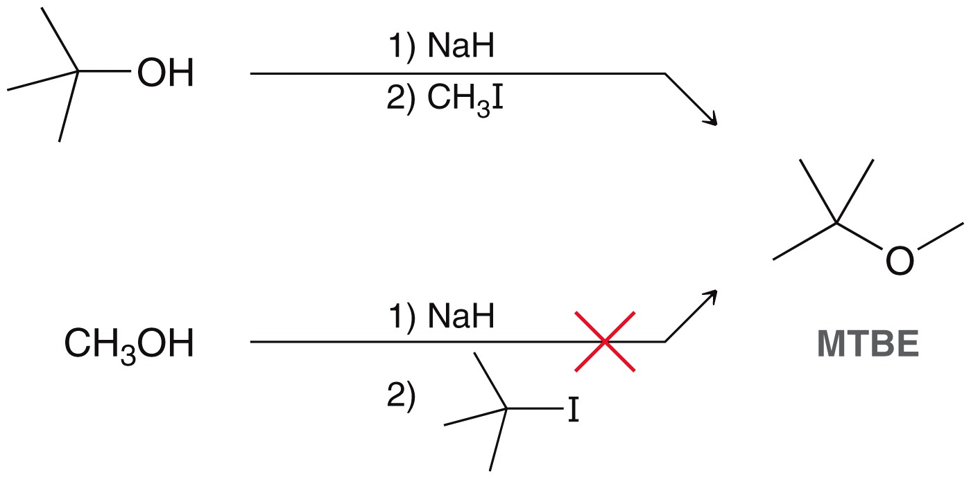
13.5 Preparation of Ethers
Consider the two possible routes to synthesize methyl t-butyl ether via Williamson ether synthesis
Practice with SkillBuilder 13.2
This route will work
because it requires a
methyl halide
This route will not
work as it requires
a 3˚ halide

Slide 20
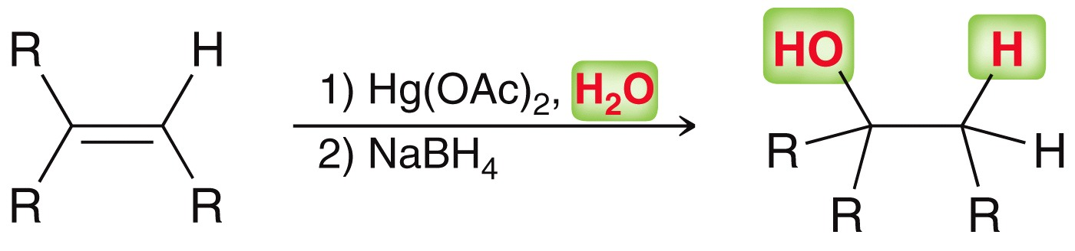
13.5 Preparation of Ethers
Recall that oxymercuration-demercuration can be used to synthesize alcohols from alkenes (section 8.6)
Markovnikov regioselectivity

Slide 21
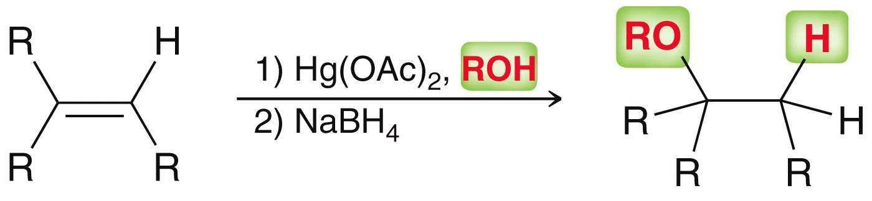
13.5 Preparation of Ethers
Similarly, alkoxymercuration-demercuration can be used to synthesize ethers
Also Markovnikov regioselectivity
Practice Conceptual Checkpoints 13.7-13.9

Slide 22
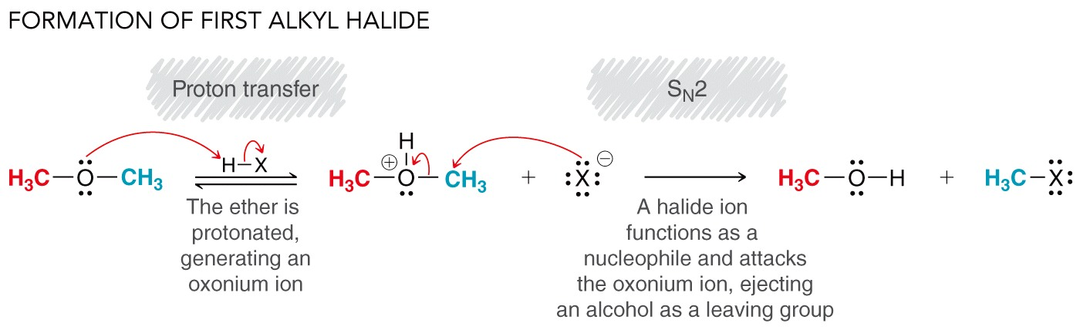
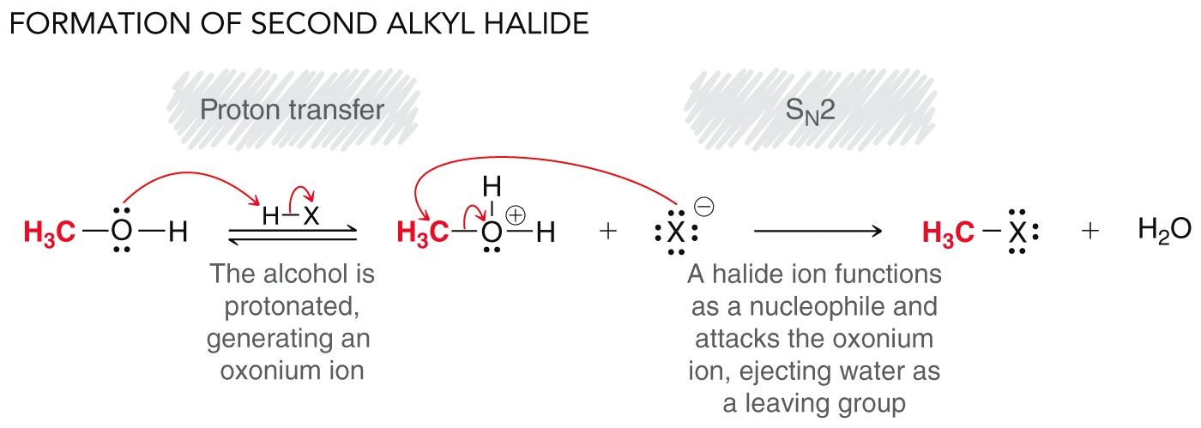
13.6 Reactions of Ethers
Ethers can undergo acid-promoted cleavage

Slide 23
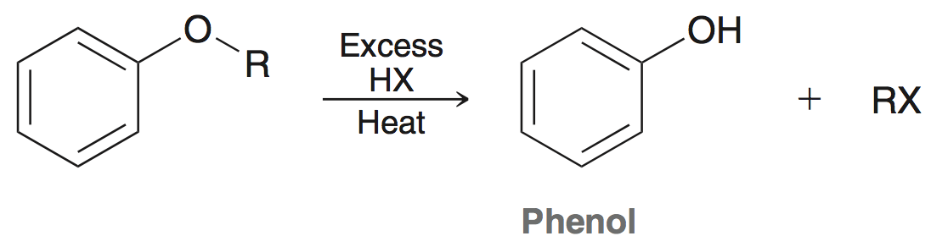
13.6 Reactions of Ethers
Acidic cleavage of ethers to produce an alkyl halide works with HBr and HI
If –R group is 3˚ then cleave occurs via SN1 mechanism
If –R group is aryl or vinyl, substitution doesn’t occur:
Practice with conceptual checkpoint 13.10

Slide 24
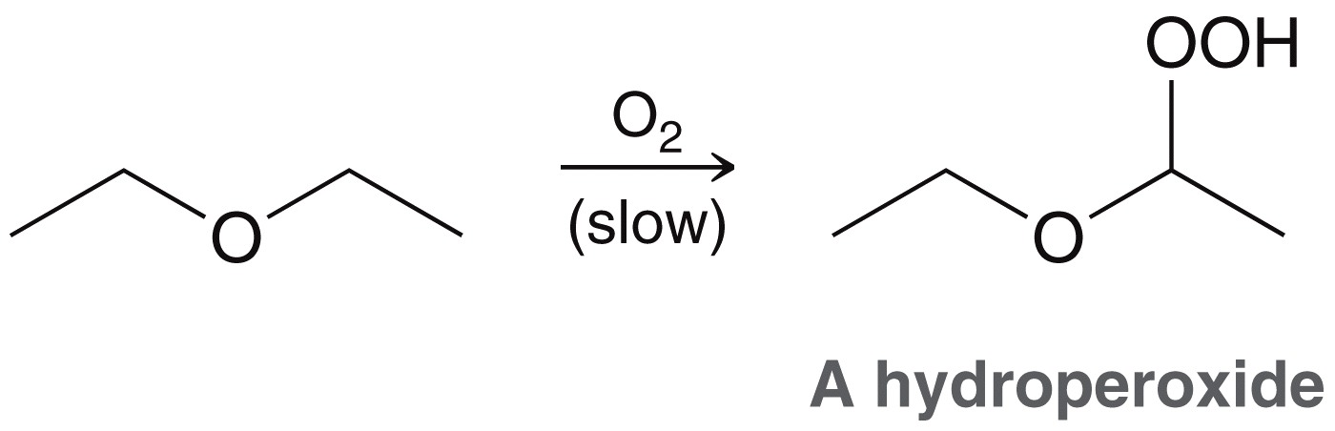
13.6 Reactions of Ethers
Recall (section 10.9) ethers undergo autooxidation:
laboratory samples of ether must be frequently tested for the presence of hydroperoxides before they are used (explosive).
The autooxidation occurs through a free radical mechanism

Slide 25
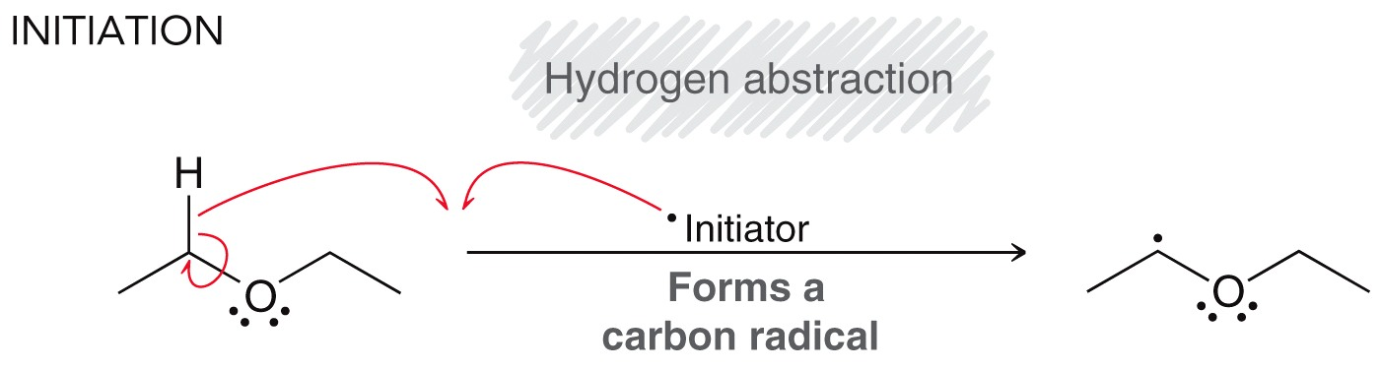
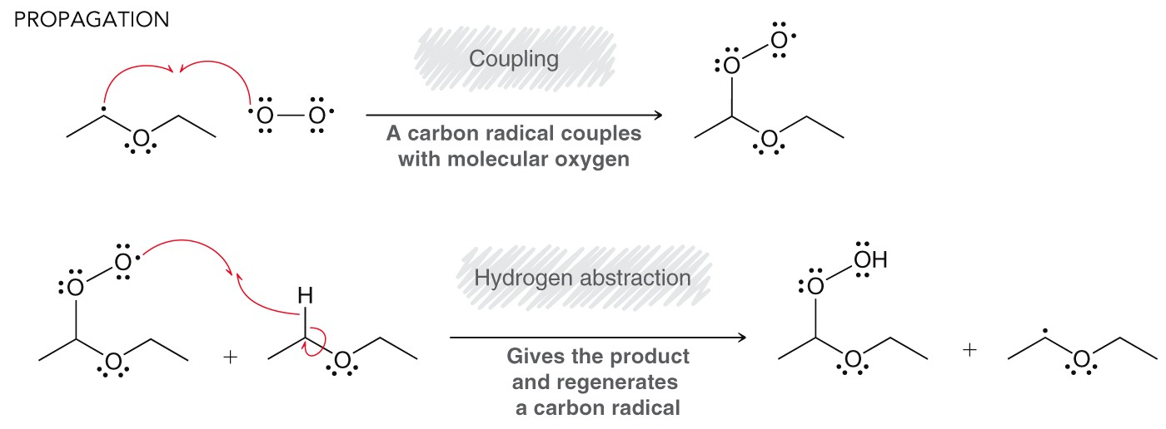
13.6 Reactions of Ethers

Slide 26
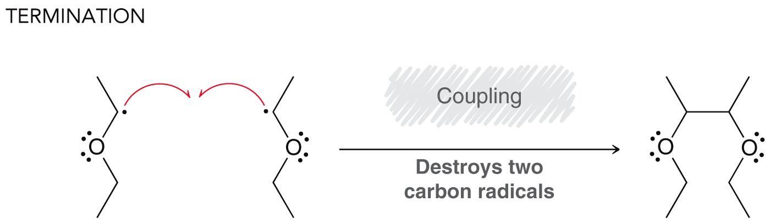
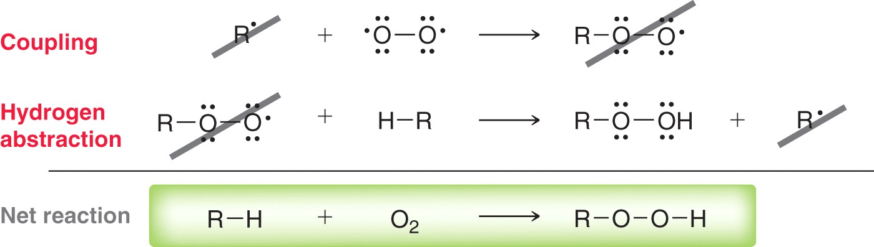
13.6 Reactions of Ethers
Recall that the net reaction is the sum of the propagation steps

Slide 27
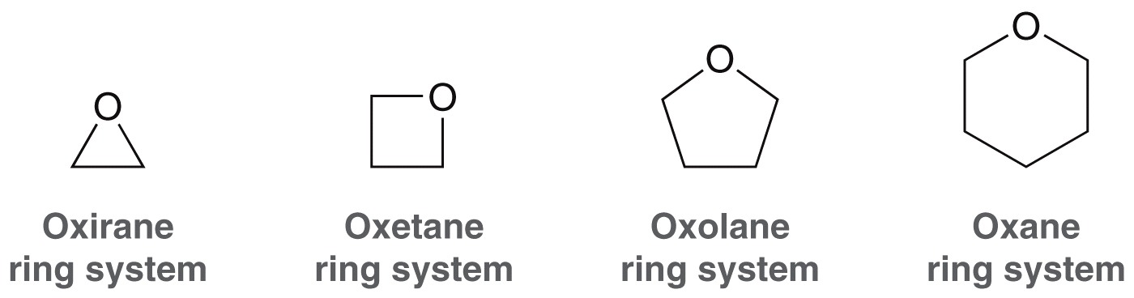
13.7 Nomenclature of Epoxides
For cyclic ethers, the size of the ring determines the parent name of the molecule
Oxiranes are also known as epoxides

Slide 28
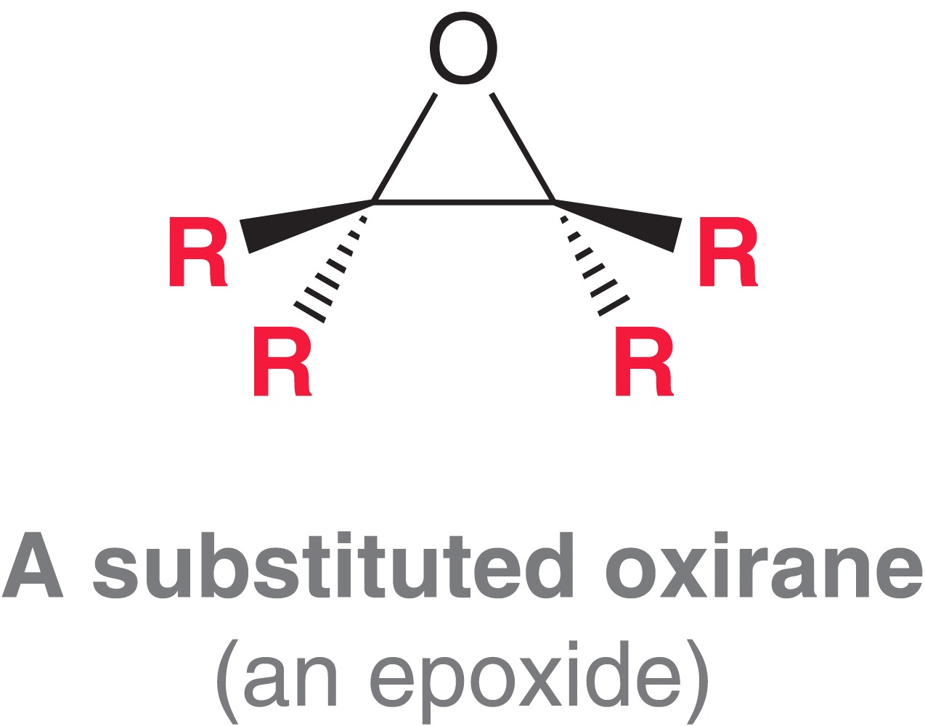
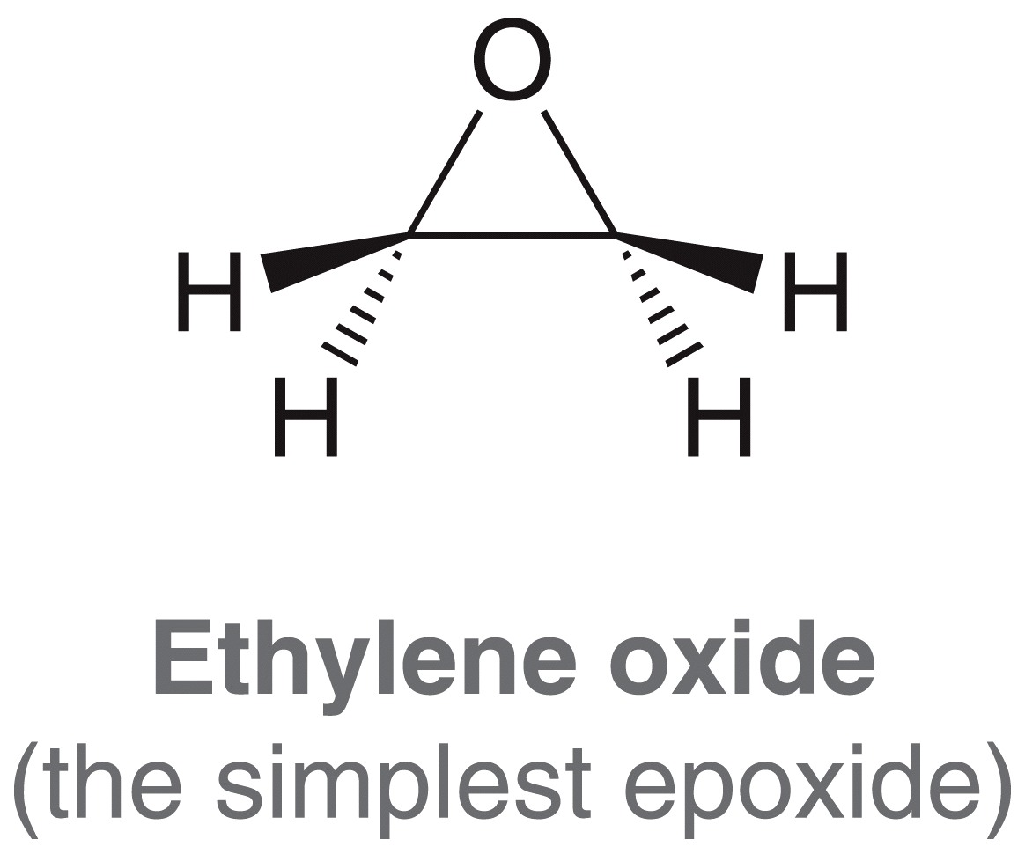
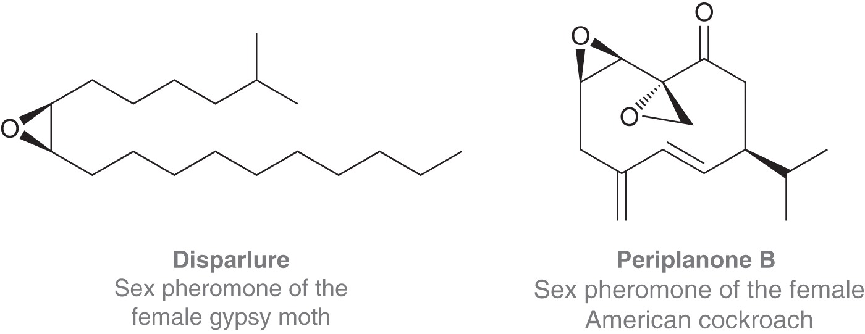
13.7 Nomenclature of Epoxides
An epoxide can have up to 4 –R groups
Although they are unstable, epoxides are found commonly in nature

Slide 29
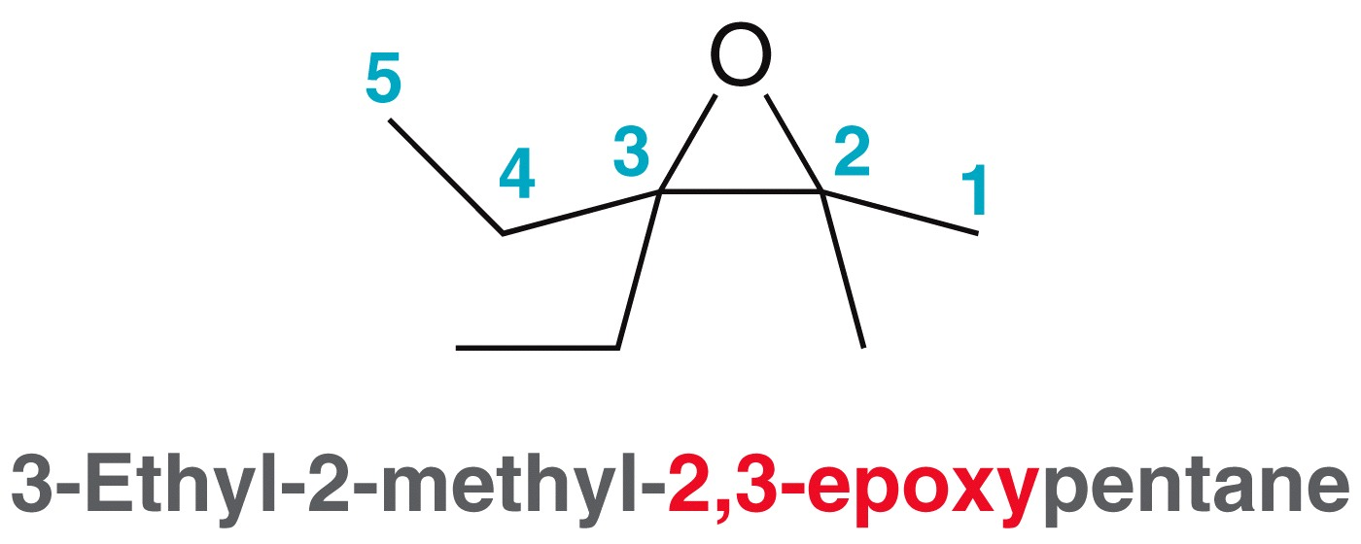
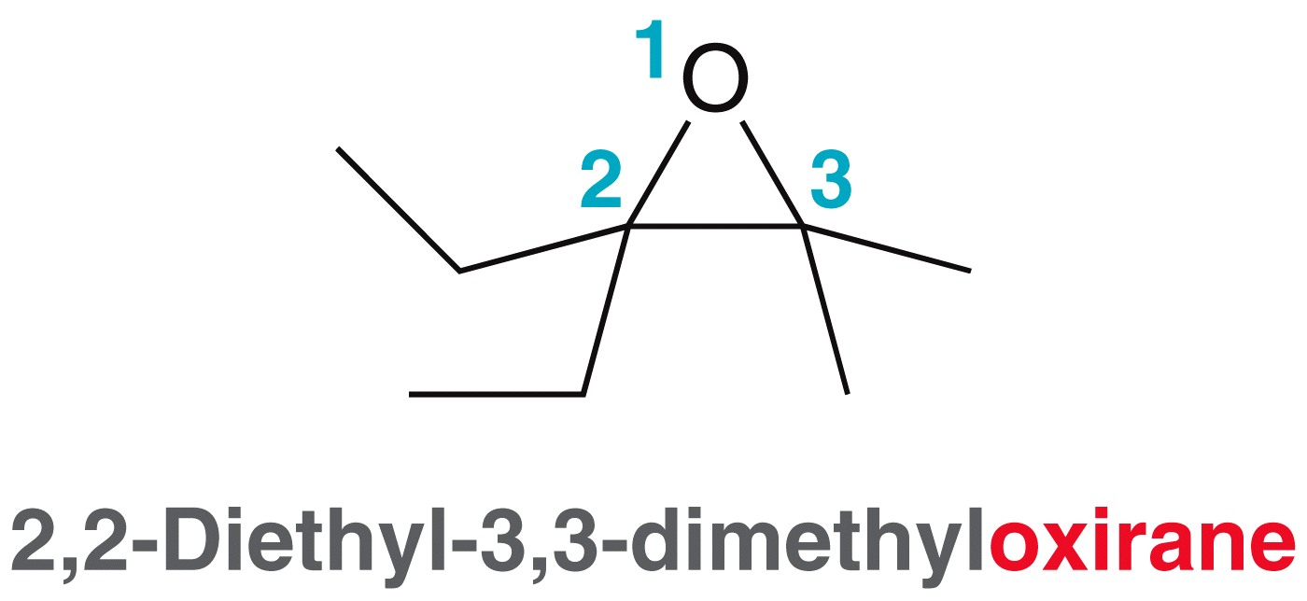
13.7 Nomenclature of Epoxides
There are two methods for naming epoxides
  The oxygen is treated as a side group, and two numbers are given as its locants
  Oxirane is used as the parent name

Slide 30
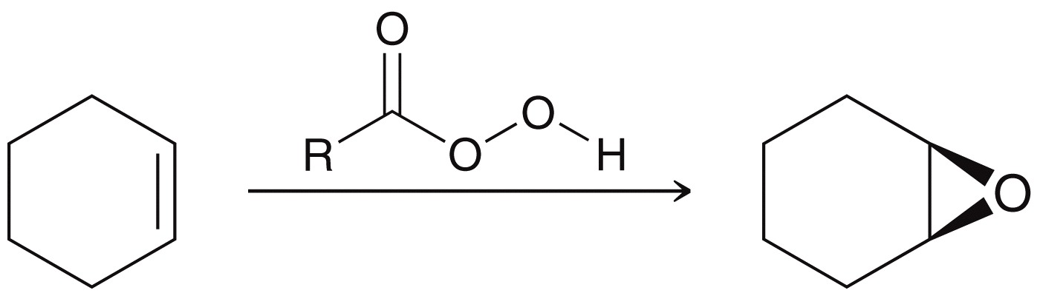
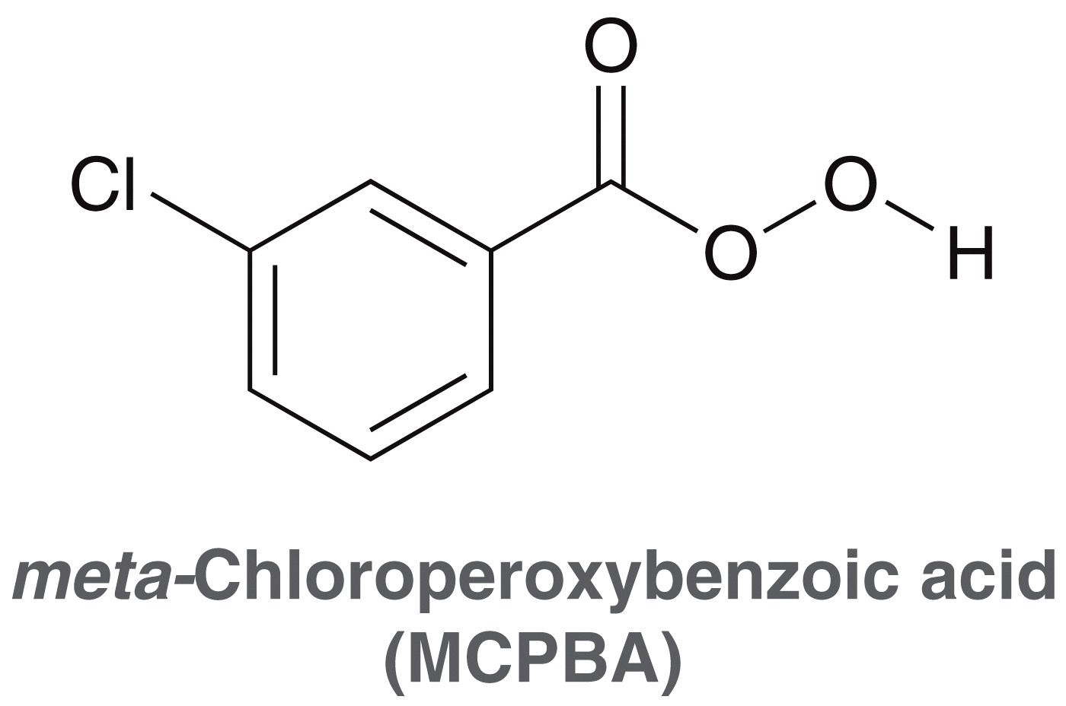
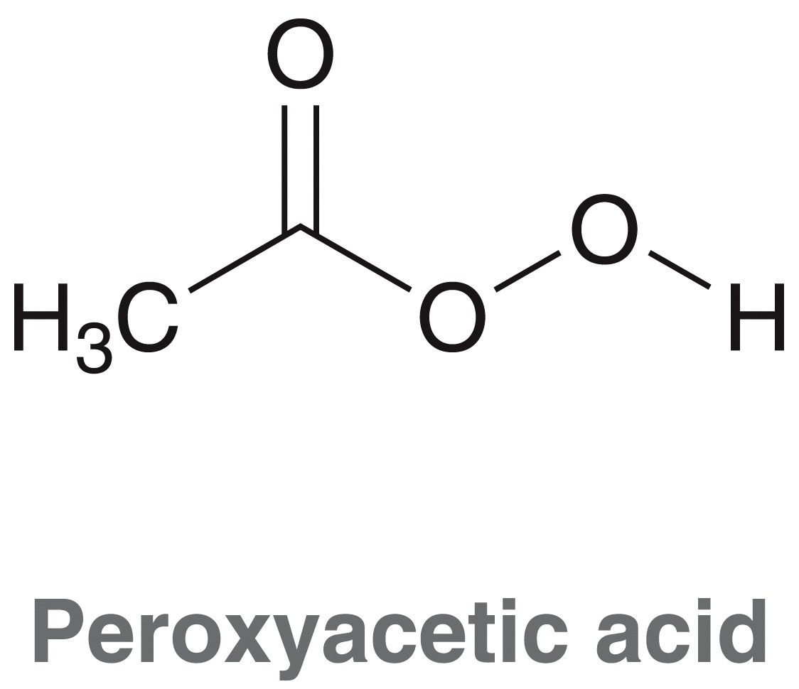
13.8 Preparation of Epoxides
Recall that epoxides can be formed when an alkene is treated with a peroxy acid
MCPBA and peroxyacetic acid are most commonly used

Slide 31
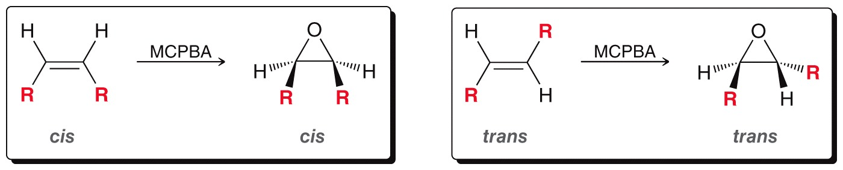
13.8 Preparation of Epoxides
Epoxidation of an alkene is stereospecific

Slide 32
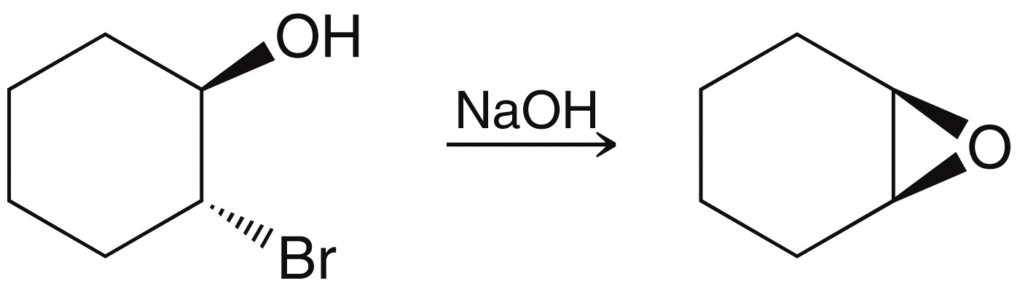
13.8 Preparation of Epoxides
Epoxides are also be synthesized from halohydrins
Halohydrins are synthesized from an alkene

Slide 33
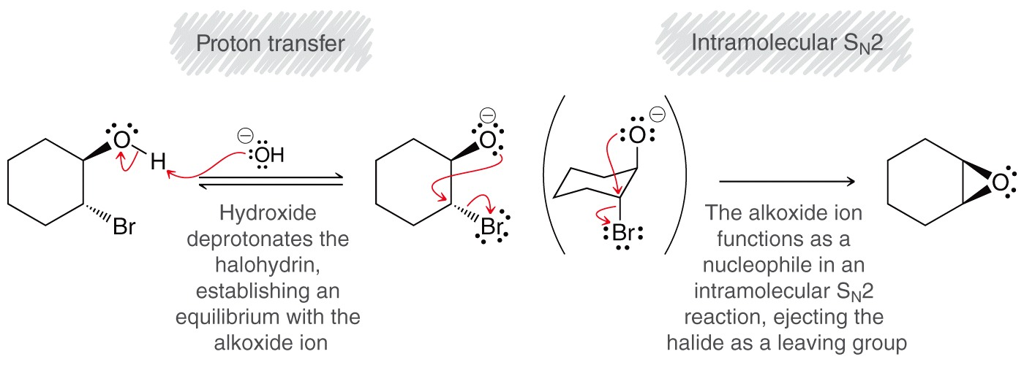
13.8 Preparation of Epoxides

Slide 34
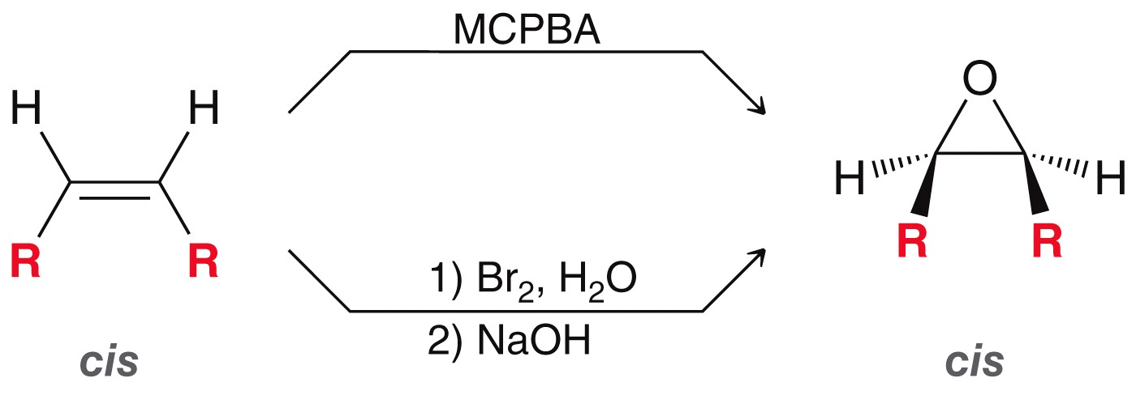
13.8 Preparation of Epoxides
Note that either route, from alkene to epoxide, is stereospecific:
Practice with SkillBuilder 13.3

Slide 35
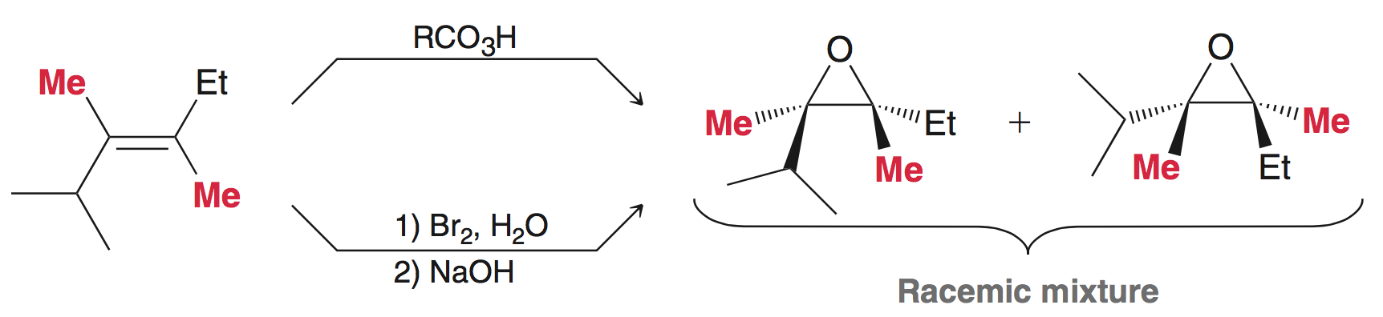
13.9 Enantioselective Epoxidation
The epoxidation methods we have discussed so far are NOT enantioselective
Epoxidation of an achiral alkene produces a racemic mixture

Slide 36
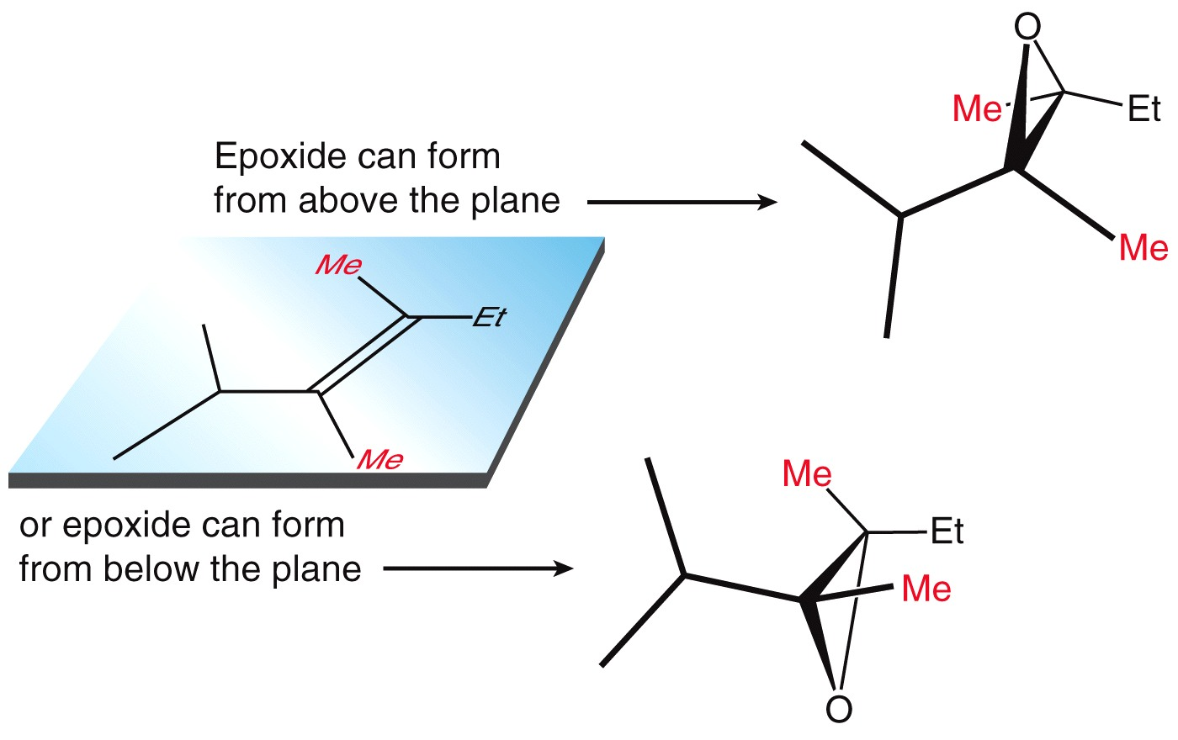
13.9 Enantioselective Epoxidation
The epoxidation forms a racemic mixture because the alkene can react on either face
To selectively react with one face of the alkene, a chiral catalyst would have to be used

Slide 37
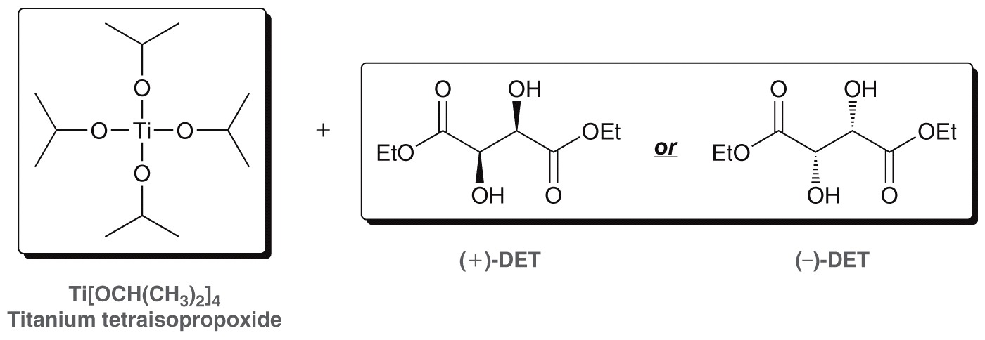
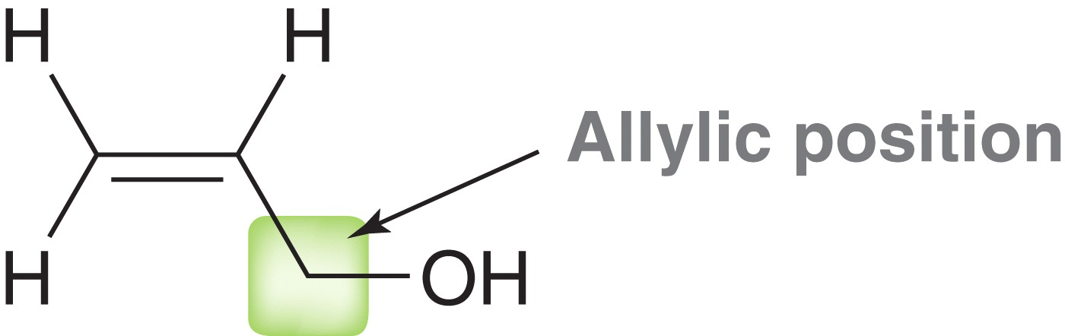
13.9 Enantioselective Epoxidation
The Sharpless catalyst is a chiral complex of titanium tetraisoproxide and diethyl tartrate.
This catalyst will cause an enantioselective
epoxidation of an allylic alcohol

Slide 38
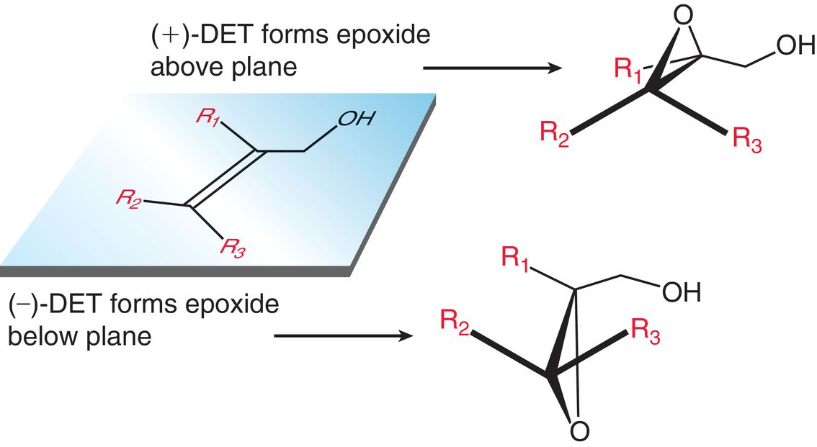
13.9 Enantioselective Epoxidation
A given enantiomer of the catalyst (DET) will favor the formation of a given enantiomer of the epoxide:

Slide 39

13.9 Enantioselective Epoxidation
A given enantiomer of the catalyst (DET) will favor the formation of a given enantiomer of the epoxide:
Practice with Conceptual Checkpoint 13.5

Slide 40
13.10 Ring-opening Reactions of Epoxides
Epoxides are useful synthetic intermediates
Because of their significant ring strain, epoxides are reactive towards weak and strong nucleophiles, such as:
  Grignard reagents
  Hydride reagents
  Alcohols
  alkoxides

Slide 41

13.10 Ring-opening Reactions of Epoxides
Strong nucleophiles react readily with epoxides
Opening of the ring is thermodynamically favored due to the relief of ring strain.

Slide 42

13.10 Ring-opening Reactions of Epoxides
Although alkoxides are typically not good leaving groups, ring-opening of the epoxide is thermodynamically favored

Slide 43

13.10 Ring-opening Reactions of Epoxides
Epoxides can be opened by many other strong nucleophiles as well
Ring opening of an epoxide is regioselective and stereoselective

Slide 44

13.10 Ring-opening Reactions of Epoxides
Regioselectivity - Epoxide ring-opening is S_{N}2, and so the least hindered carbon is more reactive towards a strong nucleophile.

Slide 45

13.10 Ring-opening Reactions of Epoxides
Stereoselectivity – as with SN2, inversion of configuration is observed.
Practice with SkillBuilder 13.4

Slide 46

13.10 Ring-opening Reactions of Epoxides
Acidic conditions can also be used to open epoxides with a weak nucleophile (HCl, HBr, water, or an alcohol)

Slide 47


13.10 Ring-opening Reactions of Epoxides
Water or an alcohol can also be used as the nucleophile under acidic conditions
Antifreeze (ethylene glycol) is made industrially by this method

Slide 48

13.10 Ring-opening Reactions of Epoxides
Acid-catalyzed mechanism:

Slide 49


13.10 Ring-opening Reactions of Epoxides
Under acidic, conditions, Nu attack still occurs at the less substituted carbon, if a 1˚ and a 2˚ carbon are present:
But if a 3˚ carbon is present, then the Nu attacks there:

Slide 50


13.10 Ring-opening Reactions of Epoxides
Since the epoxide is cationic under acidic conditions, electronic effects result in the C-O bond to a 3˚ carbon to be much weaker
But, if a 3˚ carbon is not present, then steric effects dominate

Slide 51

13.10 Ring-opening Reactions of Epoxides
But, under acidic conditions, inversion of configuration is still observed, regardless of which carbon of the epoxide is attacked:
Practice with SkillBuilder 13.5

Slide 52

13.11 Thiols and Sulfides
Sulfur appears just under oxygen on the periodic table
Thiol (-SH group): sulfur analog of an alcohol
The name of a compound with an –SH group ends in “thiol” rather than “ol”
Thiols are also called mercaptans

Slide 53


13.11 Thiols and Sulfides
The mercapto- prefix is used to name –SH as a substituent
Dimercaprol is used to treat
mercury poisoning

Slide 54
13.11 Thiols and Sulfides
Thiols are known for their unpleasant odor
Skunks use thiols as a defense mechanism
Methanethiol is added to natural gas (methane) so that gas leaks can be detected
The hydrosulfide ion (HS⁻) is a strong nucleophile and a weak base
HS⁻ promotes S_{N}2 rather than E2

Slide 55


13.11 Thiols and Sulfides
1˚ and 2˚ thiols can be synthesized from SN2 reaction of NaSH with an alkyl halide:
Practice with Conceptual Checkpoint 13.20

Slide 56


13.11 Thiols and Sulfides
Thiols are oxidized to disulfides with Br₂ under basic conditions:

Slide 57
13.11 Thiols and Sulfides
A disulfide can be reduced to corresponding thiols with Zn metal:
The interconversion between thiol and disulfide can also occur directly via a free radical mechanism.
The bond dissociation energy of a S-S bond is only about 53 kcal/mol, and so the bond is easily made and broken (the shape of proteins relies on this bond being easily broken and made).

Slide 58


13.11 Thiols and Sulfides
Sulfur analogs of ethers are called sulfides or thioethers
Sulfides can also be named as a substituent

Slide 59

13.11 Thiols and Sulfides
Sulfides are generally prepared by nucleophilic attack of a thiolate on an alkyl halide
Recall that thiolates are formed be deprotonating a thiol with NaOH.

Slide 60


13.11 Thiols and Sulfides
Sulfides undergo a number of reactions:
SN2 substitution with an alkyl halide
  The product is a strong alkylating reagent that can add an alkyl group to a variety of nucleophiles

Slide 61

13.11 Thiols and Sulfides
Sulfides can also be oxidized to sulfoxides or sulfones:
The choice of oxidizing agent depends on whether one needs to make a sulfoxide or a sulfone

Slide 62


13.11 Thiols and Sulfides
Sulfides can also be oxidized to sulfoxides or sulfones
Sodium meta-periodiate can be used to form the sulfoxide
Hydrogen peroxide can be used to form a sulfone

Slide 63

13.11 Thiols and Sulfides
The S=O bond has very little double bond character, the 2p orbital on O poorly overlaps with the larger, 3p orbital on the S
Sulfoxide
Sulfone
Significant resonance
contributors

Slide 64

13.11 Thiols and Sulfides
Because sulfides are readily oxidized, they make good reducing agents
DMS is used to reduce the ozonide and complete an ozonolysis reaction
Practice with conceptual checkpoint 13.21

Slide 65

13.12 Synthesis Strategies w/ Epoxides
Epoxides allow for installing two functional groups on adjacent carbons:
Whenever you see two adjacent functional groups, you should think of epoxide (made from an alkene) as the starting material:
Practice with SkillBuilder 13.6
1) mCPBA
2) NaCN

Slide 66

13.12 Synthesis Strategies w/ Epoxides
By reacting an epoxide with a Grignard reagent, the carbon skeleton can be modified:
Think of the alkyl halide as the starting material, to which carbons will be added via Grignard reagent
The epoxide consists of the carbon chain that will be added to the alkyl halide

Slide 67


13.12 Synthesis Strategies w/ Epoxides
An epoxide yields a longer carbon chain, with a functional group on the 2nd carbon of the newly installed chain
A carbonyl would be used to install a functional group on the 1st carbon of the newly installed part of the chain:

Slide 68
13.12 Synthesis Strategies w/ Epoxides
Consider the reagents necessary to accomplish the synthesis below:

Slide 69
13.12 Synthesis Strategies w/ Epoxides
Consider the reagents necessary to accomplish the synthesis below:
We need to add a 3-carbon chain, with the functional group on the 2nd carbon of the new chain… so an epoxide should be used:
Practice with SkillBuilder 13.7

