Slide 1
Organic Chemistry
Third Edition
David Klein
Chapter 14
Infrared Spectroscopy and Mass Spectrometry

Slide 2
14.1 Introduction to Spectroscopy
Spectroscopy involves an interaction between matter and light (electromagnetic radiation)
Light can be thought of as waves of energy or packets (particles) of energy called photons
Properties of light waves include wavelength and frequency
Wavelength is inversely proportional to energy
Frequency is directly proportional to energy

Slide 3
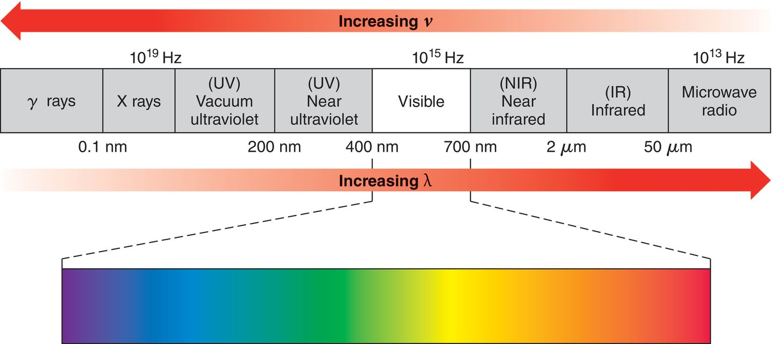
14.1 Introduction to Spectroscopy
Electromagnetic spectrum: The range of possible frequencies of light.

Slide 4
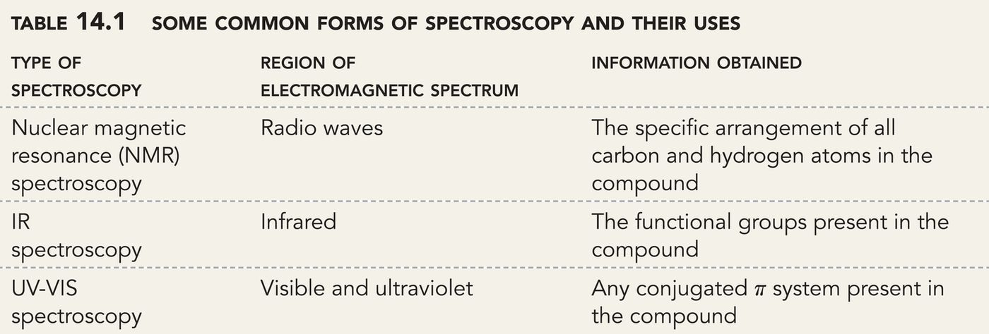
14.1 Introduction to Spectroscopy
Different regions of the electromagnetic spectrum are used to probe for different aspects of molecular structure:

Slide 5
14.1 Introduction to Spectroscopy
Matter exhibits particle-like properties
On the macroscopic scale, matter appears to exhibit continuous behavior rather than quantum behavior
Consider the example of an engine powering the rotation of a tire. The tire should be able to rotate at nearly any rate
Matter also exhibits wave-like properties
Matter on the molecular scale exhibits quantum behavior
A molecule will only rotate or vibrate at certain rates (energies)

Slide 6
14.1 Introduction to Spectroscopy
For the electrons in covalent bonds, vibrational energy levels are separated by gaps (quantized)
If a photon of light strikes the molecule with the exact amount of energy needed, the light is absorbed, and vibrational excitation will occur
Infrared (IR) Light generally causes molecular vibration. Different types of bonds absorb different IR energies.
Eventually, the absorbed energy is released from the molecule as heat

Slide 7
14.2 IR Spectroscopy
Molecular bonds can vibrate by stretching or by bending in a number of ways
This chapter will focus mainly on stretching frequencies

Slide 8
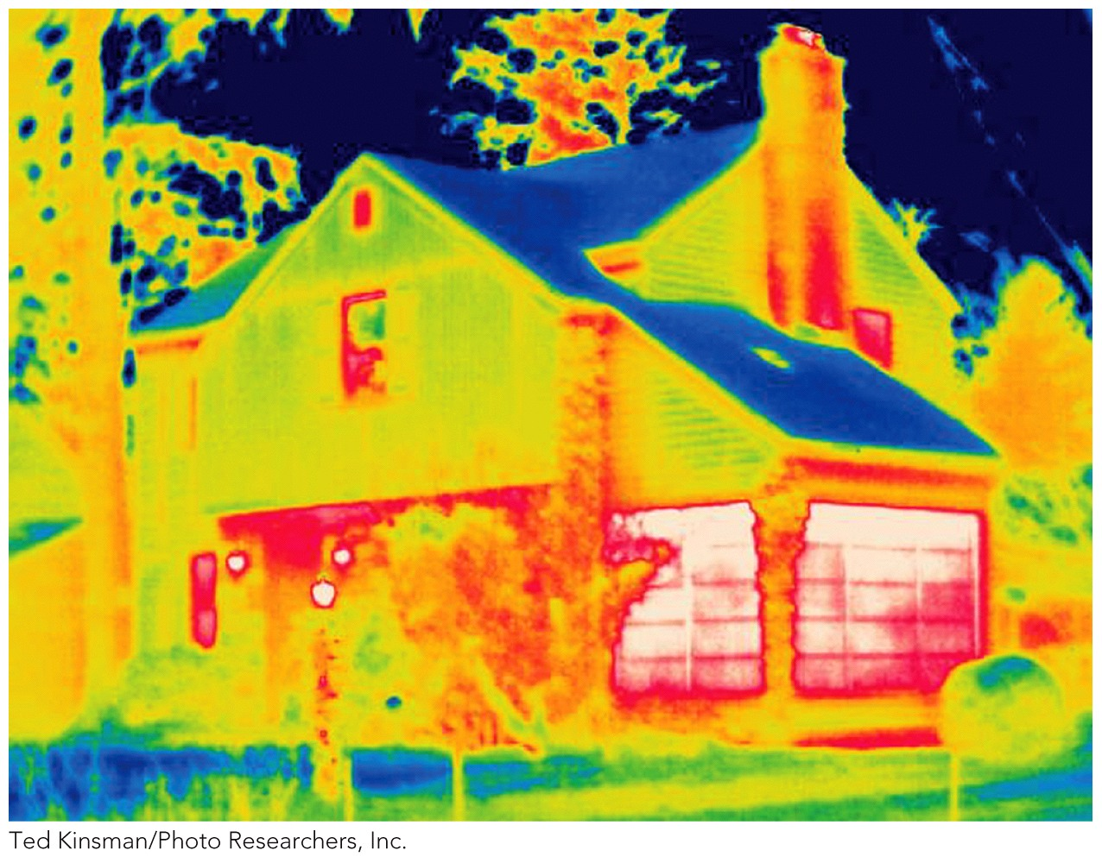
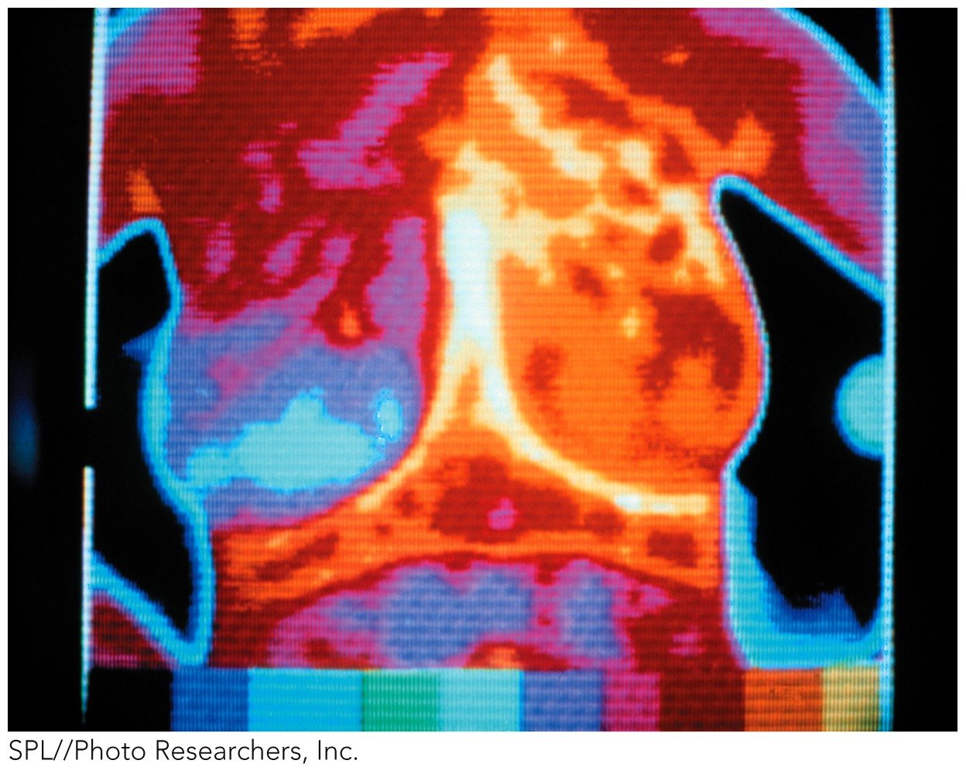
14.2 IR Spectroscopy
Some night vision goggles can detect IR light that is emitted
IR or thermal imaging is also used to detect breast cancer

Slide 9
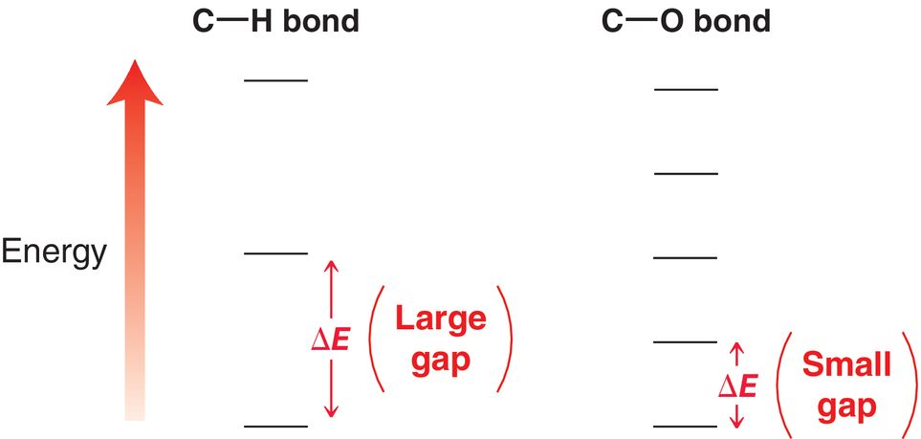
14.2 IR Spectroscopy
The energy necessary to cause vibration depends on the type of bond

Slide 10
14.2 IR Spectroscopy
An IR spectrophotometer irradiates a sample with all frequencies of IR light
The frequencies absorbed by the sample tell us the types of bonds (functional groups) that are present
Most commonly, samples are deposited on a salt (NaCl) plate.
Alternatively, the compound may be dissolved in a solvent or embedded in a KBr pellet

Slide 11
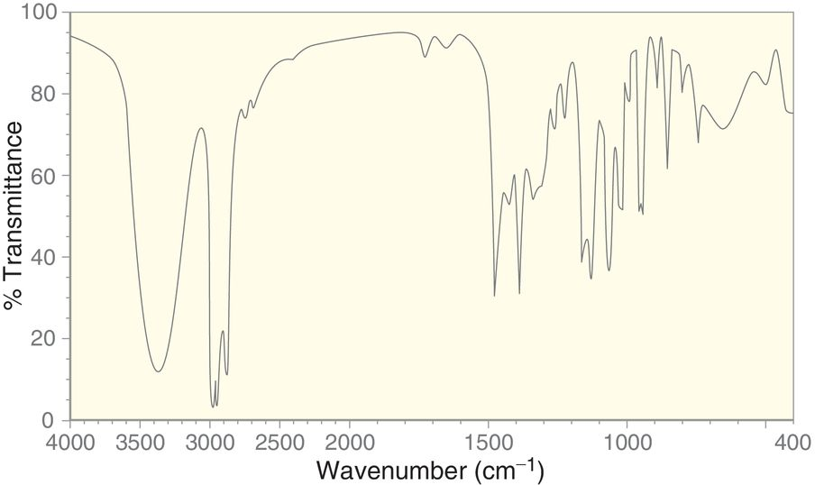
14.2 IR Spectroscopy
An IR absorption spectrum plots the % transmittance as a function of frequency. The “peaks” are called absorption bands

Slide 12
14.2 IR Spectroscopy
Units of frequency in IR are called wavenumbers
The values range from 400 to 4000 cm⁻¹

Slide 13
14.2 IR Spectroscopy
A signal (peak) on the IR spectrum has three important characteristics: wavenumber, intensity, and shape

Slide 14
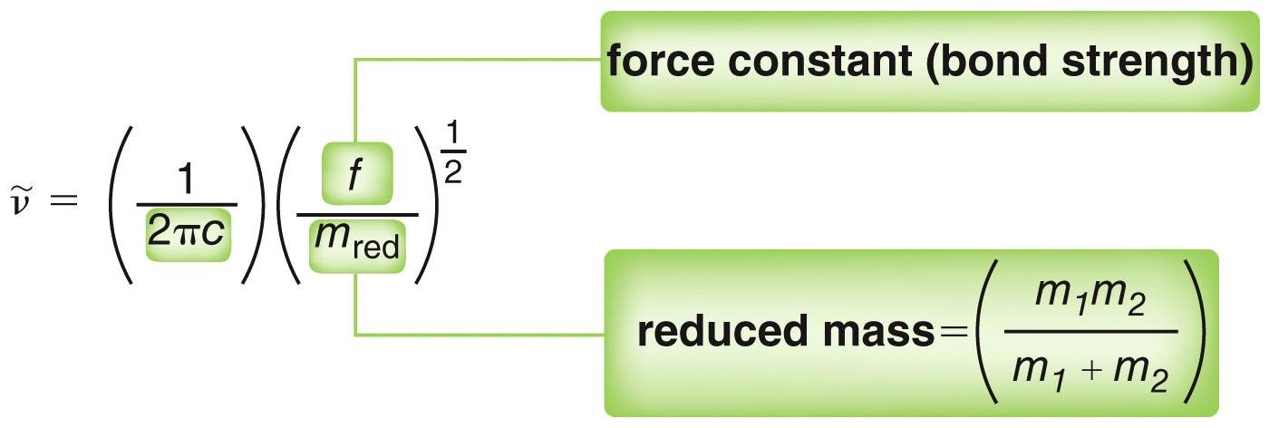
14.3 Signal Characteristics: Wavenumber
The frequency (wavenumber) for a stretching vibration depends on (1) bond strength and (2) mass difference of the atoms bonded together
Stronger bond = higher stretching frequency
Larger mass difference = higher stretching frequency

Slide 15
14.3 Signal Characteristics: Wavenumber
The trends in stretching frequency of given bonds can be rationalized based on bond strength and mass difference

Slide 16
14.3 Signal Characteristics: Wavenumber
The wavenumber formula and empirical observations allow us to designate regions as representing specific types of bonds

Slide 17
14.3 Signal Characteristics: Wavenumber
The region above 1500 cm⁻¹ is called the diagnostic region. The peaks in this region provide clear information
The region below 1500 cm⁻¹ is called the fingerprint region. There are typical many signals here and it is difficult to analyze

Slide 18
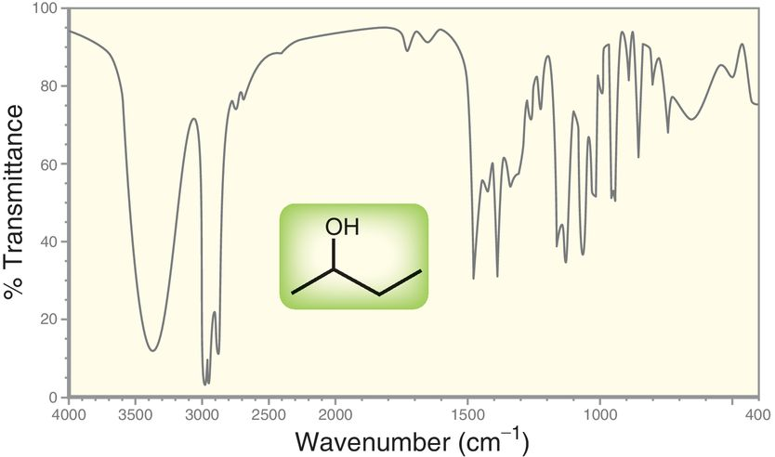
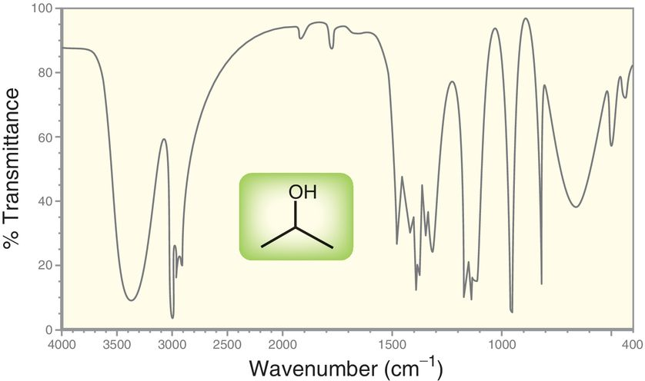
14.3 Signal Characteristics: Wavenumber
Because the have the same types of covalent bonds, the IR spectra for 2-butanol and 2-propanol are virtually indistinguishable.

Slide 19
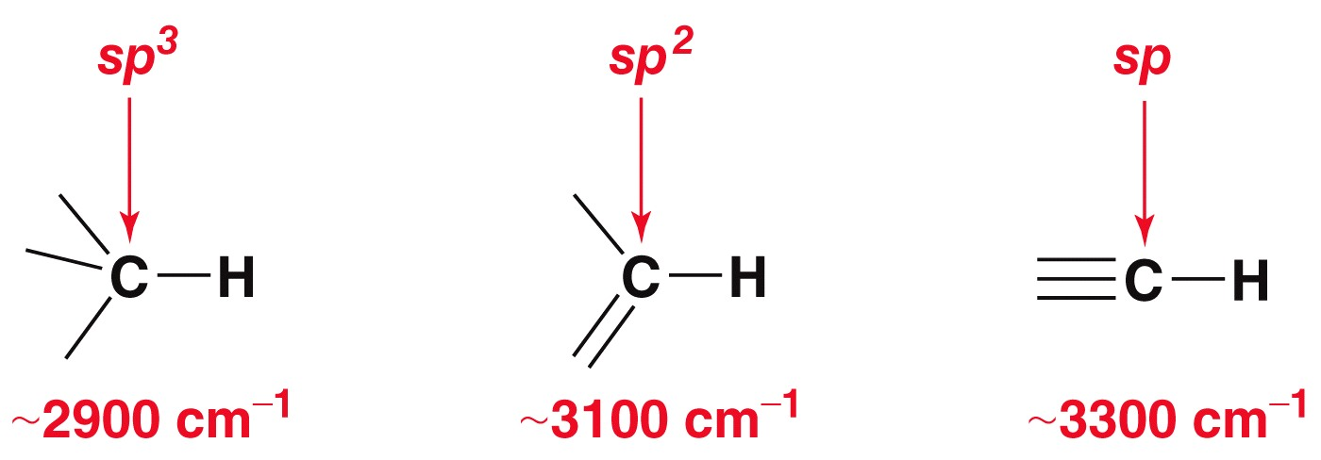
14.3 Signal Characteristics: Wavenumber
Compare the IR stretching frequencies for each C-H bond below:
The higher the s character of the carbon, the stronger the C-H bond, and so the higher the stretching frequency of the C-H bond.

Slide 20
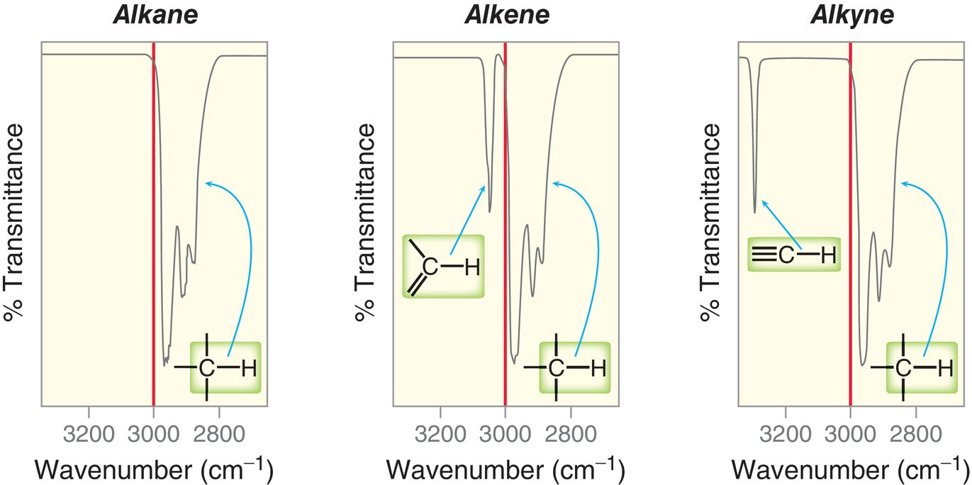
14.3 Signal Characteristics: Wavenumber
Alkyl C-H bonds come just under 3000 cm⁻¹, while alkenyl and alkynyl C-H bonds are over 3000 cm⁻¹

Slide 21
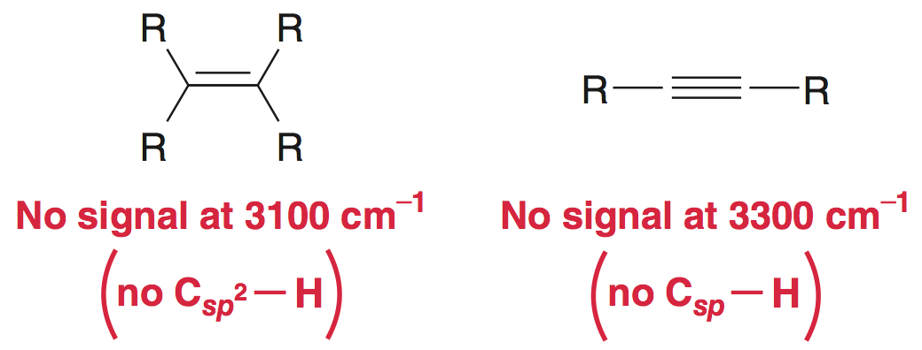
14.3 Signal Characteristics: Wavenumber
It is possible that an alkene or alkyne could give an IR spectra without any signals above 3000 cm⁻¹

Slide 22
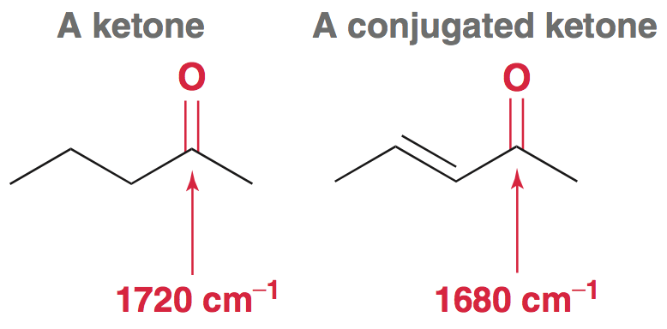
14.3 Signal Characteristics: Wavenumber
Resonance delocalization of electrons affects the strength of a covalent bond, and thus the wavenumber of a stretching signal
Consider the C=O stretching value for the following compounds:

Slide 23
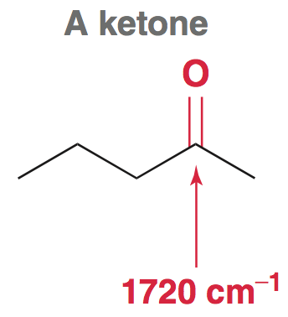
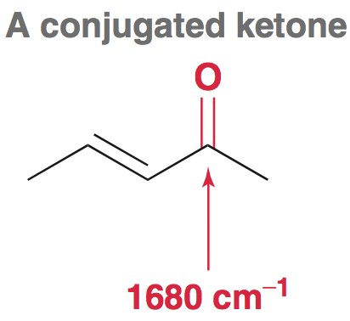
14.3 Signal Characteristics: Wavenumber
The more delocalized the pi electrons, the weaker the pi bond, and the lower the stretching frequency

Slide 24
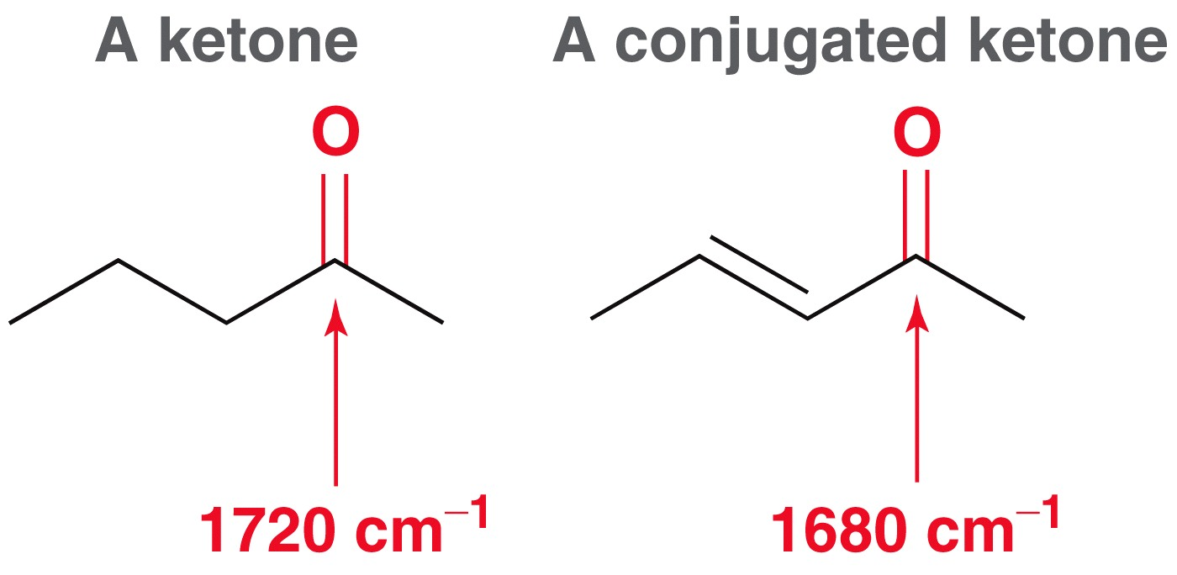
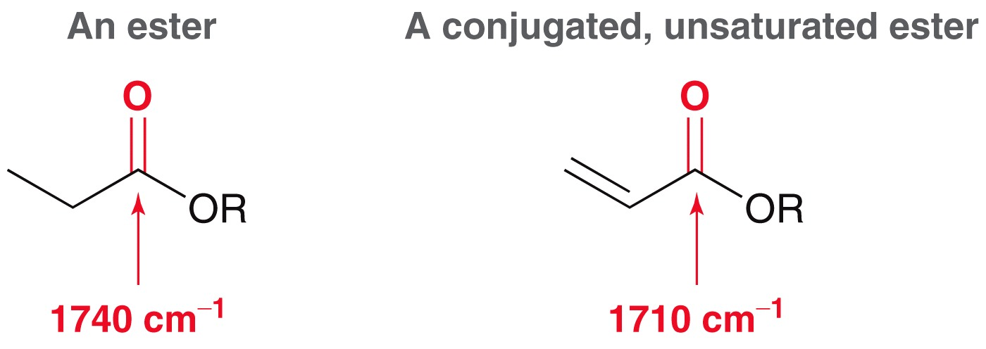
14.3 Signal Characteristics: Wavenumber
Conjugated carbonyls have lower stretching frequencies
Practice with Conceptual Checkpoints 14.1 – 14.4

Slide 25
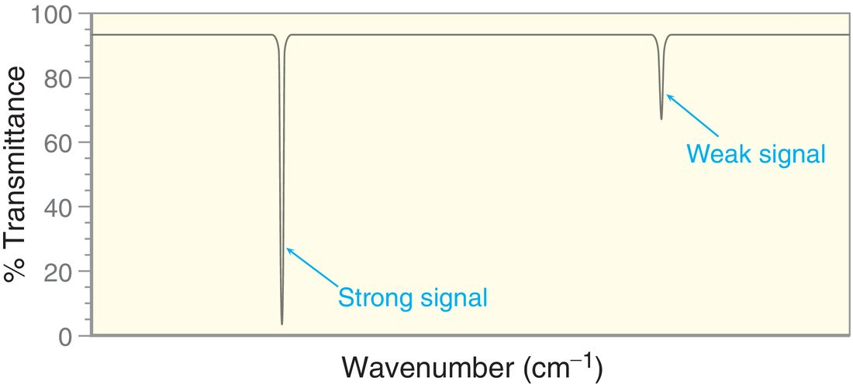
14.4 Signal Characteristics: Intensity
The strength (intensity) of IR signals can vary

Slide 26
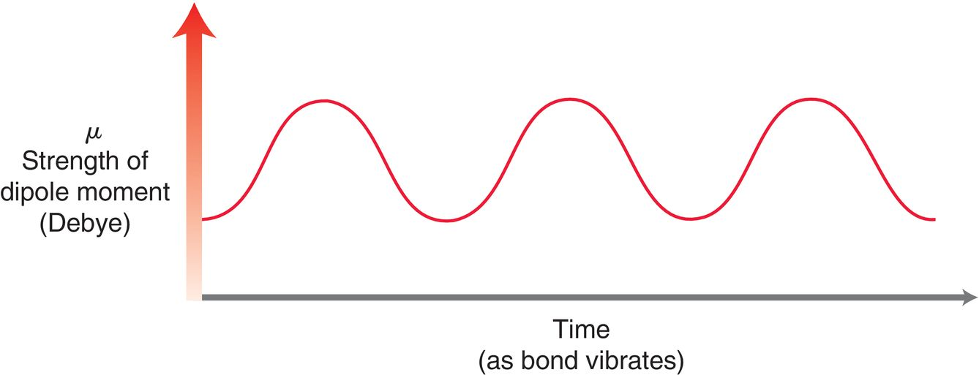
14.4 Signal Characteristics: Intensity
When a bond undergoes a stretching vibration, its dipole moment also oscillates
Recall the formula for dipole moment includes the distance between the partial charges,
The oscillating dipole moment creates an electrical field surrounding the bond

Slide 27
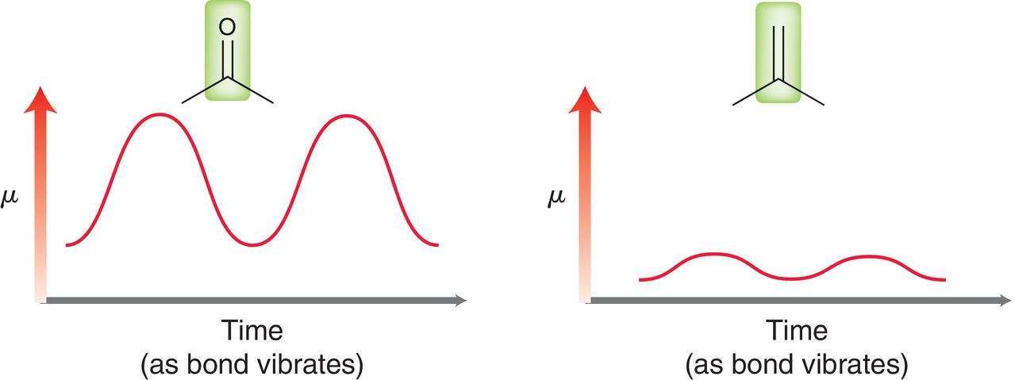
14.4 Signal Characteristics: Intensity
The more polar the bond, the greater the opportunity for interaction between the waves of the electrical field and the IR radiation
Greater bond polarity = stronger IR signals

Slide 28
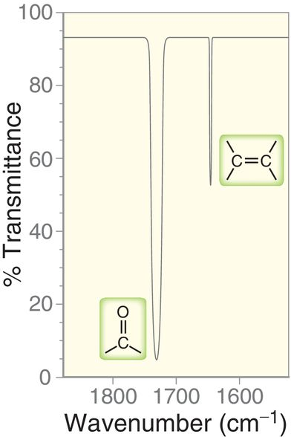
14.4 Signal Characteristics: Intensity
Note the general strength of the C=O stretching signal vs. the C=C stretching signal

Slide 29
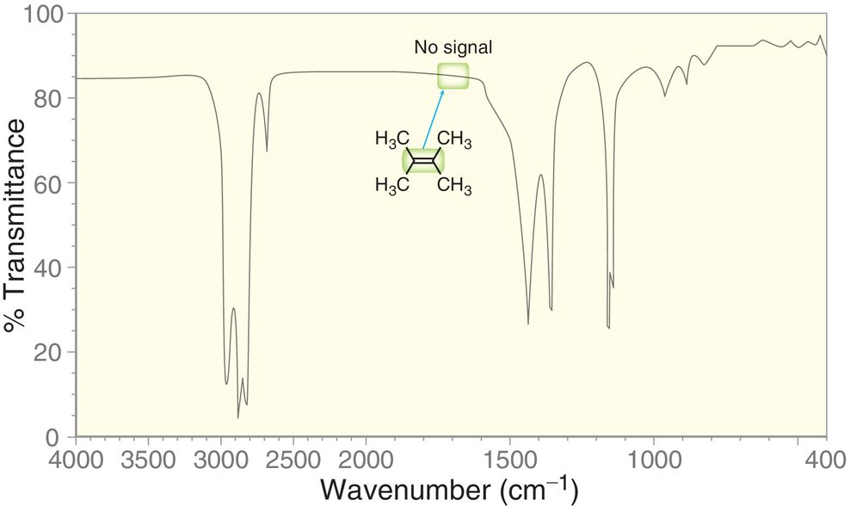
14.4 Signal Characteristics: Intensity
If a bond is completely symmetrical, then a stretching frequency is not observed in the IR spectrum:

Slide 30
14.4 Signal Characteristics: Intensity
Stronger signals are also observed when there are multiple bonds of the same type vibrating
Although C-H bonds are not very polar, they often give very strong signals, because there are often many of them in an organic compound
Because sample concentration can affect signal strength, the Intoxilyzer 5000 can be used to determine blood alcohol levels be analyzing the strength of C-H bond stretching in blood samples
Practice with conceptual checkpoints 14.5 – 14.7

Slide 31
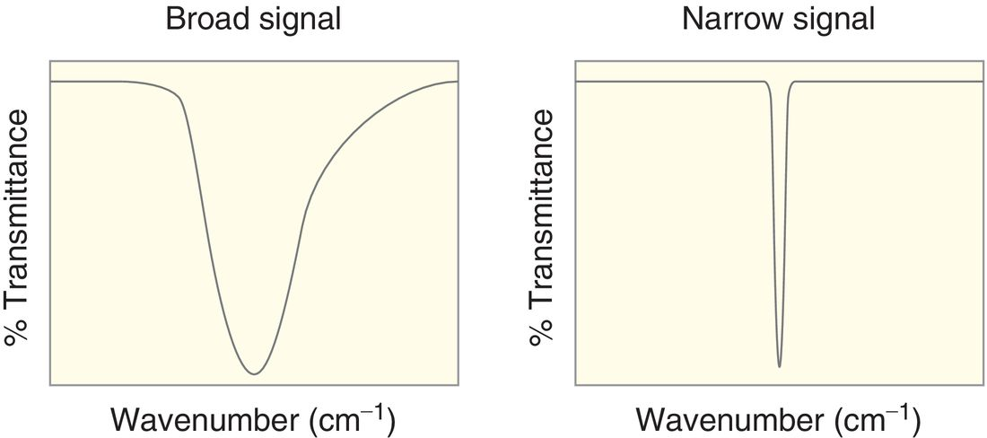
14.5 Signal Characteristics: Shape
Some IR signals are broad, while others are very narrow
O-H stretching signals are often quite broad

Slide 32
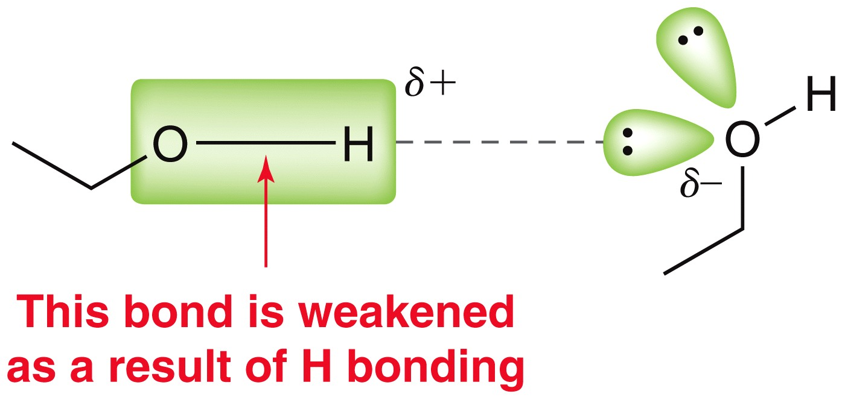
14.5 Signal Characteristics: Shape
When possible, O-H bonds form H-bonds that weaken the O-H bond strength
The H-bonds are transient, so the sample will contain molecules with varying O-H bond strengths
But, the O-H stretch signal will be narrow if a dilute solution of an alcohol is prepared in a solvent incapable of H-bonding

Slide 33
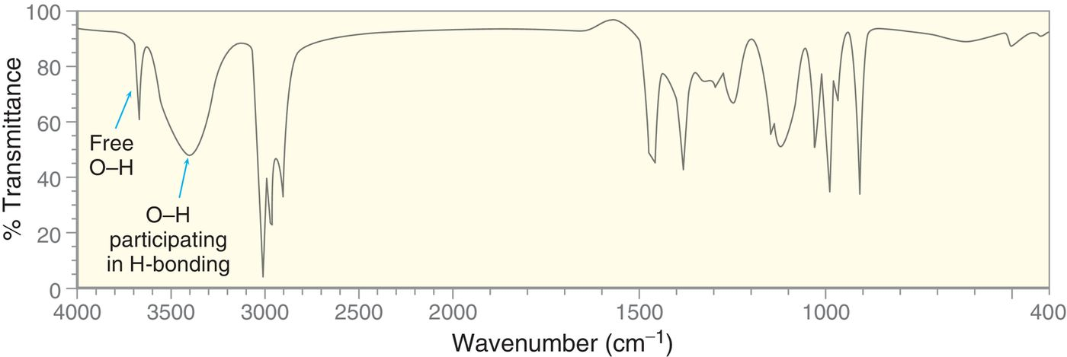
14.5 Signal Characteristics: Shape
Its possible to see two signals for an O-H bond, one for the “free” OH and one for those engaged in H-bonding.
Practice with Conceptual Checkpoint 14.8

Slide 34
14.5 Signal Characteristics: Shape
Consider how broad the O-H stretch is for a carboxylic acid and how its wavenumber is around 3000 cm⁻¹ rather than 3400 cm⁻¹ for a typical O-H stretch

Slide 35
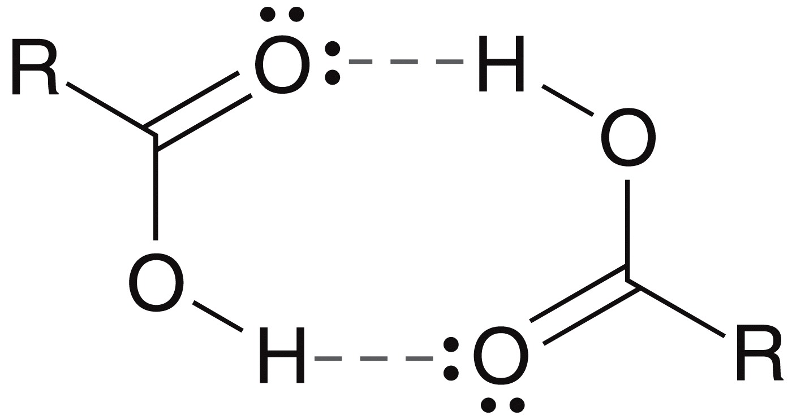
14.5 Signal Characteristics: Shape
H-bonding is often more pronounced in carboxylic acids, because they can forms H-bonding dimers
Practice with Conceptual Checkpoint 14.9

Slide 36
14.5 Signal Characteristics: Shape
Primary and secondary amines exhibit N-H stretching signals.
Because N-H bonds are capable of H-bonding, their stretching signals are often broadened
1˚ amines exhibit two signals for the N-H bonds
2˚ amines exhibit only one signal for N-H bond
See example spectra on next slide

Slide 37
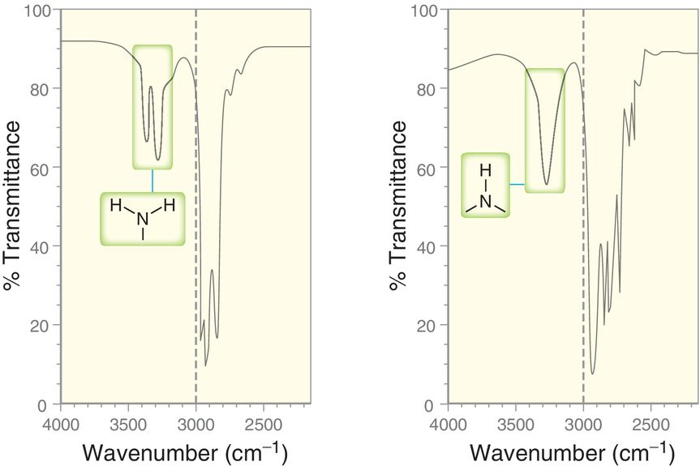
14.5 Signal Characteristics: Shape

Slide 38
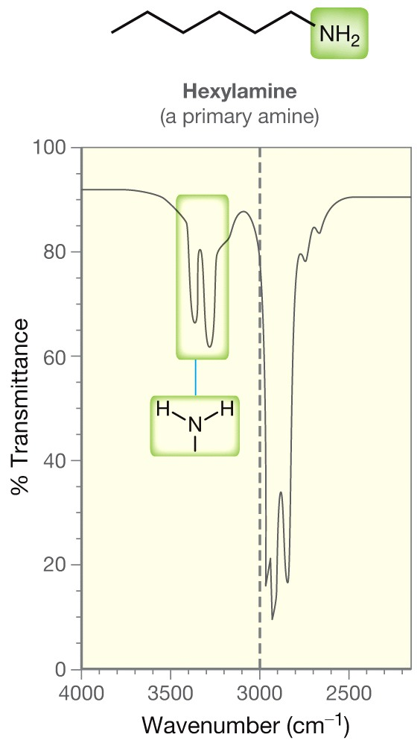
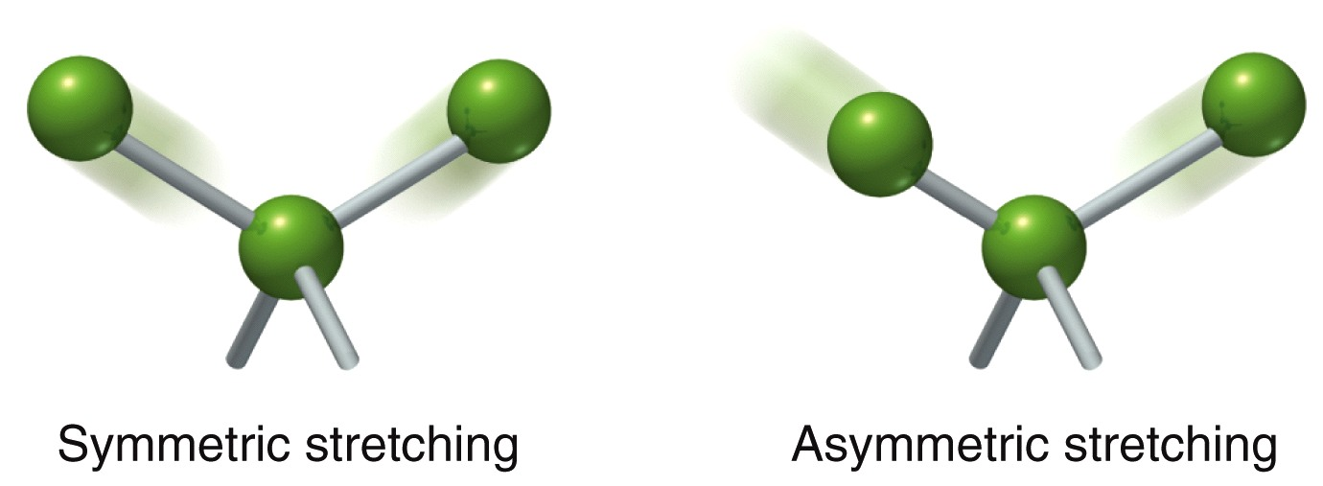
14.5 Signal Characteristics: Shape
The two N-H bonds vibrate together in two different ways
At any point in time, half the molecules are stretching one way, the rest stretching the other way, giving rise to a total of two signals
Practice with Conceptual Checkpoint 14.10

Slide 39
14.6 Analyzing an IR Spectrum
Table 14.2 summarizes some of the key signals that help us to identify functional groups present in molecules
Often, the molecular structure can be identified from an IR spectra
Focus on the diagnostic region (above 1500 cm⁻¹)
1600-1850 cm⁻¹ – check for double bonds
2100-2300 cm⁻¹ – check for triple bonds
2700-4000 cm⁻¹ – check for X-H bonds
Analyze wavenumber, intensity, and shape for each signal

Slide 40
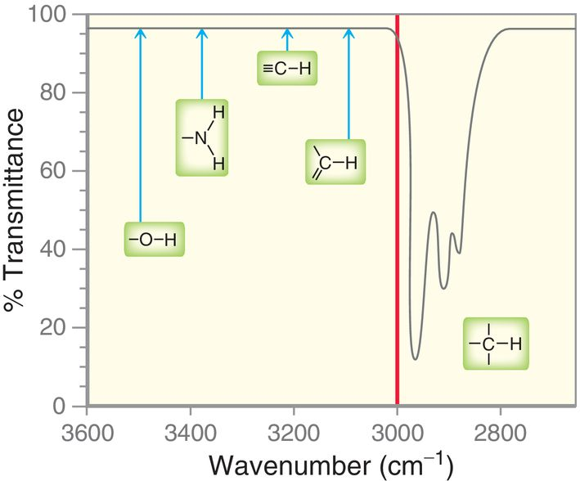
14.6 Analyzing an IR Spectrum
Often, the molecular structure can be identified from an IR spectra
When looking at the 2700-4000 cm⁻¹ (X-H) region, draw a line at 3000, and focus on the signals that come above it.
Practice with SkillBuilder 14.1

Slide 41
14.7 Using IR to Distinguish Between Two Compounds
As we have learned in previous chapters, organic chemists often carry out reactions to convert one functional group into another
IR spectroscopy can often be used to determine the success of such reactions
For the reaction below, we could look for the absence of an O-H signal to confirm the starting material has been consumed
Practice with SkillBuilder 15.2

Slide 42
14.8 Introduction to Mass Spectrometry
Mass spectrometry is primarily used to determine the molar mass and formula for a compound
In a mass spectrometer:
A compound is vaporized, then ionized, and undergoes fragmentation
The masses of the ions are detected and graphed

Slide 43
14.8 Introduction to Mass Spectrometry
The most common method of ionizing molecules is by electron impact (EI)
The sample is bombarded with a beam of high energy electrons (1600 kcal or 70 eV)
EI usually causes an electron to be ejected from the molecule.

Slide 44
14.8 Introduction to Mass Spectrometry
The mass of the radical cation is the same as the parent compound (mass of an electron is negligible)
If the radical cation remains intact, it is known as the molecular ion (M^{+•}) or parent ion

Slide 45
14.8 Introduction to Mass Spectrometry
Most of the radical cations (parent ions) typically fragment into a radical and a cation:
The ions are deflected by a magnetic field, and their mass-to-charge ratio (m/z) is detected.
Neutrally charged fragments are not detected.

Slide 46
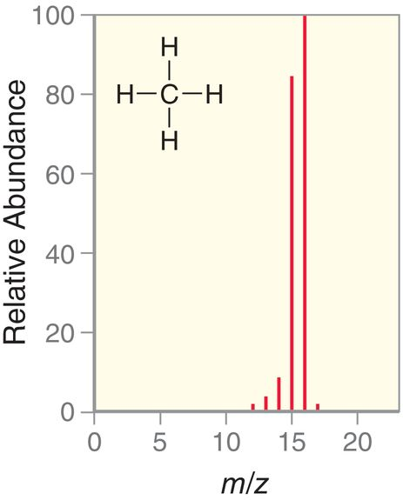
14.8 Introduction to Mass Spectrometry
the mass spectrum shows the relative abundance of each cation that was detected
The base peak is the tallest peak in the spectrum, and is the most abundant fragment
For methane the base peak is the parent ion, M^{+•}

Slide 47
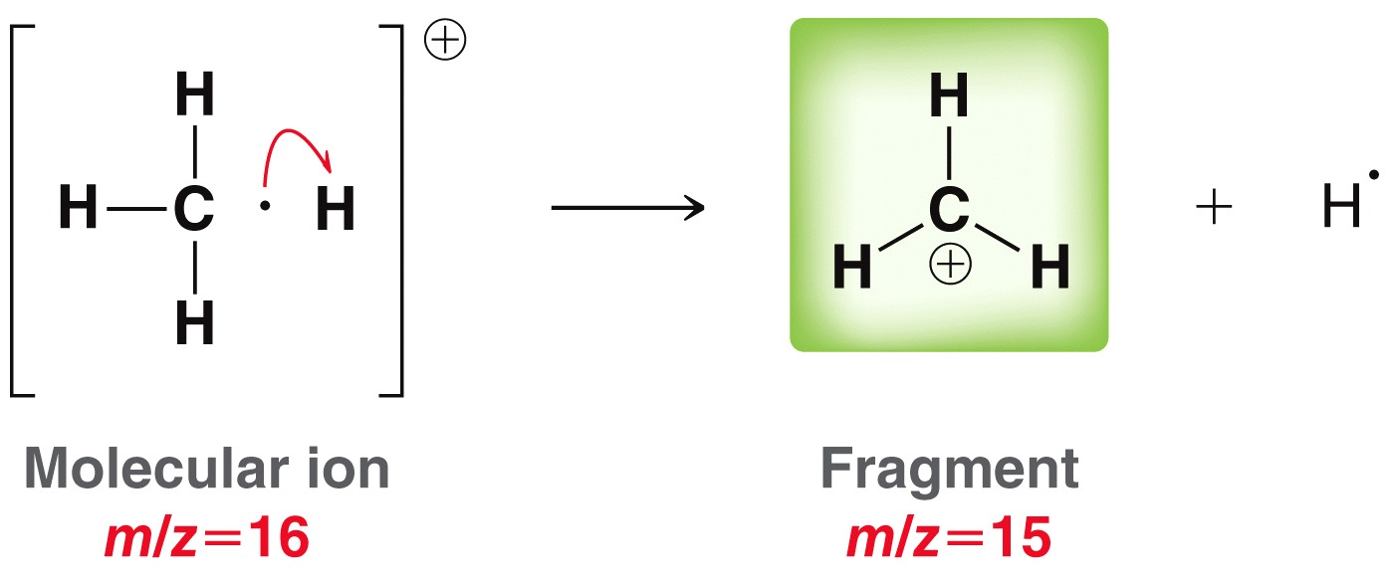
14.8 Introduction to Mass Spectrometry
Peaks with a m/z less than M^{+•} represent fragments
Subsequent H radicals can be fragmented to give the ions with a mass/charge = 12, 13 and 14

Slide 48
14.8 Introduction to Mass Spectrometry
Mass spec is a relatively sensitive analytical method
Many organic compounds can be identified
Pharmaceutical: drug discovery and drug metabolism, reaction monitoring
Biotech: amino acid sequencing, analysis of macromolecules
Clinical: neonatal screening, hemoglobin analysis
Environmental: drug testing, water quality, food contamination testing
Geological: evaluating oil composition
Forensic: Explosive detection
Many More

Slide 49
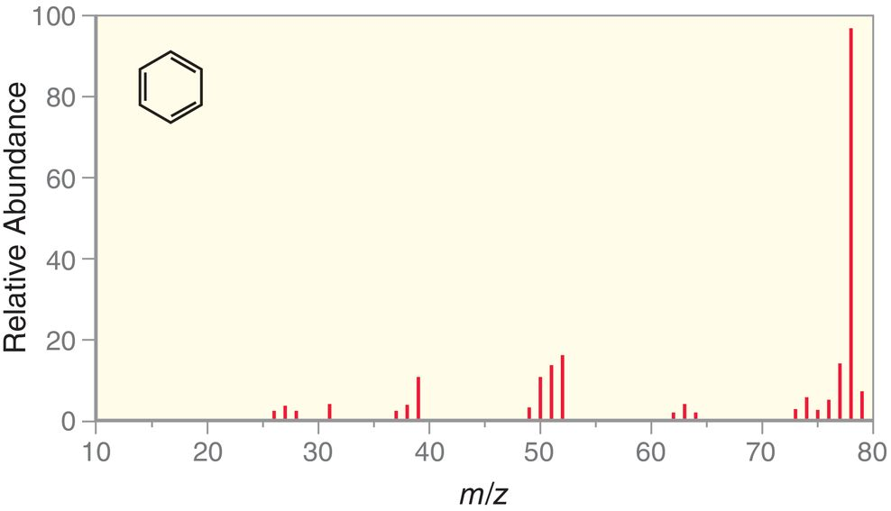
14.9 Analyzing the (M)^{+•} Peak
In the mass spec for benzene, the M^{+•} peak is the base peak
The M^{+•} peak does not easily fragment

Slide 50
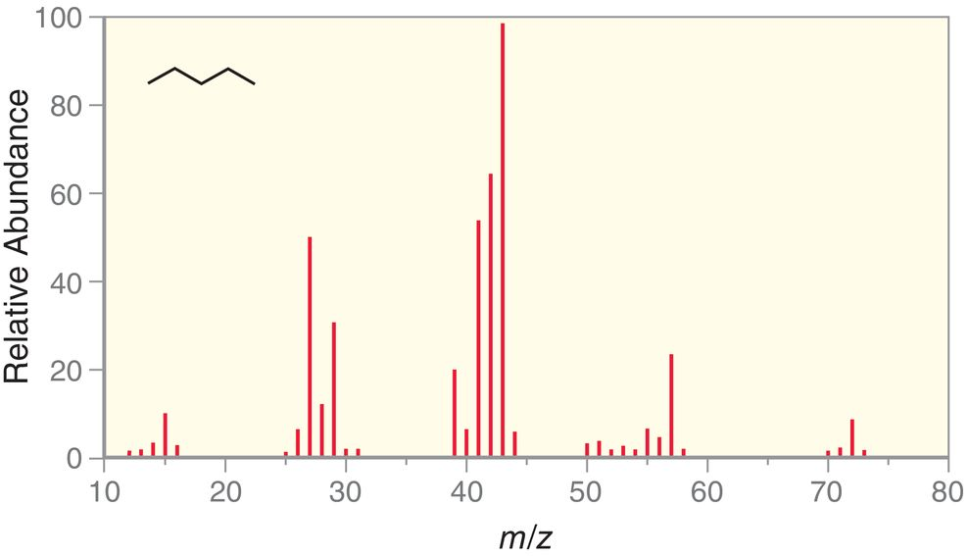
14.9 Analyzing the (M)^{+•} Peak
For most compounds, the M^{+•} peak is NOT the base peak
The parent ion for pentane fragments easily

Slide 51
14.9 Analyzing the (M)^{+•} Peak
The first step in analyzing a mass spec is to identify the M^{+•} peak
The m/z of the parent ion = molar mass of the compound
An odd massed M^{+•} peak generally means there is an odd number of N atoms in the molecule
An even massed M^{+•} peak generally indicates an absence of nitrogen, or an even number of N atoms are present
Practice with conceptual checkpoints 14.18 and 14.19

Slide 52
14.10 Analyzing the (M+1)^{+•} Peak
For methane, there is an (M+1)^{+•} that is about 1% as abundant as the M^{+•} peak
The (M+1)^{+•} peak results from the presence of ¹³C in the sample.
1% of all carbon atoms are ¹³C

Slide 53
14.10 Analyzing the (M+1)^{+•} Peak
The more carbon atoms in a compound, the more abundant the (M+1)^{+•} peak is.
So, comparing the heights of the (M+1)^{+•} peak and the M^{+•} peak can allow you to estimate how many carbons are in the molecule.
Practice with SkillBuilder 14.3

Slide 54
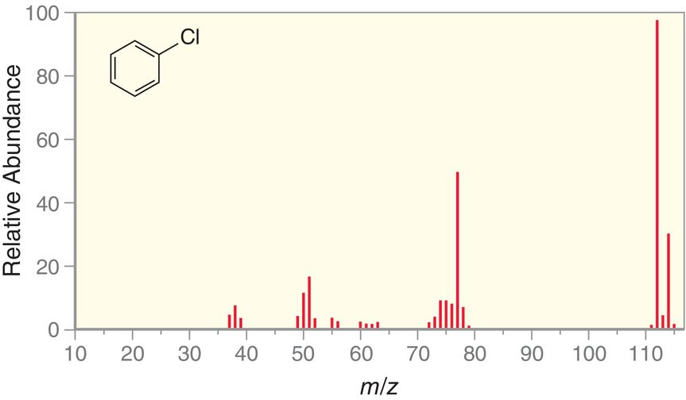
14.11 Analyzing the (M+2)^{+•} Peak
Chlorine has two abundant isotopes ³⁵Cl=76% and ³⁷Cl=24%
So, compounds containing a Cl atom have a 3-to-1 ratio of there (M) ^{+•} to (M+2)^{+•} peaks

Slide 55
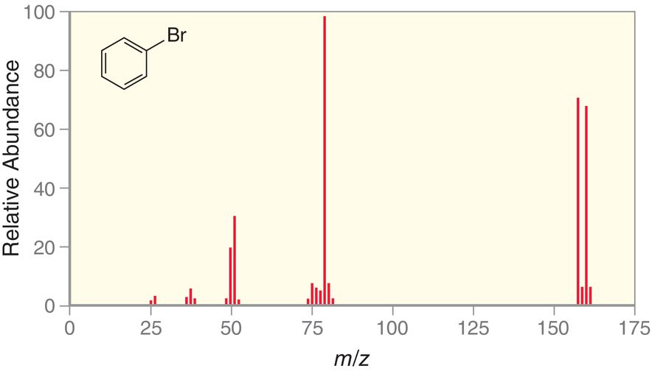
14.11 Analyzing the (M+2)^{+•} Peak
⁷⁹Br=51% and ⁸¹Br=49%, so molecules with bromine often have equally strong (M)^{+•} and (M+2)^{+•} peaks, because these isotopes are equally abundant
Practice with conceptual checkpoints 14.22 and 15.23

Slide 56
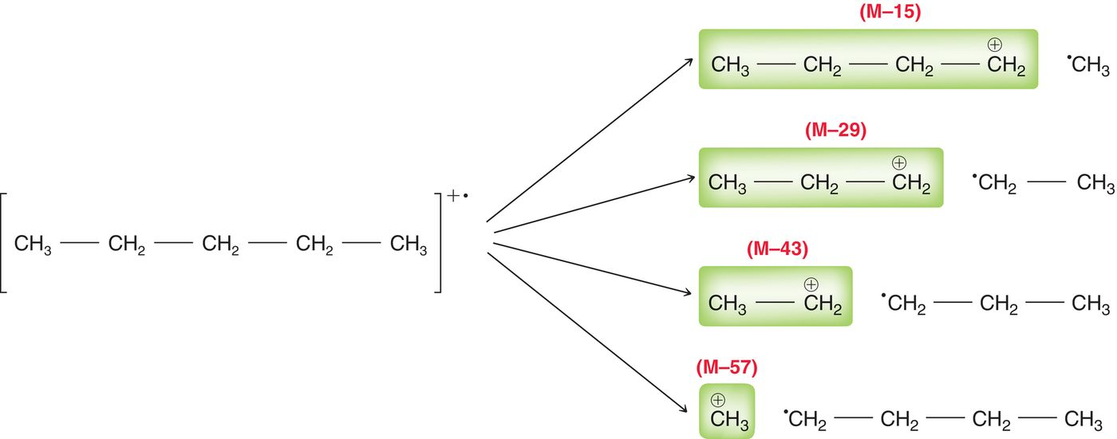
14.12 Analyzing the Fragments
A thorough analysis of the molecular fragments can often yield structural information
Consider pentane
Remember, MS only detects charged fragments

Slide 57
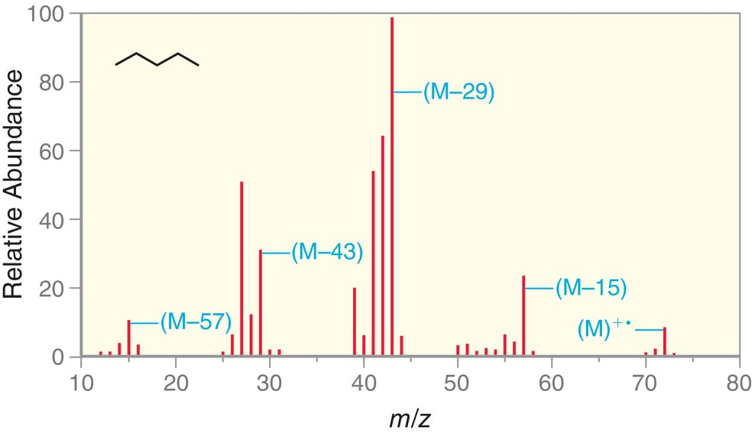
14.12 Analyzing the Fragments
Clusters around each ion are the result of further fragmentation (loss of H atoms)

Slide 58
14.12 Analyzing the Fragments
Consider the fragmentation below
While all possible fragmentations are possible, and observed, the most abundant fragment is the most stable cation possible.
Since a 3˚ cation is more stable than 1˚ or 2˚, the M-43 peak in the above example will be the most abundant.

Slide 59
14.12 Analyzing the Fragments
Alcohols generally undergo two main types of fragmentation: alpha cleavage and dehydration
A stabilized oxonium
ion is formed
A stable, neutral
molecule is formed

Slide 60
14.12 Analyzing the Fragments
Amines also undergo alpha cleavage
Carbonyls generally undergo McLafferty rearrangement

Slide 61
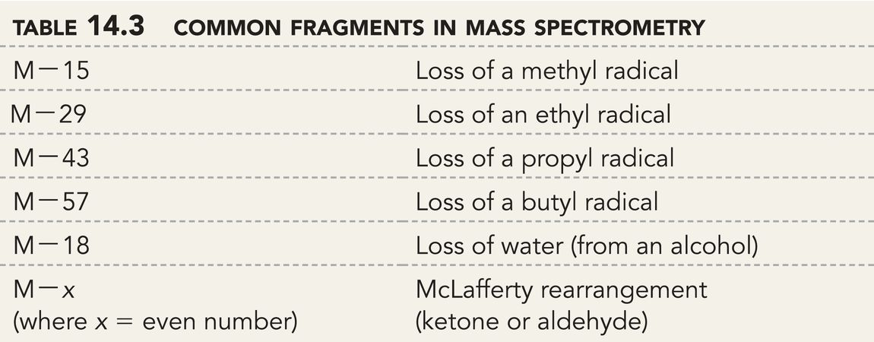
14.12 Analyzing the Fragments
Presence of these characteristics fragments in a mass spectrum confirm the following structural features:
Practice with conceptual checkpoints 14.24 – 15.27

Slide 62
14.13 High-Resolution Mass Spec
High Resolution Mass Spectrometry allows m/z to be measured with up to 4 decimal places
Masses are generally not whole number integers
1 proton = 1.0073 amu and 1 neutron = 1.0086 amu
One ¹²C atom = exactly 12.0000 amu, because the amu scale is based on the mass of ¹²C
All atoms other than ¹²C will have a mass in amu that can be measured to 4 decimal places by a high-resolution mass spec instrument

Slide 63
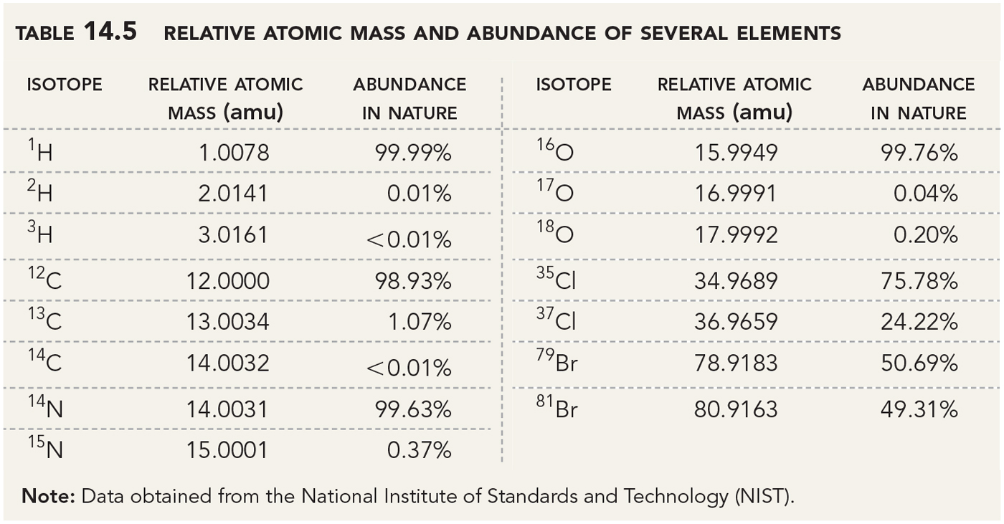
14.13 High-Resolution Mass Spec
Note the exact masses and natural abundances below

Slide 64
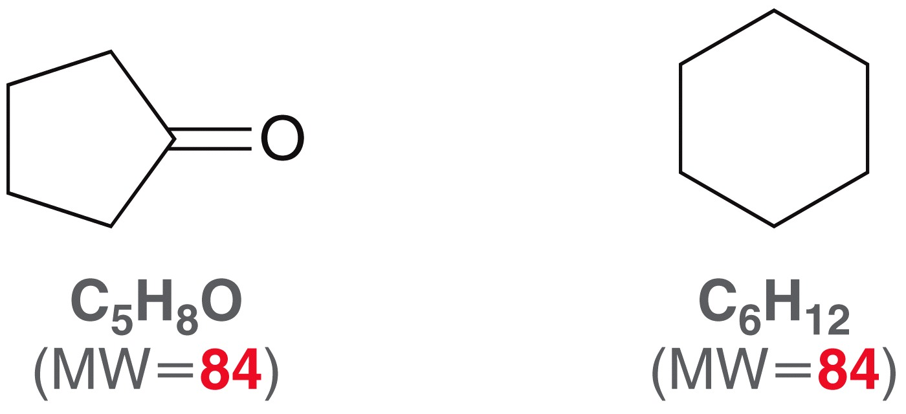
14.13 High-Resolution Mass Spec
Recall the atomic weights on the PTE are based on isotopic abundance.
high-res MS allows one to distinguish between compounds that have the same MW when rounded to the nearest amu:
84.0573 amu
84.0936 amu

Slide 65
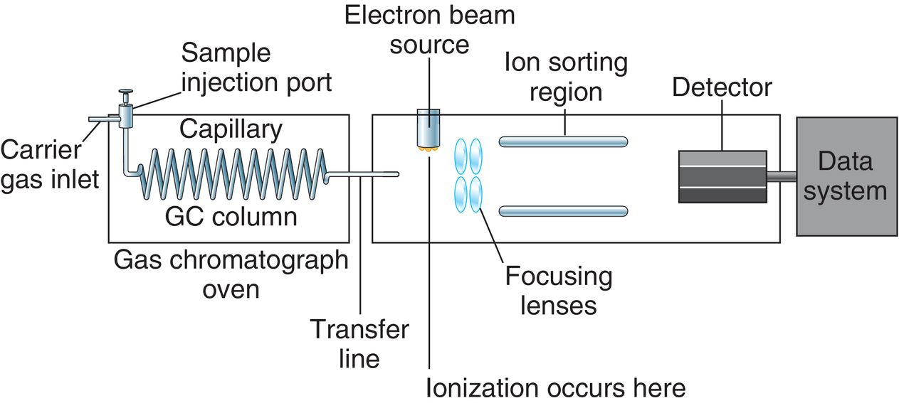
14.14 Gas Chromatography - Mass Spec
Mass Spec is suited for the identification of pure substances
MS instruments can be connected to a gas chromatograph so mixtures can be separated prior to MS identification

Slide 66
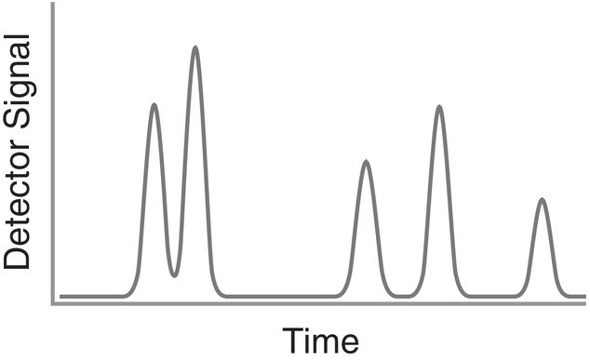
14.14 Gas Chromatography - Mass Spec
GC-MS gives two sets of data:
GC-MS is a great technique for detecting compounds in complex mixtures, such as blood or urine
The chromatogram gives the retention time
The mass spectrum

Slide 67
14.15 Mass Spec of Large Biomolecules
To be analyzed by EI mass spec, substances generally must be vaporized prior to ionization
In Electrospray ionization (ESI), a high-voltage needle sprays a liquid solution of an analyte into a vacuum causing ionization
The molecular ions generally do not fragment… ESI is a “softer” ionizing technique?
Useful for large molecules that otherwise give complex fragmentation patterns

Slide 68
14.16 Degrees of Unsaturation
Mass spec is often used to determine the molecular formula for an organic compound
IR can often determine the functional groups present
Alkanes, or saturated hydrocarbons, follow the formula below:
C_{n}H_{2n+2}

Slide 69
14.16 Degrees of Unsaturation
Degree of unsaturation: a π bond or a ring
For every degree of unsaturation in a compound, the number of H’s is reduced by 2
These are unsaturated compounds

Slide 70
14.16 Degrees of Unsaturation
Consider the isomers of C₄H₆
1 degree of unsaturation = 1 unit on the hydrogen deficiency index (HDI)

Slide 71
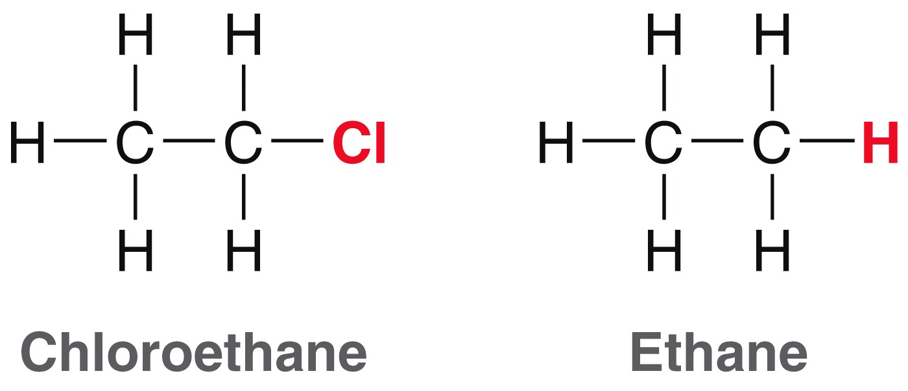
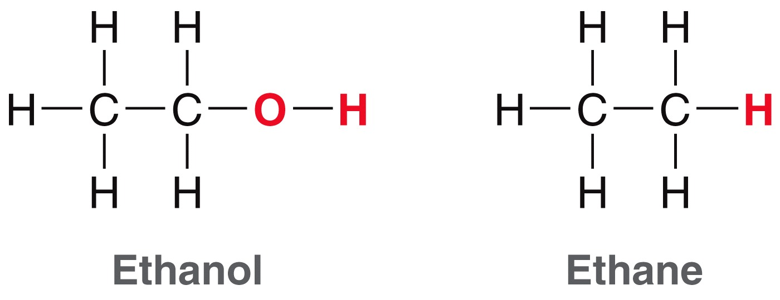
14.16 Degrees of Unsaturation
For the HDI scale, a halogen is treated as if it were a hydrogen atom
An oxygen does not affect the HDI.

Slide 72
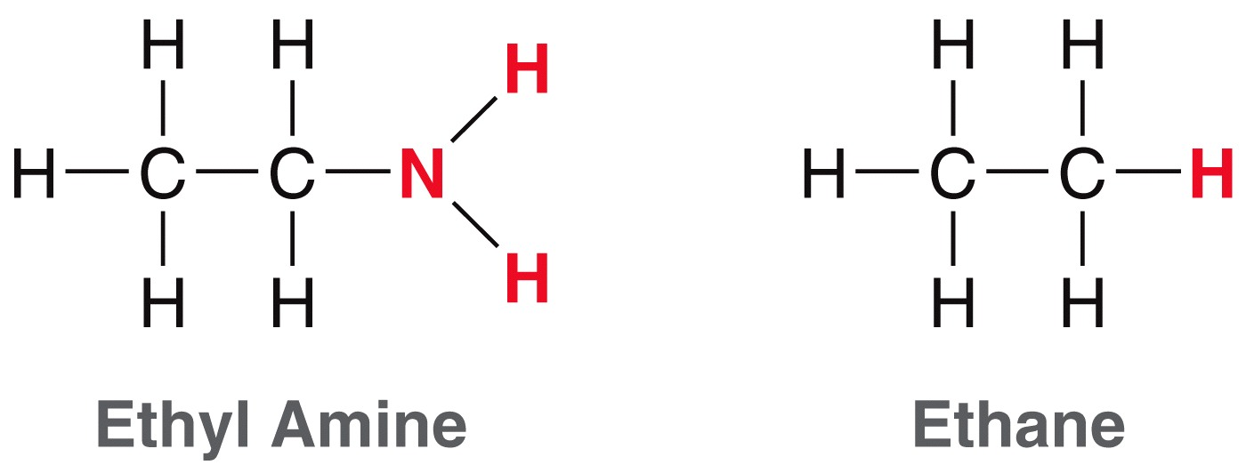
14.16 Degrees of Unsaturation
For the HDI scale, a nitrogen increases the number of expected hydrogen atoms by ONE
You can also use this formula:

Slide 73
14.16 Degrees of Unsaturation
Calculating the HDI can be very useful. For example, if HDI=0, the molecule can NOT have any rings, double bonds, or triple bonds
Practice with SkillBuilder 14.4

