Slide 1
Organic Chemistry
Third Edition
David Klein
Chapter 16
Conjugated Pi Systems and Pericyclic Reactions

Slide 2
16.1 Classes of Dienes
Three types of dienes:
Cumulated diene – pi bonds are adjacent
Conjugated diene – pi bonds are separated by a single bond
Isolated diene – pi bonds are separated by more than one single bond

Slide 3
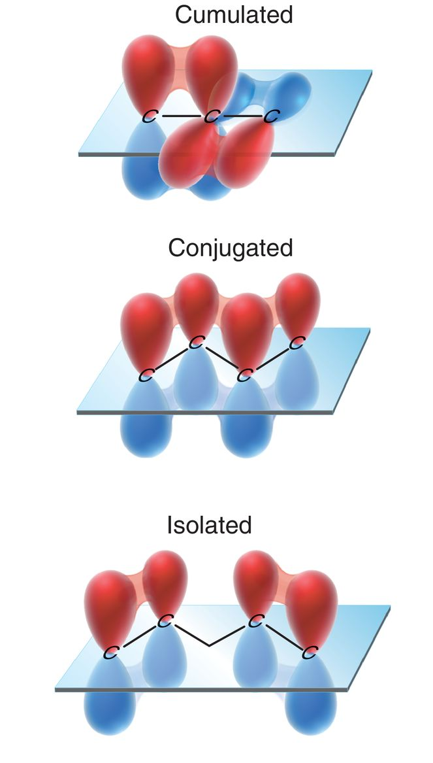
16.1 Classes of Dienes
Three types of dienes:
Cumulated – pi bonds are perpendicular (no conjugation)
Conjugated – continuous system of overlapping p orbitals
Isolated – pi bonds are separated (no conjugation)

Slide 4
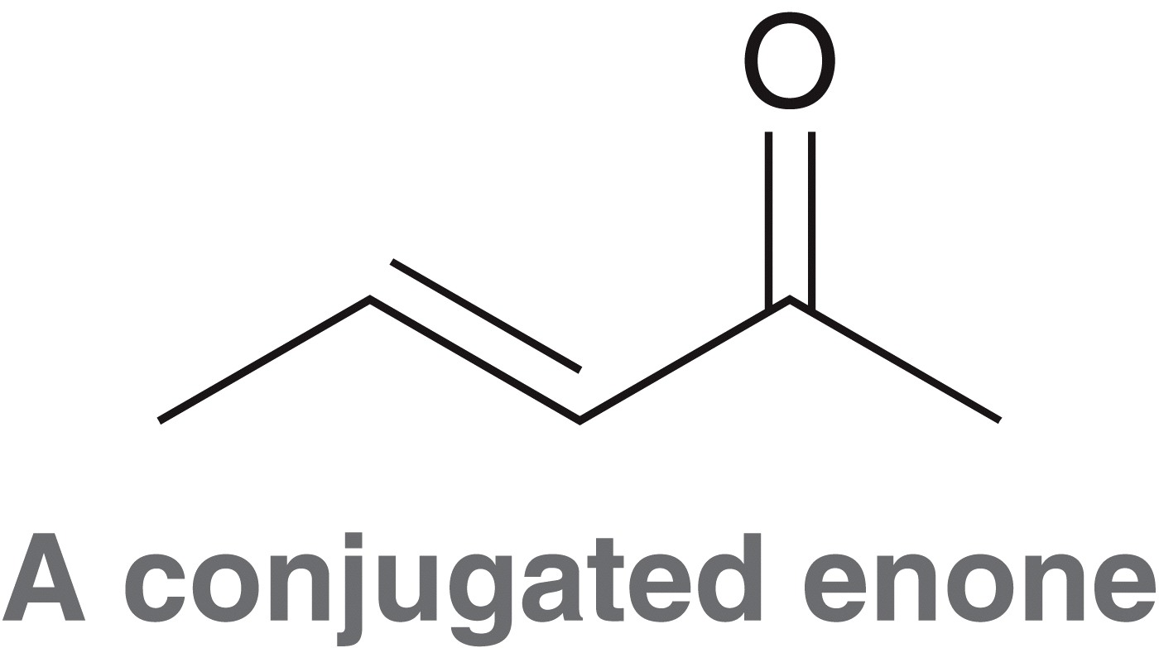
16.1 Classes of Dienes
This chapter focuses on conjugated systems, and the special properties and reactivity associated with them.
Heteroatoms may be involved in a conjugated system
Practice with
Conceptual Checkpoint 16.1

Slide 5
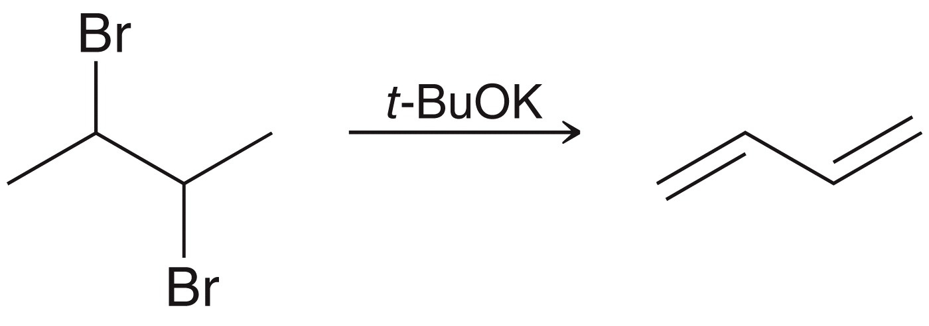
16.2 Preparation of Conjugated Dienes
A sterically hindered base can be used to form dienes via elimination reaction
Practice with conceptual checkpoint 16.2

Slide 6
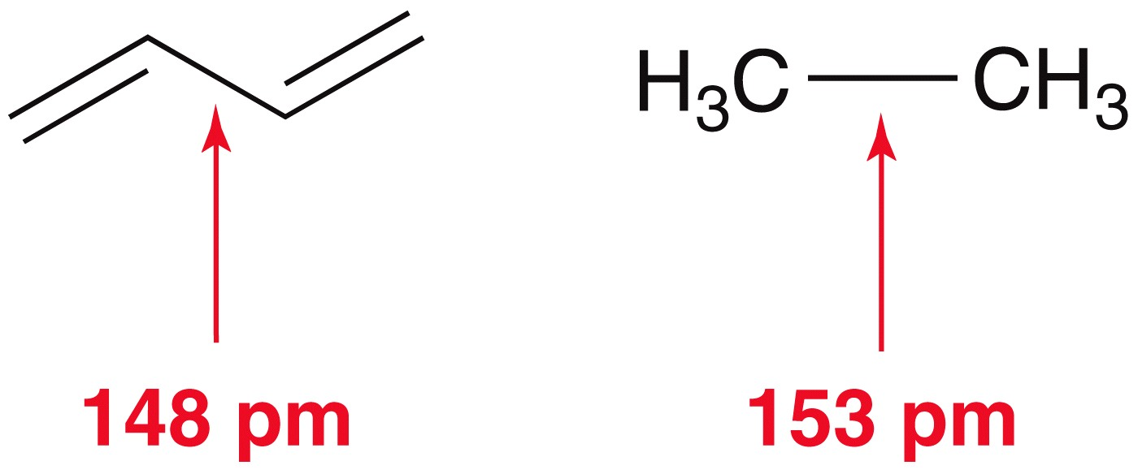
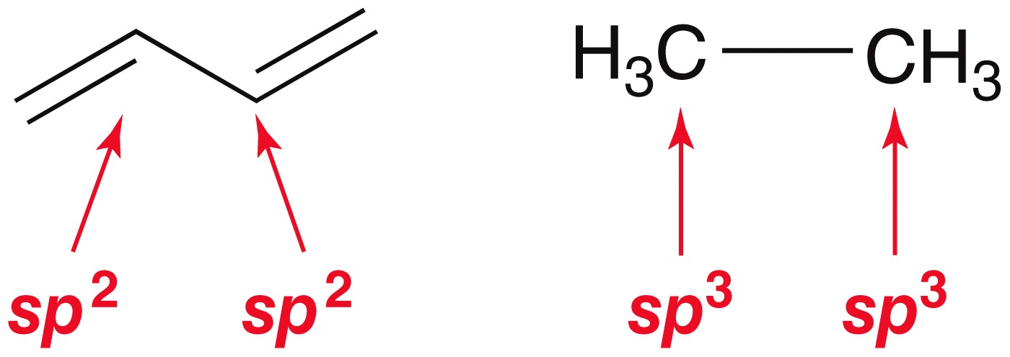
16.2 Conjugated Dienes – Bond Lengths
Single bonds that are part of a conjugated pi system are shorter than typical single bonds
This is due, at least in part, to overlap of sp² orbitals, versus sp³

Slide 7
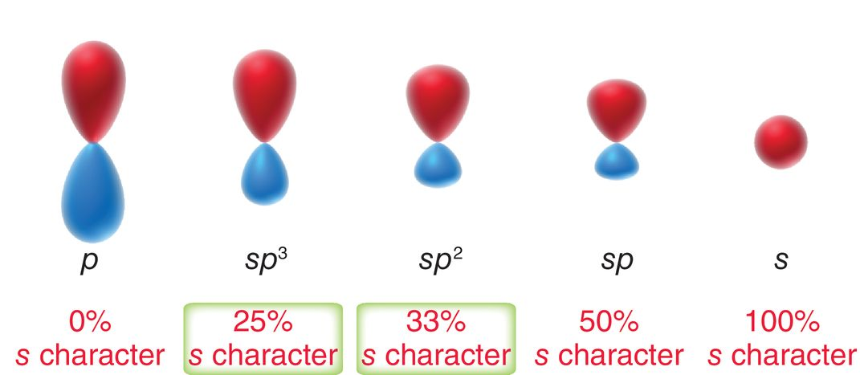
16.2 Conjugated Dienes
The more s-character, the shorter the orbitals, and the shorter sigma bonds will be.
Practice with conceptual checkpoint 17.3

Slide 8
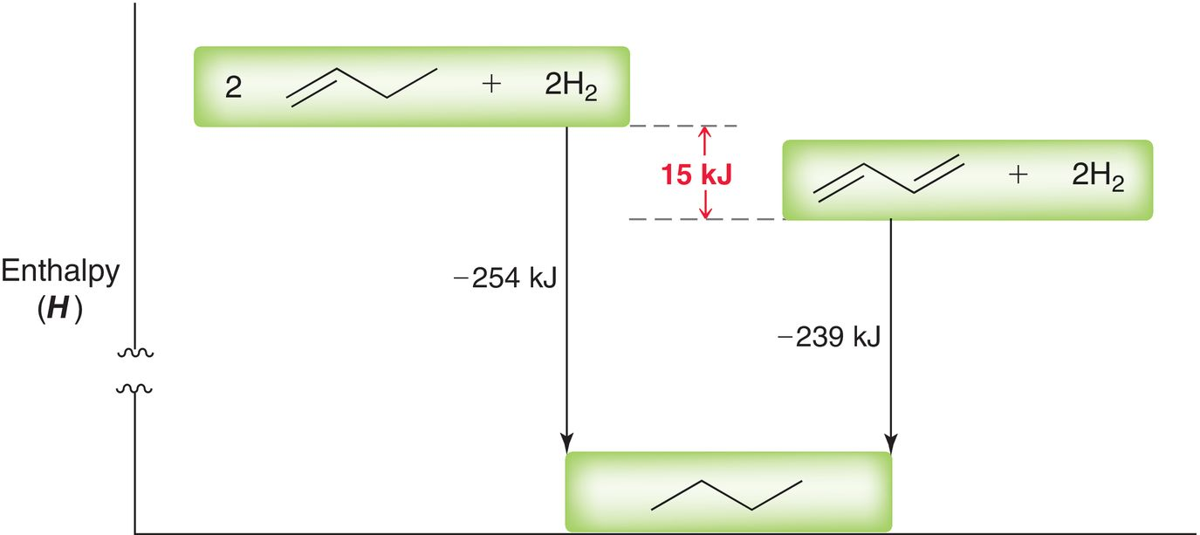
16.2 Conjugated Dienes
Heats of hydrogenation show conjugated dienes are more stable?
15 kJ/mol of stabilization energy when 2 π bonds are conjugated

Slide 9
16.2 Conjugated Dienes
Rank the following compounds in order of increasing stability

Slide 10
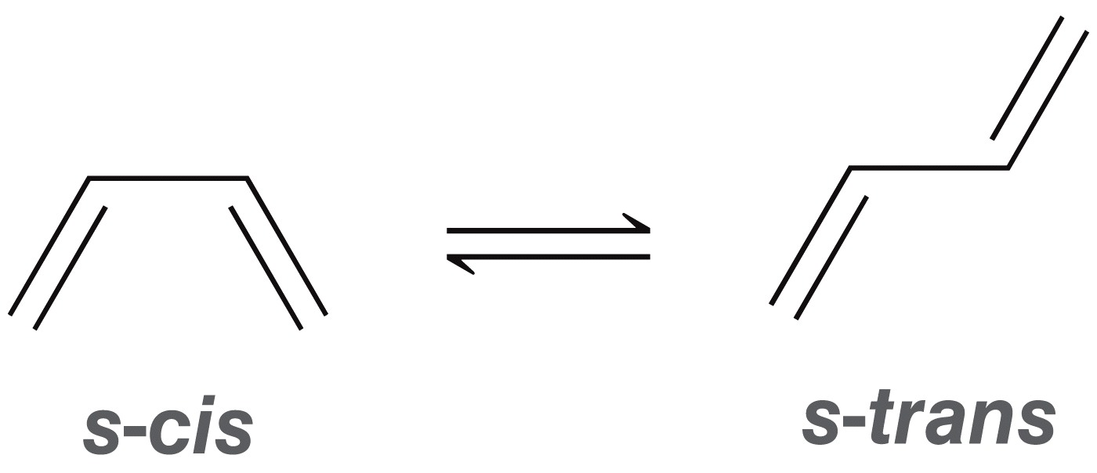
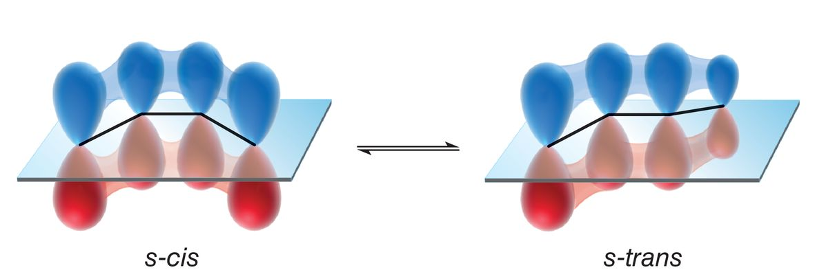
16.2 Conjugated Dienes
Generally, sigma bonds freely rotate
The two most stable rotational conformations for butadiene are the s-cis and s-trans
P orbitals are conjugated only in these two rotamers

Slide 11
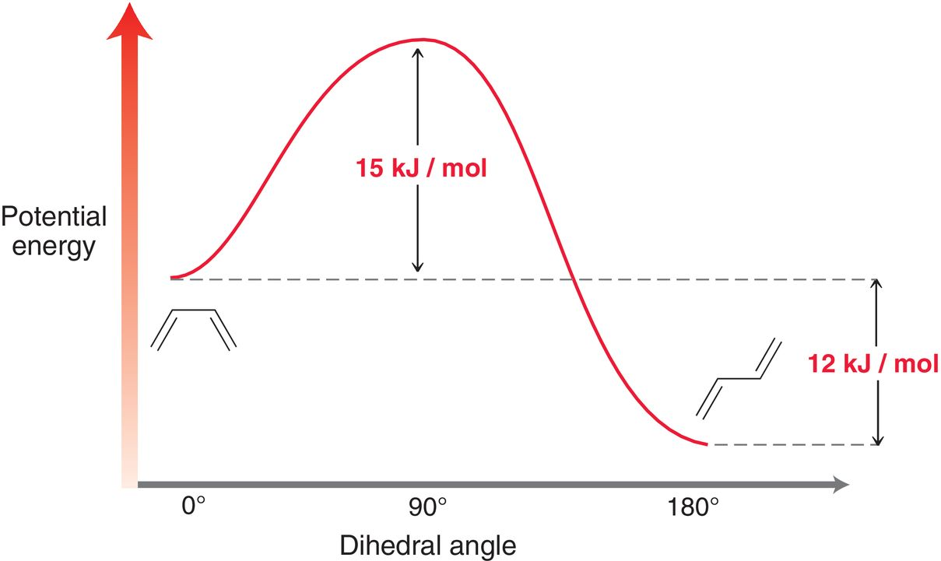
16.2 Conjugated Dienes
s-trans lower in energy, it has less steric hindrance

Slide 12
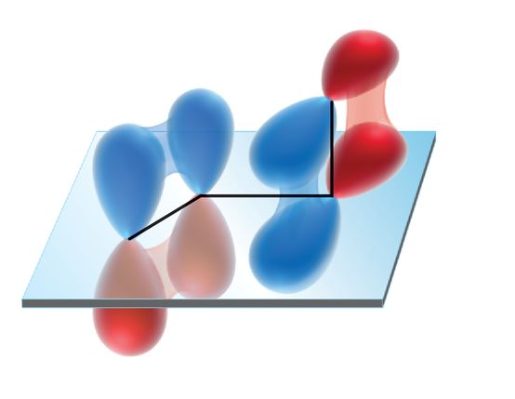
16.2 Conjugated Dienes
The highest energy conformer is not conjugated, and is 15 kJ less stable

Slide 13
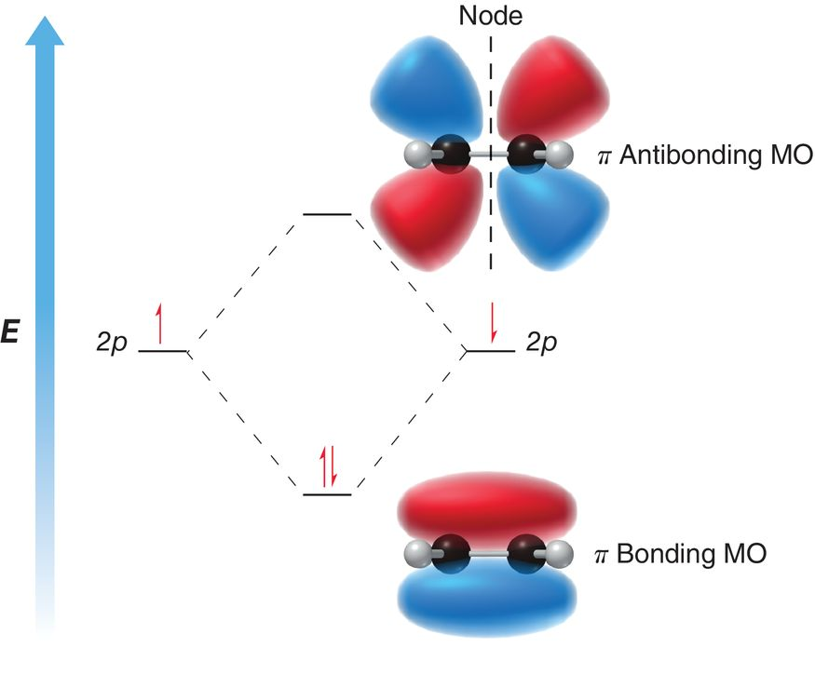
16.3 Molecular Orbital Theory
Review of MO theory:
Two atomic orbitals overlap to form two new MO’s
The MO extends over the entire molecule
Overlap of the p orbitals in ethylene result in a bonding MO and an antibonding MO

Slide 14
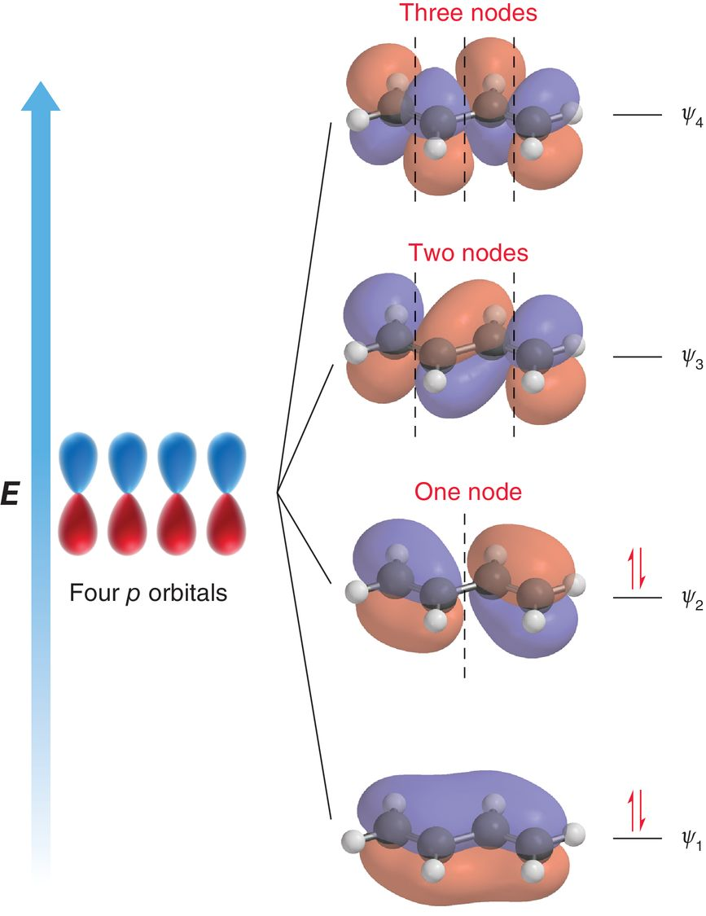
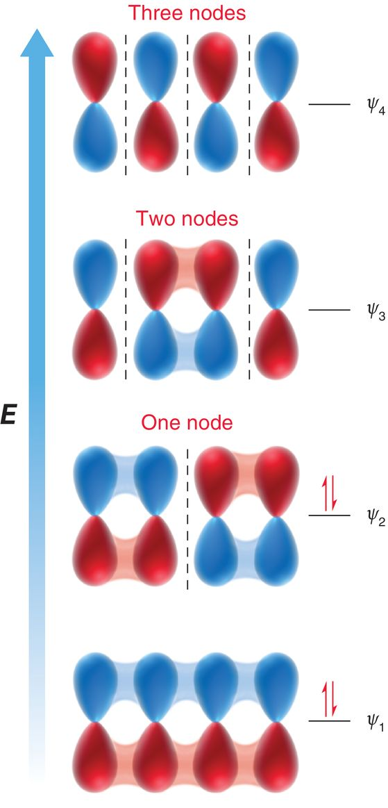
16.3 Molecular Orbital Theory
MO’s for butadiene:

Slide 15
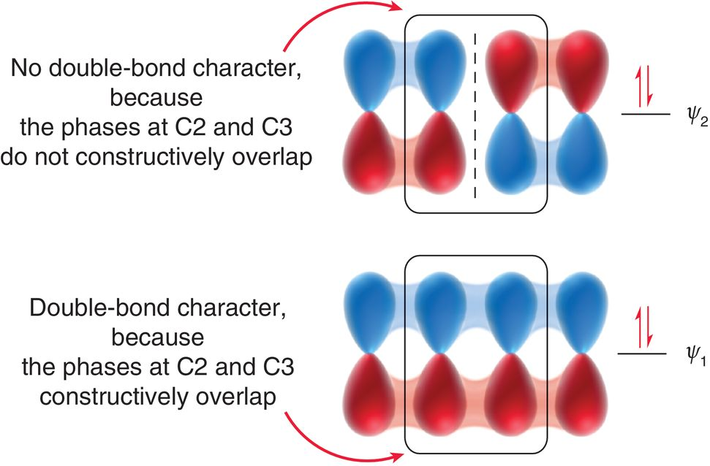
16.3 Molecular Orbital Theory
The 4 π electrons in butadiene will occupy the lowest energy MOs.

Slide 16
16.3 Molecular Orbital Theory
MO theory offers an alternate explanation why the central C-C single bond is shorter and stronger than a typical C-C single bond

Slide 17
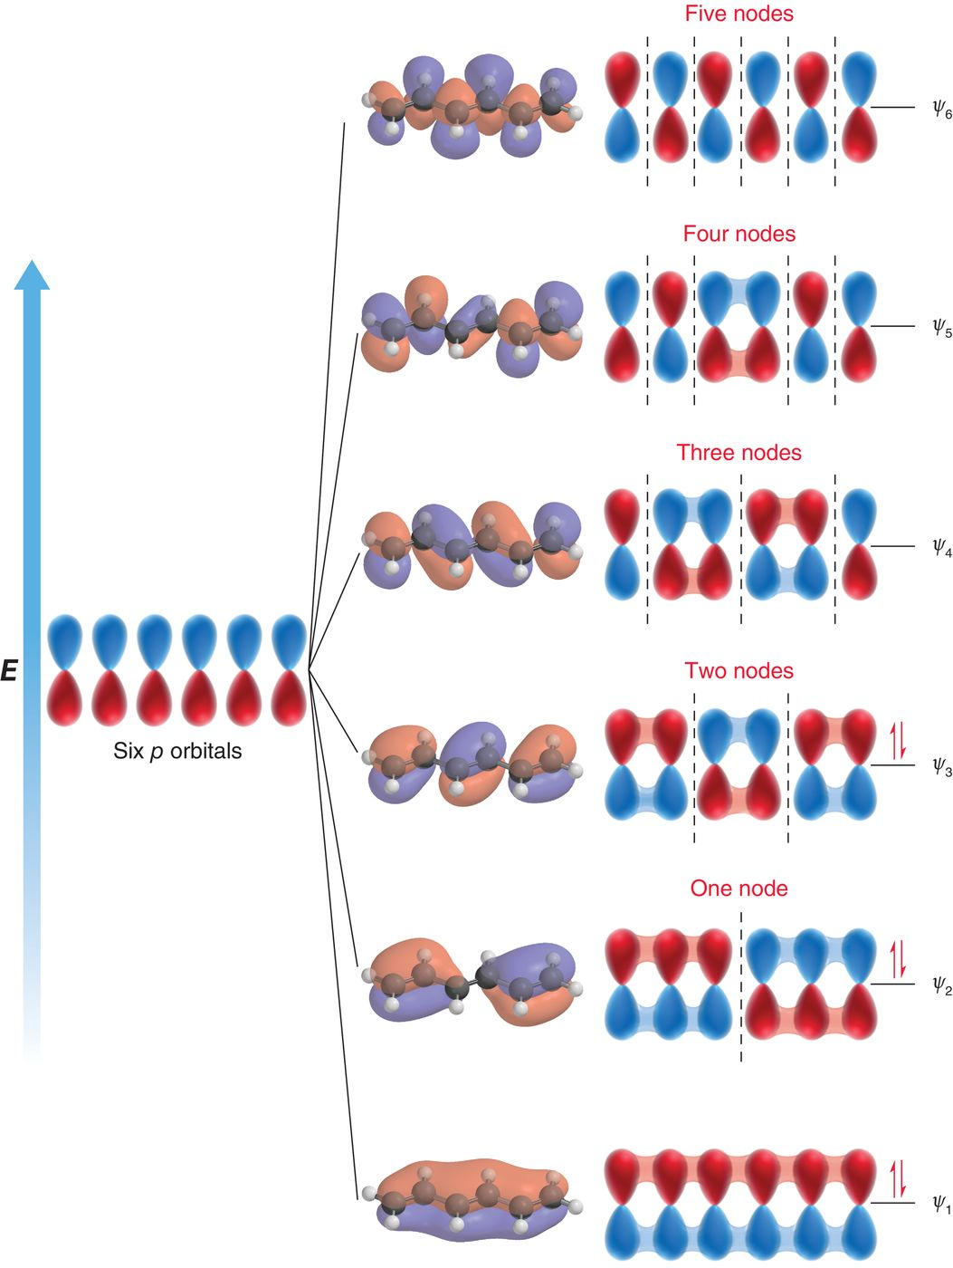
16.3 Molecular Orbital Theory
1,3,5-Hexatriene

Slide 18
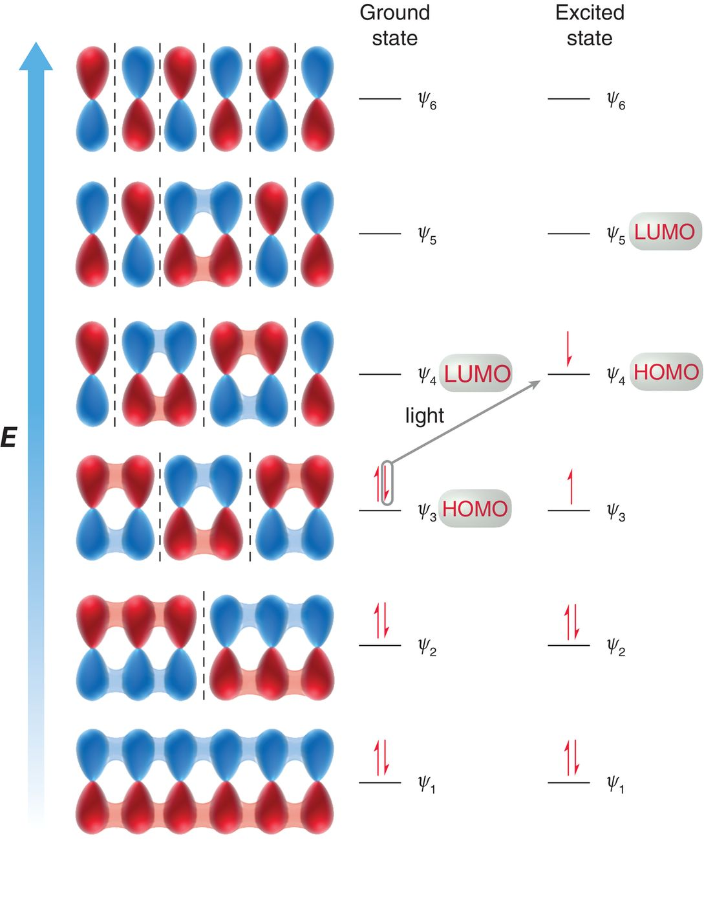
16.3 Molecular Orbital Theory
Reactions that molecules undergo can often be explained by studying their frontier orbitals
Light can be used to excite an electron from the HOMO to the LUMO
Practice with Conceptual Checkpoint 16.5

Slide 19
16.4 Electrophilic Addition
Recall addition of H-X to a C=C double bond (Markovnikov addition, section 9.3)
Two products obtained with a conjugated diene:

Slide 20
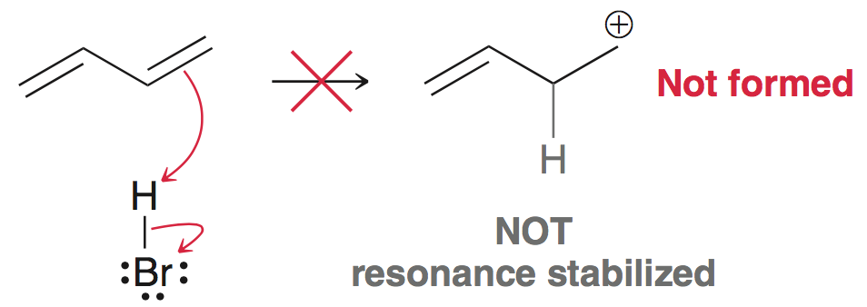
16.4 Electrophilic Addition
Protonation results in the most stable carbocation; in this case, an allylic carbocation.
Primary carbocation will not form

Slide 21
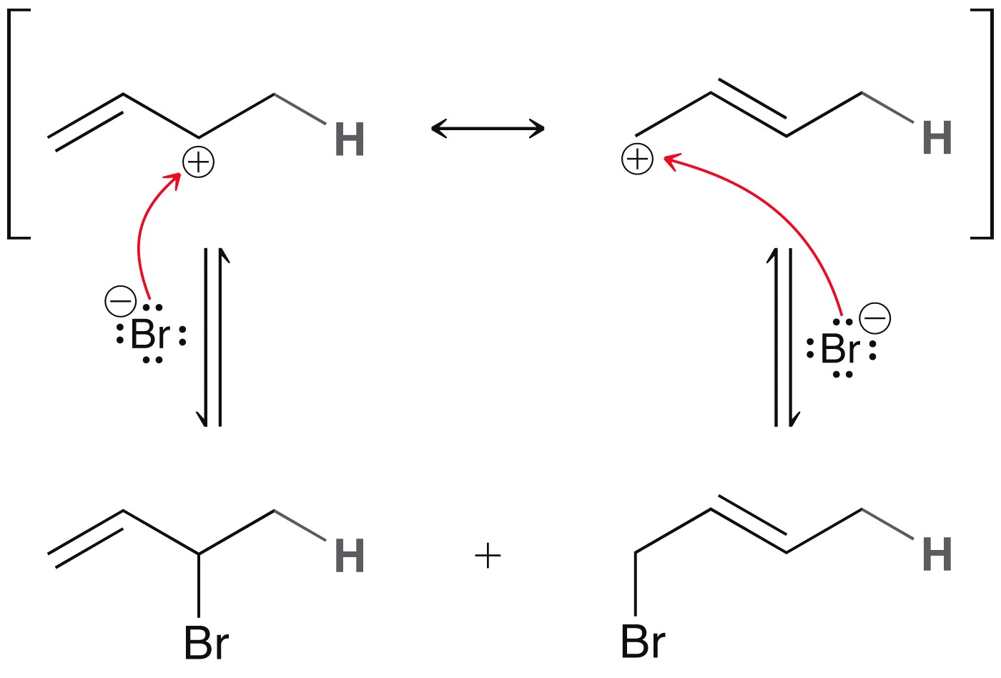
16.4 Electrophilic Addition
Nu attack at either of the two carbons results in two products
Product of
1,2-addition
Product of
1,4-addition
Practice with SkillBuilder 16.1

Slide 22
16.4 Electrophilic Addition
The addition of bromine to a conjugated diene also results in two products: both 1,2 and 1,4 addition occurs

Slide 23
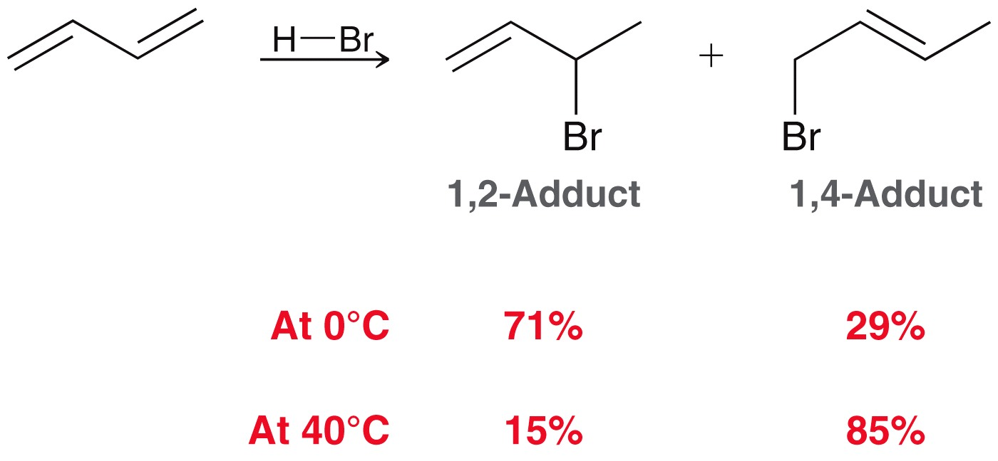
16.5 Thermodynamic vs. Kinetic Control
The ratio of 1,2 vs. 1,4 addition is highly dependent on temperature
An energy diagram of the two reaction pathways efficiently explains why this selectivity is observed

Slide 24
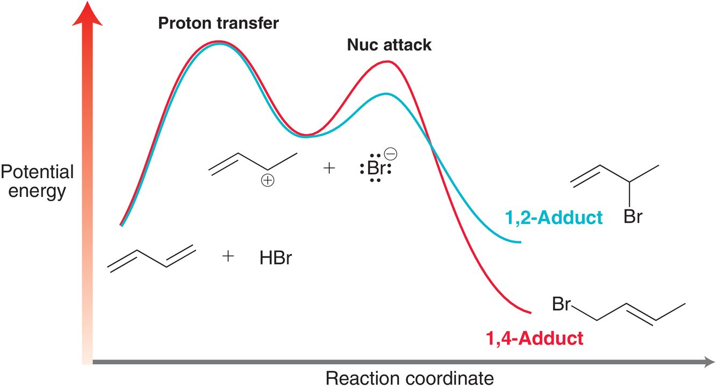
16.5 Thermodynamic vs. Kinetic Control
The formation of 1,2-adduct occurs faster (kinetically favored)
The 1,4 adduct is more stable (thermodynamically favored)

Slide 25
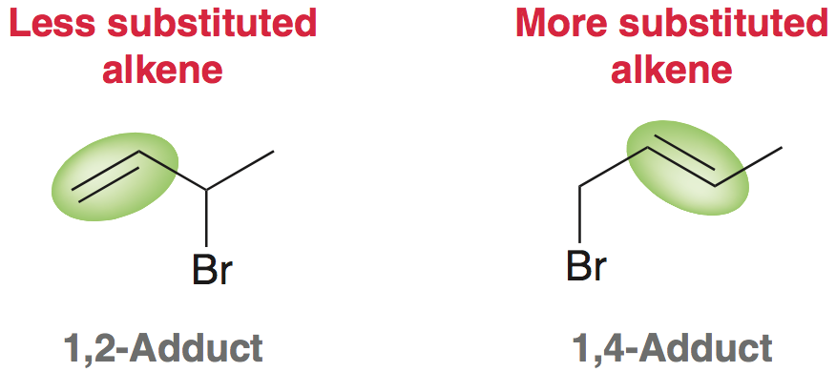
16.5 Thermodynamic vs. Kinetic Control
The 1,4 adduct is more stable; it is the more substituted alkene
At higher temps, the formation of product(s) is equilibrating; the reaction is under thermodynamic control. The product that is more stable will be the major product

Slide 26
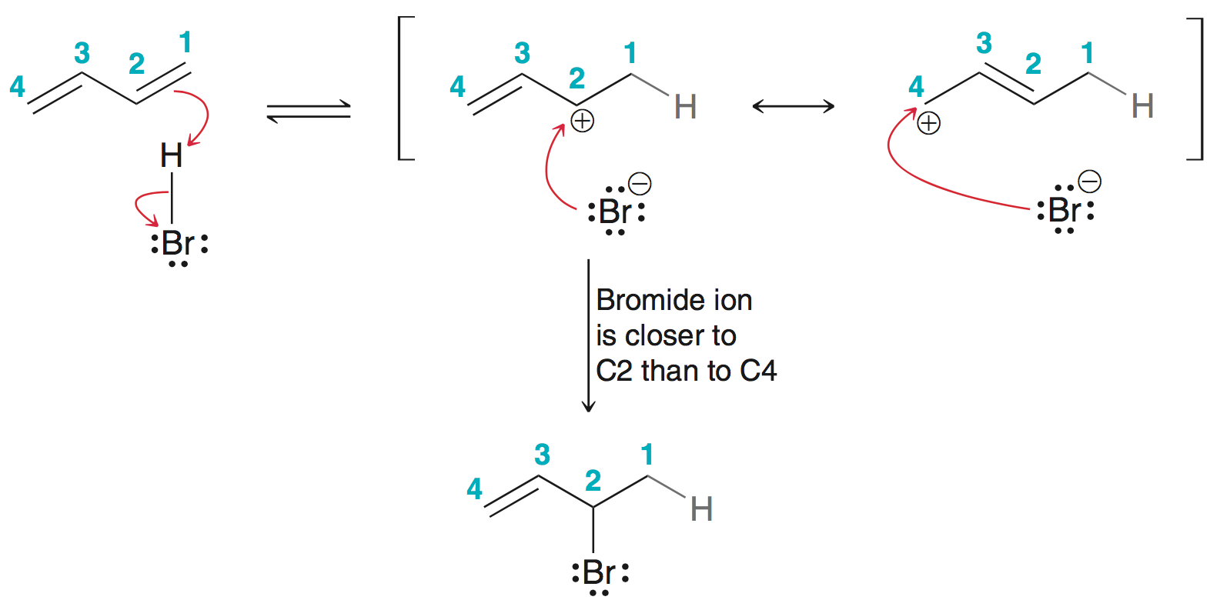
16.5 Thermodynamic vs. Kinetic Control
The 1,2 adduct forms faster presumably due to a proximity effect.
At lower temps, the reaction is under kinetic control; the reaction is irreversible, the product that forms faster is the major product
Practice with Skillbuilder 16.2

Slide 27
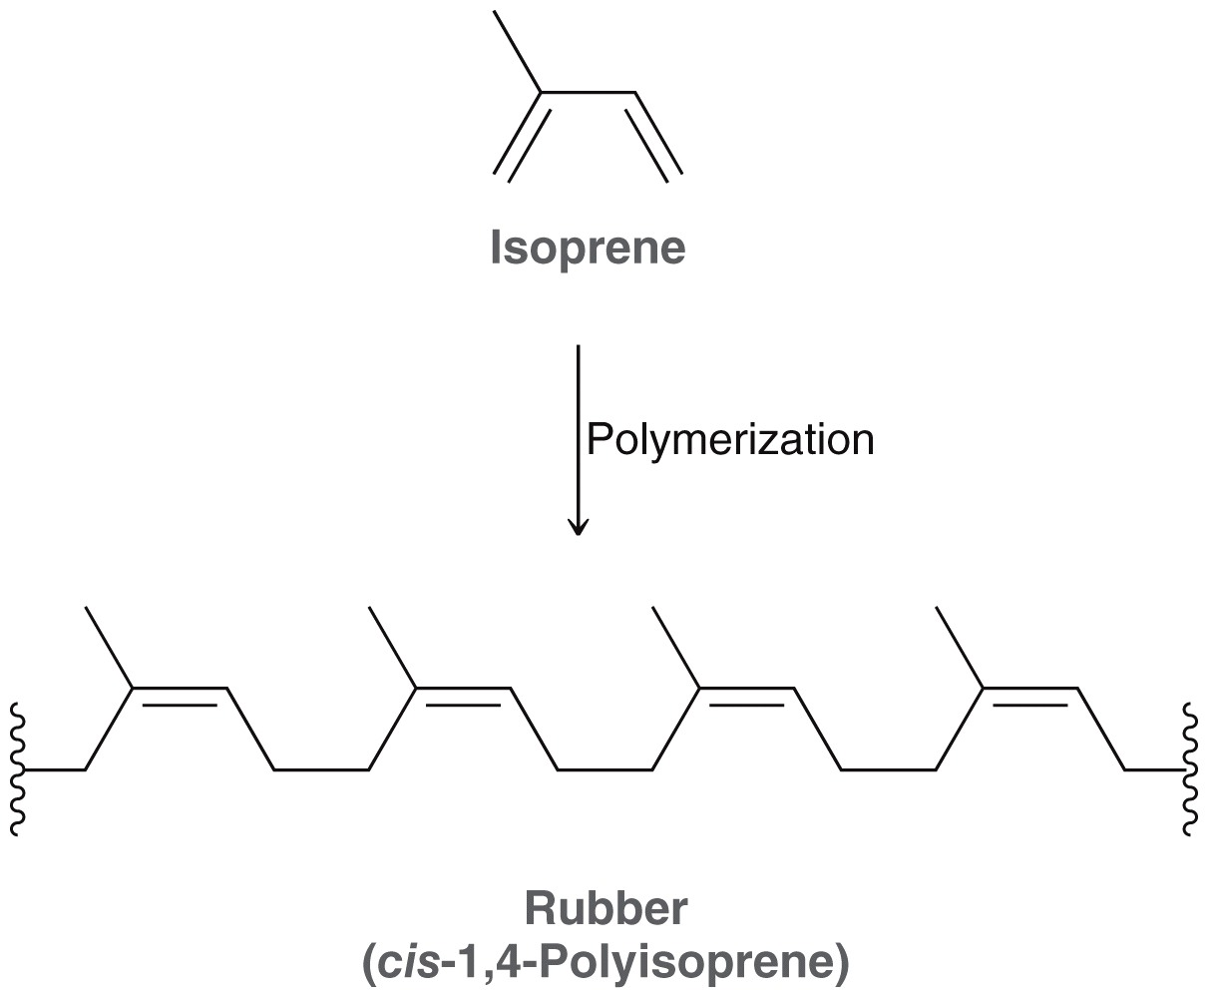
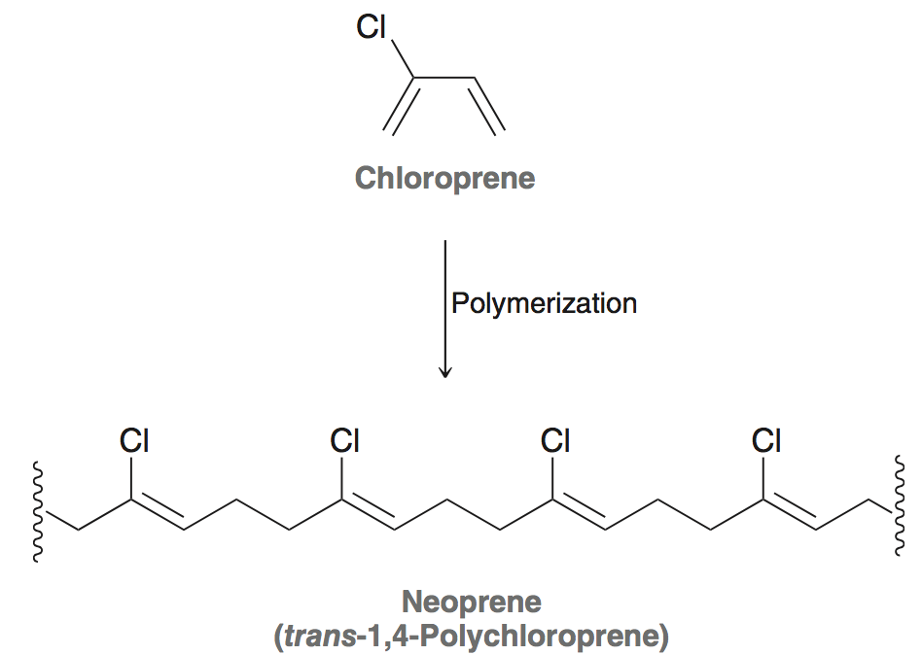
16.5 Natural and Synthetic Rubbers
Many polymerization reactions are a special case of 1,4 addition
Practice with Conceptual Checkpoint 16.12
Natural rubber
Synthetic rubber

Slide 28
16.6 Intro to Pericyclic Reactions
Pericyclic reactions occur without ionic or free radical intermediates
There are three main types of pericyclic reactions
Cycloaddition reactions

Slide 29
16.6 Intro to Pericyclic Reactions
Pericyclic reactions occur without ionic or free radical intermediates
There are three main types of pericyclic reactions
Electrocyclic Reactions

Slide 30
16.6 Intro to Pericyclic Reactions
Pericyclic reactions occur without ionic or free radical intermediates
There are three main types of pericyclic reactions
Sigmatropic Rearrangement

Slide 31
16.6 Intro to Pericyclic Reactions
Pericyclic reactions have 4 characteristic features
The reaction mechanism is concerted. It proceeds without any intermediates
The mechanism involves a ring of electrons moving around a closed loop
The transition state is cyclic
The polarity of the solvent generally has no effect on the reaction rate (transition state has little, if any, charge)

Slide 32
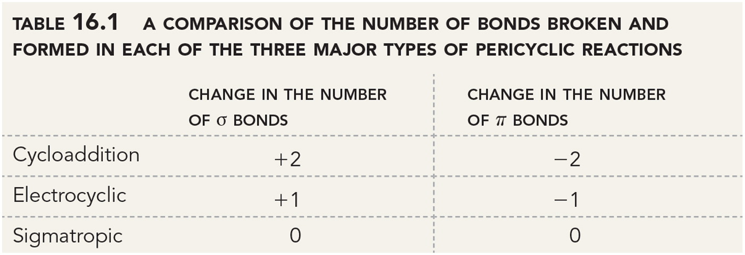
16.6 Intro to Pericyclic Reactions
Changes in the number of pi and sigma bonds distinguish the pericyclic reactions from one another

Slide 33
16.7 Diels-Alder Reactions
Diels-Alder reactions can be very useful
Like all pericyclic reactions, the mechanism is concerted (the curved arrows can be draw clockwise or counterclockwise)
[4+2] cycloaddition

Slide 34
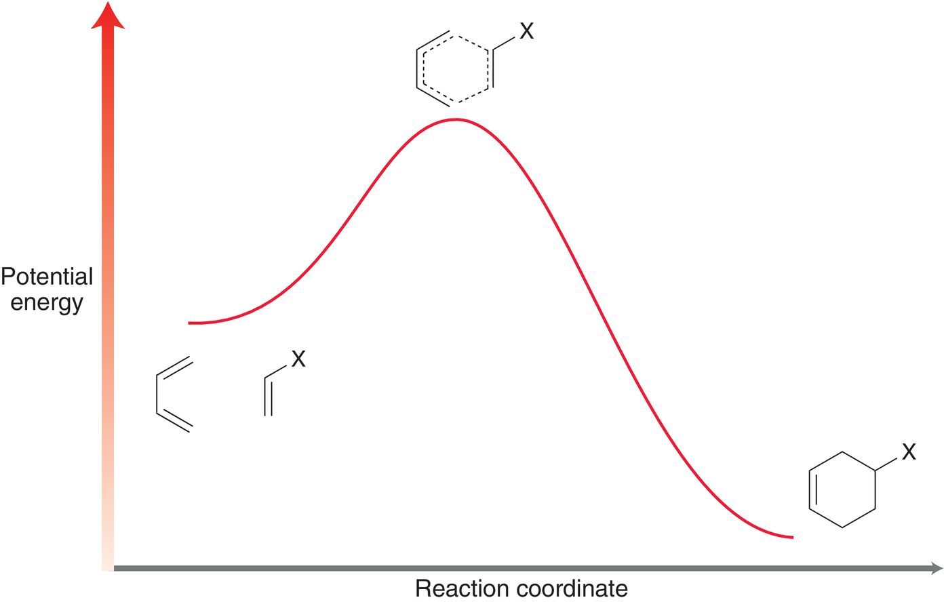
16.7 Diels-Alder Reactions

Slide 35
16.7 Diels-Alder Reactions
Most Diels-Alder reactions are thermodynamically favored at low and moderate temperatures; product stability dominates
At temperatures above 200 ˚C, the retro Diels-Alder can predominate; entropy is the dominant factor

Slide 36
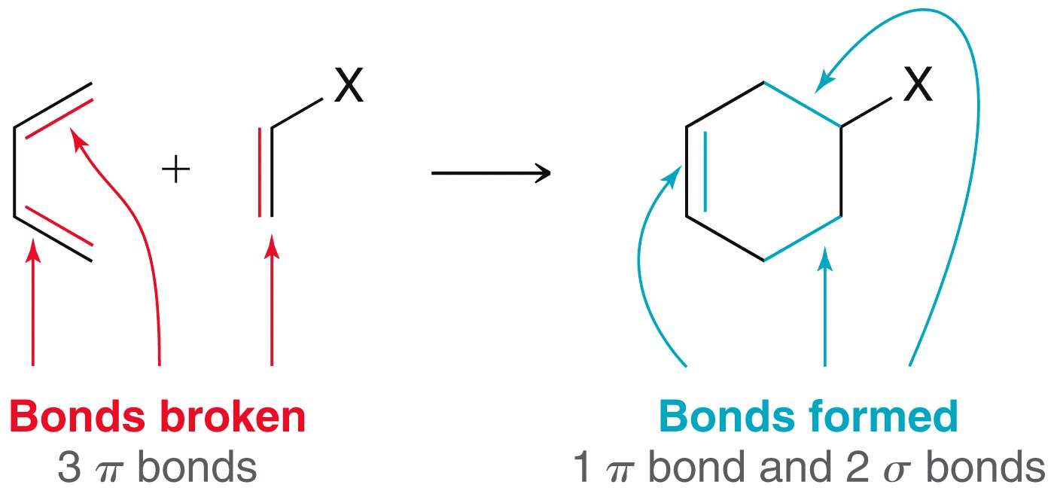
16.7 Diels-Alder Reactions
The pi bond → sigma bond conversion provides a (-)ΔH

Slide 37
16.7 Diels-Alder Reactions
ΔS should be (-), two molecules combine to form a single product

Slide 38
16.7 Diels-Alder Reactions
For Diels-Alder rxn, the enthalpy term must be larger than the entropy term for the reaction to be favored.
At very high temps, entropy term opposes the formation of product (retro Diels-Alder is favored).
Ideal temp is typically between room temp and 200 ˚C

Slide 39
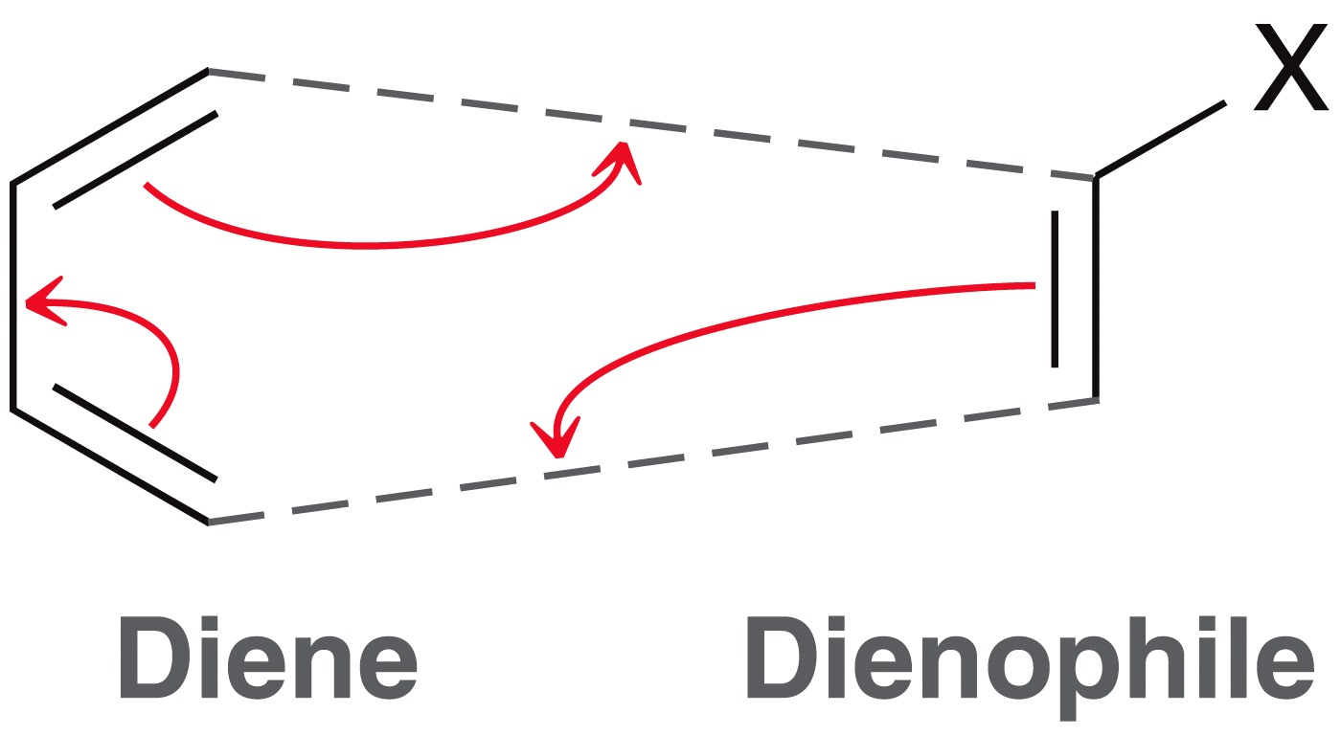
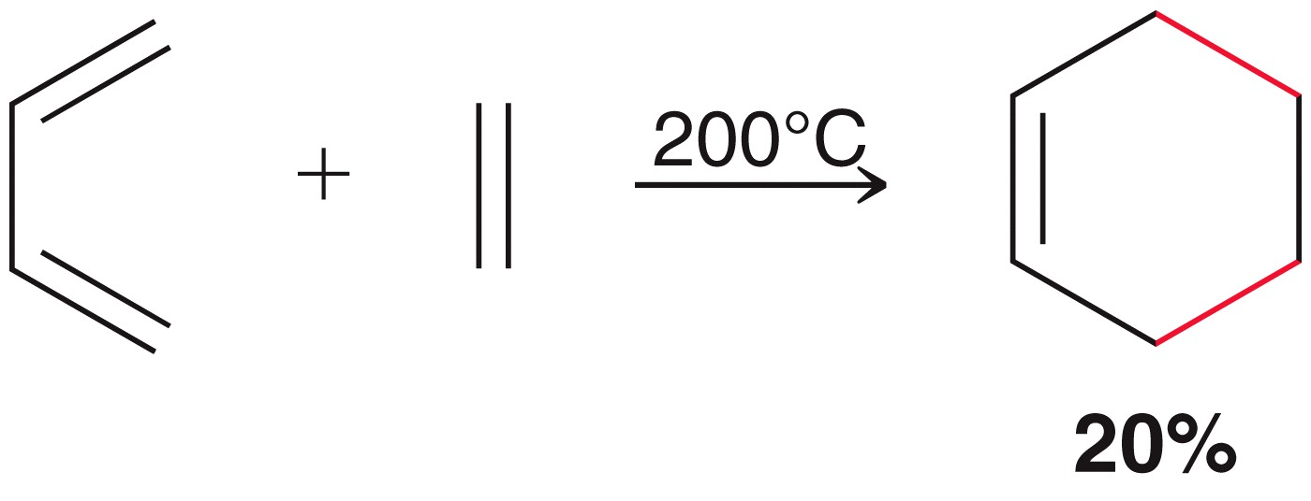
16.7 Diels-Alder Reactions
the reactants are the diene and dienophile
dienophile needs to possess an electron withdrawing group or the reaction will require high temp, which does not favor product formation

Slide 40
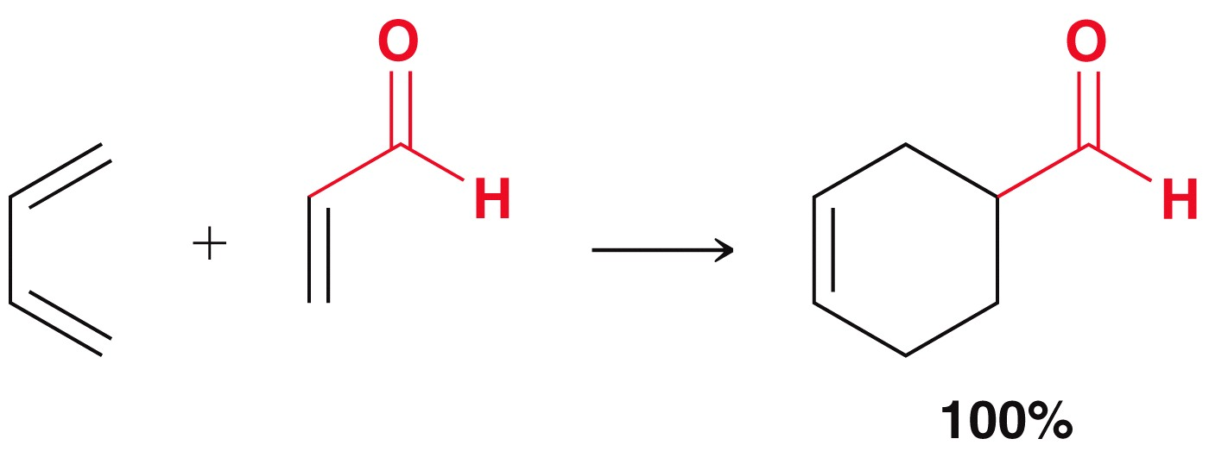
16.7 Diels-Alder Reactions
When an electron withdrawing group is attached to the dienophile, the reaction is generally spontaneous
the groups highlighted in red are electron withdrawing

Slide 41
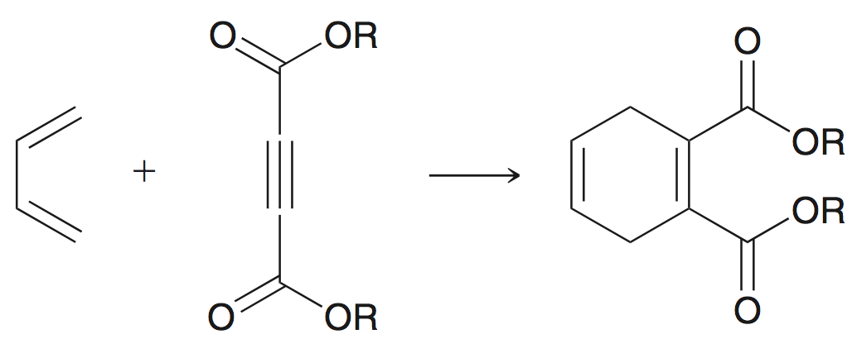
16.7 Diels-Alder Reactions
Diels-Alder reactions are stereospecific depending on whether a (E) or (Z) dienophile is used
An alkyne can also function as a dienophile:
Practice with Skillbuilder 16.3

Slide 42
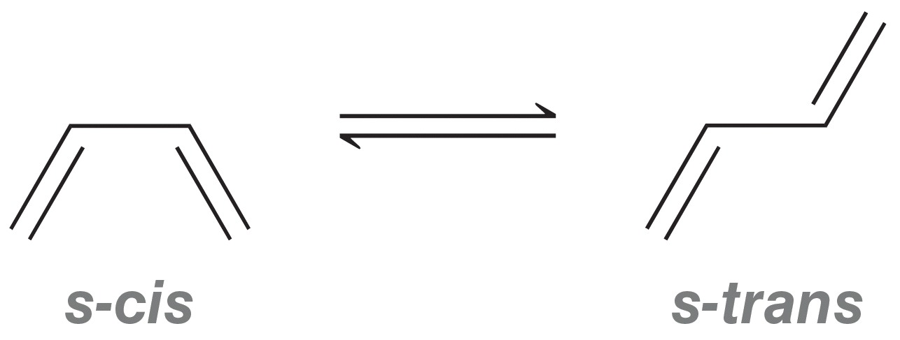
16.7 Diels-Alder Reactions
Recall that many dienes can exist in an s-cis or an s-trans conformation
Diels-Alder reactions can only occur when the diene is in the s-cis conformation

Slide 43
16.7 Diels-Alder Reactions
Dienes trapped in an s-trans conformation can not undergo Diels-Alder reaction, because carbons 1 and 4 are too far apart
Dienes that are locked into the s-cis conformation undergo Diels-Alder reactions readily
4
1

Slide 44
16.7 Diels-Alder Reactions
Cyclopentadiene is so reactive towards Diels-Alder reaction that it reacts without itself at room temperature to form a dimer:
Practice with Conceptual Checkpoint 16.15-16.16

Slide 45
16.7 Diels-Alder Reactions
When bicyclic systems form, the terms ENDO and EXO are used to describe functional group positioning

Slide 46
16.7 Diels-Alder Reactions
The electron withdrawing groups attached to dieneophiles tend to occupy the endo position. Often the endo product is the only observed product
Major product
Minor product

Slide 47
16.7 Diels-Alder Reactions
The endo transition state benefits from favorable interaction between the withdrawing groups and the developing pi bond
The exo transition state does not have the favorable interaction

Slide 48
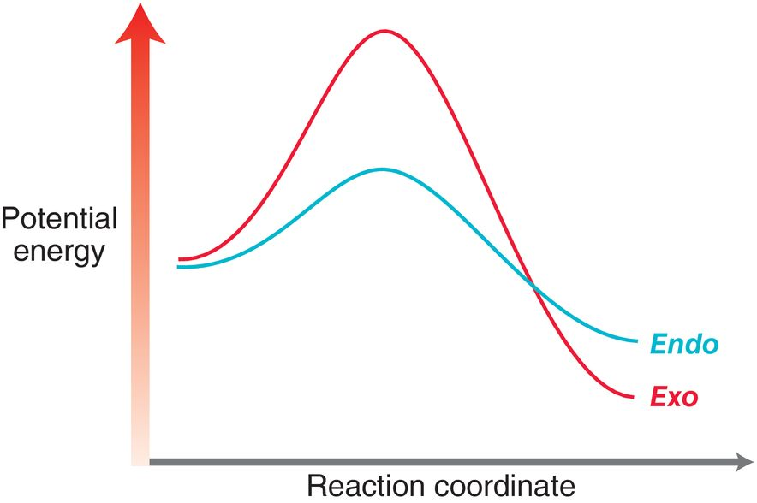
16.7 Diels-Alder Reactions
The endo transition state is lower in energy, and so the endo product forms faster:
Practice with Conceptual Checkpoint 16.17

Slide 49
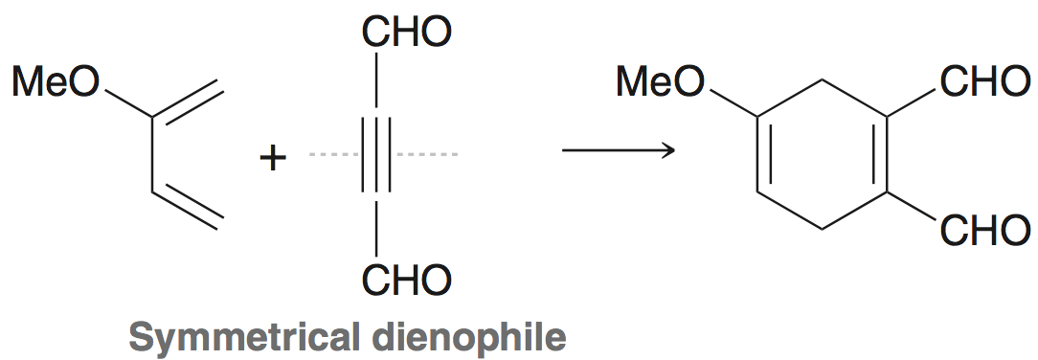
16.7 Diels-Alder Regioselectivity
Only one regiochemical outcome if the diene or dienophile is symmetrical:

Slide 50
16.7 Diels-Alder Regioselectivity
If diene and dienophile are both unsymmetrical, then two regioisomeric products are possible:
One of the regioisomers is formed as the major product; the reaction is regioselective

Slide 51
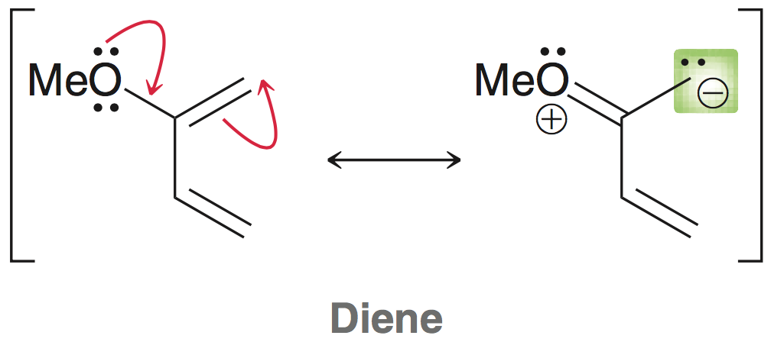
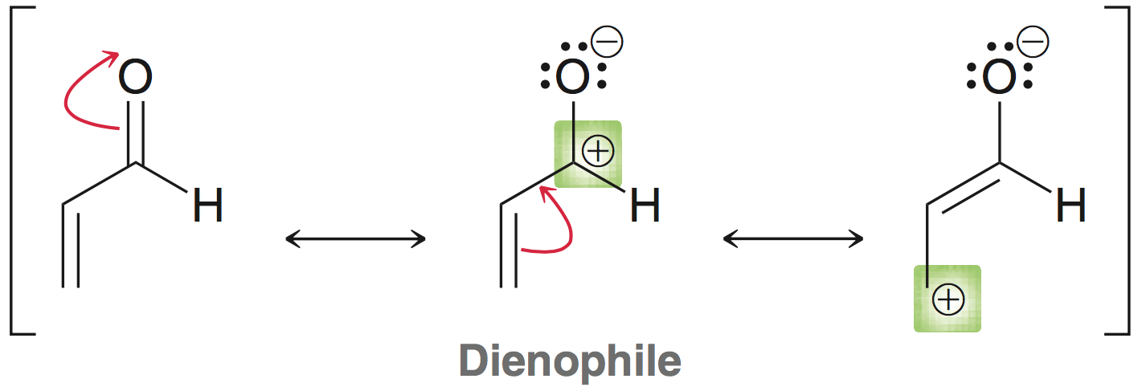
16.7 Diels-Alder Regioselectivity
The major product of Diels-Alder can be predicted by considering the charge distribution of the reactants:
Consider the location of the partial charges, and the attractive force(s) that result(s)…

Slide 52
16.7 Diels-Alder Regioselectivity
The alignment of the electrostatic forces results in a lower energy transition state; the major product is formed faster
Practice with Conceptual Checkpoint 16.18

Slide 53
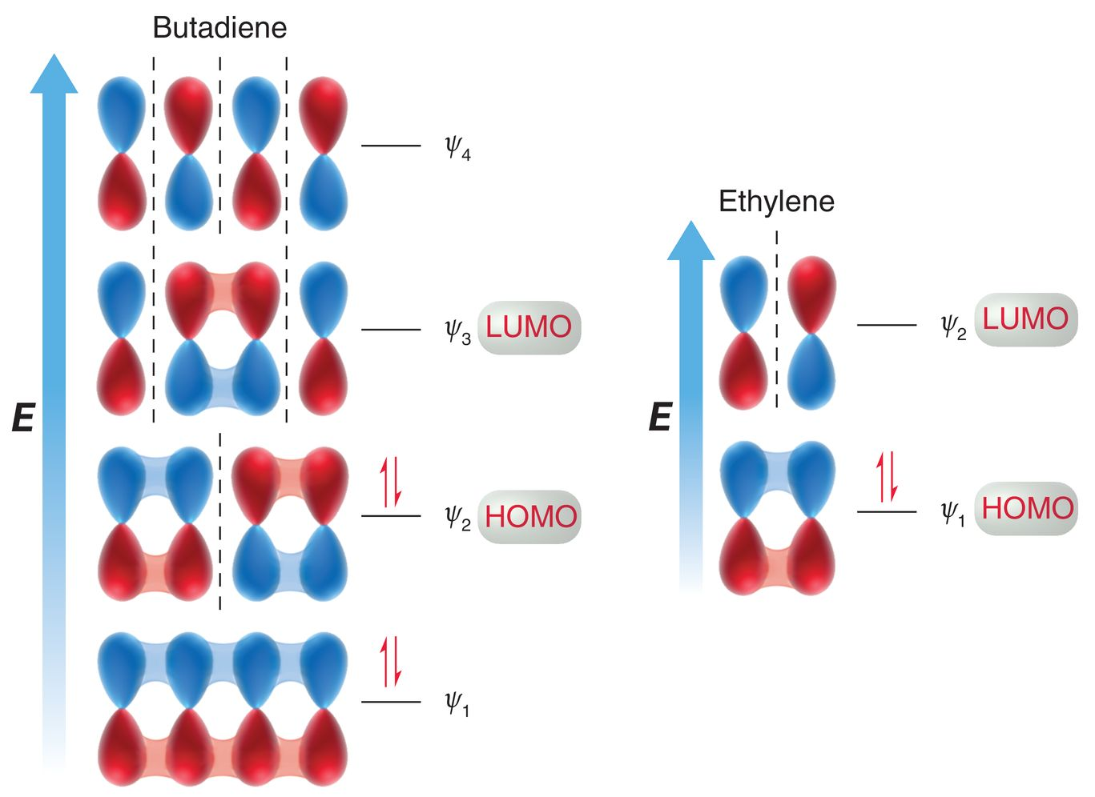
16.8 MO Descriptions of Cycloadditions
Consider the MO’s for the simplest 1,3-diene and dienophile

Slide 54
16.8 MO Descriptions of Cycloadditions
For Diels-Alder, the HOMO of one compound must interact with the LUMO of the other

Slide 55
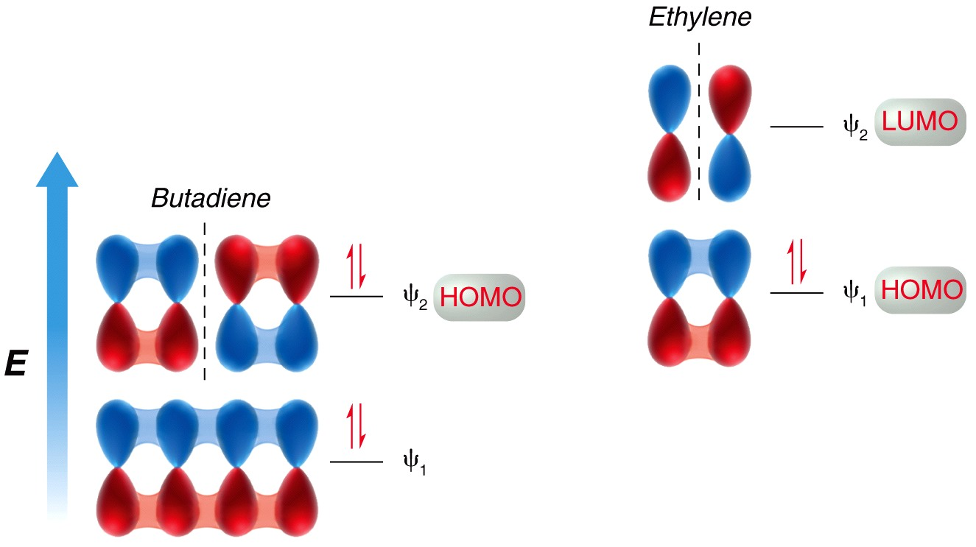
16.8 MO Descriptions of Cycloadditions
With an electron withdrawing group, the dieneophile’s LUMO will accept electrons from the diene’s HOMO

Slide 56
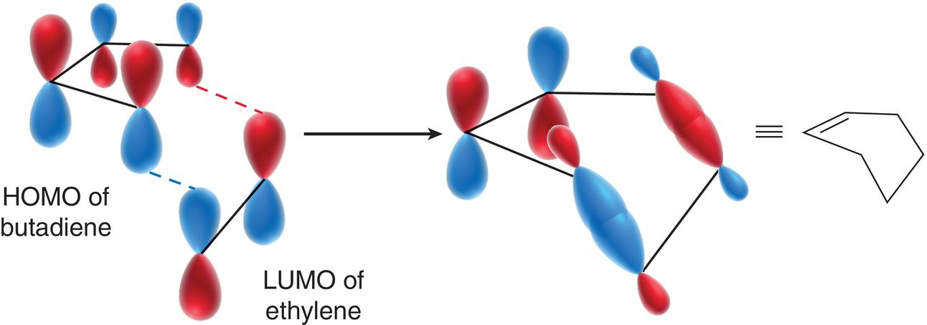
16.8 MO Descriptions of Cycloadditions
The phases of the reacting MO’s must be symmetrical
In other words, if there is conservation of orbital symmetry, then the reaction is symmetry allowed
Note the carbons that change their hybridization from sp² to sp³

Slide 57
16.8 MO Descriptions of Cycloadditions
Similar to a Diels-Alder ([4+2] cycloaddition),the reaction below is a [2+2] cycloaddition
The reacting MO’s (HOMO and LUMO) can be analyzed to determine if the reaction is symmetry-allowed.

Slide 58
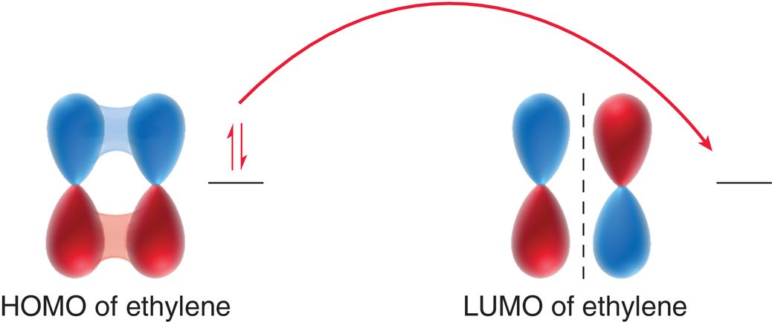
16.8 MO Descriptions of Cycloadditions
The LUMO of one reactant must have the same symmetry as the HOMO of the other reactant, in order for reaction to occur:

Slide 59
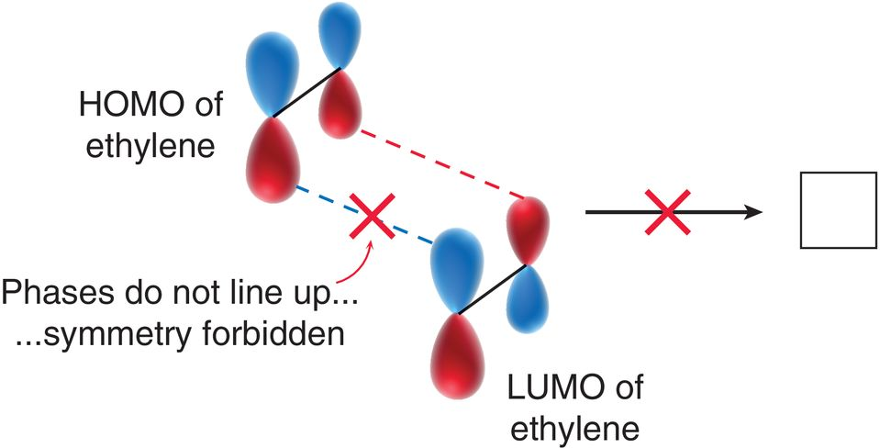
16.8 MO Descriptions of Cycloadditions
The phases of the HOMO and LUMO can not line up; the reaction is symmetry-forbidden:

Slide 60
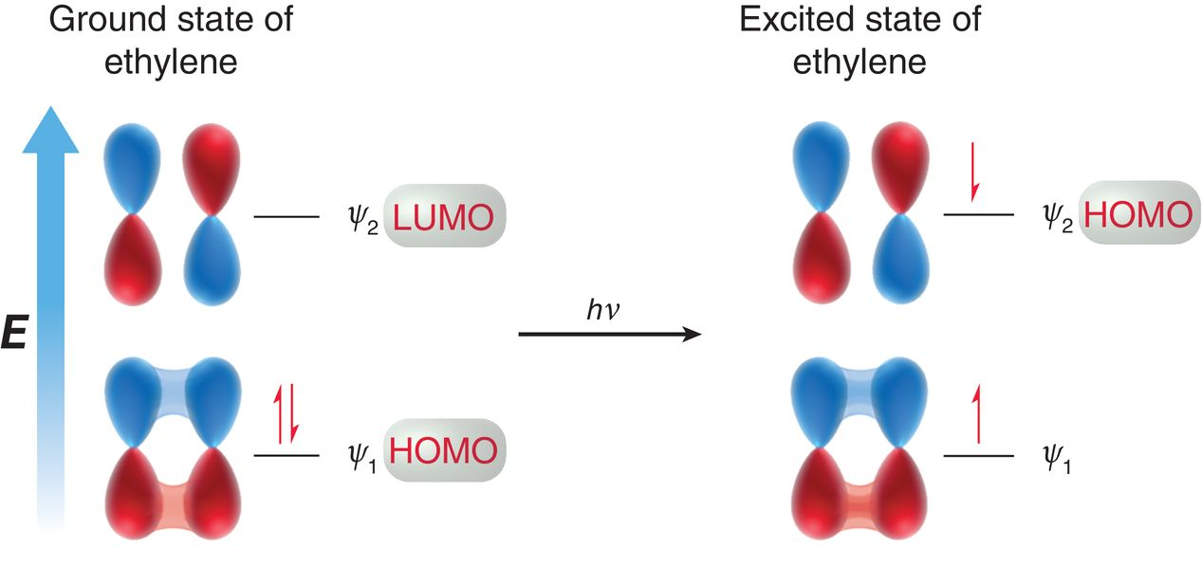
16.8 MO Descriptions of Cycloadditions
[2+2] cycloadditions are only possible when light is used to excite an electron

Slide 61
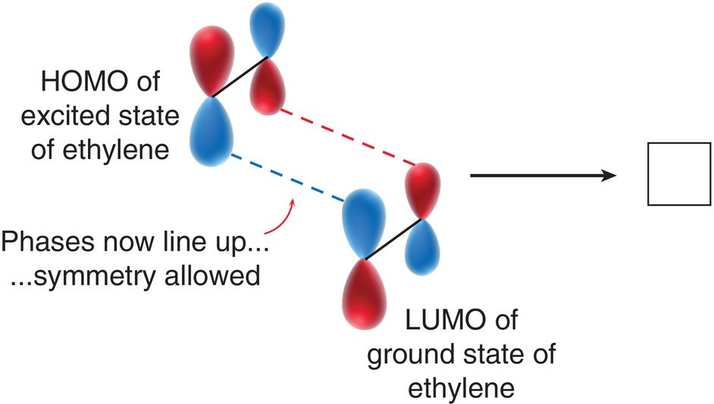
16.8 MO Descriptions of Cycloadditions
[2+2] cycloadditions are only possible when light is used to excite an electron. In this case the reaction is symmetry-allowed:
Practice with Conceptual Checkpoint 16.19

Slide 62
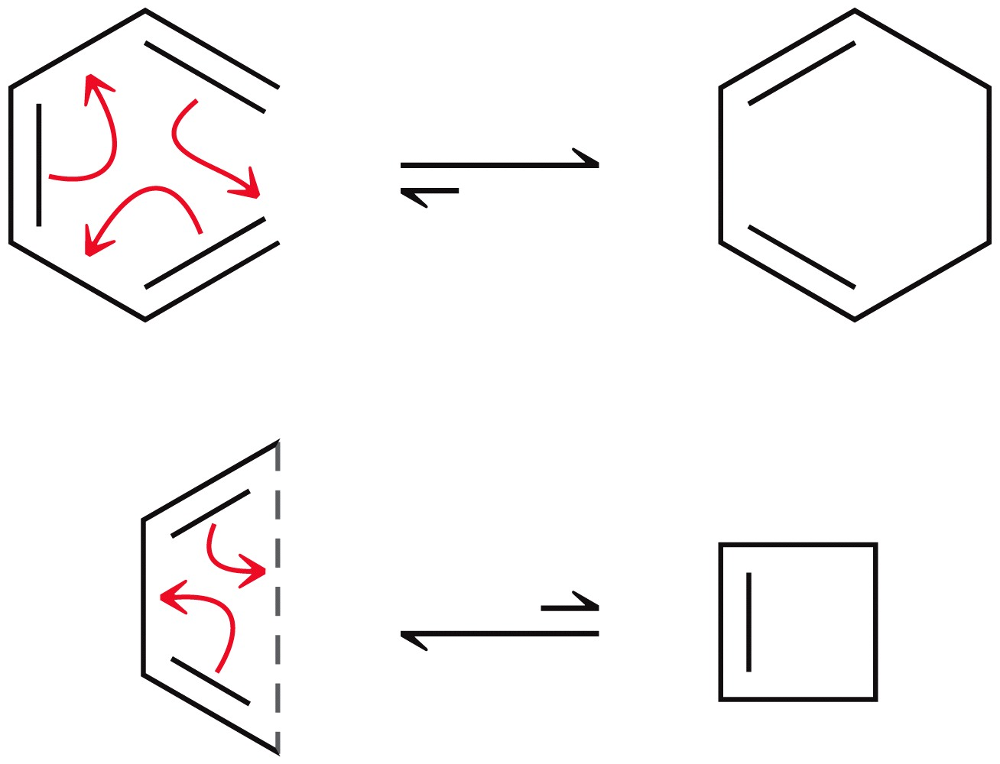
16.9 Intro to Electrocyclic Reactions
Electrocyclic reaction – pericyclic process where a conjugated polyene undergoes cyclization:
Overall, a π-bond is converted to a σ-bond

Slide 63
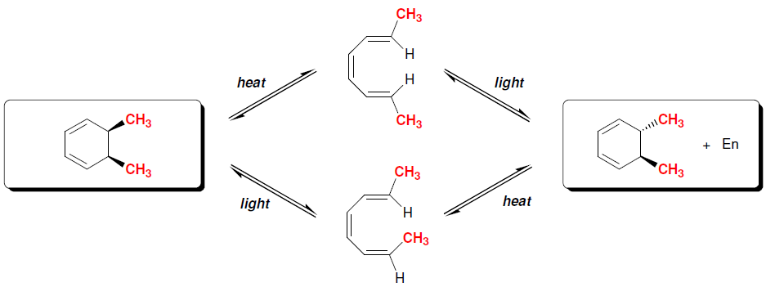
16.9 Electrocyclic Reactions
When substituents are present on the terminal carbons, stereoisomers are possible:
Note that the use of light versus heat yields different stereoisomers

Slide 64
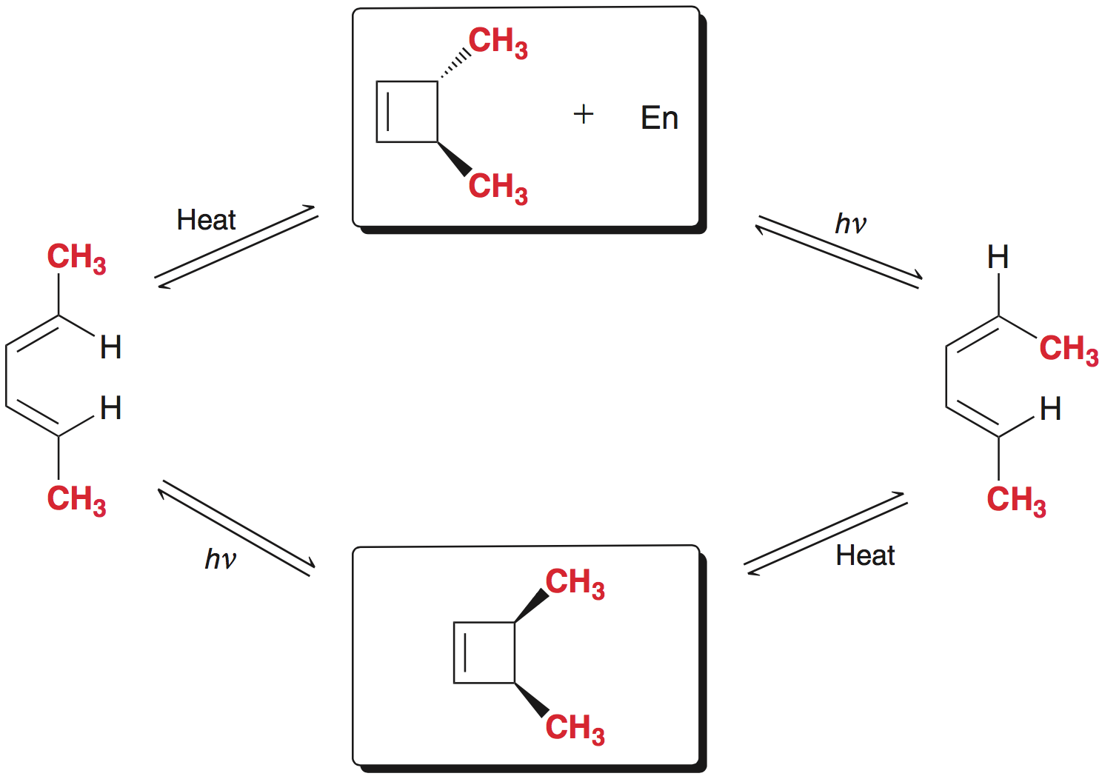
16.9 Electrocyclic Reactions
Note that both the stereochemistry of the reactants AND the conditions (heat vs. light) affect the stereochemistry of the product
Conservation of orbital symmetry explains this observation

Slide 65
16.9 Electrocyclic Reactions
Consider the stereochemical outcome resulting from thermal cyclization of a π system with three conjugated π bonds:
Note: room temperature is often sufficient to facilitate thermal cyclization

Slide 66
16.9 Electrocyclic Reactions
The symmetry of the HOMO determines the outcome
The outermost lobes of the HOMO rotate so like phases overlap

Slide 67
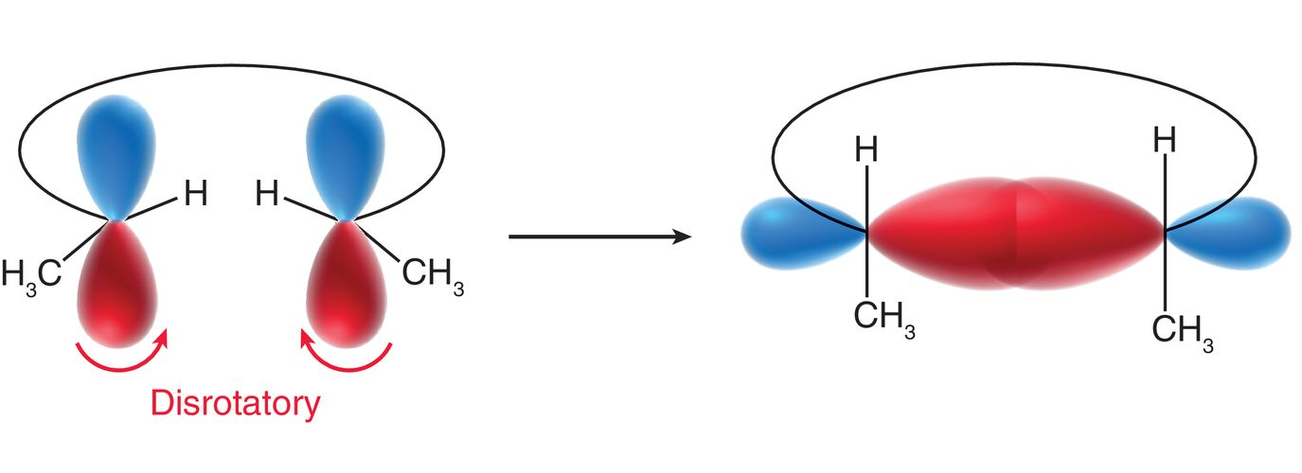
16.9 Electrocyclic Reactions
The outermost lobes of the HOMO rotate so like phases overlap
Disrotatory rotation (one rotates clockwise and the other counterclockwise) gives the cis product

Slide 68
16.9 Electrocyclic Reactions
The symmetry of the HOMO determines the outcome
The outermost lobes of the HOMO rotate as they become sp³ hybridized so that like phases overlap

Slide 69
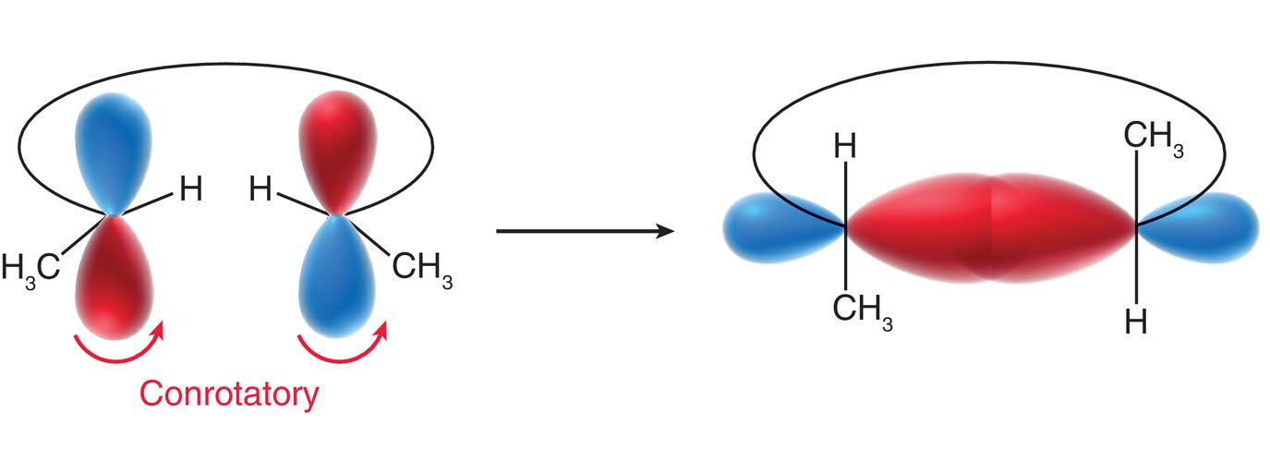
16.9 Electrocyclic Reactions
The outermost lobes of the HOMO rotate so like phases overlap
conrotatory rotation - both rotate clockwise the same direction, to yield (in this example) the trans product

Slide 70
16.9 Electrocyclic Reactions
Under thermal conditions:
Conjugated systems with 6 π electrons = disrotatory
Conjugated systems with 4 π electrons = conrotatory
Practice with Conceptual Checkpoint 16.20

Slide 71
16.9 Electrocyclic Reactions
Under photochemical conditions, light energy excites an electron from the HOMO to the LUMO
What was the LUMO becomes the new HOMO

Slide 72
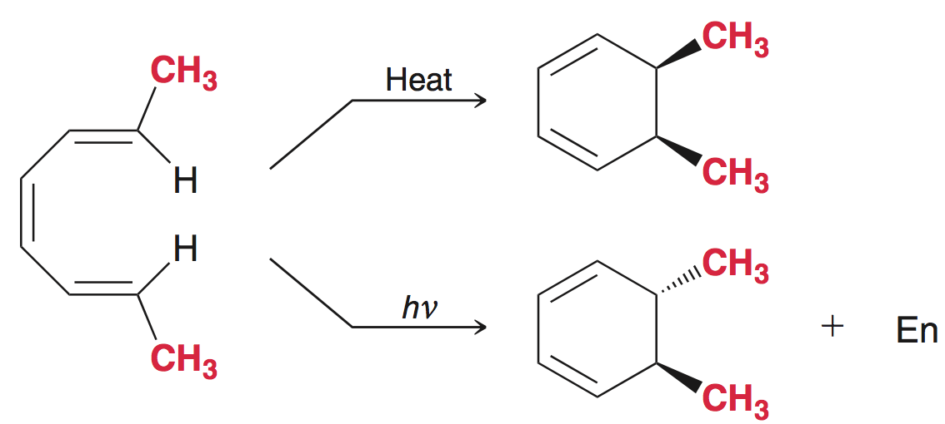
16.9 Electrocyclic Reactions
In this case, cyclization must occur in a conrotatory fashion
Disrotatory cyclization
conrotatory cyclization

Slide 73
16.9 Electrocyclic Reactions
The same “switching” of stereochemistry is also observed in conjugated systems with 4 π electrons:
conrotatory cyclization
Disrotatory cyclization

Slide 74
16.9 Electrocyclic Reactions
The Woodward-Hoffmann rules summarize the trends for electrocyclic reactions:
Practice with SkillBuilder 16.4

Slide 75
16.10 Sigmatropic Rearrangements
Sigmatropic Rearrangements – a pericyclic reaction in which one sigma bond is replaced with another
the location of the π bonds changes as well

Slide 76
16.10 Sigmatropic Rearrangements
notation for sigmatropic rearrangements:
Count the number of atoms on each side of the sigma bonds that are breaking and forming
This is a [3,3] sigmatropic rearrangement

Slide 77
16.10 Sigmatropic Rearrangements
[1,5] sigmatropic rearrangement

Slide 78
16.10 Sigmatropic Rearrangements
Cope rearrangement - a [3,3] sigmatropic reaction in which all 6 atoms in the cyclic transition state are carbon atoms
Equilibrium favors the more substitute alkene(s)

Slide 79
16.10 Sigmatropic Rearrangements
Claisen rearrangement - a [3,3] sigmatropic reaction and is the oxygen analogue of a Cope rearrangement:
Occurs with allylic vinylic ethers
Equilibrium favors the formation of the C=O bond (more stable than a C=C bond)

Slide 80
16.10 Sigmatropic Rearrangements
Claisen rearrangement - a [3,3] sigmatropic reaction and is the oxygen analogue of a Cope rearrangement:
Also observed with allylic aryl ethers
Practice with Conceptual Checkpoint 16.23 – 16.26

Slide 81
16.10 Sigmatropic Rearrangements
Two pericyclic reactions occur in the biosynthesis of Vitamin D

Slide 82
16.11 UV-Vis Spectroscopy
Compounds with conjugated π systems absorb UV or visible light
Light energy is converted into potential energy

Slide 83
16.11 UV-Vis Spectroscopy
In general, the necessary energy to excite an electron from π → π* (HOMO to LUMO) falls within the UV or visible region of the spectrum

Slide 84
16.11 UV-Vis Spectroscopy
UV-Vis spectroscopy gives structural information about molecules
The amount of light absorbed by a sample is function of wavelength, called absorbance (A):
UV-Vis spectrum of butadiene

Slide 85
16.11 UV-Vis Spectroscopy
More conjugation gives a smaller π → π* energy gap
The smaller the energy gap, the greater the λ_{max}
217
258
290

Slide 86
16.11 UV-Vis: Woodward-Fieser Rules
The group of atoms responsible for absorbing UV-Vis light is known as the chromophore
Woodward and Fieser developed rules to predict λ_{max} for chromophore starting with butadiene as the base

Slide 87
16.11 UV-Vis Spectroscopy
The Woodward-Fieser rules are a guide to estimate λ_{max}

Slide 88
16.11 UV-Vis Spectroscopy
Practice with SkillBuilder 16.5

Slide 89
16.12 Color
Highly conjugated compounds absorb light in the visible region of the spectrum (400-700 nm)
Responsible for the red color of tomatoes
Responsible for the orange color of carrots

Slide 90
16.12 Color
The color observed by your eyes will be the opposite of what is required to cause the π → π* excitation.
Practice with Conceptual Checkpoint 16.29

Slide 91
16.13 Chemistry of Vision
Rods and Cones are photosensitive cells in your eyes:
Rods: do not detect color (they dominate in dim lighting).
Cones: are responsible for detection of color.
Light-sensitive compounds in rods

Slide 92
16.13 Chemistry of Vision
Sources of 11-cis-retinal include Vitamin A and β-carotene

Slide 93
16.13 Chemistry of Vision
When rhodopsin is excited photochemically, a change in shape occurs that causes a release of Ca²⁺ ions
The Ca²⁺ ions block channels through which billions of Na⁺ ions generally travel each second
The decrease of Na⁺ ion flow culminates in a nerve impulse to the brain
Our eyes are extremely sensitive
Just a few photons can cause a nerve impulse

