Slide 1
Organic Chemistry
Third Edition
David Klein
Chapter 20
Carboxylic Acids and Their Derivatives

Slide 2
20.1 Introduction Carboxylic Acids
Carboxylic acids are abundant in nature, and found in a wide variety of synthetic pharmaceuticals

Slide 3
20.1 Introduction Carboxylic Acids
The US produces over 2.5 million tons of acetic acid per year, which is primarily used to produce vinyl acetate
Vinyl acetate is used in paints and adhesives
Carboxylic acid derivatives such as vinyl acetate are very common and play a central role in organic chemistry

Slide 4
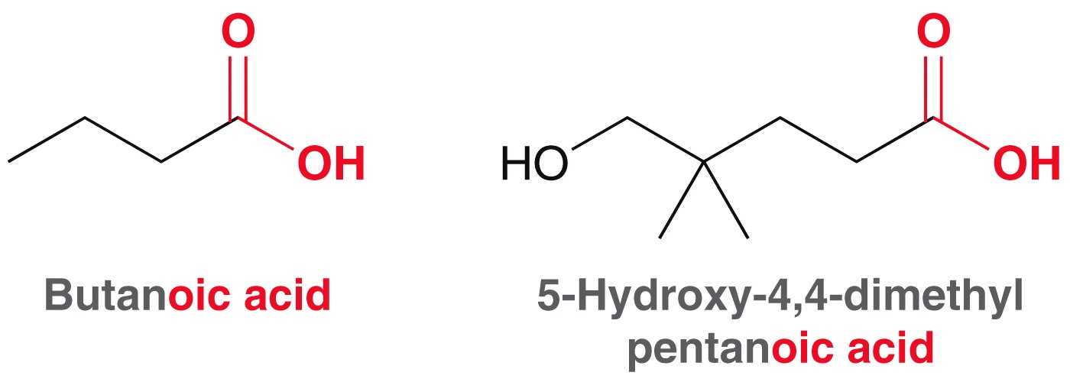
20.2 Nomenclature of Carboxylic Acids
Monocarboxylic acids are named with the suffix “oic acid”
The carbon of the carboxylic acid moiety is assigned locant position 1

Slide 5
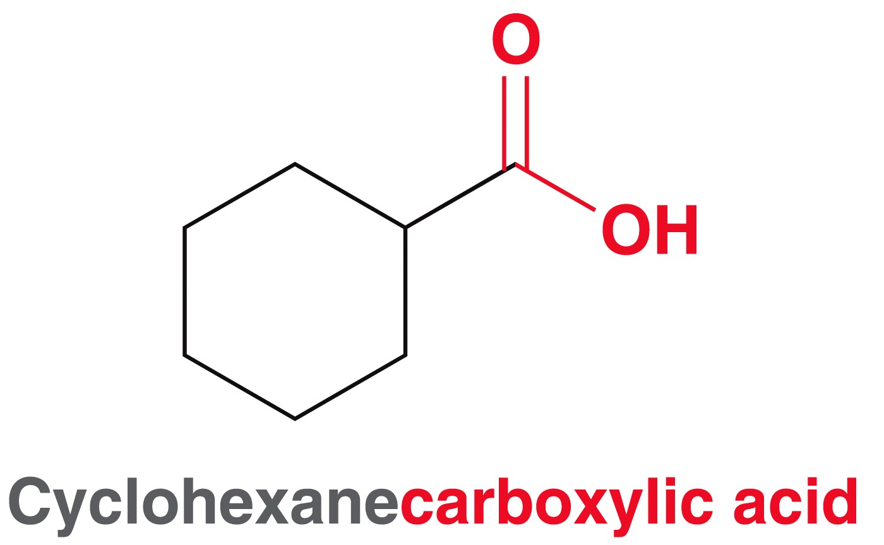
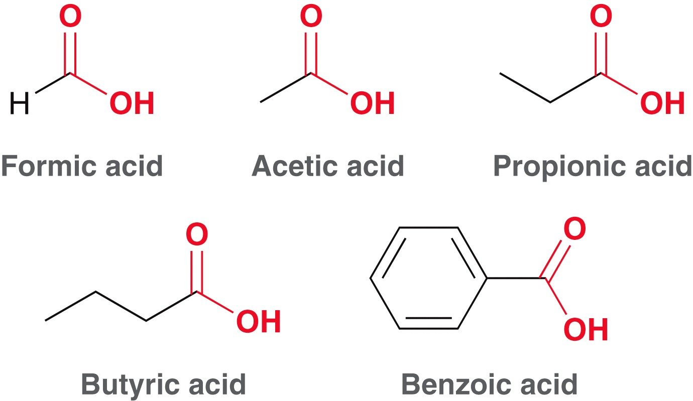
20.2 Nomenclature of Carboxylic Acids
When the carboxylic acid group is attached to a ring, it is named as an alkane carboxylic acid
There are also many common names for carboxylic acids

Slide 6
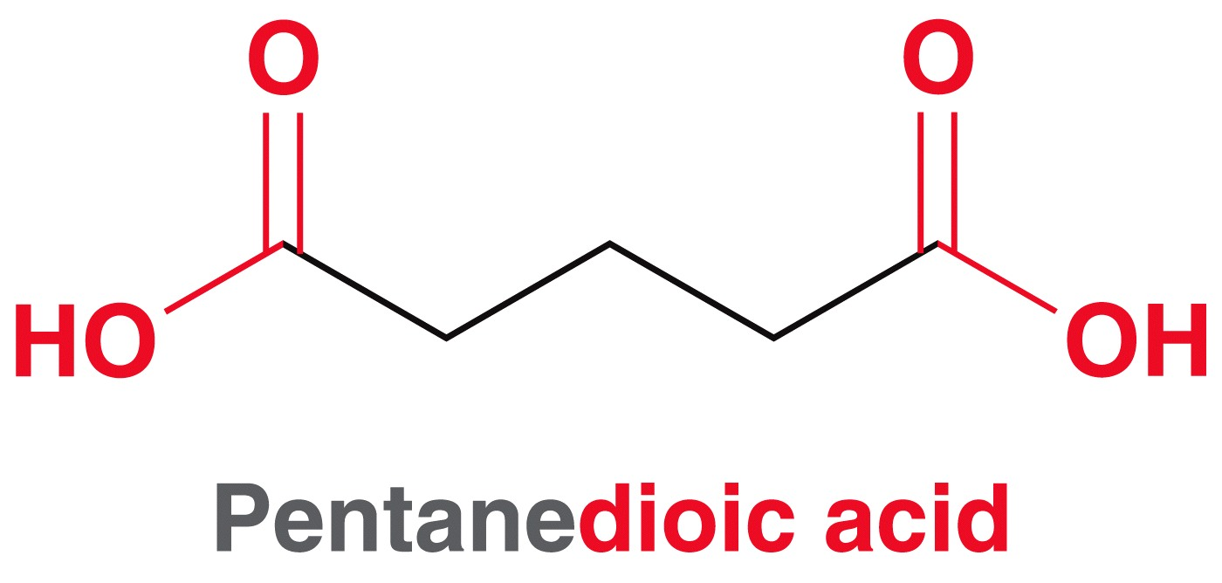
20.2 Nomenclature of Carboxylic Acids
Dicarboxylic acids are named with the suffix “dioic acid”
Some dicarboxylic acids have common names
Practice with Conceptual Checkpoints 20.1 – 20.3

Slide 7
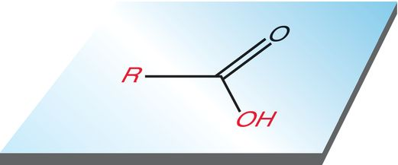
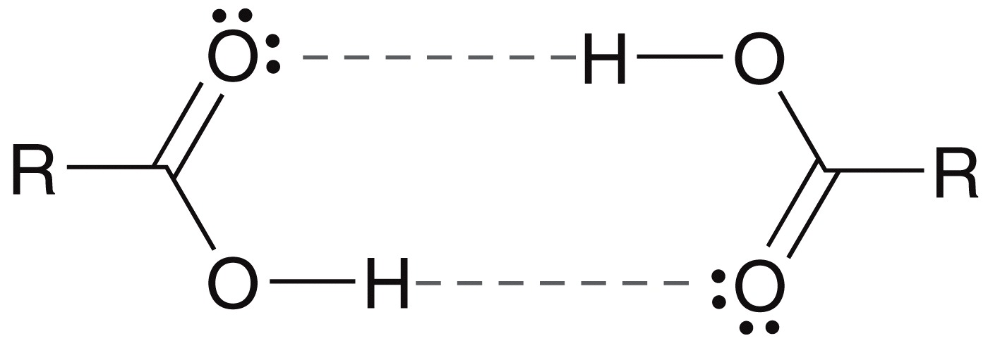
20.3 Structure & Properties of Carb. Acids
Recall the carbonyl has trigonal planar geometry
The acid moiety is capable of strong hydrogen bonding including H-bonding between acid pairs
As a result, carboxylic acids have higher boiling points than alcohols

Slide 8
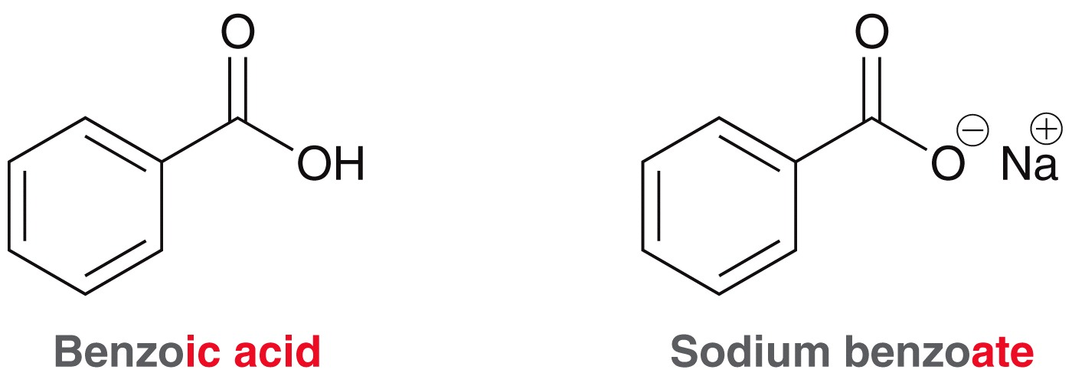
20.3 Structure & Properties of Carb. Acids
Recall carboxylic acids are weak acids, and exist as a carboxylate salt in the presence of base:
Carboxylate ions end in the suffix “oate”

Slide 9
20.3 Structure & Properties of Carb. Acids
In water, carboxylic acids only dissociate slightly (i.e. they are weak acids)
pK_{a} of most carboxylic acids is between 4 and 5.

Slide 10
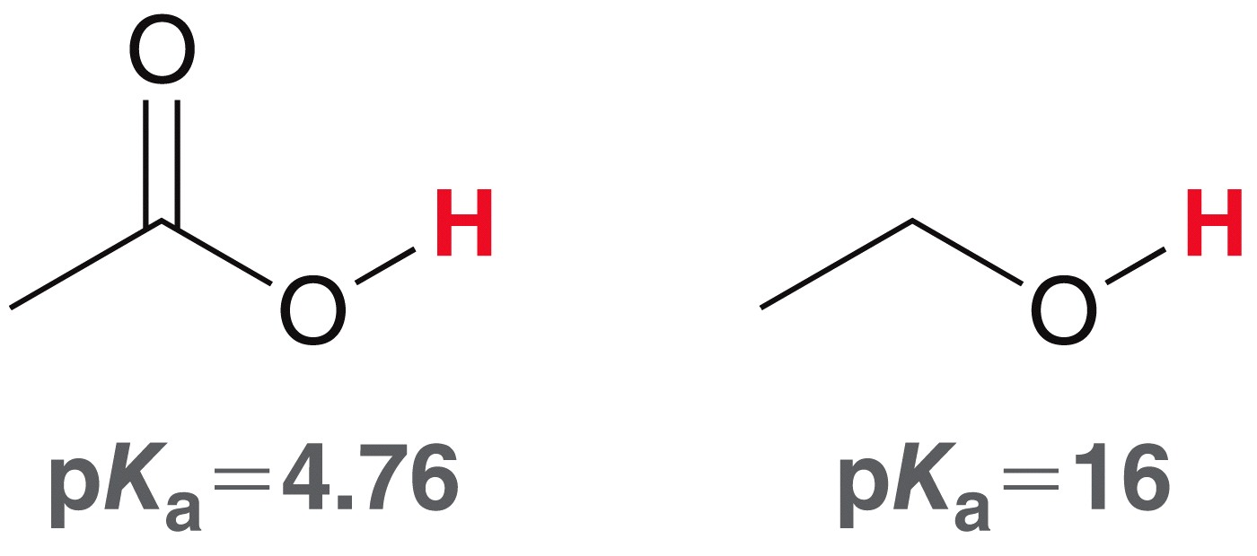
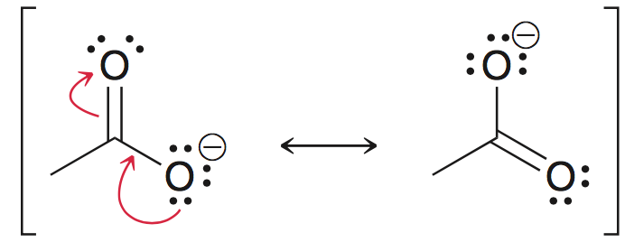
20.3 Structure & Properties of Carb. Acids
Compared to HCl or H2SO4, carboxylic acids are very weak acids.
Compared to an alcohol, they are relatively acidic:
Recall the stability of the conjugate base (carboxylate) due to resonance:
Practice with conceptual checkpoints 20.4 through 20.7

Slide 11
20.3 Structure & Properties of Carb. Acids
Consider the equilibrium between a carboxylic acid and a carboxylate at physiological pH (7.3)
The acid and the conjugate act as a buffer
Recall the Henderson-Hasselbalch equation:
At physiological pH (7.3) the ratio of a carboxylate ion and the corresponding carboxylic acid is 1000:1

Slide 12
20.3 Structure & Properties of Carb. Acids
At physiological pH (7.3) the ratio of a carboxylate ion and the corresponding carboxylic acid is 1000:1
pyruvic acid exists primarily as the pyruvate ion as physiological pH:
Carboxylate ions, and their vital roles in biology, is covered in chapter 25
(favored)

Slide 13
20.3 Structure & Properties of Carb. Acids
Recall, electron-withdrawing substituents have a great effect on acidity
The stronger and/or closer they are to the acidic proton, the stronger the acid:

Slide 14
20.3 Structure & Properties of Carb. Acids
Electron withdrawing substituents affect benzoic acid as well
Practice with Conceptual Checkpoints 20.8 – 20.9

Slide 15
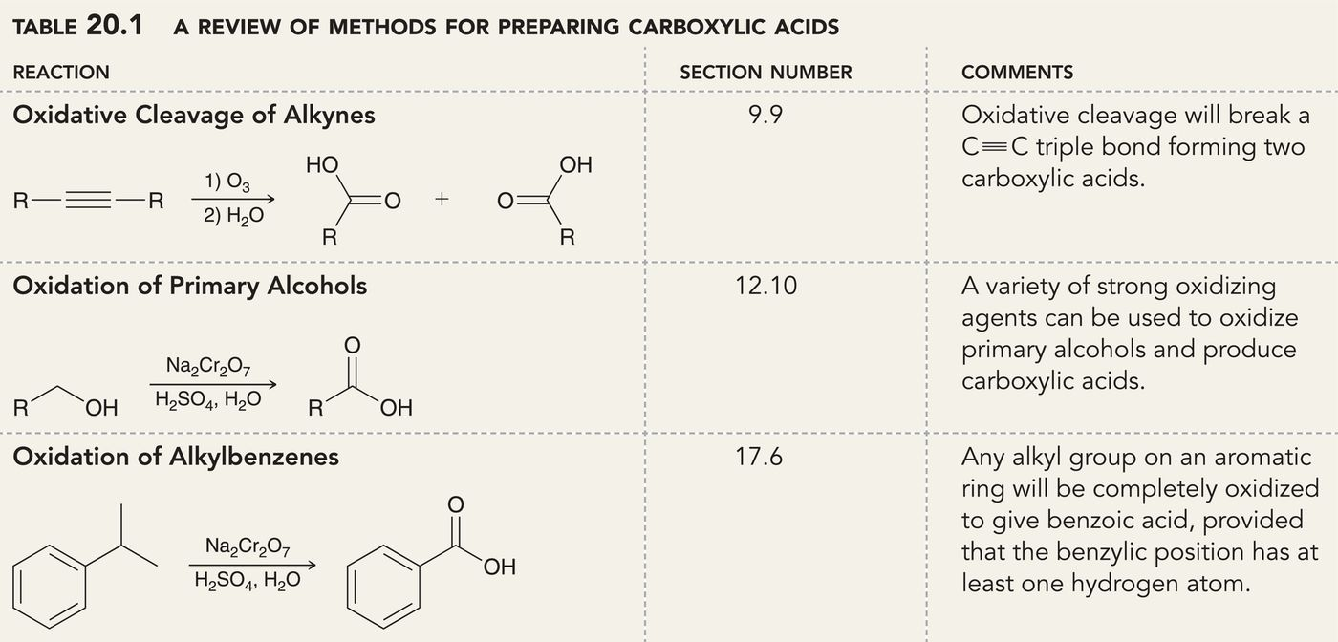
20.4 Preparation of Carboxylic Acids
Recall the reactions that produce a carboxylic acid, covered in earlier chapters:

Slide 16
20.4 Preparation of Carboxylic Acids
Two more reactions that produce a carboxylic acid:
Hydrolysis of nitriles
This allows a two-step synthesis of a carboxylic acid from an alkyl halide:

Slide 17
20.4 Preparation of Carboxylic Acids
Two more reactions that produce a carboxylic acid:
Carboxylation of a Grignard reagent w/ CO₂:
Acidic workup is necessary, as with any Grignard reaction

Slide 18
20.4 Preparation of Carboxylic Acids
This gives us a second method to convert an alkyl halide into a carboxylic acid in a two-step synthesis:
Practice with Conceptual Checkpoint 20.10

Slide 19
20.5 Reactions of Carboxylic Acids
Carboxylic acids can be reduced to a 1˚ alcohol with LAH
LAH is a strong base, so it deprotonates the carboxylic acid first:
Carboxylate is formed

Slide 20
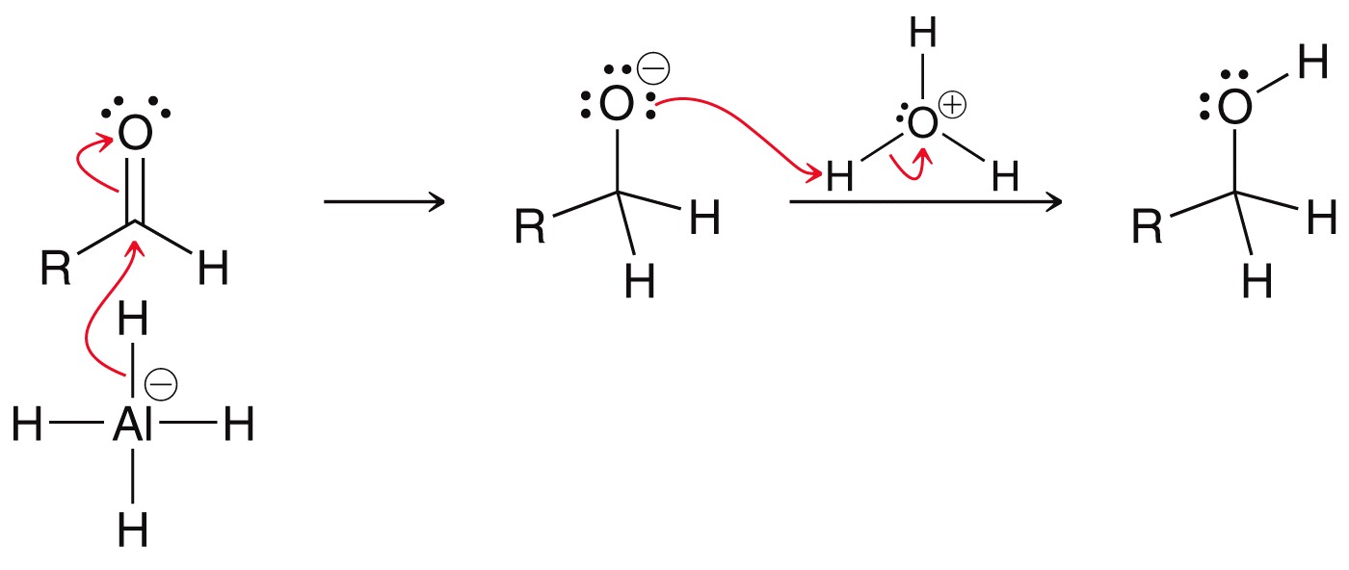
20.5 Reactions of Carboxylic Acids
The carboxylate is reduced to an aldehyde…
… and the aldehyde is reduced to the 1˚ alcohol

Slide 21
20.5 Reactions of Carboxylic Acids
BH₃ can be used, instead of LAH, and is chemoselective for the carboxylic acid.
Chemoselectivity of BH₃ allows for reduction of a carboxylic acid in the presence of an ester:
Practice with Conceptual Checkpoint 20.11

Slide 22
20.6 Carboxylic Acid Derivatives
Note the reduction of a carboxylic acid involves a change in oxidation state:
There are also many reactions where carboxylic acids don’t change the oxidation state, if Z = heteroatom
carboxylic
acid
derivatives
carboxylic
acid

Slide 23
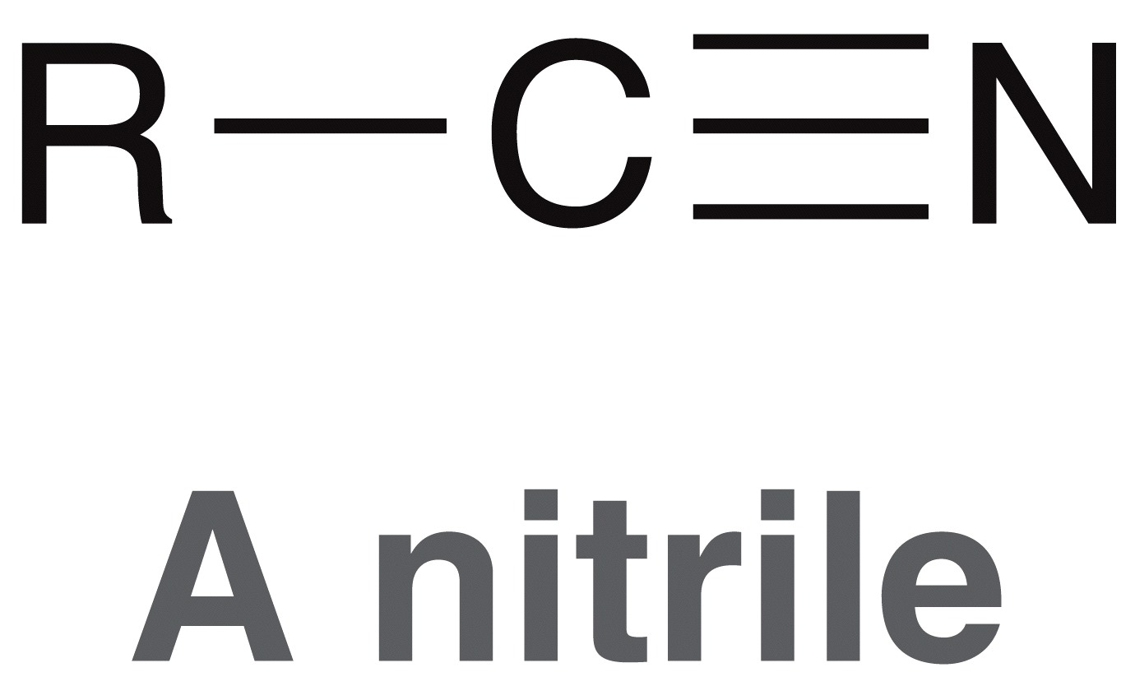
20.6 Carboxylic Acid Derivatives
Most common carboxylic acid derivatives:
Any compound where carbon has three bonds to electronegative atom(s) is a carboxylic acid derivative:

Slide 24
20.6 Carboxylic Acid Derivatives
Acid halides and anhydrides are relatively unstable, and are not common in naturally occurring compounds
Esters and amides are abundant in nature

Slide 25
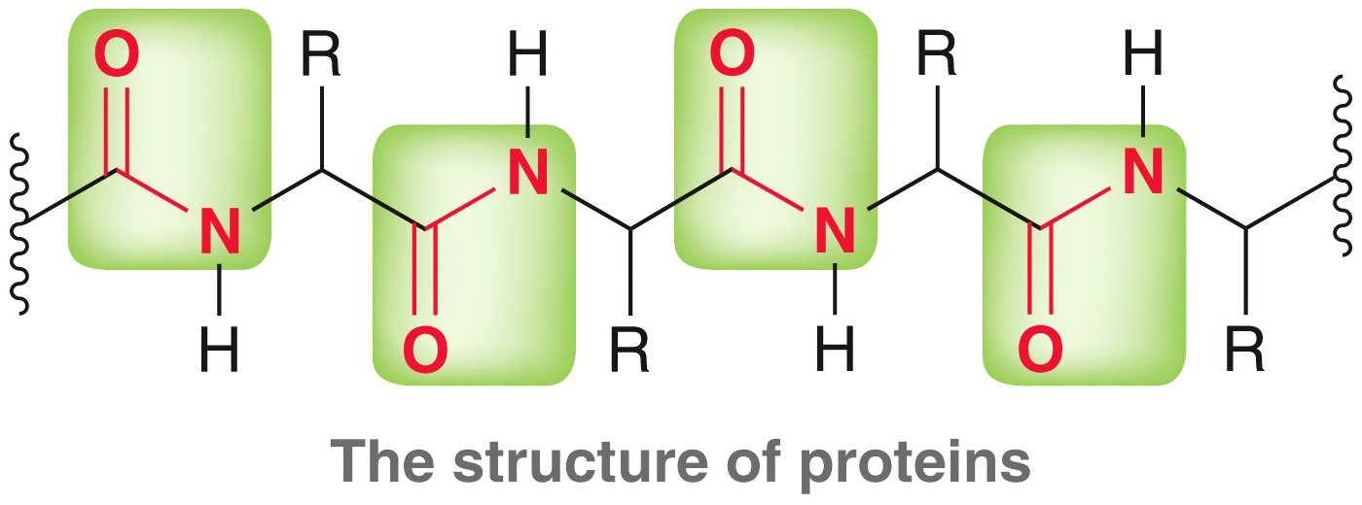
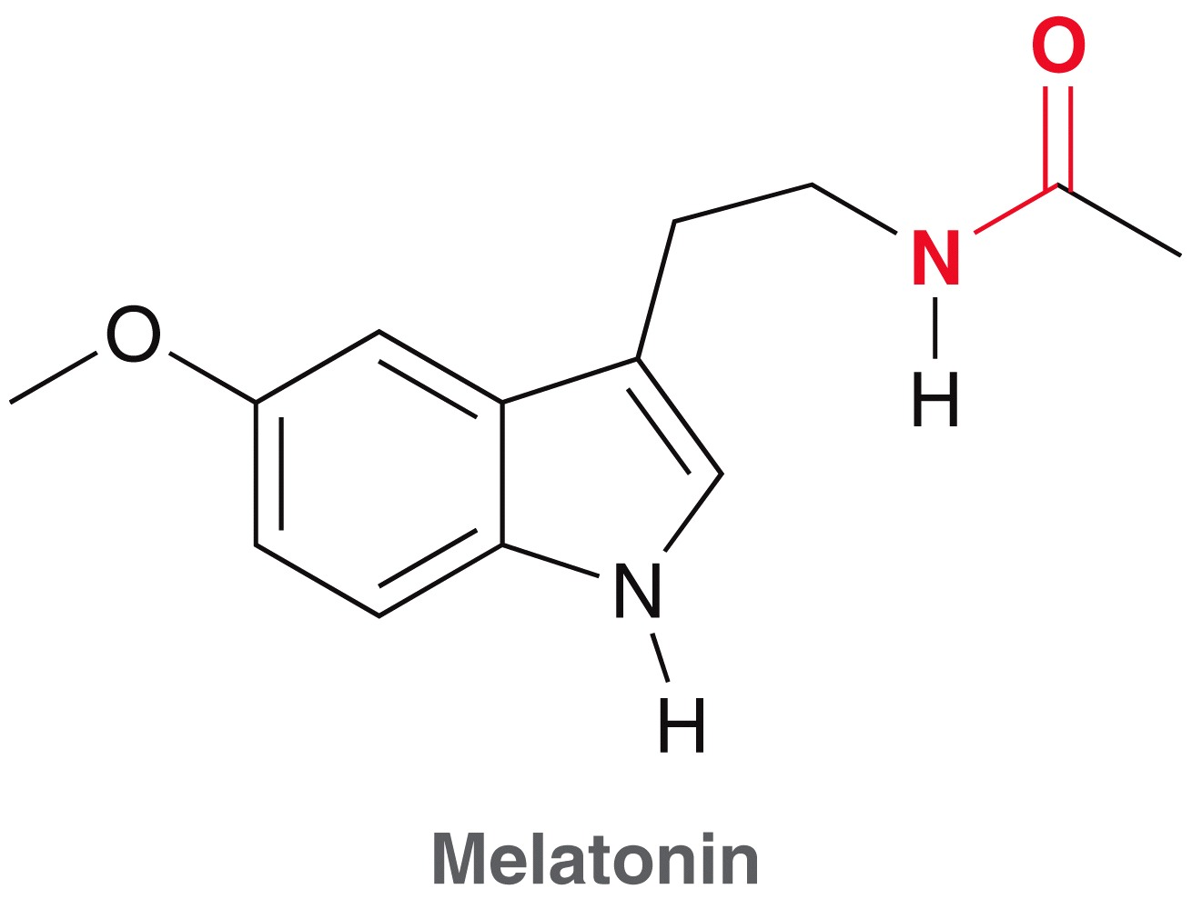
20.6 Carboxylic Acid Derivatives
Proteins are comprised of repeating amide linkages
Many other compounds feature amides including some natural sedatives like melatonin

Slide 26
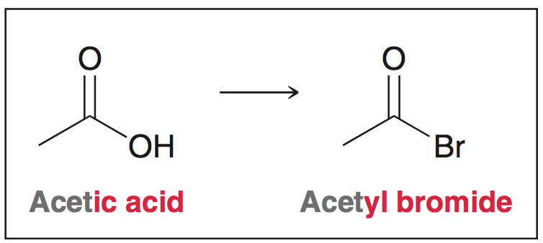
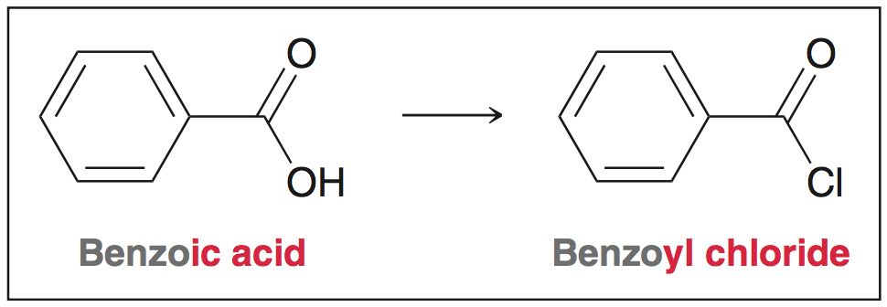
20.6 Naming Acid Halides
To name an acid halide, replace - ic acid with - yl halide

Slide 27
20.6 Naming Acid Halides
If an acid halide group is connected to a ring, the suffix, “carboxylic acid” can be replaced with “carbonyl halide”

Slide 28
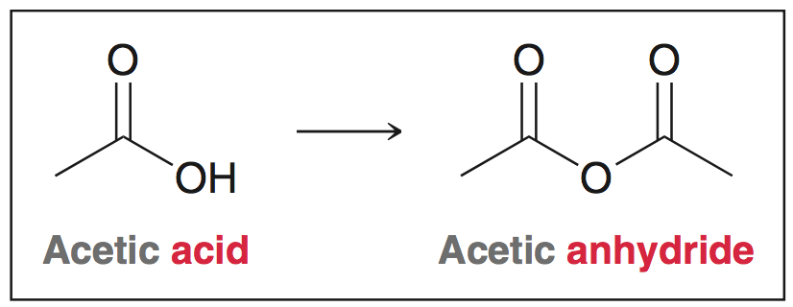
20.6 Naming Anhydrides
Acid anhydrides are named by replacing “acid” with “anhydride”

Slide 29
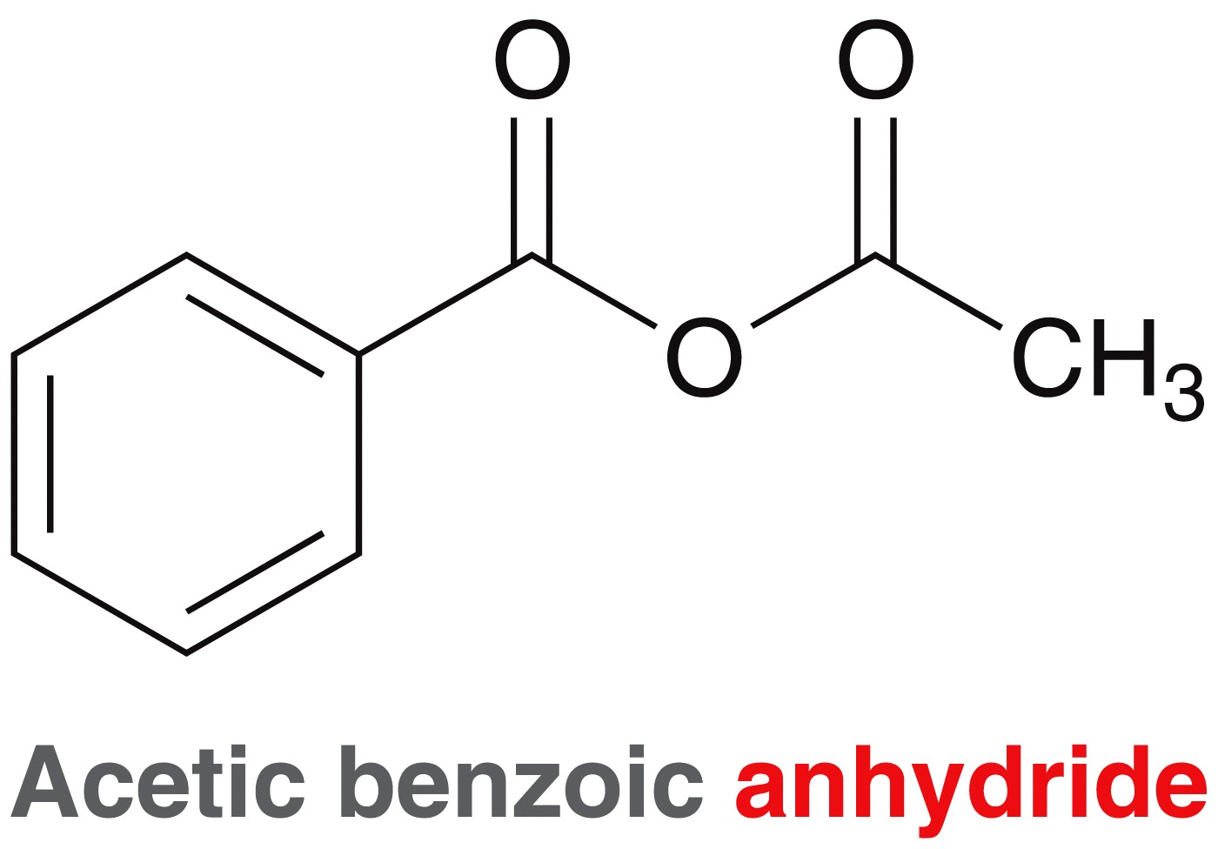
20.6 Naming Anhydrides
Asymmetrical anhydrides are named by listing the acids alphabetically, followed by “anhydride”

Slide 30
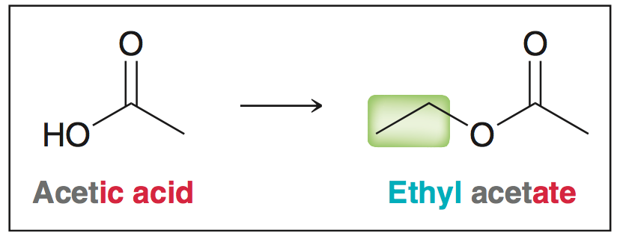
20.6 Naming Esters
Esters are named by naming the alkyl group attached to the oxygen followed by the carboxylic acid’s name with the suffix -ate

Slide 31
20.6 Naming Esters
Esters are named by naming the alkyl group attached to the oxygen followed by the carboxylic acid’s name with the suffix –ate
Same rules apply if the ester is connected to a ring

Slide 32
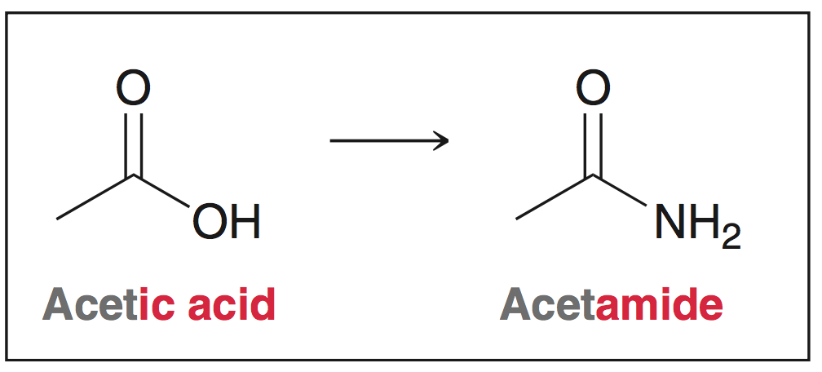
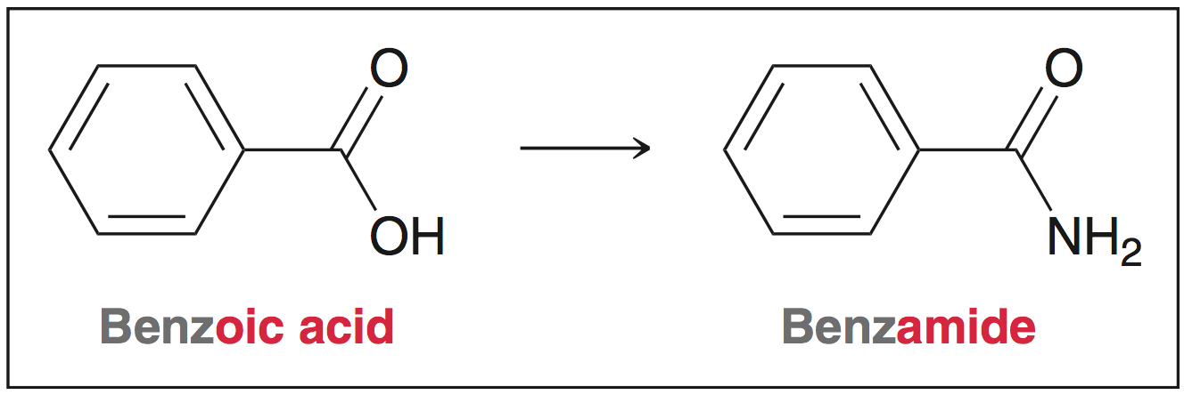
20.6 Naming Amides
Amides are named by replacing the suffix -ic acid or -oic acid with -amide

Slide 33
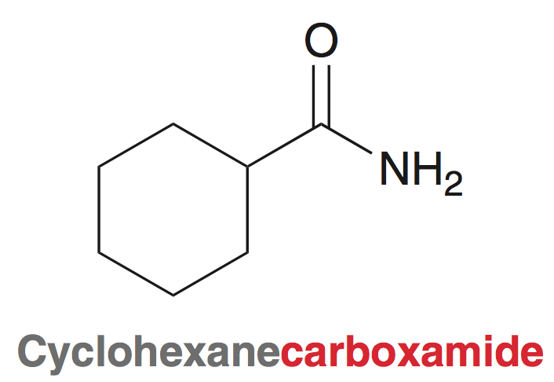
20.6 Naming Amides
Amides are named by replacing the suffix -ic acid or -oic acid with –amide
If amide group is connected to a ring, “carboxylic acid” is replaced with “carboxamide”

Slide 34
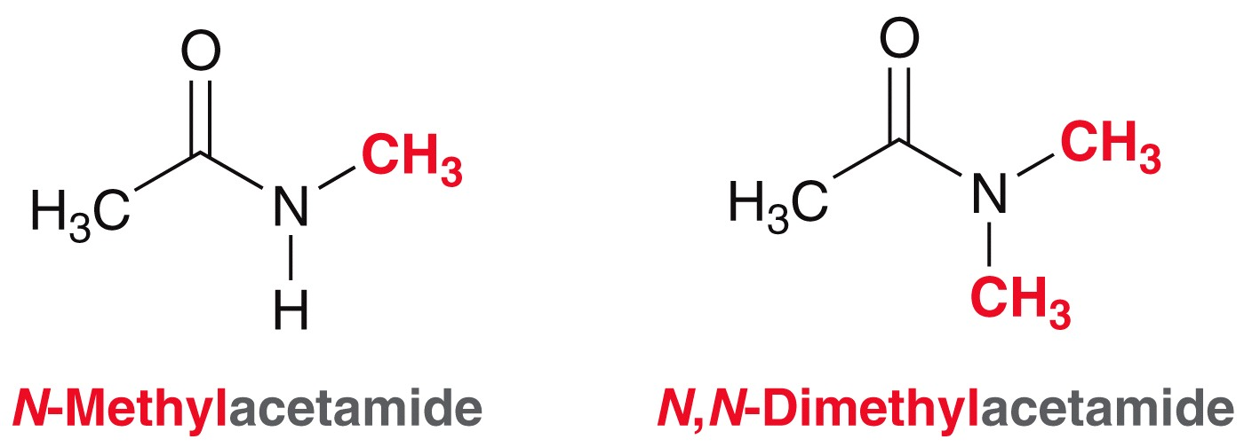
20.6 Naming Amides
If the nitrogen atom of the amide group bears alkyl substituents, their names are placed at the beginning of the name with N as their locant

Slide 35
20.6 Naming Nitriles
Nitriles are named by replacing the suffix -ic acid or -oic acid with –onitrile
Practice with Conceptual Checkpoints 20.12 - 20.13

Slide 36
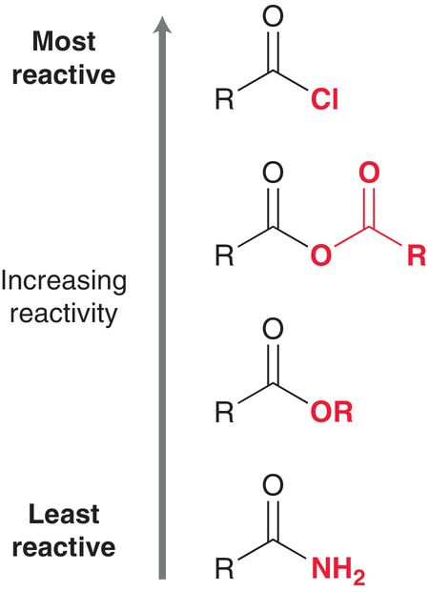
20.7 Reactivity of Carb. Acid Derivatives
Carboxylic acid derivatives are electrophilic at the carbonyl carbon
Reactivity determined by:
Induction
Resonance
Sterics
Quality of leaving group

Slide 37
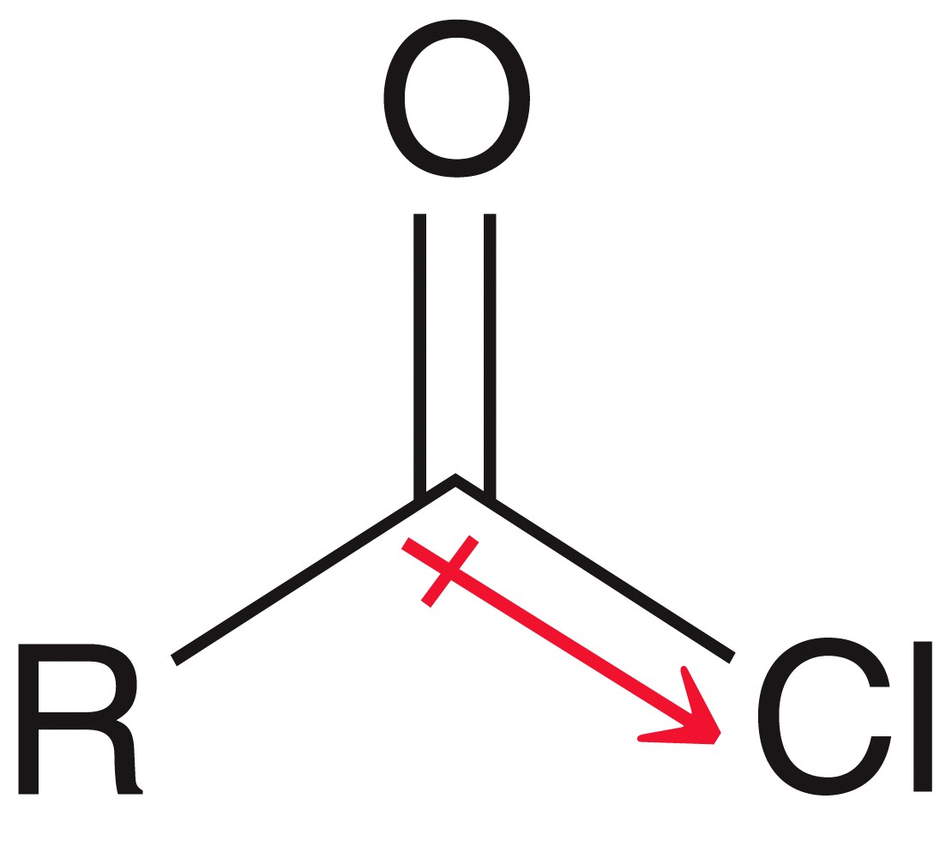
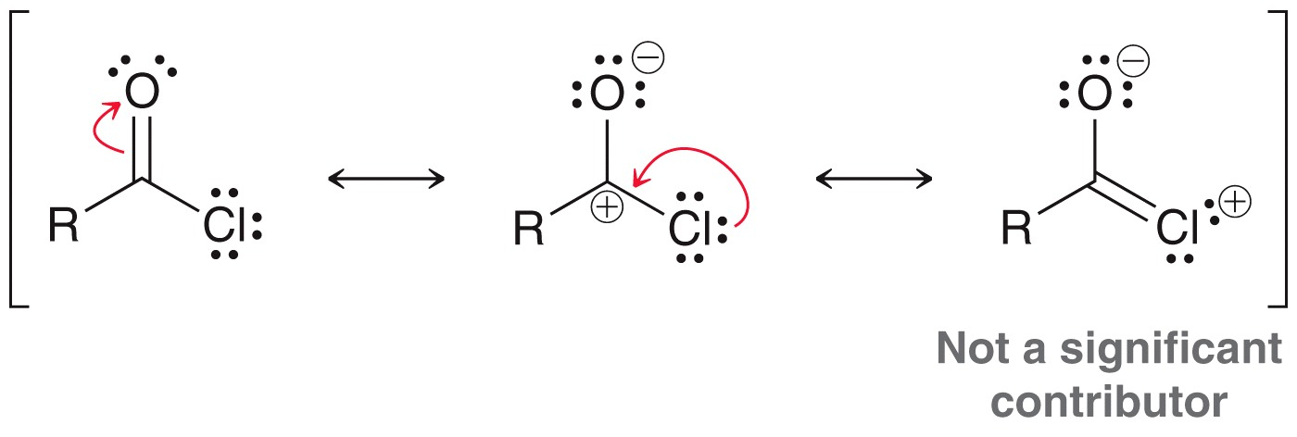
20.7 Reactivity of Carb. Acid Derivatives
Acyl chlorides are the most reactive derivatives:
Induction - The electronegative chlorine enhances the electrophilic character of the carbonyl.
Resonance - The chlorine atom does not donate much electron density to the carbonyl carbon
The chlorine does not significantly donate electron density to the carbonyl.

Slide 38
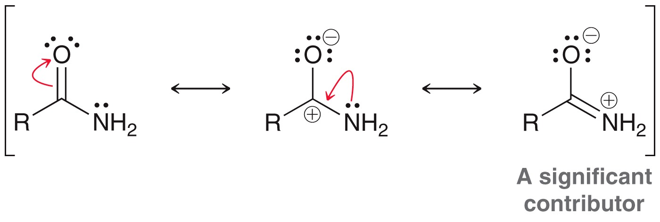
20.7 Reactivity of Carb. Acid Derivatives
Amides are the least reactive acid derivative
Examine the factors below to explain amide reactivity
Induction: the N atom is less electronegative than Cl, or O
Resonance: the N atom contributes significant electron density to the carbonyl carbon

Slide 39
20.7 Nucleophilic Acyl Substitution
Aldehydes and ketones are also electrophilic, but they do not undergo substitution
Carboxylic acid derivatives undergo nucleophilic acyl substitution

Slide 40
20.7 Reactivity of Carb. Acid Derivatives
Nucleophilic acyl substitution: the general mechanism has two core steps:
Nucleophile attacks the carbonyl; tetrahedral intermediate forms
Then, carbonyl reforms via loss of a leaving group
H⁻ and C⁻ generally cannot be expelled as leaving groups

Slide 41
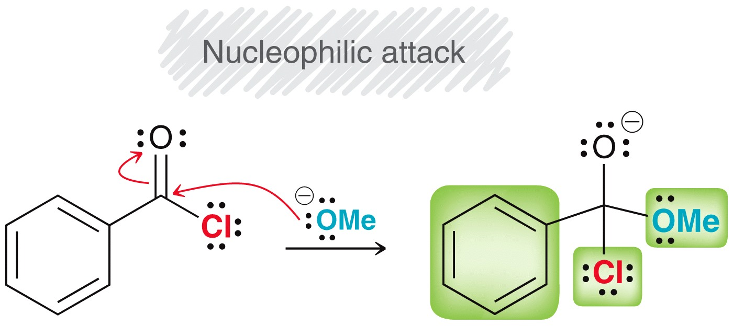
20.7 Reactivity of Carb. Acid Derivatives
specific example:
The best leaving group is eliminated; carbonyl is reformed
Cl⁻ is better leaving group than MeO⁻

Slide 42
20.7 Reactivity of Carb. Acid Derivatives
Understand that nucleophilic acyl substitution is not an S_{N}2 mechanism
Sometimes a proton transfer will be necessary in the mechanism
Under acidic conditions, (–) charges rarely form.
Under basic conditions, (+) charges rarely form.

Slide 43
20.7 Reactivity of Carb. Acid Derivatives
All the participants a reaction mechanism (reactants, intermediates, leaving groups) should be consistent with the conditions employed:
Specific example, where acidic conditions are used:

Slide 44
20.7 Reactivity of Carb. Acid Derivatives
All the participants a reaction mechanism (reactants, intermediates, leaving groups) should be consistent with the conditions employed:
The first step will NOT be nucleophilic attack… because a negatively charged oxygen will not be produced under acidic conditions

Slide 45
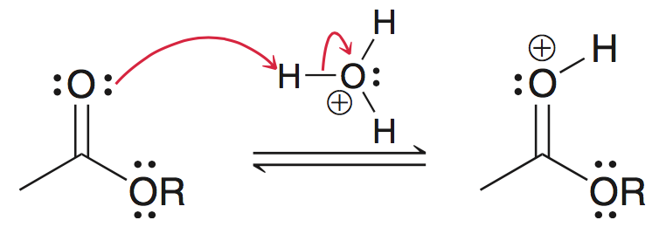
20.7 Reactivity of Carb. Acid Derivatives
All the participants a reaction mechanism (reactants, intermediates, leaving groups) should be consistent with the conditions employed:
Under acidic conditions, the first step will be protonation of the carbonyl:
protonation is generally ALWAYS the first step in an acyl substitution mechanism under acidic conditions

Slide 46
20.7 Reactivity of Carb. Acid Derivatives
All the participants a reaction mechanism (reactants, intermediates, leaving groups) should be consistent with the conditions employed:
Nucleophilic attack on the protonated carbonyl makes much more sense, under acidic conditions:

Slide 47
20.7 Reactivity of Carb. Acid Derivatives
All the participants a reaction mechanism (reactants, intermediates, leaving groups) should be consistent with the conditions employed:
Under BASIC conditions, the carbonyl is not protonated first. The strong nucleophile would attack first:

Slide 48
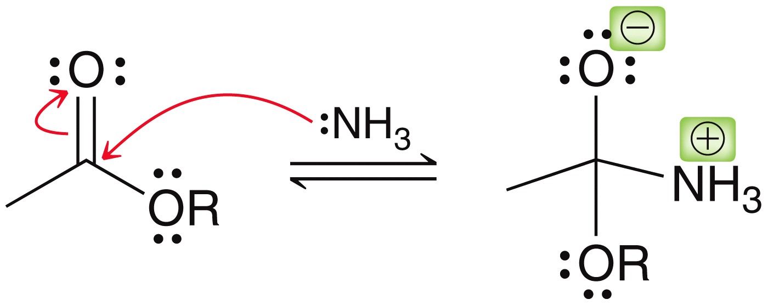
20.7 Reactivity of Carb. Acid Derivatives
When an amine is the nucleophile, it will attack the carbonyl first (without the carbonyl being protonated first
A tetrahedral intermediate with both (+) and (-) charge forms:
Just be sure to avoid drawing an intermediate with two charges of the same type when drawing these acyl substitution mechanisms

Slide 49
20.7 Reactivity of Carb. Acid Derivatives
Proton transfers are utilized in mechanisms to remain consistent with the conditions employed
Under acidic conditions, up to 3 proton transfers are necessary in the mechanism
Whether the conditions are acidic, neutral, or basic, you will have to decide where proton transfers occur in the mechanism

Slide 50
20.7 Reactivity of Carb. Acid Derivatives
Consider the mechanism for the following reaction:
The conditions are not acidic; the carbonyl is not protonated first

Slide 51
20.7 Reactivity of Carb. Acid Derivatives
Consider the mechanism for the following reaction:
The leaving group does not require protonation in order to leave, but there is a proton transfer at the end:

Slide 52
20.7 Reactivity of Carb. Acid Derivatives
Consider the mechanism for the following reaction:
This pattern is typical for reactions of acid halides:
Practice drawing mechanisms with SkillBuilder 20.1

Slide 53
20.8 Preparation of Acid Chlorides
An acid chloride is synthesized from a carboxylic acid using SOCl₂:
The mechanism is split into two parts
The first part is conversion of –OH into a good leaving group:

Slide 54
20.8 Preparation of Acid Chlorides
The second part is typical nucleophilic acyl substitution
the Cl⁻ (formed in the first part) is the nucleophile:

Slide 55
20.8 Hydrolysis of Acid Chlorides
When reacted with water, an acid chloride is converted to a carboxylic acid:
Mechanism:

Slide 56
20.8 Hydrolysis of Acid Chlorides
When reacted with water, an acid chloride is converted to a carboxylic acid:
Since HCl is a byproduct of hydrolysis, pyridine is usually used to neutralize it :

Slide 57
20.8 Alcoholysis of Acid Chlorides
Acid chlorides are reacted with an alcohol to make an ester:
Sterically hindered alcohols react more slowly, so a 1˚ alcohol can be acylated selectively in the presence of a 2˚ alcohol:

Slide 58
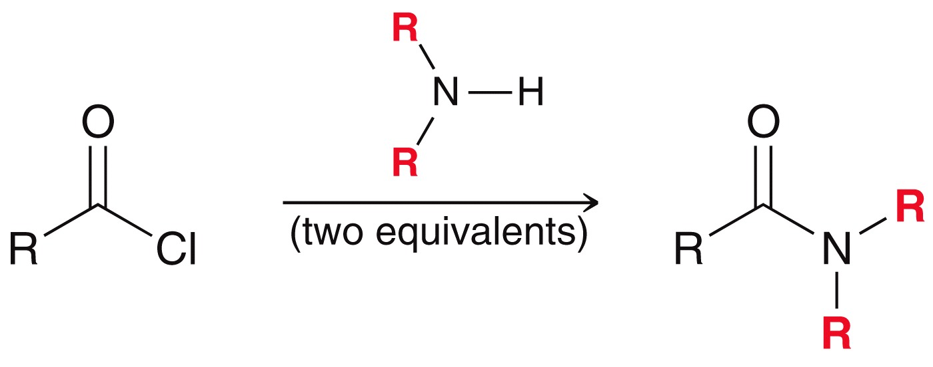
20.8 Aminolysis of Acid Chlorides
acid chlorides are used to synthesize amides
Pyridine is not used to mop up the HCl byproduct here… instead, 2 equivalents of the amine are used

Slide 59
20.8 Reduction of Acid Chlorides
Acid chlorides can also be reduced using LAH to form a 1˚ alcohol:
Note that an acidic workup is necessary:

Slide 60
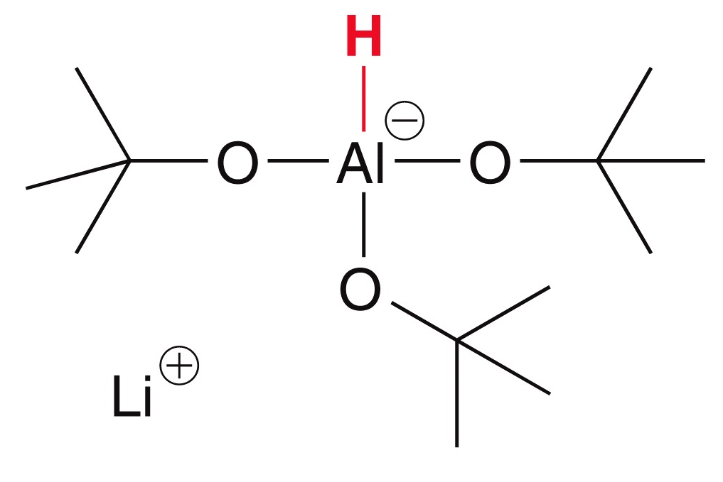
20.8 Reduction of Acid Chlorides
By using lithium tri(t-butoxy) aluminum hydride, instead of LAH, the reduction can be stopped at the aldehyde:
This reagent is more selective, and reacts with acid chlorides faster than aldehydes, so the aldehyde can be isolated

Slide 61
20.8 Reactions of Acid Chlorides
An acid chlorides can be reacted with a Grignard reagent to form a 3˚ alcohol
The mechanism is analogous to reduction using LAH:

Slide 62
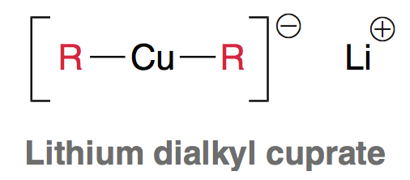
20.8 Reactions of Acid Chlorides
The Gilman reagent (lithium dialkyl cuprate) can be used instead of a Grignard
The Gilman reagent adds only once to the acid chloride, to form a ketone:

Slide 63
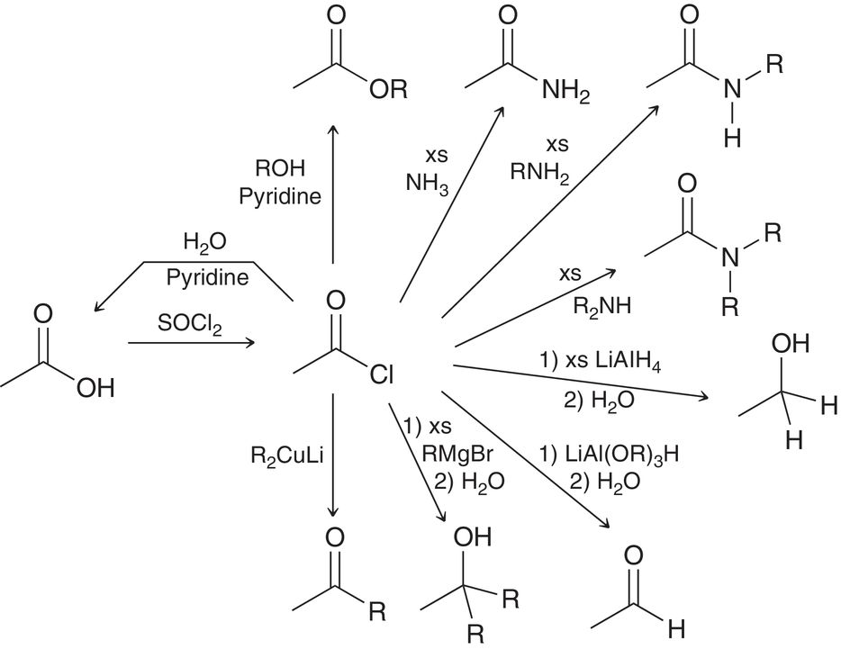
20.8 Reactions of Acid Chlorides-Summary
Figure 20.9 illustrates the reactions of acid chlorides we discussed
Practice with conceptual checkpoints 20.16 through 20.18

Slide 64
20.9 Preparation of Acid Anhydrides
Anhydrides can be synthesized by excessive heating of a carboxylic acid:
This only works for acetic acid, to make acetic anhydride (most acids can’t survive extreme temperature)
acetic acid
acetic anhydride

Slide 65
20.9 Preparation of Acid Anhydrides
A more practical synthesis requires an acid chloride reacted with a carboxylate nucleophile:
Mechanism (basic conditions):

Slide 66
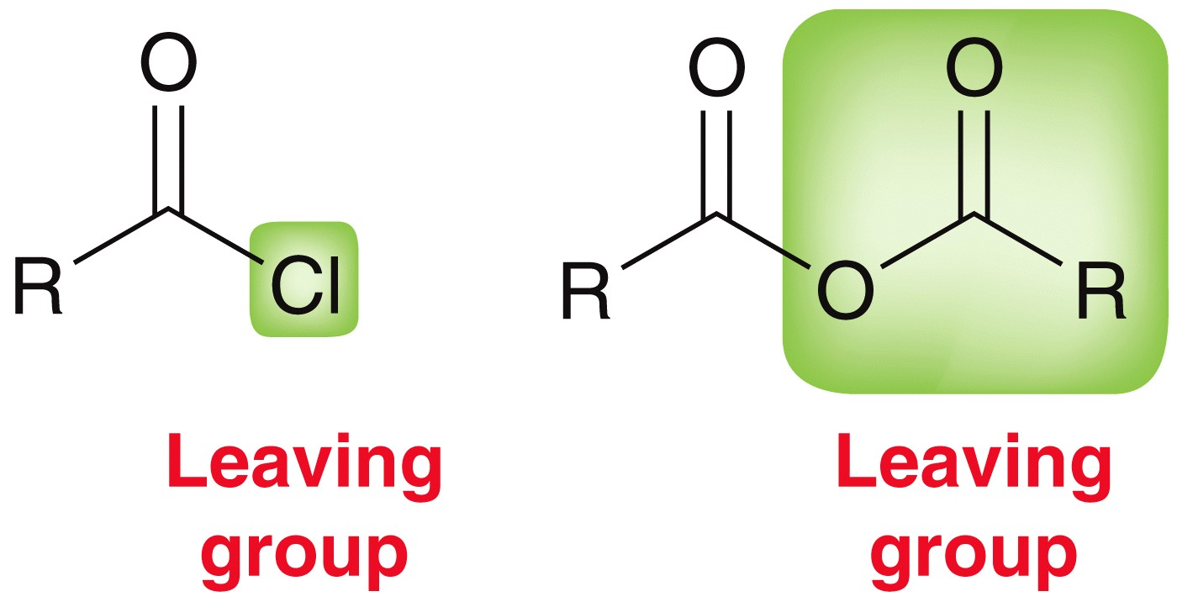
20.9 Reactions of Acid Anhydrides
Given that they both contain quality leaving groups, the reactivity of anhydrides is analogous to acid chlorides:
But it is not necessary to use pyridine with anhydrides because a strong acid is not generated as a byproduct

Slide 67
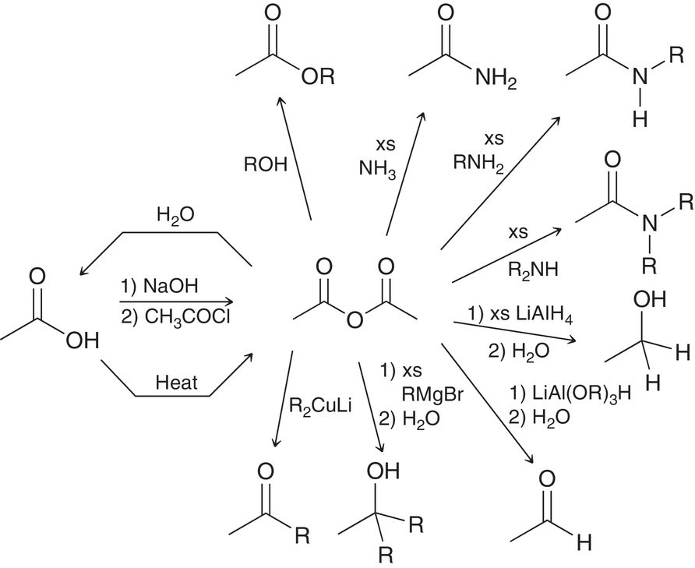
20.9 Reactions of Acid Anhydrides
Figure 20.10 shows how anhydrides can undergo many reactions analogous to those of acid chlorides

Slide 68
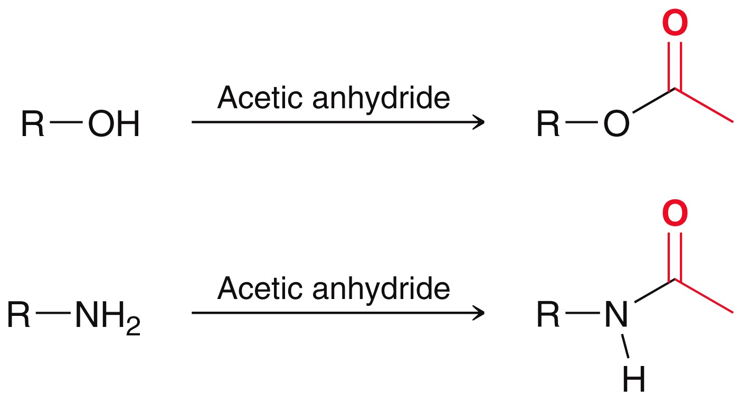
20.9 Reactions of Acid Anhydrides
Acetic anhydride is often used to acetylate an amine or an alcohol to make an ester or an amide:

Slide 69
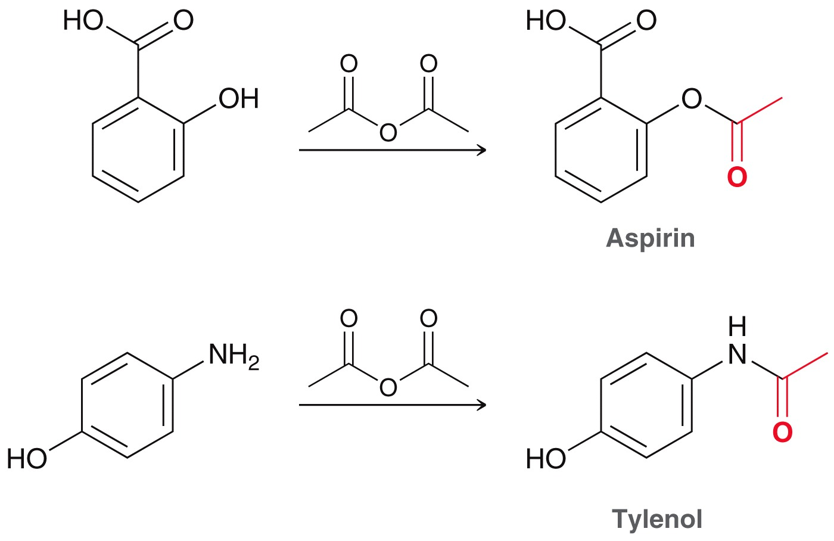
20.9 Reactions of Acid Anhydrides
Acetic anhydride is used commercially to synthesize Aspirin and Tylenol
Practice with Conceptual Checkpoint 20.19

Slide 70
20.10 Preparation of Esters
Esters can be prepared by S_{N}2 reaction of a carboxylate with an alkyl halide:
NaOH is used to deprotonate the carboxylic acid and yield a carboxylate

Slide 71
20.10 Preparation of Esters
Fischer esterification combines a carboxylic acid and an alcohol using an acid catalyst (i.e. acidic conditions):
The mechanism is consistent with one that occurs under acidic conditions (next slide)

Slide 72
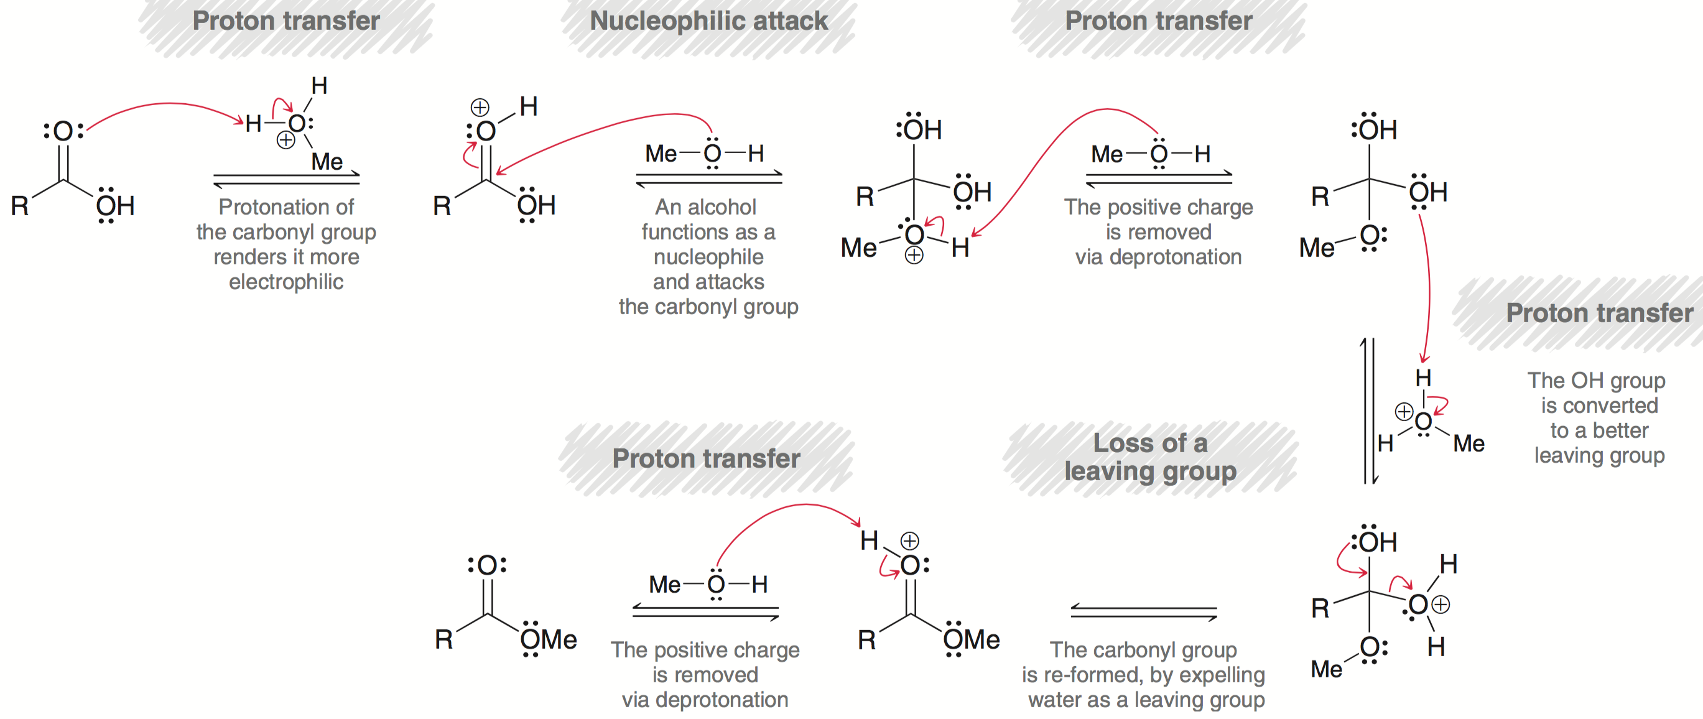
20.10 Preparation of Esters

Slide 73
20.10 Preparation of Esters
The mechanism for Fischer esterification reaction is supported by an isotope labelling experiment:
Fischer esterification is an equilibrating process. Water must be removed to favor the formation of the ester:

Slide 74
20.10 Preparation of Esters
Esters can also be prepared by treating an acid chloride with an alcohol – (section 20.8)
Practice with Conceptual Checkpoint 20.20 - 20.21

Slide 75
20.11 Reactions of Esters
Esters can undergo hydrolysis under basic conditions (saponification)
Acidic workup is necessary to obtain the neutral carboxylic acid product.

Slide 76
20.11 Reactions of Esters
Saponification mechanism (basic conditions):

Slide 77
20.11 Reactions of Esters
Esters can also be hydrolyzed under acidic conditions:
The mechanism is what one would expect under acidic conditions, and is the reverse of Fischer Esterification

Slide 78
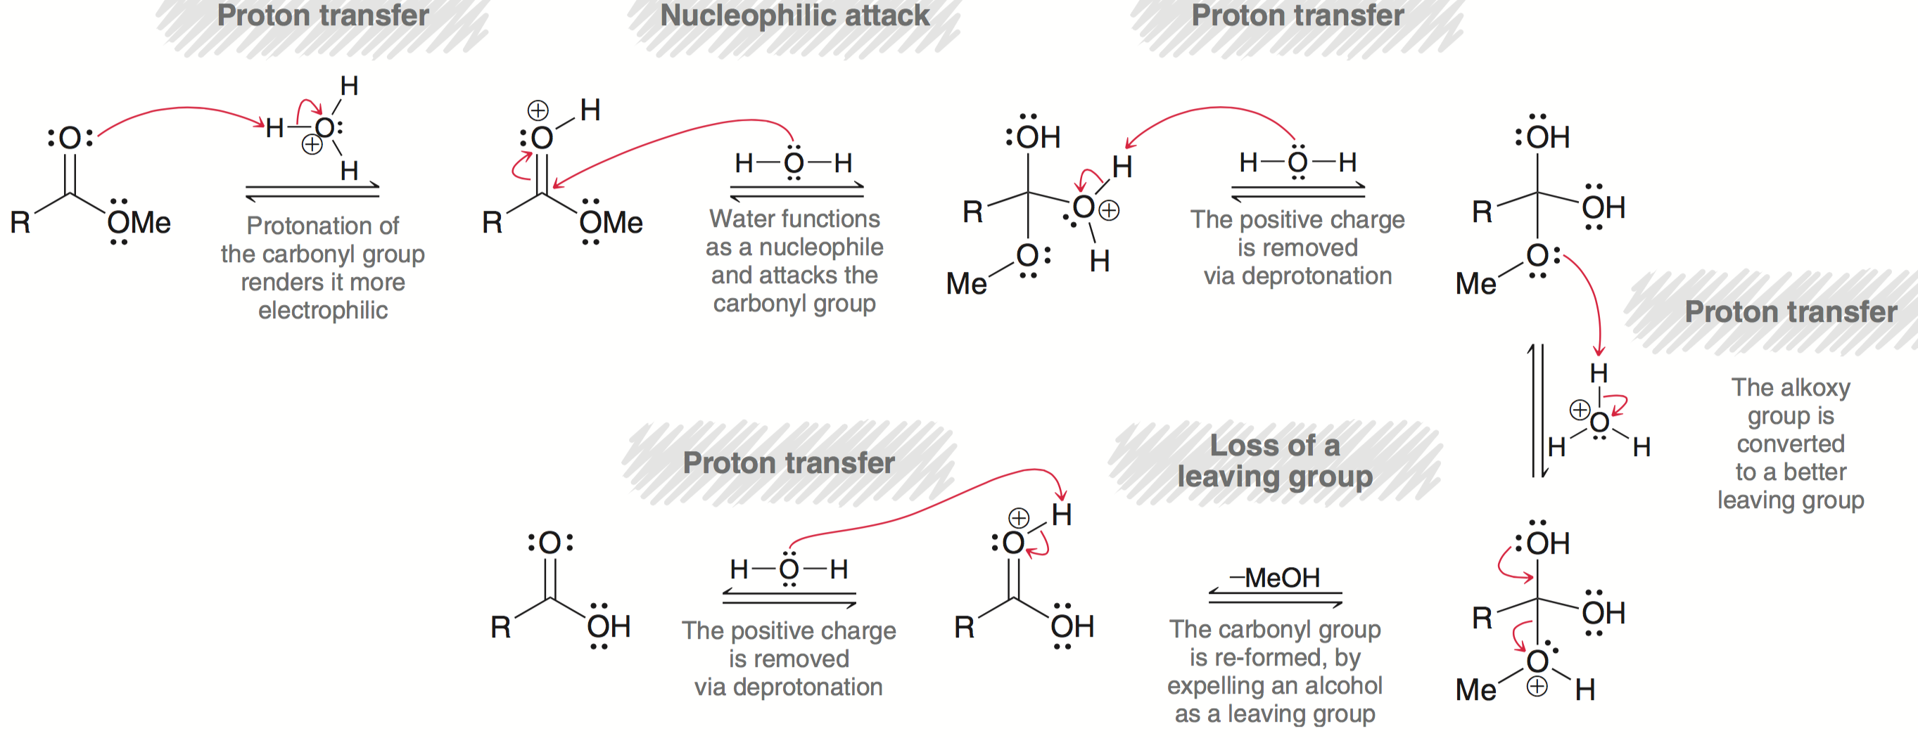
20.11 Reactions of Esters
Mechanism (acidic conditions):

Slide 79
20.11 Reactions of Esters
Esters can also undergo aminolysis to form amides:
The overall equilibrium favors the amide formation: amides are more stable (less reactive) than esters
The synthetic utility is limited, because the process is slow. It is more efficient to make an amide from an acid chloride (section 20.8)

Slide 80
20.11 Reactions of Esters
Esters can be reduced using reagents such as LiAlH₄
Two equivalents of reducing agent are required
Two alcohols are produced
Mechanism is analogous to reduction of an acid halide with LAH

Slide 81
20.11 Reactions of Esters
Mechanism:

Slide 82
20.11 Reactions of Esters
Reduction of an ester can be stopped at the aldehyde by using DIBAH (instead of LAH) at a low temperature

Slide 83
20.11 Reactions of Esters
Esters can also react with Grignard reagents to form a 3˚ alcohol
This reaction (and mechanism) is analogous to the reaction of an acid halide with Grignard reagents.

Slide 84
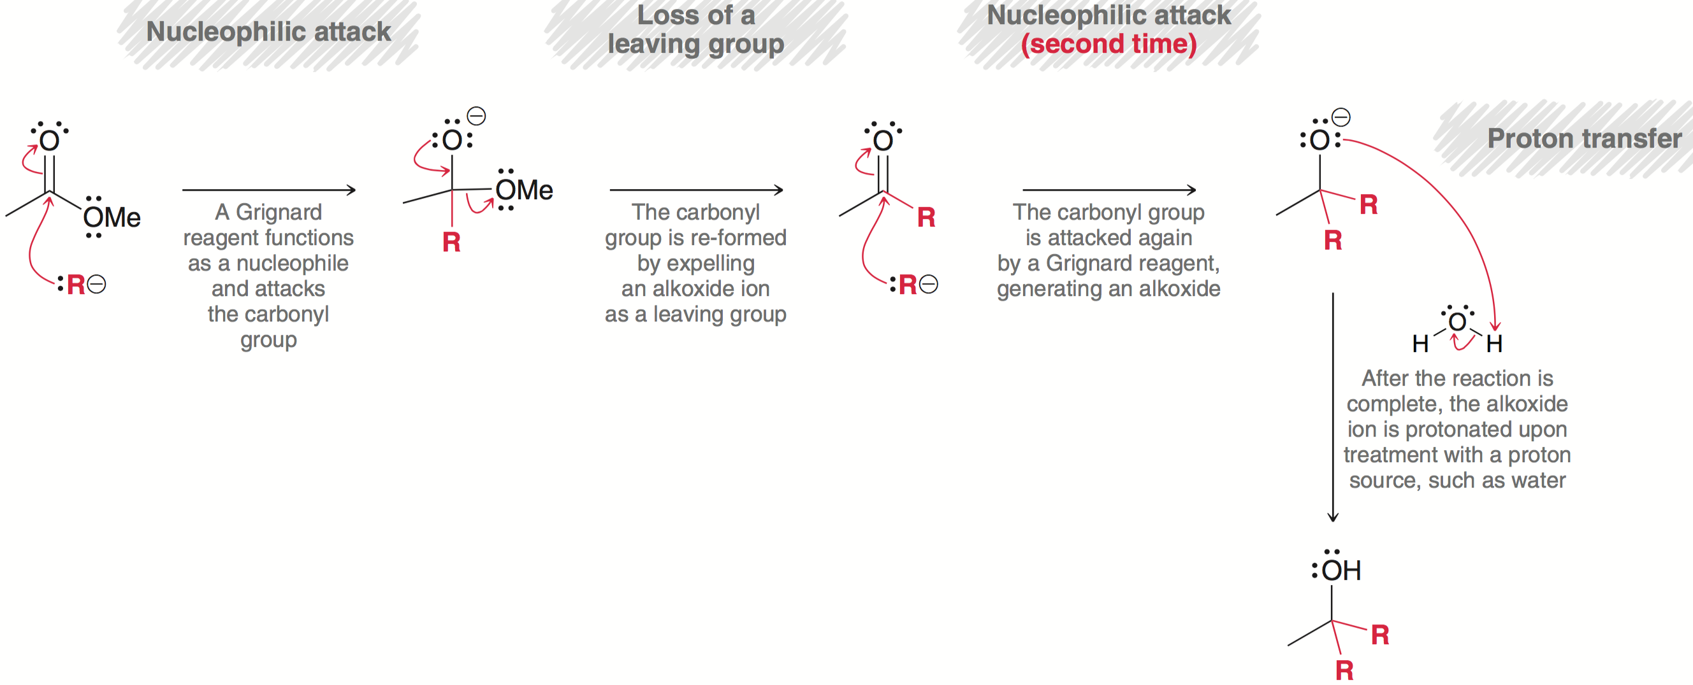
20.11 Reactions of Esters
This reaction (and mechanism) is analogous to the reaction of an acid halide with Grignard reagents.
Practice with Conceptual Checkpoint 20.22 and 20.23

Slide 85
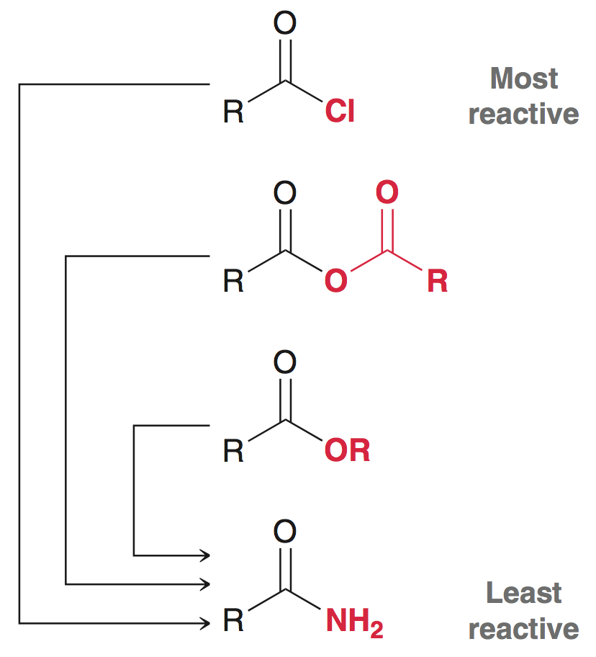
20.12 Preparation of Amides
Amides can be made from any of the carboxylic acid derivatives already discussed:

Slide 86
20.12 Preparation of Amides
The most popular way to make an amide is from an acid chloride and the corresponding amine:
Remember, two equivalents of the amine are necessary; one full equivalent is neutralized by the HCl byproduct from the reaction

Slide 87
20.12 Reactions of Amides
Amides can be hydrolyzed with H₃O⁺ (acidic conditions):
The reaction is slow and requires high temperatures

Slide 88
20.12 Reactions of Amides
Amides can be hydrolyzed with H₃O⁺ (acidic conditions):
The reaction is slow and requires high temperatures
The products are favored at equilibrium because the –NH₃ group is protonated, and not capable of acting like a nucleophile in the reverse direction

Slide 89
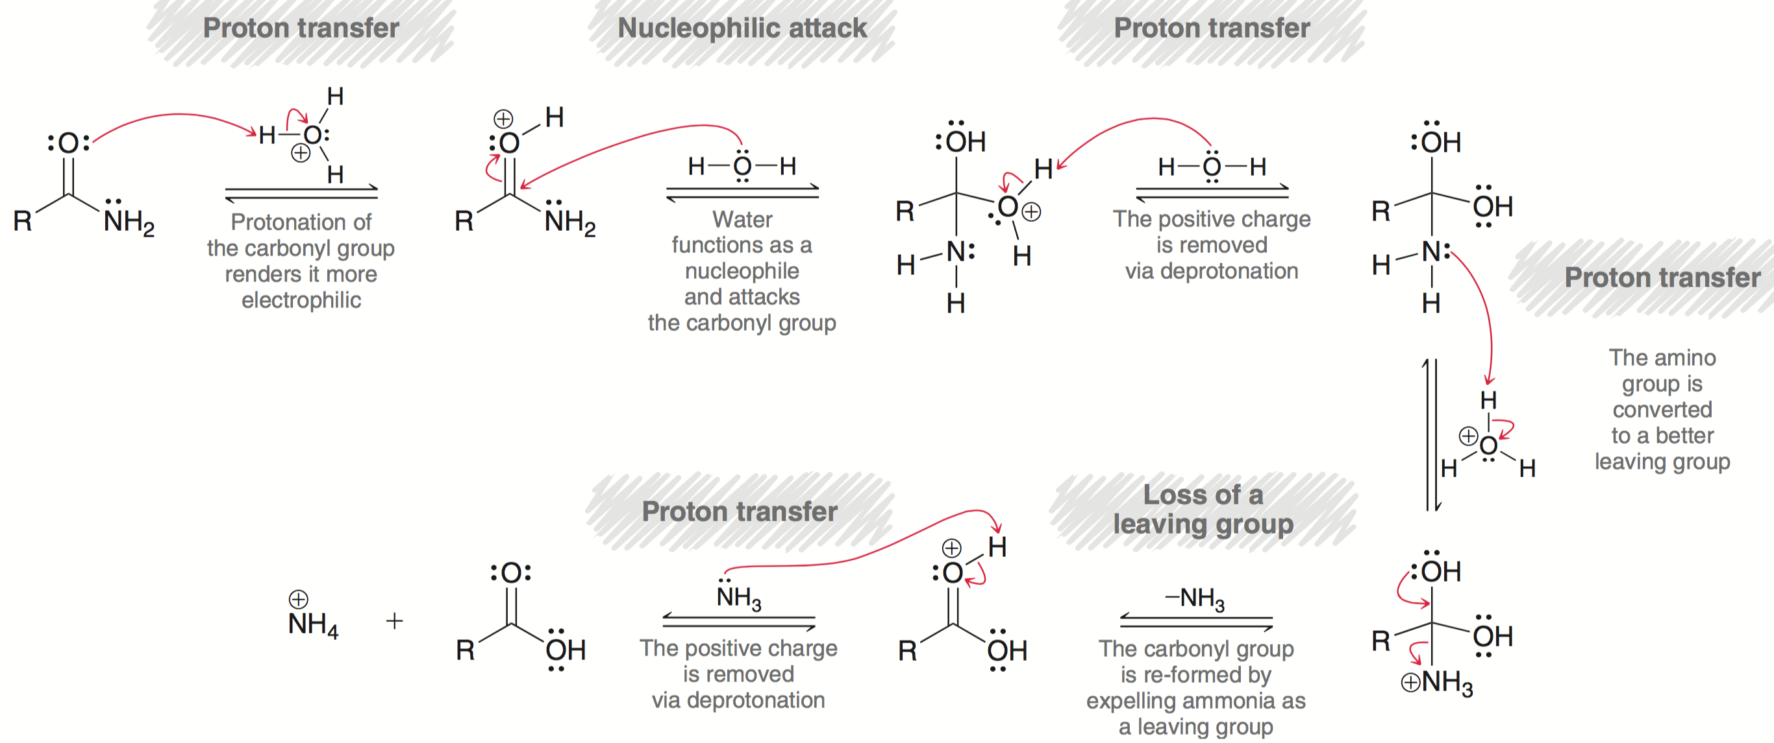
20.12 Reactions of Amides
Mechanism (acidic conditions):

Slide 90
20.12 Reactions of Amides
Amides can also be hydrolyzed under basic conditions:
The base-catalyzed hydrolysis is even slower than when acidic conditions are used
The mechanism is analogous to base-catalyzed hydrolysis of an ester (section 20.11)

Slide 91
20.12 Reactions of Amides
Mechanism (basic conditions):
Deprotonation of the carboxylic acid, in the last step, renders the process irreversible

Slide 92
20.12 Reactions of Amides
Amides are reduced to the corresponding amine with LAH:
The mechanism is quite different from the others we have seen in this chapter
The carbonyl group is completely removed, while the nitrogen remains bound to the molecule
Practice with Conceptual Checkpoint 20.24 – 20.25

Slide 93
20.13 Preparation of Nitriles
Recall when a 1° or 2° alkyl halide is treated with a cyanide ion, the CN⁻ acts as a nucleophile in an S_{N}2 reaction
Nitriles can also be made by dehydration of a 1˚ amide using a variety of reagents including SOCl₂
1˚ amide
nitrile

Slide 94
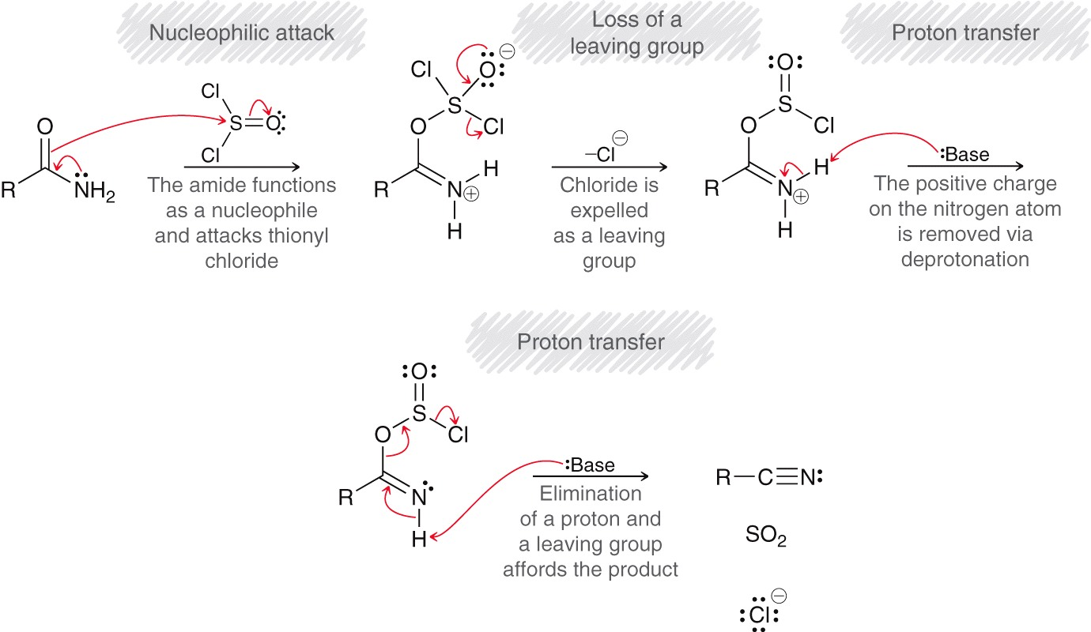
20.13 Preparation of Nitriles
1˚ amide dehydration mechanism:

Slide 95
20.13 Reactions of Nitriles
Nitriles are hydrolyzed to carboxylic acids under acidic conditions:
The nitrile is first hydrolyzed to a 1˚ amide, and then further hydrolyzed to the carboxylic acid

Slide 96
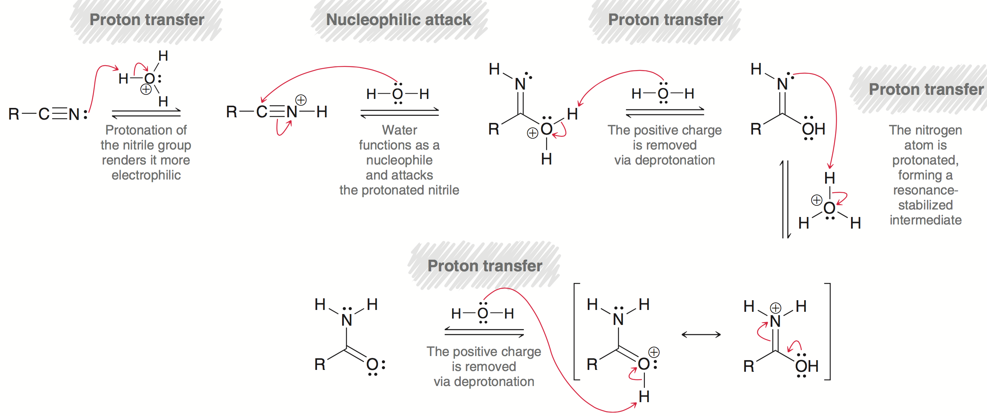
20.13 Reactions of Nitriles
Mechanism (acidic conditions):

Slide 97
20.13 Reactions of Nitriles
Nitriles can also be hydrolyzed under basic conditions:
Again, acidic workup is necessary to obtain a carboxylic acid (because basic conditions otherwise yield a carboxylate ion)

Slide 98
20.13 Reactions of Nitriles
Mechanism (basic conditions):

Slide 99
20.13 Reactions of Nitriles
Nitriles can also react with Grignards to form a ketone:
After the nitrile reacts with the Grignard, H₃O⁺ is added to form an imine, which is then hydrolyzed with excess H₃O⁺ (aq) to form the ketone.

Slide 100
20.13 Nitriles
Similar to how carboxylic acids can be converted to alcohols using LAH (section 20.5), nitriles can be converted to 1˚ amines:
Practice with conceptual checkpoints 20.27 through 20.29

Slide 101
20.14 Synthesis Strategies
When designing a synthesis, stick with the same strategy as with any synthesis discussed earlier:
Is there a change in the carbon skeleton?
Is there a change in functional groups?
There are many new functional group transformations in this chapter – see next slide
Practice with SkillBuilder 20.2

Slide 102
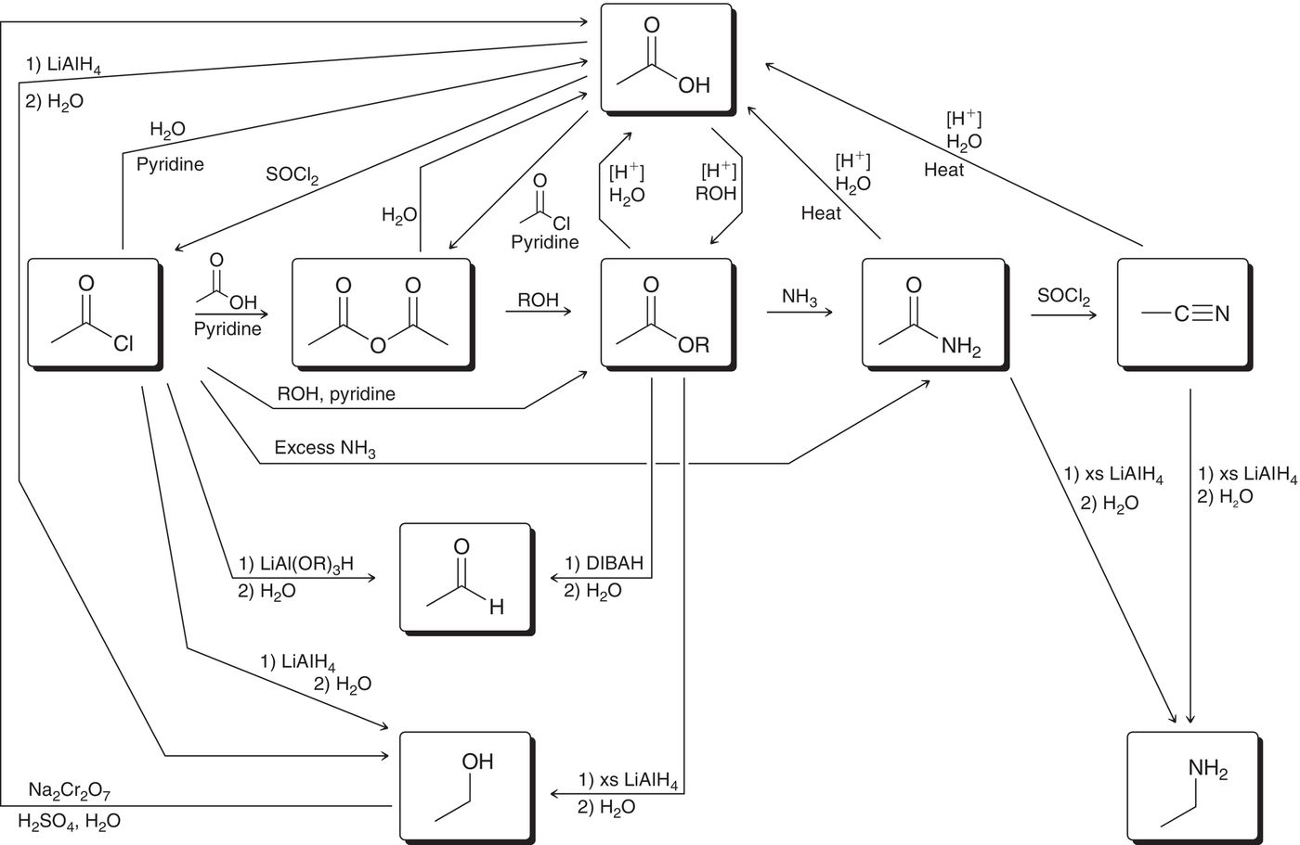
20.14 Synthesis Strategies

Slide 103
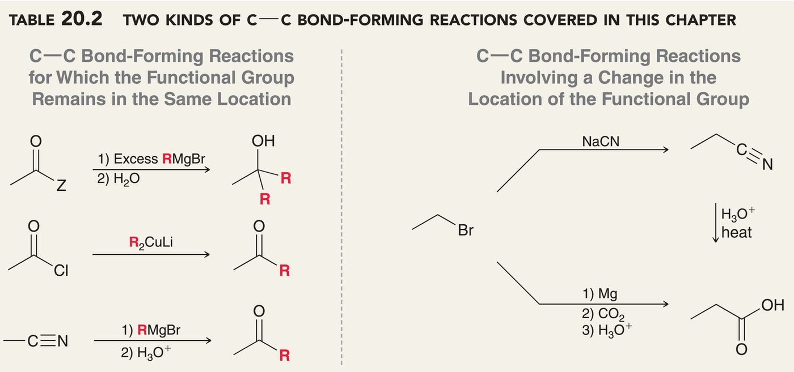
20.14 Synthesis Strategies
There are 2 kinds of C-C bond forming reactions covered in this chapter:

Slide 104
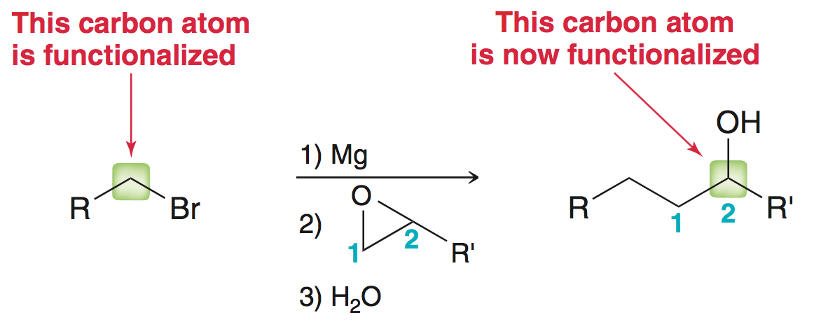
20.14 Synthesis Strategies
It is useful to recall a C-C bond forming reaction from section 13.12, which moves the functional group by two atoms:
When forming new carbon-carbon bonds, it is critical to install functional groups in the proper location
Practice with SkillBuilder 20.3

Slide 105
20.15 Spectroscopy of Carb. Acids
Recall that C=O stretching is a prominent peak in IR spectra
The C=O stretching frequency can be used to identify the function group it is part of:
Recall that conjugated carbonyl signals appear at lower wavenumbers (about 40 cm⁻¹ less) than the saturated carbonyl

Slide 106
20.15 Spectroscopy of Carb. Acids
The O-H stretch of an acid gives a very broad peak (2500-3300 cm⁻¹)
The CΞN triple bond stretch appears around 2200 cm⁻¹
Carbonyl ¹³C peaks appear around 160-185 ppm
Nitrile ¹³C peaks appear around 115-130 ppm
The ¹H peak for a carboxylic acid proton appears around 12 ppm
Practice with conceptual checkpoint 20.34

Slide 107
20.15 Spectroscopy of Carb. Acids
Predict the number and chemical shift of all ¹³C peaks for the molecule below
Predict the number, chemical shift, multiplicity, and integration of all ¹H peaks for the molecule below

