Slide 1
Organic Chemistry
Third Edition
David Klein
Chapter 21
Alpha Carbon Chemistry: Enols and Enolates

Slide 2
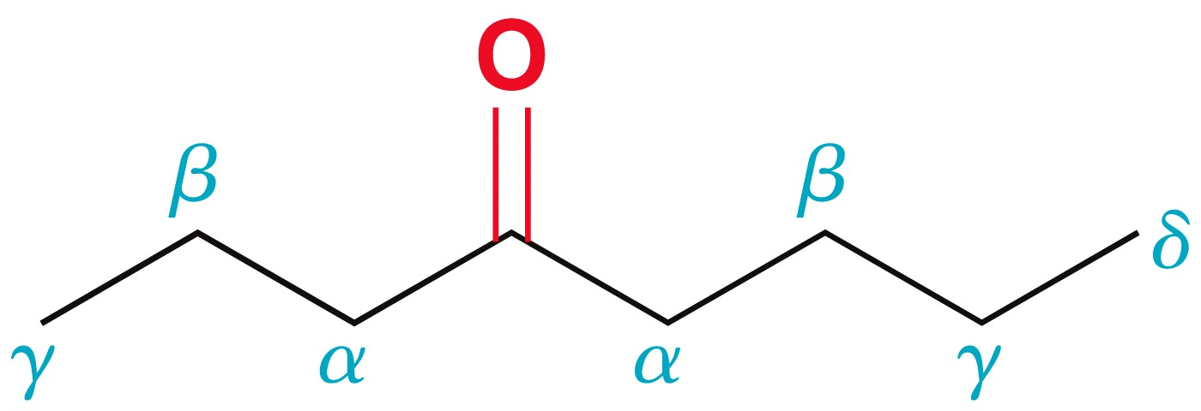
21.1 Introduction: Enols and Enolates
Greek letters are used to describe the proximity of carbon atoms relative to the carbonyl group:
This chapter will primarily explore reactions that take place at the alpha carbon

Slide 3
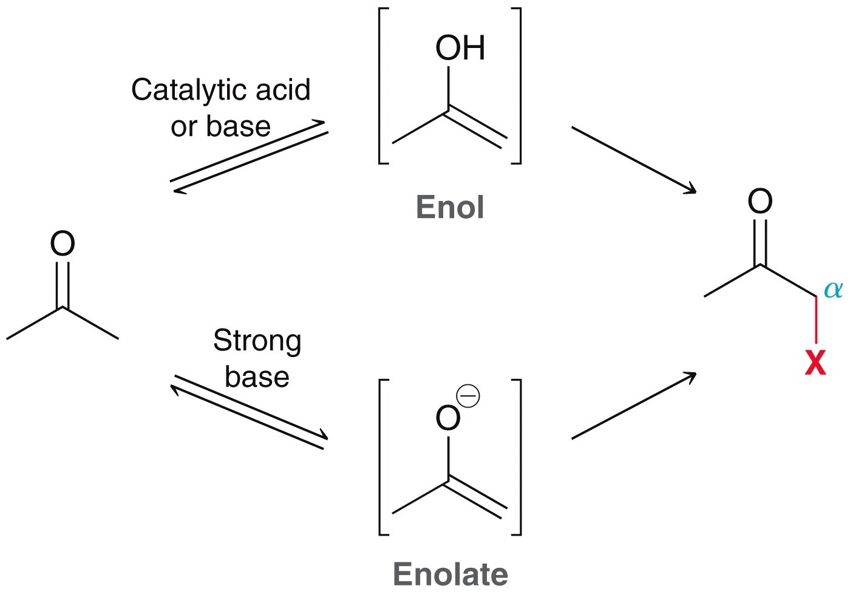
21.1 Introduction: Enols and Enolates
α protons are the protons attached to an α carbon
Most reactions covered here proceed via an enol or enolate intermediate

Slide 4
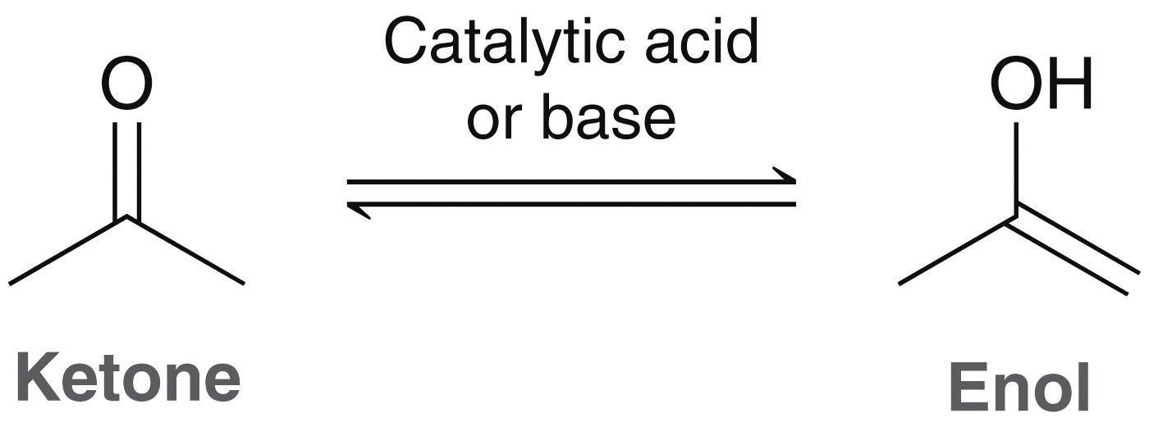
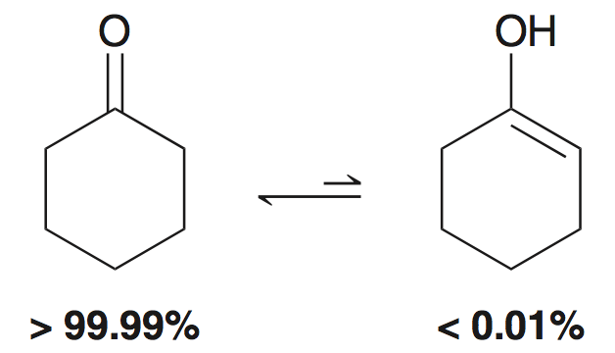
21.1 Enols
In the presence of acid or base, a ketone or aldehyde exists in equilibrium with an enol:
The ketone and enol are tautomers of one another
Equilibrium generally favors the ketone

Slide 5
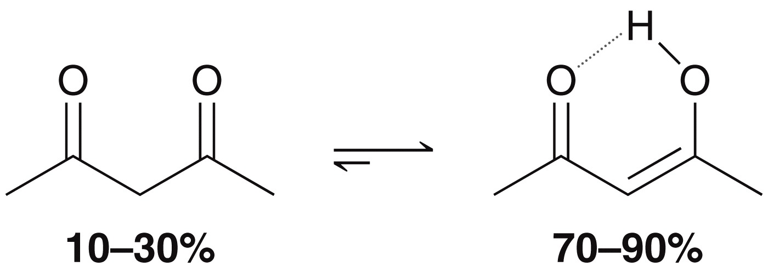
21.1 Enols and Enolates
There are exceptions, as the example below, where the enol form is favored in equilibrium
the enol of a 1,3-diketone is stabilized by conjugation and intramolecular H-bonding; it is more stable than a typical enol, and is favored at equilibrium
1,3-diketone

Slide 6
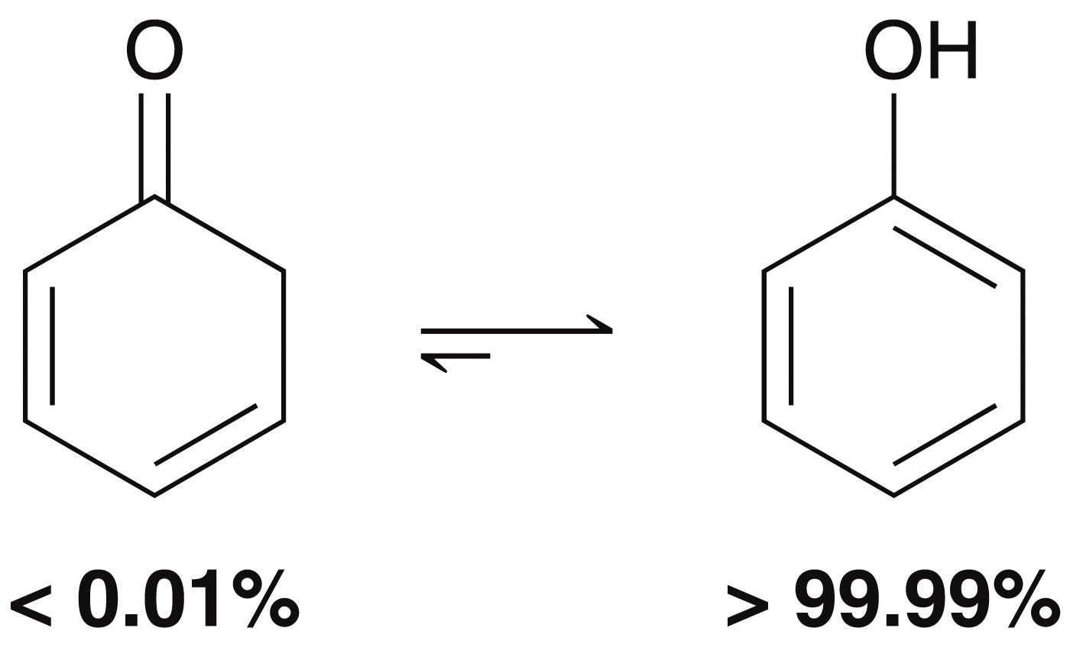
21.1 Enols and Enolates
Phenol is an example where the enol is vastly favored over the keto at equilibrium.
Phenol is an enol with aromatic stability

Slide 7
21.1 Enols and Enolates
The mechanism for the tautomerization depends on whether it is acid catalyzed or base catalyzed
Mechanism (acidic conditions)

Slide 8
21.1 Enols and Enolates
The mechanism for the tautomerization depends on whether it is acid catalyzed or base catalyzed
Mechanism (basic conditions)

Slide 9
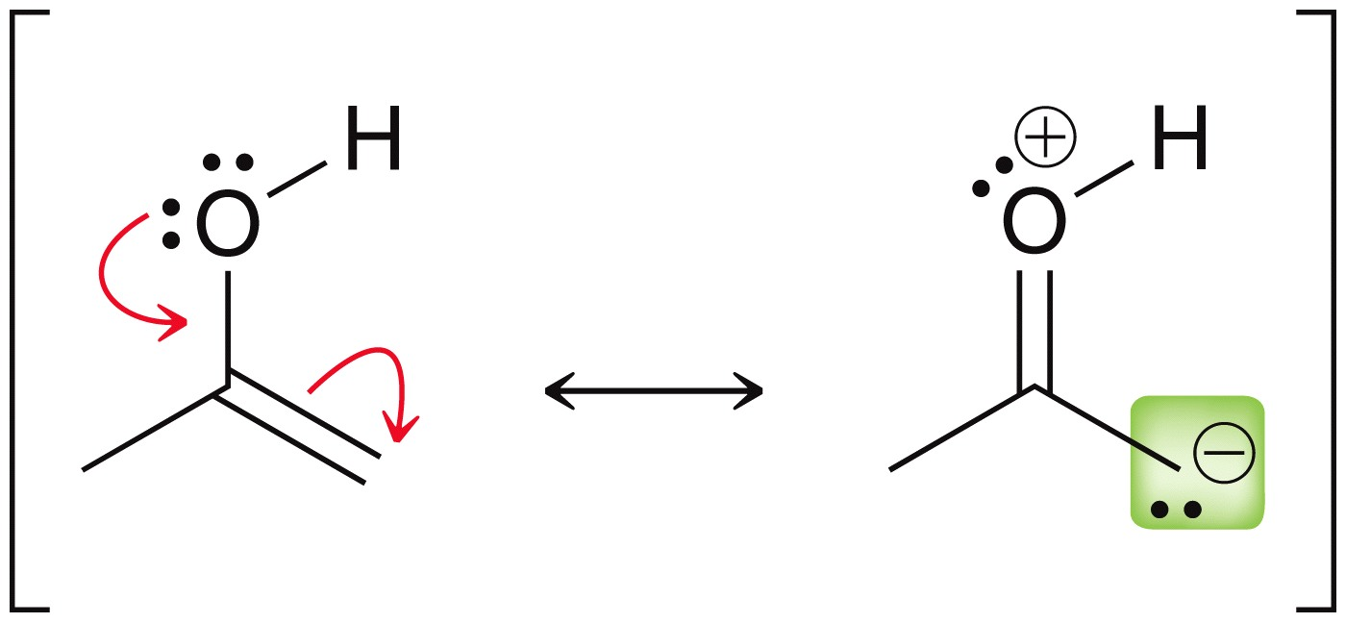
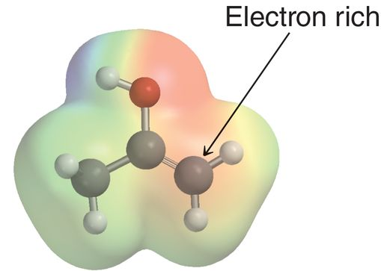
21.1 Enols and Enolates
It is safe to assume that some fraction of a ketone/aldehyde in solution will exist in the enol form
The α position is an enol is nucleophilic:
Practice with Conceptual Checkpoint 21.1 – 21.3

Slide 10
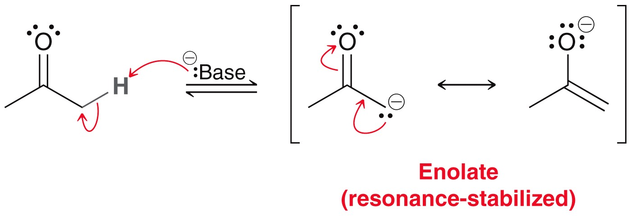
21.1 Enolates
In the presence of a strong base, an enolate forms
The enolate is much more nucleophilic than the enol, as it carries an overall negative charge

Slide 11
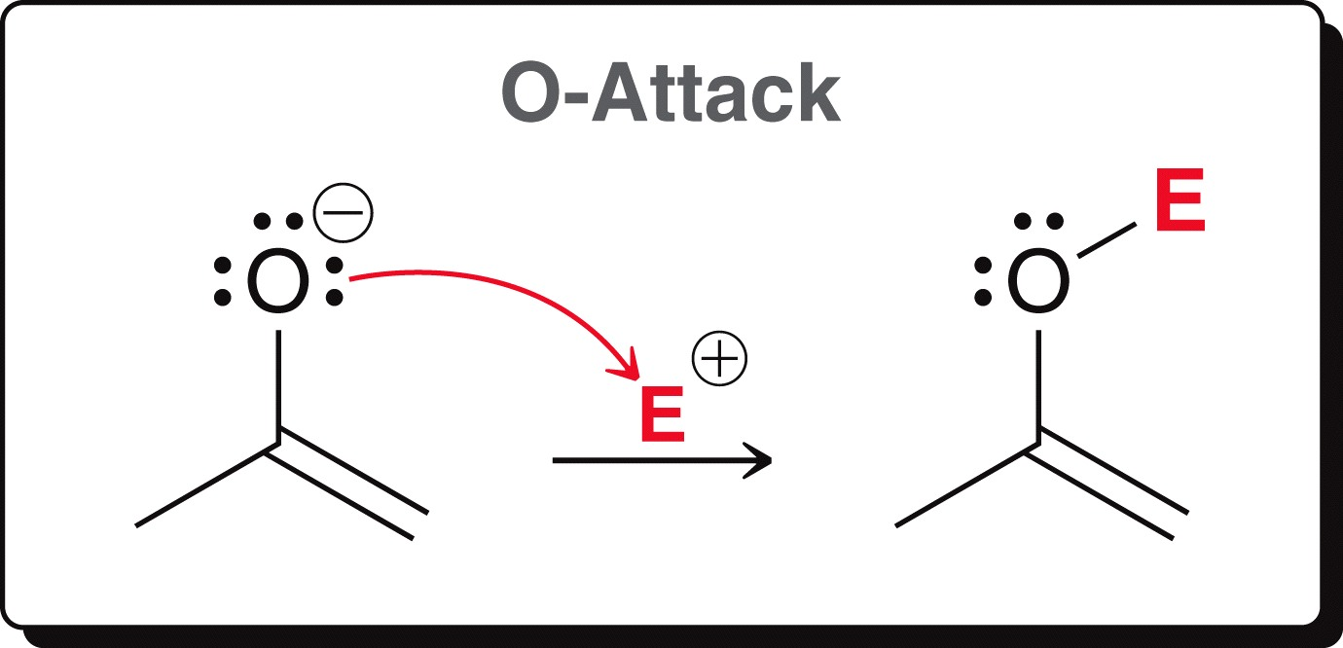
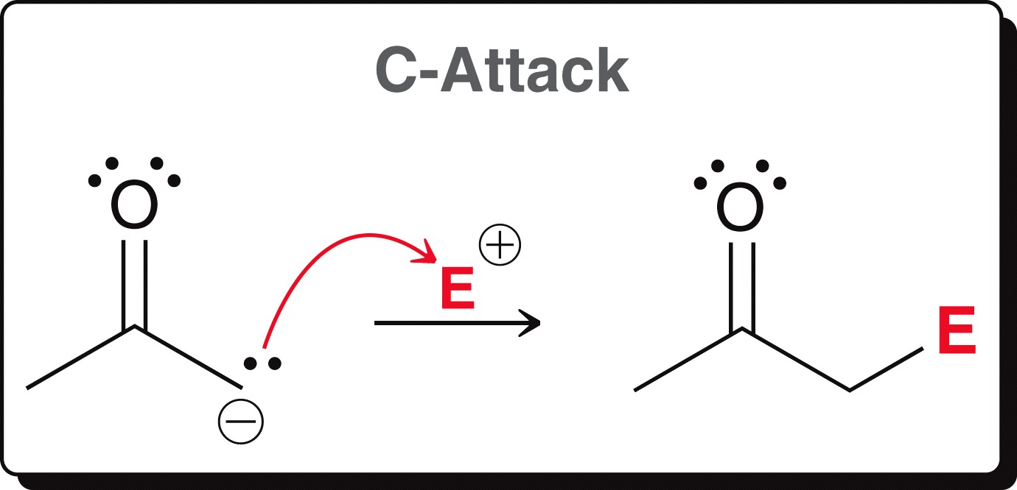
21.1 Enolates
The enolate can undergo C-attack or O-attack:
Enolates generally undergo C-attack, which is drawn one of two ways, depending on which resonance form of the enolate is used:
Most of the reactions in this chapter involve enolates!

Slide 12
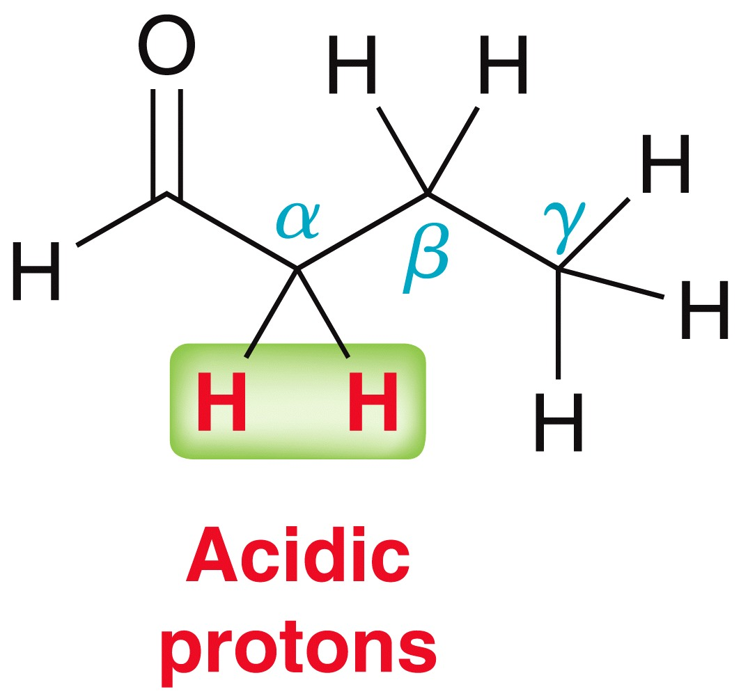
21.1 Enols and Enolates
Alpha protons are the only acidic protons on an aldehyde or ketone that can be removed to form an enolate
the beta or gamma protons are not acidic; deprotonation will NOT yield a resonance stabilized intermediate
Practice with SkillBuilder 21.1

Slide 13
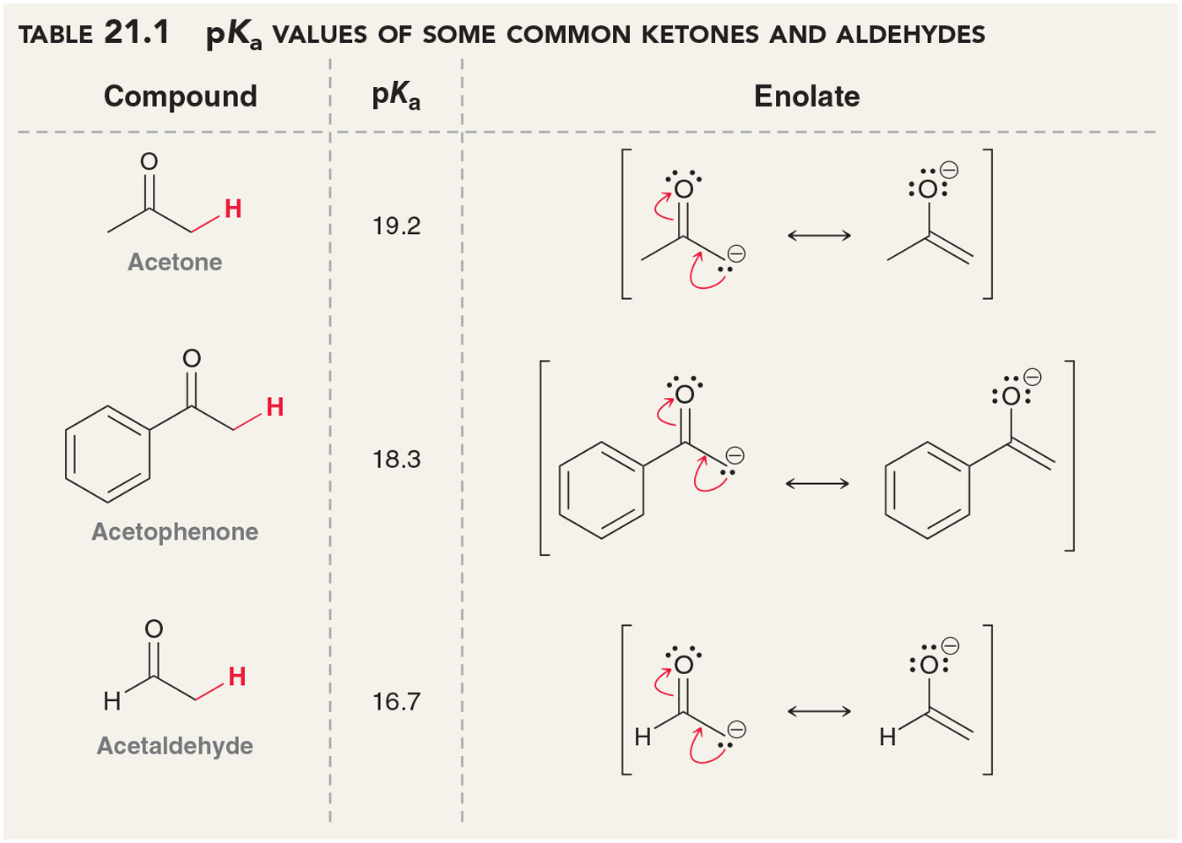
21.1 Choosing a Base for Enolate Formation
The pK_{a} value of α protons must be considered when choosing an appropriate base to form an enolate:

Slide 14
21.1 Choosing a Base for Enolate Formation
When pK_{a} values of the base and the enolate are similar, both products and reactants are present in significant amounts
When the alkoxide is used, the enolated (nucleophile) can react with the ketone (electrophile), covered in Section 21.3

Slide 15
21.1 Choosing a Base for Enolate Formation
To irreversibly and completely form an enolate, a stronger base must be used, like NaH:
LDA is a strong base commonly used to form enolates irreversibly. It is made by treating diisopropylamine with n-butyllithium:

Slide 16
21.1 Choosing a Base for Enolate Formation
When LDA is used to form an enolate, the amount of ketone present at equilibrium is negligible:
LDA features two bulky isopropyl groups, which allows it to be a strong base, but not a good nucleophile

Slide 17
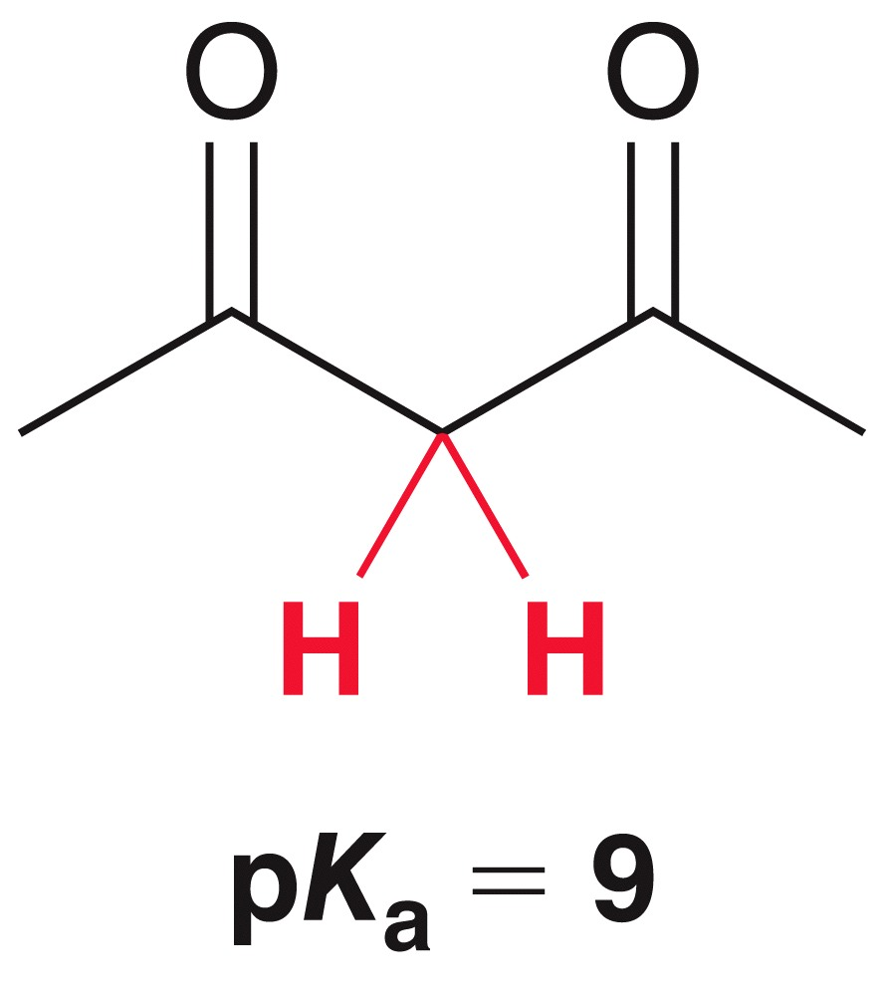
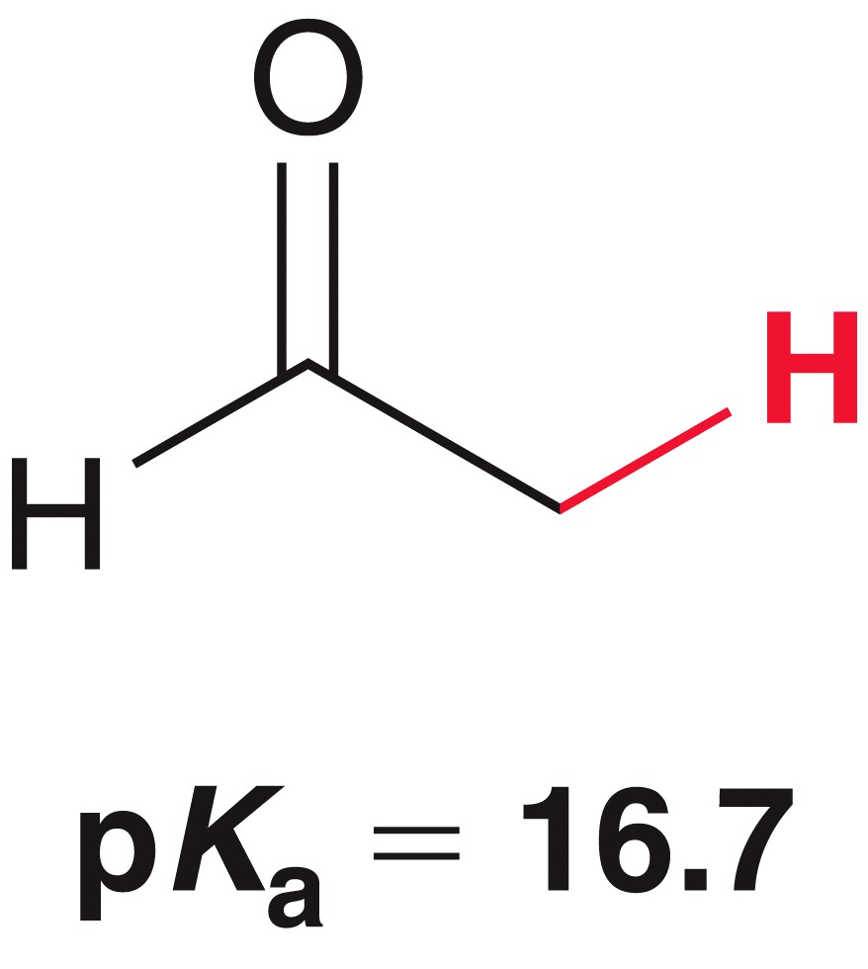
21.1 Choosing a Base for Enolate Formation
When protons are alpha to TWO carbonyl groups, are much more acidic:
The increased acidity is due to increased stability of the resulting enolate:
versus

Slide 18
21.1 Choosing a Base for Enolate Formation
1,3-dicarbonyls are acidic enough to be irreversibly deprotonated by an alkoxide:
There would be no need to use NaH or LDA to form the enolate of a 1,3-dicarbonyl; it would be overkill.

Slide 19
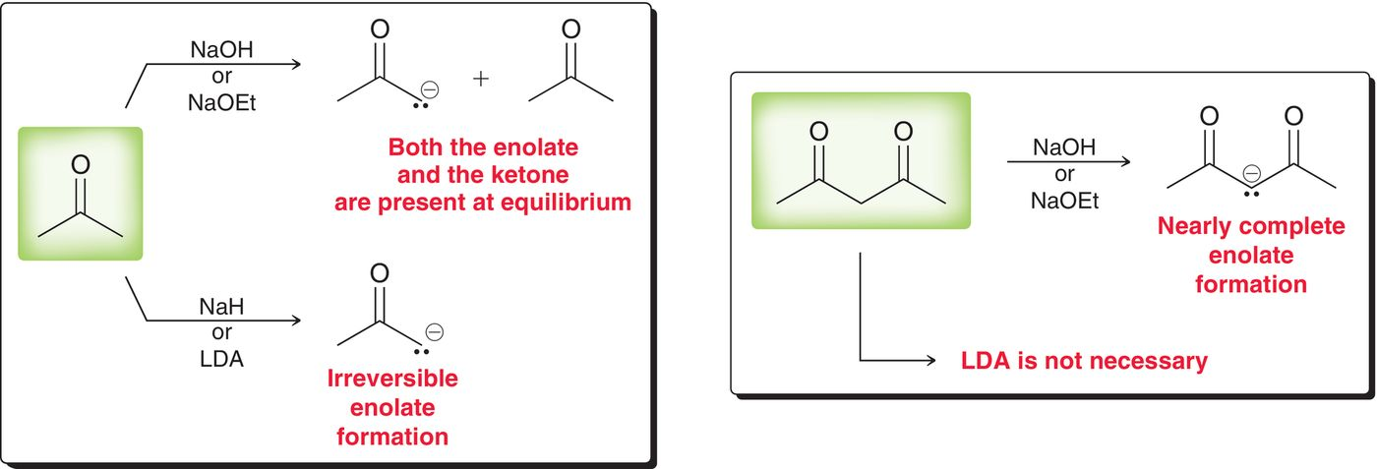
21.1 Choosing a Base for Enolate Formation
It is important to know what base to use in order to generate an enolate, depending on the carbonyl compound and the desired result (reversible vs. irreversible)
Practice with Conceptual Checkpoint 21.6 - 21.7

Slide 20
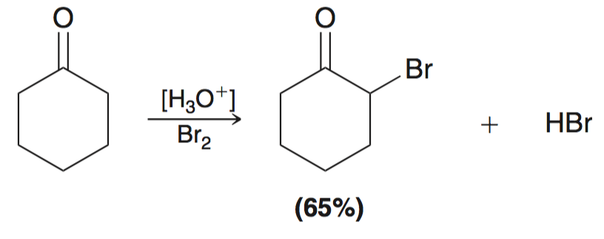
21.2 Alpha Halogenation – Acidic Conditions
Under acidic conditions, ketones/aldehydes undergo alpha halogenation:
Works with Cl₂, Br₂ and I₂ (not fluorine).
Acidic conditions means an enol is the reactive intermediate

Slide 21
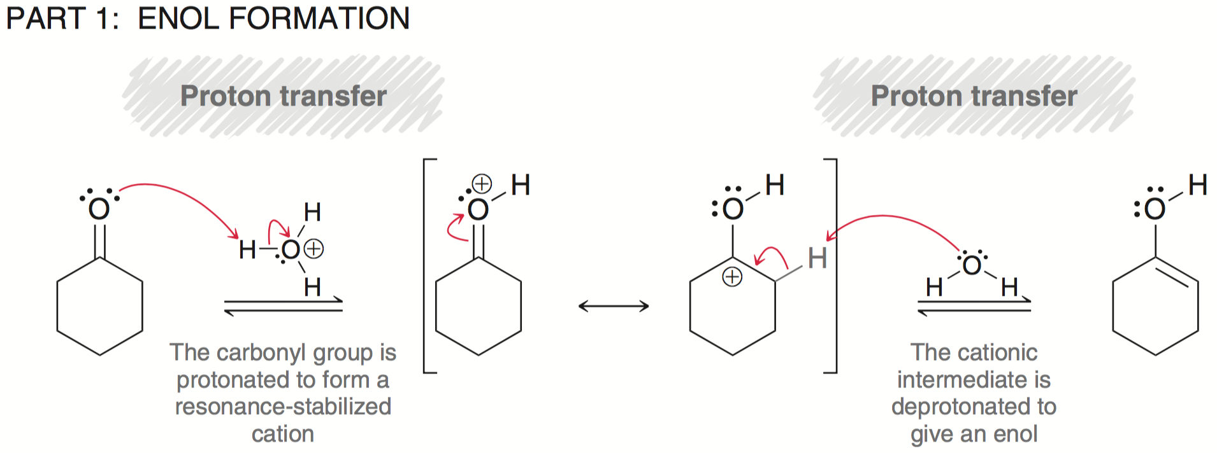
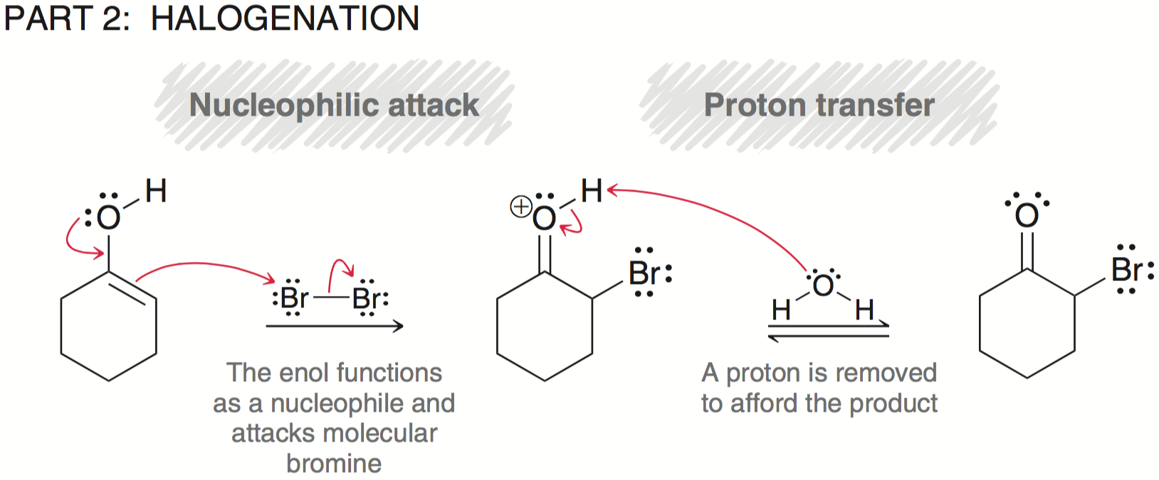
21.2 Alpha Halogenation – Acidic Conditions

Slide 22
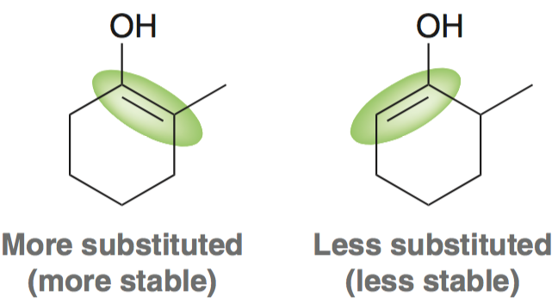
21.2 Alpha Halogenation
When an unsymmetrical ketone is used, halogenation occurs faster at the more substituted carbon
The major product results from the more stable (more substituted) enol

Slide 23
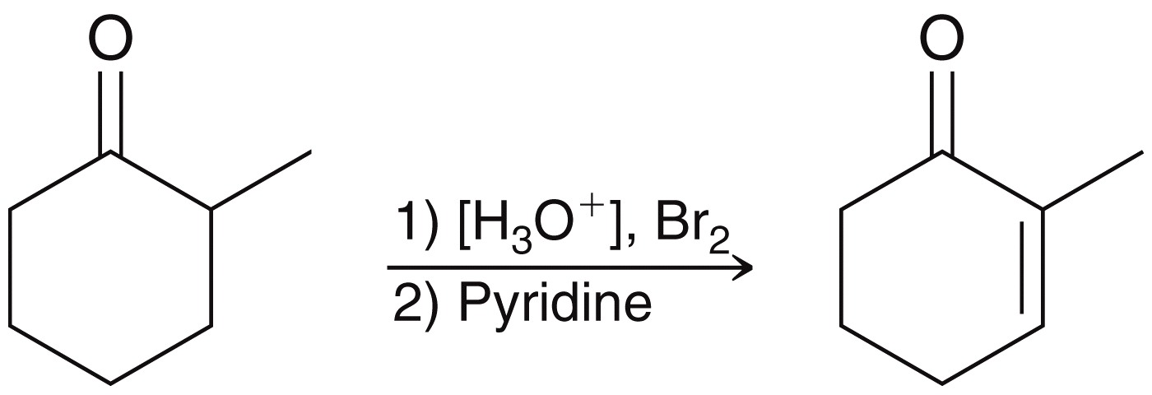
21.2 Alpha Halogenation
Alpha halogenation provides a two-step synthesis for the synthesis of an α,β-unsaturated ketone:
Other bases can be used for the elimination, t-BuOK or Li₂CO₃
Practice with Conceptual Checkpoint 21.8 – 21.9

Slide 24
21.2 Alpha Halogenation
Hell-Volhard Zelinski (HVZ) reaction brominates the alpha carbon of a carboxylic acid
The mechanism is believed to be the following sequence:
Practice with Conceptual Checkpoint 210.10 – 21.11

Slide 25
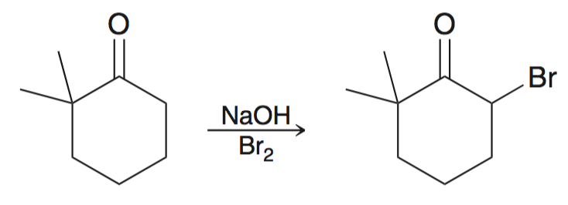
21.2 Alpha Halogenation
Alpha halogenation can also be achieved under basic conditions:
Under basic conditions, an enolate is the reactive intermediate
Mechanism:

Slide 26
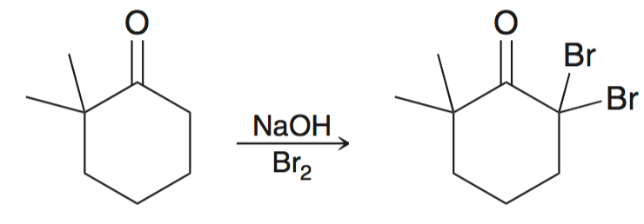
21.2 Alpha Halogenation
Under basic conditions, poly-halogenation typically results:
Once the ketone is brominated, it forms an enolate and brominates again at an even faster rate

Slide 27
21.2 Alpha Halogenation
Under basic conditions, methyl ketones are converted to carboxylic acids using excess halogen and hydroxide
This is called the Haloform Reaction:

Slide 28
21.2 Alpha Halogenation
After all three alpha protons are replaced, the –CBr₃ acts as a good leaving group, and acyl substitution occurs:
The resulting carboxylic acid is deprotonated under the basic conditions; this forces the reaction to completion:

Slide 29
21.2 Alpha Halogenation
Under basic conditions, methyl ketones are converted to carboxylic acids using excess halogen and hydroxide
Br₂, Cl₂ or I₂ can be used.
This is synthetically useful way to produce carboxylic acids from methyl ketones
Works best if the other alpha carbon has no alpha protons
Practice with Conceptual Checkpoint 21.12 – 21.13

Slide 30
21.3 Aldol Additions
Recall that when an aldehyde is treated with hydroxide (or alkoxide), an equilibrium forms where significant amounts of both enolate and aldehyde are present
If the enolate attacks the aldehyde, an aldol addition reaction occurs
The product features both aldehyde and alcohol groups
Note the location of the –OH group on the beta carbon

Slide 31
21.3 Aldol Additions
Under basic conditions, an enolate is the reactive intermediate
Aldol addition mechanism:

Slide 32
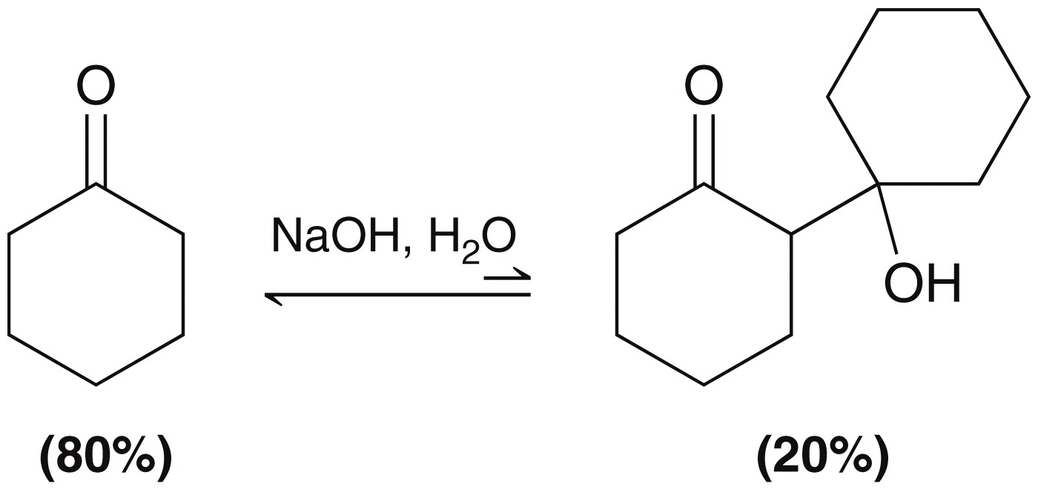
21.3 Aldol Additions
The aldol addition is an equilibrium process
For most simple aldehydes, aldol product is favored
For most ketones, aldol product is NOT favored:

Slide 33
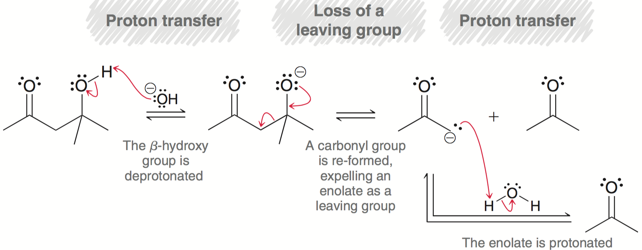
21.3 Aldol Additions
The reverse process is called a retro-aldol reaction:
The mechanism is simply the reverse of aldol addition:
Practice with SkillBuilder 21.2

Slide 34
21.3 Aldol Condensations
When an aldol product is heated under acidic or basic conditions, an α,β-unsaturated carbonyl forms
This is an aldol condensation
aldol condensation occurs when an aldol addition is performed at elevated temperatures:
aldol condensation
product

Slide 35
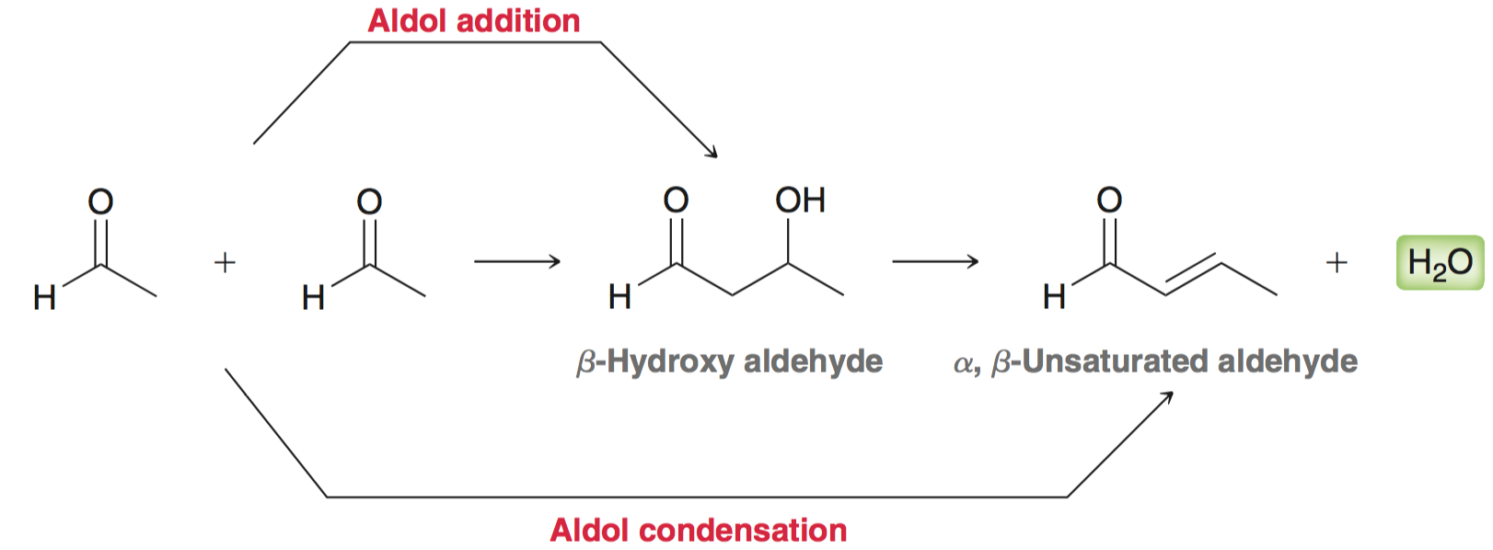
21.3 Aldol Condensations
aldol condensation occurs when an aldol addition is performed at elevated temperatures:

Slide 36
21.3 Aldol Condensations
aldol condensation mechanism:

Slide 37
21.3 Aldol Condensations
When two stereoisomeric π bonds can be formed, the product with fewer steric interactions is the major product:

Slide 38
21.3 Aldol Condensations
Because the aldol condensation is favored, often it is impossible to isolate the aldol addition product

Slide 39
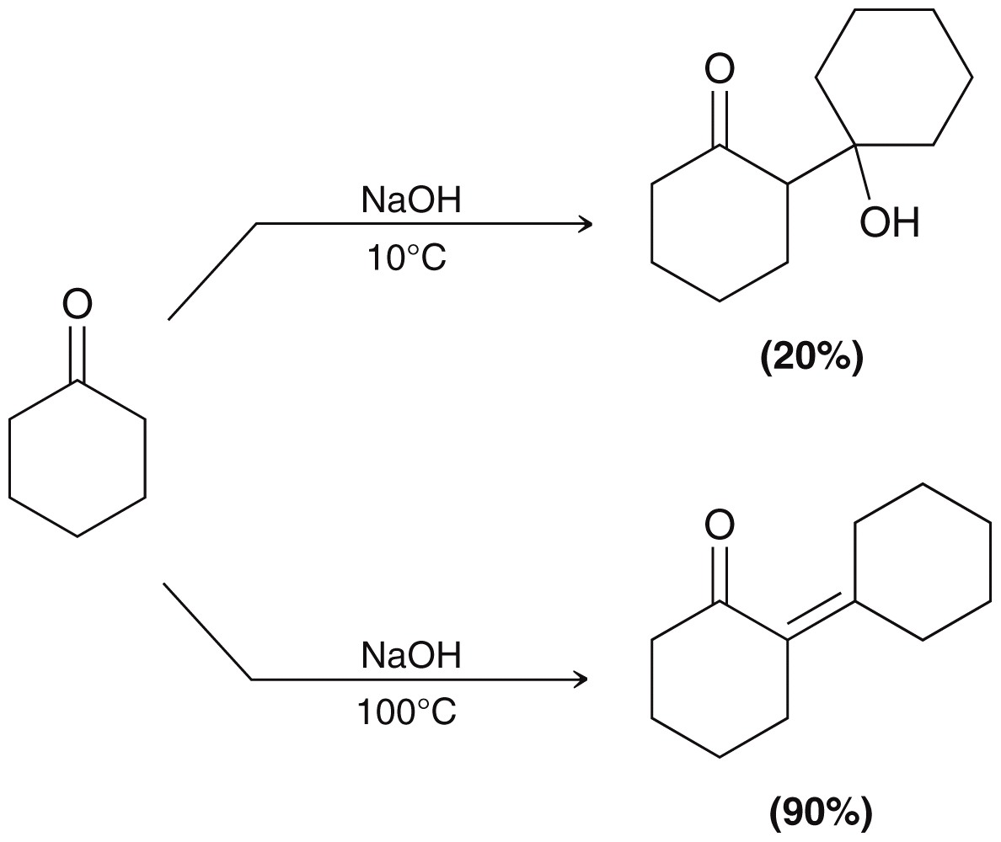
21.3 Aldol Condensations
The yields for condensation are typically much greater than yields for the addition reaction:
Practice with SkillBuilder 21.3

Slide 40
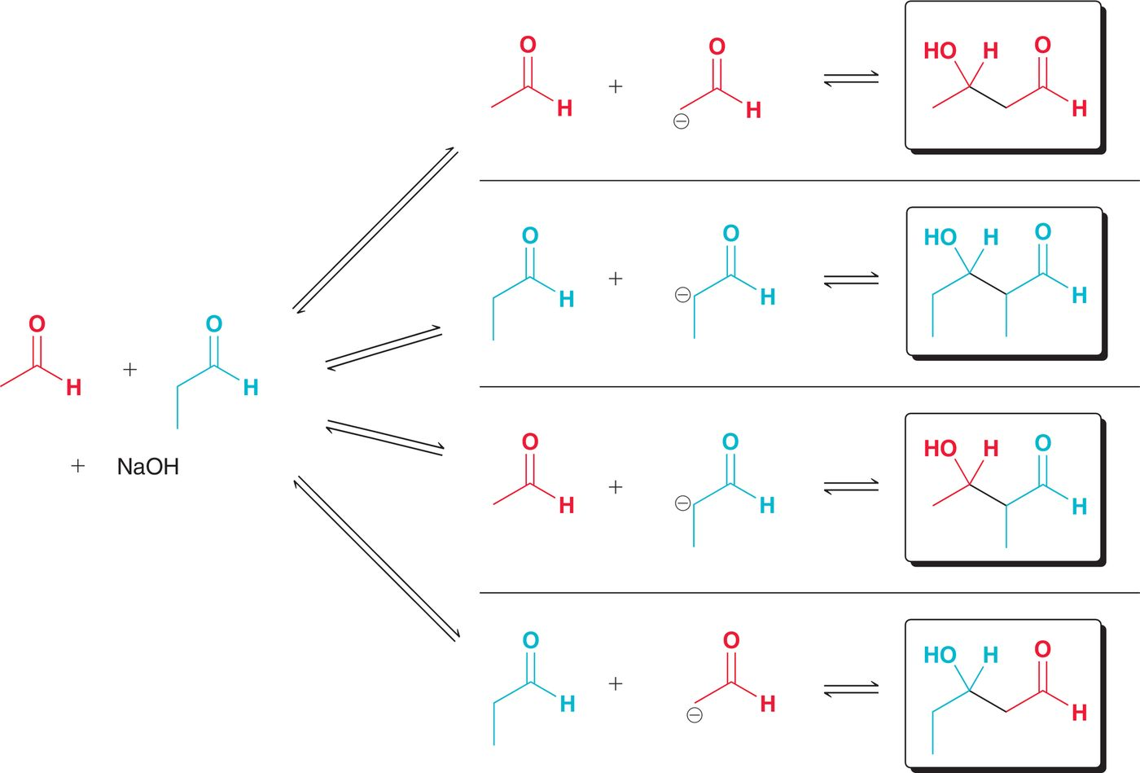
21.3 Crossed Aldol Reactions
Two different aldehydes/ketones react in a crossed aldol reaction (or a mixed aldol reaction):
Two different aldehydes
yield 4 possible aldol products

Slide 41
21.3 Crossed Aldol Reactions
Crossed aldol reactions are only practical if the number of products can be minimized, which is achieved in one of two ways:
One of the substrates is relatively unhindered and without alpha protons

Slide 42
21.3 Crossed Aldol Reactions
Crossed aldol reactions are only practical if the number of products can be minimized, which is achieved in one of two ways:
One of the substrates is relatively unhindered and without alpha protons
This is possible when only one compound can form an enolate, and the other compound reacts with enolate faster

Slide 43
21.3 Crossed Aldol Reactions
Crossed aldol reactions are only practical if the number of products can be minimized, which is achieved in one of two ways:
Use LDA as a base (i.e. directed aldol addition):
One compound is completely converted to enolate with LDA
The other carbonyl compound is then slowly added to the enolate
Practice crossed aldol reactions with SkillBuilder 21.4

Slide 44
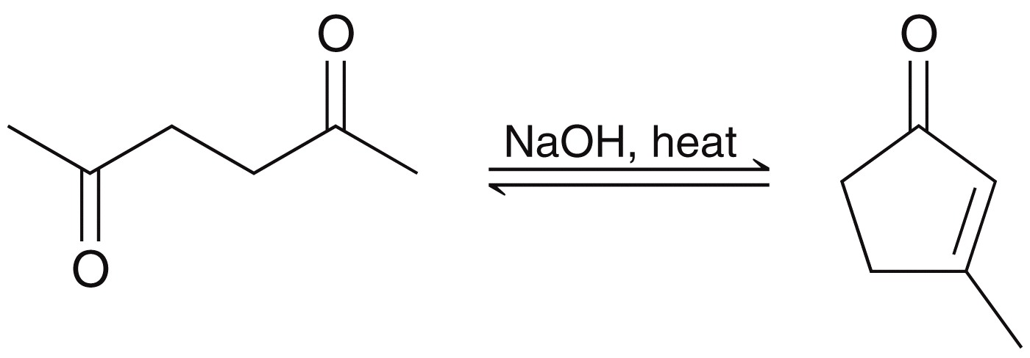
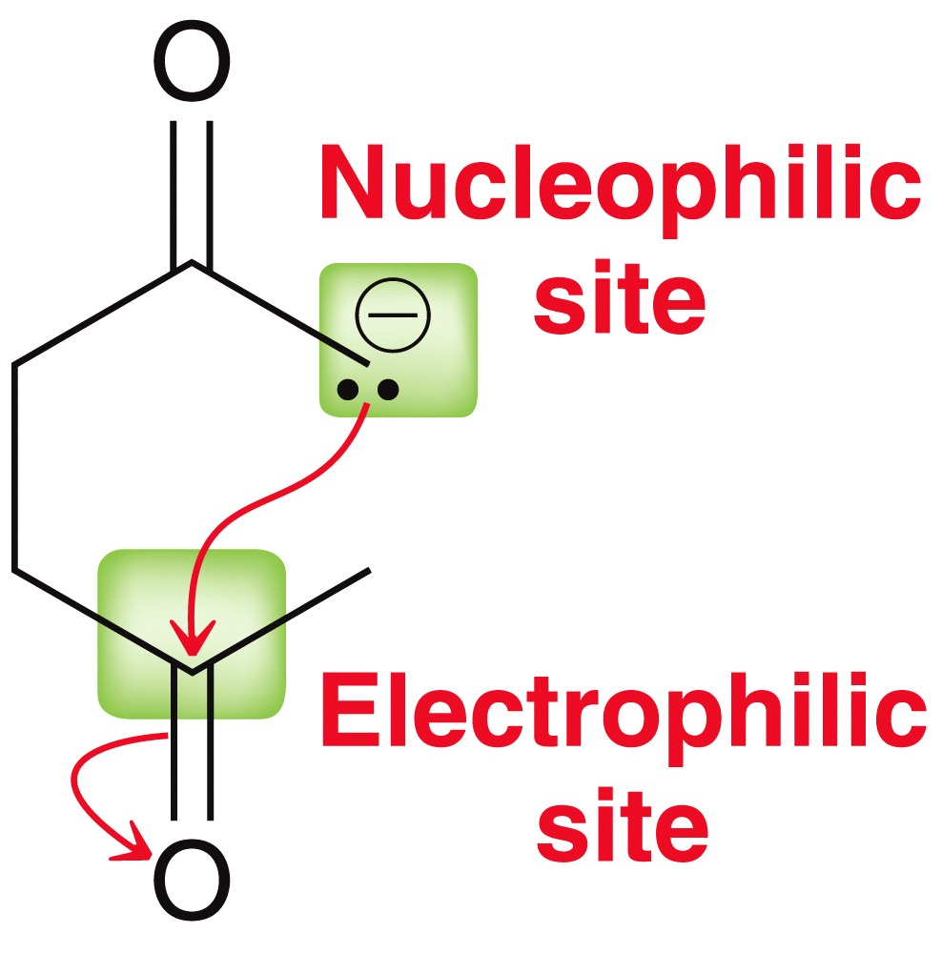
21.3 Intramolecular Aldol Reactions
intramolecular aldol reactions form cyclic compounds:
One group forms an enolate that attacks the other group
Only 5 and 6 member rings form well this way
Practice Conceptual Checkpoint 21.21 – 21.23

Slide 45
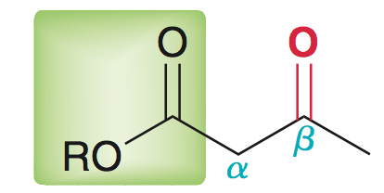
21.4 Claisen Condensations
Esters also undergo reversible condensations reactions
This type of reaction is called a Claisen condensation:
Claisen condensation is simply a nucleophilic acyl substitution reaction (nucleophile = enolate of an ester, and electrophile = ester)
Claisen condensation
product
(β-keto ester)
ester
β-keto ester

Slide 46
21.4 Claisen Condensations
Mechanism:
The last step (deprotonation of the β-ketoester) drives the reaction to completion
Acidic workup is necessary to obtain the neutral product

Slide 47
21.4 Claisen Condensations
There are some limitations to the Claisen condensation
The starting ester must have 2 alpha protons, because removal of the second proton by the alkoxide ion is what drives the equilibrium forward
Hydroxide cannot be used as the base to promote Claisen condensations; otherwise ester hydrolysis occurs:

Slide 48
21.4 Claisen Condensations
There are some limitations to the Claisen condensation
An alkoxide that matches the –OR group of the ester is needed, otherwise transesterification occurs:

Slide 49
21.4 Claisen Condensations
Crossed Claisen condensations are only useful if one of the following criteria is met:
One ester has no α protons:
Perform directed Claisen condensation with LDA as the base:

Slide 50
21.4 Claisen Condensations
Intramolecular Claisen condensations can also be achieved
Called a Dieckmann cyclization
Like with aldol reactions, Dieckmann cyclization prefers the formation of 5 and 6 member rings
Practice with Conceptual Checkpoints 21.24 – 21.28

Slide 51
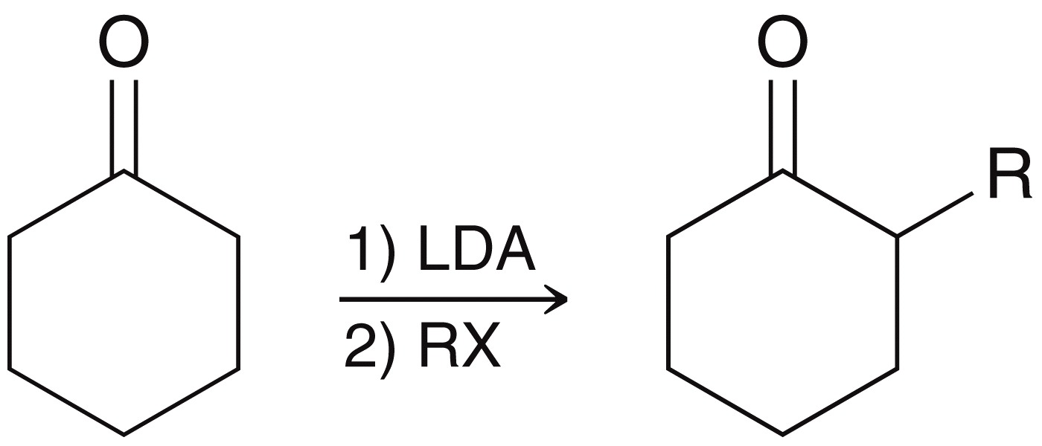
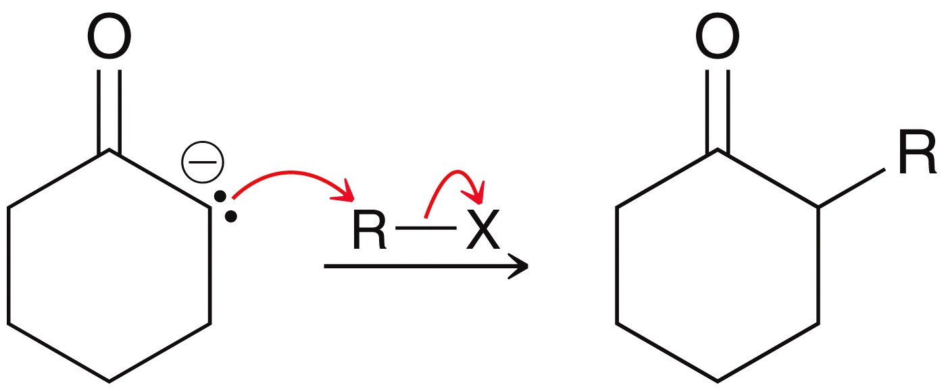
21.5 Alkylation of the Alpha Position
The alpha position can be alkylated when an enolate is treated with an alkyl halide
The enolate attacks the alkyl halide via an S_{N}2 reaction

Slide 52
21.5 Alkylation of the Alpha Position
Typical S_{N}2 restrictions apply: when 2° or 3° alkyl halides are used, E2 elimination dominates
The aldol reaction also competes with the desired alkylation, so a strong base such as LDA must be used
Regioselectivity is an issue with unsymmetrical ketones:
two different enolates can form

Slide 53
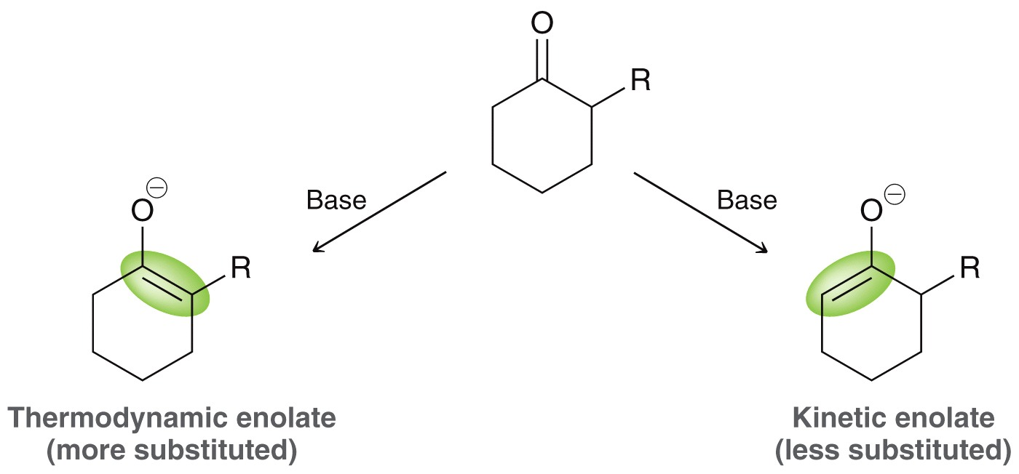
21.5 Alkylation of the Alpha Position
Regioselectivity is an issue with unsymmetrical ketones:
two different enolates can form
More stable enolate
Less stable, but
forms faster

Slide 54
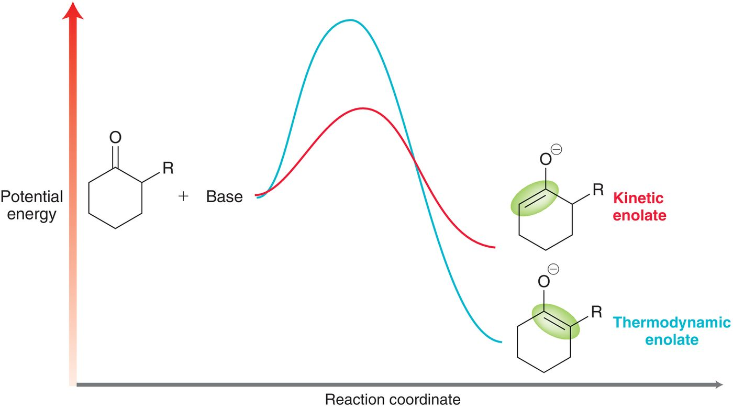
21.5 Alkylation of the Alpha Position
the kinetic and thermodynamic pathways:

Slide 55
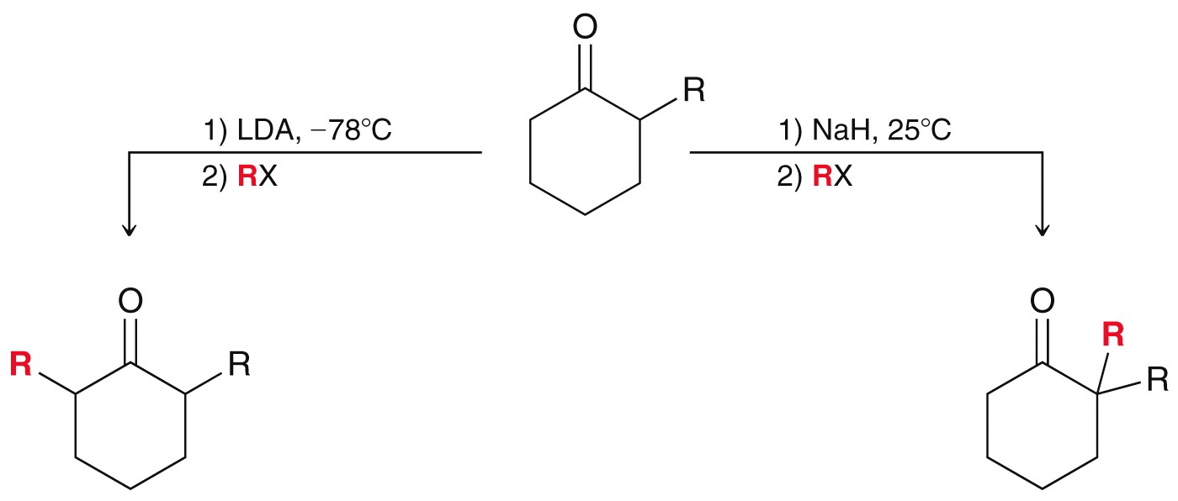
21.5 Alkylation of the Alpha Position
Kinetic enolate favored by irreversible conditions:
Use LDA at low temperature
Thermodynamic enolate favored by reversible conditions
Use NaH at room temperature
Practice with Conceptual Checkpoint 21.29 – 21.30

Slide 56
21.5 Alkylation of the Alpha Position
The malonic ester synthesis - akyl halide is converted into a carboxylic acid with two additional carbons:
Diethyl malonate is the starting material
It is first reacted with a base to form the corresponding enolate:
diethyl
malonate
stabilized
enolate

Slide 57
21.5 Alkylation of the Alpha Position
The enolate is then reacted with the alkyl halide:
Both ester groups are then hydrolyzed:

Slide 58
21.5 Alkylation of the Alpha Position
One of the resulting carboxylic acid groups is then decarboxylated with heat
1,3-dicarboxylic acids undergo decarboxylation in a pericyclic process:

Slide 59
21.5 Alkylation of the Alpha Position
Malonic ester synthesis, overall:
Diethyl malonate can also be dialkylated:
Practice with SkillBuilder 21.5

Slide 60
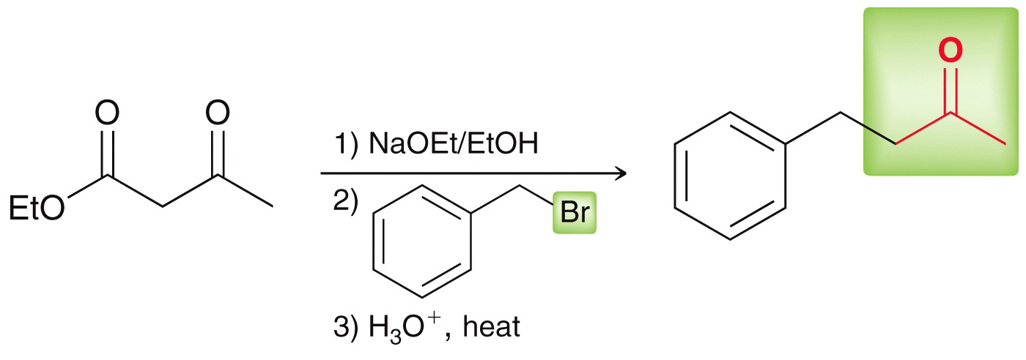
21.5 Alkylation of the Alpha Position
The acetoacetic ester synthesis is analogous to the malonate synthesis.
Converts an alkyl halide to methyl ketone with three new carbon atoms:
Practice with SkillBuilder 21.6

Slide 61
21.6 Conjugate Addition Reactions
Recall that α,β-unsaturated carbonyls are made via aldol condensation:
α,β-unsaturated carbonyls have three resonance contributors

Slide 62
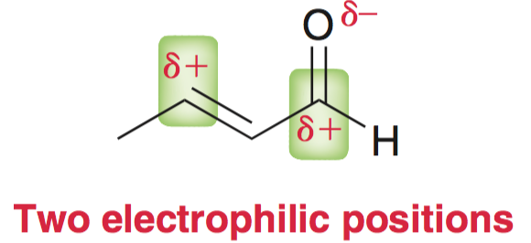
21.6 Conjugate Addition Reactions
α,β-unsaturated carbonyls have three resonance contributors
The β carbon and the carbonyl carbon are electrophilic:
Either carbon can be attacked, depending on nucleophile used

Slide 63
21.6 Conjugate Addition Reactions
Grignard reagents generally attack the carbonyl position
This is called 1,2 addition
Gilman reagents generally attack the beta position
This is called 1,4-addition or conjugate addition

Slide 64
21.6 Conjugate Addition Reactions
General mechanism of conjugate addition:
The enol then tautomerizes to the aldehyde/ketone:

Slide 65
21.6 Conjugate Addition Reactions
Stronger nucleophiles tend towards 1,2-addition; less reactive nucleophiles tend to do conjugate addition
Typical enolates often give a mixture of 1,2- and 1,4- addition products
Stabilized enolates give 1,4-addition exclusively:

Slide 66
21.6 Conjugate Addition Reactions
Stabilized enolates give 1,4-addition exclusively:
This conjugate (1,4) addition is called a Michael reaction
Michael donor = nucleophile that does conjugate addition
Michael acceptor = the α,β-unsaturated carbonyl

Slide 67
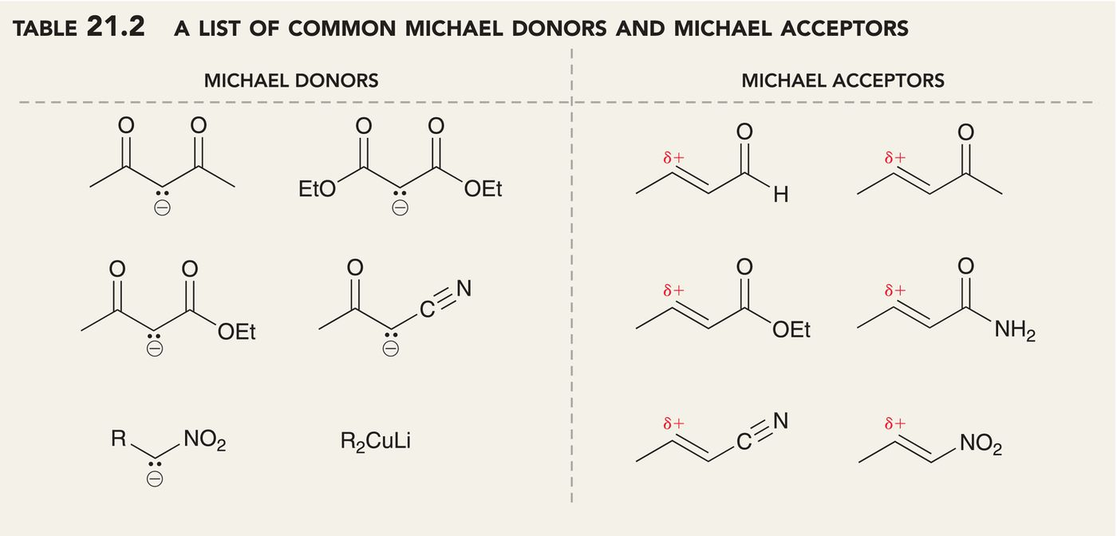
21.6 Conjugate Addition Reactions
The following Michael donors give exclusively 1,4-addition with an unsaturated carbonyl compound:
Practice with Conceptual Checkpoint 21.35 – 21.37

Slide 68
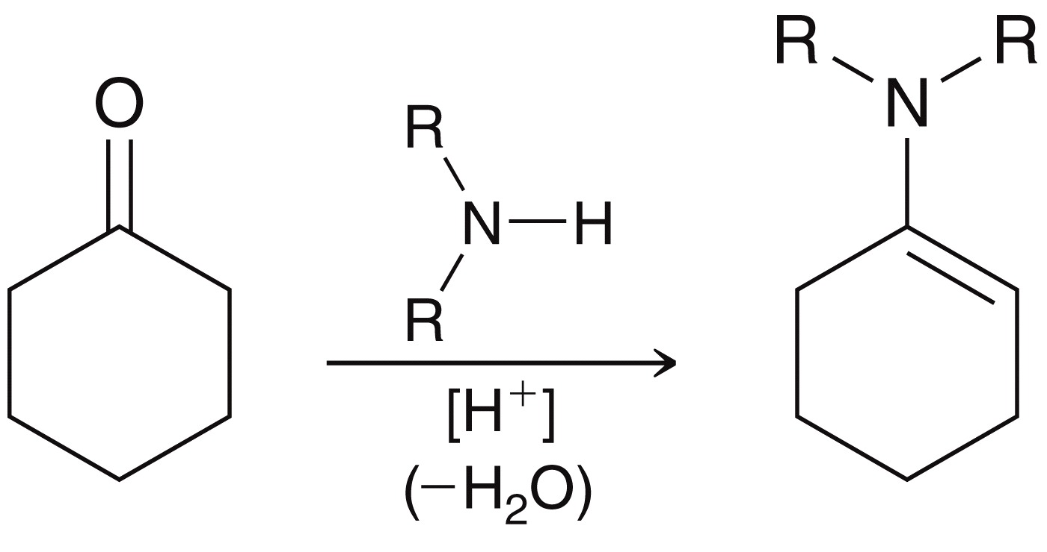
21.6 Stork Enamine Synthesis
Because singly-stabilized enolates do not give high yielding Michael additions, Gilbert Stork developed a synthesis using an enamine intermediate
Recall how an enamine is made (section 19.6)

Slide 69
21.6 Conjugate Addition Reactions
Enamines behave like enolate; they are nucleophiles:
But, an enamine is less nucleophilic, and is a Michael donor

Slide 70
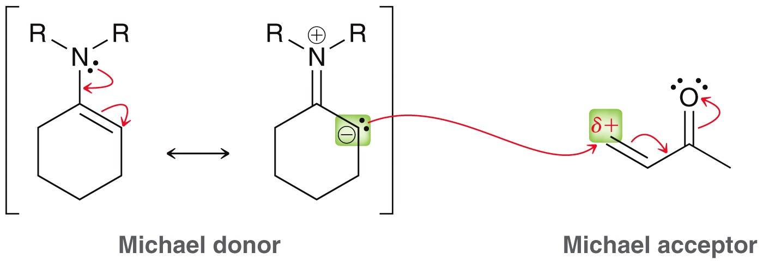
21.6 Conjugate Addition Reactions
But, an enamine is less nucleophilic, and is a Michael donor
After conjugate addition, aqueous acid converts both groups into carbonyl groups:

Slide 71
21.6 Conjugate Addition Reactions
The overall, 3-part process is a Stork enamine synthesis:
(1) formation of enamine
(2) Michael addition
(3) hydrolysis
Practice with SkillBuilder 21.7

Slide 72
21.6 Robinson Annulation
Robinson Annulation – two step process for forming a ring, specifically (1) Michael addition, followed by (2) intramolecular aldol condensation:
Practice with Conceptual Checkpoints 21.40 – 21.41

Slide 73
21.7 Synthesis Strategies
Most of the reactions in this chapter are C-C bond forming, and yield products that contain two functional groups:
Aldol reaction and/or condensation
Claisen condensation
Stork enamine synthesis (i.e. Michael reaction)
The positions of the functional groups in a target compound dictate what reactions can be used to synthesize it

Slide 74
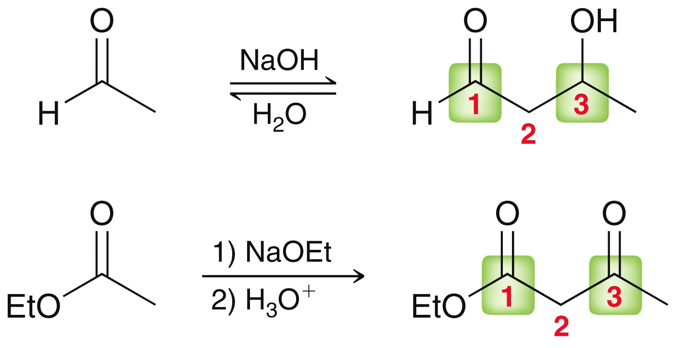
21.7 Synthesis Strategies
Stork enamine synthesis → 1,5-dicarbonyl compounds
Aldol and Claisen → 1,3-difunctional compounds
Practice with SkillBuilder 21.8

Slide 75
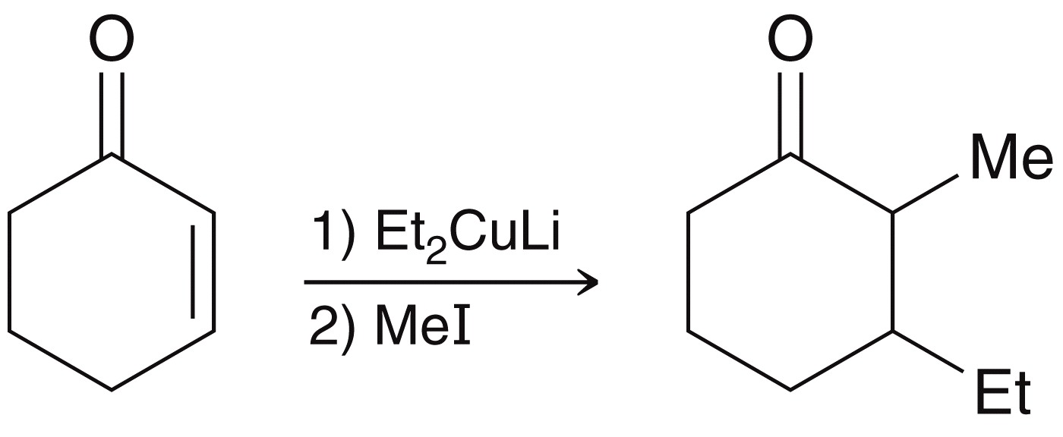
21.7 Synthesis Strategies
We have learned two methods of alkylation
The alpha position of an enolate attacks an alkyl halide
A Michael donor attacks the beta position of a Michael acceptor
These two reactions can also be combined
Practice with SkillBuilder 21.9

Slide 76
21.7 Review of Reactions

Slide 77
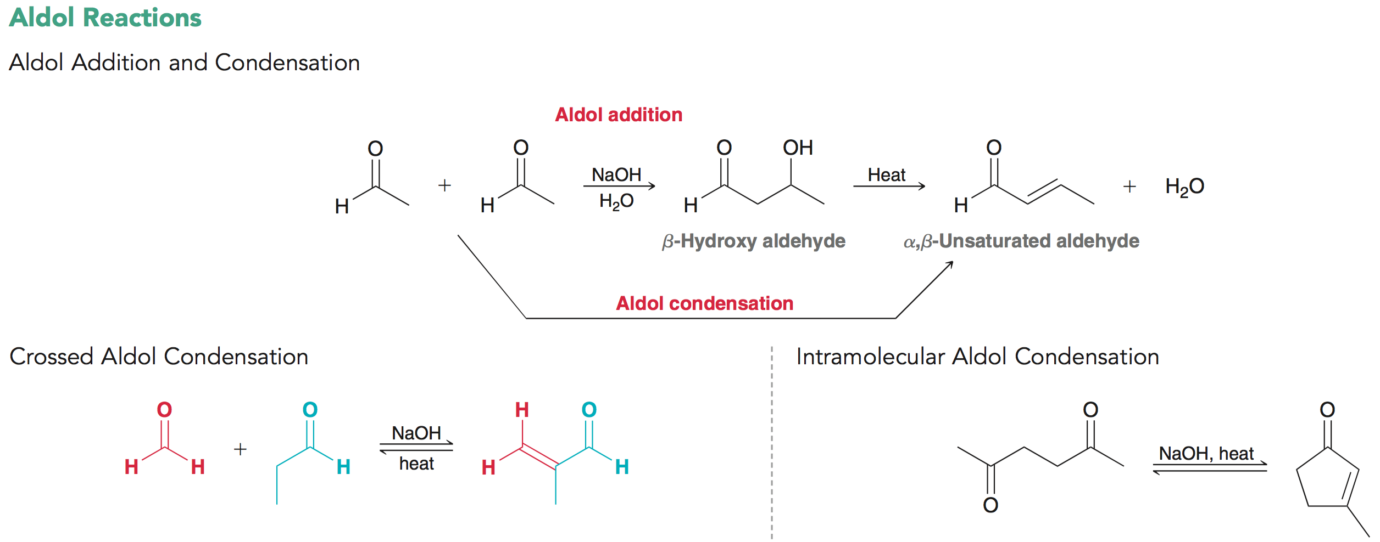
21.7 Review of Reactions

Slide 78
21.7 Review of Reactions

Slide 79
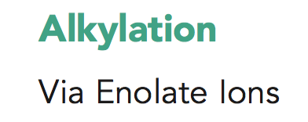
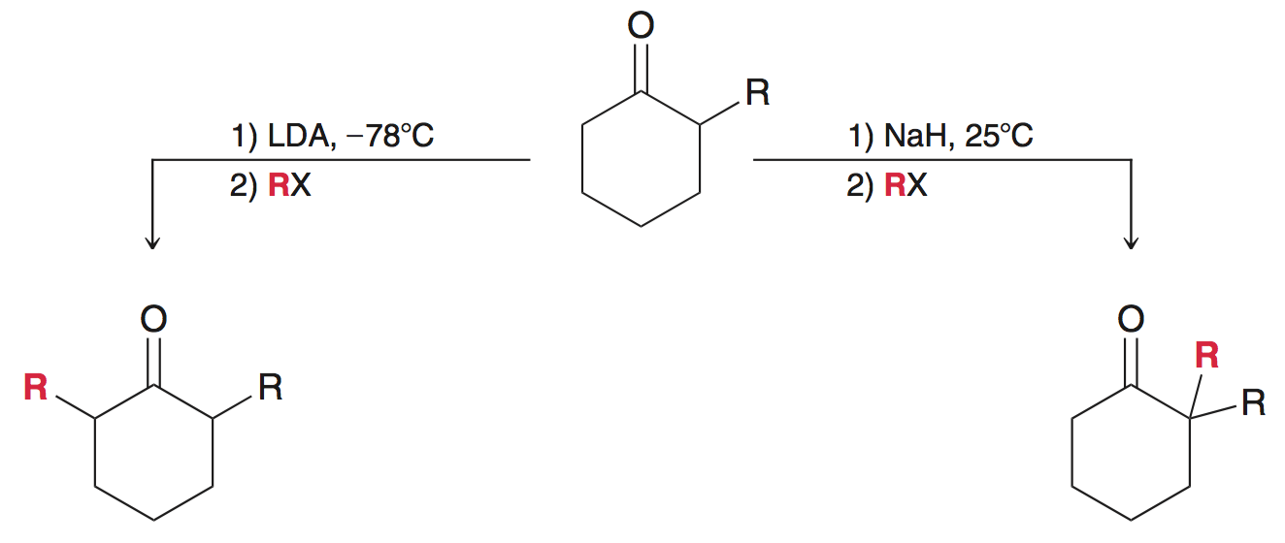
21.7 Review of Reactions

Slide 80
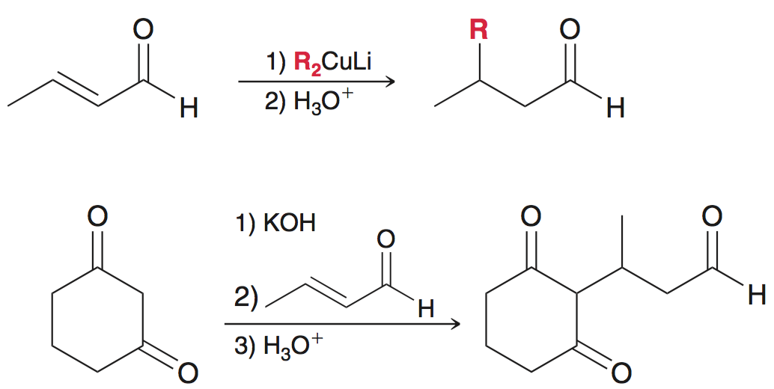
21.7 Review of Reactions

