Slide 1
Organic Chemistry
Third Edition
David Klein
Chapter 22
Amines

Slide 2
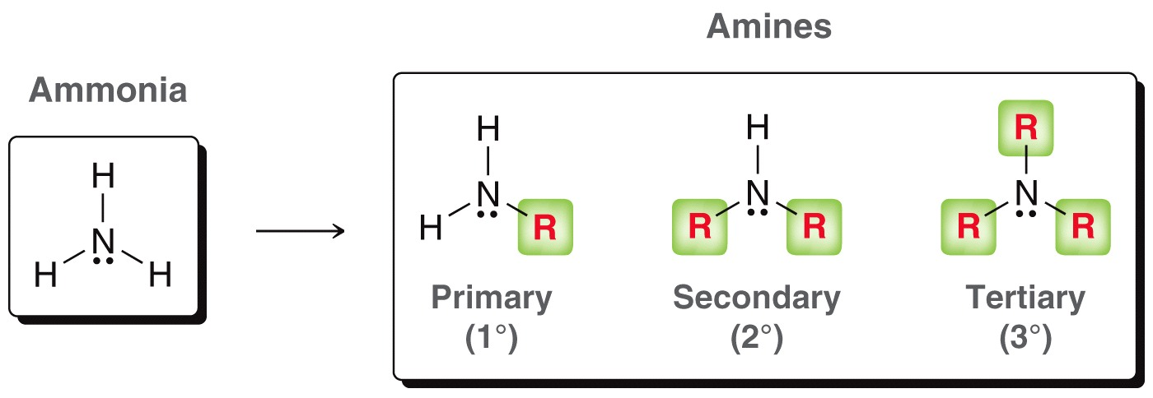
22.1 Introduction to Amines
Amines are derivatives of ammonia, and are designated as primary, secondary, or tertiary

Slide 3
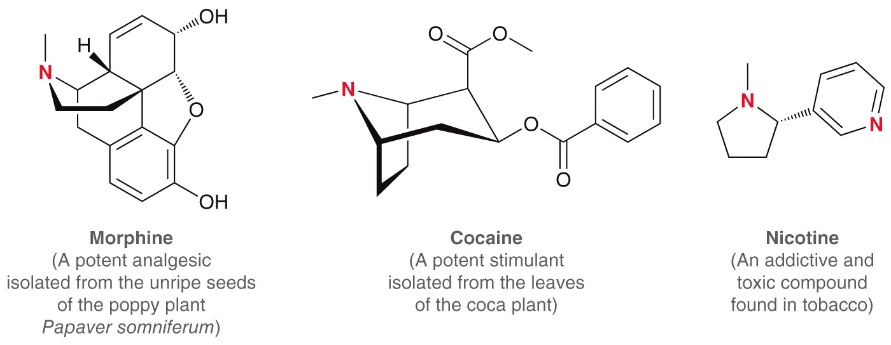
22.1 Introduction to Amines
Naturally occurring amines are called alkaloids

Slide 4
22.1 Introduction to Amines
Some naturally occurring amines are vital to neurochemistry:

Slide 5
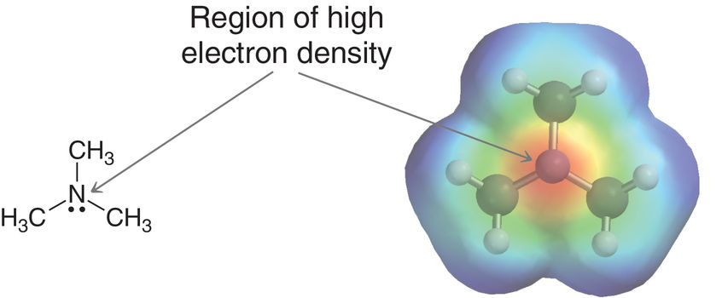
22.1 Introduction to Amines
The trigonal pyramidal nitrogen atom of an amine carries a partial negative charge on its lone pair
The lone pair can function as a base, or as a nucleophile

Slide 6
22.2 Nomenclature of Amines
IUPAC nomenclature allow for two different ways for naming 1° amines
Name the alkyl group ending in “yl” followed by the suffix “amine”

Slide 7
22.2 Nomenclature of Amines
There are multiple methods for naming 1° amines
More complicated 1˚ amines are named as alkanamines. They are named the same as alcohols, but the suffix –amine is used instead of -ol

Slide 8
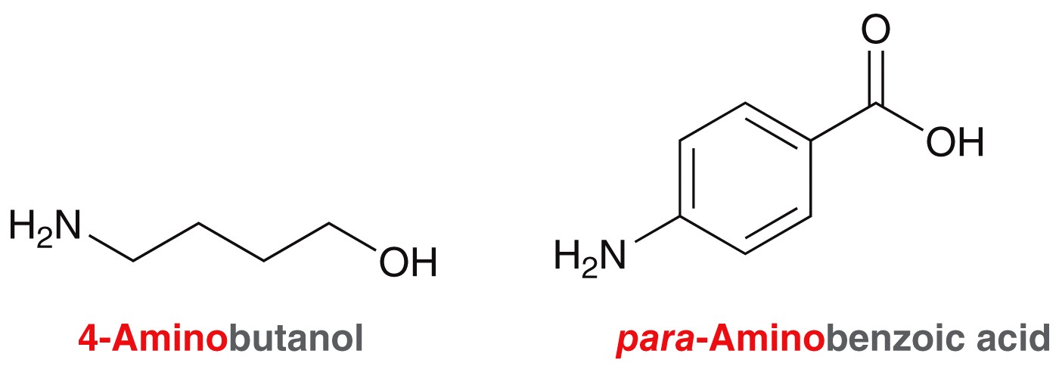
22.2 Nomenclature of Amines
There are multiple methods for naming 1° amines
Use the term “amino” for the group as a substituent

Slide 9
22.2 Nomenclature of Amines
There are multiple methods for naming 1° amines
If the amine is directly attached to an aromatic ring, the parent name is “aniline”

Slide 10
22.2 Nomenclature of Amines
There are multiple methods for naming 2˚ and 3˚ amines
Name the alkyl groups, followed by –amine suffix. Use “di” and “tri” if there are more than one of the same group.

Slide 11
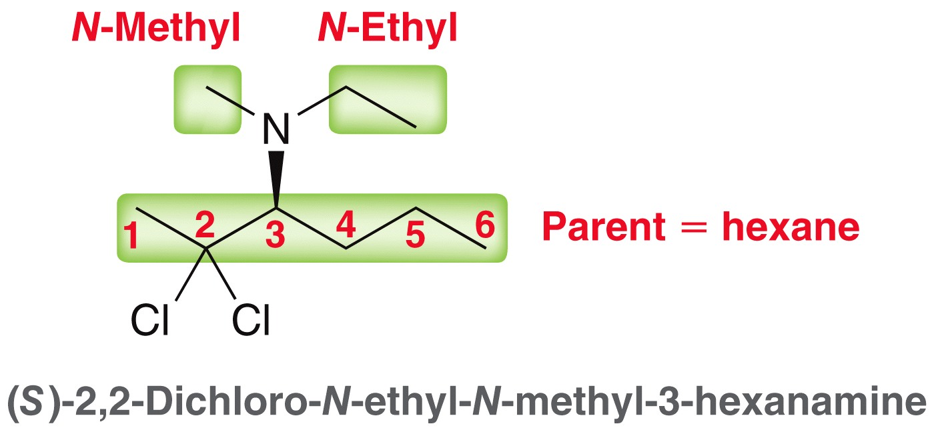
22.2 Nomenclature of Amines
There are multiple methods for naming 2° amines
Find the carbon parent chain, and use the suffix, amine. Smaller groups attached to the amine should be named as alkyl groups with the N-locant
Practice with SkillBuilder 22.1

Slide 12
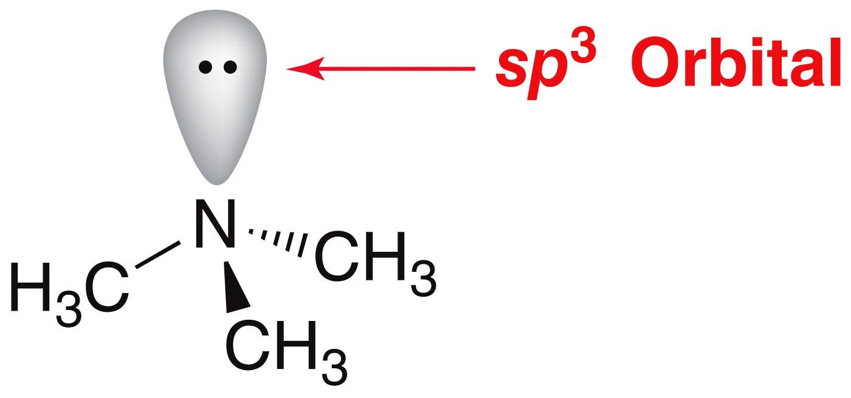
22.3 Properties of Amines
The N atom in typical amines is sp³ hybridized
bond angles around the N = 108˚
The C-N bond lengths are 147 pm, which is slightly shorter than C-C bonds, and longer than C-O bonds
Under what circumstances would the nitrogen be sp² hybridized?

Slide 13
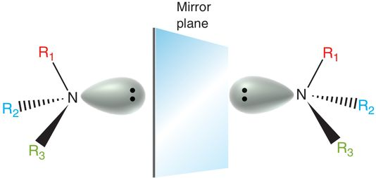
22.3 Properties of Amines
N atoms with three different alkyl groups are chiral (they possess 4 different groups; the lone pair counts as a group)
But…
Amines are generally not optically active (next slide)

Slide 14
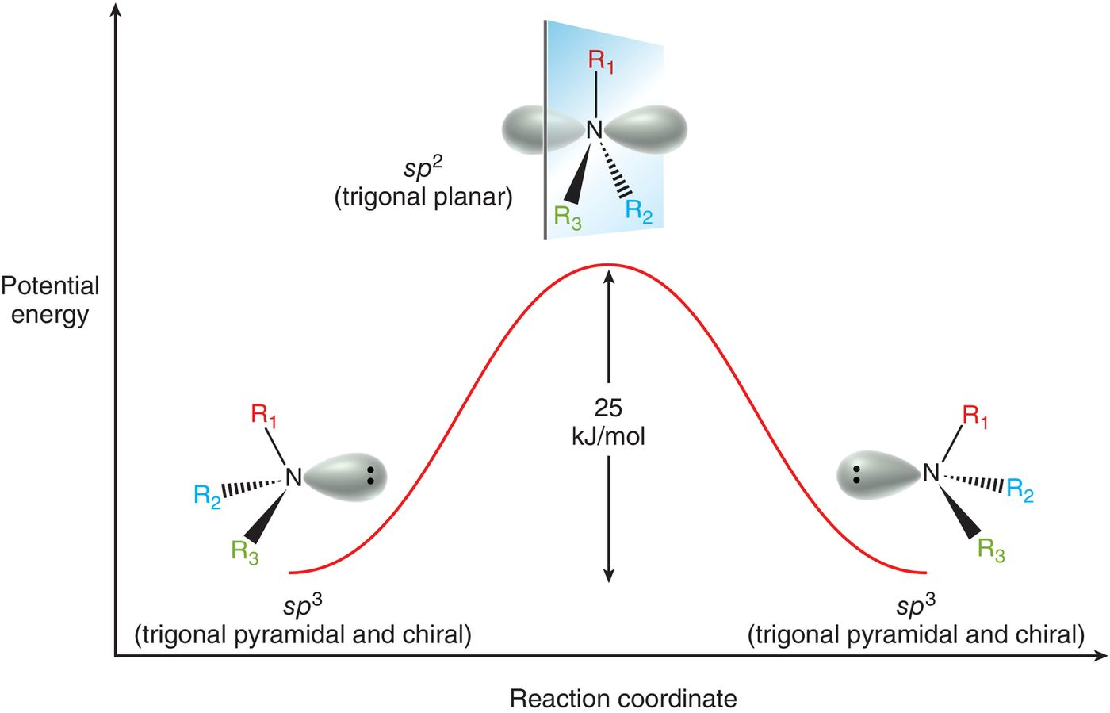
22.3 Properties of Amines
Pyramidal conversion occurs rapidly:

Slide 15
22.3 Properties of Amines
Amines with fewer than 5 carbons are typically soluble in water.
1˚ and 2˚ amines can intermolecularly H-bond, and have higher boiling points than 3˚ amines.

Slide 16
22.3 Properties of Amines
Many small molar mass amines have unpleasant odors
The smell like rotting fish
Practice with conceptual checkpoint 22.4 - 22.5

Slide 17
22.3 Basicity of Amines
Amines are stronger bases than alcohols and ethers.
Amines can be readily protonated by strong and weak acids
It is useful to have a general idea of the pKa values of protonated amines

Slide 18
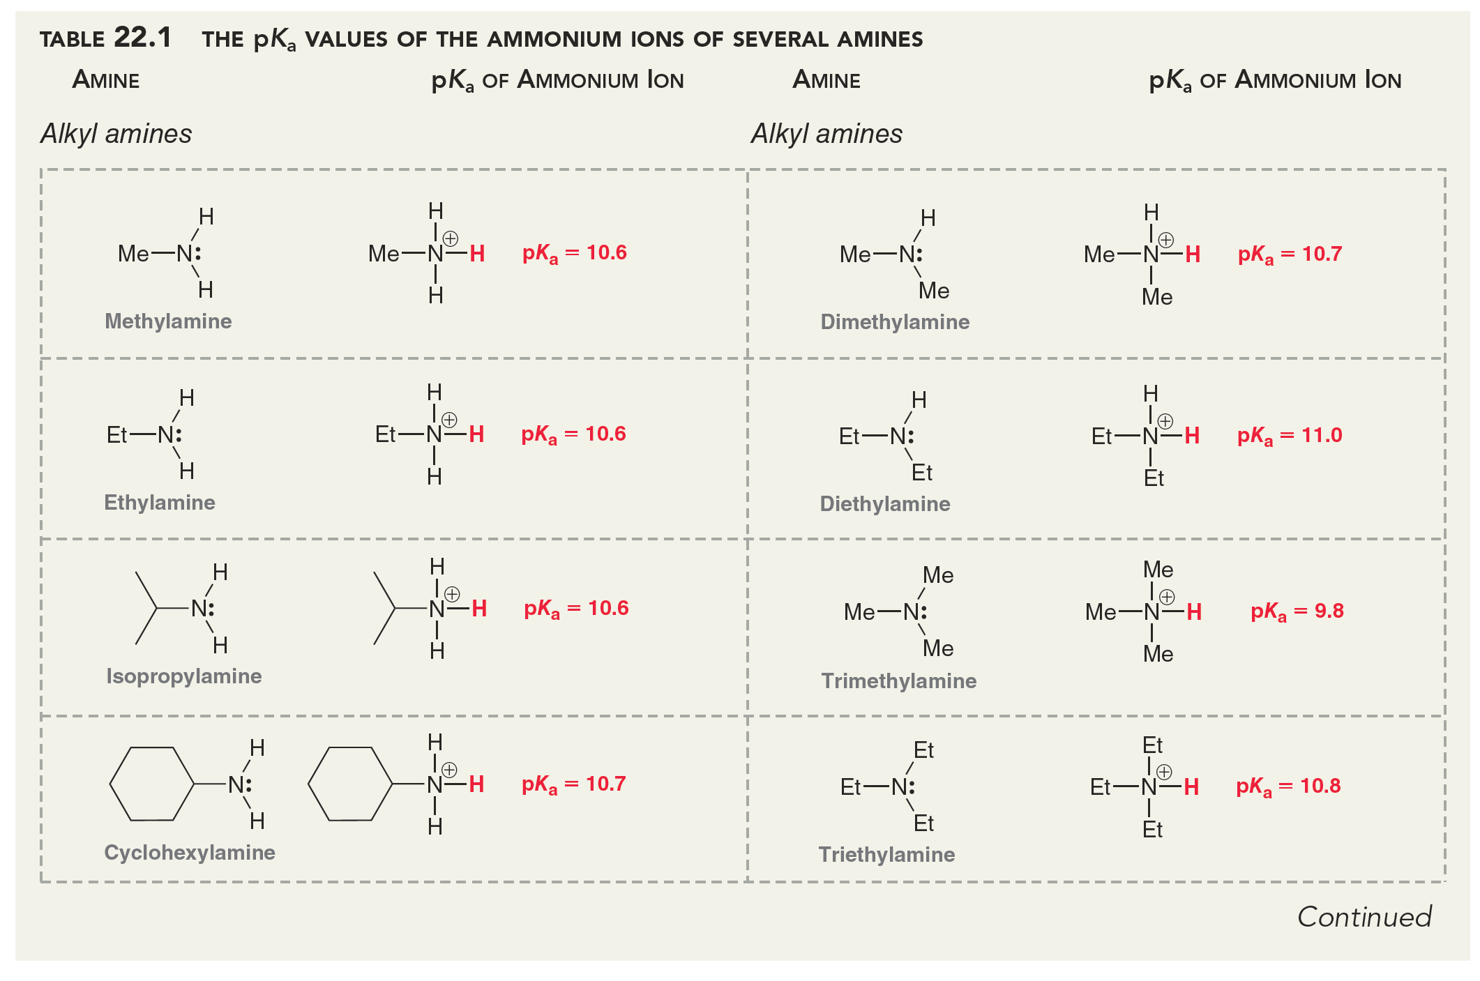
22.3 Basicity of Amines

Slide 19
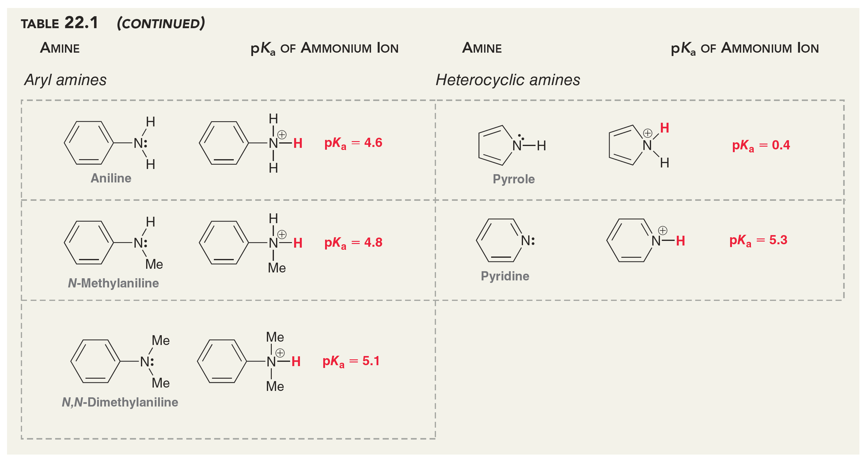
22.3 Basicity of Amines

Slide 20
22.3 Properties of Amines
In general, amines with more than 5 carbons are only slightly soluble in water
Solubility is enhanced in the presence of aqueous acid (protonated ammonium ions are cations, and therefore water soluble)
amines can be extracted from organic impurities using an aqueous acid and converting them to corresponding ammonium ions

Slide 21
22.3 Properties of Amines
The pK_{a} of most alkyl amine conjugate acids are between 10 and 11
Aryl amines are less basic than alkyl amines; the lone pair is delocalized:
A delocalized lone pair is less available for protonation

Slide 22
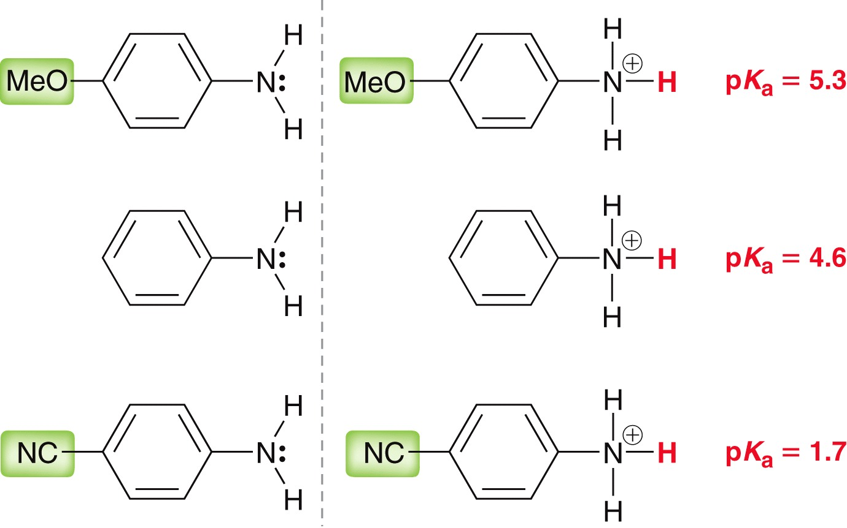
22.3 Properties of Amines
Aryl amines are less basic than alkyl amines; the lone pair is delocalized:
The presence of electron-withdrawing groups also decreases basicity

Slide 23
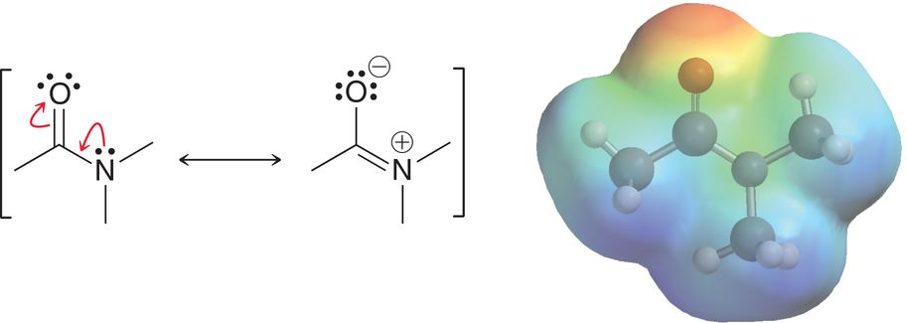
22.3 Properties of Amines
The lone pair of an amide is not considered to be basic/nucelophilic. It is extensively delocalized into the carbonyl group

Slide 24
22.3 Properties of Amines
At physiological pH (7.3), amines exist primarily as ammonium ions:
Recall that the Henderson-Hasselbalch equation can be used to calculate the ratio of amine:ammonium ion at a given pH:
Practice with Conceptual Checkpoint 22.6 – 22.9
[conjugate base]
[acid]
pH = pK_{a} + log

Slide 25
22.4 Preparation of Amines: Review
Preparing an amine from an akyl halide:
1˚ amines can be made from an alkyl halide in a 2-step process:
The carbon skeleton expanded by 1 carbon

Slide 26
22.4 Preparation of Amines: Review
Preparing an amine from a carboxylic acid:
amines can be made by converting a carboxylic acid to an amide, then reducing the amide with LAH:
The carbon skeleton is unchanged

Slide 27
22.4 Preparation of Amines: Review
Preparing aniline from benzene:
Nitration of a benzene ring, followed by reduction provides anline and aniline derivatives
Practice with Conceptual Checkpoint 22.10 – 22.11

Slide 28
22.5 Preparation of Amines via Substitution
Amines are good nucleophiles, and readily undergo SN2 substitution with an alkyl halide:
This is an efficient way to make a quaternary ammonium salt

Slide 29
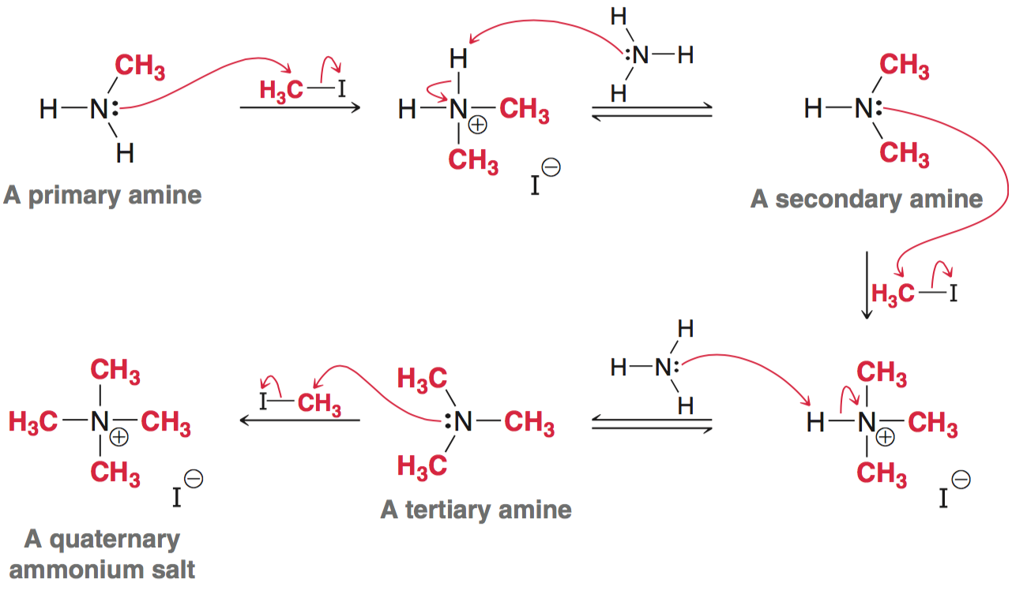
22.5 Preparation of Amines via Substitution
Monoalkylation is difficult because nitrogen becomes a better nucleophile as it picks up alkyl groups:

Slide 30
22.5 Preparation of Amines via Substitution
Azide synthesis - conversion of an alkyl halide to an azide (via SN2) followed by reduction to yield a 1˚ amine:
This is a better way to make a 1˚ amine than trying to monoalkylate ammonia

Slide 31
22.5 Preparation of Amines via Substitution
Mechanism:

Slide 32
22.5 Preparation of Amines via Substitution
Gabriel synthesis – synthesis of 1˚ or 2˚amines from phthalimide:
First, phthalimide is converted to an anion with KOH:

Slide 33
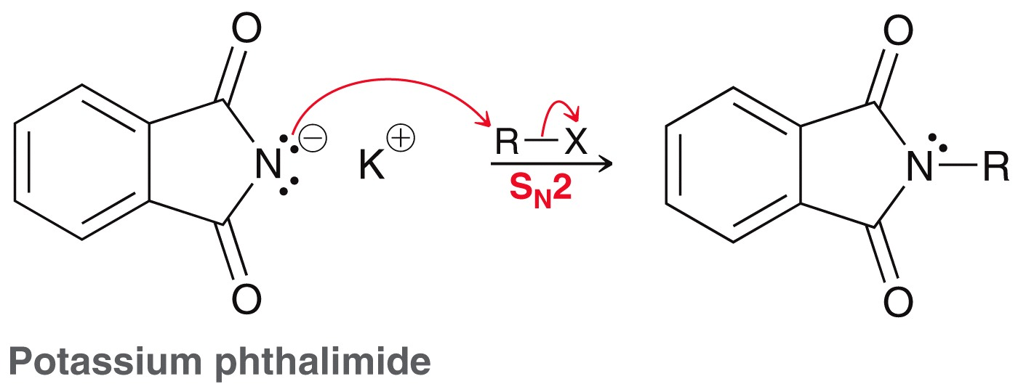
22.5 Preparation of Amines via Substitution
Potassium phthalimide is then alkylated (SN2 reaction)

Slide 34
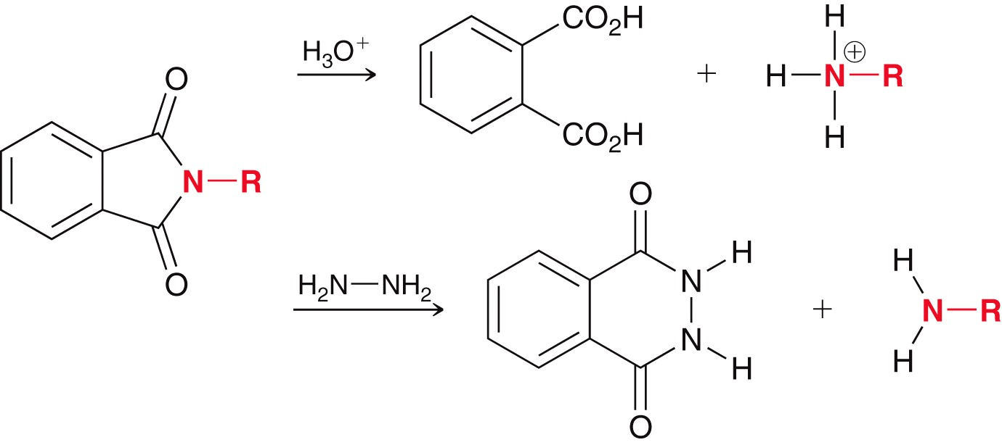
22.5 Preparation of Amines via Substitution
The last step generally employs aqueous acid or hydrazine to liberate the amine:
Practice with SkillBuilder 22.2

Slide 35
22.6 Prep. of Amines: Reductive Amination
Reductive amination – ketone/aldehyde is converted to an imine, which is then reduced to the corresponding amine
If a reducing agent is present, the imine can be reduced in situ to form an amine
Reductive amination can be accomplished with a variety of reducing agents

Slide 36
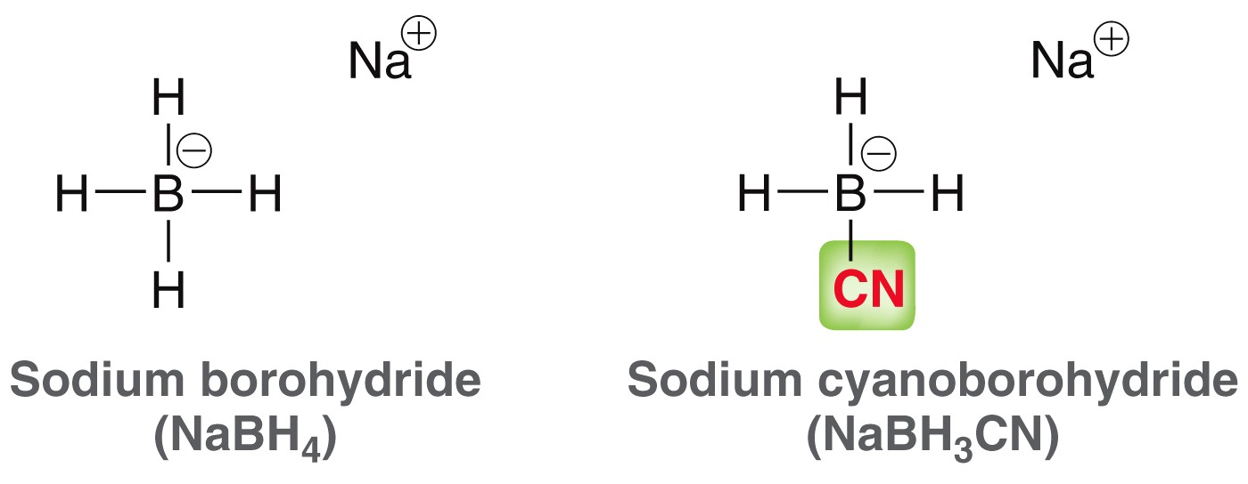
22.6 Prep. of Amines: Reductive Amination
Sodium cyanoborohydride, which is similar to NaBH₄, is commonly used because it is selective for imines:
Since NaCNBH₃ does not react with ketones/aldehydes, it can be used in situ during imine formation, and yield the desired amine in a one-reaction synthesis

Slide 37
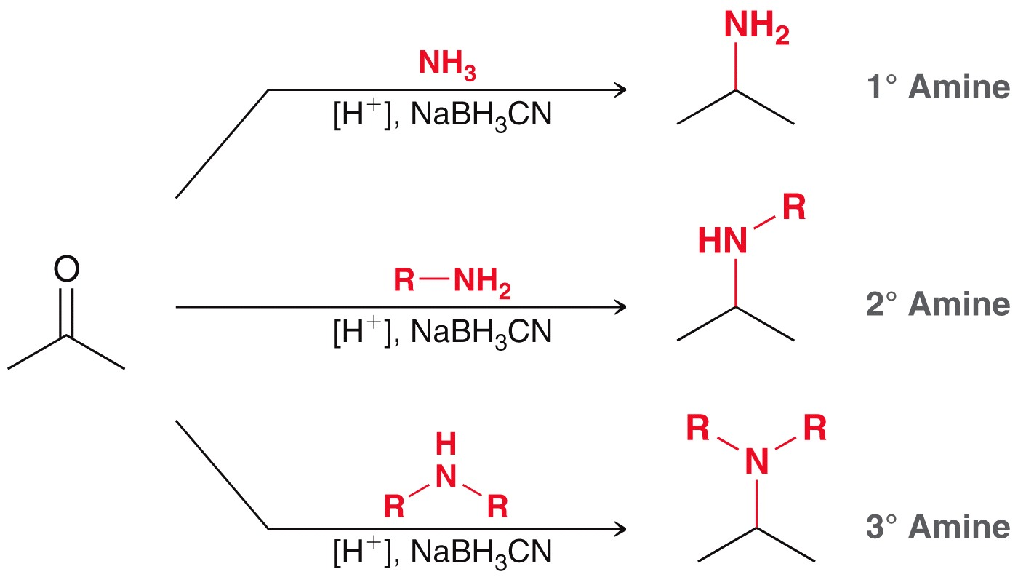
22.6 Prep. of Amines: Reductive Amination
reductive amination can yield 1˚, 2˚ or 3˚ amines:
Practice with SkillBuilder 22.3

Slide 38
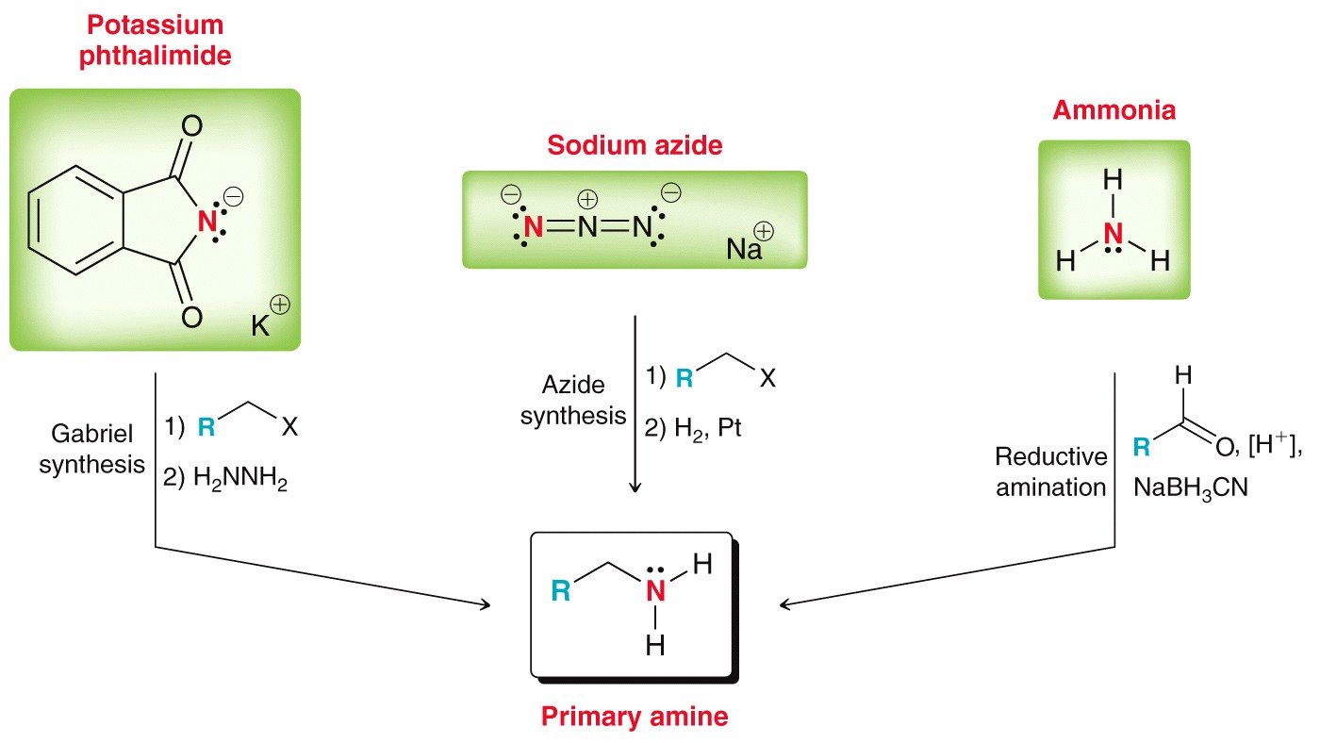
22.7 Synthesis Strategies
Overall, there are 3 options to produce a 1˚ amine:

Slide 39
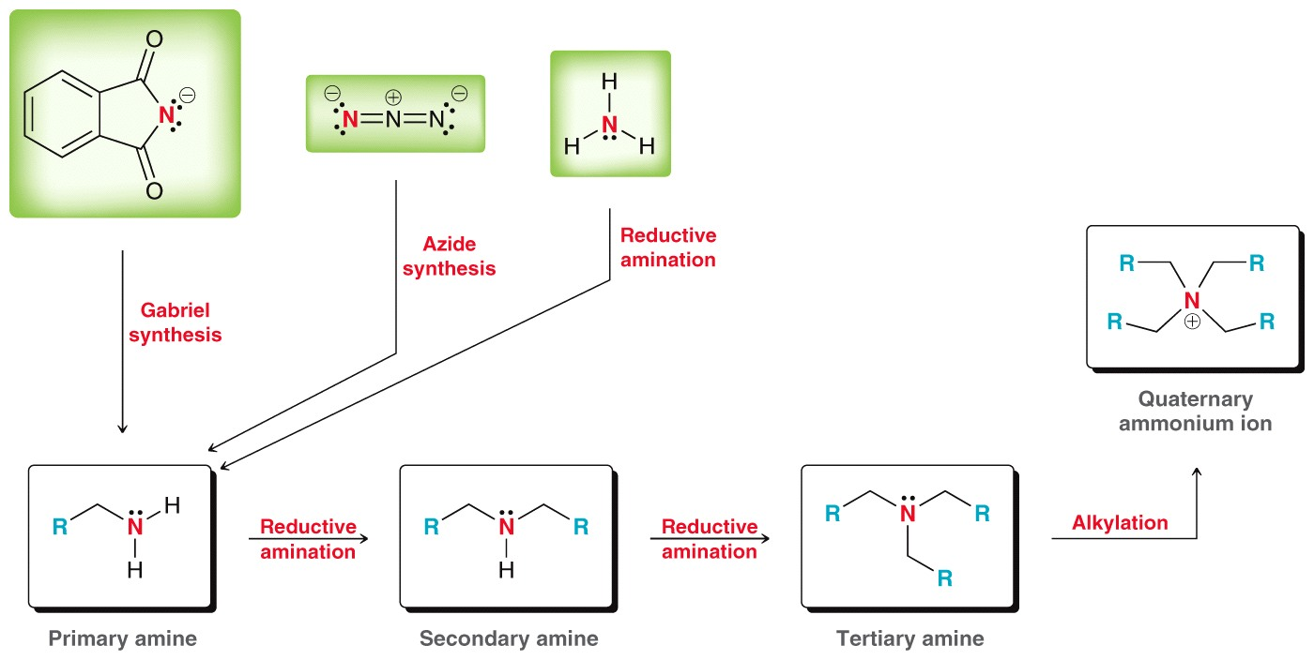
22.7 Synthesis Strategies
1˚ amines can then be used to obtain 2˚ / 3˚ amines:
Practice with SkillBuilder 22.4

Slide 40
22.8 Acylation of Amines
Recall that amines are converted to amides with an acyl chloride:
Two moles of the amine are required
Acylation of an amine can be used as a protecting group!

Slide 41
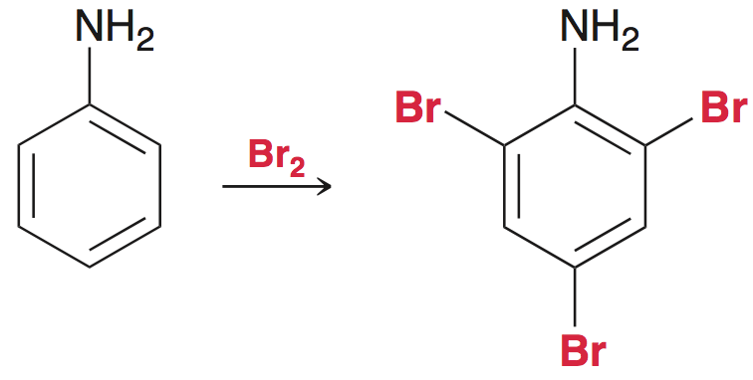
22.8 Acylation of Amines
Consider how to perform monobromination of aniline.
If aniline is directly brominated, polybromination is observed:
The amino group is too powerful of an activating group.

Slide 42
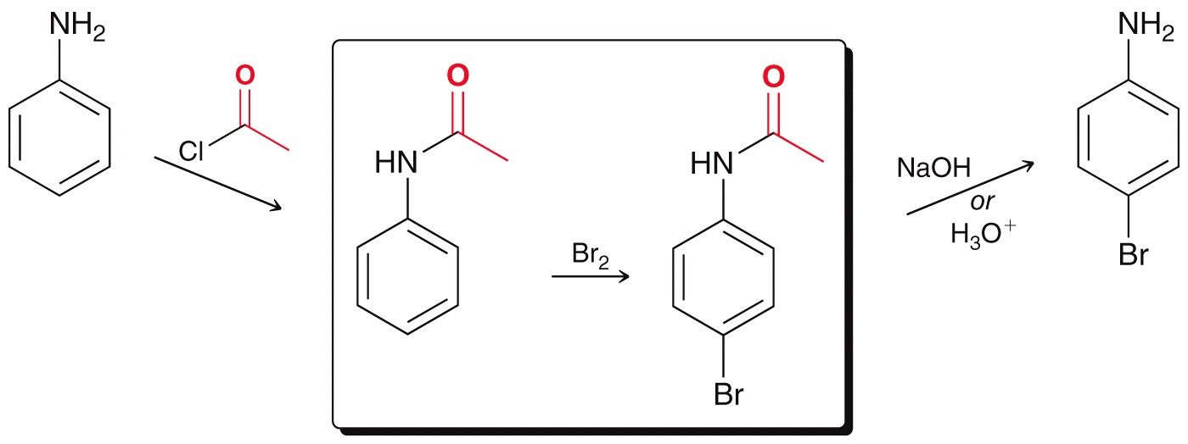
22.8 Acylation of Amines
The amine must first be protected, as an amide:
The disadvantage of this synthesis is that amide hydrolysis requires harsh conditions

Slide 43
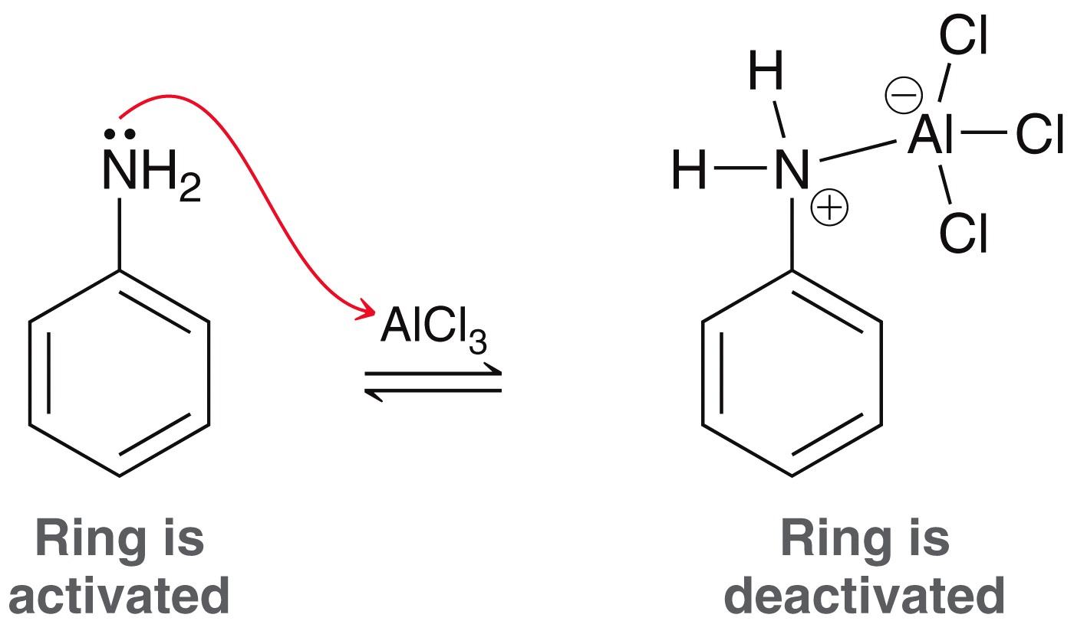
22.8 Acylation of Amines
Aromatic amines also can not undergo Friedel Crafts directly, the amine reacts with the Lewis acid catalyst:

Slide 44
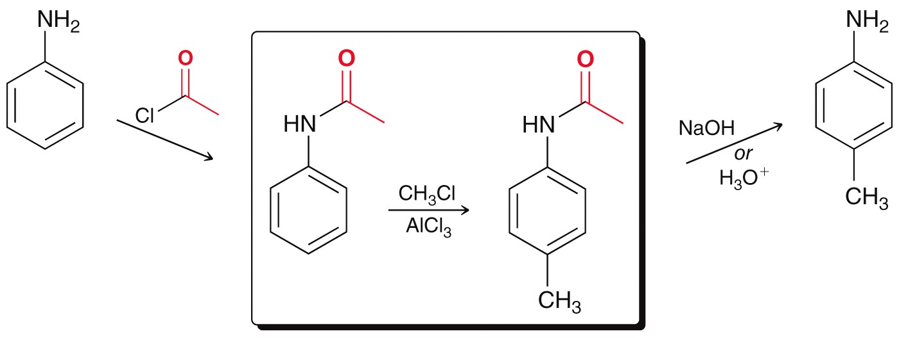
22.8 Acylation of Amines
To achieve ring alkylation, first the amine must be acylated
Practice with Conceptual Checkpoints 22.20 - 23.22

Slide 45
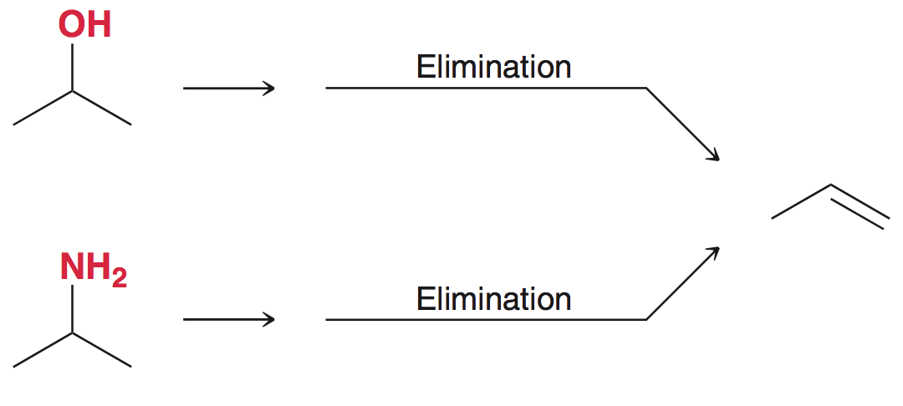
22.9 Hofmann Elimination
Like alcohols, amines can serve as precursors for the synthesis of alkenes:

Slide 46
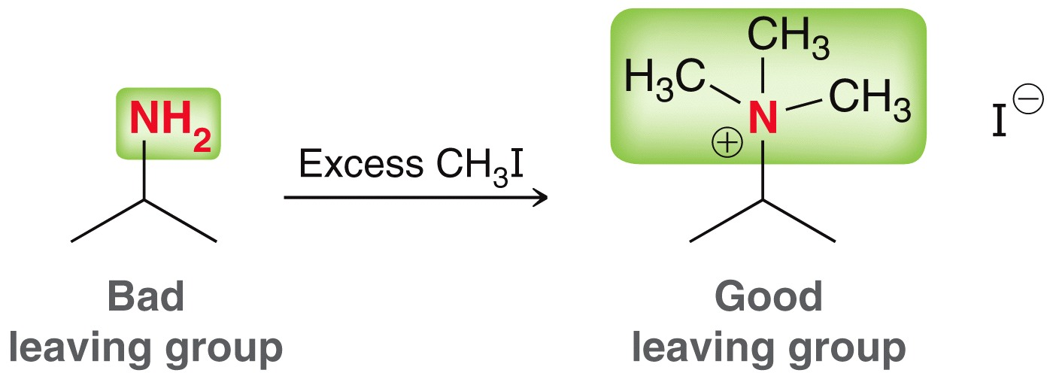
22.9 Hofmann Elimination
Excess methyl iodide will convert an amine to a 4˚ ammonium salt, which serves as a good leaving group:
Strong base than causes E2 elimination.
Ag₂O is commonly used:

Slide 47
22.9 Hofmann Elimination
The process is called a Hofmann elimination
Hofmann eliminations give the terminal alkene (less substituted alkene) regioselectively

Slide 48
22.9 Hofmann Elimination
Sterics in the anticoplanar conformation hinders attack at the more substituted site.
Practice with SkillBuilder 22.5

Slide 49
22.10 Rxns of Amines with Nitrous Acid
Nitrous acid is unstable, and has to be generated in situ in order to react it with an amine:
Nitrous acid loses water to form the active electrophile: a nitrosonium ion

Slide 50
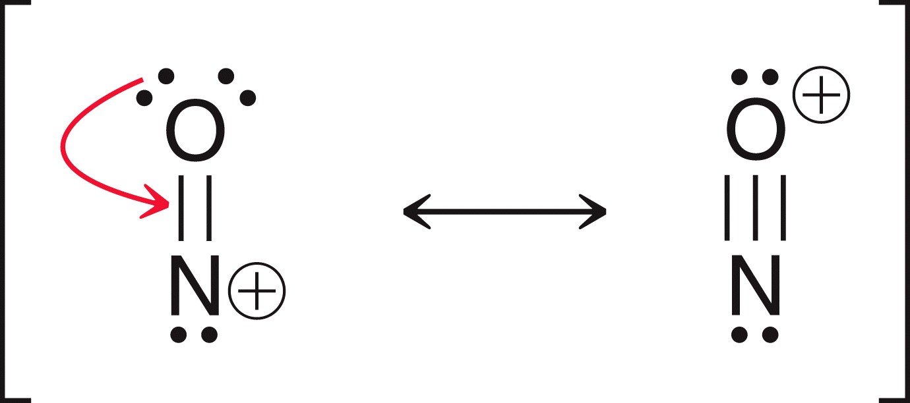
22.10 Rxns of Amines with Nitrous Acid
The nitrosonium ion is extremely electrophilic (very unstable).
It immediately reacts with an amine as soon as it forms

Slide 51
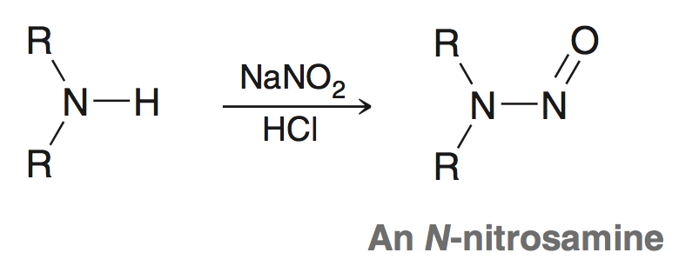
22.10 Rxns of Amines with Nitrous Acid
Reaction with a 2˚ amine yields an N-nitrosamine:
Mechanism:

Slide 52
22.10 Rxns of Amines with Nitrous Acid
Nitrosoamines are known to be potent carcinogens:

Slide 53
22.10 Rxns of Amines with Nitrous Acid
Reaction with a 1° amine yields a diazonium salt:
This process is called diazotization

Slide 54
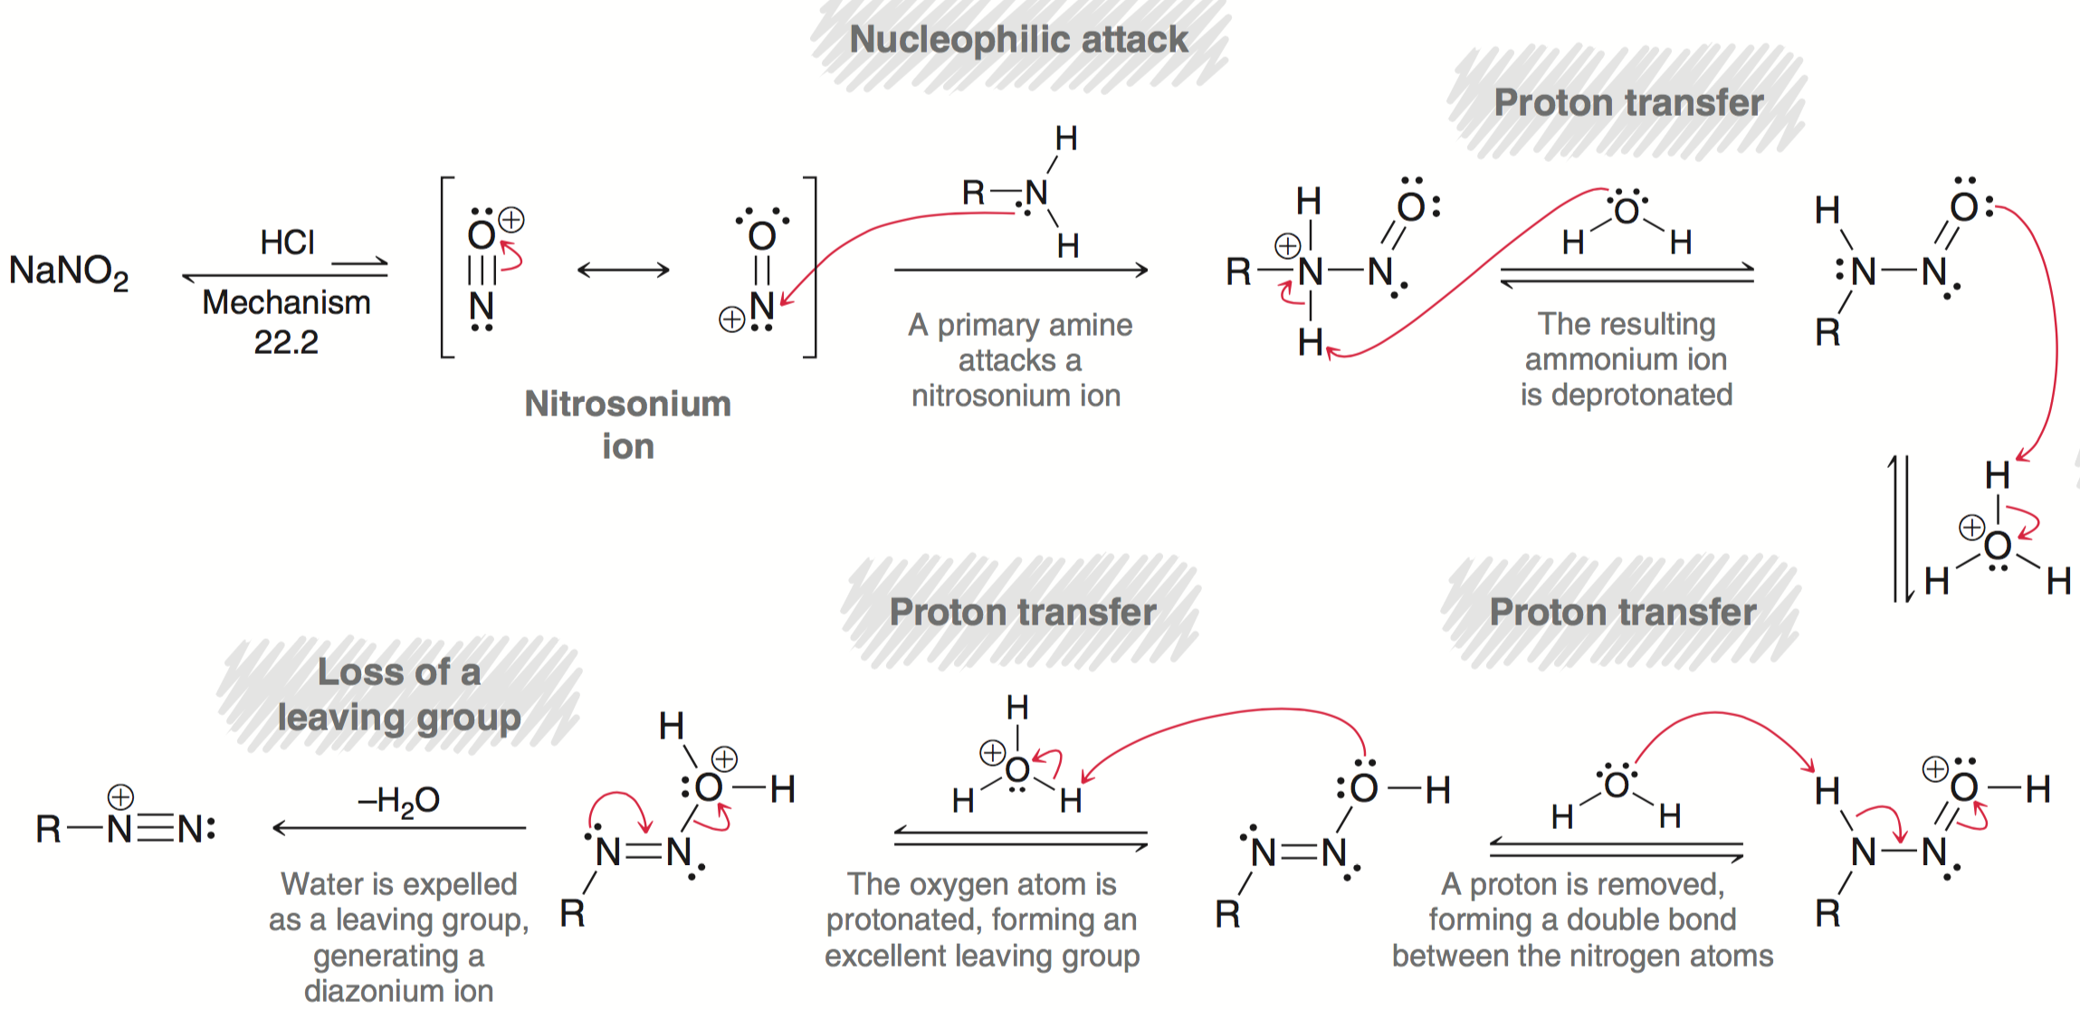
22.10 Rxns of Amines with Nitrous Acid
Mechanism:

Slide 55
22.11 Rxns of Aryl Diazonium Ions
Alkyl diazonium salts are extremely unstable, and decompose to form a variety of products (if they don’t explode first)
Aryl diazonium salts are a bit more stable and synthetically versatile, as covered in the next section:
Practice with Conceptual Checkpoint 22.25

Slide 56
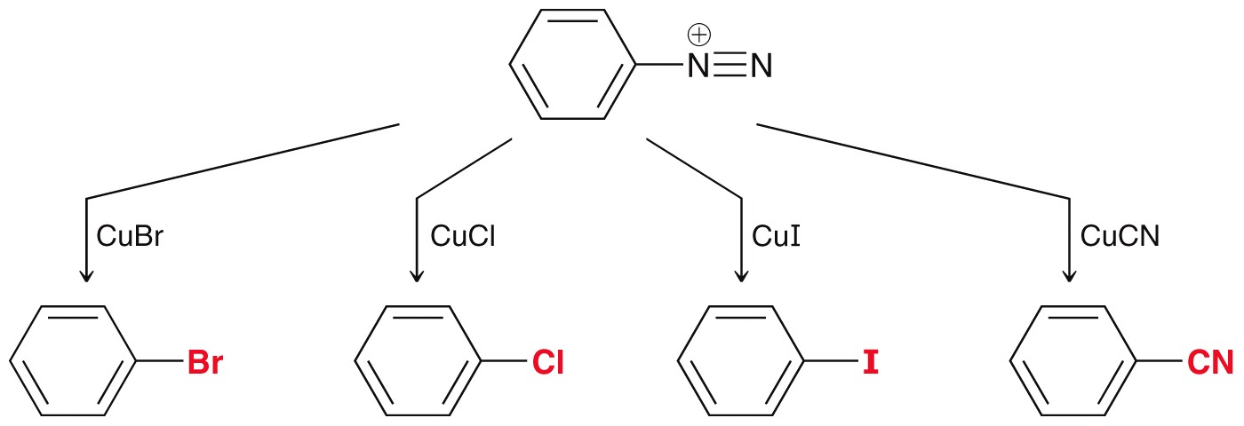
22.11 Rxns of Aryl Diazonium Ions
Sandmeyer Reactions – reaction of an aryl diazonium ion with a copper salt to install a halogen or cyano group on the ring:

Slide 57
22.11 Rxns of Aryl Diazonium Ions
Overall, the Sandmeyer reaction is part of a multistep sequence to install a –COOH on a benzene ring:

Slide 58
22.11 Rxns of Aryl Diazonium Ions
Aryl diazonium ions also serve as precursors for installing a fluorine or hydroxy group on a benzene ring:

Slide 59
22.11 Rxns of Aryl Diazonium Ions
The diazonium ion can be replaced with a H atom:
This is useful when an amino group is needed on the ring temporarily, to take advantage of its activating/directing effects:
Practice with Conceptual Checkpoint 22.26

Slide 60
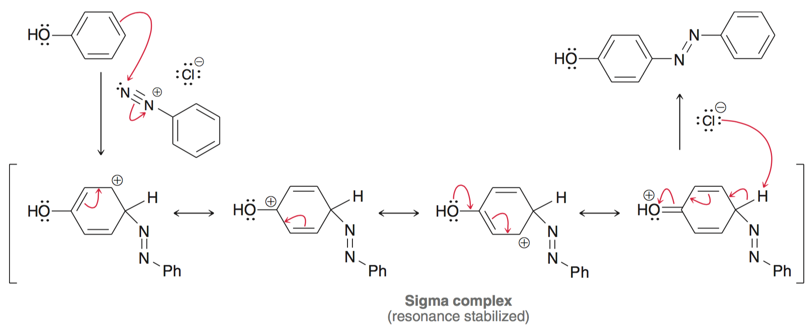
22.11 Azo Coupling
Diazonium salts also serve as electrophiles and are attacked by activated aromatic rings (i.e. electrophilic aromatic substitution)
Process is called azo coupling

Slide 61
22.11 Rxns of Aryl Diazonium Ions
Azo coupling is used to produce azo dyes (see section 18.3)
These azo compounds are highly conjugated and have a brilliant color.
Varying the substitution on the rings affects the specific dye color
Practice with SkillBuilder 22.6

Slide 62
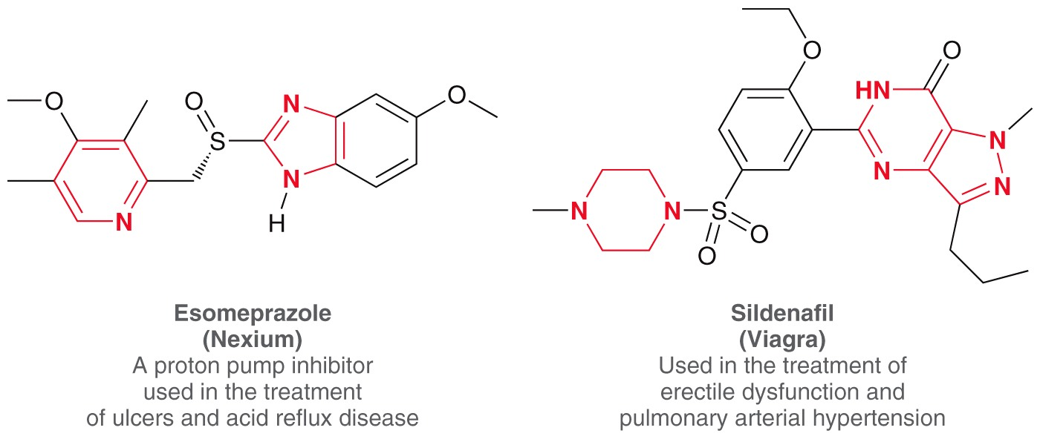
22.12 Nitrogen Heterocycles
Heterocycles - cyclic compounds that contain atoms of more than one element

Slide 63
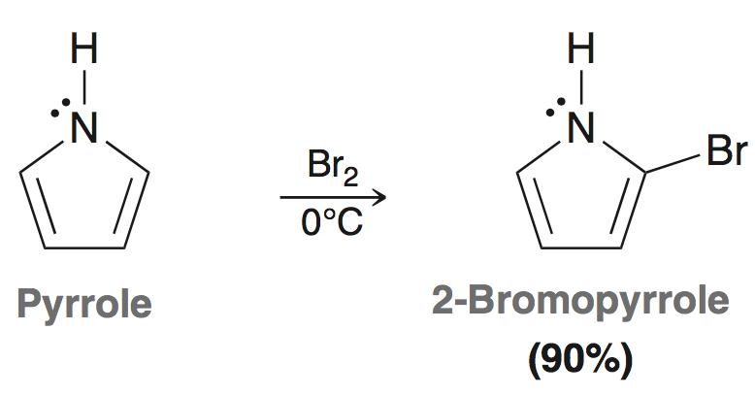
22.12 Nitrogen Heterocycles
Pyrole is a simple, aromatic heterocycle and undergoes electrophilic aromatic substitution (faster than benzene)
Substitution at C-2 gives the most stable intermediate:

Slide 64
22.12 Nitrogen Heterocycles
Imidazole is also an aromatic heterocycle, and is found in naturally occurring compounds

Slide 65
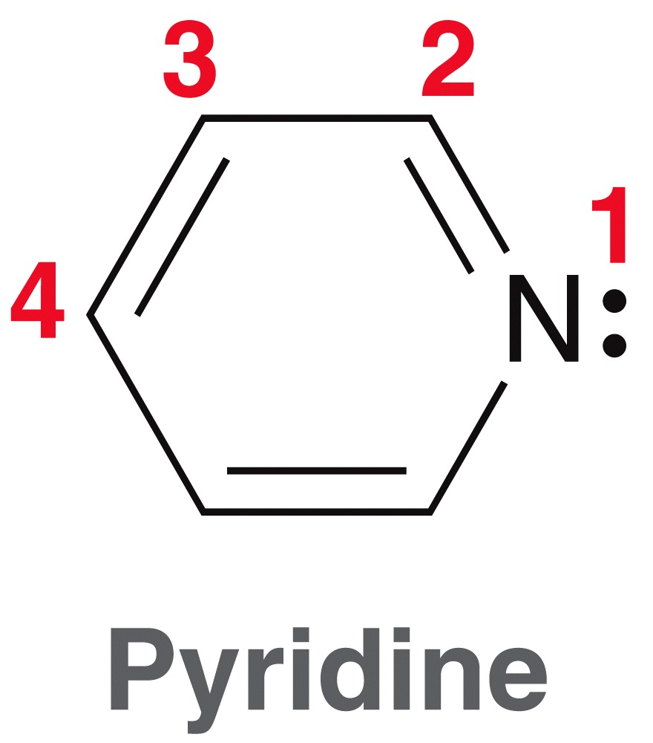
22.12 Nitrogen Heterocycles
Pyridine is a six-membered heterocycle
The lone pair on N is not delocalized; pyridine is a weak base

Slide 66
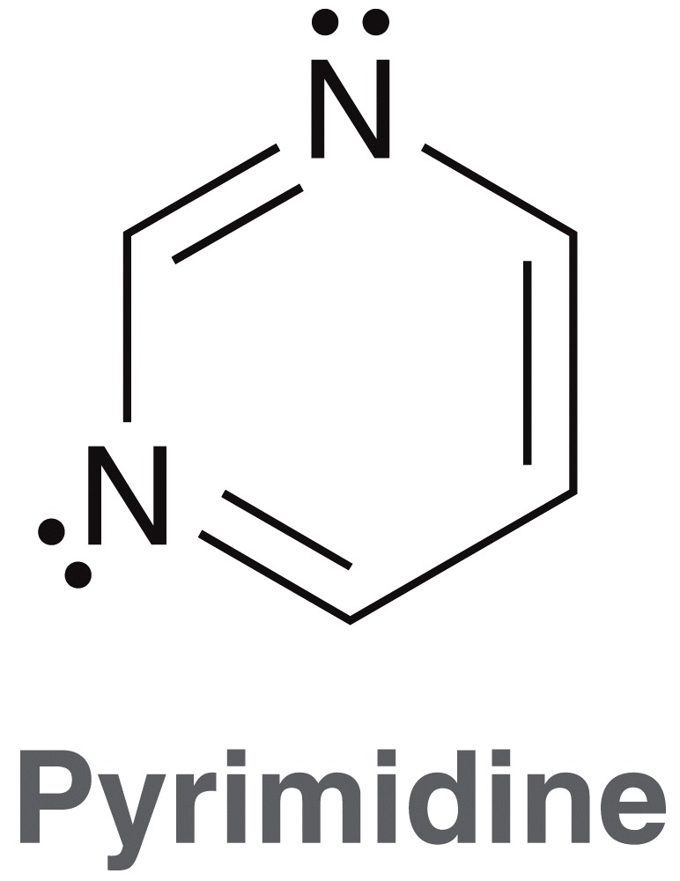
22.12 Nitrogen Heterocycles
Pyrimidine is similar to pyridine, and is a common moiety in biological molecules (e.g. DNA base pairs)
Pyridine and pyrimidine can undergo EAS reactions, however usually with low yields
Practice with Conceptual Checkpoints 23.29 - 23. 30

Slide 67
22.13 Spectroscopy of Amines
Amines generally give broad IR peaks between 3300-3500 cm⁻¹ that are less intense than O-H stretching
Recall that 1° amines give two N-H stretch IR signals (symmetric and asymmetric stretching)
2° amines give one N-H stretch IR signal
3° amines do not give N-H stretching signals

Slide 68
22.13 Spectroscopy of Amines
N-H protons generally appear between 0.5 and 5.0 ppm in the ¹H NMR
Solvent, concentration, and temperature can affect the chemical shift
Because N-H protons are generally exchanged at a faster rate than the NMR timescale, N-H protons generally give broad signals with no splitting
If a deuterated solvent is used, N-H proton peaks disappear completely.

Slide 69
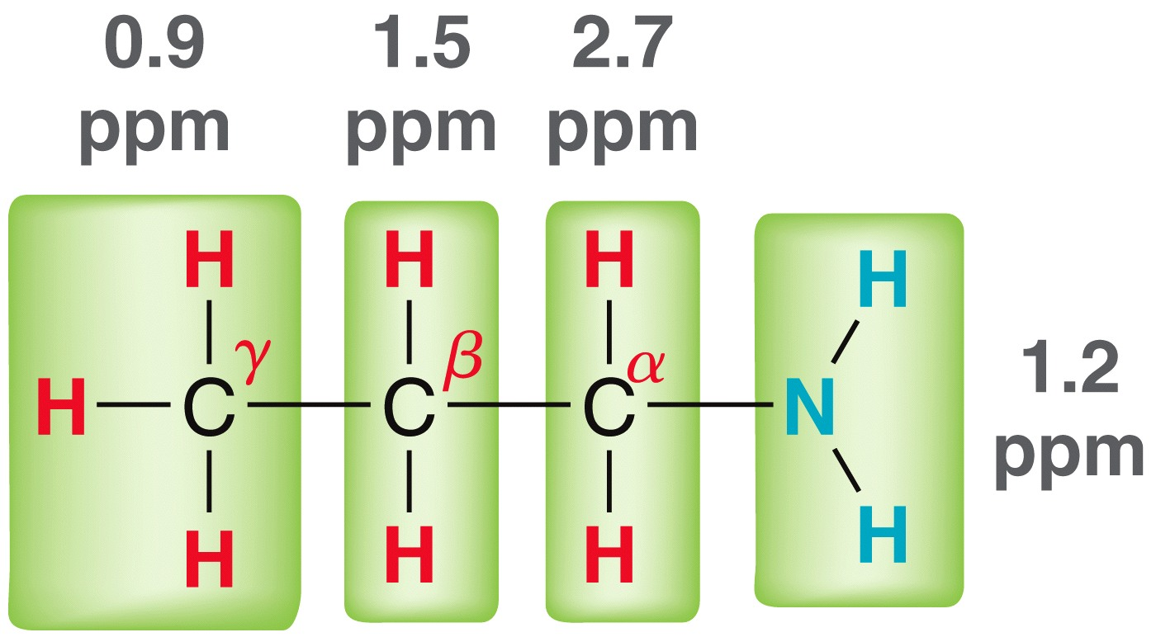
22.13 Spectroscopy of Amines
Protons adjacent to the N atom typically show up around 2 -3 ppm
Carbon atoms bonded to N typically come at 30 - 50 ppm
¹H signals
¹³C signals
11.4
ppm
27.1
ppm
44.4
ppm

Slide 70
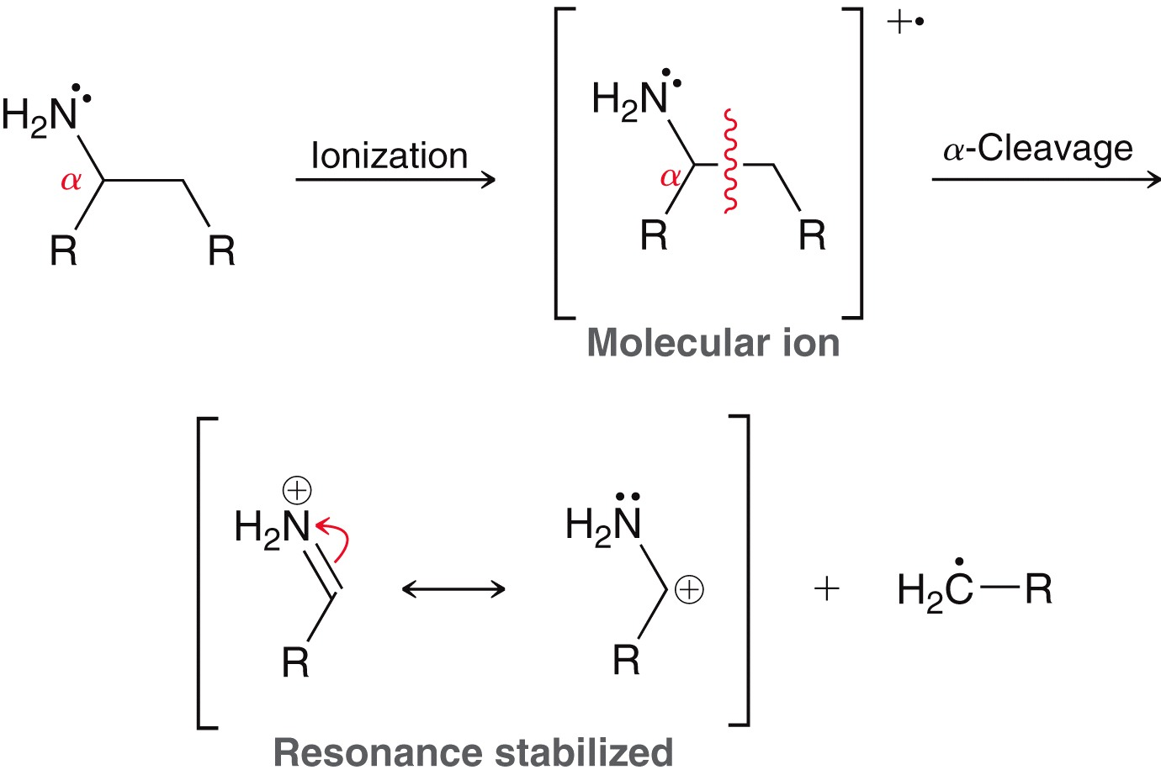
22.13 Spectroscopy of Amines
Compounds with an odd number of N atoms have an odd mass molecular ion in the mass spec
Amines also typically undergo alpha cleavage in the mass spec giving predictable mass fragments
Practice with Conceptual Checkpoints 23.31 and 23.32

Slide 71
22.13 Review of Reactions

Slide 72
22.13 Review of Reactions

Slide 73
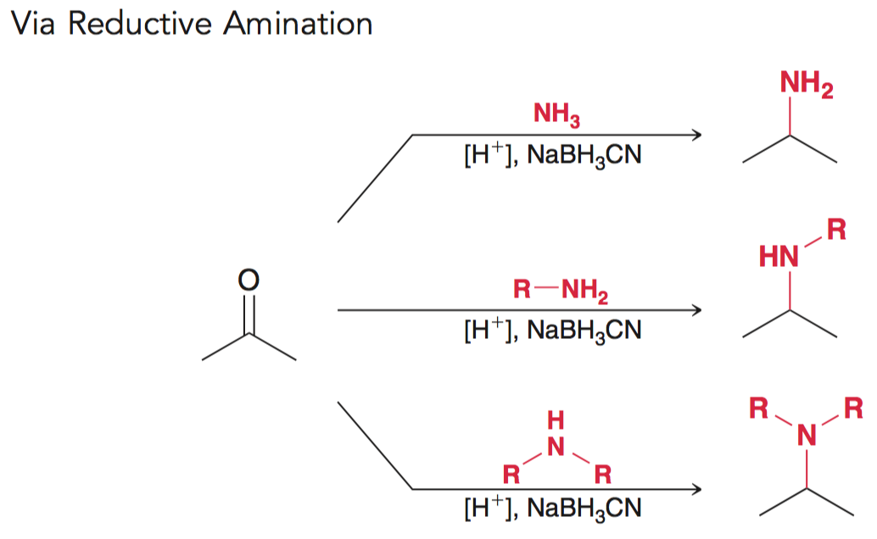
22.13 Review of Reactions

Slide 74
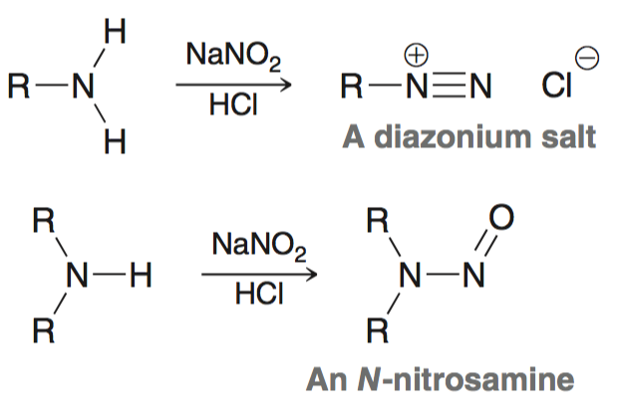
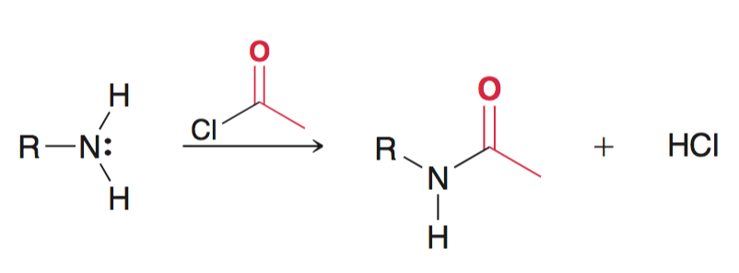
22.13 Review of Reactions

Slide 75
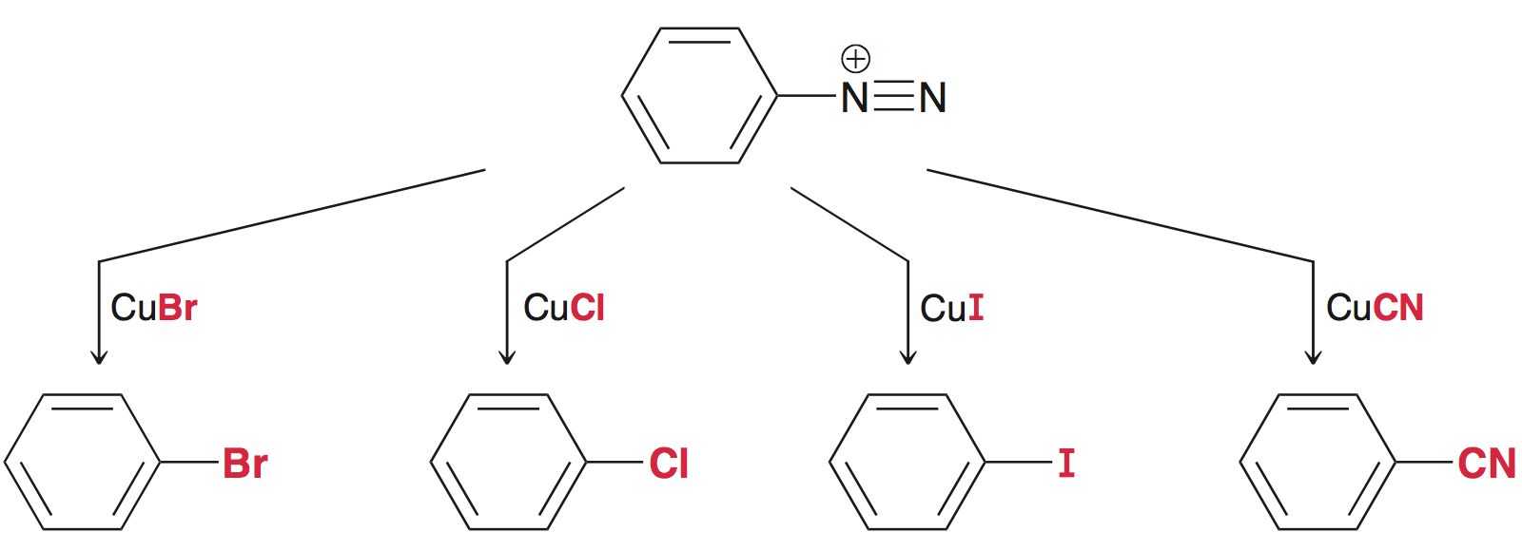
22.13 Review of Reactions

Slide 76
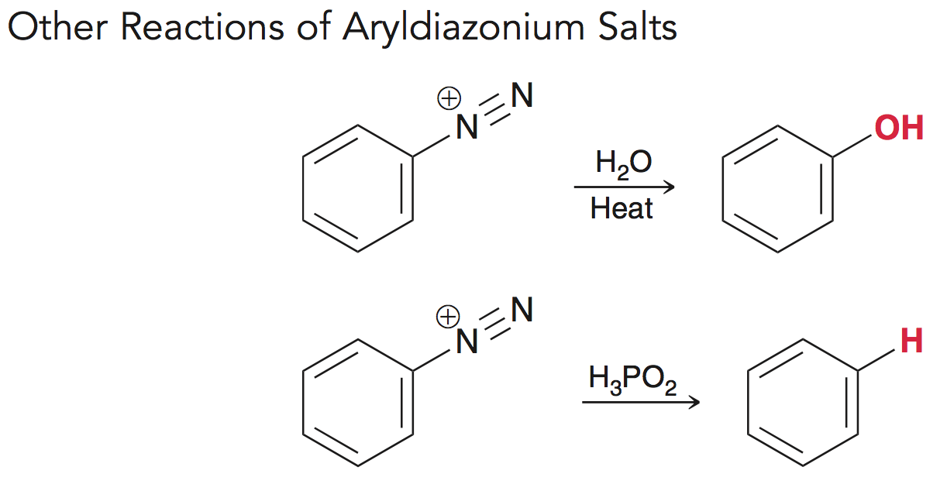
22.13 Review of Reactions

Slide 77
22.13 Review of Reactions

Slide 78
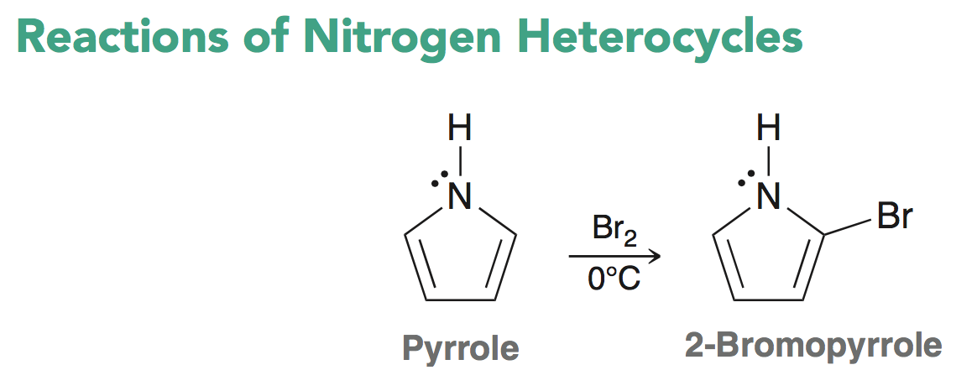
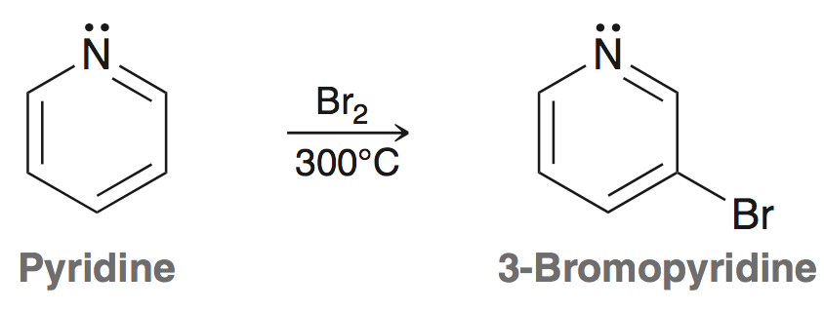
22.13 Review of Reactions

