Slide 1
Organic Chemistry
Third Edition
David Klein
Chapter 24
Carbohydrates

Slide 2
24.1 Introduction to Carbohydrates
It might be necessary to review the following topics to prepare for the material in this chapter:
Drawing chair conformations (section 4.11)
Haworth projections (section 4.14)
Fischer Projections (section 5.7)
Hemiacetals and acetals (section 19.5)
Reduction of aldehydes and ketones (19.9)

Slide 3
24.1 Introduction to Carbohydrates
Carbohydrates (sugars) are polyhydroxy aldehydes or ketones
Naturally synthesized in nature from CO₂ and H₂O (photosynthesis)

Slide 4
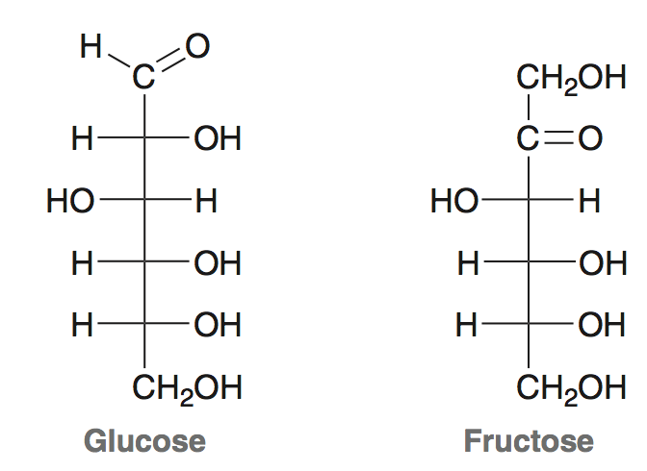
24.2 Classification of Monosaccharides
Monosaccharides = simple sugars
Contain multiple chiral centers; Fischer projections often used to represent their structure

Slide 5
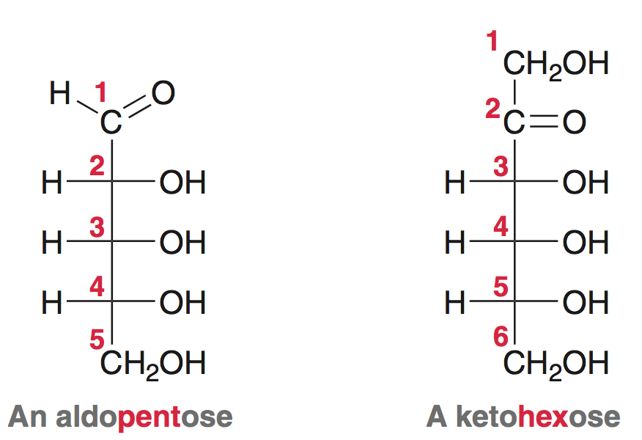
24.2 Classification of Monosaccharides
Aldose = contains an aldehyde group (prefix “aldo-”
Ketose = contains a ketone group (prefix “-keto”)
The terms di, tri, tetr, pent, hex, hept indicate # of carbons

Slide 6
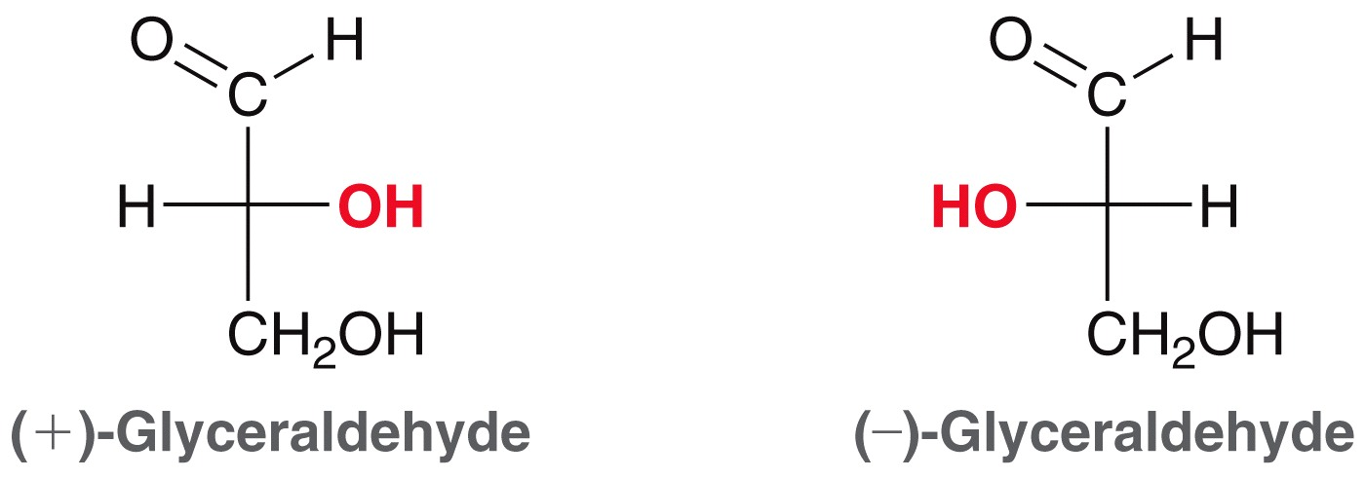
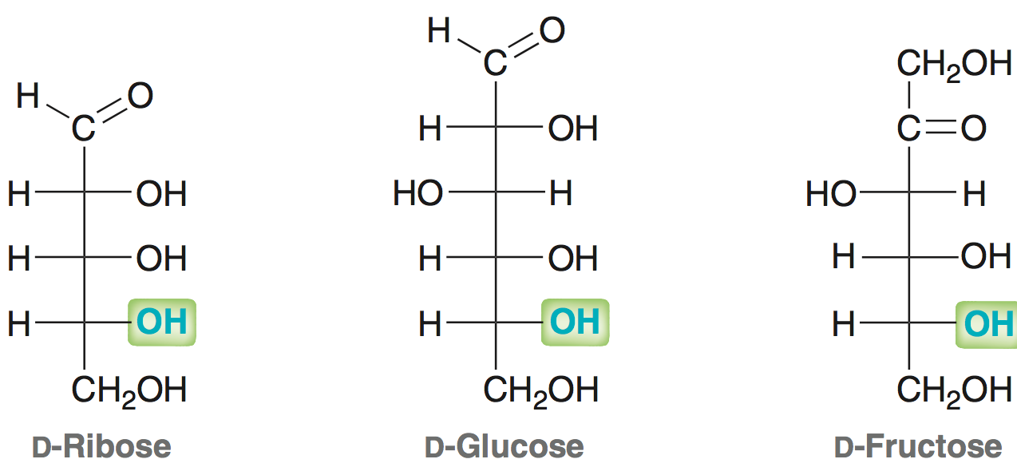
24.2 Classification of Monosaccharides
Glyceraldehyde is the simplest aldose; contains 1 chiral center
D sugars have OH group at chiral center farthest from carbonyl on the right-hand side in the Fischer projection:
D-glyceraldehyde
L-glyceraldehyde

Slide 7
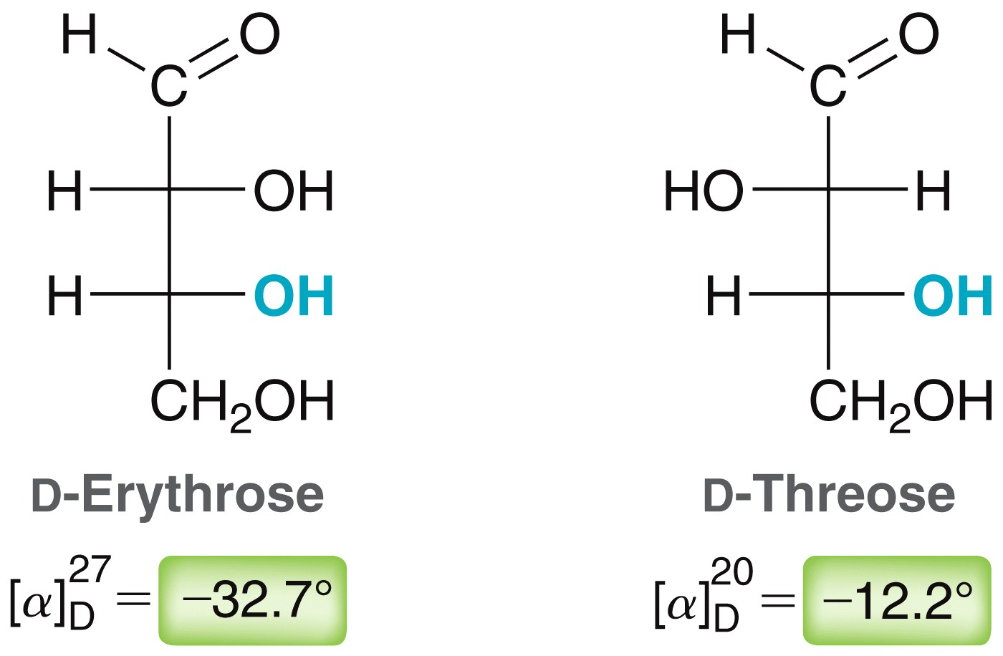
24.2 Classification of Monosaccharides
Recall that dextrorotatory versus levorotatory does not correspond to the “D” and “L” designations:
D-sugar means configuration of the furthest chiral center is “R” while an L-sugar has “S” configuration at the furthest chiral center
Practice with Conceptual Checkpoint 24.1 – 24.3

Slide 8
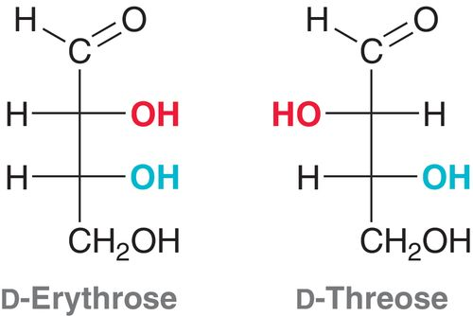
24.3 Configuration of Aldoses
There are four possible aldotetroses, two are D-sugars, and other two are the enantiomeric L-sugars:
The enantiomers of the above compounds are called L-Erythrose and L-Threose

Slide 9
24.3 Configuration of Aldoses
Aldopentoses have three chirality centers. The number of isomers will be 2³ = 8 possible stereoisomers
The D sugars are naturally occurring

Slide 10
24.3 Configuration of Aldoses
Aldohextoses have 4 chiral centers, so 16 possible stereoisomers
The 8 naturally occurring D sugars are shown below:

Slide 11
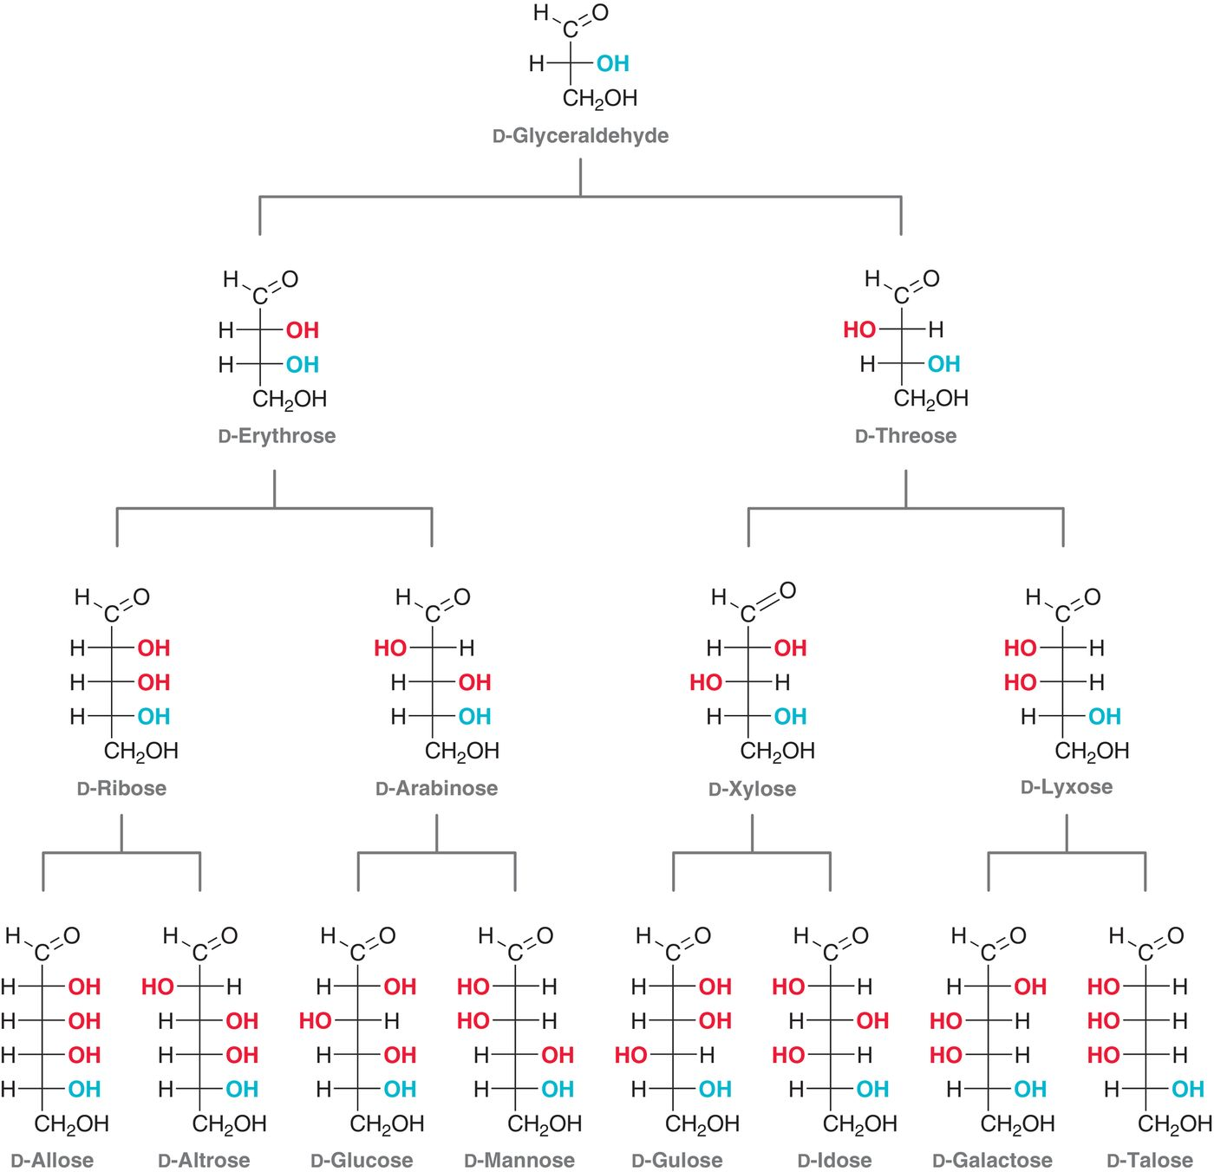

Slide 12
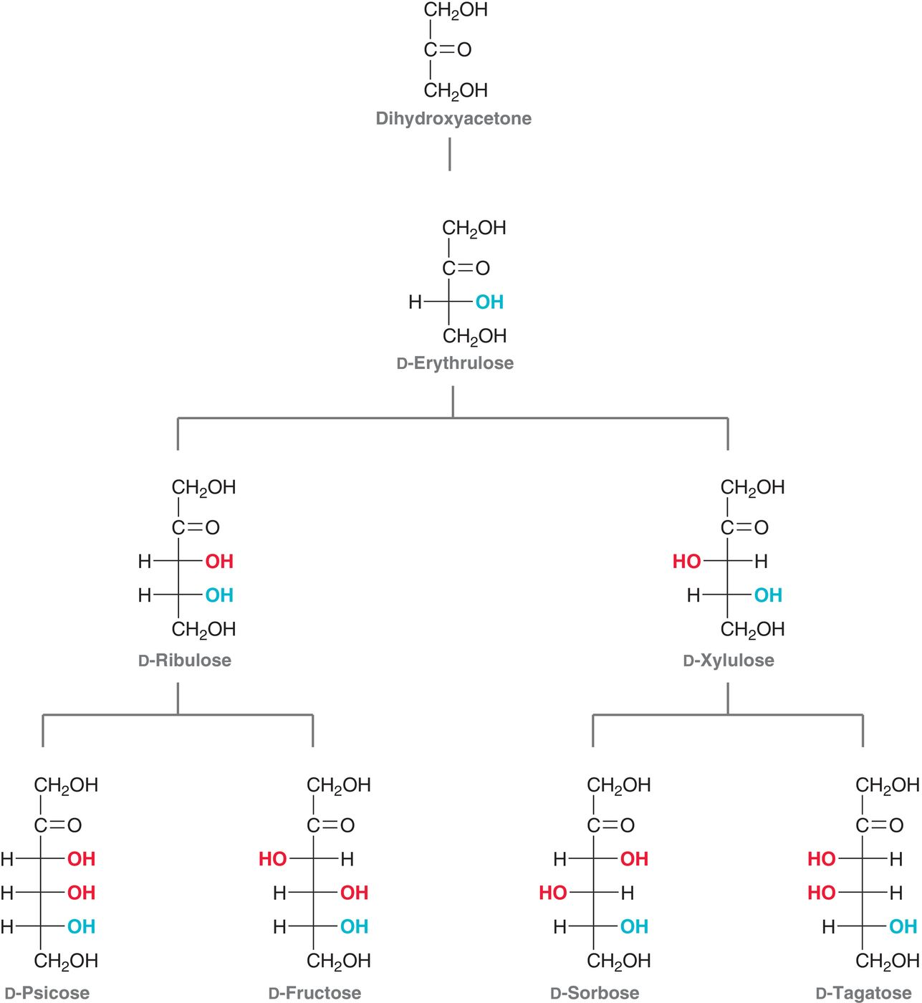
24.4 Ketoses
Naturally occurring
D-ketoses
Practice with Conceptual Checkpoint 24.7 – 24.8

Slide 13
24.5 Cyclic Structure of Monosaccharides
An aldehyde can react with an alcohol to produce a hemiacetal under protic conditions (mechanism 19.5):
Hemiacetal formation is favored for 5 and 6-membered rings
Practice drawing cyclic hemiacetals with SkillBuilder 24.1

Slide 14
24.5 Cyclic Structure of Monosaccharides
Monosaccharides undergo ring-closing hemiacetal formation
New chiral center formed at the anomeric carbon (C1).
The equilibrium greatly favors the cyclic form
6-membered hemiacetal ring of a saccharide is called a pyranose ring

Slide 15
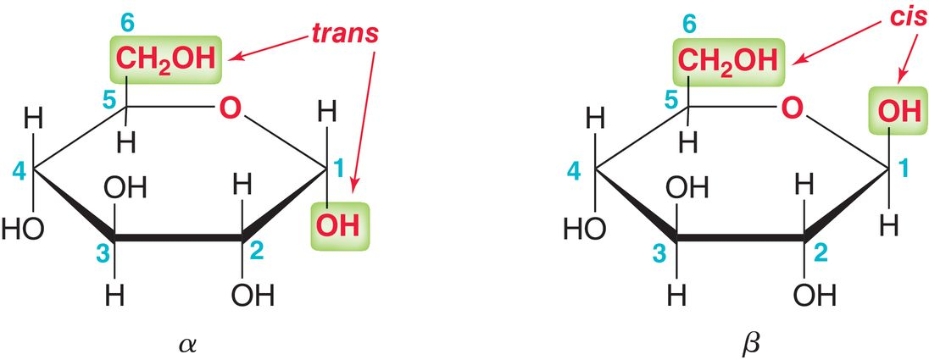
24.5 Cyclic Structure of Monosaccharides
The stereoisomers formed upon cyclization are called anomers.
α anomer = the anomeric –OH group is trans to the –CH₂OH group
β anomer = the anomeric –OH is cis to the –CH₂OH group
anomeric
carbon

Slide 16
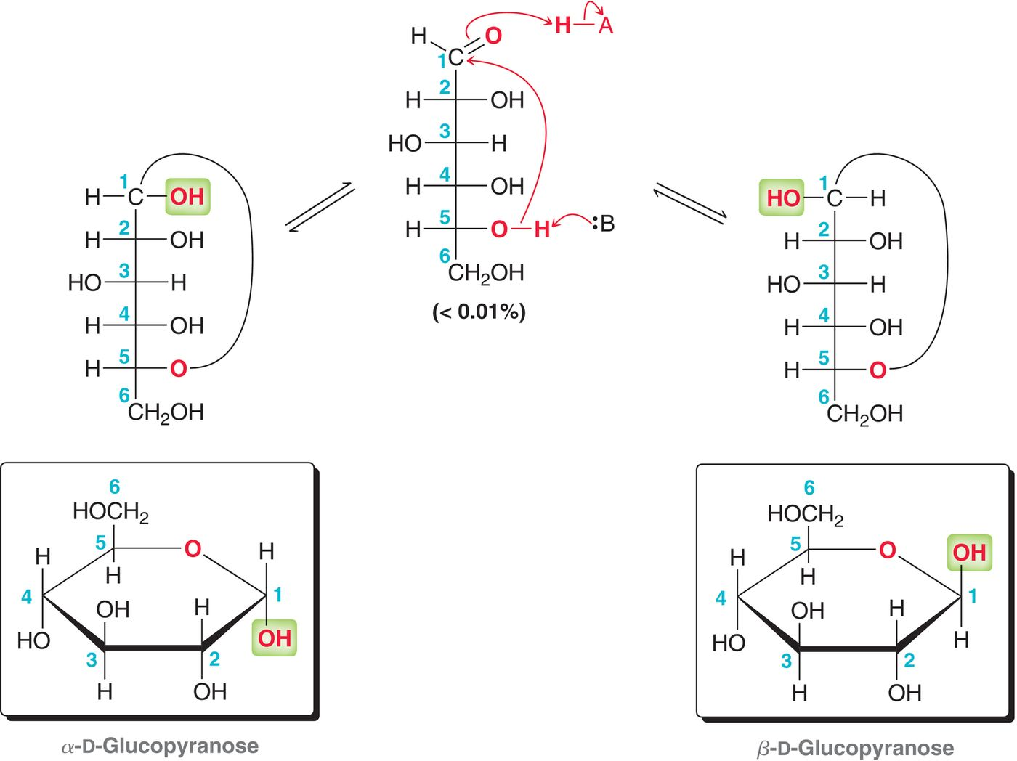
24.5 Cyclic Structure of Monosaccharides
Mutarotation: interconversion
of α and β anomers

Slide 17
24.5 Cyclic Structure of Monosaccharides
The dynamic equilibrium between the alpha and beta anomers is called mutarotation
Mutarotation is accelerated with acid or base catalysis
With some sugars, the α form dominates, but the β anomer dominates for others (hard to tell)
Practice drawing pyranose anomers for a given sugar with SkillBuilder 24.2

Slide 18
24.5 Drawing Pyranose rings
A pyranose ring is either drawn as a Haworth projection or a chair conformation (chair is better, as it reveals the 3-D conformation)
D-glucose is the only sugar where all groups are equatorial (the most stable sugar, thus the most abundant in nature)
Practice drawing pyranose chairs with SkillBuilder 24.3
ring oxygen
always drawn
in the upper
right-rear position

Slide 19
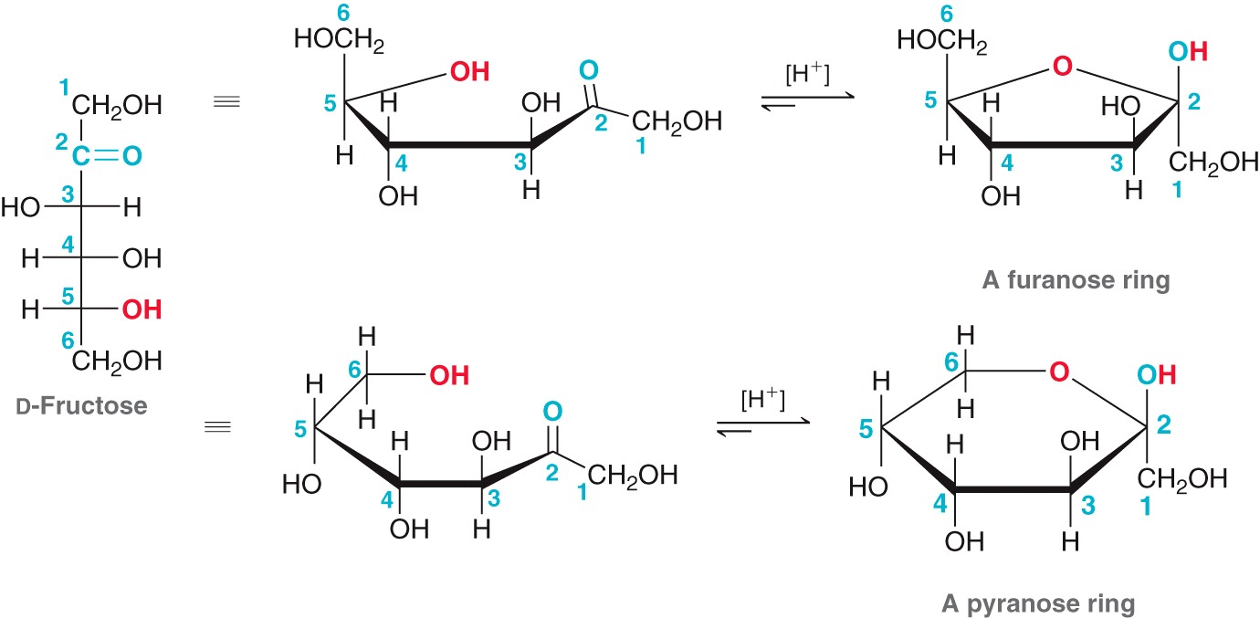
24.5 Furanose Forms of Monosaccharides
Furanose ring: 5-member ring hemiacetal of a sugar
Fructose equilibrates among in both furanose and pyranose forms:

Slide 20
24.5 Cyclic Structure of Monosaccharides
The furanose form of D-fructose takes part in most biochemical reactions
Practice with conceptual checkpoints 24.19 - 24.22

Slide 21
24.6 Reactions of Monosaccharides
Hydroxy groups of a monosaccharide can be converted to esters to improve their solubility in organic solvents:
Excess reagent allows for reaction of all free hydroxy groups

Slide 22
24.6 Reactions of Monosaccharides
The hydroxy groups can also be converted to ethers via the Williamson ether synthesis
Ag₂O is used as the base
Practice with conceptual checkpoints 24.23 and 24.24

Slide 23
24.6 Reactions of Monosaccharides
Cyclic hemiacetal of a sugar can react with an alcohol, under acidic conditions, to form an acetal
Acetals of sugars are called glycosides:
mixture of α and β glycosides is obtained

Slide 24
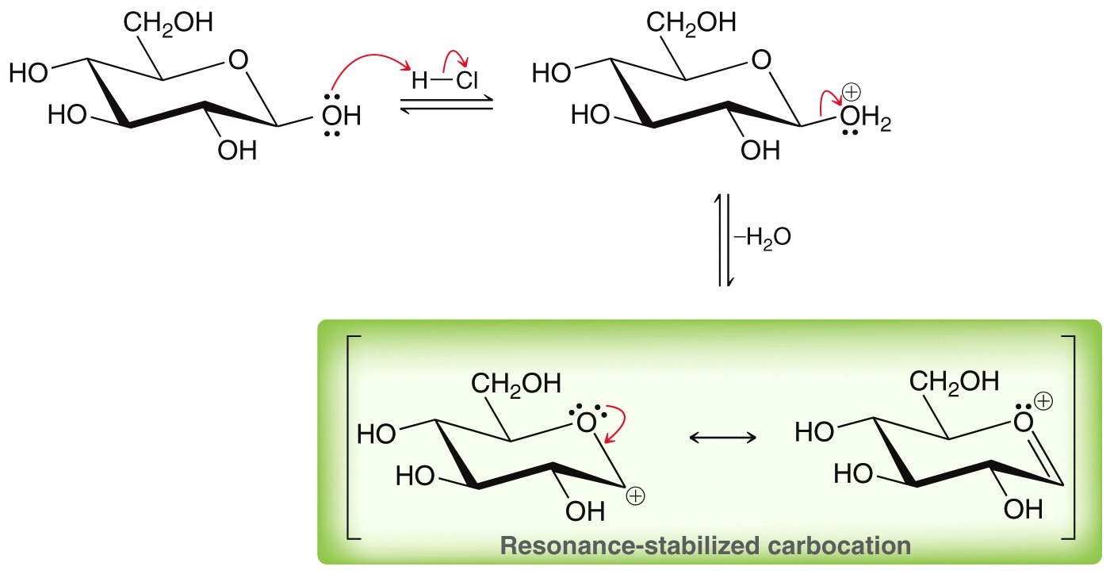
24.6 Reactions of Monosaccharides
The mechanism of glycoside formation is analogous to the formation of a typical acetal (section 19.5)

Slide 25
24.6 Reactions of Monosaccharides
The mechanism of glycoside formation is analogous to the formation of a typical acetal (section 19.5)
Practice with conceptual checkpoints 24.25 – 24.26
Formation of α glycoside
Formation of β glycoside

Slide 26
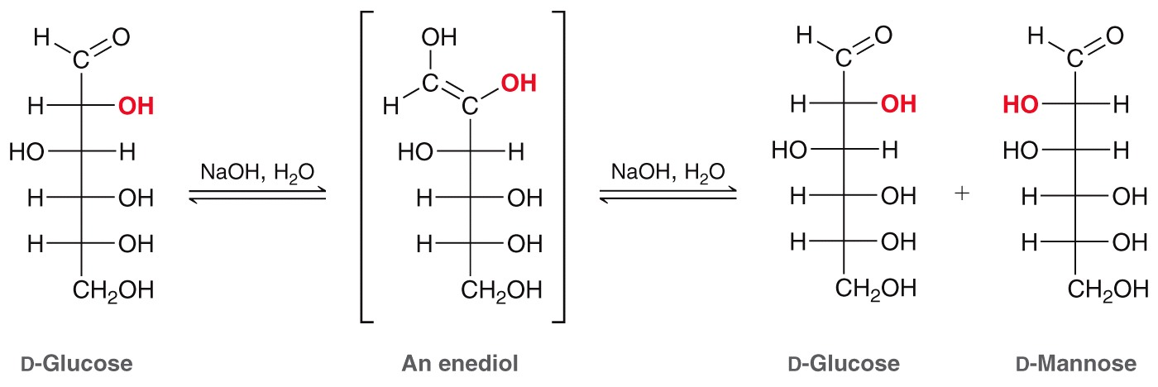
24.6 Reactions of Monosaccharides
Under strongly basic conditions, aldoses under epimerization at C2 via an enediol (i.e. enol) intermediate
Epimers are diastereomers that differ in configuration at a only one chiral center
Practice with conceptual checkpoint 24.27

Slide 27
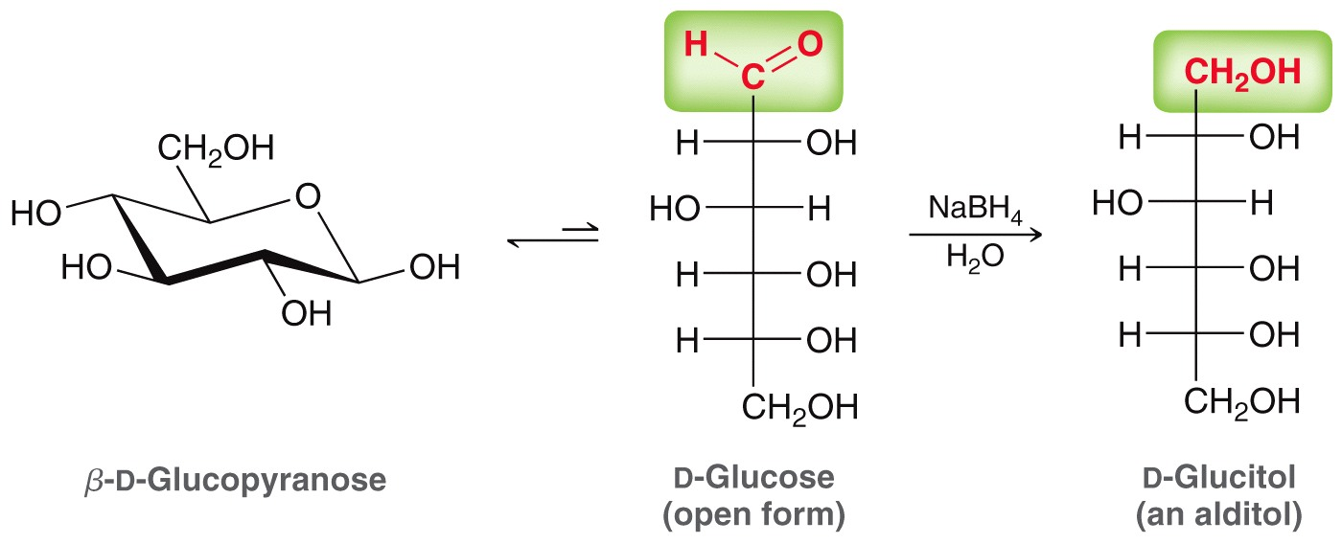
24.6 Reduction of Monosaccharides
Monosaccharides can be reduced to alditols with NaBH₄:
D-glucitol (called D-sorbitol) is used as a sugar substitute
Practice with Conceptual Checkpoints 24.28 – 24.30

Slide 28
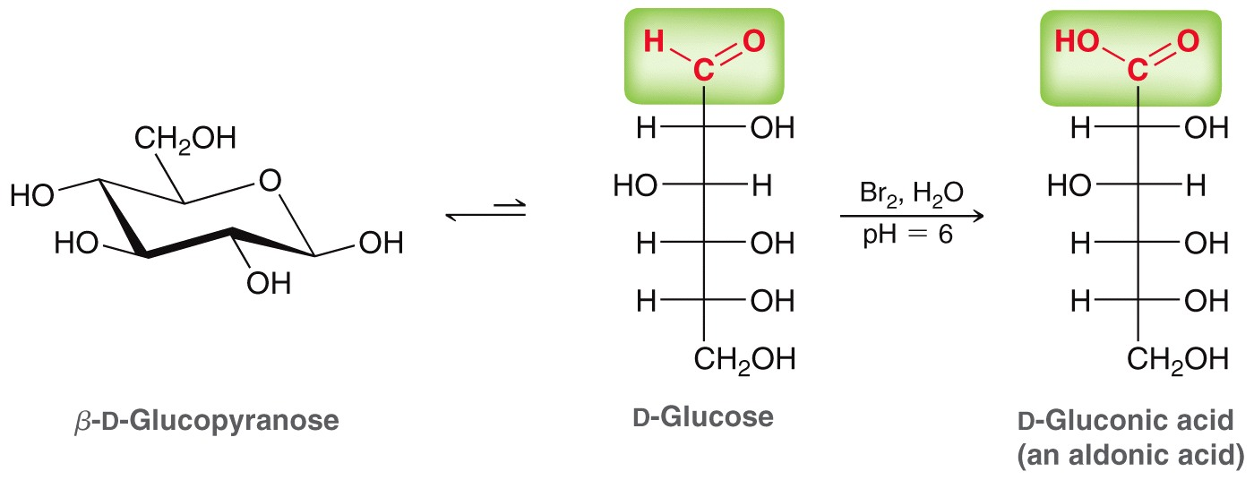
24.6 Oxidation of Monosaccharides
Aldehyde oxidation of an aldose produces an aldonic acid
Variety of oxidants can be used:
A mild oxidizing agent must be used to avoid oxidation of the alcohol groups

Slide 29
24.6 Reactions of Monosaccharides
Selective oxidation of an aldose (and not a ketose) is used as a chemical test to differentiate between the two
Oxidation tests also performed to detect the presence of reducing sugars (pyranose/furanose forms of a sugar)
Tollen’s test
Fehling’s test
Glycosides (i.e. acetals) are not reducing sugars, and are not oxidized
Practice with SkillBuilder 24.4

Slide 30
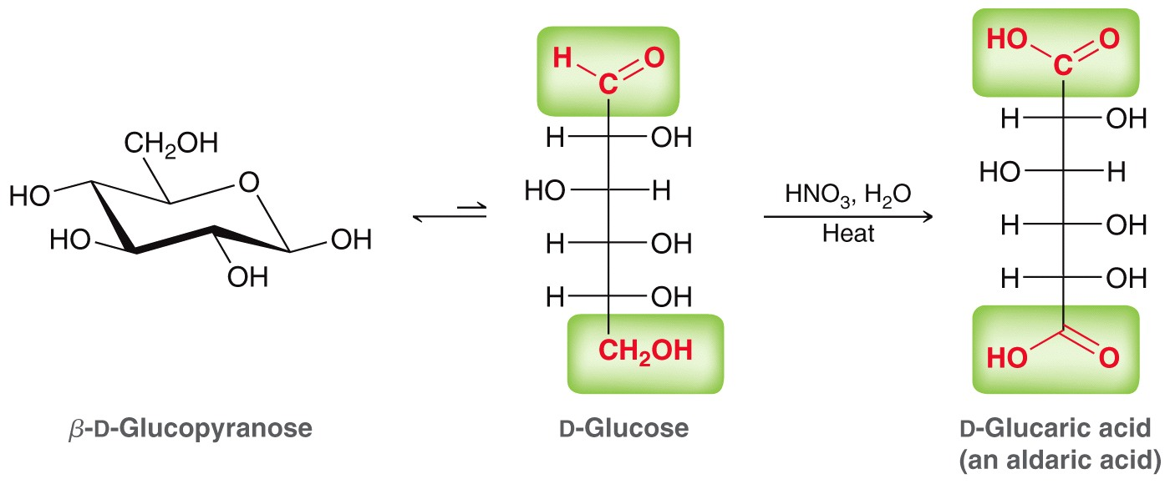
24.6 Reactions of Monosaccharides
A stronger oxidant (like HNO3) will oxidize the aldehyde and 1˚ alcohol of an aldose, forming an aldaric acid:
A mild oxidizing agent must be used to avoid oxidation of the alcohol groups

Slide 31
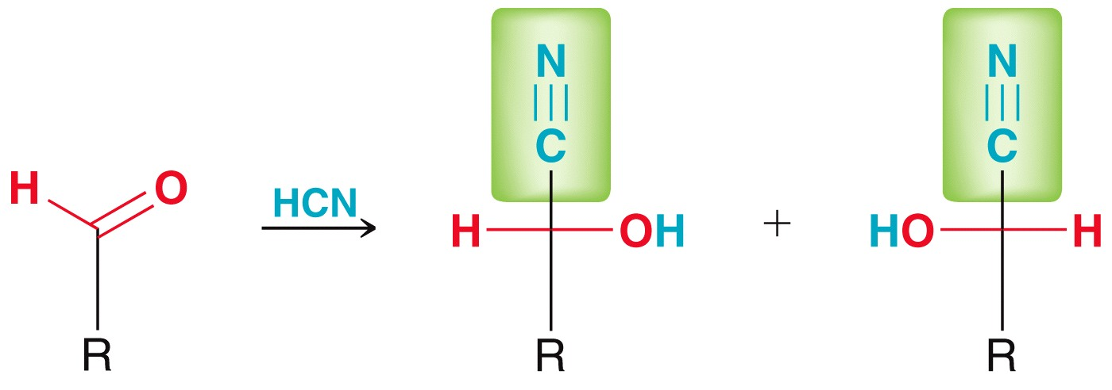
24.6 Reactions of Monosaccharides
Recall cyanohydrin formation (section 19.10); it works on aldoses
Kiliani-Fischer synthesis: the cyanohydrin is hydrolyzed to carboxylic acid and subsequently reduced to aldehyde
Mixture of
stereoisomers

Slide 32
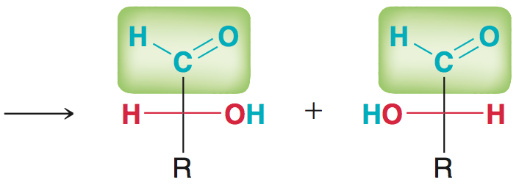
24.6 Reactions of Monosaccharides
Overall, the Kiliani-Fischer synthesis lengthens the carbon chain of a sugar by 1 carbon:
The cyano group can be converted to an aldehyde in one step:

Slide 33
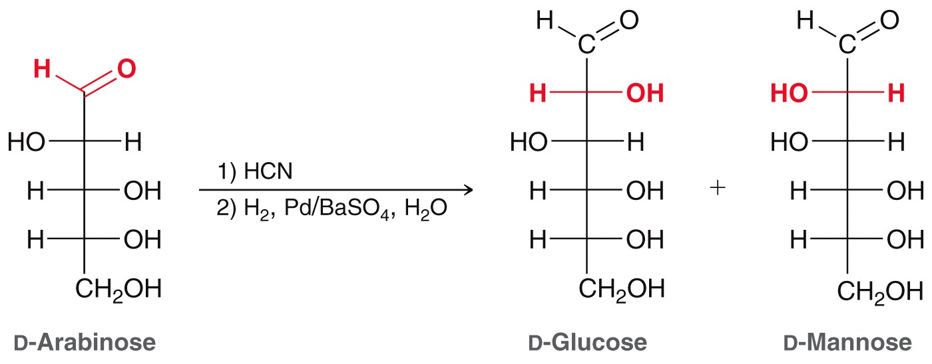
24.6 Reactions of Monosaccharides
Example:
Practice with Conceptual Checkpoints 24.34 and 24.35

Slide 34
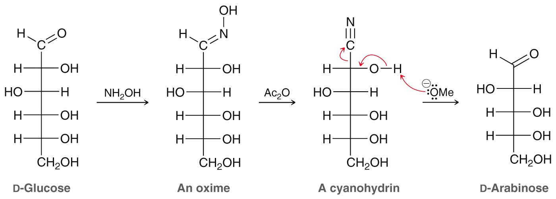
24.6 Reactions of Monosaccharides
The Wohl degradation achieves the opposite of the Kiliani-Fischer synthesis; it shortens the carbon chain by 1 carbon:
This can be useful to characterize the structure of an aldose
Practice with conceptual checkpoints 24.36 – 24.38

Slide 35
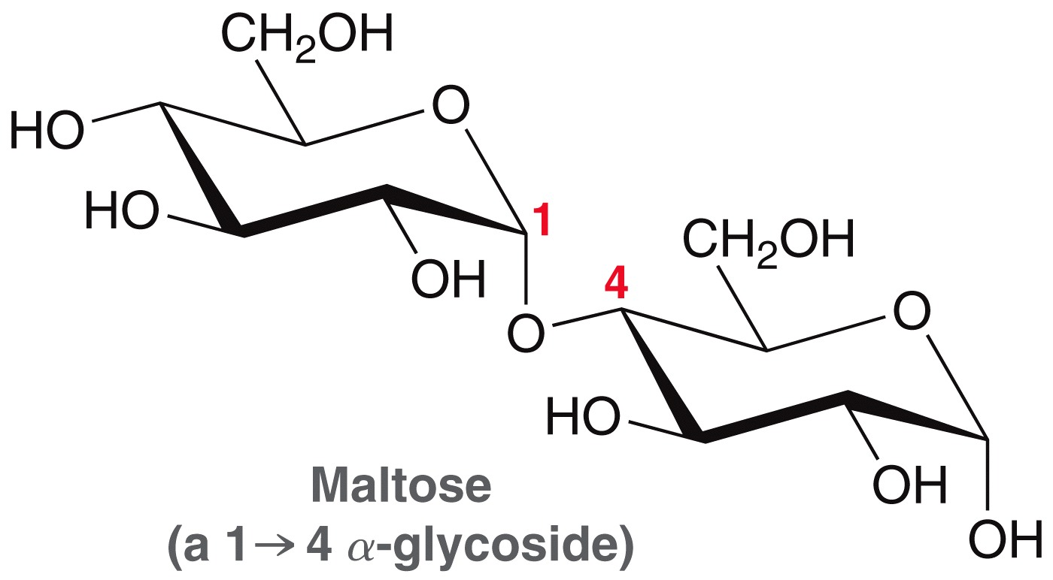
24.7 Disaccharides
Disaccharides consist of two sugars, connected through a glycosidic linkage
Glycosidic oxygen connects
C1 to C4, so this is a 1,4-
disaccharide
Maltose is a reducing sugar
Practice with SkillBuilder 24.5
Hemiacetal @ anomeric
carbon = reducing sugar

Slide 36
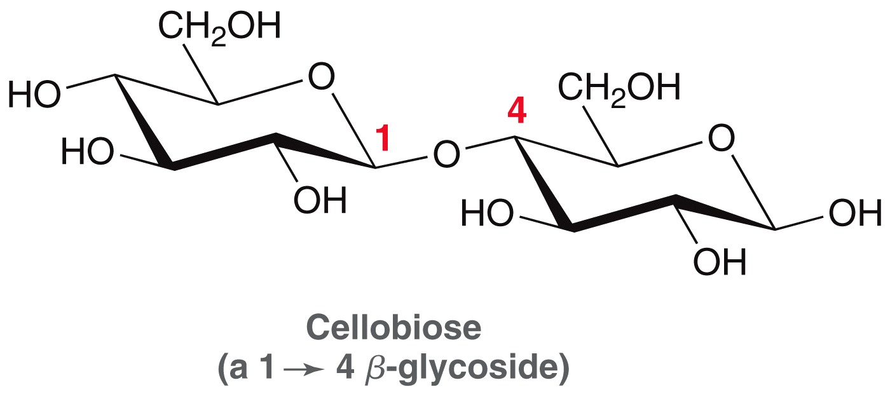
24.7 Disaccharides
Cellubiose and Maltose only differ by the stereochemistry at the anomeric carbons:
Practice Conceptual Checkpoint 24.41
β glycoside
α glycoside
β pyranose
α pyranose

Slide 37
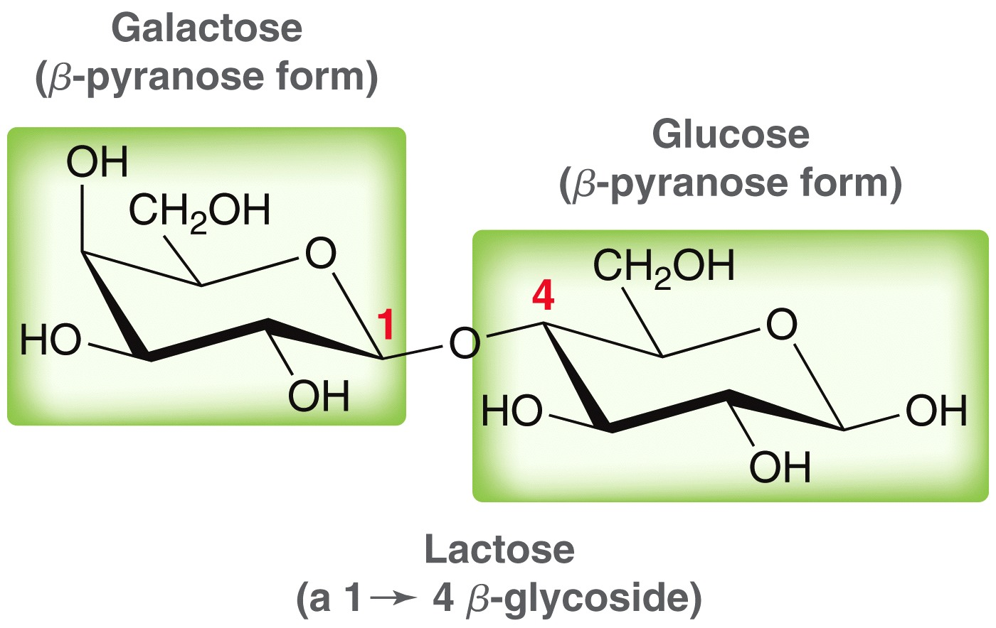
24.7 Disaccharides
Lactose is also a disaccharide

Slide 38
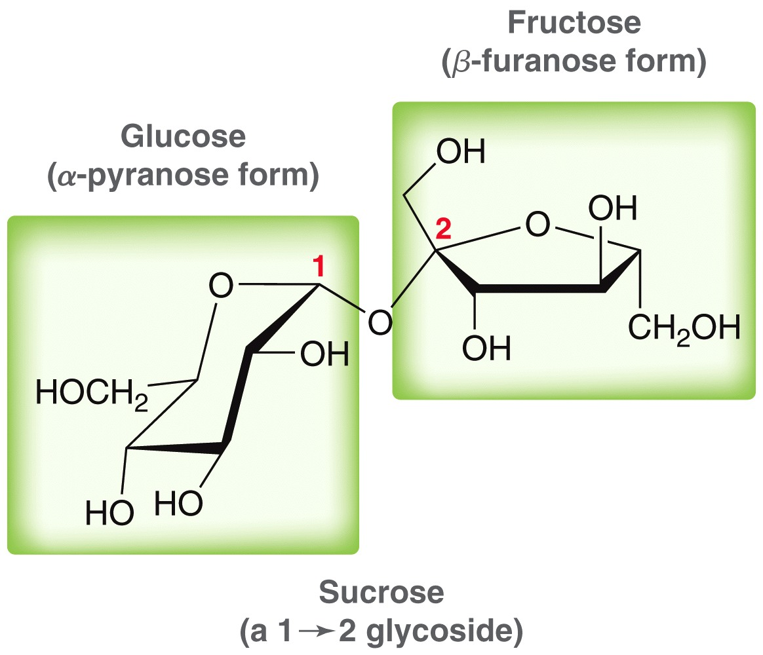
24.7 Disaccharides
Sucrose (table sugar) is a disaccharide
Honey bees can convert sucrose into a mixture of sucrose, fructose, and glucose
Sucrose is not a reducing sugar

Slide 39
24.8 Polysaccharides
Cellulose is a polysaccharide containing 7000-12000 glucose units connected through β glycosidic bonds
Cellulose strands strongly H-bond with one another, giving wood and plant material its rigid structure

Slide 40
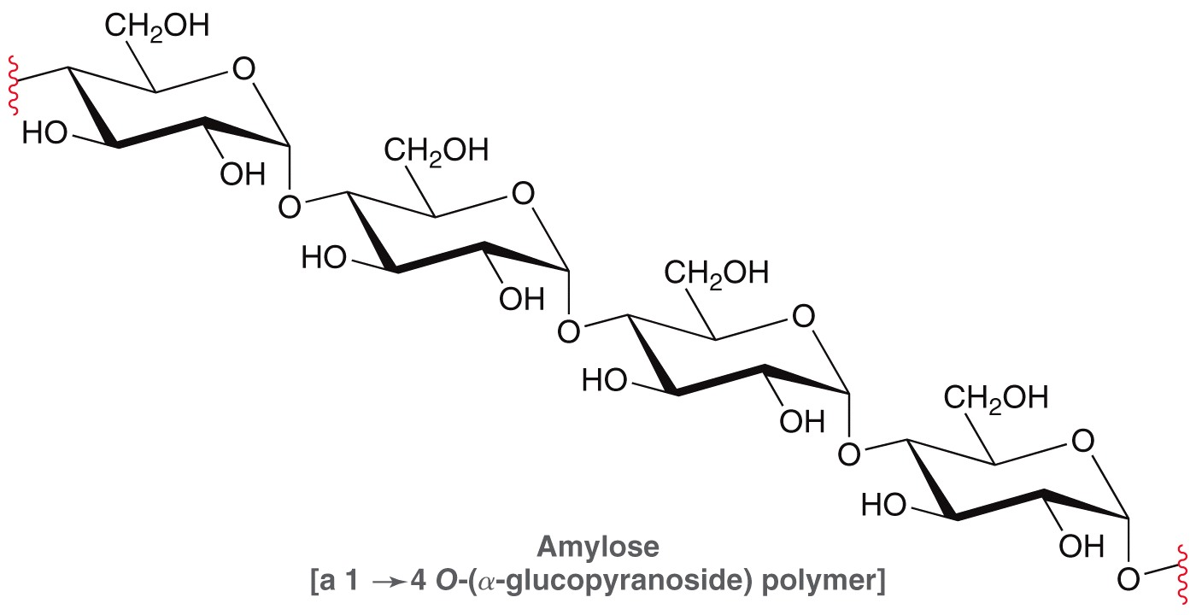
24.8 Polysaccharides
Starch is also comprised of glucose units, connected by a glycosidic linkages
two components: amylose (20%) and amylopectin (80%)

Slide 41
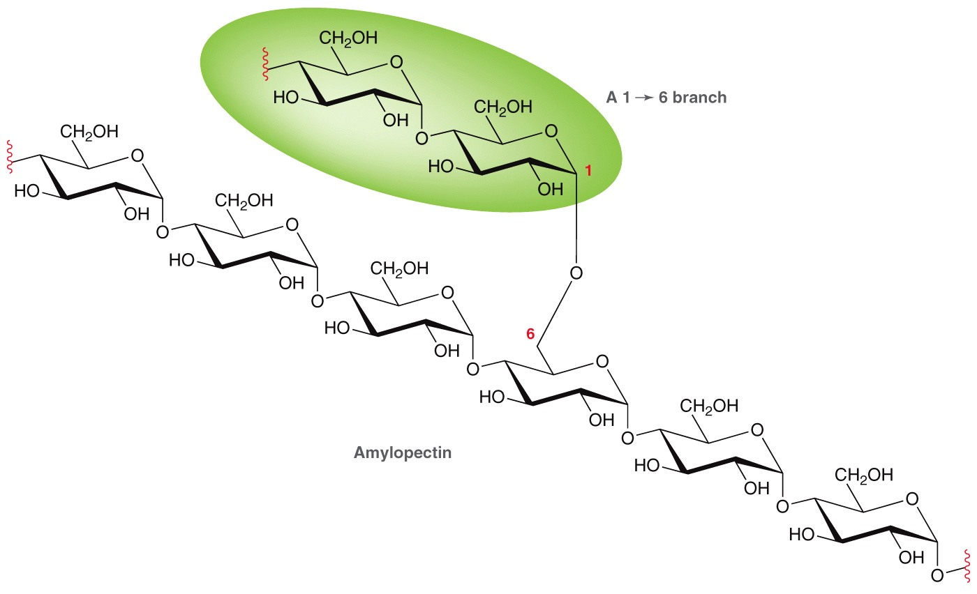
24.8 Polysaccharides
Amylopectin has glycosidic branches off of C6

Slide 42
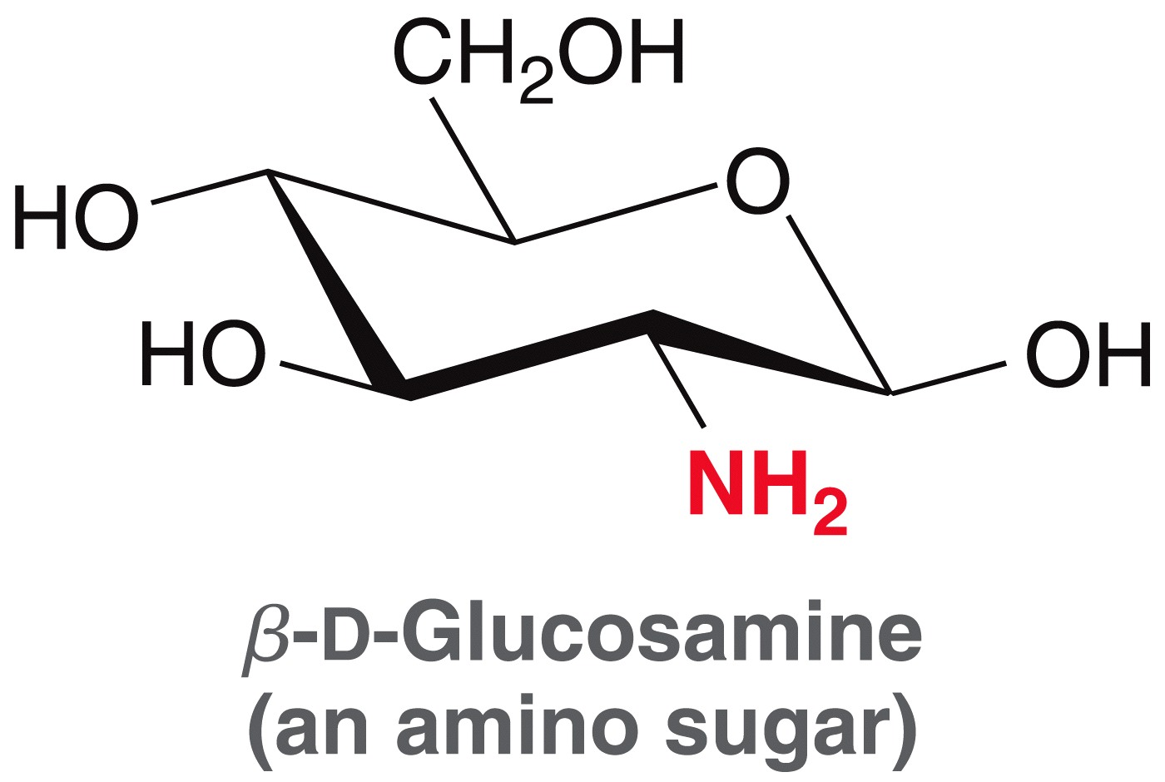
24.9 Amino Sugars
Amino sugars like glucosamine are important biomolecules
Acetylated glucosamine forms an important polysaccharide called chitin

Slide 43
24.9 Amino Sugars
The N-acyl group allow for even stronger H-bonding between neighboring chains than cellulose
Chitin is used in insect and arthropod exoskeletons.

Slide 44
24.10 N-Glycosides
N-glycosides are formed by reaction with an amine under acidic conditions:
The nitrogenous base pairs in DNA are connected to the deoxyribose units via N-glycosidic linkages, forming a nucleoside

Slide 45
24.10 N-Glycosides
Ribose forms ribonucleosides in RNA
Deoxyribose forms deoxyribonucleosides in DNA

Slide 46
24.10 N-Glycosides
There are 4 different heterocyclic amines that attach to deoxyribose, via N-glycosidic linkages, to form DNA nucleosides

Slide 47
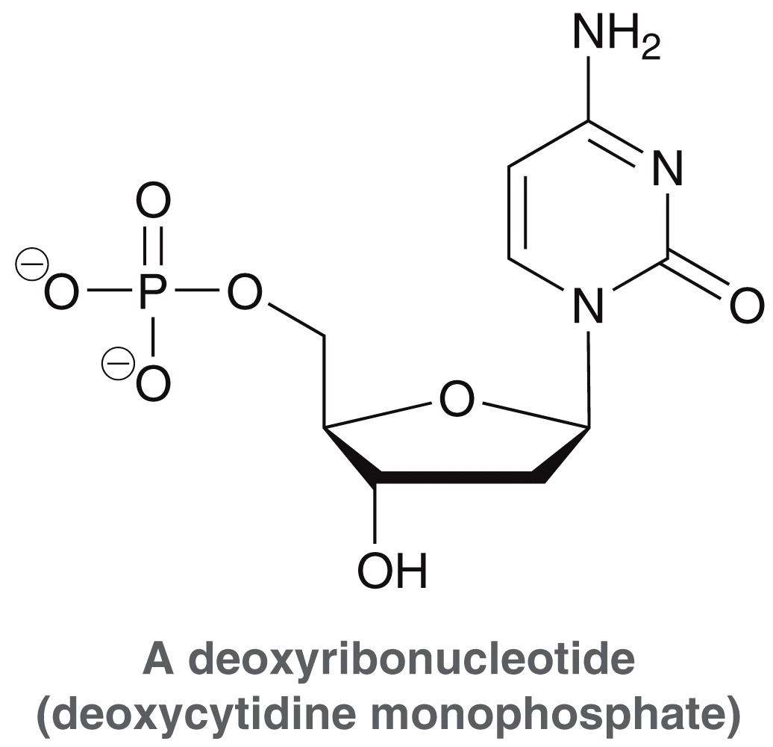
24.10 N-Glycosides
In DNA, the nucleosides are attached to phosphate groups forming nucleotides

Slide 48
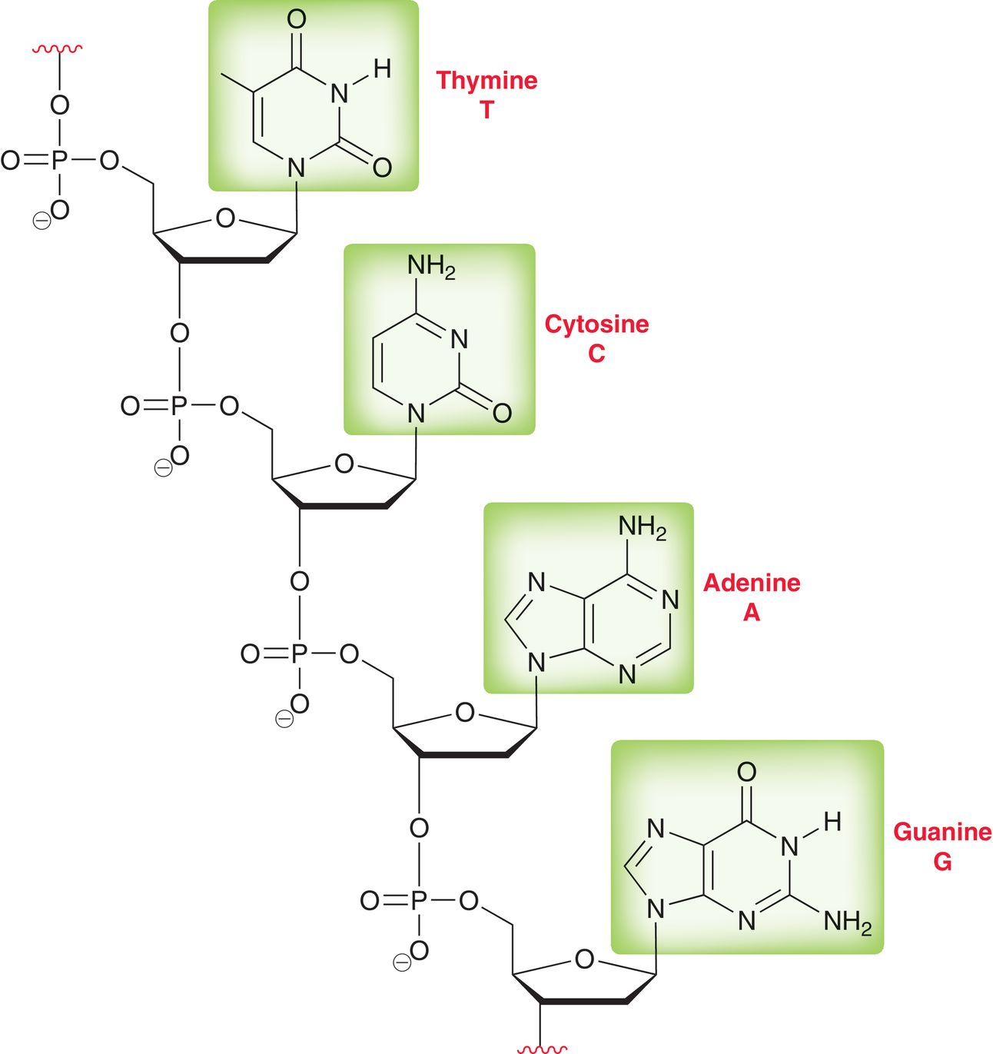
24.10 N-Glycosides
The phosphate groups of the nucleotides are connected together to make the DNA strand or polynucleotide

Slide 49
24.10 N-Glycosides
The nucleotides in DNA can attract one another through H-bonding of the DNA base pairs

Slide 50
24.10 N-Glycosides
RNA is structurally different from DNA
The sugar in RNA is ribose.
RNA contains uracil instead of thymine
RNA translates the information stored in DNA into working molecules (proteins and enzymes)

Slide 51
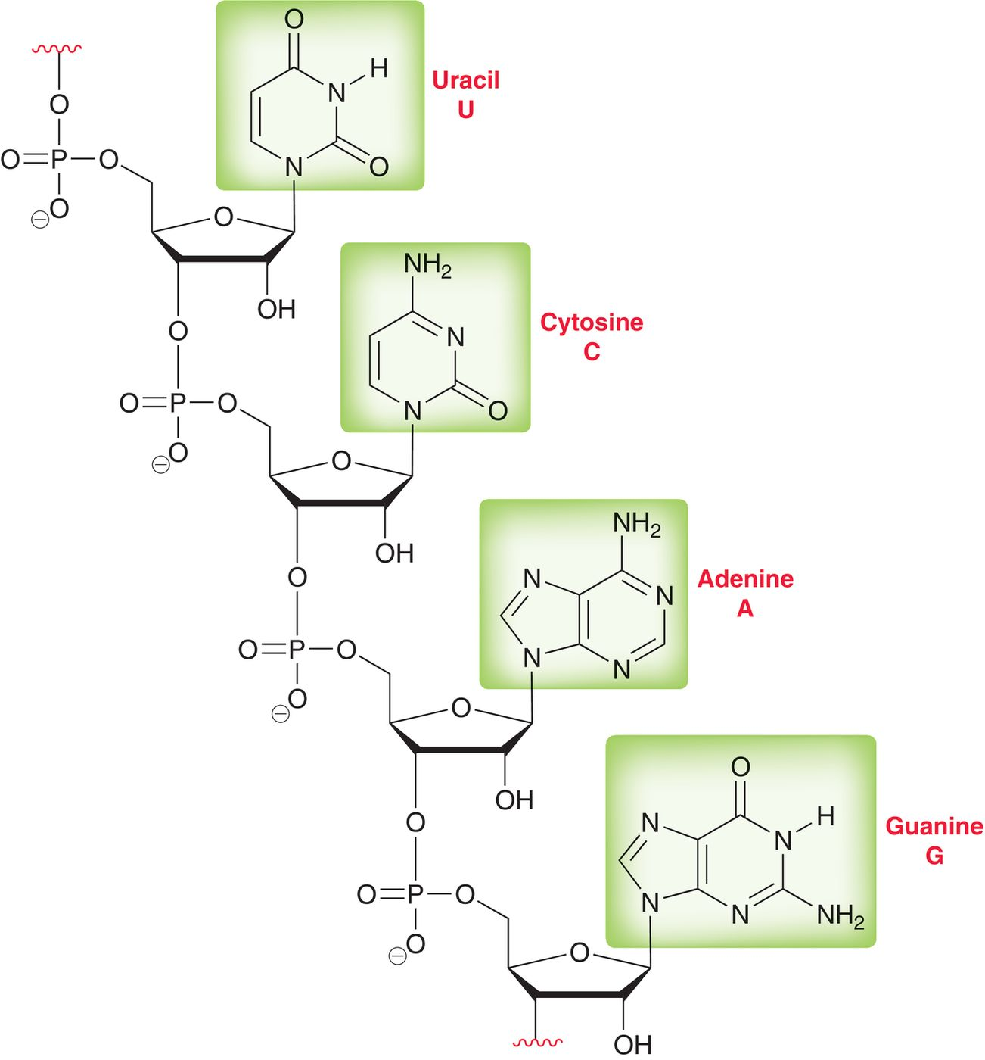
24.10 N-Glycosides
RNA strand

Slide 52
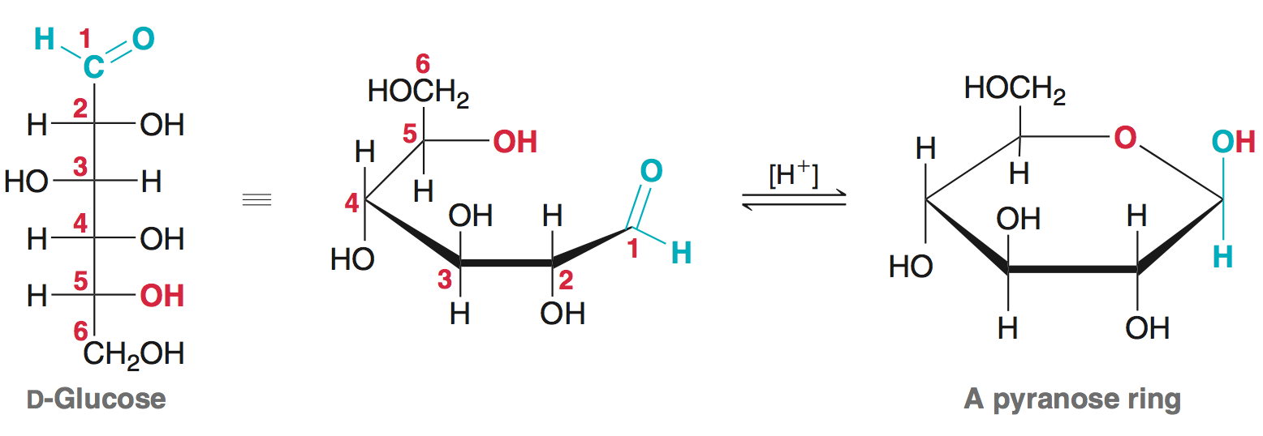
Chapter 24 - Review of Reactions

Slide 53
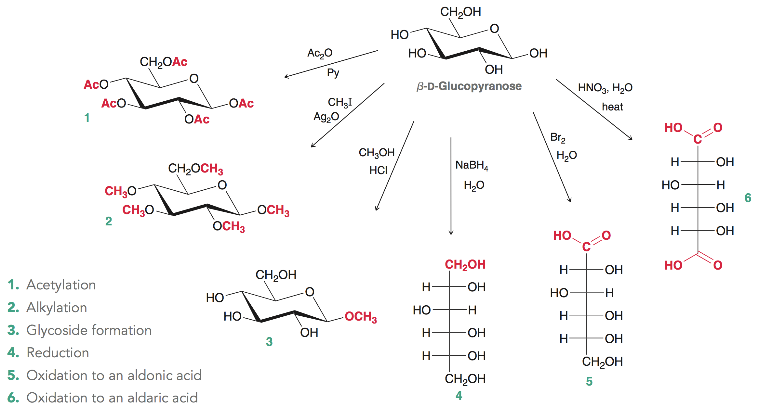
Chapter 24 - Review of Reactions

Slide 54
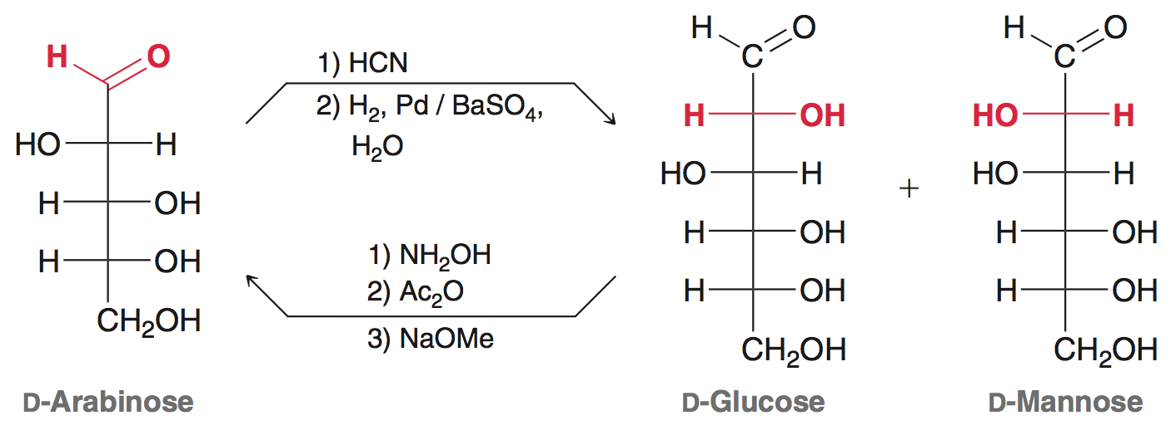
Chapter 24 - Review of Reactions

