Slide 1
Organic Chemistry
Third Edition
David Klein
Chapter 25
Amino Acids, Peptides, and Proteins

Slide 2
25.1 Introduction
It might be necessary to review the following topics to prepare for the material in this chapter:
Designating R/S configuration of a chiral center (section 5.3)
Structure and Reactivity of Carboxylic Acids (section 20.3)
Nucleophilic Acyl Substitution (section 20.7)
Properties of Amines (section 22.3)

Slide 3
25.1 Introduction
Proteins = amino acid polymers
An amino acid contains an amino group and a carboxyl group

Slide 4
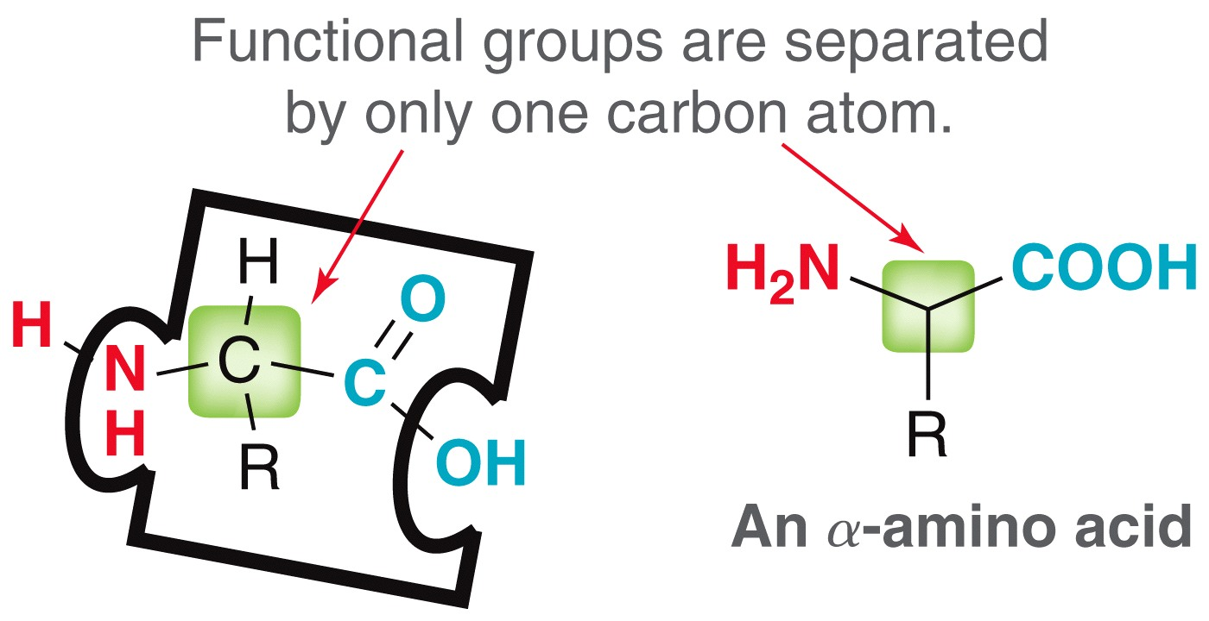
25.1 Introduction
alpha amino acids – amino and carboxyl groups are separated by one carbon (the α carbon)
All α amino acids (except for glycine) are chiral. The α carbon is a chiral center

Slide 5
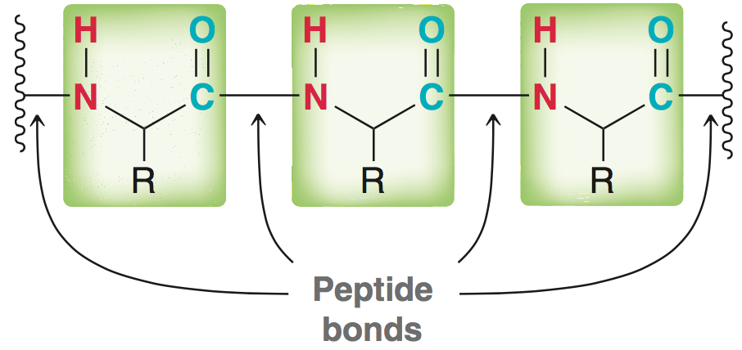
25.1 Introduction
Peptide – relatively short amino acid chain (less than 40 or 50)
Prefixes di-, tri-, tetra-, etc. are used to describe a peptide of a specific length
Polypeptide refers to chain of fewer than 40-50 amino acids
Peptide bonds – amide linkages that connect amino acids
Larger chains are often called proteins although the term “protein” implies biological function

Slide 6
25.2 Structure and Properties of Amino Acids
Twenty α amino acids occur naturally, called ; they differ in the identity of their side chains (“R” groups)
Natural amino acids called L-amino acids (stereochemistry resembles L-sugars):
Practice with Conceptual Checkpoint 25.1 – 25.3

Slide 7
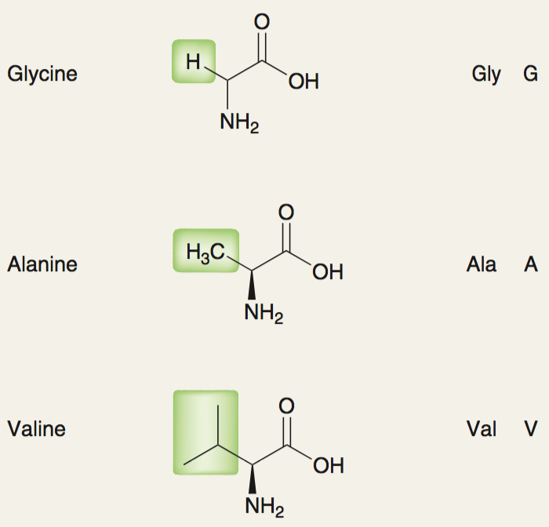
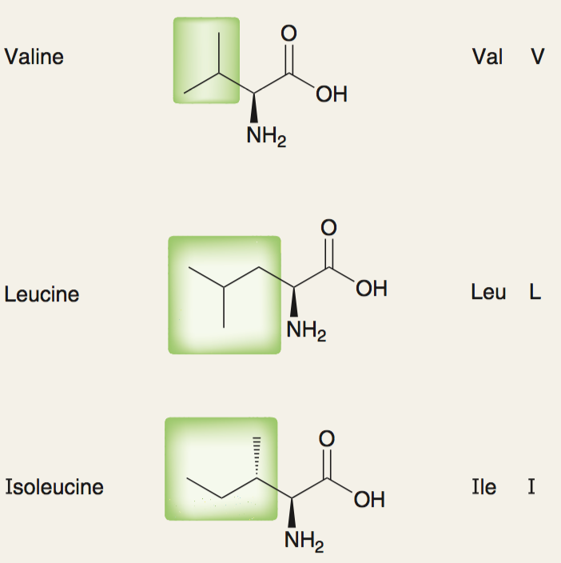
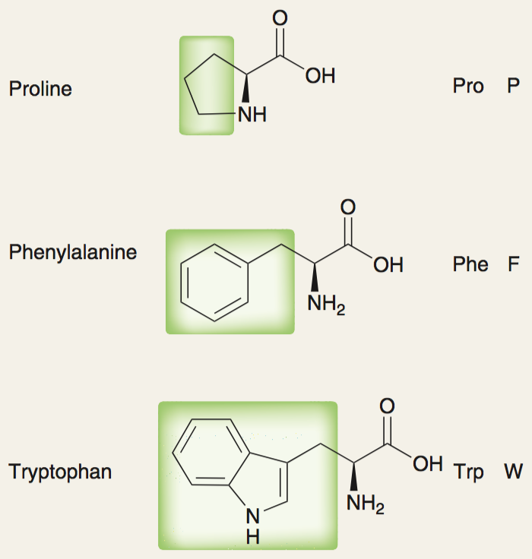
25.2 Structure and Properties of Amino Acids
Amino acids with nonpolar side chains
Each amino acid has a 3-letter and a 1-letter abbreviation code

Slide 8
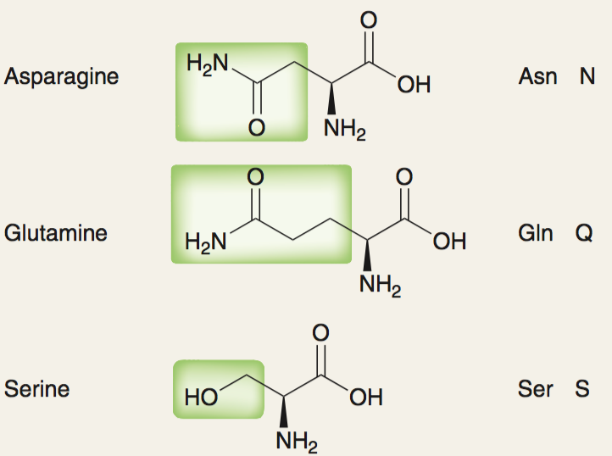
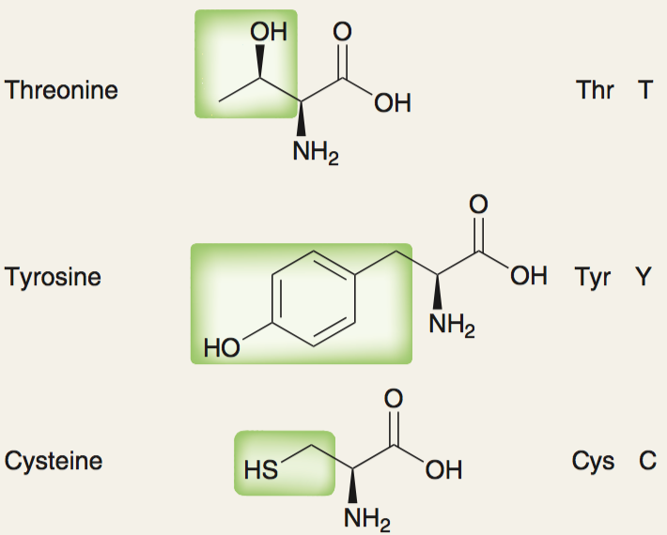
25.2 Structure and Properties of Amino Acids
Amino acids with polar side chains

Slide 9
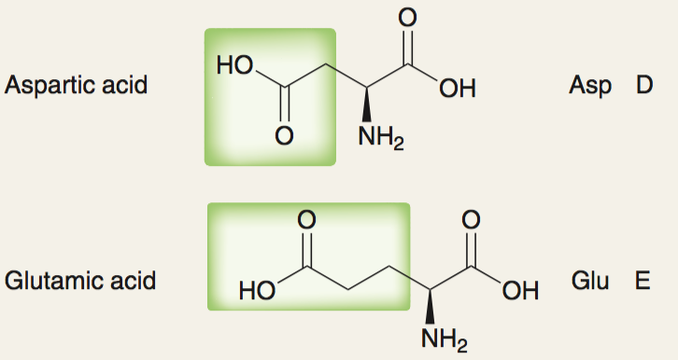
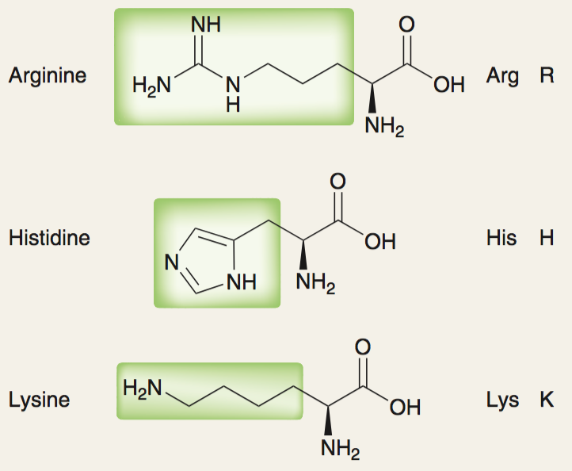
25.2 Structure and Properties of Amino Acids
acidic side chains basic side chains

Slide 10
25.2 Structure and Properties of Amino Acids
Our bodies can make 10 of the 20 amino acids we need
We must get the other 10 amino acids from our diet
Meat eaters can get all of their essential proteins from meat, fish, milk, and eggs
No single plant source contains all of the essential amino acids
Vegetarians and vegans need a combination of grains, beans, and nuts

Slide 11
25.2 Structure and Properties of Amino Acids
Naturally occurring amino acids not found in proteins:
neurotransmitter
(found in the brain)
hormone
(found in the thyroid gland)

Slide 12
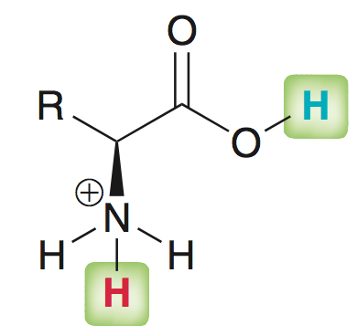
25.2 Acid-Base Properties of Amino Acids
Under acidic conditions (low pH), both the amino and carboxyl groups are protonated
Each group (highlighted above) has a unique pKa value:
cationic
(low pH)
anionic
(high pH)
Zwitterionic

Slide 13
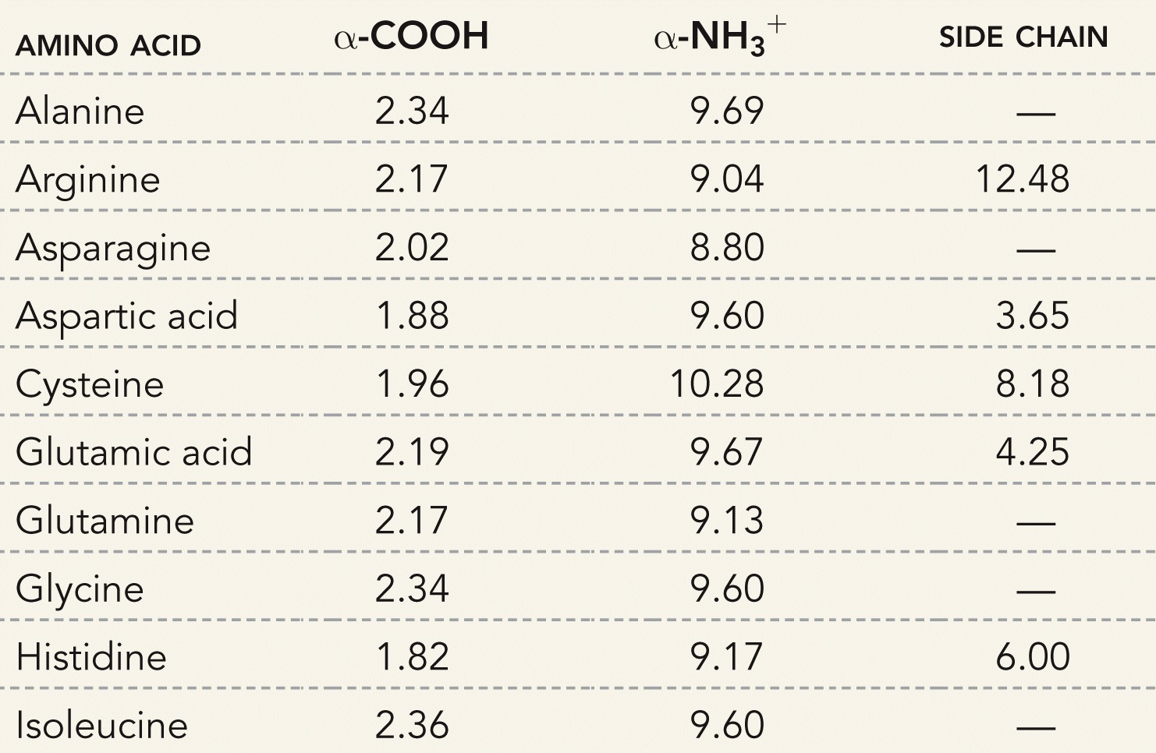
25.2 Structure and Properties of Amino Acids
Note the carboxylic acid is more acidic than the ammonium ion

Slide 14
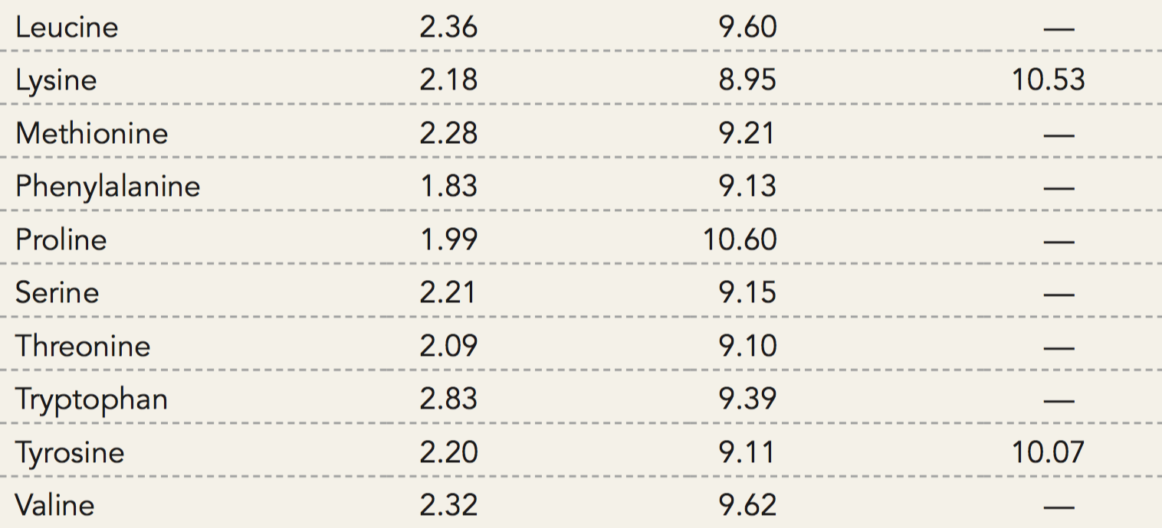
25.2 Structure and Properties of Amino Acids
Acidic and basic side chains have their own pK_{a} value well

Slide 15
25.2 Structure and Properties of Amino Acids
How to use the pKa values:
The carboxyl group of alanine has a pKa value of 2.34
when pH = 2.34, the amount of protonated (-COOH) and deprotonated (-COO⁻) alanine will be equal
At a pH higher than 2.34, more alanine molecules will be deprotonated (and vice versa).

Slide 16
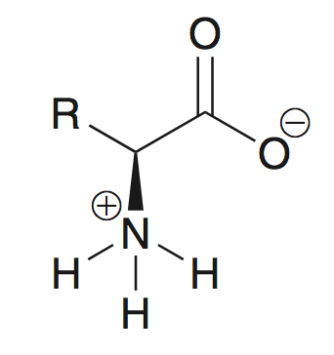
25.2 Structure and Properties of Amino Acids
At physiological pH, the structure of an amino acid is zwitterionic
(physiological pH is higher than the COOH pK_{a}, and lower than the NH3⁺ pK_{a})

Slide 17
25.2 Structure and Properties of Amino Acids
At physiological pH, amino acids are amphoteric, and functions as bases and as acids:
Practice with SkillBuilder 25.1
when treated
with a base…
when treated
with an acid…

Slide 18
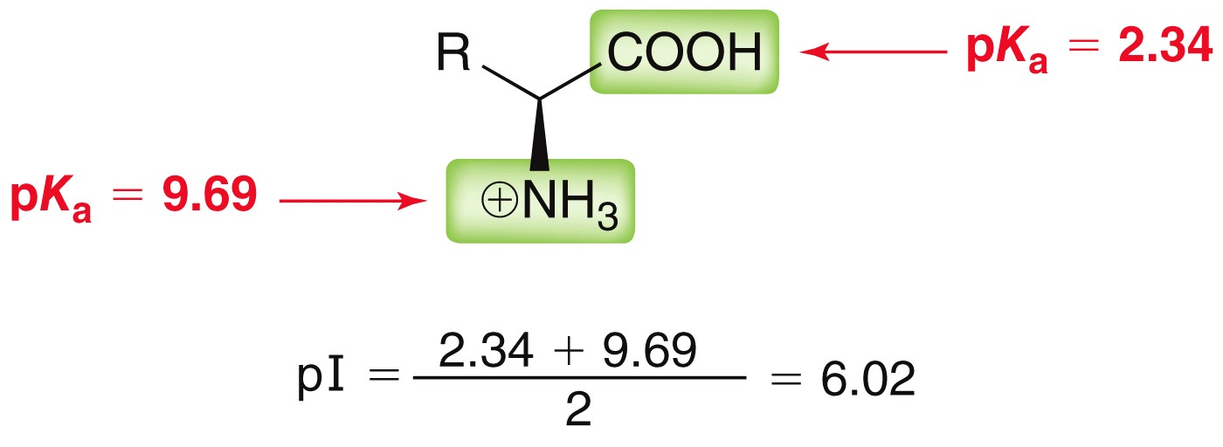
25.2 Structure and Properties of Amino Acids
isoelectric point (pI) – the pH at which zwitterion concentration is highest
For an amino acid without an acidic or basic side group, simply average the two pK_{a} values

Slide 19
25.2 Structure and Properties of Amino Acids
For other amino acids, average the pK_{a} value of the side group with the matching amino or acid group
For acidic amino acids, average pka value of side chain and COOH group
For basic amino acids, average pka value of side chain and NH3⁺ group
Practice with Conceptual Checkpoint 25.7 – 25.9

Slide 20
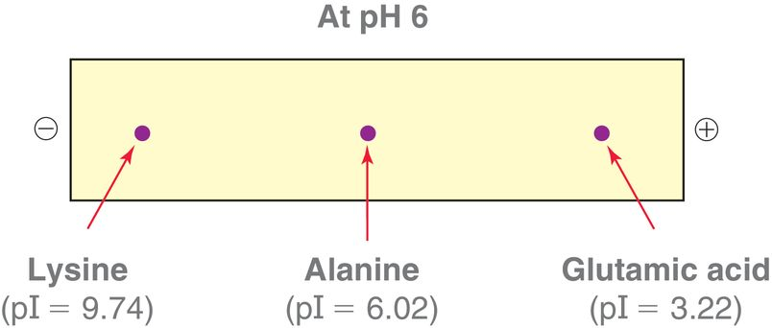
25.2 Structure and Properties of Amino Acids
Electrophoresis is used to separate amines by exploiting their pI values
when pI > pH of solution, amino acid is cationic
When pI < pH of solution, amino acid is anionic
If two amino acids have similar pI values, the larger amino acid moves more slowly
cations move toward
this end (cathode)
anions move toward
this end (anode)

Slide 21
25.2 Structure and Properties of Amino Acids
Electrophoresis is an analytical scale technique; it isn’t used to separate large amounts
Amino acids are generally colorless, but their presence can often be verified with a ninhydrin color indicator
Practice with Conceptual Checkpoint 25.10 – 25.11

Slide 22
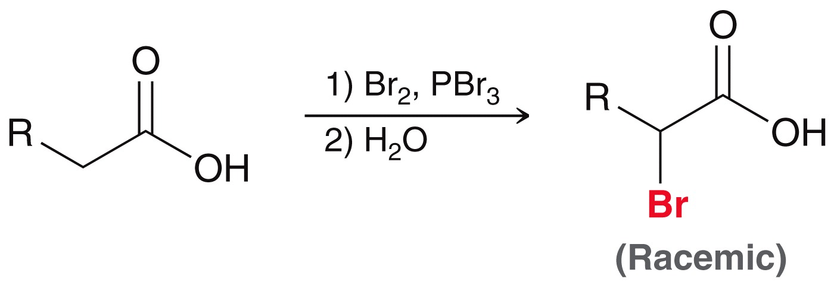
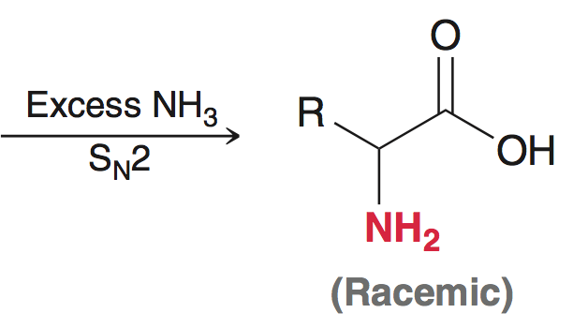
25.3 Amino Acid Synthesis
Amino Acid Synthesis via α-Haloacids
The Hell-Volhard-Zelinski reaction is used to functionalize the a carbon of a carboxylic acid (section 21.2)
Subsequent S_{N}2 reaction with NH₃ yields an a amino acid:
Practice with Conceptual Checkpoint 25.12 – 25.13

Slide 23
25.3 Amino Acid Synthesis
Amino Acid Synthesis via Amidomalonate Synthesis
Similar to the malonic ester synthesis (section 21.5)
R-X provides the side chain for the amino acid

Slide 24
25.3 Amino Acid Synthesis
Amino Acid Synthesis via Amidomalonate Synthesis
Synthesis of phenylalanine
Practice with SkillBuilder 25.2

Slide 25
25.3 Amino Acid Synthesis
Amino Acid Synthesis via the Strecker Synthesis
Two-step synthesis from an aldehyde
aldehyde
α-amino nitrile
amino acid

Slide 26
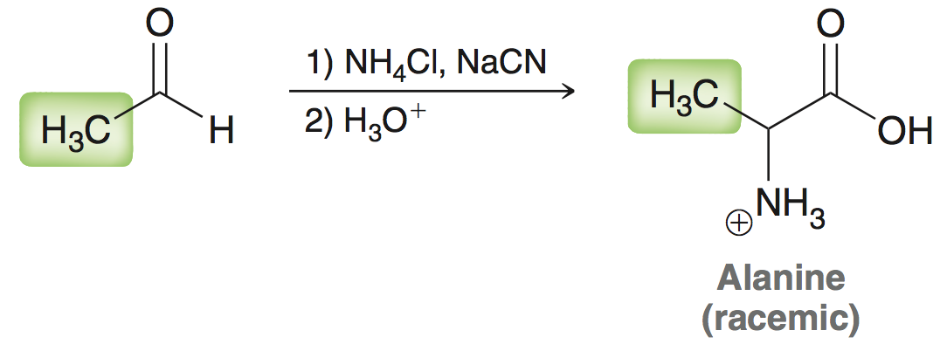
25.3 Amino Acid Synthesis
Amino Acid Synthesis via the Strecker Synthesis
The side chain of the aldehyde becomes the side chain of the resulting amino acid:

Slide 27
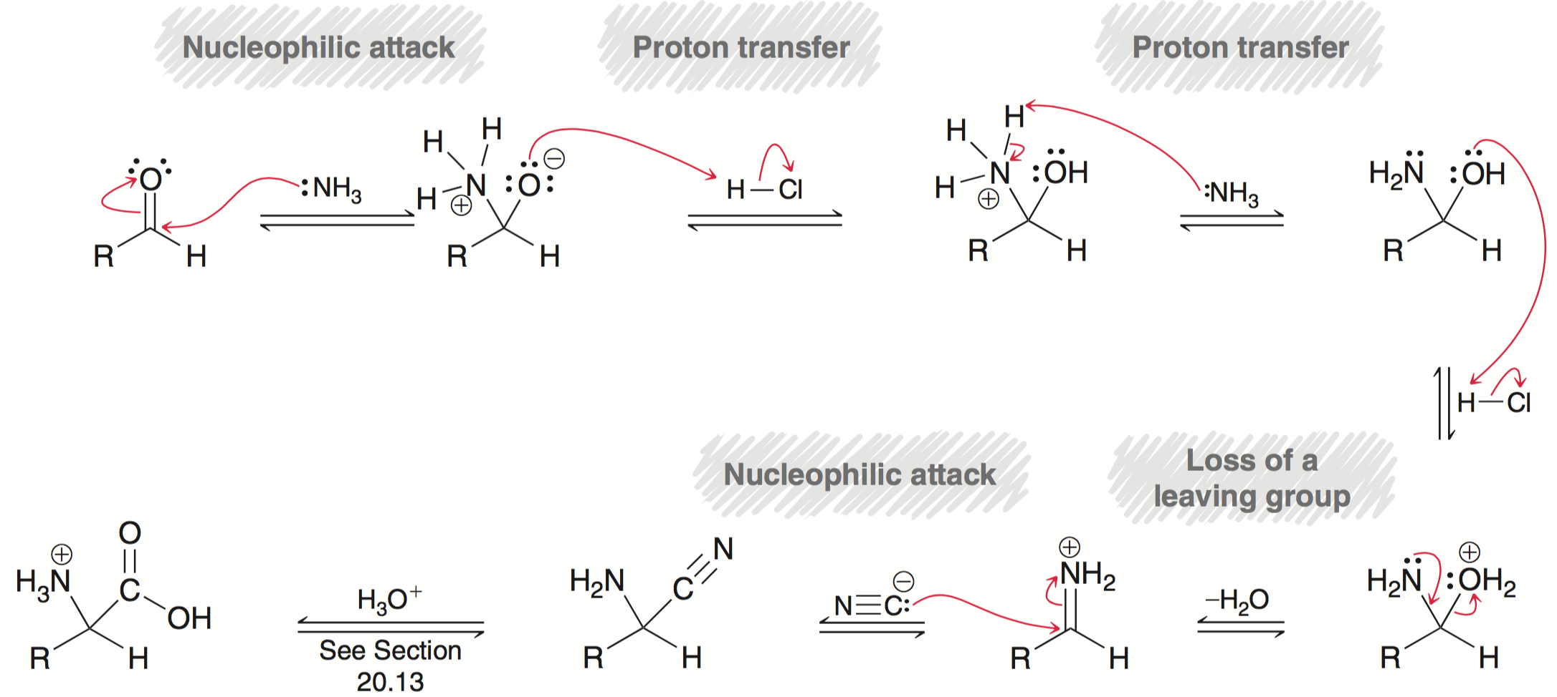
25.3 Amino Acid Synthesis
Amino Acid Synthesis via the Strecker Synthesis
Mechanism for α-amino nitrile formation:
Practice with Conceptual Checkpoint 25.17 – 25.18

Slide 28
25.3 Amino Acid Synthesis
Enantioselective Synthesis of L amino acids
Syntheses covered so far provide racemic mixtures
A desired enantiomer obtained in 1 of 2 ways:
Resolution of a racemic mixture (separation of enantiomers)
or
Asymmetric synthesis (make only one enantiomer)
It is clearly more efficient to synthesize the desired enantiomer, as opposed to fishing it out of a racemic mixture

Slide 29
25.3 Amino Acid Synthesis
Enantioselective Synthesis of L amino acids
Assymetric hydrogenation (section 8.8)

Slide 30
25.3 Amino Acid Synthesis
Enantioselective Synthesis of L amino acids
Asymmetric hydrogenation (section 8.8)
Many chiral catalysts consist of ruthenium complexed to a chiral ligand:
The following example provide D-phenylalanine with 99% ee
Practice with Conceptual Checkpoint 25.19 – 25.20

Slide 31
25.4 Structure of Peptides
Glutathione is an example of a tripeptide.
It isn’t enough to join these three amino acids to make glutathione, they have to be assembled in the correct order, from end to end:

Slide 32
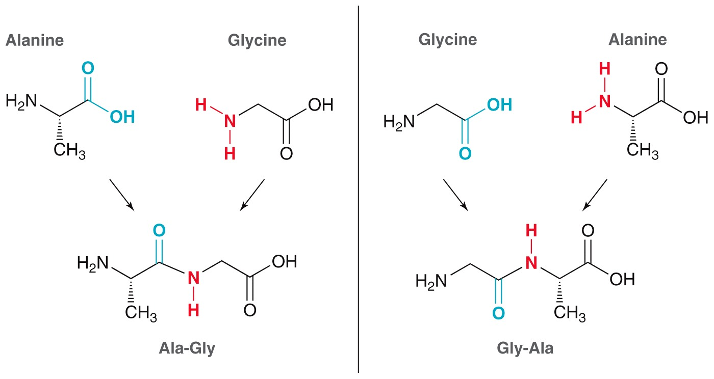
25.4 Structure of Peptides
Consider a dipeptide. Two different dipeptides are possible consisting of Alanine and Glycine:

Slide 33
25.4 Structure of Peptides
peptides has an N-terminus and a C-terminus.
The N-terminus is always written on the left-hand side
3-letter abbreviations can be used (N-terminus on the left)
Practice with SkillBuilder 25.3

Slide 34
25.4 Structure of Peptides
Recall that peptide bonds are amide bonds
C-N bond has partial double bond character (restricted rotation)
As a result, the C-N bond exists as either s-trans or s-cis rotamer

Slide 35
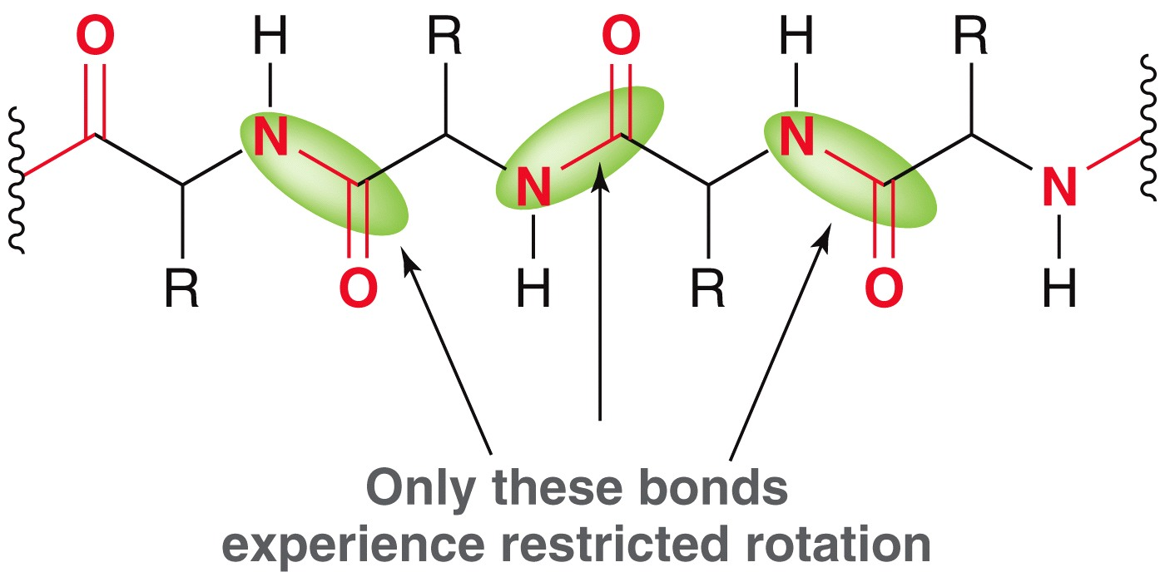
25.4 Structure of Peptides
Peptides bonds of the peptide backbone have a preference for the s-trans conformation
The other backbone bonds can freely rotate; a variety of peptide conformations are possible
Practice with conceptual checkpoints 25.25 and 25.26

Slide 36
25.4 Structure of Peptides
Formation of disulfide bridges is critical to the structure and function of many proteins
cysteine residues in a protein (or two separate proteins) can connect through a disulfide bridge:

Slide 37
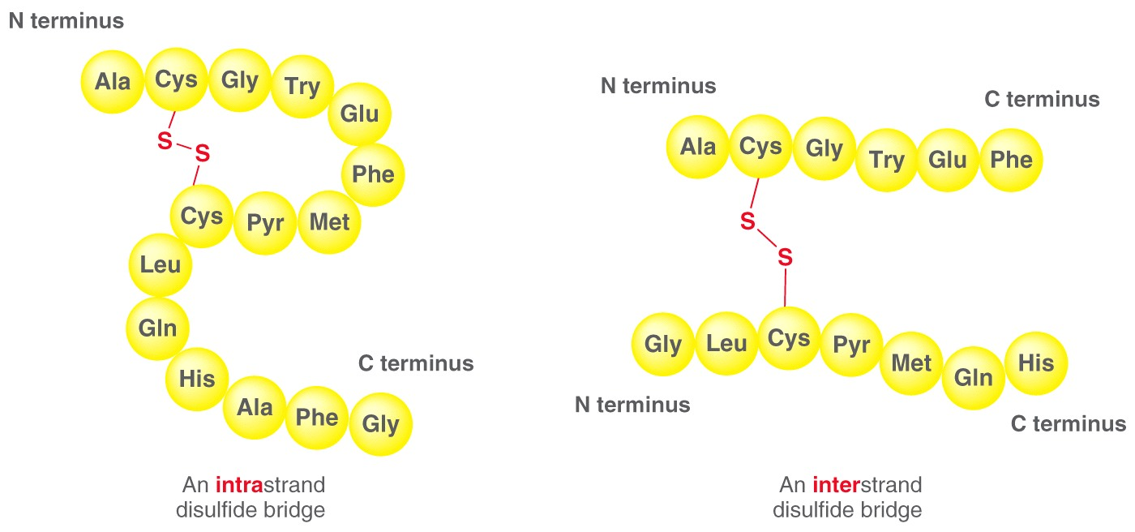
25.4 Structure of Peptides
Such linkages greatly affect the 3D structure and the function of many proteins

Slide 38
25.4 Structure of Peptides
biologically relevant peptides
Leucine enkephalin and methionine enkephalin function in the brain in control of pain:
Brandykinin is a hormone that dilates blood vessels and acts as an antiinflamatory agent

Slide 39
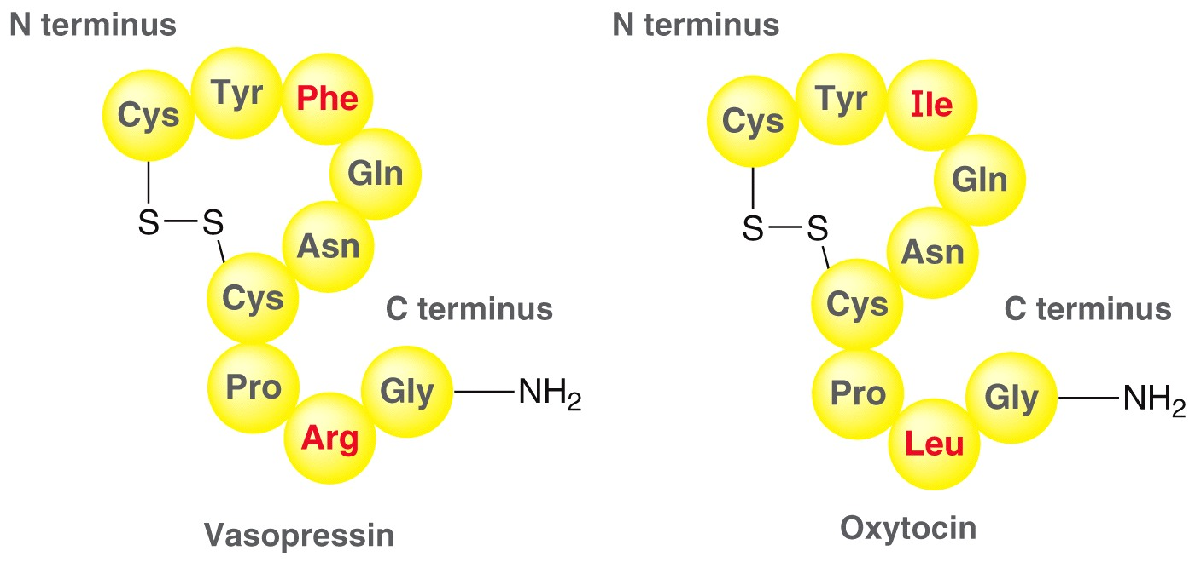
25.4 Structure of Peptides
Vasopressin causes readsorption of water by the kidneys and controls blood pressure
Oxytocin induces labor and stimulates milk production
Practice with Conceptual Checkpoint 25.27 – 25.28

Slide 40
25.5 Sequencing a Peptide
Edman Degradation
Removing an amino acid from the N-terminus of a peptide, as a phenylthiohydantoin (PTH) derivative
The PTH derivative is analyzed to identify the amino acid
The process can be automated, and is repeated until all amino acids in a peptide have been identified (up to 50)

Slide 41
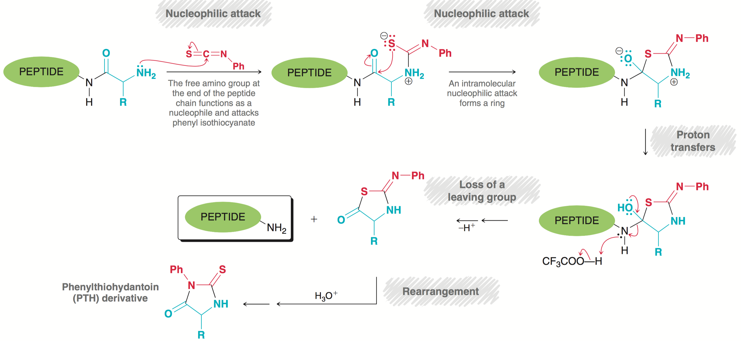
25.5 Sequencing a Peptide
Edman Degradation (mechanism)
Practice with Conceptual Checkpoint 25.30

Slide 42
25.5 Sequencing a Peptide
Enzymatic Cleavage
Larger peptides (>50 amino acids) are broken into smaller chains with peptidases for sequencing
A given peptidase will selectively hydrolyze specific peptide bonds
Trypsin cleaves the peptide bond on the C-terminus of arginine and lysine:

Slide 43
25.5 Sequencing a Peptide
Enzymatic Cleavage
Chymotrypsin catalyzes the hydrolysis of the carboxyl end of aromatic amino acids (phenylalanine, tyrosine, tryptophan)
The smaller fragments are then sequenced by Edman degradation
Practice with SkillBuilder 25.4

Slide 44
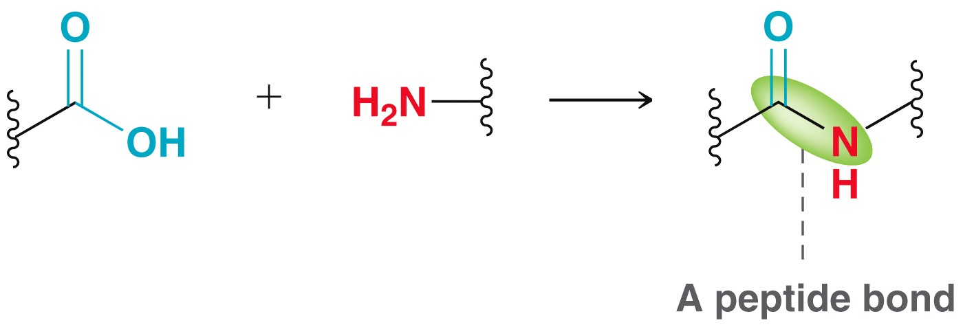
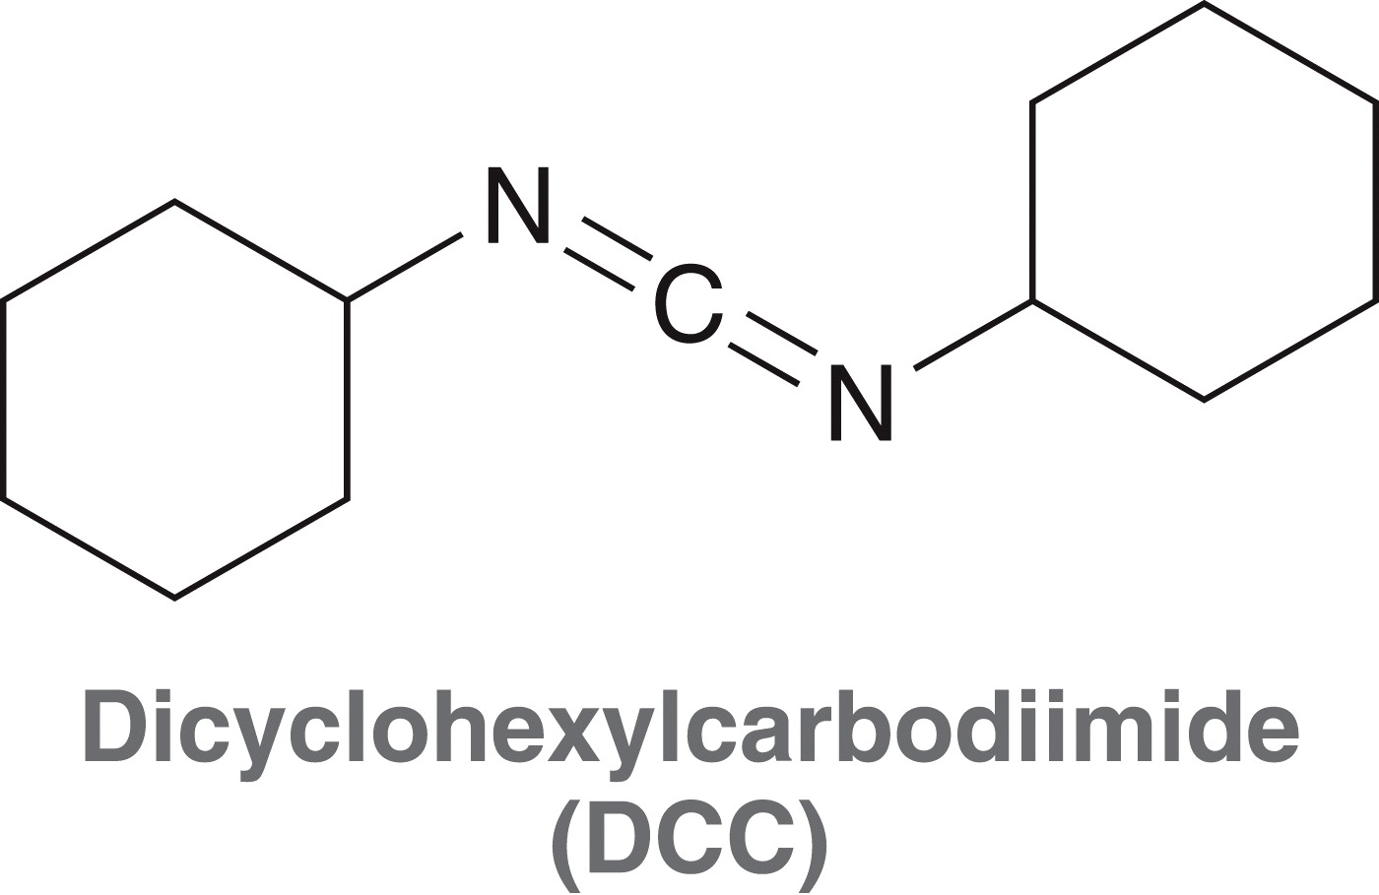
25.6 Peptide Synthesis
To form a peptide bond, the N-terminus of one molecule must be joined to the C-terminus of another molecule
DCC is a popular coupling agent used for this purpose

Slide 45
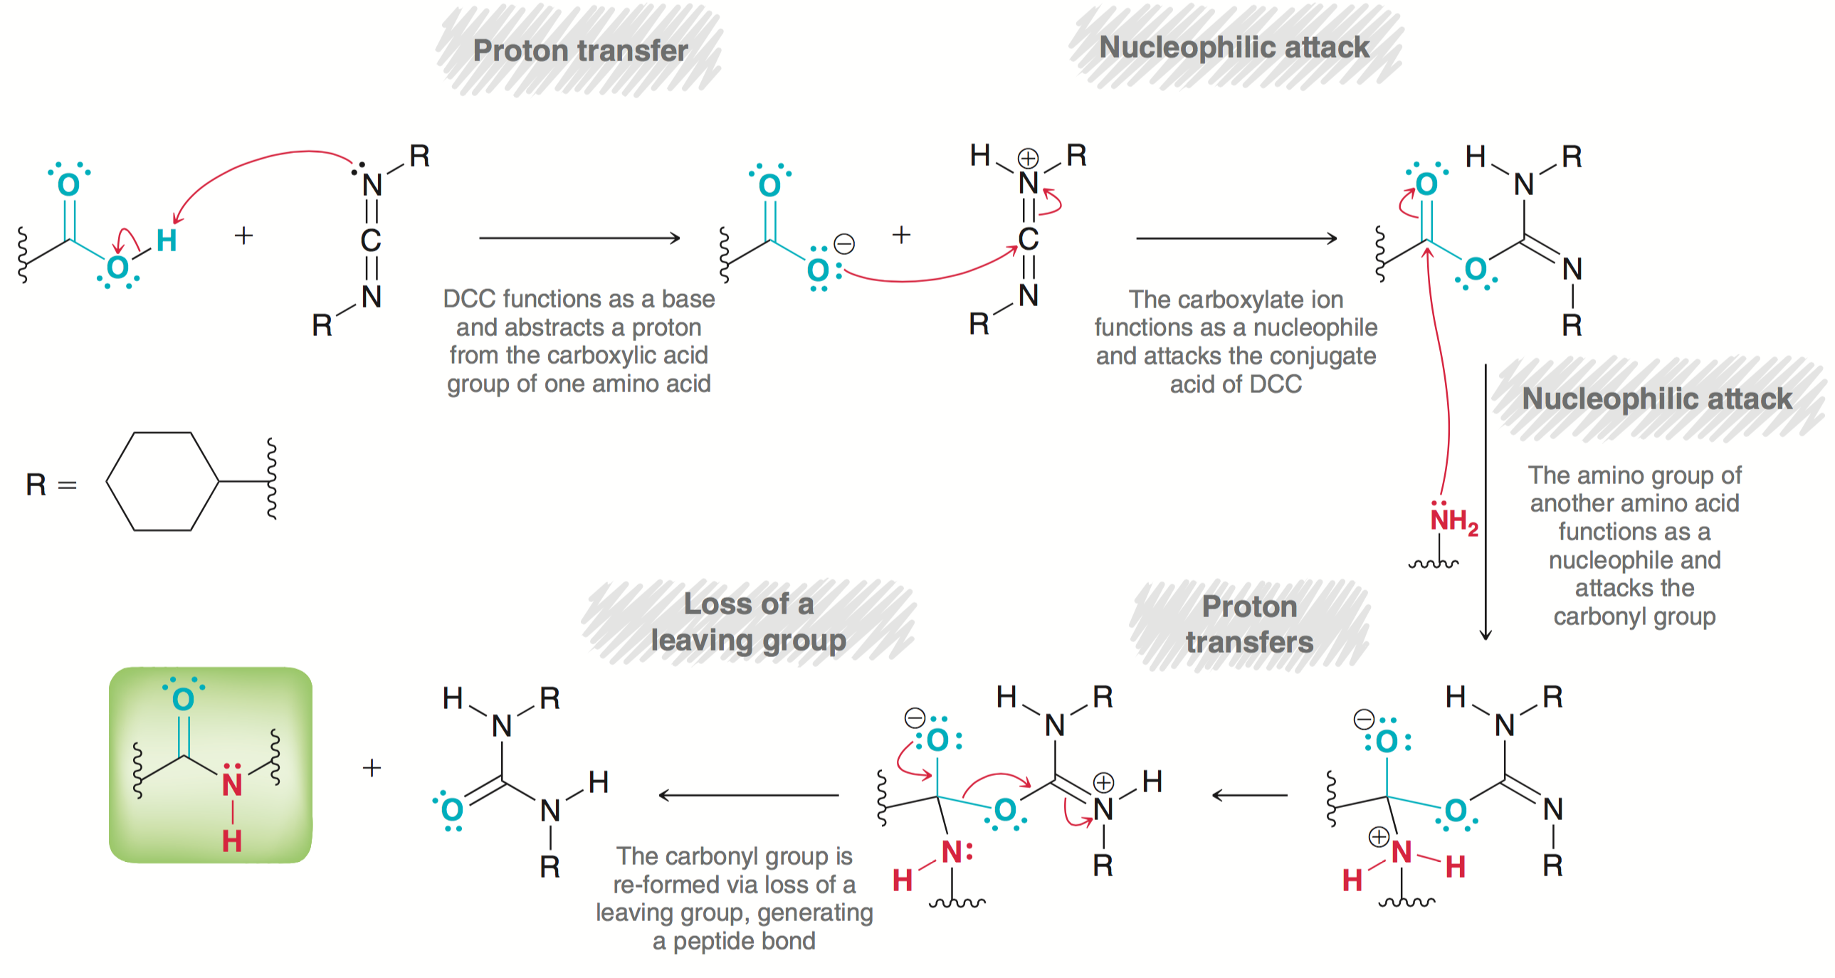
25.6 Peptide Synthesis
DCC coupling mechanism

Slide 46
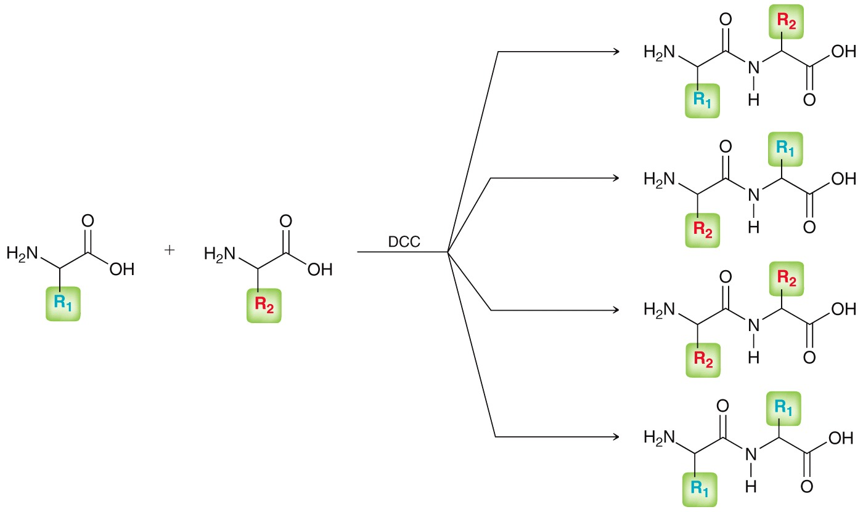
25.6 Peptide Synthesis
The coupling of two amino acids potentially yields 4 different dipeptides
To make a desired dipeptide,
protecting groups are needed

Slide 47
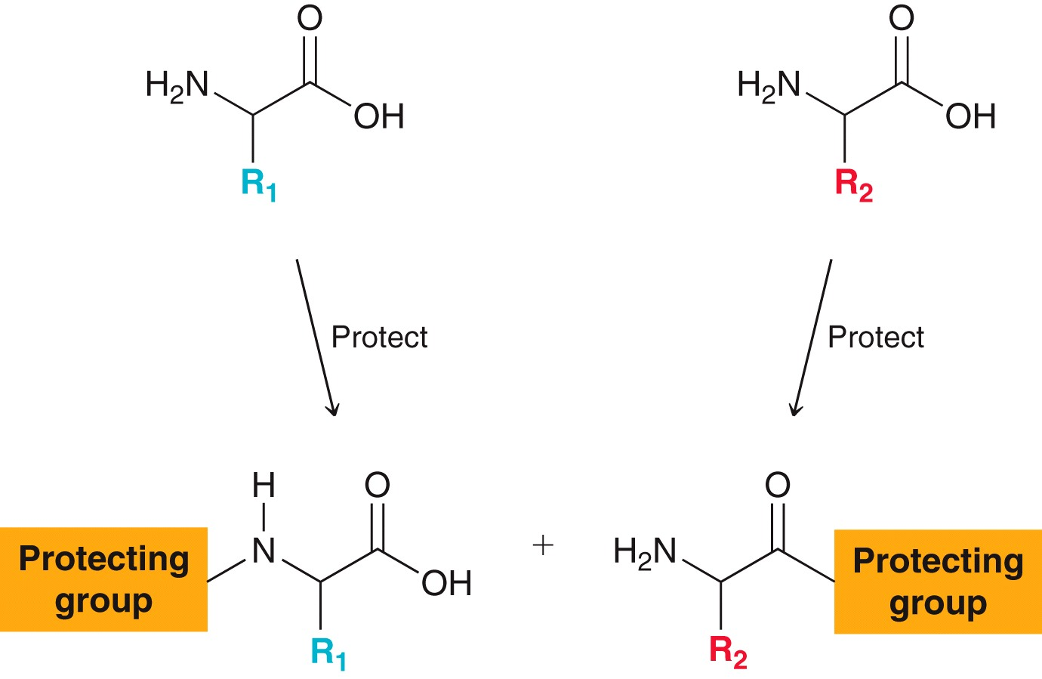
25.6 Peptide Synthesis
The N-terminus of one amino acid, and the C-terminus of the other must be protected

Slide 48
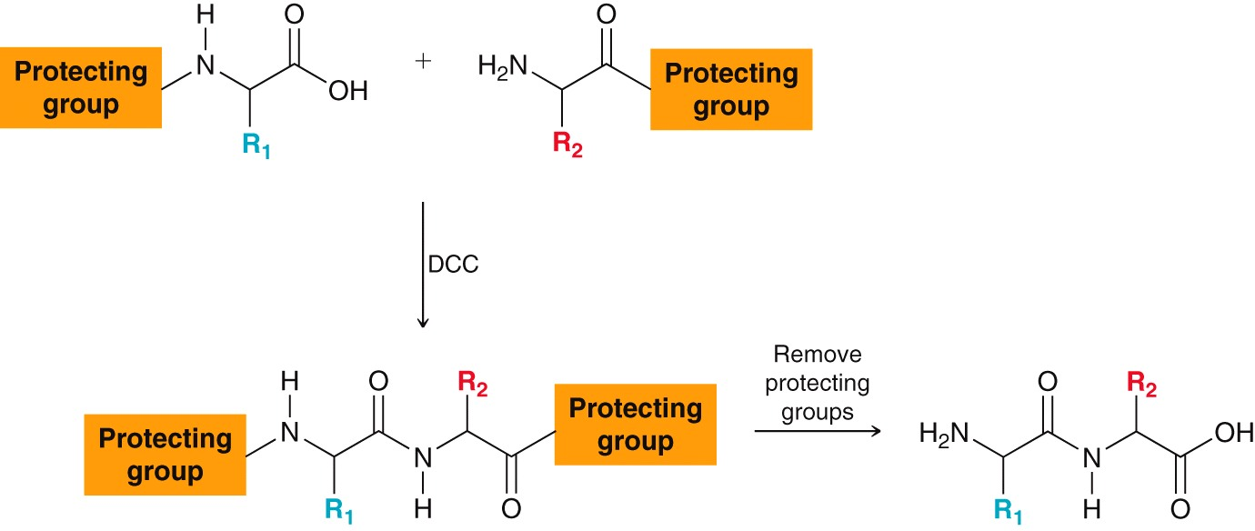
25.6 Peptide Synthesis
The protected amino acids are coupled, followed by deprotection to yield the desired dipeptide
Deprotection yields the desired dipeptide

Slide 49
25.6 Peptide Synthesis
An amino group can be protected as a carbamate

Slide 50
25.6 Peptide Synthesis
Protecting the Amino Group of an Amino Acid:
An amino group can be protected as a carbamate
Tertbutoxycarbonyl (Boc) is a popular carbamate protecting group

Slide 51
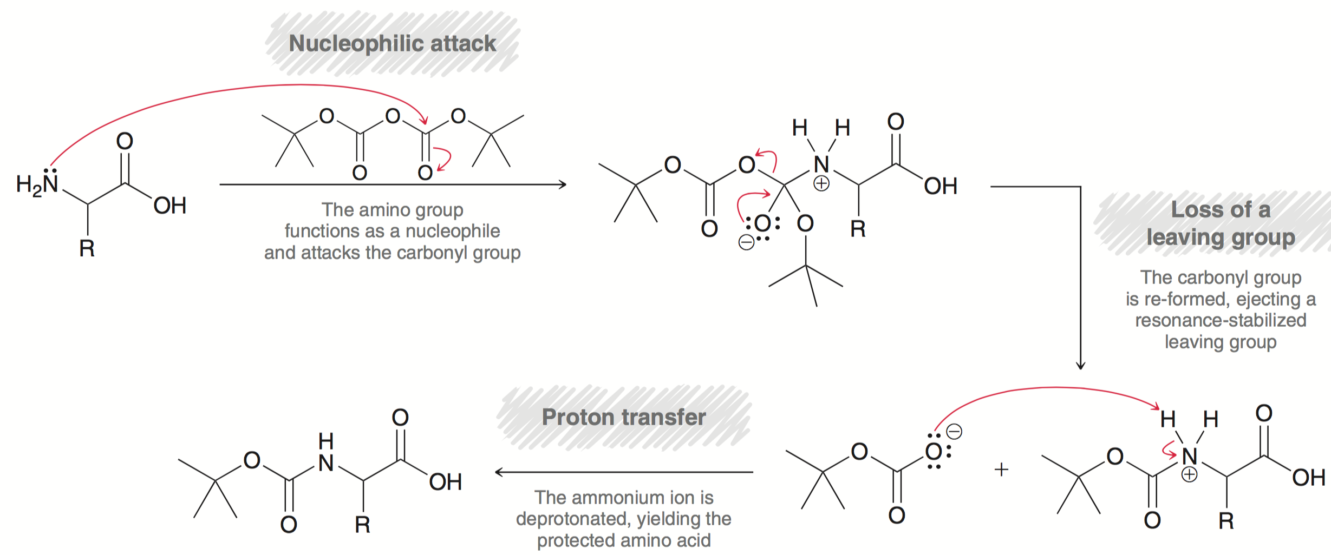
25.6 Peptide Synthesis
Installation of Boc protecting group mechanism:

Slide 52
25.6 Peptide Synthesis
Protecting the Amino Group of an Amino Acid:
Boc group is removed easily under acidic conditions, using an acid like trifluoroacetic acid:

Slide 53
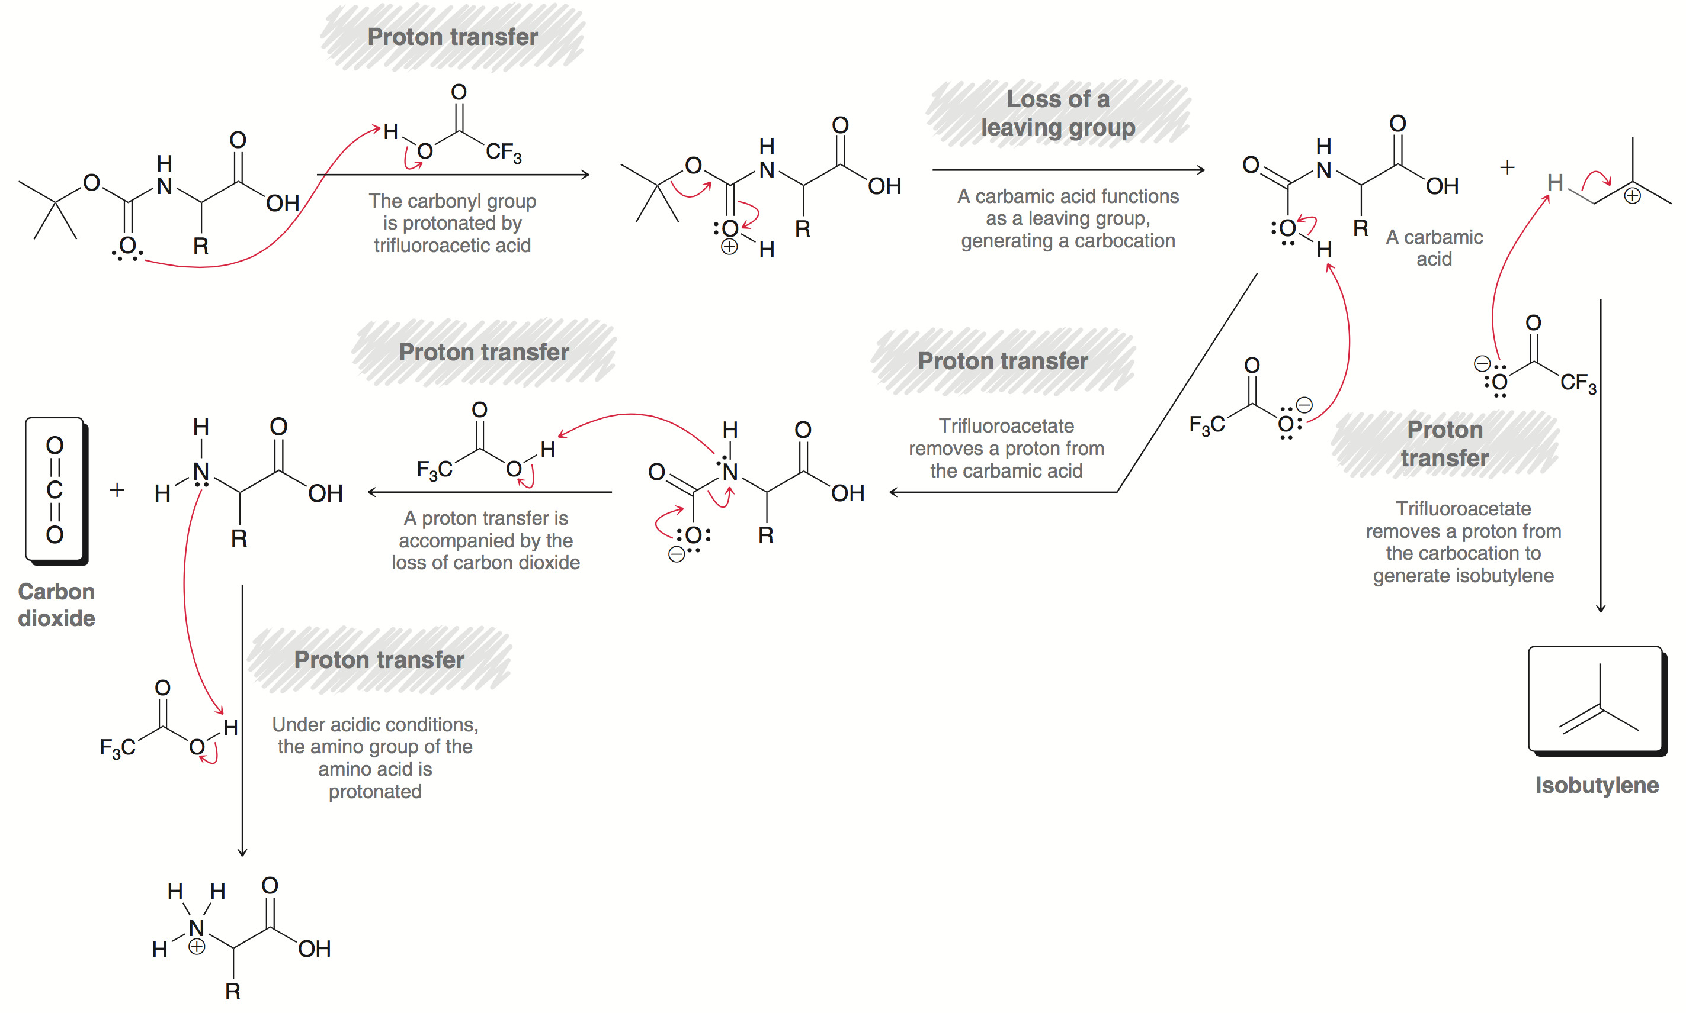
25.6 Peptide Synthesis
Removal of a Boc group mechanism:
Deprotection of boc protecting
group mechanism

Slide 54
25.6 Peptide Synthesis
Protecting the Amino Group of an Amino Acid
Can also protect an amine with an Fmoc group:
The mechanism for Fmoc installation is similar to that for the Boc protecting group

Slide 55
25.6 Peptide Synthesis
Protecting the Amino Group of an Amino Acid:
The Fmoc group is removed under basic conditions, using a base like piperidine:
Like with boc deprotection, the evolution of CO₂ gas drives the deprotection to completion

Slide 56
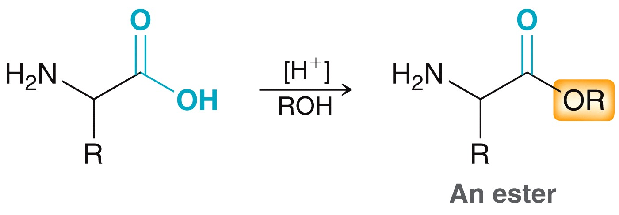
25.6 Peptide Synthesis
Protecting the Carboxyl Group of an Amino Acid
The carboxylic acid group of the amino acid is often protected with an ester
Methyl and benzyl esters are the most popular
Hydrolysis is generally used to cleave (deprotect) the ester.

Slide 57
25.6 Peptide Synthesis
Protecting the Carboxyl Group of an Amino Acid
Benzyl esters are popular because they can be deprotected without using acidic or basic conditions
Hydrogenation can remove a benzyl group:

Slide 58
25.6 Peptide Synthesis
Preparing a Dipeptide
Peptide linkage is accomplished by (1) protect amino acids (2) couple, then (3) deprotect:
Practice with SkillBuilder 25.5

Slide 59
25.6 Peptide Synthesis
The method of protection, DCC coupling, and deprotection is not practical for forming larger peptides.
For every amino acid added to the peptide, 3 reactions and 3 purifications would be necessary
The Merrifield synthesis is a superior method reducing the number of synthetic steps significantly
The peptide is tethered to a insoluble polymer
This is called solid-phase peptide synthesis (SPPS)

Slide 60
25.6 Solid-Phase Peptide Synthesis
The C-terminus of a N-protected amino acid is attached to the surface of a polymer
It attaches via SN2 reaction:

Slide 61
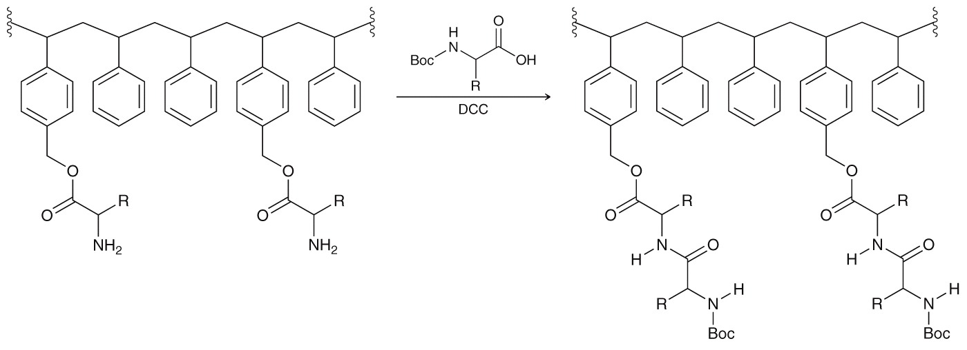
25.6 Solid-Phase Peptide Synthesis
The N-terminus is deprotected, and the next Boc-protected amino acid is coupled to the chain
Once the peptide is finished, it is cleaved from the resin using hydrofluoric acid (HF)

Slide 62
25.6 Solid-Phase Peptide Synthesis
The real advantage to SPPS is the ease of purification.
The polymer beads are dropped in solution, when reaction is done, they are collected by filtration, and plopped into the next reaction…. and so on.
The process is now completely automated;
premade solutions of amino acids and DCC can be pumped in, and out, of the reaction vessel, leaving the polymer beads in the reaction vessel throughout
For this work, Merrifield won the Nobel Prize in 1984
Practice with SkillBuilder 25.6

Slide 63
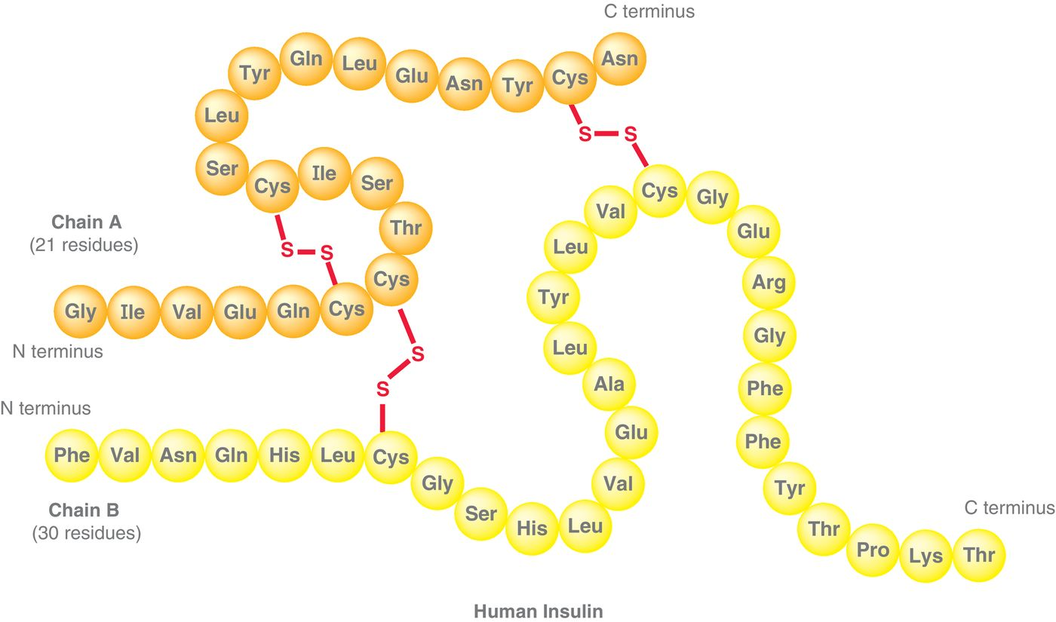
25.7 Protein Structure
Four levels of protein structure (primary, secondary, tertiary, and quaternary) are needed to describe the 3-D shape of a protein:

Slide 64
25.7 Protein Structure
Primary structure of a Protein
The primary structure is the amino acid sequence

Slide 65
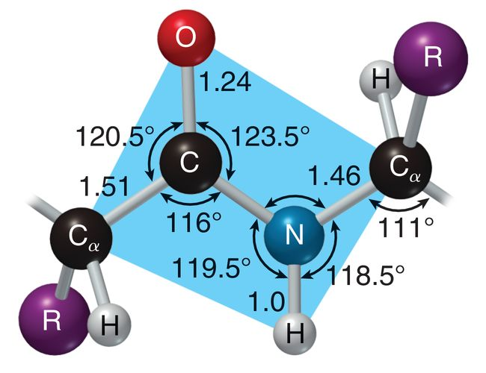
25.7 Protein Structure
Secondary Structure
2° structure refers to 3D shape of localized regions of a protein
Largely dictated by H-bonding interactions along the peptide backbone

Slide 66
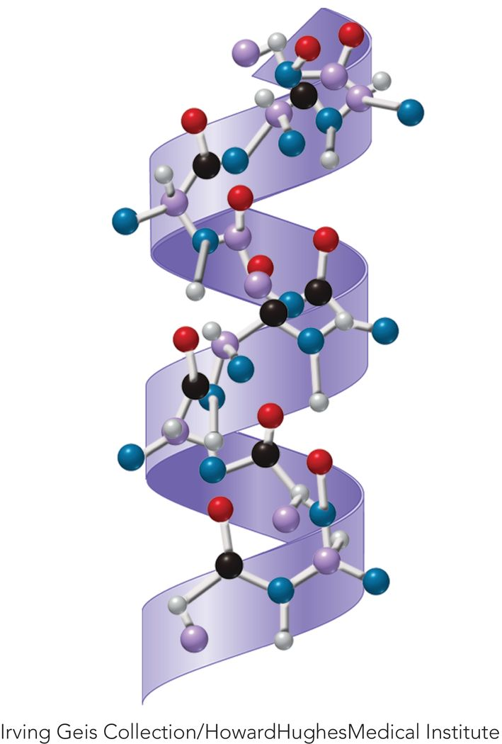
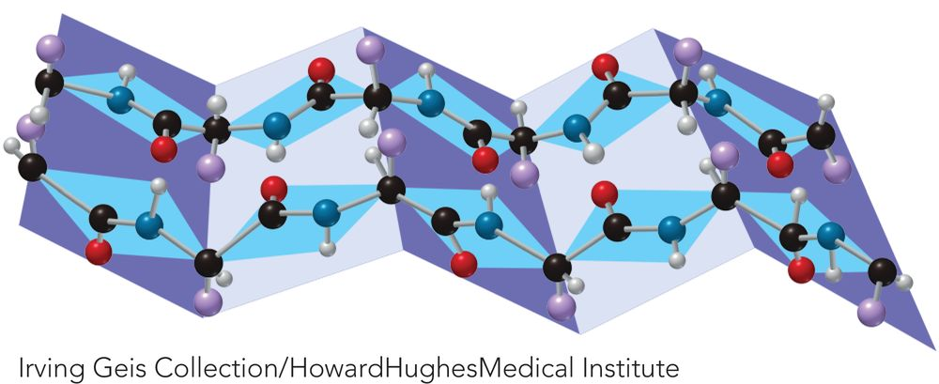
25.7 Protein Structure
Secondary Structure
Two common arrangements: α helix and β pleated sheet

Slide 67
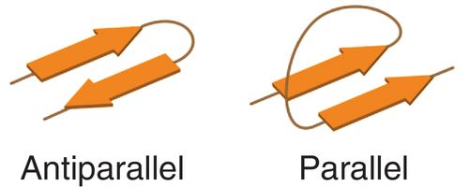
25.7 Protein Structure
Secondary Structure
shorthand representations for an α helix and β pleated sheet are often used
Antiparallel
Parallel
α helix
β sheet

Slide 68
25.7 Protein Structure
Secondary Structure
The shorthand representation for human insulin is below
Practice with Conceptual Checkpoint 25.39

Slide 69
25.7 Protein Structure
Tertiary Structure
The 3° structure of a protein refers to its 3-D shape of the entire peptide chain
Shape will change depending on the solvent/environment
Polar environment – protein adopts conformation putting polar groups around the exterior
Nonpolar environment – polar groups will be in the interior
Denaturation – intramolecular forces holding the protein together are disrupted (temperature, pH, etc.)

Slide 70
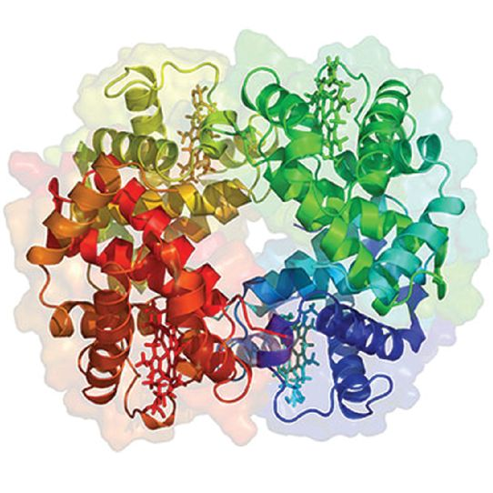
25.7 Protein Structure
Quaternary Structure
4° structure results when multiple peptide chains aggregate to form a protein
Hemoglobin is made of 4 peptide chains

Slide 71
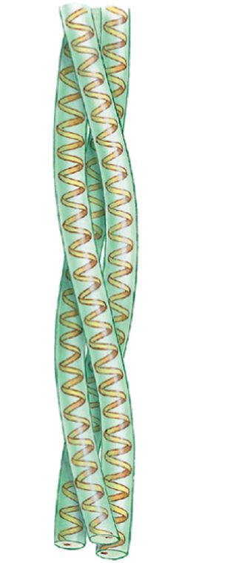
25.8 Protein Function
Structural Proteins
Also called fibrous proteins, found in hair, skin, fingernails…
They provide structural rigidity by bundling together, several polypeptide chains of α-keratin bundle coil together in hair (above)
α-keratins coil into α helices and then into larger and larger coils
HOW might disulfide bonds affect function?

Slide 72
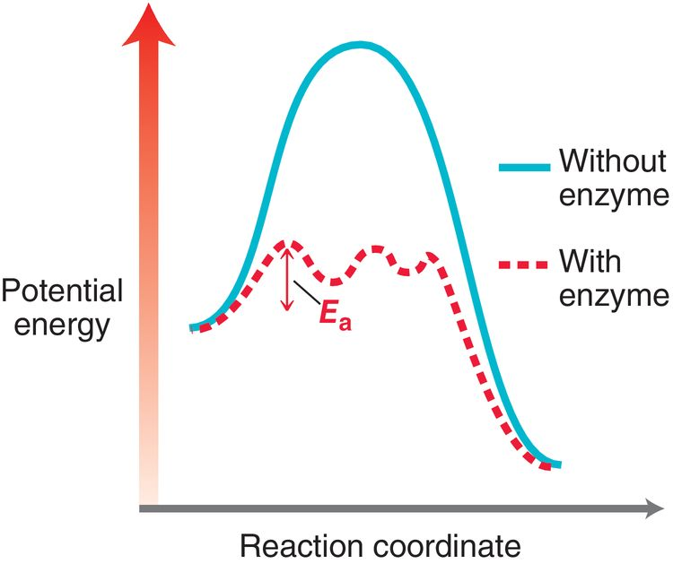
25.8 Protein Function
Enzymes
Enzymes are globular proteins
Enzymes catalyze biological reactions by stabilizing transition states and/or reactive conformations
Lower energy transition state = faster rate

Slide 73
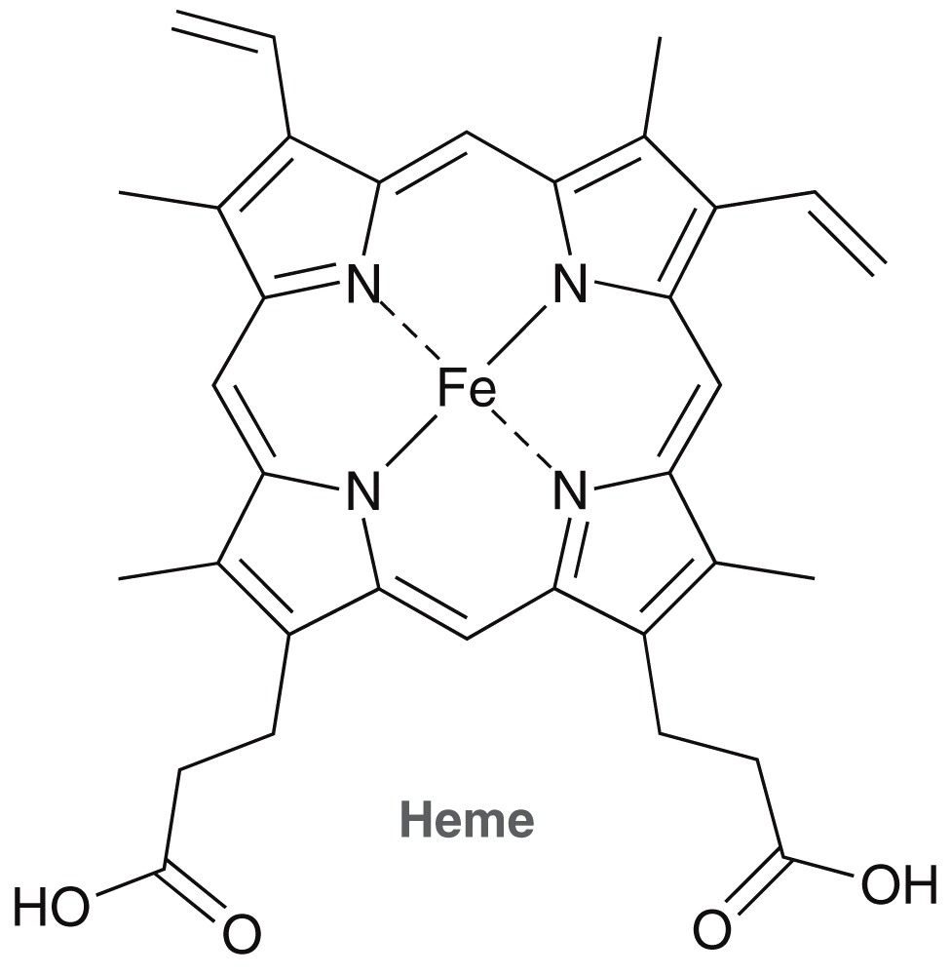
25.8 Protein Function
Transport Proteins
Transport proteins are used to transport molecules from one location to another
Hemoglobin is the classic example of a transport protein
It contains prosthetic groups (heme) that bind the O₂ molecules for transport

