Slide 1
Assembly Drawings

Slide 2
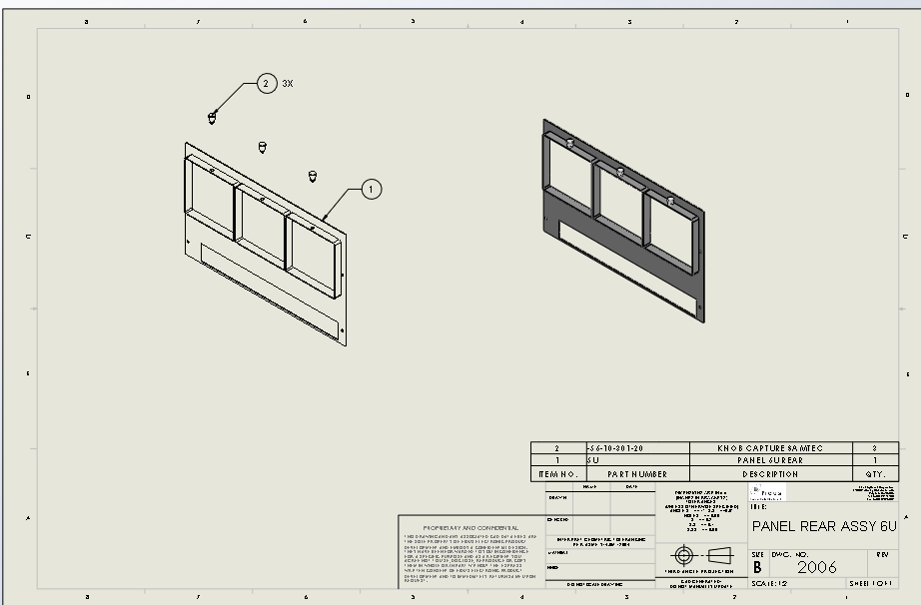
Components in Assembly Drawings
Exploded View
Collapsed View
Item Balloons
Parts List

Slide 3
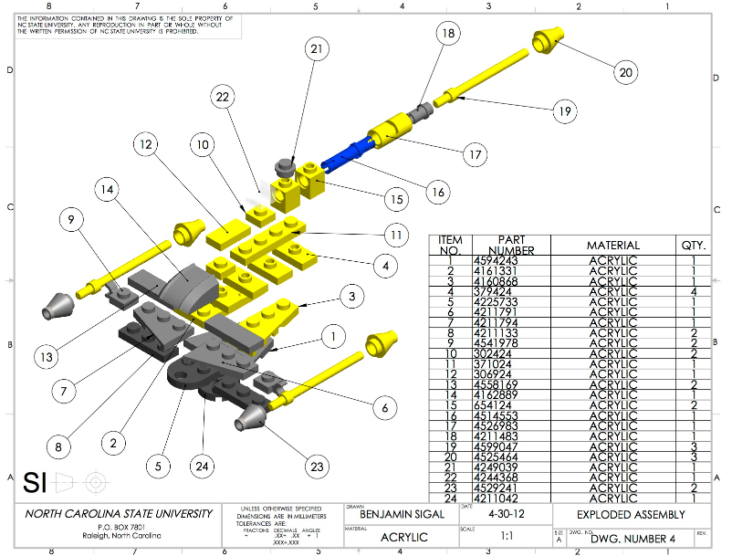
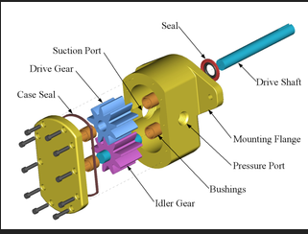
Exploded View
A good exploded view…
Shows all components clearly
Labels each component with an item balloon

Slide 4
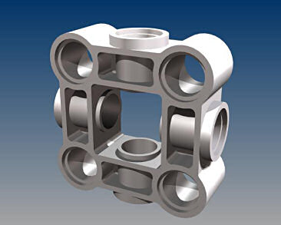
A good Collapsed View shows
How the assembly looks when all parts are assembled

Slide 5
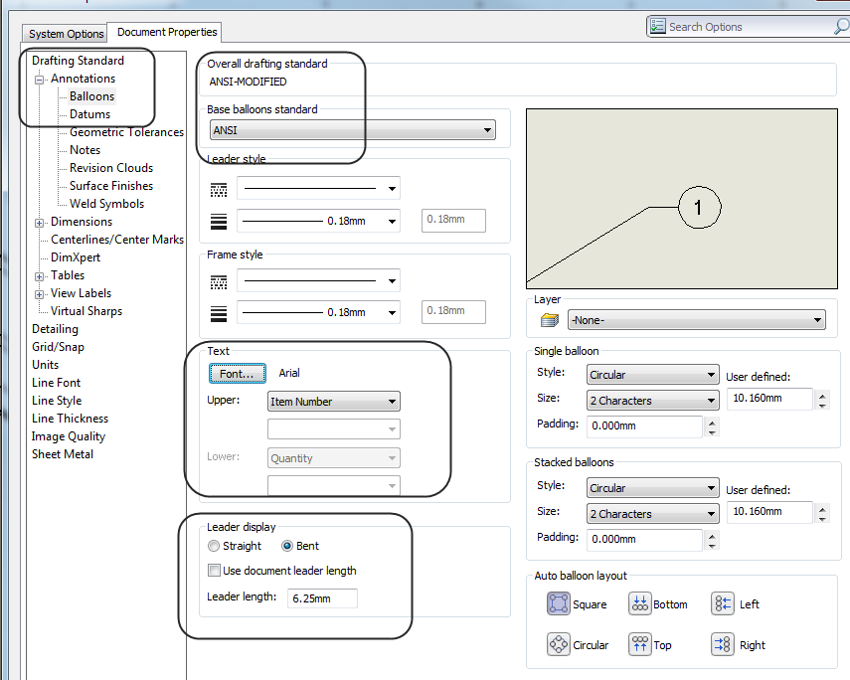
Item Balloons
Use ANSI Standard
Font should be ARIAL 12 pt
Use BENT Leader

Slide 6
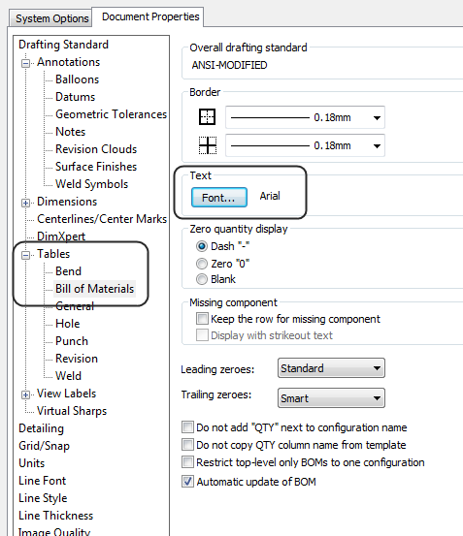
Parts List AKA BOM AKA Bill of Materials
Verify that Document Properties are set to ANSI

Slide 7
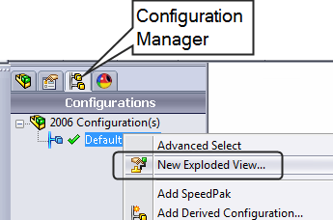
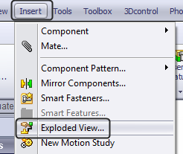
To create an Exploded View
Must be an Assembly File
Must use the Configuration Manager
Create an Exploded View
Right click on configuration
On the Assembly Ribbon
On the Insert Menu

Slide 8
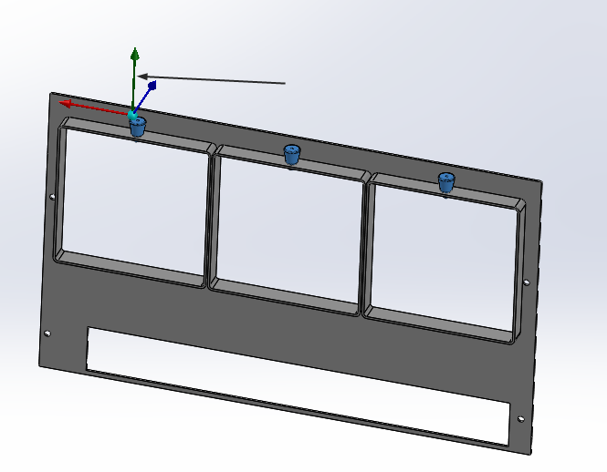
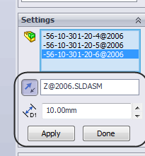
To position components
Use the Gizmo
Use the Dialog

Slide 9
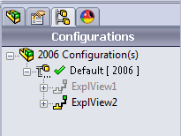
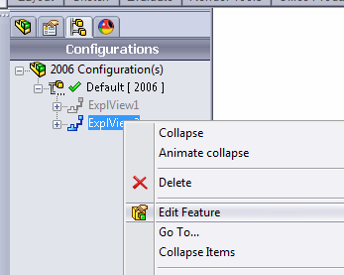
Exploded Views
You can have more than one exploded view
To edit or change an exploded view, select it in the Configuration Manager, right click and select Edit Feature
To delete, right click and select Delete

Slide 10
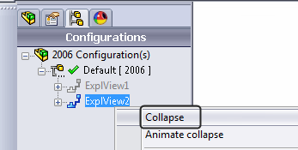
To collapse an Exploded View
Highlight the Exploded View, right click and select Collapse

Slide 11
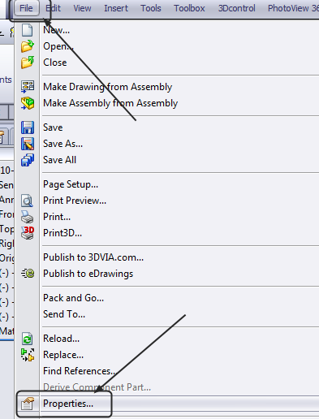
To Create an Assembly Drawing
You must first define the exploded view in your ASSEMBLY file
You should have filled in the DESCRIPTION for all parts used in the assembly
To change or add the DESCRIPTION, open the PART file and go to File->Properties

Slide 12
File Properties
Go to the Custom Tab
Set the Property Name to Description
Type the Value in ALL CAPITAL LETTERS

Slide 13
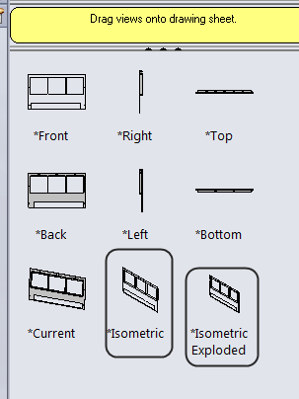
Open a Blank Drawing
You should have two isometric views- one exploded and one collapsed
Place a collapsed view and an exploded view on the sheet

Slide 14
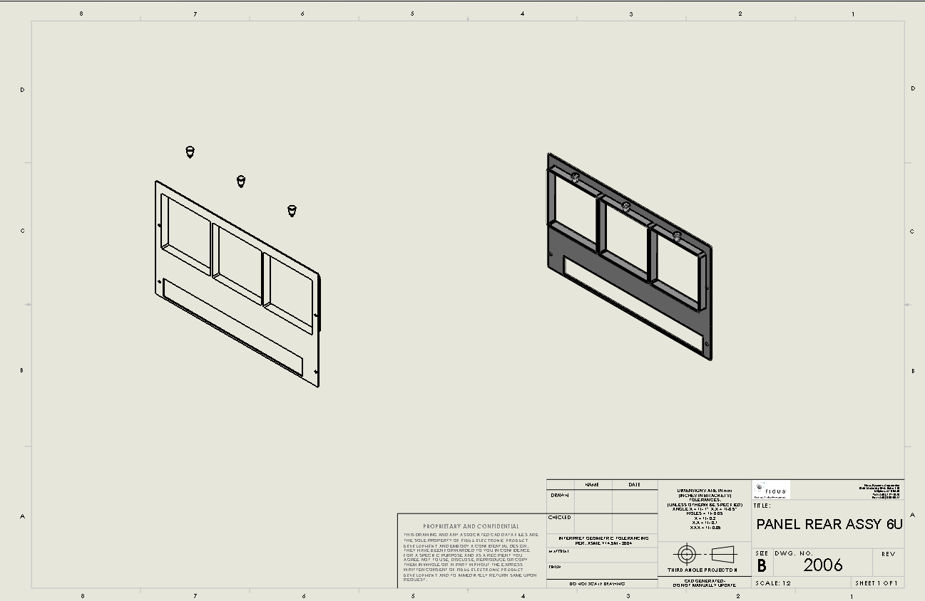
Scale the views and position on the sheet
Both views should clearly show all components
Do not overlap any components in the exploded view

Slide 15
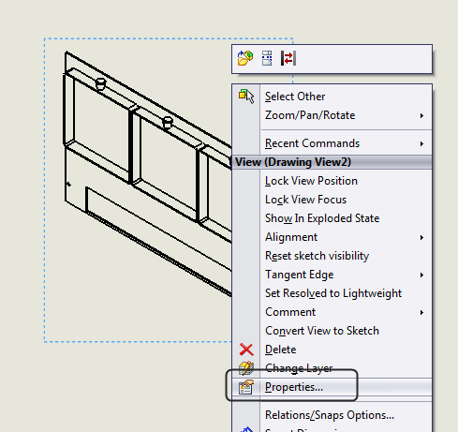
To change a Collapsed View to Exploded
Highlight the view, right click and select Properties
Under Configuration Information, ENABLE Show in exploded state

Slide 16
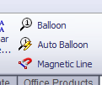
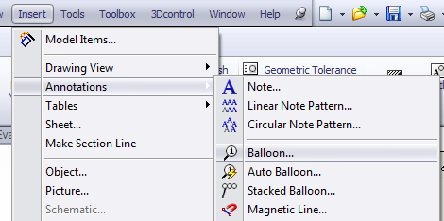
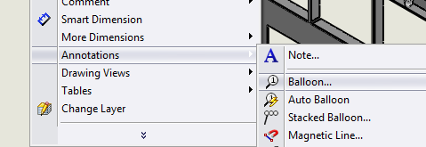
Add Item Balloons
Add Balloon from the Annotation Ribbon
From the Insert menu
From the right click menu (Right click anywhere on the sheet)

Slide 17
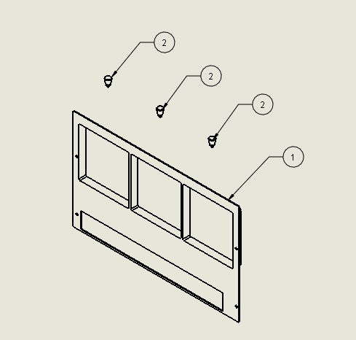
Placing Balloons
Place balloons close the part
Place them so they are easy to read

Slide 18
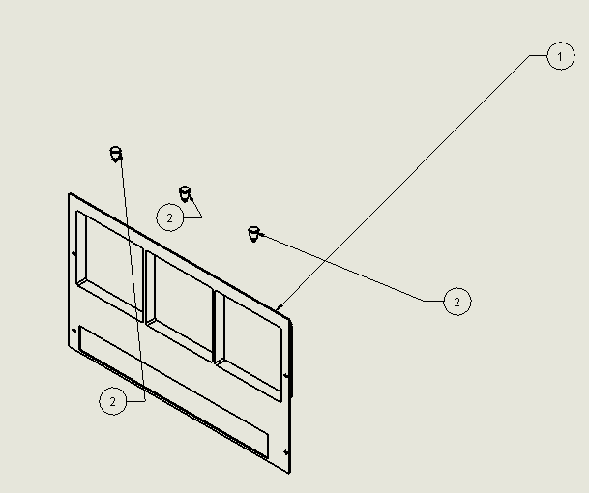
Don’t Do this!
Don’t place balloons far away from the part
Cross balloons over the part or another balloon leader

Slide 19
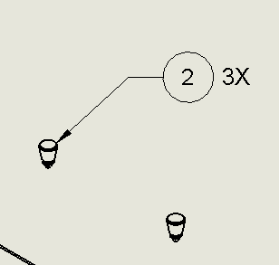
If you have more than one part
Instead of labeling each part, add a Note to indicate the Qty

Slide 20
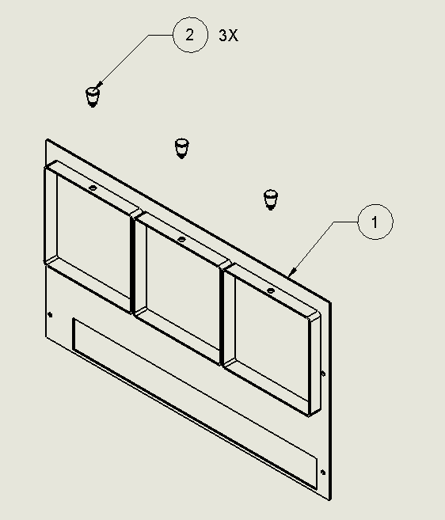
Which view is easier to read?

Slide 21
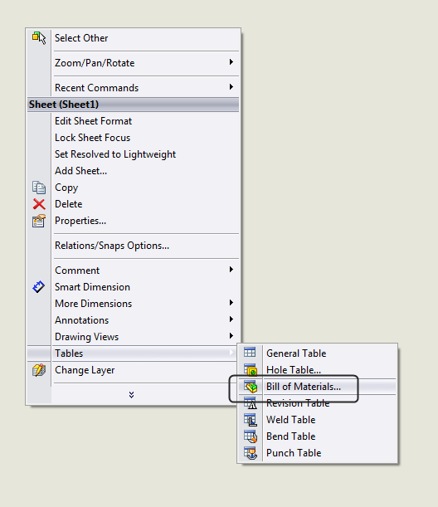
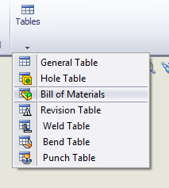
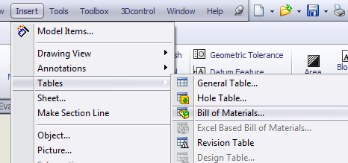
Parts List
From the Annotation Ribbon->Tables->Bill of Materials
From the Insert menu,Tables->Bills of Materials
Right click anywhere on the sheet and go to menu, Tables->Bills of Materials

Slide 22
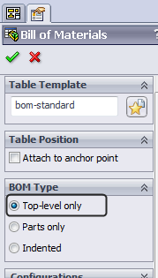
Select the Exploded View
Enable Top-level only
Green Check FIRST and THEN place the table

Slide 23
BOM Format
Use the Table Header tool to set the headers to the BOTTOM of the BOM
BOM should be placed on top of the title block
BOM should have ITEM NO, PART NUMBER, DESCRIPTION, AND QTY
USE ALL CAPITAL LETTERS
NO BLANK COLUMNS

Slide 24
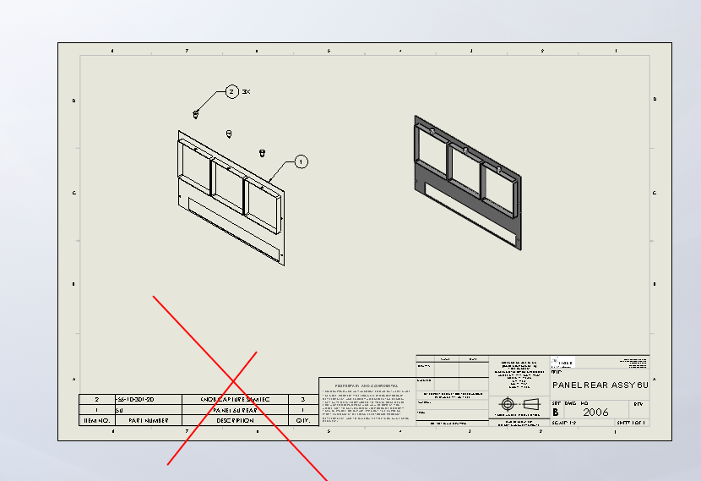
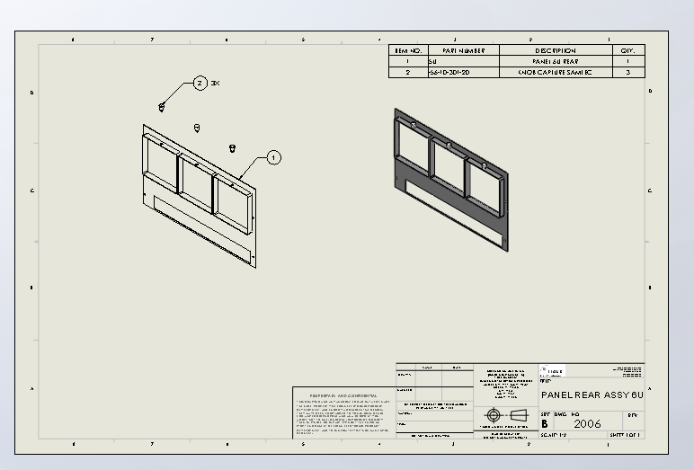
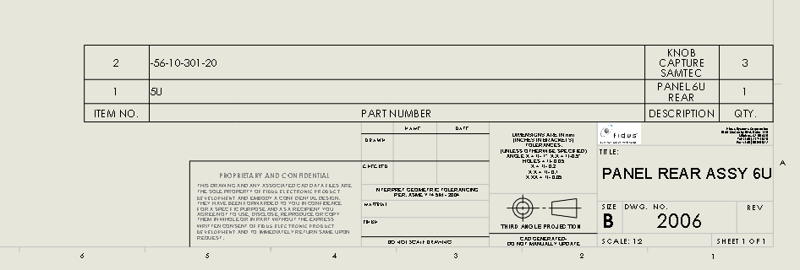
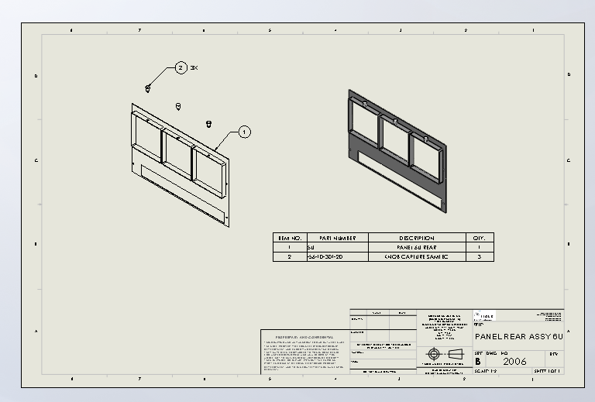
BAD BOMS

Slide 25
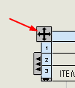
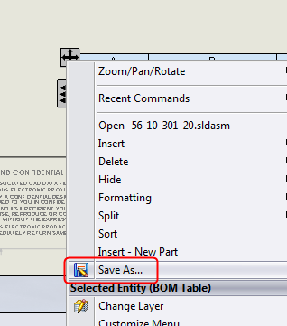
Save Your BOM Format
You can save the format of your BOM so you don’t have to reformat it each time
Right click on the Move icon and select Save As
Save the BOM format to your Templates folder

Slide 26
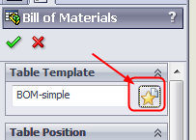
To use a BOM Template
Select the Star icon next to the Table Template Name and browse for your saved BOM Template

Slide 27
A Good Assembly Drawing Example
Use a Checklist
Exploded View
Collapsed View
Item Balloons
BOM
Easy to Read
BOM in correct location
BOM Header on the Bottom

