Slide 1
Features

Slide 2
Parent Features
Extrude
Revolve
Sweep
Loft

Slide 3
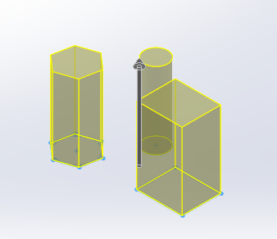
Extrude Rules
One or more closed profiles
Height added normal/perpendicular to the sketch
No gaps or intersecting lines in the sketch

Slide 4
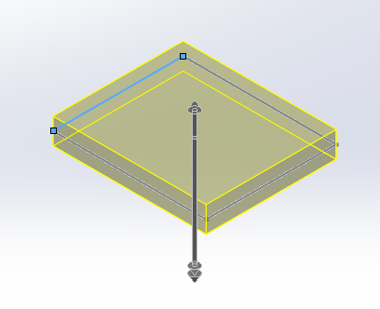
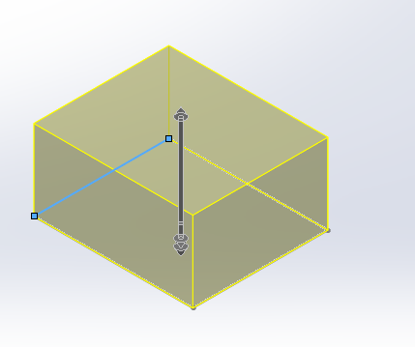
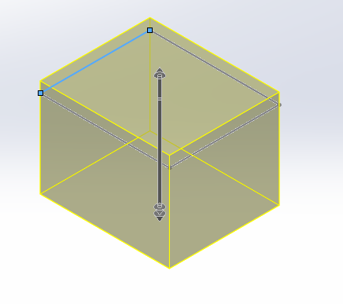
Extrude - Height
Can be added in one direction
In two directions
Mid-plane

Slide 5
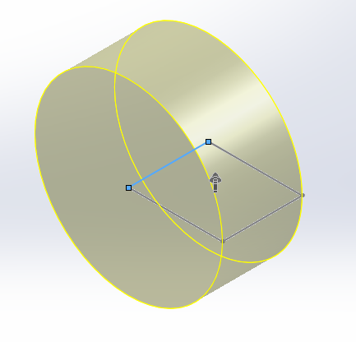
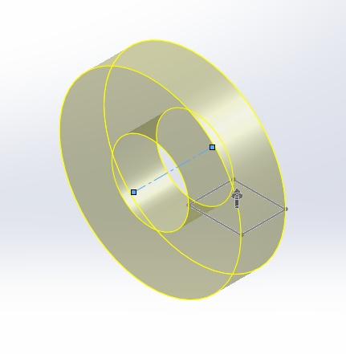
Revolve Rules
One closed profile
Use an edge or centerline as an axis of rotation
You MUST select an axis!

Slide 6
Sweep Rules
Two sketches
One sketch is the profile – Label it for easy ID
One sketch is the path – Label it for easy ID
The path can be open or closed
The profile should be closed
You should exit Sketch mode to create the Sweep
One point on the profile sketch MUST be coincident to the path sketch
The profile can not be bigger than the radius of the path or it will be self-intersecting

Slide 7
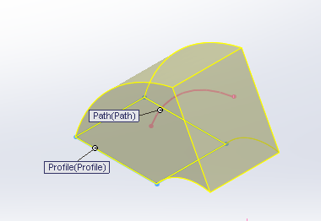
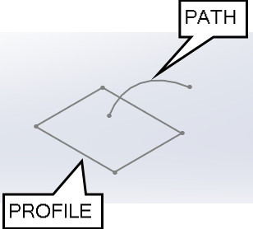
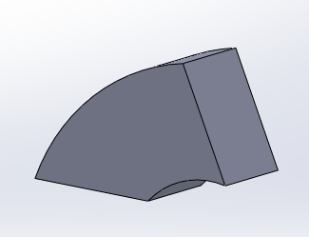
Sweep

Slide 8
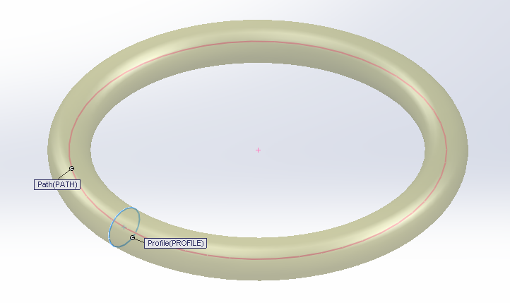
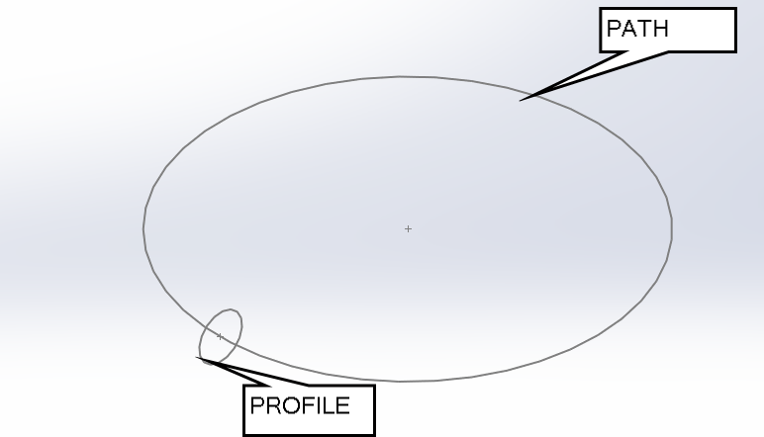
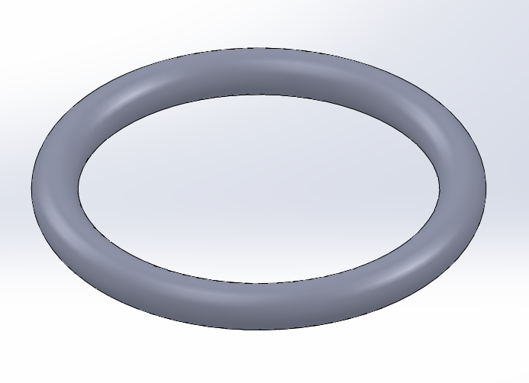
Sweep

Slide 9
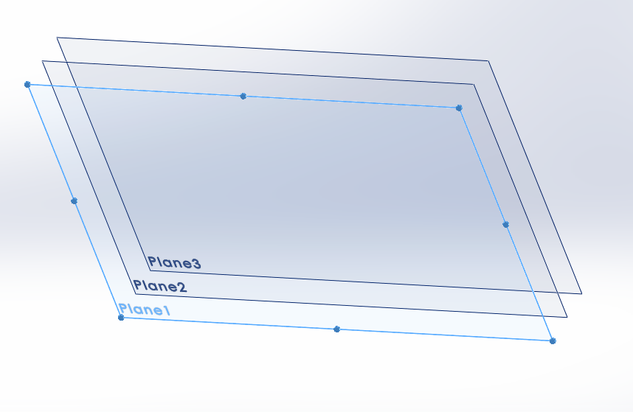
Loft Rules
Two or more closed profiles on offset planes
The planes can be parallel or at an angle
You must exit Sketch mode to create a Loft
You can use Guide Curves to control the loft contour BUT each guide curve must be a single sketch – one curve per sketch!
You must create at least one plane in addition to the starting plane!

Slide 10
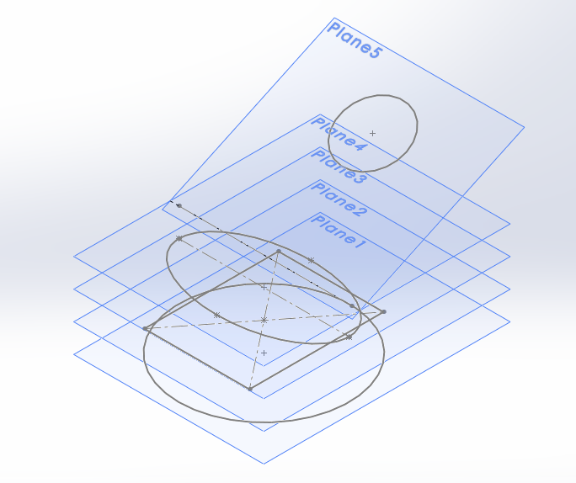
Loft Rules
Each Plane must have a single sketch
More than one plane
Planes offset or angled from each other
Each sketch on a different plane
Each sketch should be closed with no gaps or intersecting lines

Slide 11
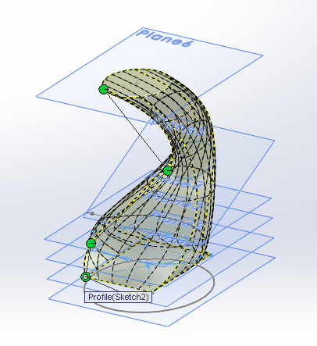
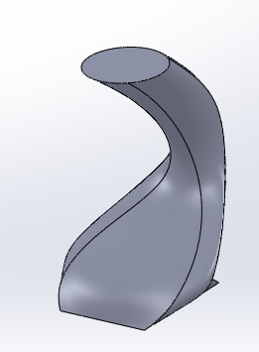
Loft Rules
The order you select the sketch matters!

Slide 12
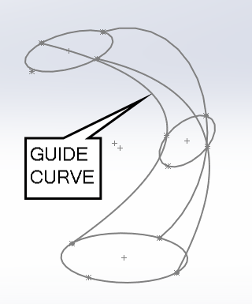
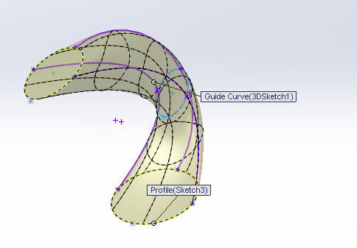
Guide Curves
EACH GUIDE CURVE MUST INTERSECT EACH PROFILE USED IN THE LOFT

Slide 13
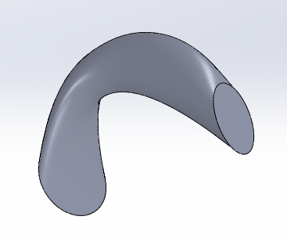
Guide Curves provide more control

