Slide 1
Rules for making parts

Slide 2
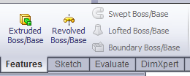
PARTS ARE MADE OF FEATURES
The first feature you place is a Boss/Base Feature

Slide 3
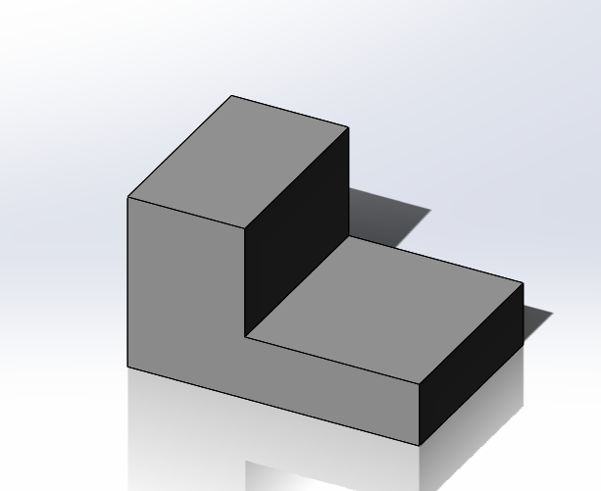
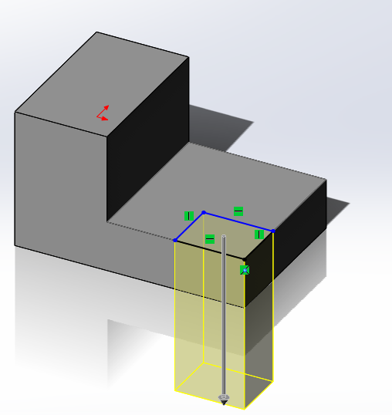
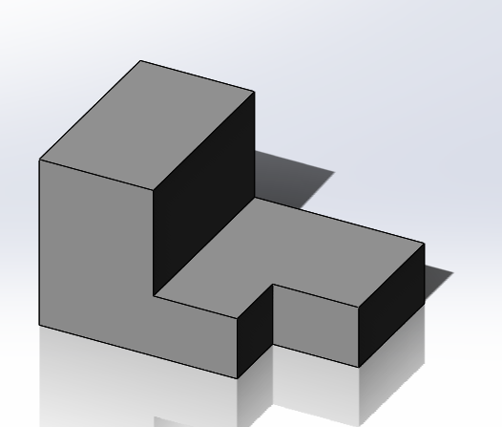
When creating a Part…
Break the part up into features

Slide 4
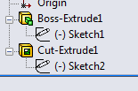
Each Feature has a Sketch

Slide 5
Plan Your Part
Figure out the features
Create a napkin sketch of each profile
Figure out how you can leverage existing planes to create your sketches and features

