Slide 1
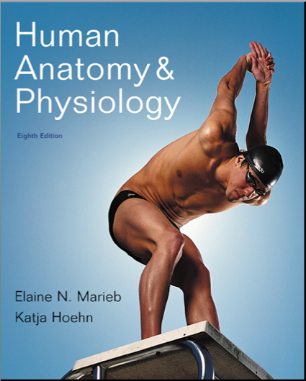
Chapter 23
16
The Digestive System

Slide 2
Digestive System
Two groups of organs
1. Alimentary canal (gastrointestinal or GI tract)
Digests and absorbs food
Mouth, pharynx, esophagus, stomach, small intestine, large intestine, rectum & anal canal
2. Accessory digestive organs
Teeth, tongue & salivary glands
Liver, gallbladder & pancreas

Slide 3
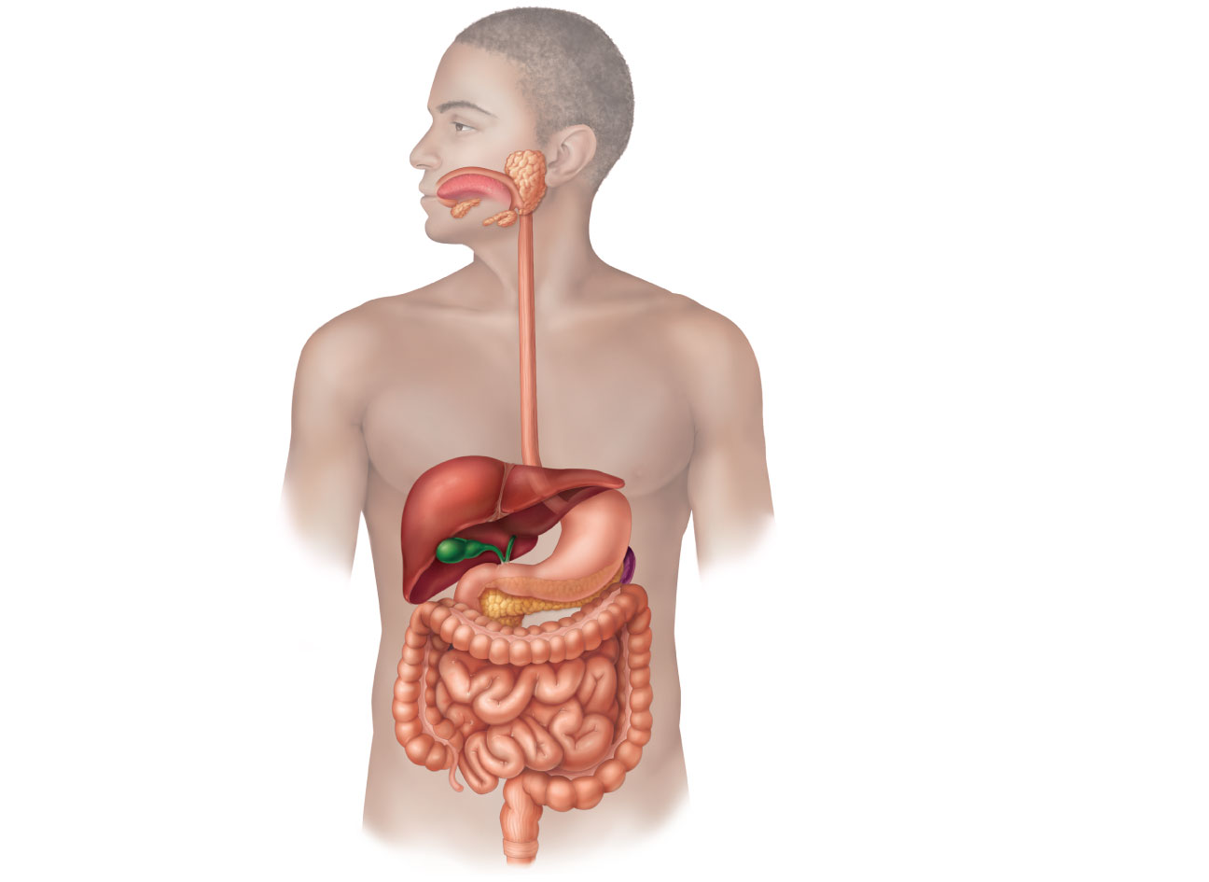
Parotid gland
Mouth (oral cavity)
Sublingual gland
Tongue
Salivary
glands
Submandibular
gland
Esophagus
Pharynx
Stomach
Pancreas
Liver
(Spleen)
Gallbladder
Transverse colon
Duodenum
Descending colon
Small
intestine
Jejunum
Ascending colon
Ileum
Cecum
Large
intestine
Sigmoid colon
Rectum
Vermiform appendix
Anus
Anal canal
Figure 23.1

Slide 4
Digestive Processes
Six essential activities
Ingestion
Propulsion
Mechanical digestion
Chemical digestion
Absorption
Defecation

Slide 5
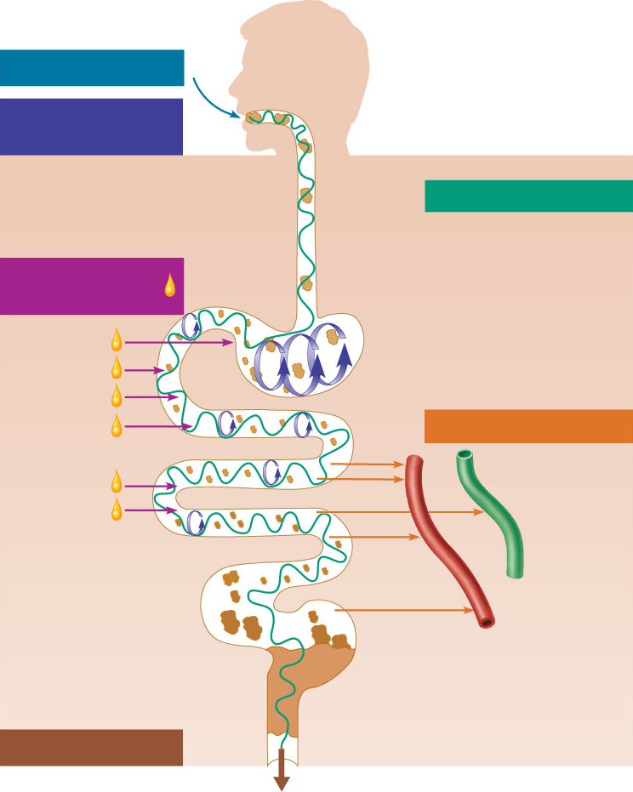
Ingestion
Food
Mechanical
digestion
Pharynx
• Chewing (mouth)
Esophagus
• Churning (stomach)
Propulsion
• Segmentation
(small intestine)
• Swallowing
(oropharynx)
Chemical
digestion
• Peristalsis
(esophagus,
stomach,
small intestine,
large intestine)
Stomach
Absorption
Lymph
vessel
Small
intestine
Large
intestine
Blood
vessel
Mainly H₂O
Feces
Defecation
Anus
Figure 23.2

Slide 6
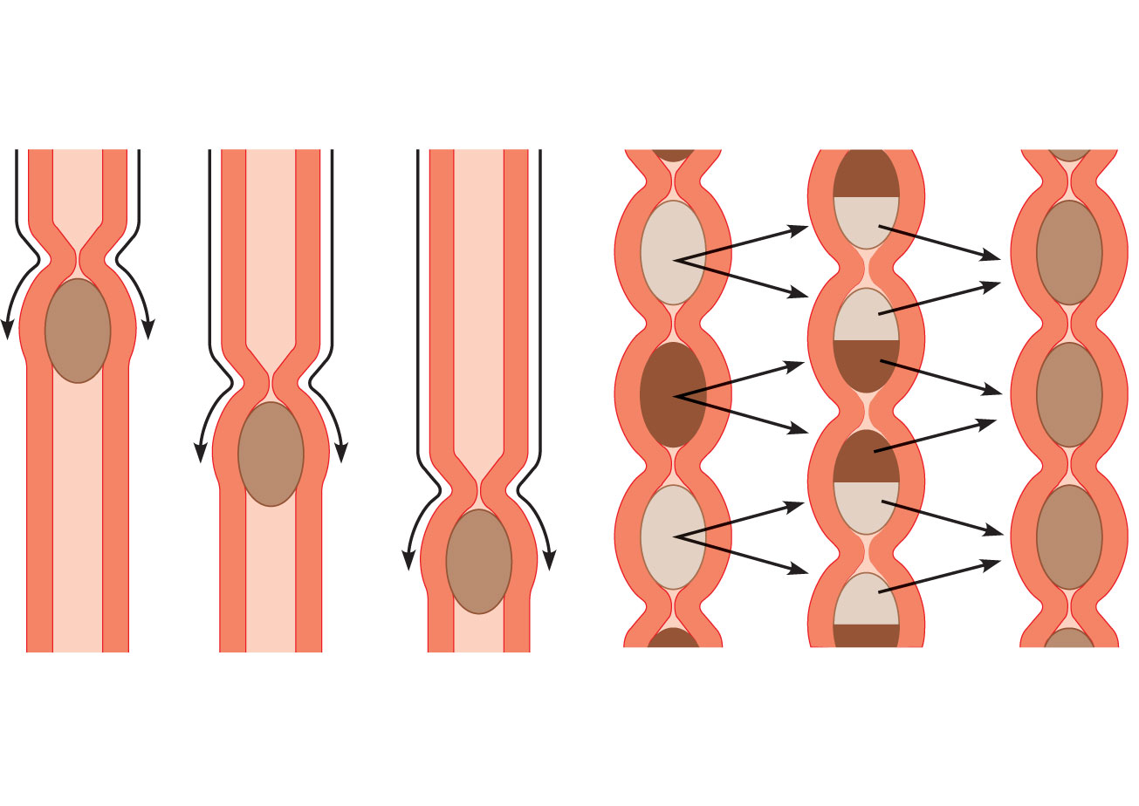
From
mouth
(a) Peristalsis: Adjacent segments of
alimentary tract organs alternately contract
and relax, which moves food along the tract
distally.
(b) Segmentation: Nonadjacent segments
of alimentary tract organs alternately
contract and relax, moving the food
forward then backward. Food mixing and
slow food propulsion occurs.
Figure 23.3

Slide 7
GI tract regulatory mechanisms
Mechanoreceptors and chemoreceptors
Respond to stretch, changes in osmolarity and pH, and presence of substrate and end products of digestion
Initiate reflexes that
Activate or inhibit digestive glands
Stimulate smooth muscle to mix and move lumen contents

Slide 8
GI tract regulatory mechanisms
Intrinsic and extrinsic controls
Enteric nerve plexuses (gut brain) initiate short reflexes in response to stimuli in the GI tract
Long reflexes in response to stimuli inside or outside the GI tract involve CNS centers and autonomic nerves
Hormones from cells in the stomach and small intestine stimulate target cells in the same or different organs

Slide 9
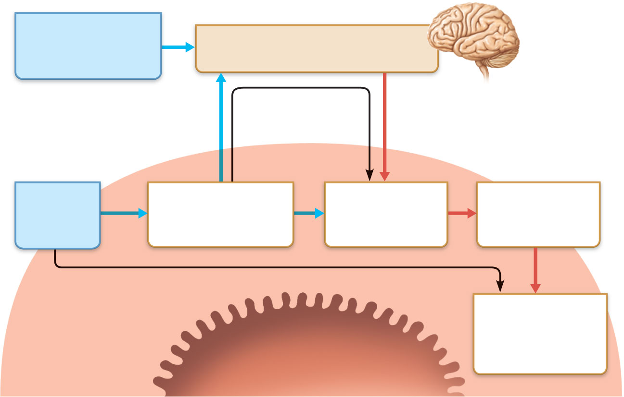
External stimuli
(sight, smell, taste,
thought of food)
Central nervous system
and extrinsic autonomic nerves
Long reflexes
Afferent impulses
Efferent impulses
Internal
(GI tract)
stimuli
Chemoreceptors,
osmoreceptors, or
mechanoreceptors
Local (intrinsic)
nerve plexus
(“gut brain”)
Effectors:
Smooth muscle
or glands
Short reflexes
Gastrointestinal
wall (site of short
reflexes)
Response:
Change in
contractile or
secretory activity
Lumen of the
alimentary canal
Figure 23.4

Slide 10
Peritoneum and Peritoneal Cavity
Peritoneum: serous membrane of the abdominal cavity
Visceral peritoneum on external surface of most digestive organs
Parietal peritoneum lines the body wall
Peritoneal cavity
Between the two peritoneums
Fluid lubricates mobile organs

Slide 11
Blood Supply: Splanchnic Circulation
Arteries
Hepatic, splenic, and left gastric
Inferior and superior mesenteric
Hepatic portal circulation
Drains nutrient-rich blood from digestive organs
Delivers it to the liver for processing

Slide 12
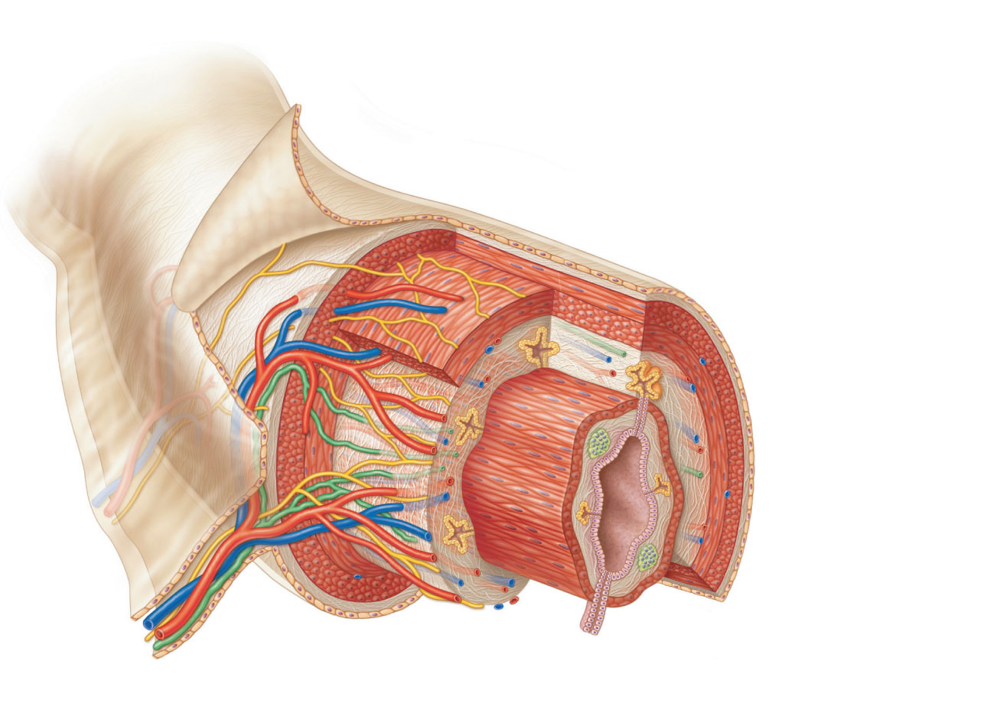
Intrinsic nerve plexuses
• Myenteric nerve plexus
• Submucosal nerve plexus
Glands in submucosa
Mucosa
• Epithelium
• Lamina propria
• Muscularis
mucosae
Submucosa
Muscularis
externa
• Longitudinal
muscle
• Circular muscle
Nerve
Serosa
Artery
• Epithelium
Vein
• Connective
tissue
Gland in mucosa
Lumen
Lymphatic
vessel
Duct of gland outside
alimentary canal
Mucosa-associated
lymphoid tissue
Mesentery
Figure 23.6

Slide 13
Mucosa
Lines the lumen
Functions
Secretes mucus, digestive enzymes and hormones
Absorbs end products of digestion
Protects against infectious disease
Three sublayers: epithelium, lamina propria, and muscularis mucosae

Slide 14
Intrinsic nerve plexuses
• Myenteric nerve plexus
• Submucosal nerve plexus
Glands in submucosa
Mucosa
• Epithelium
• Lamina propria
• Muscularis
mucosae
Submucosa
Muscularis
externa
• Longitudinal
muscle
• Circular muscle
Nerve
Serosa
Artery
• Epithelium
Vein
• Connective
tissue
Gland in mucosa
Lumen
Lymphatic
vessel
Duct of gland outside
alimentary canal
Mucosa-associated
lymphoid tissue
Mesentery
Figure 23.6

Slide 15
Submucosa
Composed of Connective Tissue.
May contain glands, derived from the epithelium of the mucosa.
Toward the outside, contains the submucosal myenteric plexus.

Slide 16
Intrinsic nerve plexuses
• Myenteric nerve plexus
• Submucosal nerve plexus
Glands in submucosa
Mucosa
• Epithelium
• Lamina propria
• Muscularis
mucosae
Submucosa
Muscularis
externa
• Longitudinal
muscle
• Circular muscle
Nerve
Serosa
Artery
• Epithelium
Vein
• Connective
tissue
Gland in mucosa
Lumen
Lymphatic
vessel
Duct of gland outside
alimentary canal
Mucosa-associated
lymphoid tissue
Mesentery
Figure 23.6

Slide 17
Muscularis Externa
Muscularis externa
Responsible for segmentation and peristalsis
Inner circular and outer longitudinal layers
Myenteric nerve plexus
Sphincters in some regions

Slide 18
Intrinsic nerve plexuses
• Myenteric nerve plexus
• Submucosal nerve plexus
Glands in submucosa
Mucosa
• Epithelium
• Lamina propria
• Muscularis
mucosae
Submucosa
Muscularis
externa
• Longitudinal
muscle
• Circular muscle
Nerve
Serosa
Artery
• Epithelium
Vein
• Connective
tissue
Gland in mucosa
Lumen
Lymphatic
vessel
Duct of gland outside
alimentary canal
Mucosa-associated
lymphoid tissue
Mesentery
Figure 23.6

Slide 19
Enteric Nervous System
Intrinsic nerve supply of the alimentary canal
Submucosal nerve plexus
Regulates glands and smooth muscle in the mucosa
Myenteric nerve plexus
Controls GI tract motility

Slide 20
Enteric Nervous System
Linked to the CNS via afferent visceral fibers
Long ANS fibers synapse with enteric plexuses
Sympathetic impulses inhibit secretion and motility
Parasympathetic impulses stimulate

Slide 21
Mouth
Oral (buccal) cavity
Bounded by lips, cheeks, palate, and tongue
Oral orifice is the anterior opening
Lined with stratified squamous epithelium

Slide 22
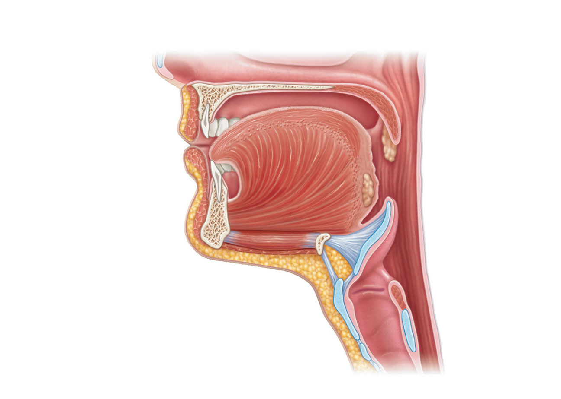
Soft palate
Palatoglossal arch
Uvula
Hard palate
Oral cavity
Palatine tonsil
Tongue
Oropharynx
Lingual tonsil
Epiglottis
Hyoid bone
Laryngopharynx
Esophagus
Trachea
(a) Sagittal section of the oral cavity and pharynx
Figure 23.7a

Slide 23
Lips and Cheeks
Contain orbicularis oris and buccinator muscles
Vestibule: recess internal to lips and cheeks, external to teeth and gums
Oral cavity proper lies within the teeth and gums
Labial frenulum: median attachment of each lip to the gum

Slide 24
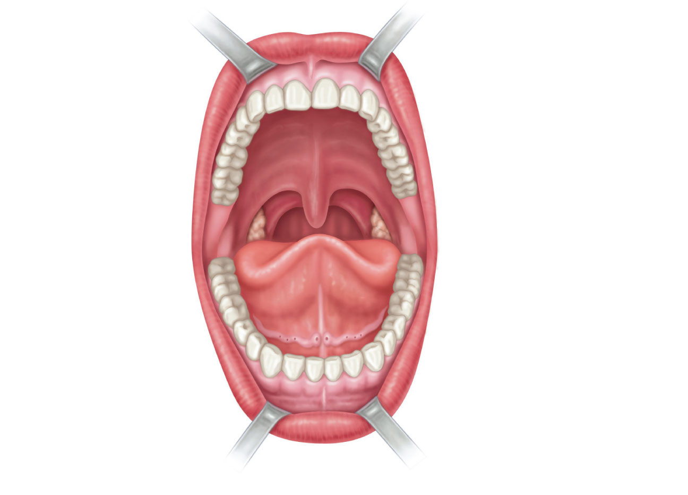
Upper lip
Gingivae (gums)
Superior labial
frenulum
Palatine raphe
Palatoglossal arch
Hard palate
Soft palate
Palatopharyngeal
arch
Uvula
Posterior wall
of oropharynx
Palatine tonsil
Tongue
Sublingual fold
with openings of
sublingual ducts
Lingual frenulum
Opening of
submandibular duct
Gingivae (gums)
Vestibule
Lower lip
Inferior labial
frenulum
(b) Anterior view
Figure 23.7b

Slide 25
Palate
Hard palate: palatine bones and palatine processes of the maxillae
Slightly corrugated to help create friction against the tongue
Soft palate: fold formed mostly of skeletal muscle
Closes off the nasopharynx during swallowing
Uvula projects downward from its free edge

Slide 26
Tongue
Functions include
Repositioning and mixing food during chewing
Formation of the bolus
Initiation of swallowing, speech, and taste
Intrinsic muscles change the shape of the tongue
Extrinsic muscles alter the tongue’s position
Lingual frenulum: attachment to the floor of the mouth

Slide 27
Tongue
Surface bears papillae
Filiform—whitish, give the tongue roughness and provide friction
Fungiform—reddish, scattered over the tongue
Circumvallate (vallate)—V-shaped row in back of tongue
These three house taste buds
Foliate—on the lateral aspects of the posterior tongue

Slide 28
Tongue
Terminal sulcus marks the division between
Body: anterior 2/3 residing in the oral cavity
Root: posterior third residing in the oropharynx

Slide 29
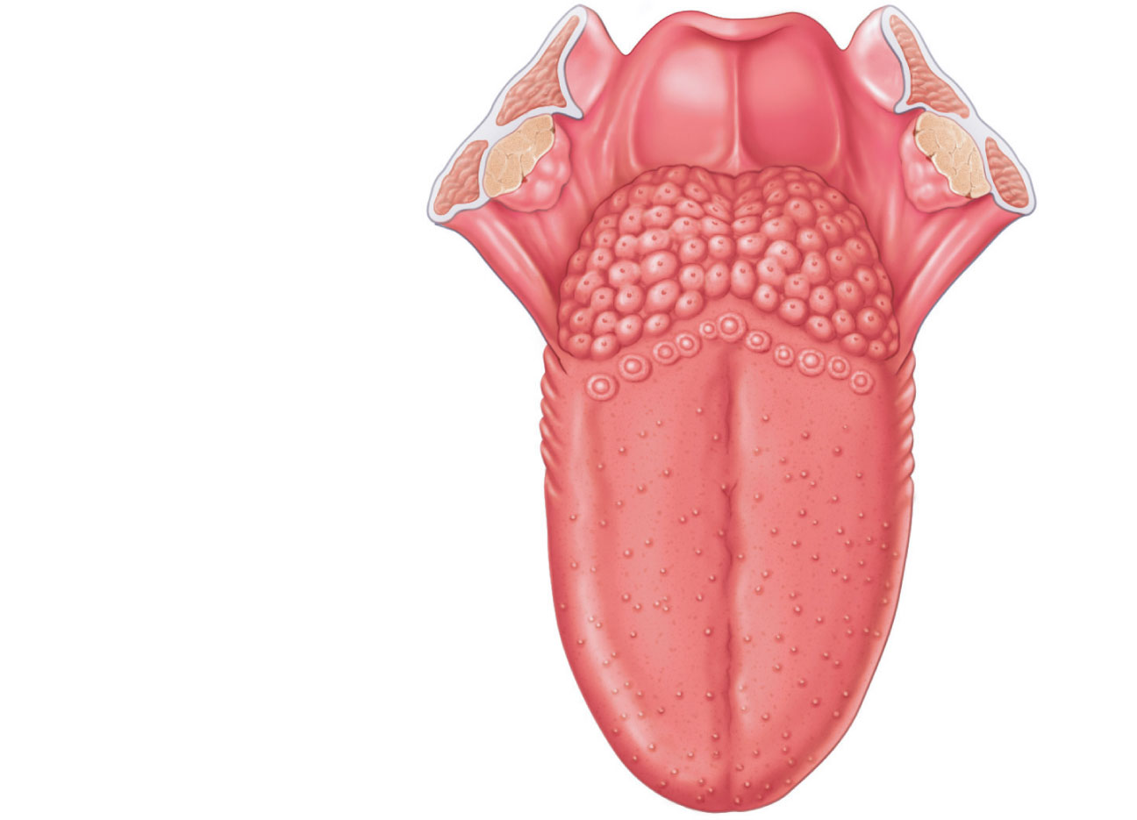
Epiglottis
Palatopharyngeal
arch
Palatine tonsil
Lingual tonsil
Palatoglossal
arch
Terminal sulcus
Foliate papillae
Circumvallate
papilla
Midline groove
of tongue
Dorsum of tongue
Fungiform papilla
Filiform papilla
Figure 23.8

Slide 30
Salivary Glands
Extrinsic salivary glands (parotid, submandibular, and sublingual)

Slide 31
Salivary Glands
Intrinsic (buccal) salivary glands are scattered in the oral mucosa
Secretion (saliva)
Cleanses the mouth
Moistens and dissolves food chemicals
Aids in bolus formation
Contains enzymes that begin the breakdown of starch

Slide 32
Salivary Glands
Parotid gland
Anterior to the ear external to the masseter muscle
Parotid duct opens into the vestibule next to second upper molar
Submandibular gland
Medial to the body of the mandible
Duct opens at the base of the lingual frenulum
Sublingual gland
Anterior to the submandibular gland under the tongue
Opens via 10–12 ducts into the floor of the mouth

Slide 33
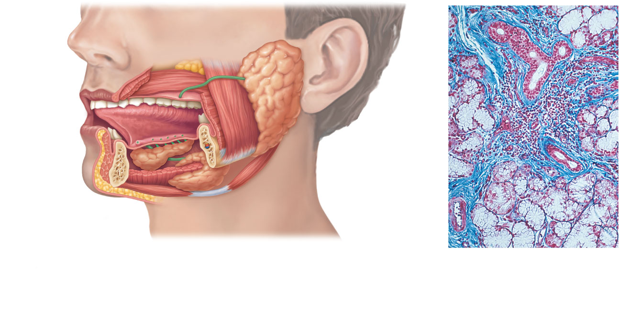
Tongue
Teeth
Ducts of
sublingual
gland
Parotid
gland
Parotid duct
Frenulum
of tongue
Masseter muscle
Body of
mandible (cut)
Sublingual
gland
Posterior belly
of digastric
muscle
Mylohyoid
muscle (cut)
Anterior belly of
digastric muscle
Submandibular
gland
Submandibular
duct
Mucous
cells
Serous cells
forming
demilunes
(a)
(b)
Figure 23.9

Slide 34
Composition of Saliva
Secreted by serous and mucous cells
97–99.5% water, slightly acidic solution containing
Electrolytes—Na⁺, K⁺, Cl–, PO₄ ^{2–}, HCO₃–
Salivary amylase and lingual lipase
Mucin
Metabolic wastes—urea and uric acid
Lysozyme, IgA, defensins, and a cyanide compound protect against microorganisms

Slide 35
Control of Salivation
Intrinsic glands continuously keep the mouth moist
Extrinsic salivary glands produce secretions when
Ingested food stimulates chemoreceptors and mechanoreceptors in the mouth
Salivatory nuclei in the brain stem send impulses along parasympathetic fibers in cranial nerves VII and IX
Strong sympathetic stimulation inhibits salivation and results in dry mouth (xerostomia)

Slide 36
Pharynx
Oropharynx and laryngopharynx
Allow passage of food, fluids, and air
Stratified squamous epithelium lining
Skeletal muscle layers: inner longitudinal, outer pharyngeal constrictors

Slide 37
Esophagus
Flat muscular tube from laryngopharynx to stomach
Pierces diaphragm at esophageal hiatus
Joins stomach at the cardiac orifice

Slide 38
Esophagus
Esophageal mucosa contains stratified squamous epithelium
Changes to simple columnar at the stomach
Esophageal glands in submucosa secrete mucus to aid in bolus movement
Muscularis: skeletal superiorly; smooth inferiorly

Slide 39
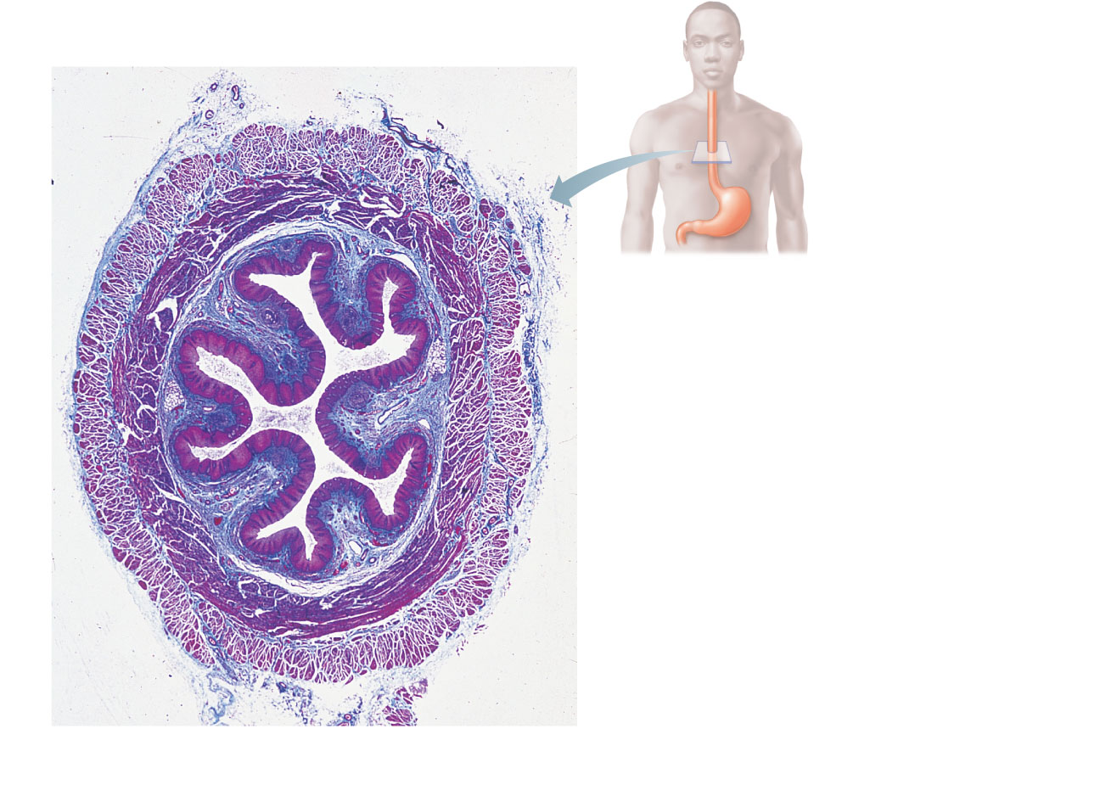
Mucosa
(contains a stratified
squamous epithelium)
Submucosa (areolar
connective tissue)
Lumen
Muscularis externa
• Longitudinal layer
• Circular layer
Adventitia (fibrous
connective tissue)
(a)
Figure 23.12a

Slide 40
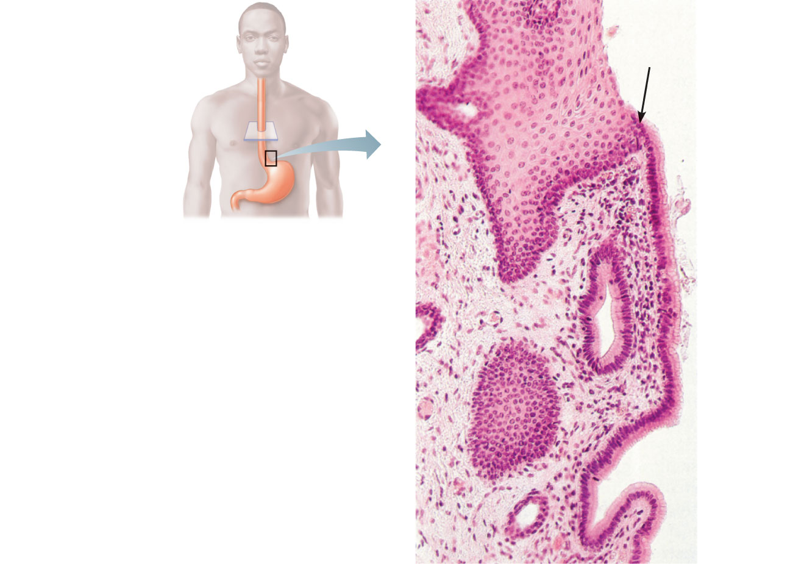
Mucosa
(contains a stratified
squamous epithelium)
(b)
Figure 23.12b

Slide 41
Digestive Processes: Mouth
Ingestion
Mechanical digestion
Mastication is partly voluntary, partly reflexive
Chemical digestion (salivary amylase and lingual lipase)
Propulsion
Deglutition (swallowing)

Slide 42
Deglutition
Involves the tongue, soft palate, pharynx, esophagus, and 22 muscle groups
Buccal phase
Voluntary contraction of the tongue
Pharyngeal-esophageal phase
Involuntary
Control center in the medulla and lower pons

Slide 43
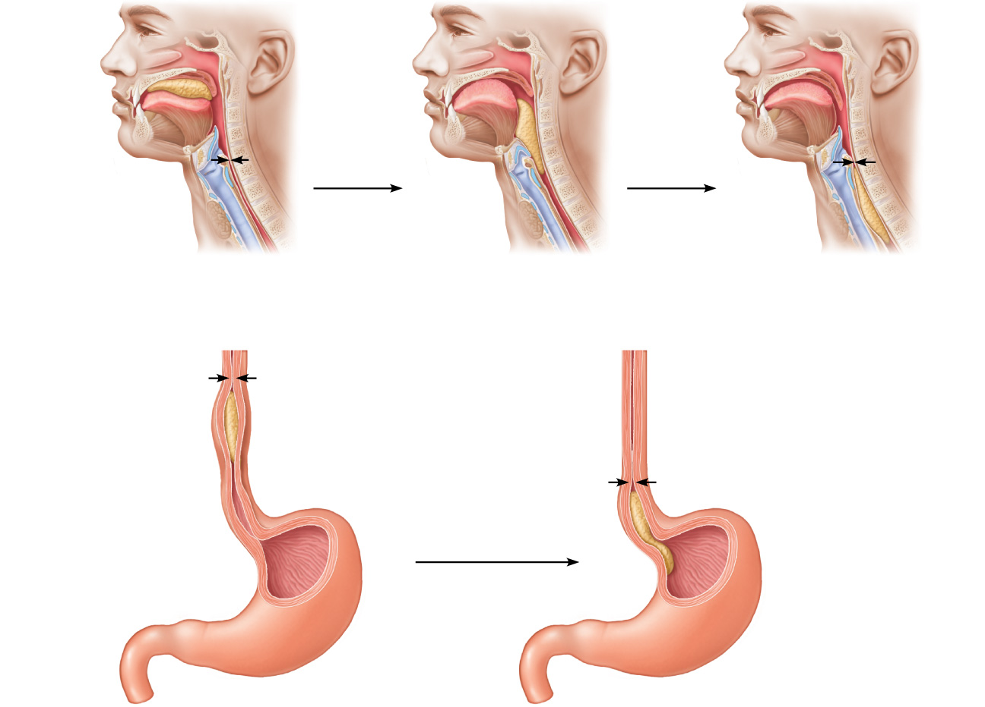
Bolus of food
Tongue
Uvula
Pharynx
Bolus
Epiglottis
Epiglottis
Glottis
Trachea
Esophagus
Bolus
1
2
3
Upper esophageal sphincter is
contracted. During the buccal phase, the
tongue presses against the hard palate,
forcing the food bolus into the oropharynx
where the involuntary phase begins.
The uvula and larynx rise to prevent food
from entering respiratory passageways. The
tongue blocks off the mouth. The upper
esophageal sphincter relaxes, allowing food
to enter the esophagus.
The constrictor muscles of the
pharynx contract, forcing food
into the esophagus inferiorly. The
upper esophageal sphincter
contracts (closes) after entry.
Relaxed muscles
4
5
Circular muscles
contract
Food is moved
through the esophagus
to the stomach by
peristalsis.
Relaxed
muscles
The gastroesophageal
sphincter opens, and food
enters the stomach.
Bolus of food
Longitudinal muscles
contract
Gastroesophageal
sphincter closed
Gastroesophageal
sphincter opens
Stomach
Figure 23.13

Slide 44
Stomach: Gross Anatomy
Cardiac region (cardia)
Surrounds the cardiac orifice
Fundus
Dome-shaped region beneath the diaphragm
Body
Midportion

Slide 45
Stomach: Gross Anatomy
Pyloric region: antrum, pyloric canal, and pylorus
Pylorus is continuous with the duodenum through the pyloric valve (sphincter)
Greater curvature
Convex lateral surface
Lesser curvature
Concave medial surface

Slide 46
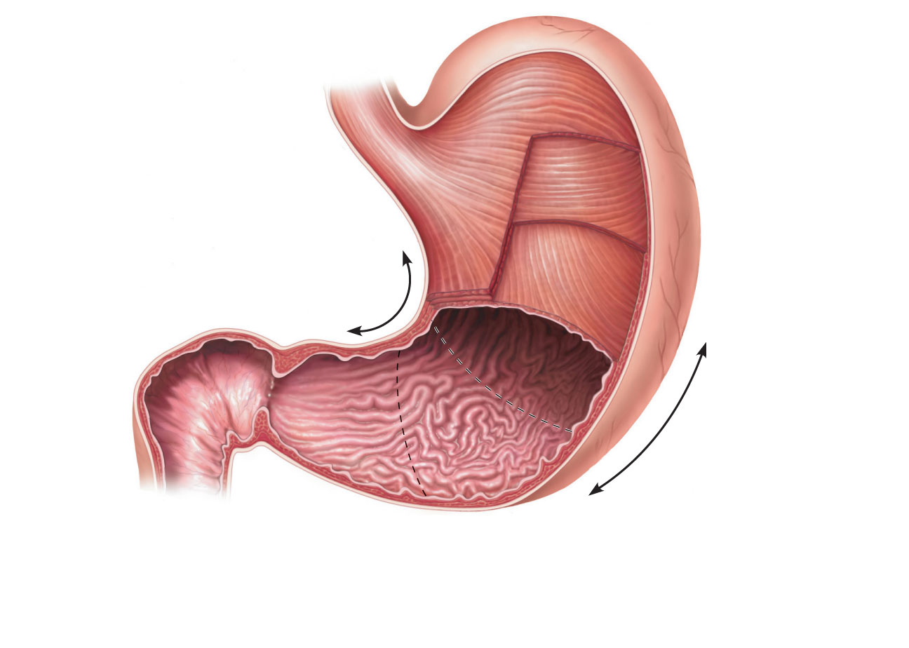
Cardia
Fundus
Esophagus
Muscularis
externa
Serosa
• Longitudinal layer
• Circular layer
Body
• Oblique layer
Lesser
curvature
Lumen
Rugae of
mucosa
Greater
curvature
Pyloric
canal
Pyloric
antrum
Duodenum
Pyloric sphincter
(valve) at pylorus
(a)
Figure 23.14a

Slide 47
Stomach: Gross Anatomy
Lesser omentum
From the liver to the lesser curvature
Greater omentum
Drapes from greater curvature
Anterior to the small intestine

Slide 48
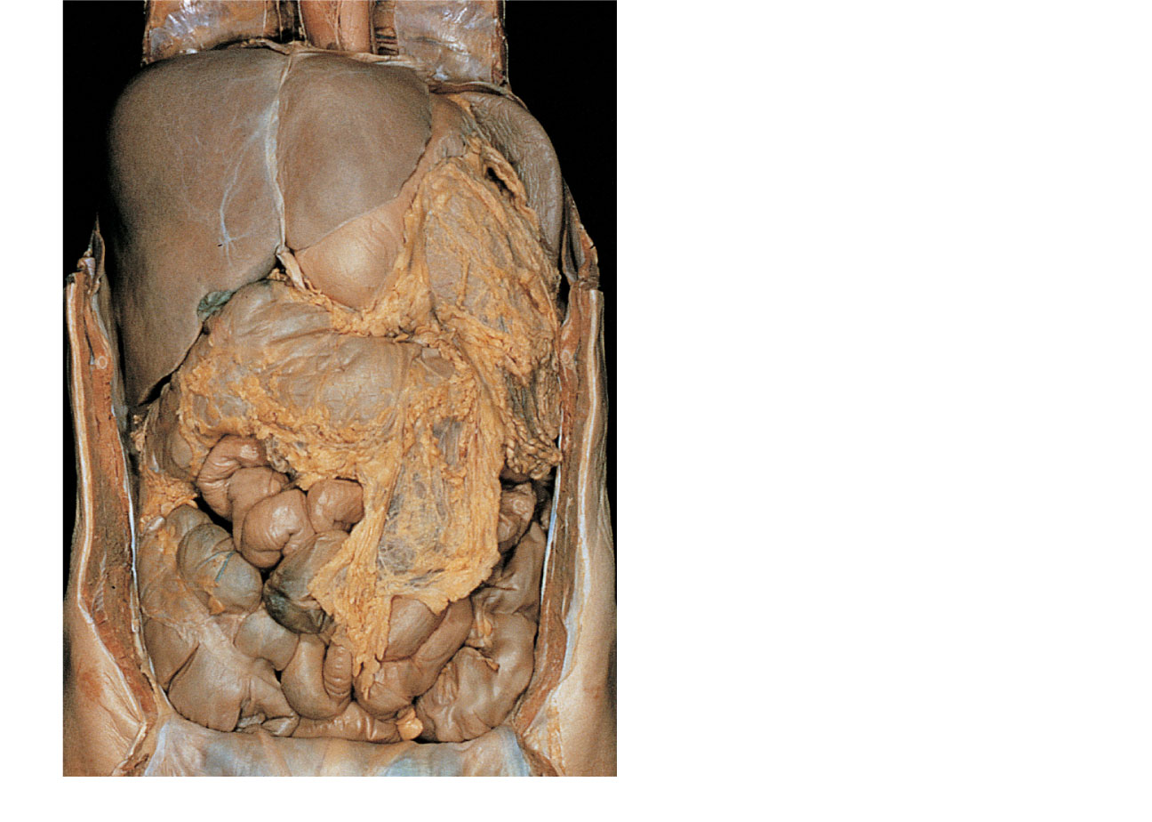
Falciform ligament
Liver
Gallbladder
Spleen
Stomach
Ligamentum teres
Greater omentum
Small intestine
Cecum
(a)
Figure 23.30a

Slide 49
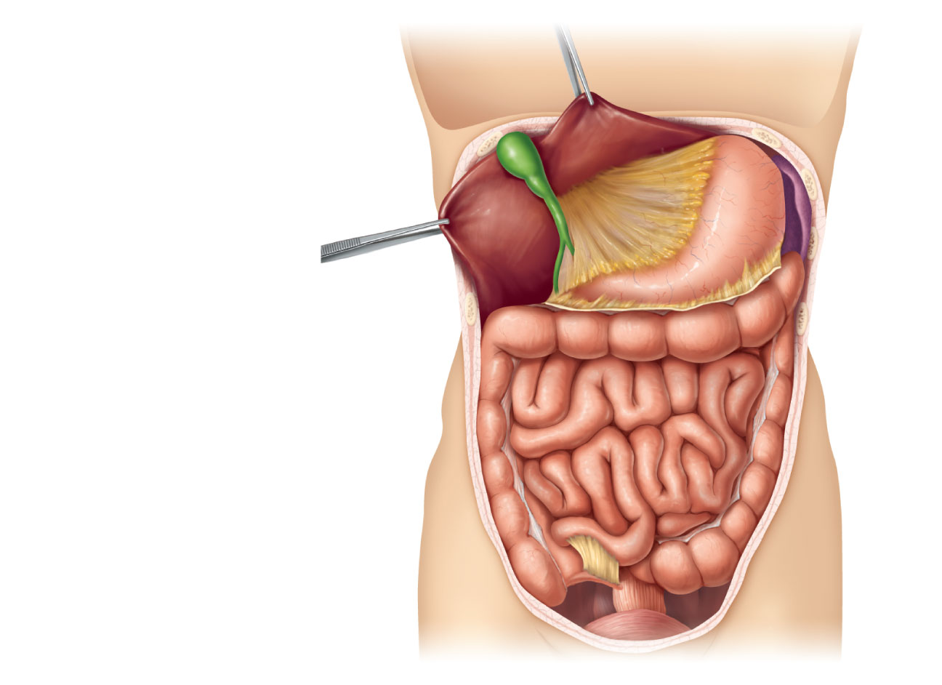
Liver
Gallbladder
Lesser omentum
Stomach
Duodenum
Transverse colon
Small intestine
Cecum
Urinary bladder
(b)
Figure 23.30b

Slide 50
Stomach: Gross Anatomy
ANS nerve supply
Sympathetic via splanchnic nerves and celiac plexus
Parasympathetic via vagus nerve
Blood supply
Celiac trunk
Veins of the hepatic portal system

Slide 51
Stomach: Microscopic Anatomy
Four tunics
Muscularis and mucosa are modified
Muscularis externa
Three layers of smooth muscle
Inner oblique layer allows stomach to churn, mix, move, and physically break down food

Slide 52
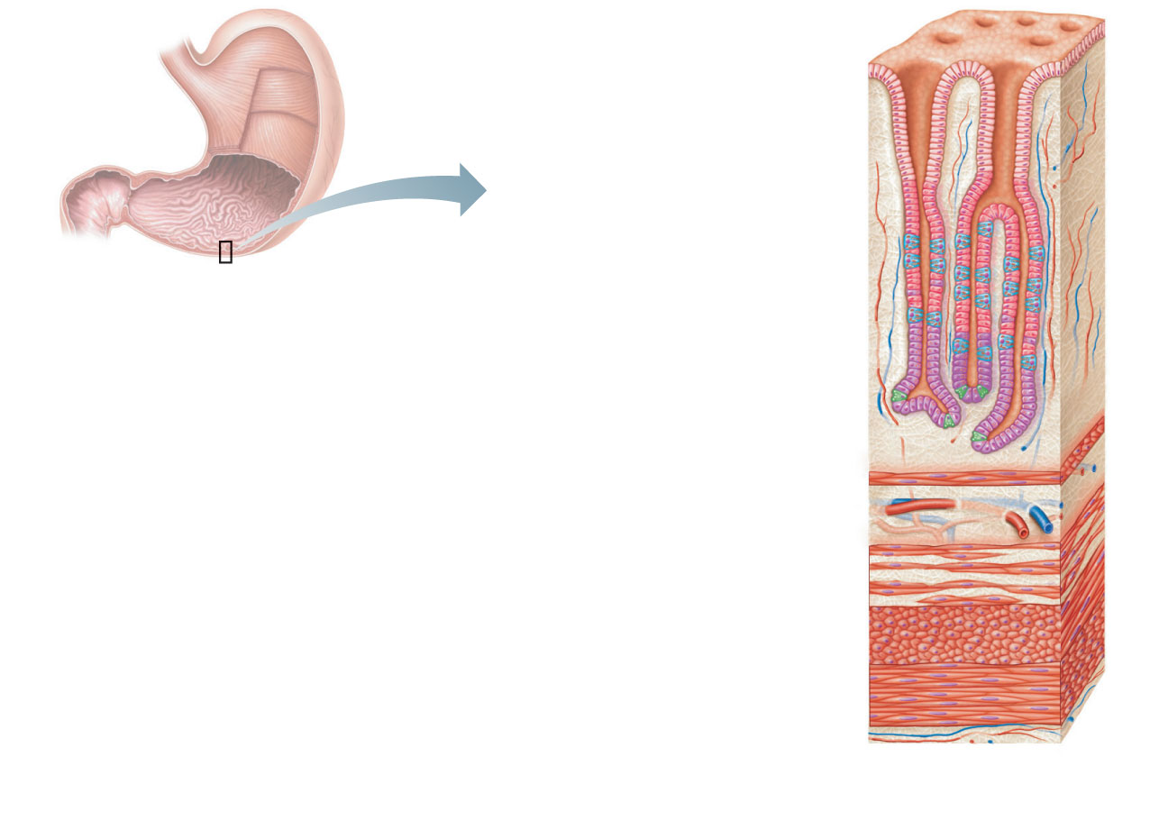
Surface
epithelium
Mucosa
Lamina propria
Muscularis
mucosae
Submucosa
(contains submucosal
plexus)
Oblique layer
Muscularis externa
(contains myenteric
plexus)
Circular layer
Longitudinal
layer
Serosa
Stomach wall
(a) Layers of the stomach wall (l.s.)
Figure 23.15a

Slide 53
Stomach: Microscopic Anatomy
Mucosa
Simple columnar epithelium composed of mucous cells
Layer of mucus traps bicarbonate-rich fluid beneath it
Gastric pits lead into gastric glands

Slide 54
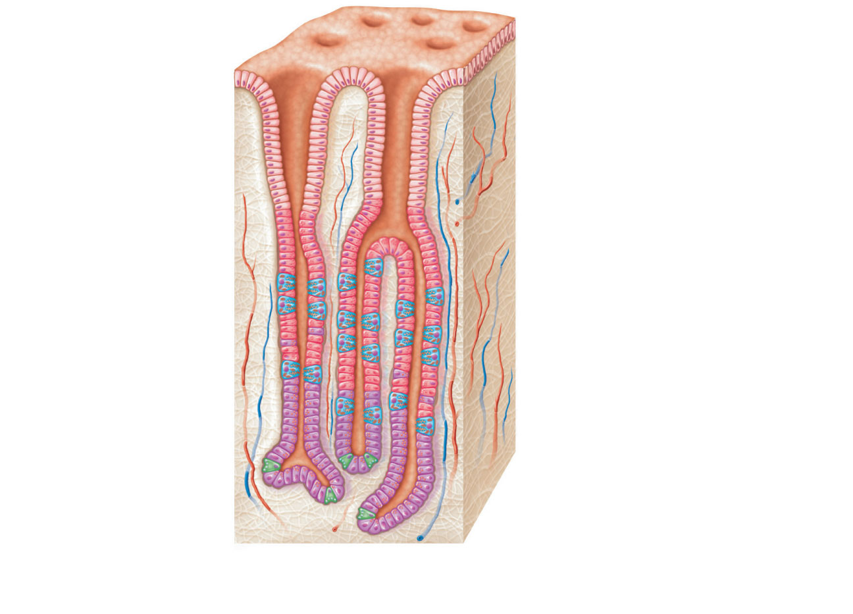
Gastric pits
Surface epithelium
(mucous cells)
Gastric
pit
Mucous neck cells
Parietal cell
Chief cell
Gastric
gland
Enteroendocrine cell
(b) Enlarged view of gastric pits and gastric glands
Figure 23.15b

Slide 55
Gastric Glands
Cell types
Mucous neck cells (secrete thin, acidic mucus)
Parietal cells
Chief cells
Enteroendocrine cells

Slide 56
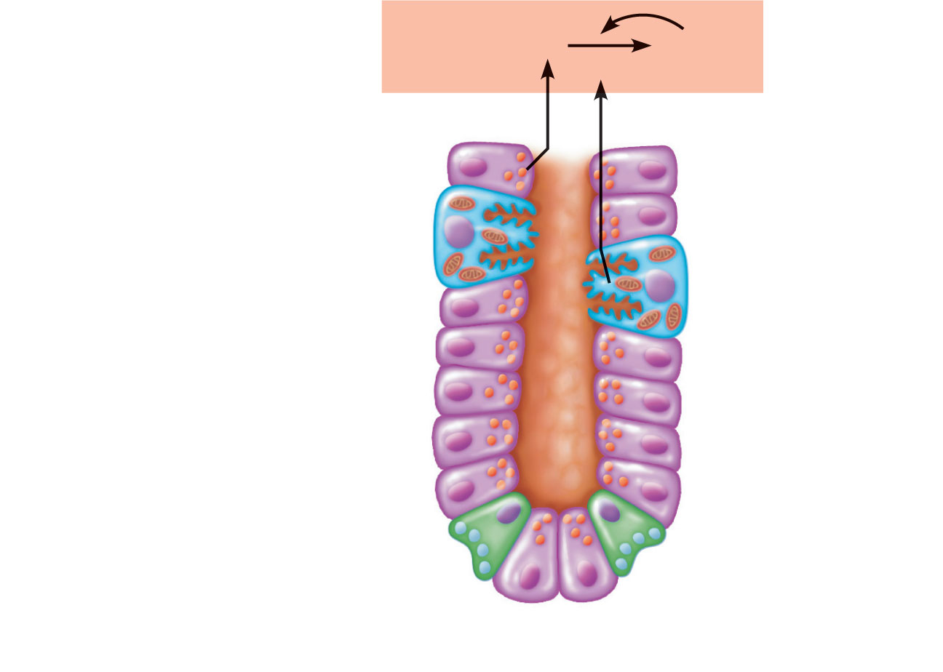
Pepsinogen
Pepsin
HCl
Mitochondria
Parietal cell
Chief cell
Enteroendocrine
cell
(c) Location of the HCl-producing parietal cells and
pepsin-secreting chief cells in a gastric gland
Figure 23.15c

Slide 57
Gastric Gland Secretions
Glands in the fundus and body produce most gastric juice
Parietal cell secretions
HCl with pH 1.5–3.5 denatures protein in food, activates pepsin, and kills many bacteria
Intrinsic factor is a glycoprotein required for absorption of vitamin B₁₂ in small intestine
Chief cell secretions
Inactive enzyme pepsinogen
Activated to pepsin by HCl and by pepsin itself (a positive feedback mechanism)
Enteroendocrine cells - Secrete chemical messengers into lamina propria
Paracrines = Serotonin and histamine
Hormones = Somatostatin and gastrin

Slide 58
Mucosal Barrier
Layer of bicarbonate-rich mucus
Tight junctions between epithelial cells
Damaged epithelial cells are quickly replaced by division of stem cells

Slide 59
Digestive Processes in the Stomach
Physical digestion
Denaturation of proteins
Enzymatic digestion of proteins by pepsin
Secretes intrinsic factor required for absorption of vitamin B₁₂
Lack of intrinsic factor → pernicious anemia
Delivers chyme to the small intestine

Slide 60
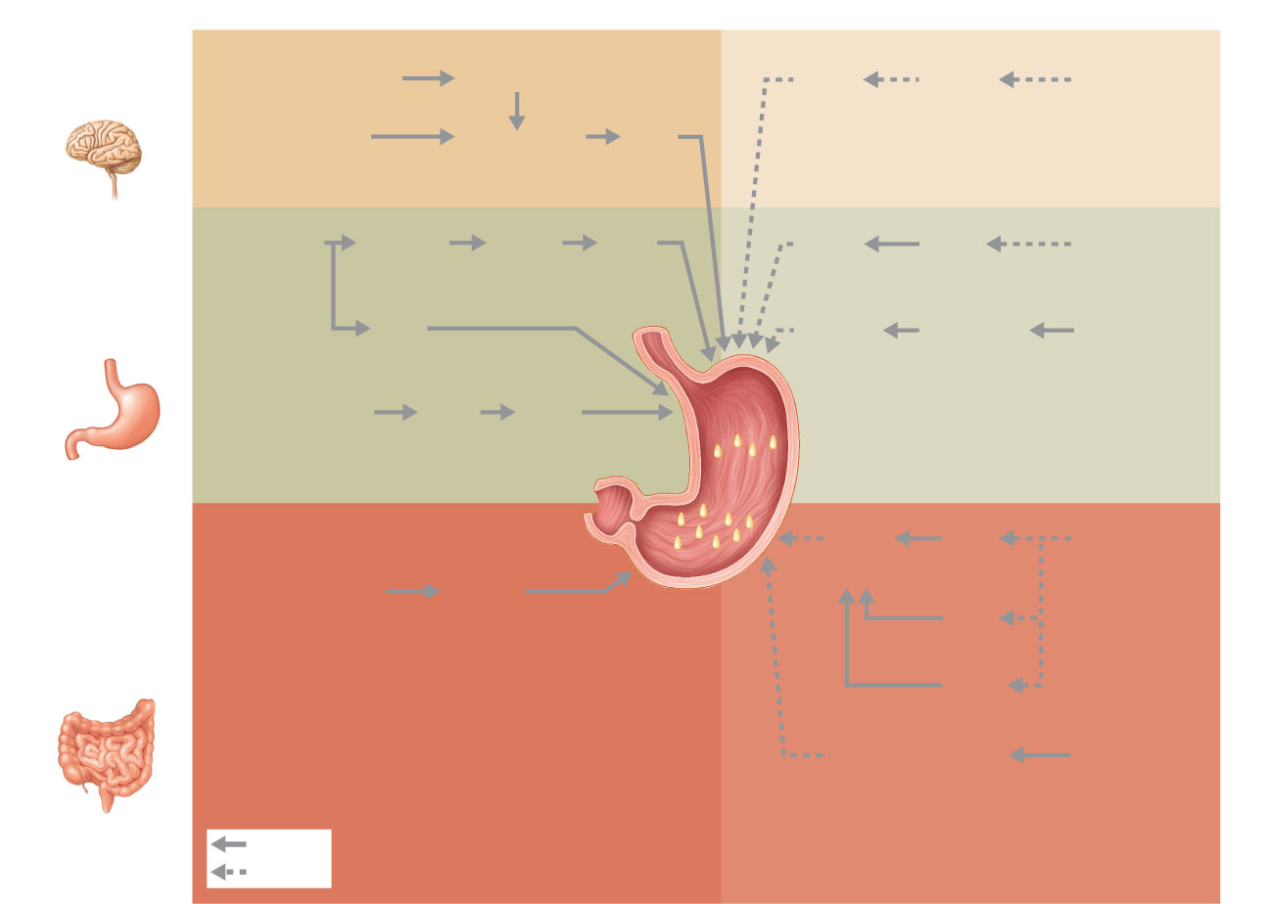
Stimulatory events
Inhibitory events
1
1
Cephalic
phase
Sight and thought
of food
Cerebral cortex
Lack of
stimulatory
impulses to
parasym-
pathetic
center
Cerebral
cortex
Loss of
appetite,
depression
Conditioned reflex
2
Stimulation of
taste and smell
receptors
Hypothalamus
and medulla
oblongata
Vagus
nerve
1
1
Stomach
distension
activates
stretch
receptors
Vagovagal
reflexes
Medulla
Vagus
nerve
Gastrin
secretion
declines
G cells
Excessive
acidity
(pH <2)
in stomach
Gastric
phase
2
Local
reflexes
Overrides
parasym-
pathetic
controls
Sympathetic
nervous
system
activation
Emotional
upset
2
Food chemicals
(especially peptides and
caffeine) and rising pH
activate chemoreceptors
G cells
Gastrin
release
to blood
Stomach
secretory
activity
1
Entero-
gastric
reflex
Local
reflexes
Distension
of duodenum;
presence of
fatty, acidic,
hypertonic
chyme, and/or
irritants in
the duodenum
1
Presence of low
pH, partially digested
foods, fats, or
hypertonic solution
in duodenum when
stomach begins to
empty
Intestinal
(enteric)
gastrin
release
to blood
Vagal
nuclei
in medulla
Intestinal
phase
Brief
effect
Pyloric
sphincter
2
Release of intestinal
hormones (secretin,
cholecystokinin, vasoactive
intestinal peptide)
Distension;
presence of
fatty, acidic,
partially
digested food
in the
duodenum
Stimulate
Inhibit
Figure 23.17

Slide 61
Regulation and Mechanism of HCl Secretion
Three chemicals (ACh, histamine, and gastrin) stimulate parietal cells through second-messenger systems
All three are necessary for maximum HCl secretion
Antihistamines block H₂ receptors and decrease HCl release

Slide 62
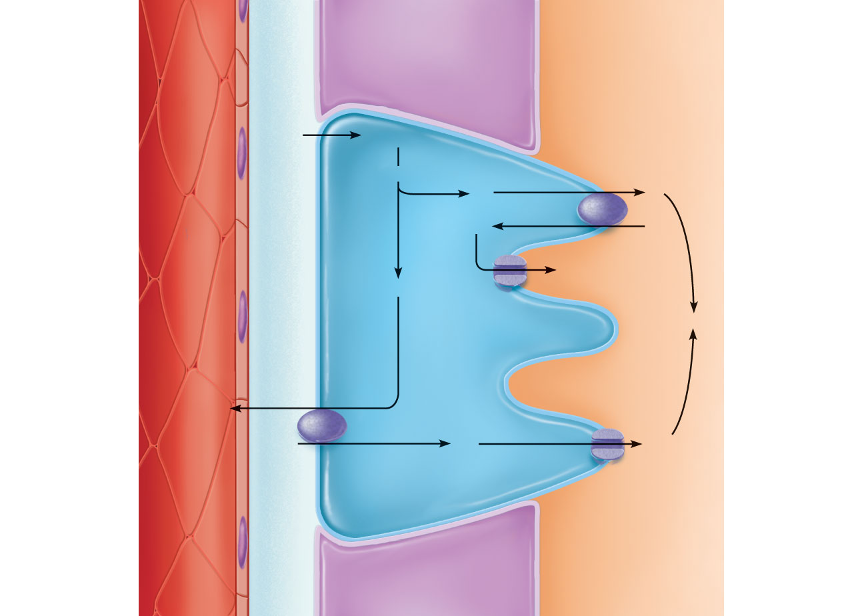
Blood
capillary
Chief cell
Stomach lumen
CO₂
CO₂ + H₂O
H⁺-K⁺
ATPase
Carbonic
anhydrase
H₂CO₃
H⁺
H⁺
K⁺
K⁺
HCO₃–
Alkaline
tide
Parietal cell
HCI
HCO₃–
Cl–
Cl–
Cl–
l
HCO₃–- Cl–
antiporter
Inter-
stitial
fluid
Figure 23.18

Slide 63
Response of the Stomach to Filling
Stretches to accommodate incoming food
Reflex-mediated receptive relaxation
Coordinated by the swallowing center of the brain stem
Gastric accommodation
Plasticity (stress-relaxation response) of smooth muscle

Slide 64
Gastric Contractile Activity
Peristaltic waves move toward the pylorus at the rate of 3 per minute
Basic electrical rhythm (BER) initiated by pacemaker cells (cells of Cajal)
Distension and gastrin increase force of contraction

Slide 65
Gastric Contractile Activity
Most vigorous near the pylorus
Chyme is either
Delivered in ~ 3 ml spurts to the duodenum, or
Forced backward into the stomach

Slide 66
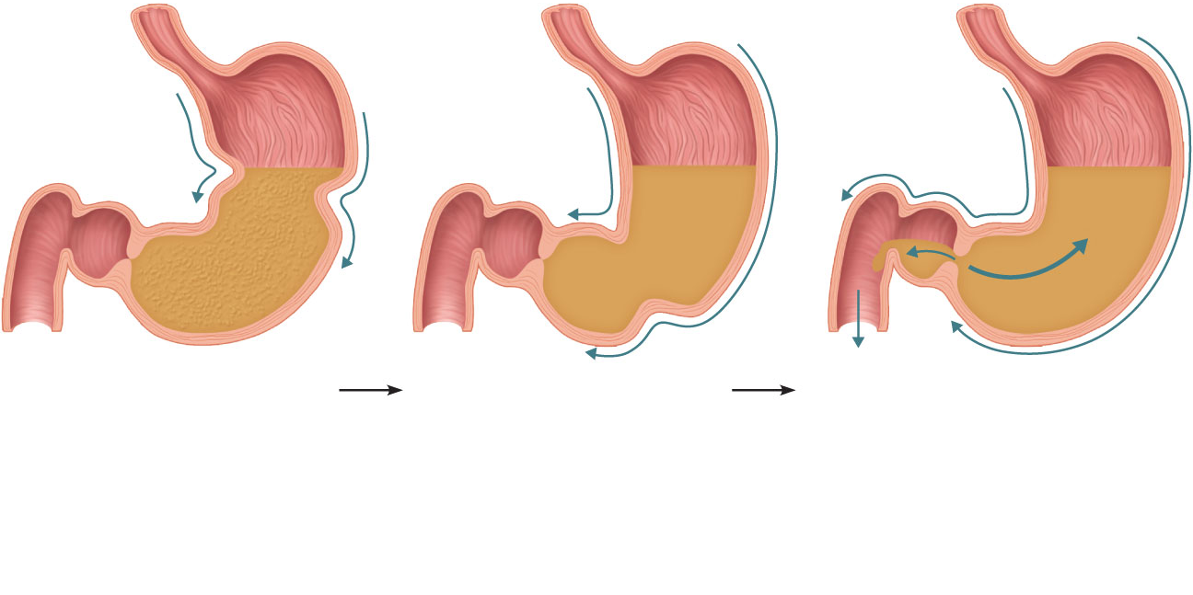
Pyloric
valve
closed
Pyloric
valve
closed
Pyloric
valve
slightly
opened
Propulsion: Peristaltic
waves move from the
fundus toward the
pylorus.
Grinding: The most
vigorous peristalsis and
mixing action occur
close to the pylorus.
Retropulsion: The pyloric
end of the stomach acts as a
pump that delivers small
amounts of chyme into the
duodenum, simultaneously
forcing most of its contained
material backward into the
stomach.
1
2
3
Figure 23.19

Slide 67
Regulation of Gastric Emptying
As chyme enters the duodenum
Receptors respond to stretch and chemical signals
Enterogastric reflex and enterogastrones inhibit gastric secretion and duodenal filling
Carbohydrate-rich chyme moves quickly through the duodenum
Fatty chyme remains in the duodenum 6 hours or more

Slide 68
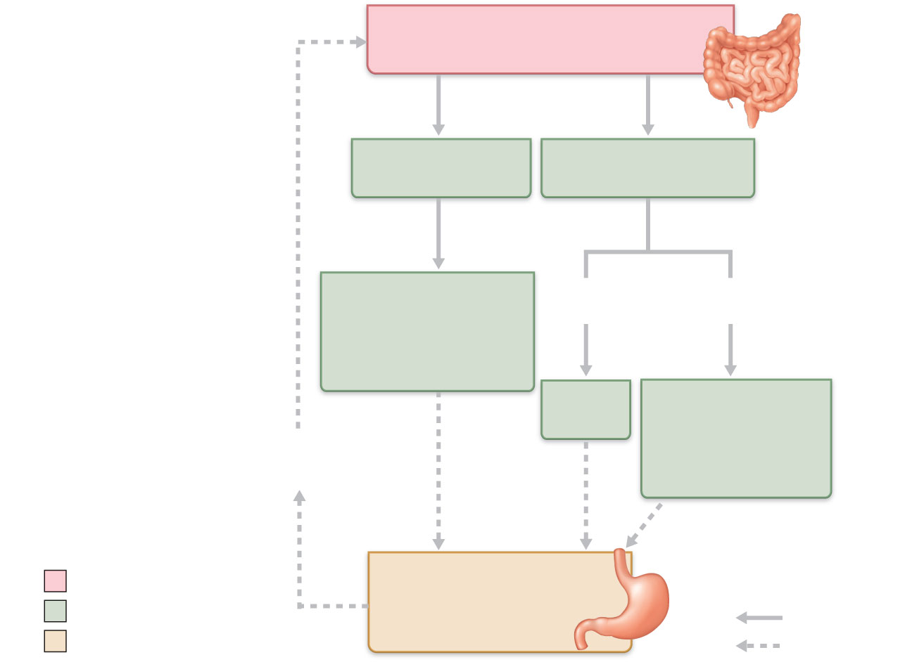
Presence of fatty, hypertonic,
acidic chyme in duodenum
Duodenal entero-
endocrine cells
Chemoreceptors and
stretch receptors
Secrete
Target
Enterogastrones
(secretin,
cholecystokinin,
vasoactive intestinal
peptide)
Via short
reflexes
Via long
reflexes
Enteric
neurons
CNS centers
sympathetic
activity;
parasympathetic
activity
Duodenal
stimuli
decline
Initial stimulus
Contractile force and
rate of stomach
emptying decline
Physiological response
Stimulate
Result
Inhibit
Figure 23.20

Slide 69
Small Intestine: Gross Anatomy
Major organ of digestion and absorption
2–4 m long; from pyloric sphincter to ileocecal valve
Subdivisions
Duodenum (retroperitoneal)
Jejunum (attached posteriorly by mesentery)
Ileum (attached posteriorly by mesentery)

Slide 70
Parotid gland
Mouth (oral cavity)
Sublingual gland
Tongue
Salivary
glands
Submandibular
gland
Esophagus
Pharynx
Stomach
Pancreas
Liver
(Spleen)
Gallbladder
Transverse colon
Duodenum
Descending colon
Small
intestine
Jejunum
Ascending colon
Ileum
Cecum
Large
intestine
Sigmoid colon
Rectum
Vermiform appendix
Anus
Anal canal
Figure 23.1

Slide 71
Duodenum
The bile duct and main pancreatic duct
Join at the hepatopancreatic ampulla
Enter the duodenum at the major duodenal papilla
Are controlled by the hepatopancreatic sphincter

Slide 72
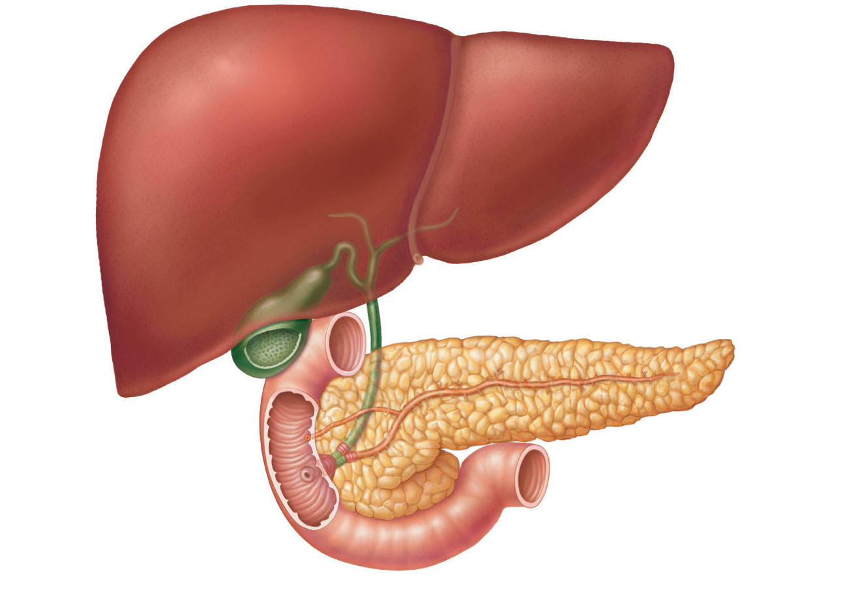
Right and left
hepatic ducts
of liver
Cystic duct
Common hepatic duct
Bile duct and sphincter
Accessory pancreatic duct
Mucosa
with folds
Tail of pancreas
Gallbladder
Pancreas
Major duodenal
papilla
Jejunum
Main pancreatic duct
and sphincter
Hepatopancreatic
ampulla and sphincter
Duodenum
Head of pancreas
Figure 23.21

Slide 73
Structural Modifications
Increase surface area of proximal part for nutrient absorption
Circular folds (plicae circulares) - Permanent (~1 cm deep) that force chyme to slowly spiral through lumen
2. Villi- Motile fingerlike extensions (~1 mm high) in mucosa. Villus epithelium is simple columnar absorptive cells (enterocytes) and goblet cells.
3. Microvilli - Projections (brush border) of absorptive cells. These bear “brush border” enzymes.

Slide 74
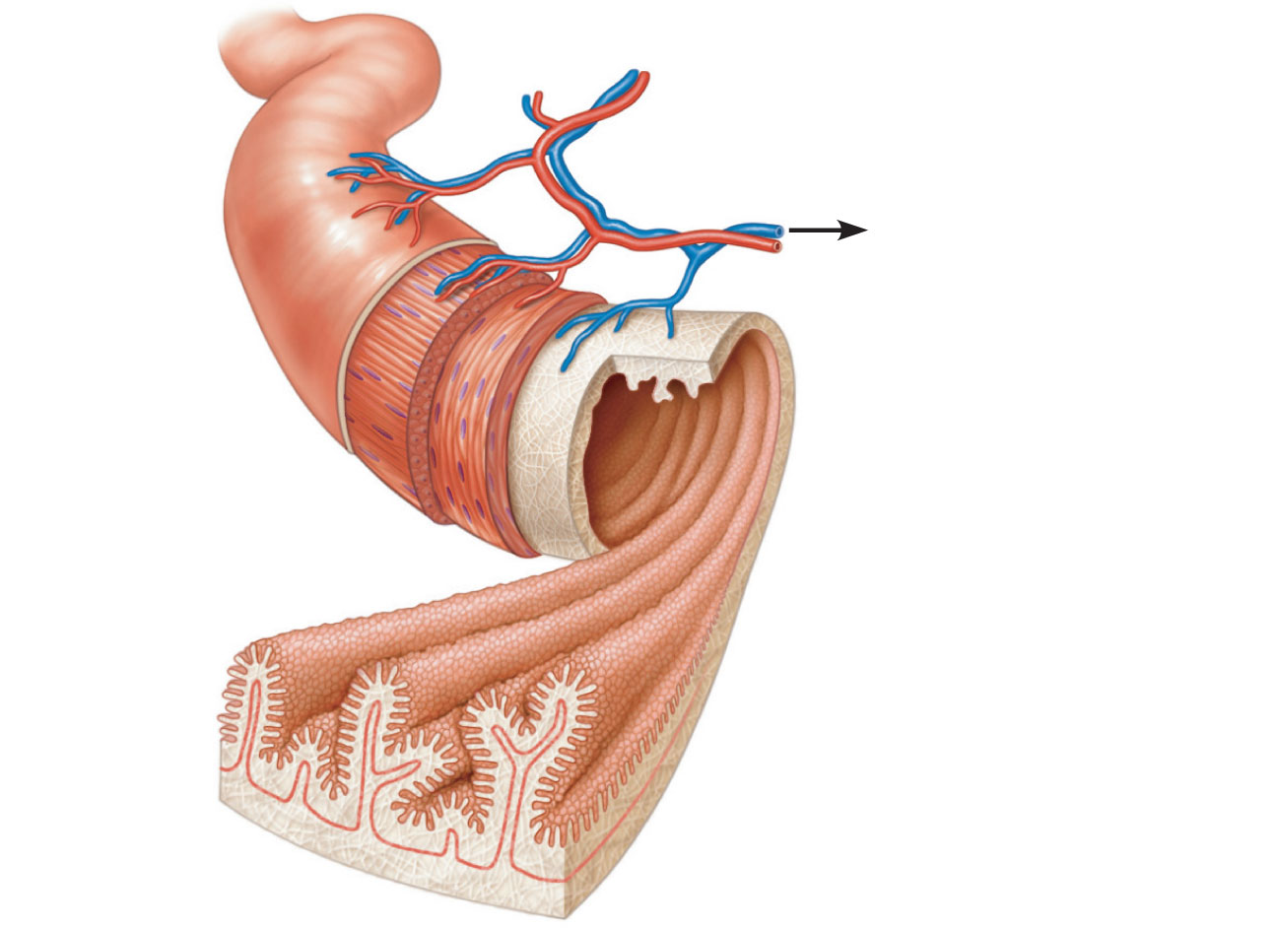
Vein carrying blood to
hepatic portal vessel
Muscle
layers
Lumen
Circular
folds
Villi
(a)
Figure 23.22a

Slide 75
Microvilli
(brush border)
Absorptive cells
Lacteal
Goblet cell
Blood
capillaries
Vilus
Mucosa
associated
lymphoid tissue
Enteroendocrine
cells
Intestinal crypt
Muscularis
mucosae
Venule
Lymphatic vessel
Duodenal gland
Submucosa
(b)
Figure 23.22b

Slide 76
Submucosa
Peyer’s patches protect distal part against bacteria
Duodenal (Brunner’s) glands of the duodenum secrete alkaline mucus

Slide 77
Intestinal Juice
Secreted in response to distension or irritation of the mucosa
Slightly alkaline and isotonic with blood plasma
Largely water, enzyme-poor, but contains mucus
Facilitates transport and absorption of nutrients

Slide 78
Liver
Largest gland in the body
Four lobes—right, left, caudate, and quadrate

Slide 79
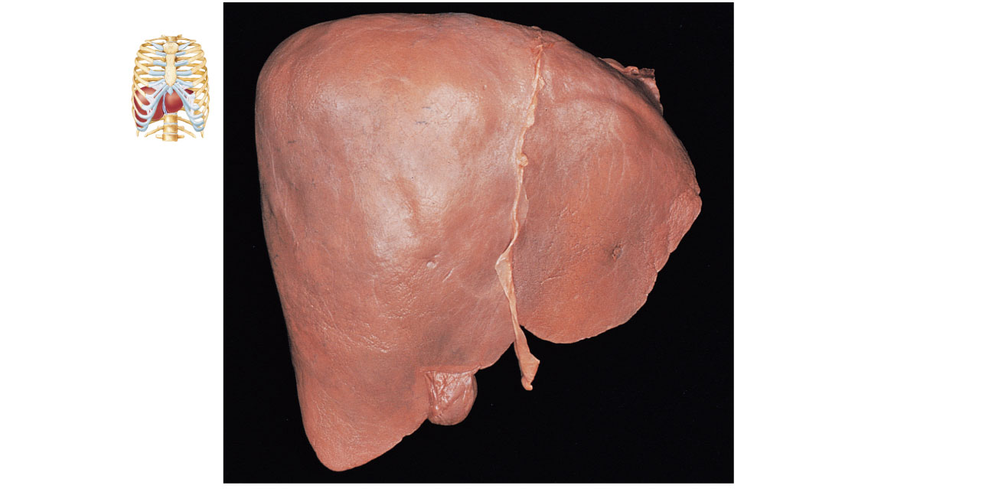
Sternum
Bare area
Nipple
Falciform
ligament
Liver
Left lobe of liver
Right lobe
of liver
Round ligament
(ligamentum
teres)
Gallbladder
(a)
Figure 23.24a

Slide 80
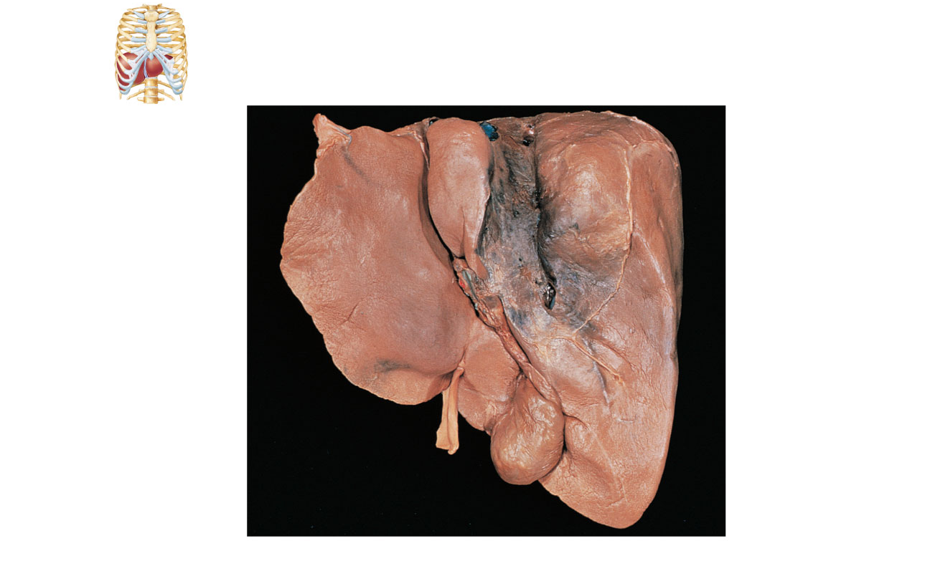
Sternum
Nipple
Liver
Lesser omentum
(in fissure)
Bare area
Caudate lobe
of liver
Left lobe of liver
Sulcus for
inferior
vena cava
Porta hepatis
containing hepatic
artery (left) and
hepatic portal vein
(right)
Hepatic vein
(cut)
Bile duct (cut)
Right lobe of
liver
Quadrate lobe
of liver
Gallbladder
Ligamentum teres
(b)
Figure 23.24b

Slide 81
Liver: Associated Structures
Lesser omentum anchors liver to stomach
Hepatic artery and vein at the porta hepatis
Bile ducts
Common hepatic duct leaves the liver
Cystic duct connects to gallbladder
Bile duct formed by the union of the above two ducts

Slide 82
Right and left
hepatic ducts
of liver
Cystic duct
Common hepatic duct
Bile duct and sphincter
Accessory pancreatic duct
Mucosa
with folds
Tail of pancreas
Gallbladder
Pancreas
Major duodenal
papilla
Jejunum
Main pancreatic duct
and sphincter
Hepatopancreatic
ampulla and sphincter
Duodenum
Head of pancreas
Figure 23.21

Slide 83
Liver: Microscopic Anatomy
Liver lobules
Hexagonal structural and functional units
Filter and process nutrient-rich blood
Composed of plates of hepatocytes (liver cells)
Longitudinal central vein

Slide 84
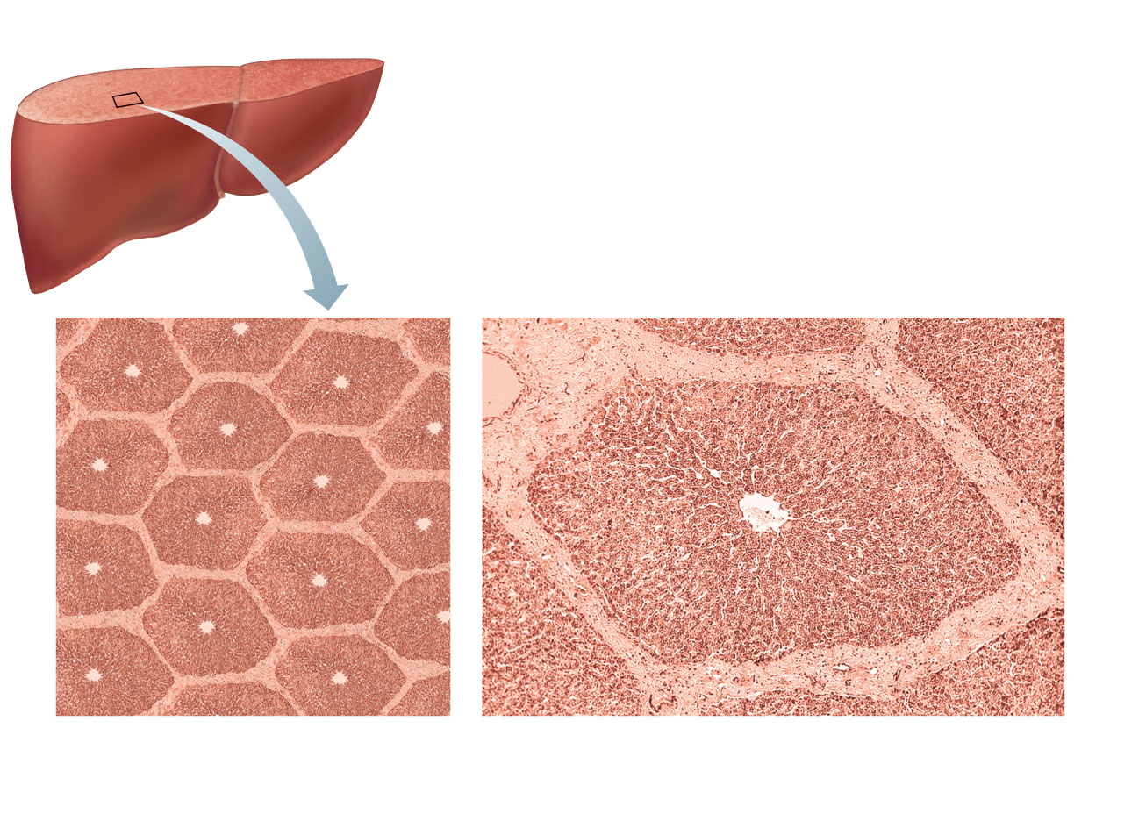
(a)
Lobule
(b)
Central vein
Connective
tissue septum
Figure 23.25a, b

Slide 85
Liver: Microscopic Anatomy
Portal triad at each corner of lobule
Bile duct receives bile from bile canaliculi
Portal arteriole is a branch of the hepatic artery
Hepatic venule is a branch of the hepatic portal vein
Liver sinusoids are leaky capillaries between hepatic plates
Kupffer cells (hepatic macrophages) in liver sinusoids

Slide 86
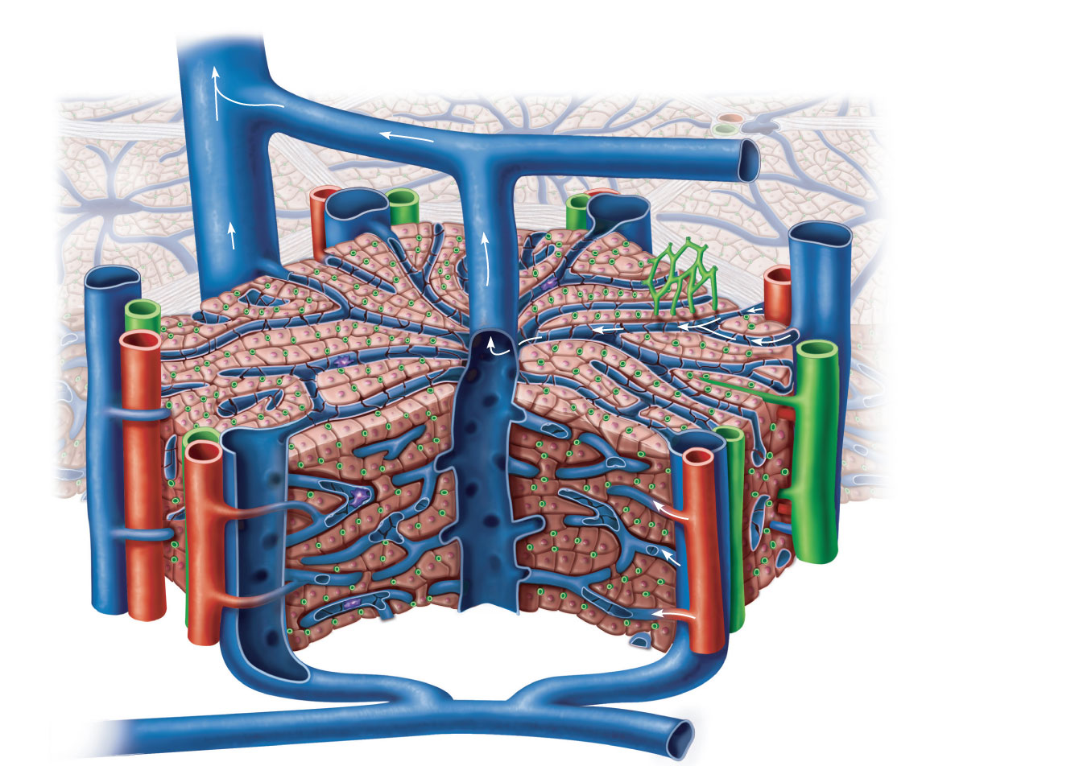
Interlobular veins
(to hepatic vein)
Central vein
Sinusoids
Plates of
hepatocytes
Bile canaliculi
Bile duct (receives
bile from bile
canaliculi)
Fenestrated
lining (endothelial
cells) of sinusoids
Bile duct
Hepatic
macrophages
in sinusoid walls
Portal venule
Portal triad
Portal arteriole
Portal vein
(c)
Figure 23.25c

Slide 87
Liver: Microscopic Anatomy
Hepatocyte functions
Process bloodborne nutrients
Store fat-soluble vitamins
Perform detoxification
Produce ~900 ml bile per day

Slide 88
Bile
Yellow-green, alkaline solution containing
Bile salts: cholesterol derivatives that function in fat emulsification and absorption
Bilirubin: pigment formed from heme
Cholesterol, neutral fats, phospholipids, and electrolytes

Slide 89
Bile
Enterohepatic circulation
Recycles bile salts
Bile salts → duodenum → reabsorbed from ileum → hepatic portal blood → liver → secreted into bile

Slide 90
The Gallbladder
Thin-walled muscular sac on the ventral surface of the liver
Stores and concentrates bile by absorbing its water and ions
Releases bile via the cystic duct, which flows into the bile duct

Slide 91
Pancreas
Location
Mostly retroperitoneal, deep to the greater curvature of the stomach
Head is encircled by the duodenum; tail abuts the spleen

Slide 92
Pancreas
Endocrine function
Pancreatic islets secrete insulin and glucagon
Exocrine function
Acini (clusters of secretory cells) secrete pancreatic juice
Zymogen granules of secretory cells contain digestive enzymes

Slide 93
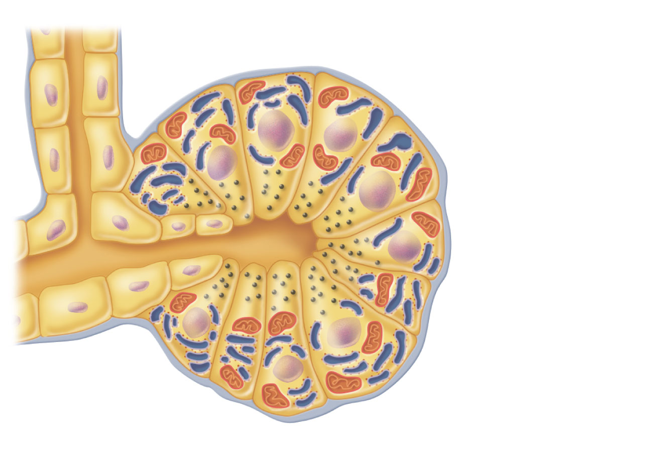
Small
duct
Acinar cells
Basement
membrane
Zymogen
granules
Rough
endoplasmic
reticulum
(a)
Figure 23.26a

Slide 94
Pancreatic Juice
Watery alkaline solution (pH 8) neutralizes chyme
Electrolytes (primarily HCO₃–)
Enzymes
Amylase, lipases, nucleases are secreted in active form but require ions or bile for optimal activity
Proteases secreted in inactive form

Slide 95
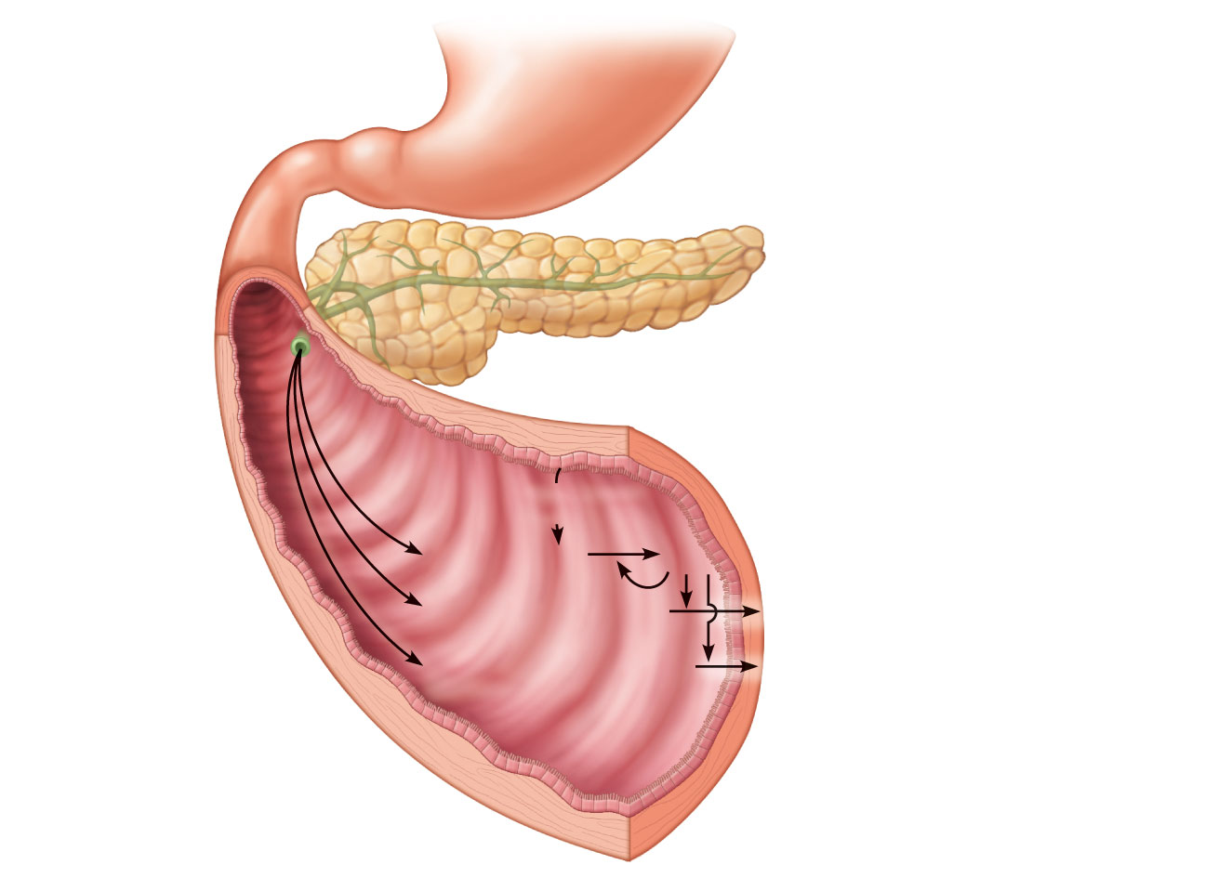
Stomach
Pancreas
Epithelial
cells
Membrane-bound
enteropeptidase
Trypsinogen
(inactive)
Chymotrypsinogen
(inactive)
Procarboxypeptidase
(inactive)
Trypsin
Chymotrypsin
Carboxypeptidase
Figure 23.27

Slide 96
Regulation of Bile Secretion
Bile secretion is stimulated by
Bile salts in enterohepatic circulation
Secretin from intestinal cells exposed to HCl and fatty chyme
Gallbladder contraction is stimulated by
Cholecystokinin (CCK) from intestinal cells exposed to proteins and fat in chyme
Vagal stimulation (minor stimulus)
CCK also causes hepatopancreatic sphincter to relax

Slide 97
Regulation of Pancreatic Secretion
CCK induces the secretion of enzyme-rich pancreatic juice by acini
Secretin causes secretion of bicarbonate-rich pancreatic juice by duct cells
Vagal stimulation also causes release of pancreatic juice (minor stimulus)

Slide 98
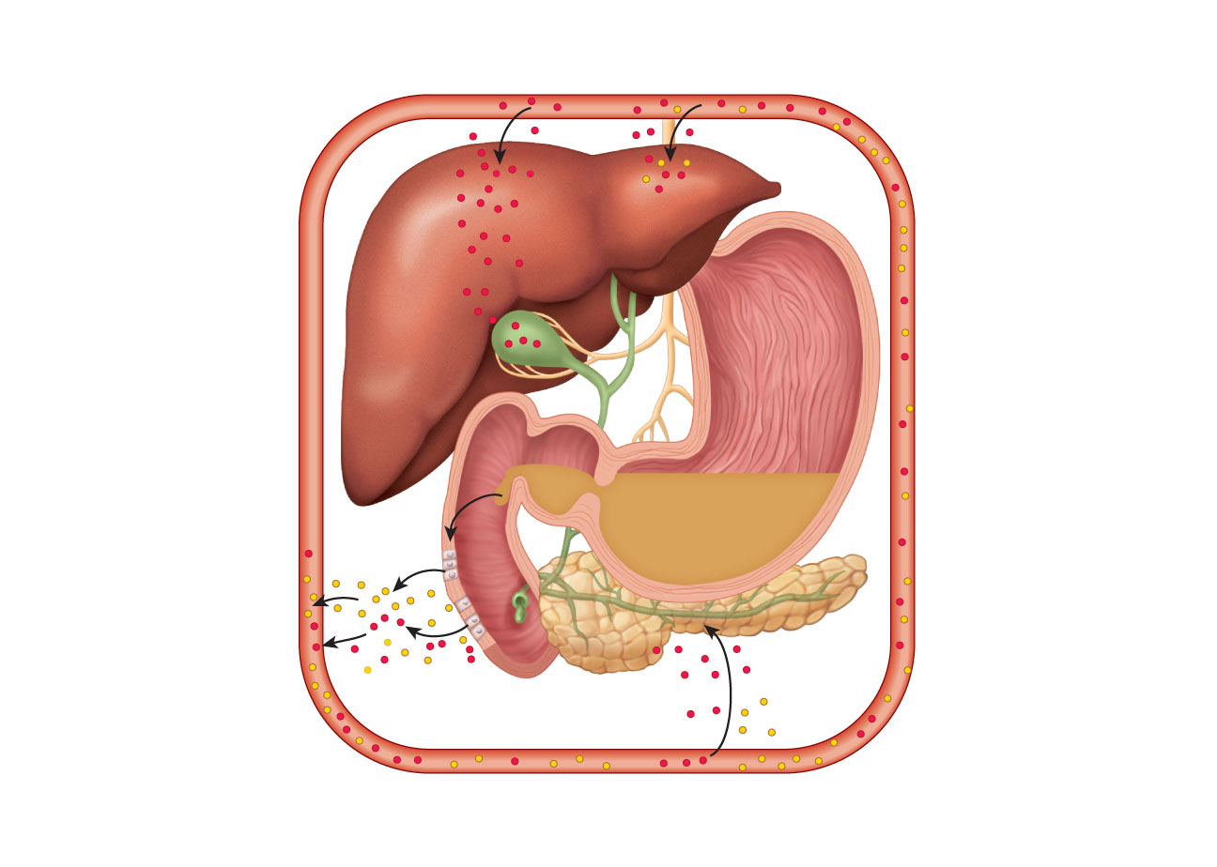
Slide 1
1
4
Chyme enter-
ing duodenum
causes release of
cholecystokinin
(CCK) and
secretin from
duodenal
enteroendocrine
cells.
Bile salts and,
to a lesser extent,
secretin
transported via
bloodstream
stimulate liver to
produce bile
more rapidly.
5
CCK (via
bloodstream)
causes
gallbladder to
contract and
hepatopancreatic
sphincter to
relax; bile enters
duodenum.
2
CCK (red
dots) and
secretin (yellow
dots) enter the
bloodstream.
3
CCK induces
secretion of
enzyme-rich
pancreatic juice.
Secretin causes
secretion of
HCO₃–-rich
pancreatic juice.
6
During
cephalic and
gastric phases,
vagal nerve
stimulation
causes weak
contractions of
gallbladder.
Figure 23.28

Slide 99
Digestion in the Small Intestine
Chyme from stomach contains
Partially digested carbohydrates and proteins
Undigested fats

Slide 100
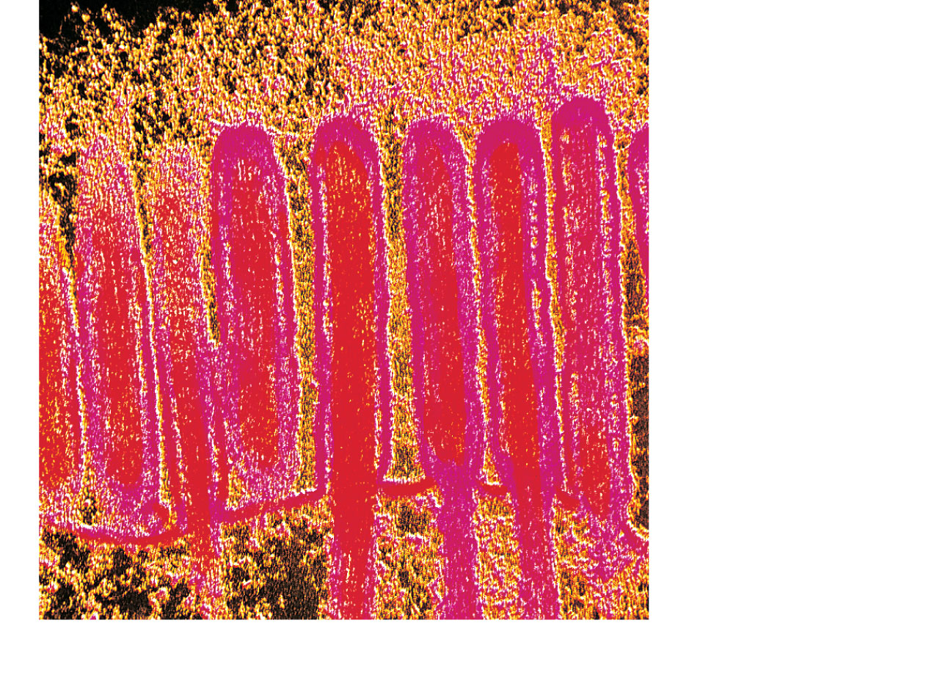
Microvilli
Absorptive
cell
(b)
Figure 23.3b

Slide 101
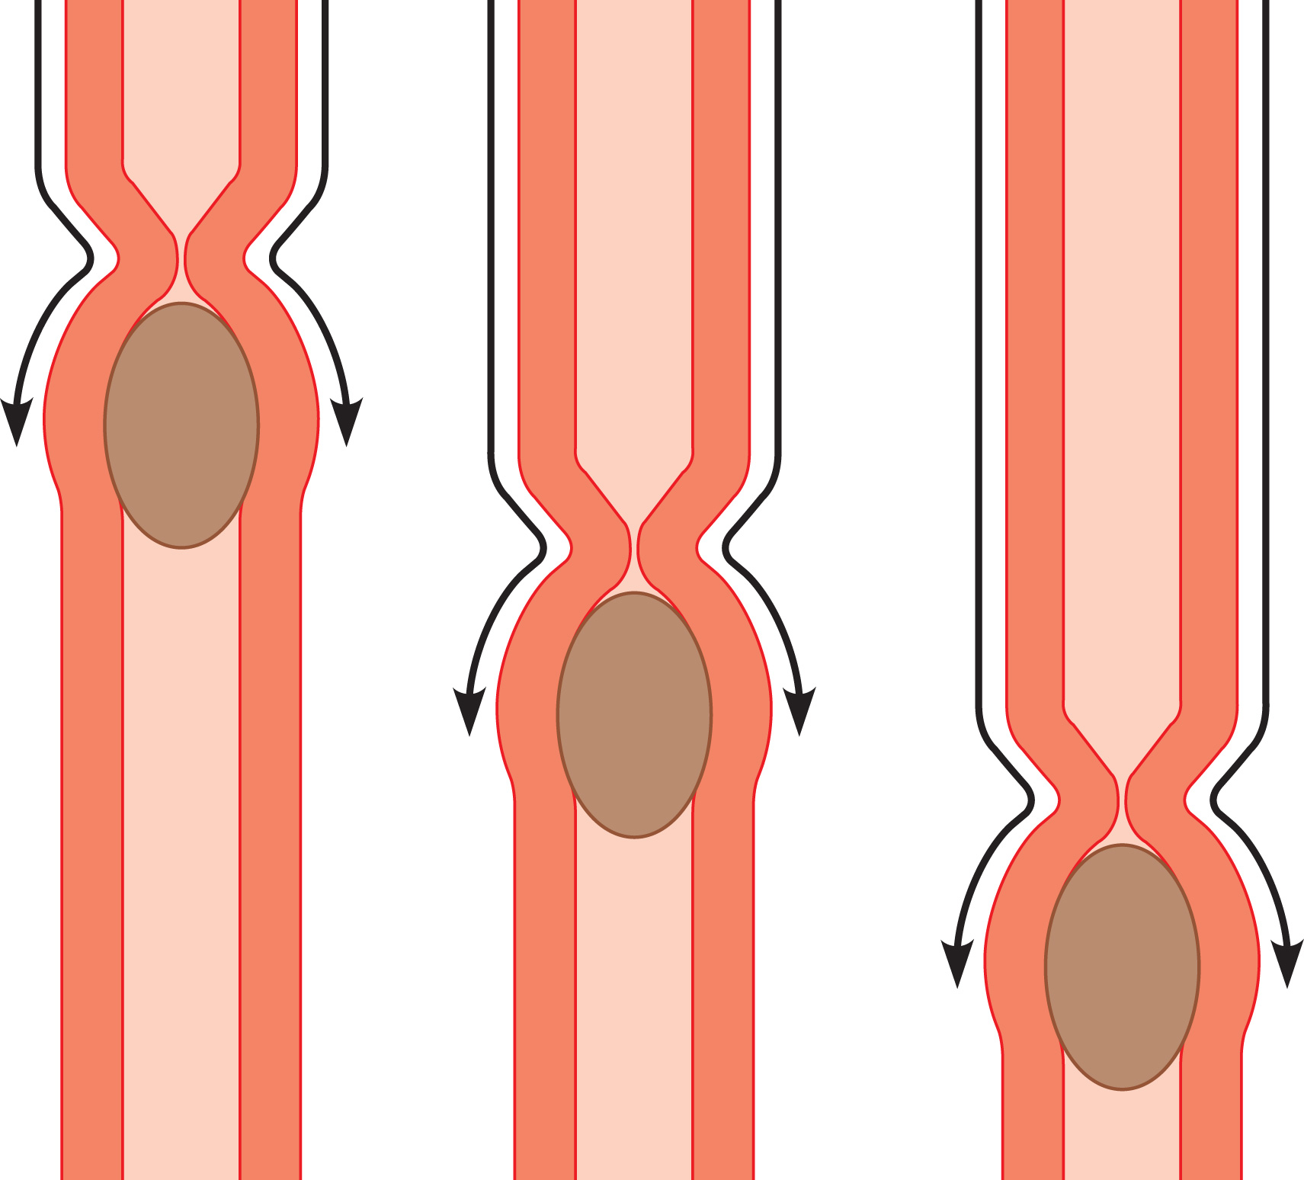
From mouth
(a) Peristalsis: Adjacent segments of alimentary
tract organs alternately contract and relax,
which moves food along the tract distally.
Figure 23.3a

Slide 102
Motility of the Small Intestine
Ileocecal sphincter relaxes and admits chyme into the large intestine when
Gastroileal reflex enhances the force of segmentation in the ileum
Gastrin increases the motility of the ileum
Ileocecal valve flaps close when chyme exerts backward pressure

Slide 103
Large Intestine
Unique features
Teniae coli
Three bands of longitudinal smooth muscle in the muscularis
Haustra
Pocketlike sacs caused by the tone of the teniae coli
Epiploic appendages
Fat-filled pouches of visceral peritoneum

Slide 104
Large Intestine
Regions
Cecum (pouch with attached vermiform appendix)
Colon (Ascending, Descending, Transverse & Sigmoid)
Rectum
Anal canal (with 2 sphincters)

Slide 105
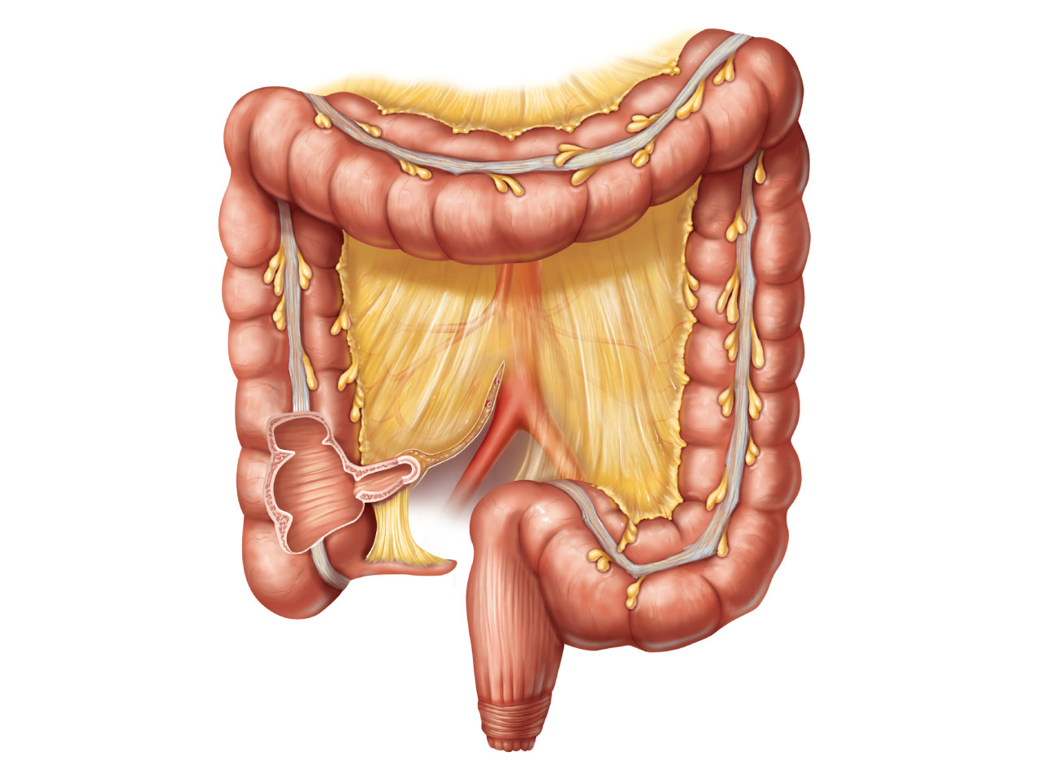
Right colic
(hepatic)
flexure
Left colic
(splenic) flexure
Transverse
mesocolon
Transverse
colon
Epiploic
appendages
Superior
mesenteric
artery
Descending
colon
Haustrum
Ascending
colon
Cut edge of
mesentery
IIeum
Teniae coli
IIeocecal
valve
Sigmoid
colon
Cecum
Vermiform appendix
Rectum
Anal canal
External anal sphincter
(a)
Figure 23.29a

Slide 106
Colon
Ascending colon and descending colon are retroperitoneal
Transverse colon and sigmoid colon are anchored via mesocolons (mesenteries)

Slide 107
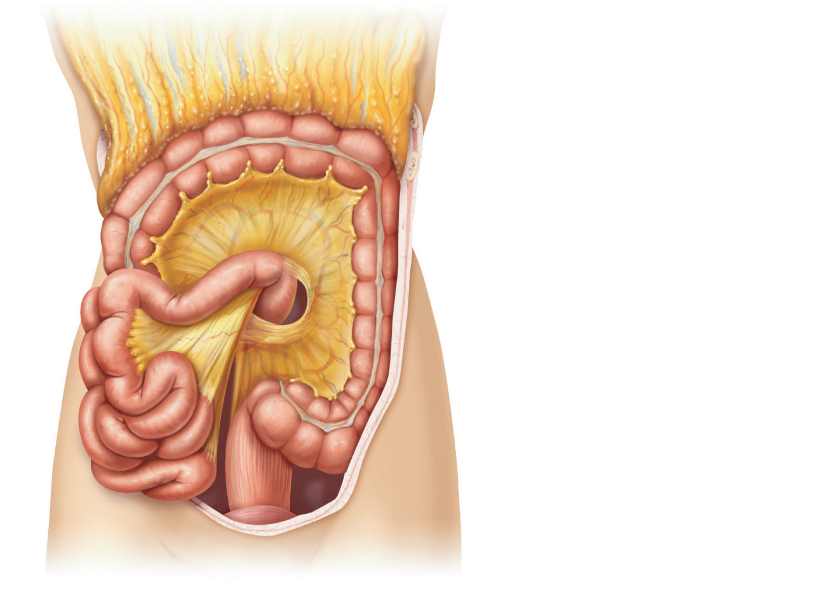
Greater omentum
Transverse colon
Transverse
mesocolon
Descending colon
Jejunum
Mesentery
Sigmoid
mesocolon
Sigmoid colon
Ileum
(c)
Figure 23.30c

Slide 108
Rectum and Anus
Rectum
Three rectal valves stop feces from being passed with gas
Anal canal
The last segment of the large intestine
Sphincters
Internal anal sphincter—smooth muscle
External anal sphincter—skeletal muscle

Slide 109
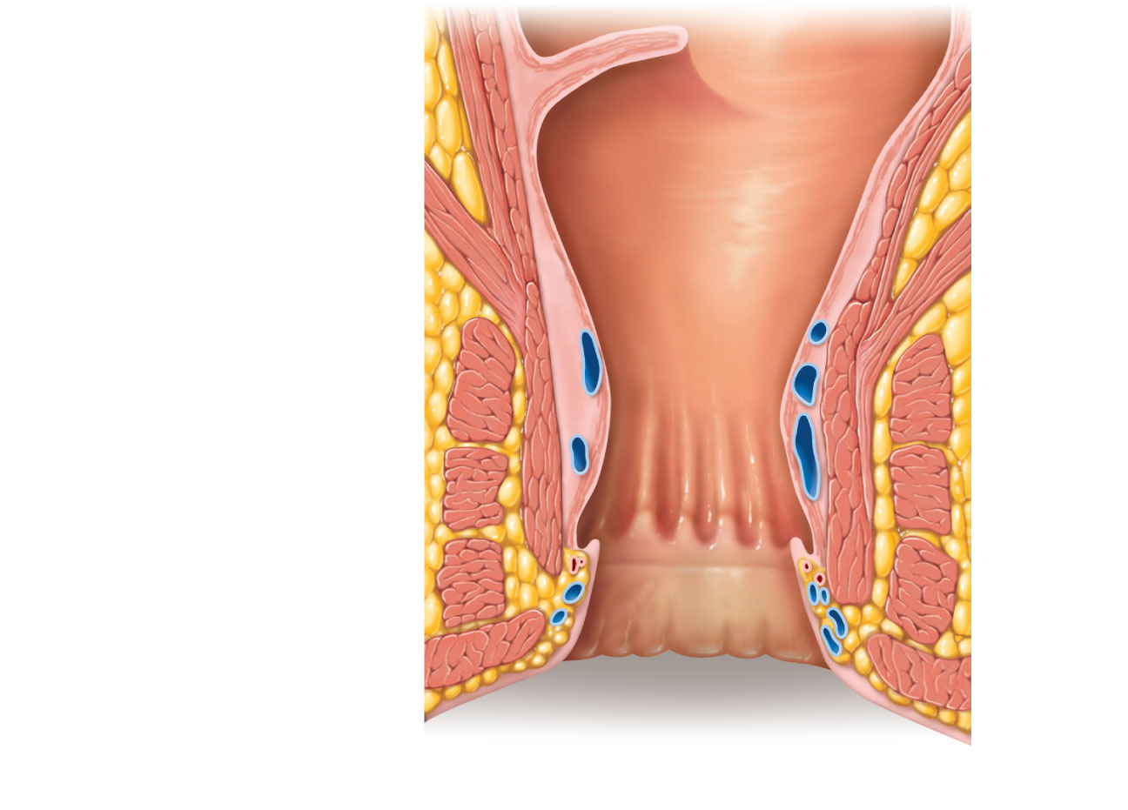
Rectal valve
Rectum
Hemorrhoidal
veins
Levator ani
muscle
Anal canal
External anal
sphincter
Internal anal
sphincter
Anal columns
Pectinate line
Anal sinuses
Anus
(b)
Figure 23.29b

Slide 110
Bacterial Flora
Enter from the small intestine or anus
Colonize the colon
Ferment indigestible carbohydrates
Release irritating acids and gases
Synthesize B complex vitamins and vitamin K

Slide 111
Functions of the Large Intestine
Vitamins, water, and electrolytes are reclaimed
Major function is propulsion of feces toward the anus
Colon is not essential for life

Slide 112
Motility of the Large Intestine
Haustral contractions
Slow segmenting movements
Haustra sequentially contract in response to distension

Slide 113
Motility of the Large Intestine
Gastrocolic reflex
Initiated by presence of food in the stomach
Activates three to four slow powerful peristaltic waves per day in the colon (mass movements)

Slide 114
Defecation
Mass movements force feces into rectum
Distension initiates spinal defecation reflex
Parasympathetic signals
Stimulate contraction of the sigmoid colon and rectum
Relax the internal anal sphincter
Conscious control allows relaxation of external anal sphincter

Slide 115
Chemical Digestion
Catabolic
Enzymatic
Hydrolysis

Slide 116
Chemical Digestion and Absorption of Carbohydrates
Digestive enzymes
Salivary amylase, pancreatic amylase, and brush border enzymes (dextrinase, glucoamylase, lactase, maltase, and sucrase)

Slide 117
Chemical Digestion and Absorption of Carbohydrates
Absorption
Secondary active transport (cotransport) with Na⁺
Facilitated diffusion of some monosaccharides
Enter the capillary beds in the villi
Transported to the liver via the hepatic portal vein

Slide 118
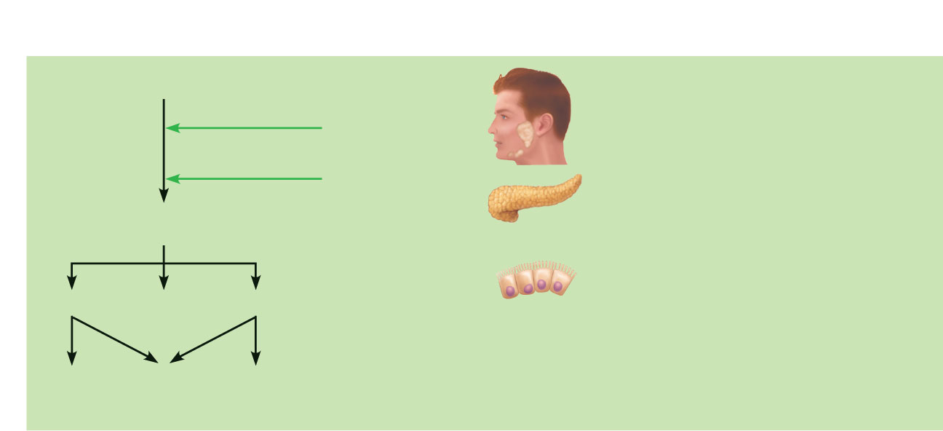
Carbohydrate digestion
Enzyme(s)
and source
Site of
action
Foodstuff
Path of absorption
Starch and disaccharides
• Glucose and galactose
are absorbed via
cotransport with
sodium ions.
Salivary
amylase
Mouth
Pancreatic
amylase
Small
intestine
• Fructose passes via
facilitated diffusion.
Oligosaccharides
and disaccharides
• All monosaccharides
leave the epithelial
cells via facilitated
diffusion, enter the
capillary blood in the
villi, and are
transported to the liver
via the hepatic portal
vein.
Brush border
enzymes in
small intestine
(dextrinase, gluco-
amylase, lactase,
maltase, and sucrase)
Small
intestine
Lactose
Maltose
Sucrose
Galactose
Glucose
Fructose
Figure 23.32 (1 of 4)

Slide 119
Chemical Digestion and Absorption of Proteins
Enzymes: pepsin in the stomach
Pancreatic proteases
Trypsin, chymotrypsin, and carboxypeptidase
Brush border enzymes
Aminopeptidases, carboxypeptidases, and dipeptidases
Absorption of amino acids is coupled to active transport of Na⁺

Slide 120
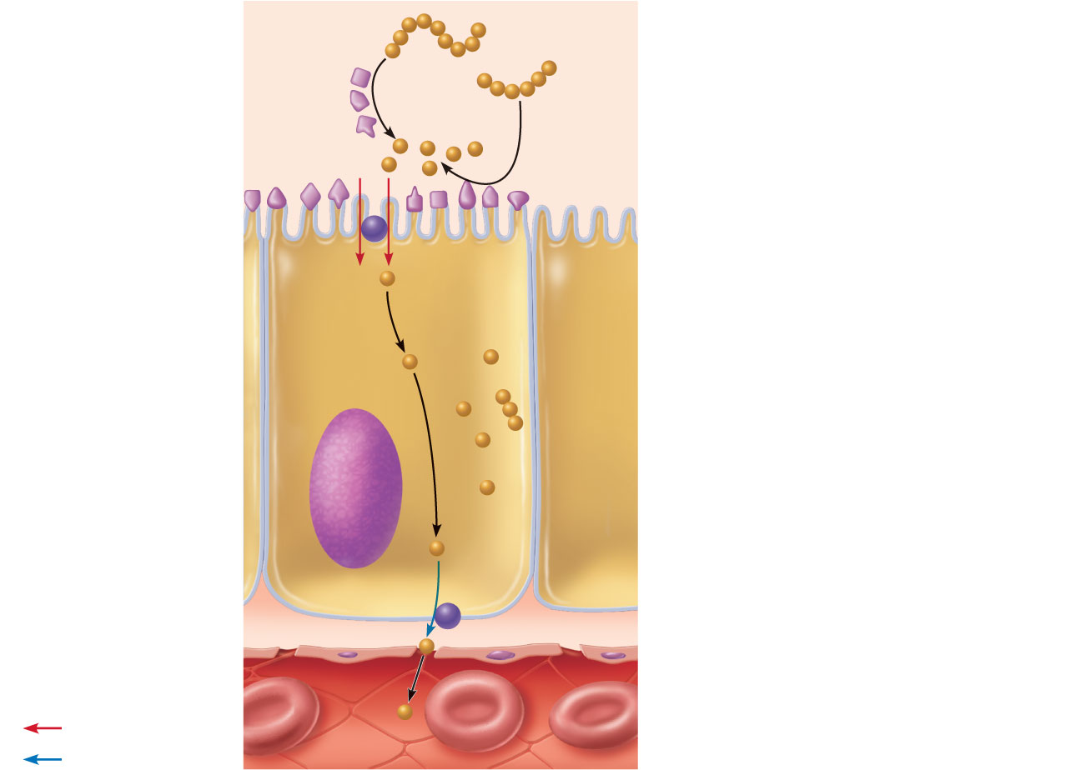
Lumen of
intestine
Amino acids of protein fragments
Brush border enzymes
Apical membrane (microvilli)
Pancreatic
proteases
1
Proteins and protein fragments
are digested to amino acids by
pancreatic proteases (trypsin,
chymotrypsin, and carboxy-
peptidase), and by brush border
enzymes (carboxypeptidase,
aminopeptidase, and dipeptidase)
of mucosal cells.
Na⁺
Na⁺
Absorptive
epithelial
cell
2
The amino acids are then
absorbed by active transport into
the absorptive cells, and move to
their opposite side (transcytosis).
Amino
acid
carrier
3
The amino acids leave the
villus epithelial cell by facilitated
diffusion and enter the capillary
via intercellular clefts.
Active transport
Capillary
Passive transport
Figure 23.33

Slide 121
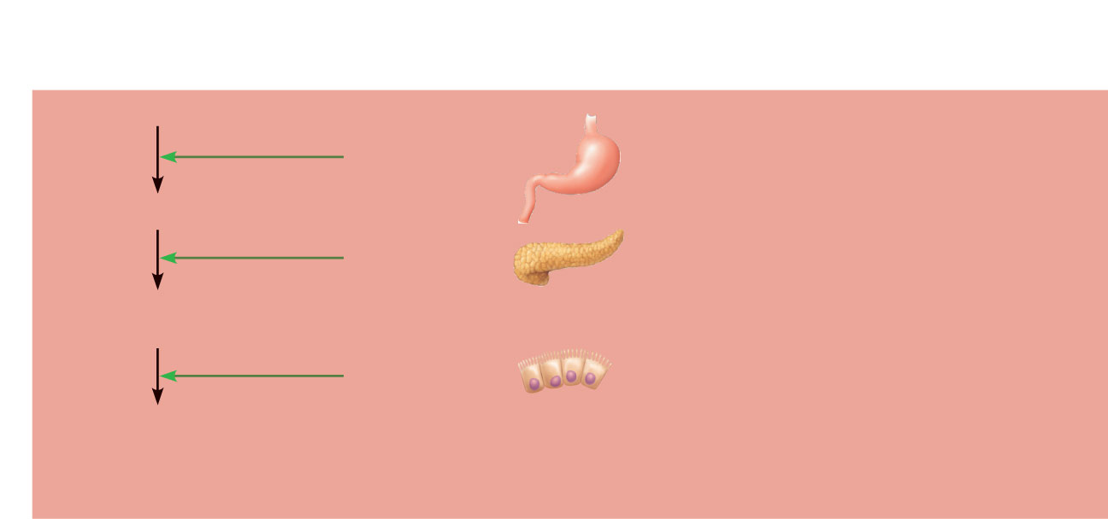
Protein digestion
Enzyme(s)
and source
Site of
action
Foodstuff
Path of absorption
Protein
Pepsin
(stomach glands)
in presence
of HCl
• Amino acids are absorbed
by cotransport with
sodium ions.
Stomach
Large polypeptides
• Some dipeptides and
tripeptides are absorbed
via cotransport with H⁺
and hydrolyzed to amino
acids within the cells.
Pancreatic
enzymes
(trypsin, chymotrypsin,
carboxypeptidase)
Small
intestine
+
Small polypeptides,
small peptides
• Amino acids leave the
epithelial cells by
facilitated diffusion, enter
the capillary blood in the
villi, and are transported
to the liver via the hepatic
portal vein.
Brush border
enzymes
(aminopeptidase,
carboxypeptidase,
and dipeptidase)
Small
intestine
Amino acids
(some dipeptides
and tripeptides)
Figure 23.32 (2 of 4)

Slide 122
Chemical Digestion and Absorption of Lipids
Pre-treatment—emulsification by bile salts
Enzymes—pancreatic lipase
Absorption of glycerol and short chain fatty acids
Absorbed into the capillary blood in villi
Transported via the hepatic portal vein

Slide 123
Chemical Digestion and Absorption of Lipids
Absorption of monoglycerides and fatty acids
Cluster with bile salts and lecithin to form micelles
Released by micelles to diffuse into epithelial cells
Combine with proteins to form chylomicrons
Enter lacteals and are transported to systemic circulation

Slide 124
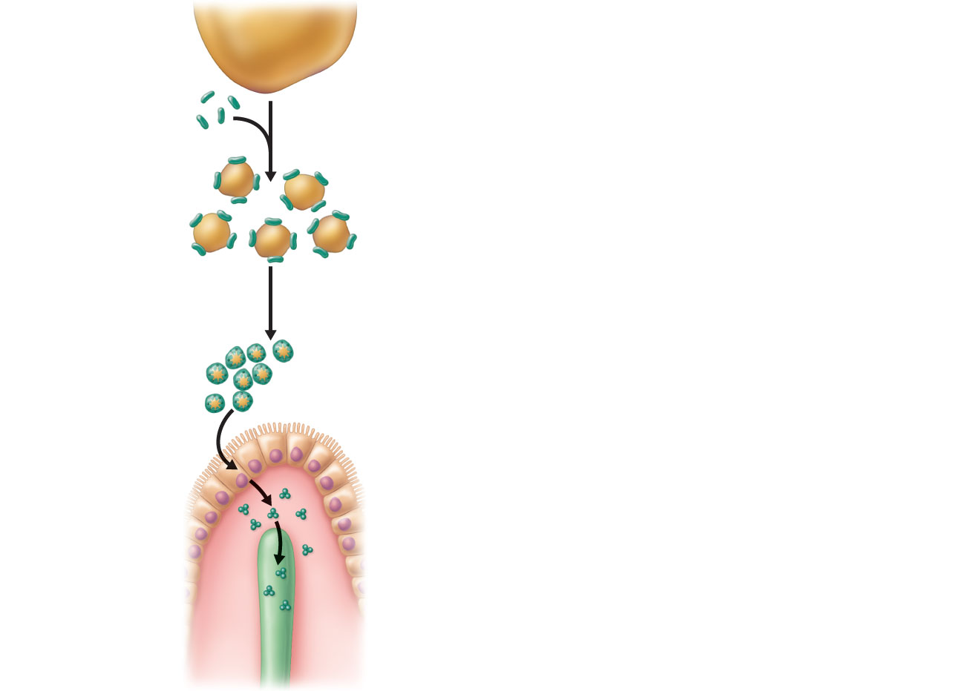
Fat globule
1
Large fat globules are emulsified
(physically broken up into smaller fat
droplets) by bile salts in the duodenum.
Bile salts
2
Digestion of fat by the pancreatic
enzyme lipase yields free fatty acids and
monoglycerides. These then associate
with bile salts to form micelles which
“ferry” them to the intestinal mucosa.
Fat droplets
coated with
bile salts
Micelles made up of fatty
acids, monoglycerides,
and bile salts
3
Fatty acids and monoglycerides leave
micelles and diffuse into epithelial cells.
There they are recombined and packaged
with other lipoid substances and proteins
to form chylomicrons.
4
Chylomicrons are extruded from the
epithelial cells by exocytosis. The
chylomicrons enter lacteals. They are
carried away from the intestine by lymph.
Epithelial
cells of
small
intestine
Lacteal
Figure 23.34

Slide 125
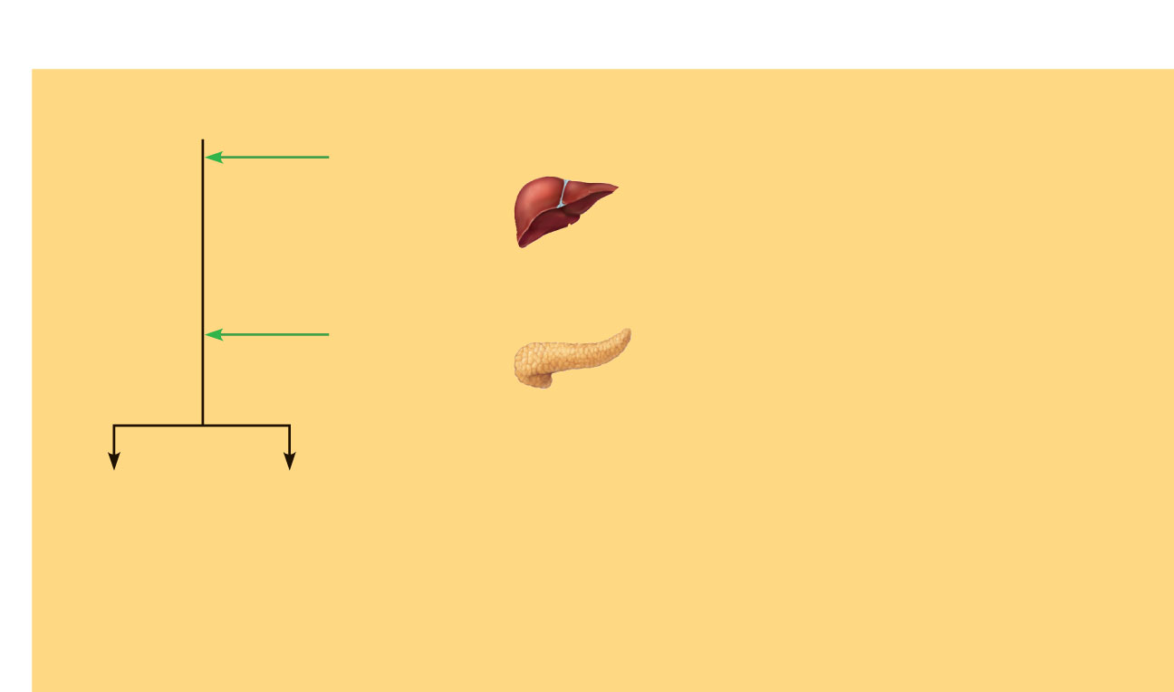
Fat digestion
Enzyme(s)
and source
Site of
action
Foodstuff
Path of absorption
Unemulsified
fats
• Fatty acids and monoglycerides
enter the intestinal cells via
diffusion.
Emulsification by
the detergent
action of bile
salts ducted
in from the liver
Small
intestine
• Fatty acids and monoglycerides
are recombined to form
triglycerides and then
combined with other lipids and
proteins within the cells, and
the resulting chylomicrons are
extruded by exocytosis.
Pancreatic
lipases
Small
intestine
• The chylomicrons enter the
lacteals of the villi and are
transported to the systemic
circulation via the lymph in the
thoracic duct.
Monoglycerides
and fatty acids
Glycerol
and
fatty acids
• Some short-chain fatty acids
are absorbed, move into the
capillary blood in the villi by
diffusion, and are transported
to the liver via the hepatic
portal vein.
Figure 23.32 (3 of 4)

Slide 126
Chemical Digestion and Absorption of Nucleic Acids
Enzymes
Pancreatic ribonuclease and deoxyribonuclease
Absorption
Active transport
Transported to liver via hepatic portal vein

Slide 127
Nucleic acid digestion
Enzyme(s)
and source
Site of
action
Foodstuff
Path of absorption
Nucleic acids
• Units enter intestinal cells
by active transport via
membrane carriers.
Pancreatic ribo-
nuclease and
deoxyribonuclease
Small
intestine
• Units are absorbed into
capillary blood in the villi
and transported to the
liver via the hepatic portal
vein.
Brush border
enzymes
(nucleosidases
and phosphatases)
Small
intestine
Pentose sugars,
N-containing bases,
phosphate ions
Figure 23.32 (4 of 4)

Slide 128
Vitamin Absorption
In small intestine
Fat-soluble vitamins (A, D, E, and K) are carried by micelles and then diffuse into absorptive cells
Water-soluble vitamins (vitamin C and B vitamins) are absorbed by diffusion or by passive or active transporters.
Vitamin B₁₂ binds with intrinsic factor, and is absorbed by endocytosis

Slide 129
Vitamin Absorption
In large intestine
Vitamin K and B vitamins from bacterial metabolism are absorbed

Slide 130
Electrolyte Absorption
Mostly along the length of small intestine
Iron and calcium are absorbed in duodenum
Na⁺ is coupled with absorption of glucose and amino acids
Ionic iron is stored in mucosal cells with ferritin
K⁺ diffuses in response to osmotic gradients
Ca²⁺ absorption is regulated by vitamin D and parathyroid hormone (PTH)

Slide 131
Water Absorption
95% is absorbed in the small intestine by osmosis
Net osmosis occurs whenever a concentration gradient is established by active transport of solutes
Water uptake is coupled with solute uptake

