Slide 1
Chapter 25
The Urinary System

Slide 2
Urinary System Organs
Kidneys are major excretory organs
Urinary bladder is the temporary storage reservoir for urine
Ureters transport urine from the kidneys to the bladder
Urethra transports urine out of the body

Slide 3
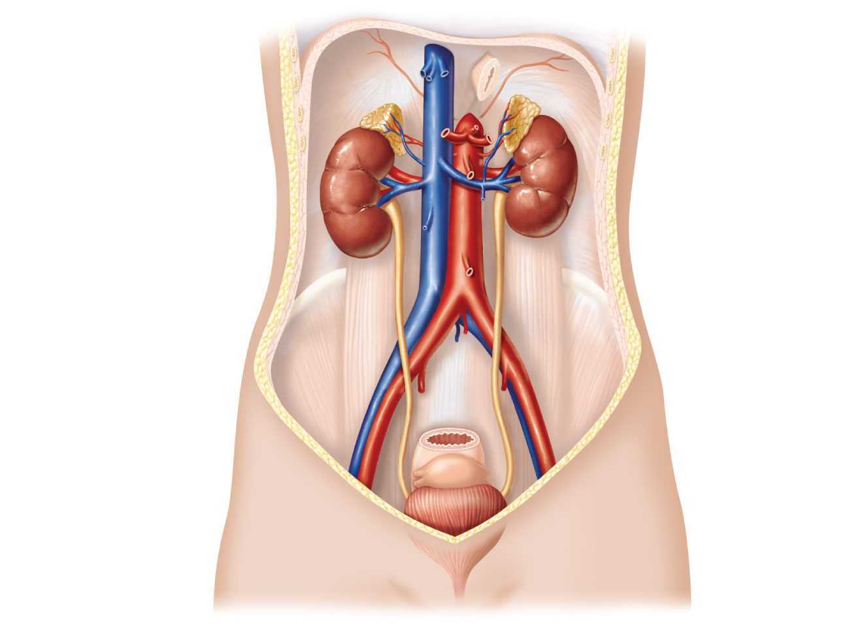
Hepatic veins (cut)
Esophagus (cut)
Inferior vena cava
Renal artery
Adrenal gland
Renal hilum
Aorta
Renal vein
Kidney
Iliac crest
Ureter
Rectum (cut)
Uterus (part
of female
reproductive
system)
Urinary
bladder
Urethra
Figure 25.1

Slide 4
Kidney Functions
Removal of toxins, metabolic wastes, and excess ions from the blood
Regulation of blood volume, chemical composition, and pH
Gluconeogenesis during prolonged fasting
Endocrine functions
Renin: regulation of blood pressure and kidney function
Erythropoietin: regulation of RBC production
Activation of vitamin D

Slide 5
Kidney Anatomy
Retroperitoneal, in the superior lumbar region
Right kidney is lower than the left
Convex lateral surface, concave medial surface
Renal hilum leads to the renal sinus
Ureters, renal blood vessels, lymphatics, and nerves enter and exit at the hilum

Slide 6
Kidney Anatomy
Layers of supportive tissue
Renal fascia
The anchoring outer layer of dense fibrous connective tissue
Perirenal fat capsule
A fatty cushion
Fibrous capsule
Prevents spread of infection to kidney

Slide 7
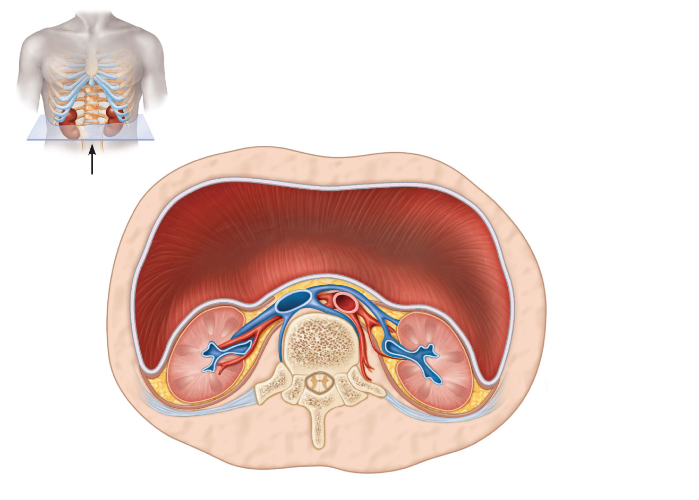
Anterior
Inferior vena cava
Peritoneal cavity
(organs removed)
Aorta
Peritoneum
Supportive
tissue layers
Renal
vein
• Renal fascia
anterior
posterior
Renal
artery
• Perirenal
fat capsule
Body of
vertebra L₂
• Fibrous
capsule
Body wall
(a)
Posterior
Figure 25.2a

Slide 8
Internal Anatomy
Renal cortex – Granular superficial region
Renal medulla – Cone-shaped medullary (renal) pyramids separated by renal columns
Lobe – Medullary pyramid & surrounding cortical tissue
Papilla - Tip of pyramid; releases urine into minor calyx
Renal pelvis – Funnel-shaped tube within the renal sinus
Major calyces – Branching channels of the renal pelvis that collect urine from minor calyces & empty urine into the pelvis
Renal Pelvis - Urine flows from the pelvis to ureter

Slide 9
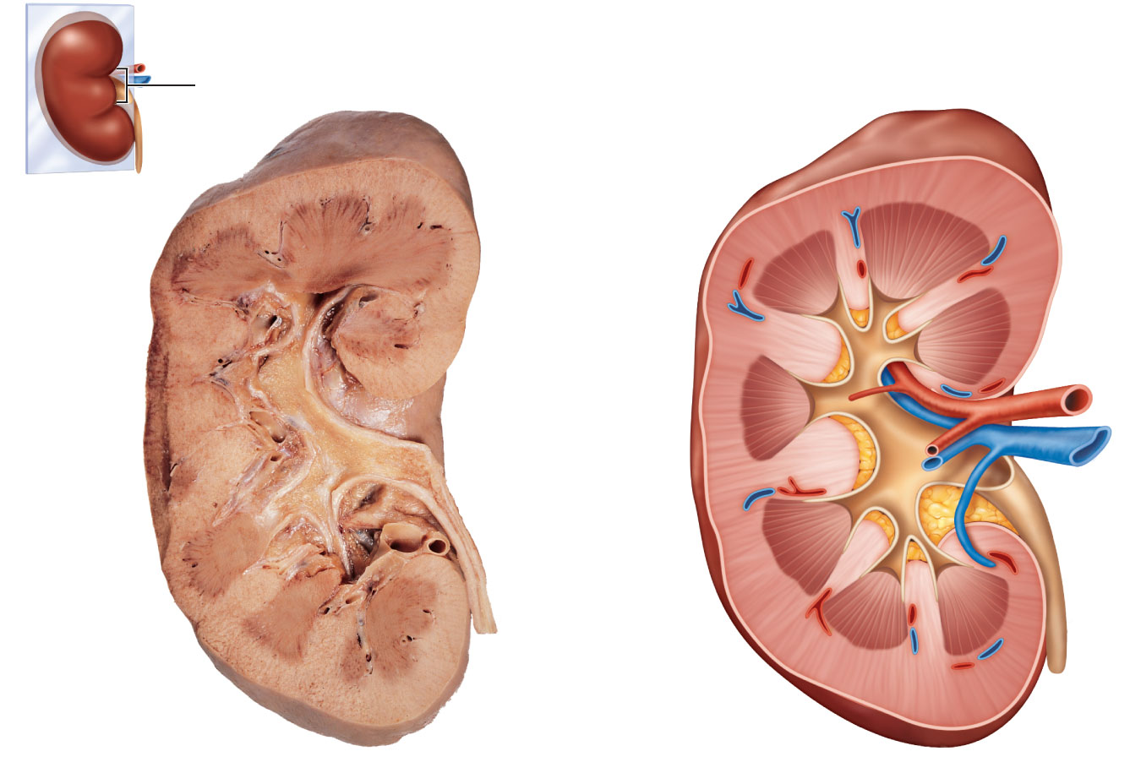
Renal
hilum
Renal cortex
Renal medulla
Major calyx
Papilla of
pyramid
Renal pelvis
Minor calyx
Ureter
Renal pyramid
in renal medulla
Renal column
Fibrous capsule
(a) Photograph of right kidney, frontal section
(b) Diagrammatic view
Figure 25.3

Slide 10
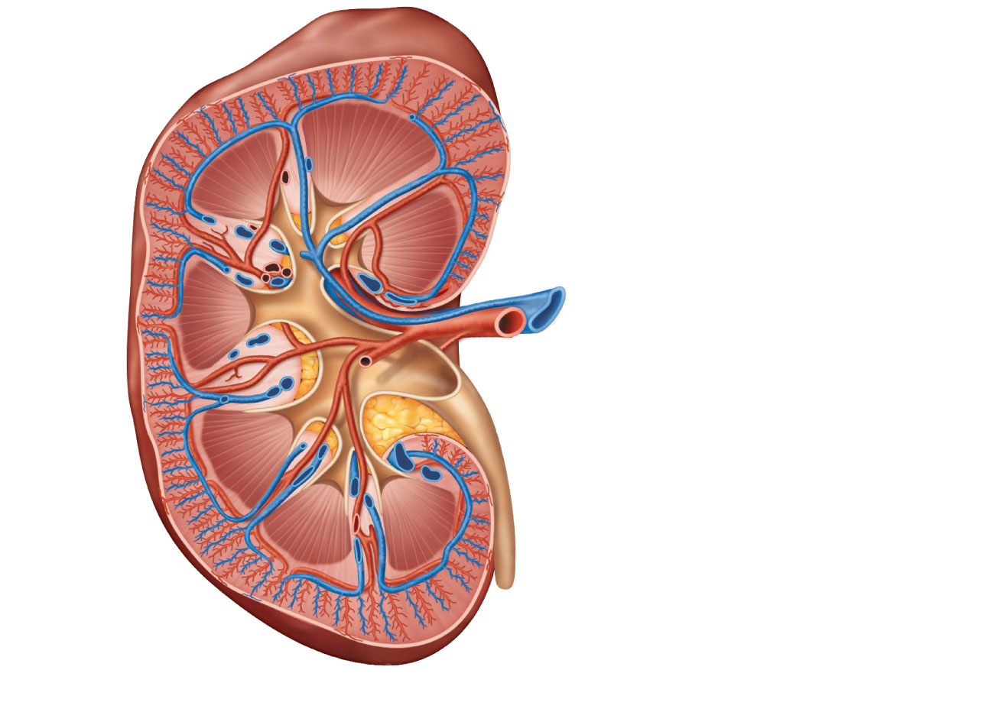
Cortical radiate vein
Cortical radiate artery
Arcuate vein
Arcuate artery
Interlobar vein
Interlobar artery
Segmental arteries
Renal vein
Renal artery
Renal pelvis
Ureter
Renal medulla
Renal cortex
(a) Frontal section illustrating major blood vessels
Figure 25.4a

Slide 11
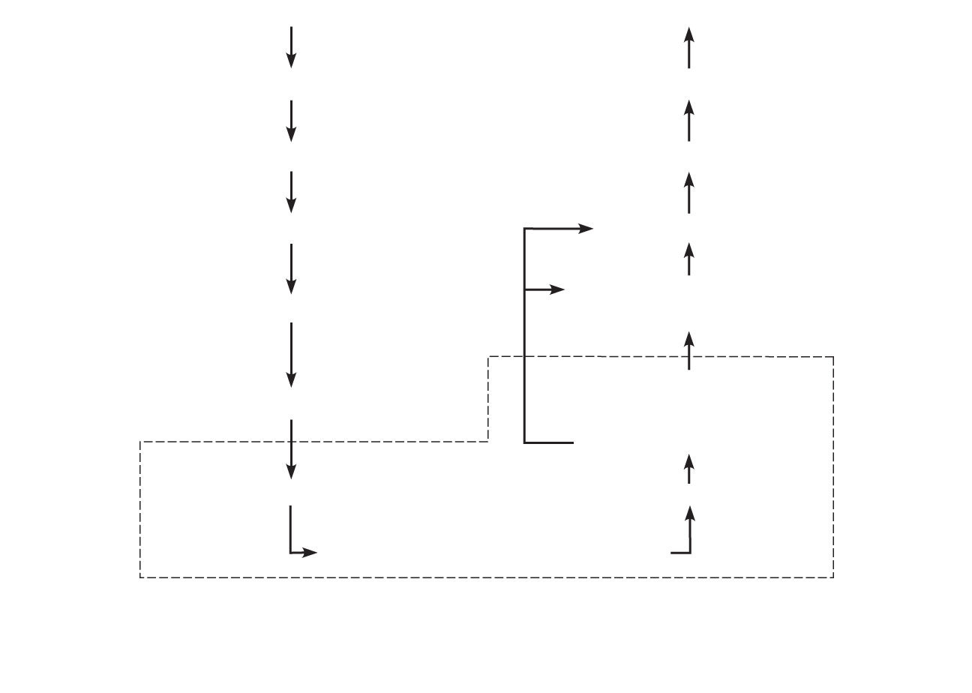
Aorta
Inferior vena cava
Renal artery
Renal vein
Segmental artery
Interlobar vein
Interlobar artery
Arcuate vein
Cortical radiate
vein
Arcuate artery
Peritubular
capillaries
and vasa recta
Cortical radiate artery
Afferent arteriole
Efferent arteriole
Glomerulus (capillaries)
Nephron-associated blood vessels
(see Figure 25.7)
(b) Path of blood flow through renal blood vessels
Figure 25.4b

Slide 12
Nephrons
Structural and functional units that form urine
~1 million per kidney
Two main parts
Glomerulus: a tuft of capillaries
Renal tubule: begins as cup-shaped glomerular (Bowman’s) capsule surrounding the glomerulus

Slide 13
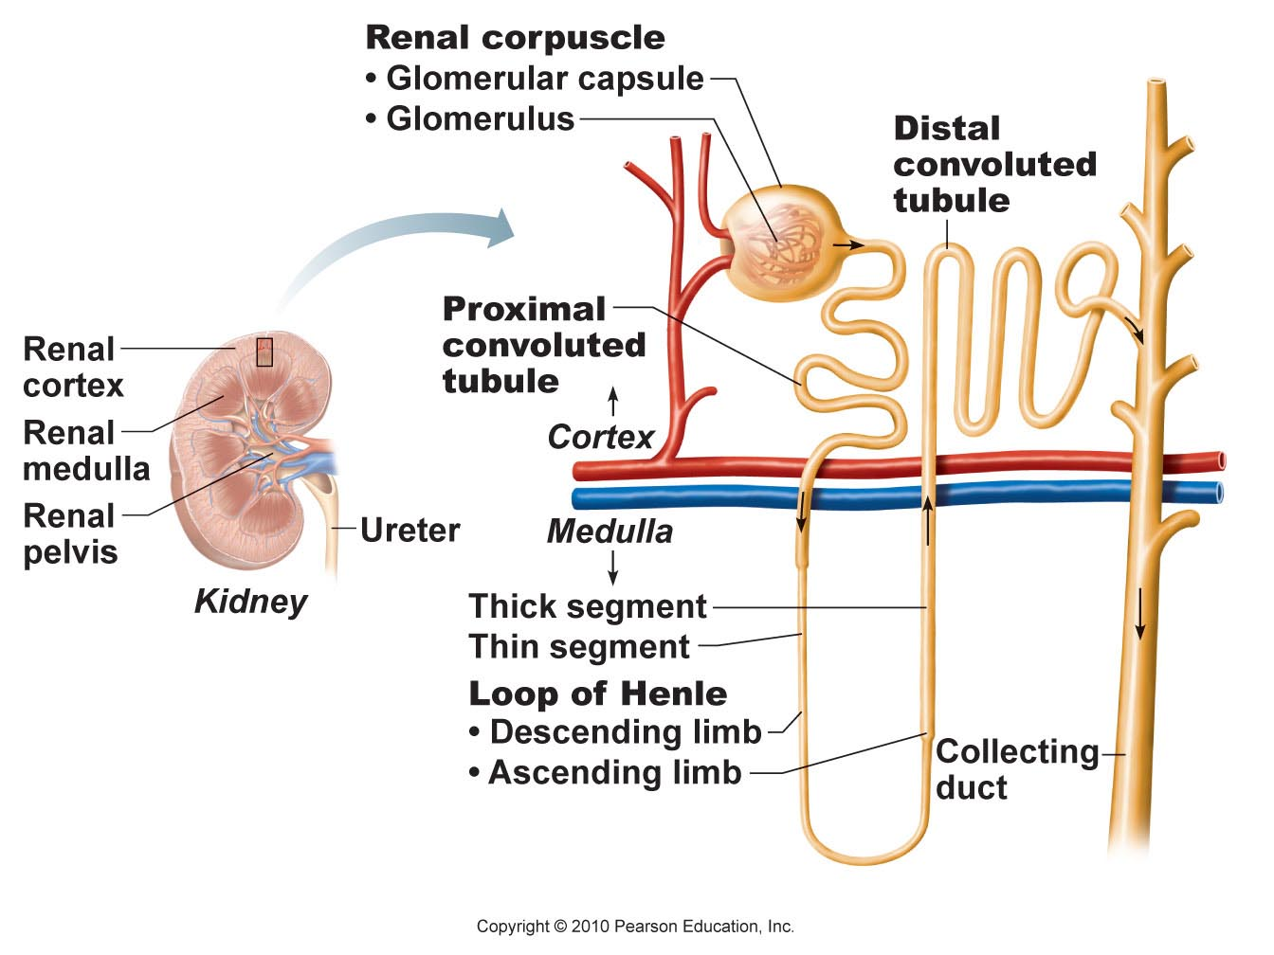
Figure 25.5

Slide 14
Ureters
Convey urine from kidneys to bladder
Retroperitoneal
Enter the base of the bladder through the posterior wall
As bladder pressure increases, distal ends of the ureters close, preventing backflow of urine

Slide 15
Ureters
Three layers of wall of ureter
Lining of transitional epithelium
Smooth muscle muscularis
Contracts in response to stretch
Outer adventitia of fibrous connective tissue

Slide 16
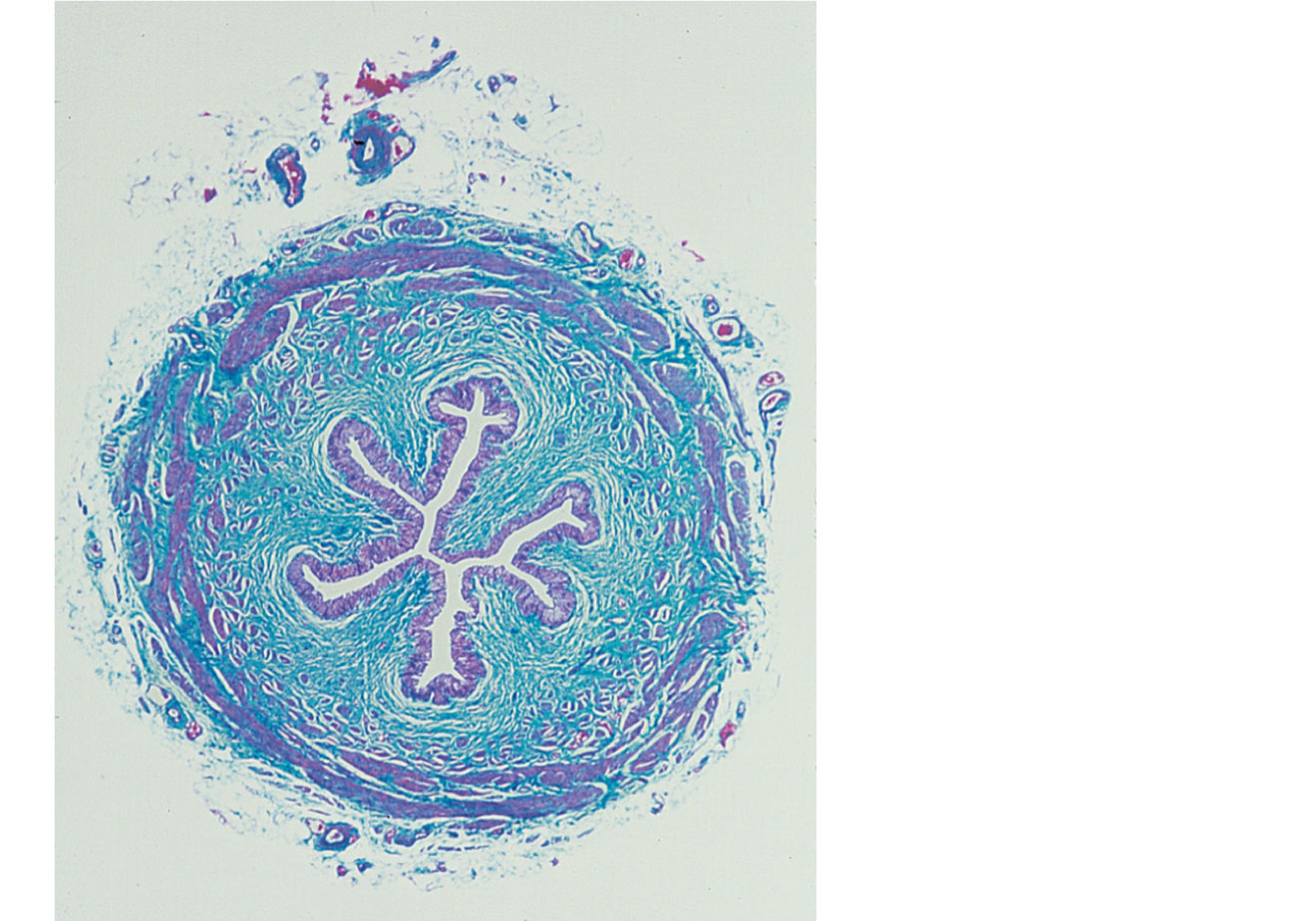
Lumen
Adventitia
Circular
layer
Longitudinal
layer
Transitional
epithelium
Lamina
propria
Figure 25.20

Slide 17
Renal Calculi
Kidney stones form in renal pelvis
Crystallized calcium, magnesium, or uric acid salts
Larger stones block ureter, cause pressure and pain in kidneys
May be due to chronic bacterial infection, urine retention, ↑Ca²⁺ in blood, ↑pH of urine

Slide 18
Urinary Bladder
Muscular sac for temporary storage of urine
Retroperitoneal, on pelvic floor posterior to pubic symphysis
Males—prostate gland surrounds the neck inferiorly
Females—anterior to the vagina and uterus

Slide 19
Urinary Bladder
Trigone
Smooth triangular area outlined by the openings for the ureters and the urethra
Infections tend to persist in this region

Slide 20
Urinary Bladder
Layers of the bladder wall
Transitional epithelial mucosa
Thick detrusor muscle (three layers of smooth muscle)
Fibrous adventitia (peritoneum on superior surface only)

Slide 21
Urinary Bladder
Collapses when empty; rugae appear
Expands and rises superiorly during filling without significant rise in internal pressure

Slide 22
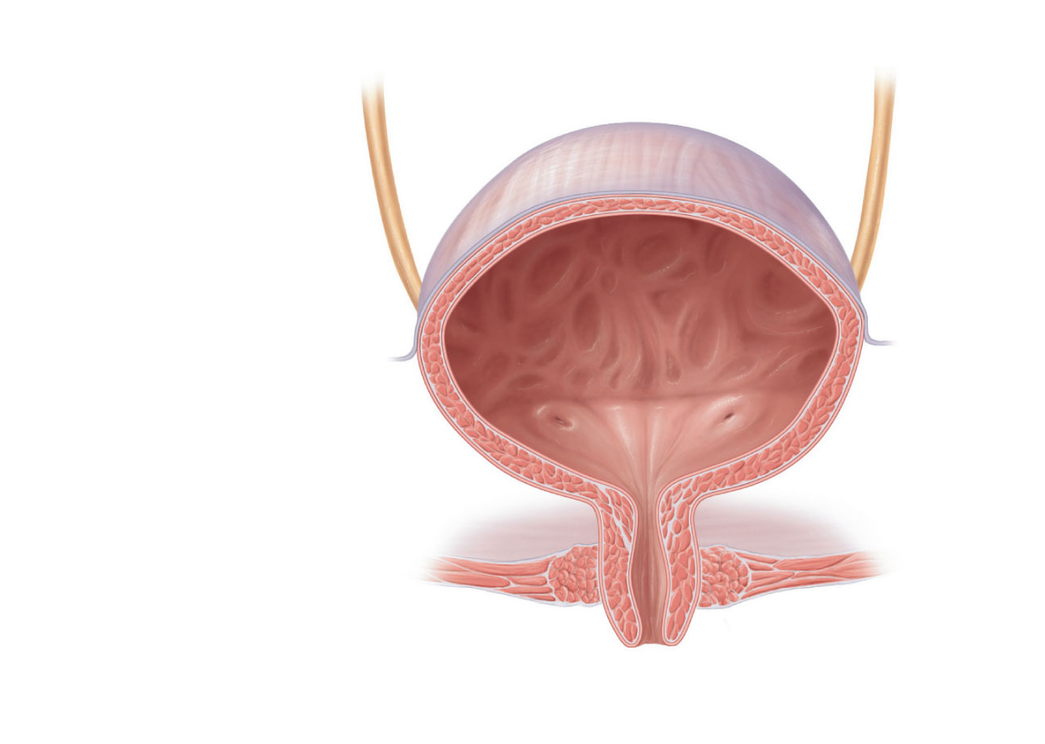
Peritoneum
Ureter
Rugae
Detrusor
muscle
Ureteric orifices
Bladder neck
Internal urethral
sphincter
Trigone
External urethral
sphincter
Urogenital diaphragm
Urethra
External urethral
orifice
(b) Female.
Figure 25.21b

Slide 23
Urethra
Muscular tube
Lining epithelium
Mostly pseudostratified columnar epithelium, except
Transitional epithelium near bladder
Stratified squamous epithelium near external urethral orifice

Slide 24
Urethra
Sphincters
Internal urethral sphincter
Involuntary (smooth muscle) at bladder-urethra junction
Contracts to open
External urethral sphincter
Voluntary (skeletal) muscle surrounding the urethra as it passes through the pelvic floor

Slide 25
Urethra
Female urethra (3–4 cm):
Tightly bound to the anterior vaginal wall
External urethral orifice is anterior to the vaginal opening, posterior to the clitoris

Slide 26
Peritoneum
Ureter
Rugae
Detrusor
muscle
Ureteric orifices
Bladder neck
Internal urethral
sphincter
Trigone
External urethral
sphincter
Urogenital diaphragm
Urethra
External urethral
orifice
(b) Female.
Figure 25.21b

Slide 27
Urethra
Male urethra
Carries semen and urine
Three named regions
Prostatic urethra (2.5 cm)—within prostate gland
Membranous urethra (2 cm)—passes through the urogenital diaphragm
Spongy urethra (15 cm)—passes through the penis and opens via the external urethral orifice

Slide 28
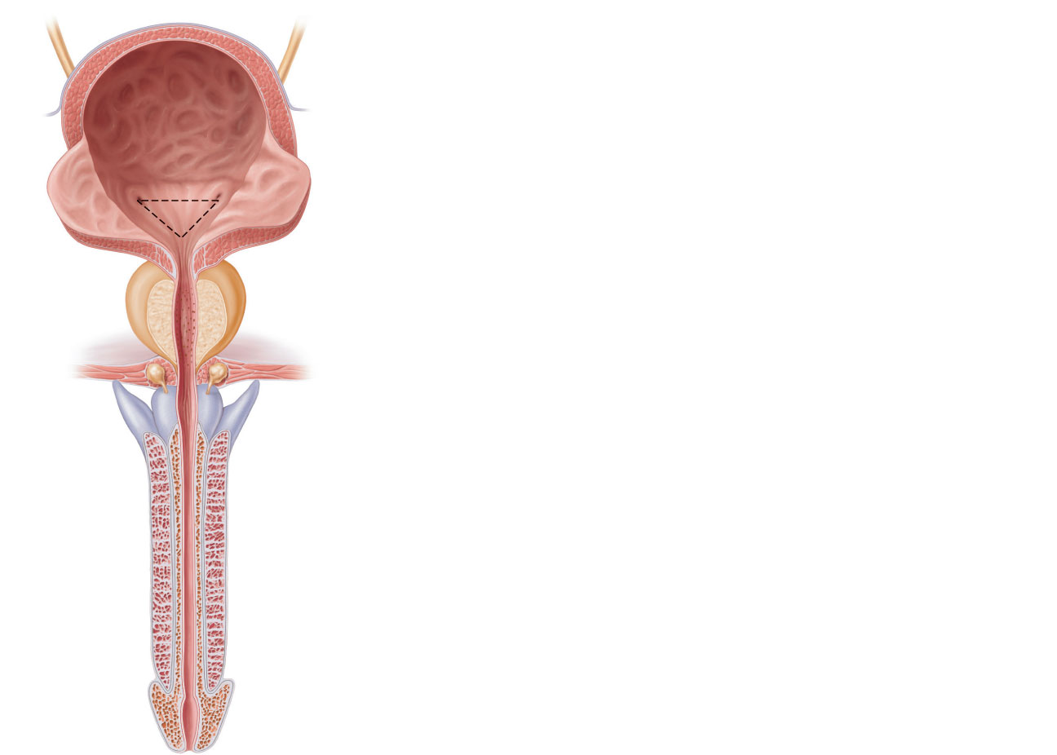
Peritoneum
Ureter
Rugae
Detrusor muscle
Adventitia
Ureteric orifices
Trigone of bladder
Bladder neck
Internal urethral sphincter
Prostate
Prostatic urethra
Urogenital diaphragm
External urethral sphincter
Membranous urethra
Spongy urethra
Erectile tissue of penis
External urethral orifice
(a) Male. The long male urethra has three
regions: prostatic, membranous and spongy.
Figure 25.21a

Slide 29
Micturition
Urination or voiding
Three simultaneous events
Contraction of detrusor muscle by ANS
Opening of internal urethral sphincter by ANS
Opening of external urethral sphincter by somatic nervous system

Slide 30
Micturition
Reflexive urination (urination in infants)
Distension of bladder activates stretch receptors
Excitation of parasympathetic neurons in reflex center in sacral region of spinal cord
Contraction of the detrusor muscle
Contraction (opening) of internal sphincter
Inhibition of somatic pathways to external sphincter, allowing its relaxation (opening)

Slide 31
Micturition
Pontine control centers mature between ages 2 and 3
Pontine storage center inhibits micturition:
Inhibits parasympathetic pathways
Excites sympathetic and somatic efferent pathways
Pontine micturition center promotes micturition:
Excites parasympathetic pathways
Inhibits sympathetic and somatic efferent pathways

Slide 32
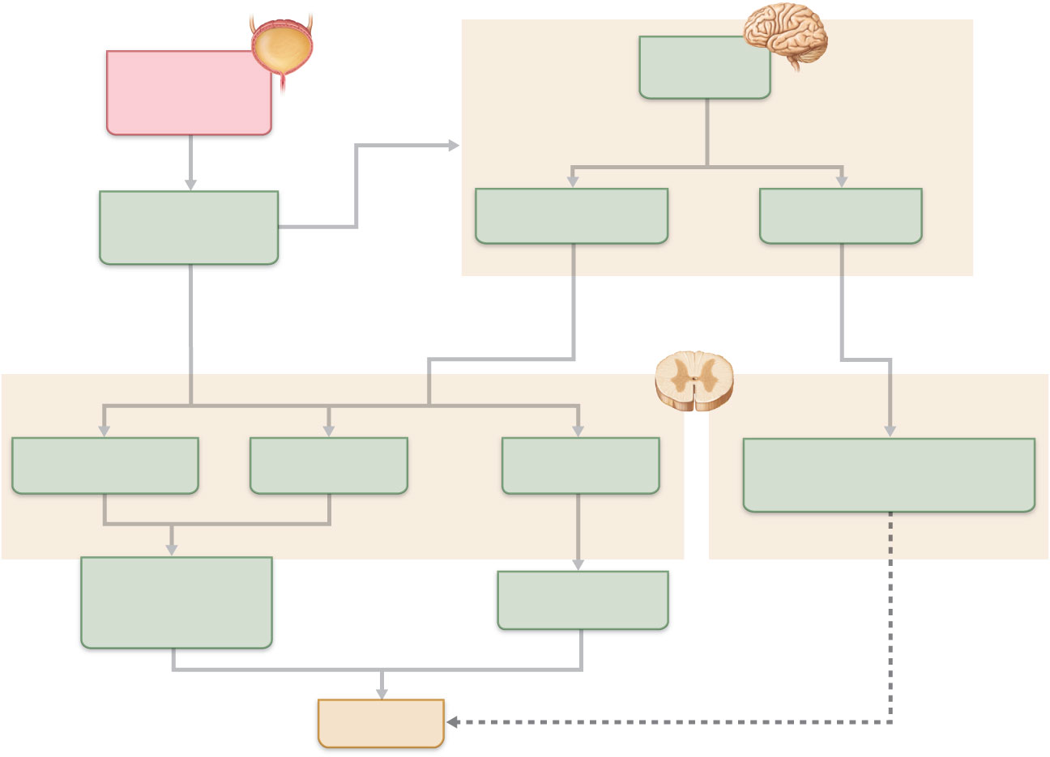
Brain
Urinary bladder
filling stretches
bladder wall
Higher brain
centers
Allow or inhibit micturition
as appropriate
Afferent impulses
from stretch
receptors
Pontine micturition
center
Pontine storage
center
Simple
spinal
reflex
Promotes micturition
by acting on all three
spinal efferents
Inhibits micturition
by acting on all three
spinal efferents
Spinal
cord
Spinal
cord
Parasympathetic
activity
Sympathetic
activity
Somatic motor
nerve activity
Parasympathetic activity
Sympathetic activity
Somatic motor nerve activity
Detrusor muscle
contracts; internal
urethral sphincter
opens
External urethral
sphincter opens
Micturition
Inhibits
Figure 25.22

Slide 33
Three Basic Processes Of The Nephron
Filtration – separating fluid from large particles in the blood to make urine
Reabsorption – drawing nutrients and other substances out of the urine, to keep in the body
Secretion – adding substances to the urine for removal from the body

Slide 34
Nephrons
Renal corpuscle
Glomerulus + its glomerular capsule
Fenestrated glomerular endothelium
Allows filtrate to pass from plasma into the glomerular capsule
Glomerular capsule
Parietal layer: simple squamous epithelium
Visceral layer: branching epithelial podocytes
Extensions terminate in foot processes that cling to basement membrane
Filtration slits allow filtrate to pass into the capsular space

Slide 35
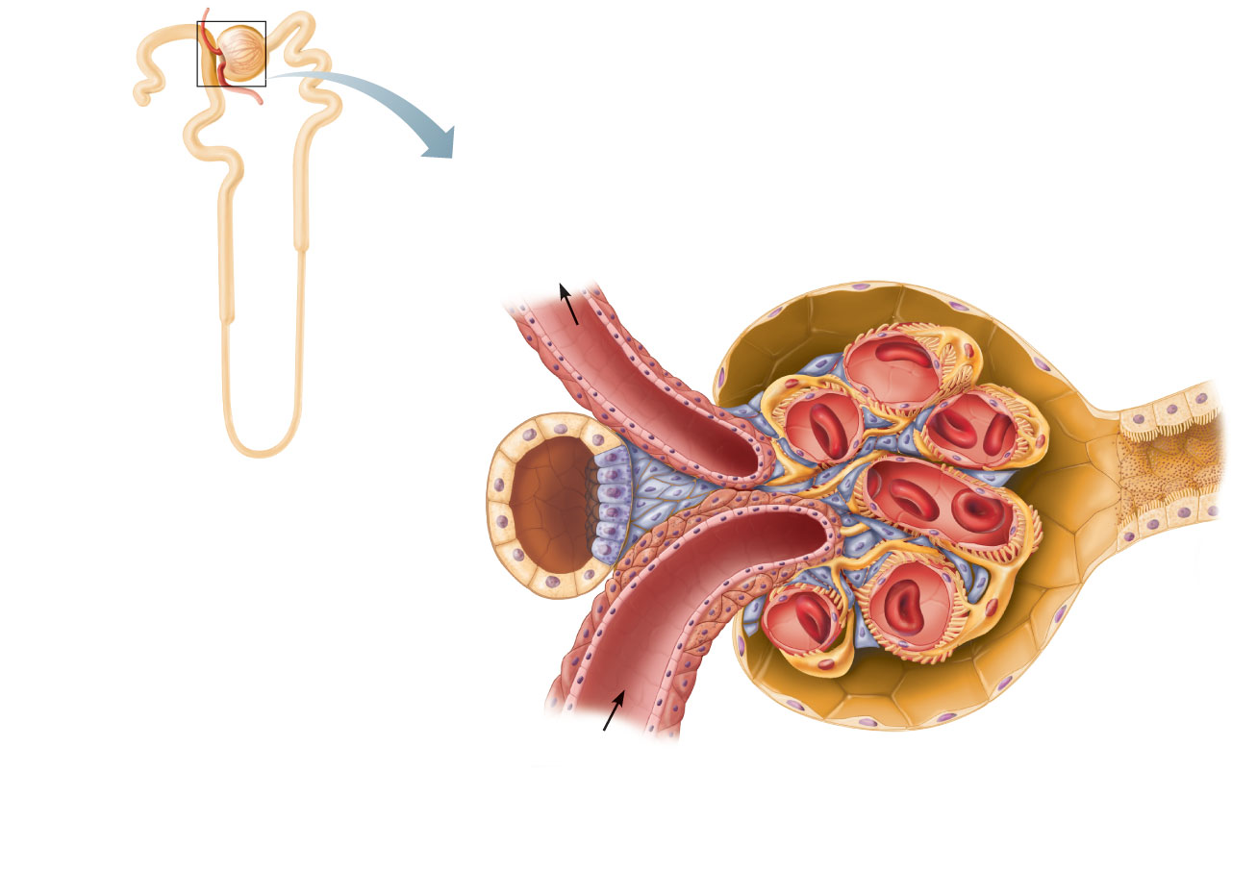
Efferent
arteriole
Glomerular capsule
Glomerulus
Afferent
arteriole
Foot processes
of podocytes
Parietal layer
of glomerular
capsule
Podocyte cell
body (visceral
layer)
Capsular
space
Red blood cell
Efferent
arteriole
Proximal
tubule cell
Juxtaglomerular
apparatus
• Macula densa cells
of the ascending limb
of loop of Henle
Lumens of
glomerular
capillaries
• Extraglomerular
mesangial cells
• Granular cells
Endothelial cell
of glomerular
capillary
Afferent arteriole
Mesangial cells
between capillaries
Juxtaglomerular
apparatus
Renal corpuscle
Figure 25.8

Slide 36
Renal Tubule
Proximal convoluted tubule (PCT)
Cuboidal cells with dense microvilli and large mitochondria
Functions in reabsorption and secretion
Confined to the cortex

Slide 37
Renal Tubule
Loop of Henle with descending and ascending limbs
Thin segment usually in descending limb
Simple squamous epithelium
Freely permeable to water
Thick segment of ascending limb
Cuboidal to columnar cells

Slide 38
Renal Tubule
Distal convoluted tubule (DCT)
Cuboidal cells with very few microvilli
Function more in secretion than reabsorption
Confined to the cortex

Slide 39
Collecting Ducts
Receive filtrate from many nephrons
Fuse together to deliver urine through papillae into minor calyces
Cuboidal to columnar epithelium

Slide 40
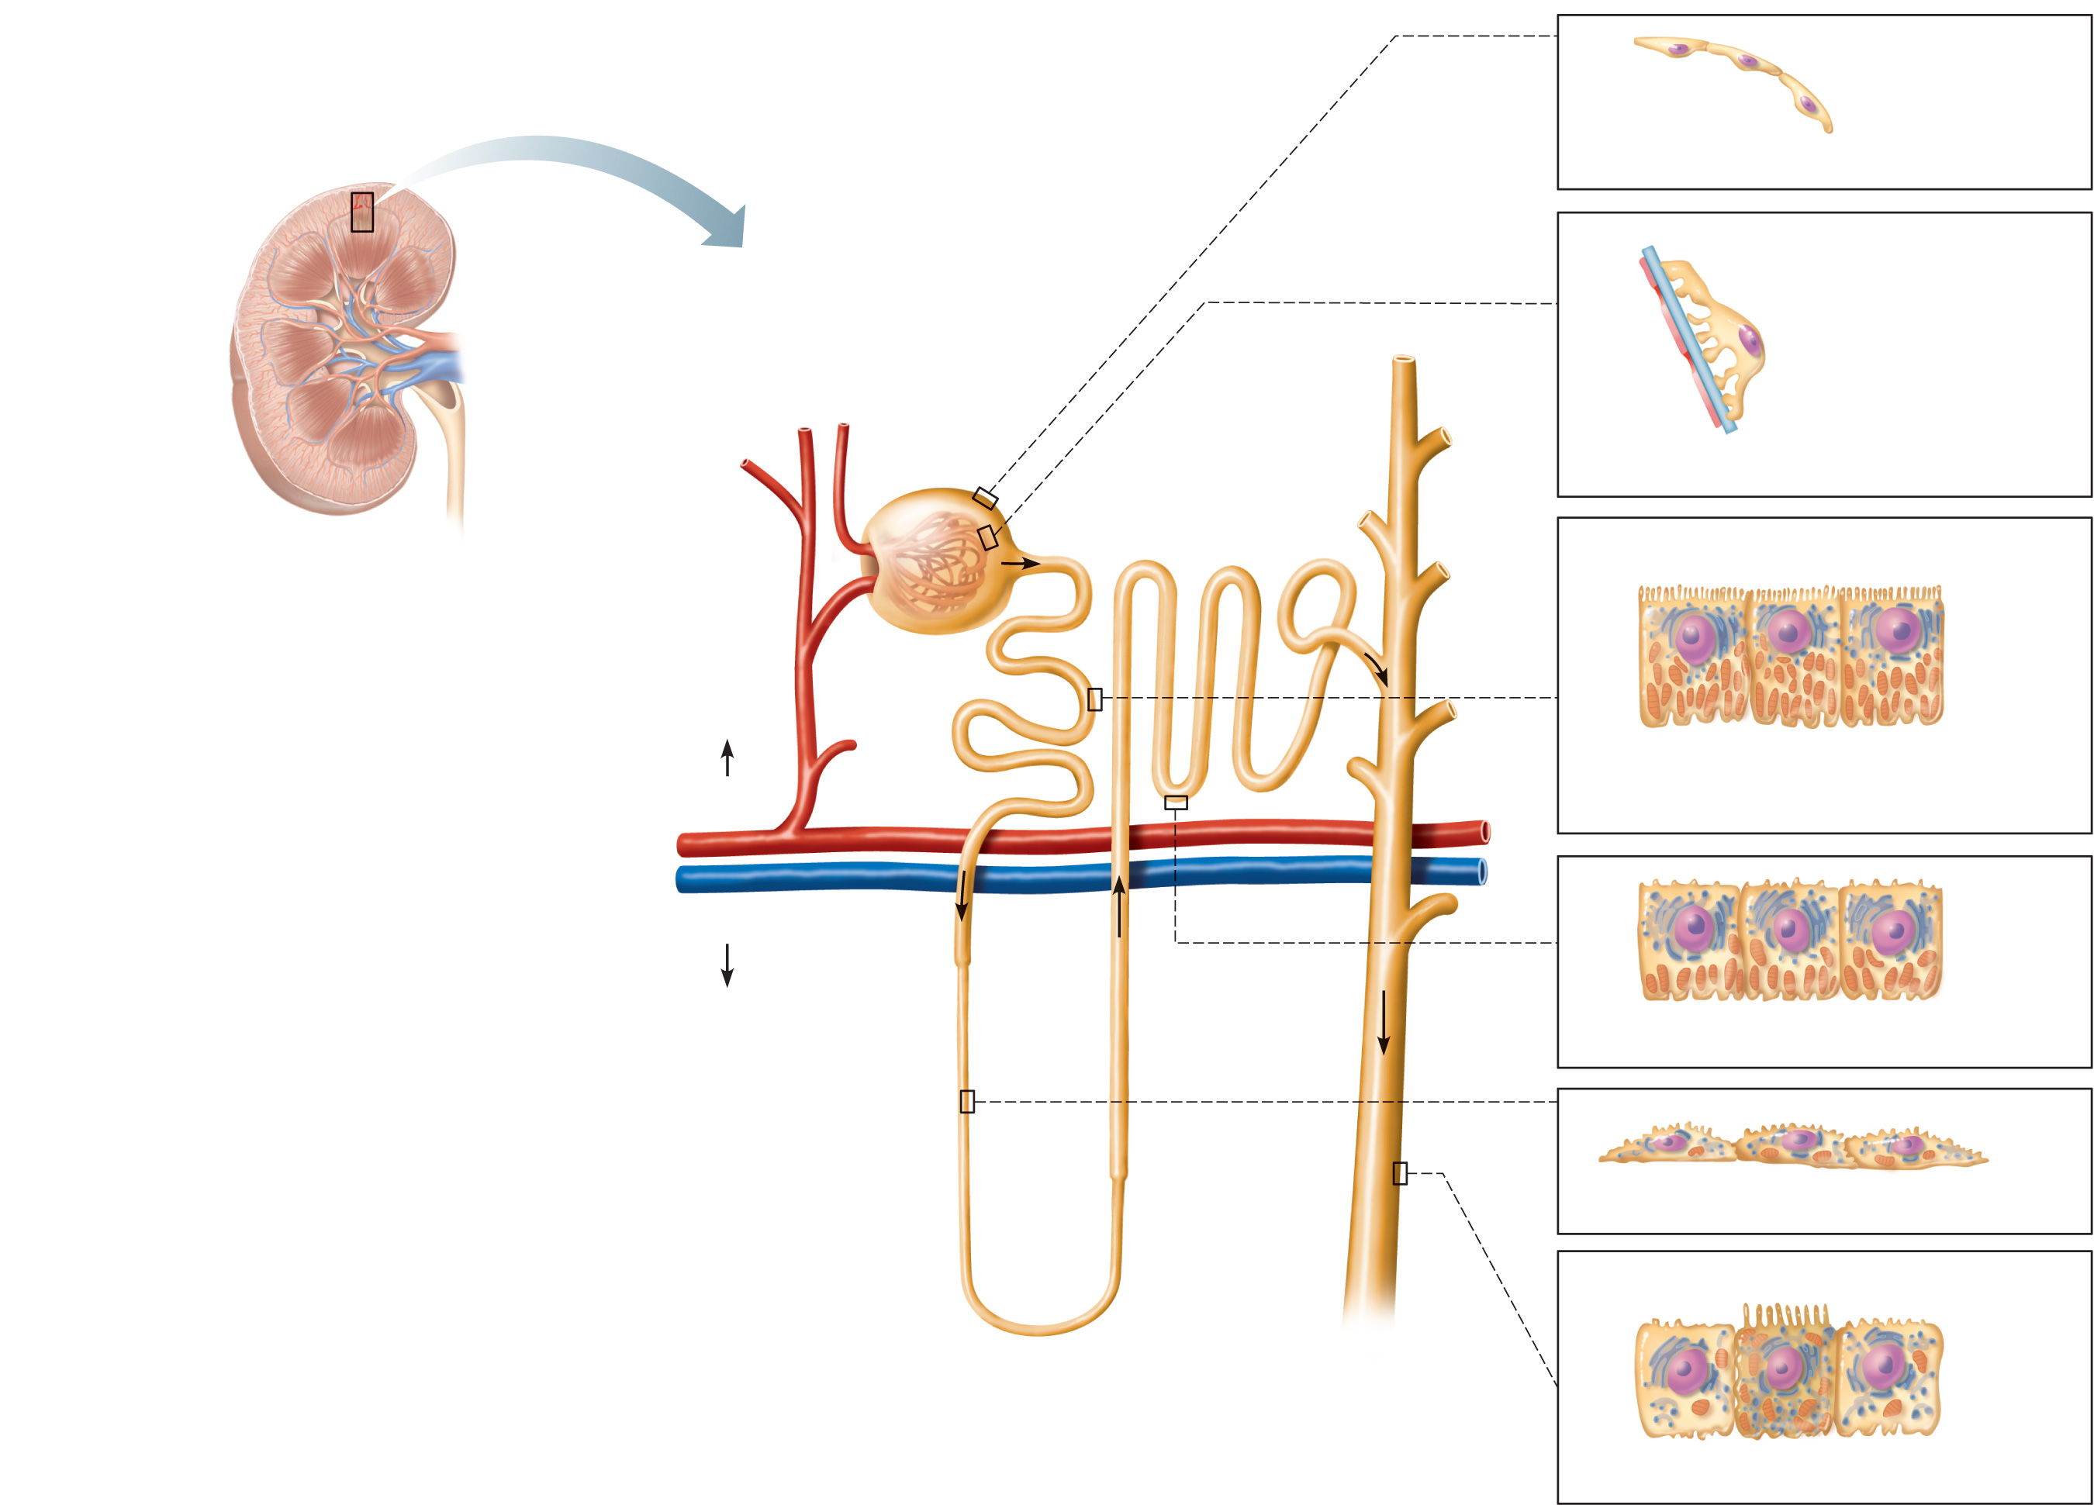
Glomerular capsule: parietal layer
Renal cortex
Renal medulla
Basement
membrane
Renal corpuscle
Podocyte
Renal pelvis
• Glomerular capsule
Fenestrated
endothelium
of the glomerulus
• Glomerulus
Ureter
Distal
convoluted
tubule
Glomerular capsule: visceral layer
Kidney
Microvilli
Mitochondria
Proximal
convoluted
tubule
Highly infolded plasma
membrane
Cortex
Proximal convoluted tubule cells
Medulla
Thick segment
Distal convoluted tubule cells
Thin segment
Loop of Henle
• Descending limb
• Ascending limb
Collecting
duct
Loop of Henle (thin-segment) cells
Principal cell
Intercalated cell
Collecting duct cells
Figure 25.5

Slide 41
Nephrons
Two Types:
Cortical nephrons—85% of nephrons; almost entirely in the cortex
Juxtamedullary nephrons
Long loops of Henle deeply invade the medulla
Extensive thin segments
Important in the production of concentrated urine

Slide 42
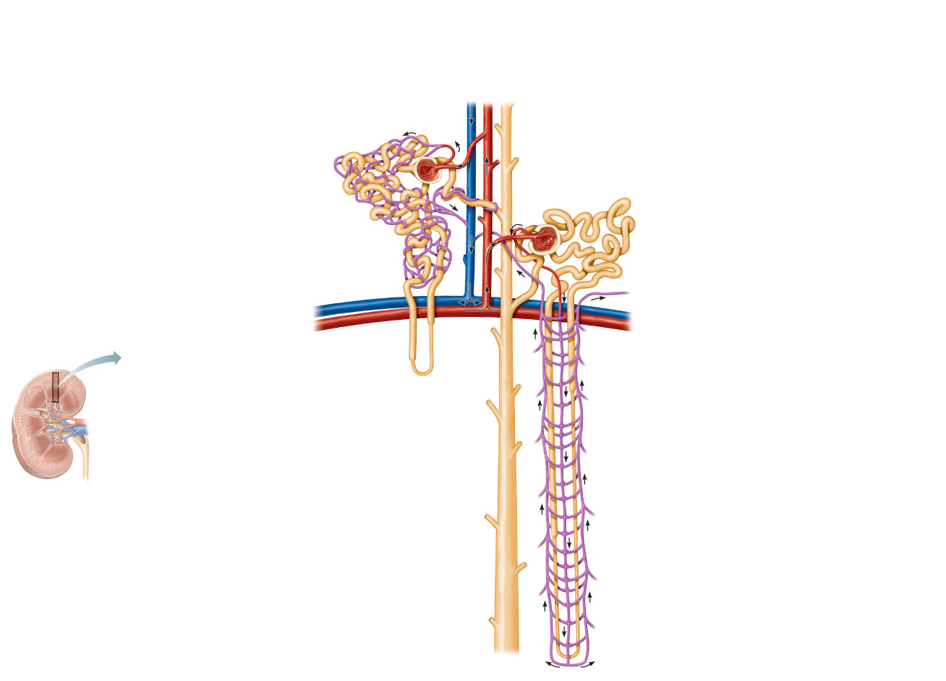
Cortical nephron
• Has short loop of Henle and glomerulus
further from the corticomedullary junction
• Efferent arteriole supplies peritubular
capillaries
Juxtamedullary nephron
• Has long loop of Henle and glomerulus
closer to the corticomedullary junction
• Efferent arteriole supplies vasa recta
Efferent arteriole
Cortical radiate vein
Renal
corpuscle
Glomerular capillaries
(glomerulus)
Cortical radiate artery
Afferent arteriole
Glomerular
(Bowman’s) capsule
Collecting duct
Distal convoluted tubule
Proximal
convoluted tubule
Afferent arteriole
Efferent arteriole
Peritubular capillaries
Ascending or thick limb
of the loop of Henle
Corticomedullary
junction
Arcuate vein
Arcuate artery
Vasa recta
Cortex
Loop of Henle
Medulla
Renal pelvis
Descending
or thin limb of
loop of Henle
Ureter
Kidney
(a)
Figure 25.7a

Slide 43
Nephron Capillary Beds
Glomerulus
Afferent arteriole → glomerulus → efferent arteriole
Specialized for filtration
Blood pressure is high because
Afferent arterioles are larger in diameter than efferent arterioles
Arterioles are high-resistance vessels

Slide 44
Nephron Capillary Beds
Peritubular capillaries
Low-pressure, porous capillaries adapted for absorption
Arise from efferent arterioles
Cling to adjacent renal tubules in cortex
Empty into venules

Slide 45
Nephron Capillary Beds
Vasa recta
Long vessels parallel to long loops of Henle
Arise from efferent arterioles of juxtamedullary nephrons
Function in formation of concentrated urine

Slide 46
Cortical nephron
• Has short loop of Henle and glomerulus
further from the corticomedullary junction
• Efferent arteriole supplies peritubular
capillaries
Juxtamedullary nephron
• Has long loop of Henle and glomerulus
closer to the corticomedullary junction
• Efferent arteriole supplies vasa recta
Efferent arteriole
Cortical radiate vein
Renal
corpuscle
Glomerular capillaries
(glomerulus)
Cortical radiate artery
Afferent arteriole
Glomerular
(Bowman’s) capsule
Collecting duct
Distal convoluted tubule
Proximal
convoluted tubule
Afferent arteriole
Efferent arteriole
Peritubular capillaries
Ascending or thick limb
of the loop of Henle
Corticomedullary
junction
Arcuate vein
Arcuate artery
Vasa recta
Cortex
Loop of Henle
Medulla
Renal pelvis
Descending
or thin limb of
loop of Henle
Ureter
Kidney
(a)
Figure 25.7a

Slide 47
Vascular Resistance in Microcirculation
High resistance in afferent and efferent arterioles
Causes blood pressure to decline from ~95 mm Hg to ~8 mm Hg in kidneys

Slide 48
Vascular Resistance in Microcirculation
Resistance in afferent arterioles
Protects glomeruli from fluctuations in systemic blood pressure
Resistance in efferent arterioles
Reinforces high glomerular pressure
Reduces hydrostatic pressure in peritubular capillaries

Slide 49
Juxtaglomerular Apparatus (JGA)
One per nephron
Important in regulation of filtrate formation and blood pressure
Involves modified portions of the
Distal portion of the ascending limb of the loop of Henle
Afferent arteriole

Slide 50
Juxtaglomerular Apparatus (JGA)
Granular cells (juxtaglomerular, or JG cells)
Enlarged, smooth muscle cells of arteriole
Secretory granules contain renin
Act as mechanoreceptors that sense blood pressure

Slide 51
Juxtaglomerular Apparatus (JGA)
Macula densa
Tall, closely packed cells of the ascending limb
Act as chemoreceptors that sense NaCl content of filtrate
Extraglomerular mesangial cells
Interconnected with gap junctions
May pass signals between macula densa and granular cells

Slide 52
Efferent
arteriole
Glomerular capsule
Glomerulus
Afferent
arteriole
Foot processes
of podocytes
Parietal layer
of glomerular
capsule
Podocyte cell
body (visceral
layer)
Capsular
space
Red blood cell
Efferent
arteriole
Proximal
tubule cell
Juxtaglomerular
apparatus
• Macula densa cells
of the ascending limb
of loop of Henle
Lumens of
glomerular
capillaries
• Extraglomerular
mesangial cells
• Granular cells
Endothelial cell
of glomerular
capillary
Afferent arteriole
Mesangial cells
between capillaries
Juxtaglomerular
apparatus
Renal corpuscle
Figure 25.8

Slide 53
Filtration Membrane
Porous membrane between the blood and the capsular space
Consists of
Fenestrated endothelium of the glomerular capillaries
Visceral membrane of the glomerular capsule (podocytes with foot processes and filtration slits)

Slide 54
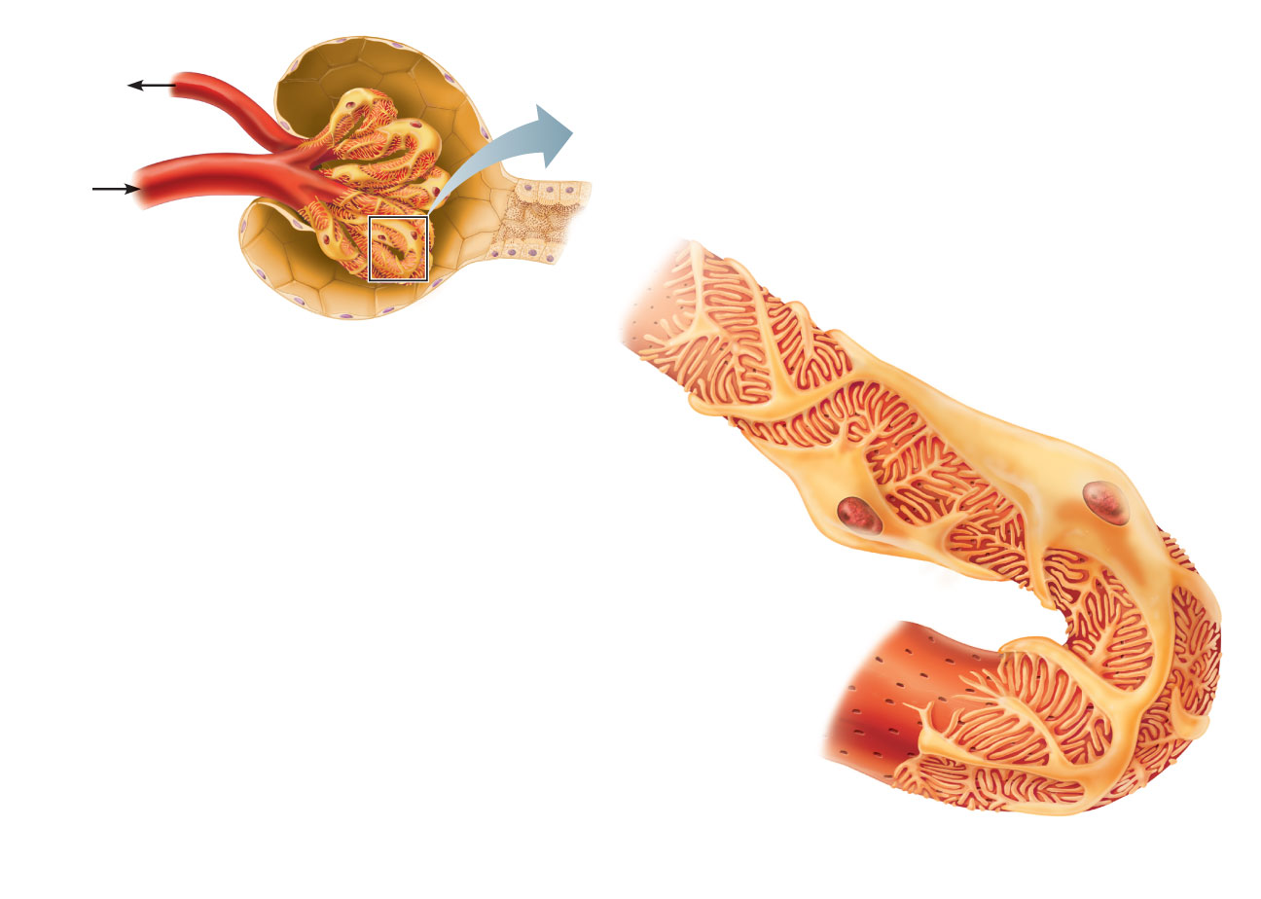
Efferent
arteriole
Glomerular capsular space
Proximal
convoluted
tubule
Afferent
arteriole
Cytoplasmic extensions
of podocytes
Glomerular capillary
covered by podocyte-
containing visceral
layer of glomerular
capsule
Parietal layer
of glomerular
capsule
Filtration slits
Podocyte
cell body
(a) Glomerular capillaries
and the visceral layer of
the glomerular capsule
Fenestrations
(pores)
Glomerular capillary
endothelium (podocyte
covering and basement
membrane removed)
Foot processes
of podocyte
Figure 25.9a

Slide 55
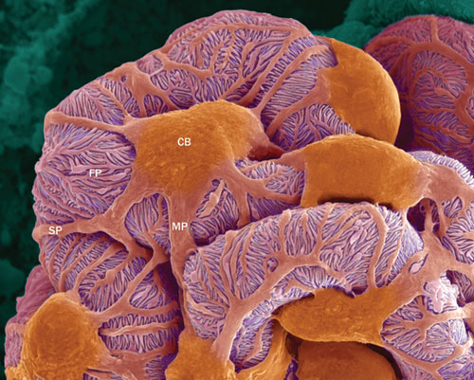

Slide 56
Filtration Membrane
Allows passage of water and solutes smaller than most plasma proteins
Fenestrations prevent filtration of blood cells
Negatively charged basement membrane repels large anions such as plasma proteins
Slit diaphragms also help to repel macromolecules

Slide 57
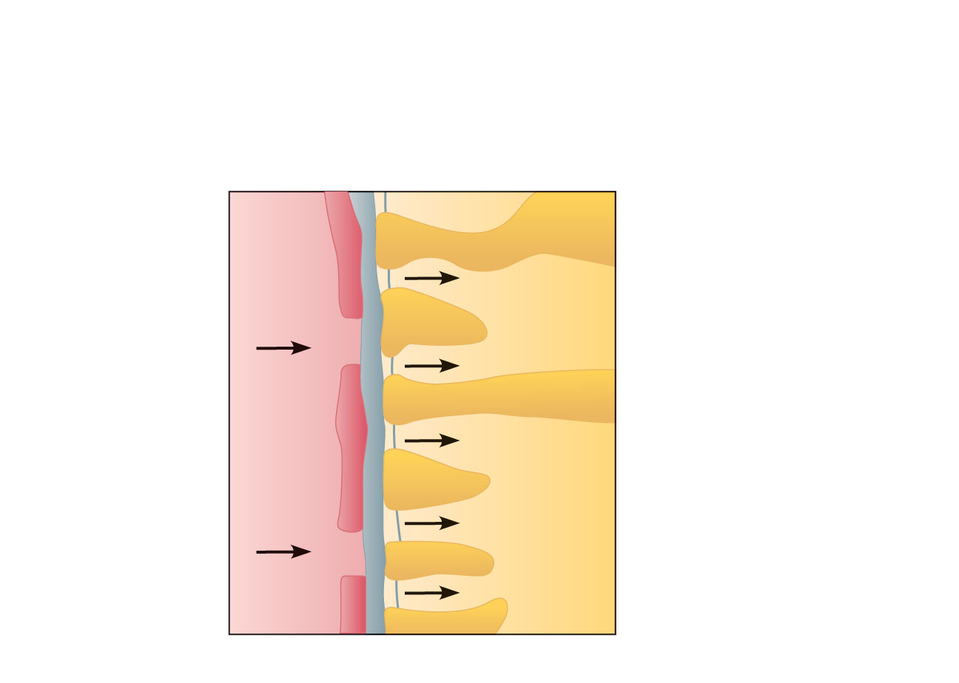
Filtration membrane
• Capillary endothelium
• Basement membrane
• Foot processes of podocyte
of glomerular capsule
Capillary
Filtration slit
Slit diaphragm
Plasma
Filtrate in
capsular
space
Fenestration
(pore)
Foot processes
of podocyte
(c) Three parts of the filtration membrane
Figure 25.9c

Slide 58
Kidney Physiology: Mechanisms of Urine Formation
The kidneys filter the body’s entire plasma volume 60 times each day
Filtrate
Blood plasma minus proteins
Urine
<1% of total filtrate
Contains metabolic wastes and unneeded substances

Slide 59
Mechanisms of Urine Formation
Glomerular filtration
Tubular reabsorption
Returns all glucose and amino acids, 99% of water, salt, and other components to the blood
Tubular secretion
Reverse of reabsoprtion: selective addition to urine

Slide 60
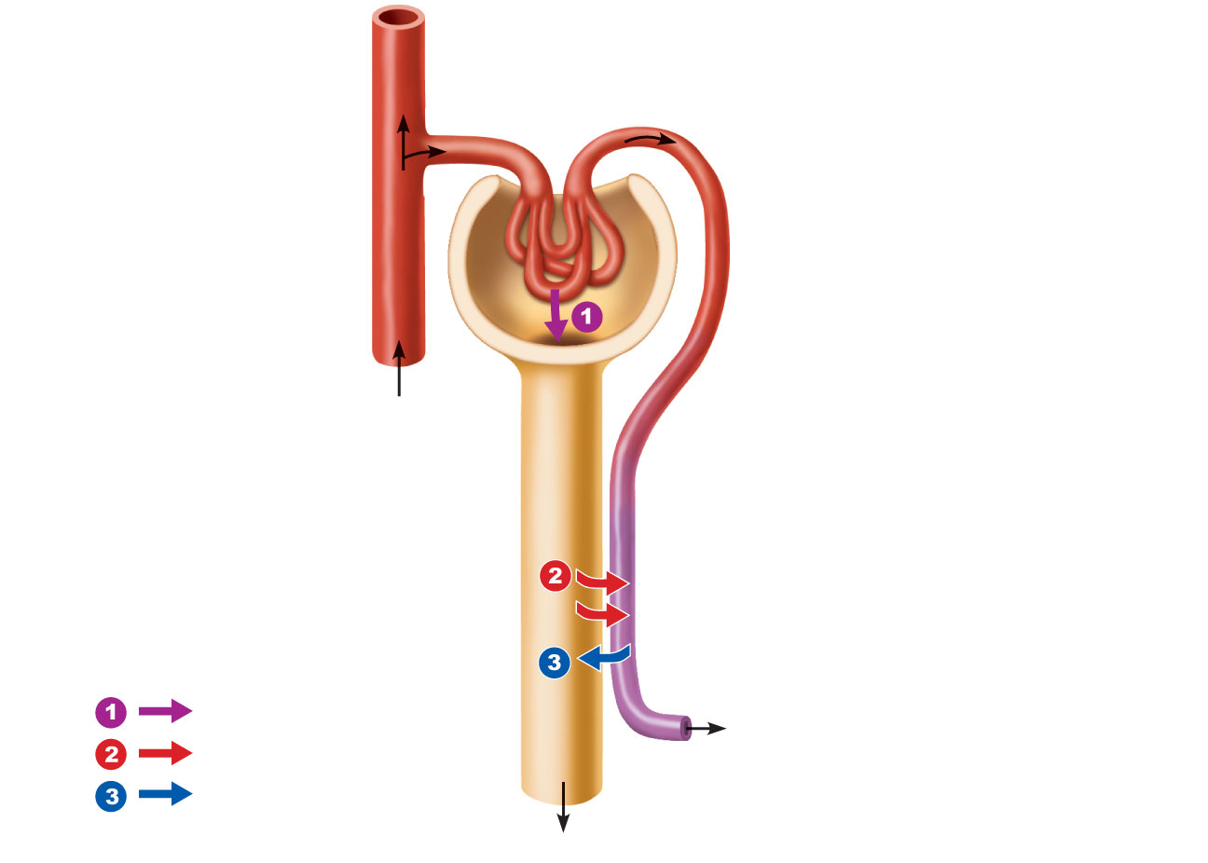
Afferent arteriole
Glomerular capillaries
Efferent arteriole
Cortical
radiate
artery
Glomerular capsule
Rest of renal tubule
containing filtrate
Peritubular
capillary
Three major
renal processes:
Glomerular filtration
To cortical radiate vein
Tubular reabsorption
Tubular secretion
Urine
Figure 25.10

Slide 61
Glomerular Filtration
Passive mechanical process driven by hydrostatic pressure in the capillaries of the glomerulus.
The glomerulus is a very efficient filter because
Its filtration membrane is very permeable and it has a large surface area
Glomerular blood pressure is higher (55 mm Hg) than other capillaries
Molecules >5 nm are not filtered (e.g., plasma proteins) and function to maintain colloid osmotic pressure of the blood

Slide 62
Net Filtration Pressure (NFP)
The pressure responsible for filtrate formation (10 mm Hg)
Determined by four pairs of opposing forces
Glomerular hydrostatic pressure (HP_{g}) the largest force
Capsular Hydrostatic Pressure (HP_{c})
Colloid Osmotic Pressure in the glomerulus (OP_{g})
Colloid Osmotic Pressure in the Capsule (OP_{c})
NFP = HP_{g} – HP_{c}- (OP_{g} - HP_{c})

Slide 63
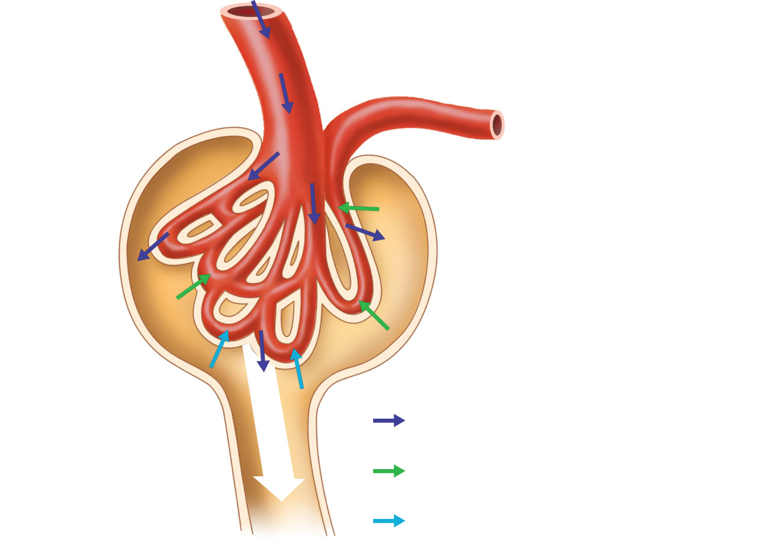
Afferent
arteriole
Glomerular
capsule
Glomerular (blood) hydrostatic pressure
(HP_{g} = 55 mm Hg)
10
mm
Hg
Blood colloid osmotic pressure
(Op_{g} = 30 mm Hg)
Net
filtration
pressure
Capsular hydrostatic pressure
(HP_{c} = 15 mm Hg)
Figure 25.11

Slide 64
Glomerular Filtration Rate (GFR)
Volume of filtrate formed per minute by the kidneys (120–125 ml/min)
Governed by (and directly proportional to)
Total surface area available for filtration
Filtration membrane permeability
NFP

Slide 65
Tubular Reabsorption
A selective transepithelial process
All organic nutrients are reabsorbed
Water and ion reabsorption are hormonally regulated
Includes active and passive process

Slide 66
Sodium Reabsorption
Na⁺ (most abundant cation in filtrate)
Primary active transport out of the tubule cell by
Na⁺-K⁺ ATPase in the basolateral membrane

Slide 67
Sodium Reabsorption in Peritubular Capillaries
Low hydrostatic pressure and high osmotic pressure in the peritubular capillaries
Promotes bulk flow of water and solutes (including Na⁺)

Slide 68
Reabsorption of Nutrients, Water, and Ions
Na⁺ reabsorption provides the energy and the means for reabsorbing most other substances
Organic nutrients are reabsorbed by secondary active transport
When the carriers are saturated, excess of that substance remains in tubule and is excreted

Slide 69
Reabsorption of Nutrients, Water, and Ions
Water is reabsorbed by osmosis (obligatory water reabsorption), aided by water-filled pores called aquaporins (“Water follows sodium”)
Cations and fat-soluble substances follow by diffusion

Slide 70
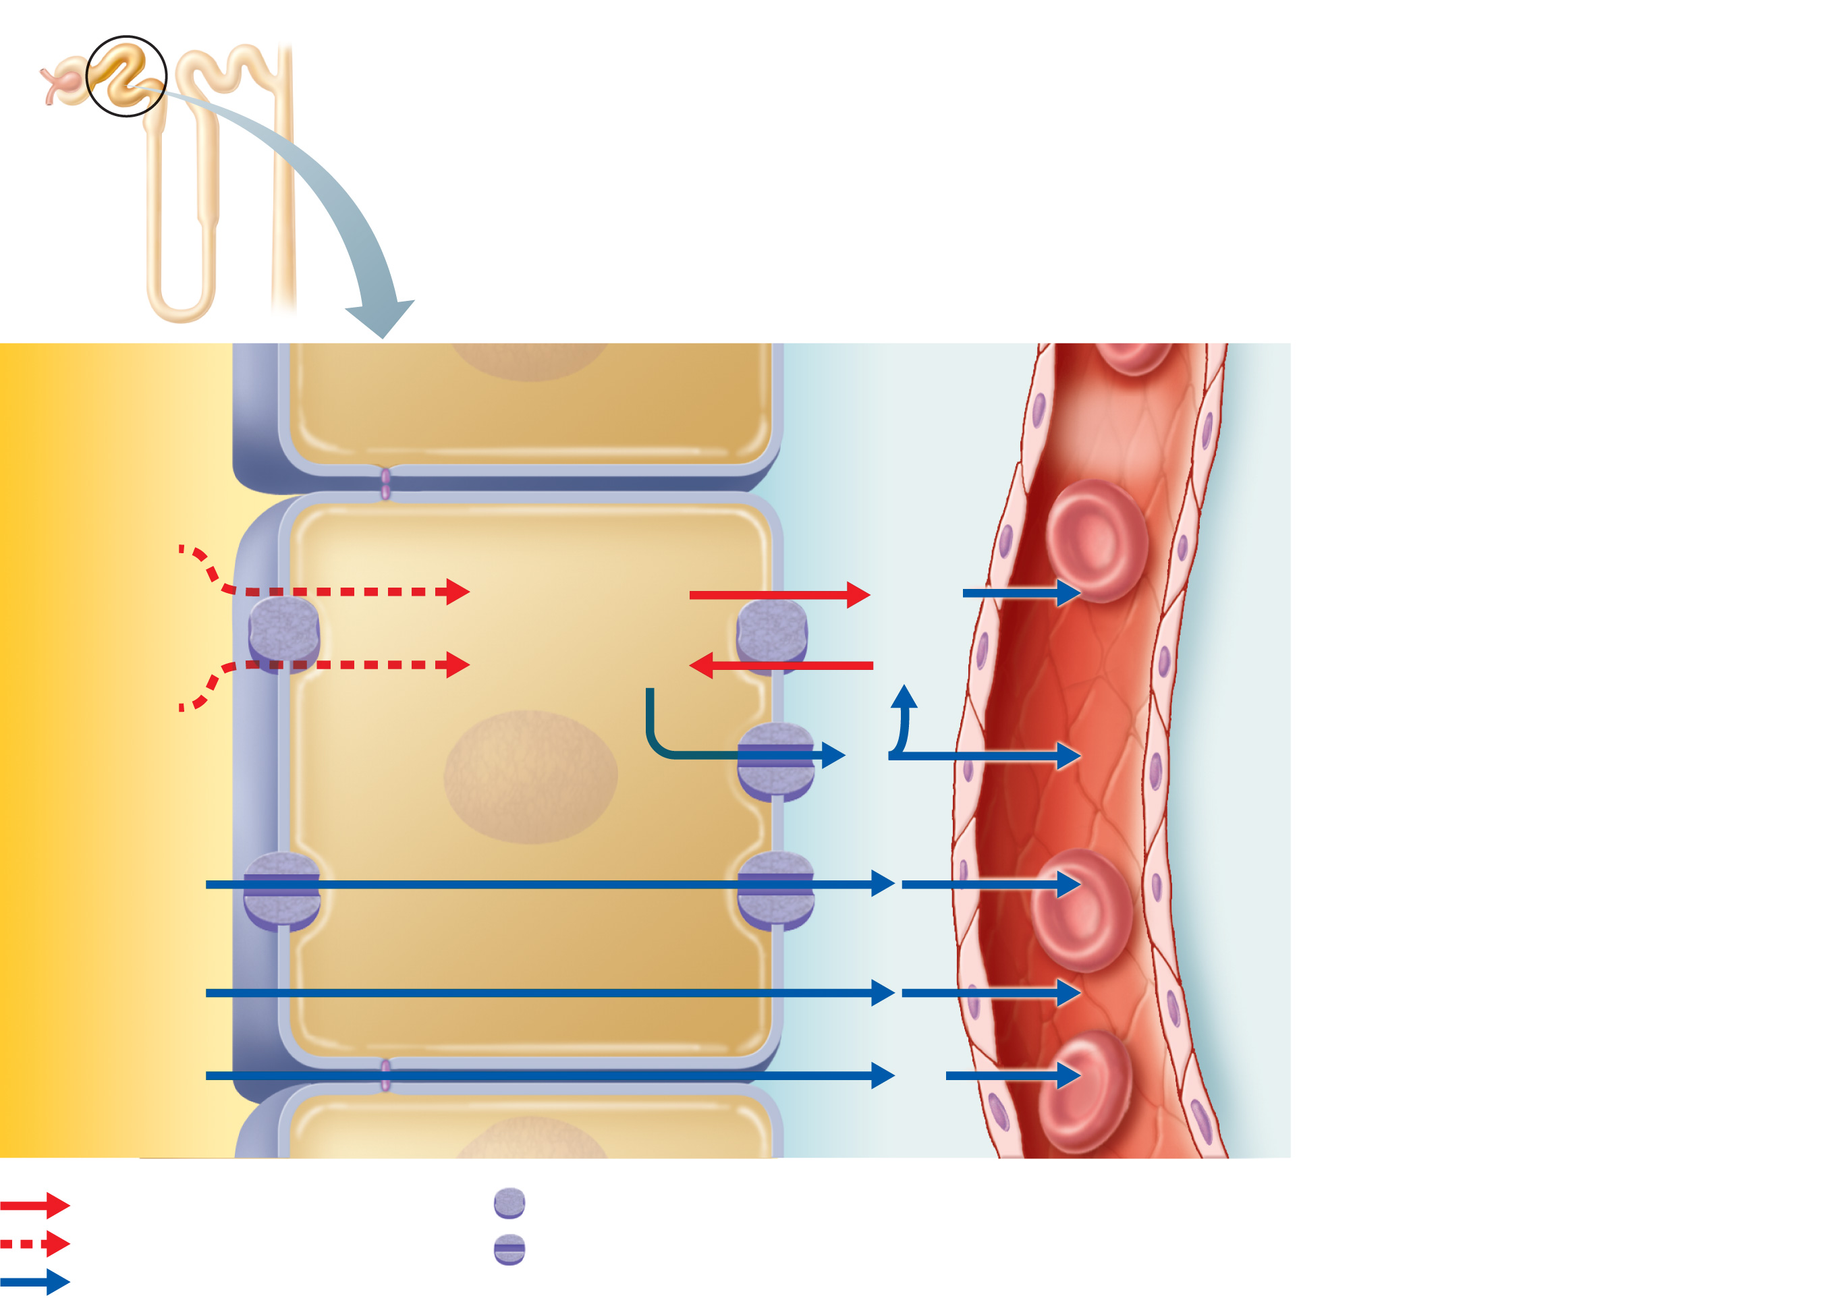
1
At the basolateral membrane,
Na⁺ is pumped into the
interstitial space by the Na⁺-K⁺
ATPase. Active Na⁺ transport
creates concentration gradients
that drive:
Filtrate
in tubule
lumen
Nucleus
Interstitial
fluid
Peri-
tubular
capillary
Tubule cell
2
“Downhill” Na⁺ entry at the
luminal membrane.
3
Na⁺
Reabsorption of organic
nutrients and certain ions by
cotransport at the luminal
membrane.
2
3Na⁺
3Na⁺
Glucose
Amino
acids
Some
ions
Vitamins
1
2K⁺
2K⁺
4
3
Reabsorption of water by
osmosis. Water reabsorption
increases the concentration of
the solutes that are left
behind. These solutes can
then be reabsorbed as
they move down their
concentration gradients:
K⁺
4
H₂O
Lipid-soluble
substances
5
5
6
Lipid-soluble
substances diffuse by the
transcellular route.
Cl–, Ca²⁺, K⁺
and other
ions, urea
Cl–
Tight junction
Paracellular
route
6
Cl– (and other anions),
K⁺, and urea diffuse by the
paracellular route.
Primary active transport
Transport protein
Secondary active transport
Ion channel or aquaporin
Passive transport (diffusion)
Figure 25.14

Slide 71
Reabsorptive Capabilities of Renal Tubules and Collecting Ducts
PCT
Site of most reabsorption
65% of Na⁺ and water
All nutrients
Ions
Small proteins

Slide 72
Reabsorptive Capabilities of Renal Tubules and Collecting Ducts
Technically, the Loop of Henle is involved in reabsorption
Descending limb: H₂O
Ascending limb: Na⁺, K⁺, Cl⁻
However, the function of this reabsorption is actually to create a counter-current multiplier (see below).

Slide 73
Reabsorptive Capabilities of Renal Tubules and Collecting Ducts
DCT and collecting duct
Reabsorption is hormonally regulated
Ca²⁺ (PTH)
Water (ADH)
Na⁺ (aldosterone and ANP)

Slide 74
Tubular Secretion
Reabsorption in reverse
K⁺, H⁺, NH₄⁺ and organic acids move from peritubular capillaries or tubule cells into filtrate
Disposes of substances that are bound to plasma proteins

Slide 75
Tubular Secretion
Eliminates undesirable substances that have been passively reabsorbed (e.g., urea and uric acid)
Rids the body of excess K⁺
Controls blood pH by altering amounts of H⁺ or HCO₃– in urine

Slide 76
Regulation of Urine Concentration and Volume
Osmolality
Number of solute particles in 1 kg of H₂O
Reflects ability to cause osmosis

Slide 77
Regulation of Urine Concentration and Volume
Osmolality of body fluids
Expressed in milliosmols (mOsm)
The kidneys maintain osmolality of plasma at ~300 mOsm, using countercurrent mechanisms

Slide 78
Countercurrent Mechanism
Occurs when fluid flows in opposite directions in two adjacent segments of the same tube
Filtrate flow in the loop of Henle (countercurrent multiplier)
Blood flow in the vasa recta (countercurrent exchanger)

Slide 79
Countercurrent Mechanism
Role of countercurrent mechanisms
Establish and maintain an osmotic gradient (300 mOsm to 1200 mOsm) from renal cortex through the medulla
Allow the kidneys to vary urine concentration

Slide 80
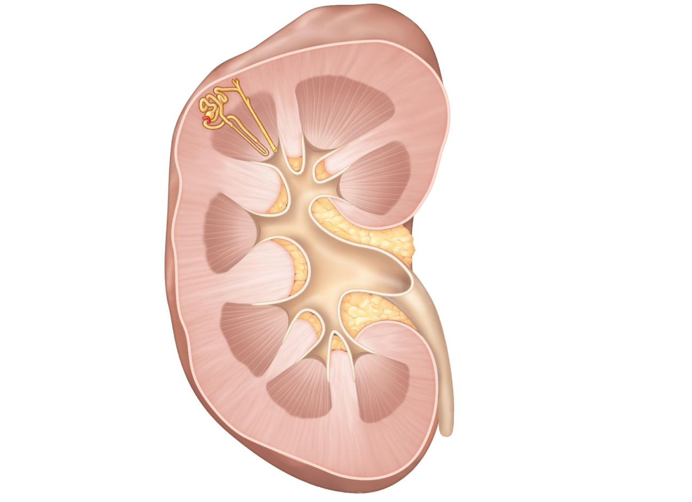
Cortex
Medulla
Figure 25.15

Slide 81
Countercurrent Multiplier: Loop of Henle
Descending limb
Freely permeable to H₂O, which passes out of the filtrate into the hyperosmotic medullary interstitial fluid
Filtrate osmolality increases to ~1200 mOsm

Slide 82
Countercurrent Multiplier: Loop of Henle
Ascending limb
Impermeable to H₂O
Selectively permeable to solutes
Na⁺ and Cl– are passively reabsorbed in the thin segment, actively reabsorbed in the thick segment
Active transport of NaCl in the ascending limb powers the whole system.
Filtrate osmolality decreases to 100 mOsm

Slide 83
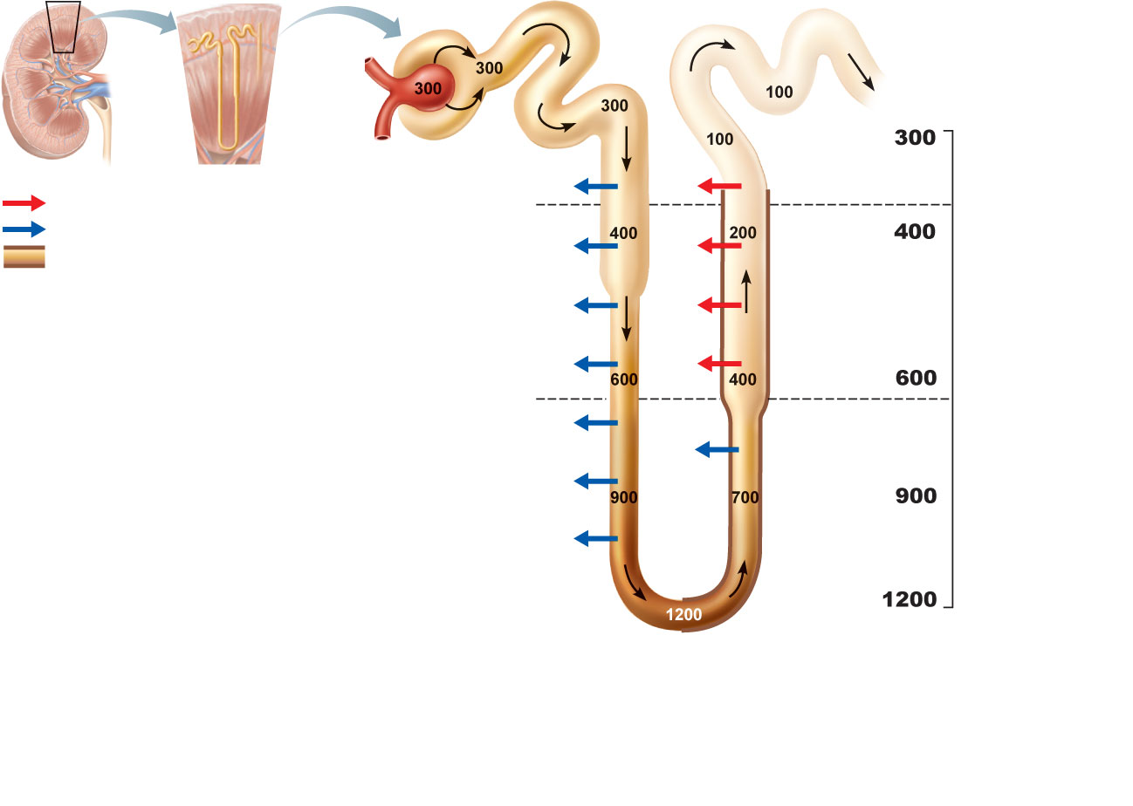
Osmolality
of interstitial
fluid
(mOsm)
Filtrate entering the
loop of Henle is
isosmotic to both
blood plasma and
cortical interstitial
fluid.
Active transport
H₂O
NaCI
Cortex
Passive transport
H₂O
NaCI
Water impermeable
H₂O
NaCI
The descending limb:
• Permeable to H₂O
• Impermeable to NaCl
As filtrate flows, it
becomes increasingly
concentrated as H₂O
leaves the tubule by
osmosis. The filtrate
osmolality increases from
300 to 1200 mOsm.
H₂O
NaCI
Outer
medulla
H₂O
NaCI
H₂O
H₂O
Inner
medulla
Loop of Henle
The ascending limb:
• Impermeable to H₂O
• Permeable to NaCl
Filtrate becomes increasingly dilute as NaCl leaves, eventually becoming
hypo-osmotic to blood at 100 mOsm in the cortex. NaCl leaving the
ascending limb increases the osmolality of the medullary interstitial fluid.
(a) Countercurrent multiplier.
The long loops of Henle of the
juxtamedullary nephrons
create the medullary
osmotic gradient.
Figure 25.16a

Slide 84
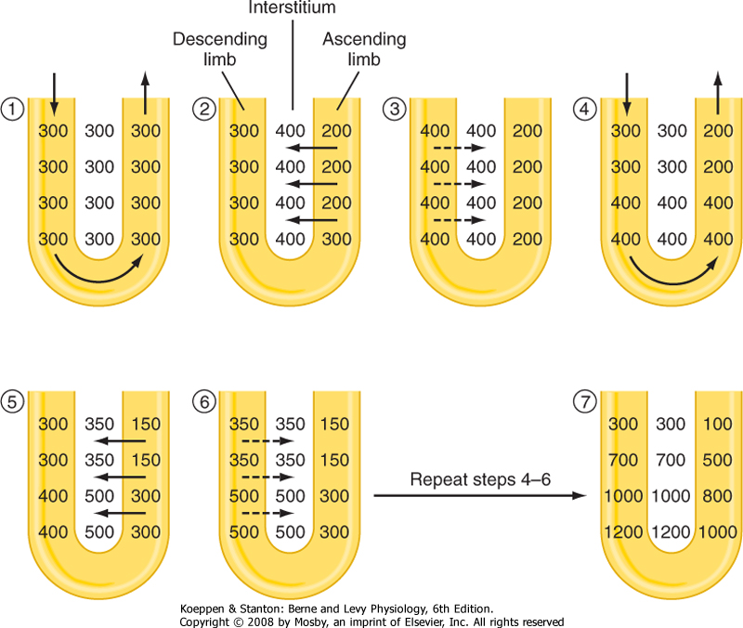

Slide 85
Urea Recycling
Urea moves between the collecting ducts and the loop of Henle
Secreted into filtrate by facilitated diffusion in the ascending thin segment
Reabsorbed by facilitated diffusion in the collecting ducts deep in the medulla
Contributes to the high osmolality in the medulla

Slide 86
Countercurrent Exchanger: Vasa Recta
The vasa recta
Maintain the osmotic gradient
Deliver blood to the medullary tissues
Protect the medullary osmotic gradient by preventing rapid removal of salt, and by removing reabsorbed H₂O

Slide 87
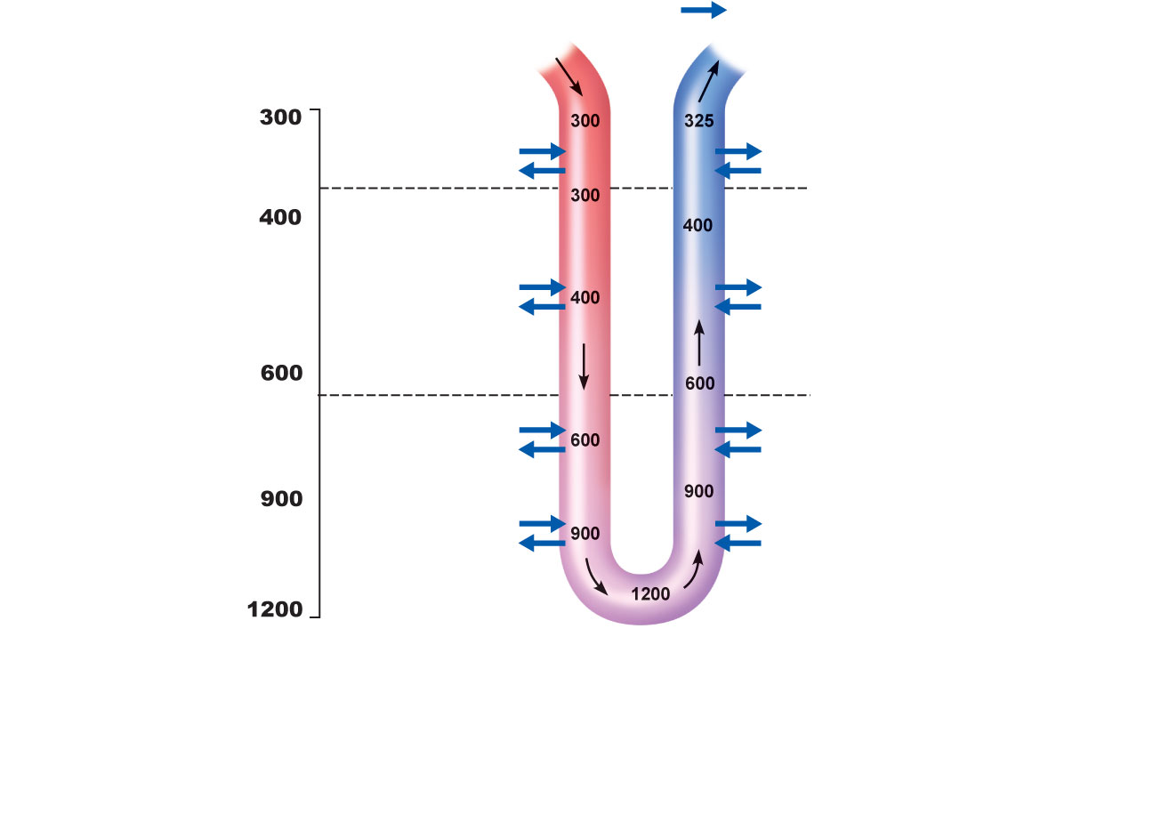
Osmolality
of interstitial
fluid
(mOsm)
Blood from
efferent
arteriole
Passive transport
To vein
NaCI
H₂O
NaCI
H₂O
Cortex
NaCI
H₂O
NaCI
H₂O
Outer
medulla
NaCI
H₂O
NaCI
H₂O
NaCI
H₂O
NaCI
H₂O
Inner
medulla
Vasa recta
(b) Countercurrent exchanger.
The vasa recta preserve the
medullary gradient while
removing reabsorbed water
and solutes.
The vasa recta:
• Highly permeable to H₂O and solute
• Nearly isosmotic to interstitial fluid due to sluggish blood flow
Blood becomes more concentrated as it descends deeper into
the medulla and less concentrated as it approaches the cortex.
Figure 25.16b

Slide 88
Formation of Dilute Urine
Filtrate is diluted in the ascending loop of Henle
In the absence of ADH, dilute filtrate continues into the renal pelvis as dilute urine
Na⁺ and other ions may be selectively removed in the DCT and collecting duct, decreasing osmolality to as low as 50 mOsm

Slide 89
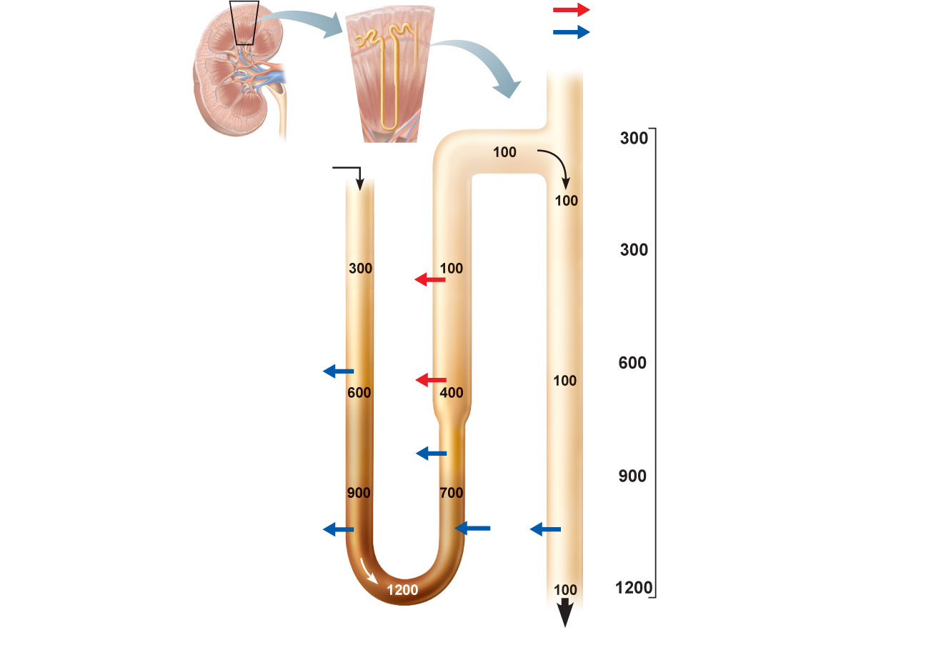
Active transport
Passive transport
Collecting duct
Descending limb
of loop of Henle
DCT
Cortex
NaCI
H₂O
NaCI
Outer
medulla
NaCI
H₂O
Urea
Inner
medulla
Large volume
of dilute urine
(a) Absence of ADH
Figure 25.17a

Slide 90
Formation of Concentrated Urine
Depends on the medullary osmotic gradient and ADH
ADH triggers reabsorption of H₂O in the collecting ducts
Facultative water reabsorption occurs in the presence of ADH so that 99% of H₂O in filtrate is reabsorbed

Slide 91
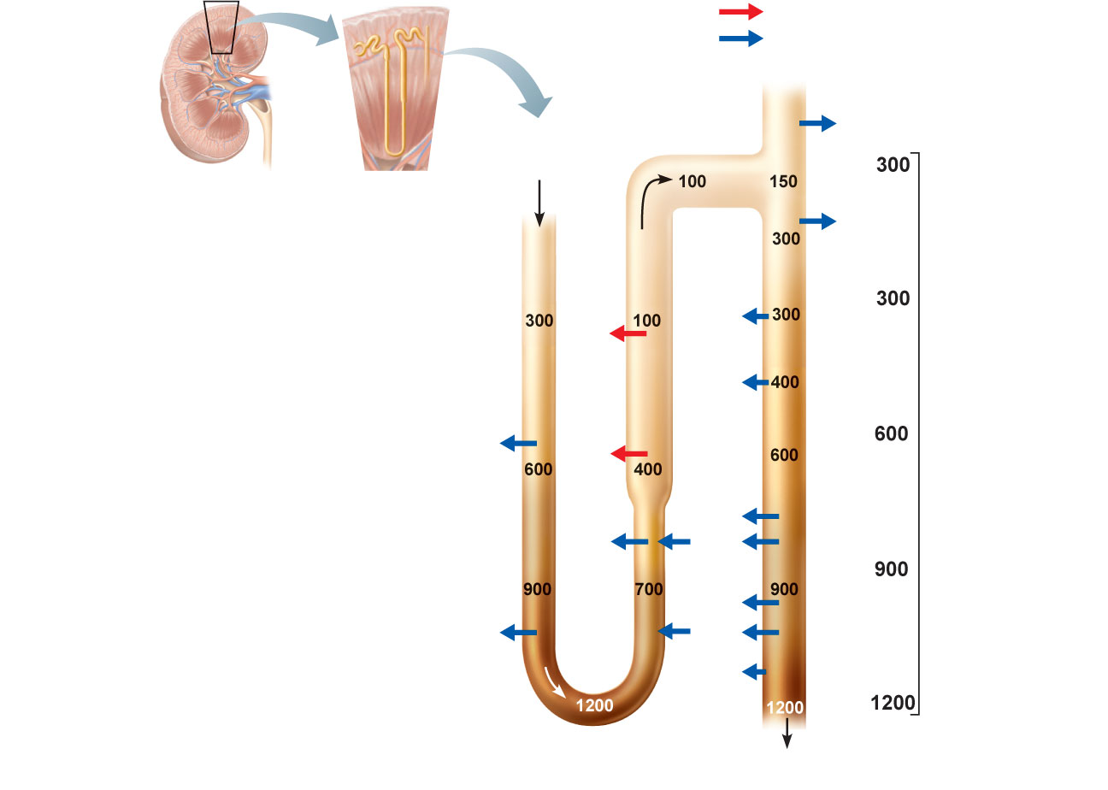
Active transport
Passive transport
Collecting duct
H₂O
Descending limb
of loop of Henle
DCT
H₂O
Cortex
NaCI
H₂O
H₂O
H₂O
NaCI
Outer
medulla
H₂O
NaCI
Urea
H₂O
H₂O
Urea
Inner
medulla
H₂O
Small volume of
concentrated urine
(b) Maximal ADH
Figure 25.17b

Slide 92
Physical Characteristics of Urine
Color and transparency
Clear, pale to deep yellow (due to urochrome)
Drugs, vitamin supplements, and diet can alter the color
Cloudy urine may indicate a urinary tract infection

Slide 93
Physical Characteristics of Urine
Odor
Slightly aromatic when fresh
Develops ammonia odor upon standing
May be altered by some drugs and vegetables

Slide 94
Physical Characteristics of Urine
pH
Slightly acidic (~pH 6, with a range of 4.5 to 8.0)
Diet, prolonged vomiting, or urinary tract infections may alter pH
Specific gravity
1.001 to 1.035, dependent on solute concentration

Slide 95
Chemical Composition of Urine
95% water and 5% solutes
Nitrogenous wastes: urea, uric acid, and creatinine
Other normal solutes
Na⁺, K⁺, PO₄^{3–}, and SO₄^{2–},
Ca²⁺, Mg²⁺ and HCO₃–
Abnormally high concentrations of any constituent may indicate pathology

Slide 96
Regulation of Glomerular Filtration
GFR is tightly controlled by two types of mechanisms
Intrinsic controls (renal autoregulation)
Act locally within the kidney
Extrinsic controls
Nervous and endocrine mechanisms that maintain blood pressure, but affect kidney function

Slide 97
Intrinsic Controls
Maintains a nearly constant GFR when Mean Arterial Pressure is in the range of 80–180 mm Hg
Two types of renal autoregulation
Myogenic mechanism (Chapter 19)
Tubuloglomerular feedback mechanism, which senses changes in the juxtaglomerular apparatus

Slide 98
Intrinsic Controls: Myogenic Mechanism
↑ BP → constriction of afferent arterioles
Helps maintain normal GFR
Protects glomeruli from damaging high BP
↓ BP → dilation of afferent arterioles
Helps maintain normal GFR

Slide 99
Intrinsic Controls: Tubuloglomerular Feedback Mechanism
Flow-dependent mechanism directed by the macula densa cells
If GFR increases, filtrate flow rate increases in the tubule
Filtrate NaCl concentration will be high because of insufficient time for reabsorption

Slide 100
Intrinsic Controls: Tubuloglomerular Feedback Mechanism
Flow-dependent mechanism directed by the macula densa cells
If GFR increases, filtrate flow rate increases in the tubule
Filtrate NaCl concentration will be high because of insufficient time for reabsorption

Slide 101
Extrinsic Controls: Sympathetic Nervous System
Under normal conditions at rest
Renal blood vessels are dilated
Renal autoregulation mechanisms prevail

Slide 102
Extrinsic Controls: Sympathetic Nervous System
Under normal conditions at rest
Renal blood vessels are dilated
Renal autoregulation mechanisms prevail

Slide 103
Extrinsic Controls: Renin-Angiotensin Mechanism
Triggered when the granular cells of the JGA detect decreased GFR
Granular cells release renin.
Renin is an enzyme that activates the hormone Angiotensinogen.

Slide 104
Extrinsic Controls: Renin-Angiotensin Mechanism
Triggered when the granular cells of the JGA release renin
angiotensinogen (a plasma globulin)
renin →
angiotensin I
angiotensin converting
enzyme (ACE) →
angiotensin II

Slide 105
Effects of Angiotensin II
Constricts arteriolar smooth muscle, causing Mean Arterial Pressure to rise
Stimulates the reabsorption of Na⁺
Acts directly on the renal tubules
Triggers adrenal cortex to release aldosterone
Stimulates the hypothalamus to release ADH and activates the thirst center
4. Constricts efferent arterioles, decreasing peritubular capillary hydrostatic pressure and increasing fluid reabsorption
5. Causes glomerular mesangial cells to contract, decreasing the surface area available for filtration

Slide 106
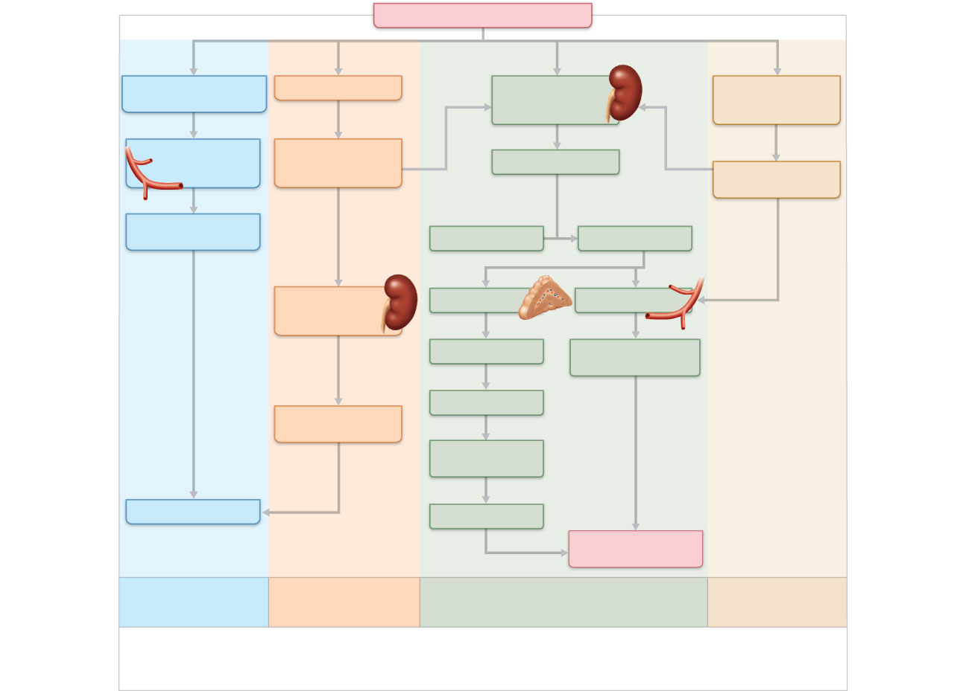
SYSTEMIC BLOOD PRESSURE
(–)
Blood pressure in
afferent arterioles; GFR
GFR
Granular cells of
juxtaglomerular
apparatus of kidney
Baroreceptors in
blood vessels of
systemic circulation
Stretch of smooth
muscle in walls of
afferent arterioles
Filtrate flow and
NaCl in ascending
limb of Henle’s loop
Release
(+)
(+)
Renin
(+)
Sympathetic
nervous system
Targets
Catalyzes cascade
resulting in conversion
Vasodilation of
afferent arterioles
Angiotensinogen
Angiotensin II
(+)
(+)
(+)
Macula densa cells
of JG apparatus
of kidney
Adrenal cortex
Systemic arterioles
Releases
Aldosterone
Vasoconstriction;
peripheral resistance
Release of vasoactive
chemical inhibited
Targets
Vasodilation of
afferent arterioles
Kidney tubules
Na⁺ reabsorption;
water follows
(+)
Stimulates
(–)
Inhibits
Increase
GFR
Blood volume
Decrease
Systemic
blood pressure
Myogenic mechanism
of autoregulation
Tubuloglomerular
mechanism of
autoregulation
Hormonal (renin-angiotensin)
mechanism
Neural controls
Intrinsic mechanisms directly regulate GFR despite
moderate changes in blood pressure (between 80
and 180 mm Hg mean arterial pressure).
Extrinsic mechanisms indirectly regulate GFR
by maintaining systemic blood pressure, which
drives filtration in the kidneys.
Figure 25.12

Slide 107
Reabsorptive Capabilities of Renal Tubules and Collecting Ducts
Mechanism of aldosterone
Targets collecting ducts (principal cells) and distal DCT
Promotes synthesis of luminal Na⁺ and K⁺ channels
Promotes synthesis of basolateral Na⁺-K⁺ ATPases

Slide 108
Summary of Urinary Hormones
ADH
Released when plasma sodium concentration is high
Increases reabsorption of water from the collecting duct
Renin
Released when GFR and/or blood pressure is low
Activates Angiotensinogen

Slide 109
Summary of Urinary Hormones
Angiotensin II
Raises MAP by
Increasing sodium reabsorption
Causes release of ADH
Vasoconstriction
Aldosterone
Released when blood pressure is low or sodium conc is low.
Increases sodium reabsorption

