Slide 1
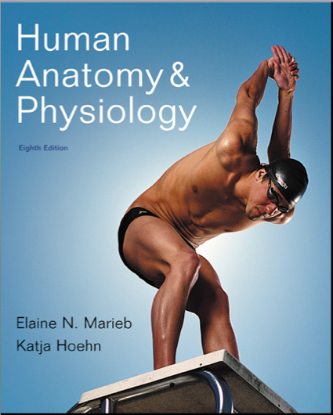
Chapter 24
Nutrition, Metabolism & Thermoregulation

Slide 2
Nutrition
Nutrient: a substance in food that promotes normal growth, maintenance, and repair
Major nutrients
Carbohydrates, lipids, and proteins
Other nutrients
Vitamins and minerals (and, technically speaking, water)

Slide 3
Major Macromolecules
Carbohydrates - (CH₂O)_{n}
Lipids – Fatty acids, Glycerol, Cholesterol and combinations of the above
Proteins – strings of amino acids

Slide 4
Vitamins
Small to medium sized organic molecules that are necessary for normal growth or maintenance, but which the body cannot synthesize in sufficient amounts.
Often used as part of an enzyme

Slide 5
Minerals
Non-organic atoms or small molecules, usually in ionic form.
Often found in the soil!
Used for many functions
Bound to proteins to activate/deactivate
Electron acceptors in an enzyme
Building bones
Osmotic balance
And many more...

Slide 6
Metabolism
Metabolism is the buildup or breakdown of nutrients (or other molecules in the body). Often used to refer to the overall process of making and breaking molecules.
Catabolism is the breakdown of molecules
Anabolism is the buildup of molecules

Slide 7
Oxidation-Reduction (Redox) Reactions
Oxidation; gain of oxygen or loss of hydrogen
Oxidation-reduction (redox) reactions
Oxidized substances lose electrons and energy
Reduced substances gain electrons and energy

Slide 8
Oxidation and Reduction
Oxidation is the loss of electrons from an atom or molecule.
Reduction is the gain of electrons from an atom or molecule.
Whenever one atom accepts an electron, some other atom must have lost an electron.
The over-all reaction in which an electron is transferred is called a redox reaction.

Slide 9
Redox Reactions Continued
Oxygen is a good oxidizer. It likes to take electrons from other atoms – that's where the word “oxidation” comes from.
Hydrogen often carries away an electron when it leaves a molecule. So a molecule can also be oxidized when it loses a hydrogen/electron pair.

Slide 10
Oxidation-Reduction (Redox) Reactions
Some coenzymes act as hydrogen (or electron) acceptors in metabolic pathways
Nicotinamide adenine dinucleotide (NAD⁺)
Flavin adenine dinucleotide (FAD)
These allow us to transfer high-energy electrons, to harvest their energy.

Slide 11
Carbohydrate Metabolism
Oxidation of glucose
C₆H₁₂O₆ + 6O₂ → 6H₂O + 6CO₂ + 36 ATP + heat
Glucose is catabolized in three pathways
Glycolysis
Krebs cycle
Electron transport chain and oxidative phosphorylation
Count those carbons in each step we study!!

Slide 12
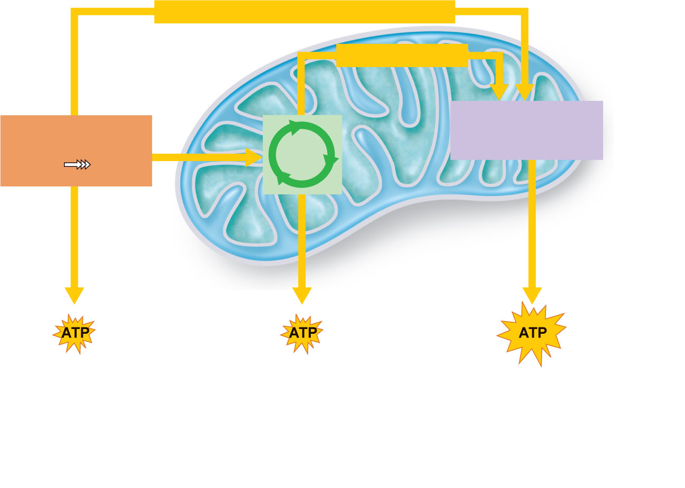
Chemical energy (high-energy electrons)
Chemical energy
Electron transport
chain and oxidative
phosphorylation
Glycolysis
Pyruvic
acid
Krebs
cycle
Glucose
Mitochondrial
cristae
Mitochondrion
Cytosol
Via oxidative
phosphorylation
Via substrate-level
phosphorylation
1
2
3
During glycolysis,
each glucose
molecule is broken
down into two
molecules of pyruvic
acid in the cytosol.
The pyruvic acid then enters
the mitochondrial matrix, where
the Krebs cycle decomposes it
to CO₂. During glycolysis and
the Krebs cycle, small amounts
of ATP are formed by substrate-
level phosphorylation.
Energy-rich electrons picked up by
coenzymes are transferred to the elec-
tron transport chain, built into the cristae
membrane. The electron transport chain
carries out oxidative phosphorylation,
which accounts for most of the ATP
generated by cellular respiration.
Figure 24.5

Slide 13
Glycolysis
10-step pathway (10 enzymes needed)
Anaerobic – no oxygen required
Occurs in the cytosol
Glucose → 2 pyruvic acid molecules
Three major phases
Sugar activation
Sugar cleavage
Sugar oxidation and ATP formation

Slide 14
Phases of Glycolysis
Sugar activation
Glucose is phosphorylated by 2 ATP to form fructose-1,6-bisphosphate

Slide 15
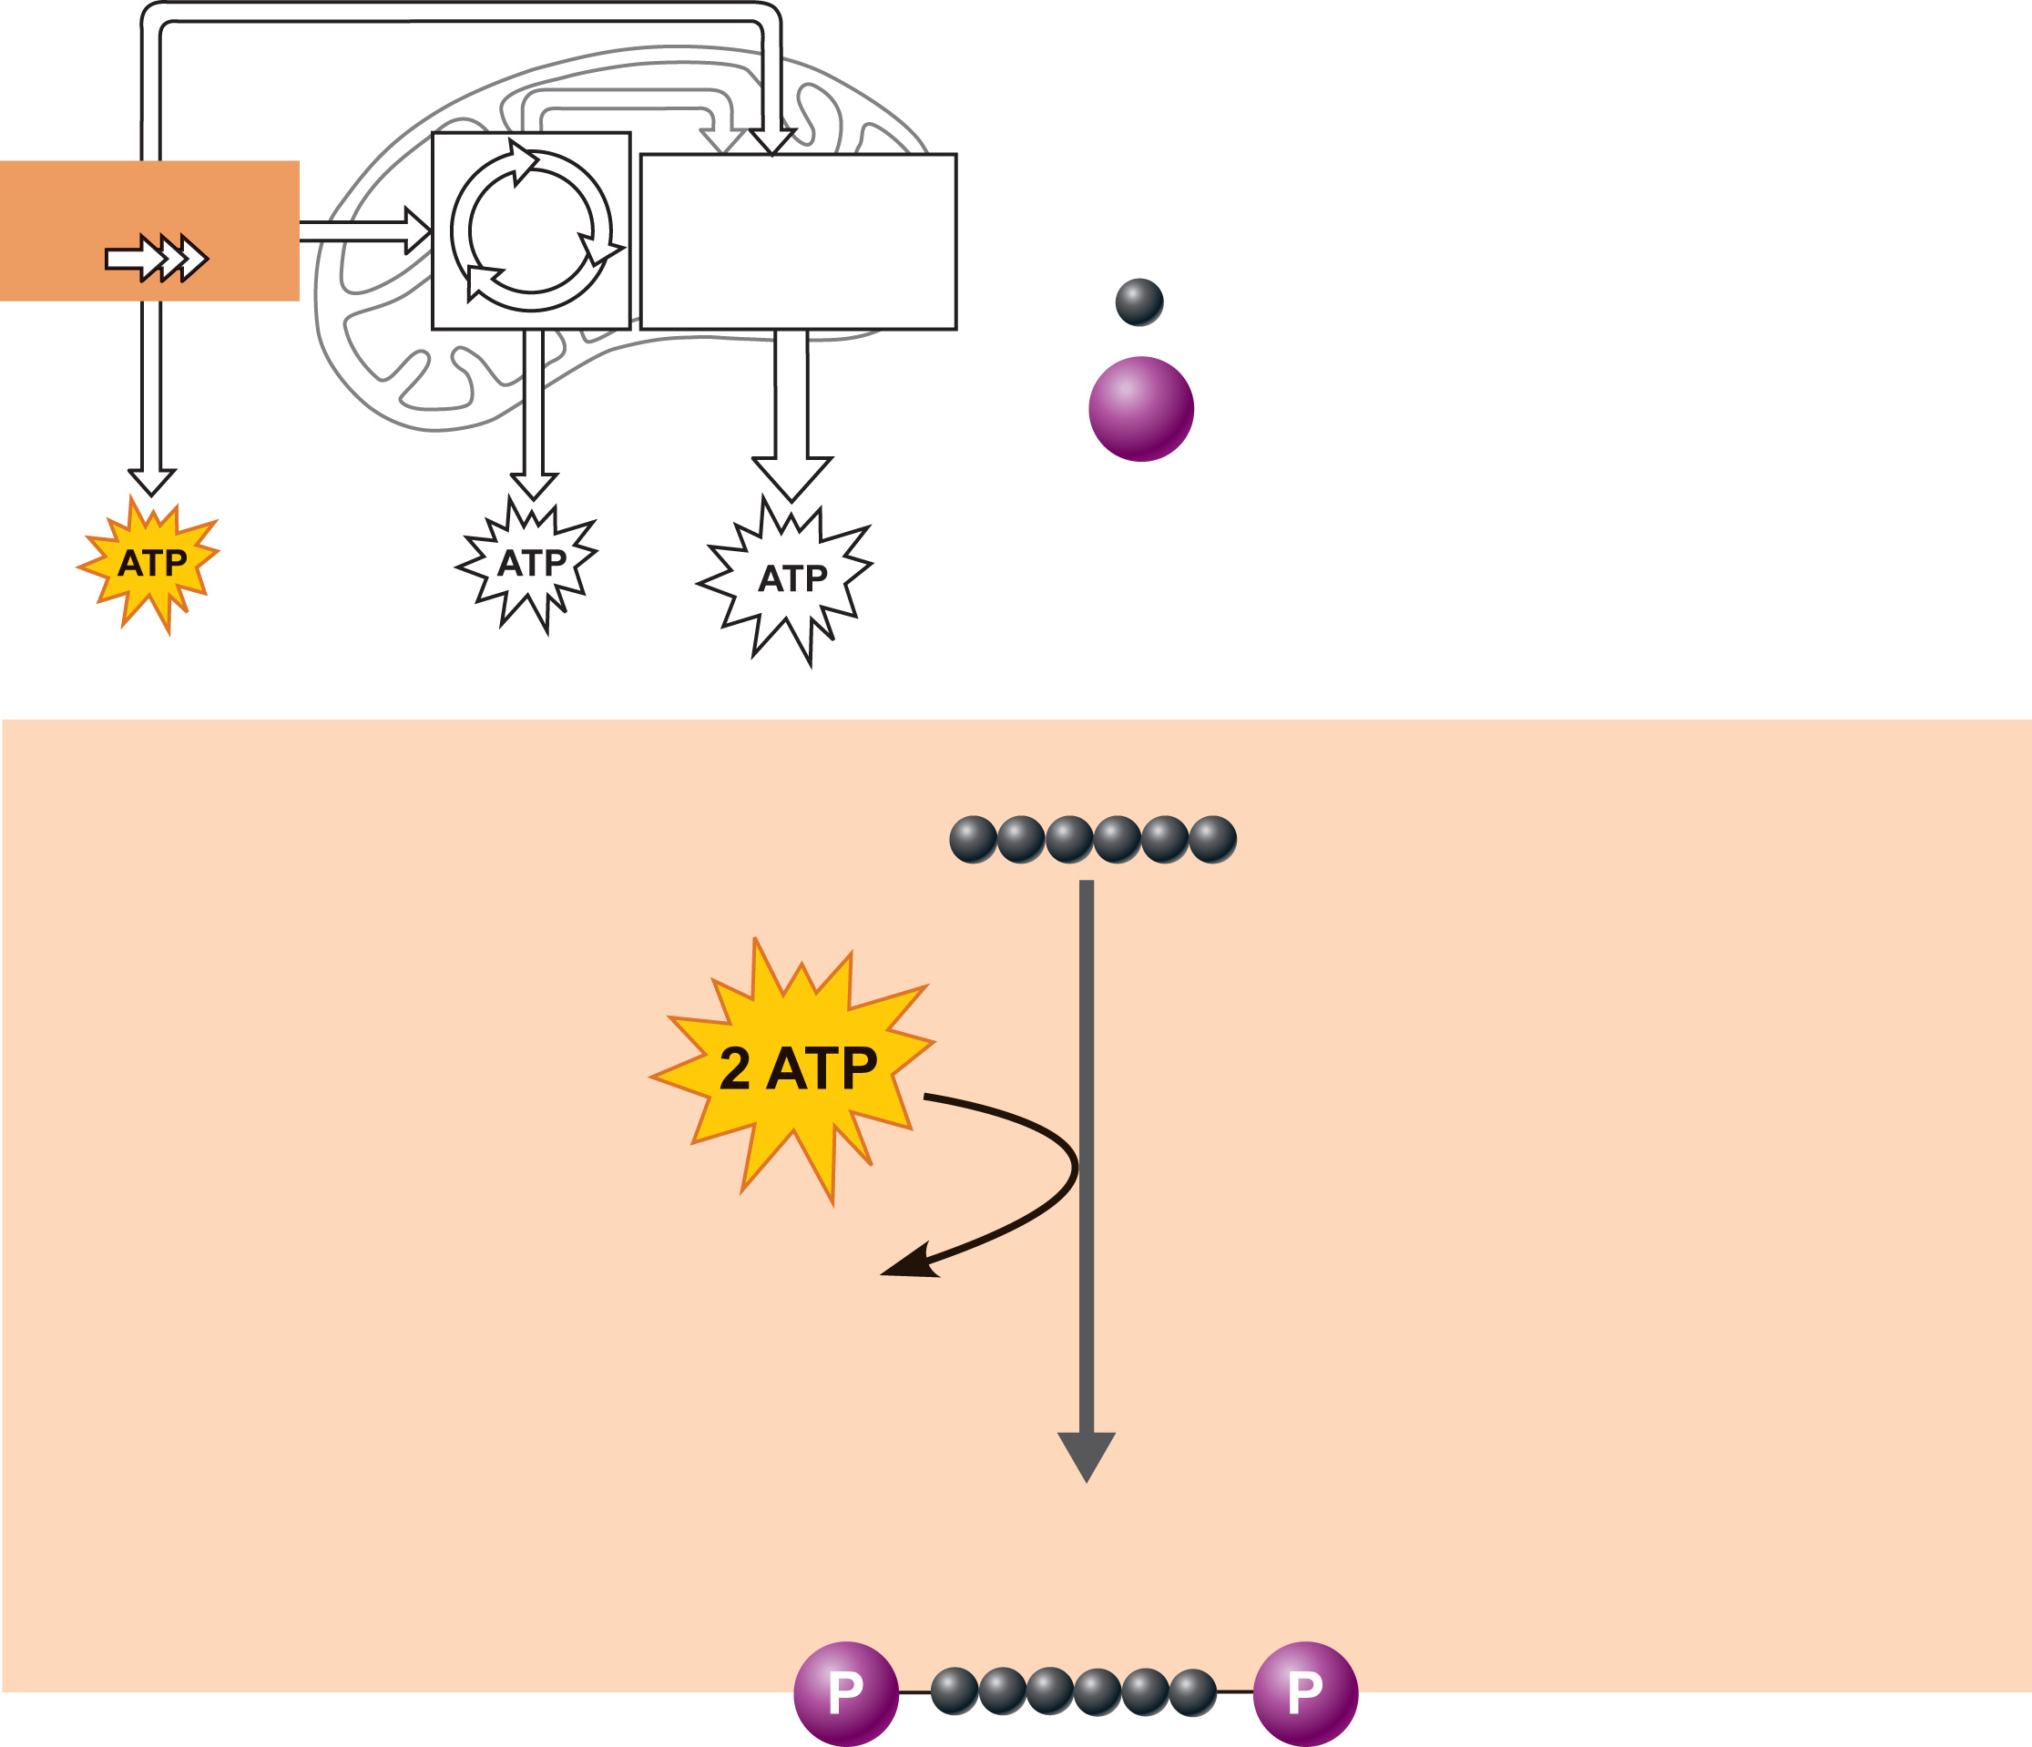
Glycolysis
Krebs
cycle
Electron trans-
port chain
and oxidative
phosphorylation
Carbon atom
Phosphate
Glucose
Phase 1
Sugar
Activation
Glucose is
activated by
phosphorylation
and converted
to fructose-1,
6-bisphosphate
2 ADP
Fructose-1,6-
bisphosphate
Figure 24.6 (1 of 3)

Slide 16
Phases of Glycolysis
Sugar cleavage
Fructose-1,6-bisphosphate is split into 3-carbon sugars
Dihydroxyacetone phosphate
Glyceraldehyde 3-phosphate

Slide 17
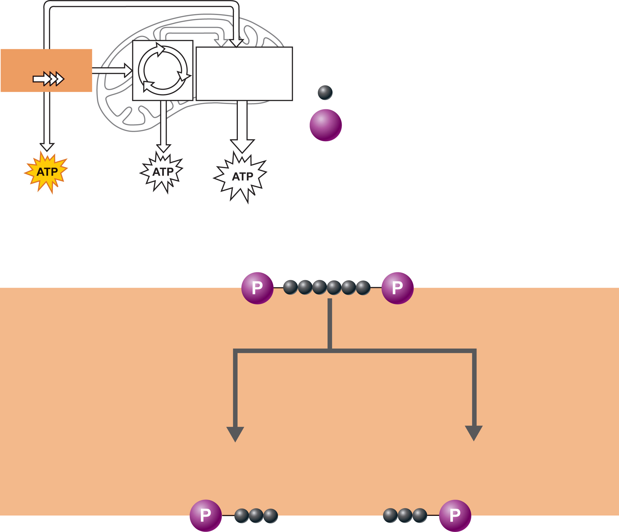
Glycolysis
Krebs
cycle
Electron trans-
port chain
and oxidative
phosphorylation
Carbon atom
Phosphate
Fructose-1,6-
bisphosphate
Phase 2
Sugar
Cleavage
Fructose-1,
6-bisphosphate
is cleaved into
two 3-carbon
fragments
Dihydroxyacetone
phosphate
Glyceraldehyde
3-phosphate
Figure 24.6 (2 of 3)

Slide 18
Phases of Glycolysis
Sugar oxidation and ATP formation
3-carbon sugars are oxidized (reducing NAD⁺)
Inorganic phosphate groups (P_{i}) are attached to each oxidized fragment
4 ATP are formed by substrate-level phosphorylation

Slide 19
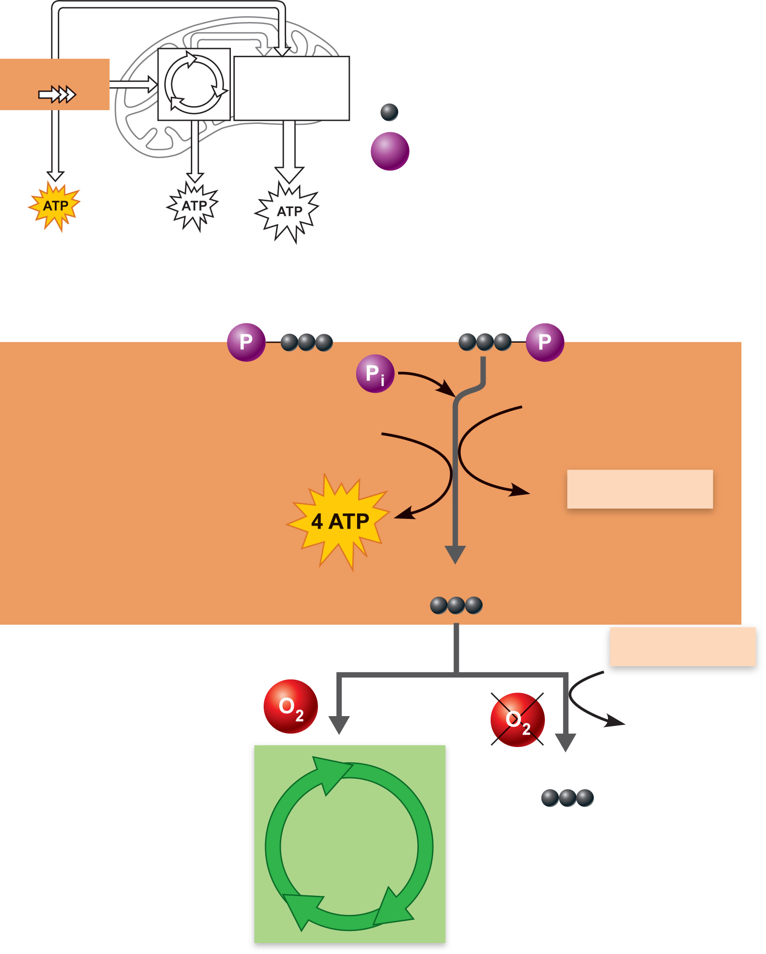
Glycolysis
Krebs
cycle
Electron trans-
port chain
and oxidative
phosphorylation
Carbon atom
Phosphate
Dihydroxyacetone
phosphate
Glyceraldehyde
3-phosphate
Phase 3
Sugar oxidation
and formation
of ATP
The 3-carbon frag-
ments are oxidized
(by removal of
hydrogen) and 4 ATP
molecules are formed
2 NAD⁺
4 ADP
2
NADH+H⁺
2 Pyruvic acid
2
NADH+H⁺
2 NAD⁺
2 Lactic acid
To Krebs
cycle
(aerobic
pathway)
Figure 24.6 (3 of 3)

Slide 20
Glycolysis
Final products of glycolysis
2 pyruvic acid
Converted to lactic acid if O₂ not readily available
Enter aerobic pathways if O₂ is readily available
2 NADH + H⁺ (reduced NAD⁺)
Net gain of 2 ATP

Slide 21
Krebs Cycle
Occurs in mitochondrial matrix
Fueled by pyruvic acid and short fatty acids

Slide 22
Krebs Cycle
Does not directly use O₂
Breakdown products of fats and proteins can also enter the cycle
Cycle intermediates may be used as building materials for anabolic reactions
PLAY
Animation: Krebs Cycle

Slide 23
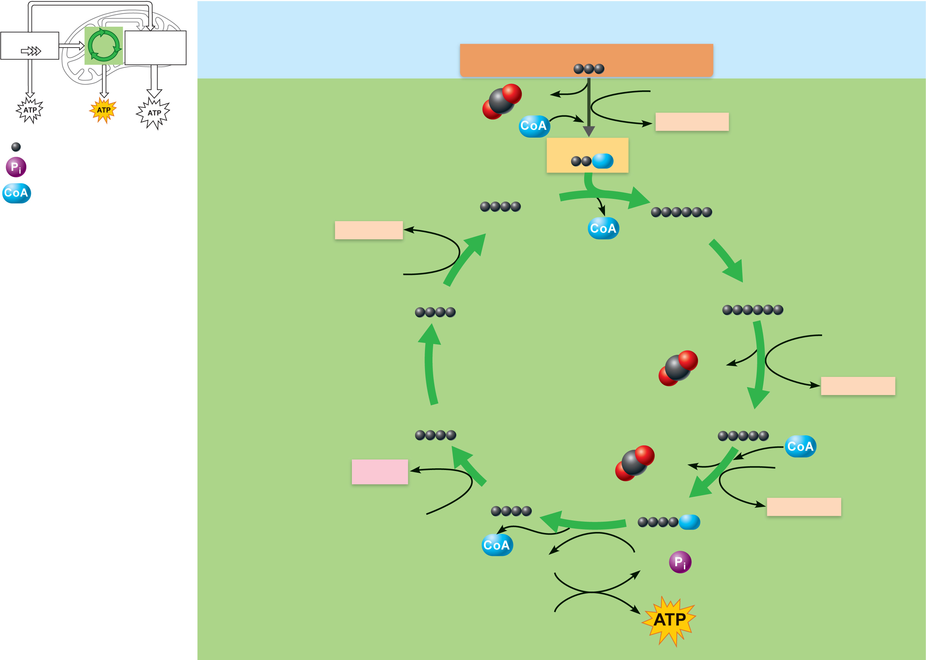
Glycolysis
Krebs
cycle
Electron trans-
port chain
and oxidative
phosphorylation
Cytosol
Pyruvic acid from glycolysis
CO₂
NAD⁺
Transitional
phase
NADH+H⁺
Carbon atom
Mitochondrion
(matrix)
Acetyl CoA
Inorganic phosphate
Coenzyme A
Oxaloacetic acid
Citric acid
NADH+H⁺
(pickup molecule)
(initial reactant)
NAD⁺
Malic acid
Isocitric acid
NAD⁺
Krebs cycle
CO₂
NADH+H⁺
Fumaric acid
α-Ketoglutaric acid
FADH₂
CO₂
NAD⁺
Succinic acid
Succinyl-CoA
NADH+H⁺
FAD
GTP
GDP +
ADP
Figure 24.7

Slide 24
Krebs Cycle
Transitional phase
Each pyruvic acid is converted to acetyl CoA
Decarboxylation: removal of 1 C to produce acetic acid and CO₂
Oxidation: H⁺ is removed from acetic acid and picked up by NAD⁺
Acetic acid + coenzyme A forms acetyl CoA

Slide 25
Glycolysis
Krebs
cycle
Electron trans-
port chain
and oxidative
phosphorylation
Cytosol
Pyruvic acid from glycolysis
CO₂
NAD⁺
Transitional
phase
NADH+H⁺
Carbon atom
Mitochondrion
(matrix)
Acetyl CoA
Inorganic phosphate
Coenzyme A
Oxaloacetic acid
Citric acid
NADH+H⁺
(pickup molecule)
(initial reactant)
NAD⁺
Malic acid
Isocitric acid
NAD⁺
Krebs cycle
CO₂
NADH+H⁺
Fumaric acid
α-Ketoglutaric acid
FADH₂
CO₂
NAD⁺
Succinic acid
Succinyl-CoA
NADH+H⁺
FAD
GTP
GDP +
ADP
Figure 24.7

Slide 26
Krebs Cycle
Starts with Acetyl-CoA
(acetic acid + coenzyme A)
Acetyl Co-A is combined with oxaloacetate to make citric acid.
End product is oxaloacetate!
(2 carbon dioxide molecules are removed in the process)

Slide 27
Glycolysis
Krebs
cycle
Electron trans-
port chain
and oxidative
phosphorylation
Cytosol
Pyruvic acid from glycolysis
CO₂
NAD⁺
Transitional
phase
NADH+H⁺
Carbon atom
Mitochondrion
(matrix)
Acetyl CoA
Inorganic phosphate
Coenzyme A
Oxaloacetic acid
Citric acid
NADH+H⁺
(pickup molecule)
(initial reactant)
NAD⁺
Malic acid
Isocitric acid
NAD⁺
Krebs cycle
CO₂
NADH+H⁺
Fumaric acid
α-Ketoglutaric acid
FADH₂
CO₂
NAD⁺
Succinic acid
Succinyl-CoA
NADH+H⁺
FAD
GTP
GDP +
ADP
Figure 24.7

Slide 28
Krebs Cycle
Coenzyme A shuttles acetic acid to an enzyme of the Krebs cycle
Each acetic acid is decarboxylated and oxidized, generating:
3 NADH + H⁺
1 FADH₂
2 CO₂
1 ATP (substrate-level phosphorylation)

Slide 29
Glycolysis
Krebs
cycle
Electron trans-
port chain
and oxidative
phosphorylation
Cytosol
Pyruvic acid from glycolysis
CO₂
NAD⁺
Transitional
phase
NADH+H⁺
Carbon atom
Mitochondrion
(matrix)
Acetyl CoA
Inorganic phosphate
Coenzyme A
Oxaloacetic acid
Citric acid
NADH+H⁺
(pickup molecule)
(initial reactant)
NAD⁺
Malic acid
Isocitric acid
NAD⁺
Krebs cycle
CO₂
NADH+H⁺
Fumaric acid
-Ketoglutaric acid
FADH₂
CO₂
NAD⁺
Succinic acid
Succinyl-CoA
NADH+H⁺
FAD
GTP
GDP +
ADP
Figure 24.7

Slide 30
But, if the Krebs cycle is so great, how come it only produces
one ATP ?!?!?

Slide 31
Electron Transport Chain and Oxidative Phosphorylation
The part of metabolism that directly uses oxygen
Chain of proteins bound to metal atoms (cofactors) on inner mitochondrial membrane.
Substrates NADH + H⁺ and FADH₂ deliver hydrogen atoms and high-energy electrons.

Slide 32
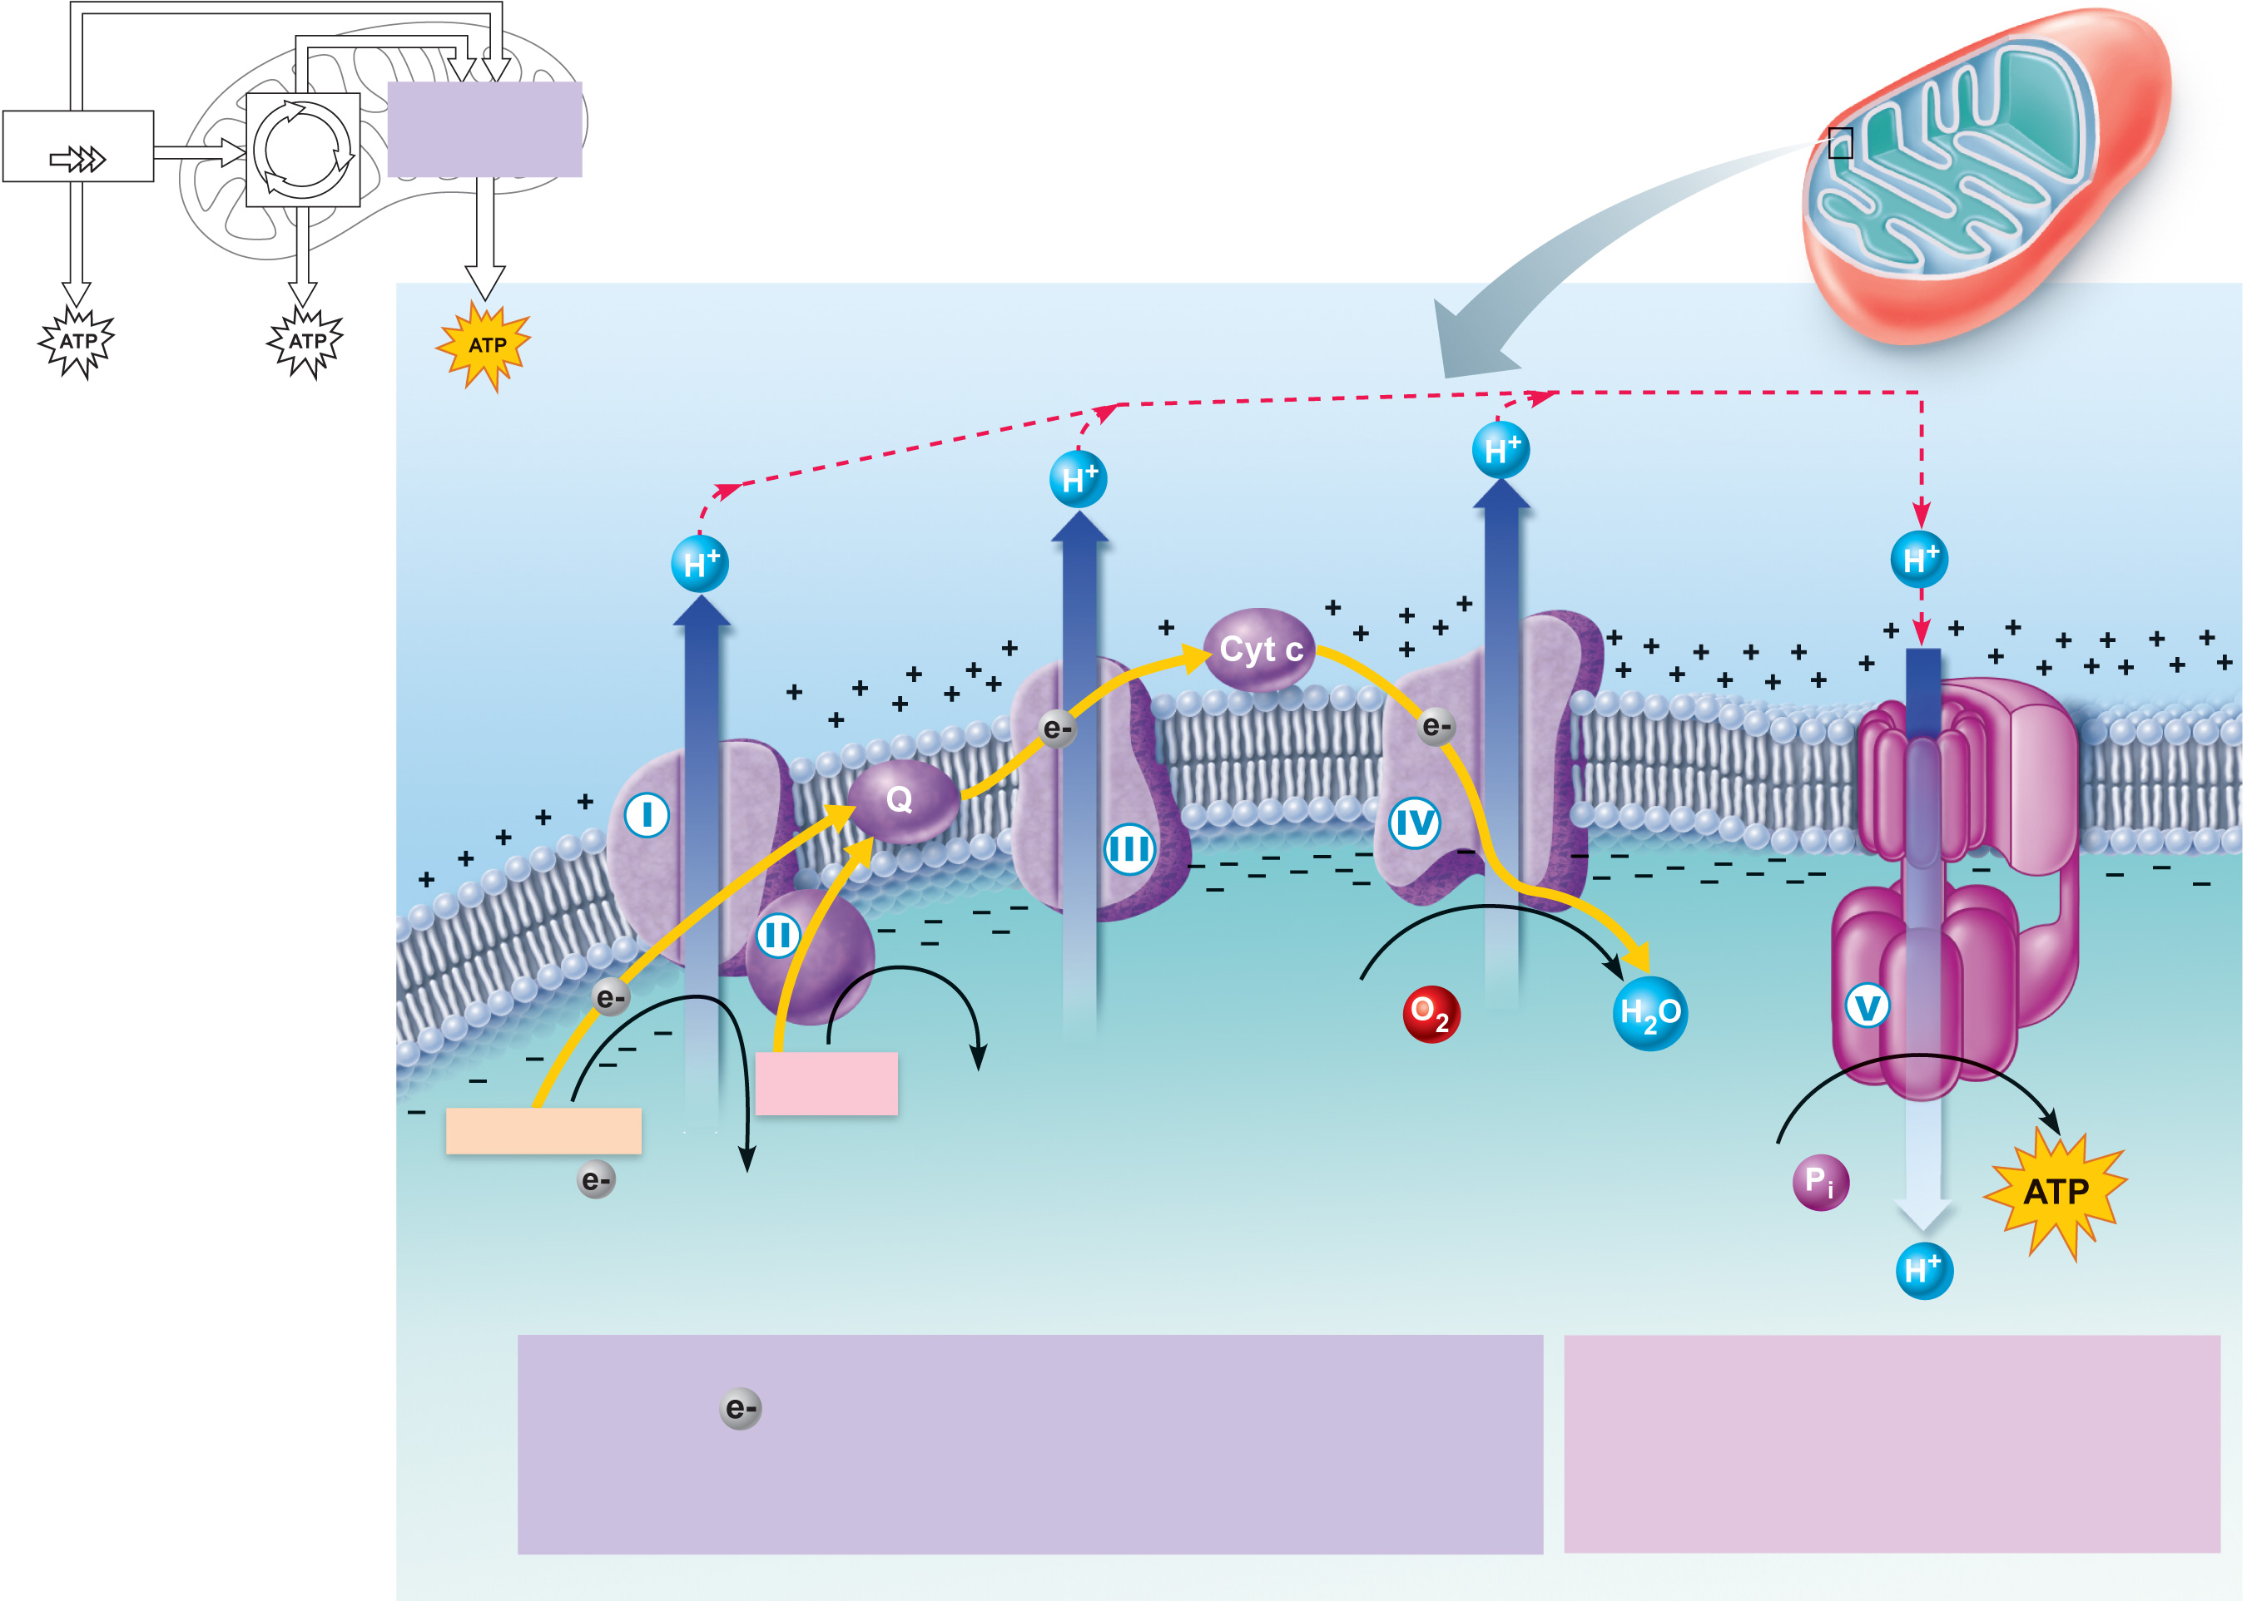
Glycolysis
Krebs
cycle
Electron transport
chain and oxidative
phosphorylation
Intermembrane
space
Inner
mitochondrial
membrane
2 H⁺ +
1
2
ATP
synthase
FADH₂
FAD
NADH + H⁺
(carrying
from food)
NAD⁺
ADP +
Mitochondrial
matrix
Electron Transport Chain
Chemiosmosis
Electrons are transferred from complex to complex and
some of their energy is used to pump protons (H⁺) into the
intermembrane space, creating a proton gradient.
ATP synthesis is powered by the
flow of H⁺ back across the inner
mitochondrial membrane through
ATP synthase.
Figure 24.8

Slide 33
Electron Transport Chain and Oxidative Phosphorylation
Hydrogen atoms are split into H⁺ and electrons
Electrons are shuttled along the inner mitochondrial membrane, losing energy at each step
Released energy is used to pump H⁺ into the intermembrane space

Slide 34
Electron Transport Chain and Oxidative Phosphorylation
Respiratory enzyme complexes I, III, and IV pump H⁺ into the intermembrane space
H⁺ diffuses back to the matrix via ATP synthase
ATP synthase uses released energy to make ATP
PLAY
Animation: Electron Transport

Slide 35
Glycolysis
Krebs
cycle
Electron transport
chain and oxidative
phosphorylation
Intermembrane
space
Inner
mitochondrial
membrane
2 H⁺ +
1
2
ATP
synthase
FADH₂
FAD
NADH + H⁺
(carrying
from food)
NAD⁺
ADP +
Mitochondrial
matrix
Electron Transport Chain
Chemiosmosis
Electrons are transferred from complex to complex and
some of their energy is used to pump protons (H⁺) into the
intermembrane space, creating a proton gradient.
ATP synthesis is powered by the
flow of H⁺ back across the inner
mitochondrial membrane through
ATP synthase.
Figure 24.8

Slide 36
Electron Transport Chain and Oxidative Phosphorylation
Electrons are delivered to O, forming O–
O– attracts H⁺ to form H₂O

Slide 37
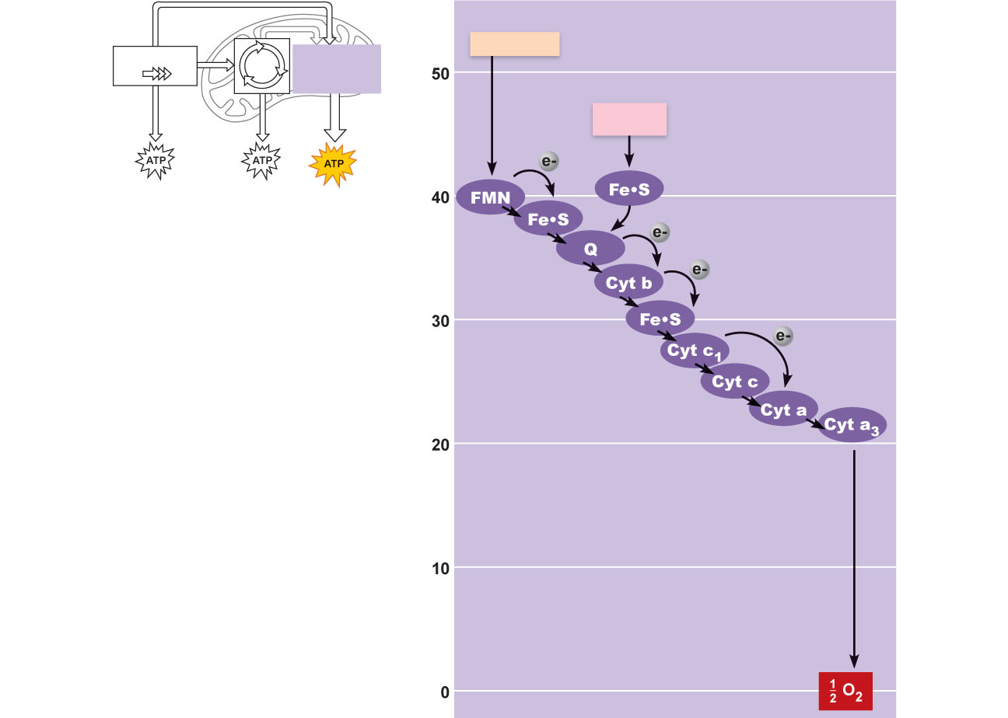
Electron trans-
port chain
and oxidative
phosphorylation
NADH+H⁺
Glycolysis
Krebs
cycle
FADH₂
Enzyme
Enzyme
Complex II
Complex I
Enzyme
Complex III
Free energy relative to O₂ (kcal/mol)
Enzyme
Complex IV
Figure 24.9

Slide 38
Electronic Energy Gradient
Transfer of energy from NADH + H⁺ and FADH₂ to oxygen releases large amounts of energy
This energy is released in a stepwise manner through the electron transport chain
Each step pumps a hydrogen ion across the membrane.

Slide 39
ATP Synthase
Two major parts connected by a rod
Rotor in the inner mitochondrial membrane
Knob in the matrix
Works like an ion pump in reverse
Its structure is literally like a water-wheel, but powered by hydrogen ions!

Slide 40
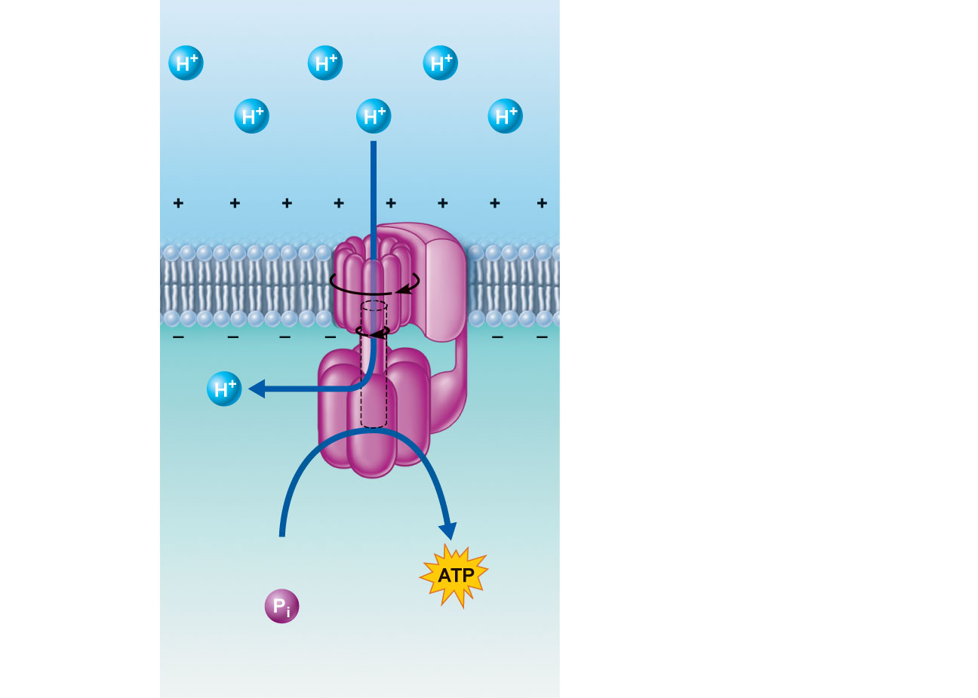
Intermembrane space
A rotor in the
membrane spins
clockwise when H⁺
flows through it down
the H⁺ gradient.
A stator anchored in
the membrane holds
the knob stationary.
As the rotor spins, a
rod connecting the
cylindrical rotor and
knob also spins.
The protruding,
stationary knob
contains three
catalytic sites that
join inorganic
phosphate to ADP
to make ATP when
the rod is spinning.
ADP
+
Mitochondrial matrix
Figure 24.11

Slide 41
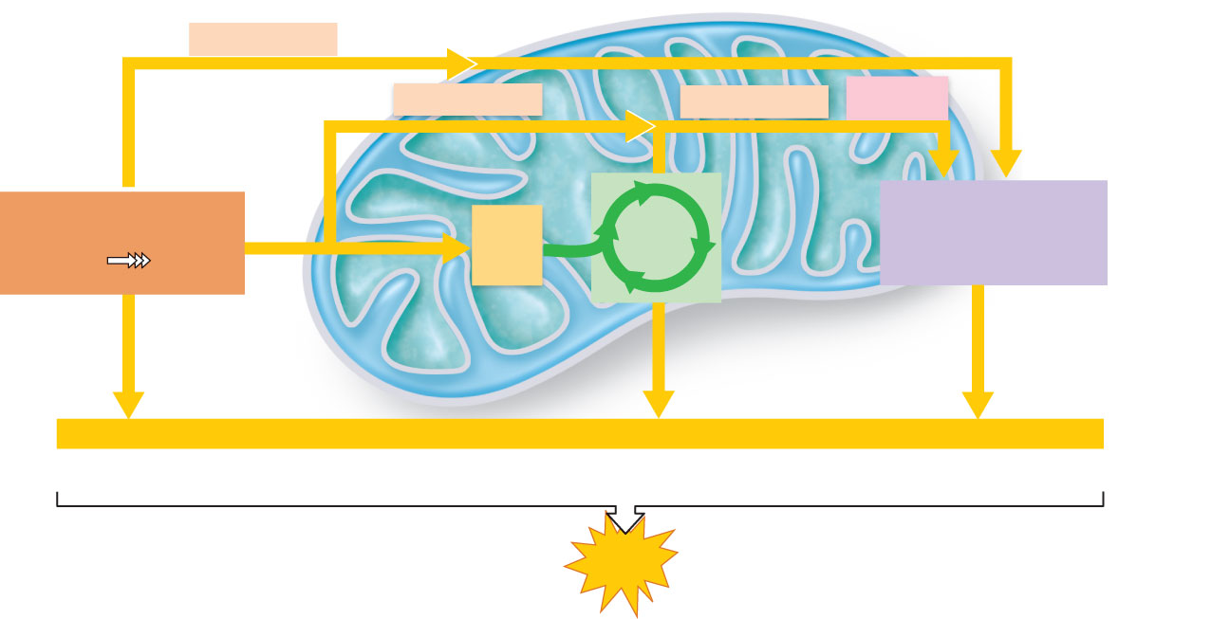
Cytosol
Mitochondrion
2 NADH + H⁺
Electron
shuttle across
mitochondrial
membrane
2 NADH + H⁺
6 NADH + H⁺
2 FADH₂
Glycolysis
2
Acetyl
CoA
Krebs
cycle
Electron transport
chain and oxidative
phosphorylation
Glucose
Pyruvic
acid
(4 ATP–2 ATP
used for
activation
energy)
10 NADH + H⁺ x 2.5 ATP
2 FADH₂ x 1.5 ATP
Net +2 ATP
by substrate-level
phosphorylation
+2 ATP
by substrate-level
phosphorylation
+ about 28 ATP
by oxidative
phosphorylation
About
32 ATP
Maximum
ATP yield
per glucose
Figure 24.12

Slide 42
Glycogenesis and Glycogenolysis
Glycogenesis
Glycogen formation when glucose supplies exceed need for ATP synthesis
Mostly in liver and skeletal muscle
Glycogenolysis
Glycogen beakdown in response to low blood glucose

Slide 43
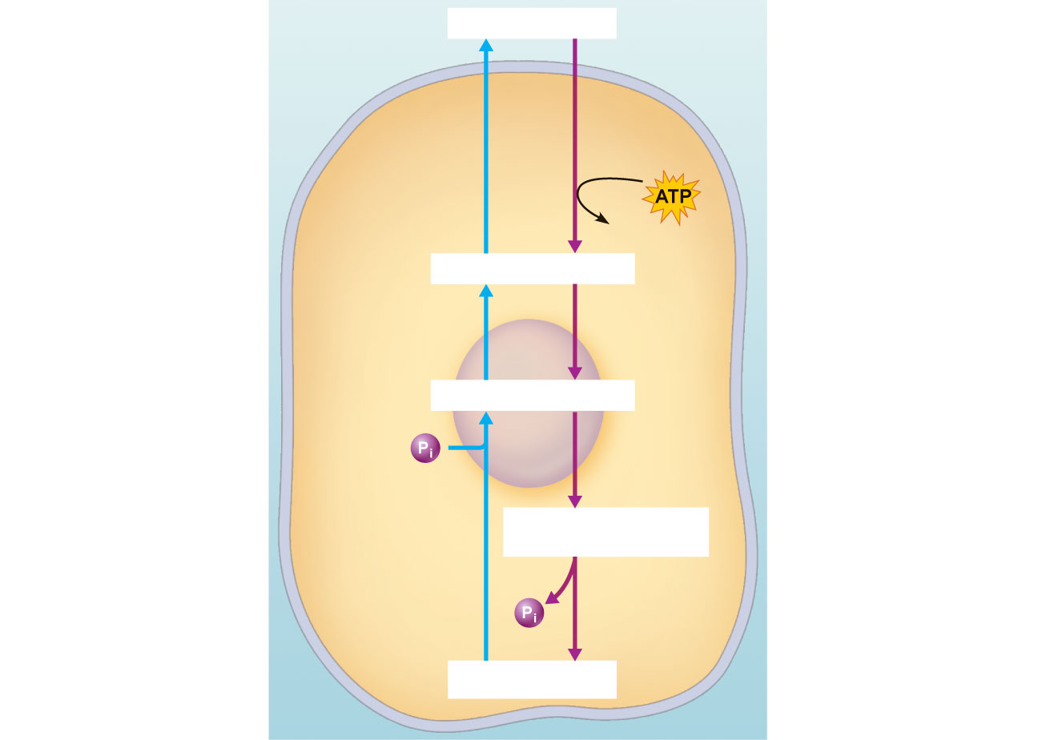
Cell exterior
Blood glucose
Glucose-6-
phosphatase
(present in liver,
kidney, and
intestinal cells)
Hexokinase
(all tissue cells)
ADP
Glucose-6-phosphate
Glycogenolysis
Glycogenesis
Mutase
Mutase
Glucose-1-phosphate
Glycogen
phosphorylase
Pyrophosphorylase
Uridine diphosphate
glucose
Cell interior
2
Glycogen
synthase
Glycogen
Figure 24.13

Slide 44
Gluconeogenesis
Glucose formation from noncarbohydrate (glycerol and amino acid) molecules
Requires oxaloacetate (not acetyl Co-A) and energy
Mainly in the liver
Protects against damaging effects of hypoglycemia

Slide 45
Glycolysis
Krebs
cycle
Electron trans-
port chain
and oxidative
phosphorylation
Cytosol
Pyruvic acid from glycolysis
CO₂
NAD⁺
Transitional
phase
NADH+H⁺
Carbon atom
Mitochondrion
(matrix)
Acetyl CoA
Inorganic phosphate
Coenzyme A
Oxaloacetic acid
Citric acid
NADH+H⁺
(pickup molecule)
(initial reactant)
NAD⁺
Malic acid
Isocitric acid
NAD⁺
Krebs cycle
CO₂
NADH+H⁺
Fumaric acid
α-Ketoglutaric acid
FADH₂
CO₂
NAD⁺
Succinic acid
Succinyl-CoA
NADH+H⁺
FAD
GTP
GDP +
ADP
Figure 24.7

Slide 46
Lipid Metabolism
Fat catabolism yields 9 kcal per gram (vs 4 kcal per gram of carbohydrate or protein)
Most products of fat digestion are transported as chylomicrons and are hydrolyzed by endothelial enzymes into fatty acids and glycerol

Slide 47
Lipid Metabolism
Only triglycerides are routinely oxidized for energy
The two building blocks are oxidized separately
Glycerol pathway
Fatty acid pathway

Slide 48
Lipid Metabolism
Glycerol is converted to glyceraldehyde phosphate (one of the intermediates of glycolysis)
Enters the Krebs cycle
Equivalent to ¹/₂ glucose

Slide 49
Glycolysis
Krebs
cycle
Electron trans-
port chain
and oxidative
phosphorylation
Carbon atom
Phosphate
Dihydroxyacetone
phosphate
↔
Glyceraldehyde
3-phosphate
Phase 3
Sugar oxidation
and formation
of ATP
The 3-carbon frag-
ments are oxidized
(by removal of
hydrogen) and 4 ATP
molecules are formed
2 NAD⁺
4 ADP
2
NADH+H⁺
2 Pyruvic acid
2
NADH+H⁺
2 NAD⁺
2 Lactic acid
To Krebs
cycle
(aerobic
pathway)
Figure 24.6 (3 of 3)

Slide 50
Lipid Metabolism
Fatty acids undergo beta oxidation, which produces
Many two-carbon acetic acid fragments, which enter the Krebs cycle as acetyl-CoA
Lots of NADH and FADH₂, which enter the electron transport chain
Nearly all of the energy in a fatty acid requires oxygen to be released!!

Slide 51
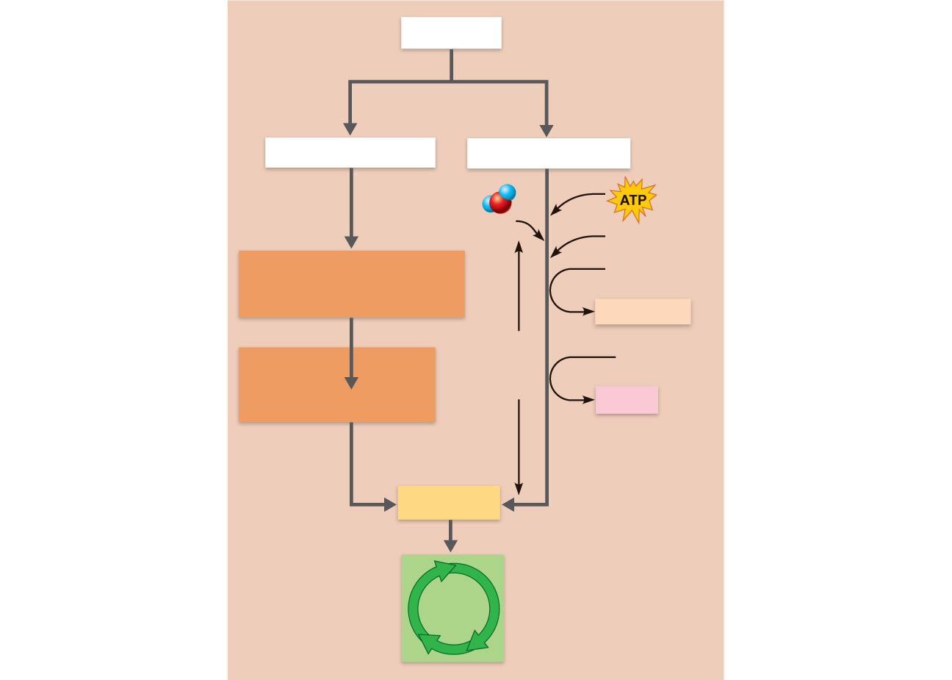
Lipids
Lipase
Glycerol
Fatty acids
H₂O
Coenzyme A
Glyceraldehyde
phosphate
(a glycolysis intermediate)
NAD⁺
NADH + H⁺
β Oxidation
in the mito-
chondria
FAD
Glycolysis
Pyruvic acid
FADH₂
Cleavage
enzyme
snips off
2C fragments
Acetyl CoA
Krebs
cycle
Figure 24.14

Slide 52
Lipogenesis
Triglyceride synthesis occurs when cellular ATP and glucose levels are high
Glucose is easily converted into fat because acetyl CoA is
An intermediate in glucose catabolism
A starting point for fatty acid synthesis
Just reverse β-oxidation and you have a fatty acid!

Slide 53
Lipolysis
The reverse of lipogenesis
Oxaloacetic acid is necessary for complete oxidation of fat (And for the Krebs cycle in general)
Without it, acetyl CoA is converted by ketogenesis in the liver into ketone bodies (ketones)

Slide 54
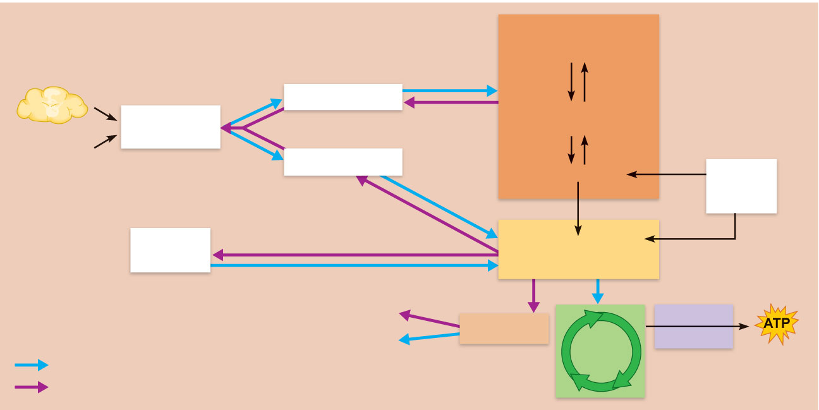
Glycolysis
Glucose
Stored fats
in adipose
tissue
Glycerol
Glyceraldehyde
phosphate
Triglycerides
(neutral fats)
Lipogenesis
Dietary fats
Fatty acids
Pyruvic acid
Certain
amino
acids
β
Ketone
Ketogenesis (in liver)
Acetyl CoA
bodies
CO₂ + H₂O
+
Steroids
Electron
transport
Bile salts
Cholesterol
Krebs
cycle
Catabolic reactions
Anabolic reactions
Figure 24.15

Slide 55
Protein Metabolism
When dietary protein is in excess, amino acids are
Oxidized for energy
Converted into fat for storage

Slide 56
Oxidation of Amino Acids
First deaminated (to make ammonia); then converted into
Pyruvic acid or
another intermediate of the Krebs cycle (a “keto-acid”)
The nitrogen-containing group can also be moved to another molecule to make a new amino acid.
The ammonia is then converted to urea, which is non-toxic.

Slide 57
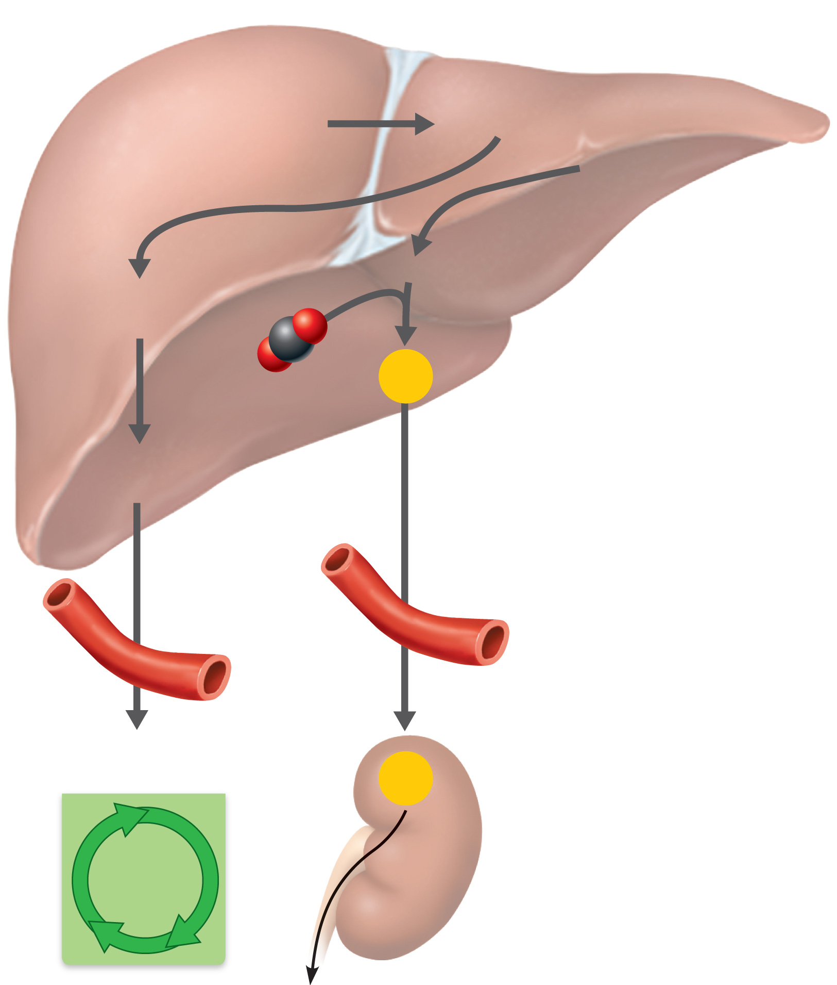
Transamination
1
During
transamination
an amine group
is switched from
an amino acid to
a keto acid.
Amino acid + Keto acid
Keto acid + Amino acid
(glutamic acid)
(α-keto-
glutaric acid)
Liver
Oxidative
deamination
Keto acid
modification
NH₃ (ammonia)
2
In oxidative
deamination, the
amine group of
glutamic acid is
removed as
ammonia and
combined with CO²
to form urea.
3
During keto
acid modification
the keto acids
formed during
transamination are
altered so they can
easily enter the
Krebs cycle
pathways.
Urea
CO₂
Modified
keto acid
Blood
Enter Krebs
cycle in body cells
Urea
Krebs
cycle
Kidney
Excreted in urine
Figure 24.16

Slide 58
Protein Synthesis
Is hormonally controlled
Requires a complete set of amino acids
Essential amino acids must be provided in the diet
Non-essential amino acids can be manufactured from the essential amino acids.

Slide 59
Nutrient Pools
Three semi-interconvertible pools
Amino acids
Carbohydrates
Fats

Slide 60
Amino Acid Pool
Body’s total supply of free amino acids
Source for
Resynthesizing body proteins
Forming amino acid derivatives
Gluconeogenesis

Slide 61
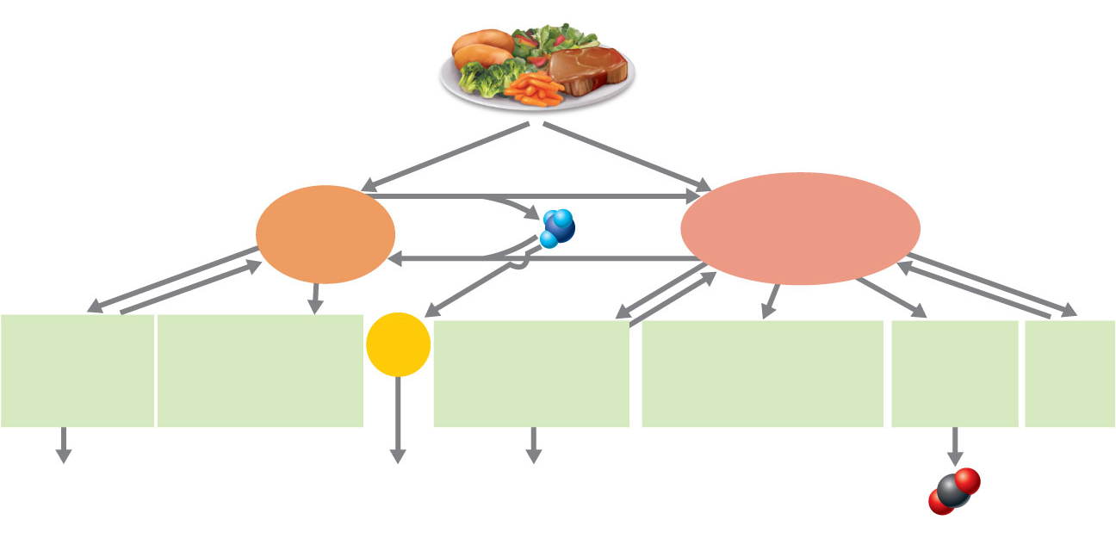
Food intake
Dietary proteins
and amino acids
Dietary carbohydrates
and lipids
Pool of
carbohydrates and fats
(carbohydrates fats)
Pool of free
amino acids
NH₃
Components
of structural
and functional
proteins
Nitrogen-containing
derivatives
(e.g., hormones,
neurotransmitters)
Urea
Structural
components of
cells (membranes,
etc.)
Specialized derivatives
(e.g., steroids,
acetylcholine); bile
salts
Catabolized
for energy
Storage
forms
Some lost via cell
sloughing, hair loss
Excreted
in urine
Some lost via surface
secretion, cell sloughing
CO₂
Excreted
via lungs
Figure 24.17

Slide 62
Carbohydrate and Fat Pools
Easily interconverted through key intermediates
Differ from the amino acid pool in that:
Fats and carbohydrates are oxidized directly to produce energy
Excess carbohydrate and fat can be stored

Slide 63
Ketones
If no oxaloacetate is present, liver produces “ketone bodies” for fuel
Ketone bodies are toxic in high amounts
Most cells can burn ketones for fuel
Exception: the brain

Slide 64
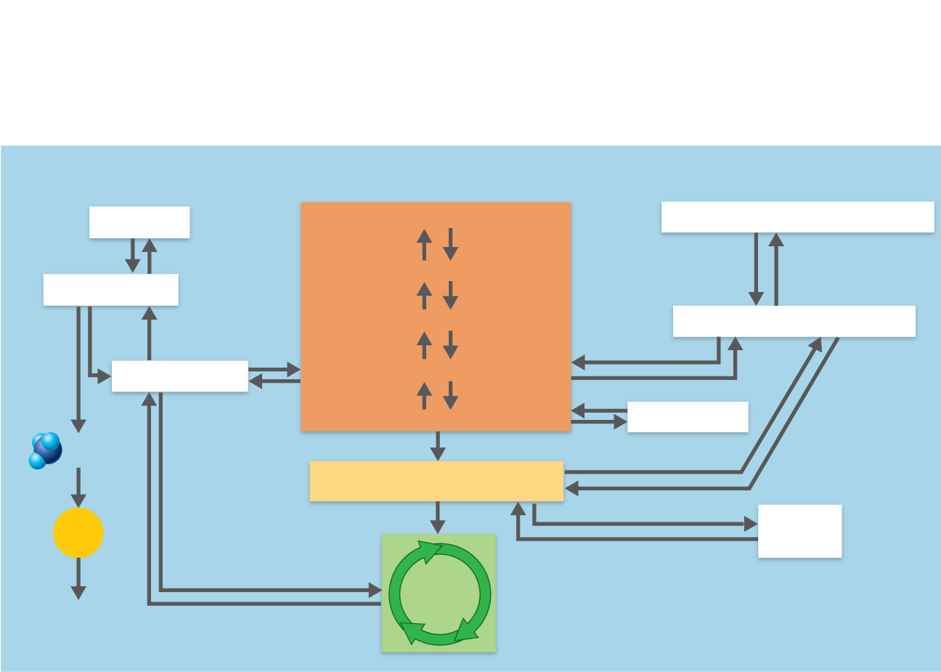
Proteins
Carbohydrates
Fats
Proteins
Glycogen
Triglycerides (neutral fats)
Glucose
Amino acids
Glucose-6-phosphate
Glycerol and fatty acids
Keto acids
Glyceraldehyde phosphate
Pyruvic acid
Lactic acid
NH₃
Acetyl CoA
Urea
Ketone
bodies
Krebs
cycle
Excreted
in urine
Figure 24.18

Slide 65
Absorptive and Postabsorptive States
Absorptive (fed) state
During and shortly after eating
Absorption of nutrients is occurring
Anabolism exceeds catabolism
Postabsorptive (fasting) state
When the GI tract is empty
Energy sources are supplied by breakdown of reserves
Catabolism exceeds anabolism

Slide 66
Absorptive State
Carbohydrates
Glucose is the major energy fuel
Glucose is converted to glycogen or fat

Slide 67
Absorptive State
Fats
In muscle and adipose cells, most glycerol and fatty acids are converted to triglycerides for storage
Triglycerides are used by adipose tissue, liver, and skeletal and cardiac muscle as a primary energy source

Slide 68
Absorptive State
Proteins
Excess amino acids are deaminated and used for ATP synthesis or stored as fat in the liver
Most amino acids are used in protein synthesis

Slide 69
Major metabolic thrust:
anabolism and energy storage
Major energy fuel:
glucose (dietary)
Liver metabolism:
amino acids deaminated and
used for energy or stored as fat
Amino
acids
Glucose
Glycerol and
fatty acids
Glucose
Amino acids
CO₂ + H₂O
Keto acids
+
Proteins
Glycogen
Triglycerides
Fats
CO₂ + H₂O +
(a) Major events of the absorptive state
Figure 24.19a

Slide 70
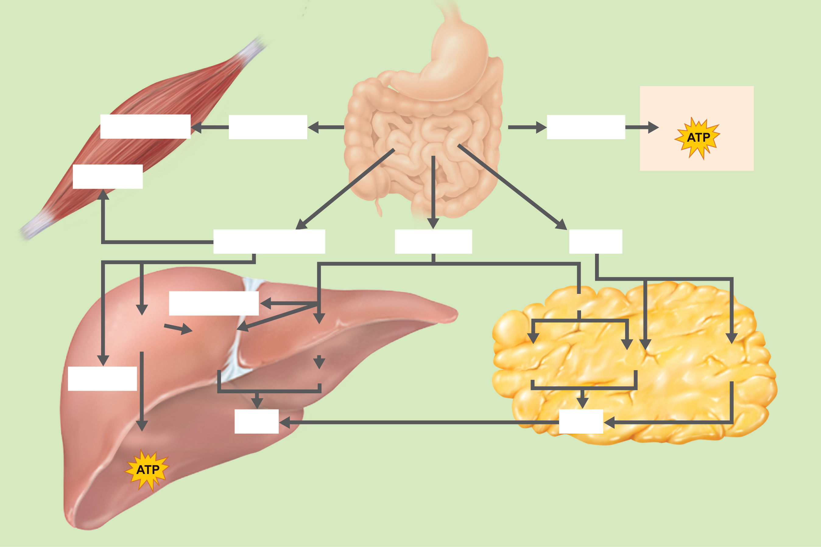
In all tissues:
In muscle:
CO₂ + H₂O
Glycogen
Glucose
Gastrointestinal
tract
Glucose
+
Protein
Amino acids
Glucose
Fats
In adipose
tissue:
In liver:
Glycogen
Glucose
Keto
acids
Fatty
acids
Glyceraldehyde-
phosphate
Fatty
acids
Glycerol
Fatty
acids
Protein
Glycerol
Fats
Fats
CO₂ + H₂O
+
(b) Principal pathways of the absorptive state
Figure 24.19b

Slide 71
Absorptive State: Hormonal Control
Insulin secretion is stimulated by
Elevated blood levels of glucose and amino acids
GIP and parasympathetic stimulation

Slide 72
Insulin Effects on Metabolism
Insulin, a hypoglycemic hormone, enhances
Facilitated diffusion of glucose into muscle and adipose cells
Glucose oxidation
Glycogen and triglyceride formation
Active transport of amino acids into tissue cells
Protein synthesis

Slide 73
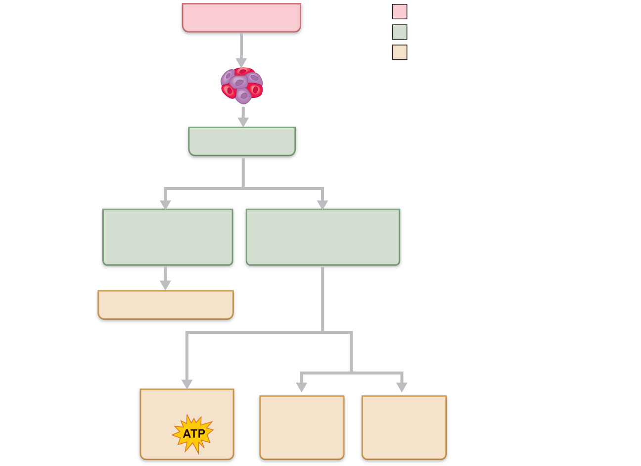
Blood glucose
Initial stimulus
Physiological response
Stimulates
Result
Beta cells of
pancreatic islets
Blood insulin
Targets tissue cells
Active transport
of amino acids
into tissue cells
Facilitated diffusion
of glucose into
tissue cells
Protein synthesis
Cellular
respiration
Enhances glucose
conversion to:
CO₂ + H₂O
Fatty acids
+
glycerol
+
Glycogen
Figure 24.20

Slide 74
Postabsorptive State
Catabolism of fat, glycogen, and proteins exceeds anabolism
Goal is to maintain blood glucose between meals
Makes glucose available to the blood
Promotes use of fats for energy (glucose sparing)

Slide 75
Sources of Blood Glucose
Glycogenolysis in the liver
Glycogenolysis in skeletal muscle
Lipolysis in adipose tissues and the liver
Glycerol is used for gluconeogenesis in the liver

Slide 76
Sources of Blood Glucose
Catabolism of cellular protein during prolonged fasting
Amino acids are deaminated and used for gluconeogenesis in the liver and (later) in the kidneys

Slide 77
Major metabolic thrust:
catabolism and replacement of
fuels in blood
Major energy fuels:
glucose provided by glycogenolysis
and gluconeogenesis, fatty acids,
and ketones
Liver metabolism:
amino acids converted to glucose
Proteins
Glycogen
Triglycerides
Amino acids
Glucose
Fatty acids
and ketones
Keto acids
CO₂ + H₂O
Amino
acids
Glycerol and
fatty acids
+
Glucose
Glucose
(a) Major events of the postabsorptive state
Figure 24.21a

Slide 78
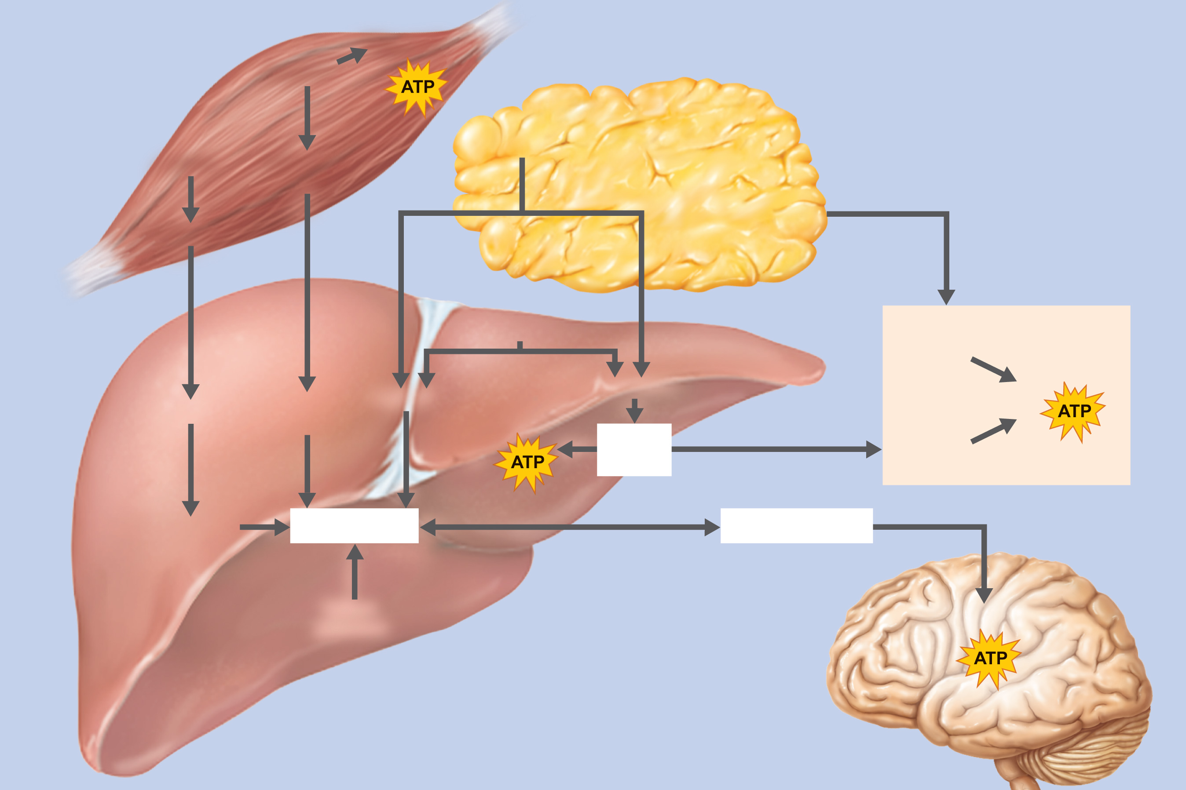
CO₂ + H₂O
In adipose
Glycogen
tissue:
+
2
In muscle:
Protein
Pyruvic and
Fat
4
lactic acids
3
Amino acids
In most tissues:
2
Fat
3
Fatty
acids +
glycerol
4
In liver:
Fatty acids
CO₂ + H₂O
Amino acids
Pyruvic and
lactic acids
Glycerol
+
CO₂ + H₂O
Keto
acids
Ketone
bodies
4
2
3
+
Keto acids
Glucose
Blood glucose
1
Stored
glycogen
CO₂ + H₂O
In nervous
tissue:
+
(b) Principal pathways of the postabsorptive state
Figure 24.21b

Slide 79
Postabsorptive State: Hormonal Controls
Glucagon release is stimulated by
Declining blood glucose
Rising amino acid levels

Slide 80
Effects of Glucagon
Glucagon, a hyperglycemic hormone, promotes
Glycogenolysis and gluconeogenesis in the liver
Lipolysis in adipose tissue
Modulation of glucose effects after a high-protein, low-carbohydrate meal

Slide 81
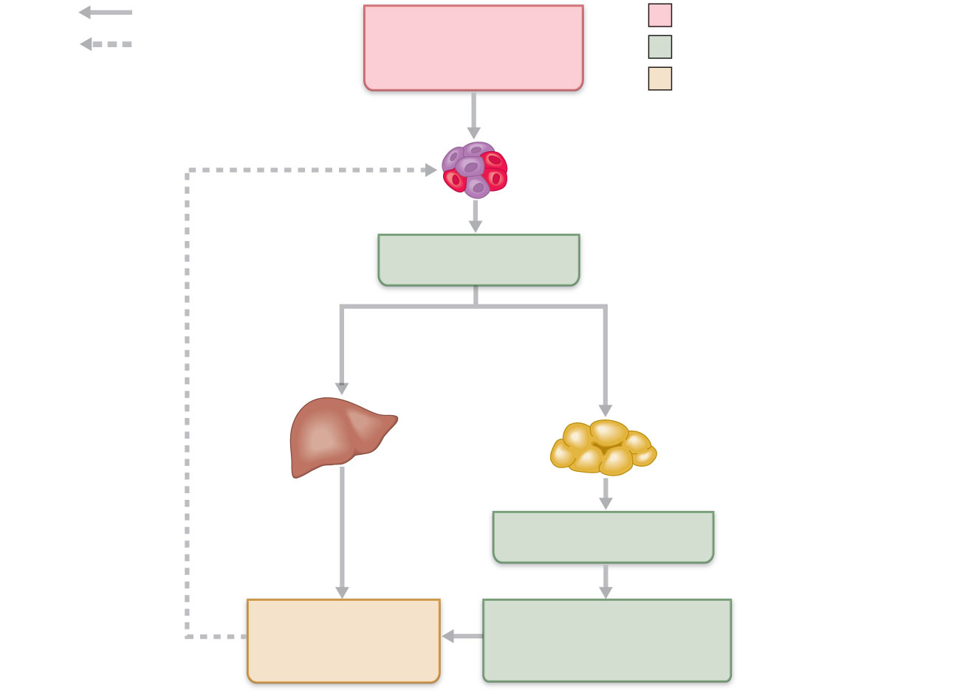
Increases, stimulates
Plasma glucose
(and rising amino
acid levels)
Initial stimulus
Reduces, inhibits
Physiological response
Result
Stimulates
Alpha cells of
pancreatic islets
Negative feedback:
rising glucose
levels shut off
initial stimulus
Plasma glucagon
Stimulates
glycogenolysis
and gluconeogenesis
Stimulates
fat breakdown
Liver
Adipose tissue
Plasma fatty acids
Plasma glucose
(and insulin)
Fat used by tissue cells
= glucose sparing
Figure 24.22

Slide 82
Postabsorptive State: Neural Controls
In response to low plasma glucose, or during fight-or-flight or exercise, the sympathetic nervous system and epinephrine from the adrenal medulla promote
Fat mobilization
Glycogenolysis

Slide 83
Metabolic Rate
Total heat produced by chemical reactions and mechanical work of the body
Measured directly with a calorimeter or indirectly with a respirometer

Slide 84
Metabolic Rate
Basal metabolic rate (BMR)
Reflects the energy the body needs to perform its most essential activities

Slide 85
Factors that Influence BMR
As the ratio of body surface area to volume increases, BMR increases
Decreases with age
Increases with temperature or stress
Males have a disproportionately higher BMR
Thyroxine increases oxygen consumption, cellular respiration, and BMR

Slide 86
Metabolic Rate
Total metabolic rate (TMR)
Rate of kilocalorie consumption to fuel all ongoing activities
Increases with skeletal muscle activity and food ingestion

Slide 87
Regulation of Body Temperature
Body temperature reflects the balance between heat production and heat loss
At rest, the liver, heart, brain, kidneys, and endocrine organs generate most heat
During exercise, heat production from skeletal muscles increases dramatically

Slide 88
Regulation of Body Temperature (Thermoregulation)
Normal body temperature = 37°C ± 5°C (98.6°F)
Optimal enzyme activity occurs at this temperature
Increased temperature denatures proteins and depresses neurons

Slide 89
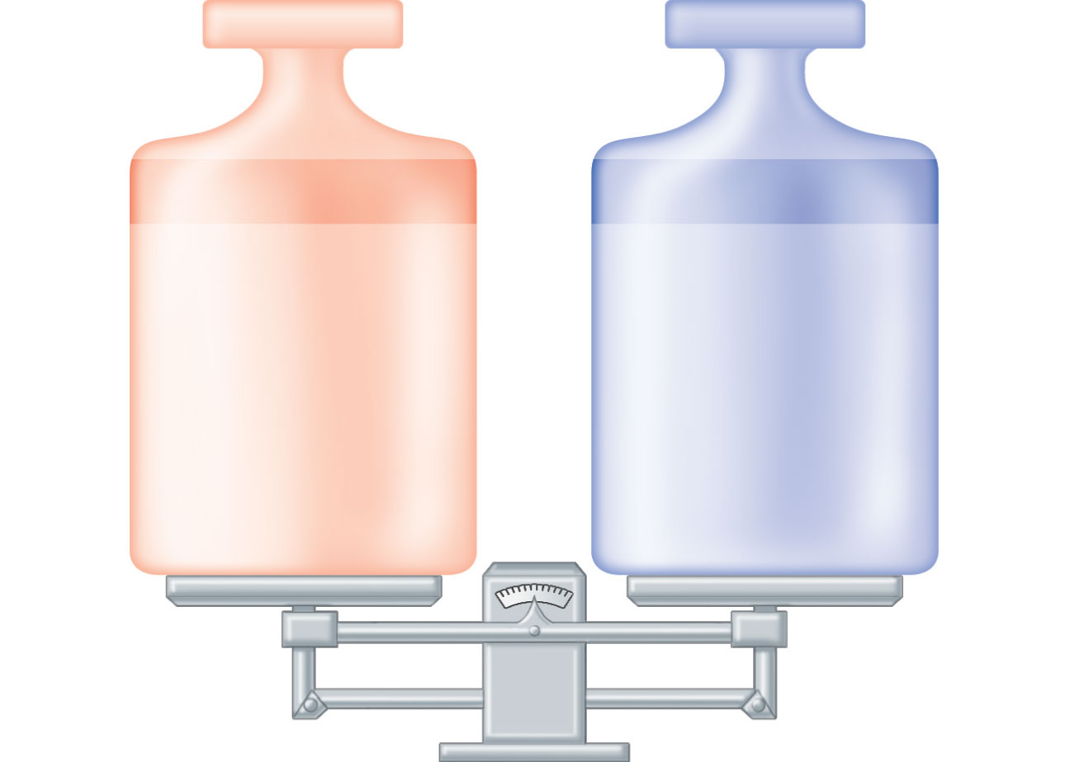
Heat production
Heat loss
• Basal metabolism
• Muscular activity
(shivering)
• Thyroxine and
epinephrine
(stimulating effects
on metabolic rate)
• Temperature effect
on cells
• Radiation
• Conduction/
convection
• Evaporation
Figure 24.25

Slide 90
Core and Shell Temperature
Organs in the core have the highest temperature
Blood is the major agent of heat exchange between the core and the shell
Core temperature is regulated
Core temperature remains relatively constant, while shell temperature fluctuates substantially (20°C–40°C)

Slide 91
Mechanisms of Heat Exchange
Four mechanisms
Radiation is the loss of heat in the form of infrared rays
Conduction is the transfer of heat by direct contact
Convection is the transfer of heat to the surrounding air
Evaporation is the heat loss due to the evaporation of water from body surfaces

Slide 92
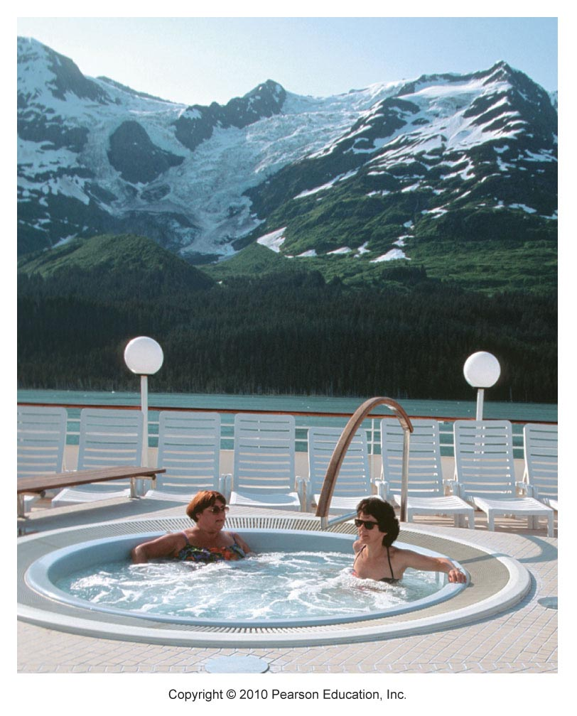
Figure 24.26

Slide 93
Mechanisms of Heat Exchange
Insensible heat loss accompanies insensible water loss from lungs, oral mucosa, and skin
Evaporative heat loss becomes sensible (active) when body temperature rises and sweating increases water vaporization

Slide 94
Role of the Hypothalamus
Preoptic region of the hypothalamus contains the two thermoregulatory centers
Heat-loss center
Heat-promoting center

Slide 95
Role of the Hypothalamus
The hypothalamus receives afferent input from
Peripheral thermoreceptors in the skin
Central thermoreceptors (some in the hypothalamus)
Initiates appropriate heat-loss and heat-promoting activities

Slide 96
Heat-Promoting Mechanisms
Constriction of cutaneous blood vessels
Shivering
Increased metabolic rate via epinephrine and norepinephrine
Enhanced thyroxine release

Slide 97
Heat-Promoting Mechanisms
Voluntary measures include
Putting on more clothing
Drinking hot fluids
Changing posture or increasing physical activity

Slide 98
Heat-Loss Mechanisms
Dilation of cutaneous blood vessels
Enhanced sweating
Voluntary measures include
Reducing activity and seeking a cooler environment
Wearing light-colored and loose-fitting clothing

Slide 99
Fever
Controlled hyperthermia
Due to infection (also cancer, allergies, or CNS injuries)
Macrophages release interleukins (“pyrogens”) that cause the release of prostaglandins from the hypothalamus

Slide 100
Fever
Prostaglandins reset the hypothalamic thermostat higher
Natural body defenses or antibiotics reverse the disease process; cryogens (e.g., vasopressin) reset the thermostat to a lower (normal) level

