Slide 1
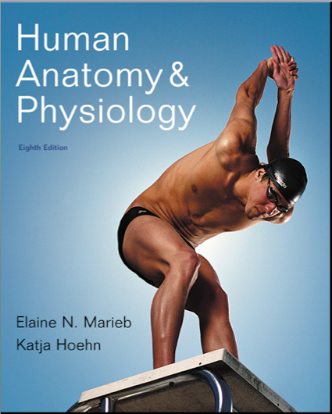
Chapter 15
Special Senses

Slide 2
The Eye and Vision
70% of all sensory receptors are in the eye
Nearly half of the cerebral cortex is involved in processing visual information!
Most of the eye is protected by a cushion of fat and the bony orbit

Slide 3
Accessory Structures of the Eye
Protect the eye and aid eye function
Eyebrows
Eyelids (palpebrae)
Conjunctiva
Lacrimal apparatus
Extrinsic eye muscles

Slide 4
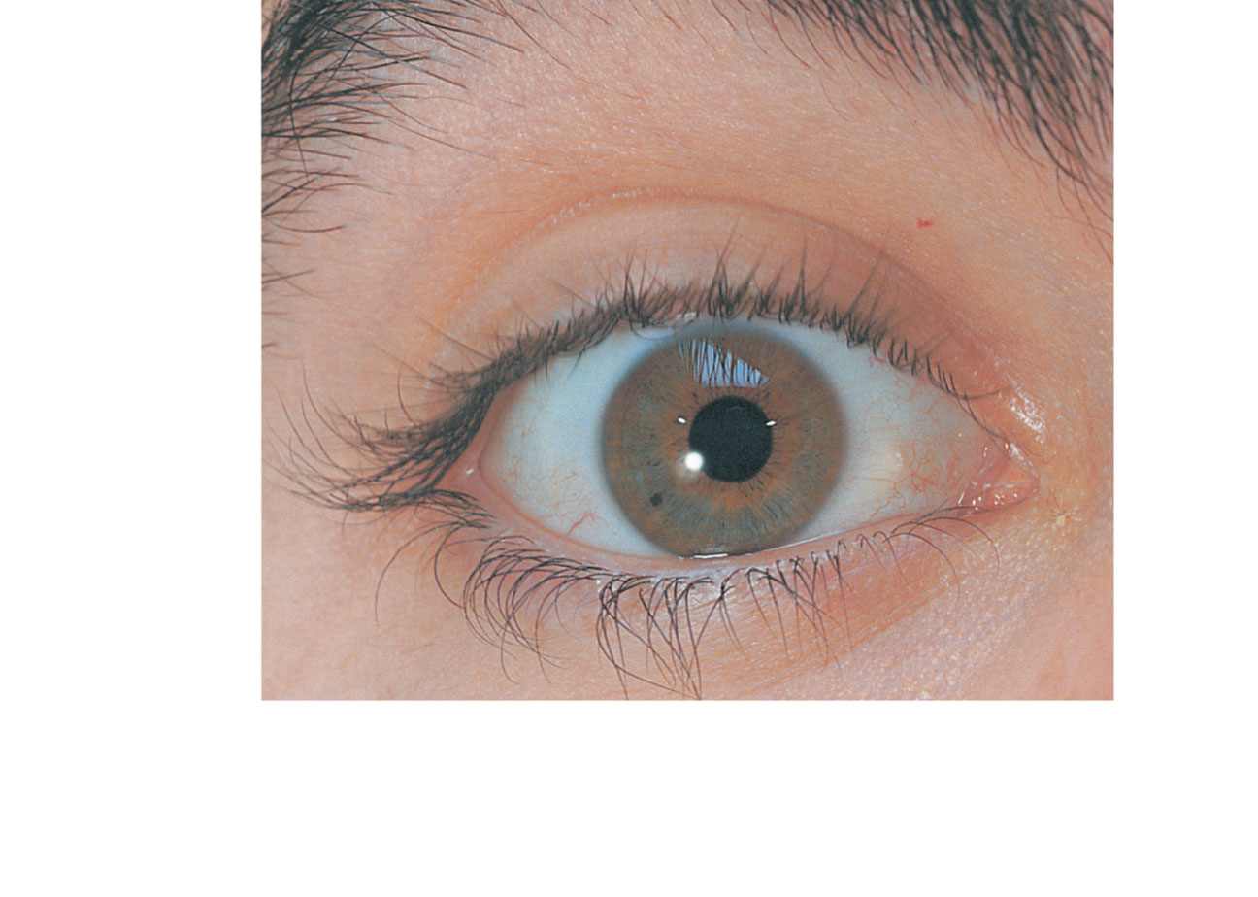
Eyebrow
Eyelid
Eyelashes
Site where
conjunctiva
merges with
cornea
Palpebral
fissure
Lateral
commissure
Iris
Eyelid
Pupil
Sclera
(covered by
conjunctiva)
Lacrimal
caruncle
Medial
commissure
(a) Surface anatomy of the right eye
Figure 15.1a

Slide 5
Eyebrows
Overlie the supraorbital margins
Function in
Shading the eye
Preventing perspiration from reaching the eye

Slide 6
Eyelids
Protect the eye anteriorly
Palpebral fissure—separates eyelids
Lacrimal caruncle—elevation at medial commissure; contains oil and sweat glands
Tarsal plates—internal supporting connective tissue sheet
Levator palpebrae superioris—gives the upper eyelid mobility

Slide 7
Eyelids
Eyelashes
Nerve endings of follicles initiate reflex blinking
Lubricating glands associated with the eyelids
Tarsal (Meibomian) glands
Sebaceous glands associated with follicles
Ciliary glands between the hair follicles

Slide 8
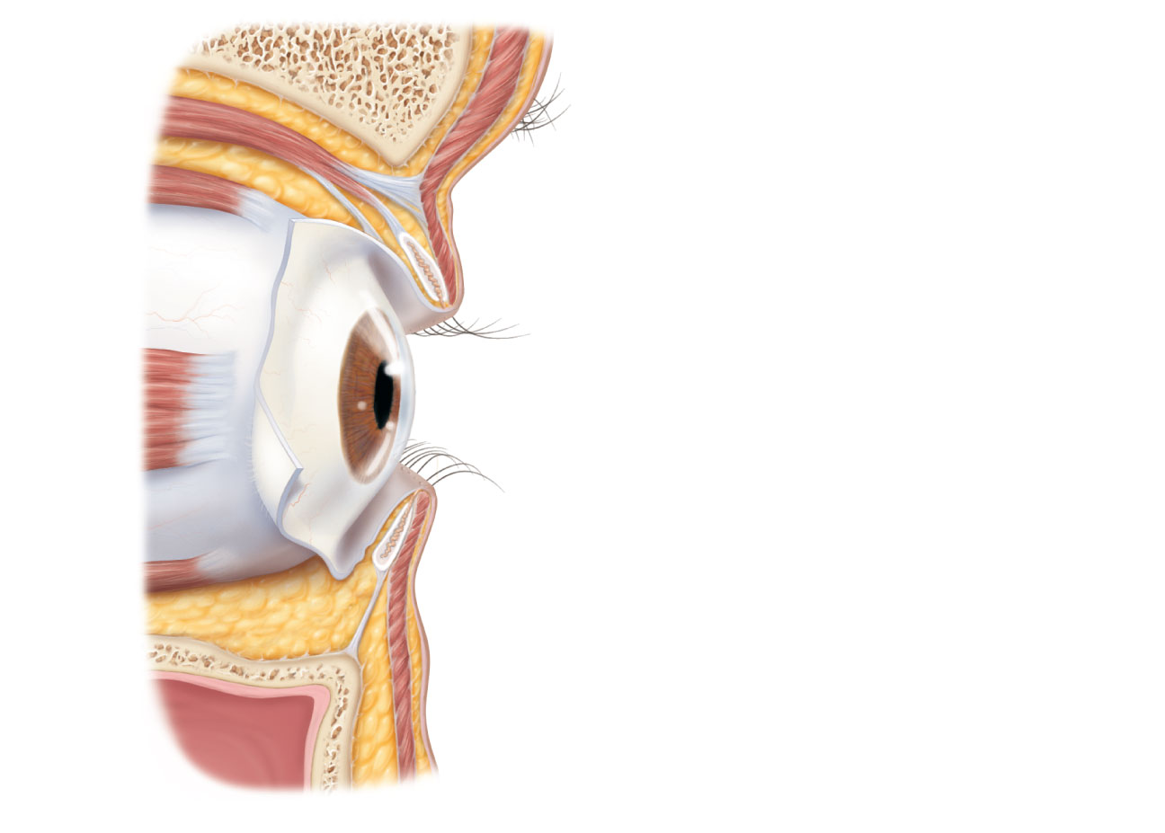
Levator palpebrae
superioris muscle
Orbicularis oculi muscle
Eyebrow
Tarsal plate
Palpebral conjunctiva
Tarsal glands
Cornea
Palpebral fissure
Eyelashes
Bulbar conjunctiva
Conjunctival sac
Orbicularis oculi muscle
(b) Lateral view; some structures shown in sagittal section
Figure 15.1b

Slide 9
Conjunctiva
Transparent membrane
Palpebral conjunctiva lines the eyelids
Bulbar conjunctiva covers the white of the eyes
Produces a lubricating mucous secretion

Slide 10
Lacrimal Apparatus
Lacrimal gland and ducts that connect to nasal cavity
Lacrimal secretion (tears)
Dilute saline solution containing mucus, antibodies, and lysozyme
Blinking spreads the tears toward the medial commissure
Tears enter paired lacrimal canaliculi via the lacrimal puncta
Drain into the nasolacrimal duct

Slide 11
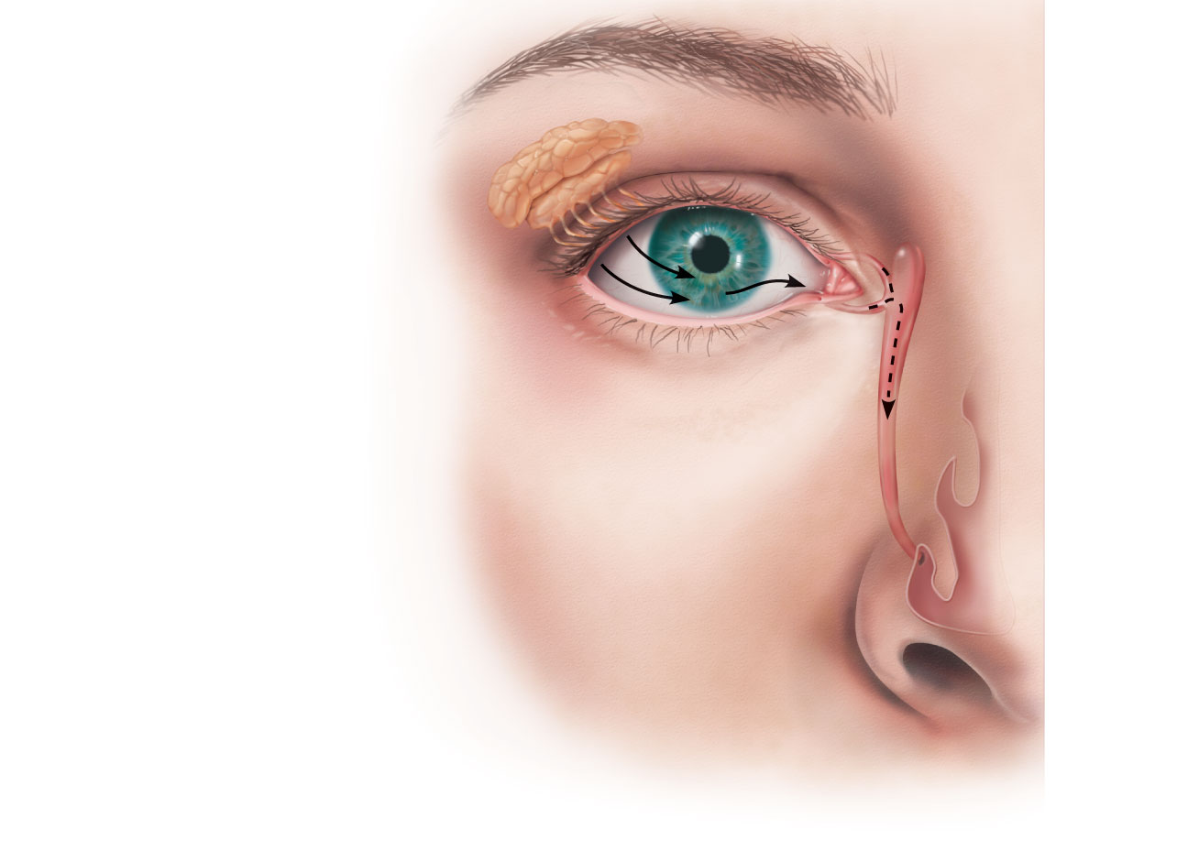
Lacrimal sac
Lacrimal gland
Excretory ducts
of lacrimal glands
Lacrimal punctum
Lacrimal canaliculus
Nasolacrimal duct
Inferior meatus
of nasal cavity
Nostril
Figure 15.2

Slide 12
Extrinsic Eye Muscles
Six straplike extrinsic eye muscles
Originate from the bony orbit
Enable the eye to follow moving objects
Maintain the shape of the eyeball
Four rectus muscles originate from the common tendinous ring; names indicate the movements they promote
Two oblique muscles move the eye in the vertical plane and rotate the eyeball

Slide 13
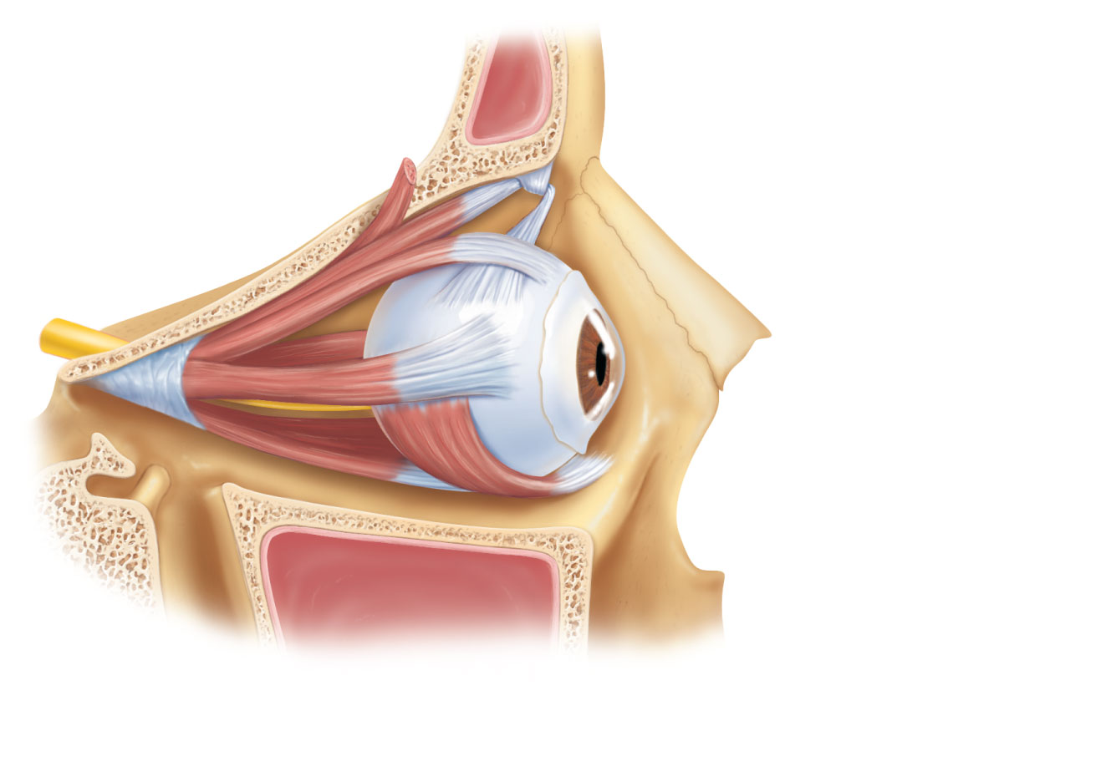
Superior oblique
muscle
Superior oblique
tendon
Superior rectus
muscle
Lateral rectus
muscle
Inferior rectus
muscle
Inferior oblique
muscle
(a) Lateral view of the right eye
Figure 15.3a

Slide 14
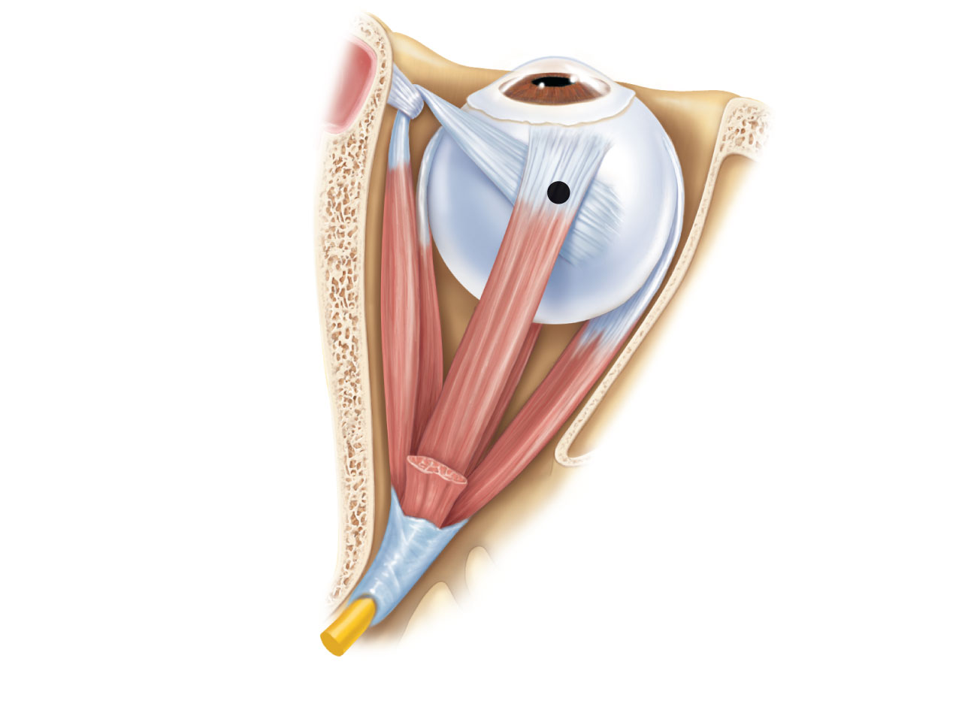
Trochlea
Superior oblique
muscle
Superior oblique
tendon
Axis at center
of eye
Superior rectus
muscle
Inferior
rectus muscle
Medial
rectus muscle
Lateral
rectus muscle
Common
tendinous ring
(b) Superior view of the right eye
Figure 15.3b

Slide 15
Muscle
Action
Controlling
cranial nerve
Lateral rectus
Medial rectus
Superior rectus
Inferior rectus
Inferior oblique
Superior oblique
Moves eye laterally
Moves eye medially
Elevates eye and turns it medially
Depresses eye and turns it medially
Elevates eye and turns it laterally
Depresses eye and turns it laterally
VI (abducens)
III (oculomotor)
III (oculomotor)
III (oculomotor)
III (oculomotor)
IV (trochlear)
(c) Summary of muscle actions and innervating cranial nerves
Figure 15.3c

Slide 16
Structure of the Eyeball
Wall of eyeball contains three layers
Fibrous
Vascular
Sensory
Internal cavity is filled with fluids called humors
The lens separates the internal cavity into anterior and posterior segments (cavities)

Slide 17
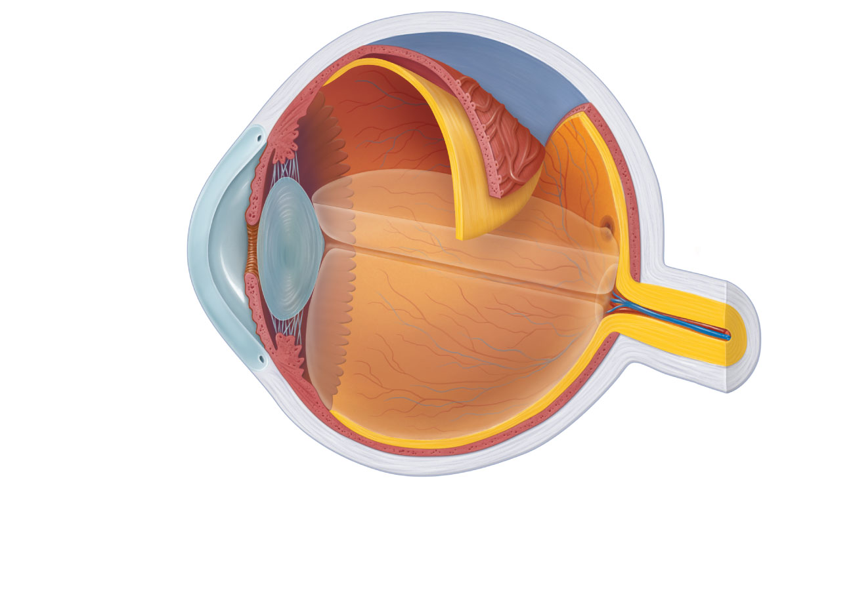
Ora serrata
Ciliary body
Ciliary zonule
(suspensory
ligament)
Sclera
Choroid
Retina
Cornea
Macula lutea
Iris
Fovea centralis
Pupil
Posterior pole
Anterior pole
Optic nerve
Anterior
segment (contains
aqueous humor)
Lens
Scleral venous
sinus
Central artery
and vein of
the retina
Posterior segment
(contains vitreous humor)
Optic disc
(blind spot)
(a) Diagrammatic view. The vitreous humor is illustrated only in the bottom part of the eyeball.
Figure 15.4a

Slide 18
Fibrous Layer
Outermost layer; dense avascular connective tissue
Two regions: sclera and cornea
Sclera
Opaque posterior region
Protects and shapes eyeball
Anchors extrinsic eye muscles

Slide 19
Fibrous Layer
2. Cornea:
Transparent anterior 1/6 of fibrous layer
Bends light as it enters the eye
Sodium pumps of the corneal endothelium on the inner face help maintain the clarity of the cornea
Numerous pain receptors contribute to blinking and tearing reflexes

Slide 20
Vascular Layer (Uvea)
Middle pigmented layer
Three regions: choroid, ciliary body, and iris
Choroid region
Posterior portion of the uvea
Supplies blood to all layers of the eyeball
Brown pigment absorbs light to prevent visual confusion

Slide 21
Vascular Layer
2. Ciliary body
Ring of tissue surrounding the lens
Smooth muscle bundles (ciliary muscles) control lens shape
Capillaries of ciliary processes secrete fluid
Ciliary zonule (suspensory ligament) holds lens in position

Slide 22
Vascular Layer
3. Iris
The colored part of the eye
Pupil—central opening that regulates the amount of light entering the eye
Close vision and bright light—sphincter papillae (circular muscles) contract; pupils constrict
Distant vision and dim light—dilator papillae (radial muscles) contract; pupils dilate
Changes in emotional state—pupils dilate when the subject matter is appealing or requires problem-solving skills

Slide 23
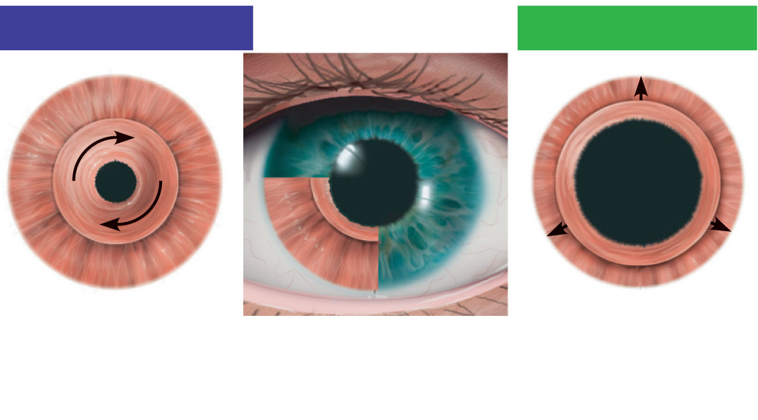
Parasympathetic +
Sympathetic +
Sphincter pupillae
muscle contraction
decreases pupil size.
Iris (two muscles)
• Sphincter pupillae
• Dilator pupillae
Dilator pupillae
muscle contraction
increases pupil size.
Figure 15.5

Slide 24
Sensory Layer: Retina
Delicate two-layered membrane
Pigmented layer
Outer layer
Absorbs light and prevents its scattering
Stores vitamin A

Slide 25
Sensory Layer: Retina
Neural layer
Photoreceptor: transduce light energy
Cells that transmit and process signals: bipolar cells, ganglion cells, amacrine cells, and horizontal cells

Slide 26
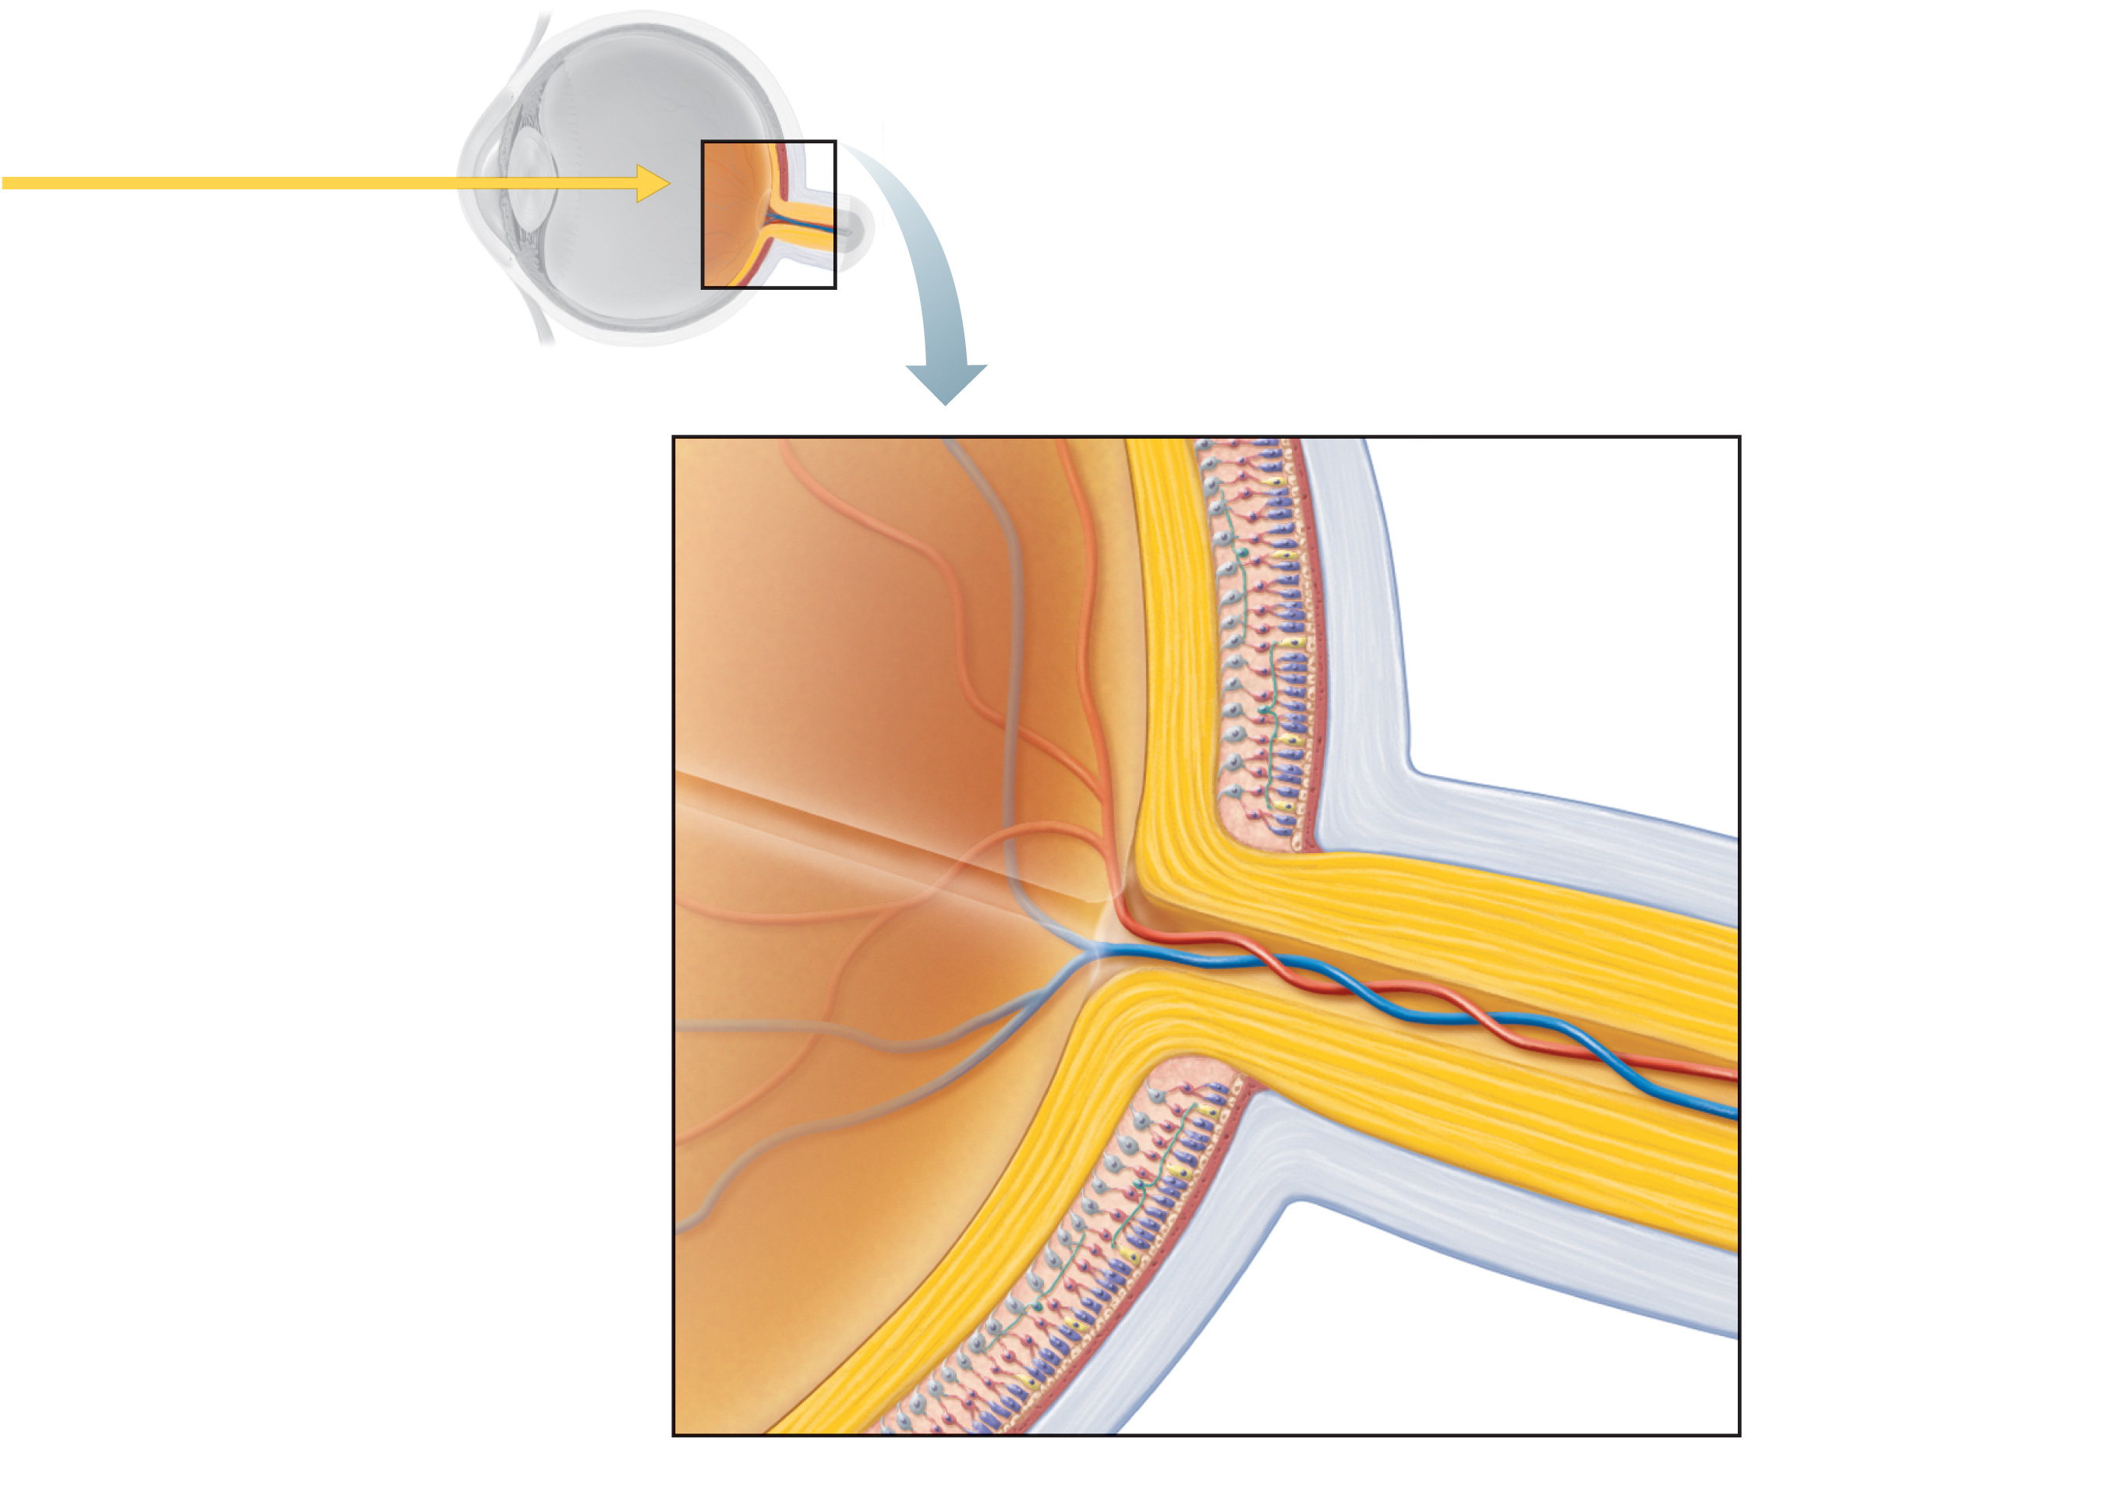
Pathway of light
Neural layer of retina
Pigmented
layer of
retina
Choroid
Sclera
Optic disc
Central artery
and vein of retina
Optic
nerve
(a) Posterior aspect of the eyeball
Figure 15.6a

Slide 27
The Retina
Ganglion cell axons
Run along the inner surface of the retina
Leave the eye as the optic nerve
Optic disc (blind spot)
Site where the optic nerve leaves the eye
Lacks photoreceptors

Slide 28
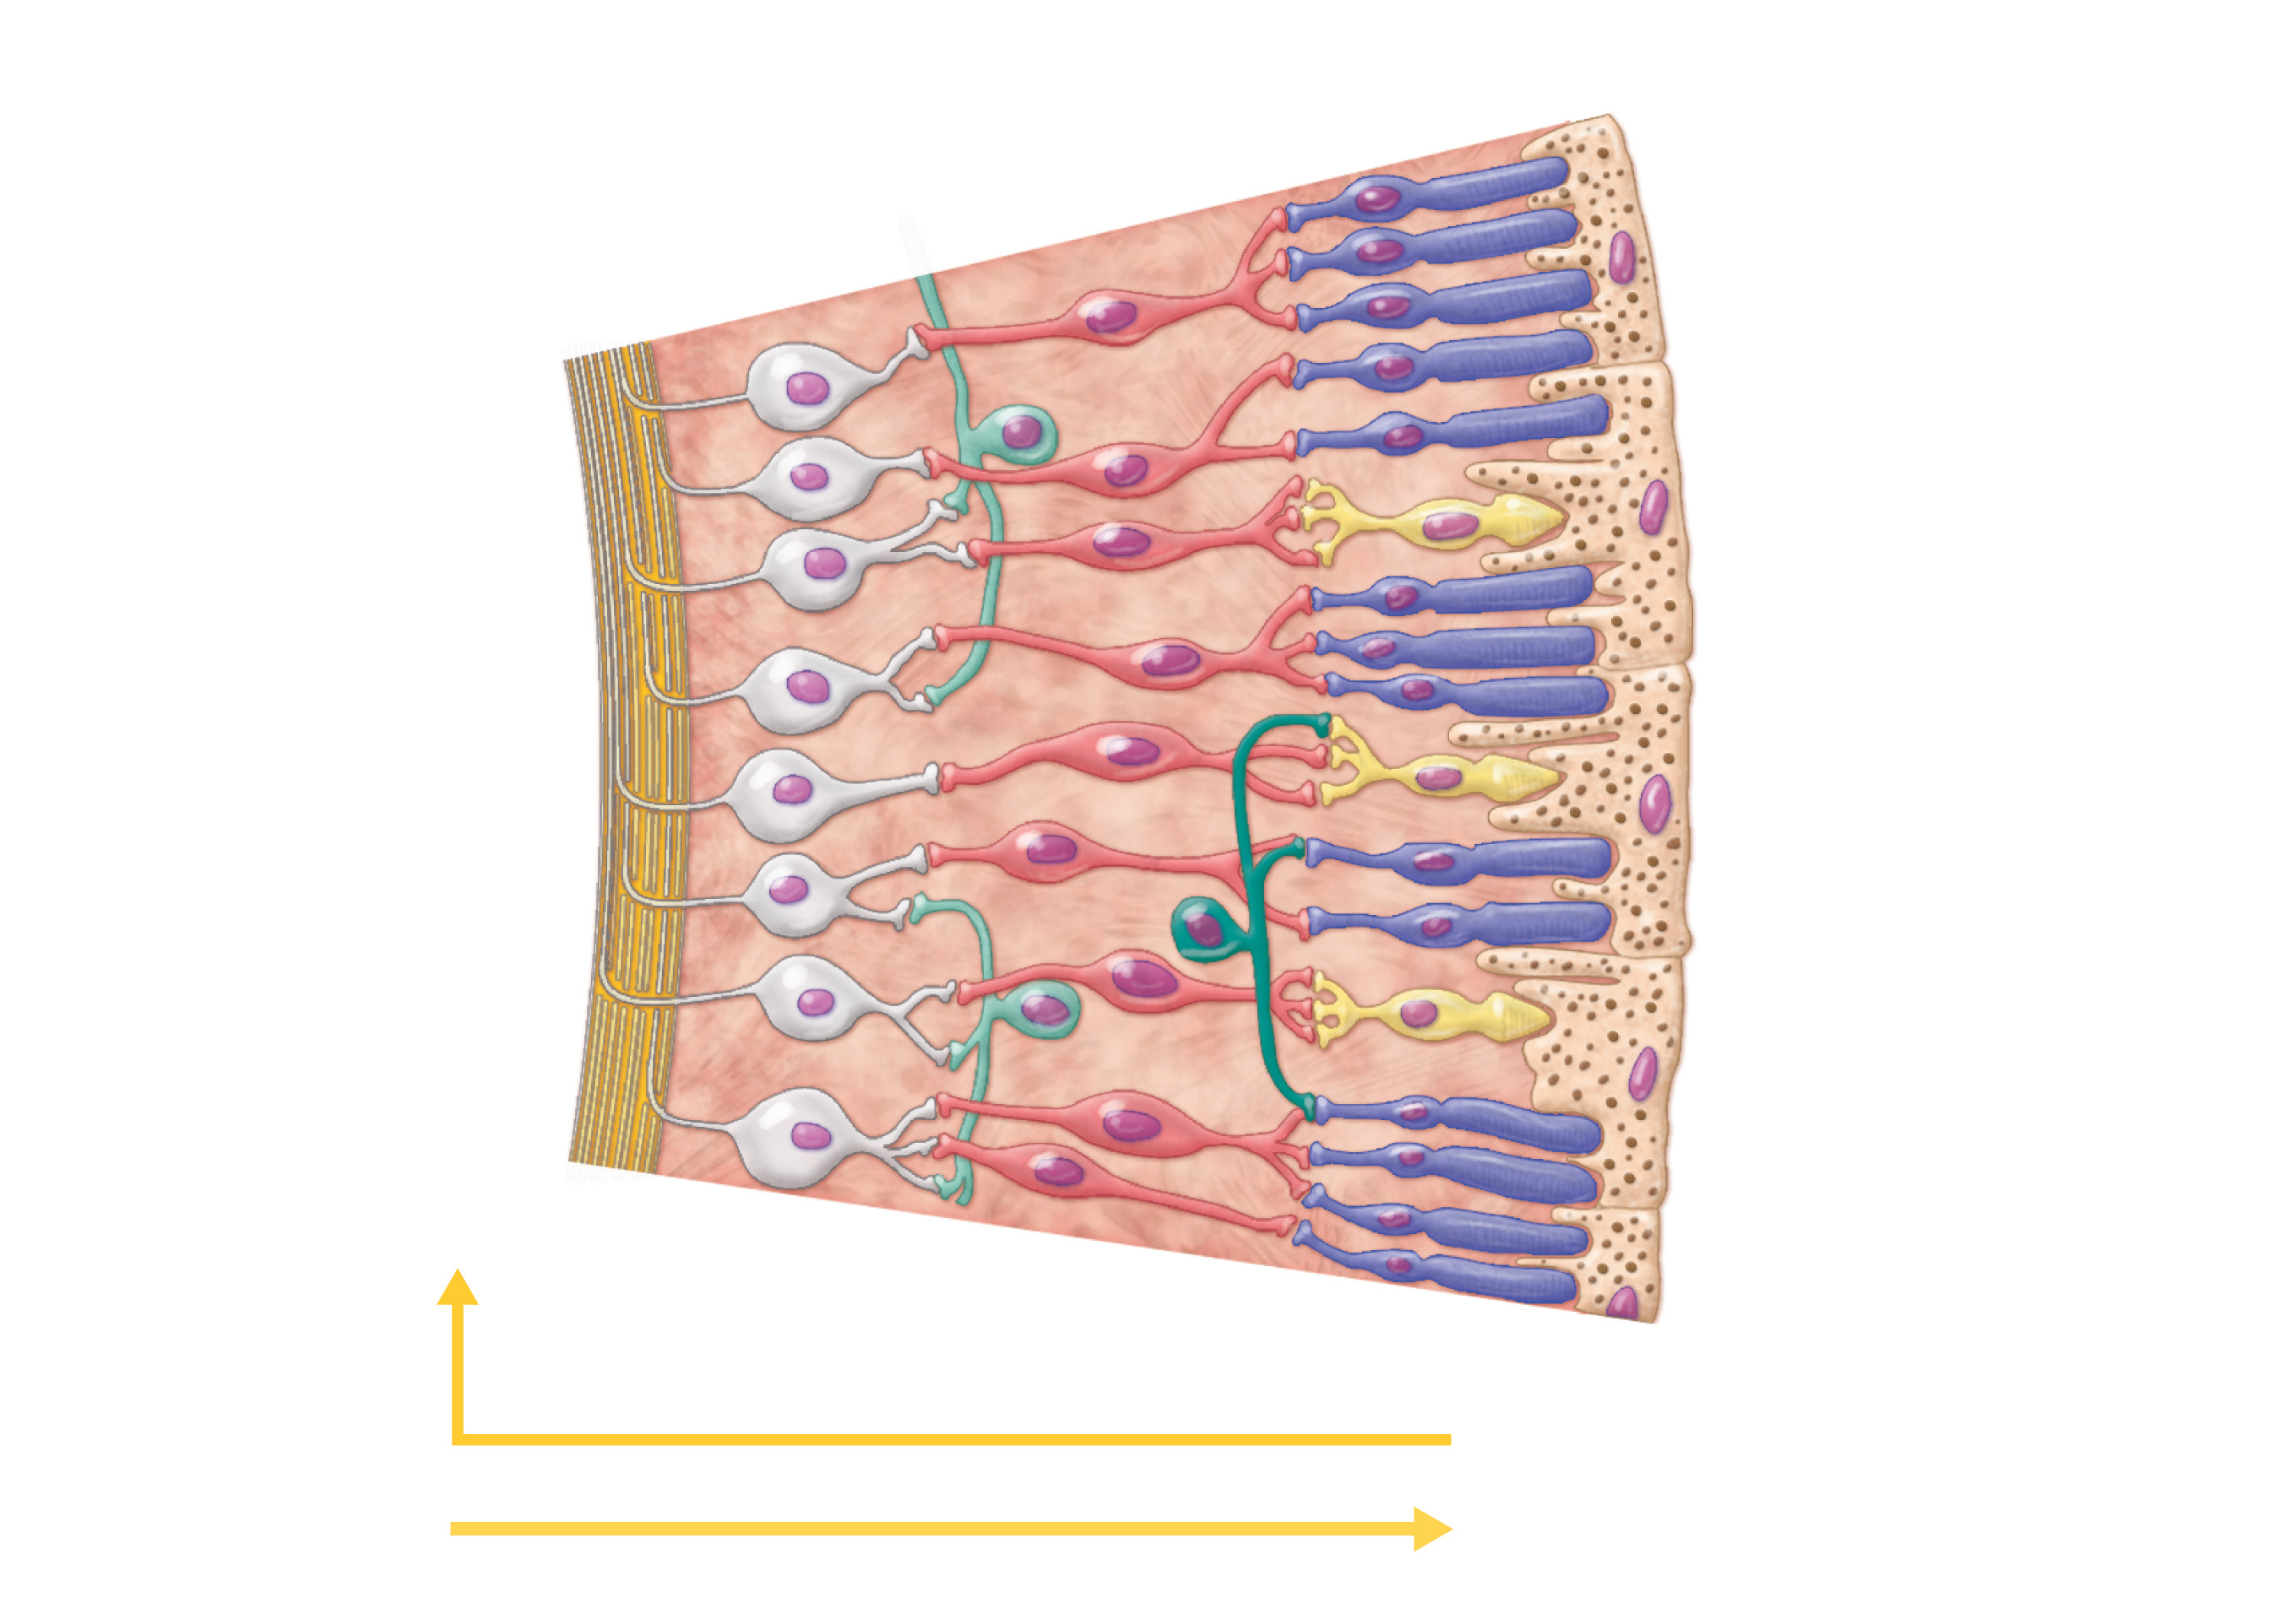
Photoreceptors
Bipolar
cells
• Rod
Ganglion
cells
• Cone
Amacrine cell
Horizontal cell
Pathway of signal output
Pigmented
layer of retina
Pathway of light
(b) Cells of the neural layer of the retina
Figure 15.6b

Slide 29
Photoreceptors
Rods
More numerous at peripheral region of retina, away from the macula lutea
Operate in dim light
Provide indistinct, fuzzy, non color peripheral vision

Slide 30
Photoreceptors
Cones
Found in the macula lutea; concentrated in the fovea centralis (low distribution in the peripheral retina)
Operate in bright light
Provide high-acuity color vision

Slide 31
Blood Supply to the Retina
Two sources of blood supply
Choroid supplies the outer third (photoreceptors)
Central artery and vein of the retina supply the inner two-thirds

Slide 32
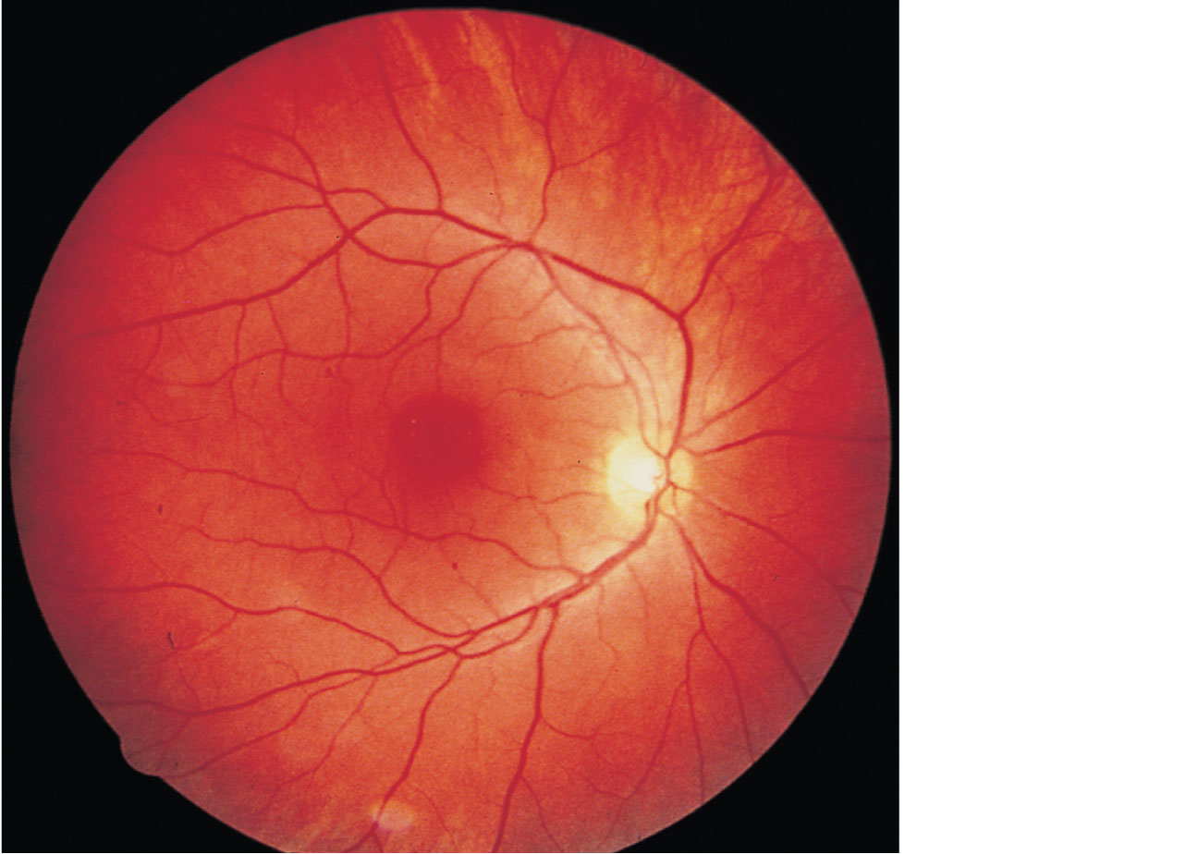
Central
artery
and vein
emerging
from the
optic disc
Macula
lutea
Optic disc
Retina
Figure 15.7

Slide 33
Internal Chambers and Fluids
The lens and ciliary zonule separate the anterior and posterior segments

Slide 34
Ora serrata
Ciliary body
Ciliary zonule
(suspensory
ligament)
Sclera
Choroid
Retina
Cornea
Macula lutea
Iris
Fovea centralis
Pupil
Posterior pole
Anterior pole
Optic nerve
Anterior
segment (contains
aqueous humor)
Lens
Scleral venous
sinus
Central artery
and vein of
the retina
Posterior segment
(contains vitreous humor)
Optic disc
(blind spot)
(a) Diagrammatic view. The vitreous humor is illustrated only in the bottom part of the eyeball.
Figure 15.4a

Slide 35
Internal Chambers and Fluids
Posterior segment contains vitreous humor that:
Transmits light
Supports the posterior surface of the lens
Holds the neural retina firmly against the pigmented layer
Contributes to intraocular pressure
Anterior segment is composed of two chambers
Anterior chamber—between the cornea and the iris
Posterior chamber—between the iris and the lens

Slide 36
Internal Chambers and Fluids
Anterior segment contains aqueous humor
Plasma like fluid continuously filtered from capillaries of the ciliary processes
Drains via the scleral venous sinus (canal of Schlemm) at the sclera-cornea junction
Supplies nutrients and oxygen mainly to the lens and cornea but also to the retina, and removes wastes
Glaucoma: compression of the retina and optic nerve if drainage of aqueous humor is blocked

Slide 37
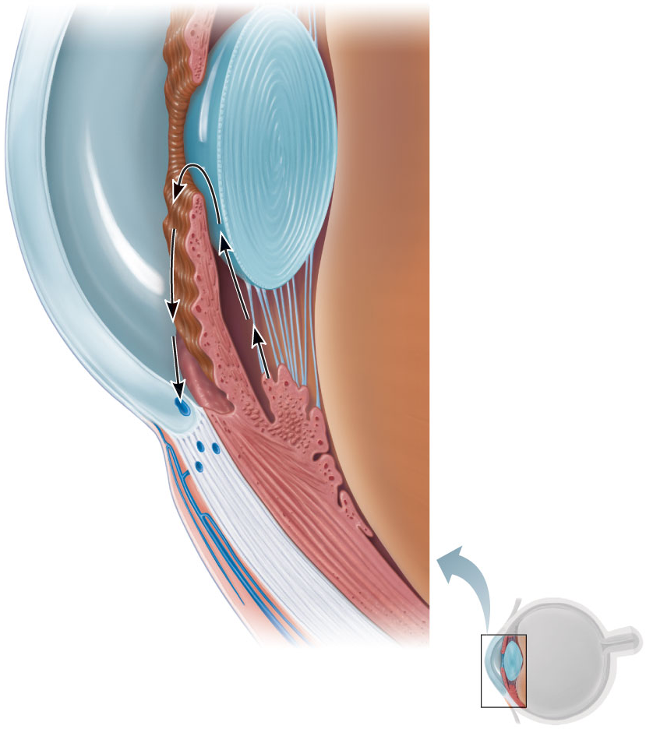
Iris
Lens epithelium
Posterior
segment
(contains
vitreous
humor)
Lens
Cornea
Corneal epithelium
2
Corneal endothelium
Aqueous humor
Ciliary zonule
(suspensory
ligament)
Anterior
segment
(contains
aqueous
humor)
Anterior
chamber
Posterior
chamber
Ciliary body
Scleral venous
sinus
3
1
Ciliary
processes
Aqueous humor is
formed by filtration
from the capillaries in
the ciliary processes.
1
Corneal-
scleral junction
Ciliary
muscle
Aqueous humor flows from the
posterior chamber through the
pupil into the anterior chamber.
Some also flows through the
vitreous humor (not shown).
Bulbar
conjunctiva
2
Sclera
Aqueous humor is reabsorbed
into the venous blood by the
scleral venous sinus.
Cornea
Lens
3
Figure 15.8

Slide 38
Lens
Biconvex, transparent, flexible, elastic, and avascular
Allows precise focusing of light on the retina
Cells of lens epithelium differentiate into lens fibers that form the bulk of the lens
Lens fibers—cells filled with the transparent protein crystallin
Lens becomes denser, more convex, and less elastic with age
Cataracts (clouding of lens) occur as a consequence of aging, diabetes mellitus, heavy smoking, and frequent exposure to intense sunlight

Slide 39
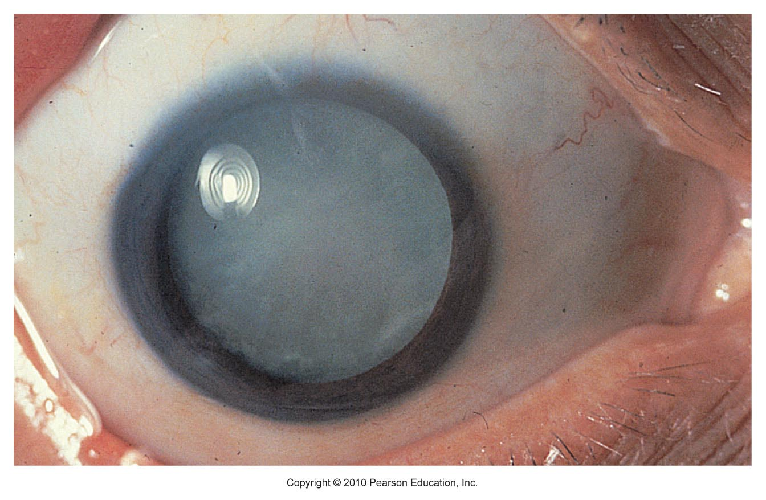
Figure 15.9

Slide 40
Light
Our eyes respond to visible light, a small portion of the electromagnetic spectrum
Light: packets of energy called photons (quanta) that travel in a wavelike fashion
Rods and cones respond to different wavelengths of the visible spectrum

Slide 41
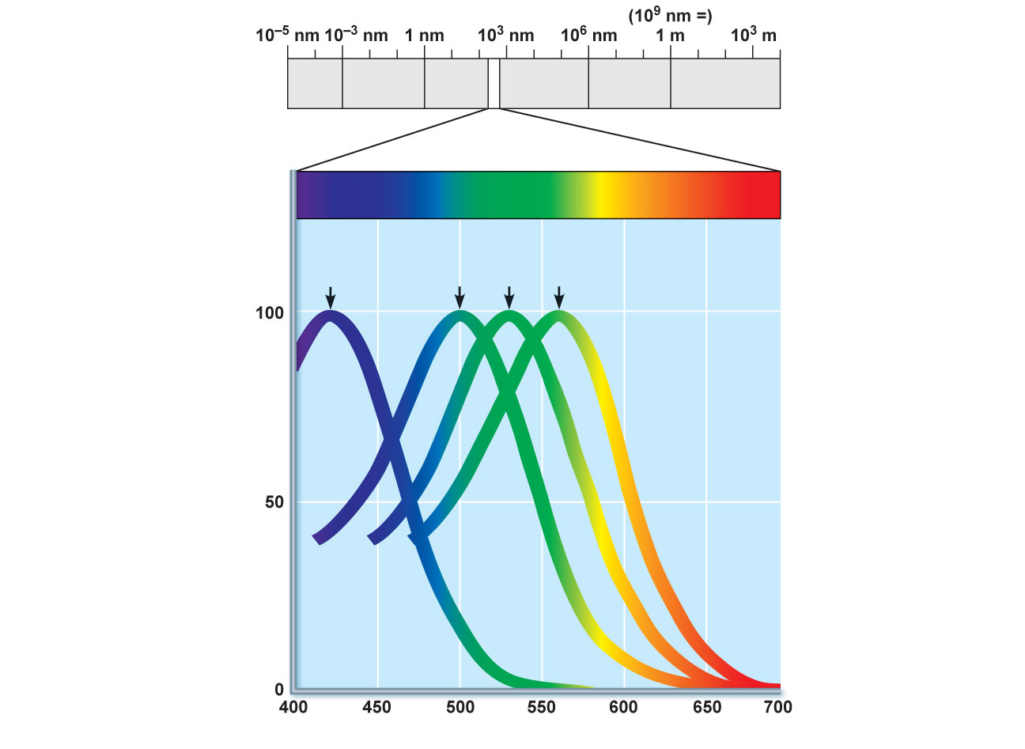
Gamma
rays
X rays
UV
Infrared
Micro-
waves
Radio waves
(a)
Visible light
Blue
cones
(420 nm)
Green
cones
(530 nm)
Red
cones
(560 nm)
Rods
(500 nm)
Light absorption (pervent of maximum)
(b)
Wavelength (nm)
Figure 15.10

Slide 42
Refraction and Lenses
Refraction
Bending of a light ray due to change in speed when light passes from one transparent medium to another
Occurs when light meets the surface of a different medium at an oblique angle

Slide 43
Refraction and Lenses
Light passing through a convex lens (as in the eye) is bent so that the rays converge at a focal point
The image formed at the focal point is upside-down and reversed right to left

Slide 44
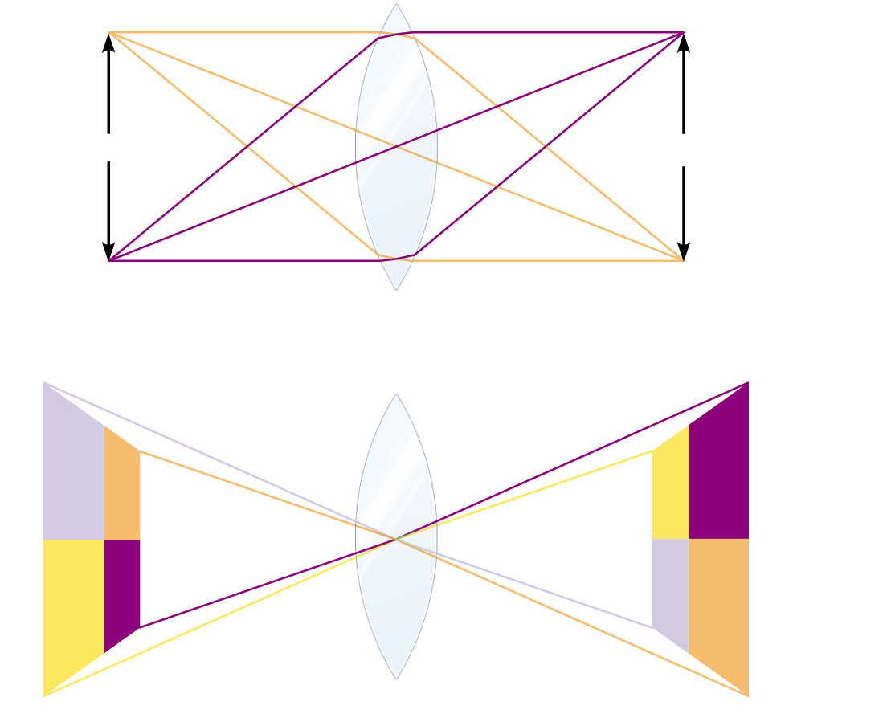
Point sources
Focal points
(a) Focusing of two points of light.
(b) The image is inverted—upside down and reversed.
Figure 15.12

Slide 45
Focusing Light on the Retina
Pathway of light entering the eye: cornea, aqueous humor, lens, vitreous humor, neural layer of retina, photoreceptors
Light is refracted
At the cornea
Entering the lens
Leaving the lens
Change in lens curvature allows for fine focusing of an image

Slide 46
Focusing for Distant Vision
Light rays from distant objects are nearly parallel at the eye and need little refraction beyond what occurs in the at-rest eye
Far point of vision: the distance beyond which no change in lens shape is needed for focusing; 20 feet for emmetropic (normal) eye
Ciliary muscles are relaxed
Lens is stretched flat by tension in the ciliary zonule

Slide 47
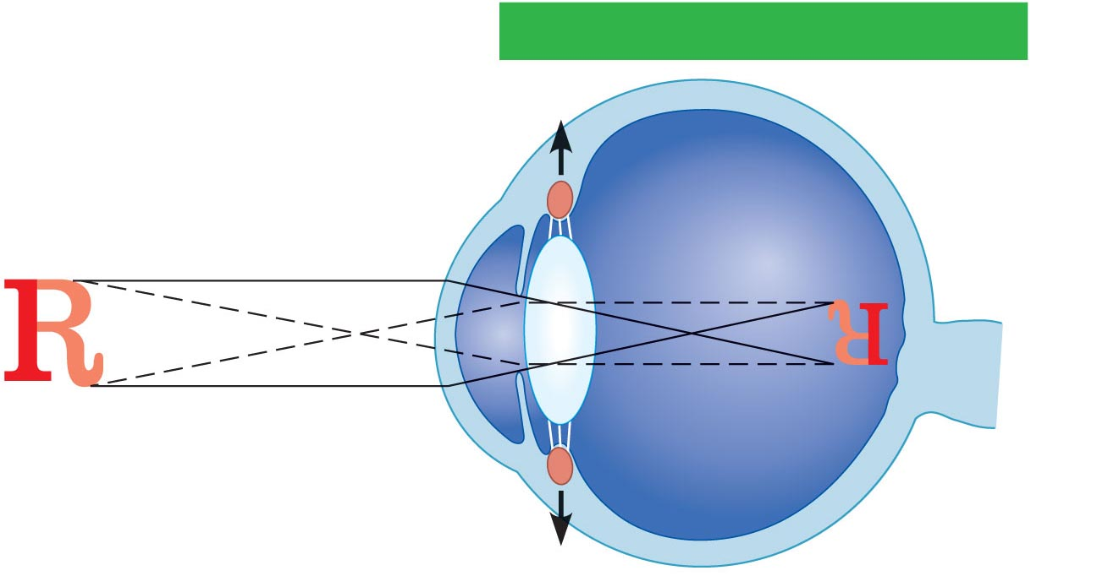
Sympathetic activation
Nearly parallel rays
from distant object
Lens
Ciliary zonule
Ciliary muscle
Inverted
image
(a) Lens is flattened for distant vision. Sympathetic input relaxes the ciliary muscle, tightening the ciliary zonule, and flattening the lens.
Figure 15.13a

Slide 48
Focusing for Close Vision
Light from a close object diverges as it approaches the eye; requires that the eye make active adjustments

Slide 49
Focusing for Close Vision
Close vision requires
Accommodation—changing the lens shape by ciliary muscles to increase refractory power
Near point of vision is determined by the maximum bulge the lens can achieve
Presbyopia—loss of accommodation over age 50
Constriction—the accommodation pupillary reflex constricts the pupils to prevent the most divergent light rays from entering the eye
Convergence—medial rotation of the eyeballs toward the object being viewed

Slide 50
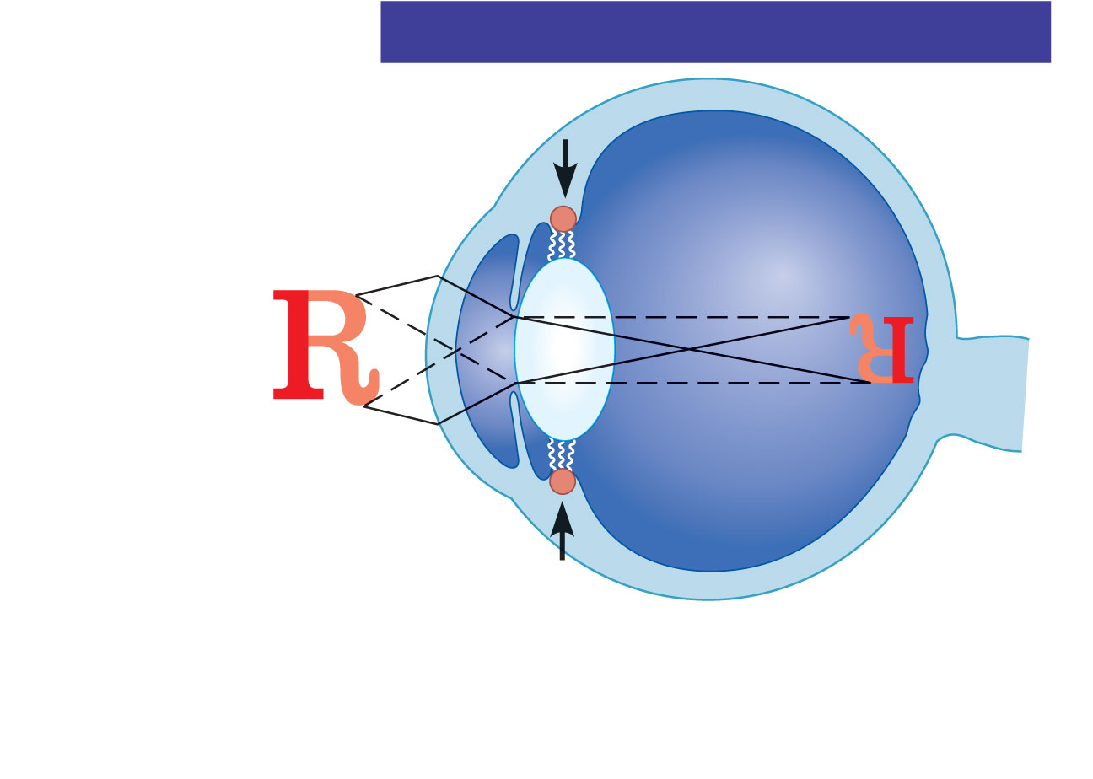
Parasympathetic activation
Divergent rays
from close object
Inverted
image
(b) Lens bulges for close vision. Parasympathetic
input contracts the ciliary muscle, loosening the
ciliary zonule, allowing the lens to bulge.
Figure 15.13b

Slide 51
Problems of Refraction
Myopia (nearsightedness)—focal point is in front of the retina, e.g. in a longer than normal eyeball
Corrected with a concave lens
Hyperopia (farsightedness)—focal point is behind the retina, e.g. in a shorter than normal eyeball
Corrected with a convex lens
Astigmatism—caused by unequal curvatures in different parts of the cornea or lens
Corrected with cylindrically ground lenses, corneal implants, or laser procedures

Slide 52
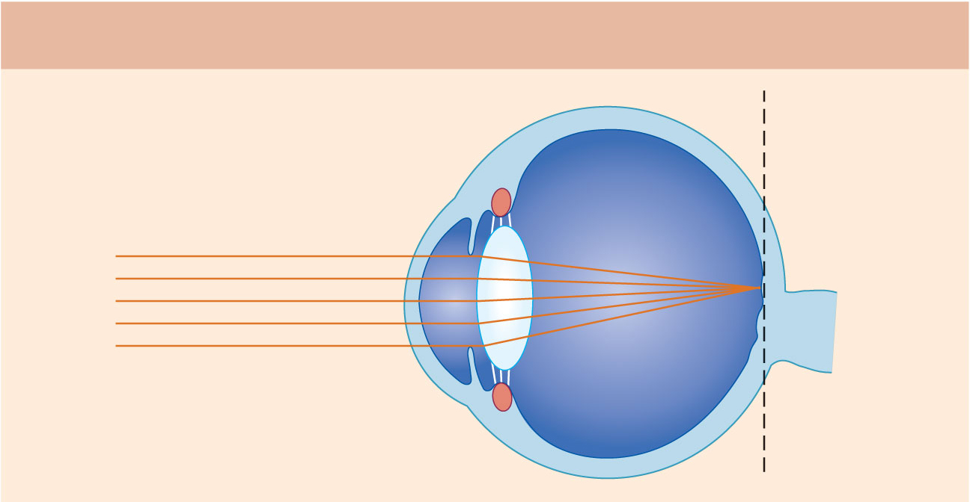
Emmetropic eye (normal)
Focal
plane
Focal point is on retina.
Figure 15.14 (1 of 3)

Slide 53
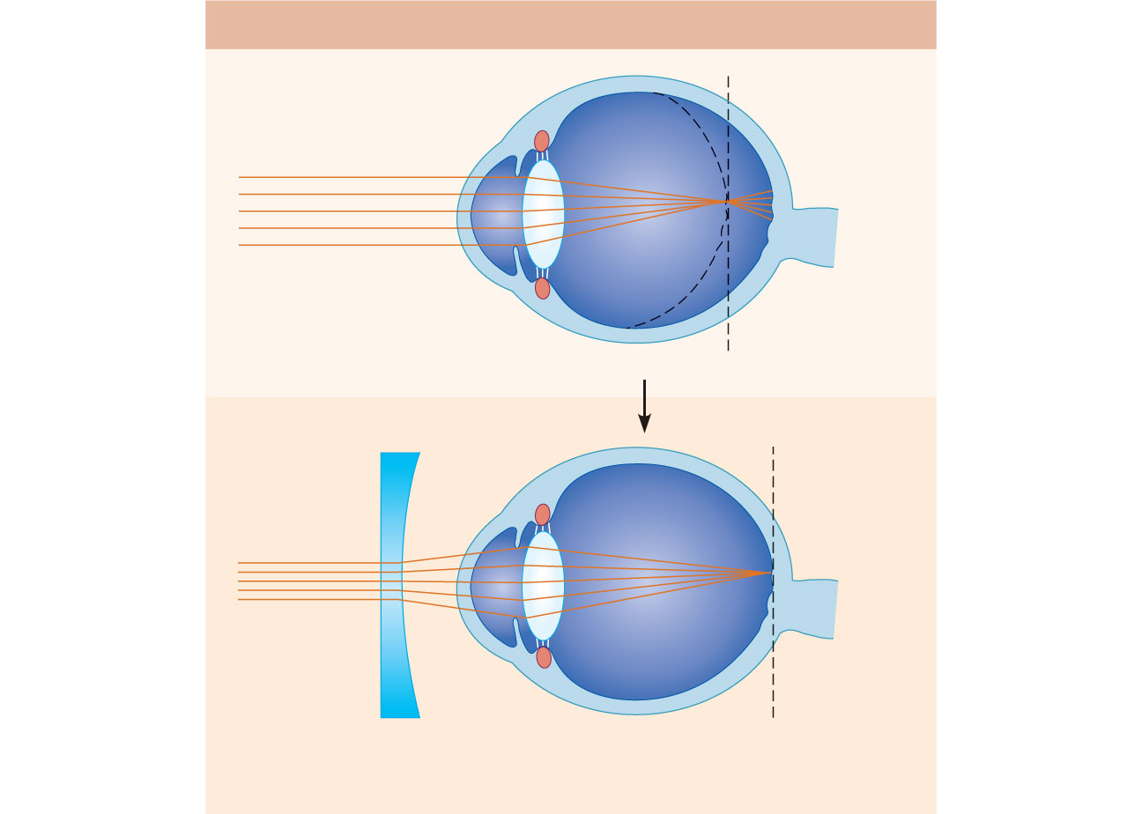
Myopic eye (nearsighted)
Eyeball
too long
Uncorrected
Focal point is in front of retina.
Concave lens moves focal
point further back.
Corrected
Figure 15.14 (2 of 3)

Slide 54
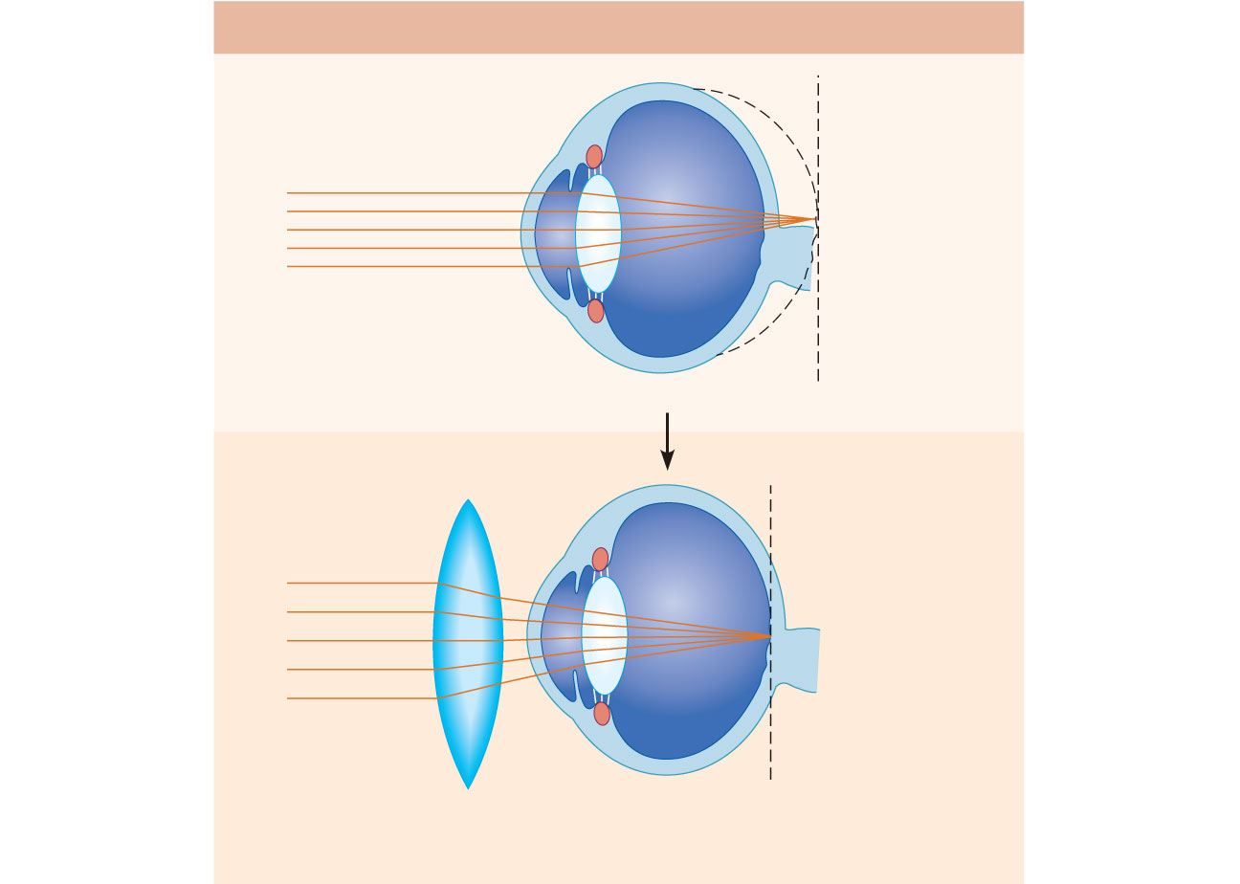
Hyperopic eye (farsighted)
Eyeball
too short
Uncorrected
Focal point is behind retina.
Convex lens moves focal
point forward.
Corrected
Figure 15.14 (3 of 3)

Slide 55
Functional Anatomy of Photoreceptors
Rods and cones
Outer segment of each contains visual pigments (photopigments)—molecules that change shape as they absorb light
Inner segment of each joins the cell body

Slide 56
Process of
bipolar cell
Inner fibers
Synaptic terminals
Rod cell body
Rod cell body
Cone cell body
Nuclei
Outer fiber
Mitochondria
Inner
segment
Connecting
cilia
Apical microvillus
Outer segment
Discs containing
visual pigments
Pigmented layer
Discs being
phagocytized
The outer segments
of rods and cones
are embedded in the
pigmented layer of
the retina.
Melanin
granules
Pigment cell nucleus
Basal lamina (border
with choroid)
Figure 15.15a

Slide 57
Rods
Functional characteristics
Very sensitive to dim light
Best suited for night vision and peripheral vision
Perceived input is in gray tones only
Pathways converge, resulting in fuzzy and indistinct images

Slide 58
Cones
Functional characteristics
Need bright light for activation (have low sensitivity)
Have one of three pigments that furnish a vividly colored view
Nonconverging pathways result in detailed, high-resolution vision

Slide 59
Chemistry of Visual Pigments
Retinal
Light-absorbing molecule that combines with one of four proteins (opsin) to form visual pigments
Synthesized from vitamin A
Two isomers: 11-cis-retinal (bent form) and all-trans-retinal (straight form)
Conversion of 11-cis-retinal to all-trans-retinal initiates a chain of reactions leading to transmission of electrical impulses in the optic nerve

Slide 60
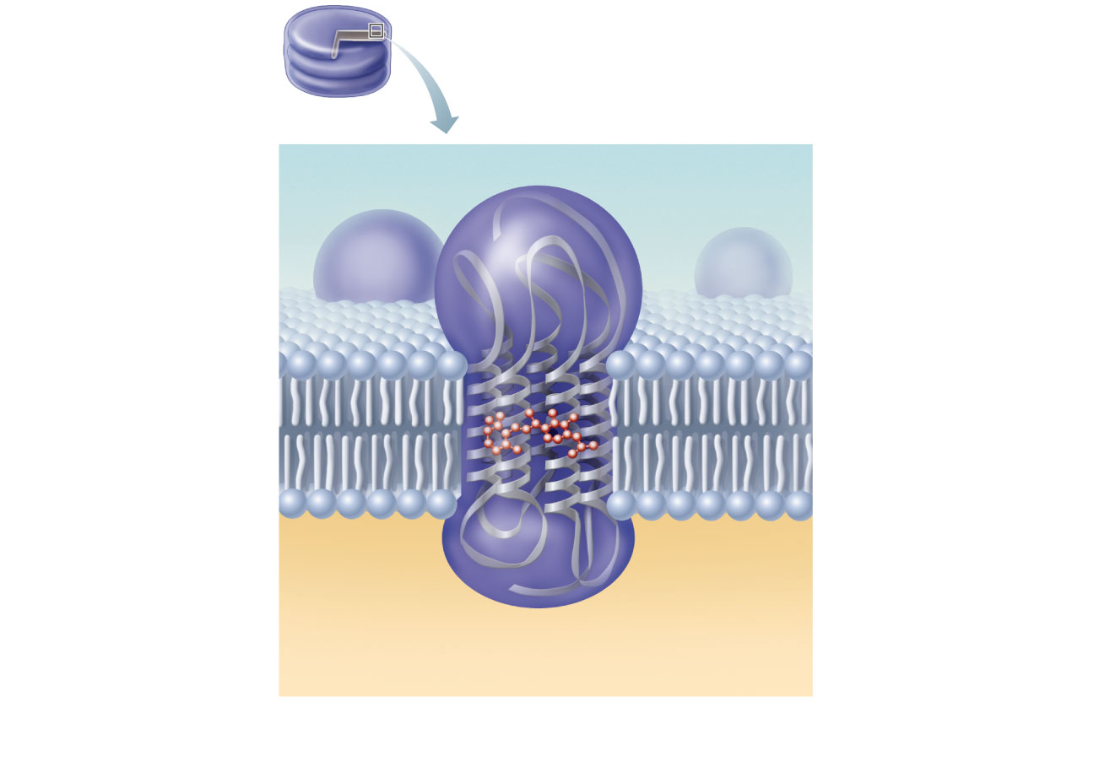
Rod discs
Visual
pigment
consists of
• Retinal
• Opsin
(b) Rhodopsin, the visual pigment in rods, is embedded in
the membrane that forms discs in the outer segment.
Figure 15.15b

Slide 61
Excitation of Rods
The visual pigment of rods is rhodopsin (opsin + 11-cis-retinal)
In the dark, rhodopsin forms and accumulates
Regenerated from all-trans-retinal
Formed from vitamin A
When light is absorbed, rhodopsin breaks down
11-cis isomer is converted into the all-trans isomer
Retinal and opsin separate (bleaching of the pigment)

Slide 62
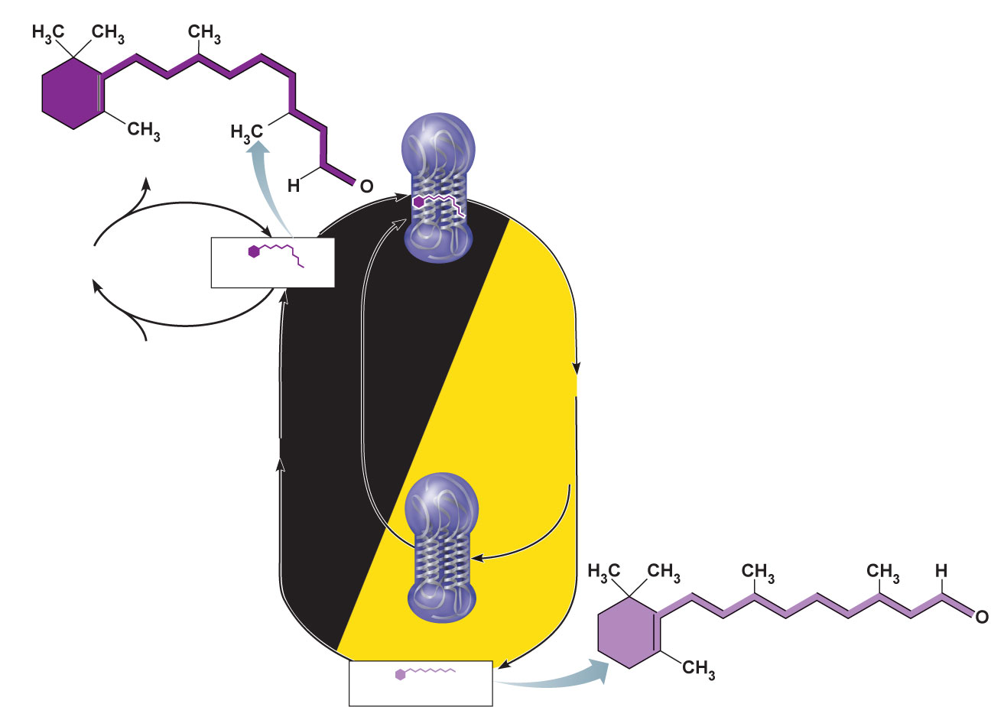
11-cis-retinal
Bleaching of
the pigment:
Light absorption
by rhodopsin
triggers a rapid
series of steps
in which retinal
changes shape
(11-cis to all-trans)
and eventually
releases from
opsin.
1
2H⁺
Oxidation
Vitamin A
11-cis-retinal
Rhodopsin
Reduction
2H⁺
Regeneration
of the pigment:
Enzymes slowly
convert all-trans
retinal to its
11-cis form in the
pigmented
epithelium;
requires ATP.
Dark
Light
2
Opsin and
All-trans-retinal
All-trans-retinal
Figure 15.16

Slide 63
Excitation of Cones
Method of excitation is similar to that of rods
There are three types of cones, named for the colors of light absorbed: blue, green, and red
Intermediate hues are perceived by activation of more than one type of cone at the same time
Color blindness is due to a congenital lack of one or more of the cone types

Slide 64
Phototransduction
In the dark, cGMP binds to and opens cation channels in the outer segments of photoreceptor cells
Na⁺ and Ca²⁺ influx creates a depolarizing dark potential of about −40 mV

Slide 65
Phototransduction
In the light, light-activated rhodopsin activates a G protein, transducin
Transducin activates phosphodiesterase (PDE)
PDE hydrolyzes cGMP to GMP and releases it from sodium channels
Without bound cGMP, sodium channels close; the membrane hyperpolarizes to about −70 mV

Slide 66
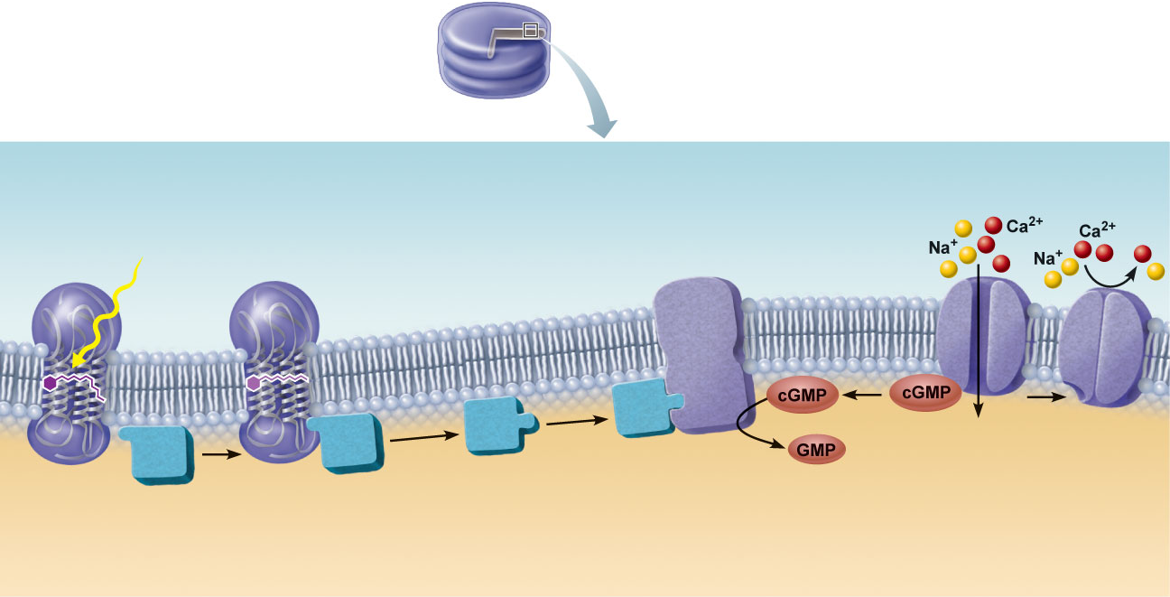
1
Light (photons)
activates visual pigment.
Visual
pigment
Phosphodiesterase (PDE)
Light
All-trans-retinal
Open
cGMP-gated
cation
channel
Closed
cGMP-gated
cation
channel
11-cis-retinal
Transducin
(a G protein)
Visual pig-
ment activates
transducin
(G protein).
3
4
5
2
Transducin
activates
phosphodiester
ase (PDE).
PDE converts
cGMP into GMP,
causing cGMP
levels to fall.
As cGMP levels
fall, cGMP-gated
cation channels
close, resulting in
hyperpolarization.
Figure 15.17

Slide 67
Signal Transmission in the Retina
Photoreceptors and bipolar cells only generate graded potentials (EPSPs and IPSPs)
Light hyperpolarizes photoreceptor cells, causing them to stop releasing the inhibitory neurotransmitter glutamate
Bipolar cells (no longer inhibited) are then allowed to depolarize and release neurotransmitter onto ganglion cells
Ganglion cells generate APs that are transmitted in the optic nerve

Slide 68
In the dark
1
cGMP-gated channels
open, allowing cation influx;
the photoreceptor
depolarizes.
Na⁺
Ca²⁺
Photoreceptor
cell (rod)
2
Voltage-gated Ca²⁺
channels open in synaptic
terminals.
3
Ca²⁺
Neurotransmitter is
released continuously.
4
Neurotransmitter causes
IPSPs in bipolar cell;
hyperpolarization results.
5
Bipolar
cell
Hyperpolarization closes
voltage-gated Ca²⁺ channels,
inhibiting neurotransmitter
release.
6
No EPSPs occur in
ganglion cell.
Ganglion
cell
7
No action potentials occur
along the optic nerve.
Figure 15.18 (1 of 2)

Slide 69
In the light
1
cGMP-gated channels
are closed, so cation influx
stops; the photoreceptor
hyperpolarizes.
Light
Photoreceptor
cell (rod)
2
Voltage-gated Ca²⁺
channels close in synaptic
terminals.
3
No neurotransmitter
is released.
4
Lack of IPSPs in bipolar
cell results in depolarization.
5
Depolarization opens
voltage-gated Ca²⁺ channels;
neurotransmitter is released.
Bipolar
cell
6
Ca²⁺
EPSPs occur in ganglion
cell.
7
Action potentials
propagate along the
optic nerve.
Ganglion
cell
Figure 15.18 (2 of 2)

Slide 70
Light Adaptation
Occurs when moving from darkness into bright light
Large amounts of pigments are broken down instantaneously, producing glare
Pupils constrict
Dramatic changes in retinal sensitivity: rod function ceases
Cones and neurons rapidly adapt
Visual acuity improves over 5–10 minutes

Slide 71
Dark Adaptation
Occurs when moving from bright light into darkness
The reverse of light adaptation
Cones stop functioning in low-intensity light
Pupils dilate
Rhodopsin accumulates in the dark and retinal sensitivity increases within 20–30 minutes

Slide 72
Visual Pathway
Axons of retinal ganglion cells form the optic nerve
Medial fibers of the optic nerve decussate at the optic chiasma
Most fibers of the optic tracts continue to the lateral geniculate body of the thalamus

Slide 73
Visual Pathway
The optic radiation fibers connect to the primary visual cortex in the occipital lobes
Other optic tract fibers send branches to the midbrain, ending in superior colliculi (initiating visual reflexes)

Slide 74
Visual Pathway
A small subset of ganglion cells in the retina contain melanopsin (circadian pigment), which projects to:
Pretectal nuclei (involved with pupillary reflexes)
Suprachiasmatic nucleus of the hypothalamus, the timer for daily biorhythms

Slide 75
Fixation point
Right eye
Left eye
Optic nerve
Suprachiasmatic
nucleus
Optic chiasma
Optic tract
Pretectal nucleus
Lateral geniculate
nucleus of
thalamus
Uncrossed (ipsilateral) fiber
Crossed (contralateral) fiber
Optic radiation
Superior colliculus
Occipital lobe
(primary visual cortex)
The visual fields of the two eyes overlap considerably.
Note that fibers from the lateral portion of each retinal field do
not cross at the optic chiasma.
Figure 15.19a

Slide 76
Depth Perception
Both eyes view the same image from slightly different angles
Depth perception (three-dimensional vision) results from cortical fusion of the slightly different images

Slide 77
Retinal Processing
Several different types of ganglion cells are arranged in doughnut-shaped receptive fields
On-center fields
Stimulated by light hitting the center of the field
Inhibited by light hitting the periphery of the field
Off-center fields have the opposite effects
These responses are due to different receptor types for glutamate in the “on” and “off” fields

Slide 78
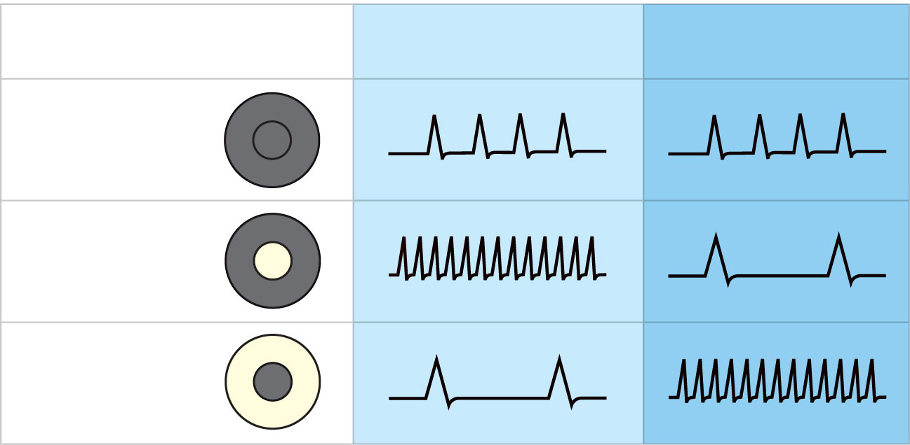
Stimulus pattern
(portion of receptive
field illuminated)
Response of on-center
ganglion cell during
period of light stimulus
Response of off-center
ganglion cell during
period of light stimulus
No illumination or
diffuse illumination
(basal rate)
Center
illuminated
Surround
illuminated
Figure 15.20

Slide 79
Thalamic Processing
Lateral geniculate nuclei of the thalamus
Relay information on movement
Segregate the retinal axons in preparation for depth perception
Emphasize visual inputs from regions of high cone density
Sharpen contrast information

Slide 80
Cortical Processing
Two areas in the visual cortex
Striate cortex (primary visual cortex)
Processes contrast information and object orientation
Prestriate cortices (visual association areas)
Processes form, color, and motion input from striate cortex
Complex visual processing extends into other regions
Temporal lobe—processes identification of objects
Parietal cortex and postcentral gyrus—process spatial location

Slide 81
Chemical Senses
Taste and smell (olfaction)
Their chemoreceptors respond to chemicals in aqueous solution

Slide 82
Sense of Smell
The organ of smell—olfactory epithelium in the roof of the nasal cavity
Olfactory receptor cells—bipolar neurons with radiating olfactory cilia
Bundles of axons of olfactory receptor cells form the filaments of the olfactory nerve (cranial nerve I)
Supporting cells surround and cushion olfactory receptor cells
Basal cells lie at the base of the epithelium

Slide 83
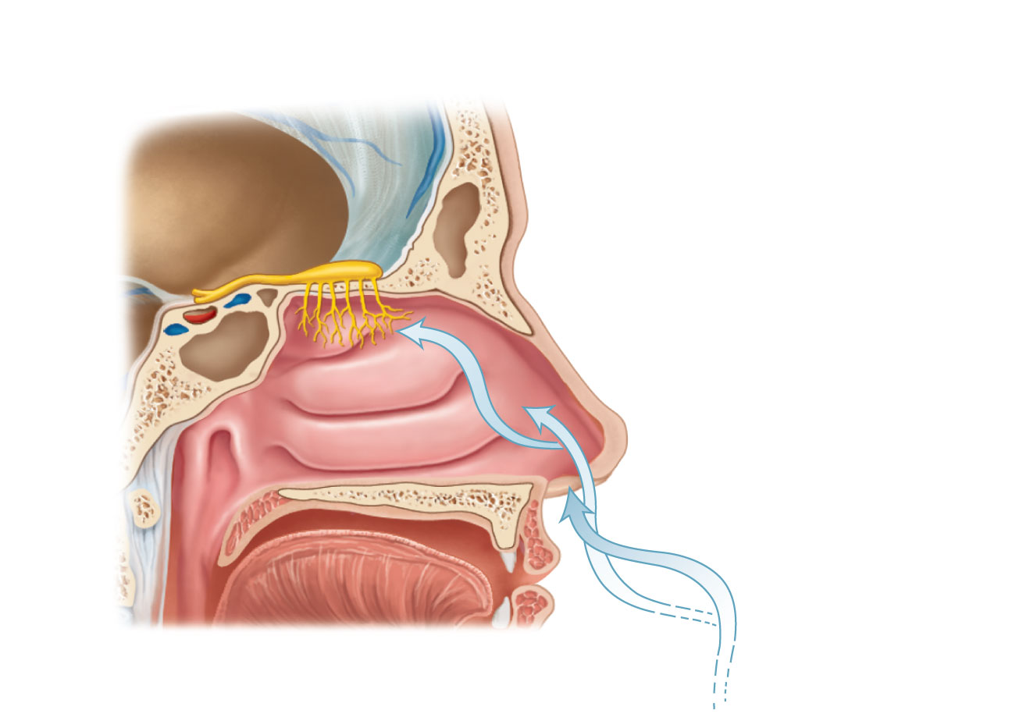
Olfactory
epithelium
Olfactory tract
Olfactory bulb
Nasal
conchae
Route of
inhaled air
(a)
Figure 15.21a

Slide 84
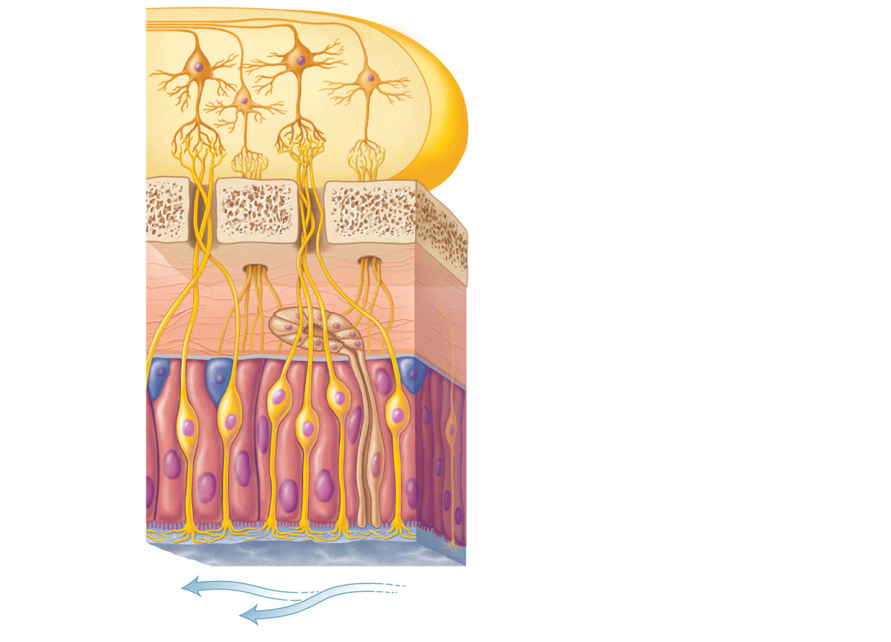
Olfactory
tract
Mitral cell (output cell)
Glomeruli
Olfactory bulb
Cribriform plate of ethmoid bone
Filaments of olfactory nerve
Lamina propria connective tissue
Olfactory
gland
Axon
Basal cell
Olfactory receptor cell
Olfactory
epithelium
Supporting cell
Dendrite
Olfactory cilia
Mucus
Route of inhaled air
containing odor molecules
(b)
Figure 15.21a

Slide 85
Physiology of Smell
Dissolved odorants bind to receptor proteins in the olfactory cilium membranes
A G protein mechanism is activated, which produces cAMP as a second messenger
cAMP opens Na⁺ and Ca²⁺ channels, causing depolarization of the receptor membrane that then triggers an action potential

Slide 86
Olfactory Pathway
Olfactory receptor cells synapse with mitral cells in glomeruli of the olfactory bulbs
Mitral cells amplify, refine, and relay signals along the olfactory tracts to the:
Olfactory cortex
Hypothalamus, amygdala, and limbic system

Slide 87
1
Odorant binds
to its receptor.
Odorant
Adenylate cyclase
G protein (G_{olf})
Open
cAMP-gated
cation channel
Receptor
GDP
Receptor
activates G
protein (G_{olf}).
2
G protein
activates
adenylate
cyclase.
3
Adenylate
cyclase converts
ATP to cAMP.
4
cAMP opens a
cation channel allowing
Na⁺ and Ca²⁺ influx and
causing depolarization.
5
Figure 15.22

Slide 88
Sense of Taste
Receptor organs are taste buds
Found on the tongue
On the tops of fungiform papillae
On the side walls of foliate papillae and circumvallate (vallate) papillae

Slide 89
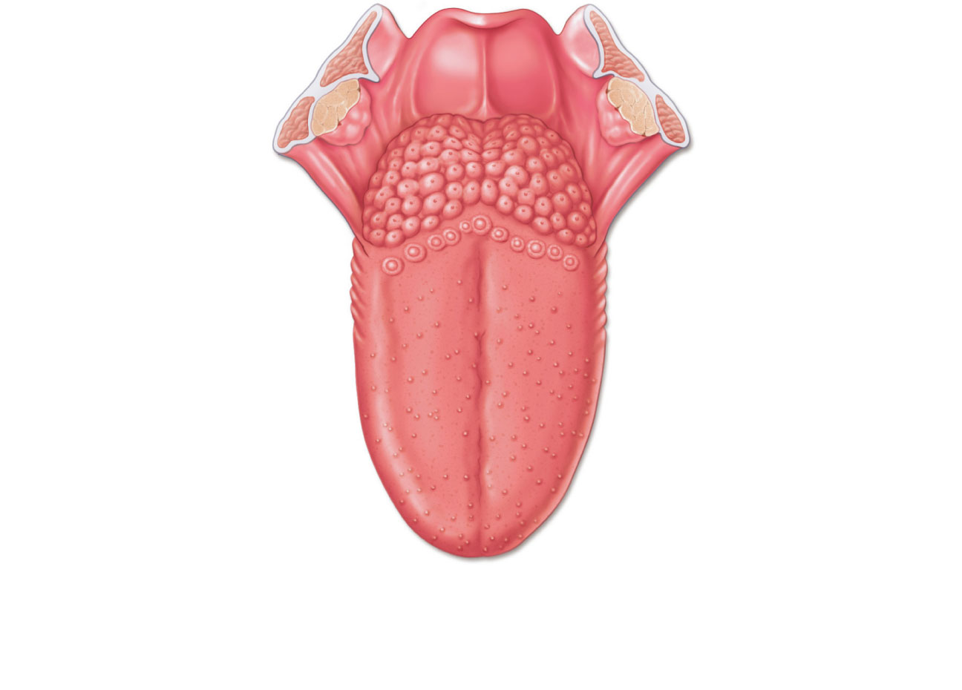
Epiglottis
Palatine tonsil
Lingual tonsil
Foliate papillae
Fungiform papillae
(a) Taste buds are associated with fungiform,
foliate, and circumvallate (vallate) papillae.
Figure 15.23a

Slide 90
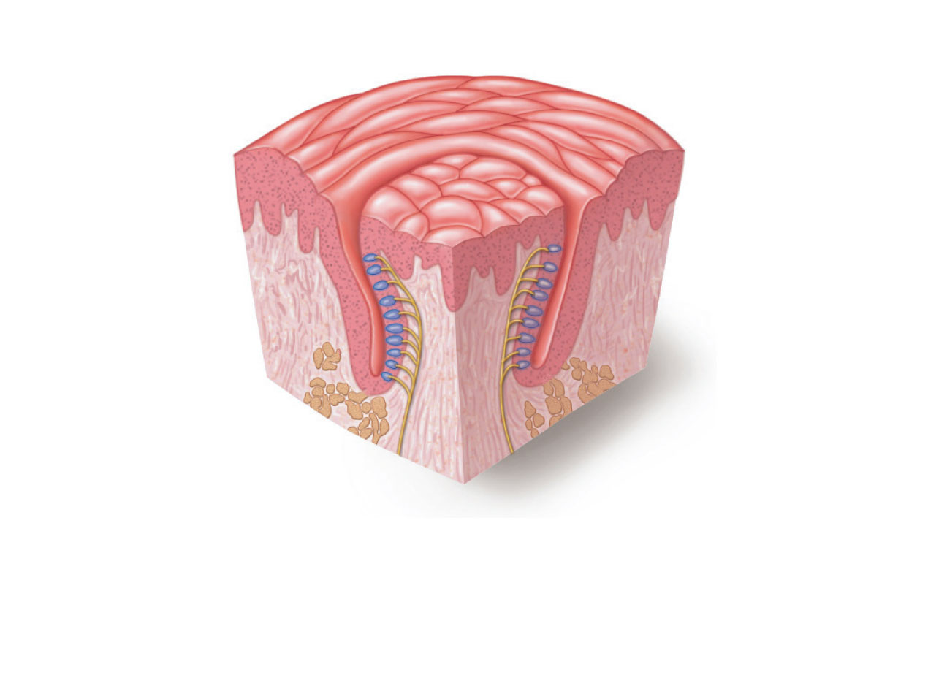
Circumvallate papilla
Taste bud
(b) Enlarged section of a
circumvallate papilla.
Figure 15.23b

Slide 91
Structure of a Taste Bud
Flask shaped
50–100 epithelial cells:
Basal cells—dynamic stem cells
Gustatory cells—taste cells
Microvilli (gustatory hairs) project through a taste pore to the surface of the epithelium

Slide 92
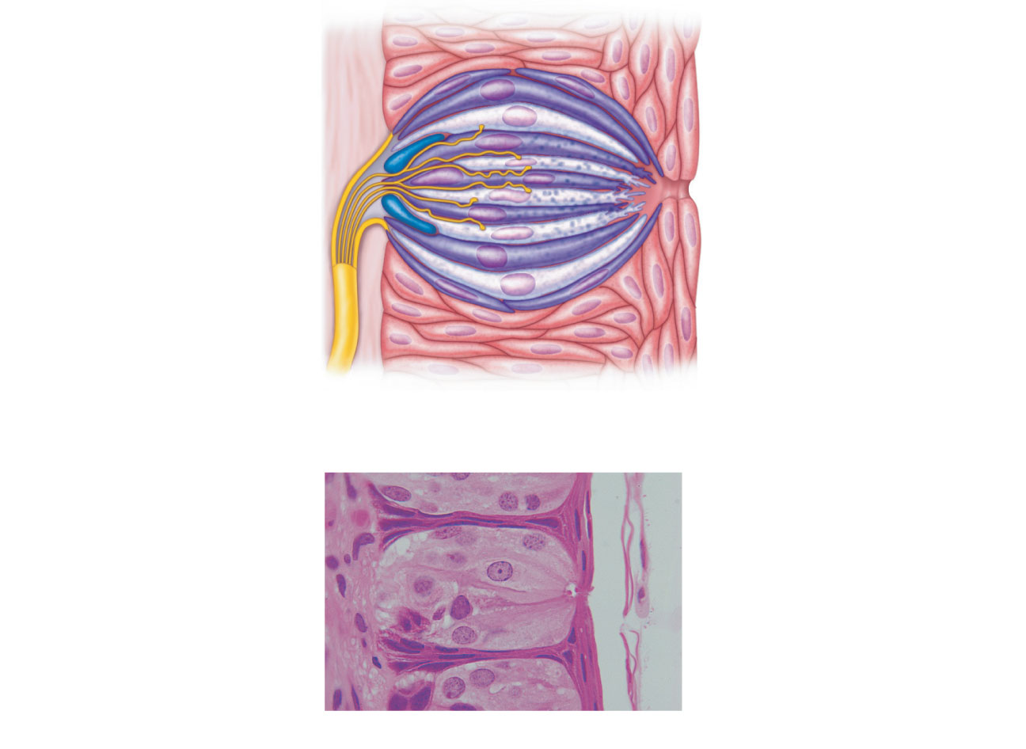
Connective
tissue
Gustatory
hair
Taste fibers
of cranial
nerve
Stratified
squamous
epithelium
of tongue
Basal
cells
Gustatory
(taste) cells
Taste
pore
(c) Enlarged view of a taste bud.
Figure 15.23c

Slide 93
Taste Sensations
There are five basic taste sensations
Sweet—sugars, saccharin, alcohol, and some amino acids
Sour—hydrogen ions
Salt—metal ions
Bitter—alkaloids such as quinine and nicotine
Umami—amino acids glutamate and aspartate

Slide 94
Physiology of Taste
In order to be tasted, a chemical:
Must be dissolved in saliva
Must contact gustatory hairs
Binding of the food chemical (tastant)
Depolarizes the taste cell membrane, causing release of neurotransmitter
Initiates a generator potential that elicits an action potential

Slide 95
Taste Transduction
The stimulus energy of taste causes gustatory cell depolarization by:
Na⁺ influx in salty tastes (directly causes depolarization)
H⁺ in sour tastes (by opening cation channels)
G protein gustducin in sweet, bitter, and umami tastes (leads to release of Ca²⁺ from intracellular stores, which causes opening of cation channels in the plasma membrane)

Slide 96
Gustatory Pathway
Cranial nerves VII and IX carry impulses from taste buds to the solitary nucleus of the medulla
Impulses then travel to the thalamus and from there fibers branch to the:
Gustatory cortex in the insula
Hypothalamus and limbic system (appreciation of taste)

Slide 97
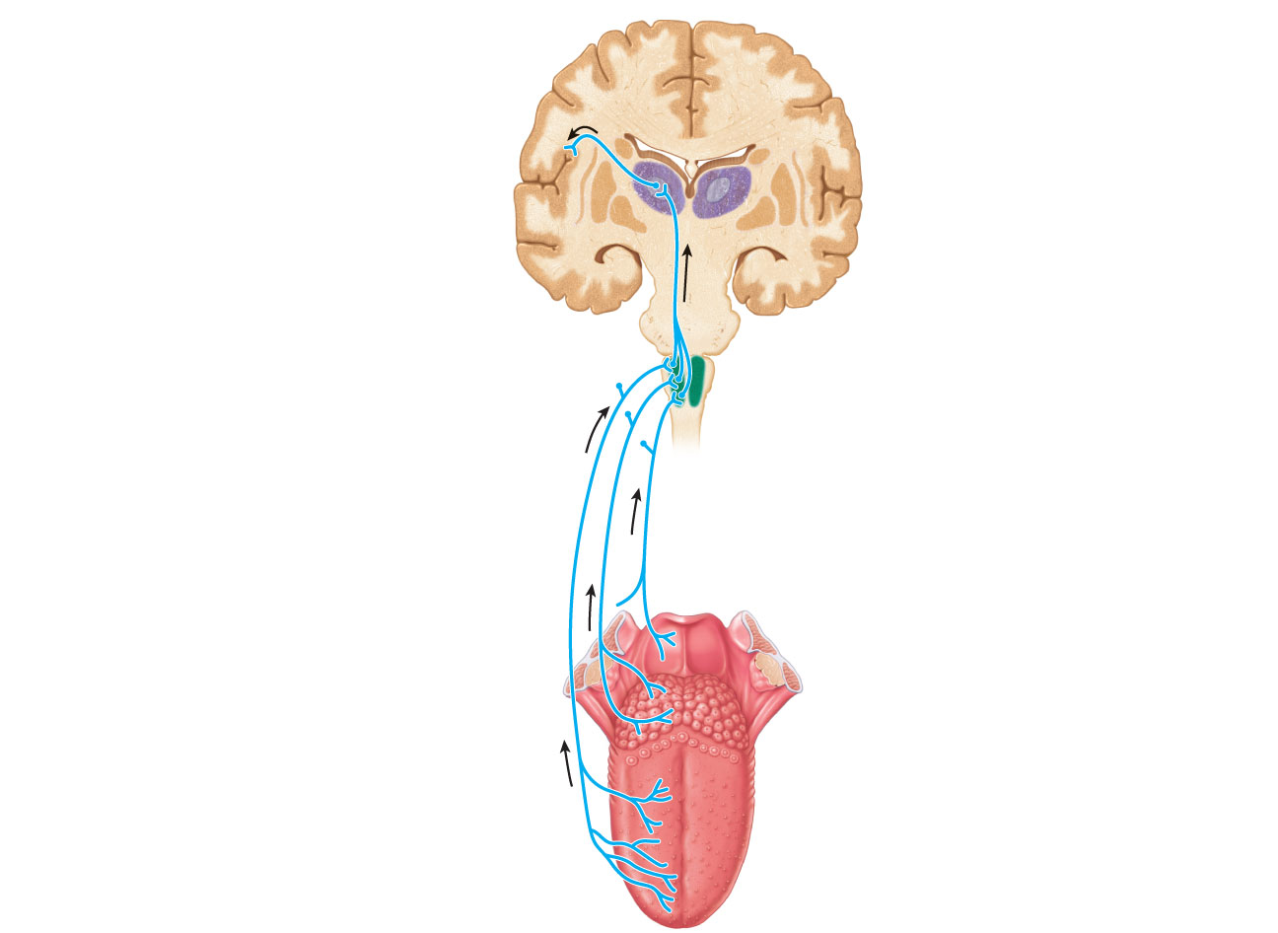
Gustatory cortex
(in insula)
Thalamic nucleus
(ventral posteromedial
nucleus)
Pons
Solitary nucleus in
medulla oblongata
Facial nerve (VII)
Vagus nerve (X)
Glossopharyngeal
nerve (IX)
Figure 15.24

Slide 98
Influence of Other Sensations on Taste
Taste is 80% smell
Thermoreceptors, mechanoreceptors, nociceptors in the mouth also influence tastes
Temperature and texture enhance or detract from taste

Slide 99
The Ear: Hearing and Balance
Three parts of the ear
External (outer) ear
Middle ear (tympanic cavity)
Internal (inner) ear

Slide 100
The Ear: Hearing and Balance
External ear and middle ear are involved with hearing
Internal ear (labyrinth) functions in both hearing and equilibrium
Receptors for hearing and balance
Respond to separate stimuli
Are activated independently

Slide 101
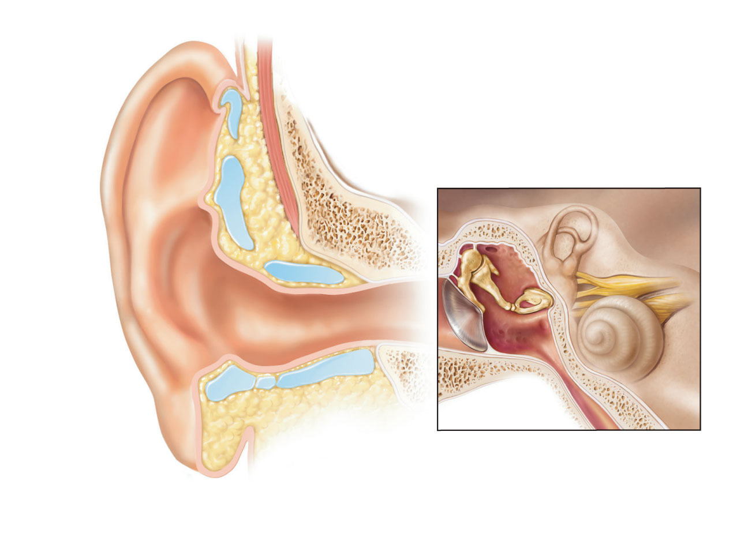
Middle
ear
Internal ear
(labyrinth)
External
ear
Auricle
(pinna)
Helix
Lobule
External
acoustic
meatus
Tympanic
membrane
Pharyngotympanic
(auditory) tube
(a) The three regions of the ear
Figure 15.25a

Slide 102
External Ear
The auricle (pinna) is composed of:
Helix (rim)
Lobule (earlobe)
External acoustic meatus (auditory canal)
Short, curved tube lined with skin bearing hairs, sebaceous glands, and ceruminous glands

Slide 103
External Ear
Tympanic membrane (eardrum)
Boundary between external and middle ears
Connective tissue membrane that vibrates in response to sound
Transfers sound energy to the bones of the middle ear

Slide 104
Middle Ear
A small, air-filled, mucosa-lined cavity in the temporal bone
Flanked laterally by the eardrum
Flanked medially by bony wall containing the oval (vestibular) and round (cochlear) windows

Slide 105
Middle Ear
Epitympanic recess—superior portion of the middle ear
Pharyngotympanic (auditory) tube—connects the middle ear to the nasopharynx
Equalizes pressure in the middle ear cavity with the external air pressure

Slide 106
Oval window
(deep to stapes)
Semicircular
canals
Entrance to mastoid
antrum in the
epitympanic recess
Malleus
(hammer)
Vestibule
Auditory
ossicles
Incu
(anvil)
Vestibular
nerve
Stapes
(stirrup)
Cochlear
nerve
Tympanic membrane
Cochlea
Round window
Pharyngotympanic
(auditory) tube
(b) Middle and internal ear
Figure 15.25b

Slide 107
Ear Ossicles
Three small bones in tympanic cavity: the malleus, incus, and stapes
Suspended by ligaments and joined by synovial joints
Transmit vibratory motion of the eardrum to the oval window
Tensor tympani and stapedius muscles contract reflexively in response to loud sounds to prevent damage to the hearing receptors

Slide 108
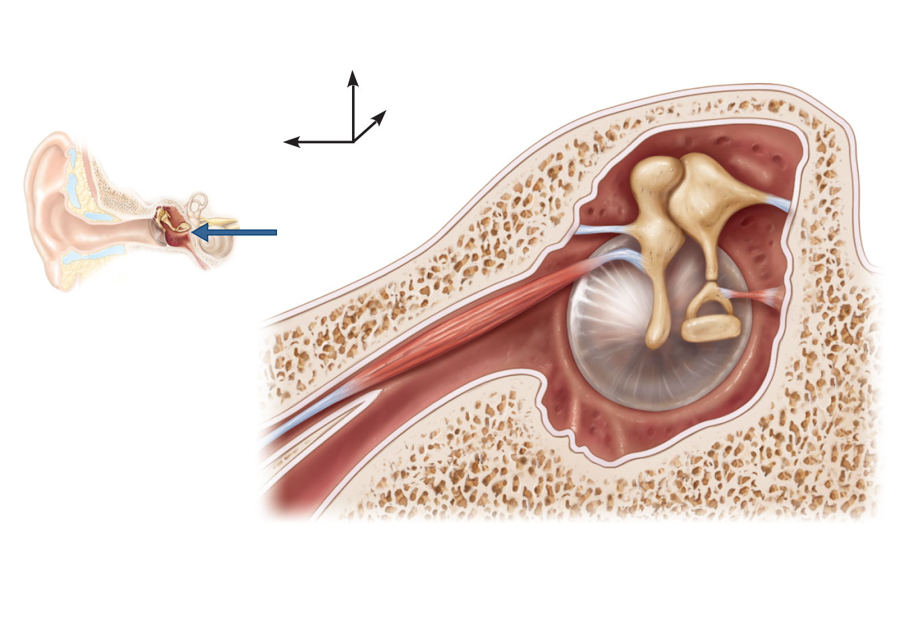
Epitympanic
recess
Superior
Malleus
Incus
Lateral
Anterior
View
Pharyngotym-
panic tube
Tensor
tympani
muscle
Tympanic
membrane
(medial view)
Stapes
Stapedius
muscle
Figure 15.26

Slide 109
Internal Ear
Bony labyrinth
Tortuous channels in the temporal bone
Three parts: vestibule, semicircular canals, and cochlea
Filled with perilymph
Series of membranous sacs within the bony labyrinth
Filled with a potassium-rich endolymph

Slide 110
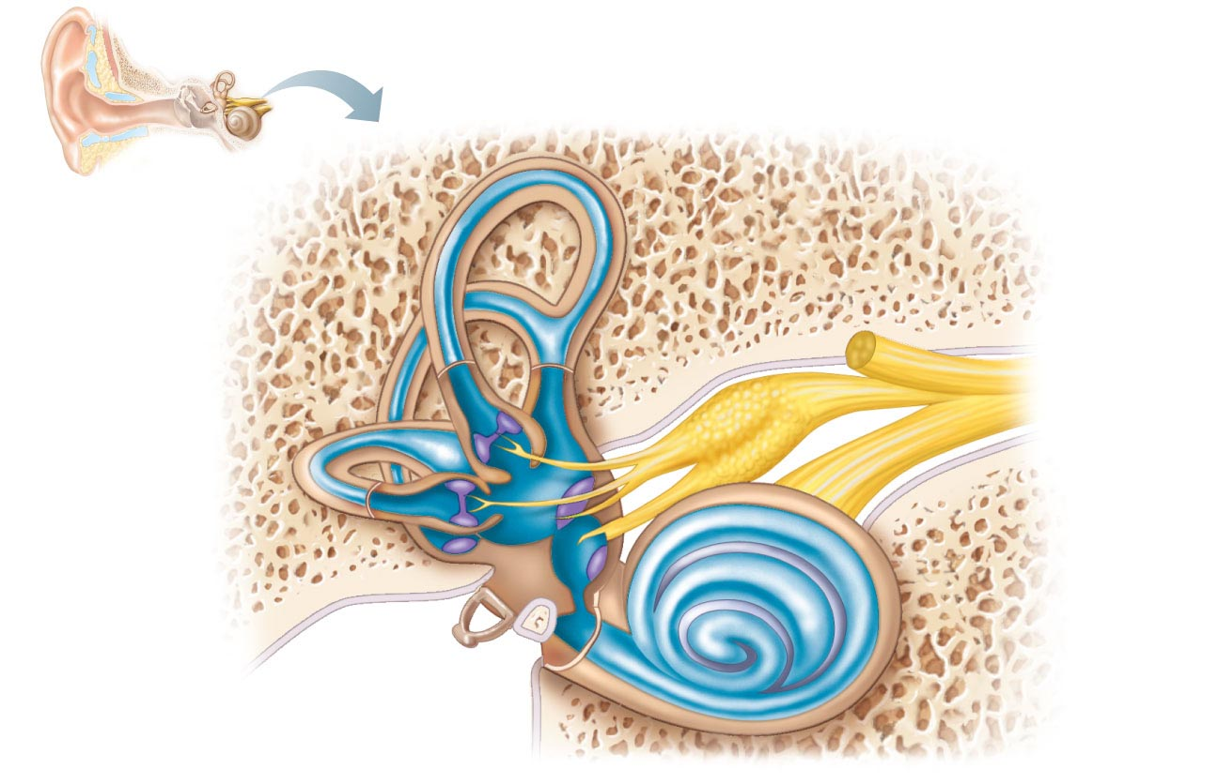
Superior vestibular ganglion
Inferior vestibular ganglion
Temporal
Semicircular
ducts in
semicircular
canals
bone
Facial nerve
Vestibular
nerve
Anterior
Posterior
Lateral
Cochlear
nerve
Cristae ampullares
in the membranous
ampullae
Maculae
Spiral organ
(of Corti)
Utricle in
vestibule
Cochlear
duct
in cochlea
Saccule in
vestibule
Stapes in
oval window
Round
window
Figure 15.27

Slide 111
Vestibule
Central egg-shaped cavity of the bony labyrinth
Contains two membranous sacs
Saccule is continuous with the cochlear duct
Utricle is continuous with the semicircular canals
These sacs
House equilibrium receptor regions (maculae)
Respond to gravity and changes in the position of the head

Slide 112
Semicircular Canals
Three canals (anterior, lateral, and posterior) that each define two-thirds of a circle
Membranous semicircular ducts line each canal and communicate with the utricle
Ampulla of each canal houses equilibrium receptor region called the crista ampullaris
Receptors respond to angular (rotational) movements of the head

Slide 113
Superior vestibular ganglion
Inferior vestibular ganglion
Temporal
Semicircular
ducts in
semicircular
canals
bone
Facial nerve
Vestibular
nerve
Anterior
Posterior
Lateral
Cochlear
nerve
Cristae ampullares
in the membranous
ampullae
Maculae
Spiral organ
(of Corti)
Utricle in
vestibule
Cochlear
duct
in cochlea
Saccule in
vestibule
Stapes in
oval window
Round
window
Figure 15.27

Slide 114
The Cochlea
A spiral, conical, bony chamber
Extends from the vestibule
Coils around a bony pillar (modiolus)
Contains the cochlear duct, which houses the spiral organ (of Corti) and ends at the cochlear apex

Slide 115
The Cochlea
The cavity of the cochlea is divided into three chambers
Scala vestibuli—abuts the oval window, contains perilymph
Scala media (cochlear duct)—contains endolymph
Scala tympani—terminates at the round window; contains perilymph
The scalae tympani and vestibuli are continuous with each other at the helicotrema (apex)

Slide 116
The Cochlea
The “roof” of the cochlear duct is the vestibular membrane
The “floor” of the cochlear duct is composed of:
The bony spiral lamina
The basilar membrane, which supports the organ of Corti
The cochlear branch of nerve VIII runs from the organ of Corti to the brain

Slide 117
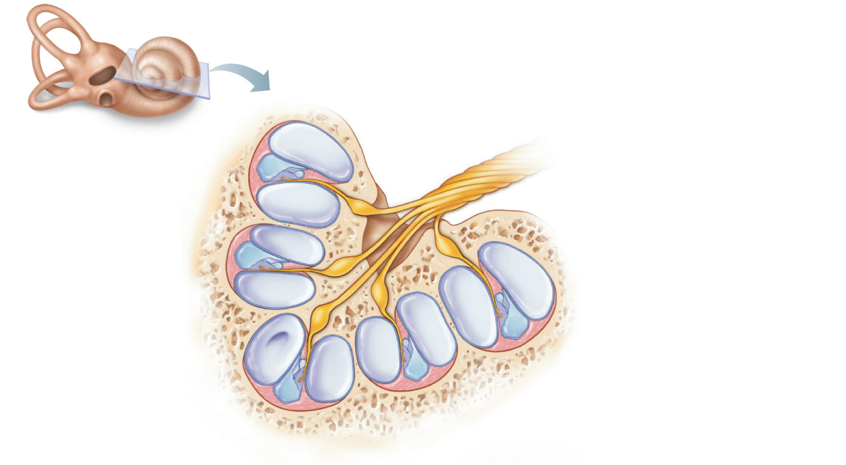
Modiolus
Cochlear nerve,
division of the
vestibulocochlear
nerve (VIII)
Spiral ganglion
Osseous spiral lamina
Vestibular membrane
Cochlear duct
(scala media)
(a)
Helicotrema
Figure 15.28a

Slide 118
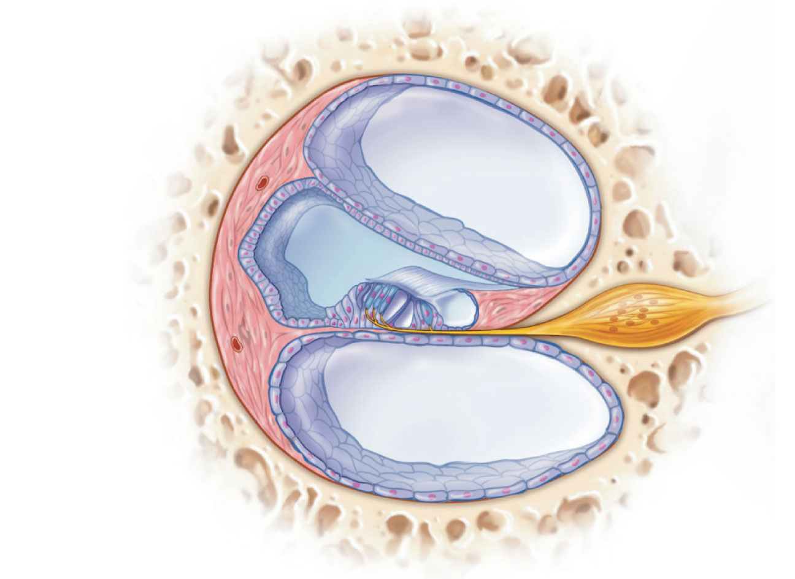
Vestibular membrane
Osseous spiral lamina
Tectorial membrane
Spiral
ganglion
Scala
vestibuli
(contains
perilymph)
Cochlear duct
(scala media;
contains
endolymph)
Stria
vascularis
Spiral organ
(of Corti)
Scala tympani
(contains
perilymph)
Basilar
membrane
(b)
Figure 15.28b

Slide 119
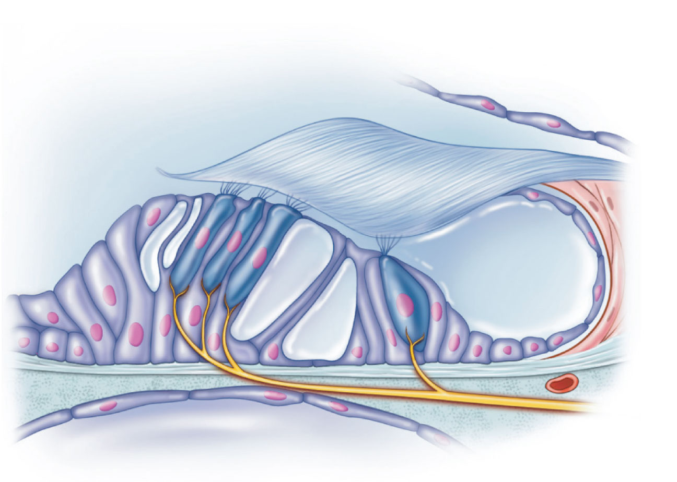
Tectorial membrane
Inner hair cell
Hairs (stereocilia)
Afferent nerve
fibers
Outer hair cells
Supporting cells
Fibers of
cochlear
nerve
Basilar
membrane
(c)
Figure 15.28c

Slide 120
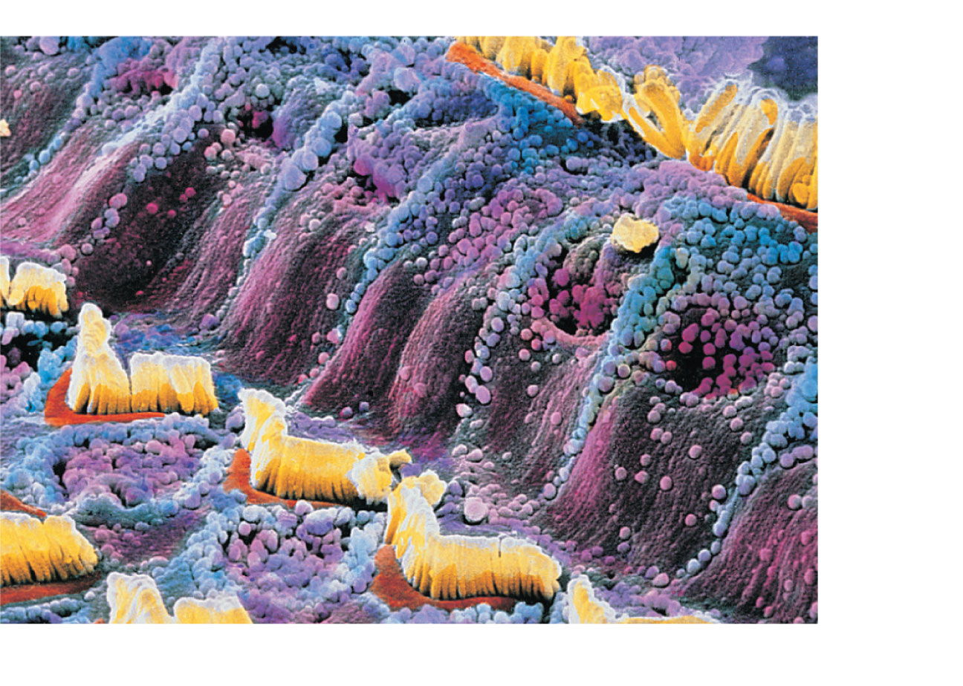
Inner
hair
cell
Outer
hair
cell
(d)
Figure 15.28d

Slide 121
Properties of Sound
Sound is
A pressure disturbance (alternating areas of high and low pressure) produced by a vibrating object
A sound wave
Moves outward in all directions
Is illustrated as an S-shaped curve or sine wave

Slide 122
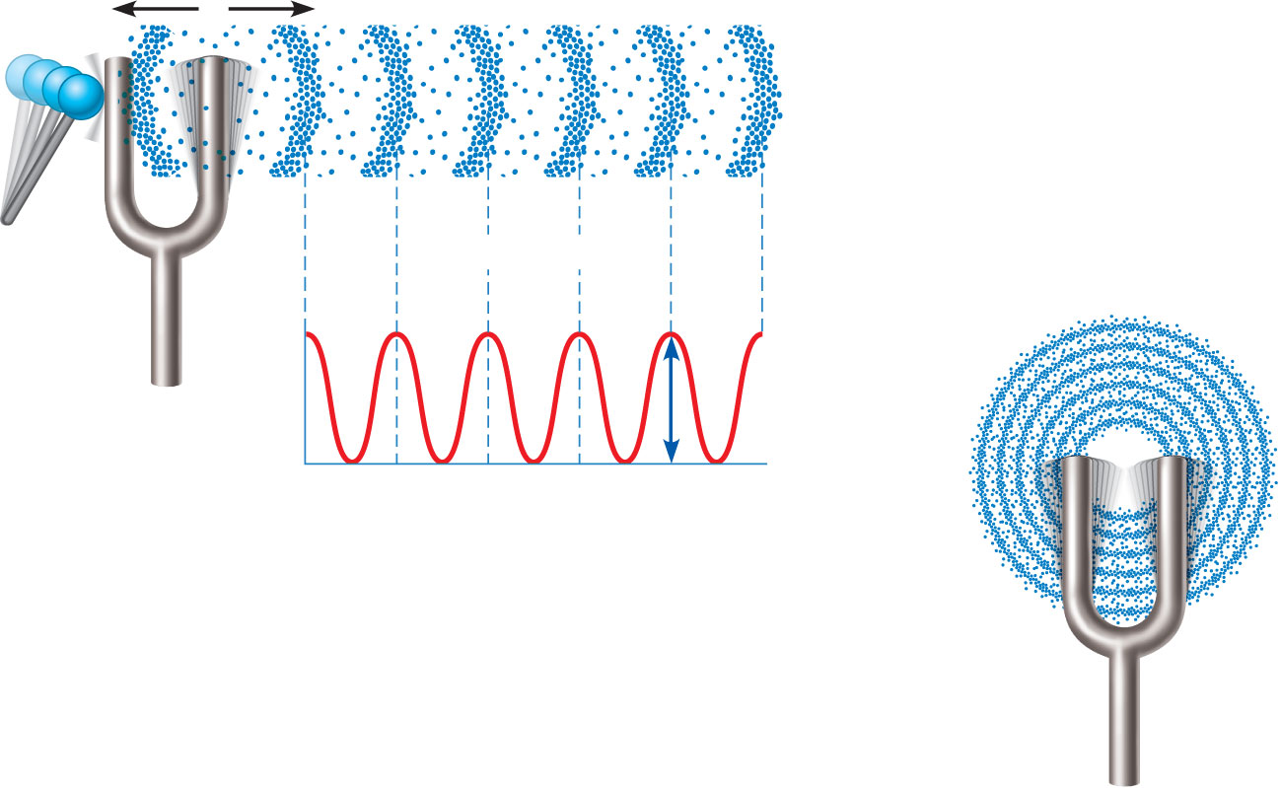
Area of
high pressure
(compressed
molecules)
Area of
low pressure
(rarefaction)
Wavelength
Air pressure
Crest
Trough
Distance
Amplitude
A struck tuning fork alternately compresses
and rarefies the air molecules around it,
creating alternate zones of high and
low pressure.
(b) Sound waves
radiate outward
in all directions.
Figure 15.29

Slide 123
Properties of Sound Waves
Frequency
The number of waves that pass a given point in a given time
Wavelength
The distance between two consecutive crests
Amplitude
The height of the crests

Slide 124
Properties of Sound
Pitch
Perception of different frequencies
Normal range is from 20–20,000 Hz
The higher the frequency, the higher the pitch
Loudness
Subjective interpretation of sound intensity
Normal range is 0–120 decibels (dB)

Slide 125
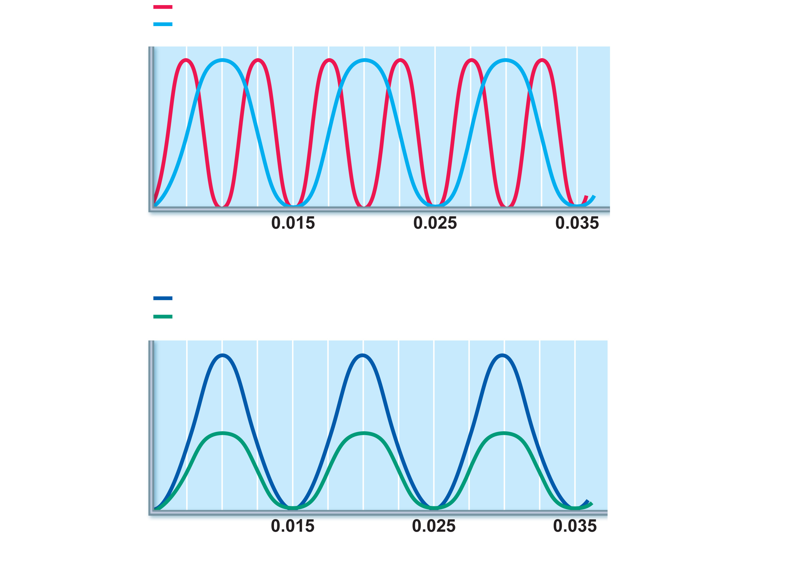
High frequency (short wavelength) = high pitch
Low frequency (long wavelength) = low pitch
Pressure
Time (s)
(a) Frequency is perceived as pitch.
High amplitude = loud
Low amplitude = soft
Pressure
Time (s)
(b) Amplitude (size or intensity) is perceived as loudness.
Figure 15.30

Slide 126
Transmission of Sound to the Internal Ear
Sound waves vibrate the tympanic membrane
Ossicles vibrate and amplify the pressure at the oval window
Pressure waves move through perilymph of the scala vestibuli

Slide 127
Transmission of Sound to the Internal Ear
Waves with frequencies below the threshold of hearing travel through the helicotrema and scali tympani to the round window
Sounds in the hearing range go through the cochlear duct, vibrating the basilar membrane at a specific location, according to the frequency of the sound

Slide 128
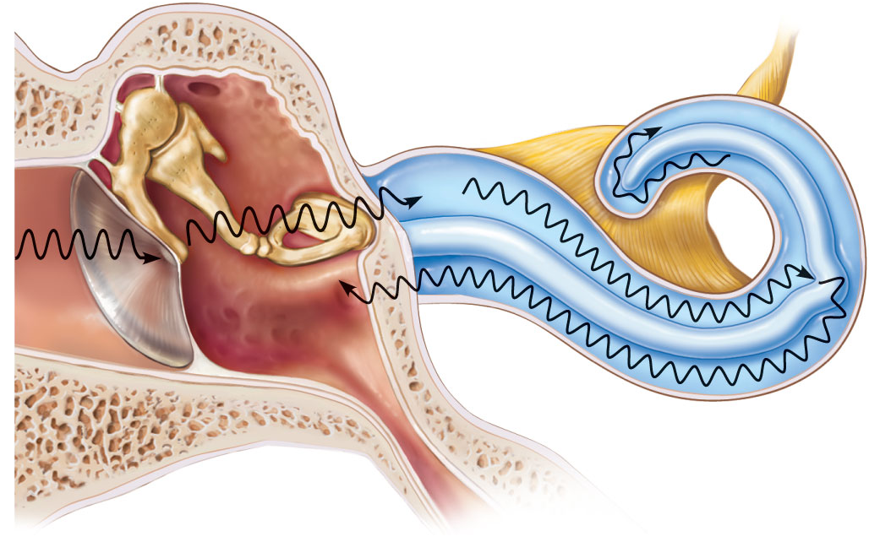
Auditory ossicles
Malleus
Incus
Stapes
Cochlear nerve
Scala vestibuli
Oval
window
Helicotrema
Scala tympani
2
Cochlear duct
3
Basilar
membrane
1
Sounds with frequencies
below hearing travel through
the helicotrema and do not
excite hair cells.
Tympanic
membrane
Round
window
(a) Route of sound waves through the ear
Sounds in the hearing range
go through the cochlear duct,
vibrating the basilar membrane
and deflecting hairs on inner
hair cells.
1
3
Sound waves vibrate
the tympanic membrane.
Pressure waves created by
the stapes pushing on the oval
window move through fluid in
the scala vestibuli.
2
Auditory ossicles vibrate.
Pressure is amplified.
Figure 15.31a

Slide 129
Resonance of the Basilar Membrane
Fibers that span the width of the basilar membrane are short and stiff near oval window, and resonate in response to high-frequency pressure waves.
Longer fibers near the apex resonate with lower-frequency pressure waves

Slide 130
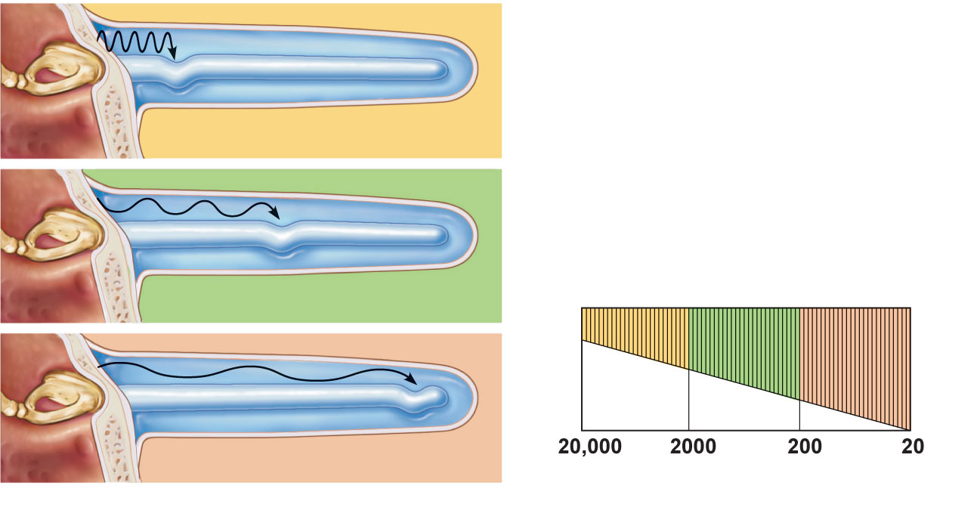
Basilar membrane
High-frequency sounds displace
the basilar membrane near the base.
Fibers of basilar membrane
Medium-frequency sounds displace
the basilar membrane near the middle.
Base
(short,
stiff
fibers)
Apex
(long,
floppy
fibers)
Low-frequency sounds displace the
basilar membrane near the apex.
Frequency (Hz)
(b) Different sound frequencies cross the
basilar membrane at different locations.
Figure 15.31b

Slide 131
Excitation of Hair Cells in the Spiral Organ
Cells of the spiral organ
Supporting cells
Cochlear hair cells
One row of inner hair cells
Three rows of outer hair cells
Afferent fibers of the cochlear nerve coil about the bases of hair cells

Slide 132
Tectorial membrane
Inner hair cell
Hairs (stereocilia)
Afferent nerve
fibers
Outer hair cells
Supporting cells
Fibers of
cochlear
nerve
Basilar
membrane
(c)
Figure 15.28c

Slide 133
Excitation of Hair Cells in the Spiral Organ
The stereocilia
Protrude into the endolymph
Enmeshed in the gel-like tectorial membrane
Bending stereocilia
Opens mechanically gated ion channels
Inward K⁺ and Ca²⁺ current causes a graded potential and the release of neurotransmitter glutamate
Cochlear fibers transmit impulses to the brain

Slide 134
Auditory Pathways to the Brain
Impulses from the cochlea pass via the spiral ganglion to the cochlear nuclei of the medulla
From there, impulses are sent to the
Superior olivary nucleus
Inferior colliculus (auditory reflex center)
From there, impulses pass to the auditory cortex via the thalamus
Auditory pathways decussate so that both cortices receive input from both ears

Slide 135
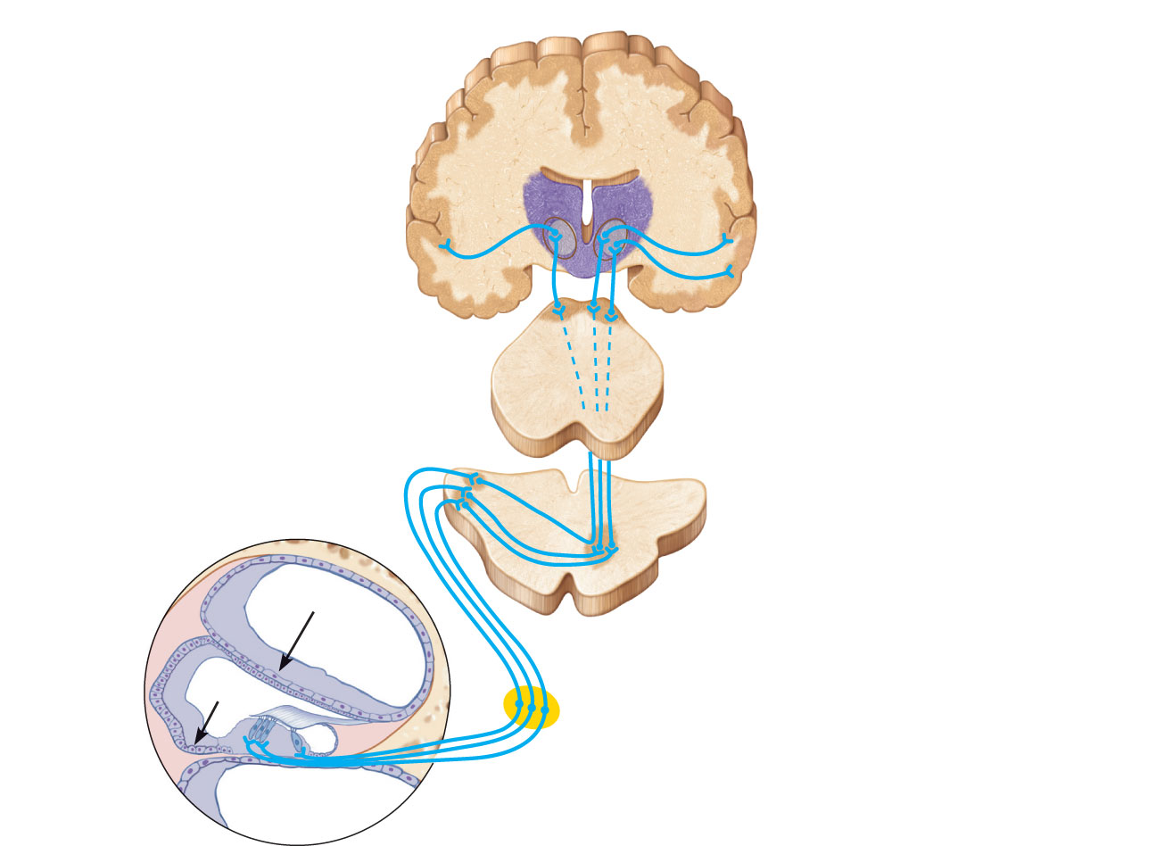
Medial geniculate
nucleus of thalamus
Primary auditory
cortex in temporal lobe
Inferior colliculus
Lateral lemniscus
Superior olivary nucleus
(pons-medulla junction)
Midbrain
Cochlear nuclei
Medulla
Vibrations
Vestibulocochlear nerve
Vibrations
Spiral ganglion of cochlear nerve
Bipolar cell
Spiral organ (of Corti)
Figure 15.33

Slide 136
Auditory Processing
Impulses from specific hair cells are interpreted as specific pitches
Loudness is detected by increased numbers of action potentials that result when the hair cells experience larger deflections
Localization of sound depends on relative intensity and relative timing of sound waves reaching both ears

Slide 137
Homeostatic Imbalances of Hearing
Conduction deafness
Blocked sound conduction to the fluids of the internal ear
Can result from impacted earwax, perforated eardrum, or otosclerosis of the ossicles
Sensorineural deafness
Damage to the neural structures at any point from the cochlear hair cells to the auditory cortical cells

Slide 138
Homeostatic Imbalances of Hearing
Tinnitus: ringing or clicking sound in the ears in the absence of auditory stimuli
Due to cochlear nerve degeneration, inflammation of middle or internal ears, side effects of aspirin
Meniere’s syndrome: labyrinth disorder that affects the cochlea and the semicircular canals
Causes vertigo, nausea, and vomiting

Slide 139
Equilibrium and Orientation
Vestibular apparatus consists of the equilibrium receptors in the semicircular canals and vestibule
Vestibular receptors monitor static equilibrium
Semicircular canal receptors monitor dynamic equilibrium

Slide 140
Maculae
Sensory receptors for static equilibrium
One in each saccule wall and one in each utricle wall
Monitor the position of the head in space, necessary for control of posture
Respond to linear acceleration forces, but not rotation
Contain supporting cells and hair cells
Stereocilia and kinocilia are embedded in the otolithic membrane studded with otoliths (tiny CaCO₃ stones)

Slide 141
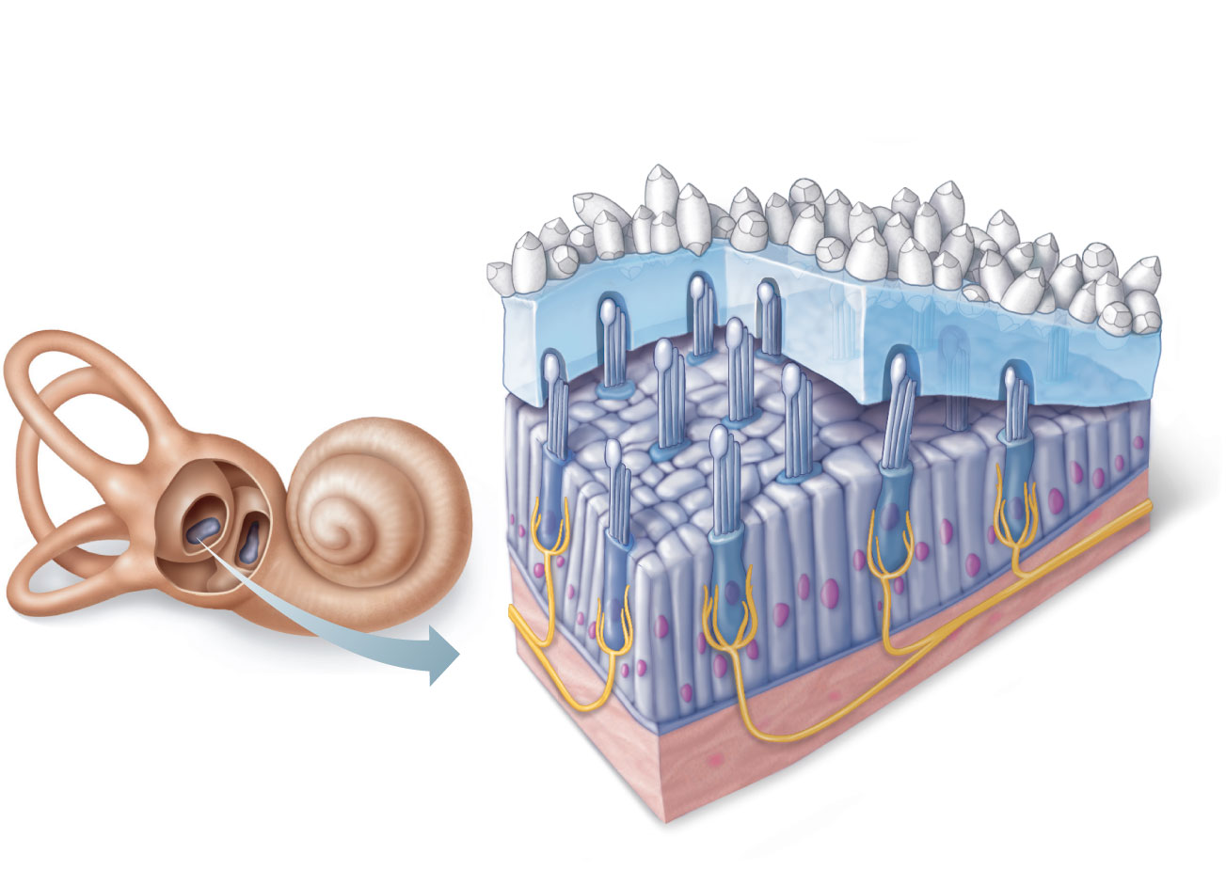
Otoliths
Kinocilium
Otolithic
membrane
Stereocilia
Hair bundle
Macula of
utricle
Macula of
saccule
Hair cells
Supporting
cells
Vestibular
nerve fibers
Figure 15.34

Slide 142
Maculae
Maculae in the utricle respond to horizontal movements and tilting the head side to side
Maculae in the saccule respond to vertical movements

Slide 143
Activating Maculae Receptors
Bending of hairs in the direction of the kinocilia
Depolarizes hair cells
Increases the amount of neurotransmitter release and increases the frequency of action potentials generated in the vestibular nerve

Slide 144
Activating Maculae Receptors
Bending in the opposite direction
Hyperpolarizes vestibular nerve fibers
Reduces the rate of impulse generation
Thus the brain is informed of the changing position of the head

Slide 145
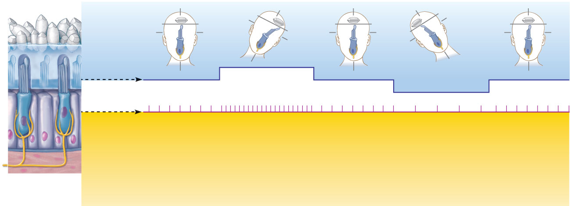
Otolithic membrane
Kinocilium
Stereocilia
Hyperpolarization
Receptor
potential
Depolarization
Nerve impulses
generated in
vestibular fiber
When hairs bend toward
the kinocilium, the hair
cell depolarizes, exciting
the nerve fiber, which
generates more frequent
action potentials.
When hairs bend away
from the kinocilium, the
hair cell hyperpolarizes,
inhibiting the nerve fiber,
and decreasing the action
potential frequency.
Figure 15.35

Slide 146
Crista Ampullaris (Crista)
Sensory receptor for dynamic equilibrium
One in the ampulla of each semicircular canal
Major stimuli are rotatory movements
Each crista has support cells and hair cells that extend into a gel-like mass called the cupula
Dendrites of vestibular nerve fibers encircle the base of the hair cells

Slide 147
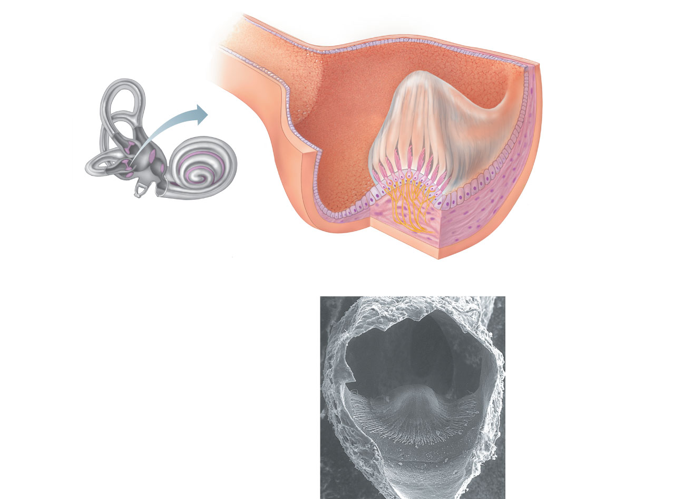
Cupula
Crista
ampullaris
Endolymph
Hair bundle (kinocilium
plus stereocilia)
Hair cell
Membranous
labyrinth
Crista
ampullaris
Supporting
cell
Fibers of vestibular nerve
(a) Anatomy of a crista ampullaris in a
semicircular canal
Cupula
(b) Scanning electron
micrograph of a
crista ampullaris
(200x)
Figure 15.36a–b

Slide 148
Activating Crista Ampullaris Receptors
Cristae respond to changes in velocity of rotatory movements of the head
Bending of hairs in the cristae causes
Depolarizations, and rapid impulses reach the brain at a faster rate

Slide 149
Activating Crista Ampullaris Receptors
Bending of hairs in the opposite direction causes
Hyperpolarizations, and fewer impulses reach the brain
Thus the brain is informed of rotational movements of the head

Slide 150
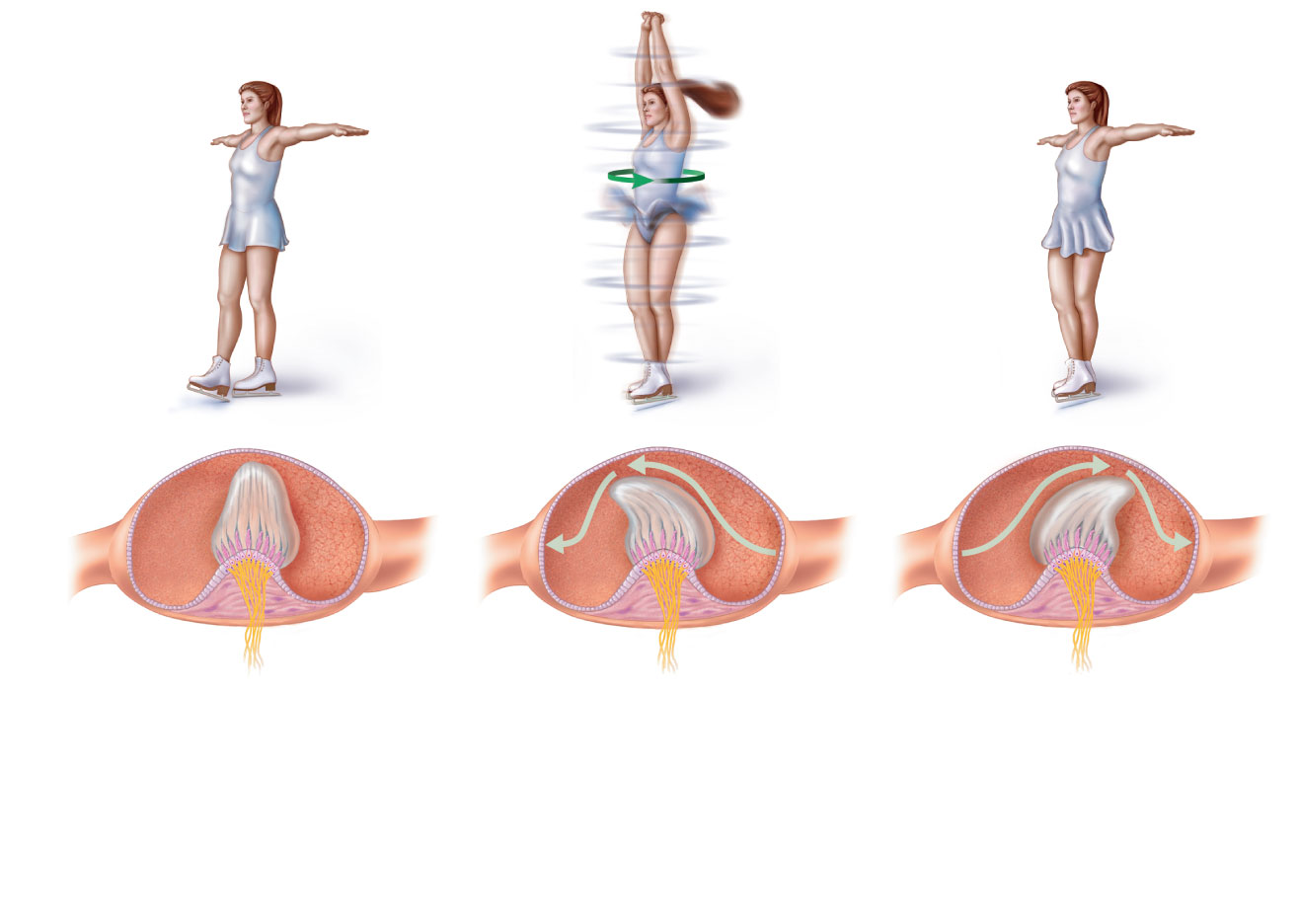
Section of
ampulla,
filled with
endolymph
Fibers of
vestibular
nerve
Cupula
Flow of endolymph
At rest, the cupula stands
upright.
During rotational acceleration,
endolymph moves inside the
semicircular canals in the
direction opposite the rotation
(it lags behind due to inertia).
Endolymph flow bends the
cupula and excites the hair
cells.
As rotational movement
slows, endolymph keeps
moving in the direction
of the rotation, bending
the cupula in the
opposite direction from
acceleration and
inhibiting the hair cells.
(c) Movement of the
cupula during
rotational
acceleration
and deceleration
Figure 15.36c

Slide 151
Equilibrium Pathway to the Brain
Pathways are complex and poorly traced
Impulses travel to the vestibular nuclei in the brain stem or the cerebellum, both of which receive other input
Three modes of input for balance and orientation
Vestibular receptors
Visual receptors
Somatic receptors

