Slide 1
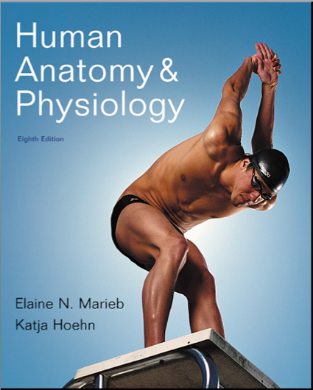
Chapter 16
Endocrine System

Slide 2
Endocrine System: Overview
Acts with the nervous system to coordinate and integrate the activity of body cells
Influences metabolic activities by means of hormones transported in the blood
Responses occur more slowly but tend to last longer than those of the nervous system
Endocrine glands: pituitary, thyroid, parathyroid, adrenal, and pineal glands

Slide 3
Endocrine System: Overview
Some organs produce both hormones and exocrine products (e.g., pancreas and gonads)
The hypothalamus has both neural and endocrine functions
Other tissues and organs that produce hormones include adipose cells, thymus, cells in the walls of the small intestine, stomach, kidneys, and heart

Slide 4
Pineal gland
Hypothalamus
Pituitary gland
Thyroid gland
Parathyroid glands
(on dorsal aspect
of thyroid gland)
Thymus
Adrenal glands
Pancreas
Ovary (female)
Testis (male)
Figure 16.1

Slide 5
Chemical Messengers
Hormones: long-distance chemical signals that travel in the blood or lymph
Two main classes
1. Amino acid-based hormones
Amines, thyroxine, peptides, and proteins
2. Steroids
Synthesized from cholesterol
Gonadal and adrenocortical hormones

Slide 6
Mechanisms of Hormone Action
Hormone action on target cells
Alter plasma membrane permeability of membrane potential by opening or closing ion channels
Stimulate synthesis of proteins or regulatory molecules
Activate or deactivate enzyme systems
Induce secretory activity
Stimulate mitosis

Slide 7
Mechanisms of Hormone Action
Two mechanisms, depending on their chemical nature
Water-soluble hormones (all amino acid–based hormones except thyroid hormone)
Cannot enter the target cells
Act on plasma membrane receptors
Coupled by G proteins to intracellular second messengers that mediate the target cell’s response
2. Lipid-soluble hormones (steroid and thyroid hormones)
Act on intracellular receptors that directly activate genes

Slide 8
Intracellular Receptors and Direct Gene Activation
Steroid hormones and thyroid hormone
Diffuse into their target cells and bind with intracellular receptors
Receptor-hormone complex enters the nucleus
Receptor-hormone complex binds to a specific region of DNA
This prompts DNA transcription to produce mRNA
The mRNA directs protein synthesis

Slide 9
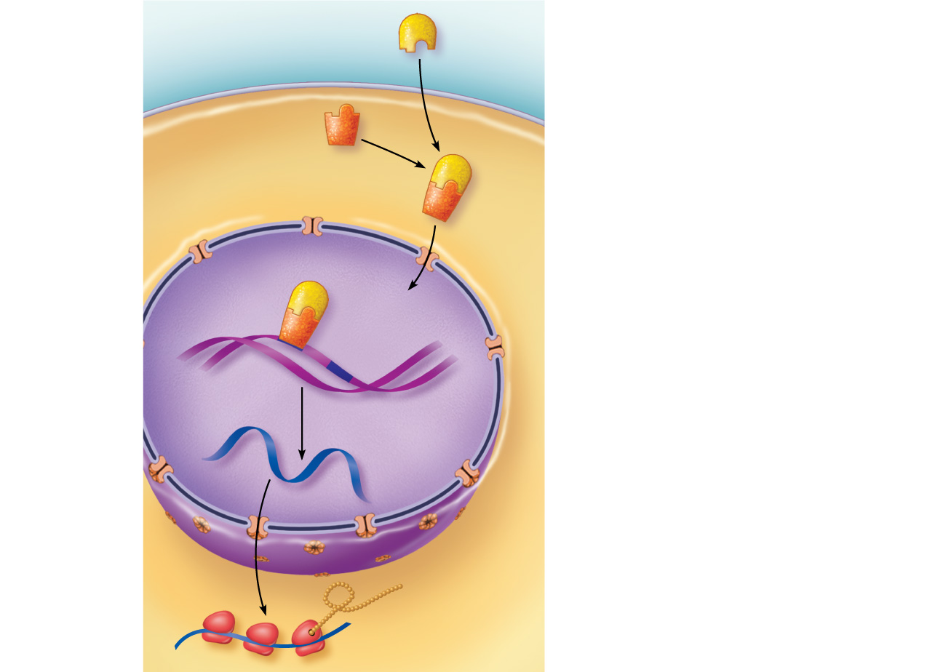
Steroid hormone
Plasma membrane
Extracellular fluid
1
The steroid hormone diffuses through the plasma membrane and binds an intracellular receptor.
Cytoplasm
Receptor protein
Receptor- hormone complex
2
The receptor- hormone complex enters the nucleus.
Nucleus
Hormone response elements
3
The receptor- hormone complex binds a hormone response element (a specific DNA sequence).
DNA
4
mRNA
Binding initiates transcription of the gene to mRNA.
5
The mRNA directs protein synthesis.
New protein
Figure 16.3

Slide 10
Target Cell Specificity
Target cells must have specific receptors to which the hormone binds
ACTH receptors are only found on certain cells of the adrenal cortex
Thyroxin receptors are found on nearly all cells of the body

Slide 11
Target Cell Activation
Target cell activation depends on three factors
Blood levels of the hormone
Relative number of receptors on or in the target cell
Affinity of binding between receptor and hormone

Slide 12
Target Cell Activation
Hormones influence the number of their receptors
Up-regulation—target cells form more receptors in response to the hormone
Down-regulation—target cells lose receptors in response to the hormone

Slide 13
Hormones in the Blood
Hormones circulate in the blood either free or bound
Steroids and thyroid hormone are attached to plasma proteins
All others circulate without carriers
The concentration of a circulating hormone reflects:
Rate of release
Speed of inactivation and removal from the body

Slide 14
Hormones in the Blood
Hormones are removed from the blood by
Degrading enzymes
Kidneys
Liver
Half-life—the time required for a hormone’s blood level to decrease by half

Slide 15
Interaction of Hormones at Target Cells
Multiple hormones may interact in several ways
Permissiveness: one hormone cannot exert its effects without another hormone being present
Synergism: more than one hormone produces the same effects on a target cell
Antagonism: one or more hormones opposes the action of another hormone

Slide 16
Control of Hormone Release
Blood levels of hormones
Are controlled by negative feedback systems
Vary only within a narrow desirable range
Hormones are synthesized and released in response to
Humoral stimuli
Neural stimuli
Hormonal stimuli

Slide 17
Humoral Stimuli
Changing blood levels of ions and nutrients directly stimulates secretion of hormones
Example: Ca²⁺ in the blood
Declining blood Ca²⁺ concentration stimulates the parathyroid glands to secrete PTH (parathyroid hormone)
PTH causes Ca²⁺ concentrations to rise and the stimulus is removed

Slide 18
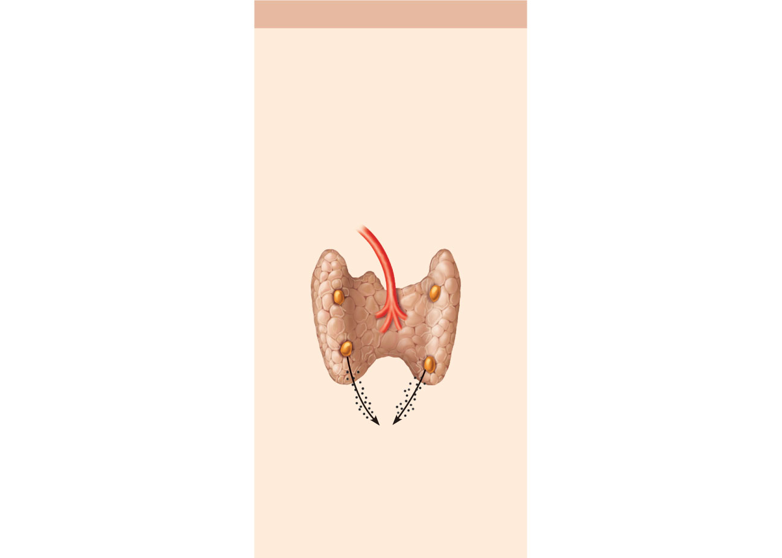
(a) Humoral Stimulus
Capillary blood contains
low concentration of Ca²⁺,
which stimulates…
1
Capillary (low
Ca²⁺ in blood)
Thyroid gland
(posterior view)
Parathyroid
glands
Parathyroid glands
PTH
…secretion of
parathyroid hormone (PTH)
by parathyroid glands*
2
Figure 16.4a

Slide 19
Neural Stimuli
Nerve fibers stimulate hormone release
Sympathetic nervous system fibers stimulate the adrenal medulla to secrete catecholamines

Slide 20
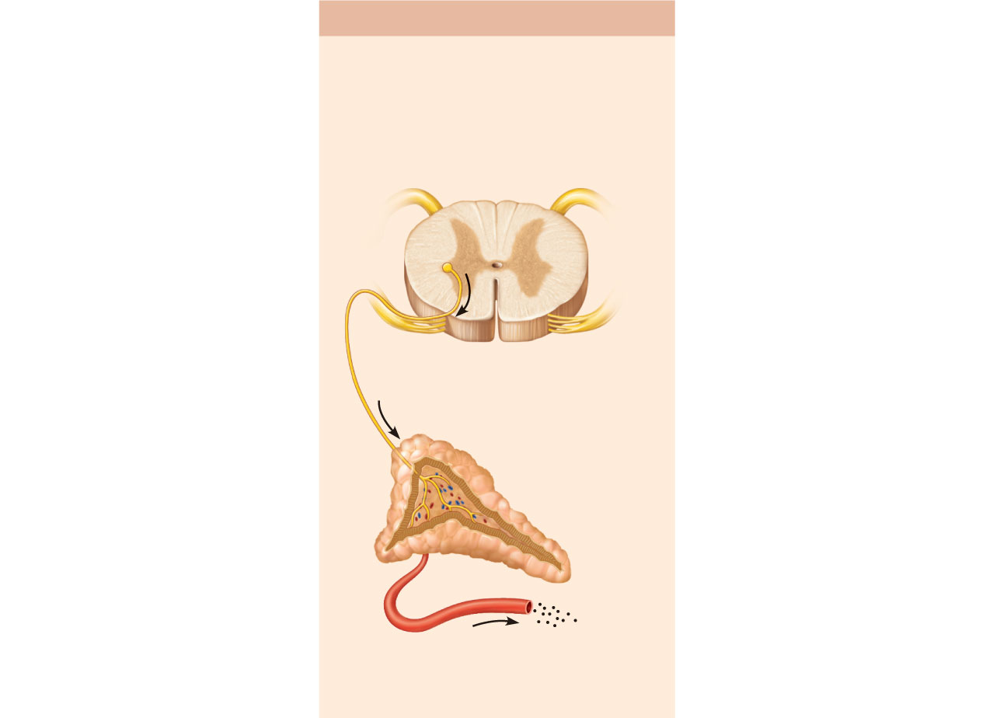
(b) Neural Stimulus
Preganglionic sympathetic
fibers stimulate adrenal
medulla cells…
1
CNS (spinal cord)
Preganglionic
sympathetic
fibers
Medulla of
adrenal
gland
Capillary
…to secrete catechola-
mines (epinephrine and
norepinephrine)
2
Figure 16.4b

Slide 21
Hormonal Stimuli
Hormones stimulate other endocrine organs to release their hormones
Hypothalamic hormones stimulate the release of most anterior pituitary hormones
Anterior pituitary hormones stimulate targets to secrete still more hormones
Hypothalamic-pituitary-target endocrine organ feedback loop: hormones from the final target organs inhibit the release of the anterior pituitary hormones

Slide 22
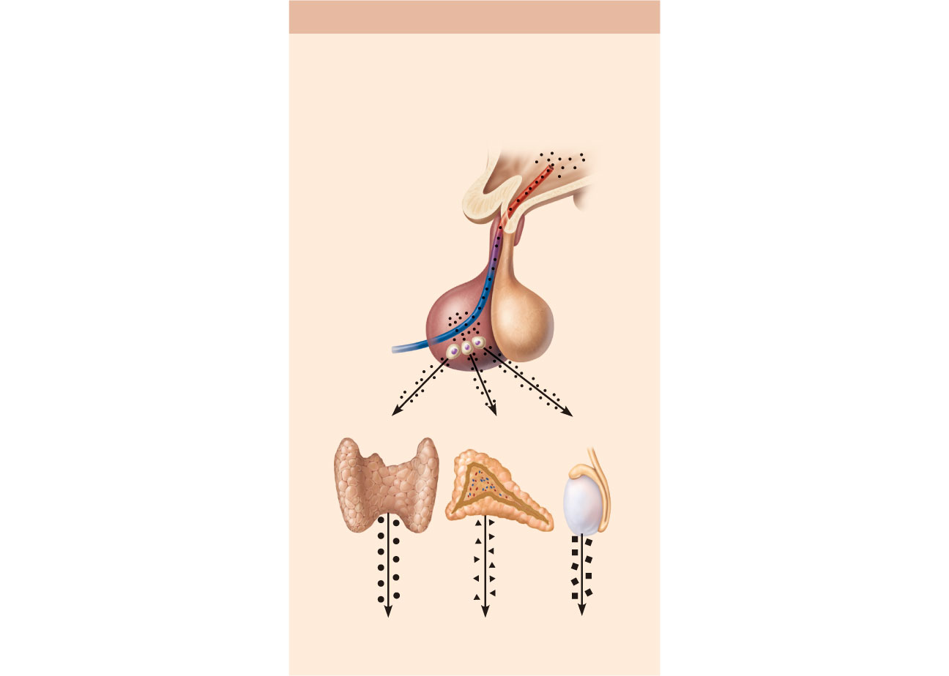
(c) Hormonal Stimulus
The hypothalamus secretes
hormones that…
1
Hypothalamus
…stimulate
the anterior
pituitary gland
to secrete
hormones
that…
2
Pituitary
gland
Thyroid
gland
Adrenal
cortex
Gonad
(Testis)
…stimulate other endocrine
glands to secrete hormones
3
Figure 16.4c

Slide 23
Nervous System Modulation
The nervous system modifies the stimulation of endocrine glands and their negative feedback mechanisms
Example: under severe stress, the hypothalamus and the sympathetic nervous system are activated
As a result, body glucose levels rise

Slide 24
The Pituitary Gland and Hypothalamus
The pituitary gland (hypophysis) has two major lobes
Posterior pituitary (lobe):
Pituicytes (glial-like supporting cells) and nerve fibers
Anterior pituitary (lobe) (adenohypophysis)
Glandular tissue

Slide 25
Pituitary-Hypothalamic Relationships
Posterior lobe
A downgrowth of hypothalamic neural tissue
Neural connection to the hypothalamus (hypothalamic-hypophyseal tract)
Nuclei of the hypothalamus synthesize the neurohormones oxytocin and antidiuretic hormone (ADH)
Neurohormones are transported to the posterior pituitary

Slide 26
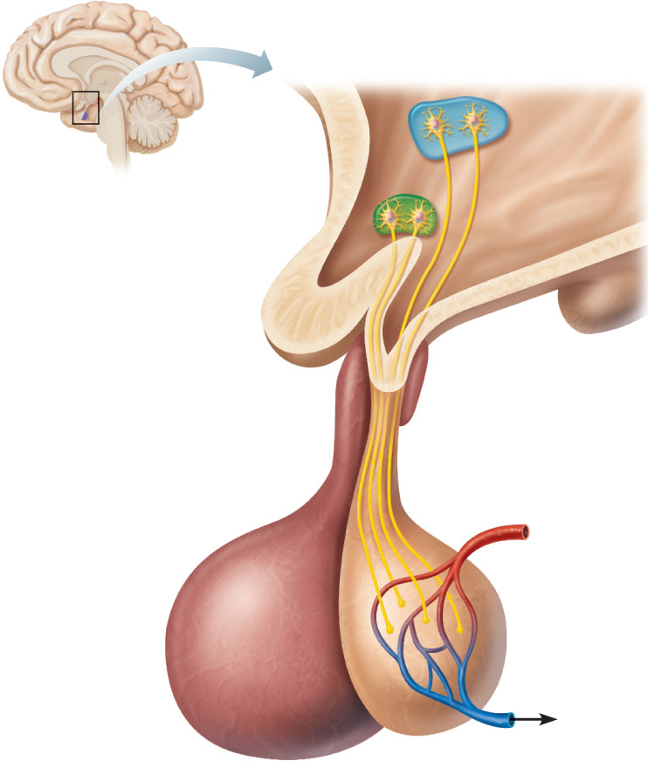
1
Hypothalamic
neurons
synthesize oxytocin
and ADH.
Paraventricular
nucleus
Hypothalamus
Supraoptic
nucleus
2
Oxytocin and ADH are
transported along the
hypothalamic-hypophyseal
tract to the posterior
pituitary.
Optic chiasma
Infundibulum
(connecting stalk)
Inferior
hypophyseal artery
Hypothalamic-
hypophyseal
tract
3
Oxytocin and ADH are
stored in axon terminals
in the posterior pituitary.
Axon
terminals
4
Posterior
lobe of
pituitary
Oxytocin and ADH are
released into the blood
when hypothalamic
neurons fire.
Oxytocin
ADH
(a) Relationship between the posterior pituitary and the hypothalamus
Figure 16.5a

Slide 27
Pituitary-Hypothalamic Relationships
Anterior Lobe:
Originates as an out-pocketing of the oral mucosa
Hypophyseal portal system
Primary capillary plexus
Hypophyseal portal veins
Secondary capillary plexus
Carries releasing and inhibiting hormones to the anterior pituitary to regulate hormone secretion

Slide 28
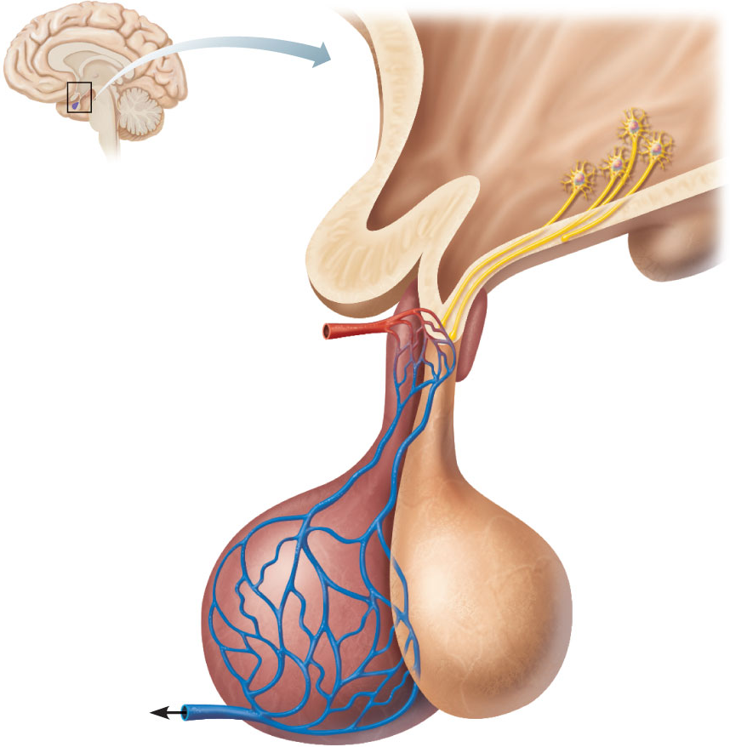
1
Hypothalamus
When appropriately
stimulated,
hypothalamic neurons
secrete releasing and
inhibiting hormones
into the primary
capillary plexus.
Hypothalamic neuron
cell bodies
Superior
hypophyseal artery
Hypophyseal
portal system
2
Hypothalamic hormones
travel through the portal
veins to the anterior pituitary
where they stimulate or
inhibit release of hormones
from the anterior pituitary.
• Primary capillary
plexus
• Hypophyseal
portal veins
• Secondary
capillary
plexus
Anterior lobe
of pituitary
3
Anterior pituitary
hormones are secreted
into the secondary
capillary plexus.
TSH, FSH,
LH, ACTH,
GH, PRL
(b) Relationship between the anterior pituitary and the hypothalamus
Figure 16.5b

Slide 29
Anterior Pituitary Hormones
Growth hormone (GH)
Thyroid-stimulating hormone (TSH) or thyrotropin
Adrenocorticotropic hormone (ACTH)
Follicle-stimulating hormone (FSH)
Luteinizing hormone (LH)
Prolactin (PRL)

Slide 30
Anterior Pituitary Hormones
All are proteins
All except GH activate cyclic AMP second-messenger systems at their targets
TSH, ACTH, FSH, and LH are all tropic hormones (regulate the secretory action of other endocrine glands)

Slide 31
Growth Hormone (GH)
Produced by somatotrophs
Stimulates most cells, but targets bone and skeletal muscle
Promotes protein synthesis and encourages use of fats for fuel
Most effects are mediated indirectly by insulin-like growth factors (IGFs)

Slide 32
Growth Hormone (GH)
GH release is regulated by
Growth hormone–releasing hormone (GHRH)
Growth hormone–inhibiting hormone (GHIH) (somatostatin)

Slide 33
Actions of Growth Hormone
Direct action of GH
Stimulates liver, skeletal muscle, bone, and cartilage to produce insulin-like growth factors
Mobilizes fats, elevates blood glucose by decreasing glucose uptake and encouraging glycogen breakdown (anti-insulin effect of GH)

Slide 34
Homeostatic Imbalances of Growth Hormone
Hypersecretion
In children results in gigantism
In adults results in acromegaly
Hyposecretion
In children results in pituitary dwarfism

Slide 35
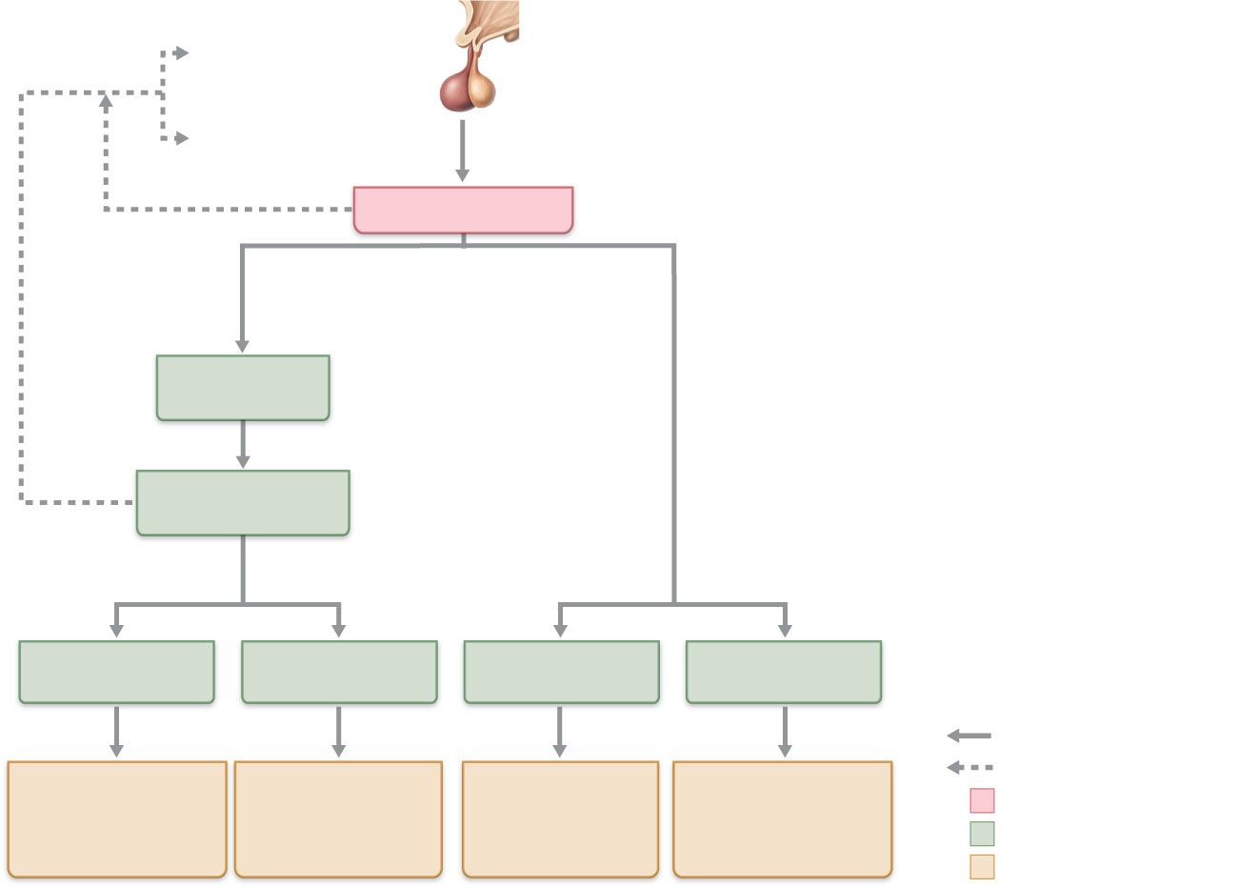
Hypothalamus
secretes growth
hormone—releasing
hormone (GHRH), and
somatostatin (GHIH)
Feedback
Inhibits GHRH release
Stimulates GHIH
release
Anterior
pituitary
Inhibits GH synthesis
and release
Growth hormone
Indirect actions
(growth-
promoting)
Direct actions
(metabolic,
anti-insulin)
Liver and
other tissues
Produce
Insulin-like growth
factors (IGFs)
Effects
Effects
Skeletal
Extraskeletal
Fat
Carbohydrate
metabolism
Increases, stimulates
Increased protein
synthesis, and
cell growth and
proliferation
Reduces, inhibits
Increased cartilage
formation and
skeletal growth
Increased
fat breakdown
and release
Increased blood
glucose and other
anti-insulin effects
Initial stimulus
Physiological response
Result
Figure 16.6

Slide 36
Thyroid-Stimulating Hormone (Thyrotropin)
Produced by thyrotrophs of the anterior pituitary
Stimulates the normal development and secretory activity of the thyroid

Slide 37
Thyroid-Stimulating Hormone (Thyrotropin)
Regulation of TSH release
Stimulated by thyrotropin-releasing hormone (TRH)
Inhibited by rising blood levels of thyroid hormones that act on the pituitary and hypothalamus

Slide 38
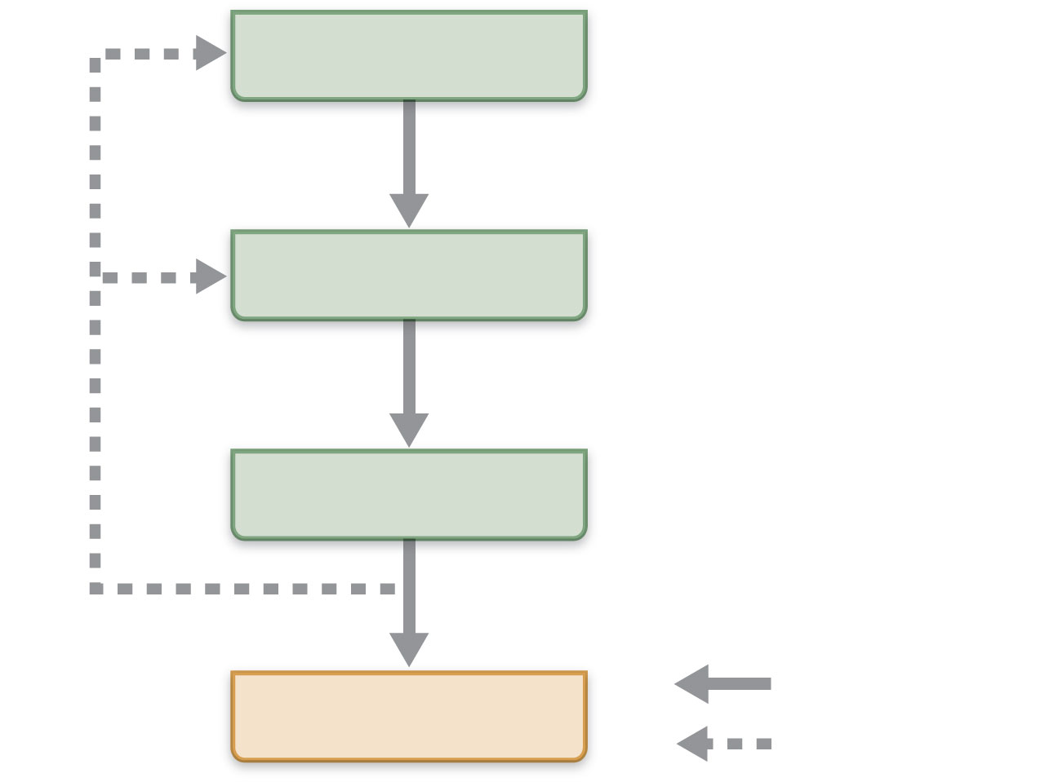
Hypothalamus
TRH
Anterior pituitary
TSH
Thyroid gland
Thyroid
hormones
Stimulates
Target cells
Inhibits
Figure 16.7

Slide 39
Adrenocorticotropic Hormone (Corticotropin)
Secreted by corticotrophs of the anterior pituitary
Stimulates the adrenal cortex to release corticosteroids

Slide 40
Adrenocorticotropic Hormone (Corticotropin)
Regulation of ACTH release
Triggered by hypothalamic corticotropin-releasing hormone (CRH) in a daily rhythm
Internal and external factors such as fever, hypoglycemia, and stressors can alter the release of CRH

Slide 41
Gonadotropins
Follicle-stimulating hormone (FSH) and luteinizing hormone (LH)
Secreted by gonadotrophs of the anterior pituitary
FSH stimulates gamete (egg or sperm) production
LH promotes production of gonadal hormones
Absent from the blood in prepubertal boys and girls

Slide 42
Gonadotropins
Regulation of gonadotropin release
Triggered by the gonadotropin-releasing hormone (GnRH) during and after puberty
Suppressed by gonadal hormones (feedback)

Slide 43
Prolactin (PRL)
Secreted by lactotrophs of the anterior pituitary
Stimulates milk production
Regulation of PRL release
Primarily controlled by prolactin-inhibiting hormone (PIH) (dopamine)
Blood levels rise toward the end of pregnancy
Suckling stimulates PRH release and promotes continued milk production

Slide 44
The Posterior Pituitary
Contains axons of hypothalamic neurons
Stores antidiuretic hormone (ADH) and oxytocin
ADH and oxytocin are released in response to nerve impulses
Both use PIP-calcium second-messenger mechanism at their targets

Slide 45
Oxytocin
Stimulates uterine contractions during childbirth by mobilizing Ca²⁺ through a PIP₂-Ca²⁺ second-messenger system
Also triggers milk ejection (“letdown” reflex) in women producing milk
Plays a role in sexual arousal and orgasm in males and females

Slide 46
Antidiuretic Hormone (ADH)
Hypothalamic osmoreceptors respond to changes in blood solute concentration
If solute concentration is high
Osmoreceptors depolarize and transmit impulses to hypothalamic neurons
ADH is synthesized & released, inhibits urine formation
If solute concentration is low
ADH is not released, allowing water loss
Alcohol inhibits ADH release &causes copious urine output

Slide 47
Homeostatic Imbalances of ADH
ADH deficiency—diabetes insipidus; huge output of urine and intense thirst
ADH hypersecretion (after neurosurgery, trauma, or secreted by cancer cells)—syndrome of inappropriate ADH secretion (SIADH)

Slide 48
Thyroid Gland
Consists of two lateral lobes connected by a median mass called the isthmus
Composed of follicles that produce the glycoprotein thyroglobulin
Colloid (thyroglobulin + iodine) fills the lumen of the follicles and is the precursor of thyroid hormone
Parafollicular cells produce the hormone calcitonin

Slide 49
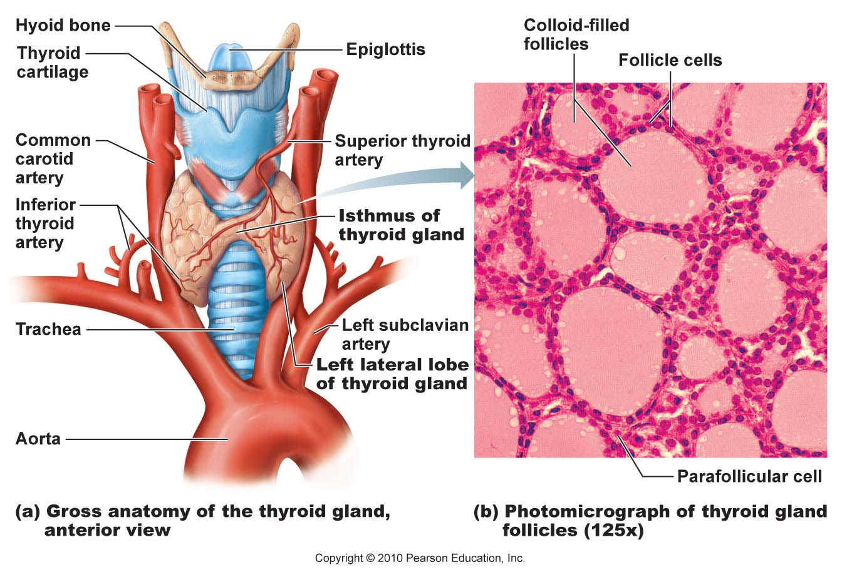
Figure 16.8

Slide 50
Thyroid Hormone (TH)
Actually two related compounds
T₄ (thyroxine); has 2 tyrosine molecules + 4 bound iodine atoms
T₃ (triiodothyronine); has 2 tyrosines + 3 bound iodine atoms

Slide 51
Thyroid Hormone
Major metabolic hormone
Increases metabolic rate and heat production (calorigenic effect)
Plays a role in
Maintenance of blood pressure
Regulation of tissue growth
Development of skeletal and nervous systems
Reproductive capabilities

Slide 52
Synthesis of Thyroid Hormone
Thyroglobulin is synthesized and discharged into the follicle lumen
Iodides (I–) are actively taken into the cell, oxidized to iodine (I₂), and released into the lumen
Iodine attaches to tyrosine, mediated by peroxidase enzymes

Slide 53
Synthesis of Thyroid Hormone
Iodinated tyrosines link together to form T₃ and T₄
Colloid is endocytosed and combined with a lysosome
T₃ and T₄ are cleaved and diffuse into the bloodstream

Slide 54
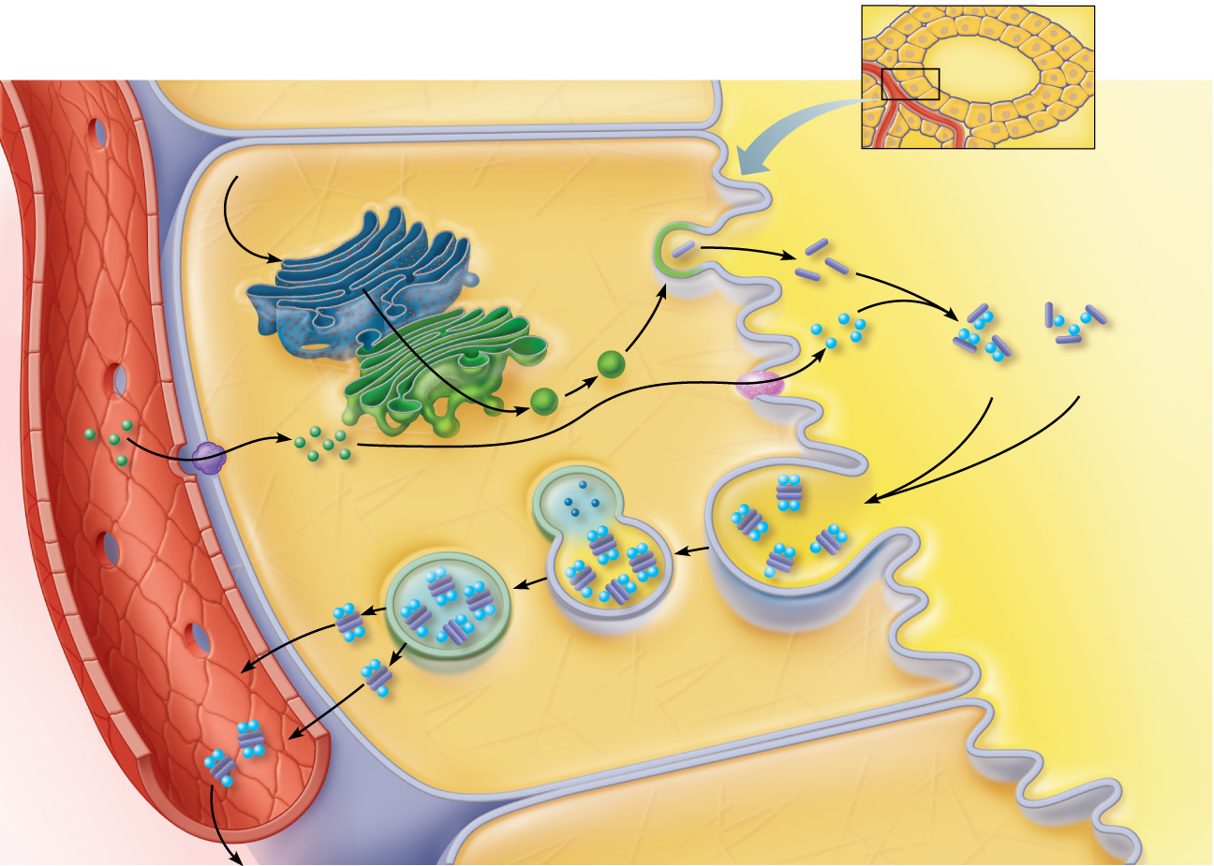
Thyroid follicle cells
Colloid
1
Thyroglobulin is synthesized and discharged into the follicle lumen.
Tyrosines (part of thyroglobulin molecule)
Capillary
4
Iodine is attached to tyrosine in colloid, forming DIT and MIT.
Golgi apparatus
Rough ER
Iodine
Thyro- globulin colloid
3
DIT (T₂)
MIT (T₁)
Iodide is oxidized to iodine.
2
Iodide (I–)
Iodide (I–) is trapped (actively transported in).
T₄
5
Iodinated tyrosines are linked together to form T₃ and T₄.
Lysosome
T₃
T₄
6
Thyroglobulin colloid is endocytosed and combined with a lysosome.
T₃
7
T₄
Lysosomal enzymes cleave T₄ and T₃ from thyroglobulin colloid and hormones diffuse into bloodstream.
Colloid in lumen of follicle
T₃
To peripheral tissues
Figure 16.9

Slide 55
Transport and Regulation of TH
T₄ and T₃ are transported by thyroxine-binding globulins (TBGs)
Both bind to target receptors, but T₃ is ten times more active than T₄
Peripheral tissues convert T₄ to T₃

Slide 56
Transport and Regulation of TH
Negative feedback regulation of TH release
Rising TH levels provide negative feedback inhibition on release of TSH
Hypothalamic thyrotropin-releasing hormone (TRH) can overcome the negative feedback during pregnancy or exposure to cold

Slide 57
Hypothalamus
TRH
Anterior pituitary
TSH
Thyroid gland
Thyroid
hormones
Stimulates
Target cells
Inhibits
Figure 16.7

Slide 58
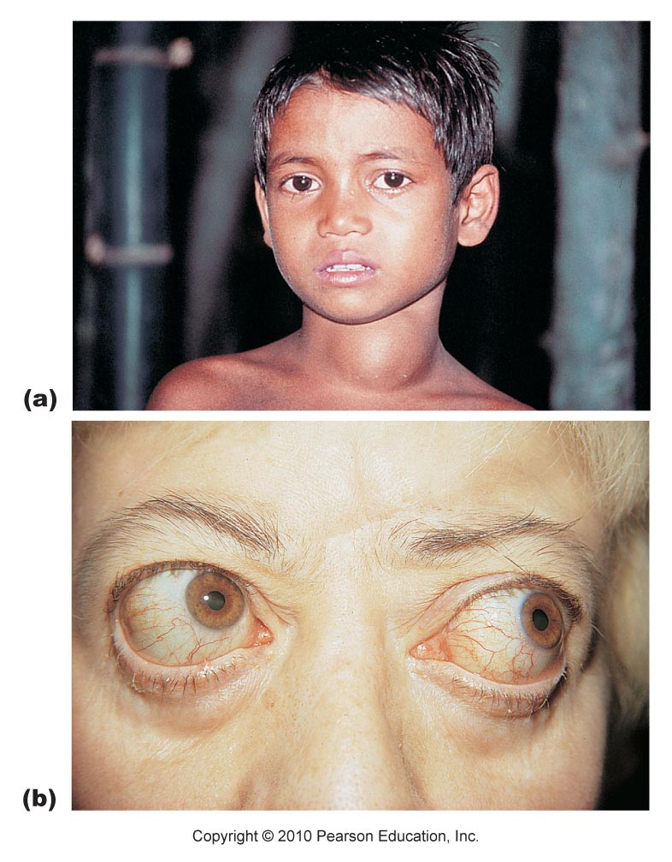
Figure 16.10

Slide 59
Calcitonin
Produced by parafollicular (C) cells
Antagonist to parathyroid hormone (PTH)
Inhibits osteoclast activity and release of Ca²⁺ from bone
Stimulates Ca²⁺ uptake and incorporation into bone
Regulated by a humoral (Ca²⁺ concentration in the blood) negative feedback mechanism
No important role in humans; removal of thyroid (and its C cells) does not affect Ca²⁺ homeostasis

Slide 60
Parathyroid Glands
Four to eight tiny glands embedded in the posterior aspect of the thyroid
Contain oxyphil cells (function unknown) and chief cells that secrete parathyroid hormone (PTH) or parathormone
PTH—most important hormone in Ca²⁺ homeostasis

Slide 61
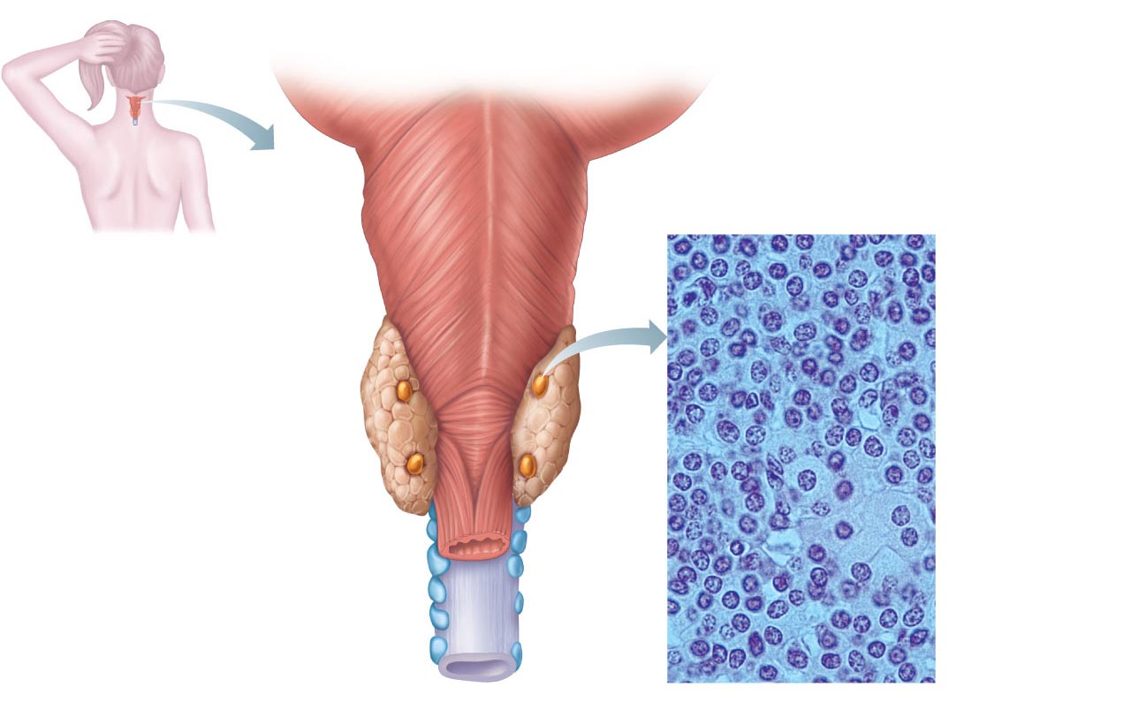
Pharynx
(posterior
aspect)
Chief
cells
(secrete
parathyroid
hormone)
Thyroid
gland
Parathyroid
glands
Oxyphil
cells
Esophagus
Trachea
Capillary
(a)
(b)
Figure 16.11

Slide 62
Parathyroid Hormone
Functions
Stimulates osteoclasts to digest bone matrix
Enhances reabsorption of Ca²⁺ and secretion of phosphate by the kidneys
Promotes activation of vitamin D (by the kidneys); increases absorption of Ca²⁺ by intestinal mucosa
Negative feedback control: rising Ca²⁺ in the blood inhibits PTH release

Slide 63
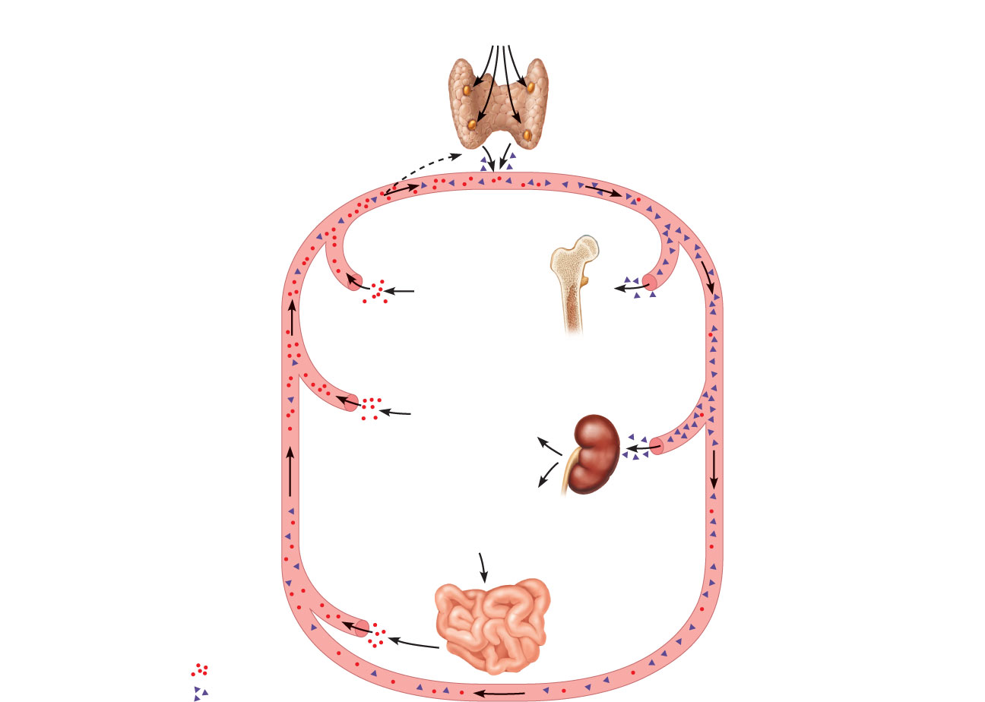
Hypocalcemia (low blood Ca²⁺) stimulates
parathyroid glands to release PTH.
Rising Ca²⁺ in
blood inhibits
PTH release.
Bone
1
PTH activates
osteoclasts: Ca²⁺
and PO₄^{3S} released
into blood.
2
Kidney
PTH increases
Ca²⁺ reabsorption
in kidney
tubules.
3
PTH promotes
kidney’s activation of vitamin D,
which increases Ca²⁺ absorption
from food.
Intestine
Ca²⁺ ions
Bloodstream
PTH Molecules
Figure 16.12

Slide 64
Homeostatic Imbalances of PTH
Hyperparathyroidism due to tumor
Bones soften and deform
Elevated Ca²⁺ depresses the nervous system and contributes to formation of kidney stones
Hypoparathyroidism following gland trauma or removal
Results in tetany, respiratory paralysis, and death

Slide 65
Adrenal (Suprarenal) Glands
Paired, pyramid-shaped organs atop the kidneys
Structurally and functionally, they are two glands in one
Adrenal medulla—nervous tissue; part of the sympathetic nervous system
Adrenal cortex—three layers of glandular tissue that synthesize and secrete corticosteroids

Slide 66
Adrenal Cortex
Three layers and the corticosteroids produced
Zona glomerulosa—mineralocorticoids
Zona fasciculata—glucocorticoids
Zona reticularis—sex hormones, or gonadocorticoids

Slide 67
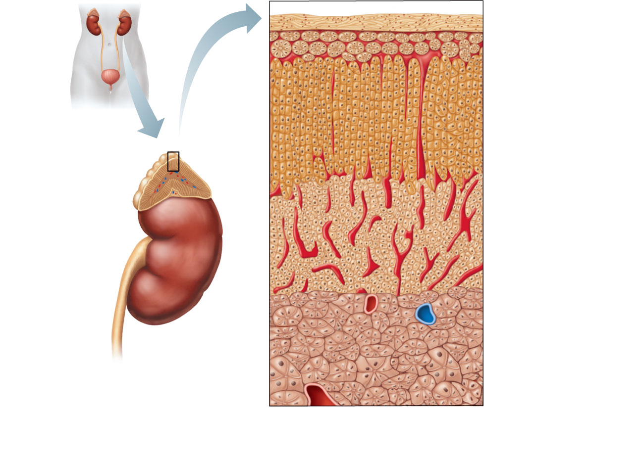
Capsule
Zona
glomerulosa
Zona
fasciculata
Adrenal gland
Cortex
• Medulla
• Cortex
Zona
reticularis
Kidney
Medulla
Adrenal
medulla
(a) Drawing of the histology of the
adrenal cortex and a portion of
the adrenal medulla
Figure 16.13a

Slide 68
Mineralocorticoids
Regulate electrolytes (primarily Na⁺ & K⁺) in ECF
Importance of Na⁺: affects ECF volume, blood volume, blood pressure, levels of other ions
Importance of K⁺: sets RMP of cells
Aldosterone is the most potent mineralocorticoid
Stimulates Na⁺ reabsorption and water retention by the kidneys

Slide 69
Mechanisms of Aldosterone Secretion
Renin-angiotensin mechanism: decreased blood pressure stimulates kidneys to release renin, triggers formation of angiotensin II, a potent stimulator of aldosterone release
Plasma concentration of K⁺: Increased K⁺ directly influences the zona glomerulosa cells to release aldosterone
ACTH: causes small increases of aldosterone during stress
Atrial natriuretic peptide (ANP): blocks renin and aldosterone secretion, to decrease blood pressure

Slide 70
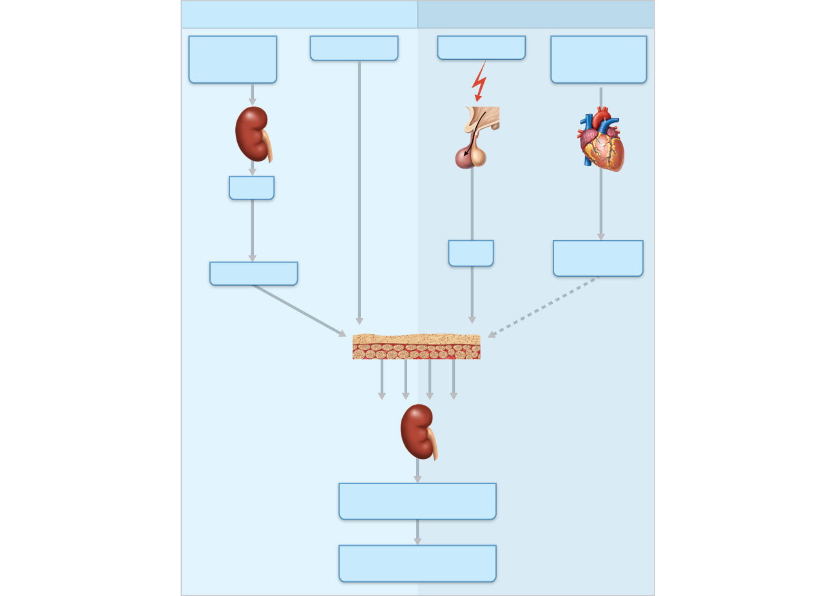
Primary regulators
Other factors
Blood volume
and/or blood
pressure
K⁺ in blood
Stress
Blood pressure
and/or blood
volume
Hypo-
thalamus
Heart
Kidney
CRH
Direct
stimulating
effect
Anterior
pituitary
Renin
Initiates
cascade
that
produces
ACTH
Atrial natriuretic
peptide (ANP)
Angiotensin II
Inhibitory
effect
Zona glomerulosa
of adrenal cortex
Enhanced
secretion
of aldosterone
Targets
kidney tubules
Absorption of Na⁺ and
water; increased K⁺ excretion
Blood volume
and/or blood pressure
Figure 16.14

Slide 71
Homeostatic Imbalances of Aldosterone
Aldosteronism—hypersecretion due to adrenal tumors
Hypertension and edema due to excessive Na⁺
Excretion of K⁺ leading to abnormal function of neurons and muscle

Slide 72
Glucocorticoids (Cortisol)
Keep blood sugar levels relatively constant
Maintain blood pressure by increasing the action of vasoconstrictors

Slide 73
Glucocorticoids (Cortisol)
Cortisol is the most significant glucocorticoid
Released in response to ACTH, patterns of eating and activity, and stress
Prime metabolic effect is gluconeogenesis—formation of glucose from fats and proteins
Promotes rises in blood glucose, fatty acids, and amino acids

Slide 74
Homeostatic Imbalances of Glucocorticoids
Hypersecretion—Cushing’s syndrome
Depresses cartilage and bone formation
Inhibits inflammation
Depresses the immune system
Promotes changes in cardiovascular, neural, and gastrointestinal function
Hyposecretion—Addison’s disease
Also involves deficits in mineralocorticoids
Decrease in glucose and Na⁺ levels
Weight loss, severe dehydration, and hypotension

Slide 75
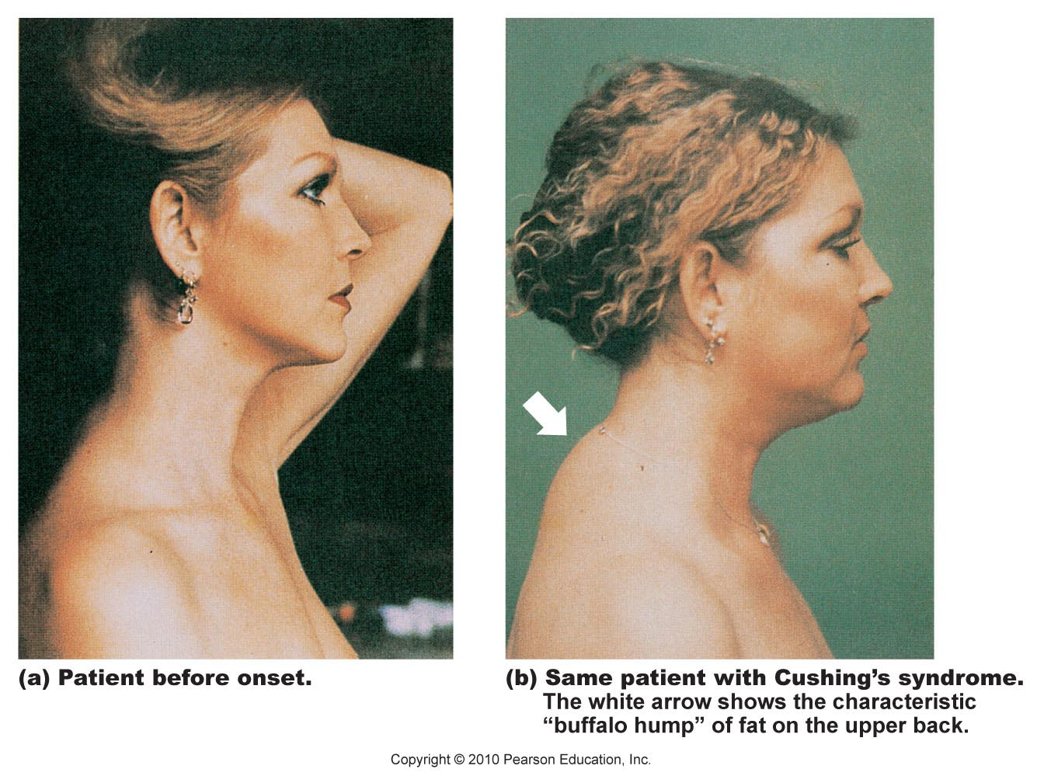
Figure 16.15

Slide 76
Gonadocorticoids (Sex Hormones)
Most are androgens (male sex hormones) that are converted to testosterone in tissue cells or estrogens in females
May contribute to
The onset of puberty
The appearance of secondary sex characteristics
Sex drive

Slide 77
Adrenal Medulla
Chromaffin cells secrete epinephrine (80%) and norepinephrine (20%)
These hormones cause
Blood glucose levels to rise
Blood vessels to constrict
The heart to beat faster
Blood to be diverted to the brain, heart, and skeletal muscle

Slide 78
Adrenal Medulla
Epinephrine stimulates metabolic activities, bronchial dilation, and blood flow to skeletal muscles and the heart
Norepinephrine influences peripheral vasoconstriction and blood pressure

Slide 79
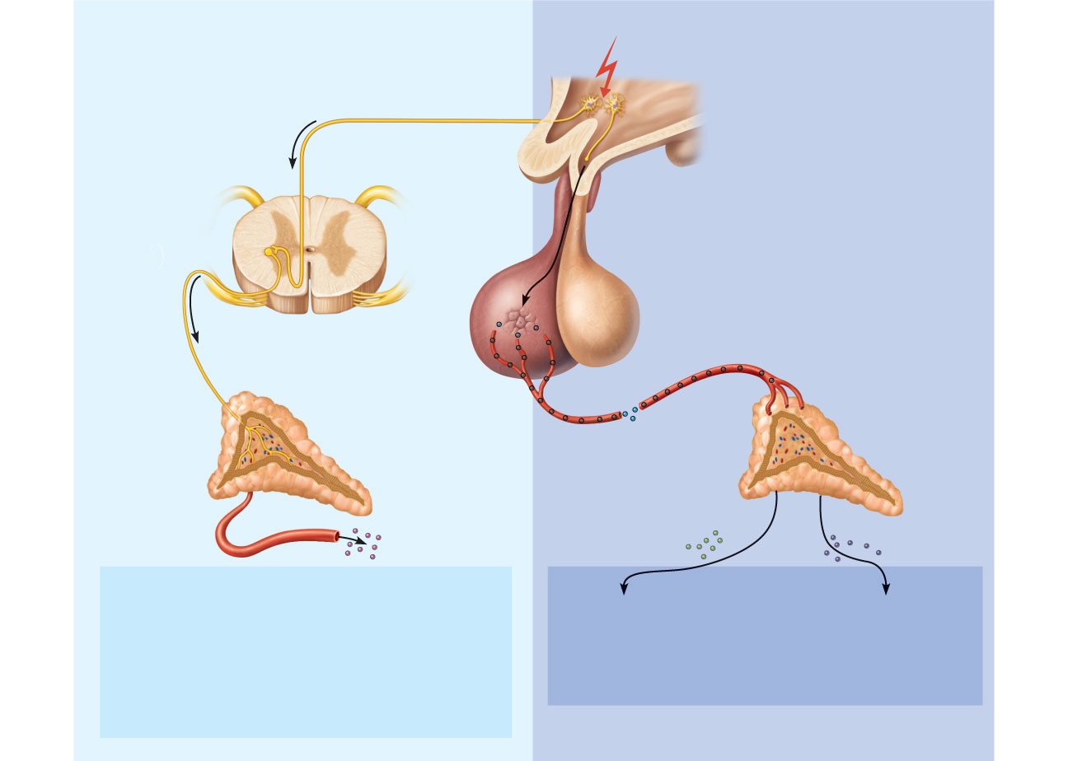
Short-term stress
More prolonged stress
Stress
Nerve impulses
Hypothalamus
CRH (corticotropin-
releasing hormone)
Spinal cord
Corticotroph cells
of anterior pituitary
Preganglionic
sympathetic
fibers
To target in blood
Adrenal medulla
(secretes amino acid-
based hormones)
Adrenal cortex
(secretes steroid
hormones)
ACTH
Catecholamines
(epinephrine and
norepinephrine)
Mineralocorticoids
Glucocorticoids
Short-term stress response
Long-term stress response
1. Increased heart rate
2. Increased blood pressure
3. Liver converts glycogen to glucose and releases
glucose to blood
4. Dilation of bronchioles
5. Changes in blood flow patterns leading to decreased
digestive system activity and reduced urine output
6. Increased metabolic rate
1. Retention of sodium
and water by kidneys
2. Increased blood volume
and blood pressure
1. Proteins and fats converted
to glucose or broken down
for energy
2. Increased blood glucose
3. Suppression of immune
system
Figure 16.16

Slide 80
Pineal Gland
Small gland hanging from the roof of the third ventricle
Pinealocytes secrete melatonin, derived from serotonin
Melatonin may affect
Timing of sexual maturation and puberty
Day/night cycles
Physiological processes that show rhythmic variations (body temperature, sleep, appetite)

Slide 81
Pancreas
Triangular gland behind the stomach
Has both exocrine and endocrine cells
Acinar cells (exocrine) produce an enzyme-rich juice for digestion
Pancreatic islets (islets of Langerhans) contain endocrine cells
Alpha (α) cells produce glucagon (a hyperglycemic hormone)
Beta (β) cells produce insulin (a hypoglycemic hormone)

Slide 82
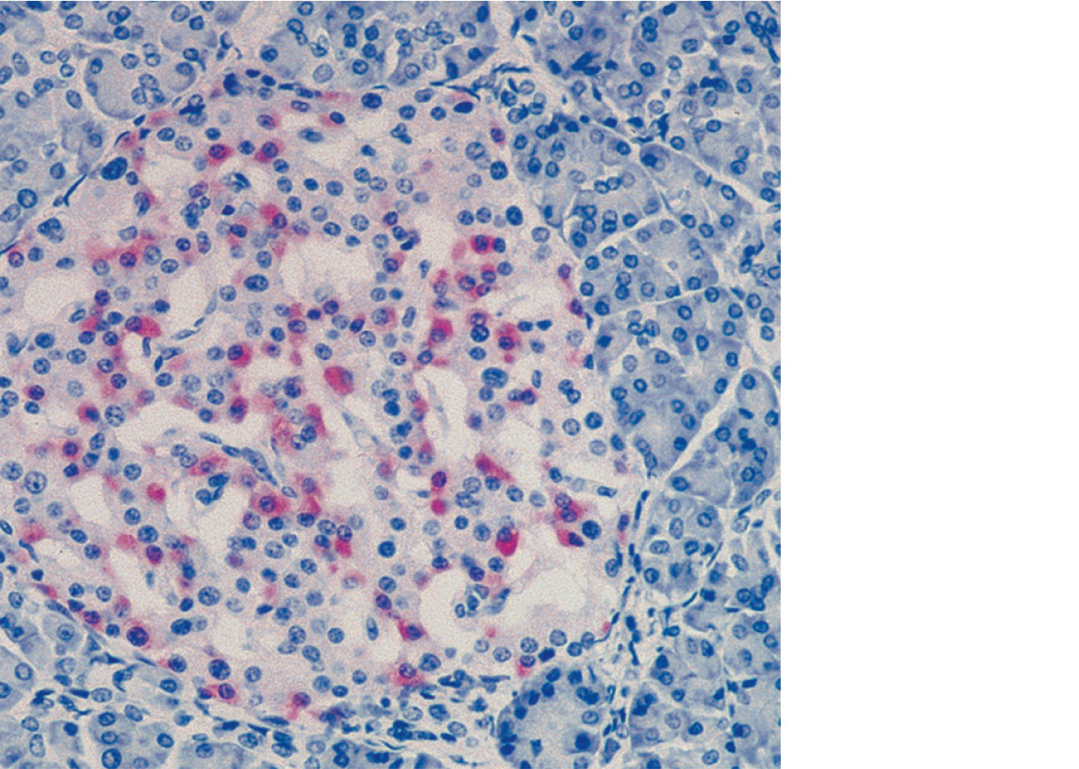
Pancreatic
islet (of
Langerhans)
• (Glucagon-
producing)
cells
• (Insulin-
producing)
cells
Pancreatic
acinar
cells (exocrine)
Figure 16.17

Slide 83
Glucagon
Major target is the liver, where it promotes
Glycogenolysis—breakdown of glycogen to glucose
Gluconeogenesis—synthesis of glucose from lactic acid and noncarbohydrates
Release of glucose to the blood

Slide 84
Insulin
Effects of insulin
Lowers blood glucose levels
Enhances membrane transport of glucose into fat and muscle cells
Participates in neuronal development and learning and memory
Inhibits glycogenolysis and gluconeogenesis

Slide 85
Insulin Action on Cells
Activates a tyrosine kinase enzyme receptor
Cascade leads to increased glucose uptake and enzymatic activities that
Catalyze the oxidation of glucose for ATP production
Polymerize glucose to form glycogen
Convert glucose to fat (particularly in adipose tissue)

Slide 86
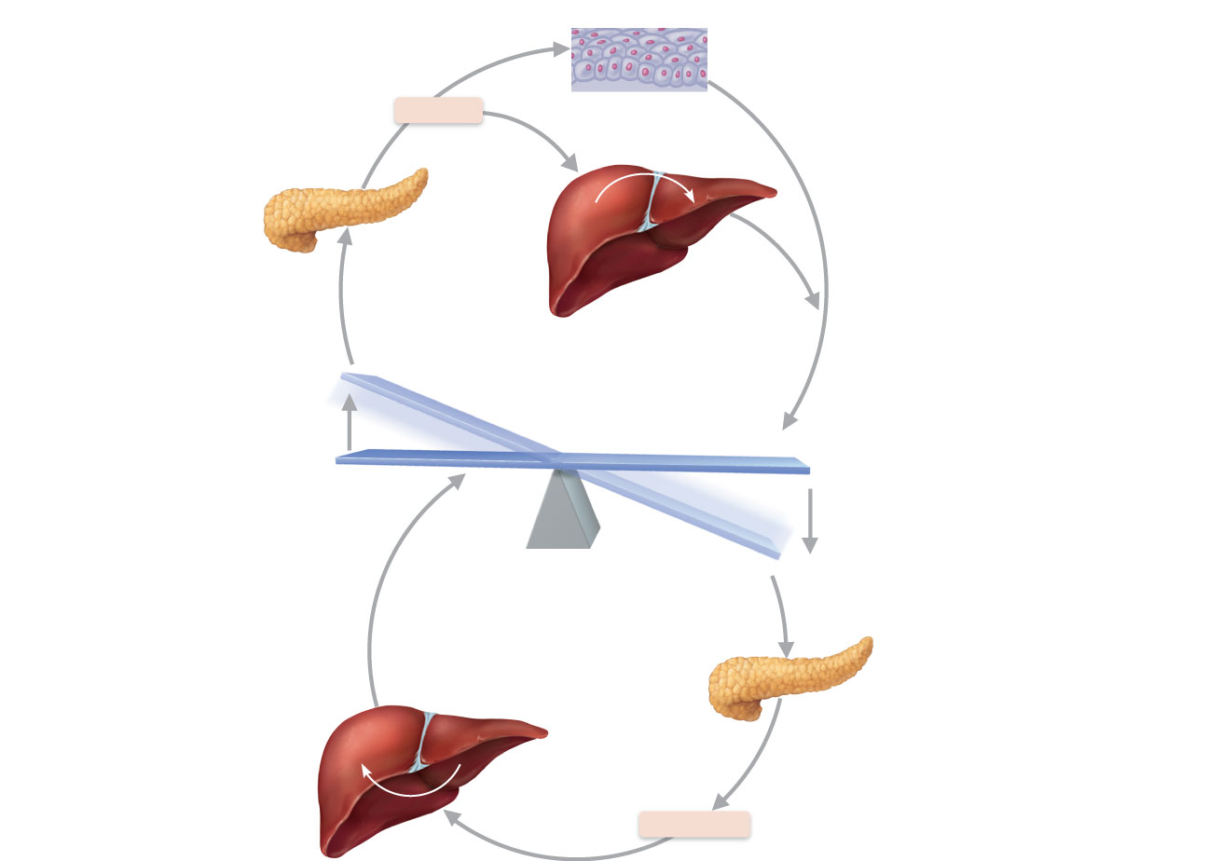
Stimulates glucose uptake by cells
Insulin
Tissue cells
Stimulates
glycogen
formation
Pancreas
Glucose
Glycogen
Liver
Blood
glucose
falls to
normal
range.
Stimulus
Blood
glucose level
Stimulus
Blood
glucose level
Blood
glucose
rises to
normal
range.
Pancreas
Liver
Glucose
Glycogen
Stimulates
glycogen
breakdown
Glucagon
Figure 16.18

Slide 87
Homeostatic Imbalances of Insulin
Diabetes mellitus (DM)
Due to hyposecretion or hypoactivity of insulin
Three cardinal signs of DM
Polyuria—huge urine output
Polydipsia—excessive thirst
Polyphagia—excessive hunger and food consumption
Hyperinsulinism:
Excessive insulin secretion; results in hypoglycemia, disorientation, unconsciousness

Slide 88
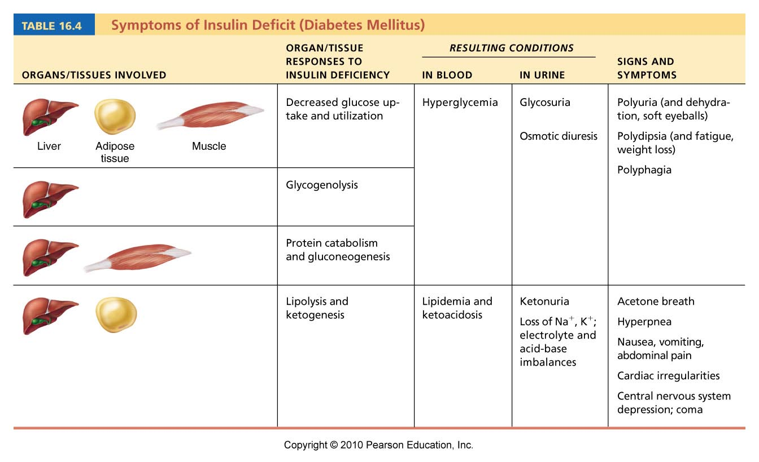
Table 16.4

Slide 89
Ovaries and Placenta
Gonads produce steroid sex hormones
Ovaries produce estrogens and progesterone responsible for:
Maturation of female reproductive organs
Appearance of female secondary sexual characteristics
Breast development and cyclic changes in the uterine mucosa
The placenta secretes estrogens, progesterone, and human chorionic gonadotropin (hCG)

Slide 90
Testes
Testes produce testosterone that
Initiates maturation of male reproductive organs
Causes appearance of male secondary sexual characteristics and sex drive
Is necessary for normal sperm production
Maintains reproductive organs in their functional state

Slide 91
Other Hormone-Producing Structures
Heart
Atrial natriuretic peptide (ANP) reduces blood pressure, blood volume, and blood Na⁺ concentration
Gastrointestinal tract enteroendocrine cells
Gastrin stimulates release of HCl
Secretin stimulates liver and pancreas
Cholecystokinin stimulates pancreas, gallbladder, and hepatopancreatic sphincter

Slide 92
Other Hormone-Producing Structures
Kidneys
Erythropoietin signals production of red blood cells
Renin initiates the renin-angiotensin mechanism
Skin
Cholecalciferol, the precursor of vitamin D
Adipose tissue
Leptin is involved in appetite control, and stimulates increased energy expenditure

Slide 93
Other Hormone-Producing Structures
Skeleton (osteoblasts)
Osteocalcin prods pancreatic beta cells to divide and secrete more insulin, improving glucose handling and reducing body fat
Thymus
Thymulin, thymopoietins, and thymosins are involved in normal the development of the T lymphocytes in the immune response

Slide 94
Developmental Aspects
Ovaries undergo significant changes with age and become unresponsive to gonadotropins; problems associated with estrogen deficiency begin to occur
Testosterone also diminishes with age, but effect is not usually seen until very old age

Slide 95
Developmental Aspects
GH levels decline with age and this accounts for muscle atrophy with age
TH declines with age, contributing to lower basal metabolic rates
PTH levels remain fairly constant with age, but lack of estrogen in older women makes them more vulnerable to bone-demineralizing effects of PTH

