Slide 1
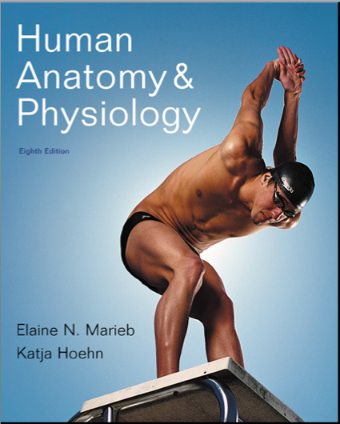
Chapter 18
The Cardiovascular System: The Heart

Slide 2
Heart Anatomy
Approximately the size of a fist
Location
In the mediastinum between second rib and fifth intercostal space
On the superior surface of diaphragm
Two-thirds to the left of the midsternal line
Anterior to the vertebral column, posterior to the sternum
Enclosed in pericardium, a double-walled sac
Notes:
<number>

Slide 3
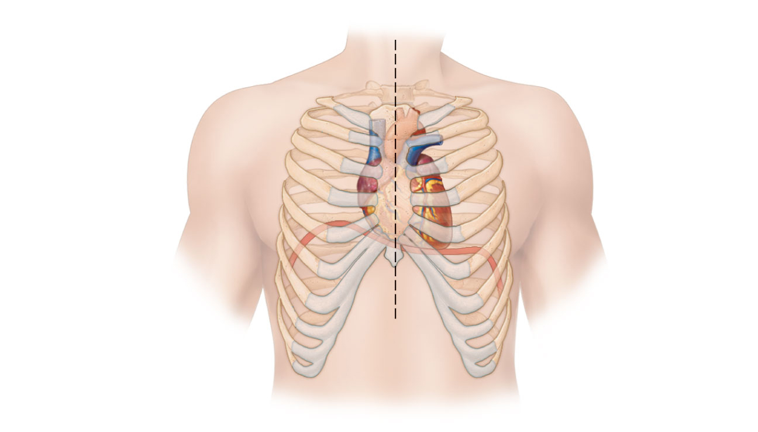
Midsternal line
2nd rib
Sternum
Diaphragm
Point of
maximal
intensity
(PMI)
(a)
Figure 18.1a
Notes:
<number>

Slide 4
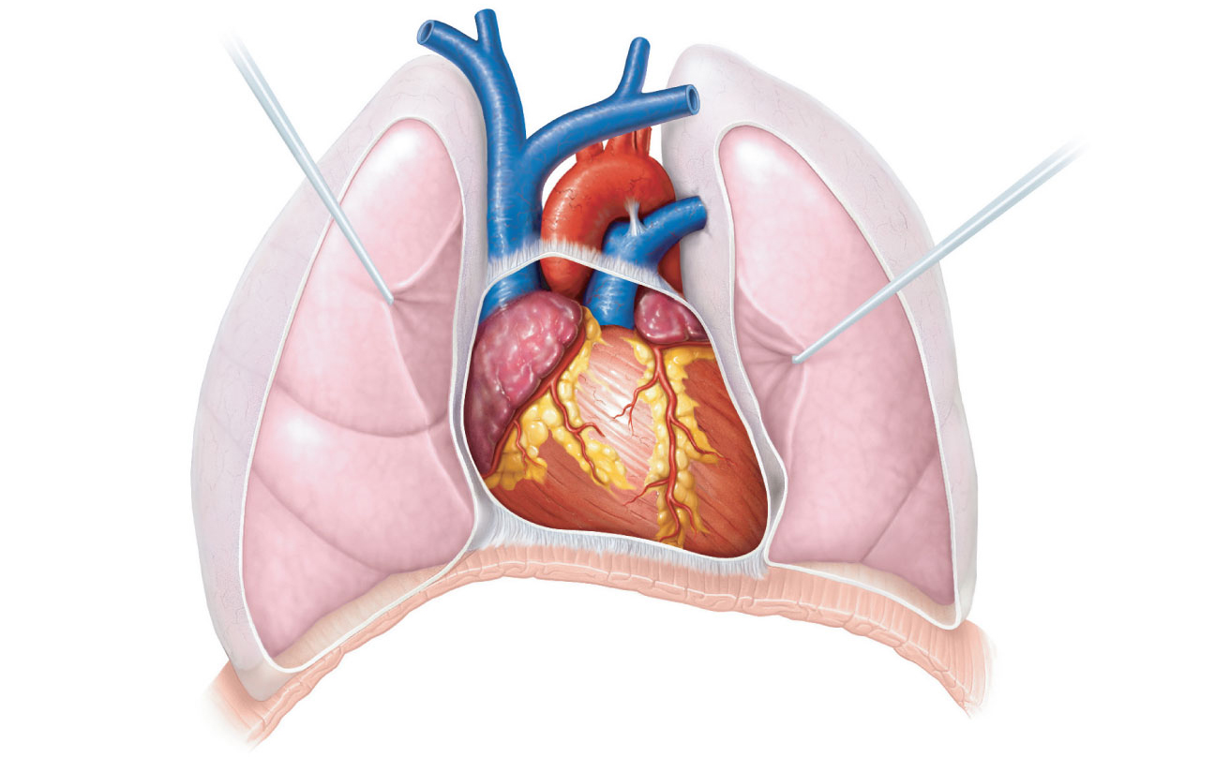
Superior
vena cava
Aorta
Parietal
pleura (cut)
Pulmonary
trunk
Left lung
Pericardium
(cut)
Apex of
heart
Diaphragm
(c)
Figure 18.1c
Notes:
<number>

Slide 5
Pericardium
Superficial fibrous pericardium
Protects, anchors, and prevents overfilling
Deep two-layered serous pericardium
Parietal layer lines the internal surface of the fibrous pericardium
Visceral layer (epicardium) on external surface of the heart
Separated by fluid-filled pericardial cavity (decreases friction)
Notes:
<number>

Slide 6
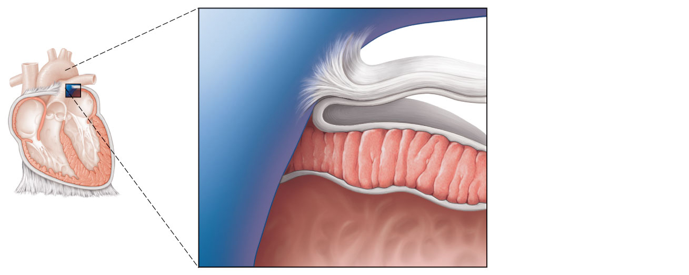
Pulmonary
trunk
Fibrous pericardium
Parietal layer of
serous pericardium
Pericardium
Pericardial cavity
Myocardium
Epicardium
(visceral layer
of serous
pericardium)
Heart
wall
Myocardium
Endocardium
Heart chamber
Figure 18.2
Notes:
<number>

Slide 7
Layers of the Heart Wall
Epicardium—visceral layer of the serous pericardium
Myocardium—Spiral bundles of cardiac muscle cells
3. Endocardium is continuous with endothelial lining of blood vessels
Notes:
<number>

Slide 8
Pulmonary
trunk
Fibrous pericardium
Parietal layer of
serous pericardium
Pericardium
Pericardial cavity
Myocardium
Epicardium
(visceral layer
of serous
pericardium)
Heart
wall
Myocardium
Endocardium
Heart chamber
Figure 18.2
Notes:
<number>

Slide 9
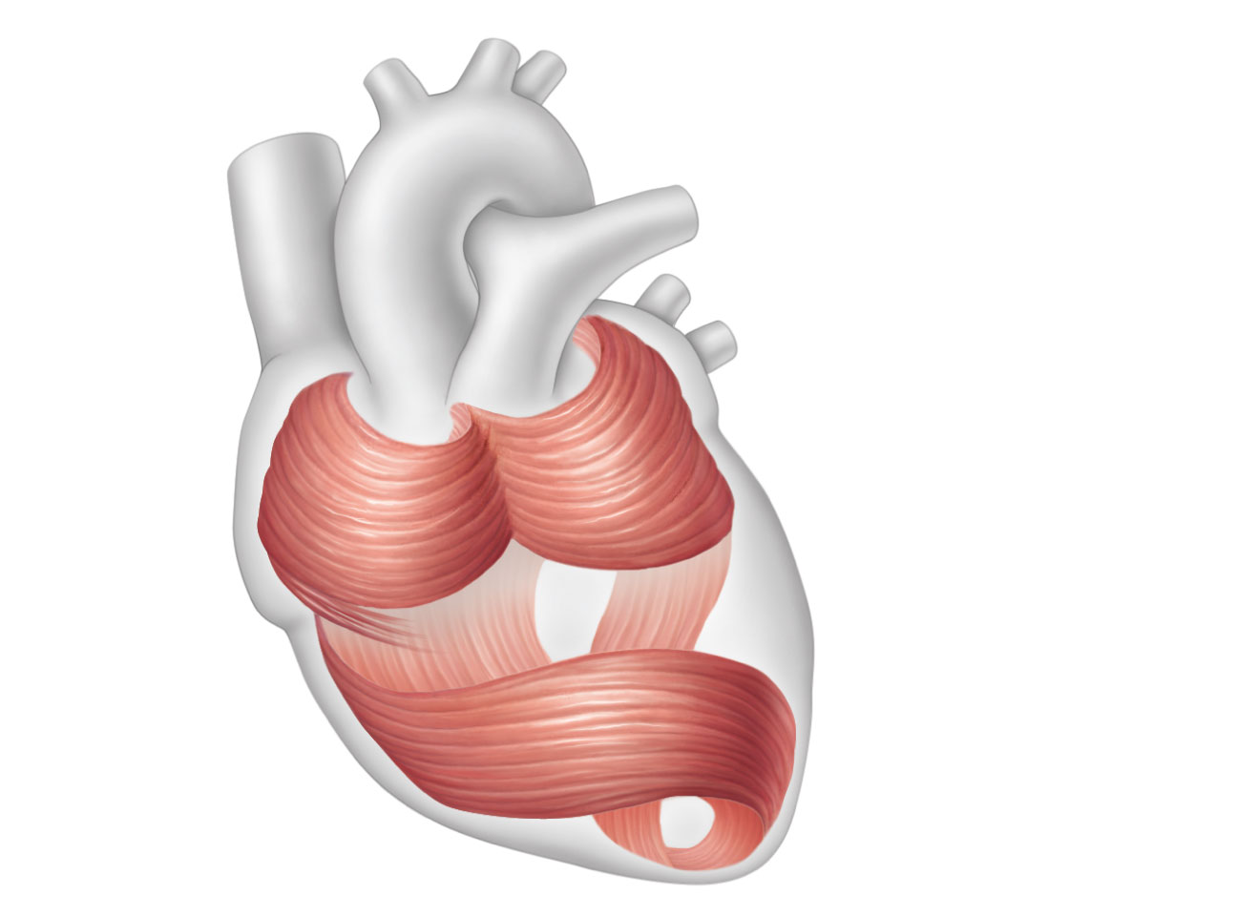
Cardiac
muscle
bundles
Figure 18.3
Notes:
<number>

Slide 10
Chambers
Four chambers
Two atria
Separated internally by the interatrial septum
Coronary sulcus (atrioventricular groove) encircles the junction of the atria and ventricles
Auricles increase atrial volume
Two ventricles
Separated by the interventricular septum
Anterior and posterior interventricular sulci mark the position of the septum externally
Notes:
<number>

Slide 11
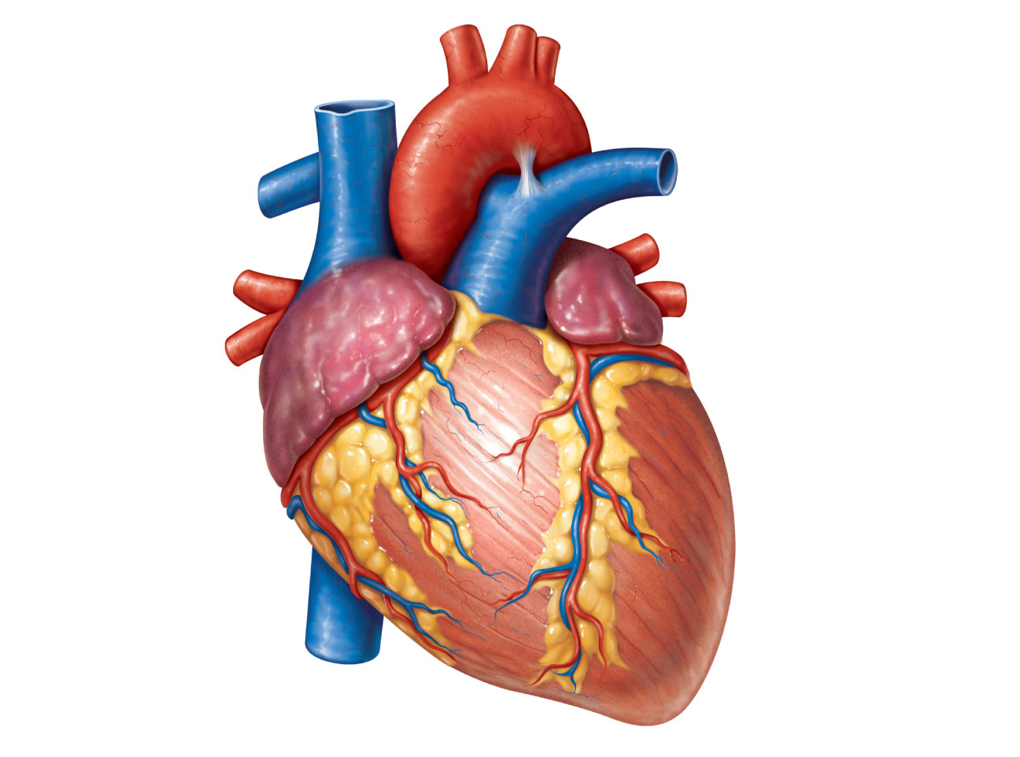
Brachiocephalic trunk
Left common carotid
artery
Left subclavian artery
Superior vena cava
Aortic arch
Right pulmonary
artery
Ligamentum arteriosum
Left pulmonary artery
Ascending aorta
Left pulmonary veins
Pulmonary trunk
Right pulmonary
veins
Auricle of
left atrium
Circumflex artery
Right atrium
Right coronary artery
(in coronary sulcus)
Left coronary artery
(in coronary sulcus)
Anterior cardiac vein
Left ventricle
Right ventricle
Right marginal artery
Great cardiac vein
Small cardiac vein
Anterior interventricular
artery (in anterior
interventricular sulcus)
Inferior vena cava
(b) Anterior view
Apex
Figure 18.4b
Notes:
<number>

Slide 12
Atria: The Receiving Chambers
Walls are ridged by pectinate muscles
Vessels entering right atrium
Superior vena cava
Inferior vena cava
Coronary sinus
Vessels entering left atrium
Right and left pulmonary veins
Notes:
<number>

Slide 13
Ventricles: The Discharging Chambers
Walls are ridged by trabeculae carneae
Papillary muscles project into the ventricular cavities
Vessel leaving the right ventricle
Pulmonary trunk
Vessel leaving the left ventricle
Aorta
Notes:
<number>

Slide 14
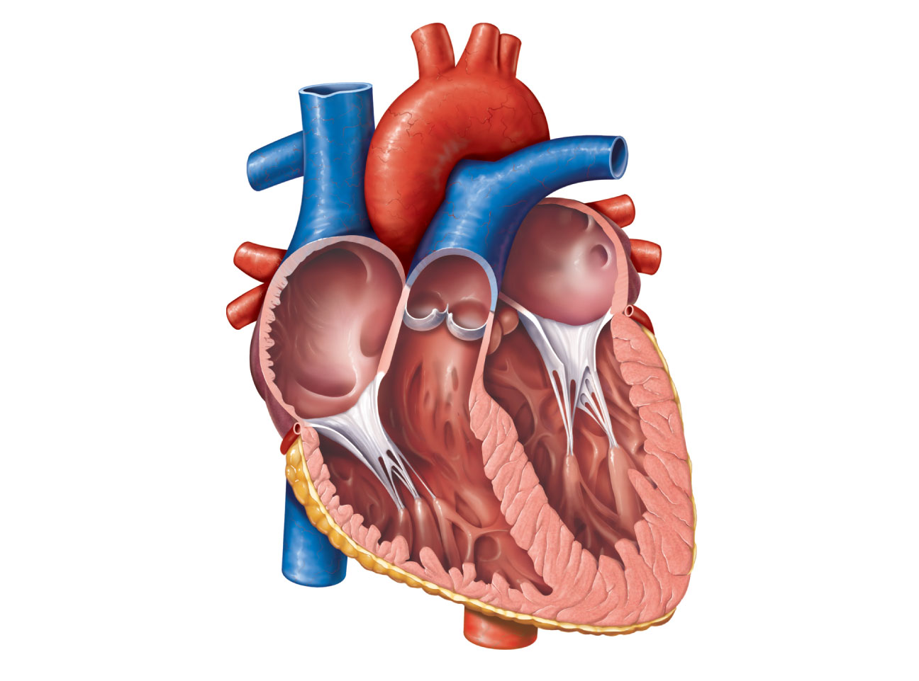
Aorta
Superior vena cava
Left pulmonary
artery
Right pulmonary
artery
Left atrium
Left pulmonary
veins
Pulmonary trunk
Right atrium
Mitral (bicuspid)
valve
Right pulmonary
veins
Fossa ovalis
Aortic valve
Pectinate muscles
Pulmonary valve
Tricuspid valve
Left ventricle
Right ventricle
Papillary muscle
Chordae tendineae
Interventricular
septum
Trabeculae carneae
Epicardium
Inferior vena cava
Myocardium
Endocardium
(e) Frontal section
Figure 18.4e
Notes:
<number>

Slide 15
Pathway of Blood Through the Heart
The heart is two side-by-side pumps
Right side is the pump for the pulmonary circuit
Vessels that carry blood to and from the lungs
Left side is the pump for the systemic circuit
Vessels that carry the blood to and from all body tissues
Notes:
<number>

Slide 16
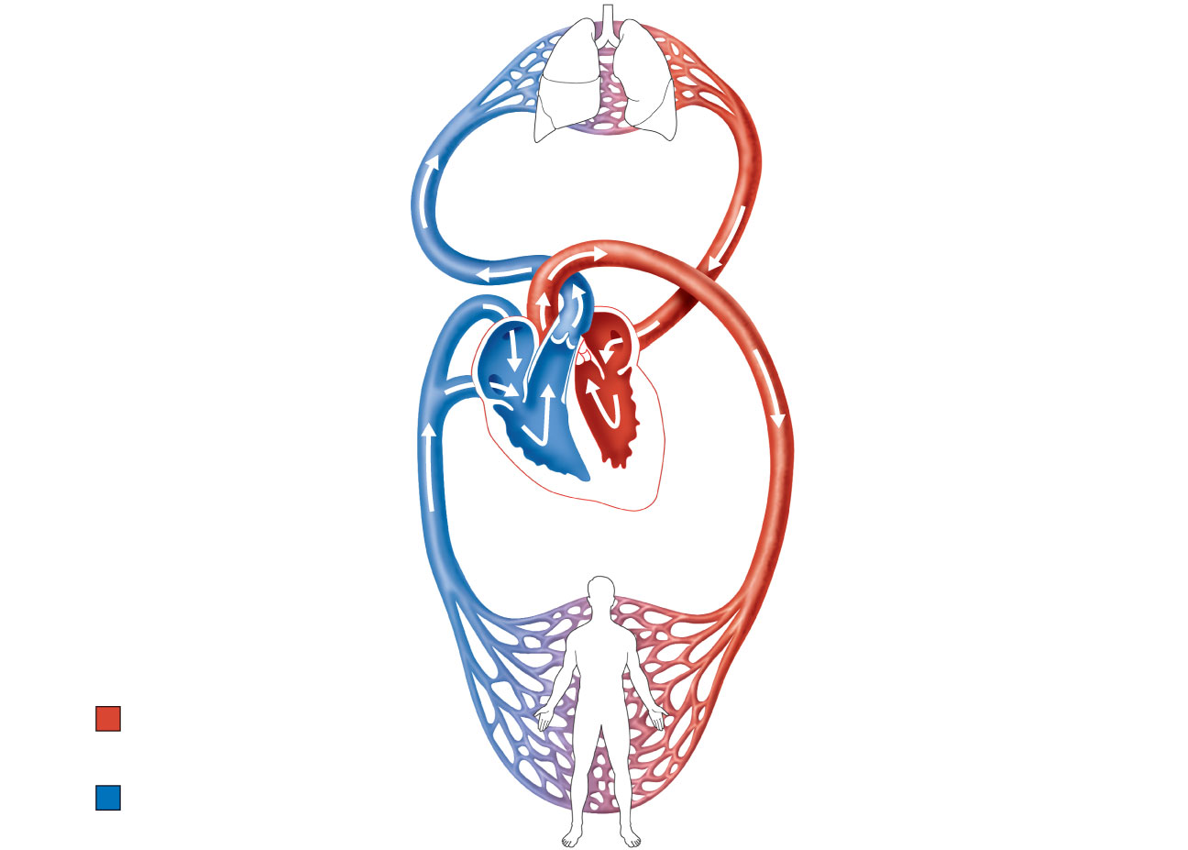
Capillary beds
of lungs where
gas exchange
occurs
Pulmonary
Circuit
Pulmonary arteries
Pulmonary veins
Aorta and branches
Venae cavae
Left atrium
Right atrium
Left ventricle
Heart
Right ventricle
Systemic
Circuit
Oxygen-rich,
CO₂-poor blood
Capillary beds of all
body tissues where
gas exchange occurs
Oxygen-poor,
CO₂-rich blood
Figure 18.5
Notes:
<number>

Slide 17
Pathway of Blood Through the Heart
Right atrium → tricuspid valve → right ventricle
Right ventricle → pulmonary semilunar valve → pulmonary trunk → pulmonary arteries → lungs
Notes:
<number>

Slide 18
Pathway of Blood Through the Heart
Lungs → pulmonary veins → left atrium
Left atrium → bicuspid valve → left ventricle
Left ventricle → aortic semilunar valve → aorta
Aorta → systemic circulation
Notes:
<number>

Slide 19
Pathway of Blood Through the Heart
Equal volumes of blood are pumped to the pulmonary and systemic circuits
Pulmonary circuit is a short, low-pressure circulation
Systemic circuit blood encounters much resistance in the long pathways
Anatomy of the ventricles reflects these differences
Notes:
<number>

Slide 20
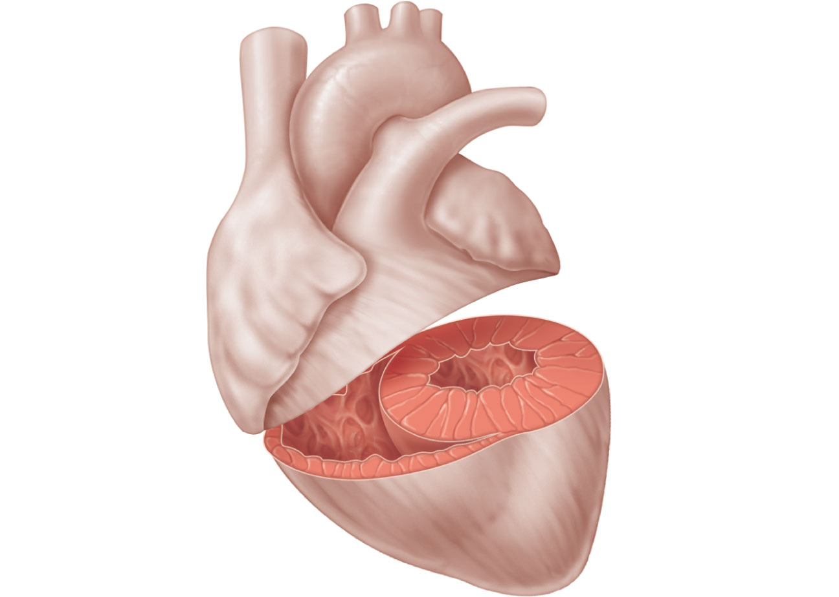
Left
ventricle
Right
ventricle
Interventricular
septum
Figure 18.6
Notes:
<number>

Slide 21
Coronary Circulation
The functional blood supply to the heart muscle itself
Arterial supply varies considerably and contains many anastomoses (junctions) among branches
Collateral routes provide additional routes for blood delivery
Notes:
<number>

Slide 22
Coronary Circulation
Arteries
Right and left coronary (in atrioventricular groove), marginal, circumflex, and anterior & posterior interventricular arteries
Veins
Small cardiac, anterior cardiac, and great cardiac veins, Coronary sinus
Notes:
<number>

Slide 23
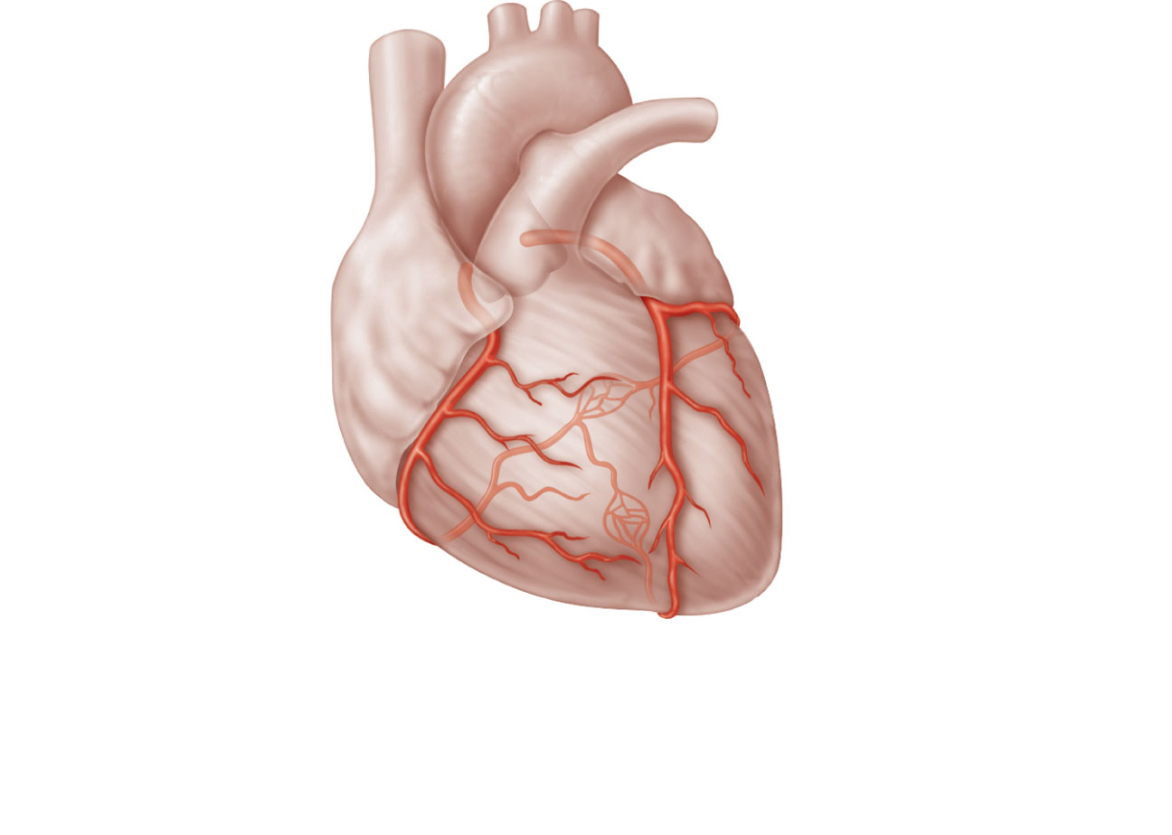
Aorta
Superior
vena cava
Pulmonary
trunk
Left atrium
Anastomosis
(junction of
vessels)
Left
coronary
artery
Right
atrium
Circumflex
artery
Right
coronary
artery
Left
ventricle
Right
ventricle
Anterior
interventricular
artery
Right
marginal
artery
Posterior
interventricular
artery
(a) The major coronary arteries
Figure 18.7a
Notes:
<number>

Slide 24
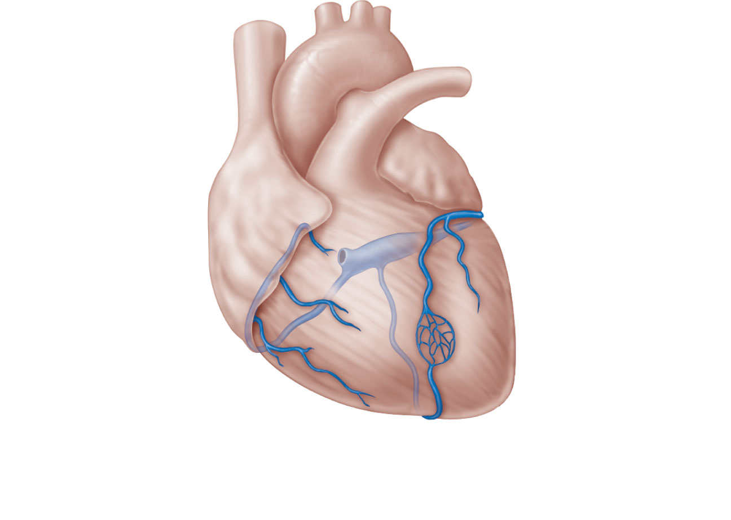
Superior
vena cava
Anterior
cardiac
veins
Great
cardiac
vein
Coronary
sinus
Small cardiac vein
Middle cardiac vein
(b) The major cardiac veins
Figure 18.7b
Notes:
<number>

Slide 25
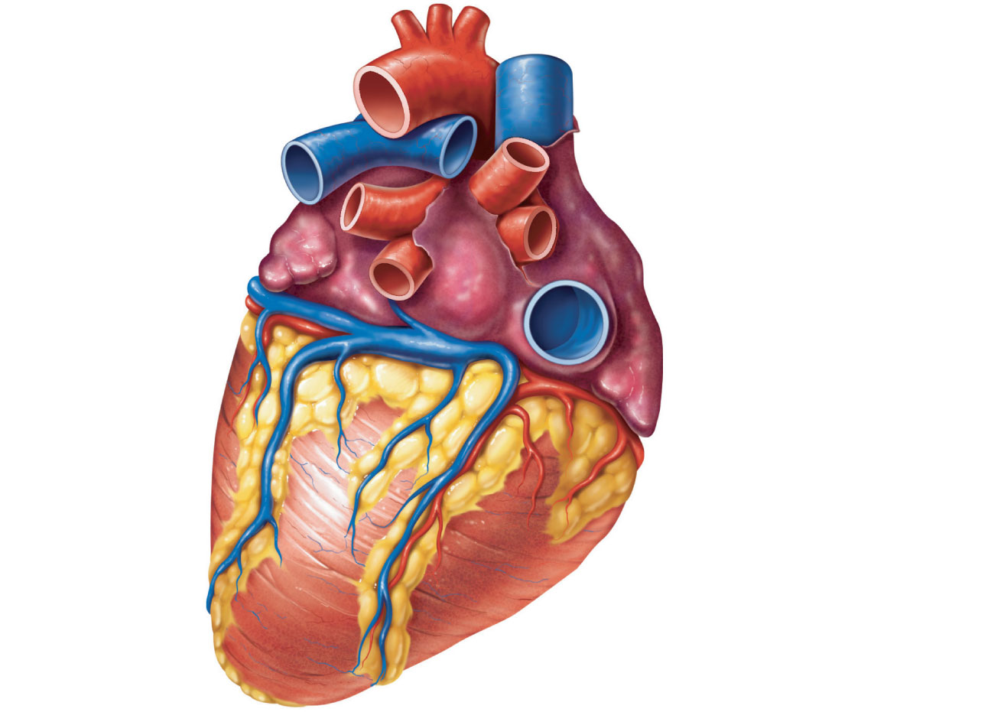
Aorta
Superior vena cava
Left pulmonary
artery
Right pulmonary artery
Left pulmonary
veins
Right pulmonary veins
Auricle of left
atrium
Right atrium
Left atrium
Inferior vena cava
Great cardiac
vein
Coronary sinus
Right coronary artery
(in coronary sulcus)
Posterior vein
of left ventricle
Posterior
interventricular
artery (in posterior
interventricular sulcus)
Left ventricle
Apex
Middle cardiac vein
Right ventricle
(d) Posterior surface view
Figure 18.4d
Notes:
<number>

Slide 26
Homeostatic Imbalances
Angina pectoris
Thoracic pain caused by a fleeting deficiency in blood delivery to the myocardium
Cells are weakened
Myocardial infarction (heart attack)
Prolonged coronary blockage
Areas of cell death are repaired with noncontractile scar tissue
Notes:
<number>

Slide 27
Heart Valves
Ensure unidirectional blood flow through the heart
Atrioventricular (AV) valves
Prevent backflow into the atria when ventricles contract
Tricuspid valve (right)
Mitral valve (left)
Chordae tendineae anchor AV valve cusps to papillary muscles
Notes:
<number>

Slide 28
Heart Valves
Semilunar (SL) valves
Prevent backflow into the ventricles when ventricles relax
Aortic semilunar valve
Pulmonary semilunar valve
Notes:
<number>

Slide 29
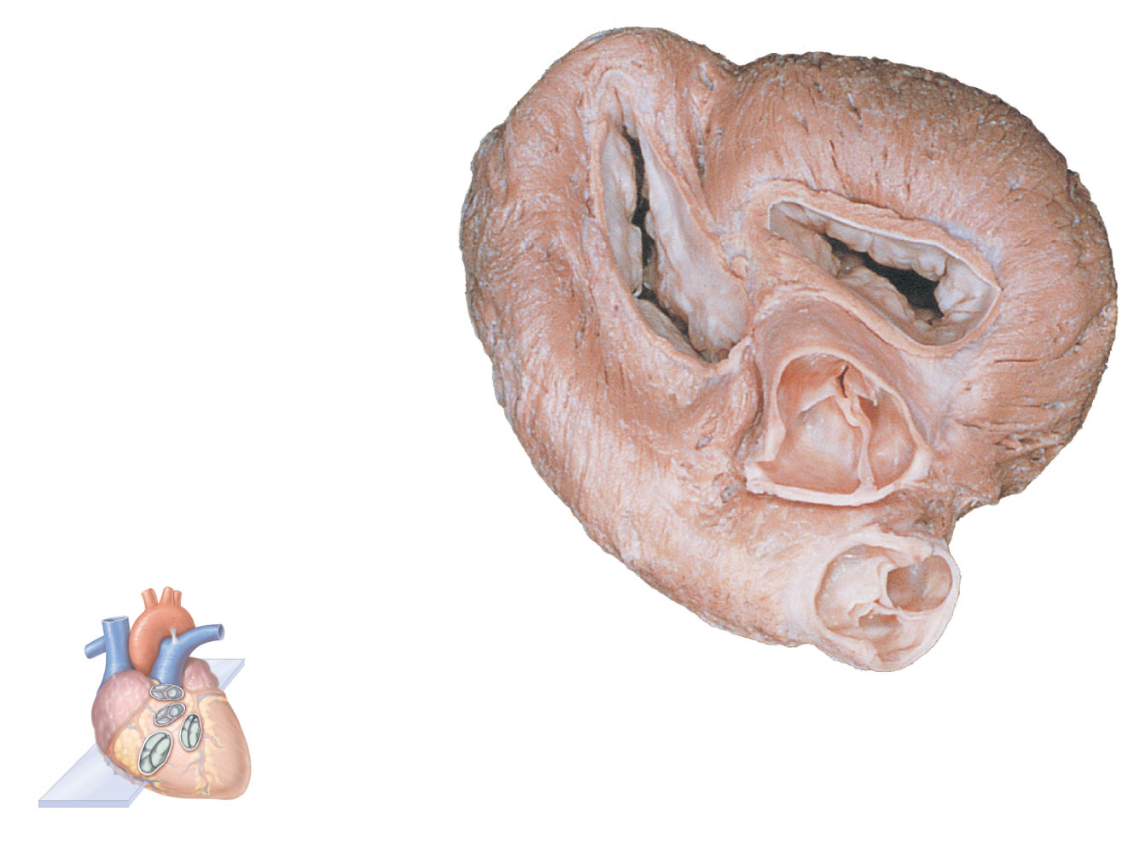
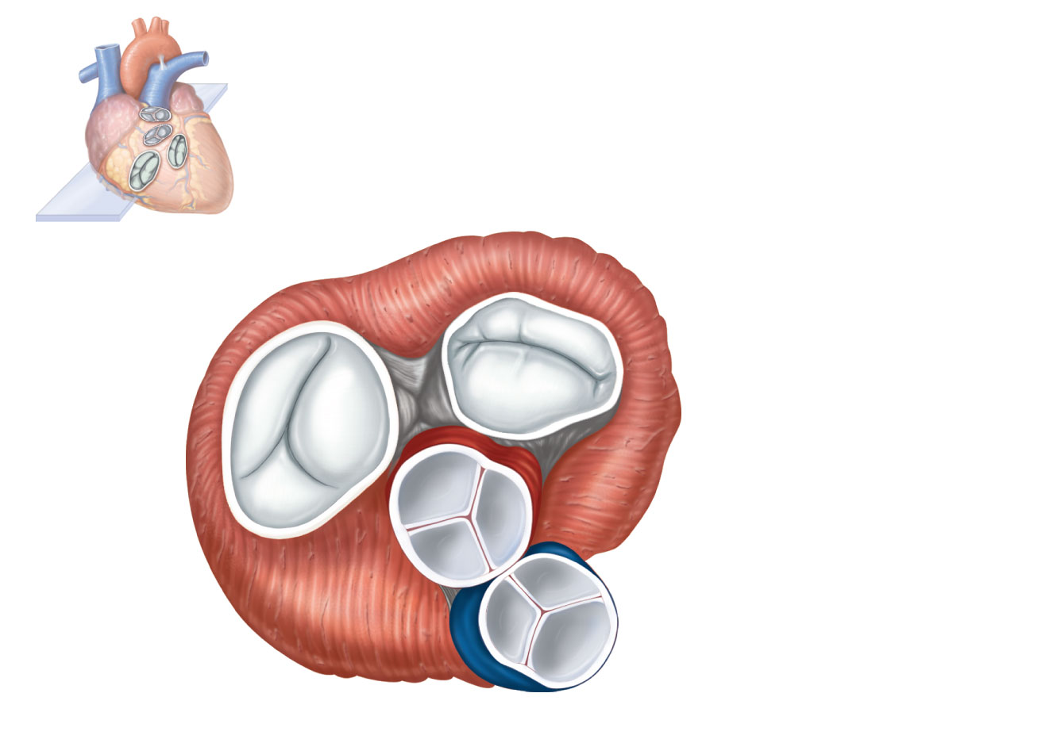
Myocardium
Pulmonary valve
Aortic valve
Tricuspid
(right atrioventricular)
valve
Area of cutaway
Mitral valve
Tricuspid valve
Mitral
(left atrioventricular)
valve
Myocardium
Tricuspid
(right atrioventricular)
valve
Aortic
valve
Mitral
(left atrioventricular)
valve
Pulmonary
valve
Aortic valve
Pulmonary valve
Aortic valve
Pulmonary
valve
Area of cutaway
(b)
Fibrous
skeleton
Mitral valve
(a)
Tricuspid valve
Anterior
Figure 18.8a
Notes:
<number>

Slide 30
Myocardium
Tricuspid
(right atrioventricular)
valve
Mitral
(left atrioventricular)
valve
Aortic
valve
Pulmonary
valve
Pulmonary valve
Aortic valve
Area of cutaway
(b)
Mitral valve
Tricuspid valve
Figure 18.8b
Notes:
<number>

Slide 31
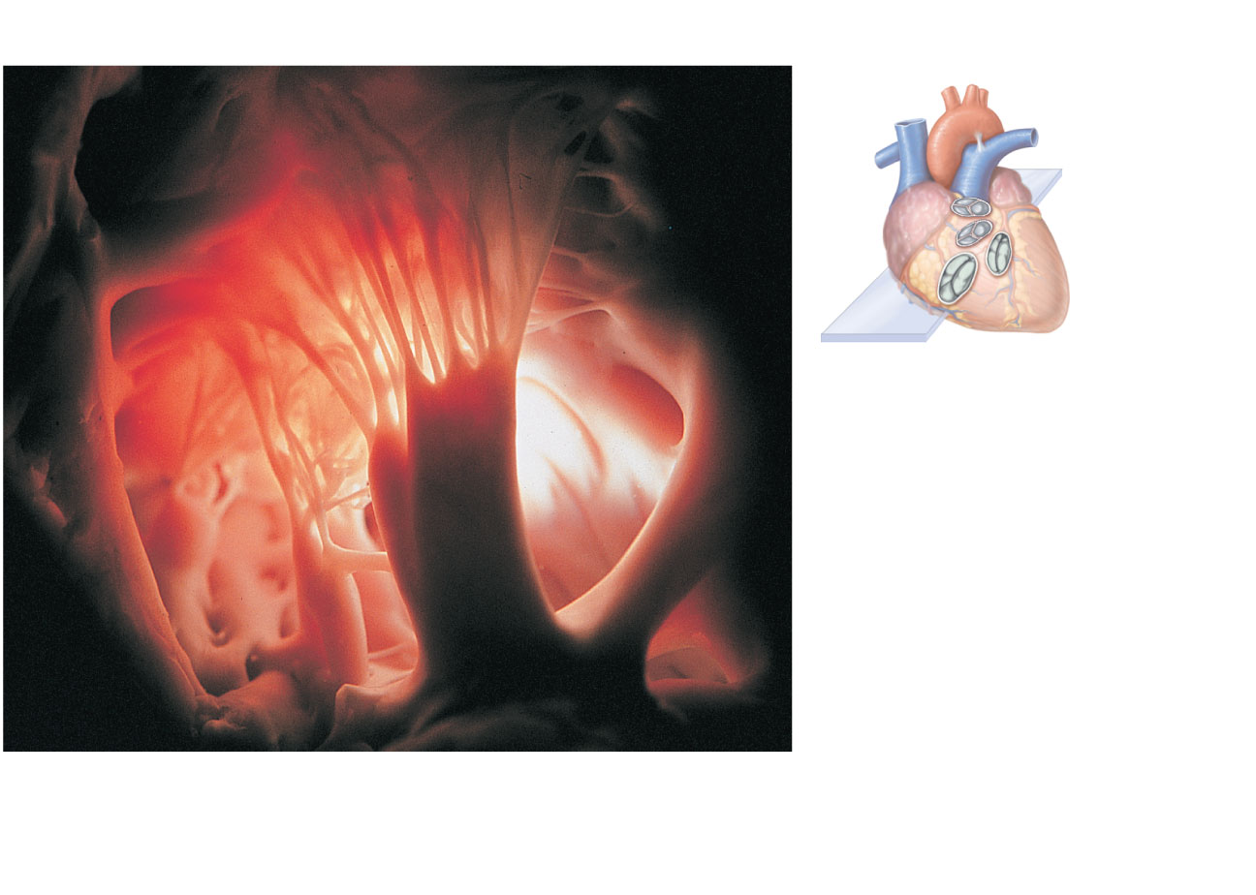
Pulmonary
valve
Aortic
valve
Area of
cutaway
Mitral
valve
Tricuspid
valve
Chordae tendineae
attached to tricuspid valve flap
Papillary
muscle
(c)
Figure 18.8c
Notes:
<number>

Slide 32
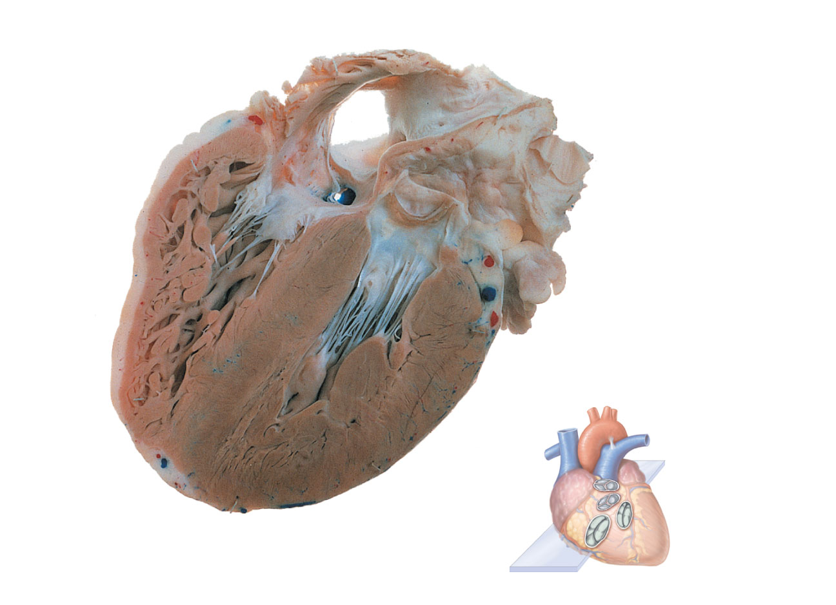
Opening of inferior
vena cava
Mitral valve
Chordae
tendineae
Tricuspid valve
Myocardium
of right
ventricle
Myocardium
of left ventricle
Pulmonary
valve
Aortic valve
Area of
cutaway
Papillary
muscles
Interventricular
septum
Mitral valve
Tricuspid
valve
(d)
Figure 18.8d
Notes:
<number>

Slide 33
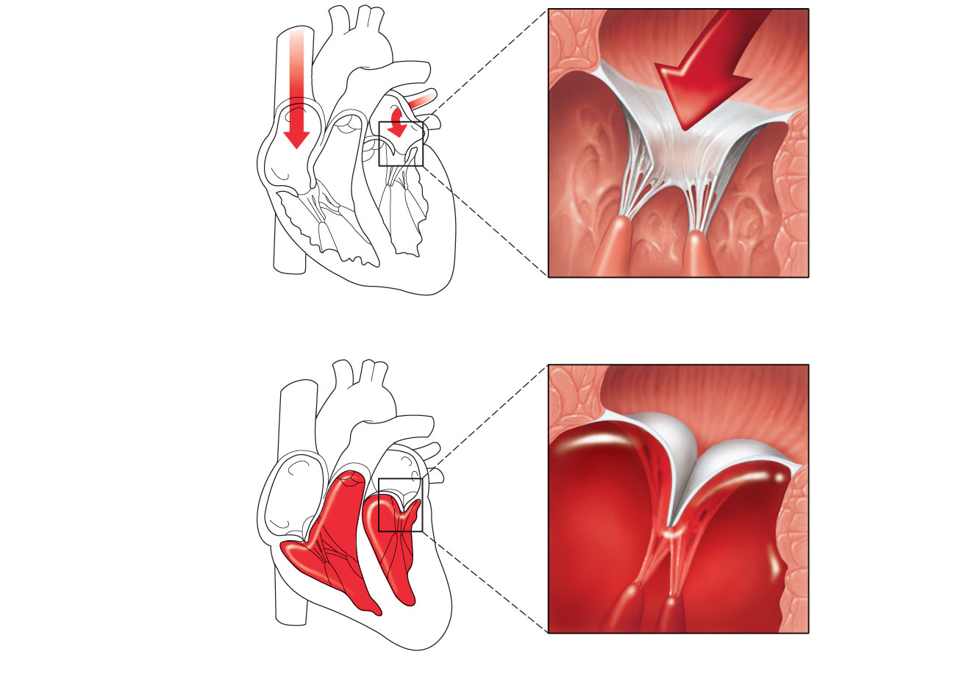
1
Blood returning to the
heart fills atria, putting
pressure against
atrioventricular valves;
atrioventricular valves are
forced open.
Direction of
blood flow
Atrium
Cusp of
atrioventricular
valve (open)
2
As ventricles fill,
atrioventricular valve flaps
hang limply into ventricles.
3
Chordae
tendineae
Atria contract, forcing
additional blood into ventricles.
Papillary
muscle
Ventricle
(a) AV valves open; atrial pressure greater than ventricular pressure
Atrium
1
Ventricles contract, forcing
blood against atrioventricular
valve cusps.
Cusps of
atrioventricular
valve (closed)
2
Atrioventricular valves
close.
Blood in
ventricle
3
Papillary muscles
contract and chordae
tendineae tighten,
preventing valve flaps
from everting into atria.
(b) AV valves closed; atrial pressure less than ventricular pressure
Figure 18.9
Notes:
<number>

Slide 34
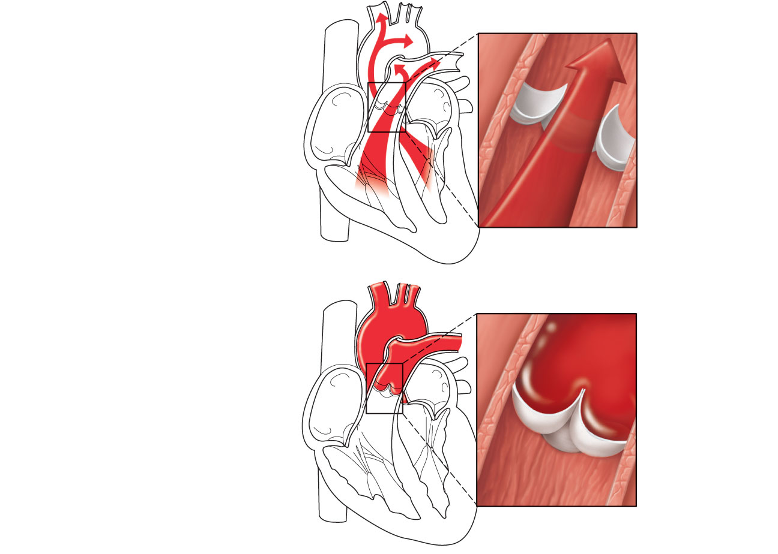
Aorta
Pulmonary
trunk
As ventricles
contract and
intraventricular
pressure rises,
blood is pushed up
against semilunar
valves, forcing them
open.
(a) Semilunar valves open
As ventricles relax
and intraventricular
pressure falls, blood
flows back from
arteries, filling the
cusps of semilunar
valves and forcing
them to close.
(b) Semilunar valves closed
Figure 18.10
Notes:
<number>

Slide 35
Microscopic Anatomy of Cardiac Muscle
Cardiac muscle cells are striated, short, fat, branched, and interconnected
Connective tissue matrix (endomysium) connects to the fibrous skeleton
T tubules are wide but less numerous; SR is simpler than in skeletal muscle
Numerous large mitochondria (25–35% of cell volume)
Notes:
<number>

Slide 36
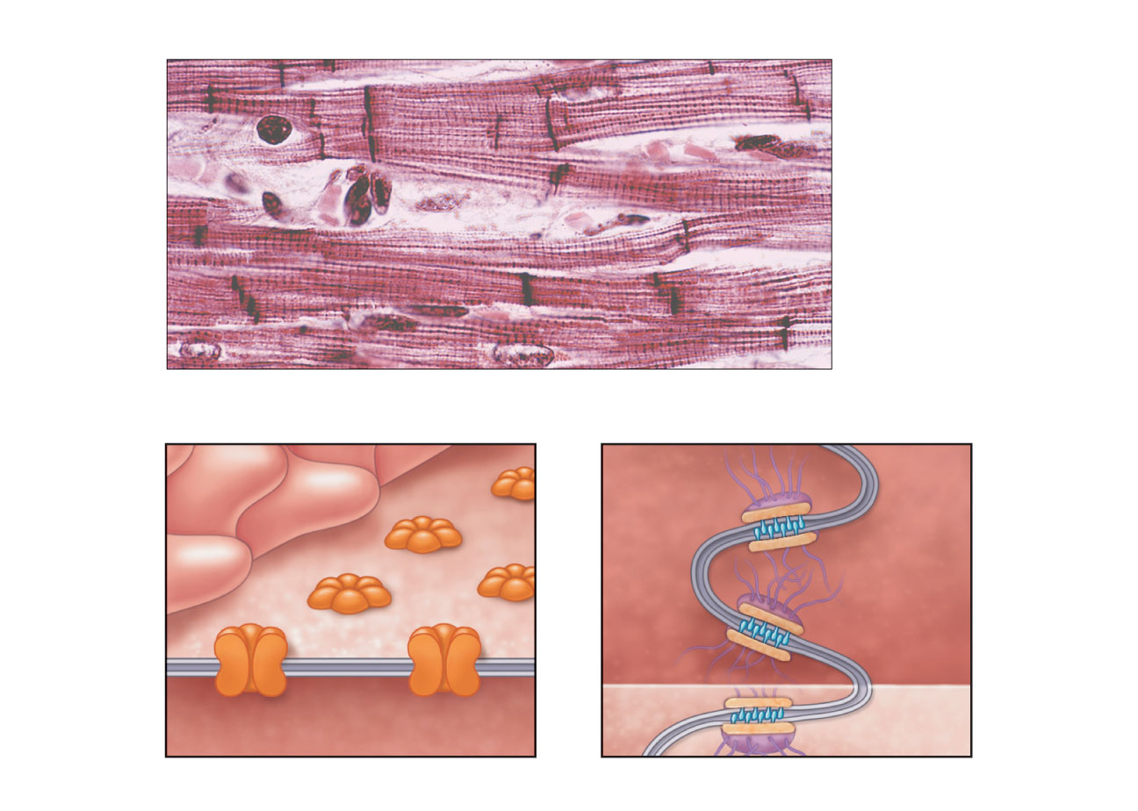
Nucleus
Intercalated discs
Cardiac muscle cell
Gap junctions
Desmosomes
(a)
Figure 18.11a
Notes:
<number>

Slide 37
Microscopic Anatomy of Cardiac Muscle
Intercalated discs: junctions between cells anchor cardiac cells
Desmosomes prevent cells from separating during contraction
Gap junctions allow ions to pass; electrically couple adjacent cells
Heart muscle behaves as a functional syncytium
Notes:
<number>

Slide 38
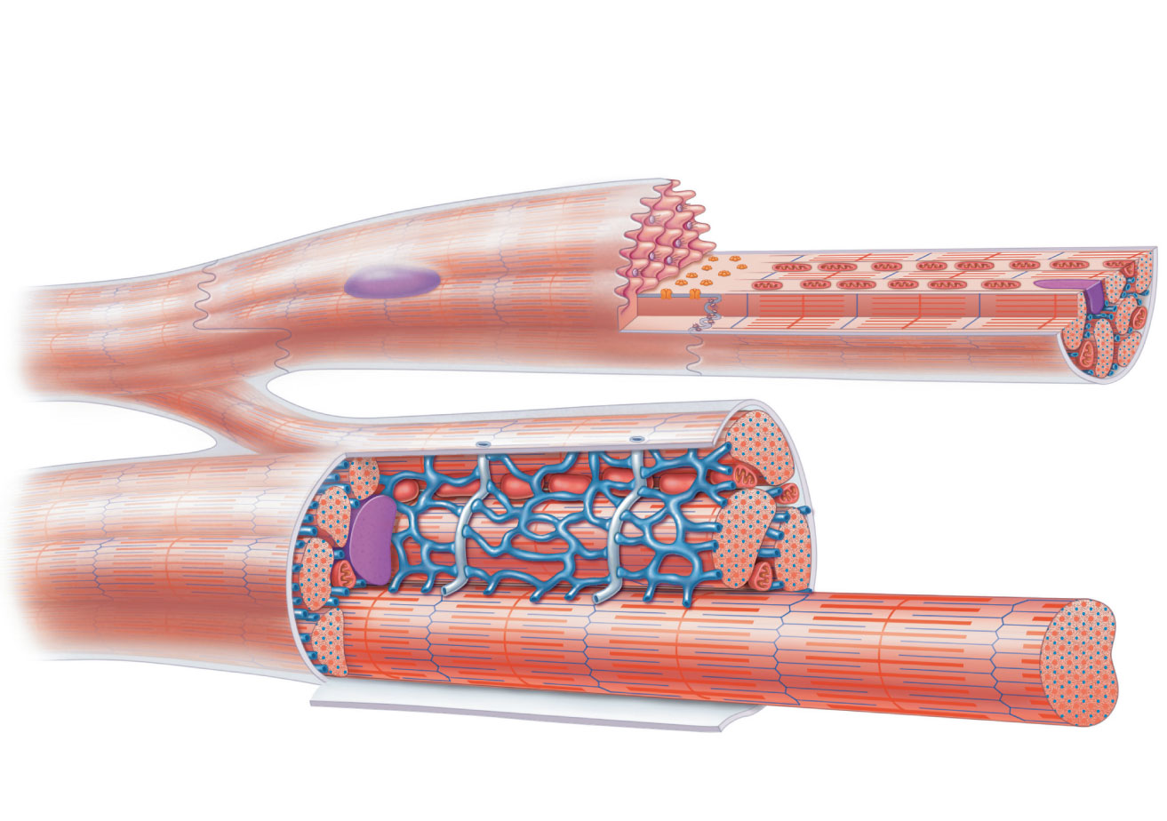
Cardiac
muscle cell
Mitochondrion
Intercalated
disc
Nucleus
T tubule
Mitochondrion
Sarcoplasmic
reticulum
Z disc
Nucleus
Sarcolemma
I band
I band
(b)
A band
Figure 18.11b
Notes:
<number>

Slide 39
Cardiac Muscle Contraction
Depolarization of the heart is rhythmic and spontaneous
About 1% of cardiac cells have automaticity— (are self-excitable)
Gap junctions ensure the heart contracts as a unit
Long absolute refractory period (250 ms)

Slide 40
Cardiac Muscle Contraction
Depolarization opens voltage-gated fast Na⁺ channels in the sarcolemma
Reversal of membrane potential from –90 mV to +30 mV
Depolarization wave in T tubules causes the SR to release Ca²⁺
Depolarization wave also opens slow Ca²⁺ channels in the sarcolemma
Ca²⁺ surge prolongs the depolarization phase (plateau)

Slide 41
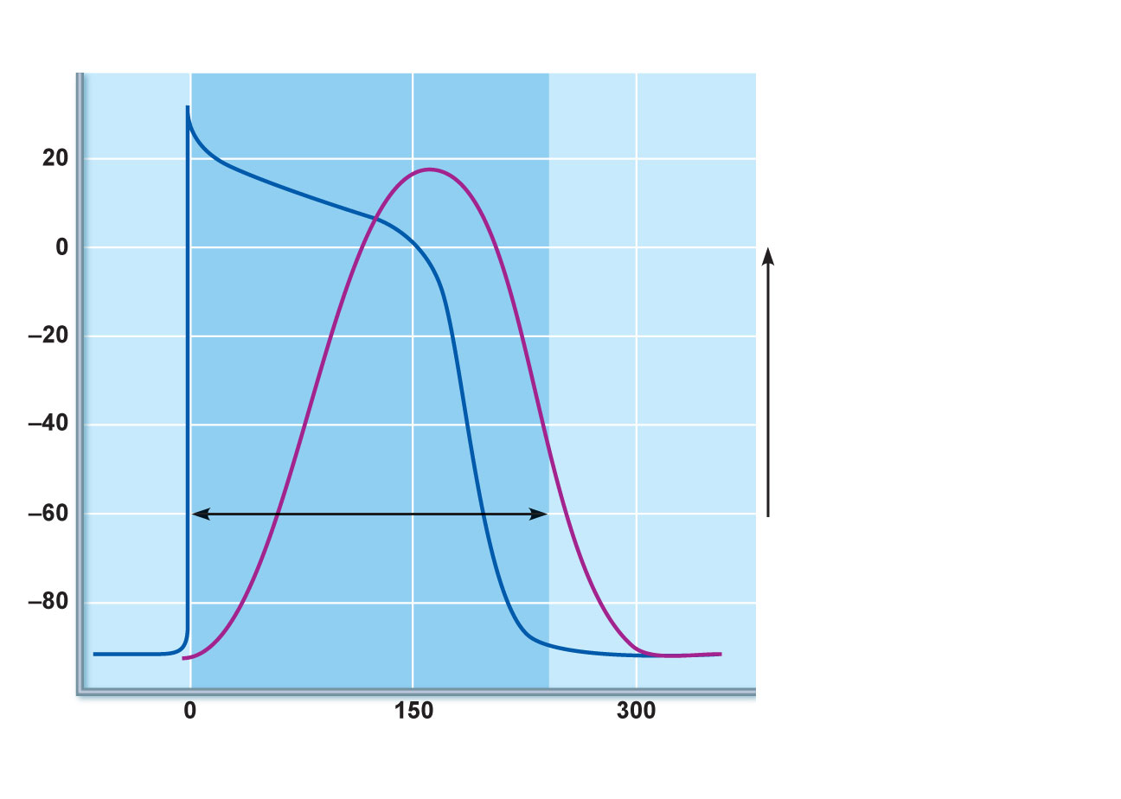
Action
potential
1
Depolarization is
due to Na⁺ influx through
fast voltage-gated Na⁺
channels. A positive
feedback cycle rapidly
opens many Na⁺
channels, reversing the
membrane potential.
Channel inactivation ends
this phase.
Plateau
2
Tension
development
(contraction)
Membrane potential (mV)
1
3
Tension (g)
2
Plateau phase is
due to Ca²⁺ influx through
slow Ca²⁺ channels. This
keeps the cell depolarized
because few K⁺ channels
are open.
Absolute
refractory
period
3
Repolarization is
due to Ca²⁺ channels
inactivating and K⁺
channels opening. This
allows K⁺ efflux, which
brings the membrane
potential back to its
resting voltage.
Time (ms)
Figure 18.12

Slide 42
Cardiac Muscle Contraction
Ca²⁺ influx triggers opening of Ca²⁺-sensitive channels in the SR, which liberates bursts of Ca²⁺
E-C coupling occurs as Ca²⁺ binds to troponin and sliding of the filaments begins
Duration of the AP and the contractile phase is much greater in cardiac muscle than in skeletal muscle
Repolarization results from inactivation of Ca²⁺ channels and opening of voltage-gated K⁺ channels

Slide 43
Heart Physiology: Electrical Events
Intrinsic cardiac conduction system
A network of noncontractile (autorhythmic) cells that initiate and distribute impulses to coordinate the depolarization and contraction of the heart

Slide 44
Autorhythmic Cells
Have unstable resting potentials (pacemaker potentials or prepotentials) due to slow opening Na⁺ channels
At threshold, Ca²⁺ channels open
Explosive Ca²⁺ influx produces the rising phase of the action potential
Repolarization results from inactivation of Ca²⁺ channels and opening of voltage-gated K⁺ channels

Slide 45
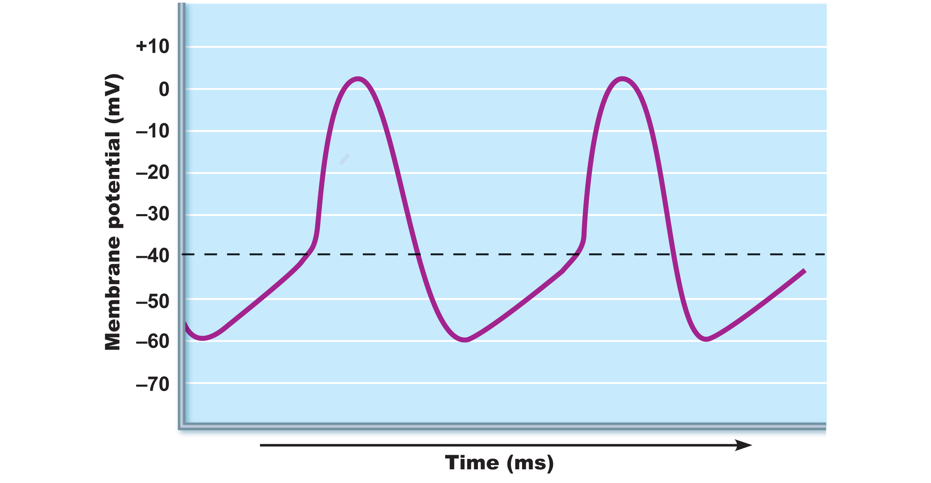
Action
potential
Threshold
2
2
3
1
1
Pacemaker
potential
1
2
3
Pacemaker potential
This slow depolarization is
due to both opening of Na⁺
channels and closing of K⁺
channels. Notice that the
membrane potential is
never a flat line.
Depolarization The
action potential begins when
the pacemaker potential
reaches threshold.
Depolarization is due to Ca²⁺
influx through Ca²⁺ channels.
Repolarization is due to
Ca²⁺ channels inactivating and
K⁺ channels opening. This
allows K⁺ efflux, which brings
the membrane potential back
to its most negative voltage.
Figure 18.13

Slide 46
Heart Physiology: Sequence of Excitation
Sinoatrial (SA) node (pacemaker)
Generates impulses about 75 times/minute (sinus rhythm)
Depolarizes faster than any other part of the myocardium

Slide 47
Heart Physiology: Sequence of Excitation
Atrioventricular (AV) node
Smaller diameter fibers; fewer gap junctions
Delays impulses approximately 0.1 second
Depolarizes 50 times per minute in absence of SA node input

Slide 48
Heart Physiology: Sequence of Excitation
Atrioventricular (AV) bundle (bundle of His)
Only electrical connection between the atria and ventricles

Slide 49
Heart Physiology: Sequence of Excitation
Right and left bundle branches
Two pathways in the interventricular septum that carry the impulses toward the apex of the heart

Slide 50
Heart Physiology: Sequence of Excitation
Purkinje fibers
Complete the pathway into the apex and ventricular walls
AV bundle and Purkinje fibers depolarize only 30 times per minute in absence of AV node input

Slide 51
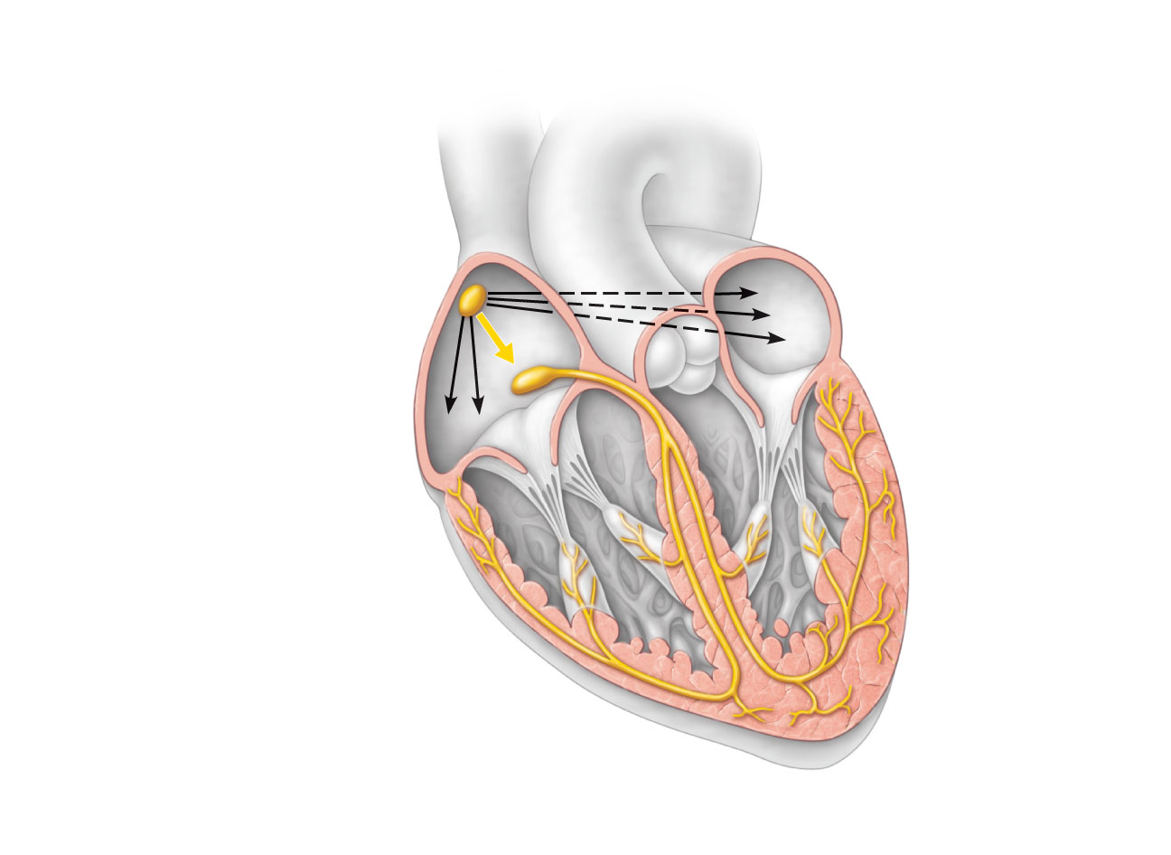
Superior vena cava
Right atrium
The sinoatrial (SA)
node (pacemaker)
generates impulses.
1
Internodal pathway
2
Left atrium
The impulses
pause (0.1 s) at the
atrioventricular
(AV) node.
The atrioventricular
(AV) bundle
connects the atria
to the ventricles.
Purkinje
fibers
3
The bundle branches
conduct the impulses
through the
interventricular septum.
4
Inter-
ventricular
septum
The Purkinje fibers
depolarize the contractile
cells of both ventricles.
5
(a) Anatomy of the intrinsic conduction system showing the
sequence of electrical excitation
Figure 18.14a

Slide 52
Homeostatic Imbalances
Defects in the intrinsic conduction system may result in
Arrhythmias: irregular heart rhythms
Uncoordinated atrial and ventricular contractions
Fibrillation: rapid, irregular contractions; useless for pumping blood

Slide 53
Homeostatic Imbalances
Defective SA node may result in
Ectopic focus: abnormal pacemaker takes over
If AV node takes over, there will be a junctional rhythm (40–60 bpm)
Defective AV node may result in
Partial or total heart block
Few or no impulses from SA node reach the ventricles

Slide 54
Extrinsic Innervation of the Heart
Heartbeat is modified by the ANS
Cardiac centers are located in the medulla oblongata
Cardioacceleratory center innervates SA and AV nodes, heart muscle, and coronary arteries through sympathetic neurons
Cardioinhibitory center inhibits SA and AV nodes through parasympathetic fibers in the vagus nerves

Slide 55
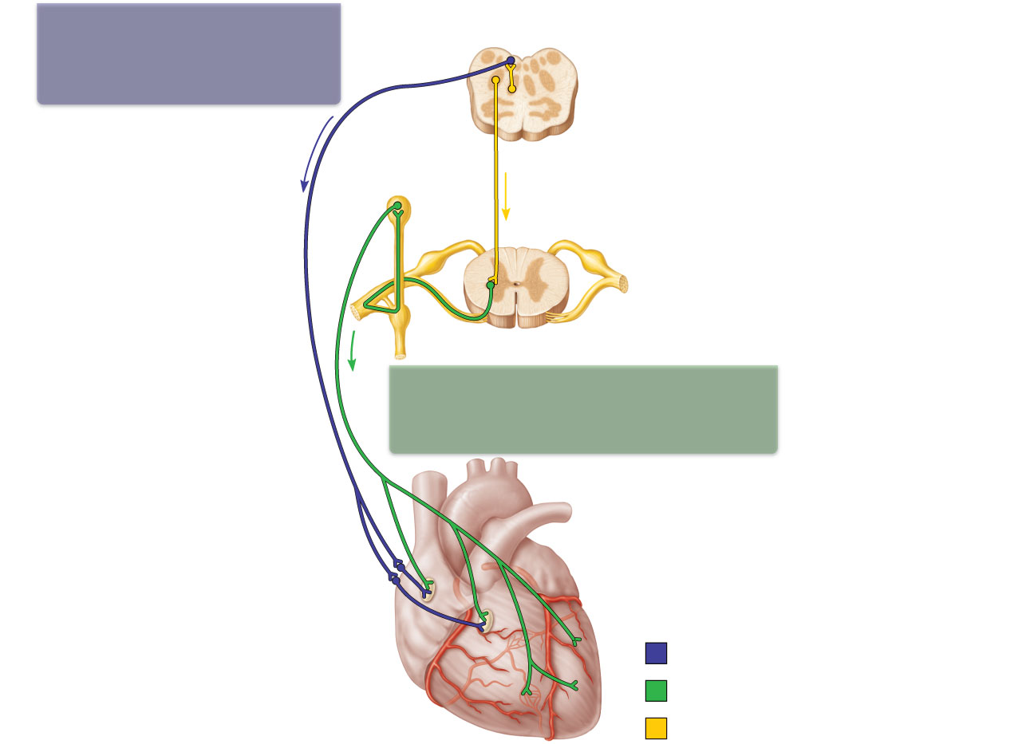
The vagus nerve
(parasympathetic)
decreases heart rate.
Dorsal motor nucleus of vagus
Cardioinhibitory center
Medulla oblongata
Cardio-
acceleratory
center
Sympathetic trunk ganglion
Thoracic spinal cord
Sympathetic trunk
Sympathetic cardiac
nerves increase heart rate
and force of contraction.
AV node
SA node
Parasympathetic fibers
Sympathetic fibers
Interneurons
Figure 18.15

Slide 56
Electrocardiography
Electrocardiogram (ECG or EKG): a composite of all the action potentials generated by nodal and contractile cells at a given time
Three waves
P wave: depolarization of SA node
QRS complex: ventricular depolarization
T wave: ventricular repolarization

Slide 57
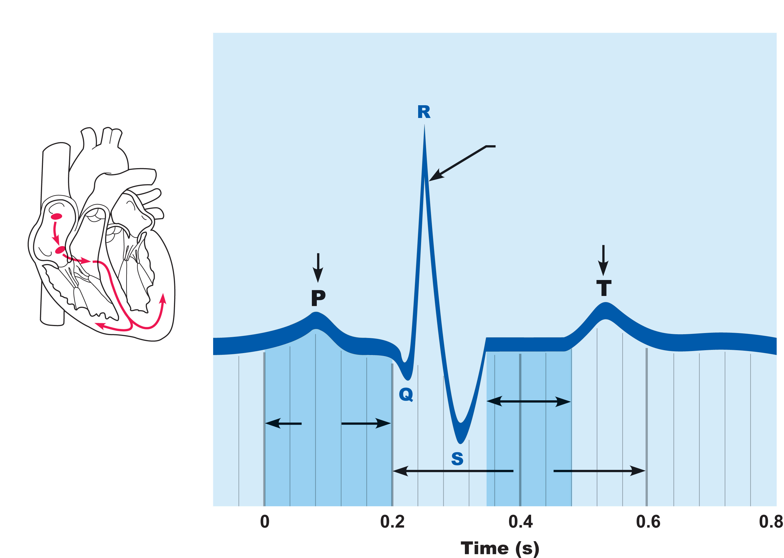
QRS complex
Sinoatrial
node
Ventricular
depolarization
Atrial
depolarization
Ventricular
repolarization
Atrioventricular
node
P-Q
Interval
S-T
Segment
Q-T
Interval
Figure 18.16

Slide 58
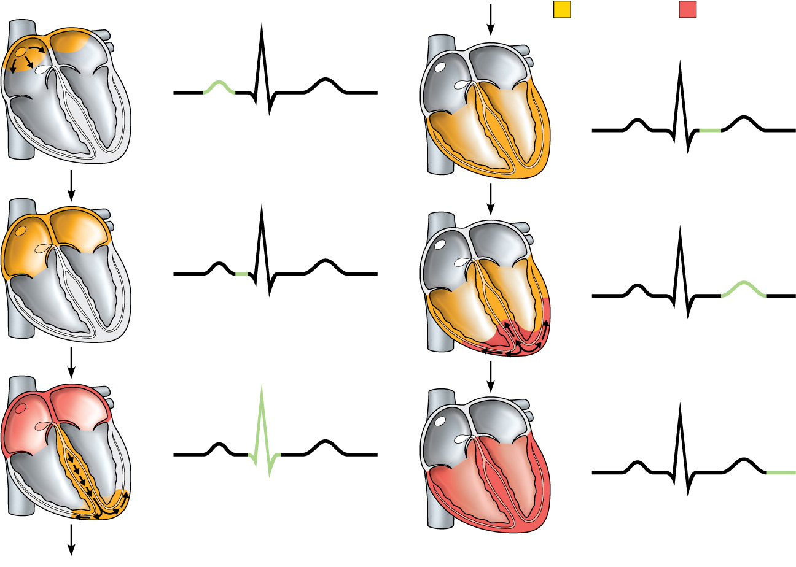
SA node
R
Depolarization
Repolarization
R
P
T
Q
P
T
S
1
Atrial depolarization, initiated by the SA node, causes the P wave.
Q
S
4
Ventricular depolarization is complete.
AV node
R
R
P
T
P
T
Q
S
2
Q
With atrial depolarization complete, the impulse is delayed at the AV node.
S
5
Ventricular repolarization begins at apex, causing the T wave.
R
R
P
T
P
T
Q
S
Q
S
3
Ventricular depolarization begins at apex, causing the QRS complex. Atrial repolarization occurs.
6
Ventricular repolarization is complete.
Figure 18.17

Slide 59
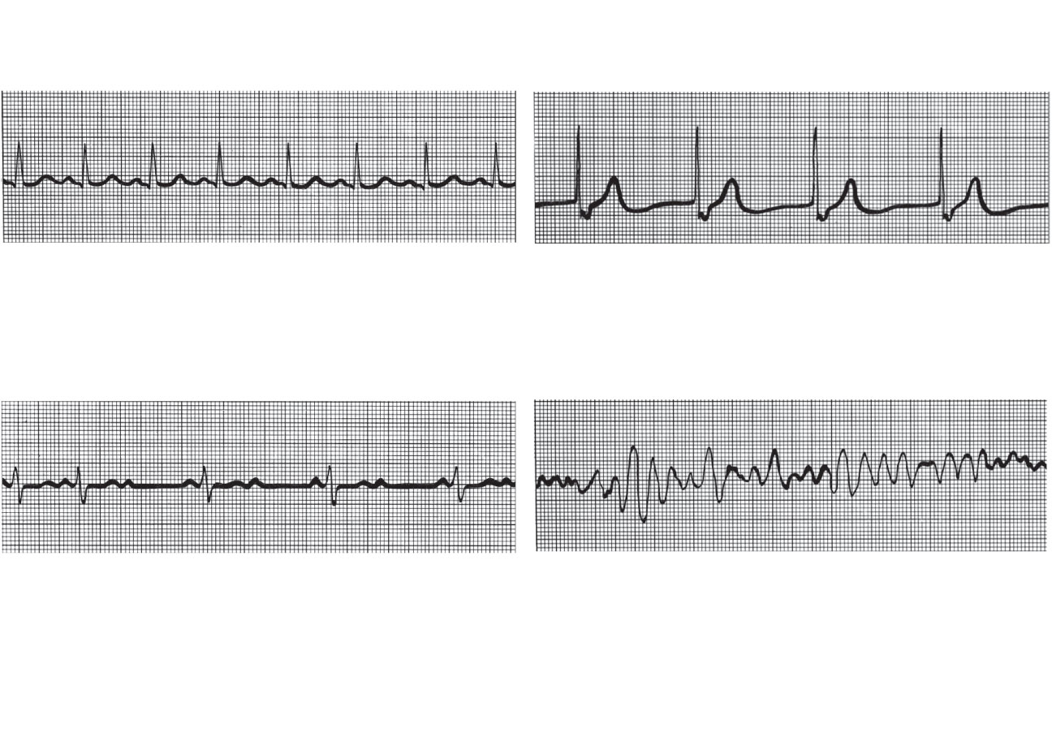
(a) Normal sinus rhythm.
(b) Junctional rhythm. The SA
node is nonfunctional, P waves
are absent, and heart is paced by
the AV node at 40 - 60 beats/min.
(c) Second-degree heart block.
Some P waves are not conducted
through the AV node; hence more
P than QRS waves are seen. In
this tracing, the ratio of P waves
to QRS waves is mostly 2:1.
(d) Ventricular fibrillation. These
chaotic, grossly irregular ECG
deflections are seen in acute
heart attack and electrical shock.
Figure 18.18

Slide 60
Heart Sounds
Two sounds (lub-dup) associated with closing of heart valves
First sound occurs as AV valves close and signifies beginning of systole
Second sound occurs when SL valves close at the beginning of ventricular diastole
Heart murmurs: abnormal heart sounds most often indicative of valve problems

Slide 61
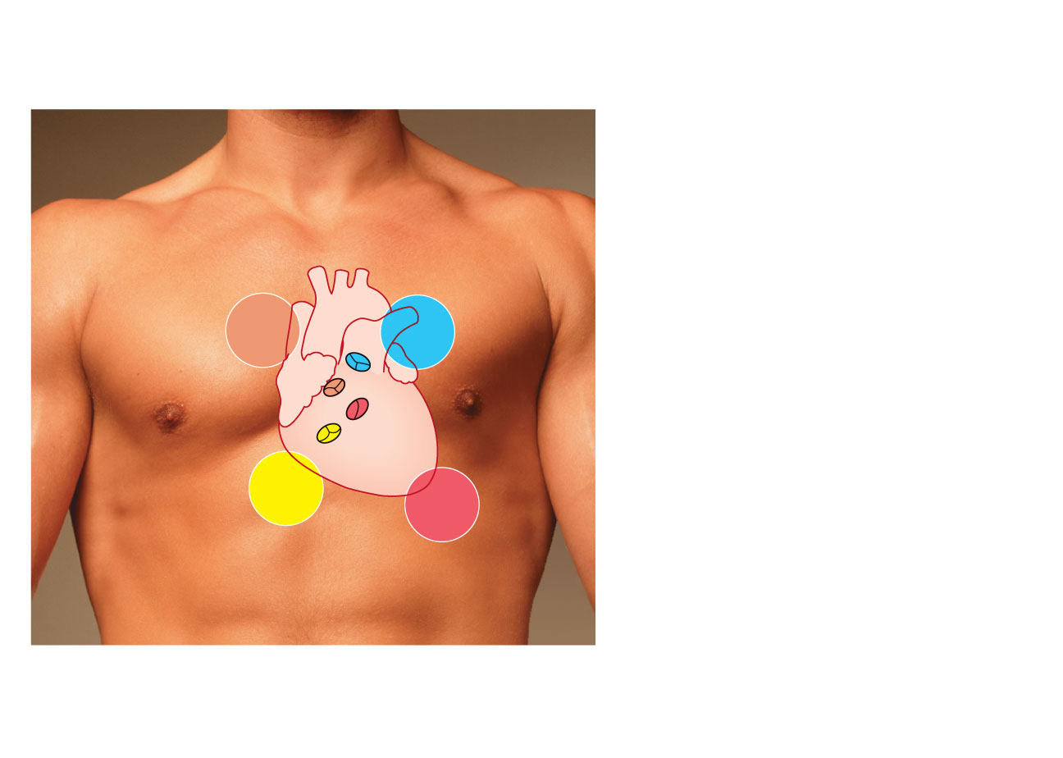
Aortic valve sounds heard
in 2nd intercostal space at
right sternal margin
Pulmonary valve
sounds heard in 2nd
intercostal space at left
sternal margin
Mitral valve sounds
heard over heart apex
(in 5th intercostal space)
in line with middle of
clavicle
Tricuspid valve sounds typically
heard in right sternal margin of
5th intercostal space
Figure 18.19

Slide 62
Mechanical Events: The Cardiac Cycle
Cardiac cycle: all events associated with blood flow through the heart during one complete heartbeat
Systole—contraction
Diastole—relaxation

Slide 63
Phases of the Cardiac Cycle
Ventricular filling—takes place in mid-to-late diastole
AV valves are open
80% of blood passively flows into ventricles
Atrial systole occurs, delivering the remaining 20%
End diastolic volume (EDV): volume of blood in each ventricle at the end of ventricular diastole

Slide 64
Phases of the Cardiac Cycle
Ventricular systole
Atria relax and ventricles begin to contract
Rising ventricular pressure results in closing of AV valves
Isovolumetric contraction phase (all valves are closed)
In ejection phase, ventricular pressure exceeds pressure in the large arteries, forcing the SL valves open
End systolic volume (ESV): volume of blood remaining in each ventricle

Slide 65
Phases of the Cardiac Cycle
Isovolumetric relaxation occurs in early diastole
Ventricles relax
Backflow of blood in aorta and pulmonary trunk closes SL valves and causes dicrotic notch (brief rise in aortic pressure)

Slide 66
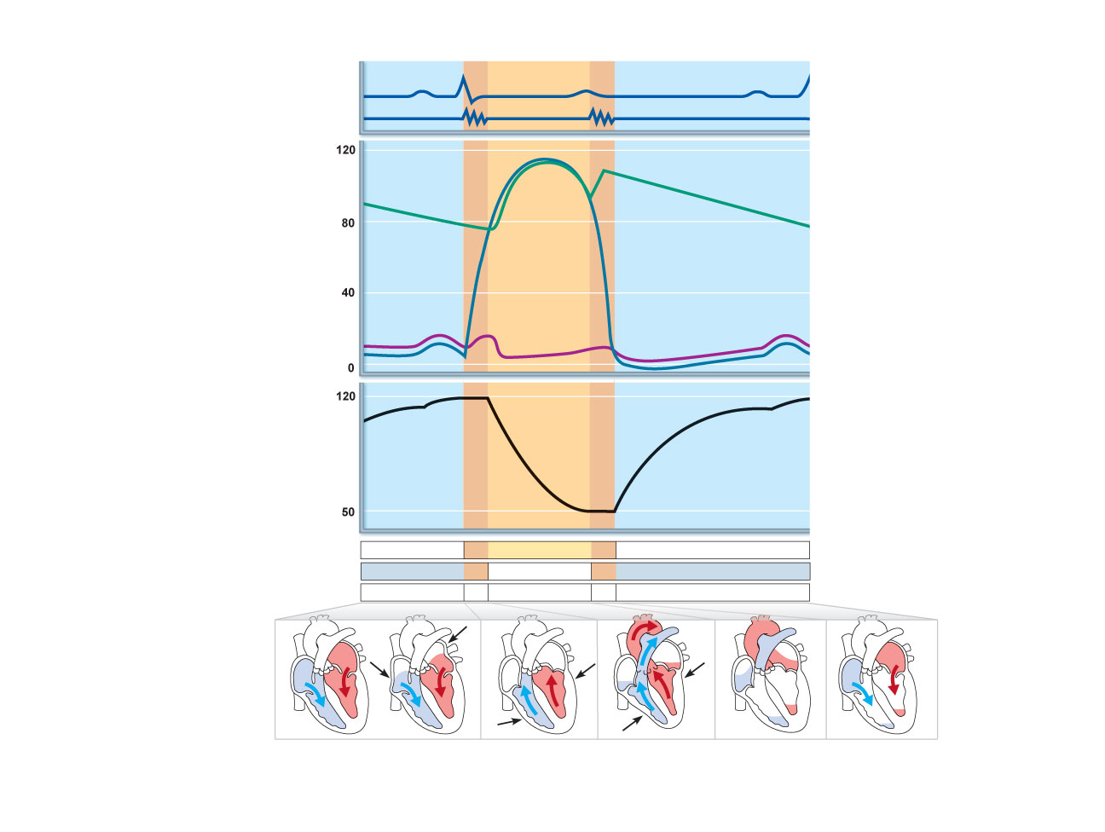
QRS
Left heart
Electrocardiogram
P
T
P
Heart sounds
1st
2nd
Dicrotic notch
Pressure (mm Hg)
Aorta
Left ventricle
Atrial systole
Left atrium
EDV
Ventricular
volume (ml)
SV
ESV
Atrioventricular valves
Open
Closed
Open
Aortic and pulmonary valves
Closed
Open
Closed
Phase
1
2a
2b
3
1
Left atrium
Right atrium
Left ventricle
Right ventricle
Ventricular
filling
Atrial
contraction
Isovolumetric
contraction phase
Ventricular
ejection phase
Isovolumetric
relaxation
Ventricular
filling
1
2a
2b
3
Ventricular filling
(mid-to-late diastole)
Ventricular systole
(atria in diastole)
Early diastole
Figure 18.20

Slide 67
Cardiac Output (CO)
Volume of blood pumped by each ventricle in one minute
CO = heart rate (HR) x stroke volume (SV)
HR = number of beats per minute
SV = volume of blood pumped out by a ventricle with each beat

Slide 68
Cardiac Output (CO)
At rest
CO (ml/min) = HR (75 beats/min) × SV (70 ml/beat)
= 5.25 L/min
Maximal CO is 4–5 times resting CO in nonathletic people
Maximal CO may reach 35 L/min in trained athletes
Cardiac reserve: difference between resting and maximal CO

Slide 69
Regulation of Stroke Volume
SV = EDV – ESV
Three main factors affect SV
Preload
Contractility
Afterload

Slide 70
Regulation of Stroke Volume
Preload: degree of stretch of cardiac muscle cells before they contract (Frank-Starling law of the heart)
Cardiac muscle exhibits a length-tension relationship
At rest, cardiac muscle cells are shorter than optimal length
Slow heartbeat and exercise increase venous return
Increased venous return distends (stretches) the ventricles and increases contraction force

Slide 71
Regulation of Stroke Volume
Contractility: contractile strength at a given muscle length, independent of muscle stretch and EDV
Positive inotropic agents increase contractility
Increased Ca²⁺ influx due to sympathetic stimulation
Hormones (thyroxine, glucagon, and epinephrine)
Negative inotropic agents decrease contractility
Acidosis
Increased extracellular K⁺
Calcium channel blockers

Slide 72
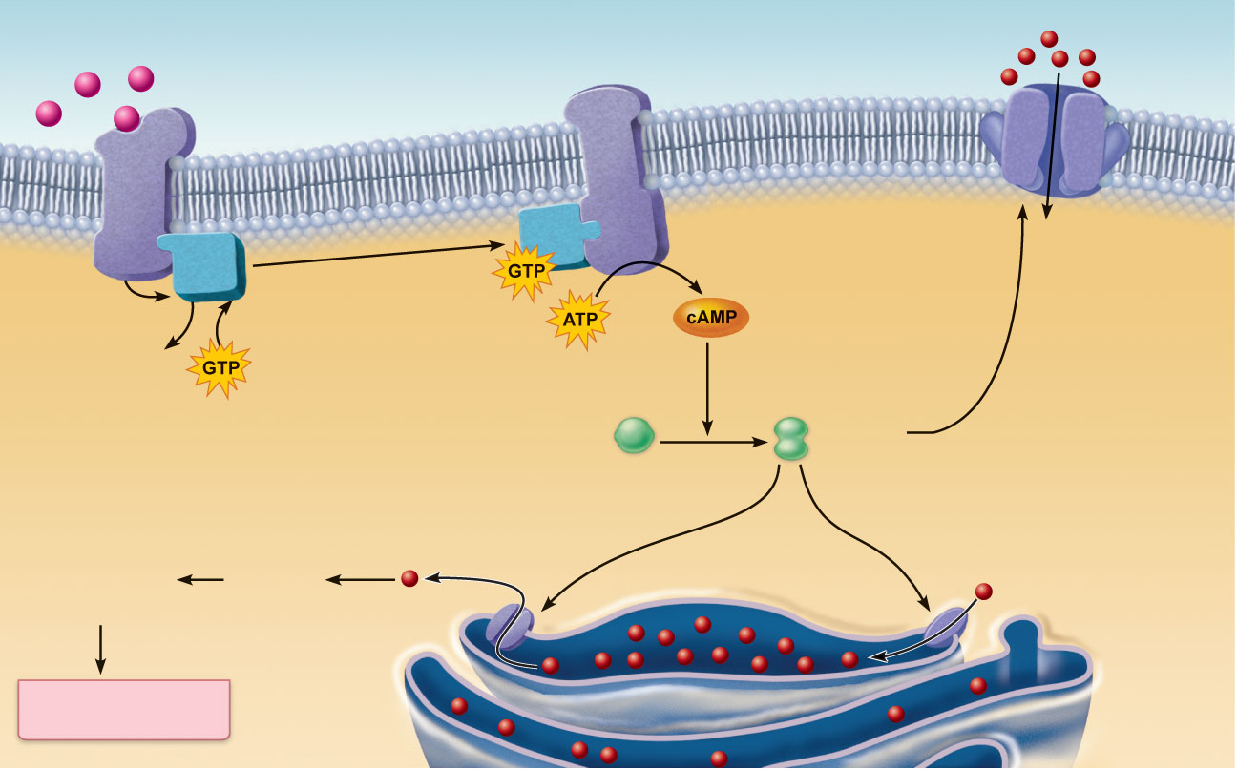
Norepinephrine
Extracellular fluid
β₁-Adrenergic
receptor
Adenylate cyclase
Ca²⁺
Ca²⁺
channel
G protein (G_{s})
ATP is converted
to cAMP
Cytoplasm
a
Phosphorylates
plasma membrane
Ca²⁺ channels,
increasing extra-
cellular Ca²⁺ entry
GDP
Inactive protein
kinase A
Active
protein
kinase A
Phosphorylates SR Ca²⁺ channels,
increasing intracellular Ca²⁺
release
Phosphorylates SR Ca²⁺
pumps, speeding Ca²⁺
removal and relaxation
b
c
Enhanced
actin-myosin
interaction
Troponin
binds
to
Ca²⁺
Ca²⁺
Ca²⁺ uptake
pump
SR Ca²⁺
channel
Cardiac muscle
force and velocity
Sarcoplasmic
reticulum (SR)
Figure 18.21

Slide 73
Regulation of Stroke Volume
Afterload: pressure that must be overcome for ventricles to eject blood
Hypertension increases afterload, resulting in increased ESV and reduced SV

Slide 74
Regulation of Heart Rate
Positive chronotropic factors increase heart rate
Negative chronotropic factors decrease heart rate

Slide 75
Autonomic Nervous System Regulation
Sympathetic nervous system is activated by emotional or physical stressors
Norepinephrine causes the pacemaker to fire more rapidly (and at the same time increases contractility)

Slide 76
Autonomic Nervous System Regulation
Parasympathetic nervous system opposes sympathetic effects
Acetylcholine hyperpolarizes pacemaker cells by opening K⁺ channels
The heart at rest exhibits vagal tone (parasympathetic)

Slide 77
Autonomic Nervous System Regulation
Atrial (Bainbridge) reflex: a sympathetic reflex initiated by increased venous return
Stretch of the atrial walls stimulates the SA node
Also stimulates atrial stretch receptors activating sympathetic reflexes

Slide 78
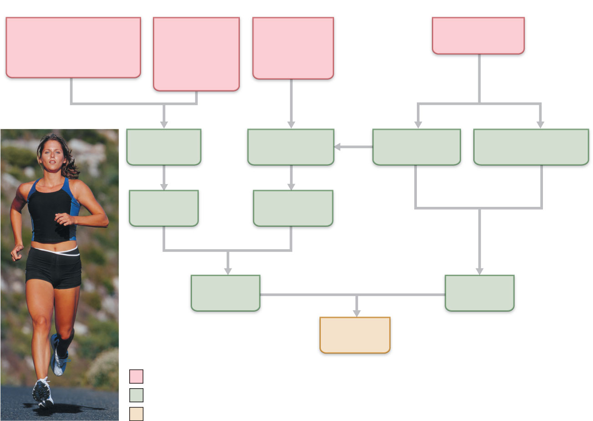
Exercise (by
skeletal muscle and
respiratory pumps;
see Chapter 19)
Heart rate
(allows more
time for
ventricular
filling)
Bloodborne
epinephrine,
thyroxine,
excess Ca²⁺
Exercise,
fright, anxiety
Venous
return
Contractility
Sympathetic
activity
Parasympathetic
activity
EDV
(preload)
ESV
Stroke
volume
Heart
rate
Cardiac
output
Initial stimulus
Physiological response
Result
Figure 18.22

Slide 79
Chemical Regulation of Heart Rate
Hormones
Epinephrine from adrenal medulla enhances heart rate and contractility
Thyroxine increases heart rate and enhances the effects of norepinephrine and epinephrine
2. Intra- and extracellular ion concentrations (e.g., Ca²⁺ and K⁺) must be maintained for normal heart function

Slide 80
Other Factors that Influence Heart Rate
Age
Gender
Exercise
Body temperature

