Slide 1
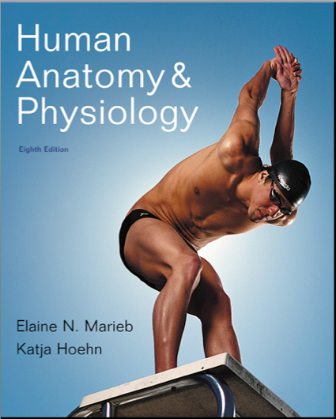
Chapter 19
The Cardiovascular system: Blood Vessels

Slide 2
Blood Vessels
Delivery system of dynamic structures that begins and ends at the heart
Arteries: carry blood away from the heart; oxygenated except for pulmonary circulation and umbilical vessels of a fetus
Capillaries: contact tissue cells and directly serve cellular needs
Veins: carry blood toward the heart

Slide 3
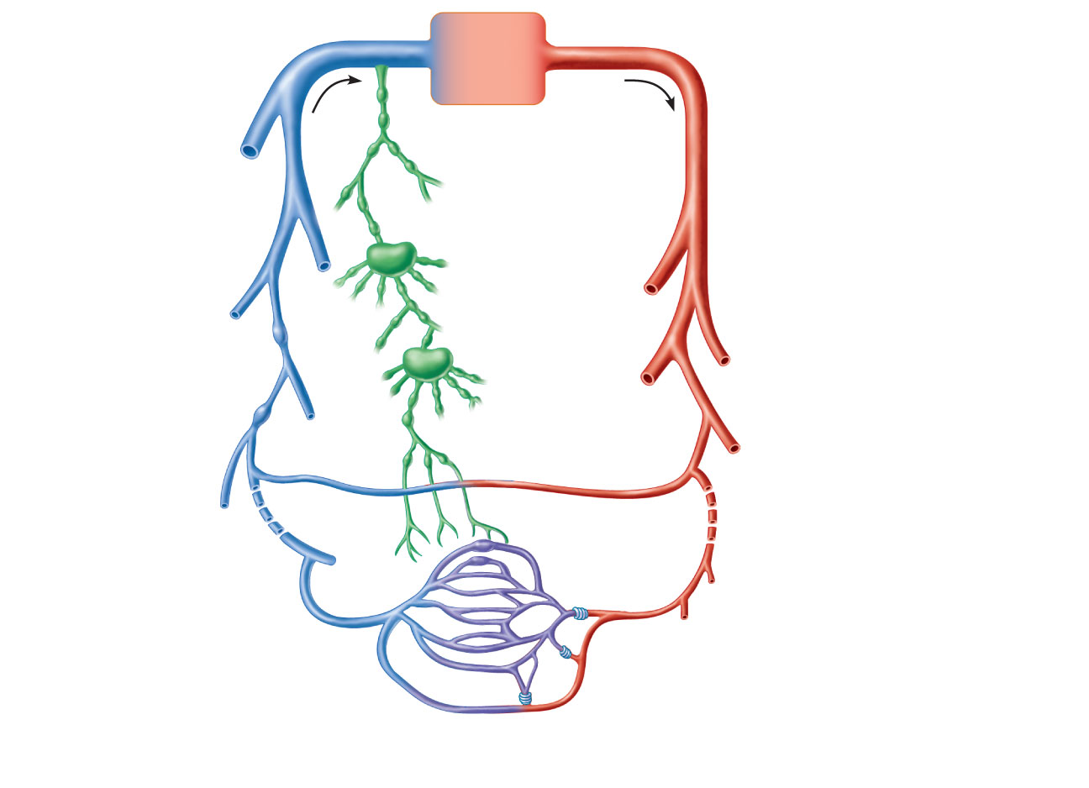
Venous system
Arterial system
Large veins
(capacitance
vessels)
Heart
Elastic arteries
(conducting
vessels)
Large
lymphatic
vessels
Lymph
node
Muscular arteries
(distributing
vessels)
Lymphatic
system
Small veins
(capacitance
vessels)
Arteriovenous
anastomosis
Lymphatic
capillary
Sinusoid
Arterioles
(resistance vessels)
Postcapillary
venule
Terminal arteriole
Metarteriole
Thoroughfare
channel
Capillaries
(exchange vessels)
Precapillary sphincter
Figure 19.2

Slide 4
Structure of Blood Vessel Walls
Arteries and veins
Tunica intima, tunica media, and tunica externa
Lumen
Central blood-containing space
Capillaries
Endothelium with sparse basal lamina

Slide 5
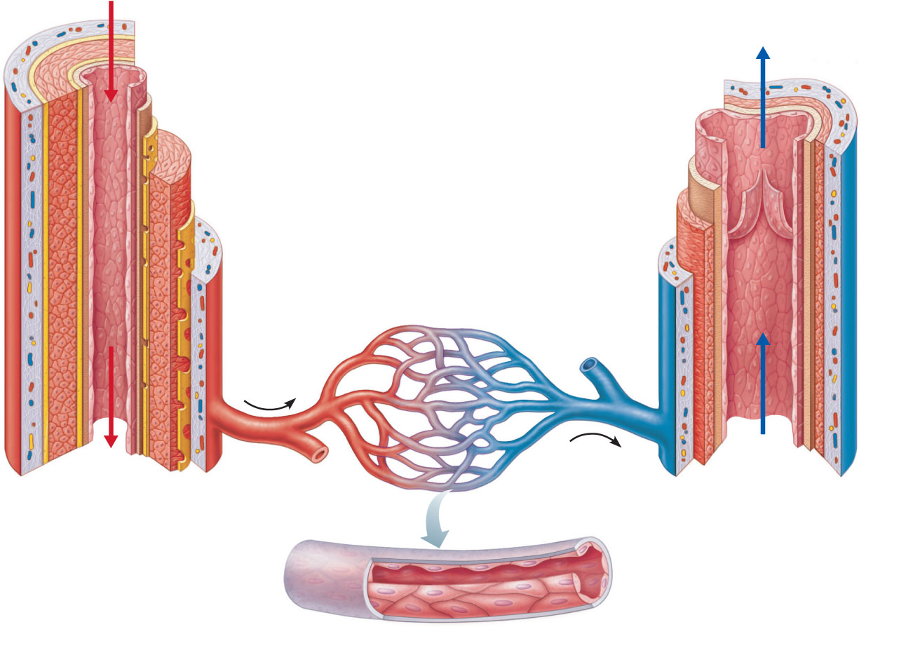
Tunica intima
• Endothelium
Valve
• Subendothelial layer
Internal elastic lamina
Tunica media
(smooth muscle and
elastic fibers)
External elastic lamina
Tunica externa
(collagen fibers)
Lumen
Artery
Lumen
Vein
Capillary
network
Basement membrane
Endothelial cells
(b)
Capillary
Figure 19.1b

Slide 6
Capillaries
Microscopic blood vessels
Walls of thin tunica intima, one cell thick
Size allows only a single RBC to pass at a time
In all tissues except for cartilage, epithelia, cornea and lens of eye
Functions: exchange of gases, nutrients, wastes, hormones, etc.

Slide 7
Capillaries
Three structural types
Continuous capillaries
Fenestrated capillaries
Sinusoidal capillaries (sinusoids)

Slide 8
Continuous Capillaries
Abundant in the skin and muscles
Tight junctions connect endothelial cells
Intercellular clefts allow the passage of fluids and small solutes
Continuous capillaries of the brain
Tight junctions are complete, forming the blood-brain barrier

Slide 9
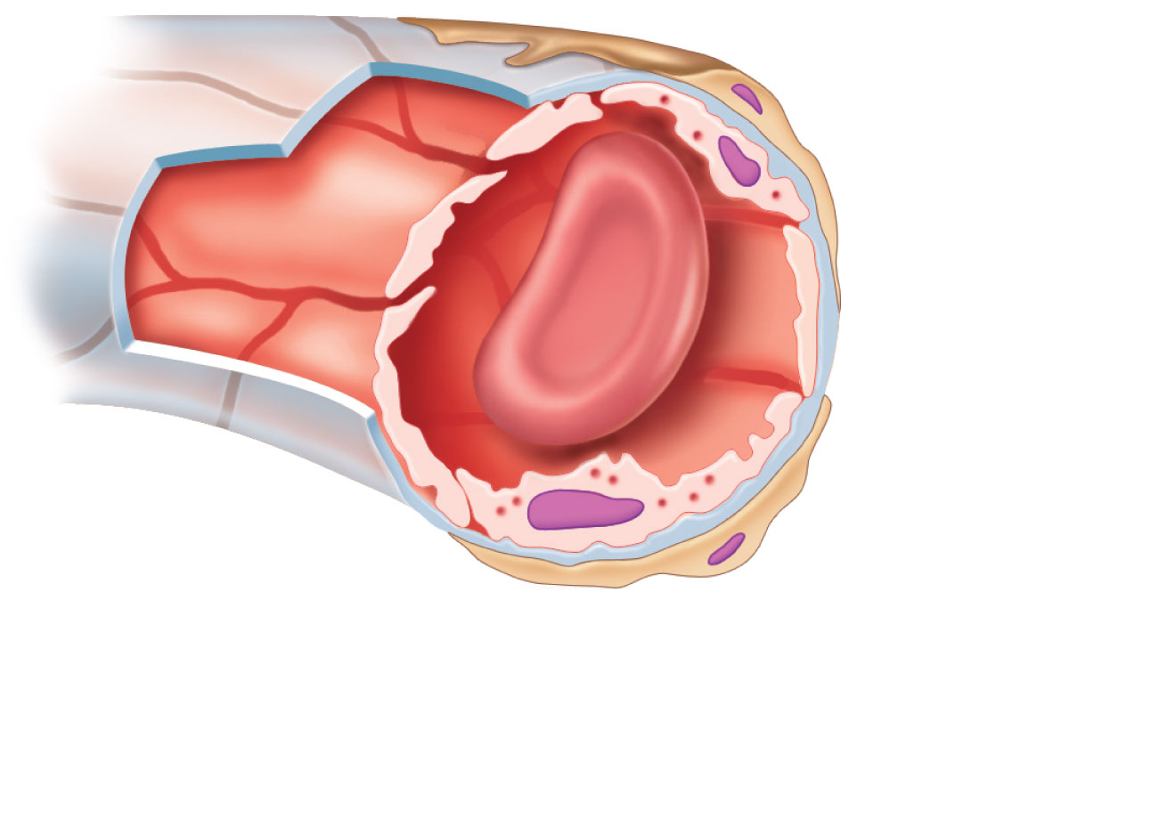
Pericyte
Red blood
cell in lumen
Intercellular
cleft
Endothelial
cell
Basement
membrane
Tight junction
Pinocytotic
vesicles
Endothelial
nucleus
(a) Continuous capillary. Least permeable, and
most common (e.g., skin, muscle).
Figure 19.3a

Slide 10
Fenestrated Capillaries
Some endothelial cells contain pores (fenestrations)
More permeable than continuous capillaries
Function in absorption or filtrate formation (small intestines, endocrine glands, and kidneys)

Slide 11
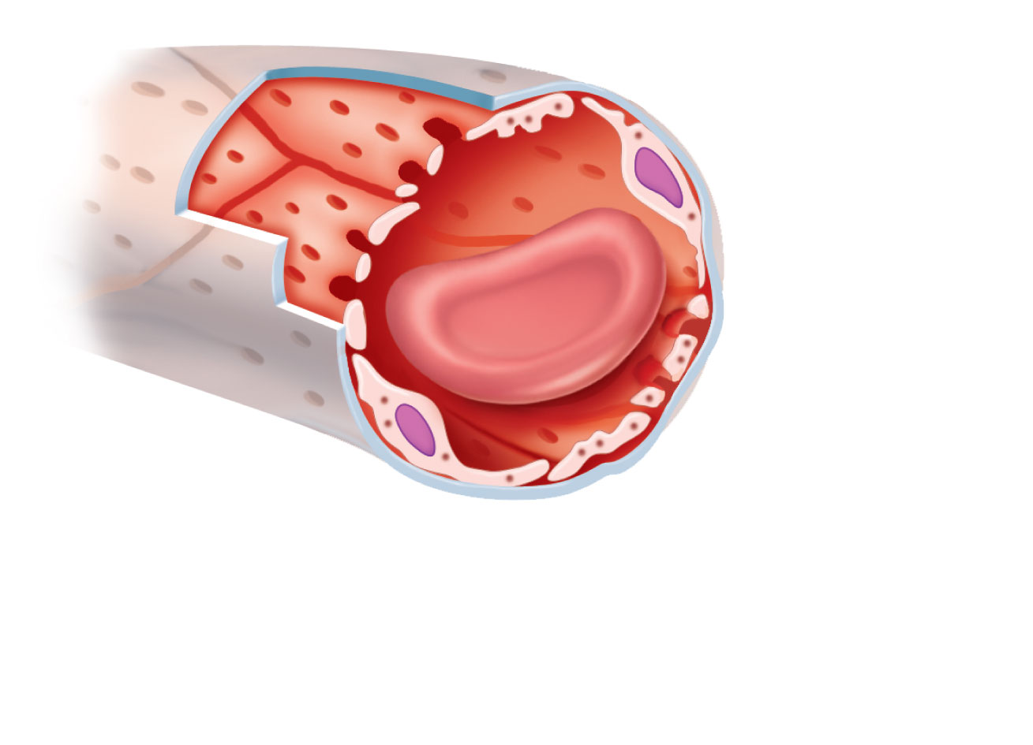
Pinocytotic
vesicles
Red blood
cell in lumen
Fenestrations
(pores)
Endothelial
nucleus
Intercellular
cleft
Basement membrane
Tight junction
Endothelial
cell
(b) Fenestrated capillary. Large fenestrations
(pores) increase permeability. Occurs in special
locations (e.g., kidney, small intestine).
Figure 19.3b

Slide 12
Sinusoidal Capillaries
Fewer tight junctions, larger intercellular clefts, large lumens
Usually fenestrated
Allow large molecules and blood cells to pass between the blood and surrounding tissues
Found in the liver, bone marrow, spleen

Slide 13
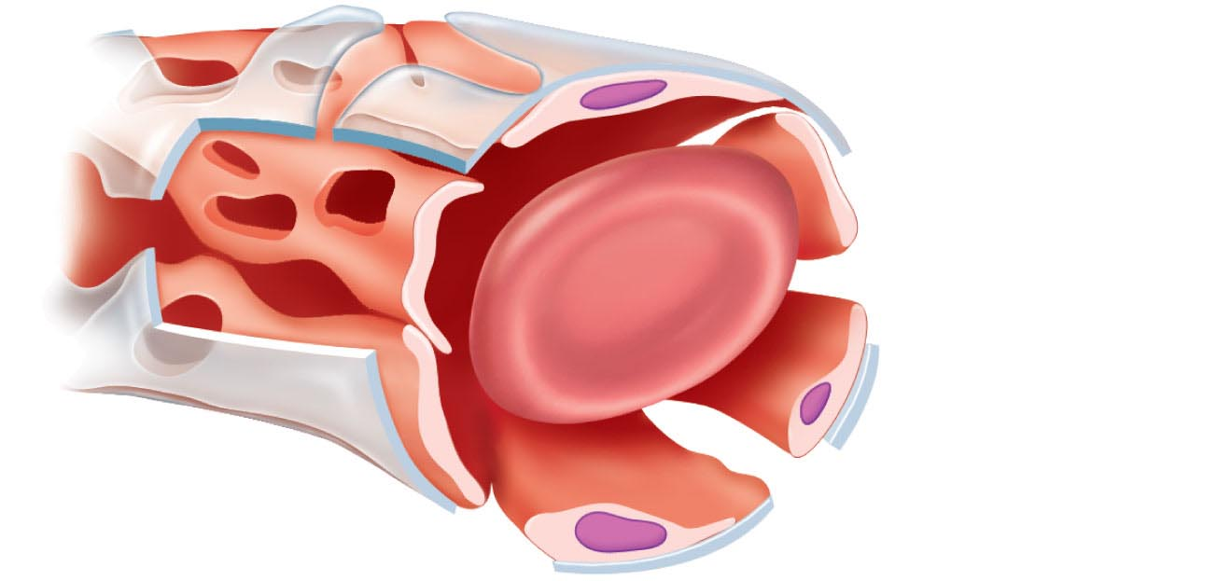
Endothelial
cell
Red blood
cell in lumen
Large
intercellular
cleft
Tight junction
Incomplete
basement
membrane
Nucleus of
endothelial
cell
(c) Sinusoidal capillary. Most permeable. Occurs in
special locations (e.g., liver, bone marrow, spleen).
Figure 19.3c

Slide 14
Capillary Beds
Interwoven networks of capillaries form the microcirculation between arterioles and venules
Consist of two types of vessels
Vascular shunt (metarteriole—thoroughfare channel):
Directly connects the terminal arteriole and a postcapillary venule
2. True capillaries
10 to 100 exchange vessels per capillary bed
Branch off the metarteriole or terminal arteriole

Slide 15
Blood Flow Through Capillary Beds
Precapillary sphincters regulate blood flow into true capillaries
Regulated by local chemical conditions and vasomotor nerves

Slide 16
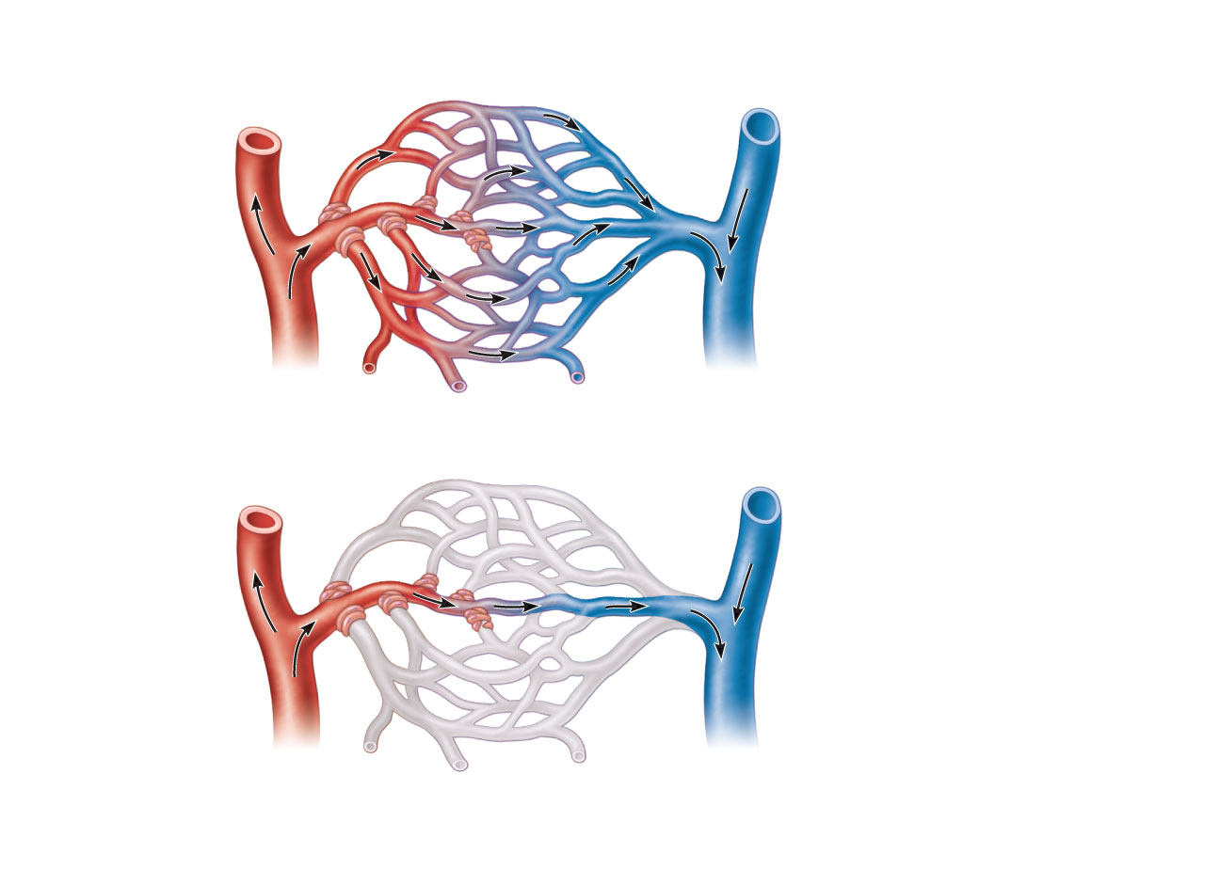
Vascular shunt
Precapillary
sphincters
Metarteriole
Thoroughfare channel
True capillaries
Terminal arteriole
Postcapillary venule
(a) Sphincters open—blood flows through true capillaries.
Terminal arteriole
Postcapillary venule
(b) Sphincters closed—blood flows through metarteriole
thoroughfare channel and bypasses true capillaries.
Figure 19.4

Slide 17
Venules
Formed when capillary beds unite
Very porous; allow fluids and WBCs into tissues
Postcapillary venules consist of endothelium and a few pericytes
Larger venules have one or two layers of smooth muscle cells

Slide 18
Veins
Formed when venules converge
Have thinner walls, larger lumens compared with corresponding arteries
Blood pressure is lower than in arteries
Thin tunica media and a thick tunica externa consisting of collagen fibers and elastic networks
Called capacitance vessels (blood reservoirs); contain up to 65% of the blood supply

Slide 19
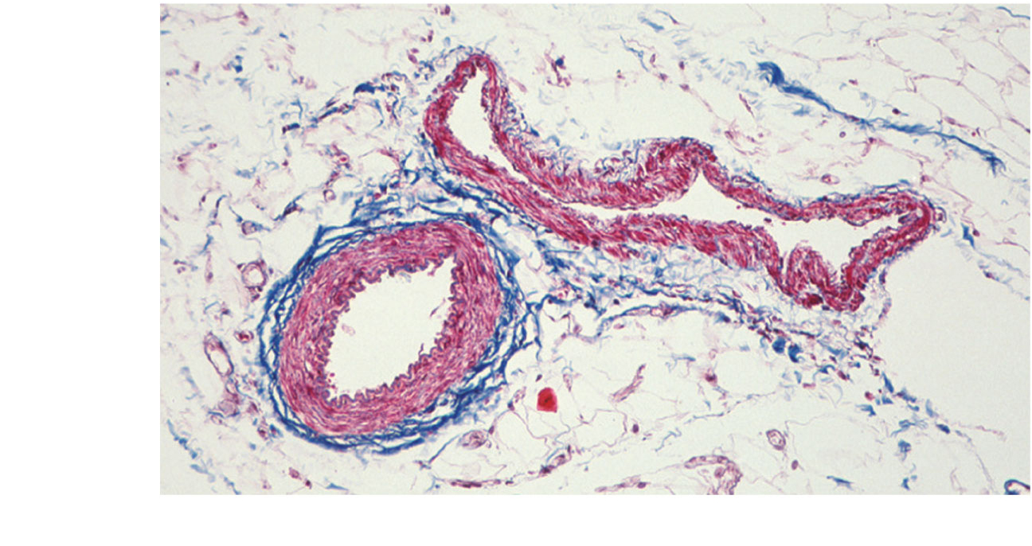
Vein
Artery
(a)
Figure 19.1a

Slide 20
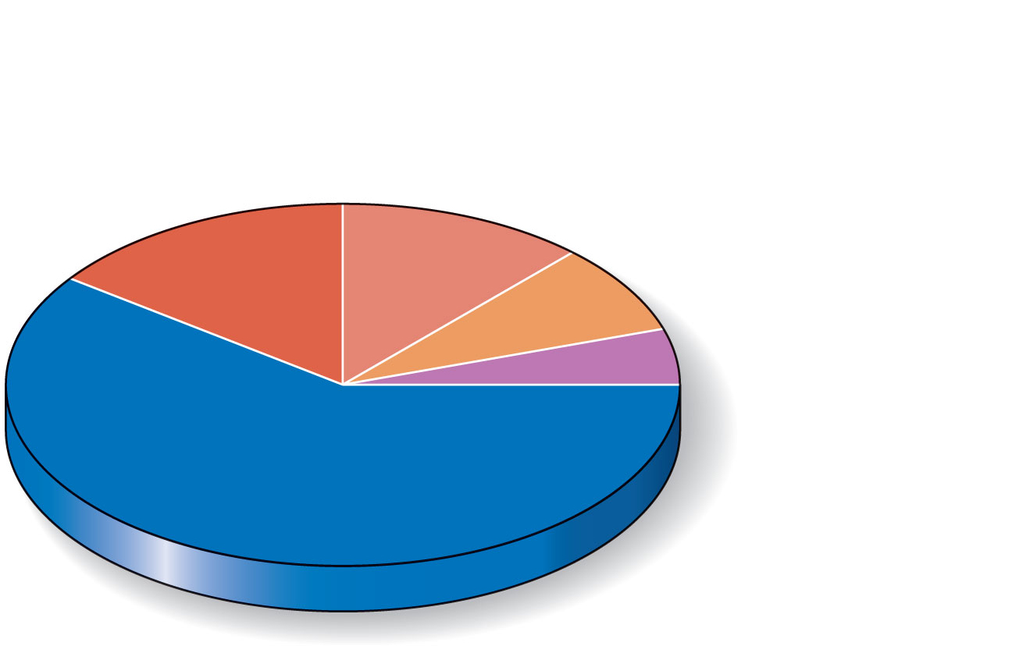
Pulmonary blood
vessels 12%
Systemic arteries
and arterioles 15%
Heart 8%
Capillaries 5%
Systemic veins
and venules 60%
Figure 19.5

Slide 21
Veins
Adaptations that ensure return of blood to the heart
Large-diameter lumens offer little resistance
Valves prevent backflow of blood
Most abundant in veins of the limbs
Venous sinuses: flattened veins with extremely thin walls (e.g., coronary sinus of the heart and dural sinuses of the brain)

Slide 22
Vascular Anastomoses
Interconnections of blood vessels
Arterial anastomoses provide alternate pathways (collateral channels) to a given body region
Common at joints, in abdominal organs, brain, and heart
Vascular shunts of capillaries are examples of arteriovenous anastomoses
Venous anastomoses are common

Slide 23
Physiology of Circulation: Definition of Terms
Blood flow
Volume of blood flowing through a vessel, an organ, or the entire circulation in a given period
Measured as ml/min
Equivalent to cardiac output (CO) for entire vascular system
Relatively constant when at rest
Varies widely through individual organs, based on needs

Slide 24
Physiology of Circulation: Definition of Terms
Blood pressure (BP)
Force per unit area exerted on the wall of a blood vessel by the blood
Expressed in mm Hg
Measured as systemic arterial BP in large arteries near the heart
The pressure gradient provides the driving force that keeps blood moving from higher to lower pressure areas

Slide 25
Physiology of Circulation: Definition of Terms
Resistance (peripheral resistance)
Opposition to flow
Measure of the amount of friction blood encounters
Generally encountered in the peripheral systemic circulation
Three important sources of resistance
Blood viscosity
Total blood vessel length
Blood vessel diameter

Slide 26
Resistance
Factors that remain relatively constant:
Blood viscosity
The “stickiness” of the blood due to formed elements and plasma proteins
Blood vessel length
The longer the vessel, the greater the resistance encountered

Slide 27
Resistance
Frequent changes alter peripheral resistance
Varies inversely to the fourth power of vessel radius
E.g., if the radius is doubled, the resistance is 1/16 as much

Slide 28
Resistance
Small-diameter arterioles are the major determinants of peripheral resistance
Abrupt changes in diameter or fatty plaques from atherosclerosis dramatically increase resistance
Disrupt laminar flow and cause turbulence

Slide 29
Relationship Between Blood Flow, Blood Pressure, and Resistance
Blood flow (F) is directly proportional to the blood (hydrostatic) pressure gradient (ΔP)
If ΔP increases, blood flow speeds up
Blood flow is inversely proportional to peripheral resistance (R)
If R increases, blood flow decreases: F = ΔP/R
R is more important in influencing local blood flow because it is easily changed by altering blood vessel diameter

Slide 30
Systemic Blood Pressure
The pumping action of the heart generates blood flow
Pressure results when flow is opposed by resistance
Systemic pressure
Is highest in the aorta
Declines throughout the pathway
Is 0 mm Hg in the right atrium
The steepest drop occurs in arterioles

Slide 31
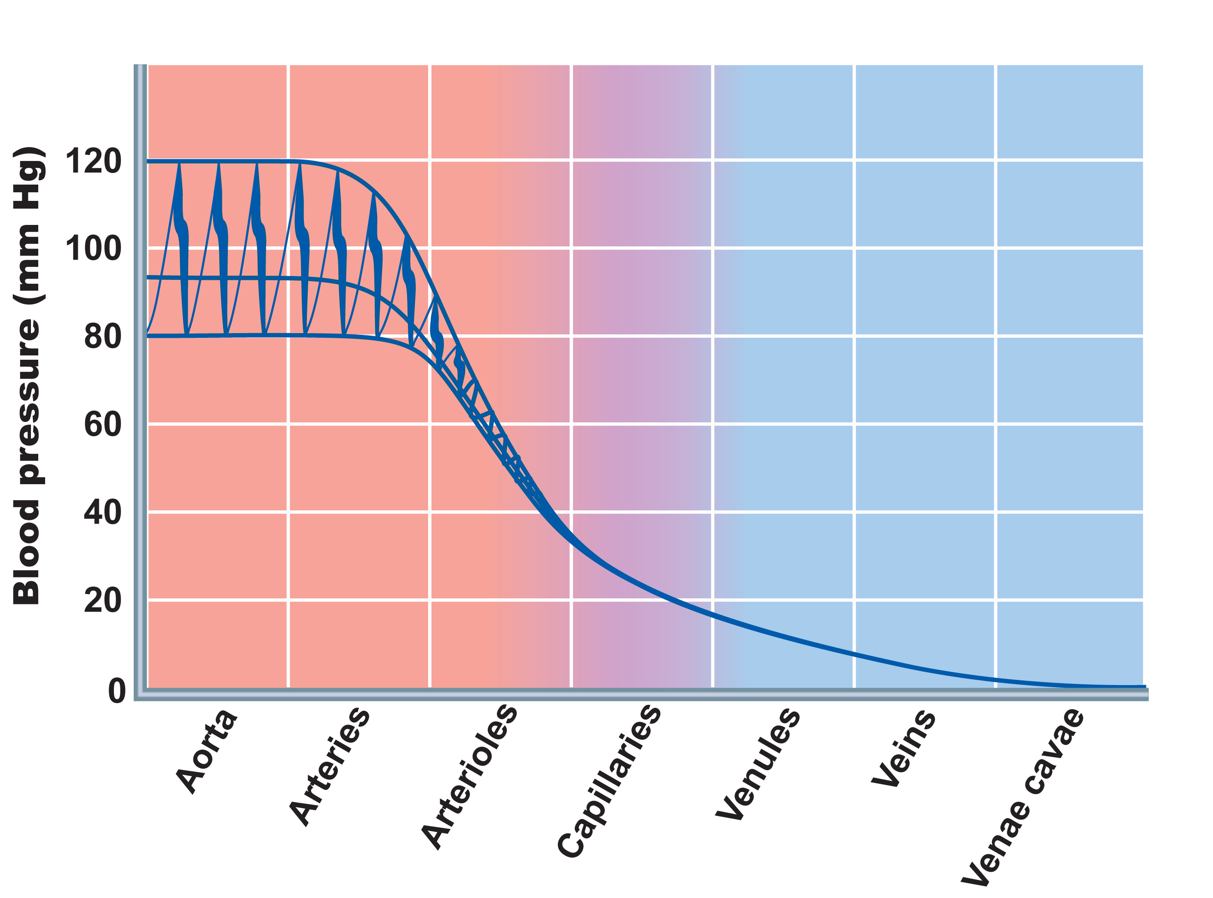
Systolic pressure
Mean pressure
Diastolic
pressure
Figure 19.6

Slide 32
Arterial Blood Pressure
Reflects two factors of the arteries close to the heart
Elasticity (compliance or distensibility)
Volume of blood forced into them at any time

Slide 33
Arterial Blood Pressure
Systolic pressure: pressure exerted during ventricular contraction
Diastolic pressure: lowest level of arterial pressure
Pulse pressure = difference between systolic and diastolic pressure

Slide 34
Arterial Blood Pressure
Mean arterial pressure (MAP): pressure that propels the blood to the tissues
MAP = diastolic pressure + 1/3 pulse pressure
Pulse pressure and MAP both decline with increasing distance from the heart

Slide 35
Capillary Blood Pressure
Ranges from 15 to 35 mm Hg
Low capillary pressure is desirable
High BP would rupture fragile, thin-walled capillaries
Most are very permeable, so low pressure forces filtrate into interstitial spaces

Slide 36
Venous Blood Pressure
Changes little during the cardiac cycle
Small pressure gradient, about 15 mm Hg
Low pressure due to cumulative effects of peripheral resistance

Slide 37
Factors Aiding Venous Return
Respiratory “pump”: pressure changes created during breathing move blood toward the heart by squeezing abdominal veins as thoracic veins expand
Muscular “pump”: contraction of skeletal muscles “milk” blood toward the heart and valves prevent backflow
Vasoconstriction of veins under sympathetic control

Slide 38
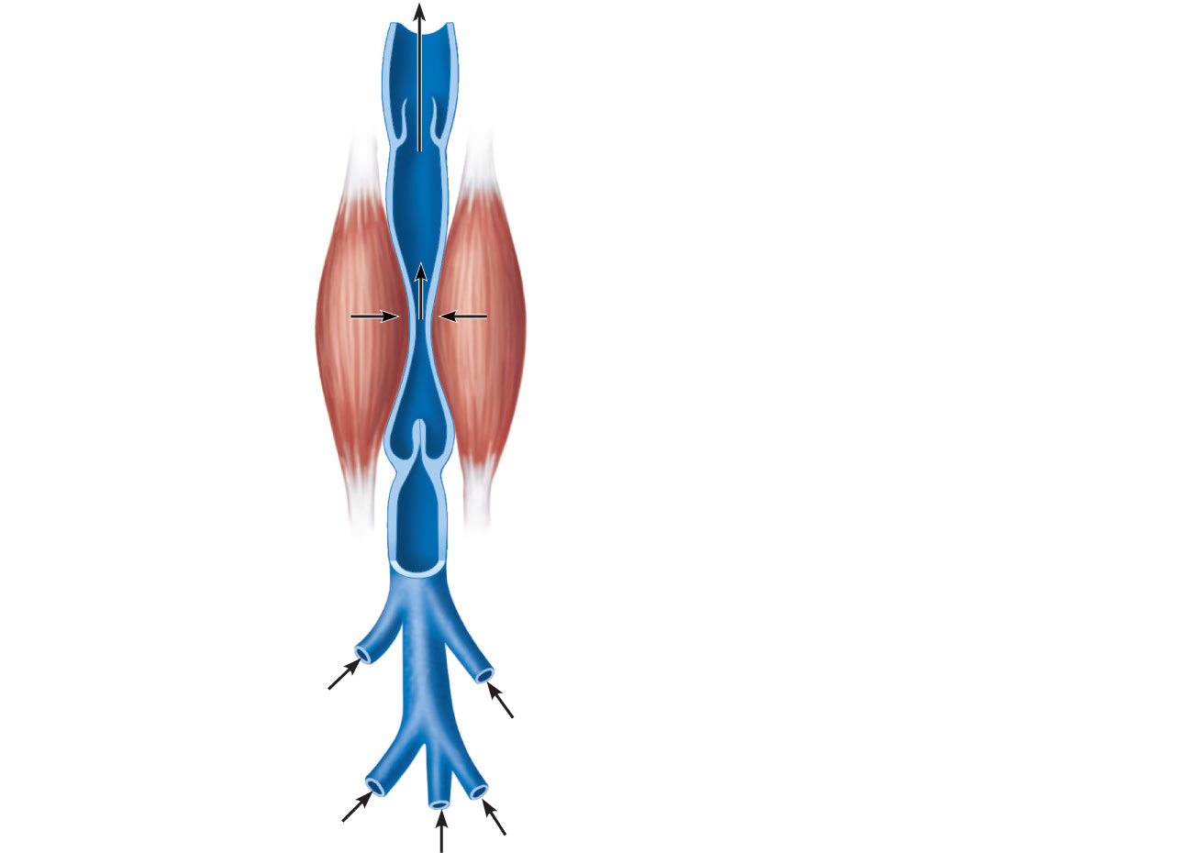
Valve (open)
Contracted
skeletal
muscle
Valve (closed)
Vein
Direction of
blood flow
Figure 19.7

Slide 39
Maintaining Blood Pressure
Requires
Cooperation of the heart, blood vessels, and kidneys
Supervision by the brain

Slide 40
Maintaining Blood Pressure
The main factors influencing blood pressure:
Cardiac output (CO)
Peripheral resistance (PR)
Blood volume

Slide 41
Maintaining Blood Pressure
Flow = ΔP/PR and CO = ΔP/PR
Blood pressure = CO x PR (and CO depends on blood volume)
Blood pressure varies directly with CO, PR, and blood volume
Changes in one variable are quickly compensated for by changes in the other variables

Slide 42
Cardiac Output (CO)
Determined by venous return and neural and hormonal controls
Resting heart rate is maintained by the cardioinhibitory center via the parasympathetic vagus nerves
Stroke volume is controlled by venous return (EDV)

Slide 43
Cardiac Output (CO)
During stress, the cardioacceleratory center increases heart rate and stroke volume via sympathetic stimulation
ESV decreases and MAP increases

Slide 44
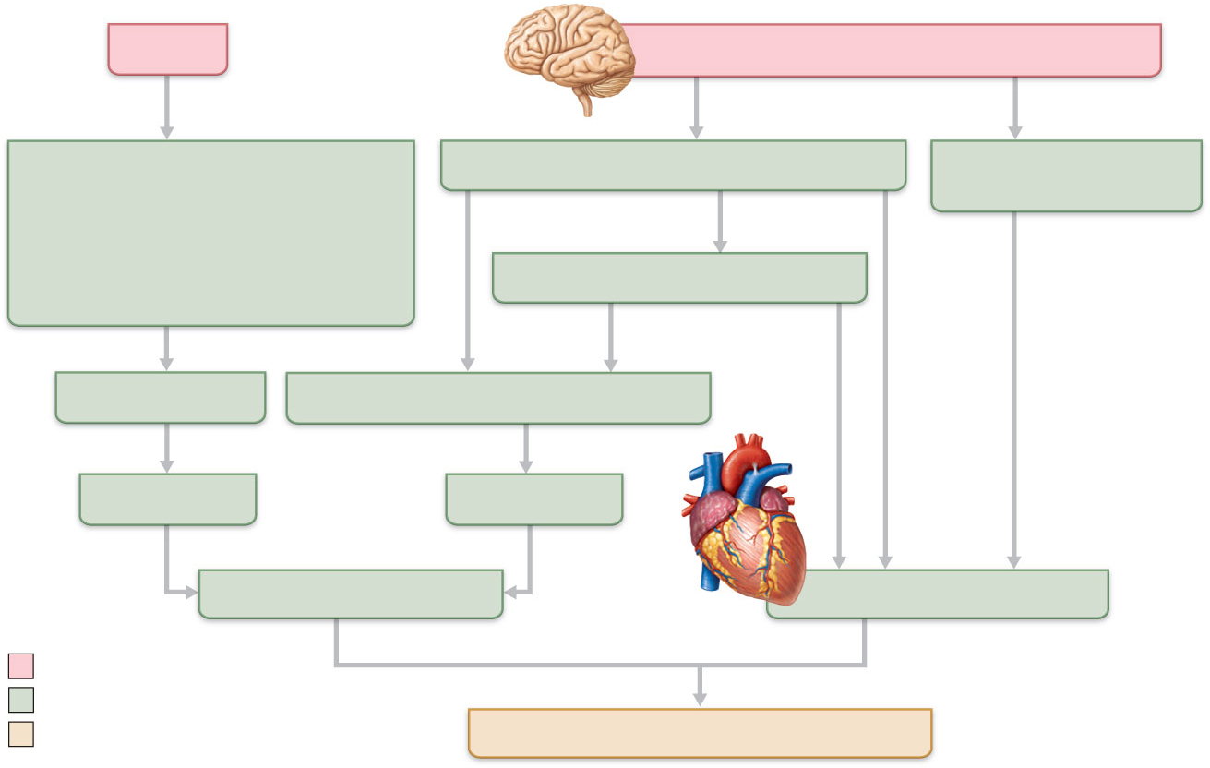
Exercise
BP activates cardiac centers in medulla
Activity of respiratory pump
(ventral body cavity pressure)
Sympathetic activity
Parasympathetic
activity
Activity of muscular pump
(skeletal muscles)
Epinephrine in blood
Sympathetic venoconstriction
Venous return
Contractility of cardiac muscle
EDV
ESV
Stroke volume (SV)
Heart rate (HR)
Initial stimulus
Physiological response
Result
Cardiac output (CO = SV x HR
Figure 19.8

Slide 45
Control of Blood Pressure
Short-term neural and hormonal controls
Counteract fluctuations in blood pressure by altering peripheral resistance
Long-term renal regulation
Counteracts fluctuations in blood pressure by altering blood volume

Slide 46
Short-Term Mechanisms: Neural Controls
Neural controls of peripheral resistance
Maintain MAP by altering blood vessel diameter
Alter blood distribution in response to specific demands

Slide 47
Short-Term Mechanisms: Neural Controls
Neural controls operate via reflex arcs that involve
Baroreceptors
Vasomotor centers and vasomotor fibers
Vascular smooth muscle

Slide 48
Short-Term Mechanisms: Chemoreceptor-Initiated Reflexes
Chemoreceptors are located in the
Carotid sinus
Aortic arch
Large arteries of the neck

Slide 49
Short-Term Mechanisms: Chemoreceptor-Initiated Reflexes
Chemoreceptors respond to rise in CO₂, drop in pH or O₂
Increase blood pressure via the vasomotor center and the cardioacceleratory center
Are more important in the regulation of respiratory rate (Chapter 22)

Slide 50
Influence of Higher Brain Centers
Reflexes that regulate BP are integrated in the medulla
Higher brain centers (cortex and hypothalamus) can modify BP via relays to medullary centers

Slide 51
Short-Term Mechanisms: Hormonal Controls
Adrenal medulla hormones norepinephrine (NE) and epinephrine cause generalized vasoconstriction and increase cardiac output
Angiotensin II, generated by kidney release of renin, causes vasoconstriction

Slide 52
Short-Term Mechanisms: Hormonal Controls
Atrial natriuretic peptide causes blood volume and blood pressure to decline, causes generalized vasodilation
Antidiuretic hormone (ADH)(vasopressin) causes intense vasoconstriction in cases of extremely low BP

Slide 53
Long-Term Mechanisms: Renal Regulation
Baroreceptors quickly adapt to chronic high or low BP
Long-term mechanisms step in to control BP by altering blood volume
Kidneys act directly and indirectly to regulate arterial blood pressure
Direct renal mechanism
Indirect renal (renin-angiotensin) mechanism

Slide 54
Direct Renal Mechanism
Alters blood volume independently of hormones
Increased BP or blood volume causes the kidneys to eliminate more urine, thus reducing BP
Decreased BP or blood volume causes the kidneys to conserve water, and BP rises

Slide 55
Indirect Mechanism
The renin-angiotensin mechanism
↓ Arterial blood pressure → release of renin
Renin→ production of angiotensin II
Angiotensin II is a potent vasoconstrictor
Angiotensin II → aldosterone secretion
Aldosterone → renal reabsorption of Na⁺ and ↓ urine formation
Angiotensin II stimulates ADH release

Slide 56
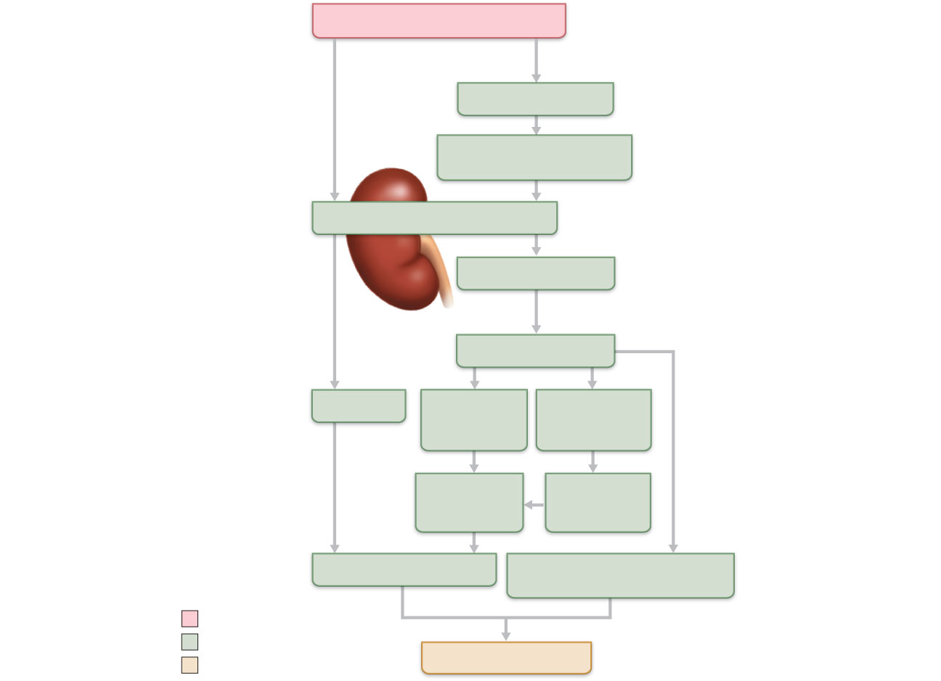
Arterial pressure
Direct renal
mechanism
Indirect renal
mechanism (hormonal)
Baroreceptors
Sympathetic stimulation
promotes renin release
Kidney
Renin release
catalyzes cascade,
resulting in formation of
Angiotensin II
Filtration
ADH release
by posterior
pituitary
Aldosterone
secretion by
adrenal cortex
Water
reabsorption
by kidneys
Sodium
reabsorption
by kidneys
Blood volume
Vasoconstriction
( diameter of blood vessels)
Initial stimulus
Physiological response
Arterial pressure
Result
Figure 19.10

Slide 57
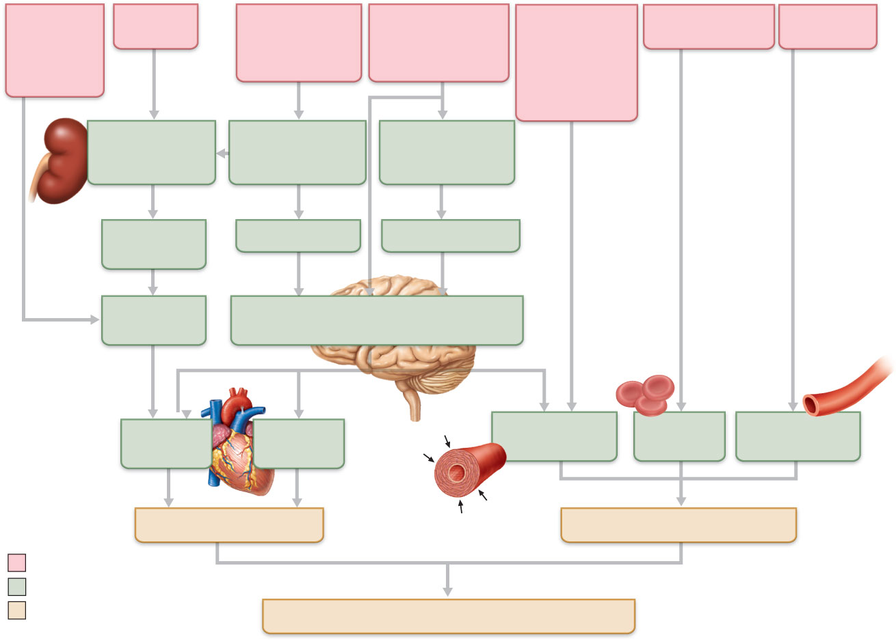
Activity of
muscular
pump and
respiratory
pump
Release
of ANP
Fluid loss from
hemorrhage,
excessive
sweating
Crisis stressors:
exercise, trauma,
body
temperature
Bloodborne
chemicals:
epinephrine,
NE, ADH,
angiotensin II;
ANP release
Dehydration,
high hematocrit
Body size
Conservation
of Na⁺ and
water by kidney
Blood volume
Blood pressure
Blood pH, O₂,
CO₂
Blood
volume
Baroreceptors
Chemoreceptors
Venous
return
Activation of vasomotor and cardiac
acceleration centers in brain stem
Stroke
volume
Heart
rate
Diameter of
blood vessels
Blood
viscosity
Blood vessel
length
Cardiac output
Peripheral resistance
Initial stimulus
Physiological response
Result
Mean systemic arterial blood pressure
Figure 19.11

Slide 58
Monitoring Circulatory Efficiency
Vital signs: pulse and blood pressure, along with respiratory rate and body temperature
Pulse: pressure wave caused by the expansion and recoil of arteries
Radial pulse (taken at the wrist) routinely used

Slide 59
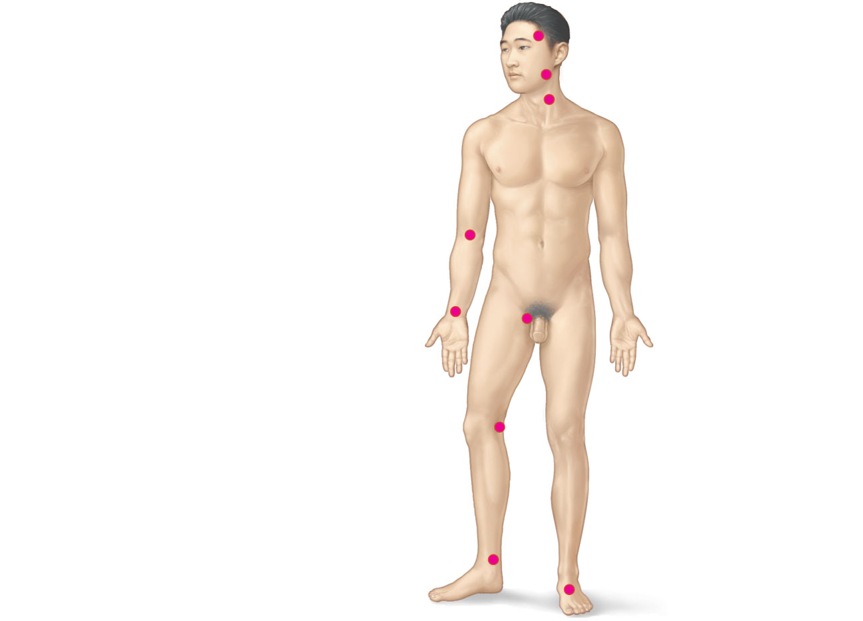
Superficial temporal
artery
Facial artery
Common carotid
artery
Brachial artery
Radial artery
Femoral artery
Popliteal artery
Posterior tibial
artery
Dorsalis pedis
artery
Figure 19.12

Slide 60
Measuring Blood Pressure
Systemic arterial BP
Measured indirectly by the auscultatory method using a sphygmomanometer
Pressure is increased in the cuff until it exceeds systolic pressure in the brachial artery

Slide 61
Measuring Blood Pressure
Pressure is released slowly and the examiner listens for sounds of Korotkoff with a stethoscope
Sounds first occur as blood starts to spurt through the artery (systolic pressure, normally 110–140 mm Hg)
Sounds disappear when the artery is no longer constricted and blood is flowing freely (diastolic pressure, normally 70–80 mm Hg)

Slide 62
Variations in Blood Pressure
Blood pressure cycles over a 24-hour period
BP peaks in the morning due to levels of hormones
Age, sex, weight, race, mood, and posture may vary BP

Slide 63
Alterations in Blood Pressure
Hypotension: low blood pressure
Systolic pressure below 100 mm Hg
Often associated with long life and lack of cardiovascular illness

Slide 64
Homeostatic Imbalance: Hypotension
Orthostatic hypotension: temporary low BP and dizziness when suddenly rising from a sitting or reclining position
Chronic hypotension: hint of poor nutrition and warning sign for Addison’s disease or hypothyroidism
Acute hypotension: important sign of circulatory shock

Slide 65
Alterations in Blood Pressure
Hypertension: high blood pressure
Sustained elevated arterial pressure of 140/90 or higher
May be transient adaptations during fever, physical exertion, and emotional upset
Often persistent in obese people

Slide 66
Homeostatic Imbalance: Hypertension
Prolonged hypertension is a major cause of heart failure, vascular disease, renal failure, and stroke
Primary or essential hypertension
90% of hypertensive conditions
Due to several risk factors including heredity, diet, obesity, age, stress, diabetes mellitus, and smoking

Slide 67
Homeostatic Imbalance: Hypertension
Secondary hypertension is less common
Due to identifiable disorders, including kidney disease, arteriosclerosis, and endocrine disorders such as hyperthyroidism and Cushing’s syndrome

Slide 68
Blood Flow Through Body Tissues
Blood flow (tissue perfusion) is involved in
Delivery of O₂ and nutrients to, and removal of wastes from, tissue cells
Gas exchange (lungs)
Absorption of nutrients (digestive tract)
Urine formation (kidneys)
Rate of flow is precisely the right amount to provide for proper function

Slide 69
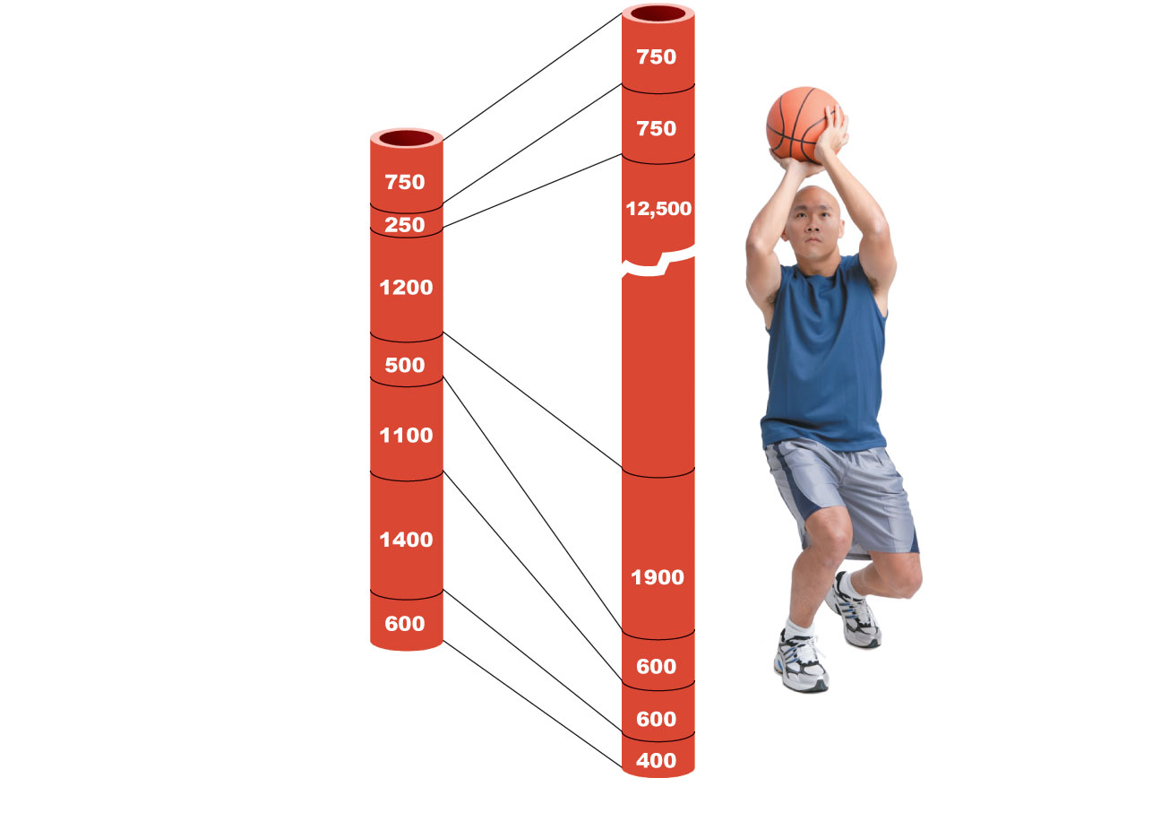
Brain
Heart
Skeletal
muscles
Skin
Kidney
Abdomen
Other
Total blood
flow at rest
5800 ml/min
Total blood flow during strenuous
exercise 17,500 ml/min
Figure 19.13

Slide 70
Velocity of Blood Flow
Changes as it travels through the systemic circulation
Is inversely related to the total cross-sectional area
Is fastest in the aorta, slowest in the capillaries, increases again in veins
Slow capillary flow allows adequate time for exchange between blood and tissues

Slide 71
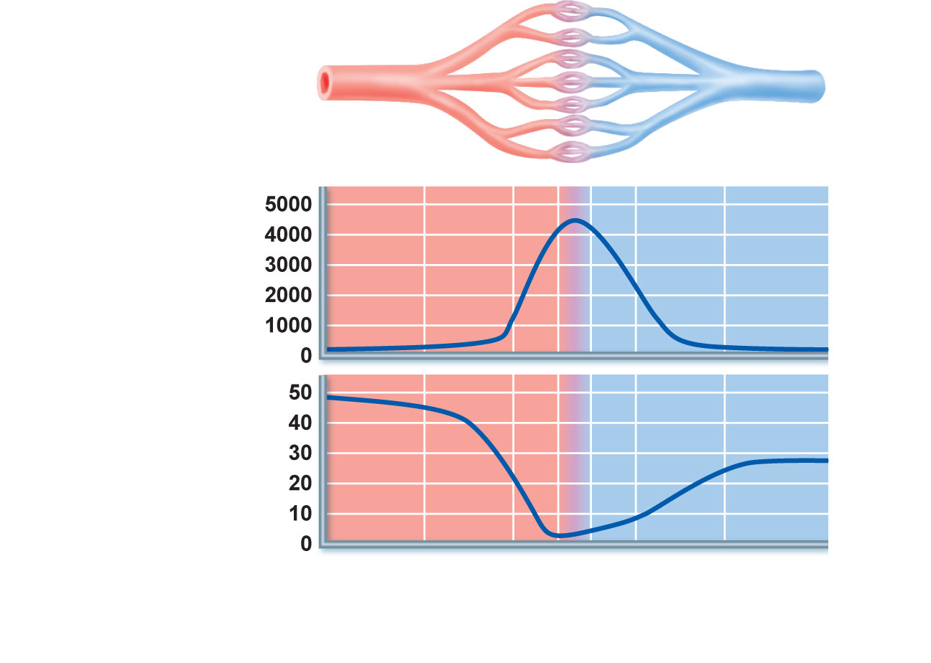
Relative cross-
sectional area of
different vessels
of the vascular bed
Total area
(cm²) of the
vascular
bed
Velocity of
blood flow
(cm/s)
Aorta
Arteries
Venules
Veins
Arterioles
Capillaries
Venae cavae
Figure 19.14

Slide 72
Autoregulation
Automatic adjustment of blood flow to each tissue in proportion to its requirements at any given point in time
Is controlled intrinsically by modifying the diameter of local arterioles feeding the capillaries
Is independent of MAP, which is controlled as needed to maintain constant pressure

Slide 73
Temperature Regulation
As temperature rises (e.g., heat exposure, fever, vigorous exercise)
Hypothalamic signals reduce vasomotor stimulation of the skin vessels
Heat radiates from the skin

Slide 74
Temperature Regulation
Sweat also causes vasodilation via bradykinin in perspiration
Bradykinin stimulates the release of NO
As temperature decreases, blood is shunted to deeper, more vital organs

Slide 75
Blood Flow Through Capillaries
Vasomotion
Slow and intermittent flow
Reflects the on/off opening and closing of precapillary sphincters

Slide 76
Capillary Exchange of Respiratory Gases and Nutrients
Diffusion of
O₂ and nutrients from the blood to tissues
CO₂ and metabolic wastes from tissues to the blood
Lipid-soluble molecules diffuse directly through endothelial membranes
Water-soluble solutes pass through clefts and fenestrations
Larger molecules, such as proteins, are actively transported in pinocytotic vesicles or caveolae

Slide 77
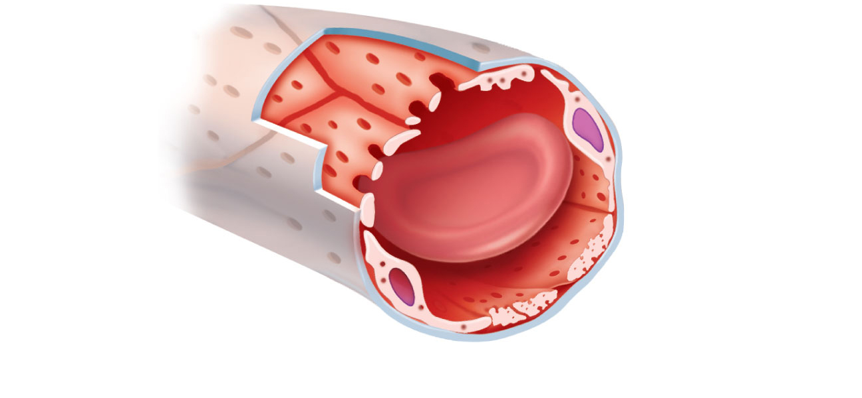
Pinocytotic vesicles
Red blood
cell in lumen
Endothelial cell
Fenestration
(pore)
Endothelial cell nucleus
Basement membrane
Tight junction
Intercellular cleft
Figure 19.16 (1 of 2)

Slide 78
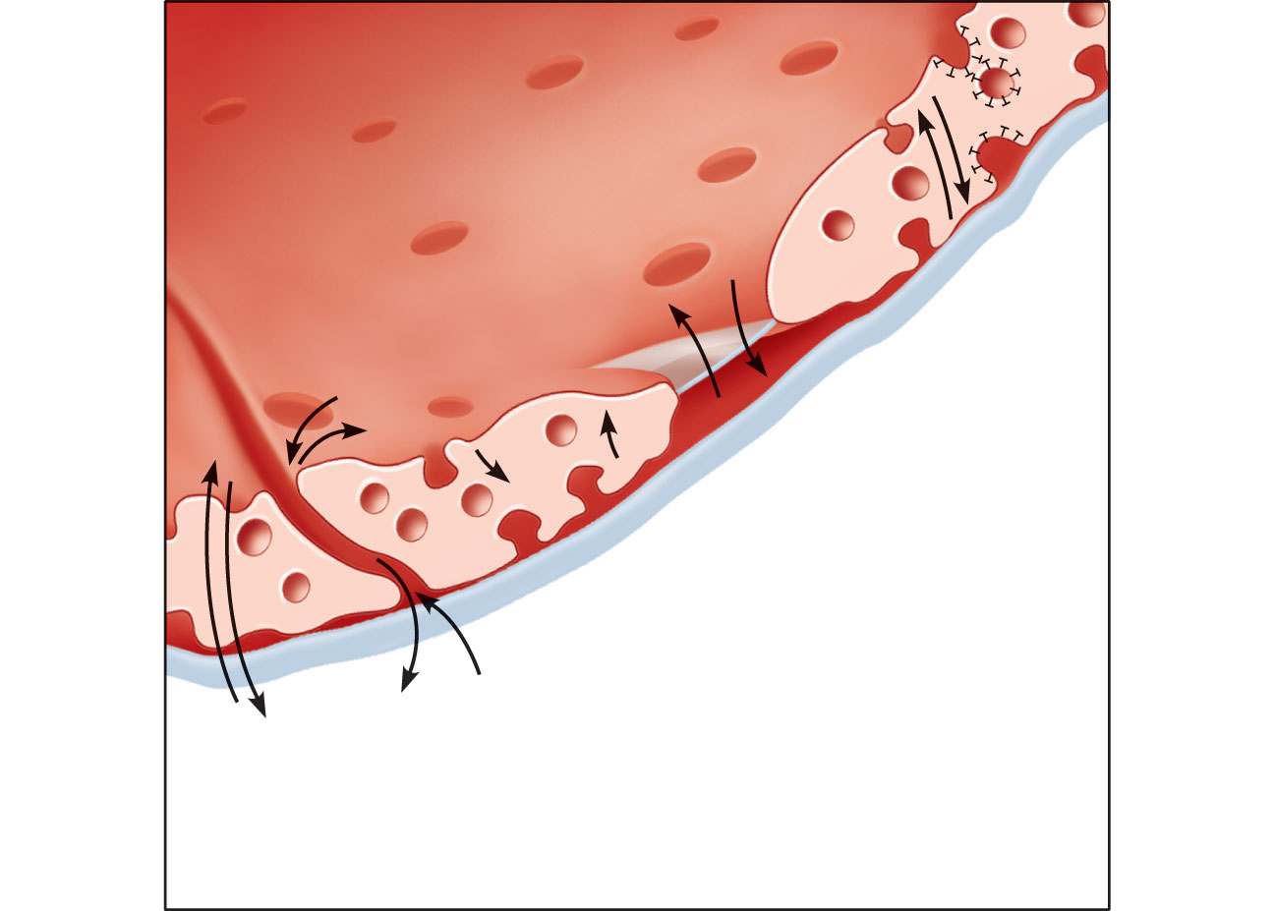
Lumen
Caveolae
Pinocytotic
vesicles
Endothelial
fenestration
(pore)
Intercellular
cleft
4
Transport
via vesicles or
caveolae (large
substances)
3
Movement
through
fenestrations
(water-soluble
substances)
Basement
membrane
2
Movement
through intercellular
clefts (water-soluble
substances)
1
Diffusion
through
membrane
(lipid-soluble
substances)
Figure 19.16 (2 of 2)

Slide 79
Fluid Movements: Bulk Flow
Extremely important in determining relative fluid volumes in the blood and interstitial space
Direction and amount of fluid flow depends on two opposing forces: hydrostatic and colloid osmotic pressures

Slide 80
Hydrostatic Pressures
Capillary hydrostatic pressure (HP_{c}) (capillary blood pressure)
Tends to force fluids through the capillary walls
Is greater at the arterial end (35 mm Hg) of a bed than at the venule end (17 mm Hg)
Interstitial fluid hydrostatic pressure (HP_{if})
Usually assumed to be zero because of lymphatic vessels

Slide 81
Colloid Osmotic Pressures
Capillary colloid osmotic pressure (oncotic pressure) (OP_{c})
Created by nondiffusible plasma proteins, which draw water toward themselves
~26 mm Hg
Interstitial fluid osmotic pressure (OP_{if})
Low (~1 mm Hg) due to low protein content

Slide 82
Net Filtration Pressure (NFP)
NFP—comprises all the forces acting on a capillary bed
NFP = (HP_{c}—HP_{if})—(OP_{c}—OP_{if})
At the arterial end of a bed, hydrostatic forces dominate
At the venous end, osmotic forces dominate
Excess fluid is returned to the blood via the lymphatic system

Slide 83
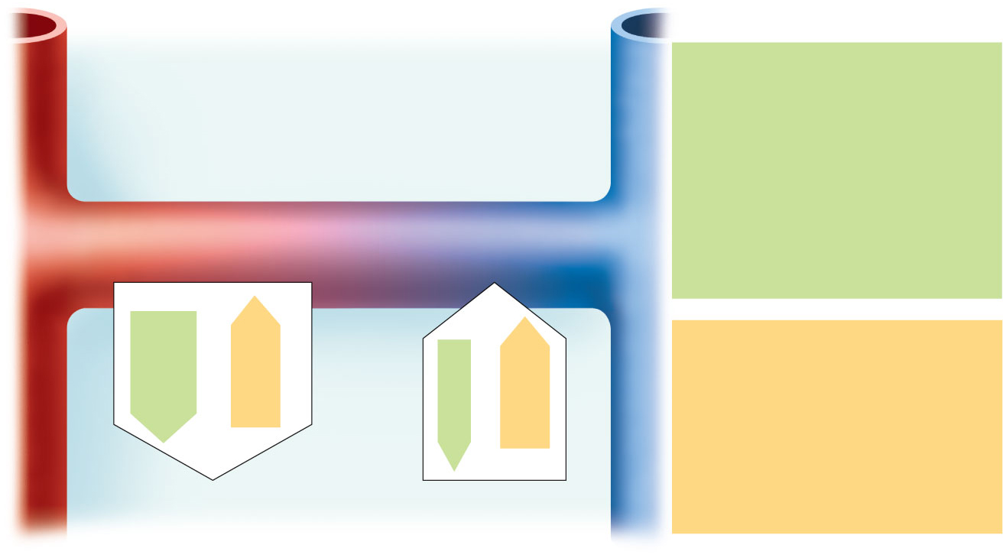
HP = hydrostatic pressure
• Due to fluid pressing against a wall
• “Pushes”
• In capillary (HP_{c})
• Pushes fluid out of capillary
• 35 mm Hg at arterial end and
17 mm Hg at venous end of
capillary in this example
• In interstitial fluid (HP_{if})
• Pushes fluid into capillary
• 0 mm Hg in this example
Arteriole
Venule
Interstitial fluid
Capillary
Net HP—Net OP
(35—0)—(26—1)
Net HP—Net OP
(17—0)—(26—1)
Net
HP
35
mm
Net
OP
25
mm
OP = osmotic pressure
• Due to presence of nondiffusible
solutes (e.g., plasma proteins)
• “Sucks”
• In capillary (OP_{c})
• Pulls fluid into capillary
• 26 mm Hg in this example
• In interstitial fluid (OP_{if})
• Pulls fluid out of capillary
• 1 mm Hg in this example
Net
HP
17
mm
Net
OP
25
mm
NFP (net filtration pressure)
is 10 mm Hg; fluid moves out
NFP is ~8 mm Hg;
fluid moves in
Figure 19.17

Slide 84
Circulatory Pathways
Two main circulations
Pulmonary circulation: short loop that runs from the heart to the lungs and back to the heart
Systemic circulation: long loop to all parts of the body and back to the heart

Slide 85
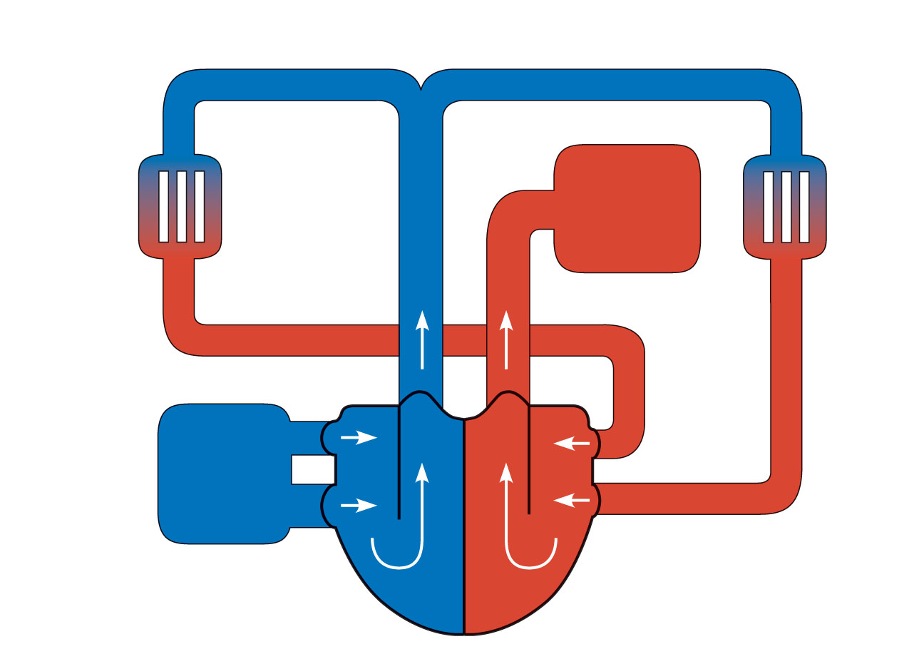
Pulmonary capillaries
of the R. lung
R. pulmonary
artery
L. pulmonary
artery
Pulmonary capillaries
of the L. lung
Pulmonary
trunk
To
systemic
circulation
R. pulmon-
ary veins
From
systemic
circulation
RA
LA
L. pulmonary
veins
RV
LV
(a) Schematic flowchart.
Figure 19.19a

Slide 86
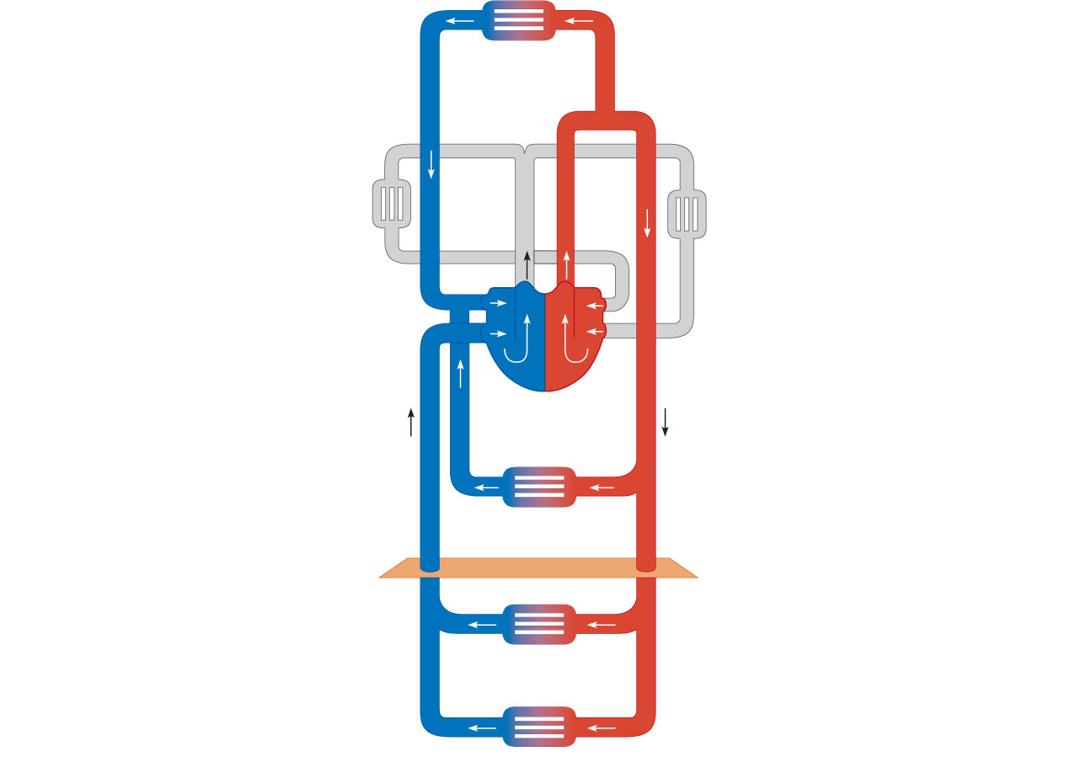
Capillary beds of
head and
upper limbs
Common
carotid arteries
to head and
subclavian
arteries to
upper limbs
Superior
vena cava
Aortic
arch
Aorta
RA
LA
RV
LV
Azygos
system
Thoracic
aorta
Venous
drainage
Arterial
blood
Inferior
vena
cava
Capillary beds of
mediastinal structures
and thorax walls
Diaphragm
Abdominal
aorta
Inferior
vena
cava
Capillary beds of
digestive viscera,
spleen, pancreas,
kidneys
Capillary beds of gonads,
pelvis, and lower limbs
Figure 19.20

Slide 87
Differences Between Arteries and Veins
 | Arteries | Veins
Delivery | Blood pumped into single systemic artery—the aorta | Blood returns via superior and interior venae cavae and the coronary sinus
Location | Deep, and protected by tissues | Both deep and superficial
Pathways | Fairly distinct | Numerous interconnections
Supply/drainage | Predictable supply | Usually similar to arteries, except dural sinuses and hepatic portal circulation

Slide 88
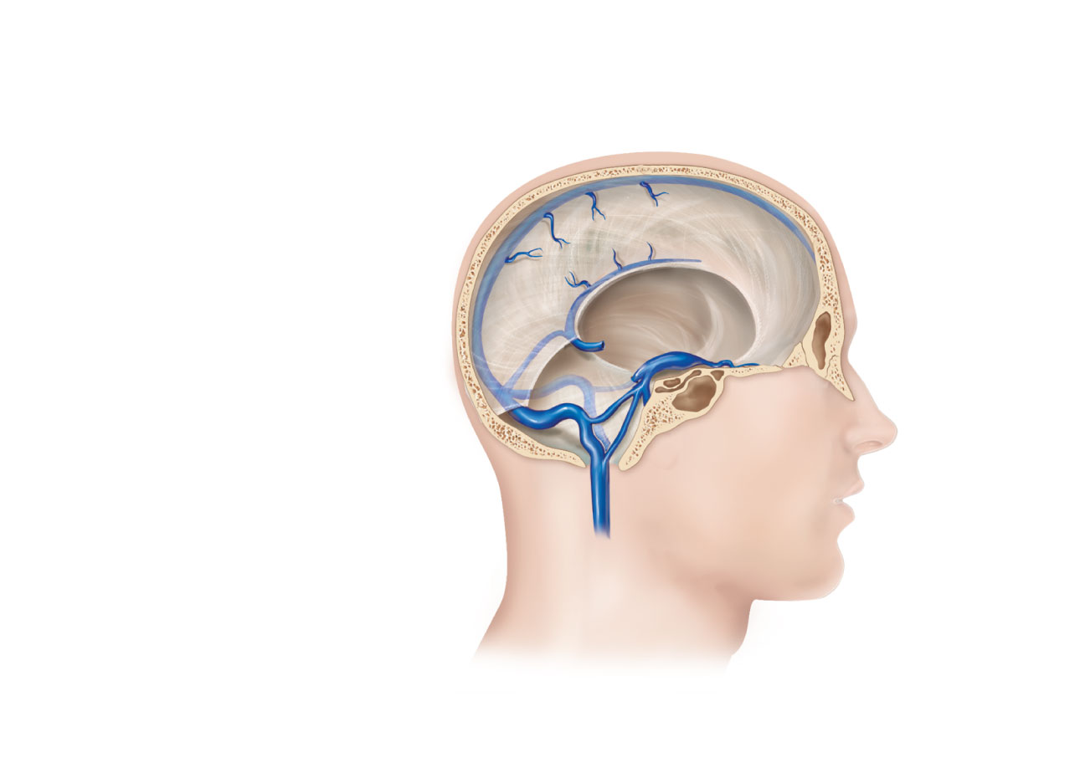
Superior sagittal
sinus
Falx cerebri
Inferior sagittal
sinus
Cavernous
sinus
Straight sinus
Confluence
of sinuses
Transverse
sinuses
Sigmoid sinus
Jugular foramen
Right internal
jugular vein
(c) Dural venous sinuses of the brain
Figure 19.27c

Slide 89
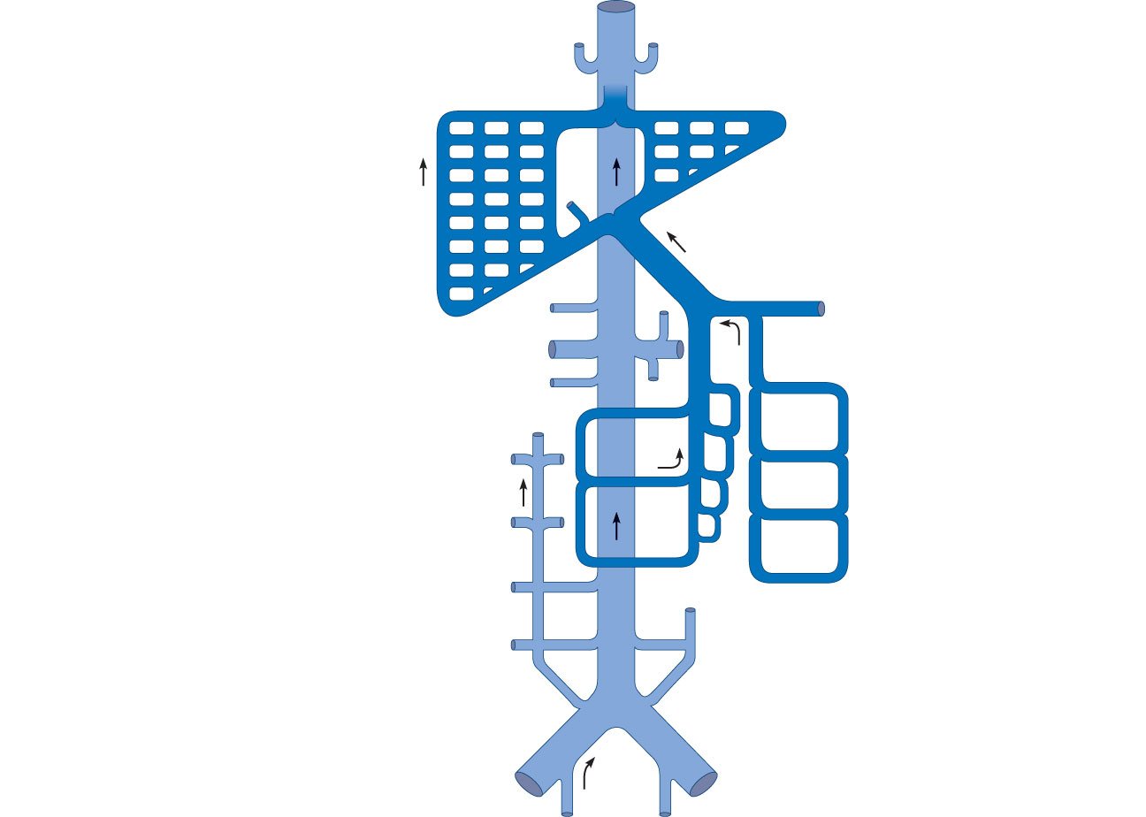
Inferior
vena cava
Inferior phrenic veins
Cystic vein
Hepatic veins
Hepatic
portal
system
Hepatic portal vein
Superior mesenteric vein
Splenic vein
Suprarenal
veins
Inferior
mesenteric
vein
Renal veins
Gonadal veins
Lumbar veins
R. ascending
lumbar vein
L. ascending
lumbar vein
Common iliac veins
External iliac vein
(a) Schematic flowchart.
Internal iliac veins
Figure 19.29a

Slide 90
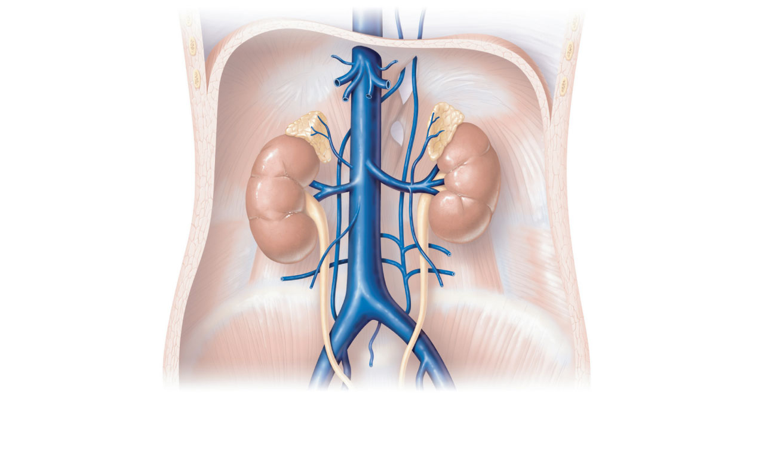
Inferior phrenic
vein
Hepatic veins
Inferior vena cava
Left suprarenal
vein
Right suprarenal
vein
Renal veins
Left ascending
lumbar vein
Right gonadal
vein
Lumbar veins
Left gonadal vein
Common iliac
vein
External iliac
vein
Internal iliac vein
(b) Tributaries of the inferior vena cava. Venous drainage
of abdominal organs not drained by the hepatic portal vein.
Figure 19.29b

Slide 91
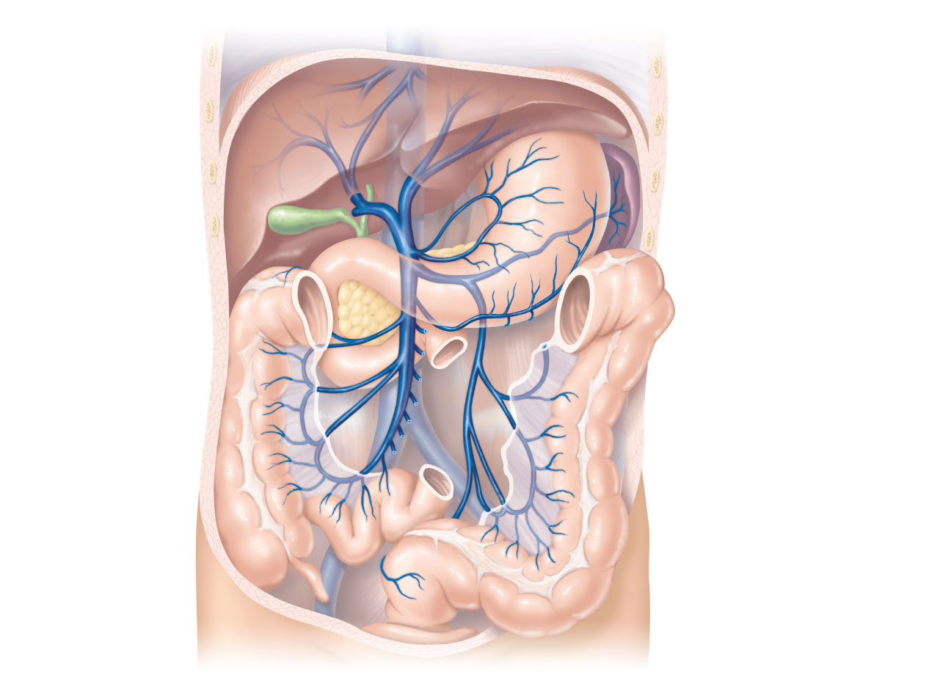
Inferior vena cava
(not part of hepatic
portal system)
Gastric veins
Hepatic veins
Spleen
Inferior vena cava
Liver
Splenic vein
Right gastroepiploic
vein
Hepatic portal
vein
Inferior
mesenteric vein
Superior
mesenteric vein
Small intestine
Large intestine
Rectum
(c) The hepatic portal circulation.
Figure 19.29c

