Slide 1
Chapter 20
The Lymphatic System

Slide 2
Lymphatic System
Consists of three parts
A network of lymphatic vessels (lymphatics)
Lymph
Lymph nodes

Slide 3
Lymphatic System: Functions
Returns interstitial fluid and leaked plasma proteins back to the blood
Once interstitial fluid enters lymphatics, it is called lymph
Together with lymphoid organs and tissues, provide the structural basis of the immune system

Slide 4
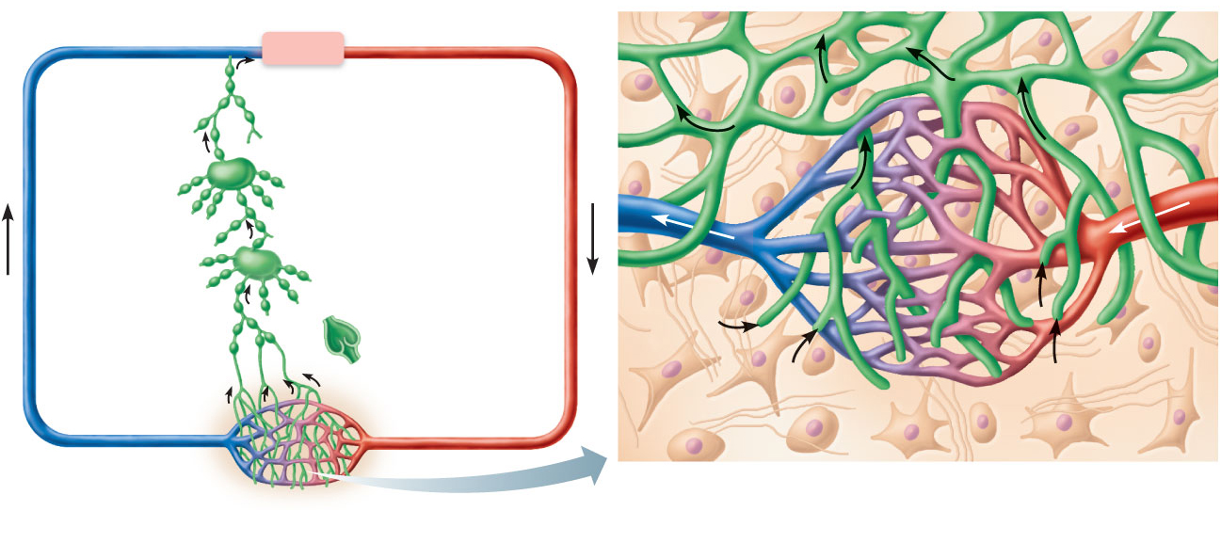
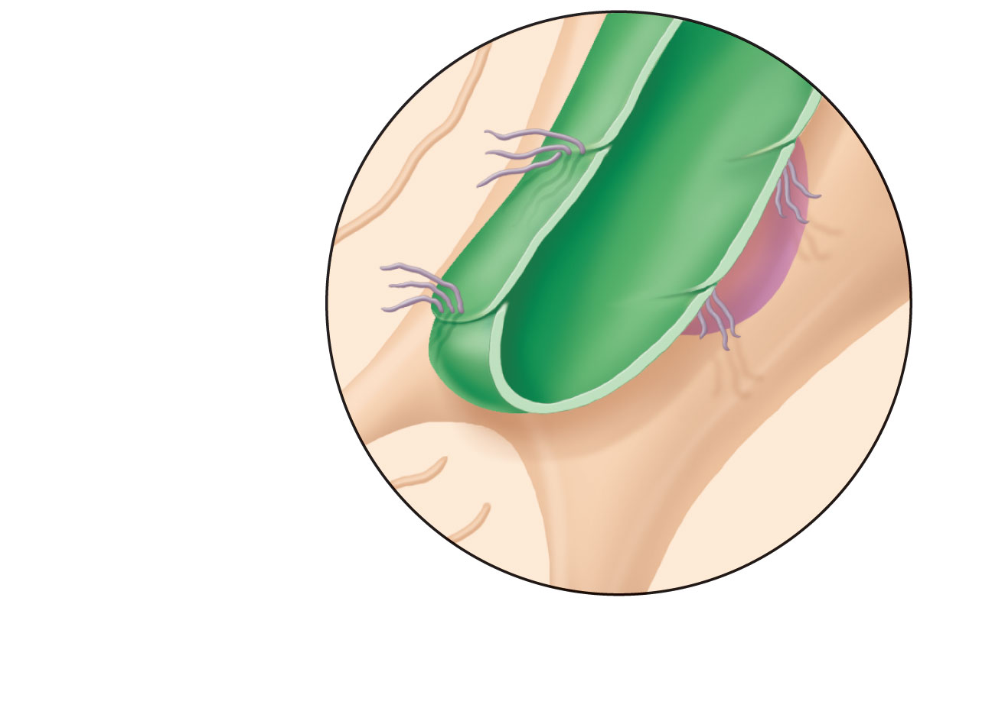
Venous system
Heart
Arterial system
Lymphatic
system:
Lymph duct
Lymph trunk
Lymph node
Lymphatic
collecting vessels,
with valves
Tissue
fluid
Blood
capillaries
Lymphatic
capillary
Tissue cell
Blood
capillaries
Lymphatic
capillaries
(a) Structural relationship between a
capillary bed of the blood vascular
system and lymphatic capillaries.
Filaments anchored
to connective tissue
Endothelial cell
Flaplike minivalve
Fibroblast in loose
connective tissue
(b) Lymphatic capillaries are blind-ended tubes in which
adjacent endothelial cells overlap each other,
forming flaplike minivalves.
Figure 20.1

Slide 5
Lymphatic Vessels
One-way system, lymph flows toward the heart
Lymph vessels (lymphatics) include:
Lymphatic capillaries
Lymphatic collecting vessels
Lymphatic trunks and ducts

Slide 6
Lymphatic Capillaries
Similar to blood capillaries, except
Very permeable (take up cell debris, pathogens, and cancer cells)
Endothelial cells overlap to form one-way minivalves, and are anchored by collagen filaments, preventing collapse of capillaries

Slide 7
Lymphatic Capillaries
Absent from bones, teeth, bone marrow and the CNS
Lacteals: specialized lymph capillaries present in intestinal mucosa
Absorb digested fat and deliver fatty lymph (chyle) to the blood

Slide 8
Filaments anchored
to connective tissue
Endothelial cell
Flaplike minivalve
Fibroblast in loose
connective tissue
(b) Lymphatic capillaries are blind-ended tubes in which
adjacent endothelial cells overlap each other,
forming flaplike minivalves.
Figure 20.1b

Slide 9
Lymphatic Collecting Vessels
Similar to veins, except
Have thinner walls, with more internal valves
Anastomose more frequently
Collecting vessels in the skin travel with superficial veins
Deep vessels travel with arteries
Nutrients are supplied from branching vasa vasorum

Slide 10
Lymphatic Ducts
Lymph is delivered into one of two large ducts
Right lymphatic duct drains the right upper arm and the right side of the head and thorax
Thoracic duct arises from the cisterna chyli and drains the rest of the body
Each empties lymph into venous circulation at the junction of the internal jugular and subclavian veins on its own side of the body

Slide 11
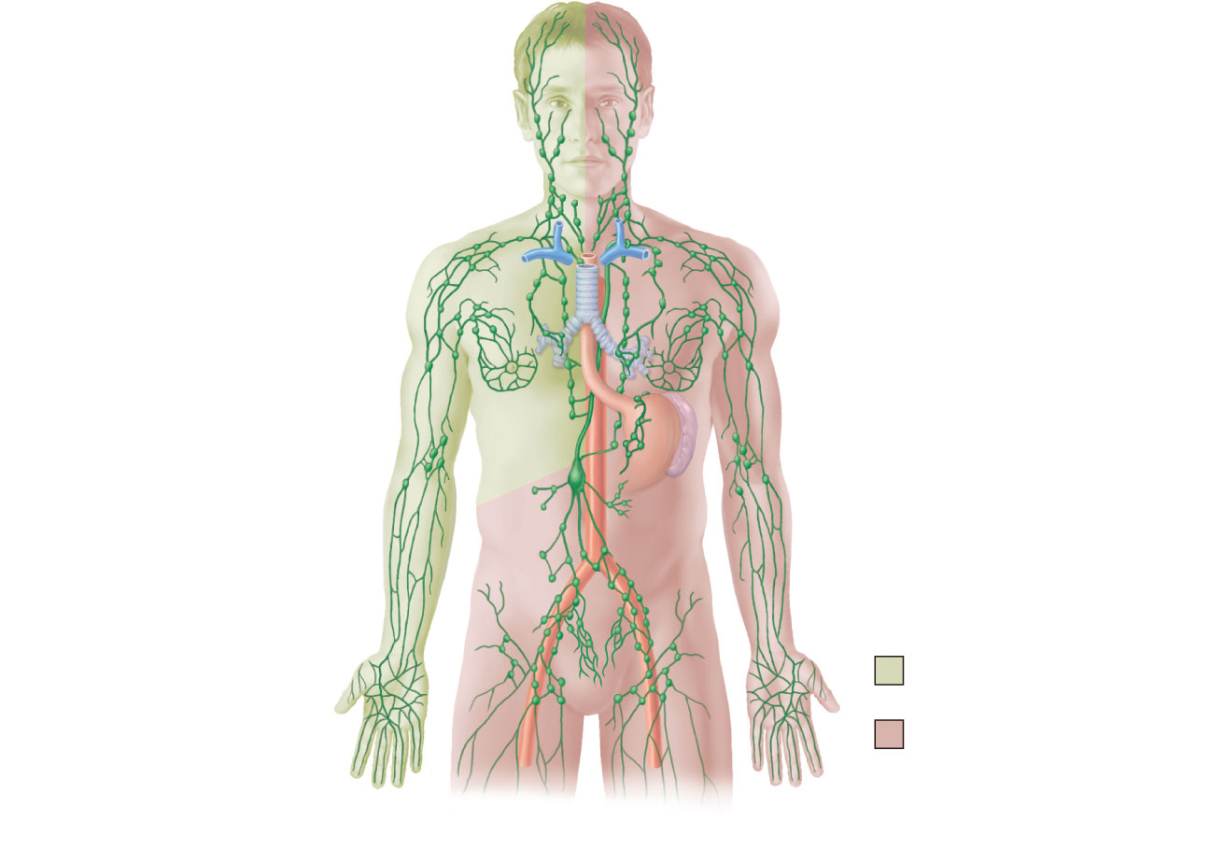
Regional
lymph nodes:
Internal jugular vein
Cervical nodes
Entrance of right
lymphatic duct into vein
Entrance of thoracic
duct into vein
Axillary nodes
Thoracic duct
Cisterna chyli
Aorta
Inguinal nodes
Lymphatic
collecting vessels
Drained by the right
lymphatic duct
Drained by the
thoracic duct
(a) General distribution of lymphatic collecting vessels
and regional lymph nodes.
Figure 20.2a

Slide 12
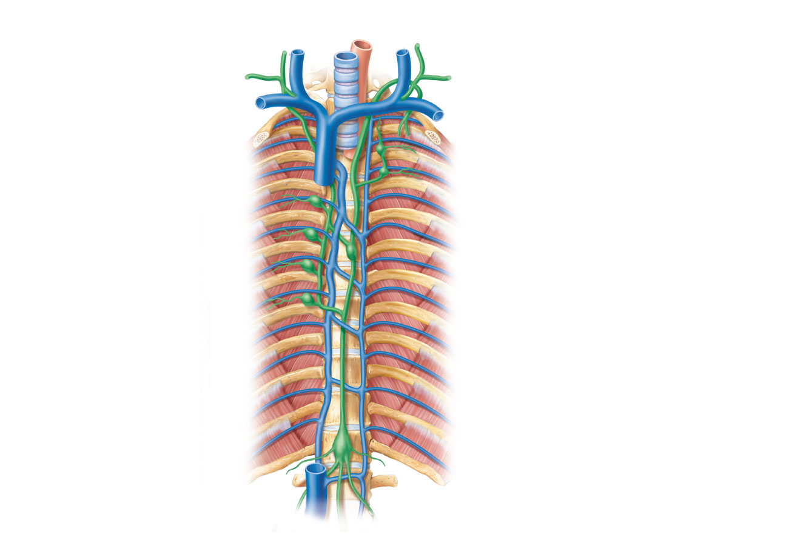
Right jugular trunk
Internal jugular veins
Right lymphatic duct
Esophagus
Right subclavian trunk
Trachea
Right subclavian vein
Left subclavian trunk
Right broncho-
mediastinal trunk
Left jugular trunk
Left subclavian vein
Brachiocephalic veins
Entrance of thoracic
duct into vein
Superior vena cava
Left bronchomediastinal
trunk
Azygos vein
Ribs
Thoracic duct
Hemiazygos vein
Cisterna chyli
Right lumbar trunk
Left lumbar trunk
Inferior vena cava
Intestinal trunk
(b) Major lymphatic trunks and ducts in relation to veins and
surrounding structures. Anterior view of thoracic and abdominal wall.
Figure 20.2b

Slide 13
Lymph Transport
Lymph is propelled by
Pulsations of nearby arteries
Contractions of smooth muscle in the walls of the lymphatics

Slide 14
Lymphoid Cells
Lymphocytes the main warriors of the immune system
Two main varieties
T cells (T lymphocytes)
B cells (B lymphocytes)

Slide 15
Lymphocytes
T cells and B cells protect against antigens
Anything the body perceives as foreign
Bacteria and their toxins; viruses
Mismatched RBCs or cancer cells

Slide 16
Lymphocytes
T cells
Manage the immune response
Attack and destroy foreign cells
B cells
Produce plasma cells, which secrete antibodies
Become Memory B cells, which confer long-term immunity.

Slide 17
Other Lymphoid Cells
Macrophages phagocytize foreign substances and help activate T cells
Dendritic cells capture antigens and deliver them to lymph nodes
Reticular cells produce stroma that supports other cells in lymphoid organs

Slide 18
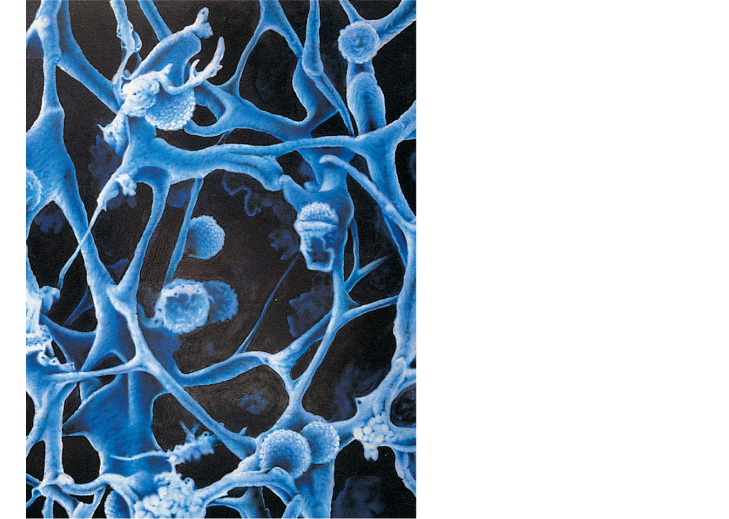
Macrophage
Reticular cells on
reticular fibers
Lymphocytes
Medullary sinus
Reticular fiber
Figure 20.3

Slide 19
Lymphoid Tissue
Houses and provides a proliferation site for lymphocytes
Furnishes a surveillance vantage point
Two main types
Diffuse lymphatic tissue
Lymphatic follicles

Slide 20
Lymphoid Tissue
Diffuse lymphatic tissue comprises scattered reticular tissue elements in every body organ
Larger collections in the lamina propria of mucous membranes and lymphoid organs

Slide 21
Lymphoid Tissue
Lymphatic follicles (nodules) are solid, spherical bodies of tightly packed reticular elements and cells
Germinal center composed of dendritic and B cells
May form part of larger lymphoid organs

Slide 22
Lymph Nodes
Principal lymphoid organs of the body
Embedded in connective tissue, in clusters along lymphatic vessels
Near the body surface in inguinal, axillary, and cervical regions of the body

Slide 23
Regional
lymph nodes:
Internal jugular vein
Cervical nodes
Entrance of right
lymphatic duct into vein
Entrance of thoracic
duct into vein
Axillary nodes
Thoracic duct
Cisterna chyli
Aorta
Inguinal nodes
Lymphatic
collecting vessels
Drained by the right
lymphatic duct
Drained by the
thoracic duct
(a) General distribution of lymphatic collecting vessels
and regional lymph nodes.
Figure 20.2a

Slide 24
Lymph Nodes
Functions
Filter lymph—macrophages destroy microorganisms and debris
Immune system—lymphocytes are activated and mount an attack against antigens

Slide 25
Structure of a Lymph Node
Bean shaped
External fibrous capsule
Trabeculae extend inward and divide the node into compartments
Two histologically distinct regions
Cortex
Medulla

Slide 26
Structure of a Lymph Node
Cortex contains follicles with germinal centers, heavy with dividing B cells
Dendritic cells nearly encapsulate the follicles
Deep cortex houses T cells in transit
T cells circulate continuously among the blood, lymph nodes, and lymphatic stream

Slide 27
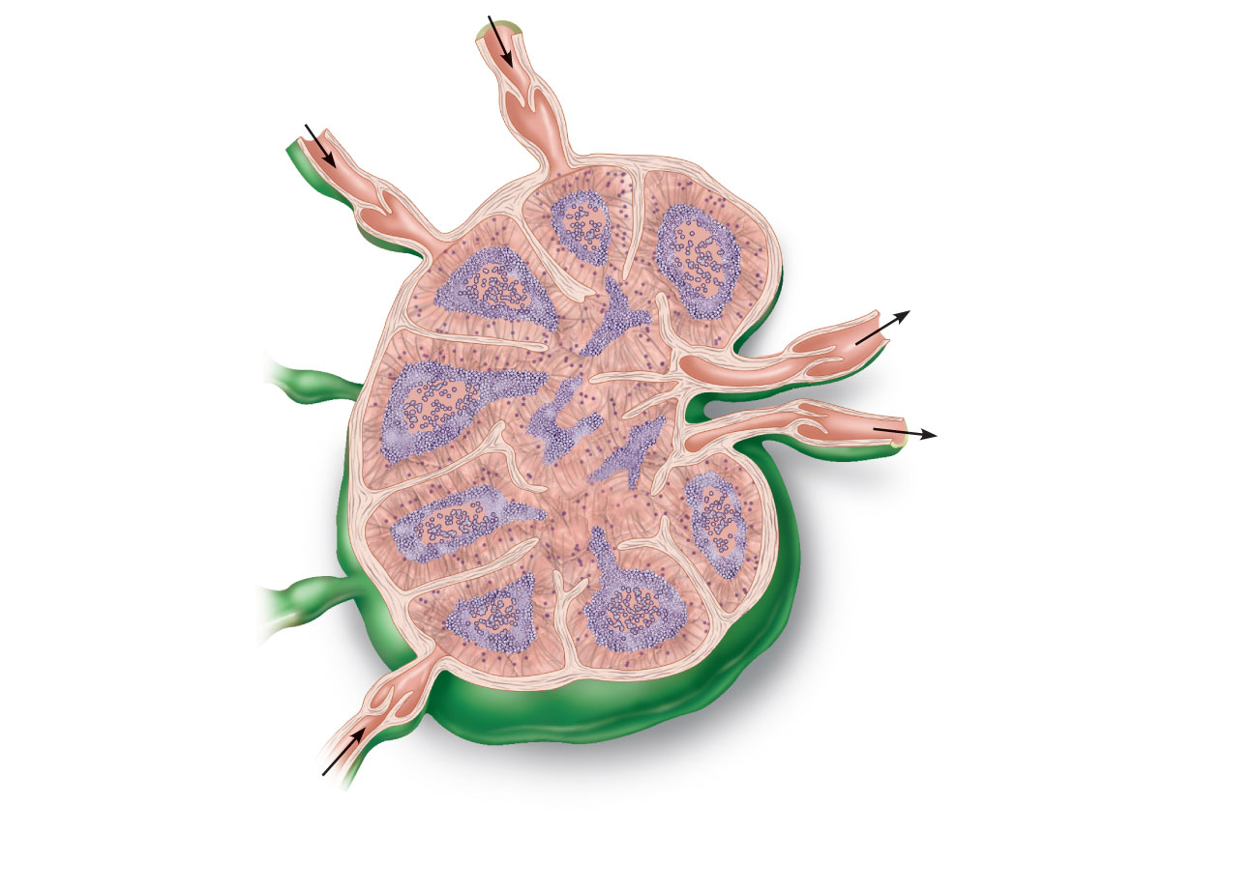
Cortex
Afferent lymphatic
vessels
• Lymphoid follicle
• Germinal center
• Subcapsular sinus
Efferent lymphatic
vessels
Hilum
Medulla:
• Medullary cord
• Medullary sinus
Trabeculae
Capsule
(a) Longitudinal view of the internal structure of a lymph
node and associated lymphatics
Figure 20.4a

Slide 28
Structure of a Lymph Node
Medullary cords extend inward from the cortex and contain B cells, T cells, and plasma cells
Lymph sinuses contain macrophages

Slide 29
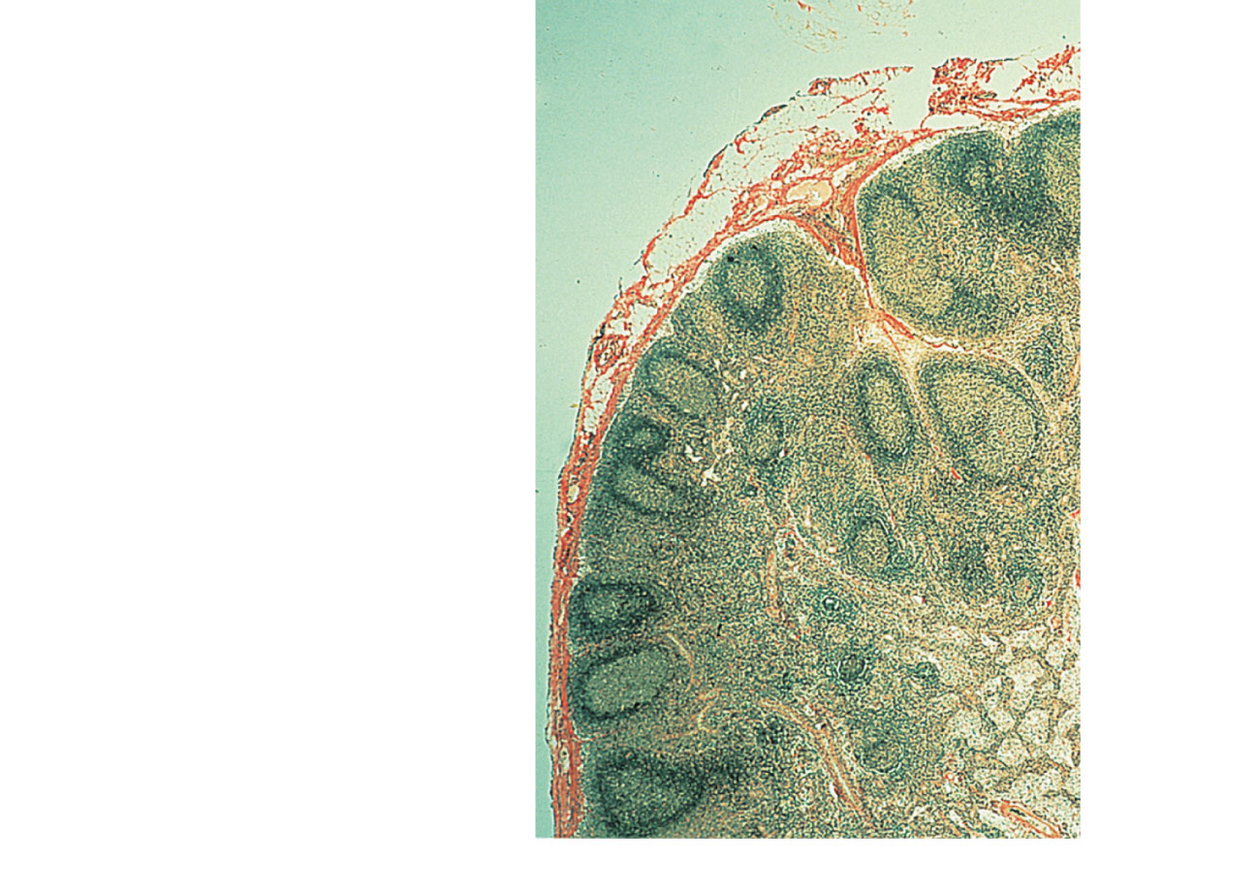
Follicles
Trabecula
Subcapsular sinus
Capsule
Medullary cords
Medullary sinuses
(b) Photomicrograph of part of a lymph node (72x)
Figure 20.4b

Slide 30
Circulation in the Lymph Nodes
Lymph
Enters via afferent lymphatic vessels
Travels through large subcapsular sinus and smaller sinuses
Exits the node at the hilus via efferent vessels
Fewer efferent vessels, causing flow of lymph to stagnate, allowing lymphocytes and macrophages time to carry out functions

Slide 31
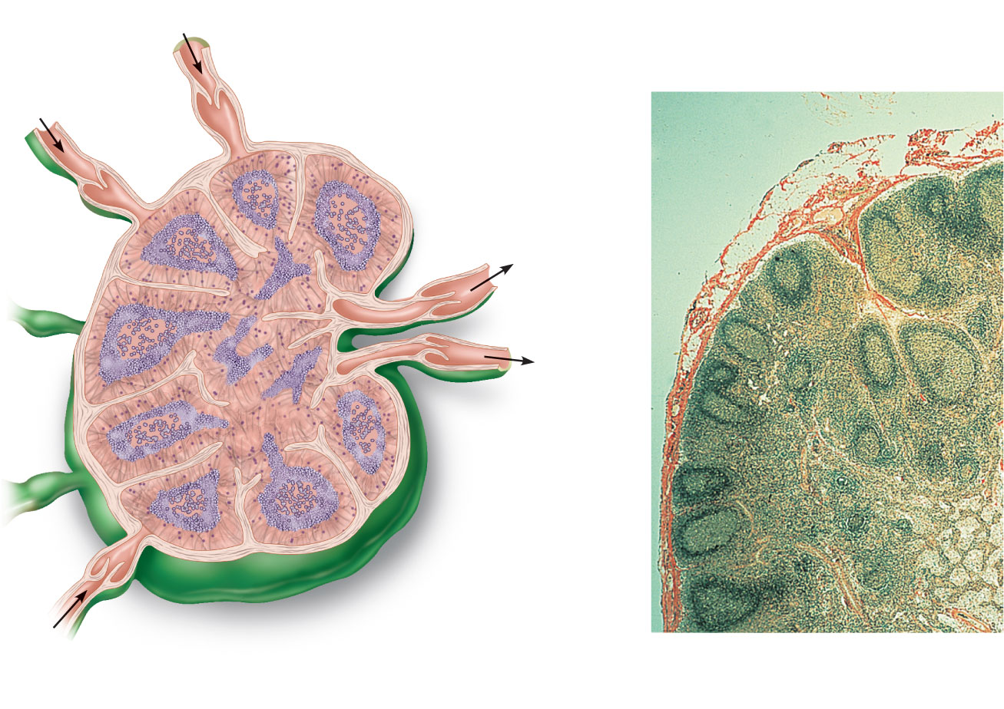
Afferent
lymphatic
vessels
Cortex
• Lymphoid follicle
• Germinal center
• Subcapsular sinus
Efferent
lymphatic
vessels
Follicles
Trabecula
Subcapsular
sinus
Hilum
Capsule
Medulla:
• Medullary
cord
• Medullary
sinus
Medullary
cords
Trabeculae
Medullary
sinuses
Capsule
(b) Photomicrograph of part of a
lymph node (72x)
(a) Longitudinal view of the internal structure
of a lymph node and associated lymphatics
Figure 20.4

Slide 32
Spleen
Largest lymphoid organ
Served by splenic artery and vein, which enter and exit at the hilus
Functions
Site of lymphocyte proliferation and immune surveillance and response
Cleanses the blood of aged cells and platelets and debris

Slide 33
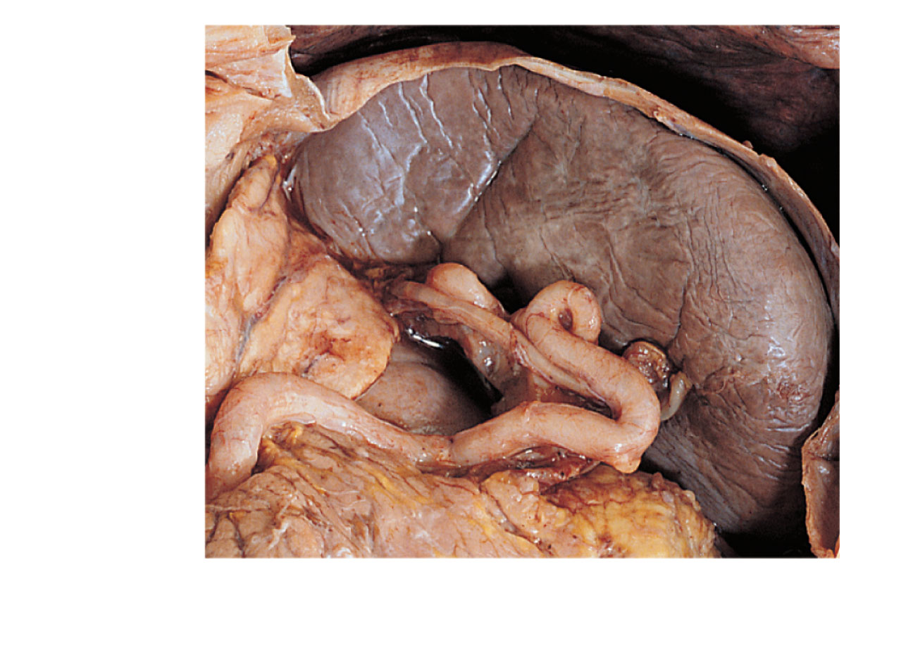
Diaphragm
Spleen
Adrenal
gland
Left
kidney
Splenic
artery
Pancreas
(c) Photograph of the spleen in its normal position
in the abdominal cavity, anterior view.
Figure 20.6c

Slide 34
Spleen
Stores breakdown products of RBCs (e.g., iron) for later reuse
Stores blood platelets
Site of fetal erythrocyte production (normally ceases after birth)
Has a fibrous capsule and trabeculae
Contains lymphocytes, macrophages, and huge numbers of erythrocytes

Slide 35
Structure of the Spleen
Two distinct areas
White pulp around central arteries
Mostly lymphocytes on reticular fibers and involved in immune functions
Red pulp in venous sinuses and splenic cords
Rich in macrophages for disposal of worn-out RBCs and bloodborne pathogens

Slide 36
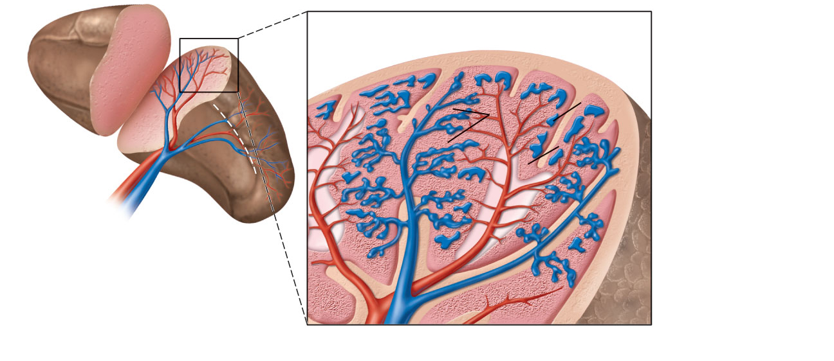
Capsule
Trabecula
Splenic cords
Venous sinuses
Arterioles and
capillaries
Splenic
artery
Splenic
vein
Red pulp
Hilum
White pulp
(a) Diagram of the
spleen, anterior view
Central artery
Splenic artery
Splenic vein
(b) Diagram of spleen histology
Figure 20.6a,b

Slide 37
Thymus
Size with age
In infants, it is found in the inferior neck and extends into the mediastinum, where it partially overlies the heart
Increases in size and is most active during childhood
Stops growing during adolescence and then gradually atrophies

Slide 38
Thymus
Thymic lobes contain an outer cortex and inner medulla
Cortex contains densely packed lymphocytes and scattered macrophages
Medulla contains fewer lymphocytes and thymic (Hassall’s) corpuscles involved in regulatory T cell development

Slide 39
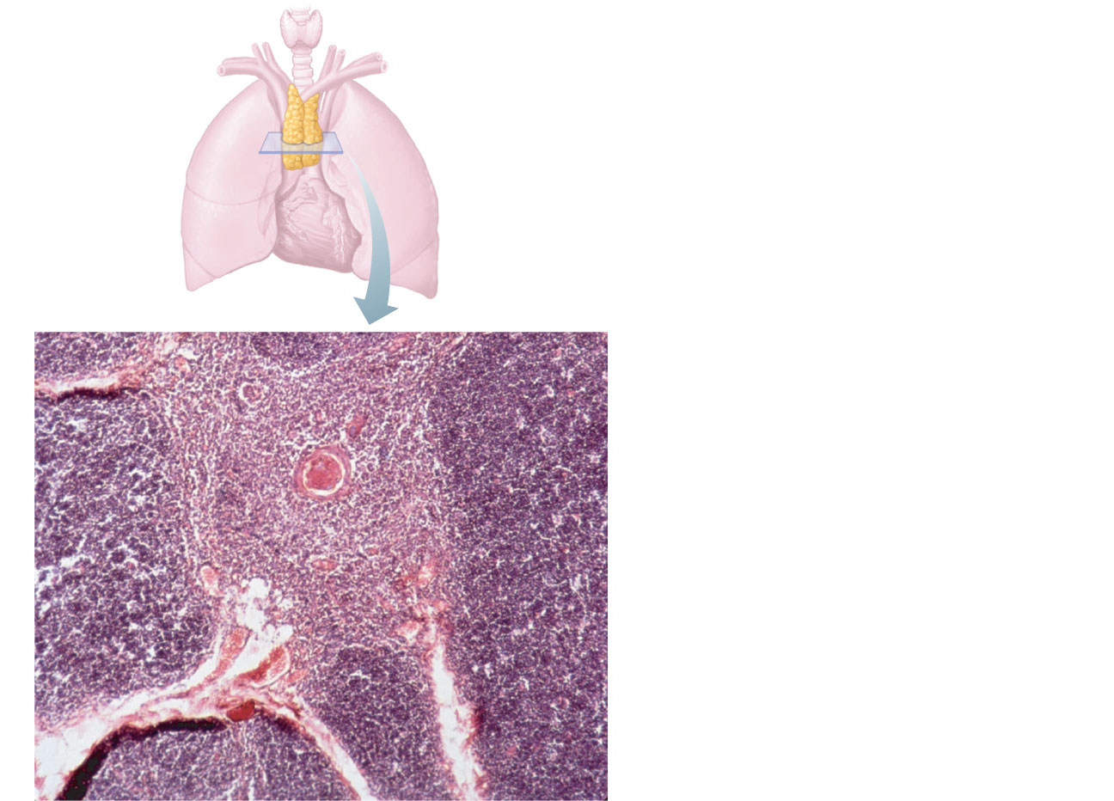
Thymic (Hassall’s)
corpuscle
Medulla
Cortex
Figure 20.7

Slide 40
Thymus
Differs from other lymphoid organs in important ways
It functions strictly in T lymphocyte maturation
It does not directly fight antigens
The stroma of the thymus consists of star-shaped epithelial cells (not reticular fibers)
These thymocytes provide the environment in which T lymphocytes become immunocompetent

Slide 41
Tonsils
Simplest lymphoid organs
Form a ring of lymphatic tissue around the pharynx
Palatine tonsils—at posterior end of the oral cavity
Lingual tonsils—grouped at the base of the tongue
Pharyngeal tonsil—in posterior wall of the nasopharynx
Tubal tonsils—surrounding the openings of the auditory tubes into the pharynx

Slide 42
Tonsils
Contain follicles with germinal centers
Are not fully encapsulated
Epithelial tissue overlying tonsil masses invaginates, forming tonsillar crypts
Crypts trap and destroy bacteria and particulate matter

Slide 43
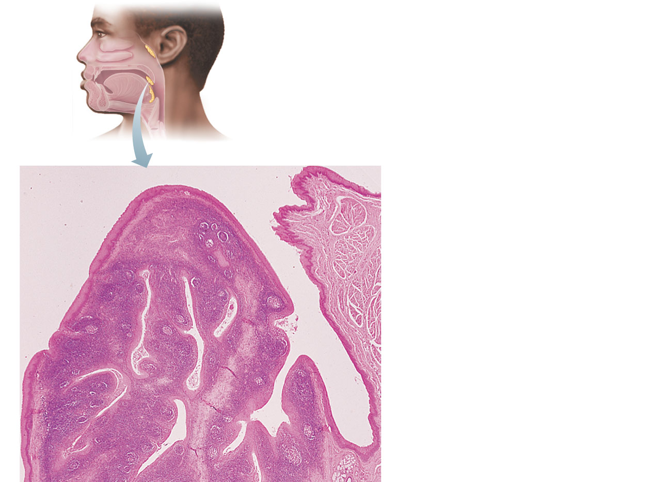
Pharyngeal tonsil
Palatine tonsil
Lingual tonsil
Tonsil
Tonsillar crypt
Germinal centers
in lymphoid follicles
Figure 20.8

Slide 44
Aggregates of Lymphoid Follicles
Peyer’s patches
Clusters of lymphoid follicles
In the wall of the distal portion of the small intestine
Similar structures are also found in the appendix
Peyer’s patches and the appendix
Destroy bacteria, preventing them from breaching the intestinal wall
Generate “memory” lymphocytes

Slide 45
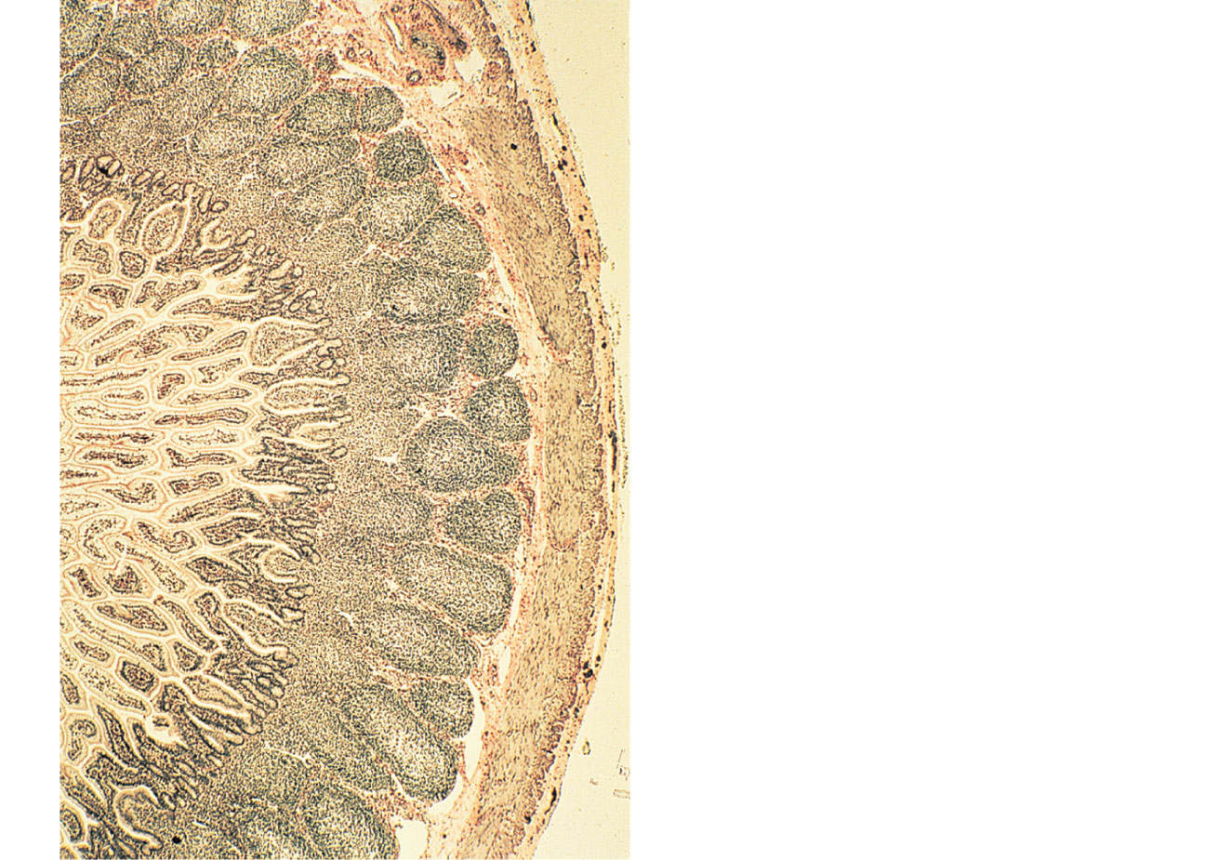
Lymphoid nodules
(follicles) of
Peyer’s patch
Smooth muscle in
the intestinal wall
Figure 20.9

Slide 46
MALT
Mucosa-associated lymphatic tissue, including
Peyer’s patches, tonsils, and the appendix (digestive tract)
Lymphoid nodules in the walls of the bronchi (respiratory tract)
Protects the digestive and respiratory systems from foreign matter

