Slide 1
Chapter 21
16
The Immune System: Innate & Adaptive Body Defenses

Slide 2
Immunity
Resistance to disease
Immune system has two intrinsic systems
Innate (nonspecific) defense system
Adaptive (specific) defense system

Slide 3
Immunity
Innate defense system has two lines of defense
First line of defense is external body membranes (skin and mucosae)
Second line of defense is antimicrobial proteins, phagocytes, and other cells
Inhibit spread of invaders
Inflammation is its most important mechanism

Slide 4
Immunity
Adaptive defense system
Third line of defense attacks particular foreign substances
Takes longer to react than the innate system
Innate and adaptive defenses are deeply intertwined

Slide 5
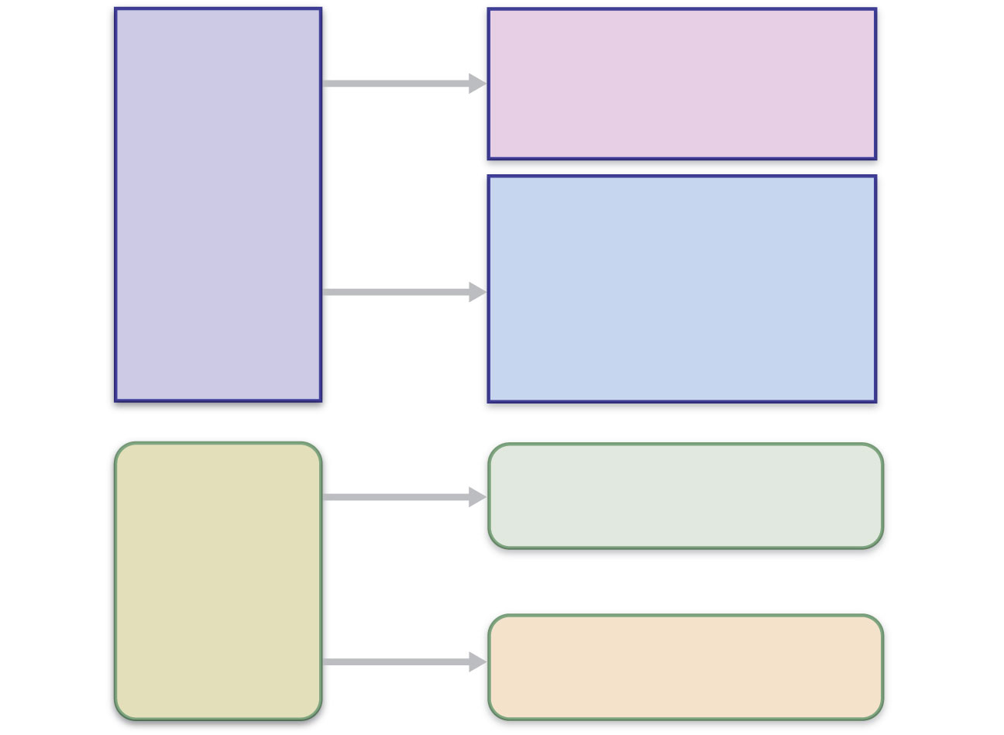
Surface barriers
• Skin
• Mucous membranes
Innate
defenses
Internal defenses
• Phagocytes
• NK cells
• Inflammation
• Antimicrobial proteins
• Fever
Humoral immunity
• B cells
Adaptive
defenses
Cellular immunity
• T cells
Figure 21.1

Slide 6
Innate Defenses
Surface barriers
Skin, mucous membranes, and their secretions
Physical barrier to most microorganisms
Keratin is resistant to weak acids and bases, bacterial enzymes, and toxins
Mucosae provide similar mechanical barriers

Slide 7
Surface Barriers
Protective chemicals inhibit or destroy microorganisms
Skin acidity
Lipids in sebum and dermcidin in sweat
HCl and protein-digesting enzymes of stomach mucosae
Lysozyme of saliva and lacrimal fluid
Mucus with defensins

Slide 8
Surface Barriers
Respiratory system modifications
Mucus-coated hairs in the nose
Cilia of upper respiratory tract sweep dust- and bacteria-laden mucus from lower respiratory passages

Slide 9
Internal Defenses: Cells and Chemicals
Necessary if microorganisms invade deeper tissues
Phagocytes
Natural killer (NK) cells
Inflammatory response (macrophages, mast cells, WBCs, and inflammatory chemicals)
Antimicrobial proteins (interferons and complement proteins)
Fever

Slide 10
Phagocytes: Macrophages
Macrophages develop from monocytes to become the chief phagocytic cells
Free macrophages wander through tissue spaces
E.g., alveolar macrophages
Fixed macrophages are permanent residents of some organs
E.g., Kupffer cells (liver) and microglia (brain)

Slide 11
Phagocytes: Neutrophils
Neutrophils
Become phagocytic on encountering infectious material in tissues

Slide 12
Mechanism of Phagocytosis
Step 1: Adherence of phagocyte to pathogen
Facilitated by opsonization—coating of pathogen by complement proteins or antibodies

Slide 13
Innate defenses
Internal defenses
(a) A macrophage (purple) uses its cytoplasmic
extensions to pull spherical bacteria (green)
toward it. Scanning electron micrograph (1750x).
Figure 21.2a

Slide 14
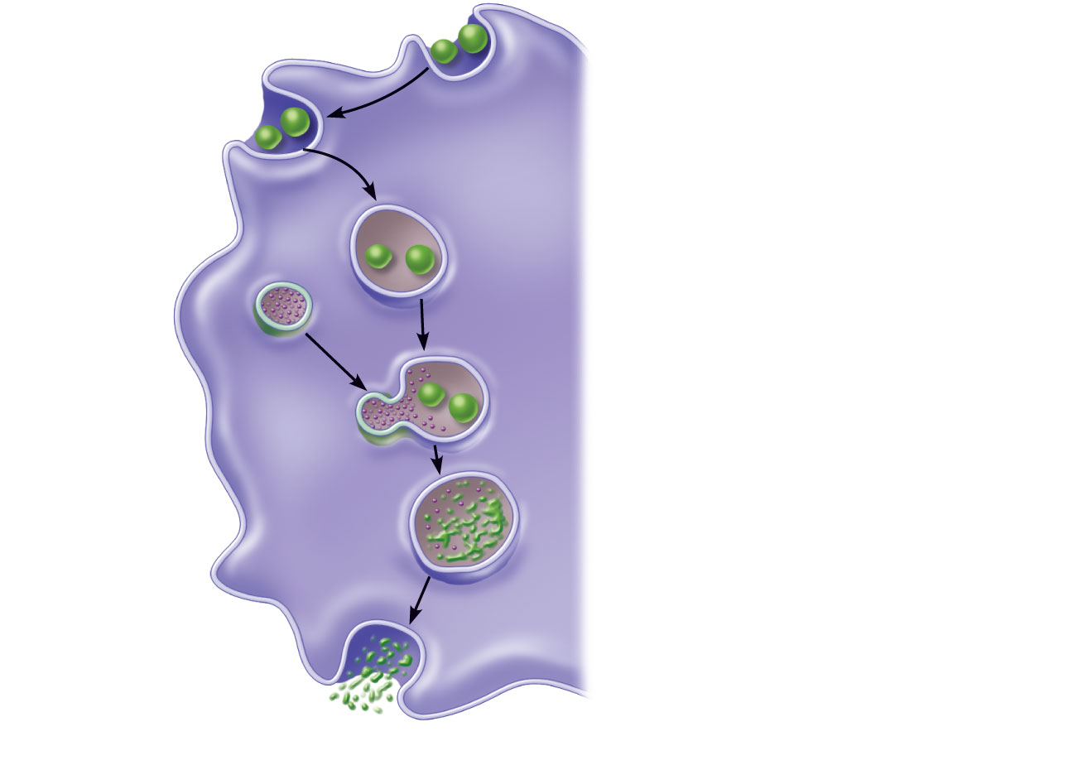
1
Phagocyte
adheres to
pathogens or debris.
2
Phagocyte forms
pseudopods that
eventually engulf the
particles forming a
phagosome.
Phagosome
(phagocytic
vesicle)
Lysosome
3
Lysosome fuses
with the phagocytic
vesicle, forming a
phagolysosome.
Acid
hydrolase
enzymes
4
Lysosomal
enzymes digest the
particles, leaving a
residual body.
5
Exocytosis of the
vesicle removes
indigestible and
residual material.
(b) Events of phagocytosis.
Figure 21.2b

Slide 15
Opsonization
The coating of foreign cells with “sticky” particles.
These particles can be antibodies or complement proteins.
Opsonized bodies are easier to phagocytize, and/or trigger phagocytosis.

Slide 16
Mechanism of Phagocytosis
Destruction of pathogens
Acidification and digestion by lysosomal enzymes
Respiratory burst
Release of cell-killing free radicals
Activation of additional enzymes
Oxidizing chemicals (e.g. H2O2)
Defensins (in neutrophils)

Slide 17
Natural Killer (NK) Cells
Large granular lymphocytes
Target cells that lack “self” cell-surface receptors
Induce apoptosis in cancer cells and virus-infected cells
Secrete potent chemicals that enhance the inflammatory response

Slide 18
Inflammatory Response
Triggered whenever body tissues are injured or infected
Prevents the spread of damaging agents
Disposes of cell debris and pathogens
Sets the stage for repair

Slide 19
Inflammatory Response
Cardinal signs of acute inflammation:
Redness
Heat
Swelling
Pain
(And sometimes 5. Impairment of function)

Slide 20
Inflammatory Response
Macrophages and epithelial cells of boundary tissues bear Toll-like receptors (TLRs)
TLRs recognize specific classes of infecting microbes
Activated TLRs trigger the release of cytokines that promote inflammation

Slide 21
Inflammatory Response
Inflammatory mediators
Histamine (from mast cells)
Blood proteins
Kinins, prostaglandins (PGs), leukotrienes, and complement
Released by injured tissue, phagocytes, lymphocytes, basophils, and mast cells

Slide 22
Vasodilation and Increased Vascular Permeability
Inflammatory chemicals cause
Dilation of arterioles
Increased permeability of local capillaries and edema (leakage of exudate)
Exudate contains proteins, clotting factors, and antibodies

Slide 23
Inflammatory Response: Edema
Functions of the surge of exudate
Moves foreign material into lymphatic vessels
Delivers clotting proteins to form a scaffold for repair and to isolate the area

Slide 24
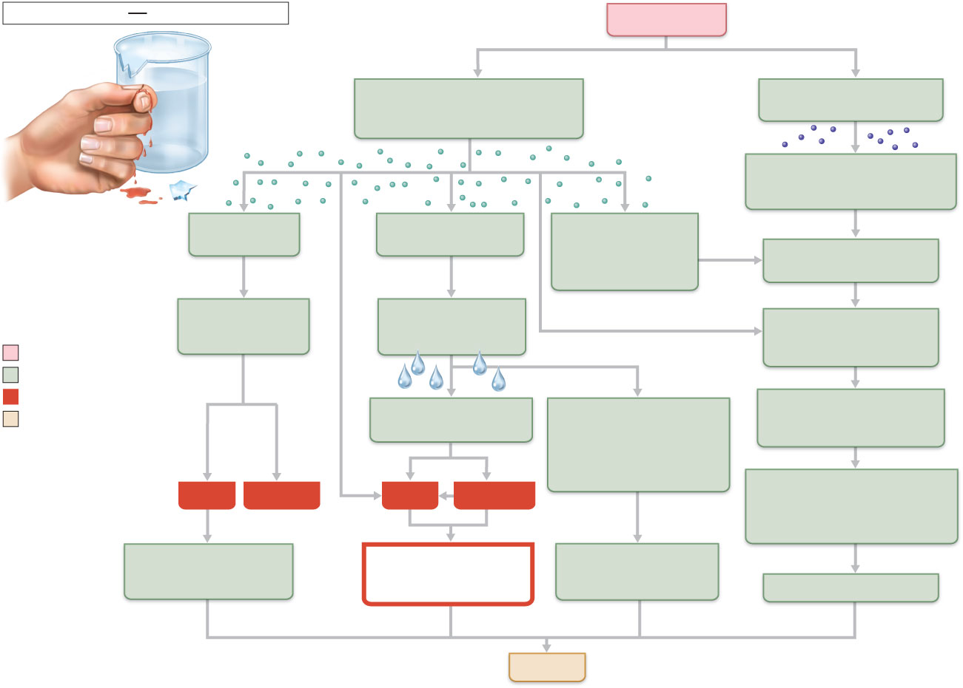
Innate defenses
Internal defenses
Tissue injury
Release of chemical mediators
(histamine, complement,
kinins, prostaglandins, etc.)
Release of leukocytosis-
inducing factor
Leukocytosis
(increased numbers of white
blood cells in bloodstream)
Vasodilation
of arterioles
Increased capillary
permeability
Attract neutrophils,
monocytes, and
lymphocytes to
area (chemotaxis)
Leukocytes migrate to
injured area
Local hyperemia
(increased blood
flow to area)
Capillaries
leak fluid
(exudate formation)
Margination
(leukocytes cling to
capillary walls)
Initial stimulus
Physiological response
Signs of inflammation
Leaked protein-rich
fluid in tissue spaces
Leaked clotting
proteins form interstitial
clots that wall off area
to prevent injury to
surrounding tissue
Diapedesis
(leukocytes pass through
capillary walls)
Result
Heat
Redness
Pain
Swelling
Phagocytosis of pathogens
and dead tissue cells
(by neutrophils, short-term;
by macrophages, long-term)
Locally increased
temperature increases
metabolic rate of cells
Possible temporary
limitation of
joint movement
Temporary fibrin
patch forms
scaffolding for repair
Pus may form
Area cleared of debris
Healing
Figure 21.3

Slide 25
Phagocyte Mobilization
Neutrophils, then phagocytes flood to inflamed sites

Slide 26
Phagocyte Mobilization
Steps for phagocyte mobilization
Leukocytosis: release of neutrophils from bone marrow in response to leukocytosis-inducing factors from injured cells
Margination: neutrophils cling to the walls of capillaries in the inflamed area
Diapedesis of neutrophils
Chemotaxis: inflammatory chemicals (chemotactic agents) promote positive chemotaxis of neutrophils

Slide 27
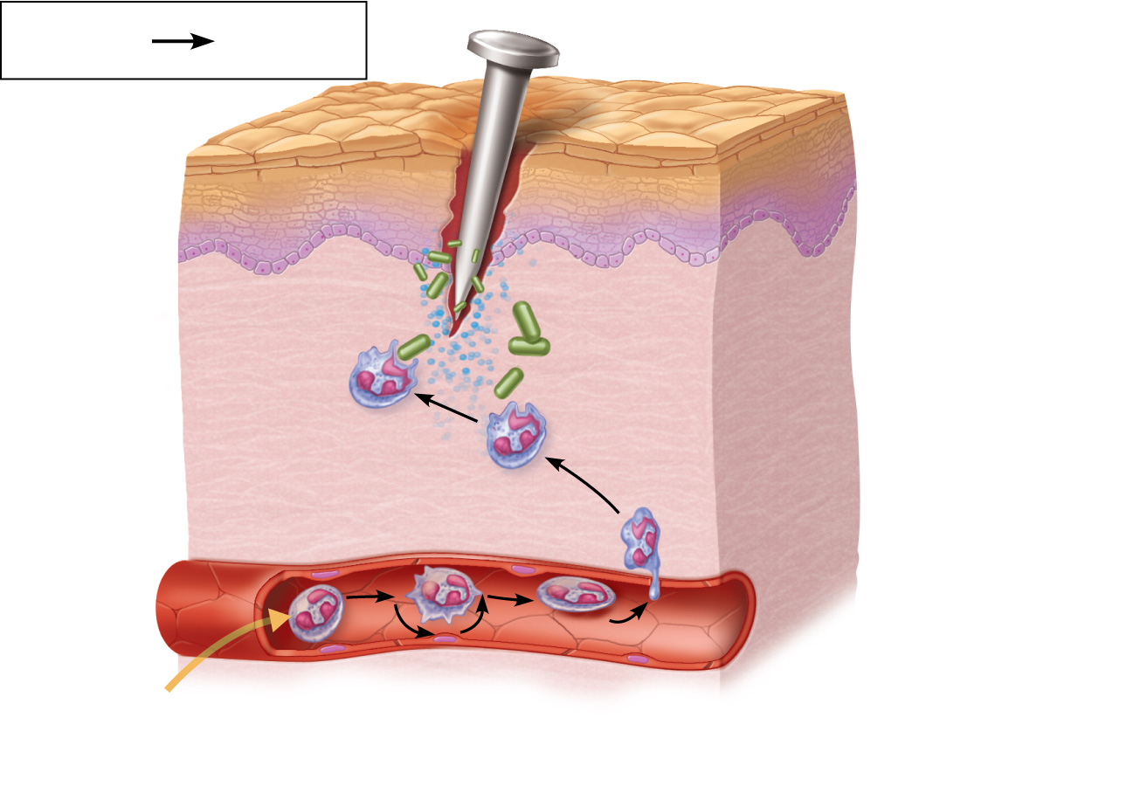
Innate
defenses
Internal
defenses
Inflammatory
chemicals
diffusing
from the
inflamed site
act as chemotactic
agents.
4
Chemotaxis.
Neutrophils
follow chemical
trail.
Capillary wall
Basement
membrane
Endothelium
1
2
3
Leukocytosis.
Neutrophils enter blood
from bone marrow.
Margination.
Neutrophils cling
to capillary wall.
Diapedesis.
Neutrophils flatten and
squeeze out of capillaries.
Figure 21.4

Slide 28
Antimicrobial Proteins
Interferons (IFNs) and complement proteins
Attack microorganisms directly
Hinder microorganisms’ ability to reproduce

Slide 29
Interferons
Viral-infected cells are activated to secrete Interferons (IFNs)
IFNs enter neighboring cells
Neighboring cells produce antiviral proteins that block viral reproduction
Produced by a variety of WBCs

Slide 30
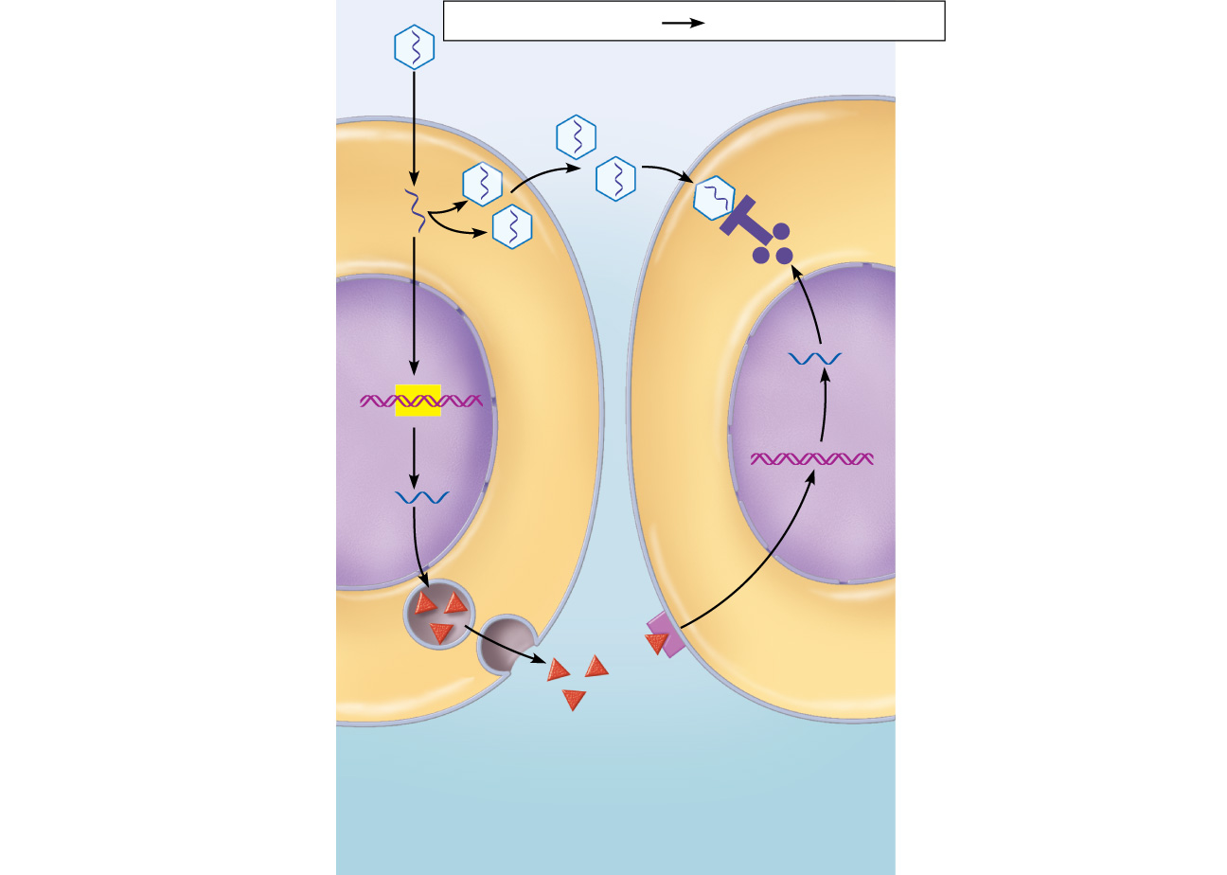
Innate defenses
Internal defenses
Virus
1
Virus
enters cell.
New viruses
Viral nucleic acid
5
Antiviral
proteins block
viral
reproduction.
2
Interferon
genes switch on.
DNA
Nucleus
mRNA
4
3
Interferon
binding
stimulates cell to
turn on genes for
antiviral proteins.
Cell produces
interferon
molecules.
Interferon
Host cell 2
Binds interferon
from cell 1; interferon
induces synthesis of
protective proteins
Host cell 1
Infected by virus;
makes interferon;
is killed by virus
Figure 21.5

Slide 31
Interferons
Functions
Anti-viral
Reduce inflammation
Activate macrophages and mobilize NK cells
Genetically engineered IFNs for
Antiviral agents against hepatitis and genital warts virus
Multiple sclerosis treatment

Slide 32
Complement
~20 blood proteins that circulate in an inactive form
Include C1–C9, factors B, D, and P, and regulatory proteins
Major mechanism for destroying foreign substances

Slide 33
Complement
Amplifies all aspects of the inflammatory response
Kills bacteria and certain other cell types by cell lysis
Enhances both nonspecific and specific defenses
Can be used to opsonize bacteria

Slide 34
Fever
Systemic response to invading microorganisms
Leukocytes and macrophages exposed to foreign substances secrete pyrogens
Pyrogens reset the body’s thermostat upward
High fevers are dangerous = heat denatures enzymes
Benefits of moderate fever
Causes the liver and spleen to sequester iron and zinc (needed by microorganisms)
Increases metabolic rate, which speeds up repair

Slide 35
Adaptive Defenses
The adaptive immune (specific defense) system
Protects against infectious agents and abnormal body cells
Amplifies the inflammatory response
Activates complement

Slide 36
Adaptive Defenses
Adaptive immune response
Is specific
Is systemic
Has memory
Two separate overlapping arms
Humoral (antibody-mediated) immunity
Cellular (cell-mediated) immunity

Slide 37
Antigens
Substances that can mobilize the adaptive defenses and provoke an immune response
Most are large, complex molecules not normally found in the body (nonself)

Slide 38
Antigen-
binding
sites
Antigenic determinants
Antibody A
Antigen
Antibody B
Antibody C
Figure 21.7

Slide 39
Self-Antigens: MHC Proteins
Protein molecules (self-antigens) on the surface of cells
Antigenic to others in transfusions or grafts
Example: MHC proteins
Coded for by genes of the major histocompatibility complex (MHC) and are unique to an individual

Slide 40
MHC Proteins
Classes of MHC proteins
Class I MHC proteins, found on virtually all body cells
Class II MHC proteins, found on certain cells in the immune response
MHC proteins display peptides (usually self-antigens)
In infected cells, MHC proteins display fragments of foreign antigens, which help mobilize

Slide 41
Cells of the Adaptive Immune System
Two types of lymphocytes
B lymphocytes (B cells)—humoral immunity
T lymphocytes (T cells)—cell-mediated immunity
Antigen-presenting cells (APCs)
Any cell type that can present antigens to a T-lymphocyte
Do not respond to specific antigens
Play essential auxiliary roles in immunity

Slide 42
Lymphocytes
Originate in red bone marrow
B cells mature in the red bone marrow
T cells mature in the thymus

Slide 43
Lymphocytes
When mature, they have
Immunocompetence; they are able to recognize and bind to a specific antigen
Self-tolerance – unresponsive to self antigens
Naive (unexposed) B and T cells are exported to lymph nodes, spleen, and other lymphoid organs

Slide 44
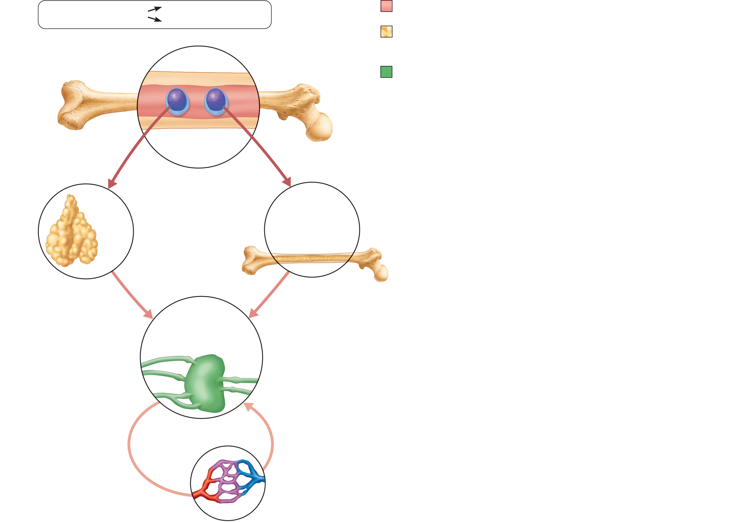
Adaptive defenses
Humoral immunity
Red bone marrow: site of lymphocyte origin
Cellular immunity
Primary lymphoid organs: site of
development of immunocompetence as B or
T cells
Immature
lymphocytes
Red
bone marrow
Secondary lymphoid organs: site of
antigen encounter, and activation to become
effector and memory B or T cells
1
Lymphocytes destined to become T cells
migrate (in blood) to the thymus and develop
immunocompetence there. B cells develop
immunocompetence in red bone marrow.
Thymus
Bone marrow
2
Immunocompetent but still naive
lymphocytes leave the thymus and bone
marrow. They “seed” the lymph nodes,
spleen, and other lymphoid tissues where
they encounter their antigen.
Lymph nodes,
spleen, and other
lymphoid tissues
3
Antigen-activated immunocompetent
lymphocytes (effector cells and memory
cells) circulate continuously in the
bloodstream and lymph and throughout
the lymphoid organs of the body.
Figure 21.8

Slide 45
T Cells
T cells mature in the thymus under negative and positive selection pressures, in two sequential rounds.
Positive selection
Selects T cells capable of binding (at all) to self-MHC proteins (MHC restriction)
Negative selection
Prompts apoptosis of T cells that bind too tightly to self-antigens displayed by self-MHC
Ensures self-tolerance

Slide 46
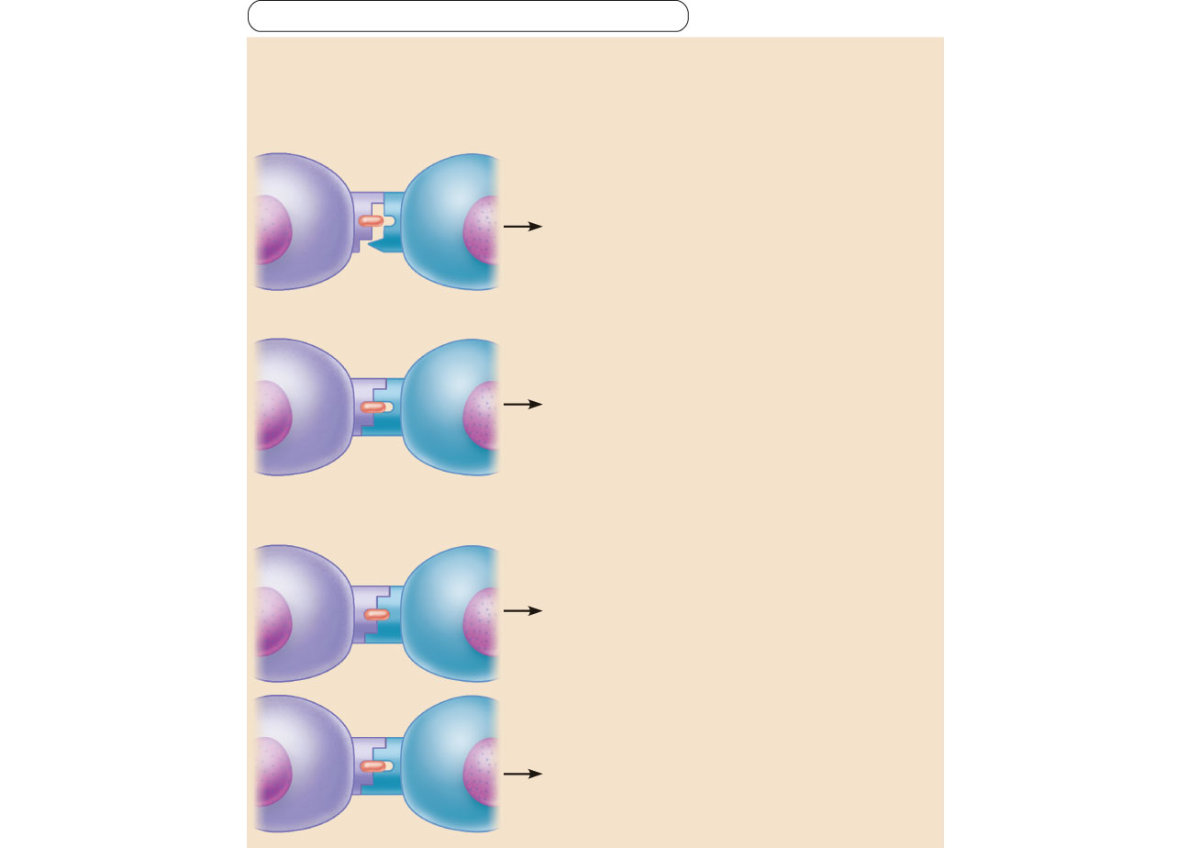
Adaptive defenses
Cellular immunity
Positive selection: T cells must recognize self major
histocompatibility proteins (self-MHC).
Antigen-
presenting
thymic cell
Developing
T cell
Failure to recognize self-MHC
results in apoptosis (death
by cell suicide).
MHC
T cell receptor
Self-antigen
Recognizing self-MHC results in
MHC restriction—survivors are
restricted to recognizing antigen
on self-MHC. Survivors proceed
to negative selection.
Negative selection: T cells must not recognize self-antigens.
Recognizing self-antigen results
in apoptosis. This eliminates
self-reactive T cells that could
cause autoimmune diseases.
Failure to recognize (bind tightly
to) self-antigen results in survival
and continued maturation.
Figure 21.9

Slide 47
B Cells
B cells mature in red bone marrow
Self-reactive B cells
Are eliminated by apoptosis (clonal deletion) or
Undergo receptor editing

Slide 48
Antigen Receptor Diversity
Lymphocytes make up to a billion different types of antigen receptors
Coded for by ~25,000 genes
Gene segments are shuffled by somatic recombination
Genes determine which foreign substances the immune system will recognize and resist

Slide 49
Antigen-Presenting Cells (APCs)
Engulf antigens
Present fragments of antigens to be recognized by T cells
Major types
Dendritic cells in connective tissues and epidermis
Macrophages in connective tissues and lymphoid organs
B cells

Slide 50
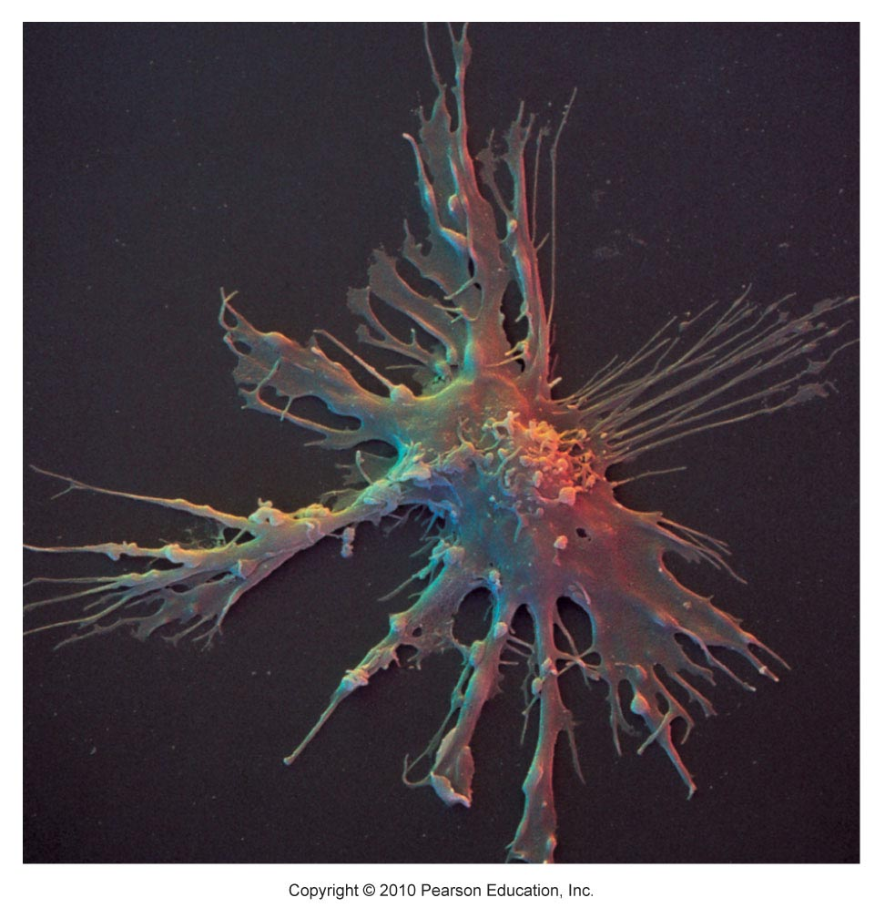
Figure 21.10

Slide 51
Macrophages and Dendritic Cells
Activated T cells release chemicals that
Prod macrophages to become insatiable phagocytes and to secrete bactericidal chemicals

Slide 52
Adaptive Immunity: Summary
Uses lymphocytes, APCs, and specific molecules to identify and destroy nonself substances
Depends upon the ability of its cells to
Recognize antigens by binding to them
Communicate with one another so that the whole system mounts a specific response

Slide 53
Humoral Immunity Response
Antigen challenge
First encounter between an antigen and a naive immunocompetent lymphocyte
Usually occurs in the spleen or a lymph node
If the lymphocyte is a B cell
The antigen provokes a humoral immune response
Antibodies are produced

Slide 54
Clonal Selection
B cell is activated when antigens bind to its surface receptors and cross-link them
Receptor-mediated endocytosis of cross-linked antigen-receptor complexes occurs
Stimulated B cell grows to form a clone of identical cells bearing the same antigen-specific receptors
(T cells are usually required to help B cells achieve full activation)

Slide 55
Fate of the Clones
Most clone cells become plasma cells
secrete specific antibodies at the rate of 2000 molecules per second for four to five days

Slide 56
Fate of the Clones
Secreted antibodies
Circulate in blood or lymph
Bind to free antigens
Mark the antigens for destruction

Slide 57
Fate of the Clones
Clone cells that do not become plasma cells become memory cells
Provide immunological memory
Mount an immediate response to future exposures of the same antigen

Slide 58
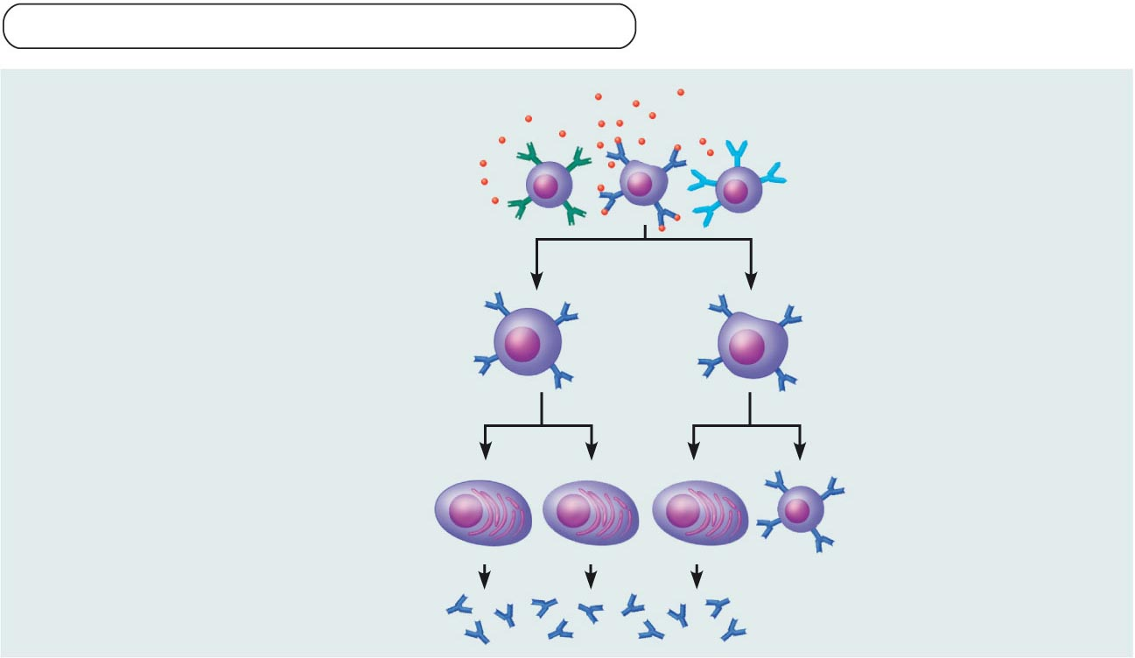
Adaptive defenses
Humoral immunity
Primary response
(initial encounter
with antigen)
Antigen
Antigen binding
to a receptor on a
specific B lymphocyte
(B lymphocytes with
non-complementary
receptors remain
inactive)
Proliferation to
form a clone
Activated B cells
Plasma cells
(effector B cells)
Memory B cell—
primed to
respond to same
antigen
Secreted
antibody
molecules
Figure 21.11 (1 of 2)

Slide 59
Immunological Memory
Primary immune response
Occurs on the first exposure to a specific antigen
Lag period: three to six days
Peak levels of plasma antibody are reached in 10 days
Antibody levels then decline

Slide 60
Immunological Memory
Secondary immune response
Occurs on re-exposure to the same antigen
Sensitized memory cells respond within hours
Antibody levels peak in two to three days at much higher levels
Antibodies bind with greater affinity
Antibody level can remain high for weeks to months

Slide 61
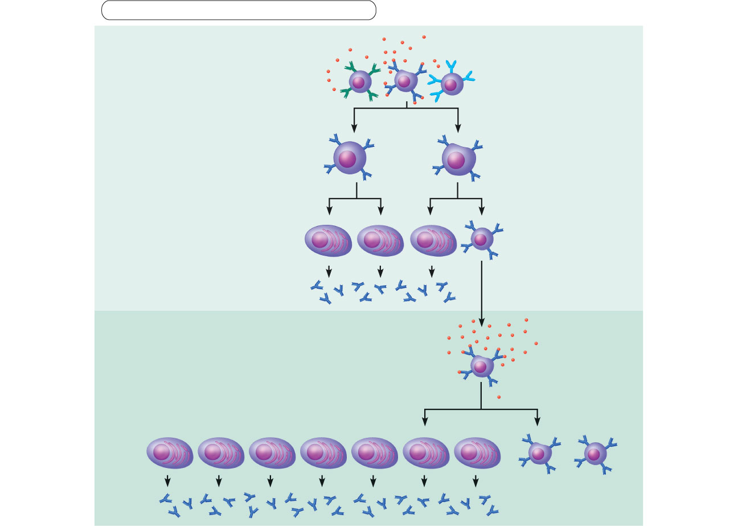
Adaptive defenses
Humoral immunity
Primary response
(initial encounter
with antigen)
Antigen
Antigen binding
to a receptor on a
specific B lymphocyte
(B lymphocytes with
non-complementary
receptors remain
inactive)
Proliferation to
form a clone
Activated B cells
Plasma cells
(effector B cells)
Memory B cell—
primed to respond
to same antigen
Secreted
antibody
molecules
Subsequent
challenge by
same antigen
results in more
rapid response
Secondary response
(can be years later)
Clone of cells
identical to
ancestral cells
Plasma
cells
Secreted
antibody
molecules
Memory
B cells
Figure 21.11

Slide 62
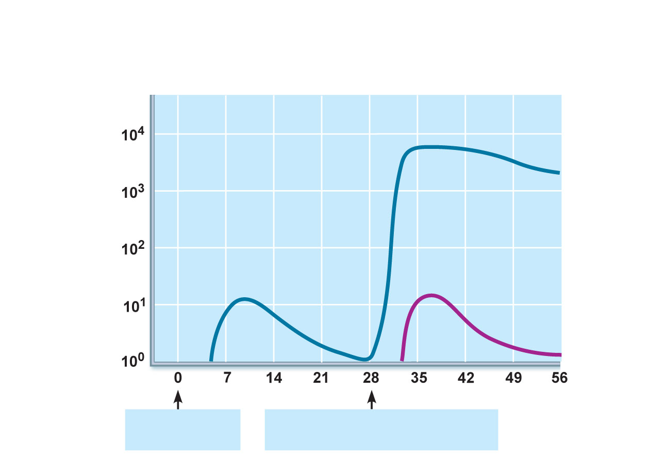
Secondary immune response to
antigen A is faster and larger; primary
immune response to antigen B is
similar to that for antigen A.
Primary immune
response to antigen
A occurs after a delay.
Anti-
bodies
to A
Anti-
bodies
to B
First exposure
to antigen A
Second exposure to antigen A;
first exposure to antigen B
Time (days)
Figure 21.12

Slide 63
Active Humoral Immunity
Occurs when B cells encounter antigens and produce specific antibodies against them
Two types
Naturally acquired—response to a bacterial or viral infection
Artificially acquired—response to a vaccine of dead or attenuated pathogens

Slide 64
Active Humoral Immunity
Vaccines
Spare us the symptoms of the primary response
Provide antigenic determinants that are immunogenic and reactive
Target only one type of helper T cell, so fail to fully establish cellular immunological memory

Slide 65
Passive Humoral Immunity
When antibodies are introduced directly to the body from outside.
B cells are not challenged by antigens
Immunological memory does not occur

Slide 66
Passive Humoral Immunity
Two types
Naturally acquired—antibodies delivered to a fetus via the placenta or to infant through milk
Artificially acquired—injection of serum, such as gamma globulin
Protection is immediate but ends when antibodies naturally degrade in the body

Slide 67
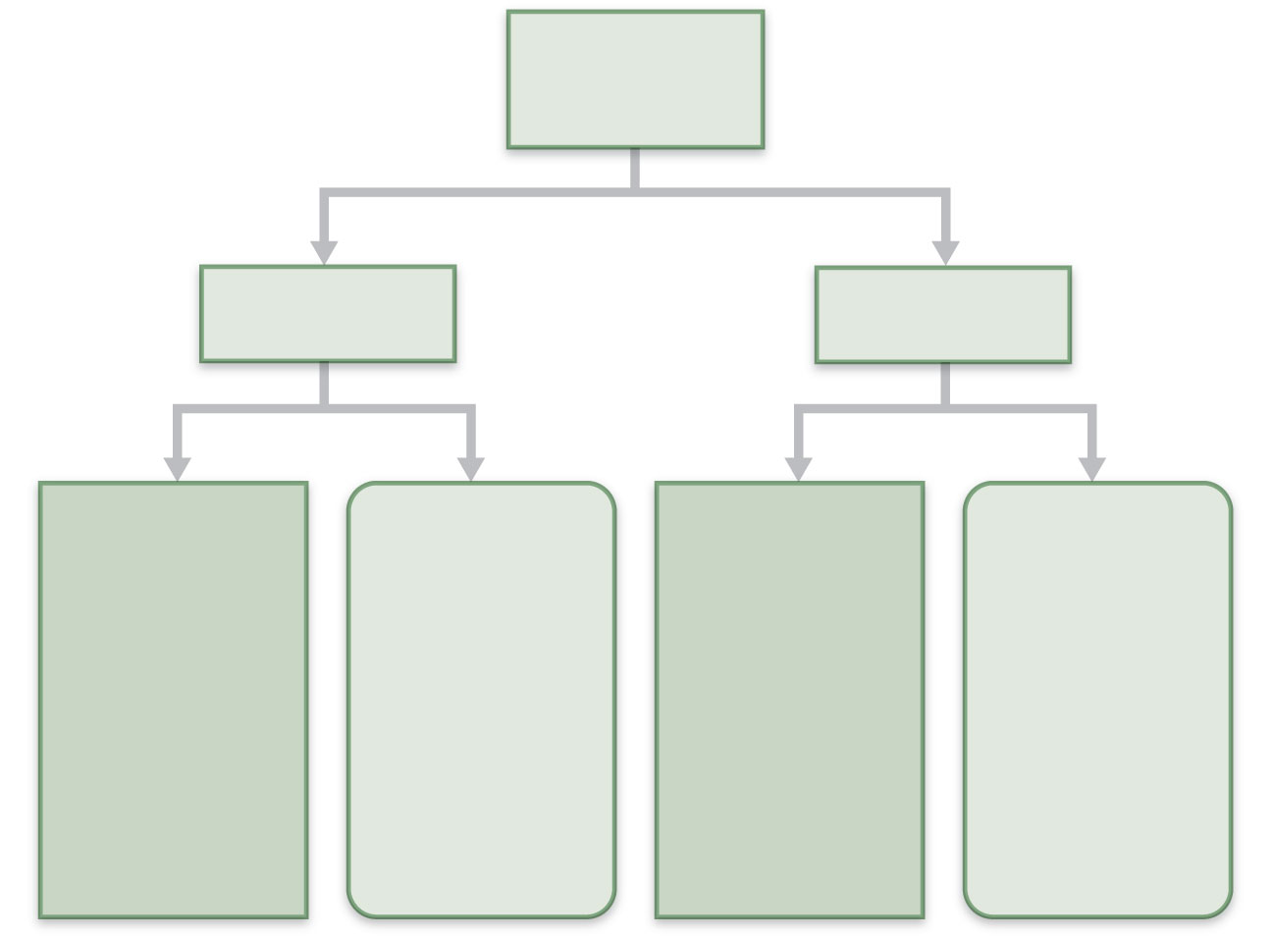
Humoral
immunity
Active
Passive
Naturally
acquired
Artificially
acquired
Naturally
acquired
Artificially
acquired
Infection;
contact
with
pathogen
Vaccine;
dead or
attenuated
pathogens
Antibodies
pass from
mother to
fetus via
placenta;
or to infant
in her milk
Injection of
immune
serum
(gamma
globulin)
Figure 21.13

Slide 68
Antibodies
Immunoglobulins—gamma globulin portion of blood
Proteins secreted by plasma cells
Capable of binding specifically with antigen detected by B cells

Slide 69
Basic Antibody Structure
T-or Y-shaped monomer of four looping linked polypeptide chains
Two identical heavy (H) chains and two identical light (L) chains
Variable (V) regions of each arm combine to form two identical antigen-binding sites

Slide 70
Basic Antibody Structure
Constant (C) region or stem determines:
The antibody class (IgM, IgA, IgD, IgG, or IgE)
The cells & chemicals that the antibody can bind to
How the antibody class functions in antigen elimination

Slide 71
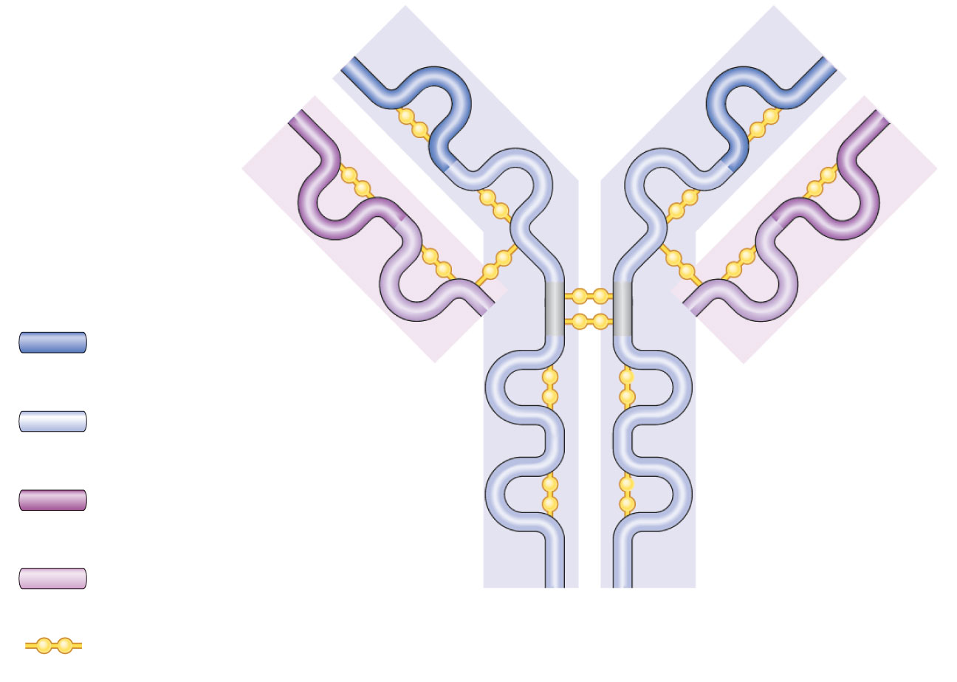
Antigen-binding
site
Heavy chain
variable region
Hinge
region
Heavy chain
constant region
Stem
region
Light chain
variable region
Light chain
constant region
Disulfide bond
(a)
Figure 21.14a

Slide 72
Generating Antibody Diversity
Billions of antibodies result from somatic recombination of gene segments
Hypervariable regions of some genes increase antibody variation through somatic mutations

Slide 73
Antibody Targets
Antibodies inactivate and tag antigens
Form antigen-antibody (immune) complexes
Defensive mechanisms used by antibodies
Neutralization and agglutination (the two most important)
Precipitation and complement fixation

Slide 74
Neutralization
Simplest mechanism
Antibodies block specific sites on viruses or bacterial exotoxins
Prevent these antigens from binding to receptors on tissue cells
Antigen-antibody complexes undergo phagocytosis

Slide 75
Agglutination
Antibodies bind the same determinant on more than one cell-bound antigen
Cross-linked antigen-antibody complexes agglutinate
Example: clumping of mismatched blood cells

Slide 76
Precipitation
Soluble molecules are cross-linked
Complexes precipitate and are subject to phagocytosis

Slide 77
Monoclonal Antibodies
Commercially prepared pure antibody
Used in research, clinical testing, and cancer treatment

Slide 78
Comparison of Humoral and Cell-Mediated Response
Antibodies of the humoral response
The simplest ammunition of the immune response
Targets
Bacteria and molecules in extracellular environments (body secretions, tissue fluid, blood, and lymph)

Slide 79
Comparison of Humoral and Cell-Mediated Response
T cells of the cell-mediated response
Recognize and respond only to processed fragments of antigen displayed on the surface of body cells
Targets
Body cells infected by viruses or bacteria
Abnormal or cancerous cells
Cells of infused or transplanted foreign tissue

Slide 80
Antigen Recognition
Immunocompetent T cells are activated when their surface receptors bind to a recognized antigen (nonself)
T cells must simultaneously recognize
Nonself (the antigen)
Self (an MHC protein of a body cell)

Slide 81
Cytokines
Mediate cell development, differentiation, and responses in the immune system
Include interleukins and interferons
Interleukin 1 (IL-1) released by macrophages. Stimulates bound T cells to
Release interleukin 2 (IL-2)
Synthesize more IL-2 receptors

Slide 82
Roles of Helper T(T_{H}) Cells
Play a central role in the adaptive immune response
Once primed by APC presentation of antigen, they
Help activate T and B cells
Induce T and B cell proliferation
Activate macrophages and recruit other immune cells
Without T_{H}, there is no immune response

Slide 83
Roles of Cytotoxic T(T_{C}) Cells
Directly attack and kill other cells
Activated T_{C} cells circulate in blood and lymph and lymphoid organs in search of body cells displaying antigen they recognize

Slide 84
Roles of Cytotoxic T(T_{C}) Cells
Targets
Virus-infected cells
Cells with intracellular bacteria or parasites
Cancer cells
Foreign cells (transfusions or transplants)

Slide 85
Natural Killer Cells
Recognize other signs of abnormality
Lack of class I MHC
Antibody coating a target cell
Different surface marker on stressed cells
Use the same key mechanisms as Tc cells for killing their target cells

Slide 86
Regulatory T (T_{Reg}) Cells
Dampen the immune response by direct contact or by inhibitory cytokines
Important in preventing autoimmune reactions

