Slide 1
Lake Merritt
BART Station Redevelopment
Ener Chiu

Slide 2
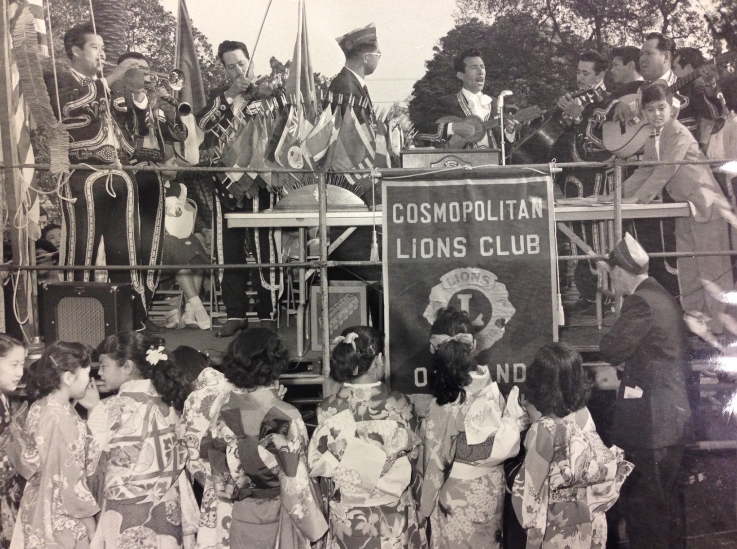
Madison (Dragon) Park, 1950s

Slide 3
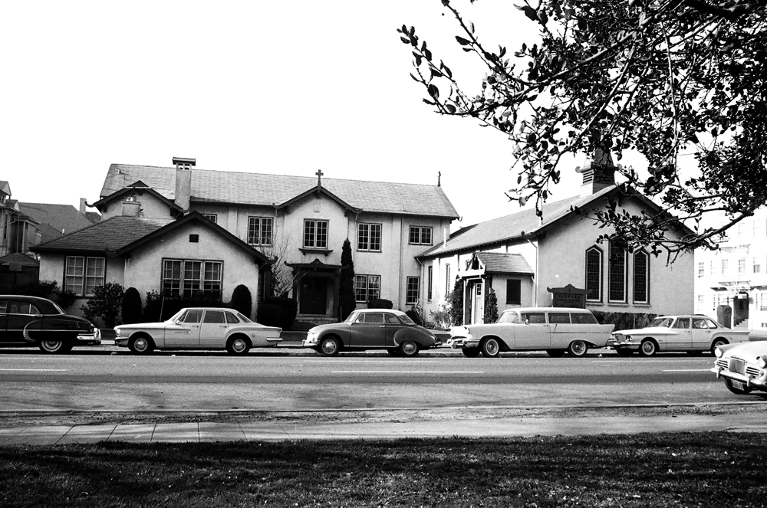
Episcopal Church of our Savior

Slide 4
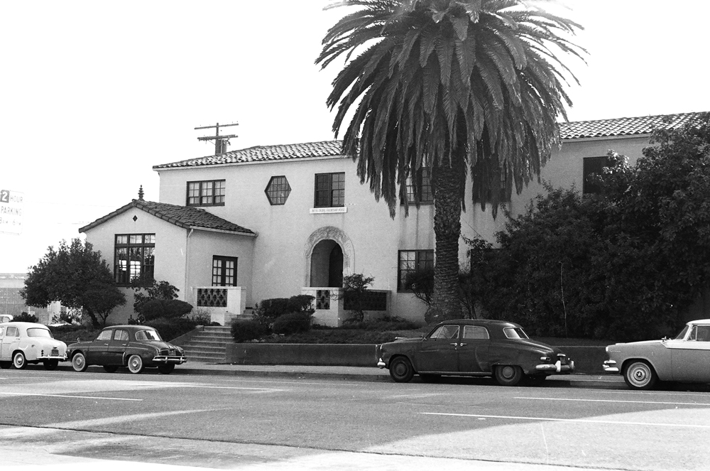
Ming Quong Orphanage for Girls

Slide 5
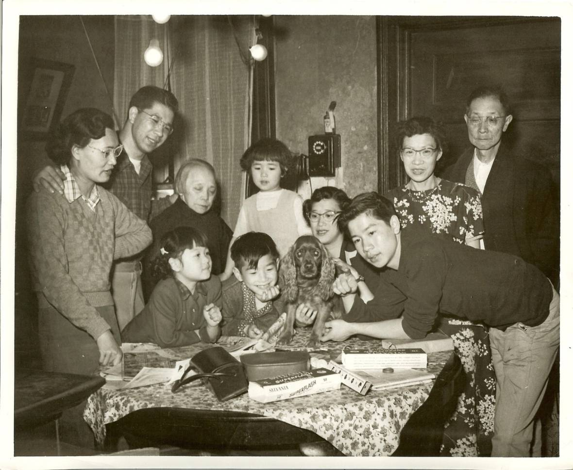
A Neighborhood for Families
Notes:
Circa 1950

Slide 6
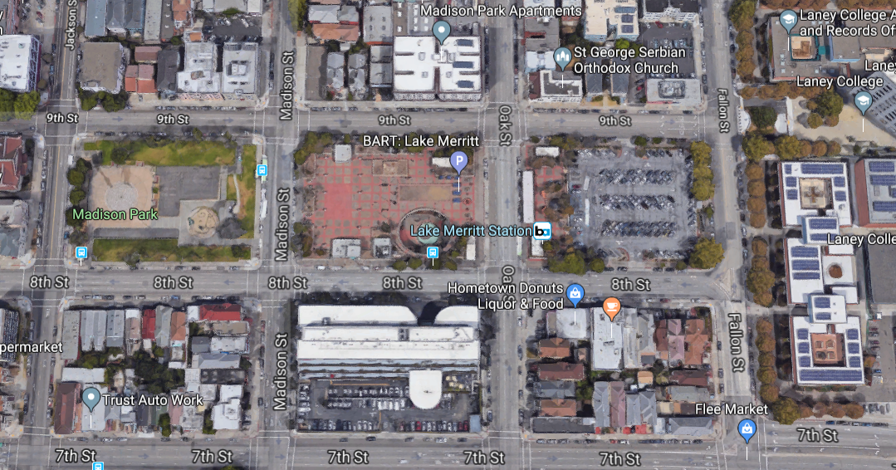
Lake Merritt BART Station Area Today
Notes:
disoriented

Slide 7
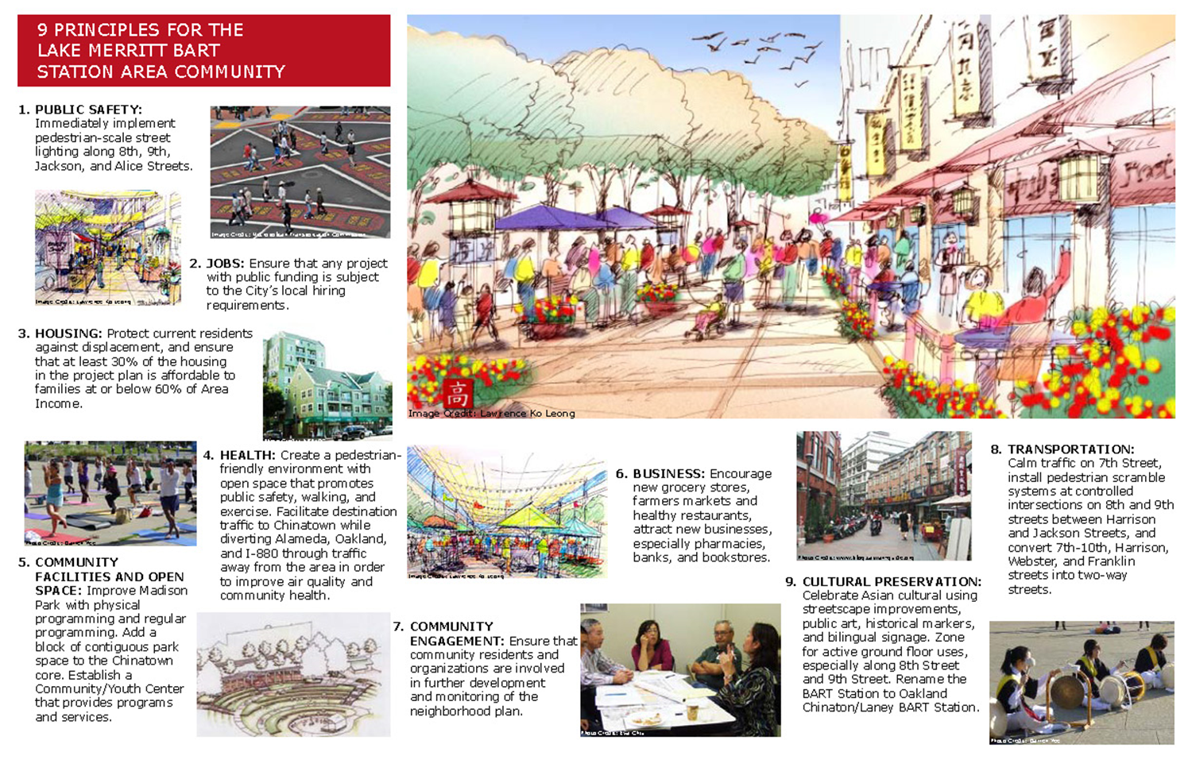
EBALDC/Chinatown Coalition Advocacy
Notes:
Many dozens of community meetings over 10 years.
Community design charrettes involving hundreds of local residents in multiple languages.
Written surveys from more than 1,000 respondents.
Worked with Dr. Elnora Webb and Marco Menendez from Laney

Slide 8
BART Lake Merritt RFQ/RFP

Slide 9
EBALDC/Chinatown Coalition Advocacy
EBALDC involved in planning for area since 2008
Oakland Chinatown criteria for new development
A program that complements rather than competes with the core commercial area of Chinatown
A program that reduces gentrification stress rather than increases it, by producing high quality jobs accessible to local residents (especially English limited)
A program that increases community control over the site
Notes:
We helped draft this letter to BART, primarily with input from Chinatown Coalition.

Slide 10
Why partner with Strada?
Alignment around community identity
Public investment in active streets, not private amenities, drives value. Outside in.
BART signaled desire for a large commercial program
Notes:
I’ve been asked by a couple of people why we chose to partner with Strada. Here’s why we chose Strada:
- We interviewed a number market rate developers before choosing Strada, and felt they were the best fit.
- We’re very excited by the philosophical alignment between Strada and EBALDC and our similar approach to development, even though we’re developing for different segments of the market.
Strada and EBALDC both understood that the way to create value at this site that can be broadly shared with the Oakland community is to invest in the public realm, and improve the areas outside of the buildings themselves. This “outside in” approach fits EBALDC’s belief that while we need to build affordable housing, we need to do it in the context of creating healthier and more holistic neighborhoods
- Strada was a partner in creating a development program that would offer BART a high level of density, while adhering to the existing zoning limits, and providing a robust community benefits package that met or exceeded the Chinatown Coalition’s request to BART.
Strada sees the existing neighborhood as valuable, and not something that the new development has to replace. Rather the purpose of our new development is to stabilize and reveal the character of the place, and to connect new riders to the areas surrounding the BART station (core commercial Chinatown, Jack London Square, Laney, Eastlake, OMCA, OUSD, Alameda County offices, and Lake Merritt)
ALSO EXCITED TO PARTNER WITH BART, staff have been really open to partnering with us on what we know will be a long marriage that will require buying into our team’s vision of placemaking and partnership to go after non-traditional sources of financing that will support our programmatic goals.

Slide 11
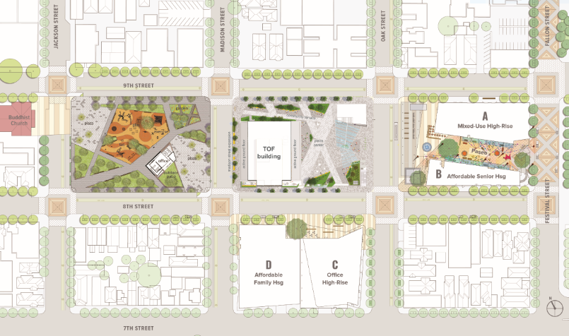
EBALDC/Strada Proposal: Conceptual

Slide 12
EBALDC/Strada Proposal: Conceptual
Building A: Mixed-Use Mixed-Income Building (Strada)
~ 326 units with 10% BMR, 27K SF of BMR office
Building B: Affordable Senior Housing (EBALDC)
~ 95 units, includes small format BMR retail space
Building C: Office High Rise Building (Strada)
~ 500,000 SF, includes 60K BMR office space
Building D: Affordable Family Housing (EBALDC)
~ 98 units, includes child care center
Notes:
Here are the concepts we’ve proposed to BART. We generally think this proposal is feasible but the exact square footages and number of units are being refined. This isn’t 100% fully baked/final yet.

Slide 13
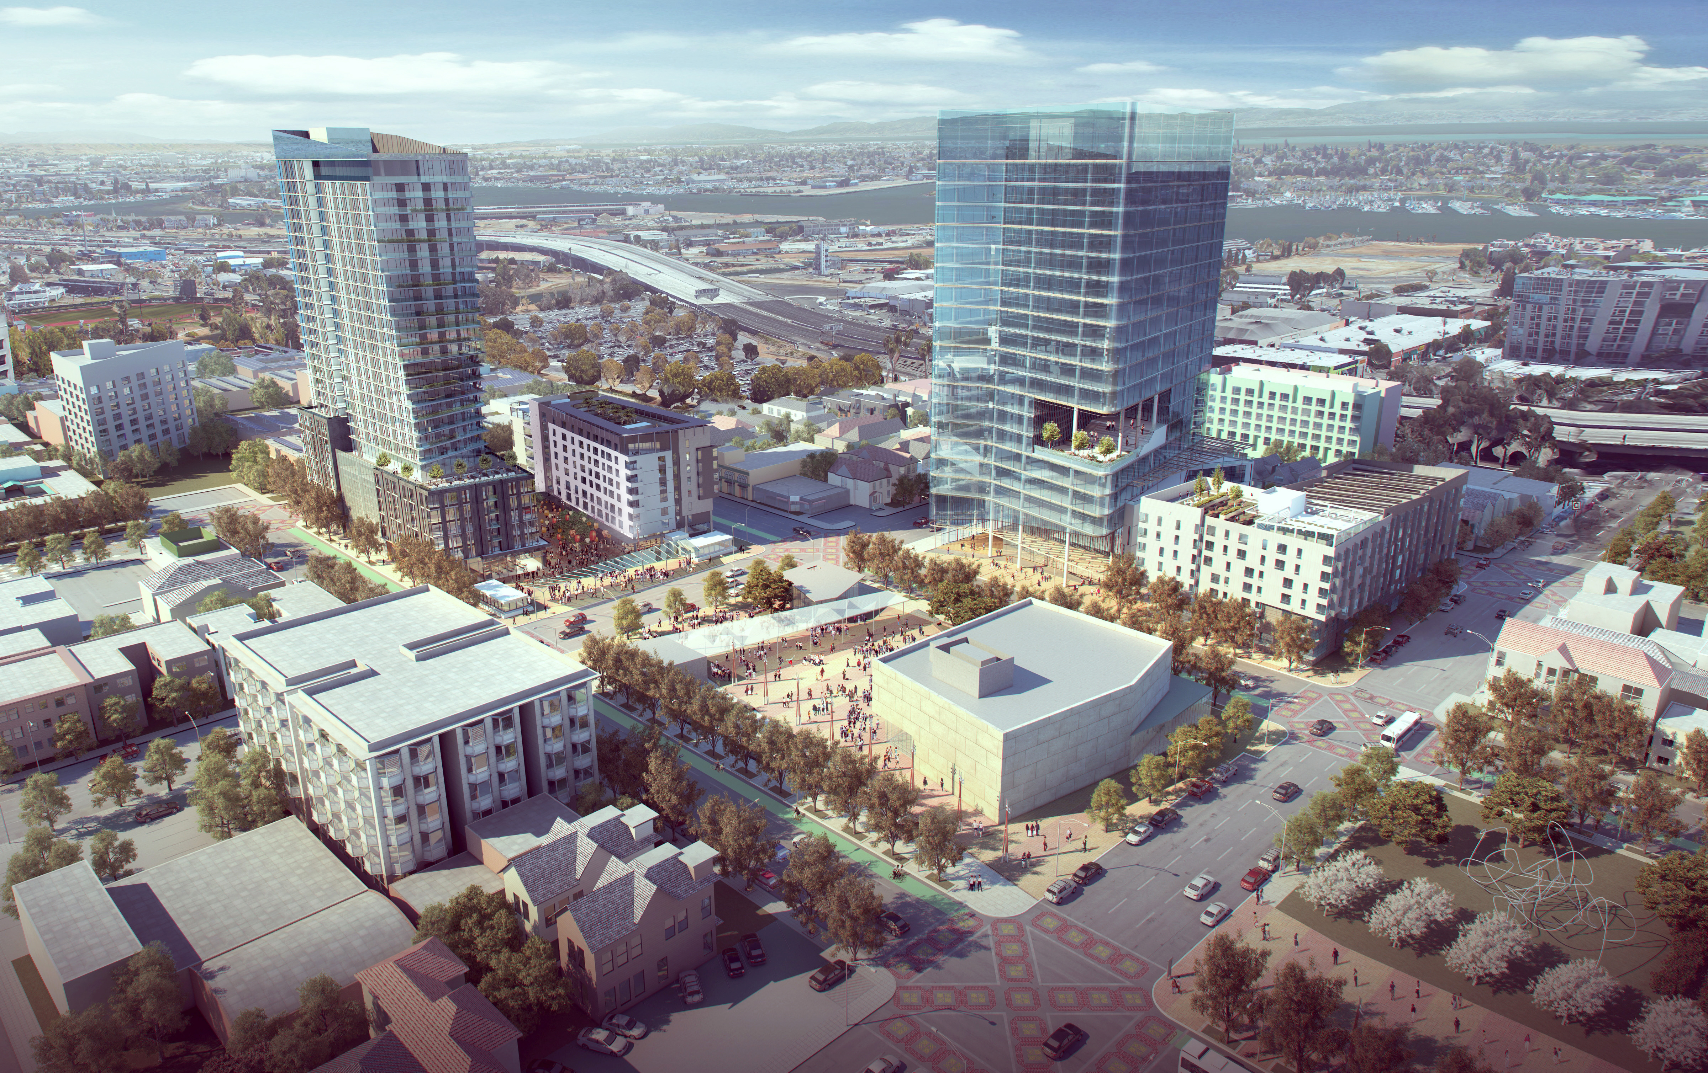
EBALDC/Strada Proposal: Conceptual
A
C
B
D

Slide 14
Community Benefits Targets
44% Affordable Housing (approximately 200 units)
20% Below Market Rate Commercial Space
High quality, public open space, connects to Madison
Chinatown identity throughout redevelopment
Opportunities for local business and workforce development

Slide 15
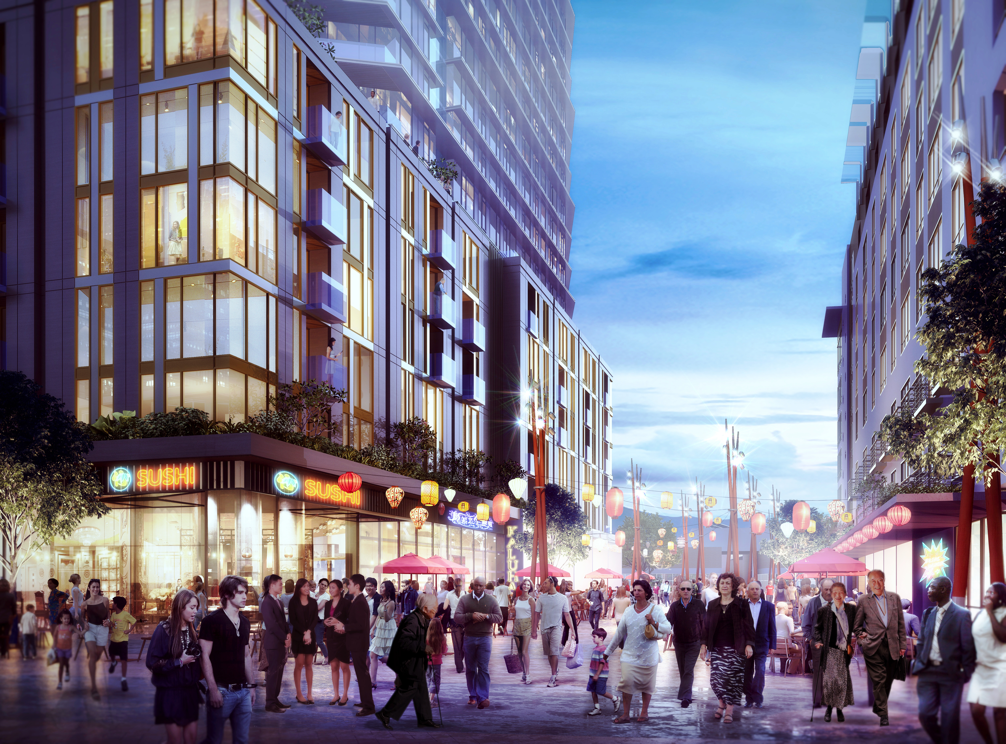
Public Space

Slide 16
BART Lake Merritt: Next Steps
Jan 2019 – executing ENA with BART
2019 Q1 & Q2 – begin meetings with community stakeholder groups on programming and massing
2020 – entitlements and securing financing
2021 – start construction on Site 1
2023 – construction completion for Site 1
2026 – start construction on Site 2
2028 – construction completion for Site 2

Slide 17
THANK YOU!
Ener Chiu
ChinatownBart@ebaldc.org

