Slide 1
Student Run Branch at Laney College in partnership with Peralta Community College District
March 20, 2019
©2018 MUFG Union Bank, N.A. Member FDIC. All rights reserved. Union Bank is a registered trademark and brand name of MUFG Union Bank, N.A.

Slide 2
Value Proposition
How do we measure success?
We aren’t the most profitable or highest profile bank in the country; we don’t have the ability to write million dollar checks for philanthropy; and we don’t have a stadium named after us.
We measure success by the fact that:
We are one of only 10% of banks that have an Outstanding Community Reinvestment Act (CRA) rating; we were the first bank in the U.S. to voluntarily negotiate a multi-year community commitment; we chose to completely avoid sub-prime mortgage lending as others reaped the benefits (and costs); and we quietly look on as marchers walk by our San Francisco headquarters on their way to protest our Financial District neighbor.
We are a humble and conservative bank with a strong record of doing things that matter, irrespective of visibility. We are a bank that uses its limited resources to run a network of 5 branches at closed-campus high schools in low-to-moderate income communities that are run by the students; not because it’s profitable (because it’s not), but because we are committed to economic justice.
Having recently been awarded the contract to bank the City of Oakland, we saw an opportunity to justify the considerable expense of evolving our high school branch program. As such, our ambition is for Laney College to be the first bank-operated student-run branch on a community college in the United States, and to represent a model that can be replicated in other markets and positively impact the lives and career trajectories of students in a manner that wouldn’t be possible through conventional philanthropy.
Union Bank will assume all tenant and improvement costs associated with the construction of the branch. The branch will serve the students, faculty, staff and community. The student-run program will serve as a recruiting tool to students interested in a career in banking, finance or accounting. The students selected for the program will receive an educational stipend and positon themselves for future employment with the bank as universal bankers. These interns will also serve as community ambassadors, going into the community and teaching financial education. This is in addition to receiving transferrable college credits.

Slide 3
Overview of the Student Run Branch Program (Statewide)
Branch Details:
We have been operating the program since 2010
We have a total of five student-run branches in California (two in Los Angeles, one in El Monte, one in Anaheim and one in Fresno)
All are located in Title 1 schools, which target low and moderate-income youth
The branches operate on closed campuses (limited access branch)
The branch is run by 10 to 12 student interns with support of a branch manager and branch service officer
Program Details:
Students receive classroom credit, and the curriculum has been approved as an accredited A-G certified class
The bank paid for all tenant improvements at each location (vault, security cameras, electrical, furniture, signage, computer equipment, etc.)
The branches are run with no expense to the school district
The branch officers also serve as community outreach specialists Foundation work and spearheading volunteer activities in the community
Students are paid up to $1,500 in educational stipends
Student interns as “bankers” provides an innovative “hands on” learning environment
Student interns have conducted hundreds of financial education workshops in the school, other area schools and the community
Only OCC-supervised bank in California with student-run branches
Program Successes:
Two hundred and seventy five (275) students have participated in the program, with over 99% graduating from high school and the vast majority have gone on to college
The bank has hired 30 students once they have graduated from the program as tellers while they attend college
Four former student interns are now bank officers (two are branch service officers, one is a project manager in our Enterprise Program Management Office and one is a credit analyst in the commercial lending department)
Realize the majority of the interns do not want a career in banking, we train them to be leaders and great citizens

Slide 4
Student Run Branch 2.0 (Laney College)
Laney College is a community college located in Oakland, California (900 Fallon Street, Oakland, CA 94607). Laney is the largest of the four colleges of the Peralta Community College District which serves northern Alameda County. It offers both certificates and credits for Associate of Arts degree, as well as prerequisites to transfer to four year universities. It does offer a certificate in banking. It has over 100 programs in liberal arts, science, business and career technical education. Laney College offers 44 Associate of Arts Degrees.
Laney College will be the first community college west of the Mississippi River with a Student Run Bank on their campus. The first one is at Piedmont Virginia Community College and is run by The University of Virginia Community Credit Union. They are only open three days a week for seven and a half hours. The branch at Laney College will be open longer and will utilize the branch of the future concept. Laney College will be the first student run branch on a community college in the United States operated by a bank.
Union Bank will hire 10 to 12 student interns to run the branch along with a Branch Manager and Branch Service Officer. The branch will position Laney College to be the “best in class” for banking, finance and accounting because of its “real world” application. The course work is required for nine certificate programs of the American Institute of Banking. With the branch in place, we are looking to create an Associates of Arts Degree in Banking.
The plan is to create the “Branch of the Future.” Instead of the interns being trained just to do teller functions, we will train them to do much more. The interns will learn branch operations and new account procedures. The branch will consist of the following:
Two Express Banking Kiosks
Welcome Desk
Security Door
Two Teller and New Accounts Stations
ATM

Slide 5
Benefits for the Student Interns
Offer a skill based curriculum program
Intern receive 12 units of transferrable credits
Create a diverse talent pool of candidates for career opportunities in banking
Interns receive an educational stipend
Established internships
On the job training
Meeting with bank executives
Opportunities to explore all careers in banking
Interpersonal communication training
Mentorships
Ambassadors in the community
Visits to the Federal Reserve
Visits to the Union Bank San Francisco Headquarters Building
Visits to the Union Bank Operational Centers
Invite ERGs to establish a mentorship program with the interns
Each student should have at least one mentor (ERG members as one source of mentors)
Establish a college pathway program for every student
Hold one-day student banker summit (career fair, life skills workshop, community service project, etc.)
Hold an alumni night for past student bankers to meet and greet students currently in the program
Establish a work readiness program. Invite the Talent, Acquisition and Staffing to conduct a series of workshops for the general student sponsored by the branch.
They participate in a bank’s simulation program (Business of Banking Program)
Teach financial education to students and in the community
Volunteer as a team in the community
Union Bank employees will serve as volunteer tutors in accounting and finance

Slide 6
Banking Course Work
Union Bank
Teller and Operations Training
Interns go through a formal teller training program
They job shadow at a traditional branch
On-going training and instruction (see appendix)
The curriculum will be updated for college students
Banker Training
Learn new accounts procedures
Learn all aspects of branch operations
On-going training and instruction (see appendix)
The curriculum will be updated for college students
Leadership Training
Annual tour of the Federal Reserve
We invite executives to speak to the interns and share their stories of success (many serve as mentors to our students)
Our interns have met with our top executives based in California, New York and Japan
They become financial education champions on campus and in their community
Sign up in our Campus Corner
Opportunity to attend community events
Establishing volunteer opportunities at the college and the community
Laney College
BNK/F 054: Principles of Banking
Comprehensive introduction to the diversified services and operations of the banking industry: Evaluation of U.S. banking; bank depositor relationships; marketing; bank deposit, loan and investment functions; Federal Reserve functions and services; regulations and controls.
BNK/F 055: Money and Banking
How money functions in the U.S. and world economies: The concept of the money supply; role banks play in the creation of money and participants in the nation's payment mechanism; various types operations of financial institutions; workings of monetary and fiscal policies; functions and powers of the Federal Reserve.
BNK/F O56: Bank Management
Introduction to bank management: Day-to-day bank activities; functional foundations in bank management; analytical techniques to measure performance; future expansion opportunities

Slide 7
Diverse Pool of Candidates for Possible Employment at Union Bank
Over the past nine years, Union Bank has hired 30 interns who have graduated from our Student Run Program at one of our five high school branches. Four of the former students are now officers in the bank. All of the interns have been people of color. One of our bank core values is inclusion. We look to attract, retain and promote diverse talent.
If students transfer to a four year university, the bank has a Student Intern Program. The student intern program at MUFG has a reputation for providing college students with the opportunity to participate in meaningful projects that contribute to the overall business unit objectives. In addition to the assigned projects, interns are given the opportunity to participate in activities that encourage networking with peers, managers, and bank employees.
The paid intern positions are full-time during the summer and can extend beyond that time depending on business needs, project requirements, and intern availability. Having students go through our internship, we prepare them for career opportunities in the financial services industry. Under the Student Run Branch 2.0 Model, we look to hire Laney College student interns as Universal Bankers once they complete the program.
A universal banker’s starting salary is $50,000. Here are the job duties:
• 60% Sales: Develop banking relationships, sell consumer loans, deposit and investment products & banking services
• 30% Ops: Perform teller transactions, handle cash, support Assistant Manager in day to day operations
• 10% Risk: Adhere to all Bank operational policies and procedures

Slide 8
Laney College
Delivery of Educational Services | Comments
Improves access to lifelong learning | As much as we teach them banking, the bank prides itself on teaching leadership and communication skills to our interns.
Improves the quality and acquisition of skills and experiences for students | The students are given a “hands on” learning experience. The officers in the branch structure “soft skills” training into the curriculum. The students are given the experience of operating a full service branch. The banking operations and new accounts training can be used to obtain a job at any financial institution.
Promotes civic engagement and empowerment of students | The students teach financial education to classmates, advocacy groups and the community. The bank encourages students to volunteer and be great corporate citizens. We invite past interns to come back and speak to the current interns thus empowering them to become leaders in their community and on campus.
Increases job placement opportunities for students | One of the bank’s goals is to hire the interns are Universal Bankers. From our high school student-run program, the bank has hired 30 students after graduation. Many of them use the Education Reimbursement Program to help them with their college education. The bank will create student-banker alumni career expo and invite our Human Resources team to speak to student interns about career opportunities at the bank. They will also discuss summer internships and part-time opportunities for those that wish to continue on to a four-year university.
Increases the variety and scope of courses/programs | Laney College has three banking courses. With the branch, we will give practical and real life experience to the students’ course work. The student will have the opportunity to apply their course work to actual branch banking experience. Having this kind of experience increases the student’s opportunity to obtain a career in banking.
Improves available resources for quality instruction and support services (e.g. technology, library, tutoring) | Real work application to course work improves quality instruction. In addition, Union Bank employees will serve as mentors and tutors. As part of our skills based volunteer initiative, bank employees will tutor students in accounting, finance and banking.

Slide 9
Laney College
Regional Enhancement: Social, Environmental and Economic | Comments
Elevates college/district image and ascetics | First community college with a bank student-run branch on their campus. The student run branch program has received over $400,000 in earned media. By being the first on a community college campus, Laney College will receive an enormous amount of positive media coverage. Laney will be the model from which all community colleges will like to follow.
Improves the likelihood of additional partnerships | With the creation of a resource center (food panty and wardrobe closet), we will be working with the Laney College officials to seek out more corporations to support the college. In addition, we believe we can work with non-profit organizations to alleviate some of the problems students have on campus (i.e. food insecurity, proper professional attire)
Increases opportunities for additional college/district revenue | Foundation support from corporations with the creation of the resource center. The branch also serves as a recruiting tool for students to attend Laney College. With increase enrollment comes increased revenue.
Improves the perception of the college/district in the region | Laney College would be a trend setter with a student run branch on the campus. Leader in the way accounting, finance and banking is taught through “real world” application. We have heard from the mayor of Oakland Libby Schaaf and Congresswomen Barbara Lee about their support of the branch. In addition, the California Community College Foundation supports the establishment of a branch at Laney College.
Promotes external community building | Having a full service banking branch on campus will serve the financial needs of the community. Branch officers and student interns will teach financial educations in the community. The branch officers also serve as community outreach specialists. When the branch is not opened, the branch officers go into the community and do foundation work, community outreach and volunteer activities on behalf of the bank. The bank serves as a financial resource center for people in the community.

Slide 10
Laney College
Safe, Functional, and Satisfying Teaching, Learning and Working Environment | Comments
Compliments and enhances quality work spaces (e.g. offices, classrooms, student meeting areas) | Union Bank will cover the costs associated with the tenant improvements for the branch. Union bank is looking to create a “branch of the future” with state-of-the-art facilities.
Mitigates the effects of noise, foot traffic, congestion, litter, etc. within campus(es) | We do expect more foot traffic with the establishment of a branch on campus. Hopefully, this will translate to increased opportunities for people to enroll in the college.
Increases opportunities for professional development | The bank trains the interns to be leaders. Within that we look to develop the interns professionally. The interns will be meeting with executives and human resource recruiters. We will have workshops on professional development for all students.
Improves campus safety | We look to establish entrance control and safety doors at the branch location. This will virtually eliminate the threat of robbery. Safety of our consumers and employees remain the number one priority for all of our branch locations.
Improves campus culture and collegiality | By offering the only student run branch on a college campus, Laney College has separated itself from every community college in the country. Students know that Laney is developing “real world” applications and programs that improves the students opportunities for success.
Improves opportunities for system and progress functionality | Working with the college, Union Bank looks to develop a pipeline of applicants for employment opportunities at the bank. This formalized process will improve the functionality of people seeking employment in the financial services field. Job opportunities at Union Bank does not only included graduates from the Banking and Finance Program. It can, and not limited to, the programs in Business Administration, Business Information Systems, Communications, Android and IOS Programming, Computer Programming, Engineering, Media Communications and Video Production.

Slide 11
Bridge Page (our internal website)
Goals and Outcomes:
Mentorship
Job opportunities
Exposure to different business units
Profile each student intern
Success stories
Feature the workshops they conduct
Track alumni from the program
Professional development
Pipeline for college internships
Opportunity to meet executives
What they are doing in the community
We profile each intern and let the employees know about the program.
It is one of the most popular pages on Bridge. Our employees love to
hear about the success of the program and the students. Our employees
become mentors for the students and serve as tutors. We would create
a Laney College page on Bridge.

Slide 12
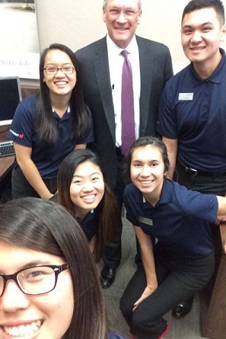
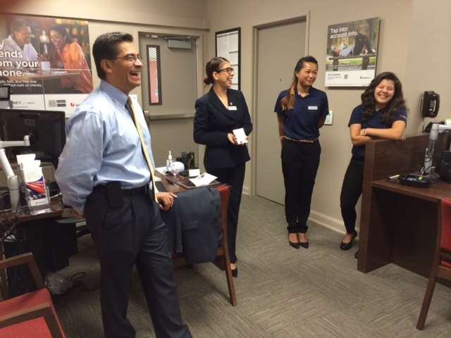
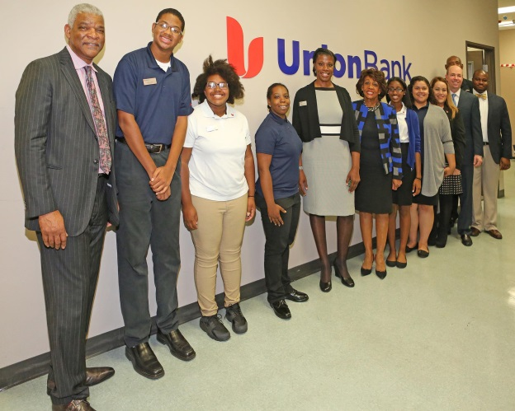
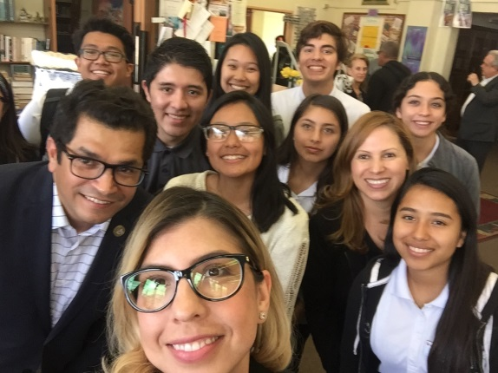
Visits from Executives, Elected Officials & Community Leaders
Our CEO Steve Cummings on
Snapchat with the interns
Congresswoman Maxine Waters
Congressman Xavier Becerra
Congresswoman Maxine Waters
U.S. Representative Jimmy Gomez
Members of the bank’s Community Advisory Board

Slide 13
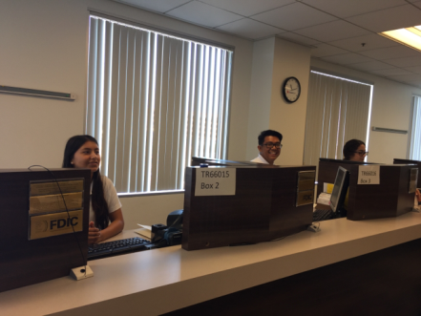
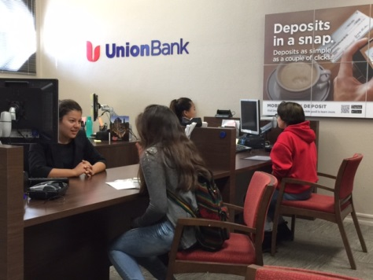
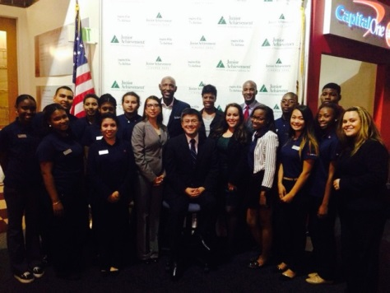
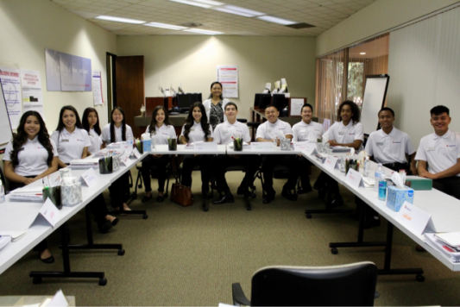
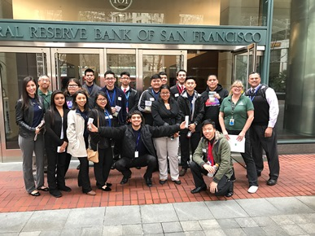
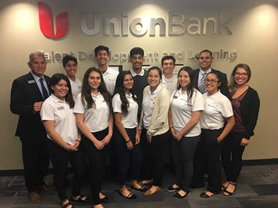
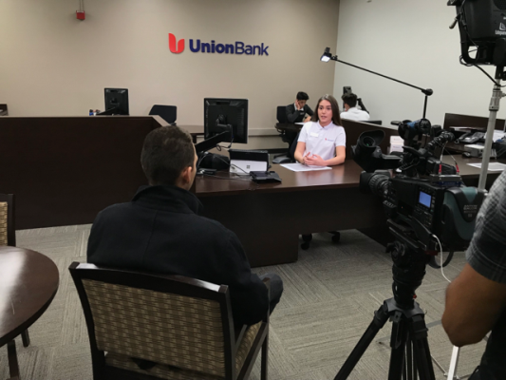
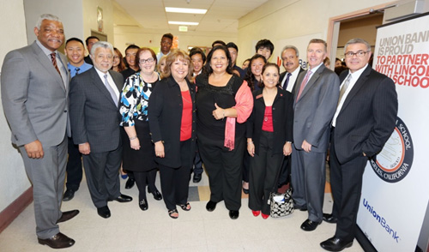
Our Interns, Our Future

Slide 14
Future of the Community College Student-Run Branch Model
Our first objective is to build the branch on the campus. Then, in time, create a resource center on a community college campus which has a branch, a food panty and wardrobe closet. The Union Bank student-run branch will become a resource center for students. After discussions with Laney College officials, the bank sees the need to create a resource center with assistance from other private and public community partners.
Data indicates that food insecurity has become a problem on college campuses. We can direct money from our annual foundation grant to the Alameda County Community Food Bank to establish a food pantry on the campus. The Alameda County Community Food Bank is a client of the bank. We will ask other corporations to do the same. Thus creating a food panty to address the issue of food insecurity of our students. The food panty is offered to students with a valid student ID card. The bank believes over 50% of the students at Laney College have some form of food insecurity. Volunteers for the food panty will come from employees of the sponsoring corporations. We believe we can operate the food panty several days a week. The food pantry’s objective is to provide students with free food regardless of verified need as a means of supporting their wellbeing.
Wardrobe Closet is donated business attire for students who need clothing for a job interview or work. Supported by Union Bank and other corporate sponsors, volunteers will assist students through quarterly clothing drives and make the clothing available on campus. We are also looking for corporate foundation support and a partnership with organizations like Wardrobe for Opportunity. Volunteers will also work in the wardrobe closet on campus. The goal is to assist students in their efforts to find a job, keep a job and build a career. Empowering these students in acquiring interview skills, professional clothing and career support they need to become economically self-sufficient.
This model has never been attempted before on a community college campus. If successful, we would like to duplicate it to others community colleges. Laney College will be the model. Our goal is to eliminate as many barriers as possible to ensure ultimate success for Laney College students.

Slide 15
Laney College Entrepreneurial Challenge
The Laney College Entrepreneurial Challenge, sponsored by Union Bank, is an entrepreneurial competition that re-engages youth in school, promotes academic improvement, builds personal character and social skills, encourages team building, promotes community economic development, teaches people advanced entrepreneur skills, and fosters cultural appreciation, acceptance, and tolerance, while helping young people create and build their businesses. Regardless of the extent to which people desire to ultimately grow their business, the Laney College Entrepreneurial Challenge competition will equip them with knowledge, skills and experience that will serve them well for the entirety of their lives.
By combining business development with competition in a manner similar to the popular show Shark Tank, the Youth Entrepreneurial Challenge presents a uniquely innovative and highly captivating opportunity to change the narrative and trajectory of people that did not exist. The competition is open to the community. Instruction will come from non-profit organizations, Union Bank and instructors are Laney College. It will be the catalysts for Laney’s Entrepreneurship – Certificate of Proficiency Program. Participants have an opportunity to win prize money and pitch their businesses to investors for funding.
The benefits of the Laney College Entrepreneurial Challenge:
• Laney College becomes the entrepreneurial resource center for the Oakland area
• Provides greater access to and increases employment and entrepreneurial opportunities
• Improves economic outcomes and the academic performance of all levels
• Re-engages people in school or heightens their academic interests by creating a thirst for knowledge
• Builds bonds of friendship, appreciation, understanding and respect across cultures, ethnicities and geographies
• Significantly improves critical thinking, communication, and conflict resolution skills
• Develops leadership, teamwork, and consensus building and builds self-confidence, self-awareness, and self-esteem
• Provides educators and academic institutions a blueprint and vehicle by which to engage people in academic pursuits

Slide 16
Contact Information
Your dedicated team at Union Bank
Julius Robinson
Head of Corporate Social Responsibility for the Americas
415 765 3883
Julius.robinson@unionbank.com
Fred Mendez
National Community Outreach Manager
415 765 3947
Horacio.mendez@unionbank.com
Bobbie Salgado
Head of CRA Operations and Strategy
916 449 1343
Bobbie.salgado@unionbank.com
Frank Robinson
Region Manager – Student Run Branch Program
619 230 4500
Frank.robinson@unionbank.com
Vernell Taylor
Branch Manager – Crenshaw High School
323 200 2008
Vernell.taylor@unionbank.com
Wendy Estrada
Branch Manager – Lincoln High School
323 909 1028
Wendy.estrada@unionbank.com
Carolina Gomez
Branch Manager – Loara High School
714 507 3695
Carolina.gomez@unionbank.com
Daniel Hedgecock
Branch Manager – McLane High School
559 230 5901
Daniel.hedgecock@unionbank.com
Jennifer Aviles
Branch Manager – Mountain View High School
626 443 6181
Jennifer.aviles@unionbank.com

Slide 17
Thank you
MUFG Union Bank, N.A.
Corporate Social Responsibility for the Americas
350 California Street, 11th Floor
San Francisco, CA 94101
©2018 MUFG Union Bank, N.A. Member FDIC. All rights reserved. Union Bank is a registered trademark and brand name of MUFG Union Bank, N.A.

