Slide 1
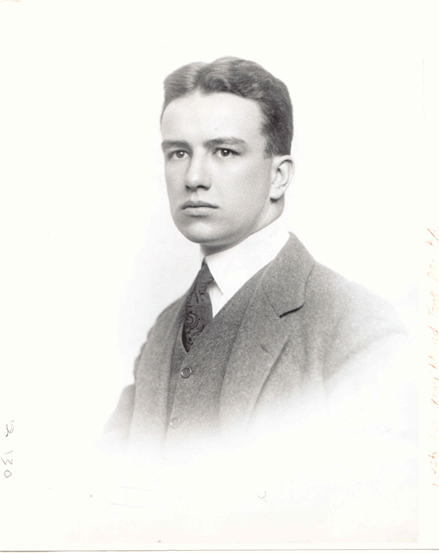
Buckminster Fuller
Engineer, Author, Designer, Inventor, and Futurist

Slide 2
Early Life
Born July 12, 1895 in Milton Massachusetts
Attended Harvard University
  Was expelled twice
  Worked as a manual laborer during expulsion
Graduated from Bates College
Joined the Navy during WWI.
Went back to work as a laborer after the war

Slide 3
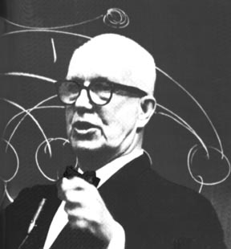
Depression and Recovery
Married Annie Hewlet in 1917
By age of 32, was homeless and destitute
Daughter died in 1922
Worked at a café in exchange for food
Gave informal lectures at café and display many of his ideas.
Eventually began teaching at various colleges from 1948-1970

Slide 4
Awards and Death
Was awarded many medals and awards
  1960 Frank P Brown award by the Franklin Institute
  1969 Humanist of the year by American Humanist Association.
  1970 Gold Medal from the American Institute of Architects
  1983 Presidential Medal of Freedom
Died in July 1, 1983

Slide 5
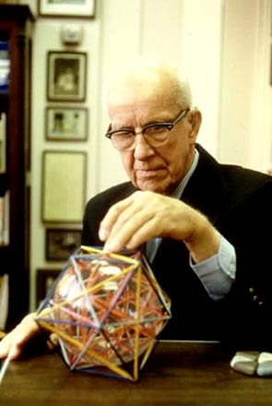
Inventions and Concepts
Best known works include:
  Geodesic Dome
  Dymaxion House
  Dymaxion Car
Coined concepts
  Ephemeralization
  Spaceship Earth

Slide 6
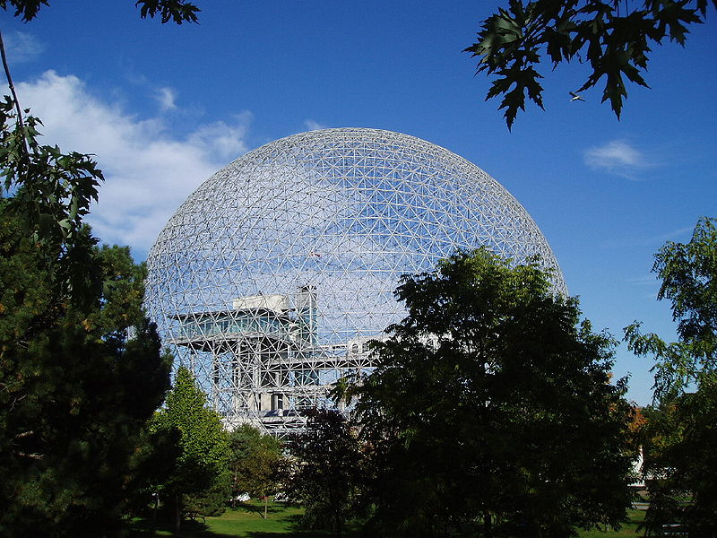
Geodesic Dome
Spherical enclosed structure that is more lightweight than other structures
An example would be the Epcot Center in Disney World

Slide 7
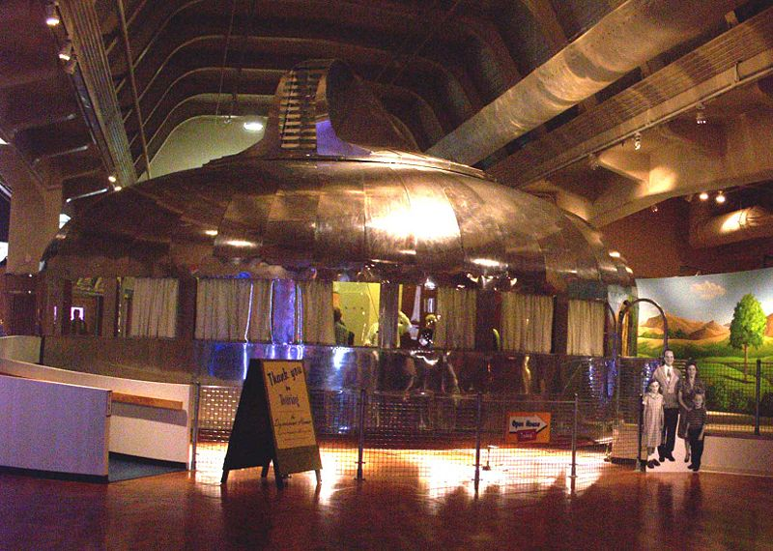
Dymaxion Housing
Type of housing structure to help improve energy-efficiency and make housing inexpensive
Had several problems that halted its development

Slide 8
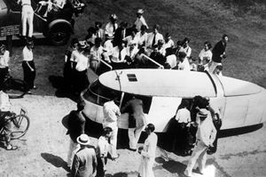
Dymaxion Car
New type of car meant to be a safer and more efficient form of transportation.
Ended up failing after testing proved it to be impractical to drive.

Slide 9
Ephemeralization
The concept of “doing more and more with less and less until you can do everything with nothing”.
Advocated programs like recycling in order to continue to use the Earth’s finite resources.
An example he used was Henry Ford’s assembly line

Slide 10
Views and Concerns
Was one of the first to explore energy and material efficiency in engineering
  Demonstrated in his inventions:
    Geodesic Dome= less material usage
    Dymaxion Housing = energy and water efficient
    Dymaxion Car = had good gas mileage for the time
One of the first people to coin the term “Spaceship Earth”.

Slide 11
Legacy
Wrote many books
  Operating Manual for Spaceship Earth
  Ideas and Integrities: A Spontaneous Autobiographical Disclosure
  Synergetics: Explorations in the Geometry of Thinking
  I am a Verb
Many geodesic domes exist today all around the world
Created the field of synergestics

