Slide 1
Multiple Measures for ESOL
Summary of Work Group's research and proposal

Slide 2
Background
AB705
Colleges must use multiple measures when assessing basic skills students.
High school transcripts have been reliable measures for college placement and success
Only 20-25% of ESOL students have high school transcripts.

Slide 3
ESOL MM Working Group
Barbara Yasue
Beth Maher
Rebecca Clayton
Beth Waddell
Evan Degennaro

Slide 4
Our Process
Met several times in Spring 2018
Researched Laney's current process for in-take and placement
Researched what others are doing or proposing
Made recommendations.

Slide 5
Propose 3 new activities:
ESOL Onboarding Fairs
Guided Self-Placement
Student Survey

Slide 6
ESOL Onboarding Fair
"One Stop Shopping"
8-12 ESOL Onboarding Fairs per year to include:
  Information sessions about ESOL Program: credit and noncredit
  Workshops to complete Peralta applications
  Information on assessment
  Assessment and/or appointments for future assessment date
  Counseling orientation and appointments
  Opportunity to meet ESOL faculty and get advice
  Community building

Slide 7
 | Current (worst possible) Option | Proposed Orientation Model
Outreach | No on-campus event | Visit 1
Complete Application | Visit 1 | Visit 1
Receive ID number | Visit 2 | Visit 2
Register for assessment Test | Visit 2 | Visit 1
Take assessment test | Visit 3 | Visit 1
Meet with an ESOL faculty | Visit 3 (at assessment test) | Visit 1
Retrieve results from assessment test and attend an orientation from counselors | Visit 4 | Visit 1 (In this version ESOL faculty will also participate in the orientation, not just counselors)
Attend counselor orientation session | Visit 4 | Visit 1
Meet with a counselor to enroll in classes | Visit 5 | Visit 2

Slide 8
Guided Self-Placement
  What is it? (implementation varies site to site...this is one model)
    Students read a prompt and write a paragraph.
    Students are shown several responses to the prompt.
    They are asked to choose the response that is most like their own. That response is linked to a language level description with more details about the level.
    Students select the level they feel most fits their needs.
    ESOL faculty mingle and assist.

Slide 9
Guided Self-Placement: Why we recommend it
  Can use current assessment facilities
  Effective use of ESOL faculty expertise
  Creates student buy-in for their placement
  Gives students a preview of the ESOL levels and curriculum
  Lowers the stakes and addresses "test anxiety"

Slide 10
Guiding principle :
  "To have respect for student agency and an appreciation for the pedagogical value of asking students to reflect on their prior writing experiences in relation to the new writing context they are entering."
  http://www.ncte.org/library/NCTEFiles/Resources/Journals/TETYC/0442-dec2016/TETYC0442Whitepaper.pdf

Slide 11

Guided Self-Placement Video from Woodland Community College

Slide 12
Sample Prompt:
Take out a piece of paper. Write for 30 minutes about the following question. You will use what you write to help you with step three. You can use a dictionary, but don't copy sentences or paragraphs from the internet. This won't help you.
Who is a hero in your life? Why?

Slide 13
Student Example 1: ESOL 510
God is my hero is the only one.
Explore this level more
Student Example 2: ESOL 520
My hero of my life is my father he is the best person, he like soccer like me. He suport old my proyects and he love my kids. He always try to keep the family together and if we need something, he is always with us.
Explore this level more
Student Example 3: ESOL 530
The person that I consider a hero in my life is my mom because she raised me and my brothers by her self and she is always trying to find the best for us. Also she always is happy no matter what the problem is.
Explore this level more
Student Example 4: ESOL 540
My father is my hero. He is the person most important in my life not only because is my father. He is my hero because all things did for me and my brothers and sister. My mom died when I was 8 years old and my dad took care about us. He did mom stuff and work at the same time. That is the reason because I think he is awesome and he is my hero.
Explore this level more

Slide 14
Student Survey
Extensive student survey to find out about:
  educational attainment
  Comfort and confidence using English
  Academic goals
Acts a bridge between student and counselor

Slide 15
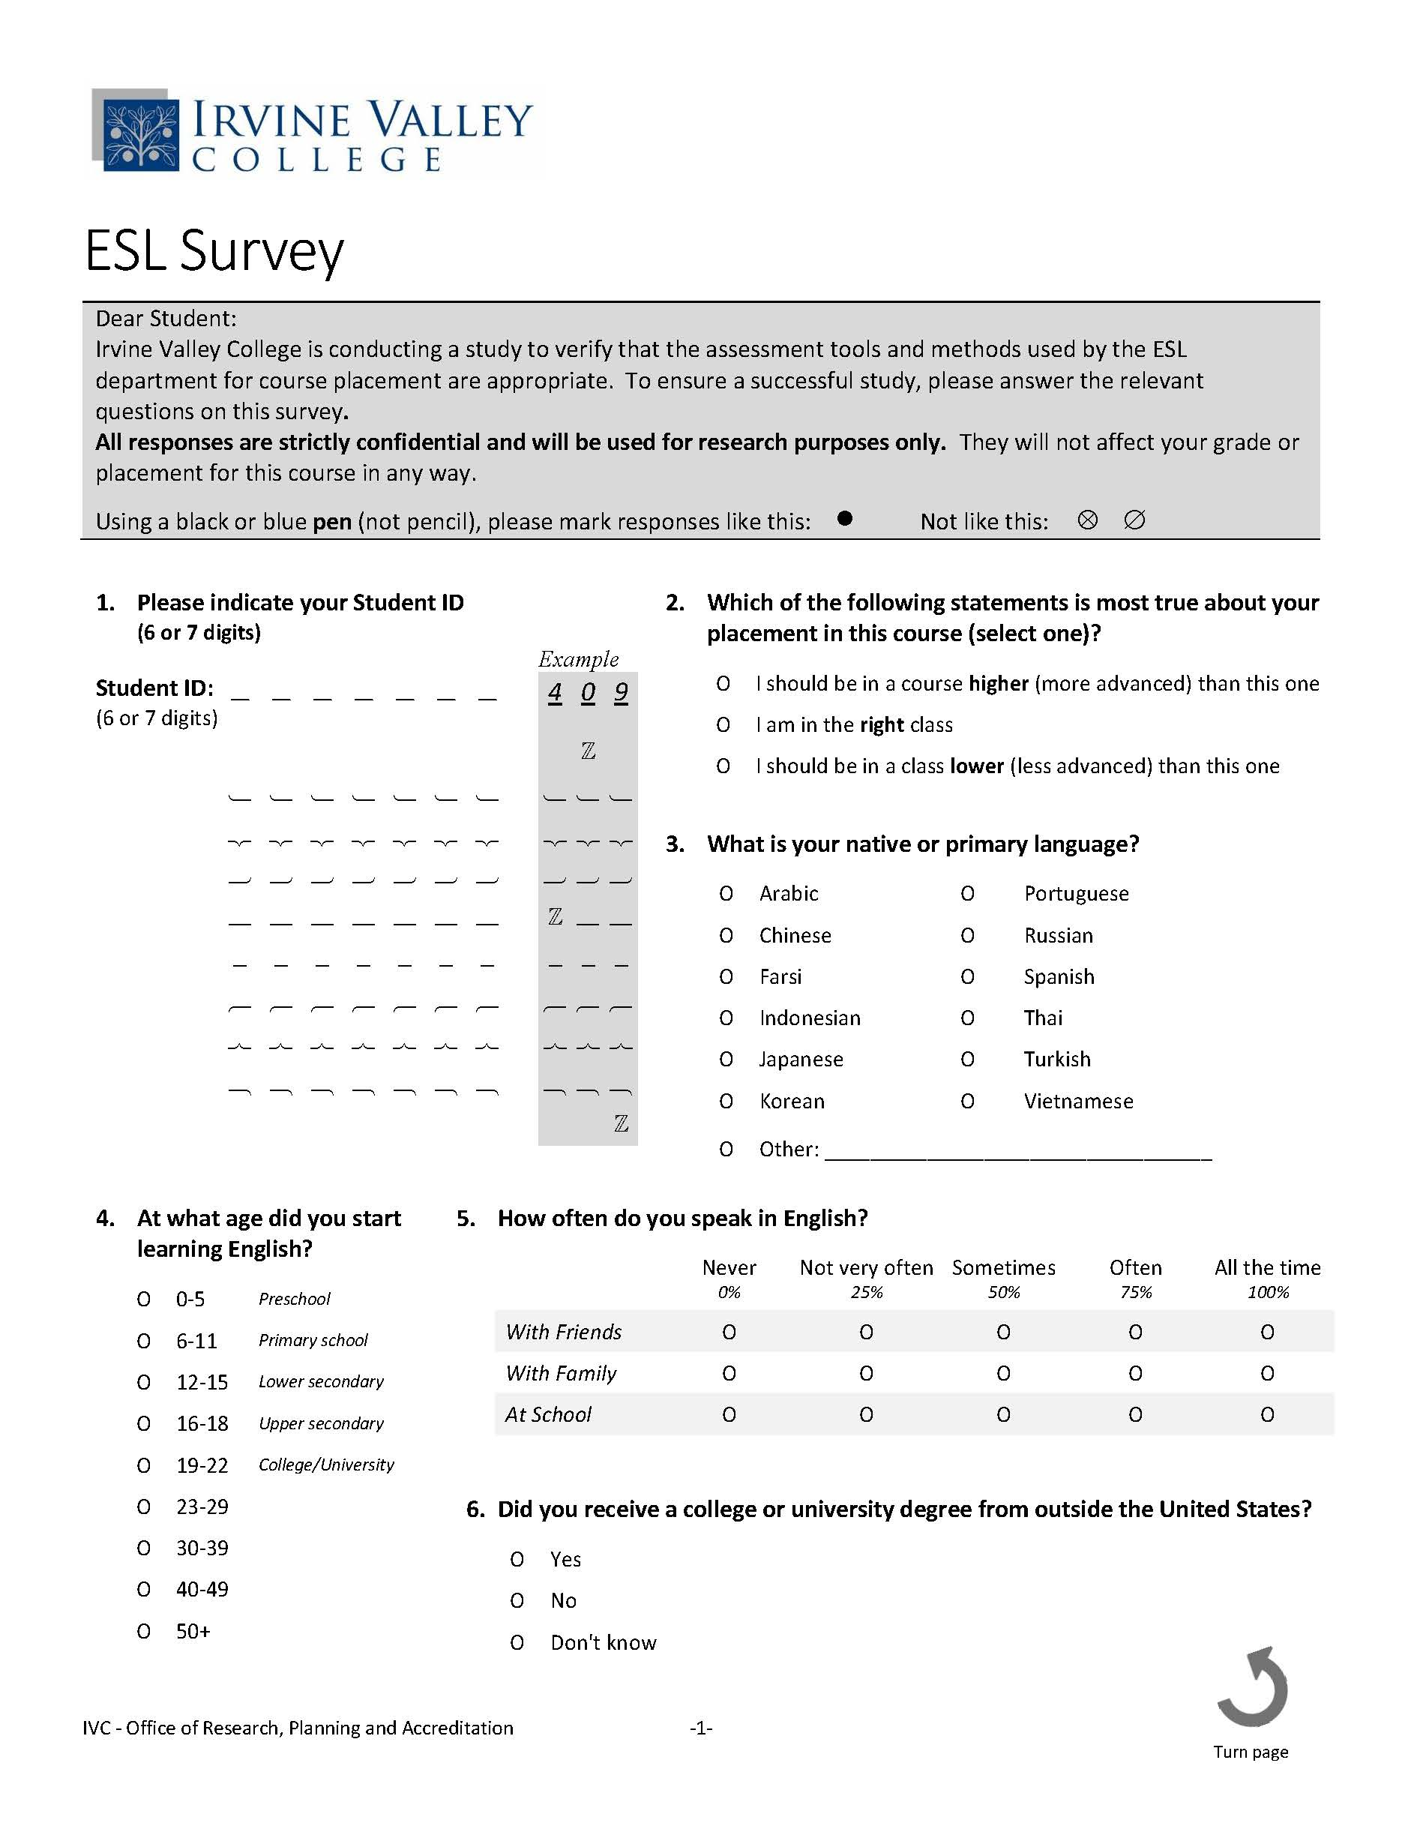

Slide 16
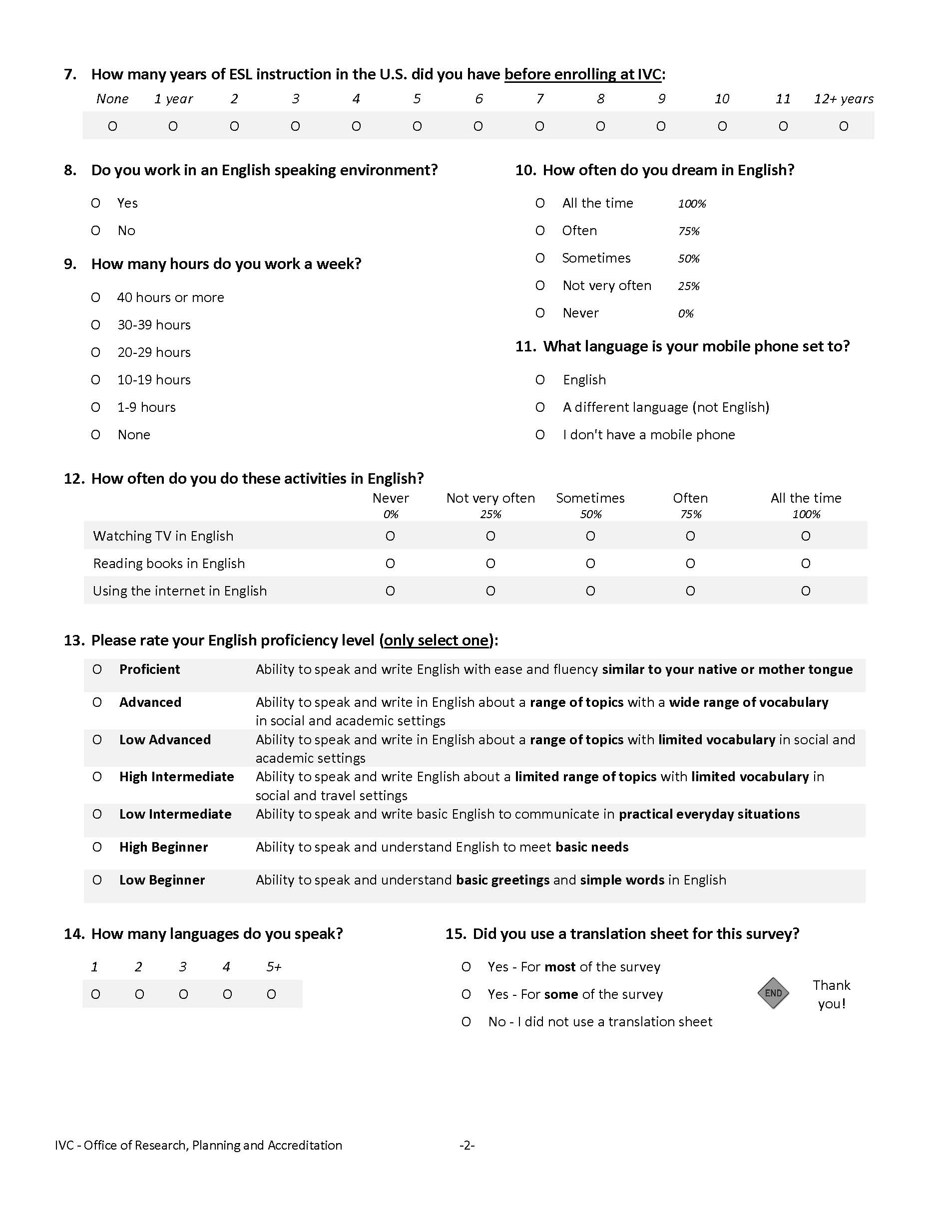

Slide 17
Implementation Timeline
Fall 2018: Create prompts, draft survey with counselors, decide on key elements of onboarding fair. Secure funding (as needed).
Spring 2019: Work with IT, PIO and institutional research, Create on-line prototype, Pilot with small sample of students.
Summer 2019: Fuller pilot with summer students and get feedback.
Fall 2019: Full implementation or continue revising.
Spring 2020: Full compliance with AB 705

