Slide 1
Graphing 101
How to make basic graphs used in science classes

Slide 2
why graph by hand or at all?
you will be doing a lot of graphing in this class and future science classes.
graphing a small data set allows one to discover hidden trends.
graphing allows you to obtain reasonable data without doing a lot of experiments.
practicing graphing by hand gives you the opportunity to explore how graphs are put together so that, later, you can make proper computer generated graphs.
Notes:
Summarized on page 1

Slide 3
What makes a good Graph?
1. A Title (descriptive, not general)
2. Labeled Axes (quantities and units)
3. Scales and size of step (evenly spaced, “1-2-5 rule”)
4. Data Points (spread out and visible)
5. The Curve (best straight line)

Slide 4
A Good Graph
Title
Labeled axes
Scales
Data Points
The Curve.

Slide 5
Title
Labeled axes
Scales
Data Points
The Curve.

Slide 6
Part A: presentation of Data
THE DATA TABLE:
ORganizeS data to be used in a graph.
Contains proper significant figures and correct units.
is organized by ordered pairs WITH THE VALUE FOR the x axis given first, followed by the value for the y-axis (x,y)
Notes:
Pages 1 & 2. Remember, the handout was passed out two weeks ago. Some students have already started the quiz. Don’t cover the problems.

Slide 7
How to Start
We start the process of creating a good graph with the Data table.
Then we will look at scaling the data to fit the graph paper
Followed by making the best fit line, reading the graph, and calculating the equation for the line.

Slide 8
What a data table can tell you
The data table should give physical information about the experiment.
The data table gives the raw data
The data table gives the units and variables

Slide 9
What a data table Can’t tell you
Trends
Interpolation
Extrapolation
Because the data is raw , there is unseen error in the values. These are exposed through graphing.

Slide 10
Part B: reading a Graph
the extraction of data
a graph is a picture of information presented in the data table.
Look at your handout on page 3: find the graph for temperature calibration.
Notice that the variables & units are shown on the graph (T °C and T°F) are the same as in the data table.
Notes:
Again, Students should pre-read.

Slide 11
Axes and the Cartesian coordinate system
The x-axis lies in the horizontal direction
the y-axis lies in the vertical direction
the intersection of these two axis is the origin.
the origin usually has the coordinates (0,0) but can also have any two values.

Slide 12
PartC: independent and dependent variables
each axis is given a set of variables
the independent variable is the variable that is measured carefully and deliberately during an experiment.
the dependent variable changes as the independent variable changes.

Slide 13
No. of rice grains
Depends on which method you pick
the number of grains of rice is the independent variable.
the mass of that number of grains of rice is the dependent variable.
the mass of rice depends on the number of grains of rice.
the mass of rice goes on the y-axis while the number of rice grains belongs on the x-axis

Slide 14
density
Sometimes it is helpful to know something about what you want to determine in a lab.
in this case, we want to determine density, which has the units grams /vol.
we want the grams to be dependent on the volume of material.
therefore, the mass is the dependent variable, and the volume is the independent variable.
we will be doing a lab involving density later.

Slide 15
growing flowers
sometimes we want to arrange an experiment based on convenience.
so which would you rather do: come to the lab every day at 10 am and measure your plant growth, or wait till your plant grows a certain height and note the time.
you decide, But i know what i would rather do.

Slide 16
Part d: selecting a scale
each axis has its own scale
the scale is designed so the axis uses the maximum amount of space on the page.
starts with a value smaller than the lowest data point and ends with a value larger than the largest data point.

Slide 17
scale
scales are uniform on each axis.
the values for the scale marks are whole numbers
the first point does not have to be zero.
the markers are not actual data points, unless they are part of the 1,2,5 rule.

Slide 18
parts to finding the best scale
there are three steps to finding the best scale for your data.
find the range
find the scale/division
set the scale to the closest 1, 2, or 5 value.

Slide 19
problem 1-range
You are given a piece of graph paper with 50 divisions on the x-axis. The following data must fit on the x-axis following the 1-2-5 rule. Time: 33.0 min, 83.5 min, 133.8 min, 205 min, and 252 min.
subtract the highest value from the lowest value.
219 min

Slide 20
problem 1:divisions
Now that you have the range, divide the range by the number of divisions on your graph paper
219 min/50 div=4.38 min/div

Slide 21
1, 2, 5 rule
the scale is based on values of 1, 2, or 5.
this limits your divisions to 1, 2, or 5 divisions.
this means you have to calculate a scale, not count and hope for the best.

Slide 22
problem 1:scale
above is a number line based on the values of 1, 2, & 5. notice that there are no other numbers on this number line.
4.38 is greater than 2 but less than 5. i have placed it on the number line. the best scale for our data is 5.00 min/div.
 |  |  |  |  |  |  |  |  |  | 4.38
 | 0.1 |  | 0.2 |  | 0.5 |  | 1 |  | 2 |  | 5 |  | 10 |  | 20 |  | 50 |  | 100 |  | 200

Slide 23
problem 1: starting and ending point
axes don’t have to start at zero. Lets determine a good starting and ending point for our axis.
starting with our scale of 5.0 min/div, multiple the scale by the number of divisions.
5 min/div X 50 div = 250 min.
looking at our data, we see that we could start at zero, but our last data point is 252 min.
zero doesn’t work!

Slide 24
Zero? not always
we need a starting point that is smaller than our smallest data point and an ending point that is larger than our largest data point. also, it must contain 250 data points.
here is one method of determining a reasonable starting and ending point
add the scale multiple (above) to your lowest point. this gives you a starting point of your lowest value and an ending point.

Slide 25
in the end: finesse
we really don’t want to start with 33 min as a starting point.
hmmm? if i use 0, then the ending point is 250. if i use 10, then the ending point is 260. this is reasonable. notice that a starting point of 20 also works. (What will be the ending point?)
answer: 270

Slide 26
practice makes perfect
the handout has problems to practice setting a scale and figuring out starting and ending points.
you will have time after the lecture to work on the handout.

Slide 27
Gay Lussac’s law data
now you have the chance to practice with a graph of Gay lussac’s law data.
follow the guidelines in the handout. pay particular attention to the y-axis. it is challenging, but not impossible.
you will have time to complete this after the lecture.

Slide 28
Drawing The curve or line
a curve is a smooth line drawn through a series of data points
the best fit line passes through many but not all of the data points.
A best-fit line ‘averages out’ the line

Slide 29
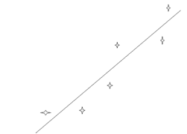
The curve (the best straight line)
it is acceptable to have the points two by two on the same side of the line

Slide 30
slope
the slope is the rise/run.
the slope has units and sig. Figs.
pick two data points from the line, not your experimental data, for example (x1,Y1)= (15°C,60°F); (X2,Y2) =(62 °C,145°F)
using data from the temperature graph:

Slide 31
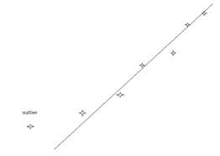
outlier points
if a point is too far from the others, an outlier, it makes no sense to use it. Graphing revels outliers.

Slide 32
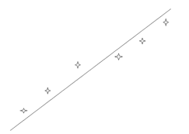
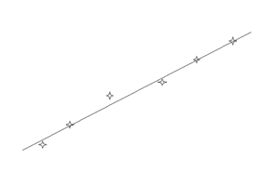
Hmmm?
some times the line does not always touch all of your data points. but be careful! the graph on the right shows the correct line.
Good

Slide 33
the line equation
in chemistry 1A and 1B, you will be asked to determine the equation for the best-fit line.
the equation has two major components: the slope & the y-intercept.
the form of the line is Y = mX + b.
in science, the slope and the y-intercept have significant figures and units.

Slide 34
the y-intercept
the y-intercept is determined using a third data point from the line.
the y-intercept has sig figs & uses the Y-axis unit

Slide 35
Remember: The best fit may not touch many of your points. How do you get the slope? Notice that the points used for the slope are not data points.
P₂(20°C, 440$)
P₁(14°C, 260$)
(18°C,380$) for the y-intercept
$$m=\frac{\left(440\$−260\$\right)USD}{\left(20−14\right)°C}=30\frac{USD}{°C}$$

Slide 36
Put it together and ...
y=mx +b is not the answer for “what is the equation for this data?”.
Sales($)= $30 (USD/C)(T_{°C})+ -$160
or
Sales in USD= $30(USD/°C) (Temperature in °C) + -$160

Slide 37
interpolation and extrapolation
Extrapolate = obtaining data outside of the data points collected experimentally
Interpolate= collecting data that is based on the experiment trend.

Slide 38
In summary:
a good graph has many attributes: two axes, a reasonable scale based on the experimental data, a trend line, and an equation that is derived from the line
it is a great tool to use to evaluate data.
with care, one can obtain useful data from a well made graph.

Slide 39
A great graph is:
easy to plot
easy to read
aesthetically pleasing to the eye
neat and well formed.

Slide 40
the axes are:
clearly labeled
the label includes the unit and the scale
the margins are well placed
there is space to the left of the y-axis and beneath the x-axis for labels and numbers with out crowding

Slide 41
the scales are:
uniform for that axis.
the scale numbers are rounded whole numbers.
represent multiples of 1, 2, or 5 and are not guessed at.
the scale values are at regular intervals on at least two spaces apart (not crowded)
the scale is chosen so the maximum amount of paper is used while maintaining readable values.

Slide 42
the line is:
a smooth line going through as many of the points as possible.
drawn with a ruler.
represents the best fit or average.
does not have to go through the origin.
is represented by y= mx +b, with a slope and y-intercept.

Slide 43
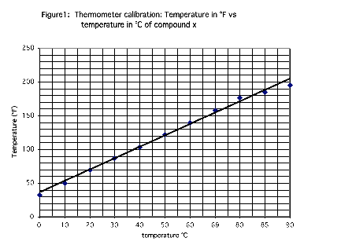
Let’s revisit the temperature calibration graph
Notes:
Looking at the x-axis, the scale is not uniform. 69°C should be 70°C, (two other temperatures are also off). Also, the title could have a bit more information: Thermometer calibration: Calibrating a thermometer at 1 atm by varying the temperatures of a water sample for Celsius and Fahrenheit scales.

Slide 44
A Good Graph
Title
Labeled Axes
Scales
Data Points
The Curve

