Slide 1
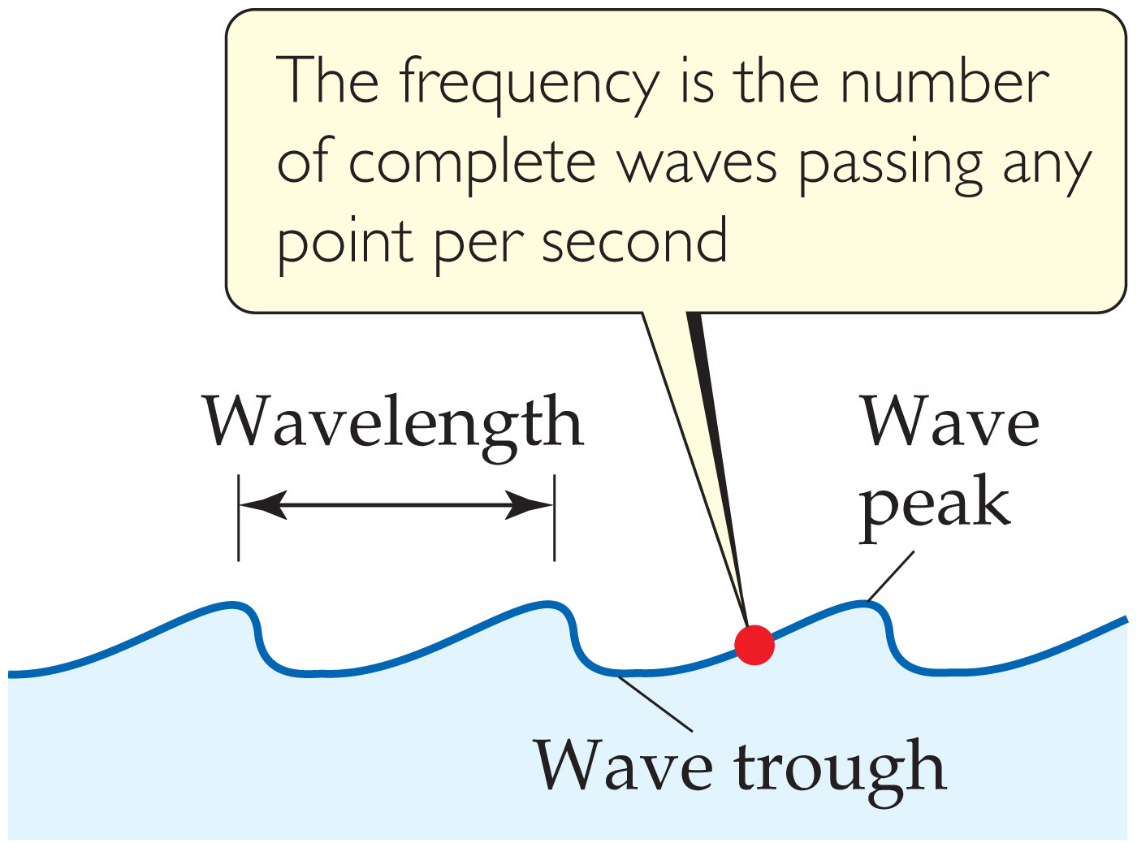
Notes:
Chapter 6, Figure 6.2, Water waves.

Slide 2
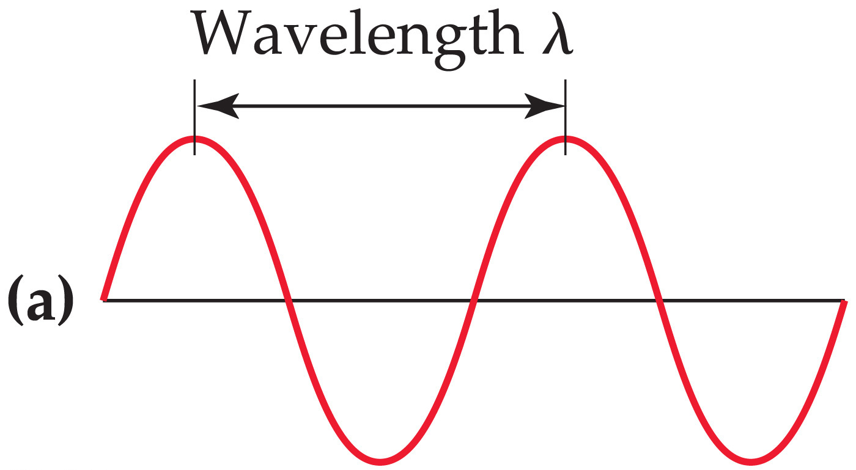
Notes:
Chapter 6, Figure 6.3A, Electromagnetic waves.

Slide 3
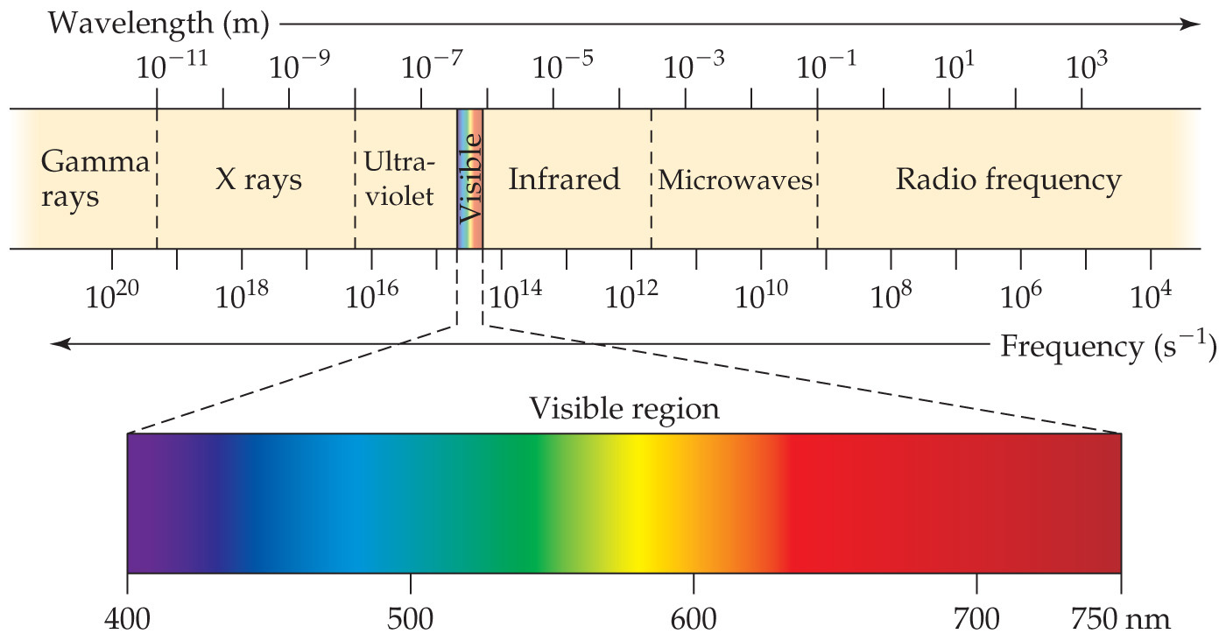
Notes:
Chapter 6, Figure 6.4, The electromagnetic spectrum.

Slide 4
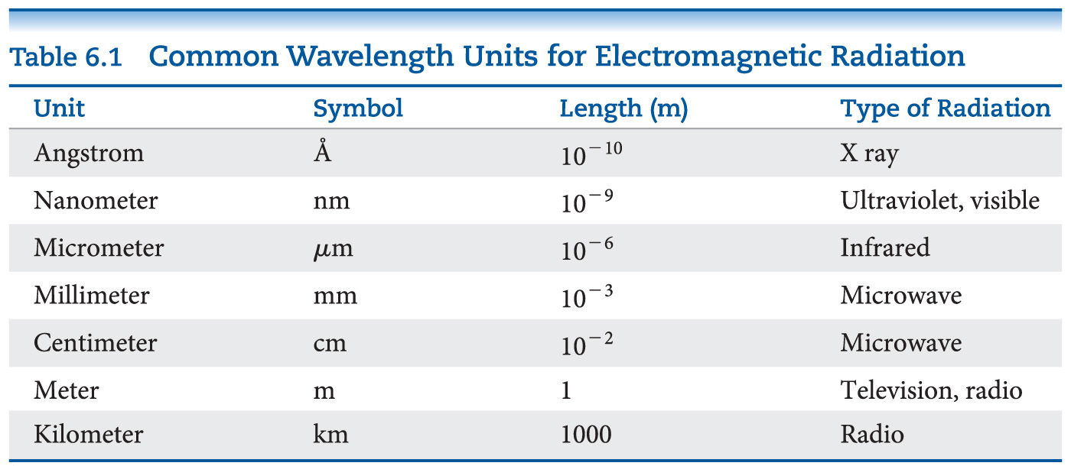

Slide 5
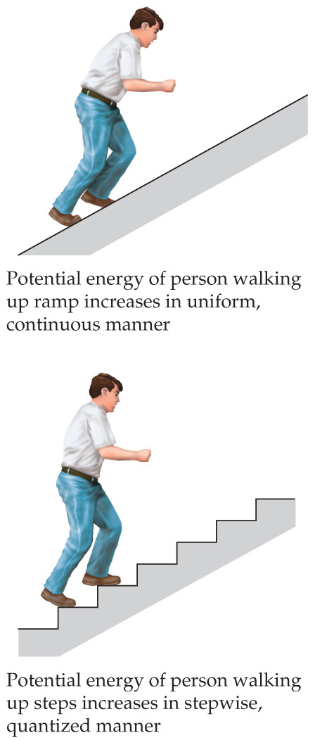
Notes:
Chapter 6, Figure 6.6, Quantized versus continuous change in energy.

Slide 6
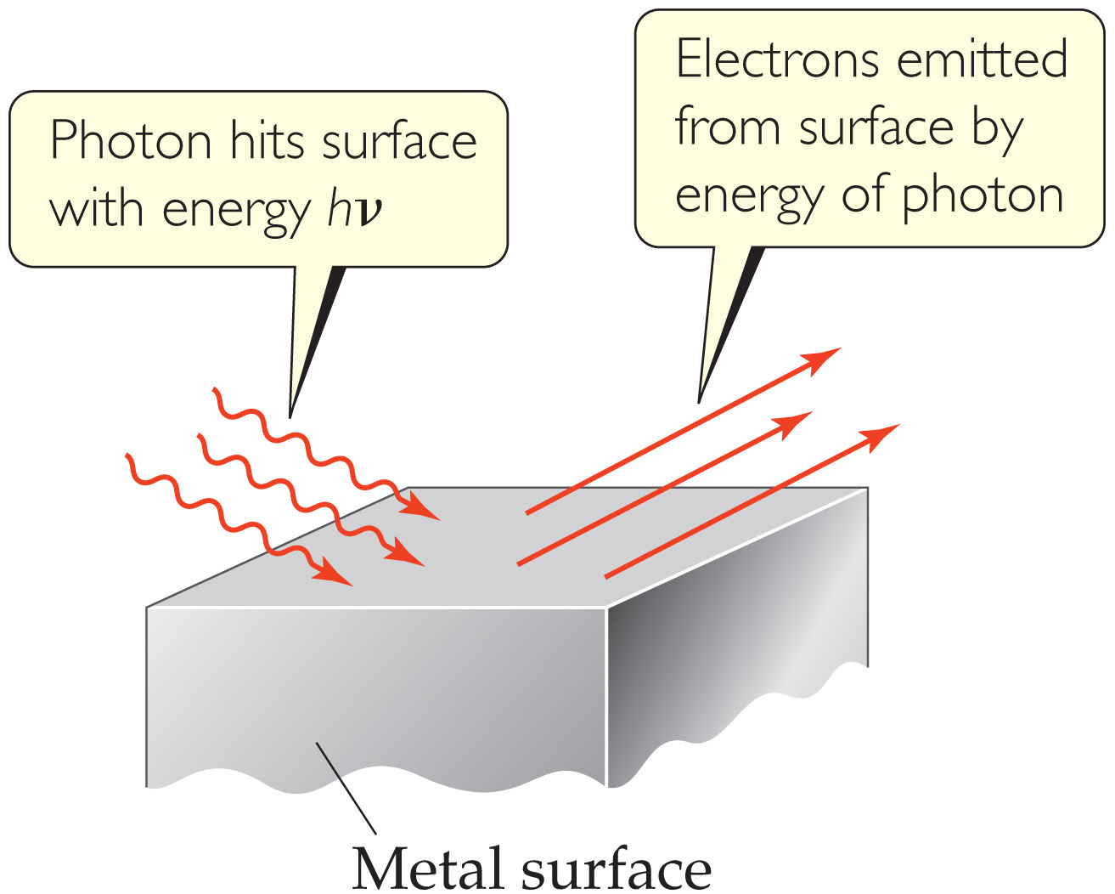
Notes:
Chapter 6, Figure 6.7, The photoelectric effect.

Slide 7
Notes:
Chapter 6, Figure 6.9, Creating a spectrum.

Slide 8
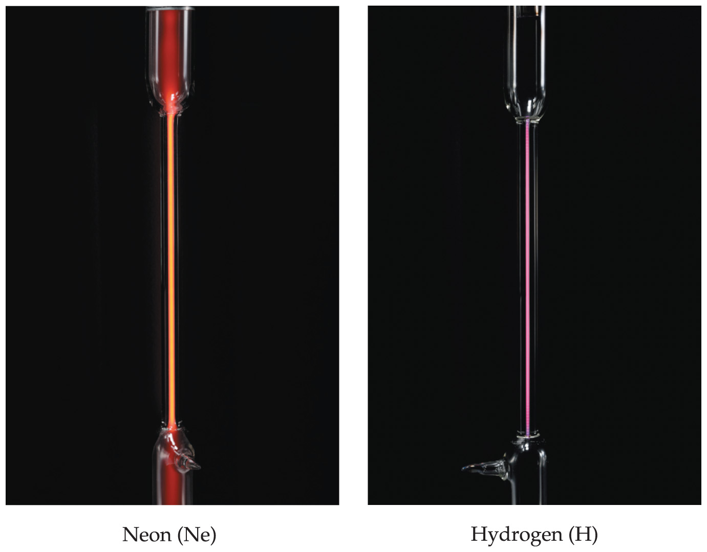
Notes:
Chapter 6, Figure 6.10, Atomic emission of hydrogen and neon.

Slide 9
Notes:
Chapter 6, Figure 6.11, Line spectra of hydrogen and neon.

Slide 10
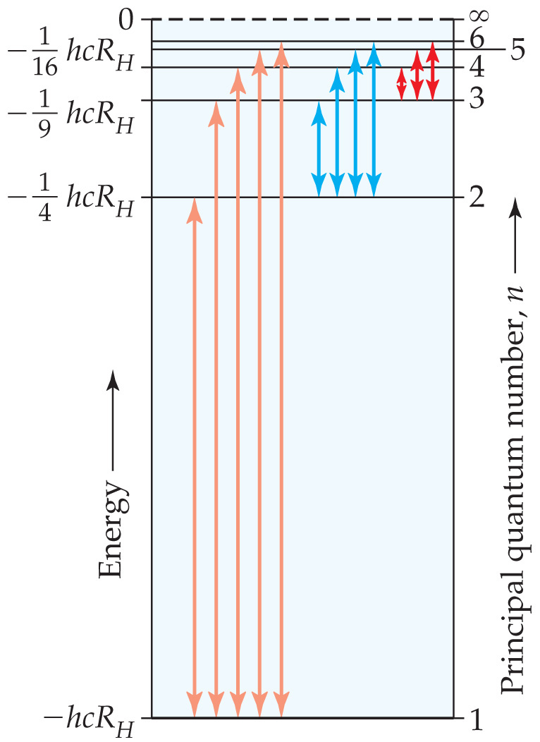
Notes:
Chapter 6, Figure 6.12, Energy levels in the hydrogen atom from the Bohr model.

Slide 11
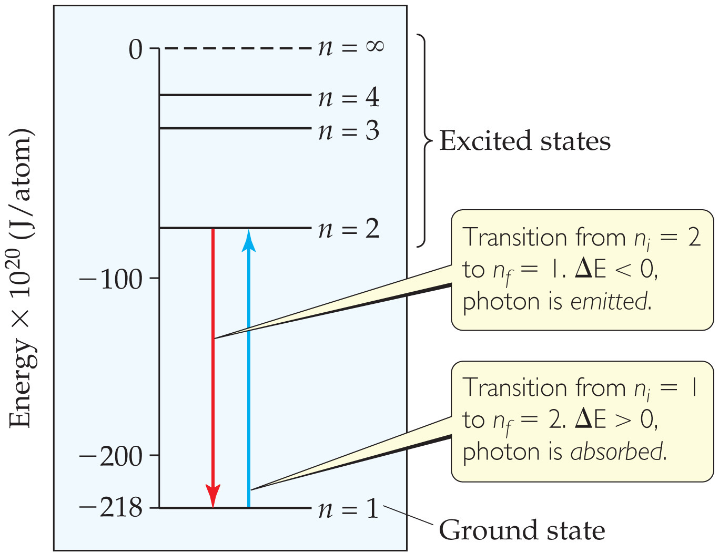
Notes:
Chapter 6, Figure 6.13, Change in energy states for absorption and emission.

Slide 12
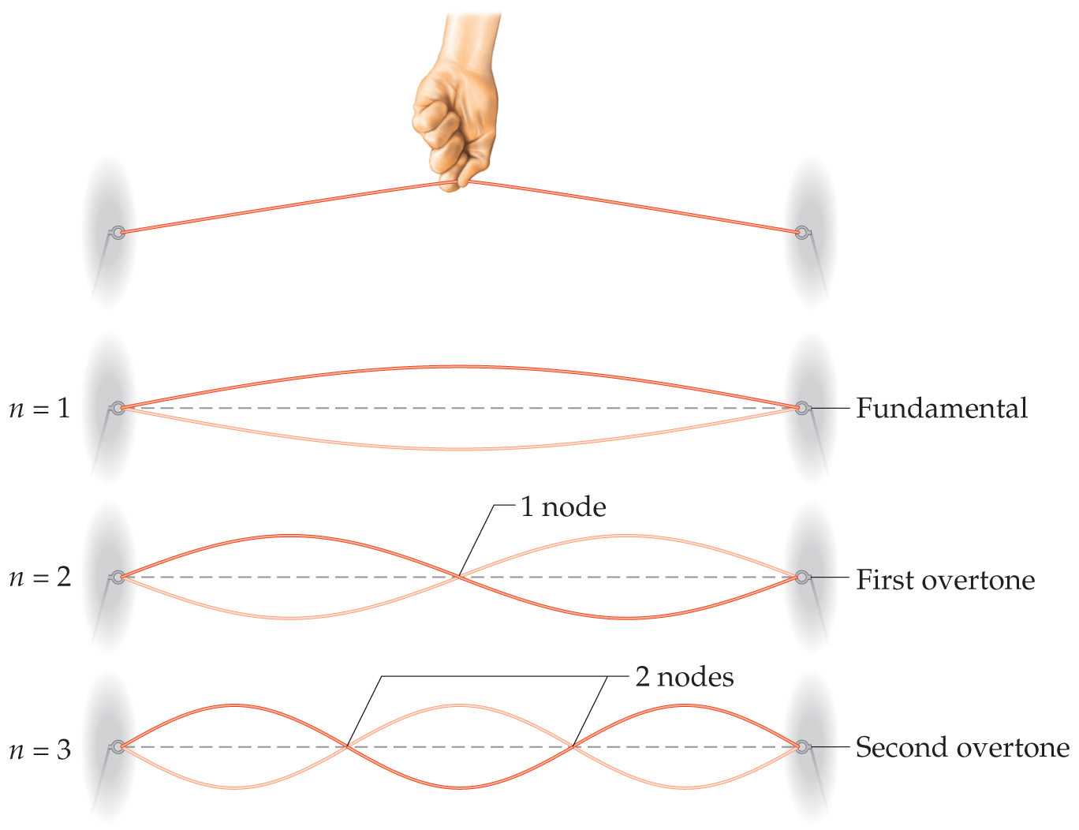
Notes:
Chapter 6, Figure 6.16, Standing waves in a vibrating string.

Slide 13
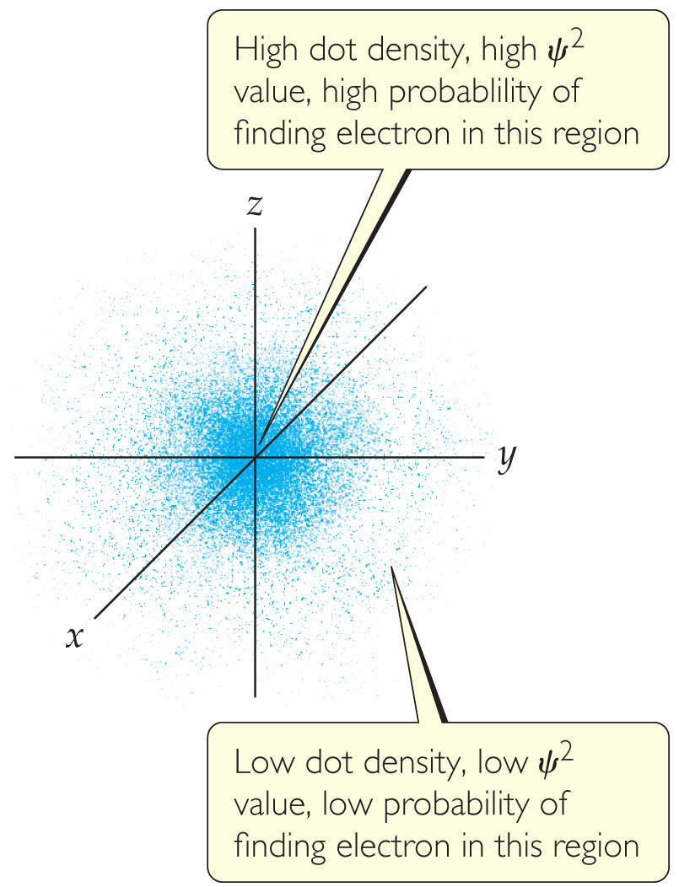
Notes:
Chapter 6, Figure 6.17, Electron-density distribution.

Slide 14
Notes:
Chapter 6, Unnumbered Table, Page 228

Slide 15
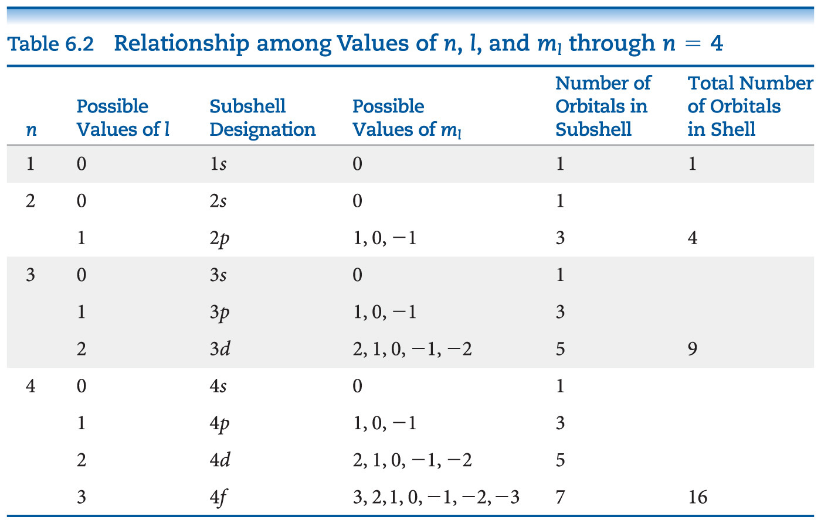

Slide 16
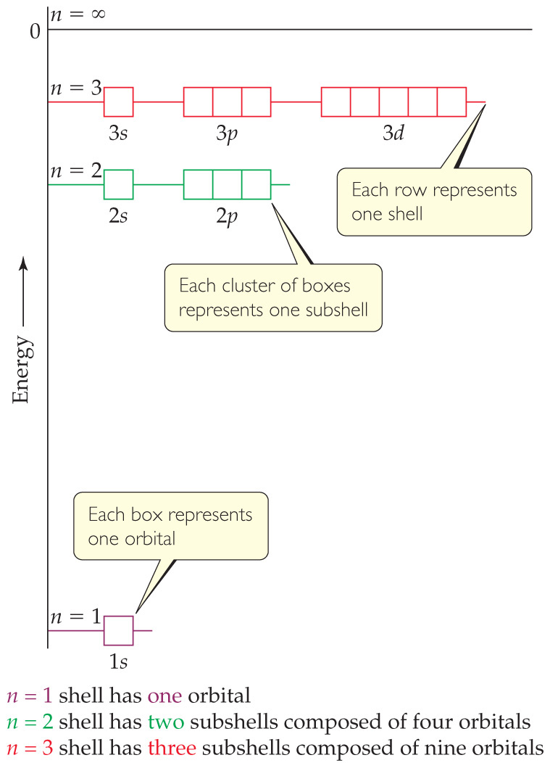
Notes:
Chapter 6, Figure 6.18, Energy levels in the hydrogen atom.

Slide 17
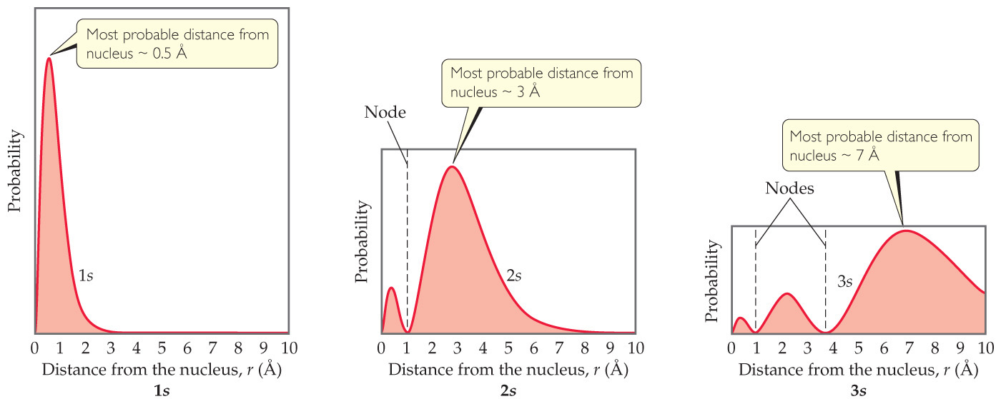
Notes:
Chapter 6, Figure 6.19, Radial probability functions for the 1s, 2s, and 3s orbitals of hydrogen.

Slide 18
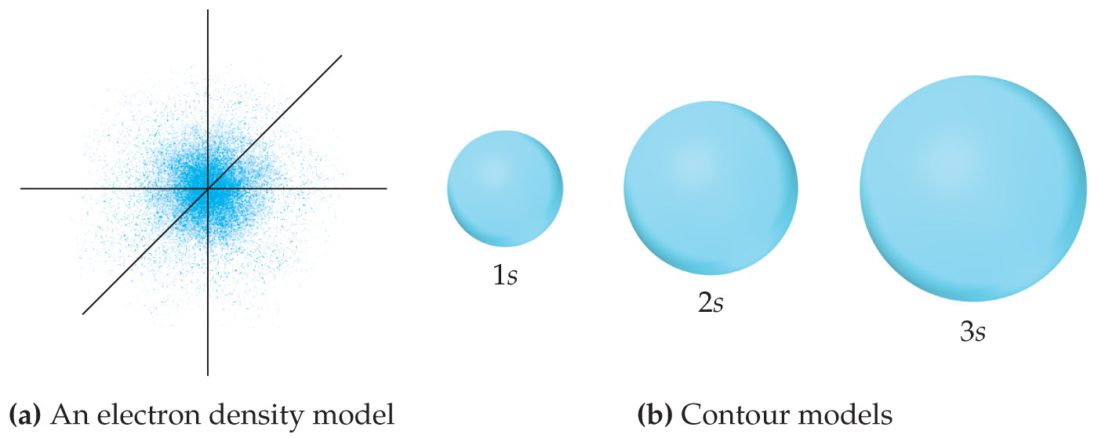
Notes:
Chapter 6, Figure 6.20, Comparison of the 1s, 2s, and 3s orbitals.

Slide 19
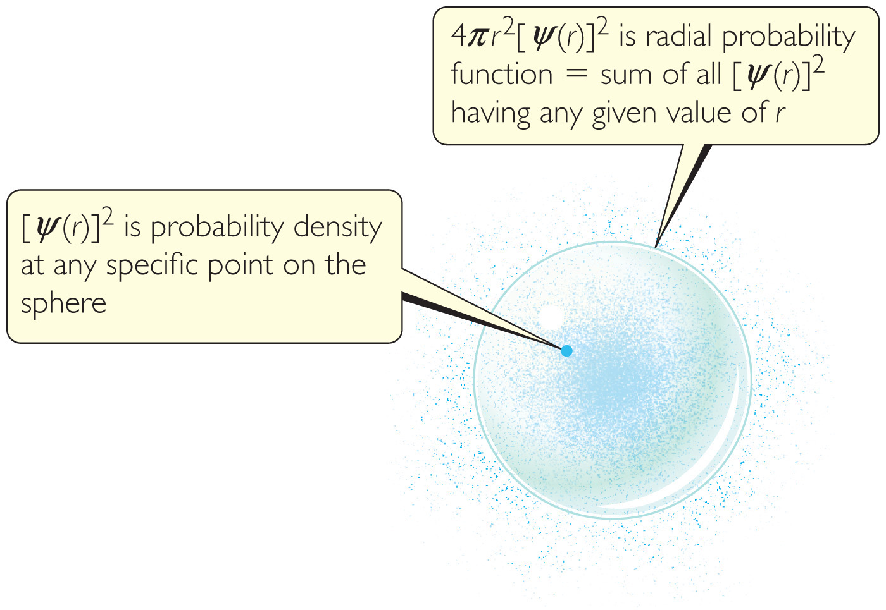
Notes:
Chapter 6, Figure 6.21, Comparing probability density [Ψ(r)]² and radial probability function 4πr ² [Ψ(r)]².

Slide 20
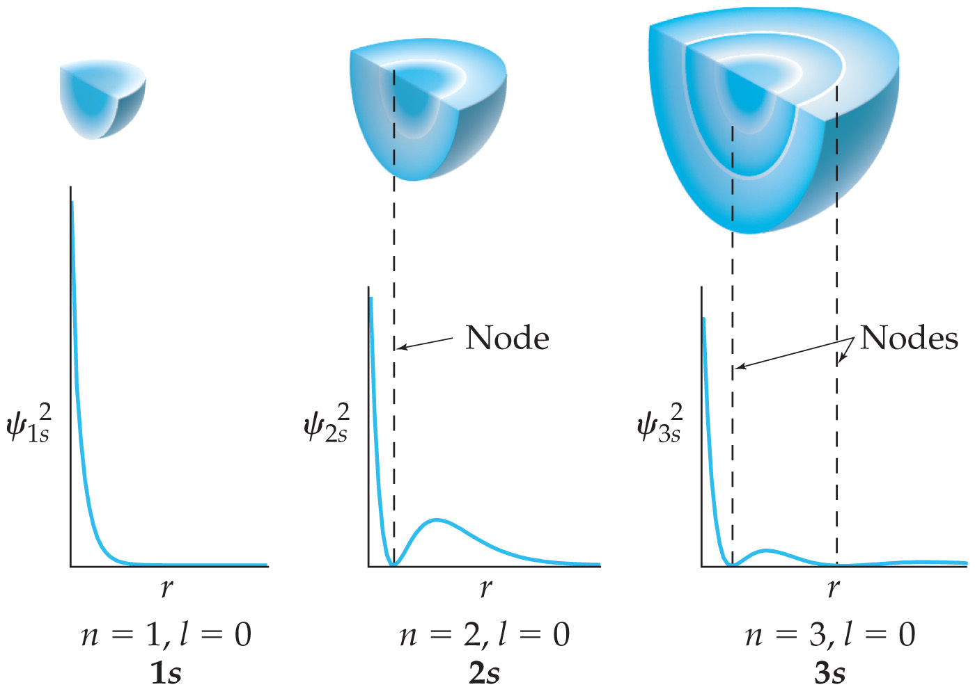
Notes:
Chapter 6, Figure 6.22, Probability density [Ψ(r)]² in the 1s, 2s, and 3s orbitals of hydrogen.

Slide 21
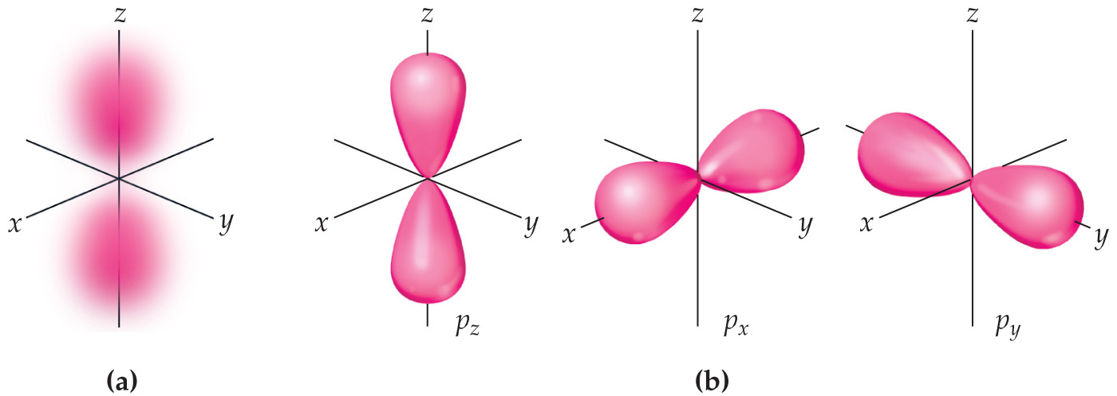
Notes:
Chapter 6, Figure 6.23, The p orbitals.

Slide 22
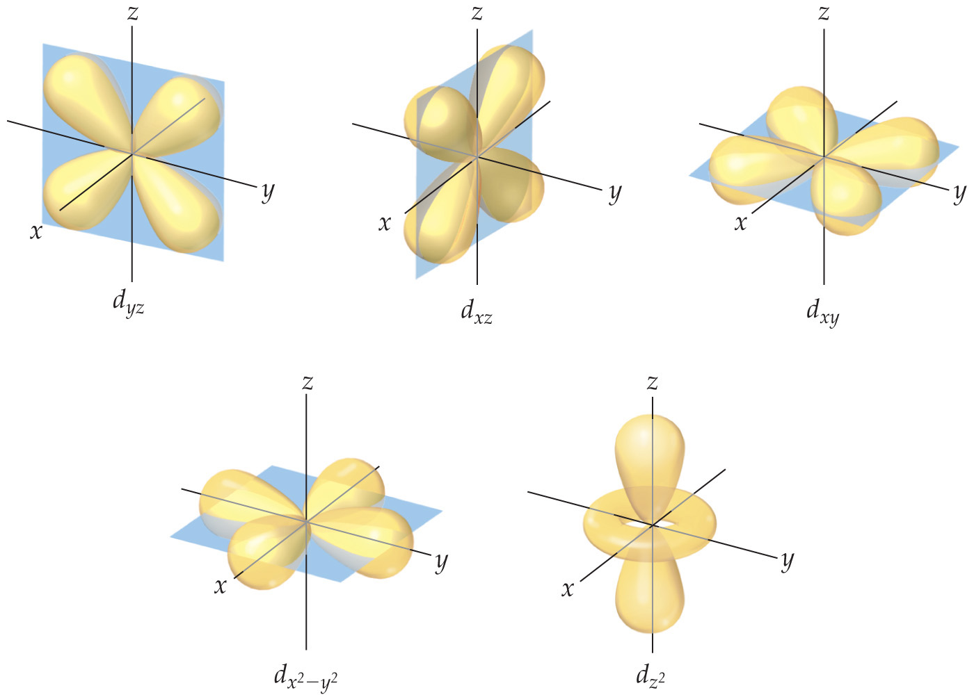
Notes:
Chapter 6, Figure 6.24, Contour representations of the five d orbitals.

Slide 23
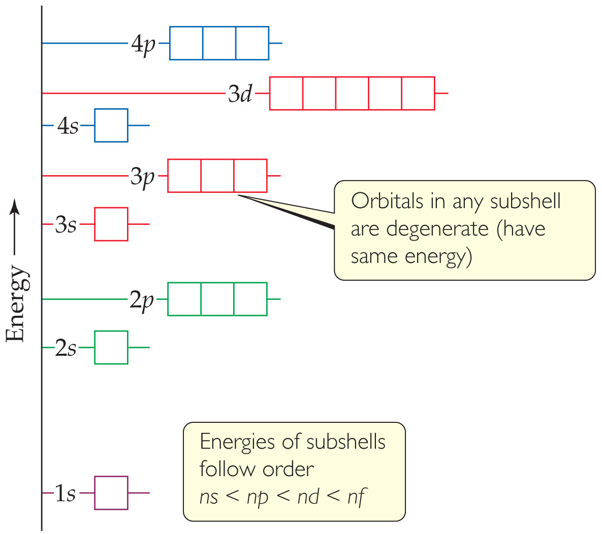
Notes:
Chapter 6, Figure 6.25, General energy ordering of orbitals for a many-electron atom.

Slide 24
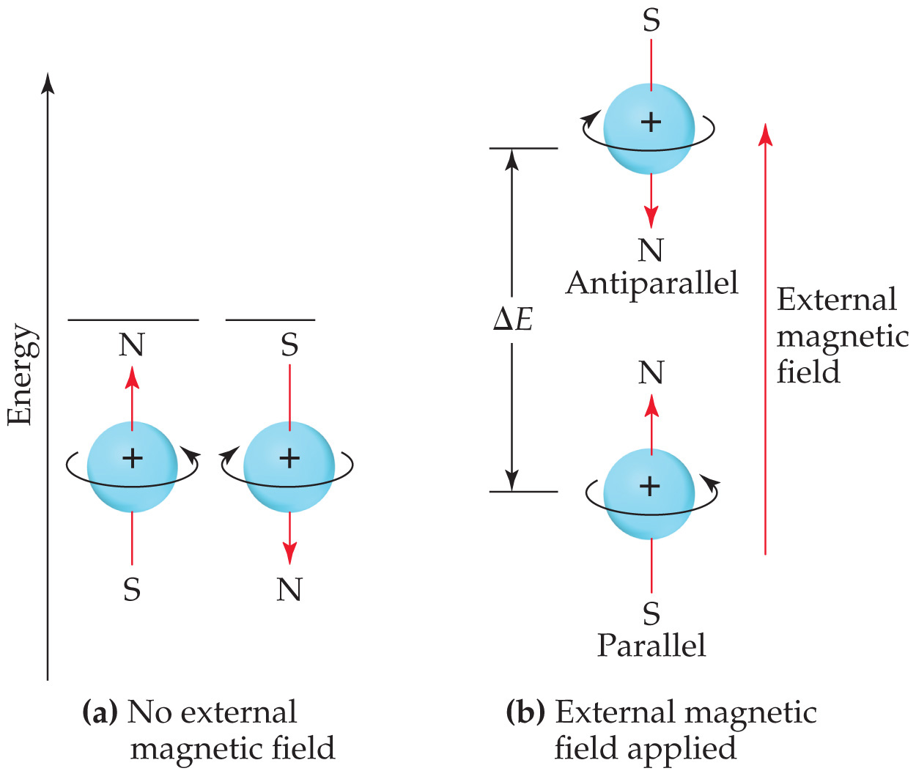
Notes:
Chapter 6, Figure 6.27, Nuclear spin.

Slide 25
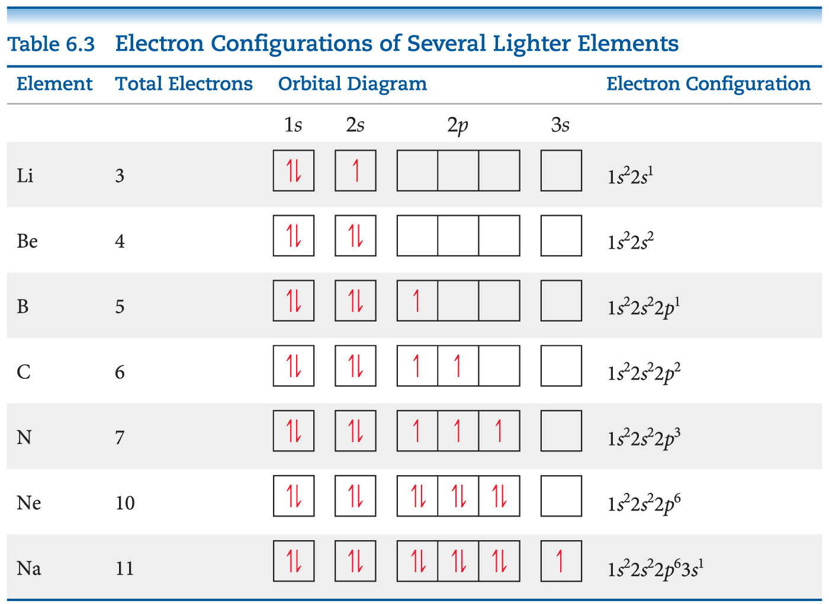

Slide 26
Notes:
Chapter 6, Unnumbered Figure, Page 239

Slide 27
Notes:
Chapter 6, Figure 6.29, The condensed electron configurations of the alkali metals (group 1A in the periodic table).

Slide 28
Notes:
Chapter 6, Unnumbered Figure, Page 240

Slide 29
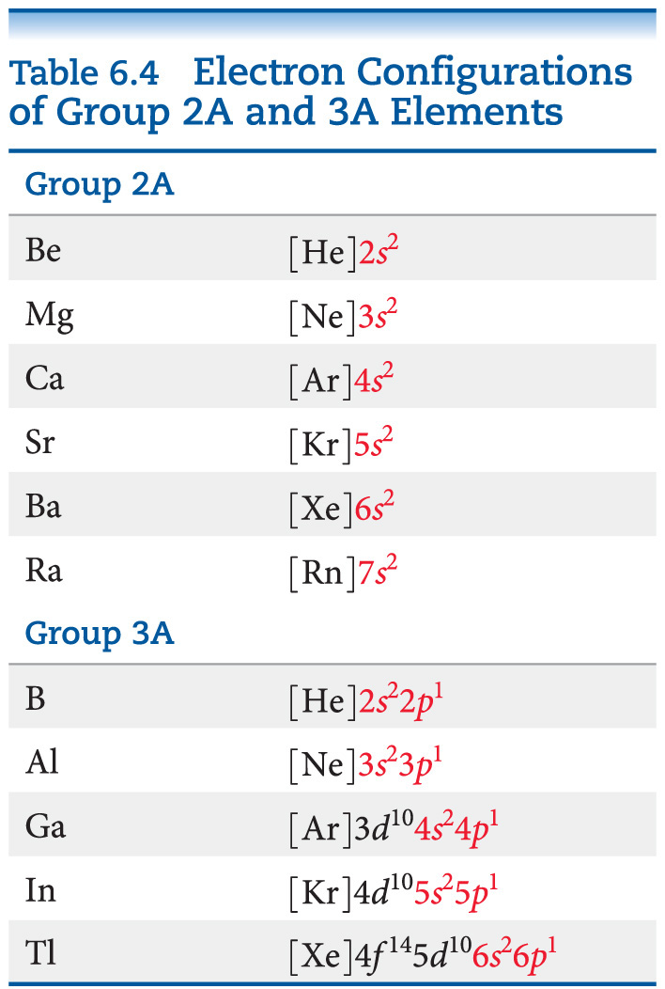

Slide 30
Notes:
Chapter 6, Figure 6.30, Regions of the periodic table.

Slide 31
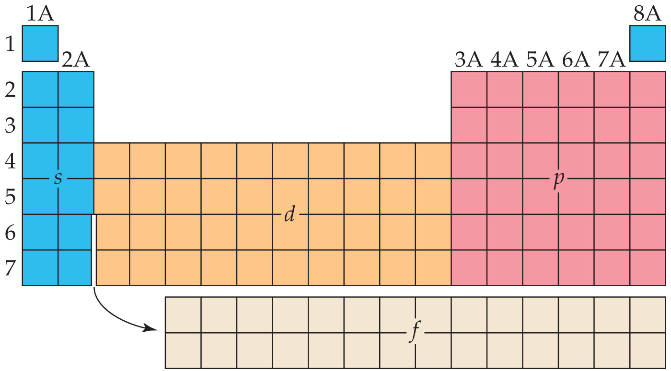
Notes:
Chapter 6, Unnumbered Figure 1, Page 242

Slide 32
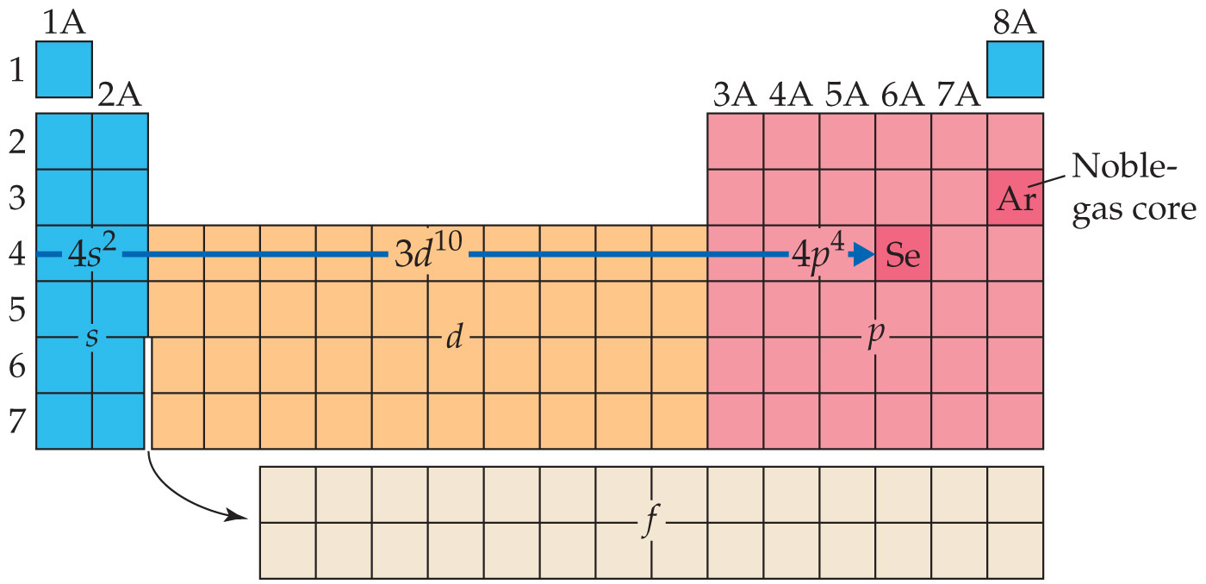
Notes:
Chapter 6, Unnumbered Figure 2, Page 242

Slide 33
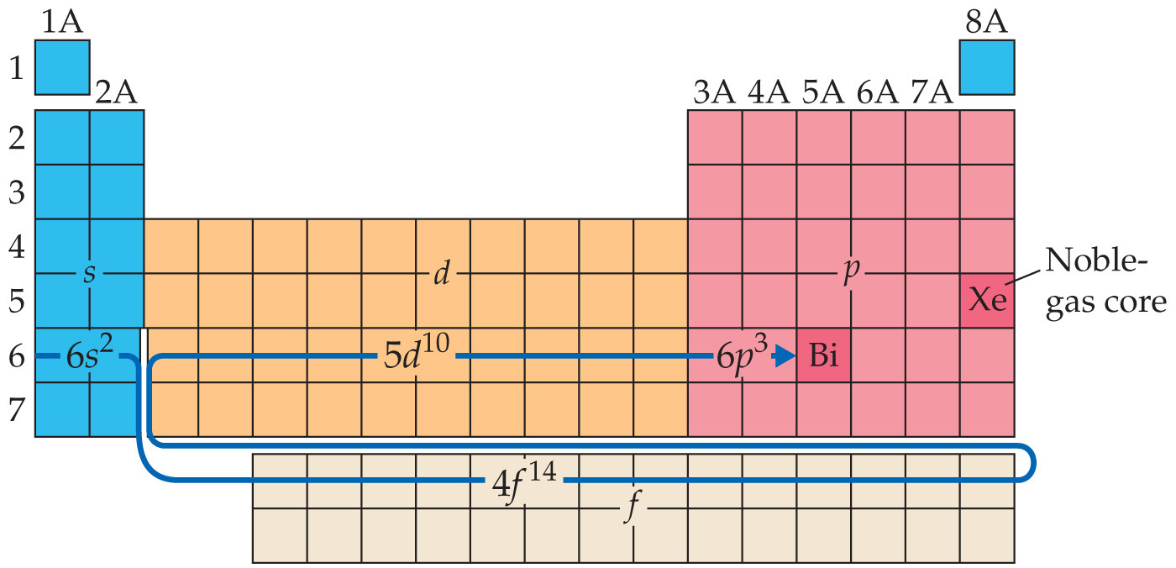
Notes:
Chapter 6, Unnumbered Figure 1, Page 244

Slide 34
Notes:
Chapter 6, Unnumbered Figure 2, Page 244

Slide 35
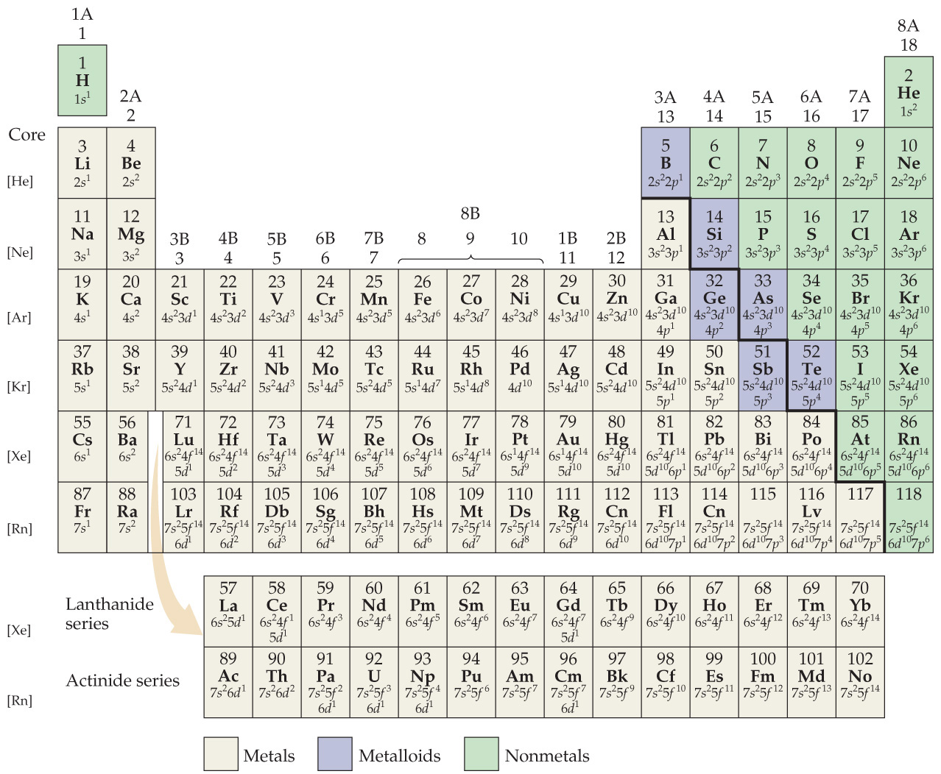
Notes:
Chapter 6, Figure 6.31, Outer-shell electron configurations of the elements.

Slide 36
Notes:
Chapter 6, Unnumbered Figure, Page 246

Slide 37
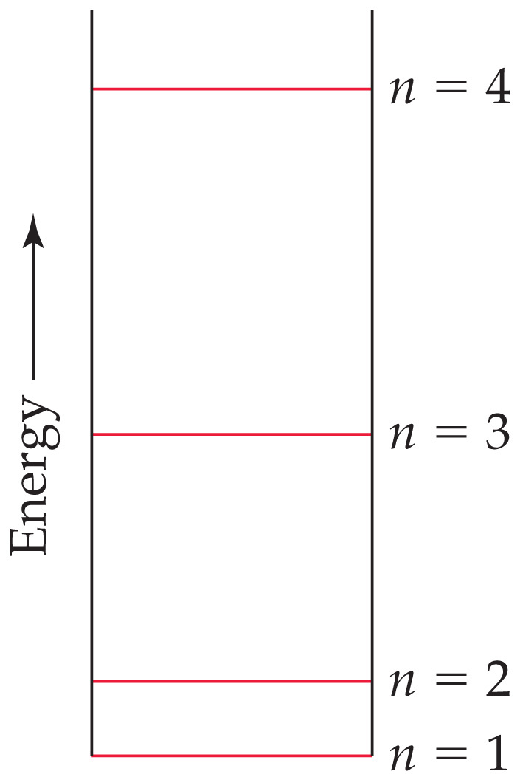
Notes:
Chapter 6, Unnumbered Figure 2, Page 249

Slide 38
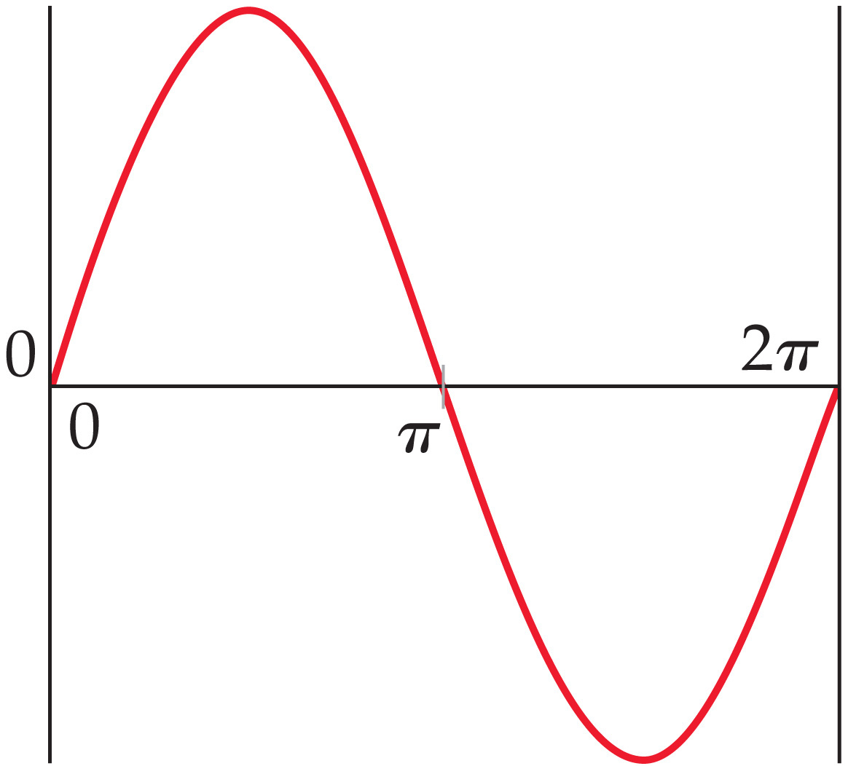
Notes:
Chapter 6, Unnumbered Figure 3, Page 249

Slide 39
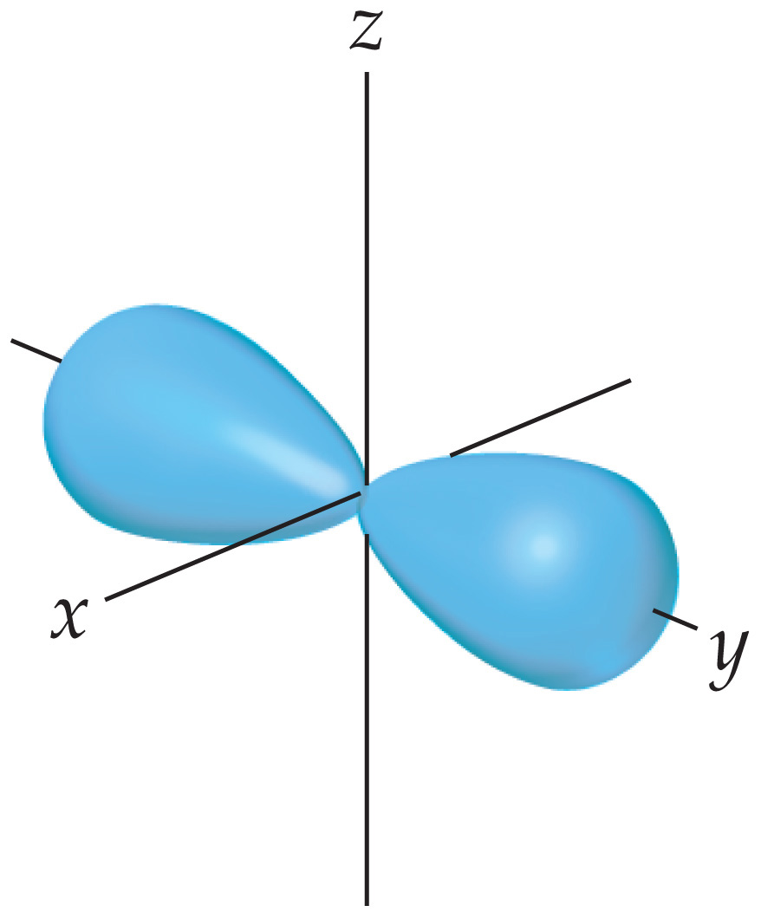
Notes:
Chapter 6, Unnumbered Figure 4, Page 249

Slide 40
Notes:
Chapter 6, Unnumbered Figure 5, Page 249

Slide 41
Notes:
Chapter 6, Unnumbered Figure 6, Page 249

Slide 42
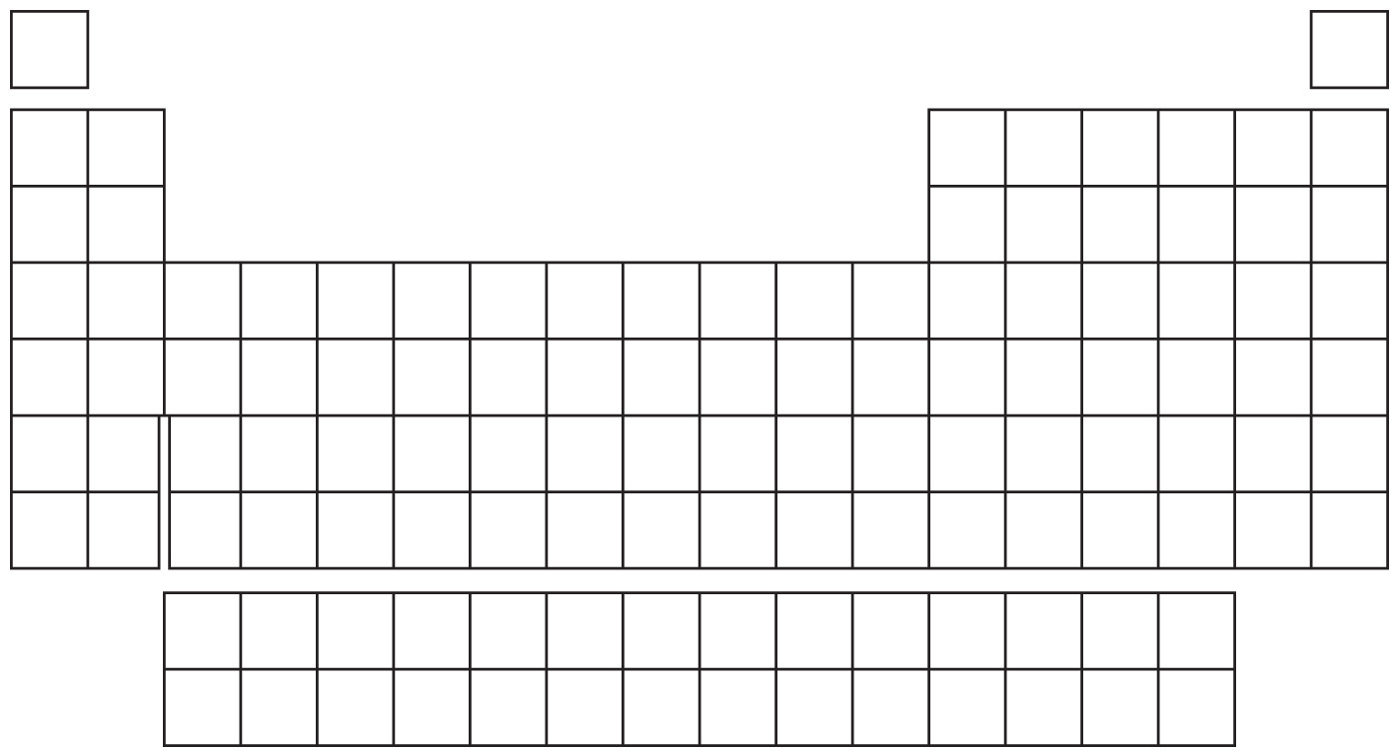
Notes:
Chapter 6, Unnumbered Figure 7, Page 249

Slide 43
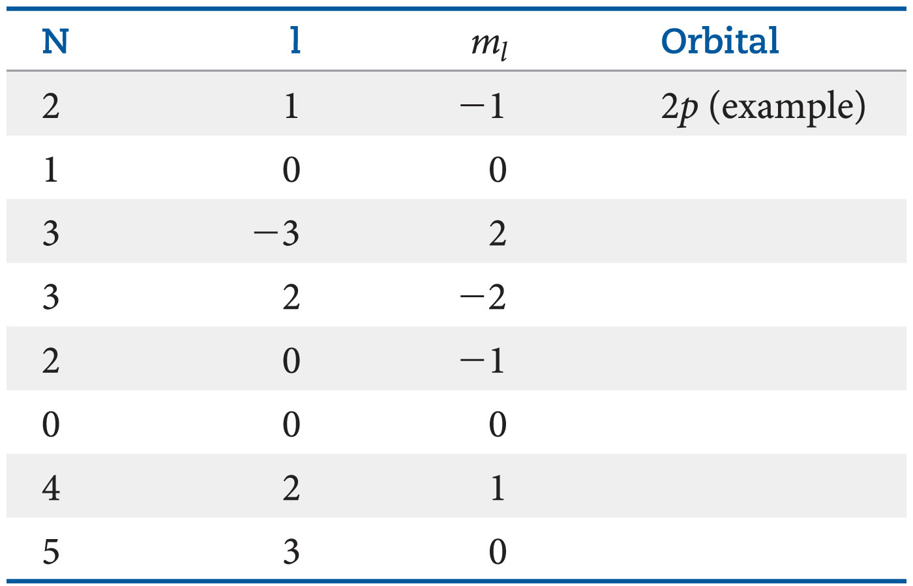
Notes:
Chapter 6, Unnumbered Table, Page 252

Slide 44
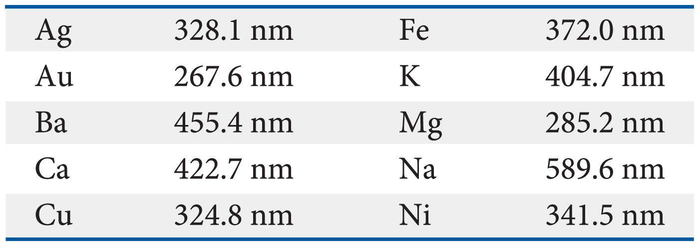
Notes:
Chapter 6, Unnumbered Table, Page 253

Slide 45
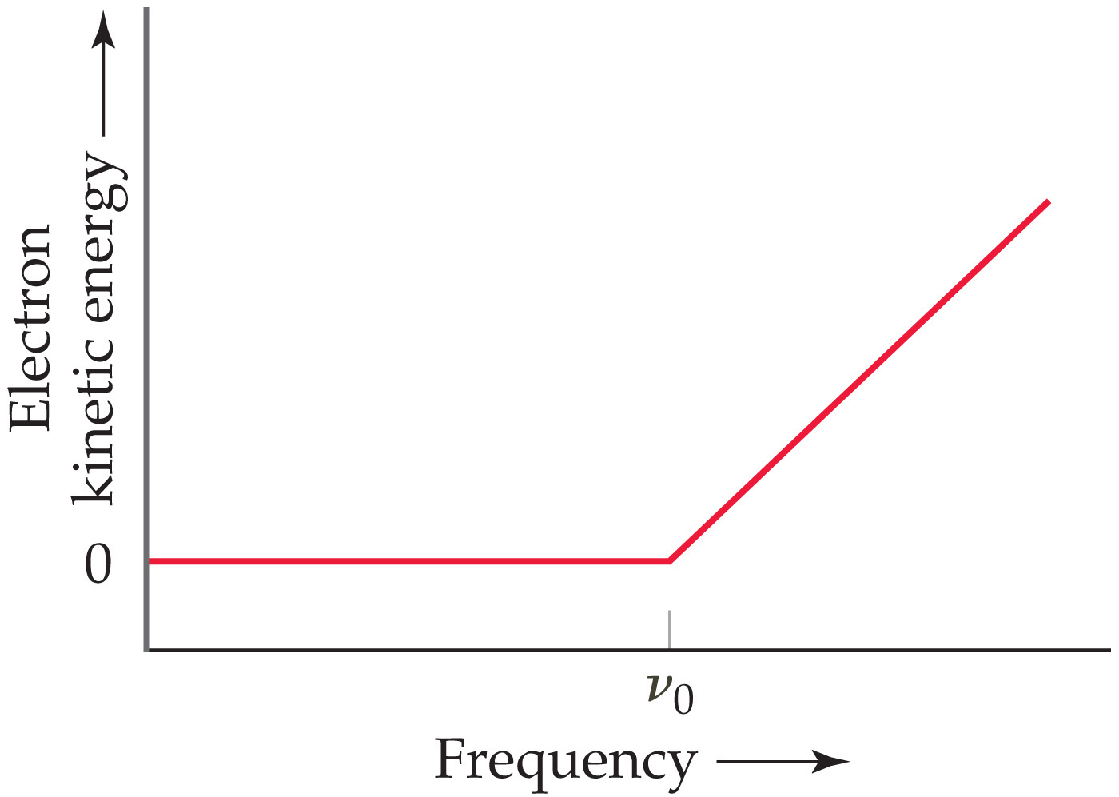
Notes:
Chapter 6, Unnumbered Figure 2, Page 253

Slide 46
Notes:
Chapter 6, Unnumbered Table, Page 254

Slide 47
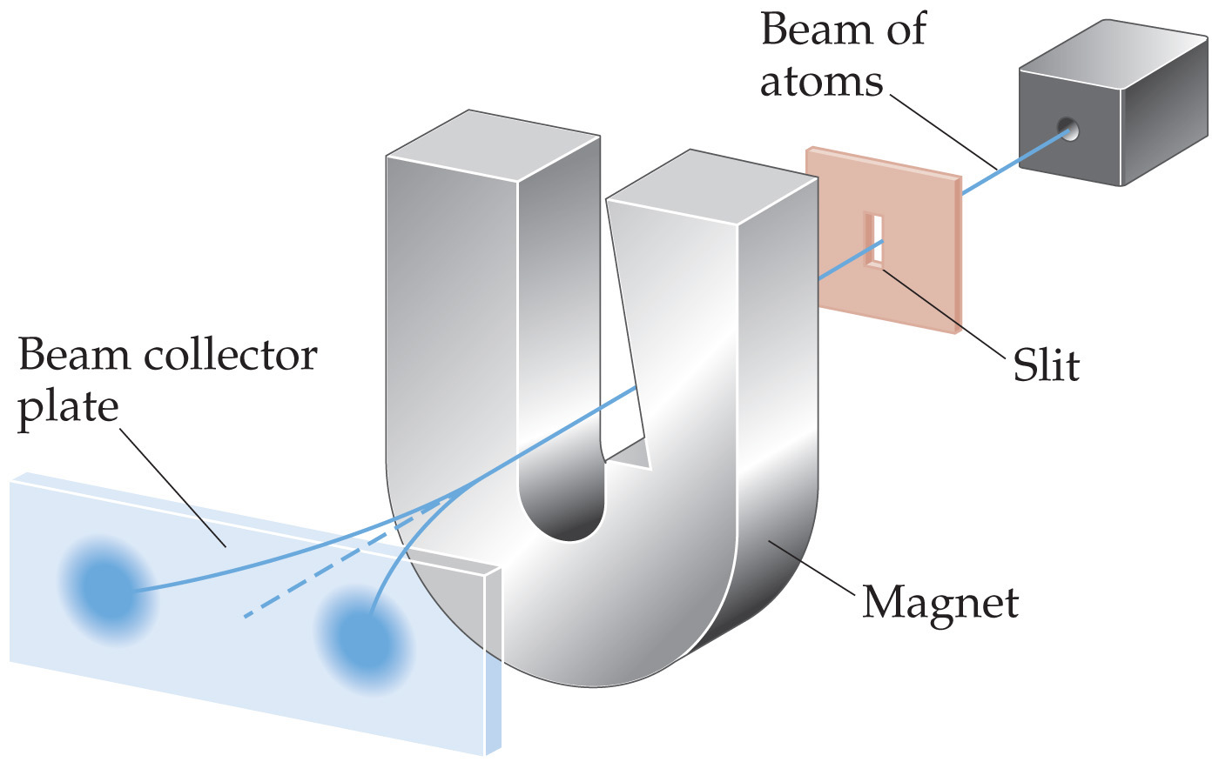
Notes:
Chapter 6, Unnumbered Figure, Page 254

