Slide 1
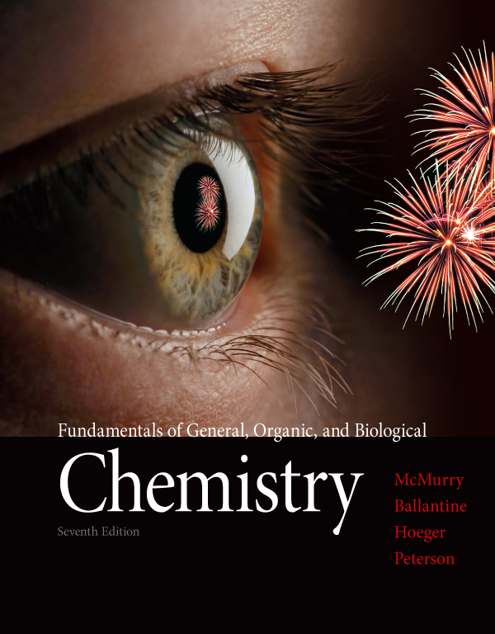
Chapter Two
Chapter 2 Lecture
Fundamentals of General, Organic, and Biological Chemistry
7th Edition
McMurry, Ballantine, Hoeger, Peterson
Atoms and the Periodic Table
Julie Klare
Gwinnett Technical College
© 2013 Pearson Education, Inc.

Slide 2
Outline
2.1 Atomic Theory
2.2 Elements and Atomic Number
2.3 Isotopes and Atomic Weight
2.4 The Periodic Table
2.5 Some Characteristics of Different Groups
2.6 Electronic Structure of Atoms
2.7 Electron Configurations
2.8 Electron Configurations and the Periodic
Table
2.9 Electron-Dot Symbols

Slide 3
Goals
1. What is the modern theory of atomic structure? Be able to explain the major assumptions of atomic theory.
2. How do atoms of different elements differ? Be able to explain the composition of different atoms according to the number of protons, neutrons, and electrons they contain.
3. What are isotopes, and what is atomic weight? Be able to explain what isotopes are and how they affect an element’s atomic weight.

Slide 4
Goals
4. How is the periodic table arranged? Be able to describe how elements are arranged in the periodic table, name the subdivisions of the periodic table, and relate the position of an element in the periodic table to its electronic structure.
5. How are electrons arranged in atoms? Be able to explain how electrons are distributed in shells and subshells around the nucleus of an atom, how valence electrons can be represented as electron-dot symbols, and how the electron configurations can help explain the chemical properties of the elements.

Slide 5
2.1 Atomic Theory
Questions about the fundamental nature of matter can be traced as far back as the Greek philosophers
Aristotle believed that matter could be divided indefinitely
Democritus argued that there was a limit (atomos)
The smallest particle that an element can be divided into and still be identifiable is the atom, from the Greek atomos, meaning “indivisible”

Slide 6
Chemistry is founded on four fundamental assumptions about atoms (matter), which together make up modern Atomic Theory

Slide 7
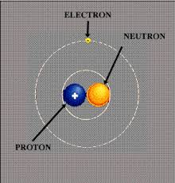
1. All matter is composed of atoms
This atomic structure is only stable at near-earth temperatures.
As temperatures rise, the electrons are lost first.
Without stable electrons, compounds and molecules cannot form.

Slide 8
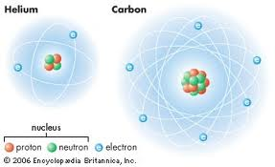
2. Elements differ in their makeup
The atoms of a given element differ
from the atoms of all other elements

Slide 9
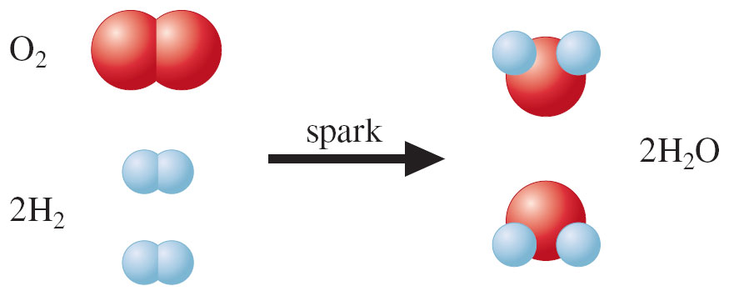
3. Atoms combine in specific ratios
Chemical compounds consist of atoms
combined in specific ratios

Slide 10
Chemistry is founded on four fundamental assumptions about atoms and matter, which together make up modern Atomic Theory:
1. All matter is composed of atoms
2. The atoms of a given element differ from the atoms of all other elements
3. Chemical compounds consist of atoms combined in specific ratios.
4. Chemical reactions change only the way the atoms are combined in compounds
The atoms themselves are unchanged

Slide 11
What are atoms made of ?
The masses of atoms and their constituent subatomic particles are incredibly small when measured in grams
So atomic masses are more conveniently expressed on a relative mass scale

Slide 12
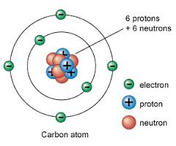
All atomic masses are relative to C-12
C-12 is the most abundant form of carbon – it contains 6 protons and 6 neutrons
It is defined as having a mass of exactly 12 atomic mass units (amu)
Atomic masses of all other atoms are measured relative to it
So C-12 is our window on the periodic table
So since protons and neutrons
have similar masses, they each
weigh approximately 1 amu

Slide 13
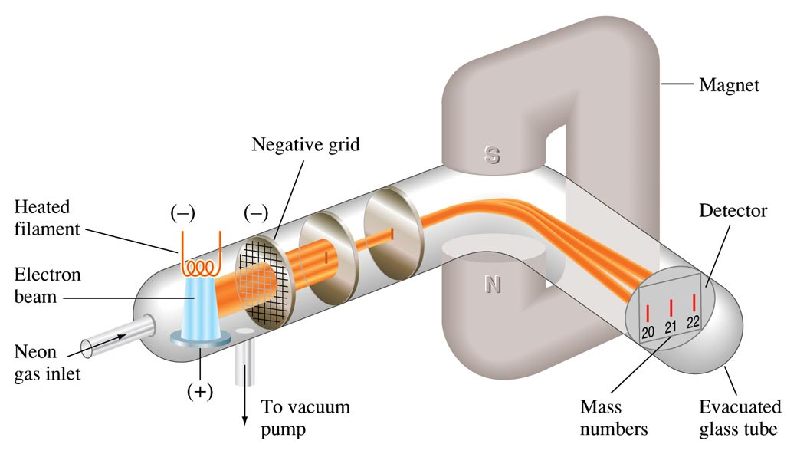
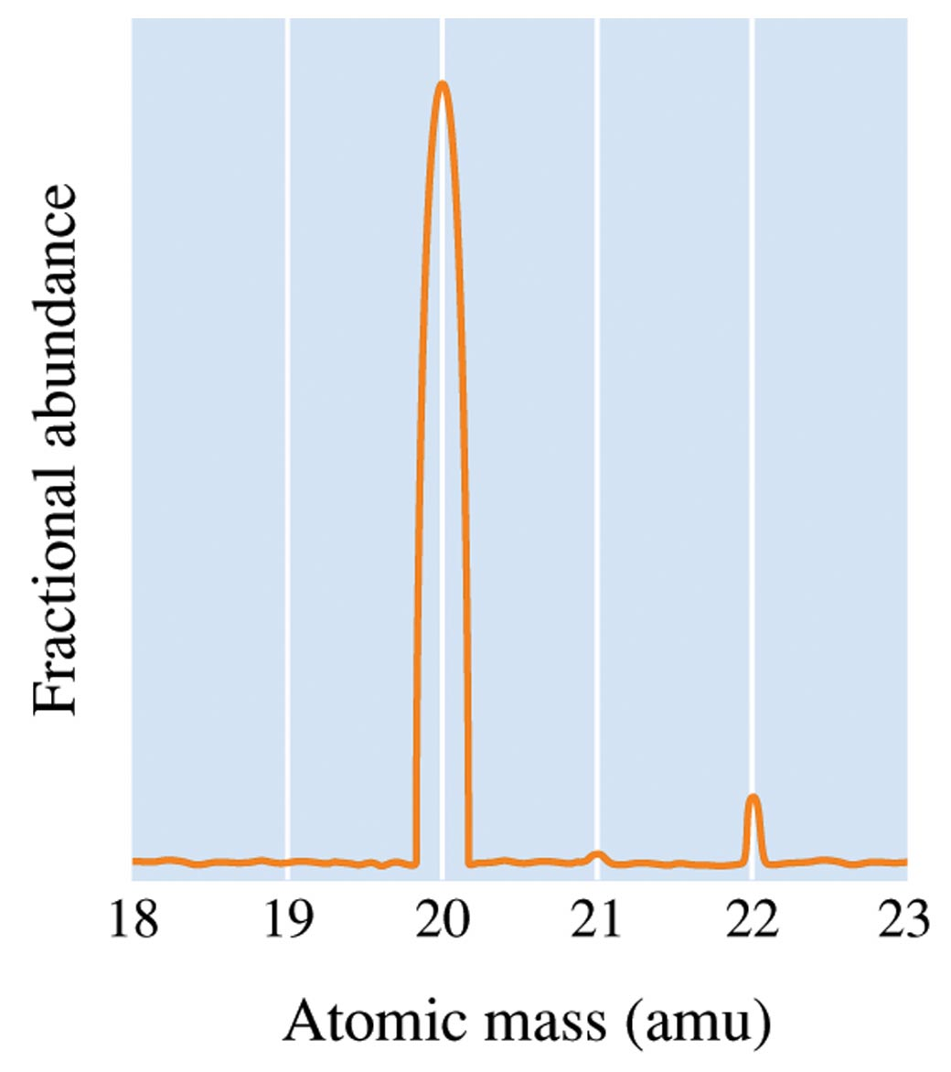
Mass Spectrometer
These days we determine the relative masses of all other atoms quickly …
… in a mass spectrometer by running them alongside our ‘standard’ carbon-12 isotope atom

Slide 14
Know these relative facts
Both protons and neutrons have a mass close to one amu
Electrons are substantially lighter than protons and neutrons
Protons and electrons have electrical charges that are equal in magnitude but opposite in sign
You are NOT expected to memorize the absolute numbers.
You ARE expected to know relative sizes and charges.

Slide 15
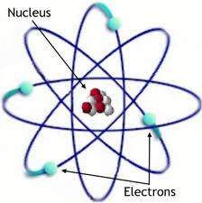
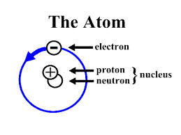
The protons and neutrons are packed closely together in a dense core called the nucleus
Surrounding the nucleus, the electrons move about rapidly through a large volume of space

Slide 16
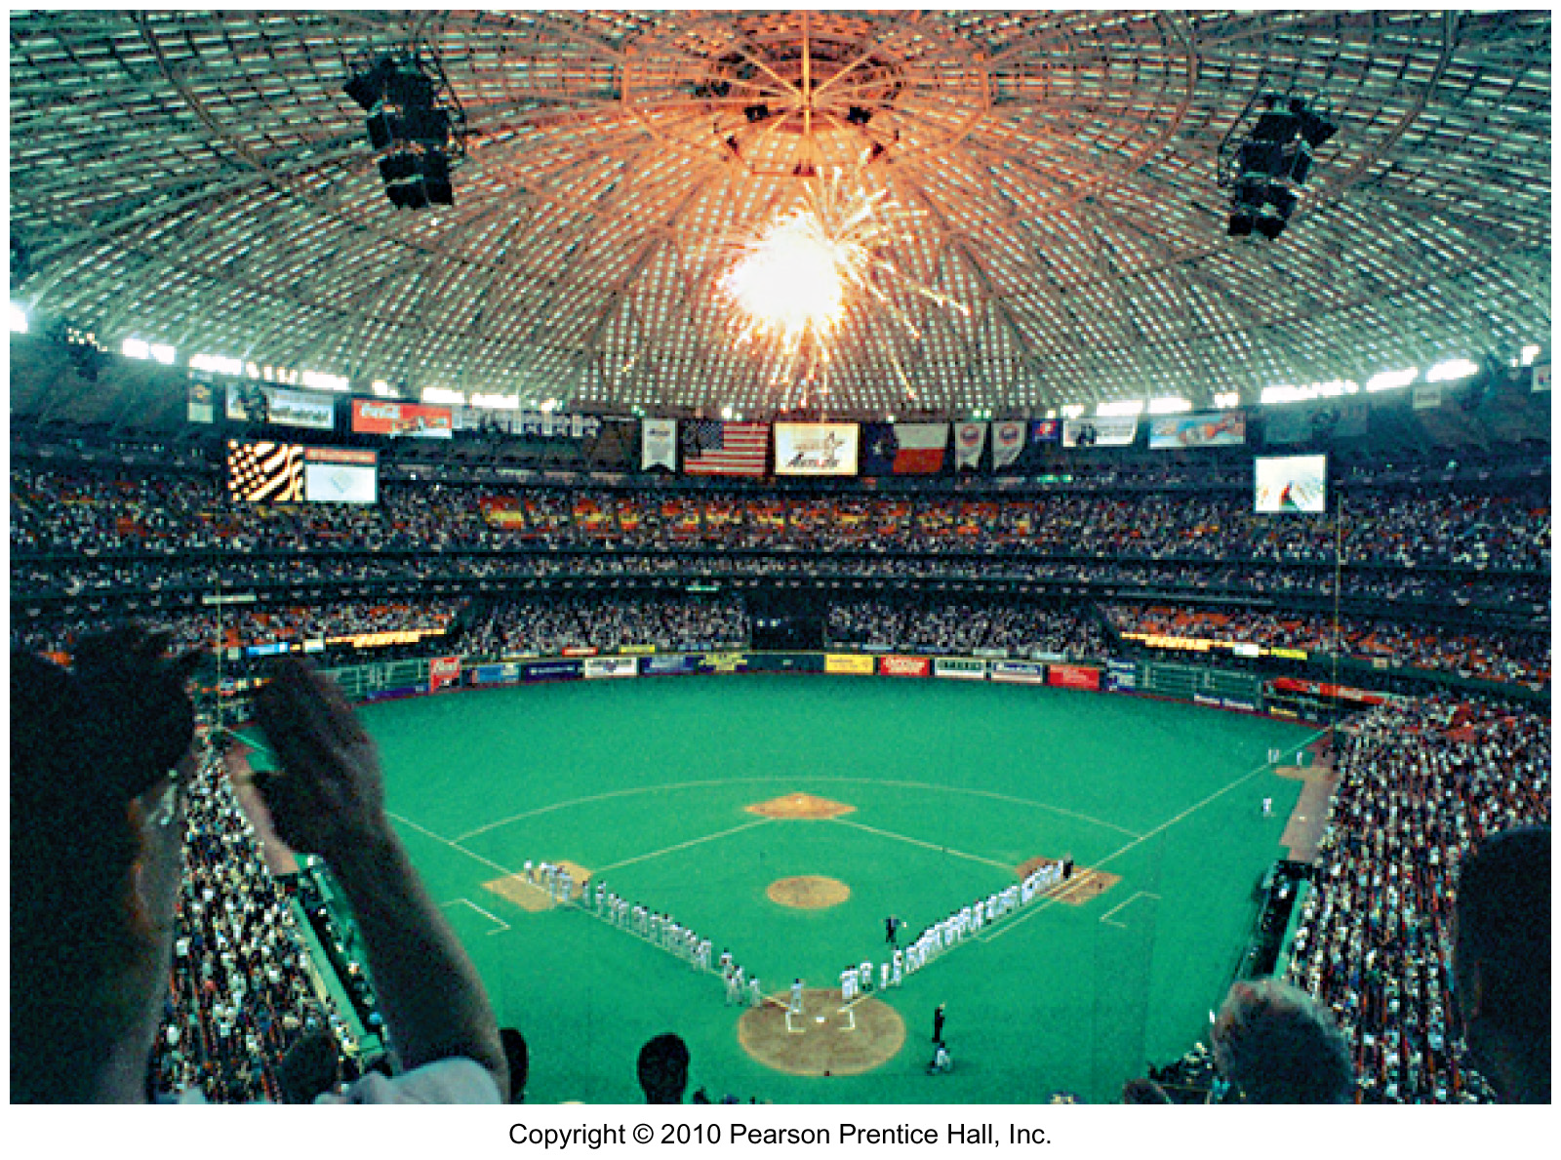
The protons and neutrons are packed closely together in a dense core called the nucleus
Surrounding the nucleus, the electrons move about rapidly through a large volume of space
The relative size of a nucleus in an atom is the same as that of a pea in the middle of this stadium

Slide 17
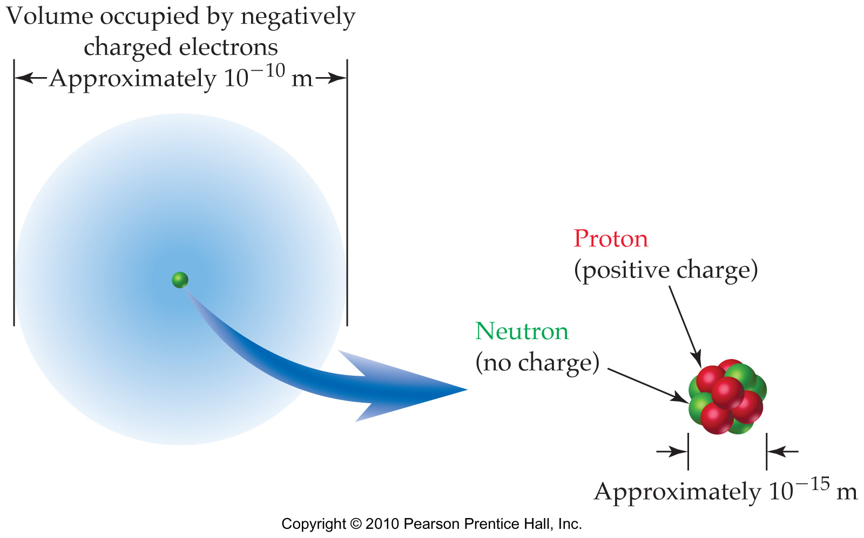
fyi
Diameter of a nucleus is only about 10⁻¹⁵ m
Diameter of an atom is only about 10⁻¹⁰ m

Slide 18
fyi
The structure of the atom is determined by the interplay of different forces
Opposite electrical charges attract each other—like charges repel each other
Protons and neutrons in the nucleus are held together by the nuclear strong force

Slide 19
How many atoms are in 0.200 g of lithium? [Li weighs 6.94 amu] [1 amu = 1.66539 x 10⁻²⁴ g]
6.02 × 10²³ atoms
8.36 × 10²³ atoms
1.74 × 10²² atoms
2.39 × 10⁻²⁵ atoms

Slide 20
What is the mass in grams of 2.4 × 10¹³ helium atoms each having a mass of 4.0 amu? [He weighs 4.00 amu] [1 amu = 1.66539 x 10⁻²⁴ g]
1.6 × 10⁻¹⁰ g
4.0 × 10⁻¹¹ g
5.8 × 10³⁷ g
2.8 × 10⁻³⁷ g

Slide 21
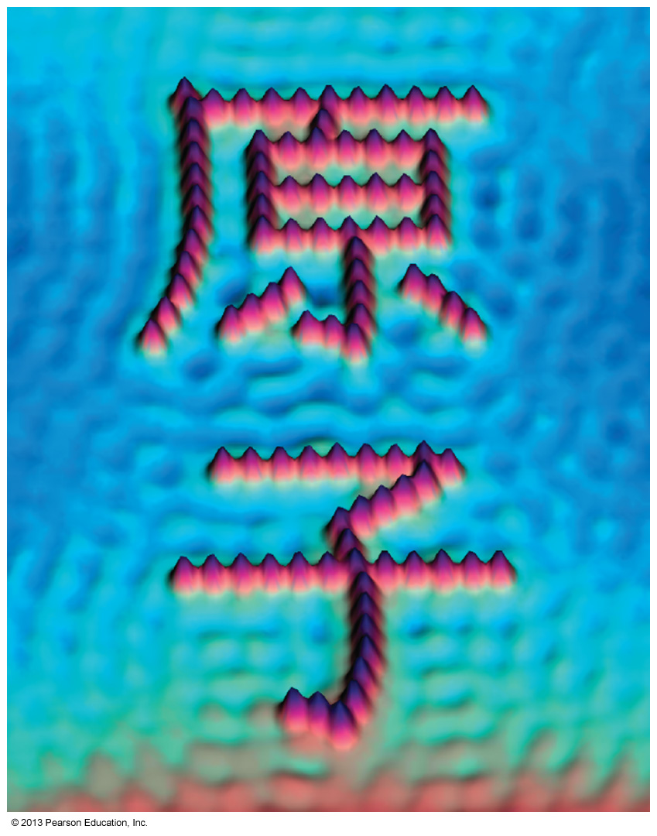
fyi
Are Atoms Real?
John Dalton proposed atomic theory in 1808.
J. J. Thomson determined the mass of the electron.
Robert Millikan identified the charge on the electron.
Ernest Rutherford deduced the existence of the nucleus.
The scanning tunneling microscope makes individual atoms visible.

Slide 22
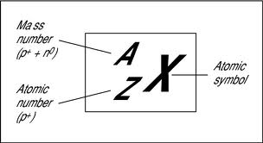
2.2 Elements and Atomic Number
Atomic Number (Z)
determines the element

Slide 23
replace on next slide,
get a helium with no atomic mass

Slide 24
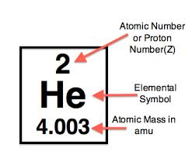
Atomic Number (Z) is the number of protons in the atoms of a given element
All atoms of a particular element have the same number of protons in the nucleus
Mass Number (A) is the sum of the protons and neutrons in an atom

Slide 25
Worked Example 2.2 Atomic Structure: Protons, Neutrons, and Electrons
Phosphorus has the atomic number Z = 15. How many protons, electrons, and neutrons are there in phosphorus atoms, which have mass number A = 31?
Analysis
The atomic number gives the number of protons, which is the same as the number of electrons, and the mass number gives the total number of protons plus neutrons.
Solution
Phosphorus atoms, with Z = 15, have 15 protons and 15 electrons. To find the number of neutrons, subtract the atomic number from the mass number:

Slide 26
Worked Example 2.3 Atomic Structure: Atomic Number and Atomic Mass
An atom contains 28 protons and has A = 60. Give the number of electrons and neutrons in the atom, and identify the element.
Analysis
The number of protons and the number of electrons are the same and are equal to the atomic number Z , 28 in this case. Subtracting the number of protons (28) from the total number of protons plus neutrons (60) gives the number of neutrons.
Solution
The atom has 28 electrons and 60 - 28 = 32 neutrons. The list of elements inside the front cover shows that the element with atomic number 28 is nickel (Ni).

Slide 27
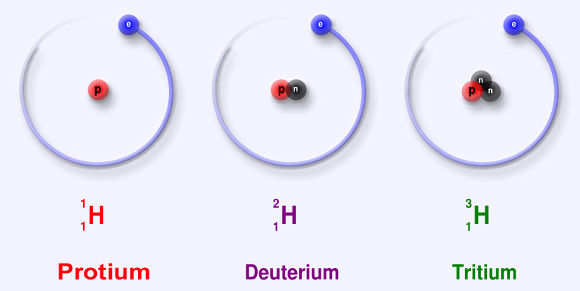
2.3 Isotopes and atomic weight
All naturally-occurring elements
are mixtures of isotopes

Slide 28
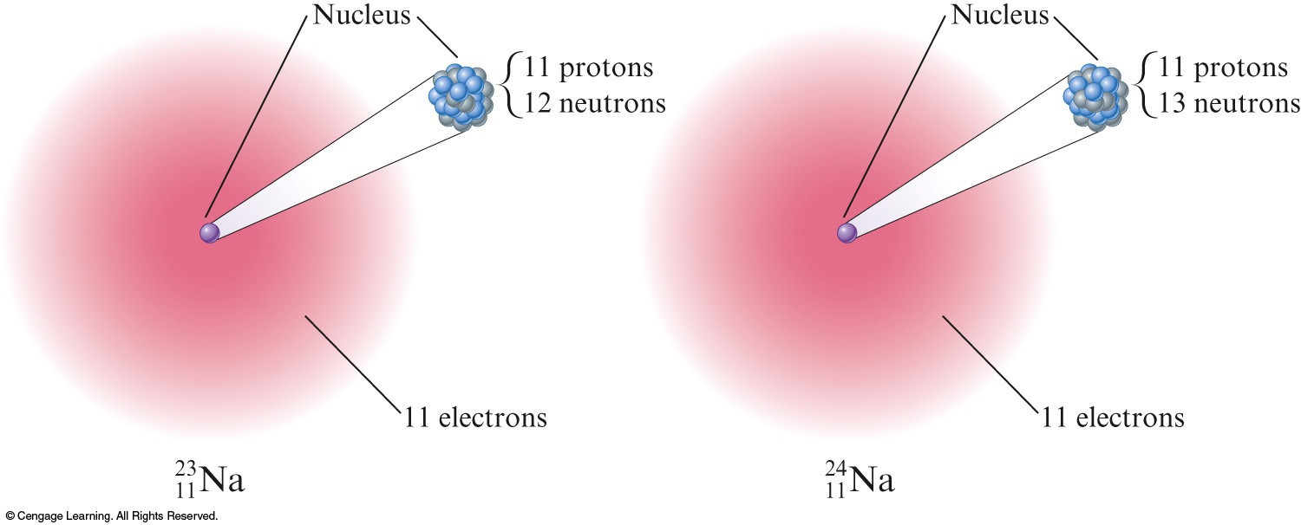
Isotopes
Atoms with the same number of protons but different numbers of neutrons show almost identical chemical properties
Because the chemistry of an atom is due to the number of its electrons
In nature all natural elements contain mixtures of isotopes
Two isotopes of sodium

Slide 29
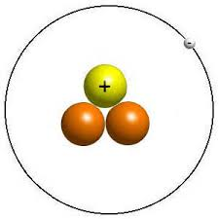
A single isotope is represented by showing its mass number (A) as a superscript and its atomic number (Z) as a subscript in front of the atomic symbol
For example, the symbol for tritium is:

Slide 30
fyi
X = the symbol of the element
A = the mass number (# of protons and neutrons)
Z = the atomic number (# of protons)

Slide 31
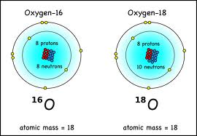
Isotope families are atoms with identical atomic numbers (Z) but different mass numbers (A)
These are the two most common isotopes of the oxygen family

Slide 32
C = the symbol for carbon
6 = the atomic number (6 protons)
14 = the mass number (6 protons and 8 neutrons)
C = the symbol for carbon
6 = the atomic number (6 protons)
12 = the mass number (6 protons and 6 neutrons)

Slide 33
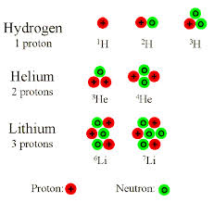
The hydrogen, helium and lithium families of isotopes
All naturally-occurring elements are actually families of isotopes
But unlike the three ‘hydrogens,’ isotopes of other families do not have distinctive names

Slide 34
FYI: The hydrogen family
P: this most abundant hydrogen isotope has one proton and no neutrons (Z=1, A=1)
D: this ‘heavy hydrogen’ isotope has one proton and one neutron (Z=1, A=2)
T: this radioactive hydrogen isotope has one proton and two neutrons (Z=1, A=3)
99.98%
0.0026 – 0.0184%
Trace

Slide 35
How many protons, electrons, and neutrons are in the atom with the following symbol? ²³⁵U ⁹²
92p, 92e, 143n
92p, 43e, 235n
92p, 92e, 235n
235p, 235e, 143n

Slide 36
Exercise
A certain isotope X contains 23 protons and 28 neutrons
What is the mass number of this isotope?
Identify the element
Notes:
The mass number is 51. Mass Number = # protons + # neutrons. Mass Number = 23 + 28 = 51. The element is vanadium. The number of protons determines the identity of the element.

Slide 37
Exercise
A certain isotope X contains 23 protons and 28 neutrons.
What is the mass number of this isotope?
Identify the element.
Mass Number = 51
Vanadium
Notes:
The mass number is 51. Mass Number = # protons + # neutrons. Mass Number = 23 + 28 = 51. The element is vanadium. The number of protons determines the identity of the element.

Slide 38
Mass Spectrometer
fyi
So the reason that the mass spec for Neon has 3 peaks is because it is a family of 3 isotopes

Slide 39
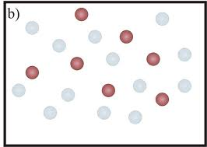
Isotope ratios
fyi
The isotope ratio represents the proportion of isotopes making up the atomic mixtures that characterize the elements in the way nature provides them to us
Red = 7
Gray = 13
Total = 20
The isotope ratio here
is 7 red / 13 gray

Slide 40
A shortcut to represent isotopes
The mass number (A) can be placed after the name or symbol of the element
The isotope of uranium used in nuclear reactors ( ) is usually referred to as uranium-235, or U-235
The dominant isotope of hydrogen (¹H) could be written as hydrogen-1 or H-1

Slide 41
An atom contains 6 protons and has A = 14. Give the number of electrons and neutrons in the atom, and identify the element.
14e, 6n, silicon
6e, 14n, carbon
6e, 14n, chromium
6e, 8n, carbon

Slide 42
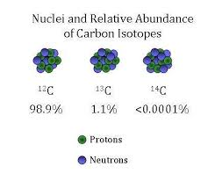
Calculating Atomic Weights
Atomic Weight (or Atomic Mass) is the weighted
average mass of a family’s isotopes
To calculate the atomic weight of an element family (like carbon), the individual masses and mass percentages of its naturally occurring isotopes must both be measured first
Let’s consider the family of
naturally occurring carbon
Note that we will ignore
the trace C-14 isotope

Slide 43
next slide: find a mass spec of carbon’s isotopes

Slide 44
From the Mass Spec we obtain both:
Mass percentages of the individual carbon isotopes
C-12 is 98.89% of all natural carbon
C-13 is 1.11% of all natural carbon
Masses of the individual carbon isotopes
The mass of C-12 is: 12 amu (by definition)
The mass of C-13 is: 13.003355 amu (by mass spec)
eg, neon’s
isotopes

Slide 45
Atomic Weight (or Atomic Mass)
C-12 is 98.89% of all natural carbon
C-13 is 1.11% of all natural carbon
The mass of C-12 is: 12 amu (by definition)
The mass of C-13 is: 13.003355 amu
The atomic weight is then calculated as the sum of the mass contributions of the individual isotopes within that element’s family
Atomic weight = Σ [(% isotope abundance) × (isotope mass)]
The Greek symbol Σ indicates summing of terms

Slide 46
Naturally Occurring Carbon
C-12 is 98.89% of all natural carbon
C-13 is 1.11% of all natural carbon
The mass of C-12 is: 12 amu (by definition)
The mass of C-13 is: 13.003355 amu
Atomic weight =  [(% isotope abundance) × (isotope mass)]
[98.89% x 12 amu] + [1.11% x 13.0034 amu] =
exact number
(0.9889)(12 amu) + (0.0111)(13.0034 amu) = 12.0111
11.8668
0.1443
12.0111 amu

Slide 47
No Carbon atom weighs 12.0111 amu
The mass of 12.0111 amu functions as a stand-in (for purposes of mathematical calculations
No carbon isotope weighs 12.0111 amu
C-12 = 12 amu (exactly)
C-13 = 13.003355 amu
C-14 = 14.003241 amu (usually ignored)
What we call “natural carbon” is the blend of carbon isotopes that exists in our biosphere

Slide 48
Pop review
Isotopes (eg, ¹²C, ¹³C, ²³Na, ²⁴Na) each have:
Mass number
Atomic number
Atomic weight (mass)
Elements (eg, C as its natural mixture of isotopes) have:
No mass number (only individual isotopes can have a mass number)
Atomic number
Average Atomic weight (mass)

Slide 49
2.4 The Periodic Table

Slide 50
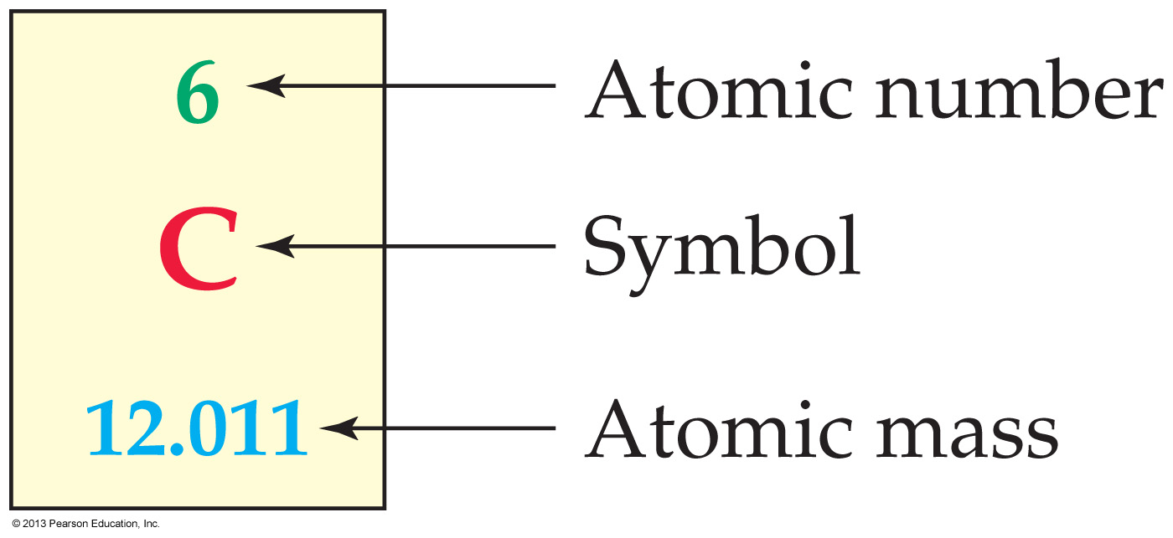
Mendeleev produced the forerunner of the modern periodic table, which has boxes for each element with the symbol, atomic number, and atomic weight
Note: Atomic mass
is the same as
Atomic Weight

Slide 51
fyi
Only 10 elements have been known since the beginning of recorded history
In the late 1700s and early 1800s, as more elements were discovered, chemists began to look for similarities among elements
Johann Döbereiner observed in 1829 that there were several triads that appeared to have similar chemical and physical properties
Dmitri Mendeleev organized elements by mass, then into columns based on chemical behavior

Slide 52
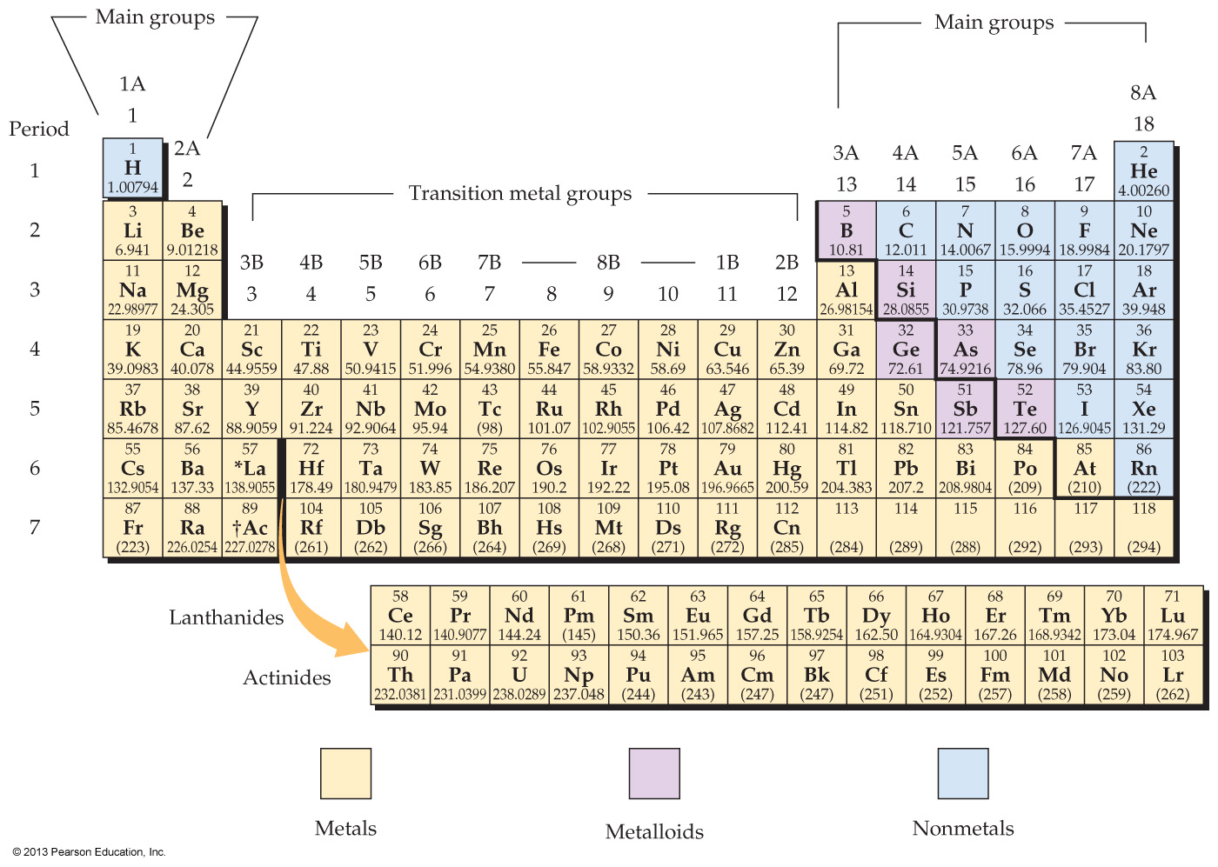

Slide 53
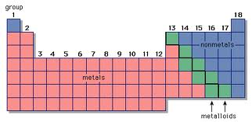
Review
Elements (except hydrogen) on the left-hand side of the black zigzag line running from boron (B) to tellurium (Te) are metals
Elements to the right of the line are nonmetals
Most elements abutting the line are metalloids

Slide 54
Groups
The vertical groups on the periodic table are divided into categories
Main Groups—The two groups on the far left (1–2) and the six on the far right (13–18) are the main groups
In Into: 1A – 8A
Transition Metal Groups—Elements in these groups are numbered 3 through 12
Inner Transition Metals—The 14 elements following lanthanum are the lanthanides and the 14 elements following actinium are the actinides
Together these are the inner transition elements

Slide 55
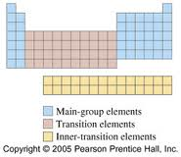

Slide 56
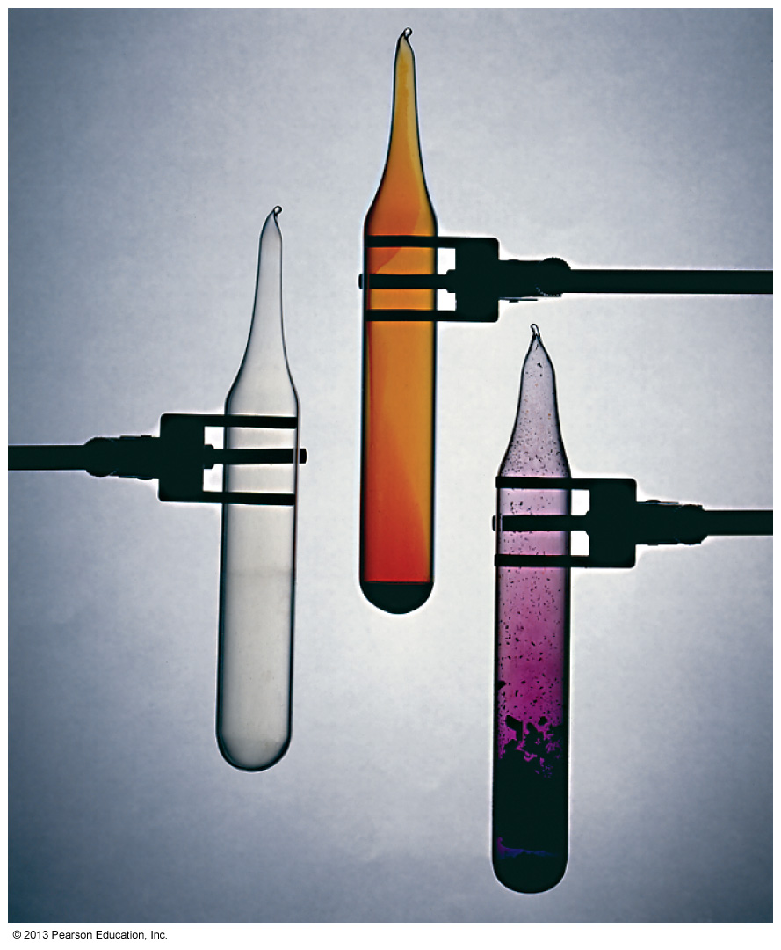
Groups
Elements in a given group have similar chemical properties
All halogens: chlorine, bromine, iodine, and other elements in group 7A behave similarly

Slide 57
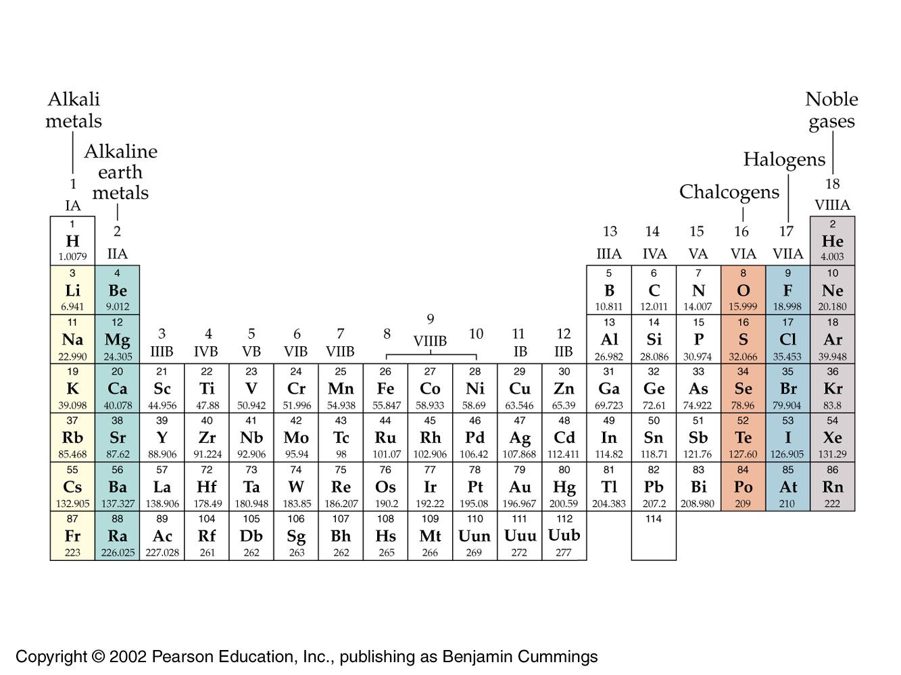
Groups

Slide 58
Periods
Notice there are seven horizontal periods in the periodic table

Slide 59
The seven horizontal periods in the periodic table do not contain the same number of elements
The first period contains only 2 elements
The second and third periods each contain 8 elements
The fourth and fifth periods each contain 18 elements
The sixth and seventh periods each contain 32 elements
The 14 lanthanides and the 14 actinides are normally pulled out and shown below the others

Slide 60
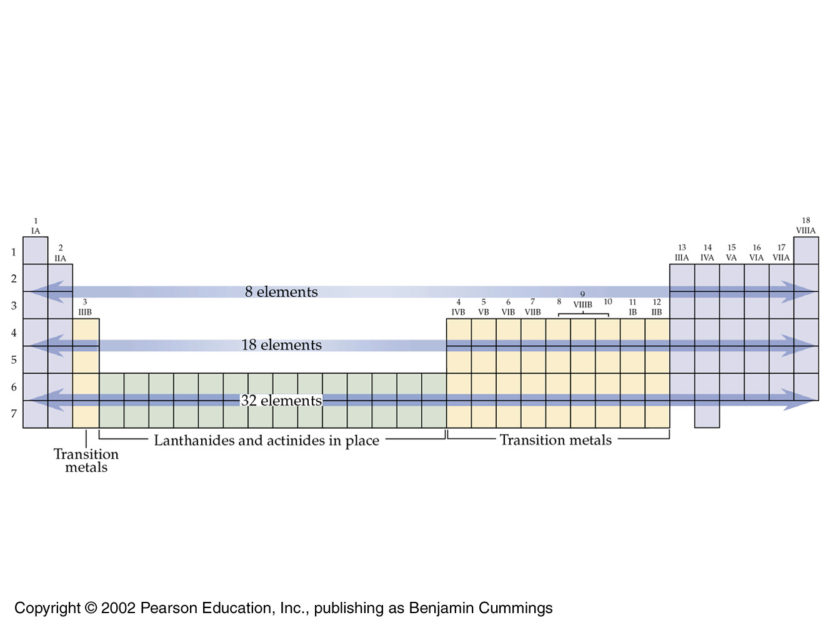
The full view

Slide 61
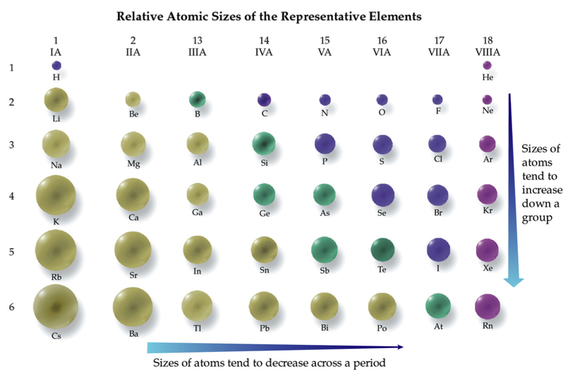
2.5 Some Characteristics of Different Groups

Slide 62
A display of atomic radius versus atomic number shows a periodic shrink-and-inflate pattern
The minima occur for group 1A elements, and the maxima occur for group 7A elements

Slide 63
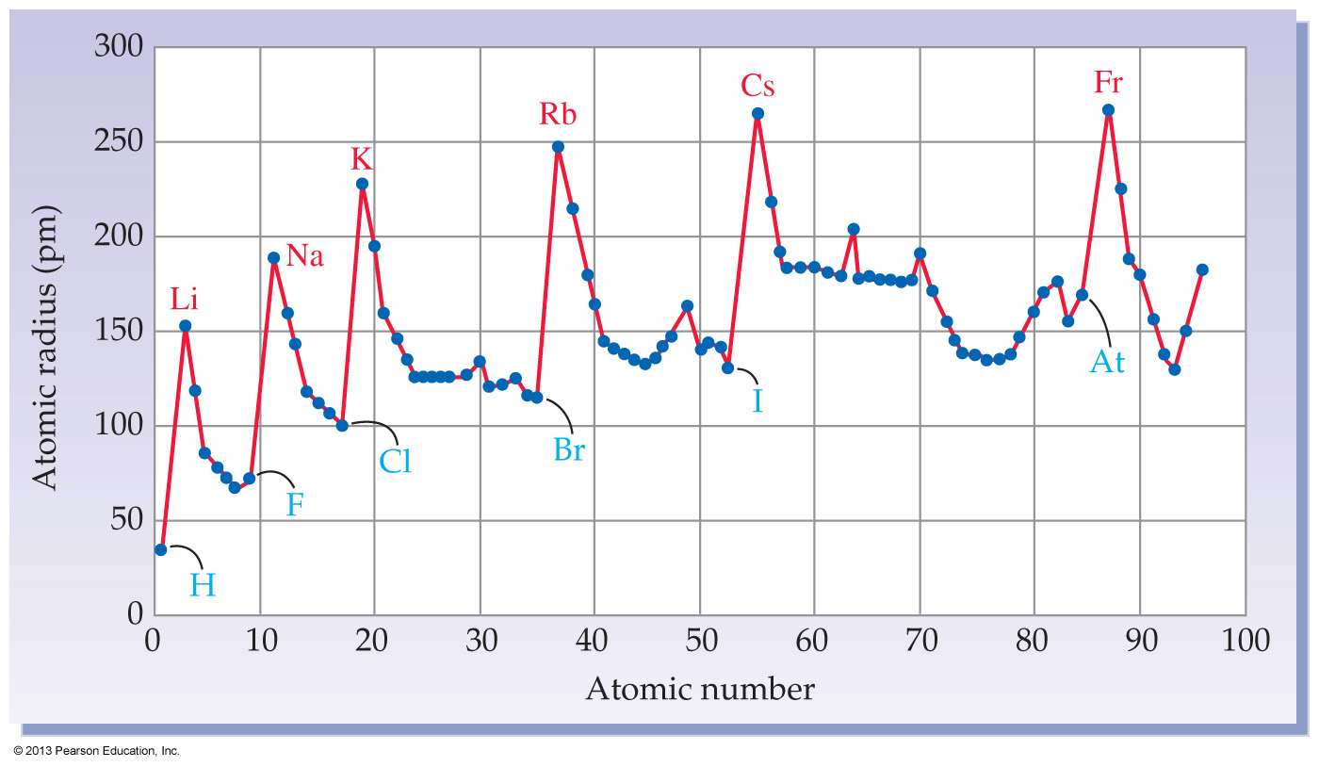
A graph of atomic radius versus atomic number shows a periodic rise-and-fall pattern
The maxima occur for group 1A elements, and the minima occur for group 7A elements

Slide 64
Periodicity
So the periodic table has the name it does because the elements in it show an obvious periodicity
Many physical and chemical properties also exhibit periodic behavior
The various elements in a group show remarkable similarities in their chemical and physical properties
Neighboring elements within a period also behave similarly
However, their behaviors are not as similar as neighbors within a group

Slide 66
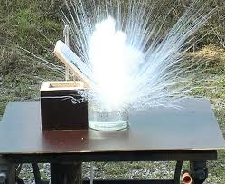
Group 1A—Alkali metals
Shiny, soft metals with low melting points
React with water to form products that are highly alkaline
Never found in nature in a pure state

Slide 67
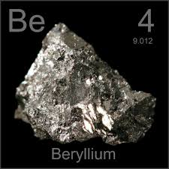
Group 2A—Alkaline earth metals
Lustrous, silvery metals
Less reactive than their neighbors in group 1A
Also never found in nature in a pure natural state

Slide 68
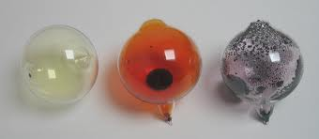
Group 7A—Halogens
Colorful and corrosive nonmetals
Found only in combination with other elements
The name, halogen, is from the Greek for salt

Slide 69
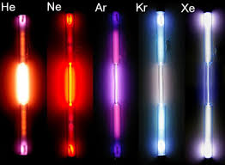
Group 8A—Noble gases
Colorless gases
Labeled “noble” because they are unreactive
Helium, neon, and argon won’t combine with any other elements
Krypton and xenon combine with a few

Slide 70
fyi
Origin of Chemical Elements

Slide 71
fyi
Within a second after the “big bang,” subatomic particles began to form
After 3 minutes, the temperature had dropped enough that helium nuclei began to form
But electrons ‘sponged’ up all the photons
After 350,000 years, the universe cooled enough that electrons could bind to protons and helium nuclei, forming hydrogen and helium atoms
Thereby freeing the photon
As clouds of hydrogen and helium condensed into stars, hydrogen fusion into helium began, releasing heat and light
As stars burned out, their core densities and temperatures increased, allowing the formation of larger nuclei
Supernovae resulted in the synthesis of even heavier elements

Slide 72
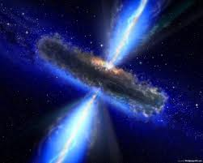
A supernovae explosion
In this moment, all elements heavier than Fe are formed instantly

Slide 73
2.6 Electronic Structure of Atoms
Beginning quantum mechanics
by explaining the periodic table
quantum mechanics explains all chemistry

Slide 74
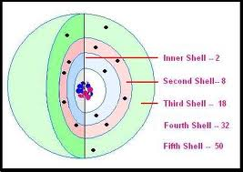
What does ‘Quantized’ mean?
A ramp is not quantized – it changes height continuously
Stairs are quantized – they change height by a fixed amount
Energy ‘places’ available to electrons in an atom are arranged along concentric shells

Slide 75
Electron shells
In quantum mechanics, the ‘stairs’ where the atom’s electrons live are called shells
Mathematical solutions to wave functions provide an electron with an “address” within an atom, composed of shell, subshell, and orbital (in that order)
we begin with electron shells

Slide 76
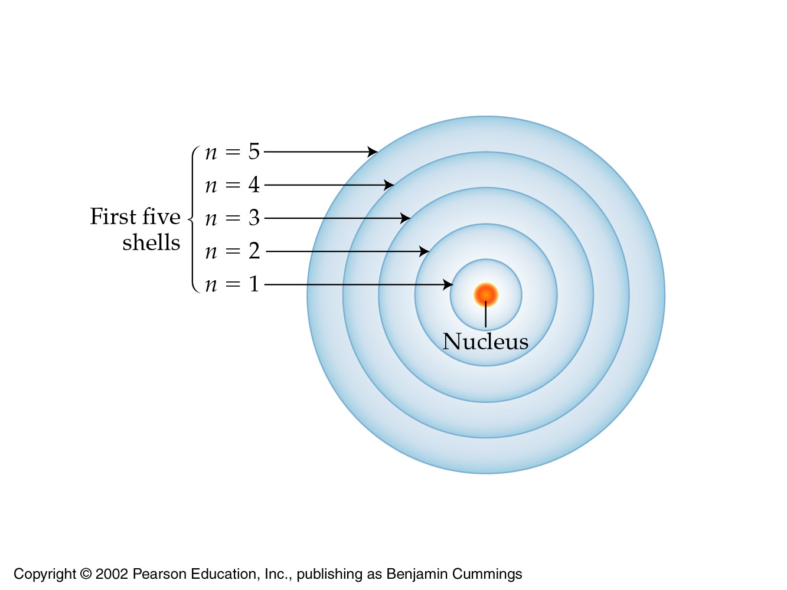

Slide 77
Shells
The farther a shell is from the nucleus
the larger it is
the more electrons it can hold
and the higher the energies (anxieties) of those electrons

Slide 78
The number of subshells in a shell
is equal to the shell number
1s is the lowest
energy subshell

Slide 79
Next: Subshells and Orbitals

Slide 80
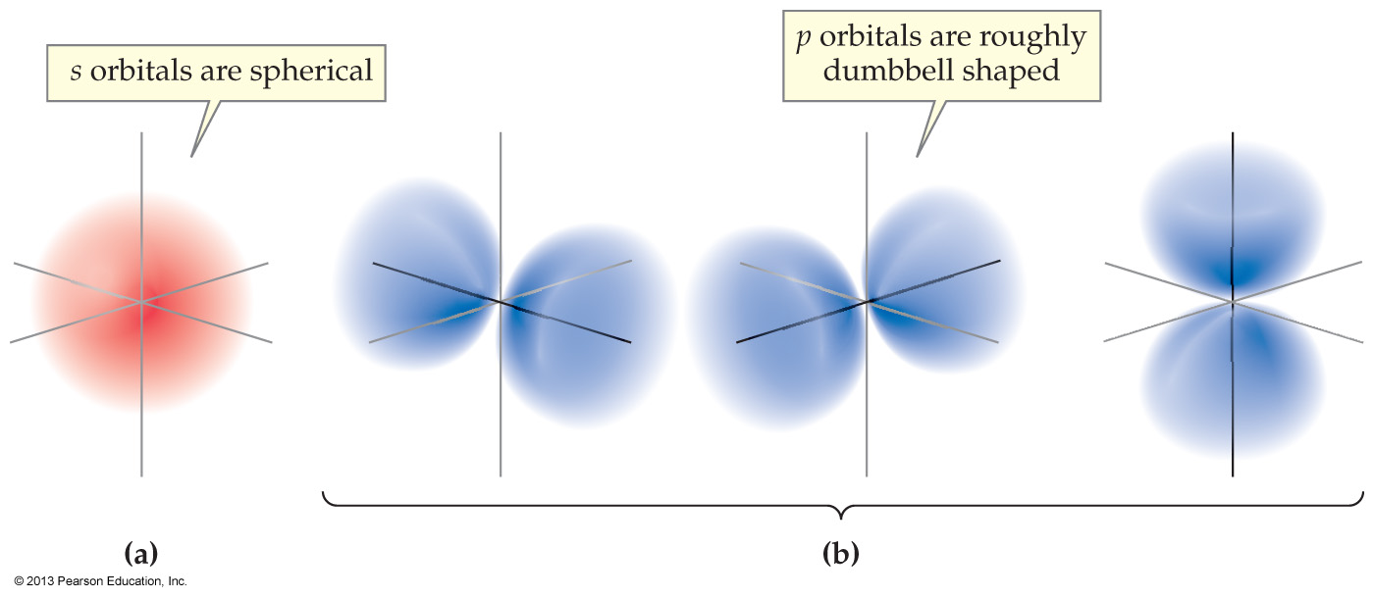
So within each shell there are subshells
And within each subshell, electrons are finally grouped into orbitals, regions of space (the final addresses) where electrons are most likely to be found around the nucleus

Slide 81
Different orbitals have different shapes and orientations
Orbitals in s subshells are spherical
Orbitals in p subshells are roughly dumbbell-shaped

Slide 82
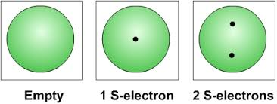
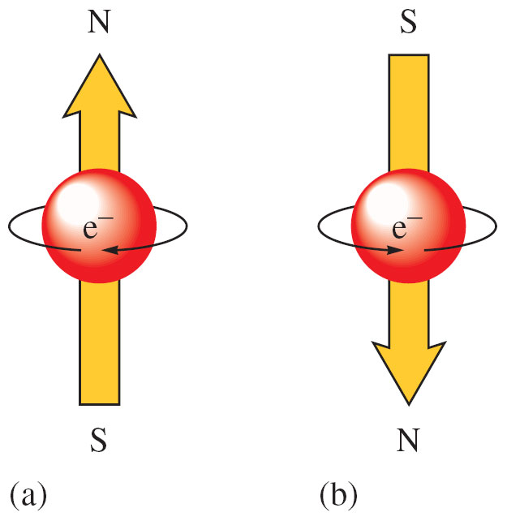
ANY orbital can hold a maximum of two electrons with opposite spin
For example, we can have up to two s electrons
For two electrons to share
an orbital, they must have
opposite spins

Slide 83
Remember this?
1s is the lowest
energy subshell

Slide 84
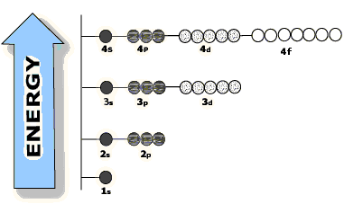
s subshells have 1 orbital
p subshells have 3 orbitals
d subshells have 5 orbitals
f subshells have 7 orbitals

Slide 85
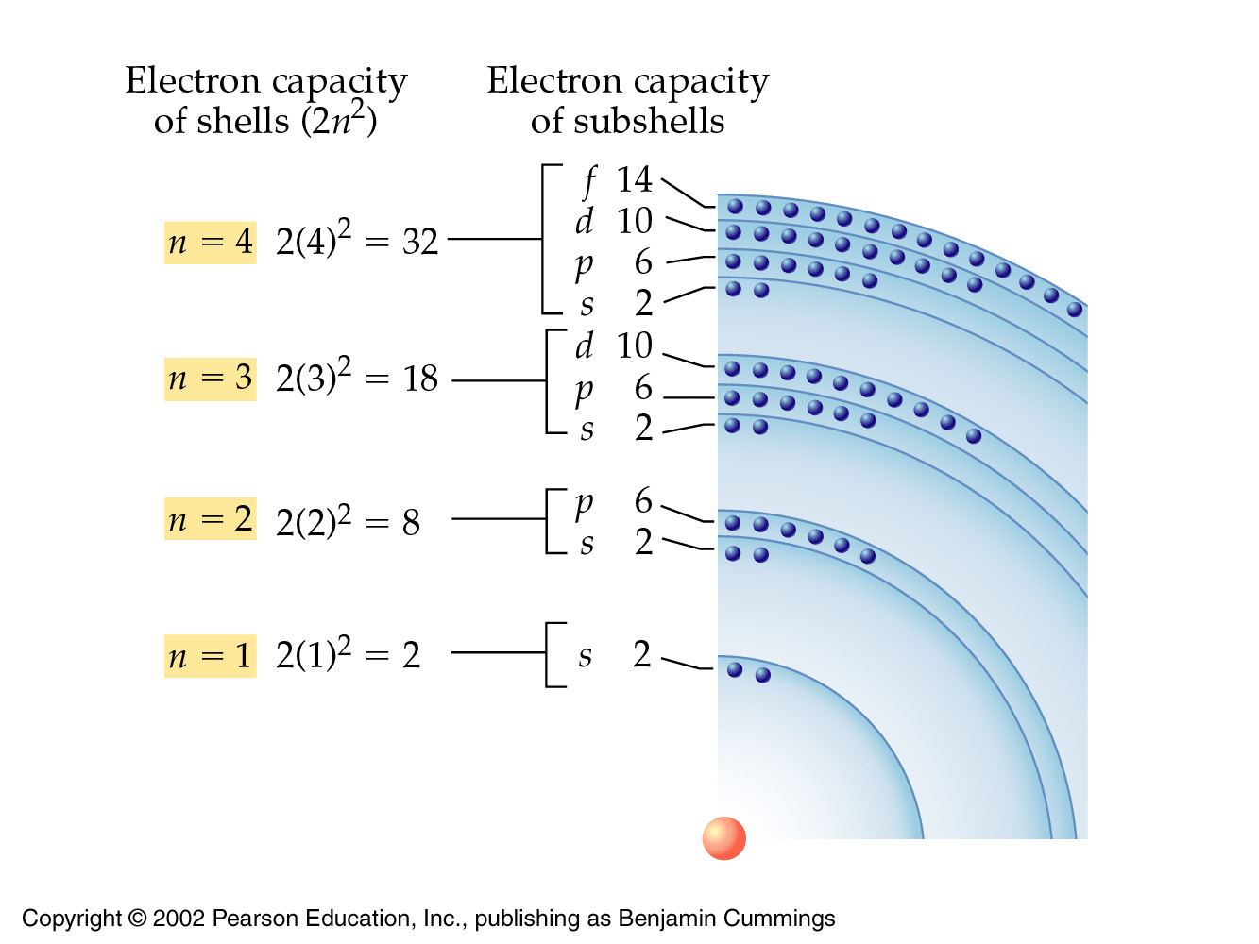
32
18
8
2
32
18
8
2

Slide 86
And finally this

Slide 87
fyi
The first shell holds 2 electrons
both in its single 1s orbital
The second shell holds 8 electrons
2 in a 2s orbital and 6 in three 2p orbitals
The third shell holds 18 electrons
2 in a 3s orbital; 6 in three 3p orbitals
10 in five 3d orbitals
The fourth shell holds 32 electrons
2 in a 4s orbital
6 in three 4p orbitals
10 in five 4d orbitals
14 in seven 4f orbitals

Slide 88
A handy table

Slide 89
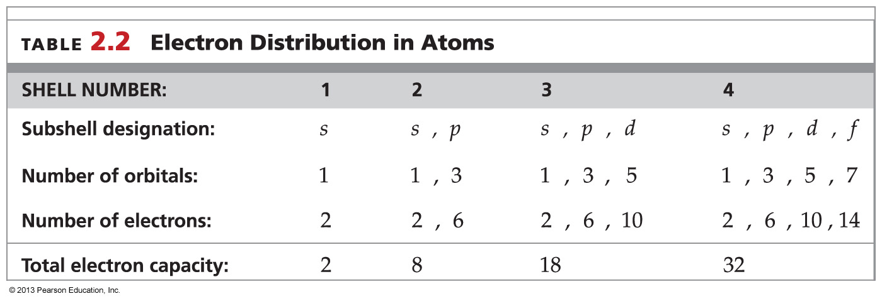
The overall electron distribution within an atom is summarized in Table 2.2:

Slide 90
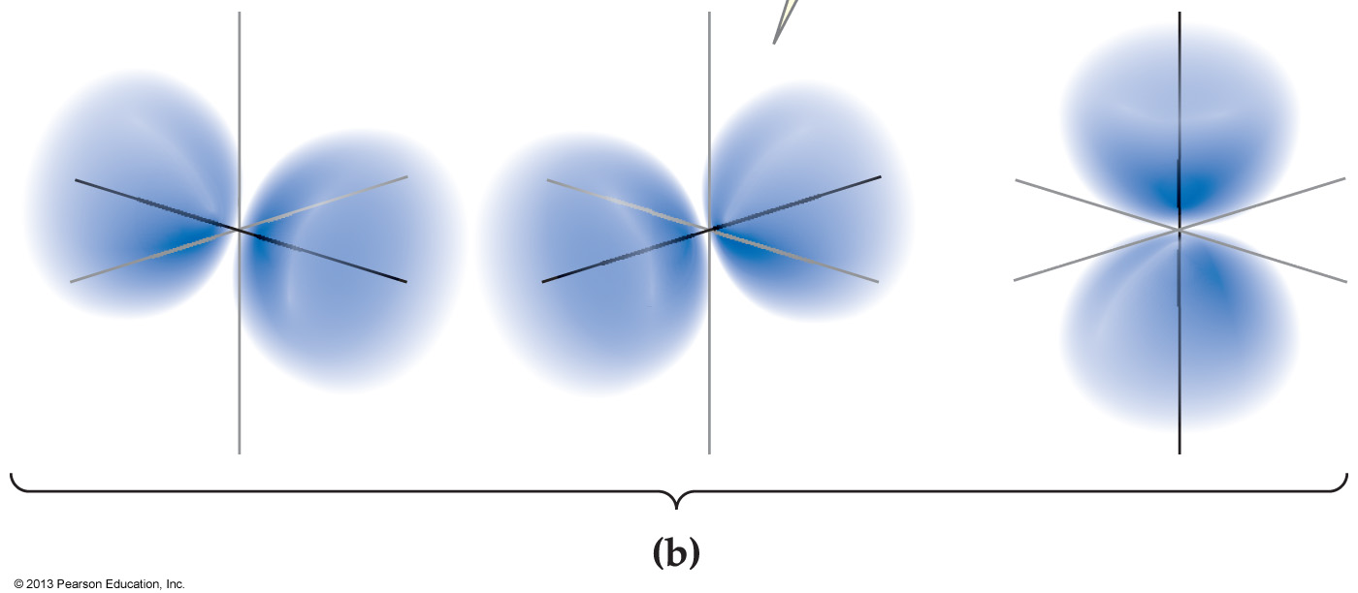
The orbitals illustrated below are _______.
s orbitals
p orbitals
d orbitals
f orbitals

Slide 91
2.7 Electron Configurations

Slide 92
The exact arrangement of electrons in an atom’s shell / subshell / orbital structure is the atom’s electron configuration
It can be predicted by applying three rules
Rule 1: Electrons occupy the lowest energy orbitals available
Unfortunately, this rule is complicated by the “crossover” of energies above the 3p level in larger-than-hydrogen atoms

Slide 93
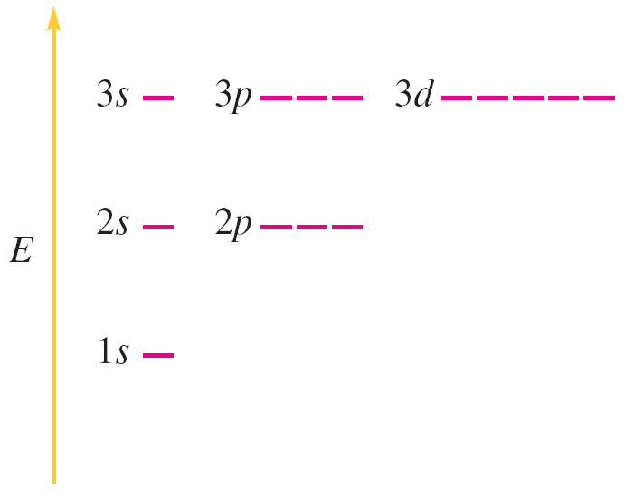
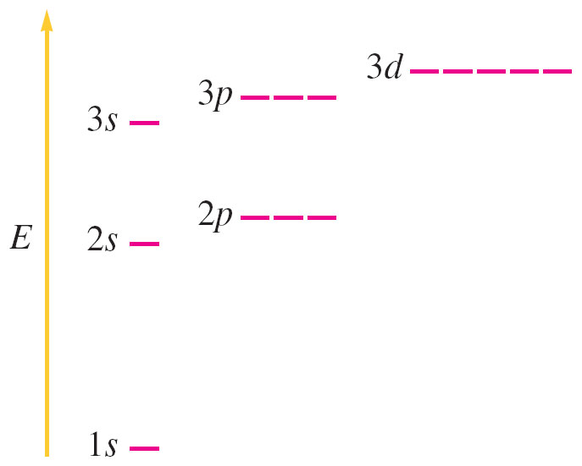
In atoms larger than hydrogen, the subshells within a shell have different energies
Hydrogen
energy-levels
Non-hydrogen
energy levels

Slide 94
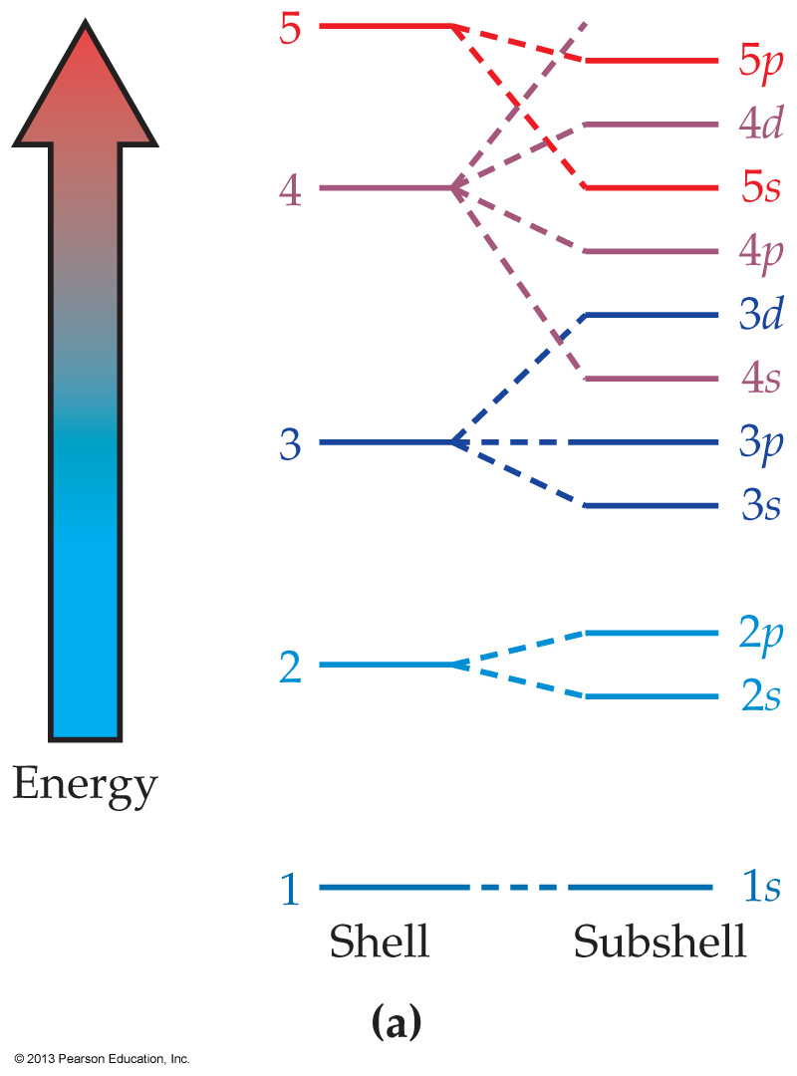
above 3p, this results in energy level ‘overlap’
Notice that the 4s is lower
in energy than the 3d
Thus the 4s is filled first – giving potassium and cesium
Only then is the 3d filled – giving scandium

Slide 95
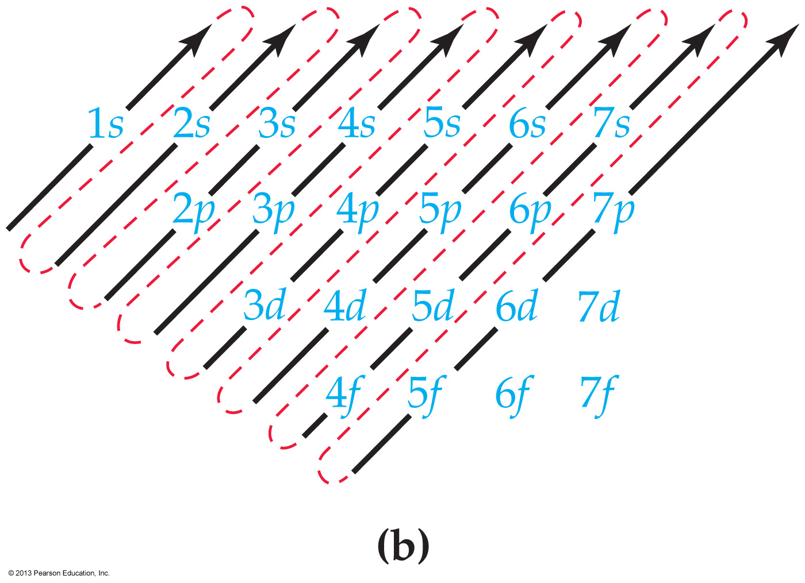
Below is a simple scheme to help remember the order in which the orbitals are filled

Slide 96
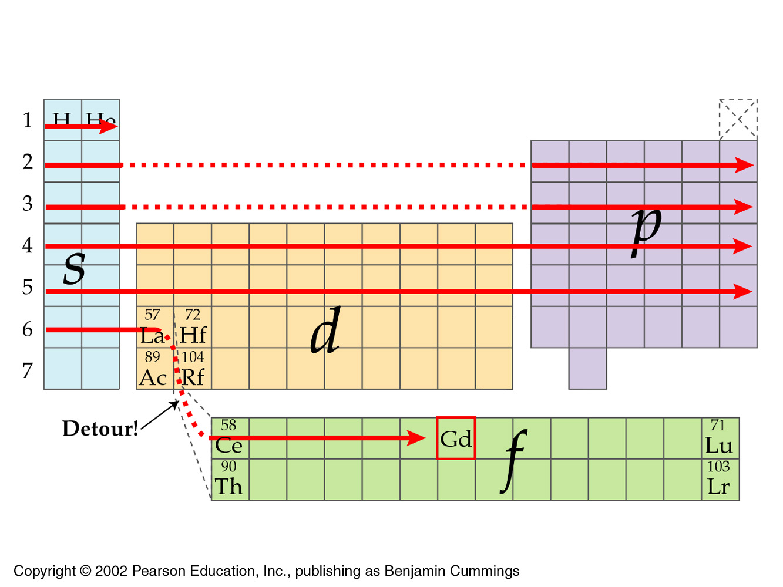
Alternatively, you can simply learn
to read the periodic table

Slide 97
The exact arrangement of electrons in an atom’s shell / subshell / orbital structure is the atom’s electron configuration
It can be predicted by applying three rules
Rule 1: Electrons occupy the lowest energy orbitals available
Unfortunately, this rule is complicated by the “crossover” of energies above the 3p level in larger-than-hydrogen atoms `

Slide 98
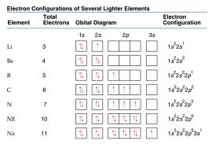
Rule 2: Each orbital can hold only two electrons, which must be of opposite spin
Rule 3: Two or more orbitals with the same energy are each half-filled by one electron before any one orbital is completely filled by addition of the second electron
Orbital box diagram
method

Slide 99
Note that the number of electrons actually in each subshell is indicated by a superscript
Electron configuration
method

Slide 100
fyi

Slide 101
fyi
Electron configurations are described by writing the shell number and subshell letter in order of increasing energy.
The number of electrons occupying each subshell is indicated by a superscript
A graphic representation can be made by indicating each orbital as a line and each electron as an arrow.
The head of the arrow indicates the electron spin
A shorthand using noble gas configurations is very useful for large atoms

Slide 102
These are the electron configurations for B – N in which the 2p shell begins to fill
noble gas
configuration

Slide 103
These are the electron configurations for O – Ne in which the 2p shell is completed

Slide 104
What is the electron configuration for the period 4 group 7A (also called Group 17) element?
1s² 2s² 2p⁶ 3s² 3p⁶ 4s² 3d⁵
1s² 2s² 2p⁶ 3s² 3p⁶ 4s² 4d⁵
1s² 2s² 2p⁶ 3s² 3p⁶ 4s² 3d¹⁰4p⁵
1s² 2s² 2p⁶ 3s² 3p⁶ 4s² 4d¹⁰4p⁵

Slide 105
The number of unpaired electrons contained in an atom of an element in group 6A (also called Group 16) is _______.
zero
two
four
six

Slide 106
2.8 Electron Configurations and the Periodic Table

Slide 107
So the periodic table provides a method for remembering the order of orbital filling

Slide 108
fyi
The periodic table can be divided into blocks of elements according to the subshell filled last
An s-Block element is a main group element that results from the filling of an s orbital.
A p-Block element is a main group element that results from the filling of p orbitals.
A d-Block element is a transition metal element that results from the filling of d orbitals.
An f-Block element is an inner transition metal element that results from the filling of f orbitals.

Slide 109
Elements in the same group of the periodic table have similar electron configurations in their valence shells
A valence shell is the outermost electron shell of an atom (its bonding electrons)
A valence electron is any electron in the valence shell of an atom – noble gases have a full eight

Slide 110
The group numbers from 1A through 8A give the numbers of valence electrons for the elements of The Main Group Elements—except for period 1
Valence electrons are the most loosely held, and they are the most important in determining an element’s properties

Slide 111
Even the period 4 elements which can have up to 18 electrons total (eg. Kr) …
can only have up to 8 valence electrons
outer shell s & p electrons are always valence
d & f electrons are never valence (in Intro Chem)

Slide 113
The number of valence electrons contained in a molybdenum (Mo) atom is _______.
zero
two
four
six

Slide 114
Elements belonging to group 2A (also called Group 2) on the periodic table below are known as the _______.
alkali metals
alkaline earth metals
halogens
noble gases

Slide 115
The element having chemical properties most similar to As is _______.
S
Sb
Se
Si

Slide 116
2.9 Electron-Dot Symbols

Slide 117
Electron-dot symbol
An atomic symbol with dots placed around it to indicate the number of valence electrons

Slide 118
How many dots are in the electron-dot symbol for boron?
one
three
five
seven

Slide 119
How many dots are in the electron-dot symbol for the oxide ion, O^{2–}?
four
six
eight
ten

Slide 120
Atoms, Excitement and Light
excited
state
ground
state

Slide 121
An atom with its electrons in their lowest-energy locations is said to be in its ground state
When just the right amount of energy is added to an atom, an electron can be kicked up from its usual energy level to a higher one
an excited state

Slide 122
The excited state does not last long—the electron quickly drops back to its ground state
In the process, releasing the light energy we observe as ‘photons’
.

Slide 123
All electromagnetic energy (photons) travels at the speed of light

Slide 124
Electromagnetic energy
Photons are ‘bundled light energy’ – quanta
The shorter the wavelength, the more the energy
The longer the wavelength, the less the energy
all photons
travel at the
speed of light

Slide 125
fyi: Electromagnetic energy
Neon lights and fireworks are the result of this phenomenon
The concentration of metals in body fluids is measured by sensitive instruments relying on the same principle of electron excitation.

Slide 126
Which color of visible light emitted possesses the highest energy?
blue
yellow
red
violet

Slide 127
Of the four types of electromagnetic radiation given, which has the most energy?
infrared
microwaves
ultraviolet
visible light

Slide 128
Chapter Summary

Slide 129
What is the modern theory of atomic structure?
All matter is composed of atoms.
An atom is the smallest and simplest unit which maintains the properties of the element.
Atoms are made up of protons, neutrons, and electrons.
Protons have a positive electrical charge and are found in the nucleus.
Neutrons are electrically neutral, and are found in the nucleus.
Electrons have a negative charge, and are a relatively large distance from the nucleus. Most of the atom is empty space.

Slide 130
How do atoms of different elements differ?
Elements differ according to the number of protons their atoms contain, a value called the atomic number (Z).
All atoms of a given element have the same number of protons and an equal number of electrons.
The number of neutrons in an atom is not predictable, but is generally as great or greater than the number of protons.
The total number of protons plus neutrons in an atom is called the atom’s mass number (A).

Slide 131
What are isotopes, and what is atomic weight?
Atoms with identical numbers of protons and electrons but different numbers of neutrons are called isotopes.
The atomic weight of an element is the weighted average mass of atoms of the element’s naturally occurring isotopes measured in atomic mass units (amu).

Slide 132
How is the periodic table arranged?
Elements are organized into the periodic table, consisting of 7 rows, or periods, and 18 columns, or groups.
The two groups on the left side of the table and the six groups on the right are called the main group elements.
The ten groups in the middle are the transition metal groups.
The 14 groups pulled out and displayed below the main part of the table are the inner transition metal groups.
Within a given group in the table, elements have the same number of valence electrons in their valence shell and similar electron configurations.

Slide 133
How are electrons arranged in atoms?
The electrons surrounding an atom are grouped into shells. Within each shell, electrons are grouped into subshells, and within each subshell into orbitals.
s orbitals are spherical; p orbitals are dumbbell-shaped.
Each shell can hold a specific number of electrons. The first shell can hold 2 electrons, the second shell can hold 8 electrons, and the third shell can hold 18 electrons.
The electron configuration of an element is predicted by assigning the element’s electrons into orbitals.
The electrons in the valence shell can be represented using electron-dot symbols.

Slide 134
Key Words

Slide 135
Alkali metal
Alkaline earth metal
Atom
Atomic mass unit (amu)
Atomic number (Z)
Atomic theory
Atomic weight
d-Block element
Electron
Electron configuration
Electron-dot symbol
f-Block element
Group
Halogen
Inner transition metal element
Isotopes

Slide 136
Main group element
Mass number (A)
Neutron
Noble gas
Nucleus
Orbital
p-Block element
Period
Proton
s-Block element
Shell (electron)
Subatomic particles
Subshell (electron)
Transition metal element
Valence electron
Valence shell

