Slide 1
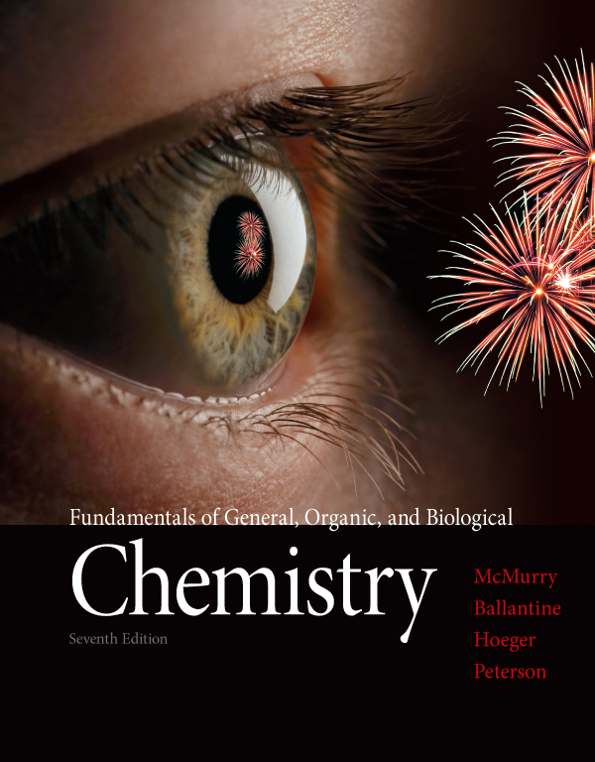
Chapter Three
Chapter 3 Lecture
Fundamentals of General, Organic, and Biological Chemistry
7th Edition
McMurry, Ballantine, Hoeger, Peterson
Ionic Compounds
Julie Klare
Gwinnett Technical College
© 2013 Pearson Education, Inc.

Slide 2
Outline
3.1 Ions
3.2 Periodic Properties and Ion Formation
3.3 Ionic Bonds
3.4 Some Properties of Ionic Compounds
3.5 Ions and the Octet Rule
3.6 Ions of Some Common Elements
3.7 Naming Ions
3.8 Polyatomic Ions
3.9 Formulas of Ionic Compounds
3.10 Naming Ionic Compounds
3.11 H⁺ and OH⁻ Ions: An Introduction to Acids and
Bases

Slide 3
Goals

Slide 4
1. What is an ion, what is an ionic bond, and what are the general characteristics of ionic compounds?
Be able to describe ions and ionic bonds, and give the general properties of compounds that contain ionic bonds.
2. What is the octet rule, and how does it apply to ions?
Be able to state the octet rule and use it to predict the electron configurations of ions of main group elements.
3. What is the relationship between an element’s position in the periodic table and the formation of its ion?
Be able to predict what ions are likely to be formed by atoms of a given element.

Slide 5
What determines the chemical formula of an ionic compound?
Be able to write formulas for ionic compounds, given the identities of the ions.
How are ionic compounds named?
Be able to name an ionic compound from its formula or give the formula of a compound from its name.
What are acids and bases?
Be able to recognize common acids and bases.

Slide 6
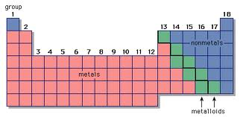
3.1 Ions

Slide 7
metals hold electrons loosely
the nuclear attraction is not strong enough to keep them all
nonmetals hold electrons tightly
the nuclear attraction is strong enough to attract a surplus
Atoms can form ions by gaining or losing electrons

Slide 8
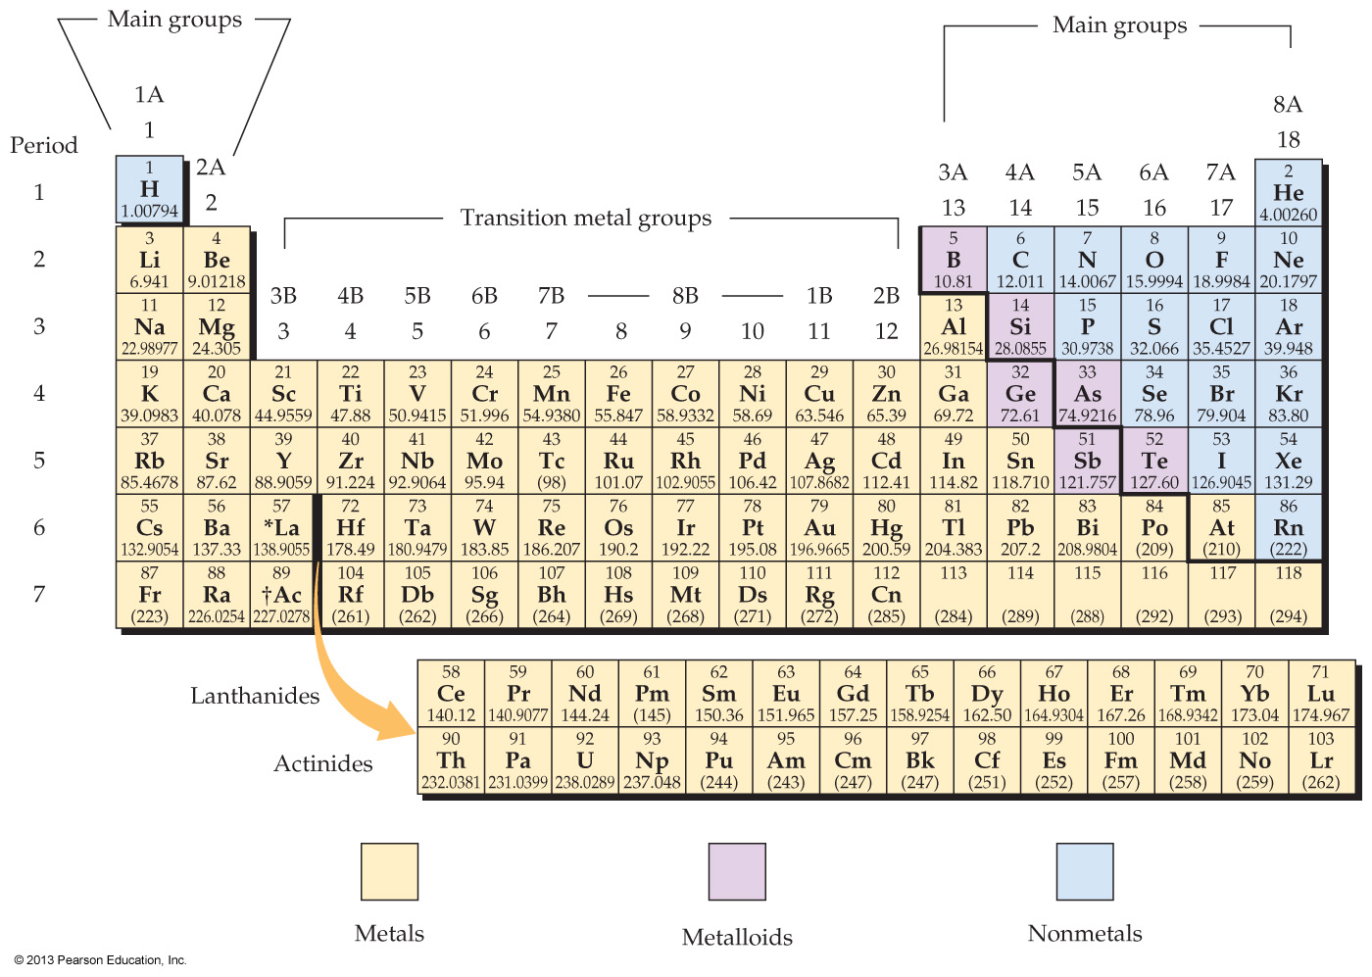

Slide 9
Scientists have observed:
Metals tend to form compounds with nonmetals
For example, alkali metals (group IA) react with halogens (group 7A) to make a variety of compounds, all with similar salt-like properties:
The two elements (1A & 7A) are always found in 1:1 ratios
The compounds have melting points over 500 °C
Each is a stable, white, crystalline solid
Each is soluble in water
The water solution of each compound conducts electricity

Slide 10
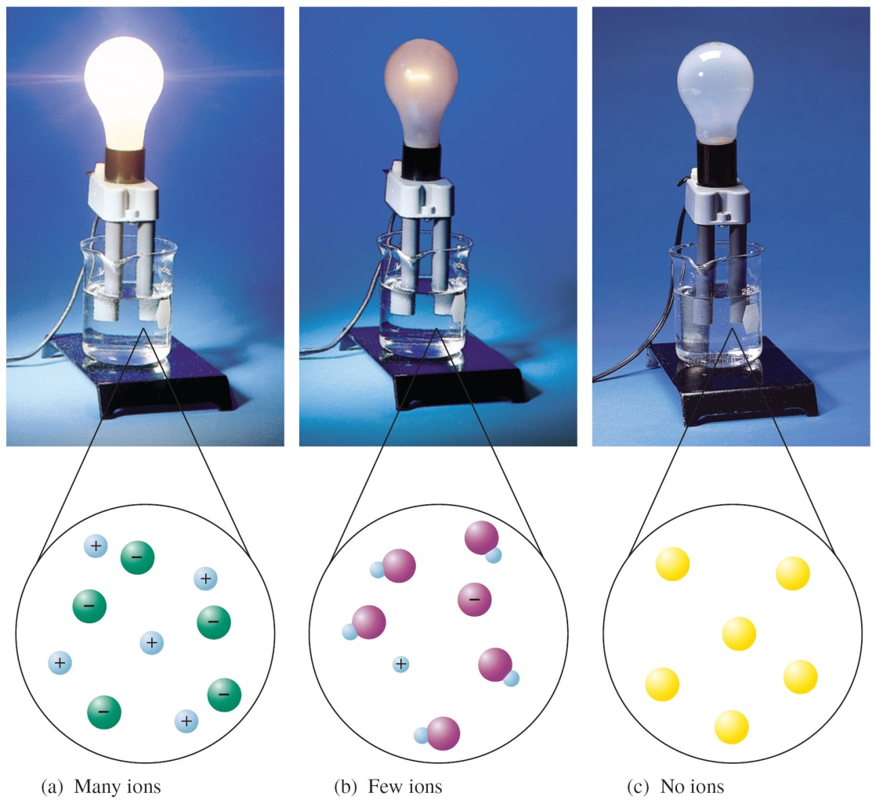
Note: Electricity can only flow through a medium containing charged particles that are free to move
Atoms are electrically neutral
because they contain equal
numbers of protons and electrons
This proves the theory that salts are composed of charged particles (ions)

Slide 11
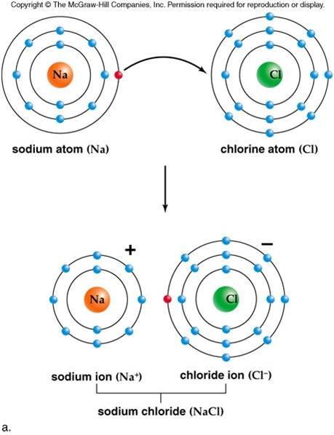
By gaining or losing electrons, an atom can be converted into a charged particle called an ion
The loss of one or more electrons from a neutral atom gives a positively charged ion called a cation
The gain of one or more electrons by a neutral atom gives a negatively charged ion called an anion
metal
nonmetal
cation
anion

Slide 12
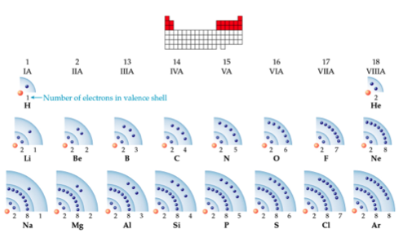
FYI

Slide 13
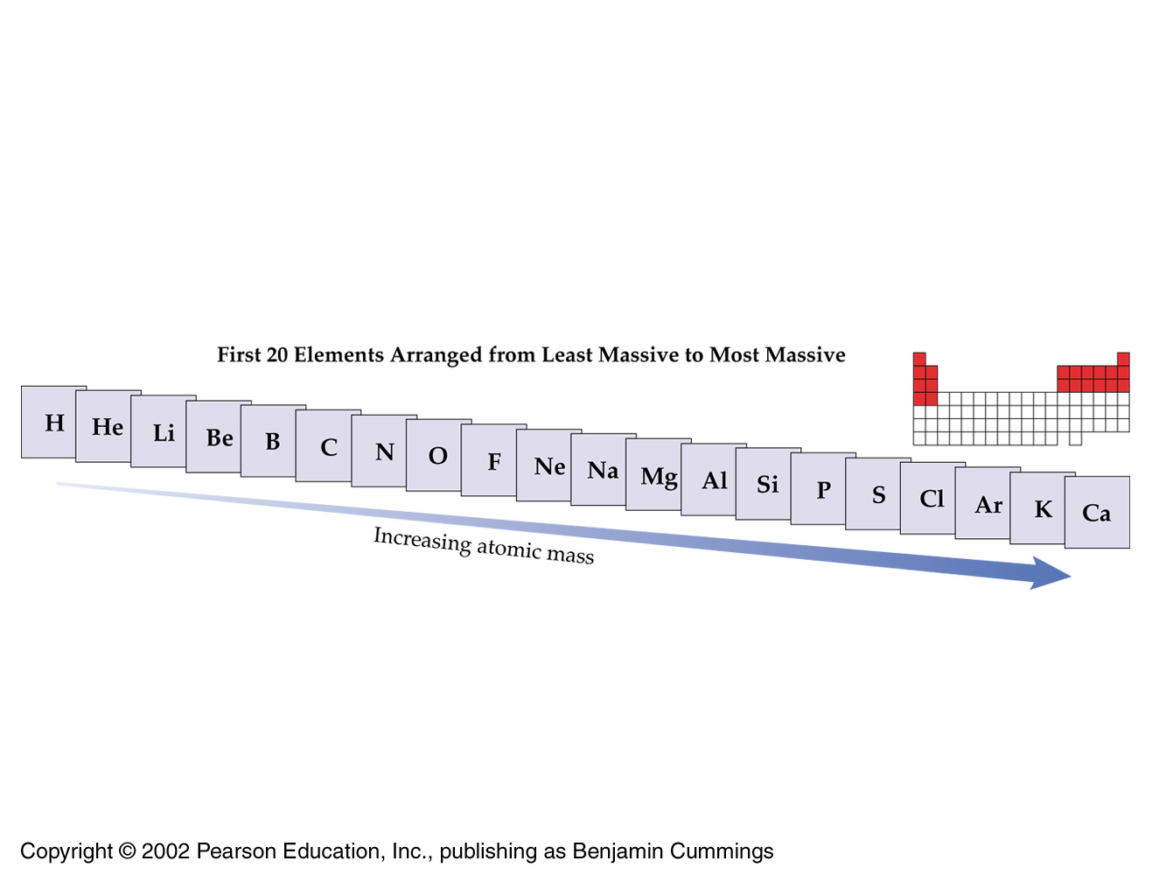
FYI
Everyone wants to go to the nearest nobles

Slide 14
The symbol for a cation is written by adding the positive charge as a superscript to the symbol for the element
An anion symbol is written by adding the negative charge as a superscript
Only if a charge is greater than 1 is a number used

Slide 15
3.2 Periodic Properties and Ion Formation

Slide 16
Ionization energy is the energy consumed (needed) to remove one electron from a single atom in the gaseous state
Small values indicate ease of losing electrons to form cations
1A (metals) have the smallest values (ie, easiest to remove electrons)
Electron affinity is the energy released on adding an electron to a single atom in the gaseous state
7A (halogens) have the largest values and so gain electrons most easily (ie, biggest drive to gain electrons)

Slide 17
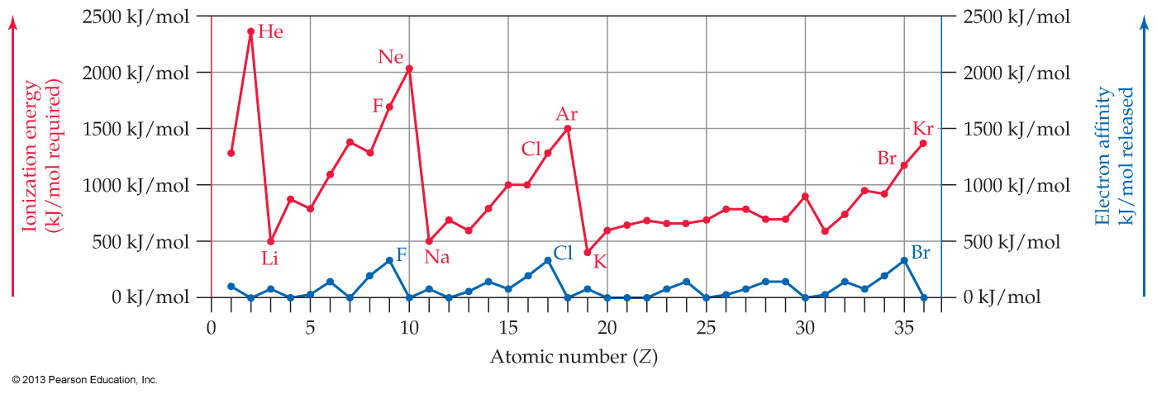
Alkali metals lose electrons most easily (ionization energy)
Halogens gain electrons most easily (electron affinity)
Noble gases neither lose nor gain electrons at all
Elements near the middle of the periodic table do not form ions as easily

Slide 18
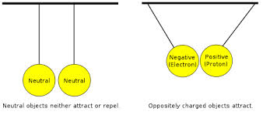
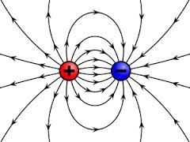
Elements that lose an electron, and those that gain an electron will attract each other (following the transfer of an electron)
this is an ionic bond
Note the compound that results is electrically neutral overall
cation and anion charges balance

Slide 20
Using only the periodic table, determine which element below gains an electron most easily?
Br
Cl
K
Na

Slide 21
Using only the periodic table, determine which element below loses an electron most easily?
Br
Ca
Na
S

Slide 22
Put the following elements in order of increasing ionization energy. N, Li, F, C
Li, C, N, F
F, N, C, Li
N, Li, F, C
C, F, Li, N

Slide 23
Put the following elements in order of decreasing electron affinity. N, Li, F, C
Li, C, N, F
F, N, C, Li
N, Li, F, C
C, F, Li, N

Slide 24
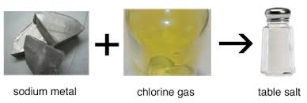
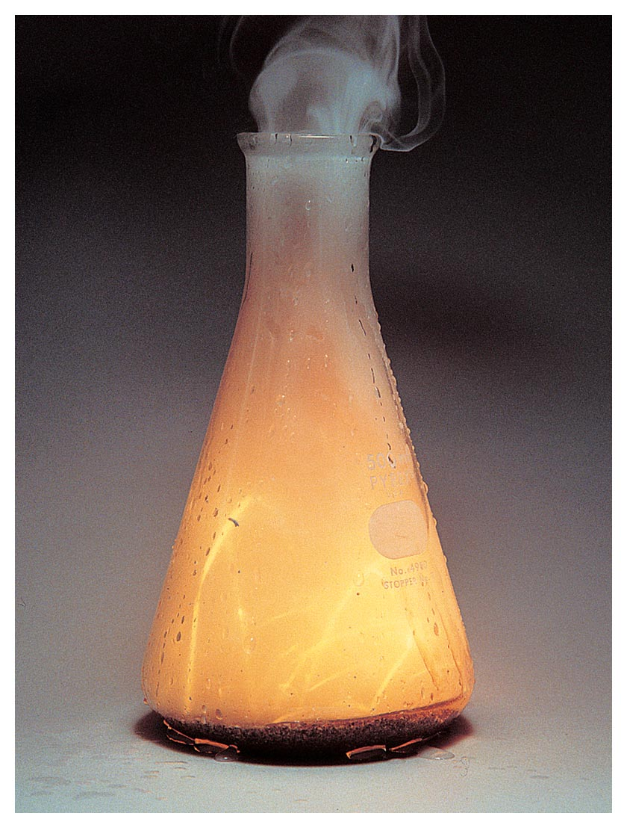
3.3 Ionic Bonds
Electron-transfer reactions of metals and nonmetals
form products unlike either element
it is a violent
reaction

Slide 25
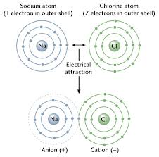
Electron-transfer reactions of metals and nonmetals form products unlike either element
Because opposite electrical charges attract each other, the positive ion and negative ion are said to be held together by an ionic bond

Slide 26
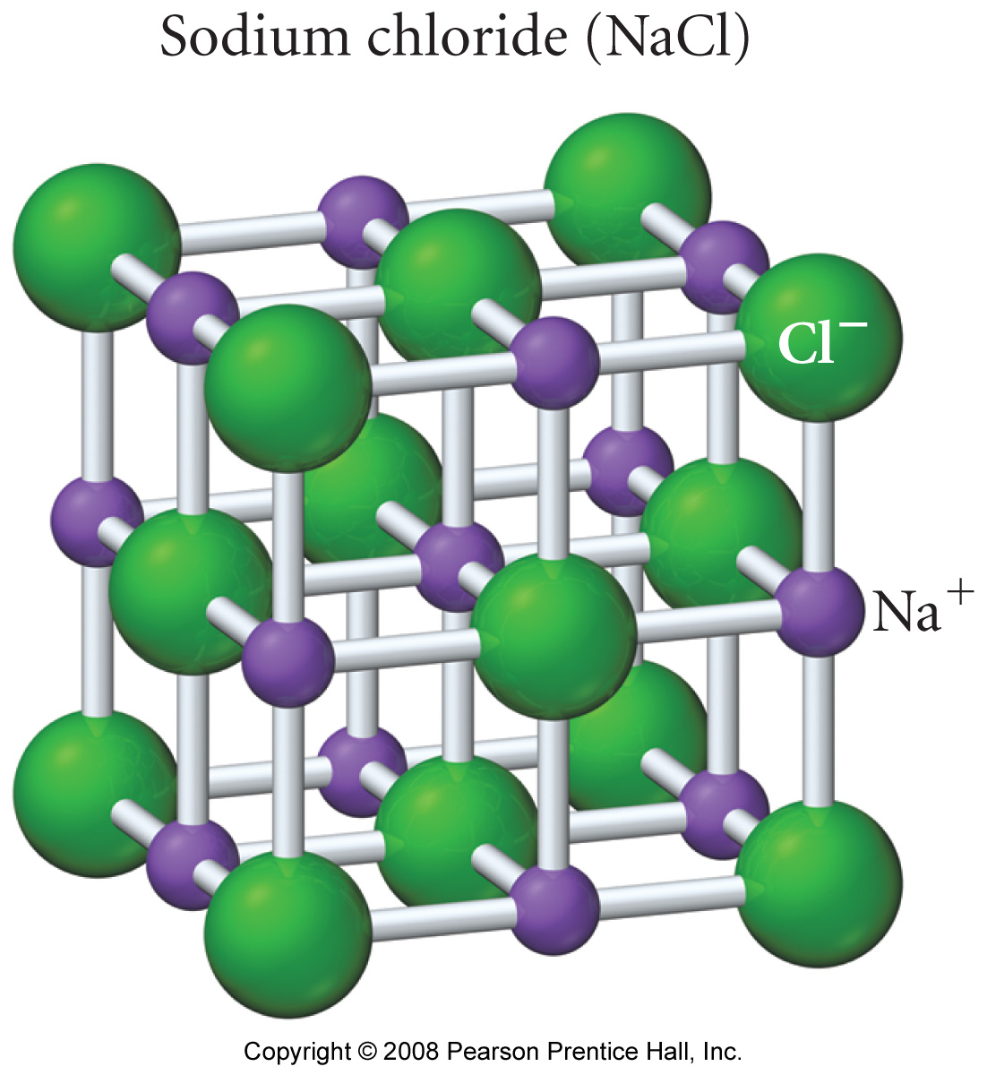
Because opposite electrical charges attract each other, the positive ion and negative ion are said to be held together by an ionic bond
There are many examples of ionic bonds
Most are common crystalline ionic solids
And are all referred to as ionic compounds
NaCl, NaBr, KBr, LiF
These are four 1A-bonded-to-7A examples

Slide 27
Which of the following best describes the way ionic bonds are formed?
Both metals and nonmetals lose electrons to form bonds.
Both metals and nonmetals gain electrons to form bonds.
Metals gain electrons and nonmetals lose electrons to form bonds.
Metals lose electrons and nonmetals gain electrons to form bonds.

Slide 28
Aluminum atoms lose three electrons when they react. Write the symbol for the ion that forms and tell whether it is an anion or a cation.
Al³⁺, anion
Al³⁺, cation
Al^{3–}, anion
Al^{3–}, cation

Slide 29
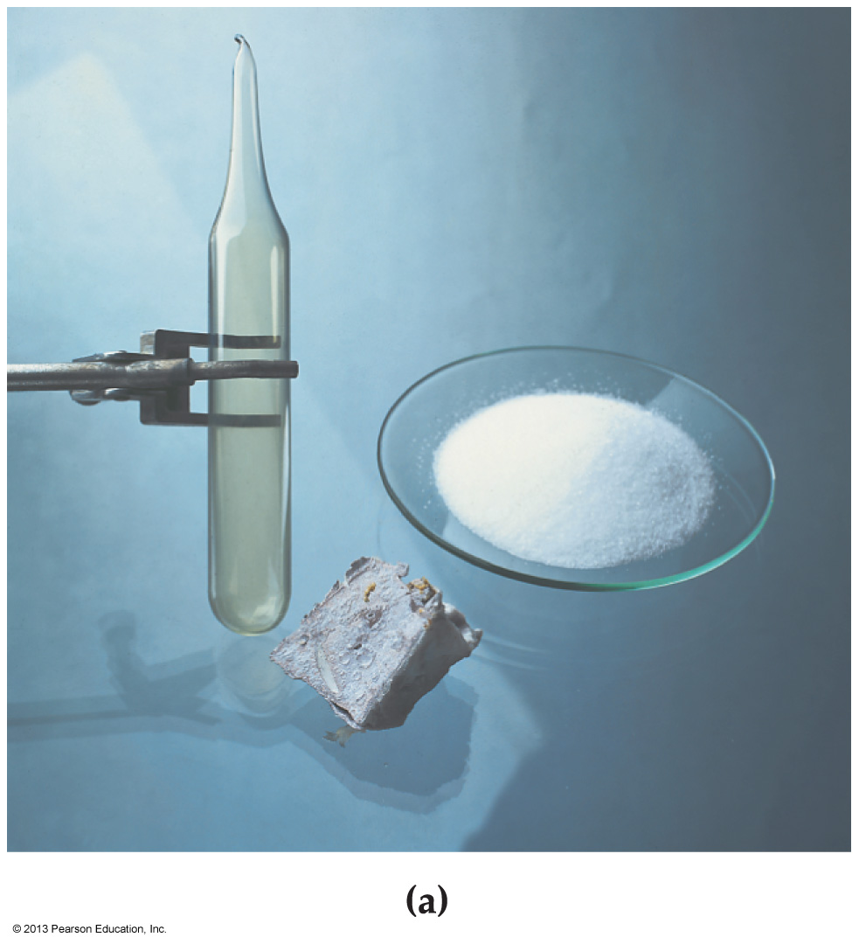
Chlorine atoms gain one electron when they react. Write the symbol for the ion that forms and indicate whether it is an anion or a cation.
Cl⁺, anion
Cl⁺, cation
Cl–, anion
Cl–, cation

Slide 30
3.4 Some Properties of Ionic Compounds

Slide 31
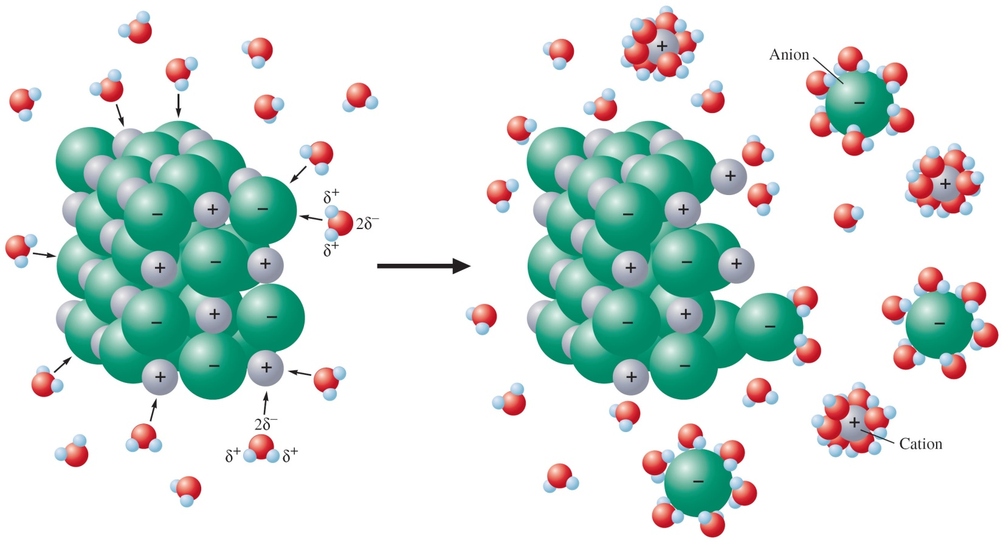
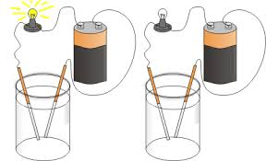
In the solid state, ions in each compound settle into a pattern that efficiently fills space and maximizes ionic bonding
Ions in an ionic solid are held rigidly in place by attraction to their neighbors
However, once an ionic solid is dissolved in water, the ions can move freely, which accounts for the electrical conductivity of these compounds in solution

Slide 32
Ionic compounds have very high melting and boiling points
Sodium chloride melts at 801 °C and boils at 1413 °C
Ionic solids shatter if struck sharply
Brittle
Ionic compounds dissolve in water if the attraction between water and the ions can overcome the attraction of the ions for one another
However, not all ionic compounds are water soluble
Solubility decreases as: 1A > 2A > 3A
So aluminum salts are generally insoluble in water

Slide 33
fyi: Ionic Liquids
Ionic liquids have low melting points, high viscosity, low to moderate electrical conductivity, and low volatility.
One of the first room temperature ionic liquids (or RTILs), ethylammonium nitrate, was synthesized in 1914 by Paul Walden.
Most RTILs consist of a bulky, asymmetric organic cation, combined with a variety of anions.
The bulky cations cannot pack together; they tend to form highly viscous liquids that exhibit low volatility.
RTILs also provide unique solvent properties, enabling them to dissolve substances that are not very soluble in more conventional solvents. Low volatility also makes them environmentally friendly.
RTILs can dissolve cellulose, facilitating its conversion into fermentable sugars.

Slide 34
3.5 Ions and the Octet Rule
Now we learn why we emphasize the 1A-8A group numbers

Slide 35
Alkali metals have a single valence electron and an electron configuration ns¹
Halogens have seven valence electrons and an electron configuration ns²np⁵
When alkali metals and halogens react, an electron is transferred, giving both ns²np⁶ configurations with eight valence electrons
This is a noble gas electron configuration
Octet rule: Main group elements tend to undergo reactions that leave them with eight valence electrons

Slide 36
FYI

Slide 37
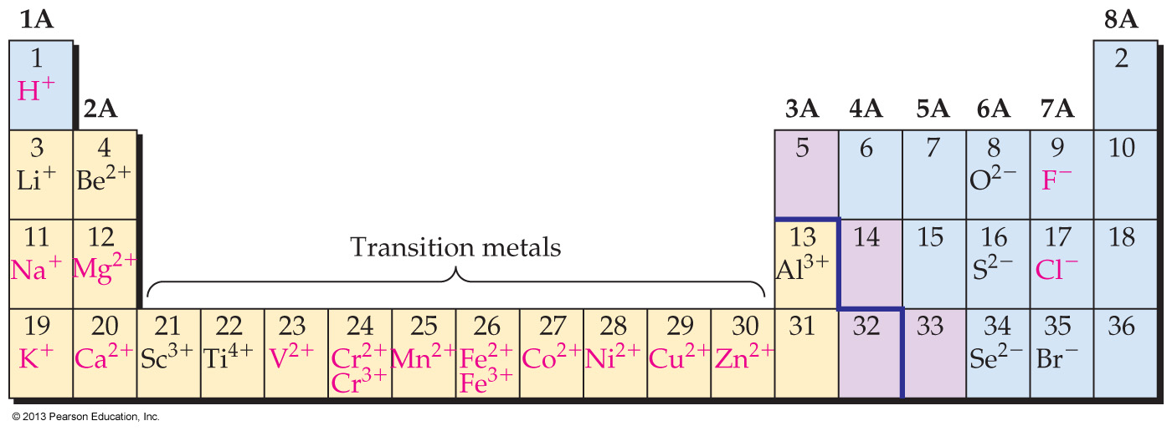
3.6 Ions of Some Common Elements

Slide 38
Group 1A: M → M⁺ + e–
Group 2A: M → M²⁺ + 2e–
Group 3A: Al → Al³⁺ + 3e–
no other common ions in Group 3A (as taught in Intro Chem)
Group 4A, 5A
no common ions in Groups 4A & 5A
Group 6A: X + 2e– → X^{2–}
Group 7A: X + e– → X–
Transition metals form cations, but can lose one or more d electrons in addition to losing valence s electrons

Slide 39
Group 8A elements (the noble gases) are unreactive
Everyone wants to go to the nearest nobles

Slide 40
Important Points about Ion Formation and the Periodic Table
Ionic charges of main group elements can be predicted using the group number and the octet rule.
For 1A, 2A, and 3A metals
Cation charge = group number
For nonmetals in groups 6A, and 7A
Anion charge = 8 – (group number)

Slide 41
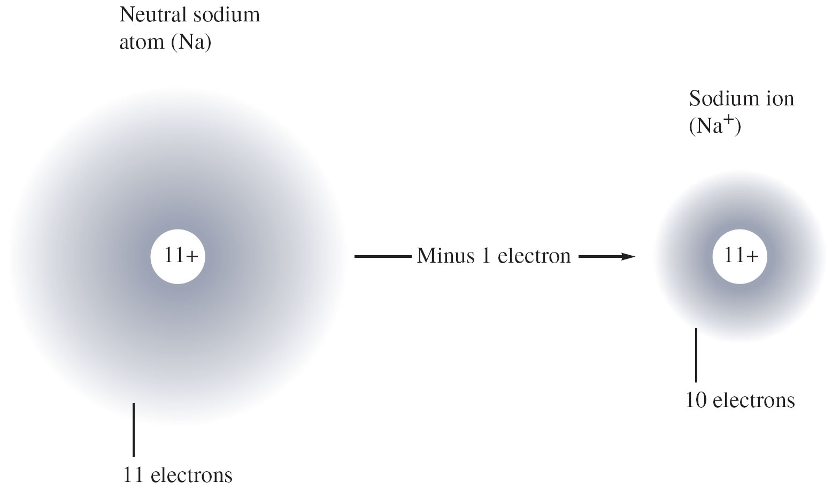
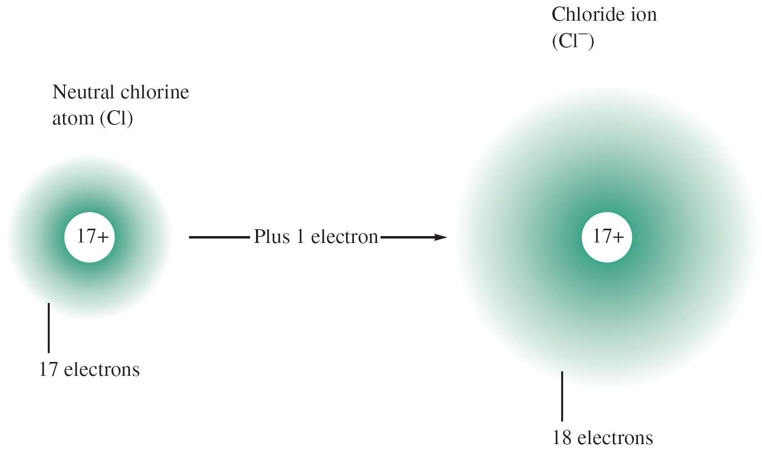
Important Points about Ion Formation and the Periodic Table
fyi
Metals form cations by losing one or more electrons to achieve a noble gas configuration
Group 1A, 2A, & 3A metals form +1, +2, and +3 anions respectively, to achieve a noble gas configuration
Nonmetals form anions by gaining one or more electrons to achieve a noble gas configuration
Group 6A & 7A nonmetals form −1 & −2 anions respectively, to achieve a noble gas configuration

Slide 42
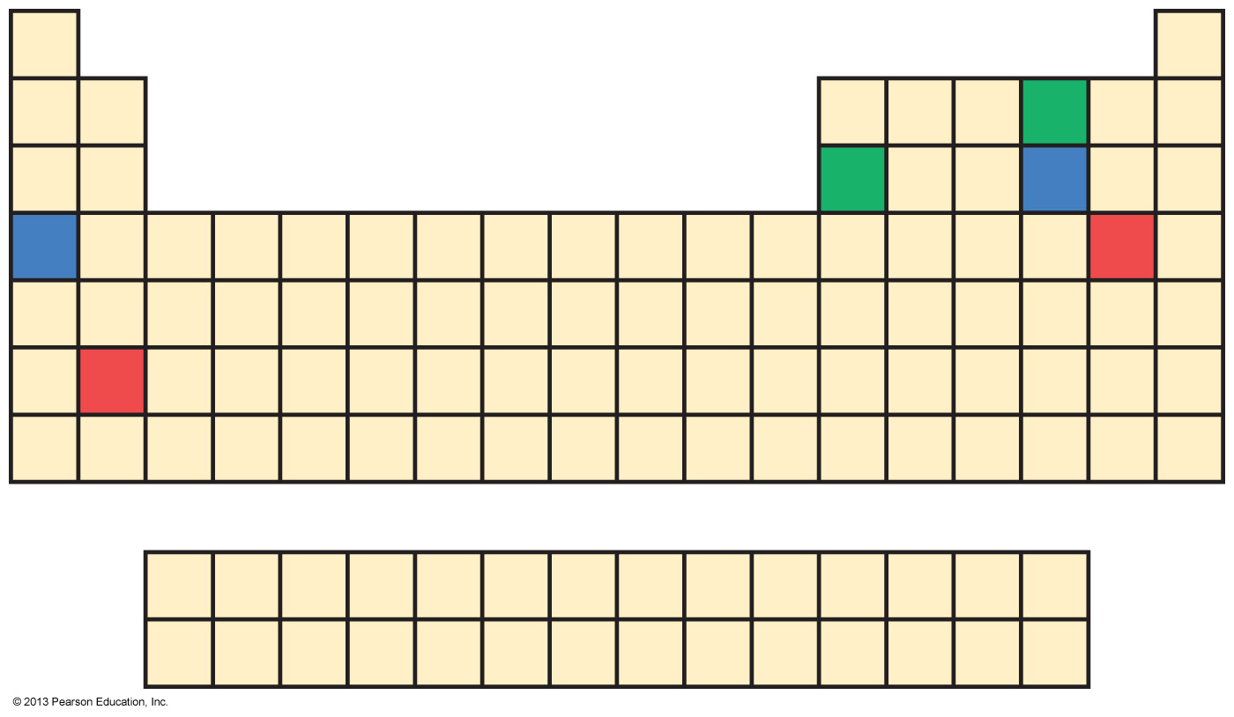
Upon reaction with the blue metal to form an ionic compound, give the number of electrons gained or lost by the blue nonmetal, and tell whether it forms an anion or a cation.
gains 2 electrons; anion
gains 2 electrons; cation
loses 6 electrons; anion
loses 6 electrons; cation

Slide 43
For the element nitrogen, write the electron configuration and indicate which electrons will be gained or lost to form an ion.
1s²1p⁵, one 1p electron gained
1s²1p³2s², two 2s electrons lost
1s²2s²2p³, two 2s and three 2p electrons lost
1s²2s²2p³, three 2p electrons gained

Slide 44
fyi: Salt
The idea that high salt intake and high blood pressure go hand-in-hand is a highly-publicized piece of nutritional lore.
Salt has been prized since the earliest recorded times as a seasoning, a food preservative, and a form of payment.
Salt is perhaps the easiest of all minerals to obtain and purify. Most salt is obtained by mining the vast deposits of halite, or rock salt, formed by evaporation of ancient inland seas.
Too much sodium has been linked to both hypertension and kidney ailments. The recommended daily intake (RDI) for sodium is 2300 mg. The average adult in most industrialized countries consumes over twice this amount.
What should an individual do? The best answer, as in so many things, is to use moderation and common sense.

Slide 45
3.7 Naming Ions

Slide 46
Main group metal cations in groups 1A, 2A, & 3A are named by identifying the metal, followed by the word “ion”
‘Sodium ion’ for Na⁺
Transition metals can form more than one type of cation
We will only use the ‘new’ naming system. Whereby:
The charge on the ion is inserted (as a Roman numeral in parentheses) right after the metal name
‘Iron (II) ion’ for Fe²⁺
‘Iron (III) ion’ for Fe³⁺
Anions in groups 6A & 7A are named by replacing the ending of the element name with -ide, followed by the word “ion”
‘Chloride ion’ for Cl⁻

Slide 47
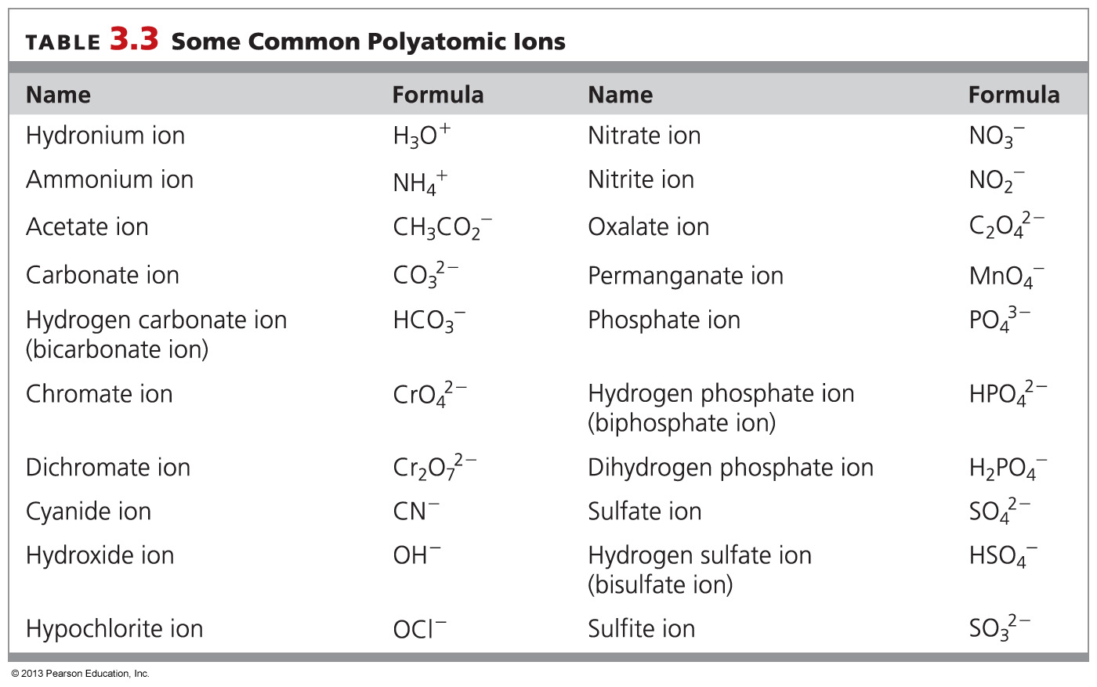
3.8 Polyatomic Ions

Slide 50
The polyatomic ion
A polyatomic ion is one that is composed of more than one atom (eg, OH⁻)
It is charged because it contains a total number of electrons that is different from the total number of protons in the combined atoms
These polyatomic ions are encountered so frequently that it is best to memorize their names and formulas

Slide 52
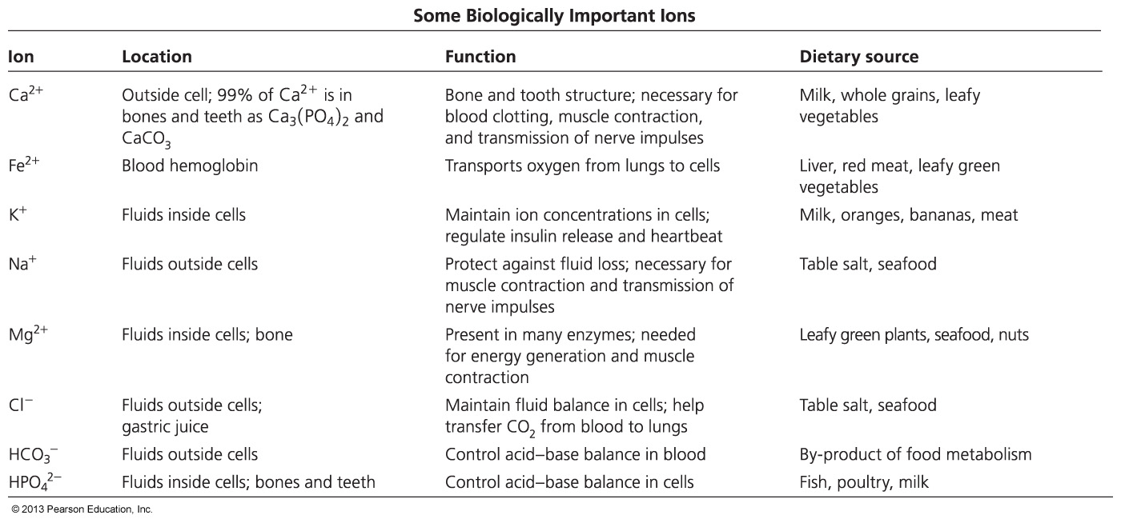

Slide 53
The polyatomic ion SO₃^{2–} is named _________.
sulfate
sulfide
sulfite
sulfur oxide

Slide 54
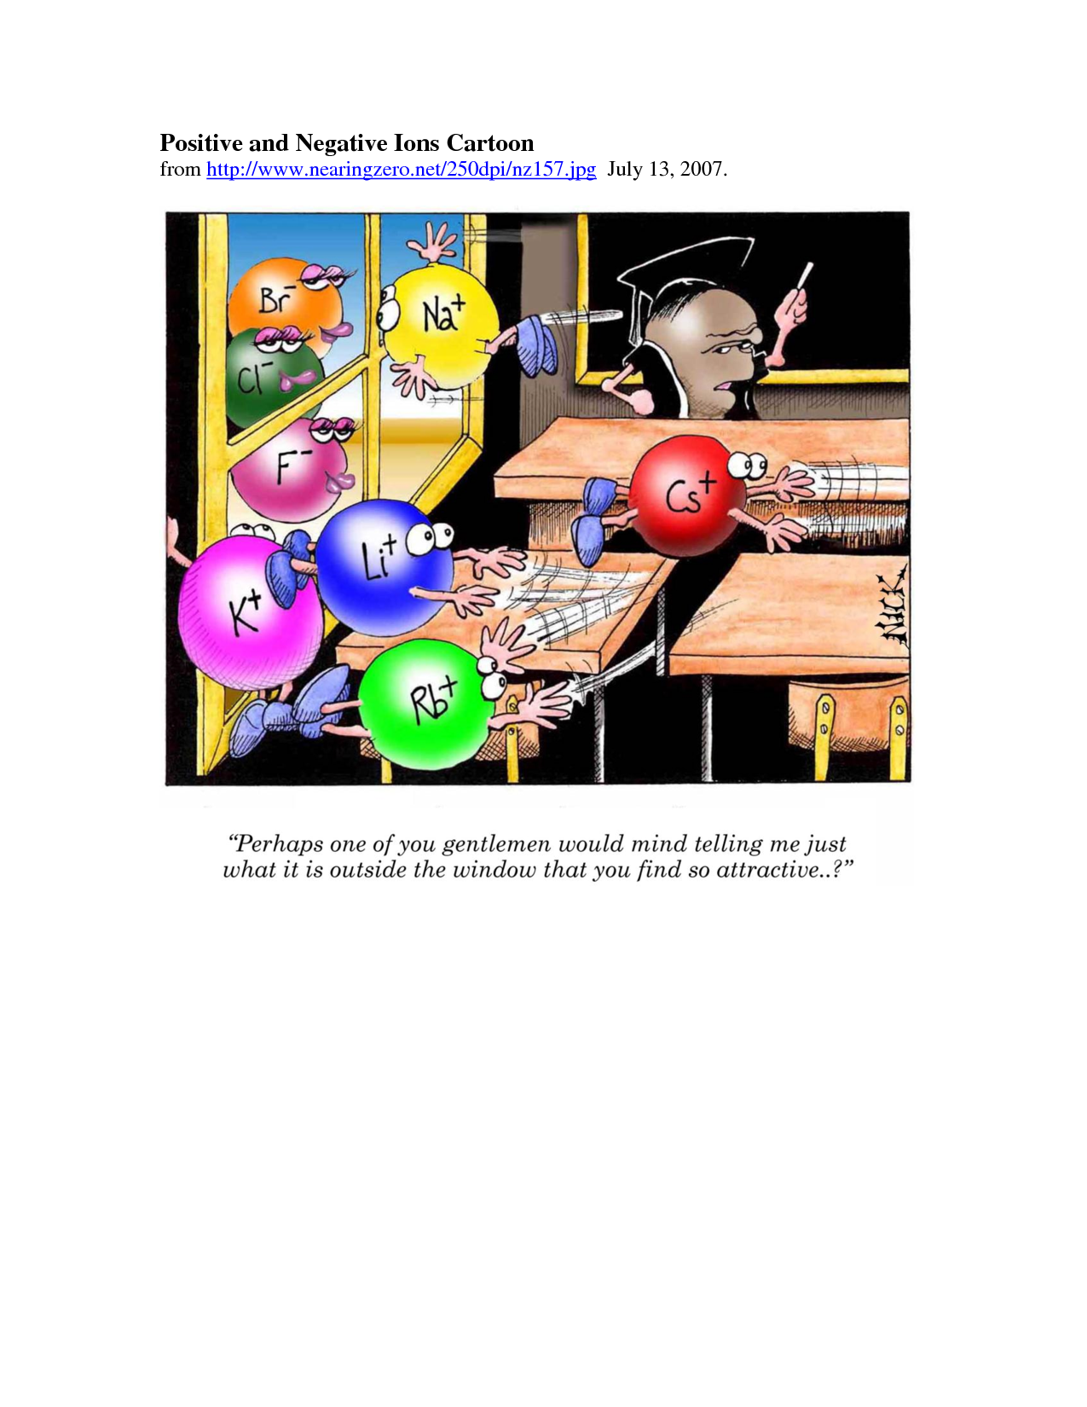
3.9 Formulas of Ionic Compounds

Slide 55
ionic (salt) formulas
To write the correct formula for a compound you must remember:
All chemical compounds are neutral
(Polyatomics are not compounds, they are ions)
So once the ions within the compound are identified
decide how many ions of each type are needed to give a total charge of zero (eg, NaCl or NaOH)
The chemical formula of an ionic compound tells the ratio of anions and cations

Slide 56
If the ions have the same number of charges, then only one of each is needed:
K⁺ + F– → KF
If the ions have different number of charges, then…
… unequal numbers of anions and cations must combine to give a net charge of zero
2 K⁺ + O^{2–} → K₂O
Ca²⁺ + 2 Cl– → CaCl₂

Slide 57
When the two combining ions have different charges, the number of one ion needed in the formula is equal to (absolute value of) the charge on the other ion

Slide 58
The written formula of an ionic compound shows the lowest possible ratio of atoms and is known as a simplest formula
Formula unit:
The formula that identifies the smallest neutral unit of an ionic compound
NaCl, not Na₂Cl₂

Slide 59
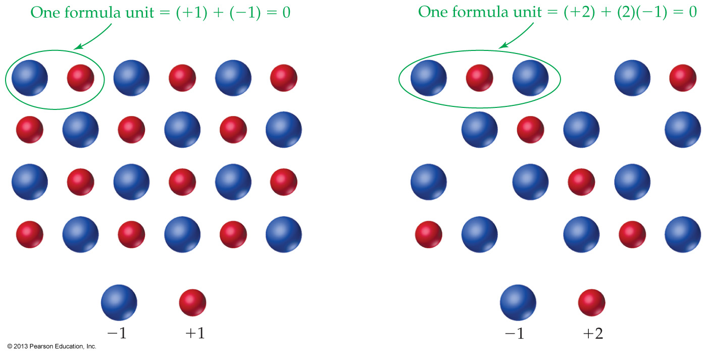
eg: NaCl
eg: CaCl₂

Slide 60
Once the numbers and kinds of ions in a compound are known, the formula is written using the following rules:
List the cation first and the anion second
Do not include the charges of the ions
Use parentheses around a polyatomic ion formula if a subscript is needed
NaOH but Ca(OH)₂
Na₂SO₄ but Al₂(SO₄)₃

Slide 61
Which is the correct formula for the compound lithium phosphide?
Li₃PO₄
Li₃PO₃
Li₃P
Li₂PO₂

Slide 62
What is the formula of the ionic compound that likely forms upon reaction between the red metal and the red nonmetal shown below?
AB₂
A₂B₃
A₃B₂
AB₃

Slide 63
What is the formula of the ionic compound that likely forms upon reaction between the green metal and the green nonmetal shown below?
AB
A₂B₃
A₃B₂
AN₂

Slide 64
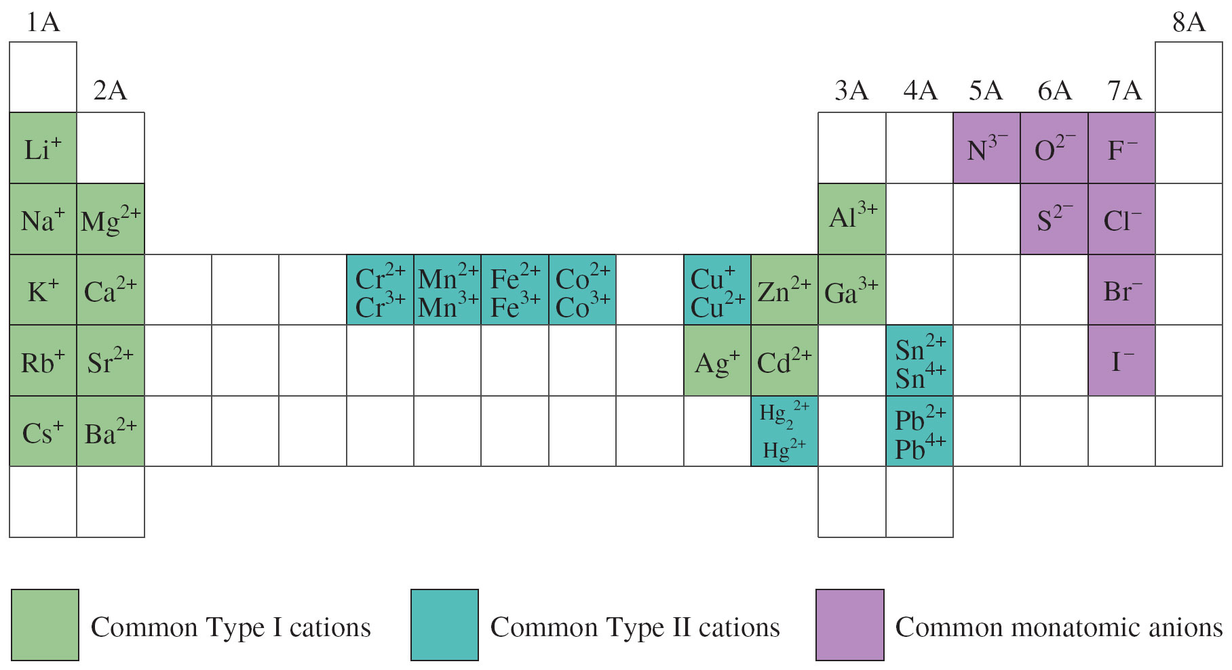
3.10 Naming Ionic Compounds

Slide 65
Chemists have adopted a logical system for naming compounds
In which the name itself describes its formula
eg, sodium chloride instead of ‘table salt’
But some historical names do not change
We do not call water: dihydrogen oxide

Slide 66
Ionic compounds are named by citing first the cation and then the anion, with a space between words
There are two kinds of ionic compounds:
Type I ionic compounds contain mostly cations of main group metals (next slide)
Type II ionic compounds contain metals that can exhibit more than one charge (mostly transition)
These require different naming conventions

Slide 67
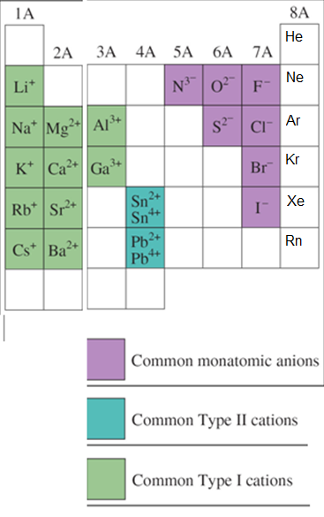
Type I ionic compounds mostly contain cations of main group elements
The charges on Type I cations do not vary
So we do not specify the charge on the cation
NaCl is sodium chloride
MgCl₂ is magnesium chloride
not magnesium dichloride

Slide 68
Type II ionic compounds contain metals that exhibit more than one charge type
Specify the charge on the cation with Roman numerals
FeCl₂ is iron(II) chloride
FeCl₃ is iron(III) chloride
not iron dichloride or trichloride

Slide 69
Of the elements listed below, which one can form more than one cation? Na, Ag, S, Fe
Na
Ag
S
Fe

Slide 70
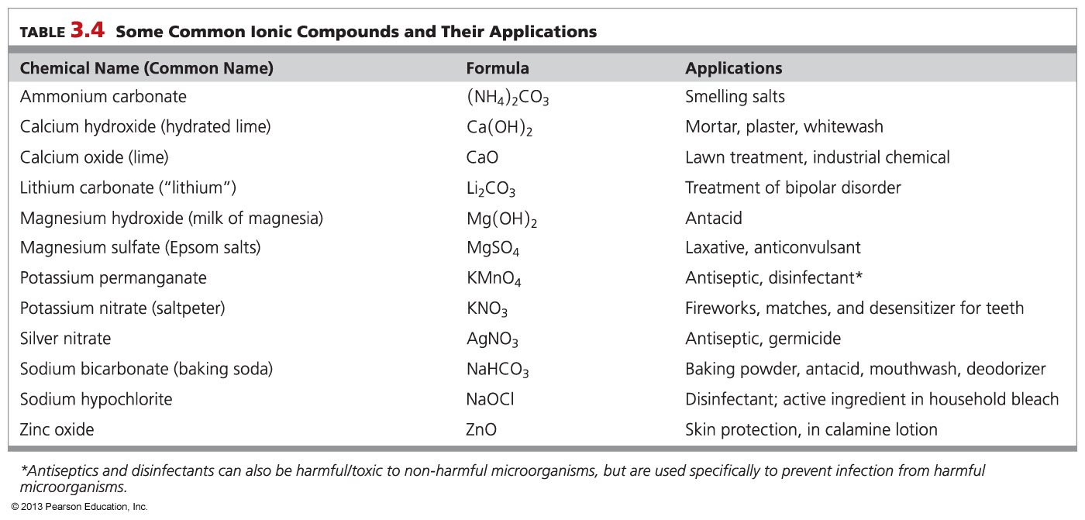
FYI

Slide 71
The name of the compound Cr₂(SO₄)₃ is ______________.
chromium sulfate
chromium(II) sulfate
chromium (III) sulfate
dichromium trisulfate

Slide 72
What you must know for the exam

Slide 73
What you must know for the exam
The common charges on all Type I metal ions
Main group: you can determine these from your periodic tables (light green)
Transition: you must have the following Type I transition metals memorized (light green)
Ag⁺, Zn²⁺, Cd²⁺
All other metals will be Type II (blue-green)
The common charges on all nonmetals
(purple)

Slide 74
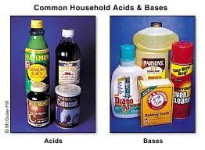
3.11: H⁺ and OH– Ions: An Introduction to Acids and Bases

Slide 75
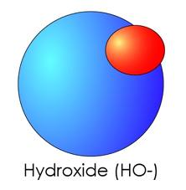
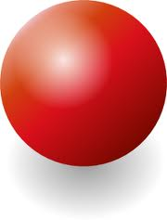
Two of the most important ions are the hydrogen cation (H⁺) and the hydroxide anion (OH–)
+
−
Proton (H⁺)
or hydrogen cation

Slide 76
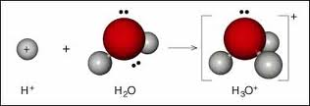
A hydrogen cation is simply a proton (H⁺)
In water, an acidic hydrogen cation will attach instantly to a molecule of water to form a hydronium ion (H₃O⁺)

Slide 77
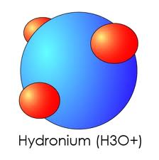
Unfortunately, chemists often speak of protons, hydrogen cations, and hydronium ions interchangeably
+
+
Proton (H⁺)
or hydrogen cation

Slide 78
A hydroxide anion (OH⁻) is a polyatomic ion in which an oxygen atom is covalently bonded to a hydrogen atom
−

Slide 79
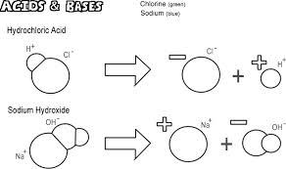
The importance of the H⁺ cation and the OH– anion is that they are fundamental to the concepts of acids and bases
Acid: A substance that provides H⁺ ions in water
Base: A substance that provides OH⁻ ions in water

Slide 80
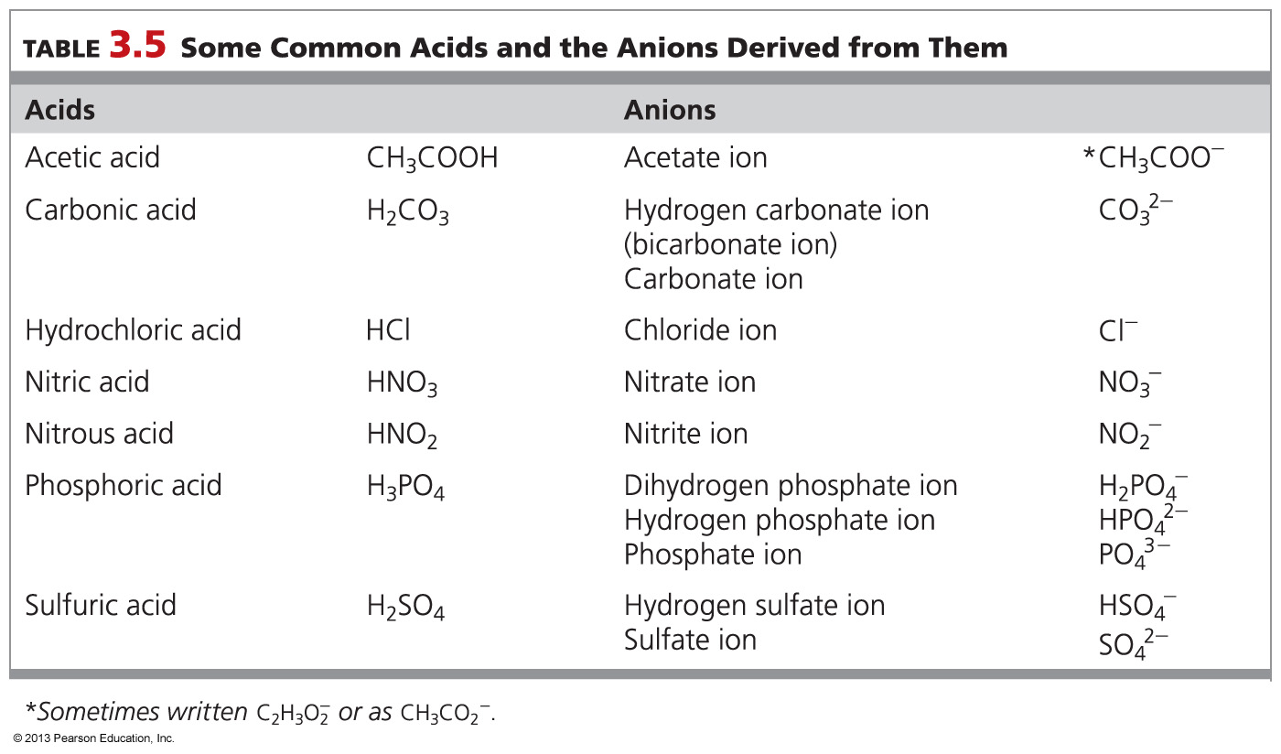

Slide 81
Different acids can provide different numbers of H⁺ ions (protons) per acid molecule when dissolved in water
Hydrochloric acid, HCl, provides one H⁺ ion per acid molecule
Sulfuric acid, H₂SO₄, can provide two H⁺ ions per acid molecule
Phosphoric acid, H₃PO_{4,} can provide three H⁺ ions per acid molecule
Sulfric and phosphoric acids are referred to as polyprotic
Note that acidic protons are written first in the formula for an acid in Intro Chem

Slide 82
Sodium hydroxide (NaOH) and potassium hydroxide (KOH) are common bases
KOH is sold as Drano®
NaOH (lye) is used to straighten hair
When these compounds dissolve, OH– anions go into solution along with the metal cation
Different bases can provide different numbers of OH– ions per formula unit
Sodium hydroxide provides one OH– ion per formula unit
Barium hydroxide, Ba(OH)₂ provides two OH– ions per formula unit

Slide 83
Of the compounds HNO₂, Ba(OH)₂, and HF, which are acids?
All are acids.
None is an acid.
Only Ba(OH)₂ is an acid.
Only HNO₂ and HF are acids.

Slide 84
Chapter Summary

Slide 85
What is an ion, what is an ionic bond, and what are the general characteristics of ionic compounds?
Atoms are converted into cations by the loss of electrons and into anions by the gain of electrons.
Ionic bonds result from the attraction between opposite electrical charges.
Ionic compounds conduct electricity when dissolved, and generally are crystalline solids with high melting and boiling points.

Slide 86
What is the octet rule, and how does it apply to ions?
A valence-shell electron configuration of eight electrons leads to stability and lack of reactivity, as typified by the noble gases.
According to the octet rule, atoms of main group elements tend to form ions in which they have gained or lost the number of electrons to reach a noble gas configuration.

Slide 87
What is the relationship between an element’s position in the periodic table and the formation of its ion?
Periodic variations in ionization energy show that metals lose electrons more easily than nonmetals. As a result, metals usually form cations.
Periodic variations in electron affinity show that nonmetals gain electrons more easily than metals. As a result, nonmetals usually form anions.
Ionic charge can be predicted from group number and the octet rule.
Main group metal cation charges are equal to the group number.
Nonmetal anion charges are equal to (8 – group number).

Slide 88
What determines the chemical formula of an ionic compound?
Ionic compounds contain appropriate numbers of anions and cations to maintain overall neutrality
This provides a means of determining their chemical formulas

Slide 89
How are ionic compounds named?
Cations have the same name as the metal from which they are derived.
Monatomic anions have the name ending -ide.
For metals that form more than one ion, a Roman numeral equal to the charge on the ion is added to the name of the cation.
Alternatively, the ending -ous is added to the name of the cation with the lesser charge and the ending -ic is added to the name of the cation with the greater charge.
To name an ionic compound, the cation name is given first, with the charge of the metal ion indicated if necessary. The anion name is given second.

Slide 90
What are acids and bases?
The hydrogen ion, H⁺, and the hydroxide ion, OH–, are among the most important ions in chemistry
An acid is a substance that yields H⁺ ions when dissolved in water.
A base is a substance that yields OH– ions when dissolved in water.

