Slide 1
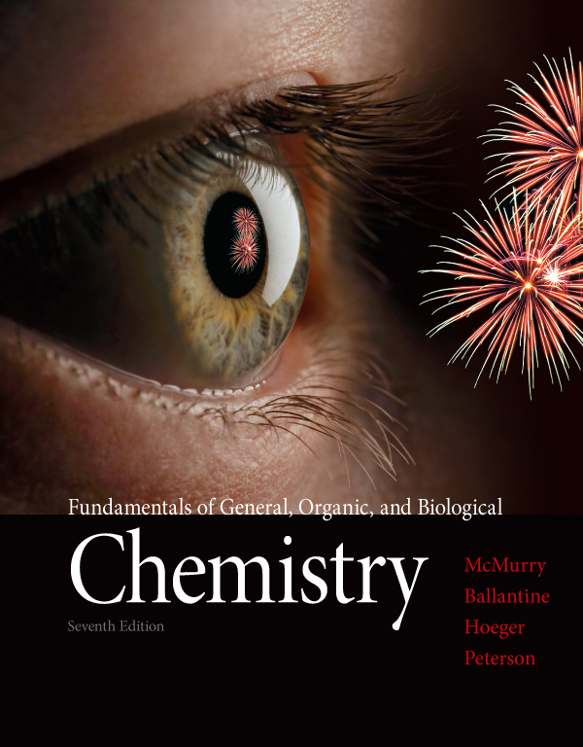
Chapter Five
Chapter 5 Lecture
Fundamentals of General, Organic, and Biological Chemistry
7th Edition
McMurry, Ballantine, Hoeger, Peterson
Classification and Balancing
of Chemical Reactions
Julie Klare
Gwinnett Technical College
© 2013 Pearson Education, Inc.

Slide 2
5.1 Chemical Equations
5.2 Balancing Chemical Equations
5.3 Classes of Chemical Reactions
5.4 Precipitation Reactions and Solubility Guidelines
5.5 Acids, Bases, and Neutralization Reactions
5.6 Redox Reactions
5.7 Recognizing Redox Reactions [skip]
5.8 Net Ionic Equations

Slide 3
Goals

Slide 4
1. How are chemical reactions written?
Given the identities of reactants and products, be able to write a balanced chemical equation or net ionic equation.
2. How are chemical reactions of ionic compounds classified?
Be able to recognize precipitation, acid–base neutralization, and redox reactions.
3. What are oxidation numbers, and how are they used?
Be able to assign oxidation numbers to atoms in compounds and identify the substances oxidized and reduced in a given reaction.
What is a net ionic equation?
Be able to recognize spectator ions and write the net ionic equation for reactions involving ionic compounds.

Slide 5
5.1 Chemical Equations

Slide 6
Chemical reactions can be thought of as “recipes”
Names are replaced with formulas
Starting materials (reactants) and products are displayed in full symbolic form
Heads up: Experiment 13: Thermal Decomposition

Slide 7
FYI: Note regarding Exp 13: Thermal Decomposition
Heating the sodium bicarbonate in the crucible even further leads to the following reaction:
Na₂CO₃(s) → CO₂(g) + Na₂O(s)
Would you expect ‘bubbles’ from treating Na₂O with 2 M HCl

Slide 8
A reactant is a substance that undergoes change in a chemical reaction
it is always written on the left side of the arrow
A product is a substance formed
and is written on the right side
Causes and conditions are shown over the arrow

Slide 9
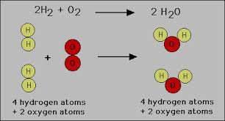
The law of the conservation of mass states that matter can neither be created nor destroyed in a chemical reaction
Bonds between atoms in the reactants are rearranged to form new compounds -- but none of the atoms disappear and no new ones are formed

Slide 10
In respect for this law of nature …
our equations must be balanced
The numbers and kinds of atoms must be the same on both sides of the arrow

Slide 11
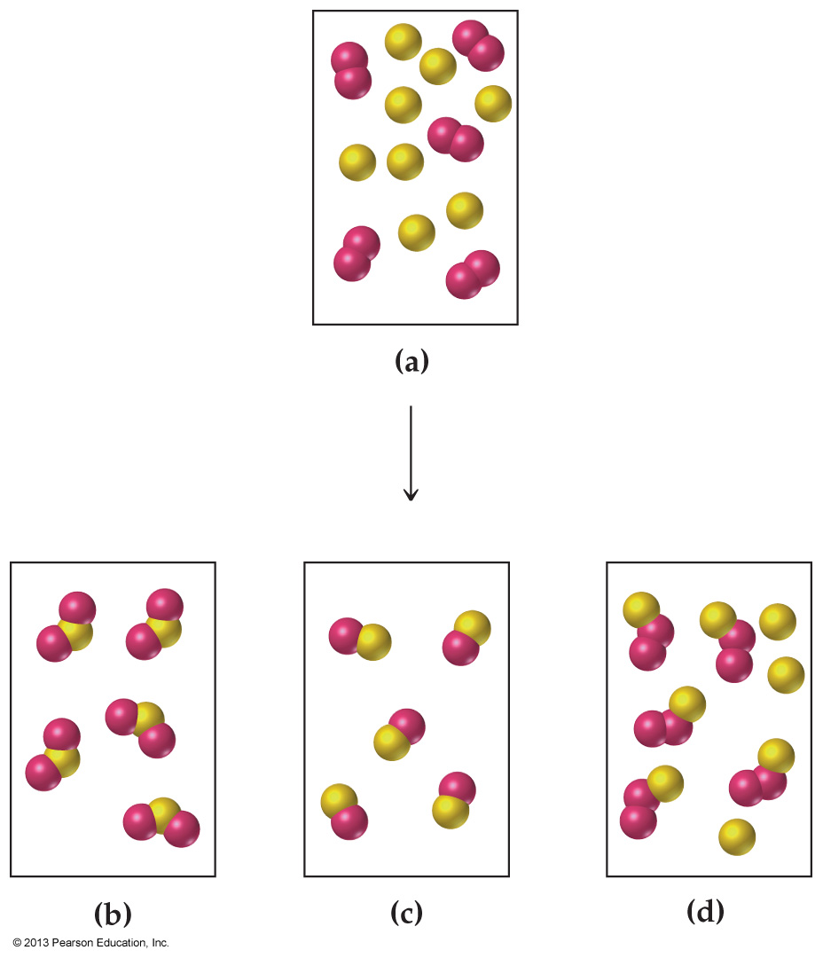
Assume the mixture of substances in drawing (a) undergoes a reaction. Which drawing(s) (b–d) represent(s) a product mixture INCONSISTENT with the law of mass conservation?
b, c, and d
b and c
c only
d only

Slide 12
A coefficient is a number placed in front of a formula to balance a chemical equation
A coefficient multiplies all the atoms within its formula
Be sure to consider coefficients
In the ideal, all reactions run to completion
2H₂ + O₂ → 2H₂O
H₂ + I₂ → 2HI
Ca(NO₃)₂ + 2NaF → CaF₂ + 2NaNO₃

Slide 13
Labels for physical states
Substances taking part in chemical reactions may be solids, liquids, gases, or dissolved
This information is added to an equation
(s) = solid
(l) = liquid (often the solvent, eg water)
(g) = gas
(aq) = dissolved in aqueous solution
2H_{2(g)} + O_{2(g)}→ 2H₂O_{(g/l)}
H₂ (g) + I₂ (g) → 2HI (g)
Ca(NO₃)₂(aq) + 2NaF(aq) → CaF₂(s) + 2NaNO₃(aq)

Slide 14
5.2 Balancing Chemical Equations
C₈H₁₈ (l) + O₂(g) → CO₂(g) + H₂O(g)
C₈H₁₈ (l) + O₂(g) → 8CO₂(g) + H₂O(g)
C₈H₁₈ (l) + O₂(g) → 8CO₂(g) + 9H₂O(g)
C₈H₁₈ (l) + 25/2O₂(g) → 8CO₂(g) + 9H₂O(g)
2C₈H₁₈ (l) + 25O₂(g) → 16CO₂(g) + 18H₂O(g)

Slide 15
STEP 1: Carbon monoxide is reacted in air to give carbon dioxide
Start with a non-balanced equation, using natural formulas for all reactants and products
CO (g) + O₂ (g) → CO₂ (g)
Hydrogen and oxygen must be expressed as H₂ and O₂ rather than as H and O
because both elements exist as diatomic molecules
Subscripts in chemical formulas cannot be changed because doing so would change identities

Slide 16
STEP 2: Add appropriate coefficients to balance atoms of each element
Begin with elements that appear in only one compound or formula on each side of the equation
Leave pure elements till last such as oxygen and hydrogen

Slide 17
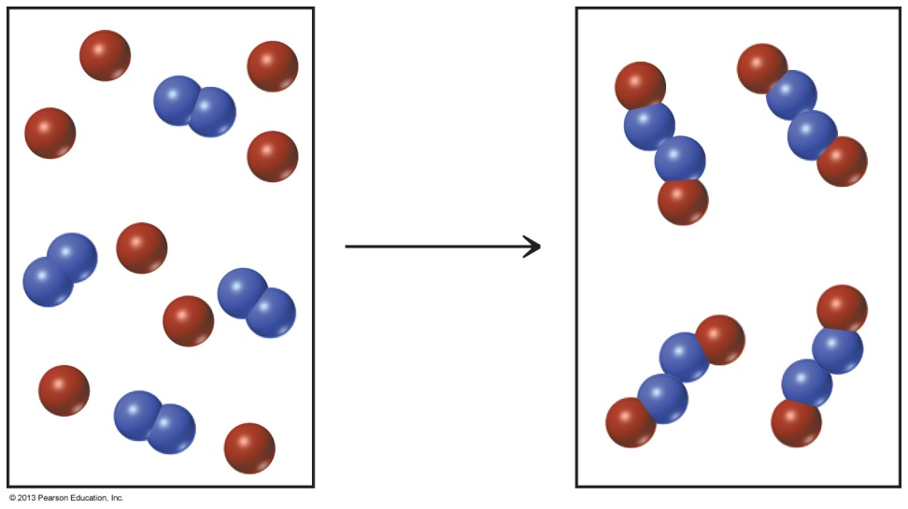
A reaction between reactants A₂ and B is depicted in the diagram below. Which equation best describes the reaction as shown?
4 A₂ + 8 B → 4 A₂B₂
4 A₂ + 4 B → 4 A₂B
4 A₂ + 4 B → 4 A₂B
2 A₂ + 4B → 2 A₂B

Slide 18
Identify polyatomics and treat them as elements where they do maintain their identity
SO₄²⁻ below
Said another way: if a polyatomic ion appears on both sides of an equation, it is treated as a single unit—much like we would treat an element.

Slide 19
STEP 3: Check the equation to make sure the numbers and kinds of atoms on both sides of the equation are the same
STEP 4: Make sure the coefficients are reduced to their lowest whole-number values

Slide 20
Which of the equations below are balanced? 1) CH₃CH₂OH + 3 O₂ → 2 CO₂ + 3 H₂O 2) Ca(OH)₂ + Na₃PO₄ → CaPO₄ + 3 NaOH
Both equations are balanced.
Neither equation is balanced.
Only equation 1 is balanced.
Only equation 2 is balanced.

Slide 21
When the equation below is balanced, what should the coefficients be? C₅H₁₂ + O₂ → CO₂ + H₂O
1,6,5,6
2,7,10,6
1,11,5,12
1,8,5,6

Slide 22
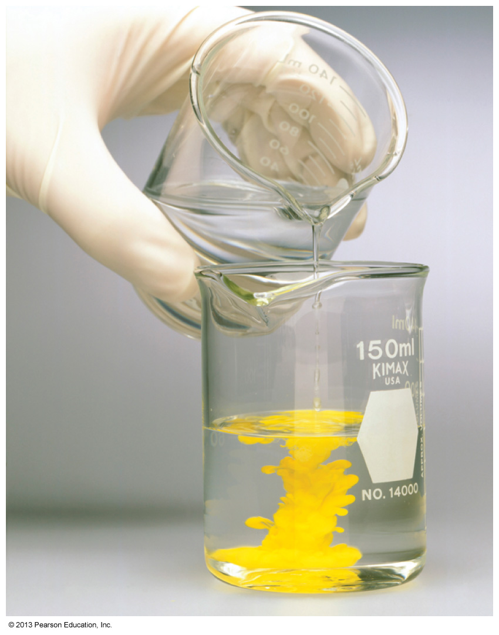
5.3 Classes of Chemical Reactions
Once over lightly
Precipitation
Acid-base neutralization
Redox

Slide 23
Precipitation reactions: where an insoluble solid (a precipitate) forms when aqueous solution are combined
Precipitations take place when the anions and cations of two solubilized ionic compounds switch partners
and one of the new ion products is insoluble in water

Slide 24
Which of the following reactions is a precipitation reaction? 1) AgNO₃(aq) + NaBr(aq) → AgBr(s) + NaNO₃(aq) 2) Na(s) + Br₂(l) → 2 NaBr(s) 3) H₂SO₄(aq) + 2 KOH(aq) → 2 H₂O(l) + K₂SO₄(aq)
1 and 3
1 only
2 only
3 only

Slide 25
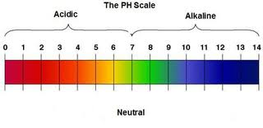
Acid–base neutralization reactions: where an acid reacts with a base to yield water plus salt
A neutralization reaction removes H⁺ and OH⁻ ions from solution by combining them into H₂O
Any ionic compound produced in an acid–base reaction is called a salt

Slide 26
Which of the following reactions is an acid–base (neutralization) reaction? 1) AgNO₃(aq) + NaBr(aq) → AgBr(s) + NaNO₃(aq) 2) Na(s) + Br₂(l) → 2 NaBr(s) 3) H₂SO₄(aq) + 2 KOH(aq) → 2 H₂O(l) + K₂SO₄(aq)
1 and 3
1 only
2 only
3 only

Slide 27
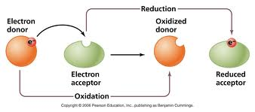
Oxidation–reduction or redox reactions: where one or more electrons are transferred between atoms
Following redox, the number (or share) of electrons ‘owned’ by individual atoms changes

Slide 28
Which of the following reactions is a redox reaction? 1) AgNO₃(aq) + NaBr(aq) → AgBr(s) + NaNO₃(aq) 2) Na(s) + Br₂(l) → 2 NaBr(s) 3) H₂SO₄(aq) + 2 KOH(aq) → 2 H₂O(l) + K₂SO₄(aq)
1 and 3
1 only
2 only
3 only

Slide 29
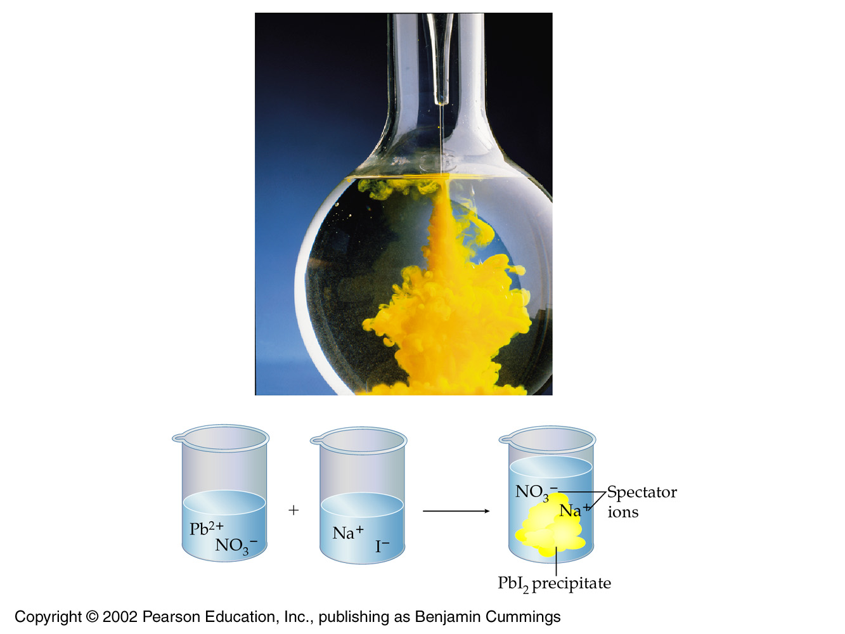
5.4 Precipitation Reactions and Solubility Guidelines

Slide 30
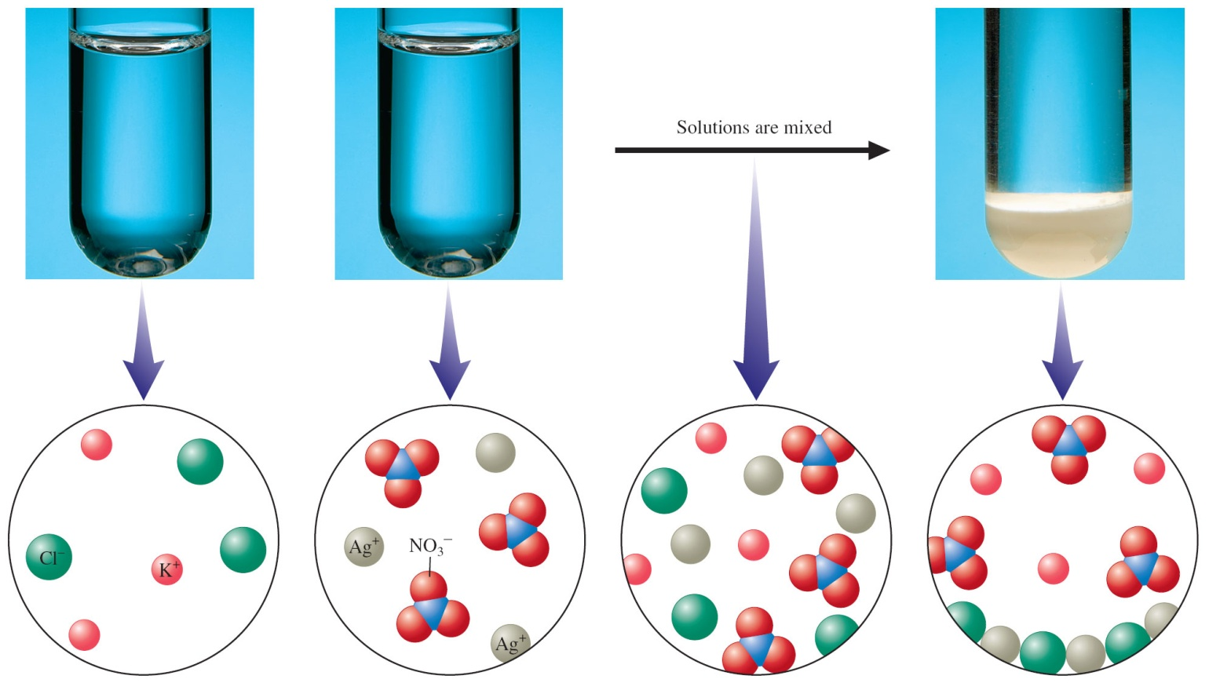
Will an insoluble solid (precipitate) form?
In this section we will be mixing beakers (or test tubes) of ionic solutions – each (normally) containing a fully dissolved salt

Slide 31
Will an insoluble solid (precipitate) form?
The solubility table in your text is inadequate for the questions asked in the book and on the exams.

Slide 32
You will get to have a copy of this on exams!
Solubility guidelines
Most nitrate (NO₃⁻) and acetate (C₂H₃O₂⁻) salts are soluble.
Most alkali metal (group 1A) salts and NH₄⁺ are soluble.
Most Cl⁻, Br⁻, and I⁻ salts are soluble (except Ag⁺, Pb²⁺, Hg₂²⁺).
Most sulfate salts are soluble (except BaSO₄, PbSO₄, Hg₂SO₄, CaSO₄).
Most OH⁻ are only slightly soluble (LiOH, NaOH, KOH are soluble, Ba(OH)₂, Ca(OH)₂ are marginally soluble).
Most S²⁻, CO₃²⁻, CrO₄²⁻, PO₄³⁻ salts are only slightly soluble, except for those containing the cations in Rule 2.

Slide 33
These rules found in your Lab Book are equivalent!

Slide 34
Whether a precipitation reaction will occur on mixing aqueous solutions of two ionic compounds, depends on the solubilities of the potential products
If even one product has low solubility, then it is likely to precipitate from an aqueous solution
If all substances have a high solubility in water, then no precipitate will form – and no reaction occurs
Definition: Solubility is the amount of a compound that will dissolve in a given amount of solvent (water) at a given temperature

Slide 35
Let’s mix: KCl and AgNO₃
KCl
AgNO₃

Slide 36
Step 1: write and balance the equation
Step 2: Determine solubilities from the chart
Step 3: Ask: Is anything insoluble?

Slide 37
KCl(?) + AgNO₃(?) → KNO₃(?) + AgCl(?)
Most nitrate (NO₃⁻) and acetate (C₂H₃O₂⁻) salts are soluble.
Most alkali metal (group 1A) salts and NH₄⁺ are soluble.
Most Cl⁻, Br⁻, and I⁻ salts are soluble (except Ag⁺, Pb²⁺, Hg₂²⁺).
Most sulfate salts are soluble (except BaSO₄, PbSO₄, Hg₂SO₄, CaSO₄).
Most OH⁻ are only slightly soluble (LiOH, NaOH, KOH are soluble, Ba(OH)₂, Ca(OH)₂ are marginally soluble).
Most S²⁻, CO₃²⁻, CrO₄²⁻, PO₄³⁻ salts are only slightly soluble, except for those containing the cations in Rule 2.

Slide 38
KCl(aq) + AgNO₃(aq) → KNO₃(aq) + AgCl(s)
Most nitrate (NO₃⁻) and acetate (C₂H₃O₂⁻) salts are soluble.
Most alkali metal (group 1A) salts and NH₄⁺ are soluble.
Most Cl⁻, Br⁻, and I⁻ salts are soluble (except Ag⁺, Pb²⁺, Hg₂²⁺).
Most sulfate salts are soluble (except BaSO₄, PbSO₄, Hg₂SO₄, CaSO₄).
Most OH⁻ are only slightly soluble (LiOH, NaOH, KOH are soluble, Ba(OH)₂, Ca(OH)₂ are marginally soluble).
Most S²⁻, CO₃²⁻, CrO₄²⁻, PO₄³⁻ salts are only slightly soluble, except for those containing the cations in Rule 2.

Slide 39
What is the solubility in water of Na₃PO₄ and PbI₂, respectively?
Soluble, soluble
Soluble, insoluble
Insoluble, insoluble
Insoluble, soluble

Slide 40
KCl(aq) + AgNO₃(aq) → KNO₃(aq) + AgCl(s)
The mechanism of precipitation reactions is ‘double displacement’

Slide 41
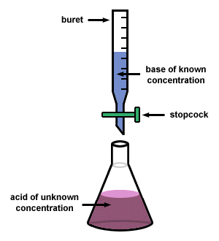
5.5 Acids, Bases, and Neutralization Reactions

Slide 42
The most common kind of neutralization reaction occurs between an acid and a base
to yield water and a salt
The mechanism of acid base neutralization is also ‘double displacement’

Slide 43
An acid HA (eg, HCl)
And a metal hydroxide base MOH (eg NaOH)
HA (aq) + MOH (aq) → H₂O (l) + MA (aq)

Slide 44
fyi
We can write HA as generic for acids in Intro Chem
But we cannot write BOH as generic for a base because there are bases in Intro Chem that do not have –OH as part of their formula, such as NH₃
Instead, they form –OH ions in situ (in solution)

Slide 45
Two non-metal hydroxide bases
Ammonia produces OH⁻ ions when dissolved in water, and is a (weak) base
NH₃ (g)+ H₂O (l) NH₄⁺ (aq) + OH⁻ (aq)
Carbonate such as Na₂CO₃ also yields OH⁻ ions when dissolved in water – and is a weak base
Na₂CO₃ (s) + H₂O (l) 2Na⁺ (aq) + HCO₃⁻ (aq) + OH⁻ (aq)

Slide 46
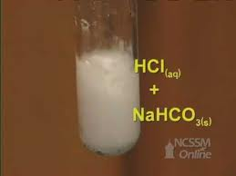
Neutralization between an acid (eg, HCl) and sodium carbonate (Na₂CO₃) yields water, a salt, and carbon dioxide
The carbonate ion first reacts with H⁺ to yield H₂CO₃
This immediately decomposes to give H₂O plus CO₂
2 HCl (aq) + Na₂CO₃ (aq) → H₂O (l) + 2 NaCl (aq) + CO₂ (g)

Slide 47
What are the correct product formulas for the reaction between nitric acid and sodium carbonate?
H₂CO₃, H₂O
H₂O, NaNO₃
H₂CO₃, NaNO₃
H₂O, CO₂, NaNO₃

Slide 48
What are the correct product formulas for the reaction between sulfuric acid and sodium hydroxide?
Na₂S, H₂O
H₂O, SO₂, Na₂SO₄
H₂SO₃, Na₂SO₄
H₂O, Na₂SO₄

Slide 49
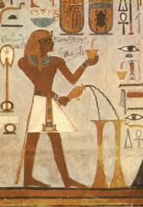
fyi: Ancient battery acid
Perhaps our oldest ‘chemical’ is sulfuric acid, prepared by heating vitriol, a pretty green mineral found in the desert
A very toxic gas is given off which is then bubbled through water

Slide 50
5.6 Redox Reactions
Redox = oxidation / reduction

Slide 51
History
Historically, the word oxidation referred to the combination of a pure metal element with oxygen to give its oxide
Historically, the word reduction referred to the removal of oxygen from an oxide (eg, iron ore) to yield the free element
The words are often combined as redox

Slide 52
Today these words have taken on a much more general application
Oxidation is the loss of one or more electrons
Reduction is the gain of one or more electrons
A redox reaction, is one in which electrons (or shares of electrons) are transferred from one atom to another

Slide 53
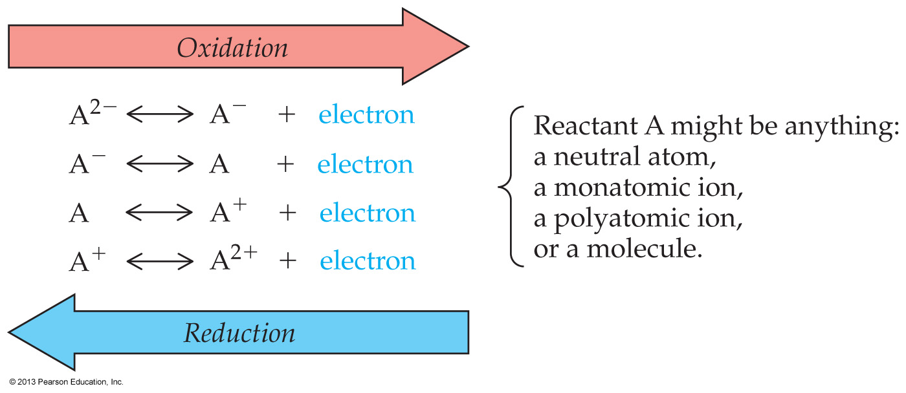
Redox Reactions

Slide 54
Which of the following pairs of reactants, when they react, will result in a redox reaction? 1) Mg(s) + O₂(g) 2) HCl(aq) + NaOH(aq) 3) Na(s) + Cl₂(g)
All of the above
1 and 3
2 and 3
1 only

Slide 55
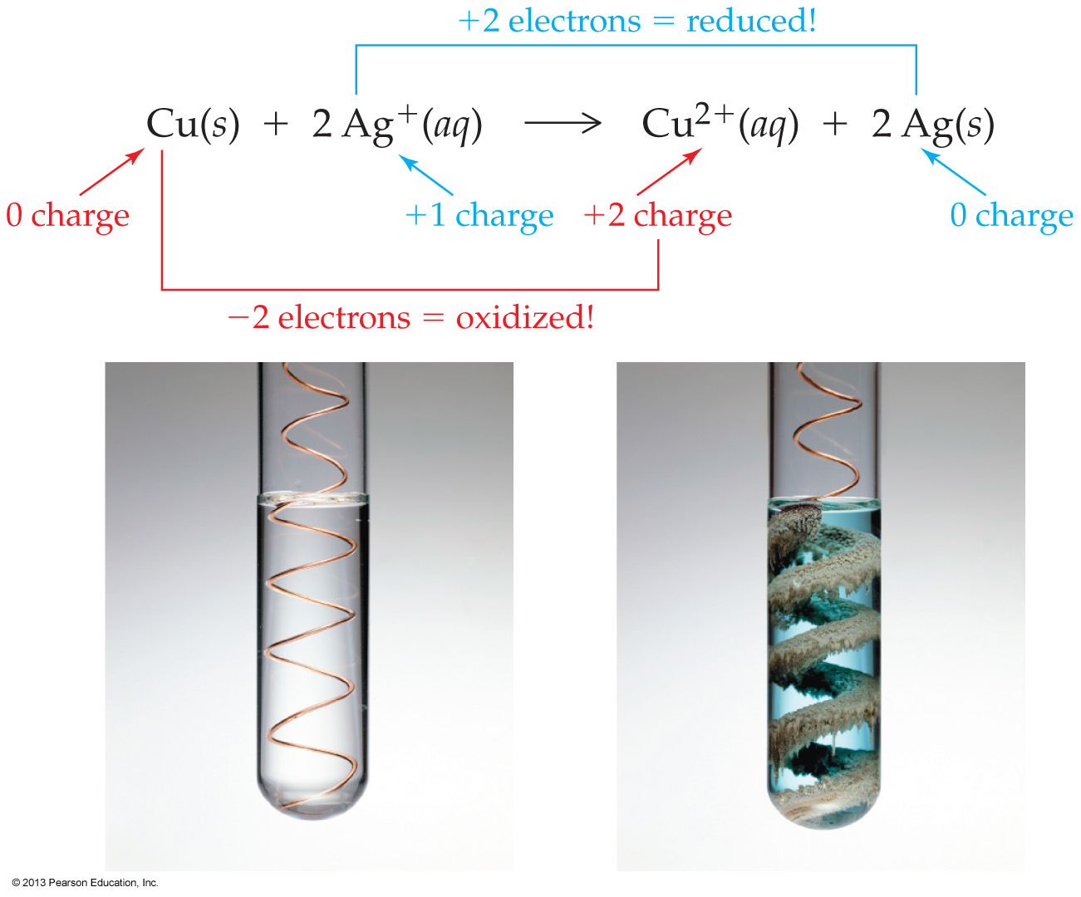
Let’s start with metals vs metals

Slide 56
In this reaction, copper metal looses electrons to silver ions [as in AgNO₃], forming copper ions [as in Cu(NO3)₂] and reduced silver metal
Copper is oxidized, and silver ions are reduced

Slide 57
fyi
Copper is oxidized, and silver ions are reduced
The charge on the copper increases from 0 to +2, when it loses two electrons
The charge on the silver decreases from +1 to 0, when it gains an electron

Slide 58
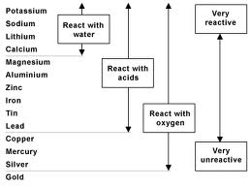
How do we know which metal will lose the electron?
They follow this
electronegativity
trend for metals.
You don’t have
to memorize
this table.

Slide 59
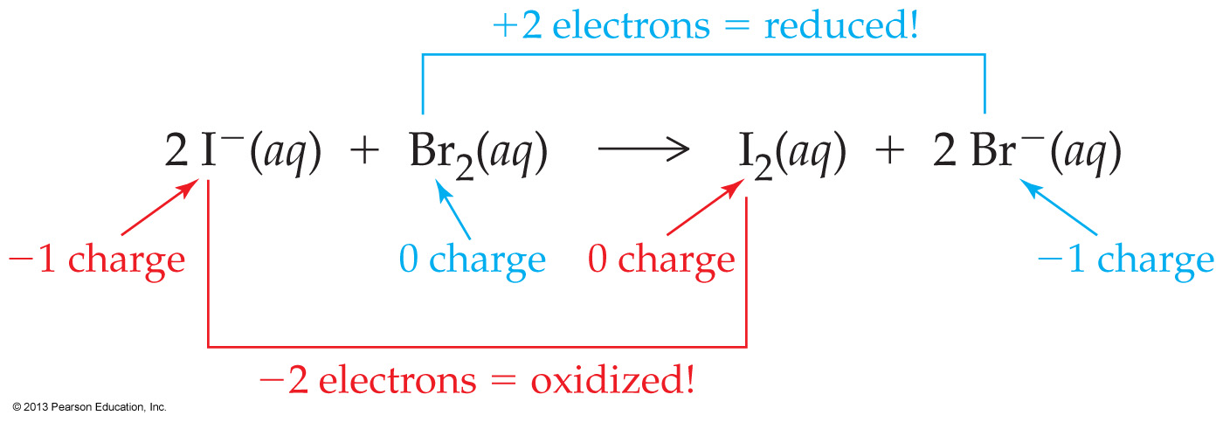
Let’s move on to nonmetals vs nonmetals
Here, an iodine ion (as in NaI) gives an electron to bromine, forming bromide ions (as in NaBr) and liberating free iodine
An iodide ion is oxidized as its charge increases from −1 to 0
Bromine is reduced as its charge decreases from 0 to −1

Slide 60
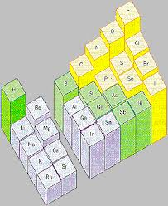
This chart explains why
I⁻ releases an
electron to Br₂
The ‘taller’ the
element, the more
it wants electrons
This is identical to the Electronegativity trend

Slide 61
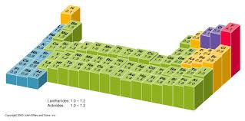
And of course, metals vs nonmetals
Metals are always oxidized in the presence of a nonmetal
Nonmetals are always reduced in the presence of a metal
Na(s) + Br₂(l) → 2 NaBr(s)

Slide 62
FYI: metals vs nonmetals
In redox reactions that involve metals with nonmetals
metals tend to lose ‘whole’ electrons
nonmetals tend to gain ‘whole’ electrons
The number of electrons lost or gained can be predicted based on the position of the element in the periodic table
Hopefully this ‘Electronegativity’ trend is familiar to you by now

Slide 63
FYI: Section summary
All alkali metals are especially redox reactive
Some alkaline earths react with water, but some need steam or H⁺ (acid)
They all have low ionization energy
Upper right nonmetals are especially redox reactive
They have the highest electron affinity
Their reactions with alkali and alkaline earth metals are particularly violent

Slide 64
Get ready for tricky vocabulary
Recall:
An element that looses electrons is oxidized
An element that gains electrons is reduced
Oxidation and reduction must occur together

Slide 65
Agents
The substance that gives up an electron (causing the reduction) is called a reducing agent
Note: the reducing agent itself is oxidized
The substance that gains an electron (causing the oxidation) is called an oxidizing agent
Note: the oxidizing agent itself is reduced

Slide 66
From another view
A reducing agent loses one or more electrons
Causes reduction
Undergoes oxidation itself
Becomes more positive (or less negative)
An oxidizing agent gains one or more electrons
Causes oxidation
Undergoes reduction itself
Becomes more negative (or less positive)

Slide 67
Which one of the following statements describes an oxidizing agent?
It causes reduction to occur.
It becomes more positive.
It undergoes reduction.
It may gain more oxygen atoms.

Slide 68
Where in the periodic table are the best reducing agents found?
Upper right hand corner
Lower right hand corner
Lower left hand corner
Upper left hand corner

Slide 69
Sulfur dioxide reacts with molecular oxygen to form sulfur trioxide. Which of the following is the correct balanced chemical equation for this reaction?
2 SO₃ + O → 2 SO₂
2 SO₂ + 2 O → 2 SO₃
2 SO₂ + O₂ → 2 SO₃
SO₂ + O₂ → (SO₃)₂

Slide 70
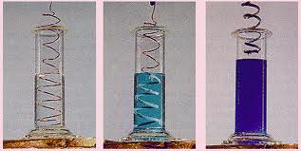
5.7 Recognizing Redox Reactions

Slide 71
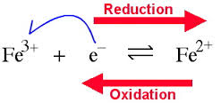
Non-molecular substances
With reactions involving Type I or II metals, simply look for a gain or loss of whole electrons
When Type II metals are involved, be sure to check for a change in oxidation state

Slide 72
Molecular substances

Slide 73
For molecules, we must ‘stretch’ the idea of whole electron loss or gain to electron sharing
An atom is oxidized when it loses a share in electrons
Always to a more electronegative atom
An atom is reduced when it gains a share in electrons
Always from a less electronegative atom

Slide 74
General rules for assigning oxidation states
For any atom in any compound, a value called an oxidation number (or oxidation state) is assigned
Ionics of course, are straightforward
In NaCl, Na⁺ really has a whole positive charge, and Cl⁻ really has a whole negative charge

Slide 75
Assigning oxidation states
But to include covalent molecules, a ‘formal’ bookkeeping system is used
Recall in the ionic CaO, oxygen has a ‘whole’ -2 charge
However, in the covalent molecule H₂O, oxygen is only assigned a ‘formal’ -2 charge

Slide 76
Assigning oxidation states
Oxygen does not really have a -2 charge in any molecule, but …
the system is used because more often than not it does give the right answer
A method called ‘rule of thumb’

Slide 77
The Rules
For assigning oxidation states

Slide 78
An atom in its elemental state has an oxidation number of 0 (next slide)
A monatomic ion in a salt has an oxidation number equal to its charge (Na⁺ or O²⁻)
In a molecular compound, an atom is assigned the same oxidation number it would have if it were a monatomic ion
Thus oxygen in H₂O is assigned a -2 charge
Thus hydrogen in H₂O is assigned a +1 charge
The sum of the oxidation numbers in a neutral compound must be 0
In a polyatomic ion, the sum of the charges is the charge on the ion

Slide 79
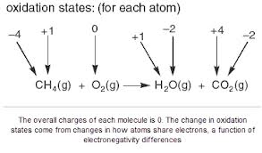

Slide 80
One more time
In ionic cases, the transfer occurs in a literal sense to form ions
2Na(s) + Cl₂(g) → 2Na⁺Cl⁻
However, in assigning oxidation states to covalent compounds, we cheat
CH₄(g) + 2O₂(g) → 2H₂O(g) + CO₂(g)

Slide 81
Like this!

Slide 82
Using oxidation states
In all cases, by comparing the oxidation number assigned to an atom in a compound before and after a reaction…
we can answer the question whether an atom has gained or lost (shares in) electrons

Slide 83
An atom in its elemental state has an oxidation number of 0
A monatomic ion in a salt has an oxidation number equal to its charge (Na⁺ or O²⁻)
In a molecular compound, an atom is assigned the same oxidation number it would have if it were a monatomic ion
Thus oxygen in H₂O is assigned a -2 charge
Thus hydrogen in H₂O is assigned a +1 charge
The sum of the oxidation numbers in a neutral compound must be 0
In a polyatomic ion, the sum of the charges is the charge on the ion

Slide 84
Identify the oxidizing agent and the reducing agent in the following reaction. Fe₂O₃(s) + 3 CO(g) → 2 Fe(s) + 3 CO₂(g)
CO is the oxidizing agent; Fe₂O₃ is the reducing agent.
CO is the reducing agent; Fe₂O₃ is the oxidizing agent.
CO₂ is the oxidizing agent; Fe is the reducing agent.
CO₂ is the reducing agent; Fe is the oxidizing agent.

Slide 85
What is the oxidation state of Cr in Na₂Cr₂O₇?
+2
+3
+6
+12

Slide 86
What is the oxidation state of Mn in the ionic compounds MnO and MnO₂, respectively?
+1, +2
+2, +3
+2, +4
+1, +3

Slide 87
An atom in its elemental state has an oxidation number of 0
A monatomic ion in a salt has an oxidation number equal to its charge (Na⁺ or O²⁻)
In a molecular compound, an atom is assigned the same oxidation number it would have if it were a monatomic ion
Thus oxygen in H₂O is assigned a -2 charge
Thus hydrogen in H₂O is assigned a +1 charge
The sum of the oxidation numbers in a neutral compound must be 0
In a polyatomic ion, the sum of the charges is the charge on the ion

Slide 88
What is the oxidation state of sulfur in the molecule H₂S?
+1
+2
−2
−1

Slide 89
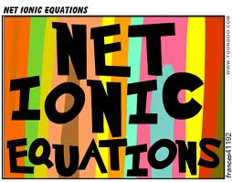
5.8 Net Ionic Equations
In reactions involving ions, it is more accurate
to write the reaction as an ionic equation

Slide 90
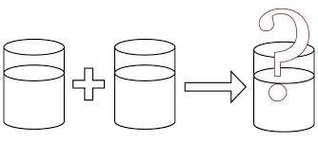
1) Formula Equation
2) Complete ionic equation
3) Net ionic equation
We will demonstrate this method by combining aqueous salt solutions, and determining whether a precipitate forms.

Slide 91
1) Formula Equation
Consider the combination of aqueous solutions of silver nitrate and sodium chloride
We begin by writing the FORMULA EQUATION
AgNO₃(?) + NaCl(?) → AgCl(?) + NaNO₃(?)

Slide 92
AgNO₃(?) + NaCl(?) → AgCl(?) + NaNO₃(?)
Most nitrate (NO₃⁻) and acetate (C₂H₃O₂⁻) salts are soluble.
Most alkali metal (group 1A) salts and NH₄⁺ are soluble.
Most Cl⁻, Br⁻, and I⁻ salts are soluble (except Ag⁺, Pb²⁺, Hg₂²⁺).
Most sulfate salts are soluble (except BaSO₄, PbSO₄, Hg₂SO₄, CaSO₄).
Most OH⁻ are only slightly soluble (LiOH, NaOH, KOH are soluble, Ba(OH)₂, Ca(OH)₂ are marginally soluble).
Most S²⁻, CO₃²⁻, CrO₄²⁻, PO₄³⁻ salts are only slightly soluble, except for those containing the cations in Rule 2.

Slide 93
1) Formula Equation
AgNO₃(aq) + NaCl(aq) → AgCl(s) + NaNO₃(aq)
In the next step, we separate soluble salts into the individual ions
This gives the COMPLETE IONIC EQUATION

Slide 94
2) Complete ionic equation
1) AgNO₃(aq) + NaCl(aq) → AgCl(s) + NaNO₃(aq) 2) Ag⁺(aq) + NO₃⁻(aq) + Na⁺(aq) + Cl⁻(aq) →
AgCl(s) + Na⁺(aq) + NO₃⁻(aq)

Slide 95
2) Ag⁺(aq) + NO₃⁻(aq) + Na⁺(aq) + Cl⁻(aq) → AgCl(s) + Na⁺(aq) + NO₃⁻(aq)
A complete ionic equation is one in which ions are explicitly shown
Some ions undergo no change during a reaction – they are called spectator ions
They appear on both sides of the reaction but play no role

Slide 96
2) Ag⁺(aq) + NO₃⁻(aq) + Na⁺(aq) + Cl⁻(aq) → AgCl(s) + Na⁺(aq) + NO₃⁻(aq)
So to write a NET IONIC EQUATION we eliminate the spectator ions from the ionic equation

Slide 97
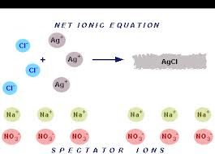
3) Net ionic equation
1) AgNO₃(aq) + NaCl(aq) → AgCl(s) + NaNO₃(aq) 2) Ag⁺(aq) + NO₃⁻(aq) + Na⁺(aq) + Cl⁻(aq) → AgCl(s) + Na⁺(aq) + NO₃⁻(aq)
3) Ag⁺(aq) + Cl⁻(aq) → AgCl(s)

Slide 98
Concept Check
Write the correct formula equation, complete ionic equation, and net ionic equation for the reaction between cobalt(II) chloride and sodium hydroxide.
Formula Equation:
Complete Ionic Equation:
Net Ionic Equation:

Slide 99
CoCl₂(?) + 2NaOH(?) → Co(OH)₂(?) + 2NaCl(?)
Most nitrate (NO₃⁻) and acetate (C₂H₃O₂⁻) salts are soluble.
Most alkali metal (group 1A) salts and NH₄⁺ are soluble.
Most Cl⁻, Br⁻, and I⁻ salts are soluble (except Ag⁺, Pb²⁺, Hg₂²⁺).
Most sulfate salts are soluble (except BaSO₄, PbSO₄, Hg₂SO₄, CaSO₄).
Most OH⁻ are only slightly soluble (LiOH, NaOH, KOH are soluble, Ba(OH)₂, Ca(OH)₂ are marginally soluble).
Most S²⁻, CO₃²⁻, CrO₄²⁻, PO₄³⁻ salts are only slightly soluble, except for those containing the cations in Rule 2.

Slide 100
Concept Check
Write the correct formula equation, complete ionic equation, and net ionic equation for the reaction between cobalt(II) chloride and sodium hydroxide.
Formula Equation:
CoCl₂(aq) + 2NaOH(aq) → Co(OH)₂(s) + 2NaCl(aq)
Complete Ionic Equation:
Net Ionic Equation:

Slide 101
Concept Check
Write the correct formula equation, complete ionic equation, and net ionic equation for the reaction between cobalt(II) chloride and sodium hydroxide.
Formula Equation:
CoCl₂(aq) + 2NaOH(aq) → Co(OH)₂(s) + 2NaCl(aq)
Complete Ionic Equation:
Co²⁺(aq) + 2Cl⁻(aq) + 2Na⁺(aq) + 2OH⁻(aq) →
Co(OH)₂(s) + 2Na⁺(aq) + 2Cl⁻(aq)
Net Ionic Equation:
.

Slide 102
Concept Check
Write the correct formula equation, complete ionic equation, and net ionic equation for the reaction between cobalt(II) chloride and sodium hydroxide.
Formula Equation:
CoCl₂(aq) + 2NaOH(aq) → Co(OH)₂(s) + 2NaCl(aq)
Complete Ionic Equation:
Co²⁺(aq) + 2Cl⁻(aq) + 2Na⁺(aq) + 2OH⁻(aq) →
Co(OH)₂(s) + 2Na⁺(aq) + 2Cl⁻(aq)
Net Ionic Equation:
Co²⁺(aq) + 2OH⁻(aq) → Co(OH)₂(s)

Slide 103
Applied to a strong acid / base reaction
The scheme can also be applied to the neutralization of acids and bases
We will only look briefly at the trivial case of the strong acids with strong bases
Note that no precipitate of formed in an acid/base neutralization reaction

Slide 104
Applied to a strong acid / base reaction
This formula equation
KOH (aq) + HNO₃ (aq) → H₂O (l) + KNO₃ (aq)
Can be rewritten as a complete ionic equation
K⁺ (aq) + OH⁻ (aq) + H⁺ (aq) + NO₃⁻ (aq) → H₂O (l) + K⁺ (aq) + NO₃⁻ (aq)
Eliminating the spectator ions (K⁺ and NO₃⁻) yields the net ionic equation
OH⁻ (aq) + H⁺ (aq) → H₂O (l)

Slide 105
Applied to a redox reaction
It can also be applied to redox reactions

Slide 106
Applied to a redox reaction
formula equation
Cu (s) + 2 AgNO₃ (aq) → 2 Ag (s) + Cu(NO₃)₂ (aq)
complete ionic equation
Cu (s) + 2 Ag⁺ (aq) + 2 NO₃⁻ (aq) → 2 Ag (s) + Cu²⁺ (aq) + 2 NO₃⁻ (aq)
net ionic equation
Cu (s) + 2 Ag⁺ (aq) → 2 Ag (s) + Cu²⁺ (aq)

Slide 107
The previous net ionic equation confirms that copper is oxidized and silver is reduced
NOTE: This is not a precipitation reaction

Slide 108
Which of the following is the net ionic equation for the reaction between HCl and NaOH?
HCl(aq) + Na⁺(aq) → NaCl(aq) + H⁺ (aq)
H⁺(aq) + OH⁻(aq) → H₂O(l)
Na⁺(aq) + Cl⁻(aq) → NaCl(aq)
Na⁺(aq) + H⁺(aq) + OH⁻(aq) → Na⁺(aq) + H₂O(l)

Slide 109
Chapter Summary

Slide 110
How are chemical reactions written?
Chemical equations must be balanced; that is, the numbers and kinds of atoms must be the same in both the reactants and the products.
To balance an equation, coefficients are placed before formulas, but the formulas themselves cannot be changed.

Slide 111
How are chemical reactions of ionic compounds classified?
Precipitation reactions are processes in which an insoluble solid called a precipitate is formed. Most precipitations take place when the anions and cations of two ionic compounds change partners.
Acid–base neutralization reactions are processes in which an acid reacts with a base to yield water plus an ionic compound called a salt. Since acids produce H⁺ ions and bases produce OH⁻ ions when dissolved in water, a neutralization reaction removes H⁺ and OH⁻ ions from solution and yields water.

Slide 112
How are chemical reactions of ionic compounds classified? (Continued)
Oxidation–reduction (redox) reactions are processes in which one or more electrons are transferred between reaction partners.
An oxidation is defined as the loss of one or more electrons by an atom.
A reduction is the gain of one or more electrons.
An oxidizing agent causes the oxidation of another reactant by accepting electrons.
A reducing agent causes the reduction of another reactant by donating electrons.

Slide 113
What are oxidation numbers, and how are they used?
Oxidation numbers are assigned to atoms in reactants and products to provide a measure of whether an atom is neutral, electron-rich, or electron-poor.
By comparing the oxidation number of an atom before and after a reaction, we can tell whether the atom has gained or lost shares in electrons and thus, whether a redox reaction has occurred.

Slide 114
What is a net ionic equation?
The net ionic equation only includes those ions that are directly involved in the ionic reaction.
These ions are found in different phases or compounds on the reactant and product sides of the chemical equation.
The net ionic equation does not include spectator ions, which appear in the same state on both sides of the equation.

