Slide 1
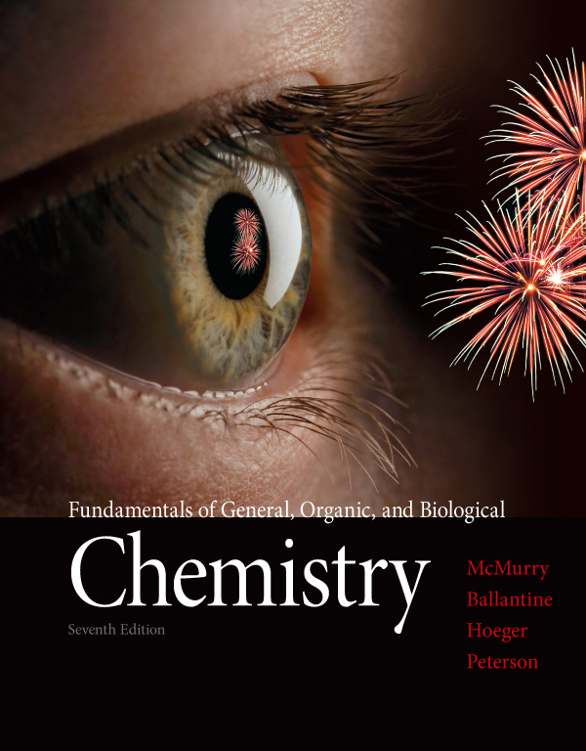
Chapter Seven
Chapter 7 Lecture
Fundamentals of General, Organic, and Biological Chemistry
7th Edition
McMurry, Ballantine, Hoeger, Peterson
Chemical Reactions:
Energy, Rates, and Equilibrium
Julie Klare
Gwinnett Technical College
© 2013 Pearson Education, Inc.

Slide 2
7.1 Energy and Chemical Bonds
7.2 Heat Changes during Chemical Reactions
7.3 Exothermic and Endothermic Reactions
7.4 Why Do Chemical Reactions Occur? Free Energy
7.5 How Do Chemical Reactions Occur? Reaction Rates
7.6 Effects of Temperature, Concentration, and Catalysis
on Reaction Rates
7.7 Reversible Reactions and Chemical Equilibrium
7.8 Equilibrium Equations and Equilibrium Constants
7.9 Le Châtelier’s Principle: The Effect of Changing Conditions on Equilibria

Slide 3
1. What energy changes take place during reactions?
Be able to explain the factors that influence energy changes in chemical reactions.
2. What is “free energy,” and what is the criterion for spontaneity in chemistry?
Be able to define enthalpy, entropy, and free-energy changes, and explain how the values of these quantities affect chemical reactions.
3. What determines the rate of a chemical reaction?
Be able to explain activation energy and other factors that determine reaction rate.
What is chemical equilibrium?
Be able to describe what occurs in a reaction at equilibrium and write the equilibrium equation for a given reaction.
What is Le Châtelier’s principle?
Be able to state Le Châtelier’s principle and use it to predict the effect of changes in temperature, pressure, and concentration on reactions.

Slide 4
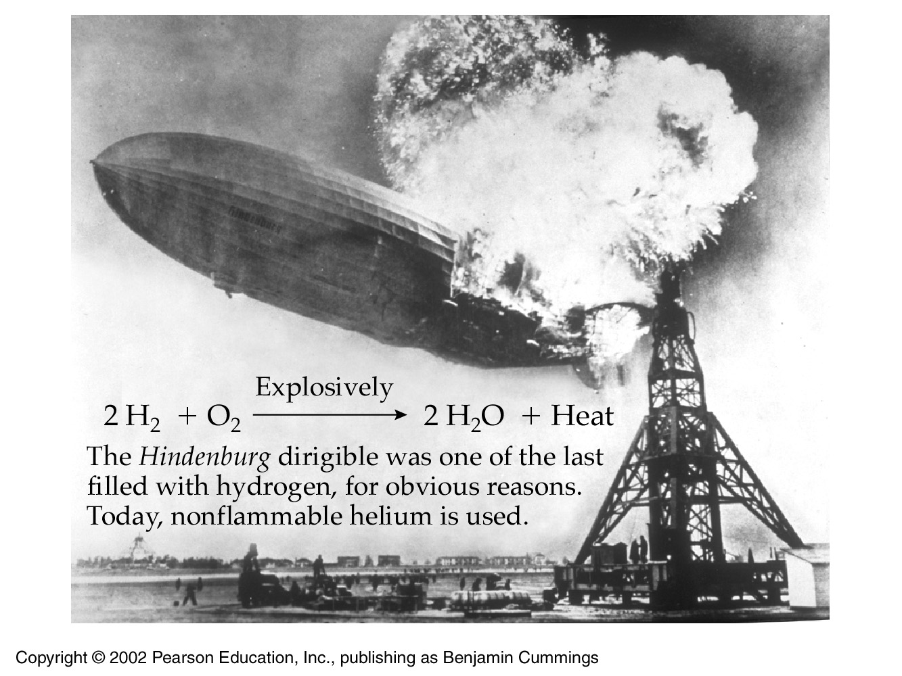
7.1 Energy and Chemical Bonds

Slide 5
Potential energy is stored energy
Water in a reservoir behind a dam
An automobile poised to coast downhill
A tightened spring
Kinetic energy is the energy of motion
Water falling, turning an electric turbine
The car rolling downhill
The spring moving the hands of a clock

Slide 6
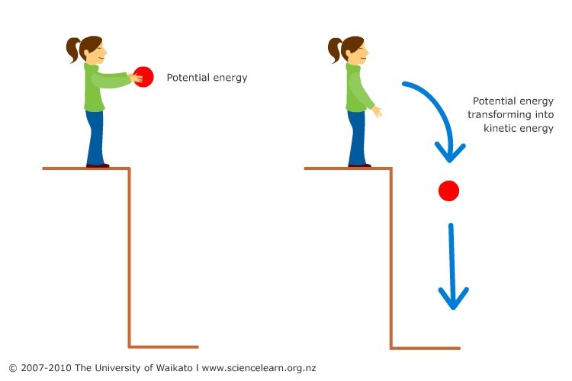
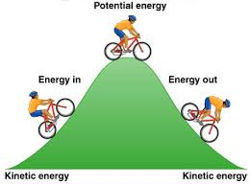
fyi: middle school physics
Potential energy (PE) – energy due to (higher) position
Kinetic energy (KE) – energy due to motion

Slide 7
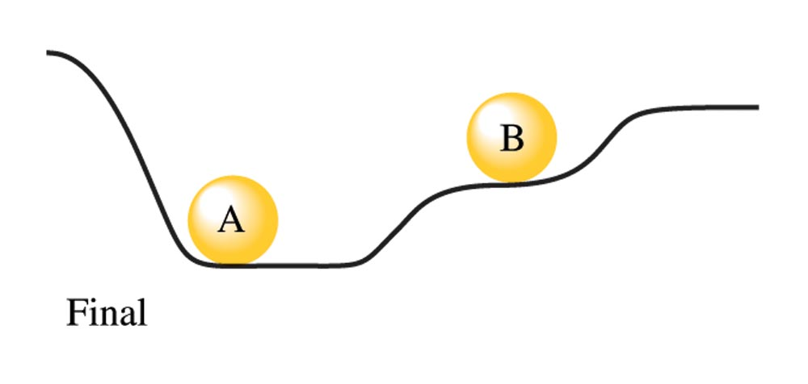
Billiards: The interplay of energies
A is released, potential energy is transformed into kinetic energy
A then hits B, transferring the kinetic energy in A… into kinetic energy in B
B then comes to rest as kinetic energy transforms back into potential energy

Slide 8
But notice!
Initial System: A has more potential energy than B
Final System: B has more potential energy than A
The final state has less potential energy than Initial
meaning that the final state is more stable
The potential energy lost kinetically by the two balls
is gained by the hill and stored as heat energy

Slide 9
We call it energy
In chemistry, energy is more like what we think of as anxiety
Something we want to get rid of
Chemical compounds get rid of their potential energy (stored energy) in numerous ways
Dispersal (kinetic energy of motion)
Bonding (heat released upon bond formation)
Radiation (light)

Slide 10
The attractive forces existing between nearby atoms are a type of potential energy
When these attractive forces result in bond formation, the potential energy is released as heat (a kind of kinetic energy)

Slide 11
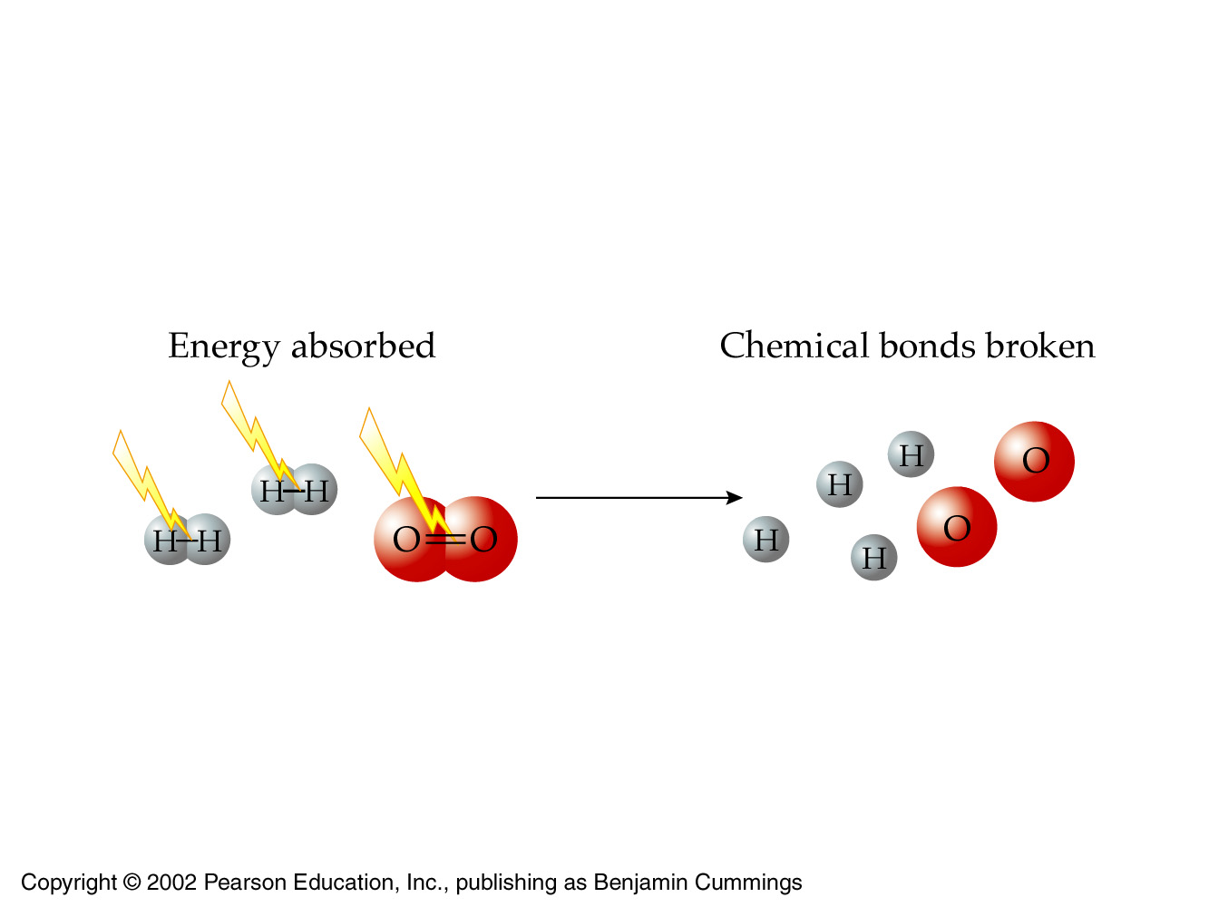
Logically then, breaking bonds must require putting the ‘lost’ energy back into the system
breaking up is hard to do

Slide 12
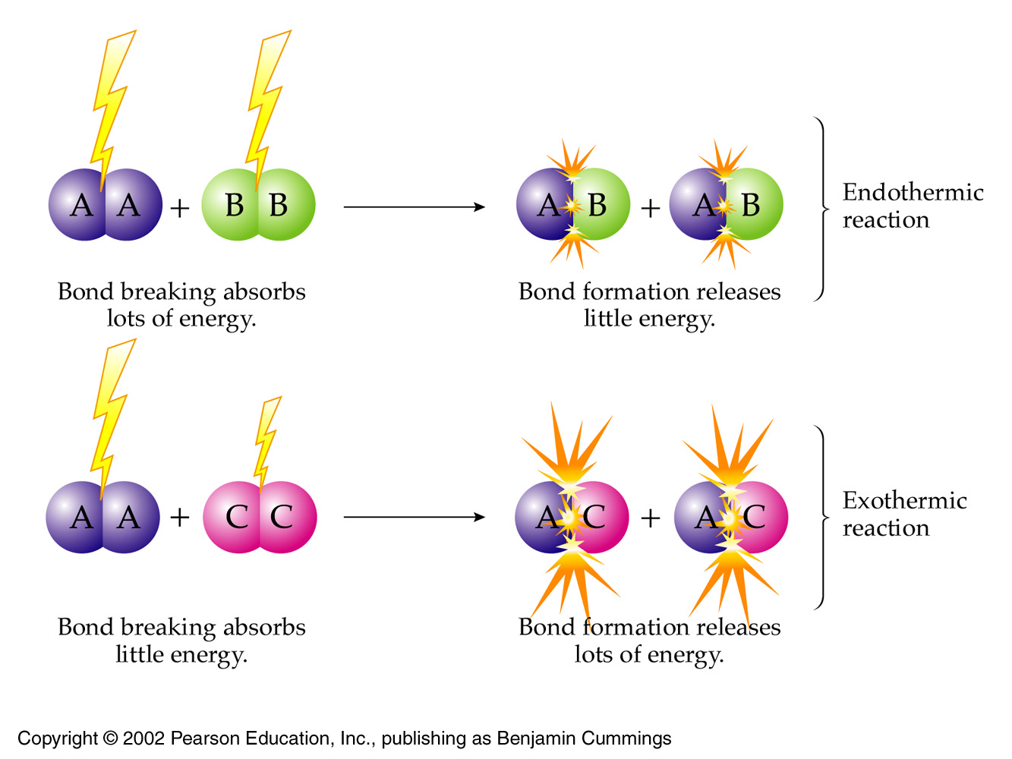
7.2 Heat Changes during Chemical Reactions
Qualitative

Slide 13
Chemical Bonds

Slide 14
Bond dissociation energy (BDE)is the amount of energy that must be supplied to break a bond …
and divide the molecule into separate atoms
Note that BDE is always measured in the gas phase
This prevents the separate atoms from recombining

Slide 15
The larger the bond dissociation energy …
(meaning the more energy it takes to break a bond)
the more stable the bond is
and thus the more stable the original molecule

Slide 16
The larger the bond dissociation energy, the more stable original molecule
Which molecule has the most stable bond?
Why?

Slide 17
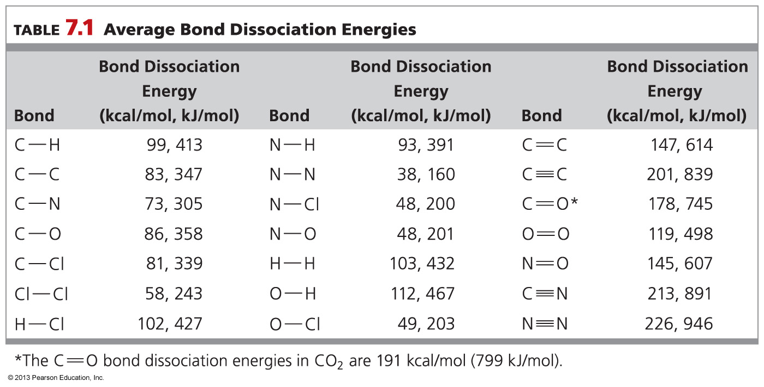
The more stable the original molecule …
the less reactive it is

Slide 18
Endothermic bond breaking
Bond breaking always absorbs heat and so is described as endothermic
from the Greek endo (inside)
meaning that heat must be put in

Slide 19
Endothermic bond breaking
For O₂ to be broken up into independent O atoms …
we must put in 119 kcal/mol of energy

Slide 20
Exothermic bond making
Bond formation always releases heat and so is described as exothermic, from the Greek exo (outside)
meaning that heat escapes the reaction and burns your hand

Slide 21
Exothermic bond making
When oxygen atoms combine to form O₂
We observe 119 kcal/mol being released
119 kcal/mol
is released
(−119kcal/mol)

Slide 22
Complete chemical reactions

Slide 23
Starting and ending with molecules

Slide 24
Bonds initially break (energy in) -- so that new bonds can form (energy out)

Slide 25
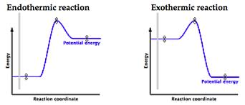
If the products have less potential energy than the reactants, the products are more stable
And the overall reaction is exothermic
Otherwise, the overall reaction is endothermic

Slide 26
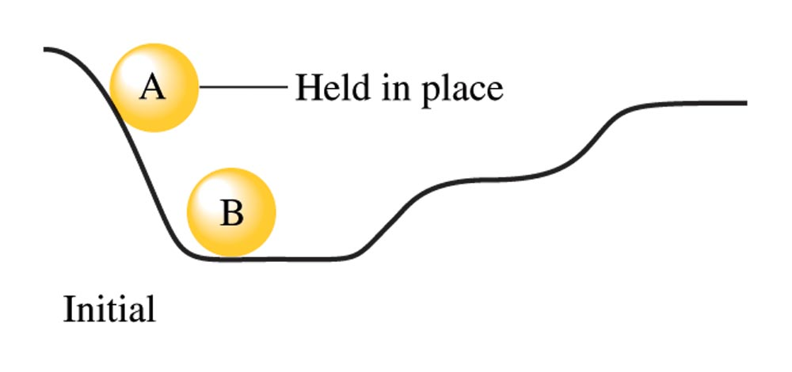
Remember this?
reactants
→
products
→
higher potential
energy
lower potential
energy

Slide 27
These products have
more potential energy
than reactants
These products have
less potential energy
than reactants

Slide 28
Section summary
Bond formation is always exothermic
Bond breaking is always endothermic
But the overall reaction may be exothermic or endothermic!

Slide 29
The direction of energy flow
of a chemical reaction

Slide 30
Keep this in mind

Slide 31
The direction of energy flow in a chemical reaction is indicated by the sign
If heat is released (exothermic) then the sign of energy change is negative (−) to indicate energy is lost by the chemical system
If heat is absorbed (endothermic) then the sign of energy change is positive (+) to indicate energy is gained by the chemical system

Slide 33
The direction of energy flow
The amount of heat transferred in one direction must be numerically equal to the amount of heat transferred in reverse
Because only the direction of the heat transfer is different
2Cl → Cl—Cl = − 243 kJ/mol (gives of heat)
Cl – Cl → 2Cl = + 243 kJ/mol (absorbs heat)
This is the First Law of Thermodynamics

Slide 34
The First Law: Conservation of energy
Energy can be transformed (converted) from one form of energy to another
Potential to kinetic to potential …
And transferred from one object to another (next slide)
Kinetic to kinetic
But it can neither be created nor destroyed
The total energy of the universe is constant

Slide 35
Enthalpy ΔH

Slide 36
ΔH (change in enthalpy)
The heat that is given off or absorbed in a reaction, when measured at constant pressure, is called a change in enthalpy, ΔH
Δ (the Greek capital letter delta) is a symbol used to indicate “a change in”

Slide 37
ΔH (change in enthalpy)
The terms enthalpy change and heat of reaction are often used interchangeably
Heat of reaction, or enthalpy change (ΔH) is the difference between the potential energy contained in reactants and the products

Slide 38
Pop quiz
Which reaction gives off heat?

Slide 39
Bond formation is always _______.
endothermic and releases energy
endothermic and requires energy
exothermic and releases energy
exothermic and requires energy

Slide 40
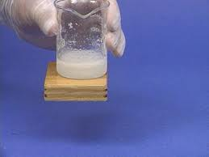
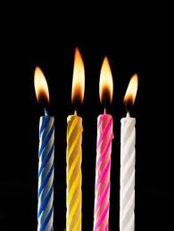
7.3 Exothermic and Endothermic Reactions
Quantitative
with calculations

Slide 41
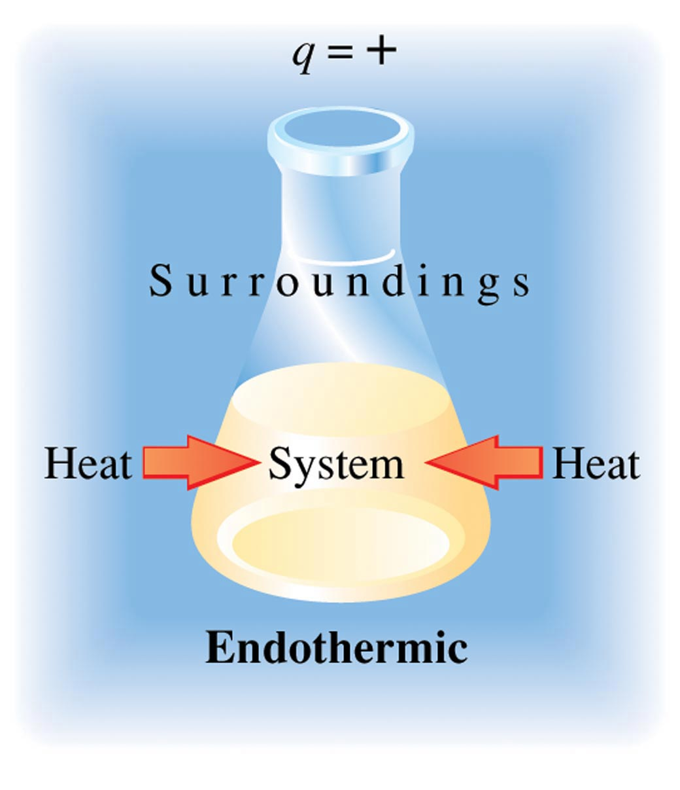
Endothermic
ΔH = +

Slide 42
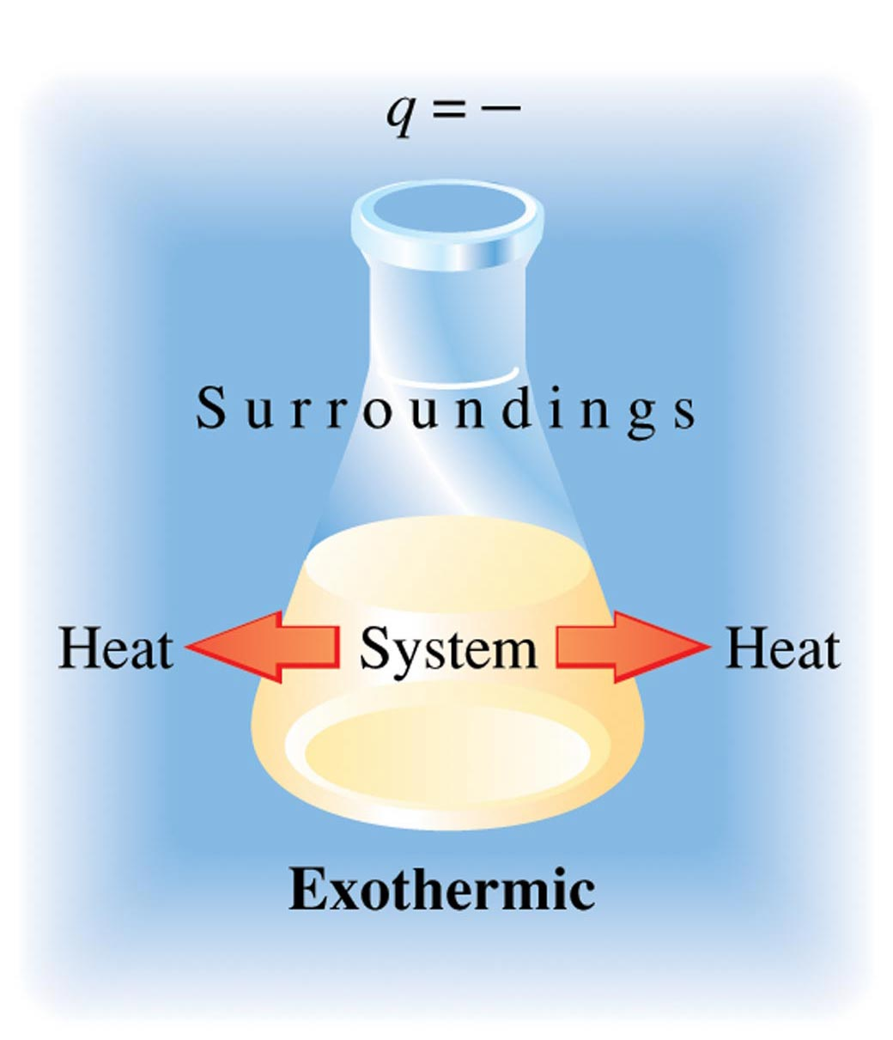
Exothermic
ΔH = −
We will focus on
exothermic
Endothermic is
‘opposite but equal’

Slide 43
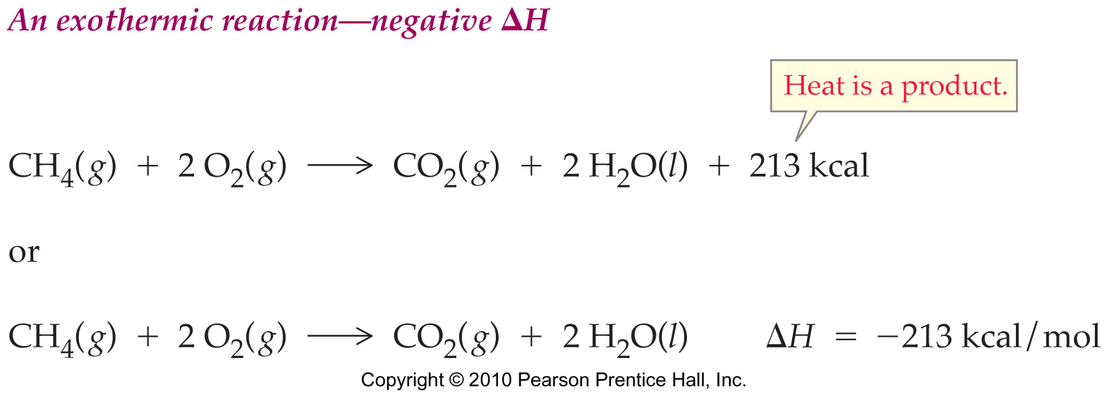
Exothermic reactions
When the strength of the new bond in the product is greater than the strength of the old bond broken … then energy is released
The heat of reaction is negative in exothermic reactions because heat energy is lost

Slide 44
Exothermic reactions
When the strength of the new bond in the product is greater than the strength of the old bond broken … then energy is released
This of course means that the new bonds contain less potential energy than the bonds broken

Slide 45
Heat of reaction can be calculated as the difference between the bond dissociation energies of the reactants and the bond dissociation energies of the products
Let’s do the oxidation of methane on the board

Slide 46
Tabular bond energies are average values
Actual bond energies may vary depending on the environment in which the bond is found

Slide 47
If the input of energy to break bonds is less than the amount of energy released when forming bonds, the reaction is exothermic
ΔH = negative
If the input of energy to break bonds is more than the amount of energy released when forming bonds, the reaction is endothermic
ΔH = positive

Slide 48
Use these values for the following problem

Slide 49
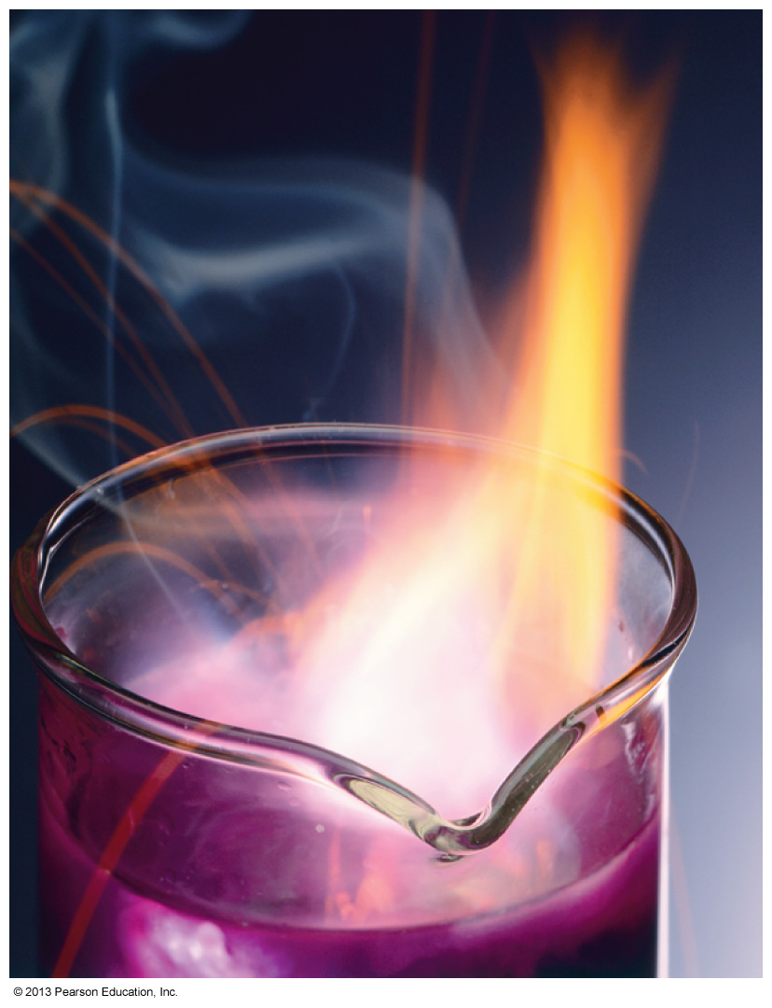
When potassium is added to water contained in a beaker, the reaction shown below occurs, and the beaker feels hot to the touch. K(s) + 2 H₂O(l) → 2 KOH(aq) + H₂(g) The reaction is _______.
endothermic and ΔH is negative
endothermic and ΔH is positive
exothermic and ΔH is negative
exothermic and ΔH is positive

Slide 50
2 Al(s) + 3 Cl₂(g) → 2 AlCl₃(s) + 337 kcal The reaction above is _______.
endothermic and ΔH is negative
endothermic and ΔH is positive
exothermic and ΔH is negative
exothermic and ΔH is positive

Slide 51
Use these values for the following problem

Slide 52
For the following reaction, use bond energies to calculate the heat of reaction (ΔH). 2 H₂O → 2 H₂ + O₂
487 kcal
−123 kcal
−487 kcal
d. 123 kcal

Slide 53
2 Al(s) + 3 Cl₂(g) → 2 AlCl₃(s) + 337 kcal When 1.00 mol of AlCl₃ forms in this reaction, _______.
169 kcal of heat are absorbed
169 kcal of heat are released
337 kcal of heat are absorbed
337 kcal of heat are released

Slide 54
Section summary
An exothermic reaction releases heat to the surroundings
ΔH is negative
An endothermic reaction absorbs heat from the surroundings
ΔH is positive
The reverse of an exothermic reaction is endothermic
The reverse of an endothermic reaction is exothermic
The amount of heat absorbed or released in the reverse of a reaction is equal to that released or absorbed in the forward reaction
But ΔH has the opposite sign.

Slide 55
7.4 Why Do Reactions Occur? Free Energy
Spontaneous:
A process occurring without an external cause
Spontaneous endothermic reactions:
can occur without the application external of energy
eg, without a Bunsen burner

Slide 56
In this section we ask…
How are spontaneous endothermic processes even possible?
What makes them go
both physical and chemical!
From where does the power come for ice on a summer day to suck energy out of the environment and melt!

Slide 57
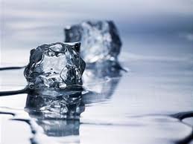
Up to this point, we can only understand why an exothermic process would occur spontaneously
because a lower-energy bond is a happier, stronger bond
With the introduction of entropy (S), we can begin to understand why some endothermic processes also occur spontaneously
So that ice can ‘legally’ melt on a summer day!

Slide 58
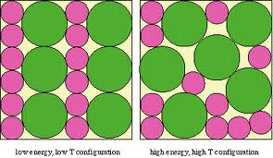
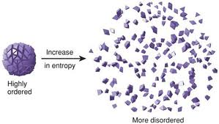
Spontaneous endothermic processes benefit from an increase in molecular disorder, or randomness in the product
Entropy (S) is a measure of the amount of molecular disorder as a reaction proceeds
solid to liquid
solid (or liquid) to gas

Slide 59
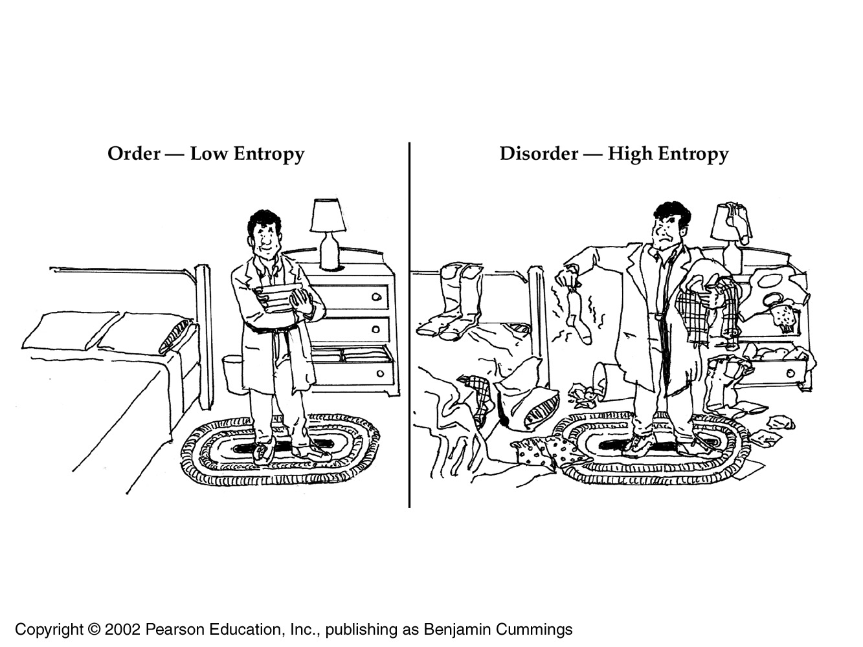
Randomness rules the universe

Slide 60
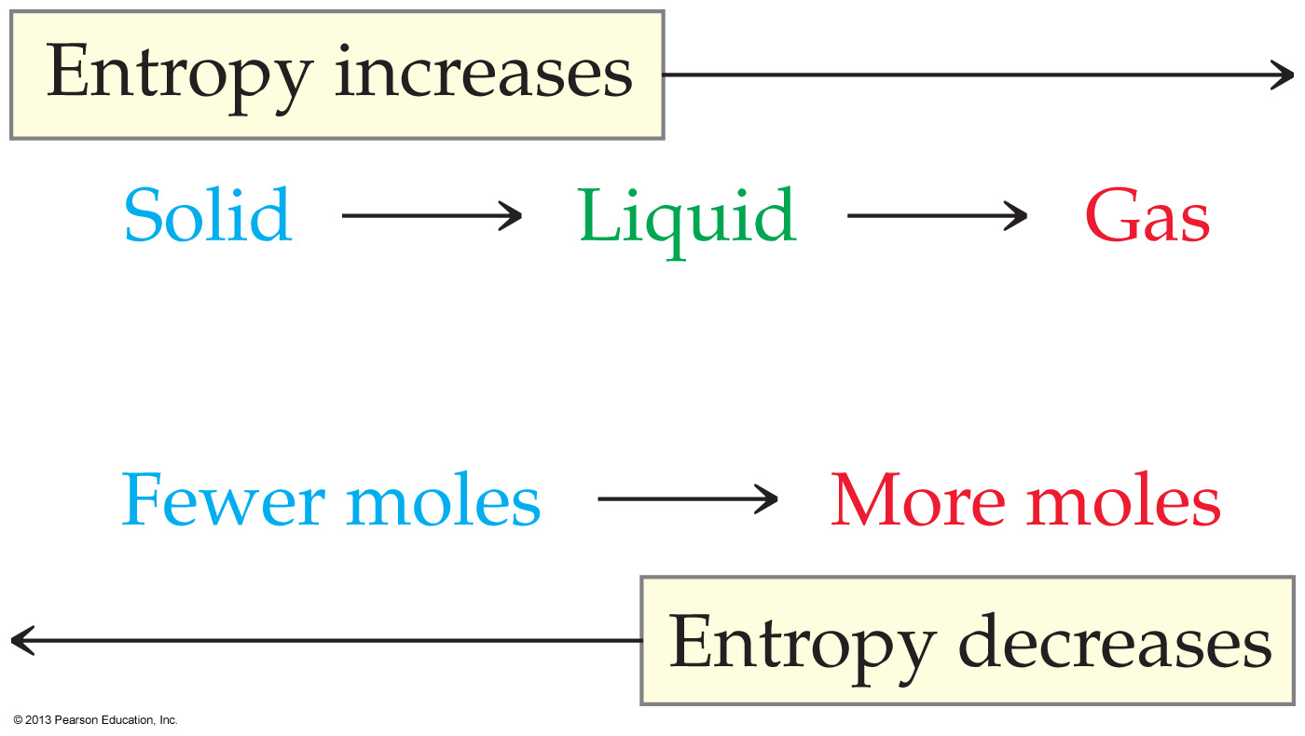
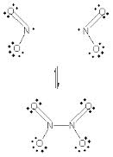
Gases have higher entropy than liquids, and liquids have higher entropy than solids
In chemical reactions, entropy increases when:
a gas is produced from a solid, or
when 1 mol of reactants split into 2 mol of products:
N₂O_{4(g)} → 2NO_{2(g)}

Slide 62
Tossing cards adds disorder to the system
The entropy change (ΔS ) for a process has a positive value if the disorder of a system increases: ∆S = +
Conversely, ΔS has a negative value if the disorder of a system decreases: ∆S = −

Slide 63
Summarized
ΔH = +
Spontaneity disfavored
ΔH = −
Spontaneity favored
ΔS = +
Spontaneity favored
∆S = −
Spontaneity disfavored

Slide 64
Spontaneity depends
on both heat and randomness
So two factors together determine the spontaneity of a chemical or physical change:
the release /absorption of heat (ΔH: enthalpy)
the increase /decrease in entropy (ΔS: randomness)

Slide 65
fyi
So it is possible for a process to be unfavored by enthalpy (the process absorbs heat) and yet be favored by entropy (there is an increase in disorder)
Ice melts at room temperature because above 0ºC the randomness factor (ΔS ) overwhelms the heat factor (ΔH )
Below 0ºC, the heat factor (ΔH ) overwhelms the randomness factor (ΔS ) and the ice remains frozen

Slide 66
Free energy (ΔG )
Putting heat (ΔH ) and randomness (ΔS ) together

Slide 67
In order to take both entropy (ΔS ) and enthalpy (ΔH ) into account at the same time, a quantity called the free-energy change (ΔG) is calculated for a reaction

Slide 68
Free-energy change (ΔG) is a measure of the change in free energy as a chemical reaction or physical change occurs
An exergonic event is a spontaneous reaction or process that releases free energy and thus has a negative ΔG
An endergonic event is a non-spontaneous reaction or process that absorbs free energy and thus has a positive ΔG

Slide 69
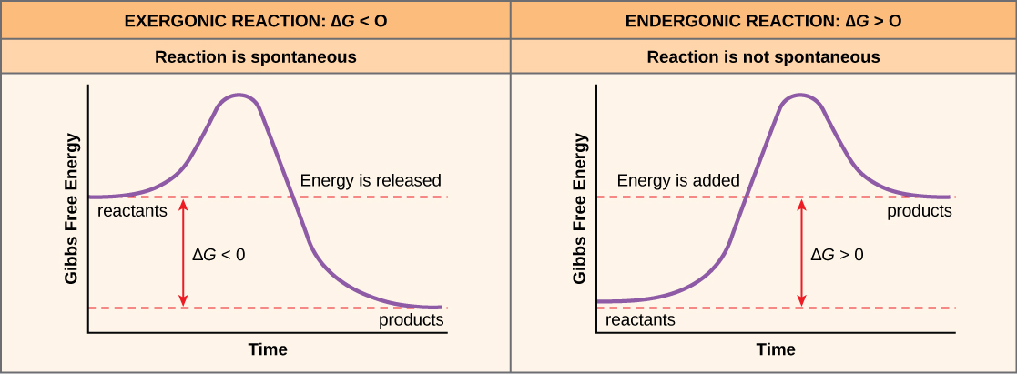

Slide 70
Summarized
ΔH = + (endothermic) Spontaneity disfavored
ΔH = − (exothermic) Spontaneity favored
ΔS = + Spontaneity favored
∆S = − Spontaneity disfavored
ΔG = + (endergonic) Spontaneity not allowed
ΔG = − (exergonic) Spontaneity allowed

Slide 71
Case I Spontaneity always occurs when:
ΔH = − (Spontaneity favored)
AND
ΔS = + (Spontaneity favored)
In such cases, the free energy change is always exergonic
ΔG = − (exergonic) (Spontaneity allowed)

Slide 72
Case II a Spontaneity sometimes occurs when:
ΔH = + (Spontaneity disfavored)
OR
∆S = + (Spontaneity favored)
In this case ΔG must be calculated:
if ΔG = + (endergonic) (Spontaneity not allowed)
if ΔG = − (exergonic) (Spontaneity allowed)

Slide 73
Case II b Spontaneity sometimes occurs when:
ΔH = − (Spontaneity favored)
OR
∆S = − (Spontaneity disfavored)
In this case ΔG must be calculated:
if ΔG = + (endergonic) (Spontaneity not allowed)
if ΔG = − (exergonic) (Spontaneity allowed)

Slide 74
Case III Spontaneity never occurs when:
ΔH = + (Spontaneity disfavored)
and
∆S = − (Spontaneity disfavored)

Slide 75
In Cases II a & b
both ΔH and ΔS have the same sign
so spontaneity depends on temperature (T)
At low temperatures, the value of TΔS is often small, so that ΔH dominants
At high temperatures, the value of TΔS dominates

Slide 76
Meaning:
an endothermic process that is not spontaneous at low temperature can become spontaneous at a higher temperature
so that ice melts above 0ºC but not below

Slide 77
Pop Quiz
Below 0ºC (273K) the melting of ice is not spontaneous
ΔG = ?
Above 0ºC (273K) the melting of ice is spontaneous
ΔG = ?

Slide 78
Pop Quiz
Below 0ºC (273K) the melting of ice is not spontaneous
ΔG = +
Above 0ºC (273K) the melting of ice is spontaneous
ΔG = −

Slide 80
Summarized
ΔH = + (endothermic) Spontaneity disfavored
ΔH = − (exothermic) Spontaneity favored
ΔS = + Spontaneity favored
∆S = − Spontaneity disfavored
ΔG = + (endergonic) Spontaneity not allowed
ΔG = − (exergonic) Spontaneity allowed

Slide 81
Which of the following will slow down the rate of a reaction?
Temperature is increased.
Adding a catalyst and maintaining the temperature.
Temperature is decreased.
More reactant is added to the system.

Slide 82
Which of the following processes results in an increase in entropy of the system?
A liquid freezing
Organizing a deck of cards into four suits
Sugar dissolving in water
A gas condensing

Slide 83
K(s) + 2 H₂O(l) → 2 KOH(aq) + H₂(g) When potassium is added to water contained in a beaker, the reaction shown above occurs and the beaker feels hot to the touch. During this reaction, _______.
entropy decreases and ΔS is negative
entropy decreases and ΔS is positive
entropy increases and ΔS is negative
entropy increases and ΔS is positive

Slide 84
K(s) + 2 H₂O(l) → 2 KOH(aq) + H₂(g) When potassium is added to water contained in a beaker, the reaction shown above occurs, and the beaker feels hot to the touch. This reaction is _______.
nonspontaneous and ΔG is negative
nonspontaneous and ΔG is positive
spontaneous and ΔG is negative
spontaneous and ΔG is positive

Slide 85
fyi: Important Points about Spontaneity and Free Energy
A spontaneous process, once begun, proceeds without any external assistance and is exergonic; that is, free energy is released and it has a negative value of ΔG.
A nonspontaneous process requires continuous external influence and is endergonic; that is, free energy is added and it has a positive value of ΔG.
The value of ΔG for the reverse of a reaction is numerically equal to the value of ΔG for the forward reaction, but has the opposite sign.
Some nonspontaneous processes become spontaneous with a change in temperature.

Slide 86
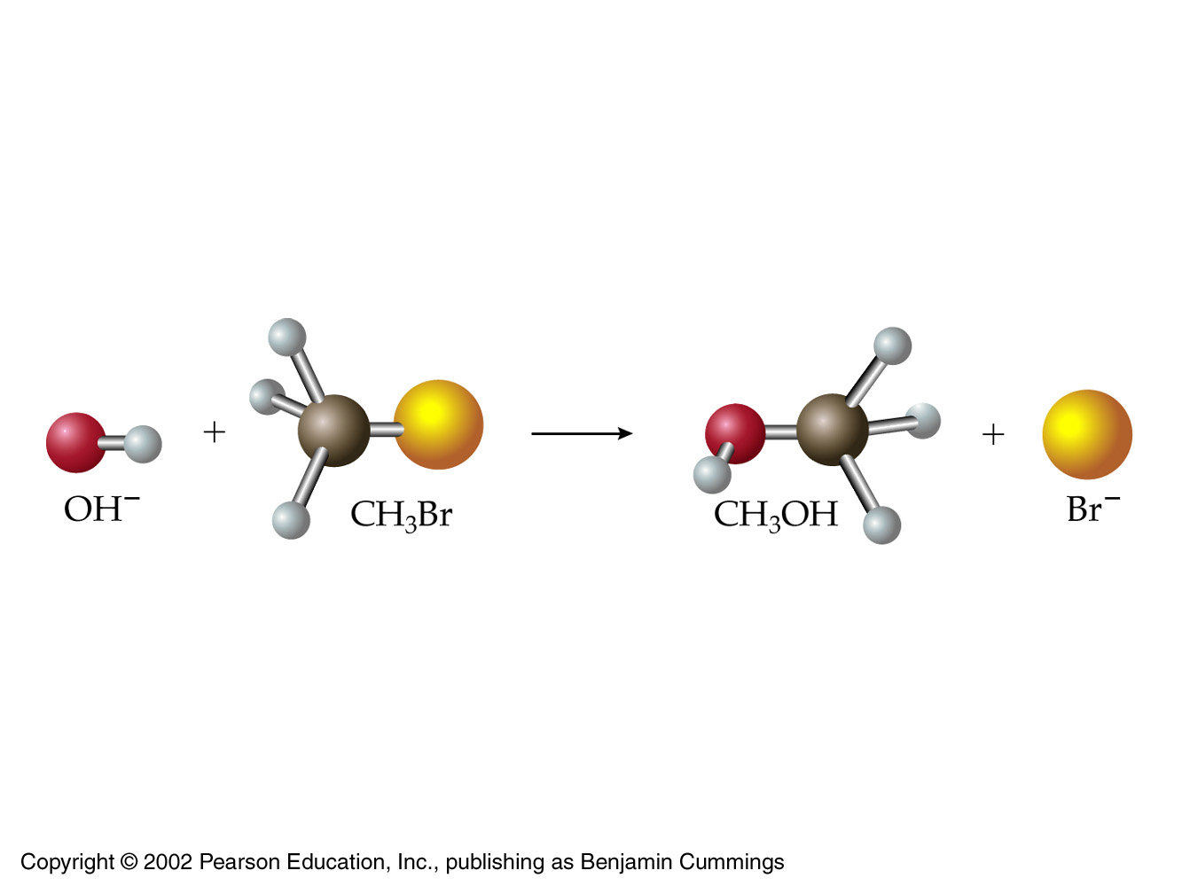
7.5 How Do Chemical Reactions Occur? Reaction Rates

Slide 87
The value of ΔG tells us only whether a reaction can occur
it says nothing about how fast the reaction will occur
Or whether it needs a ‘push’ to get started
For a reaction to occur
reactant particles must collide – in the right way!
old bonds must break
new bonds must form

Slide 88
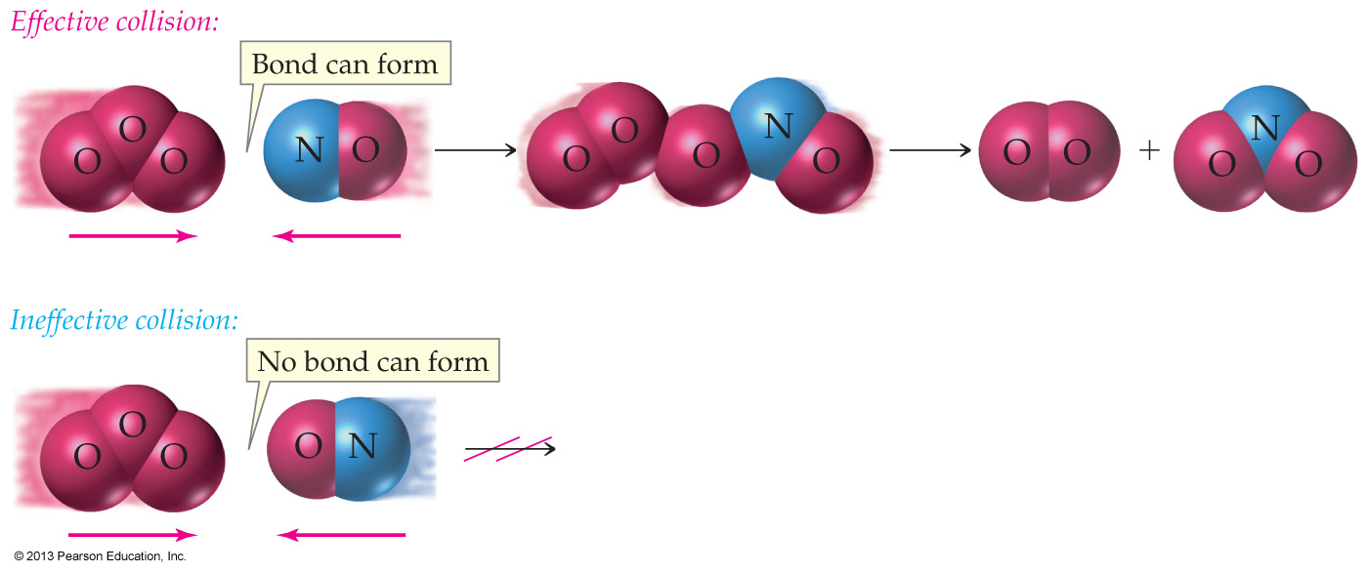
Issue: Collisions
The colliding molecules must approach with the correct orientation so that the atoms that will form the new bonds can link
And the collision must take place with enough energy to break the old bonds in the reactant

Slide 89
The colliding molecules must approach with the correct orientation so that the atoms that will form the new bonds can link
http://chemwiki.ucdavis.edu/@api/deki/files/7389/sn2.gif?size=bestfit

Slide 90
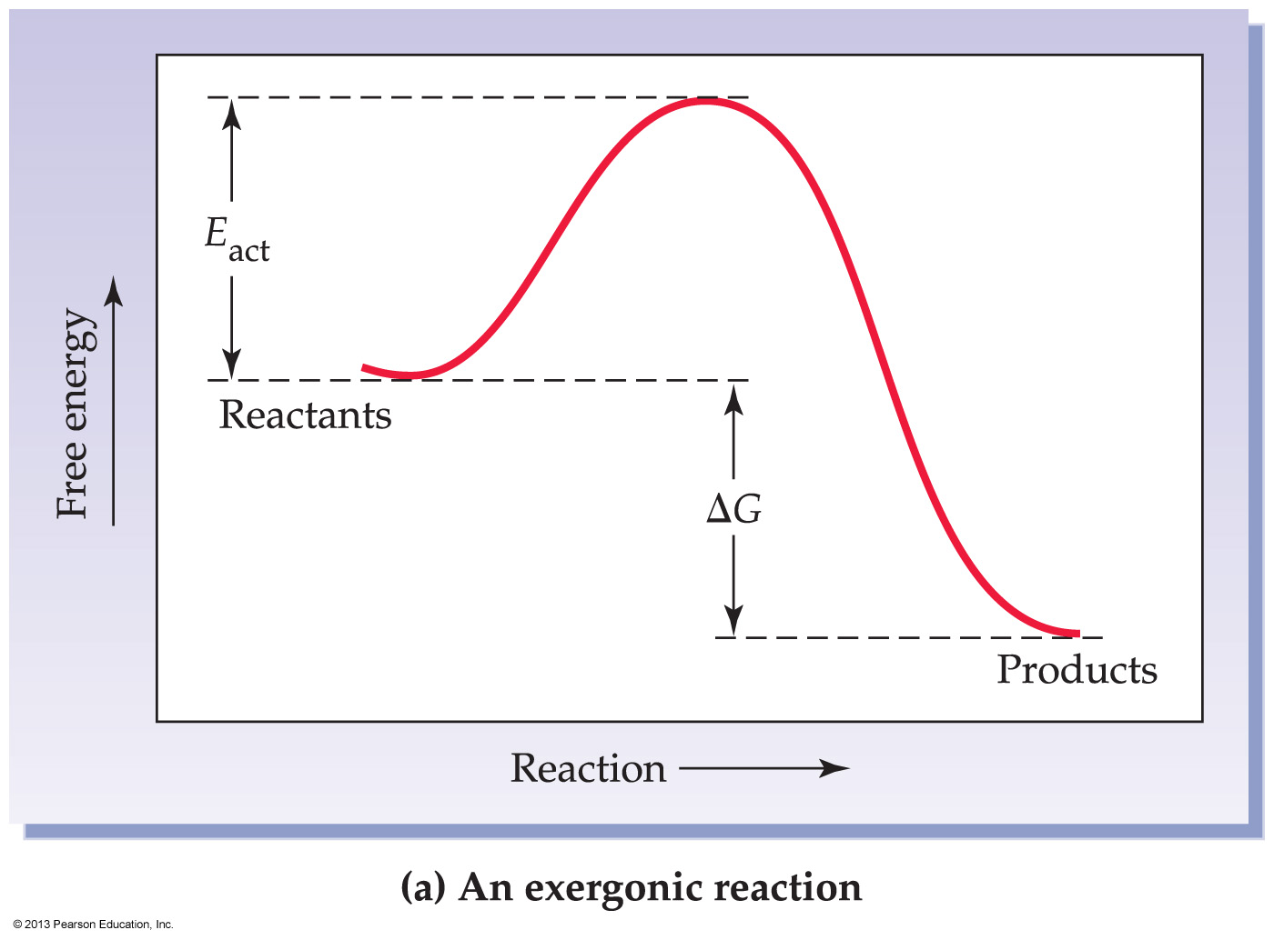
Issue: activation energy E_{act}
The minimum
energy required
for a reaction

Slide 91
Issue: activation energy E_{act}
Many reactions with an ‘allowed’ free-energy (ΔG ) cannot get started at room temperature
To get such reactions started, an activating push of energy must be supplied
Once started, the reaction self-sustains as its own heat is released

Slide 92
Lying between the reactants and the products, is an energy “barrier”
The height of the barrier is the activation energy, E_{act}
The difference between reactant and product energy levels is the free-energy change, ΔG

Slide 93
The size of the activation energy determines the reaction rate
The smaller the activation energy
the greater the number of productive collisions in a given amount of time
and the faster the reaction
The larger the activation energy
the lower the number of productive collisions
and the slower the reaction
The size of the activation energy and the size of the free-energy change are unrelated

Slide 94
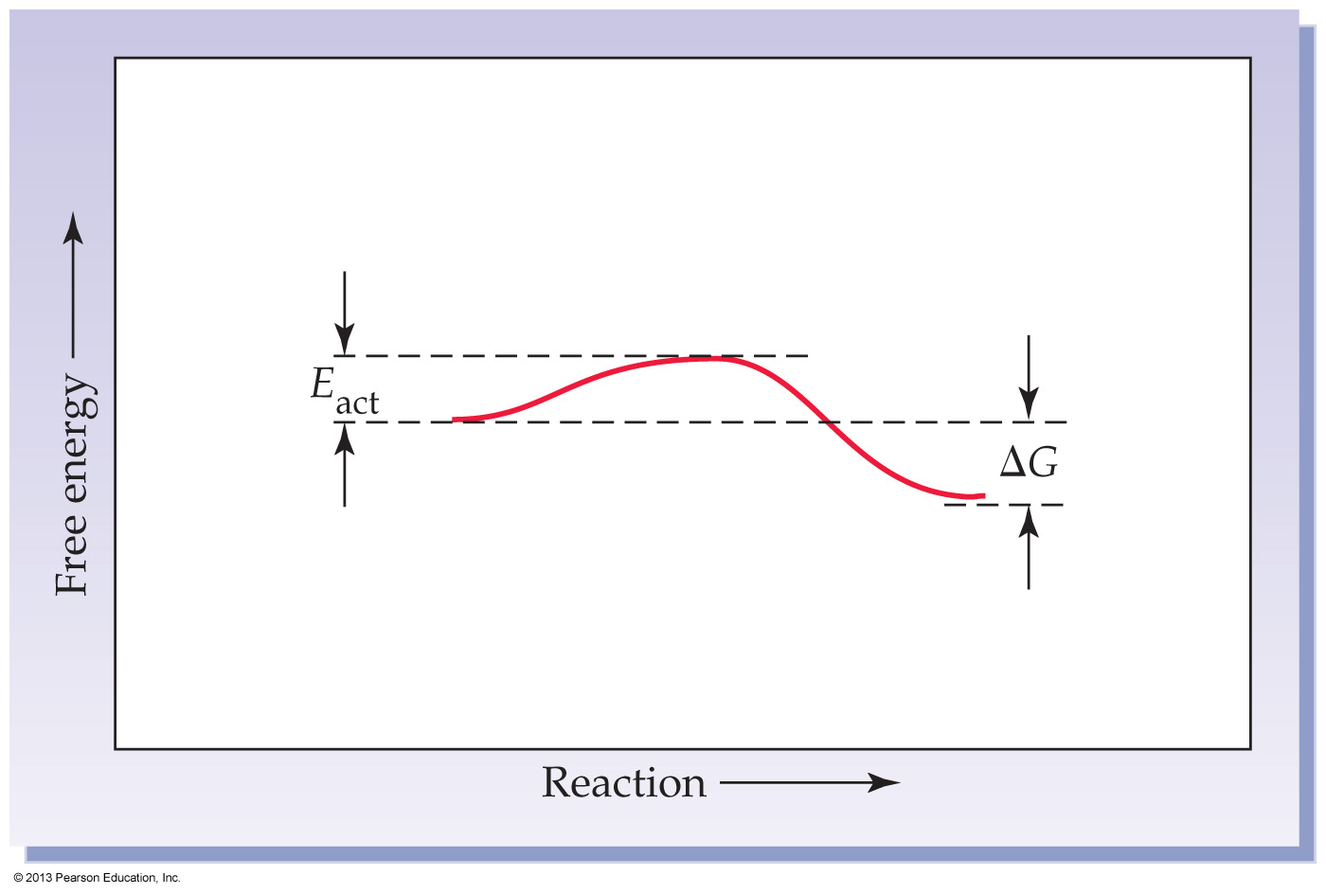
Shown is an energy diagram for a reaction with a small activation energy and products having less energy than reactants. This reaction is _______.
nonspontaneous and exothermic
nonspontaneous and endothermic
spontaneous and exothermic
spontaneous and endothermic

Slide 95
Worked Example 7.6 Spontaneity: Enthalpy, Entropy, and Free Energy
This industrial method for synthesizing hydrogen by reaction of carbon with water has:
ΔH = +31.3 kcal/mol
ΔS= +32 cal/[mol • K]
What is the value of ΔG (in kcal) for the reaction at 27°C (300 K)?
Is the reaction spontaneous or nonspontaneous at this temperature?

Slide 96
ΔH = +31.3 kcal/mol ΔS = +32 cal/[mol • K] ΔG = ? kcal / mol
ΔH: The reaction is endothermic (ΔH positive) and does not favor spontaneity energetically
ΔS: Entropy indicates an increase in disorder (ΔS positive), which does favor spontaneity
ΔG: Calculate ΔG to determine spontaneity

Slide 97
ΔH = +31.3 kcal/mol ΔS = +32 cal/[mol • K] ΔG = ? kcal / mol T = 300ºK
So the reaction is not spontaneous at 300ºK

Slide 98
Would the reaction be spontaneous at 400ºC?

Slide 99
fyi
in the previous problem, what is the easiest way to calculate the ‘reversal temperature’ at which the reaction becomes spontaneous?
Set ΔG = 0, set T = X (ie, make it a variable), and solve for X.

Slide 100
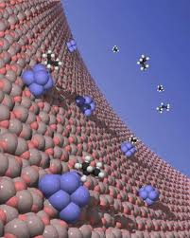
7.6 Effects of Temperature, Concentration, and Catalysts on Reaction Rates

Slide 101
Higher temperatures add energy to the reactants
With more energy in the system
reactants move faster
increasing the frequency of collisions
The force of collisions also increases
making them more likely to overcome the activation barrier
A 10°C rise in temperature will double a reaction rate

Slide 102
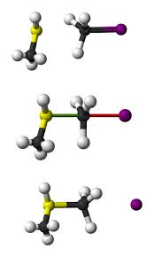
Higher temperatures increase the frequency and force of collisions

Slide 103
As concentration increases
collisions between reactant molecules increase
As the frequency of collisions increases
reactions between molecules become more likely
Doubling or tripling a reactant concentration often doubles or triples the reaction rate

Slide 104
Higher Concentration increase the frequency of collisions

Slide 105
Two ways to increase concentration
There are two ways we can increase concentration …
we can put more molecules in the box
we can make the box smaller

Slide 107
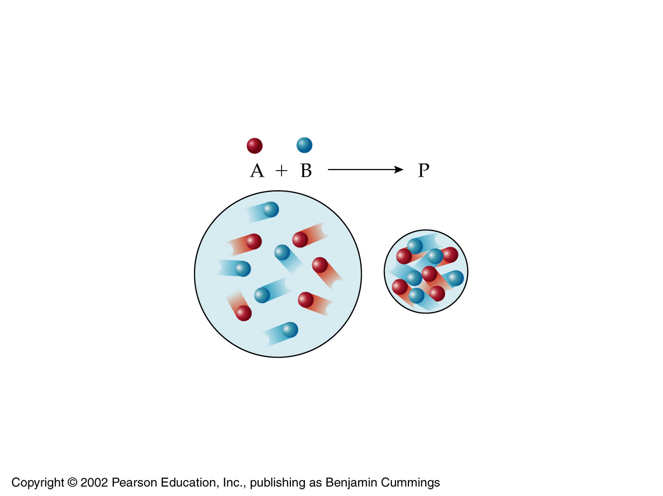

Slide 108
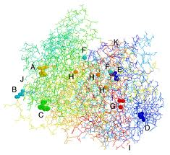
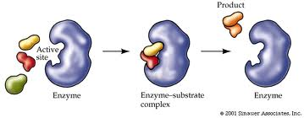
A catalyst increases reaction rate either by letting a reaction take place through an alternative pathway
one with a lower energy barrier, E_{act}
Or by ‘forcibly’ orienting the reacting molecules appropriately

Slide 109
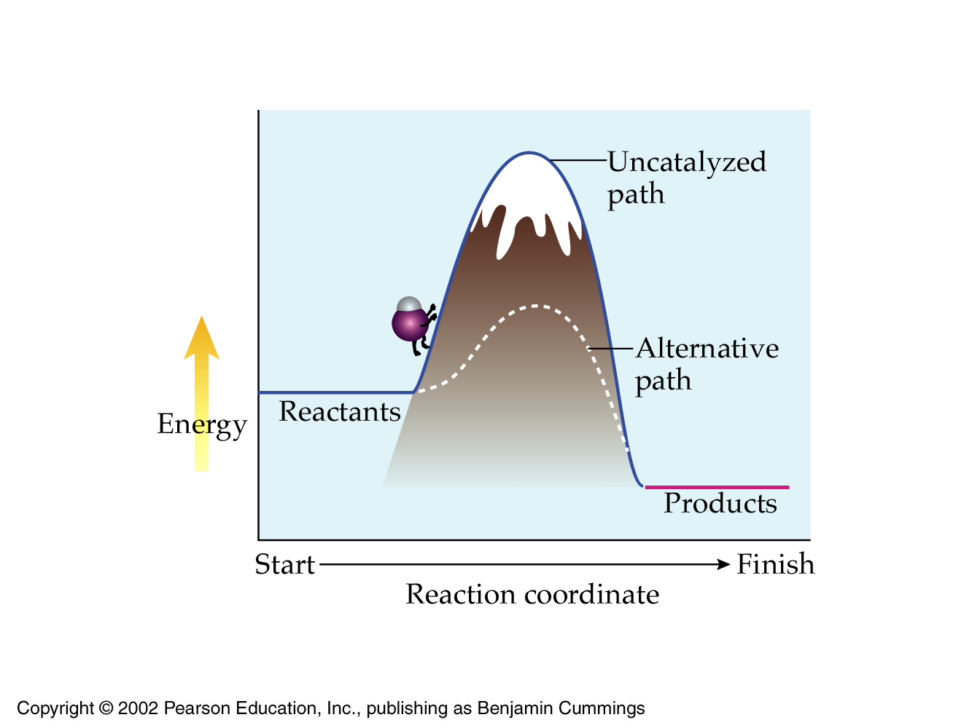
A catalyst lowers the E_{act} barrier

Slide 110
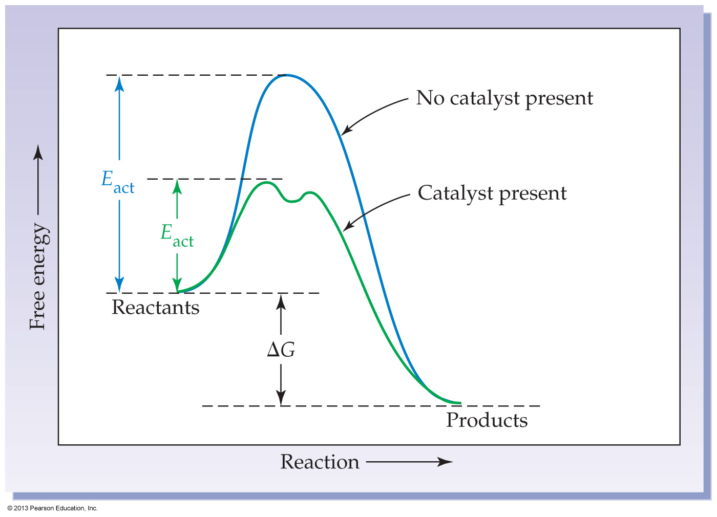
The free-energy change (ΔG) for a reaction depends only on the difference in the energy levels of the reactants and products
and not on the pathway of the reaction
So a catalyzed reaction releases (or absorbs) the same amount of energy as an uncatalyzed reaction
but occurs more rapidly

Slide 111
Summary
Reaction rates are affected by changes in:
temperature
concentration
addition of a catalyst

Slide 112
fyi
Looking Ahead
The thousands of biochemical reactions continually taking place in our bodies are catalyzed by large protein molecules called enzymes, which control the orientation of the reacting molecules. The study of enzymes is a central part of biochemistry.

Slide 113
What happens when a catalyst is added to a reaction to increase its rate?
Activation energy is lowered and ΔG becomes more negative.
Activation energy is lowered and ΔG remains unchanged.
Activation energy is raised and ΔG becomes more positive.
Activation energy is raised and ΔG remains unchanged.

Slide 114
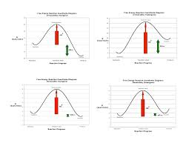
7.7 Reversible Reactions and Chemical Equilibrium
Few chemical reactions actually go to completion

Slide 115
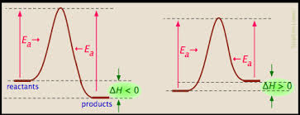
Where reactants and products are of almost equal stability …
the reaction is observed to be reversible
A reversible reaction is one that constantly goes in both directions

Slide 116
Reversible
Left to right is referred to as the forward reaction
Right to left is referred to as the reverse reaction
BUT, there is no reason you couldn’t write any reversible reaction in the opposite direction
Then, ethyl acetate will be the reactant instead of product

Slide 117
Reversible
Initially, the forward and reverse reactions occur at different rates (next slide)
But eventually, all will settle down to a stable mixture of reactants and products
then it is said to reach a state of chemical equilibrium
where it remains until conditions change (eg temperature)

Slide 118
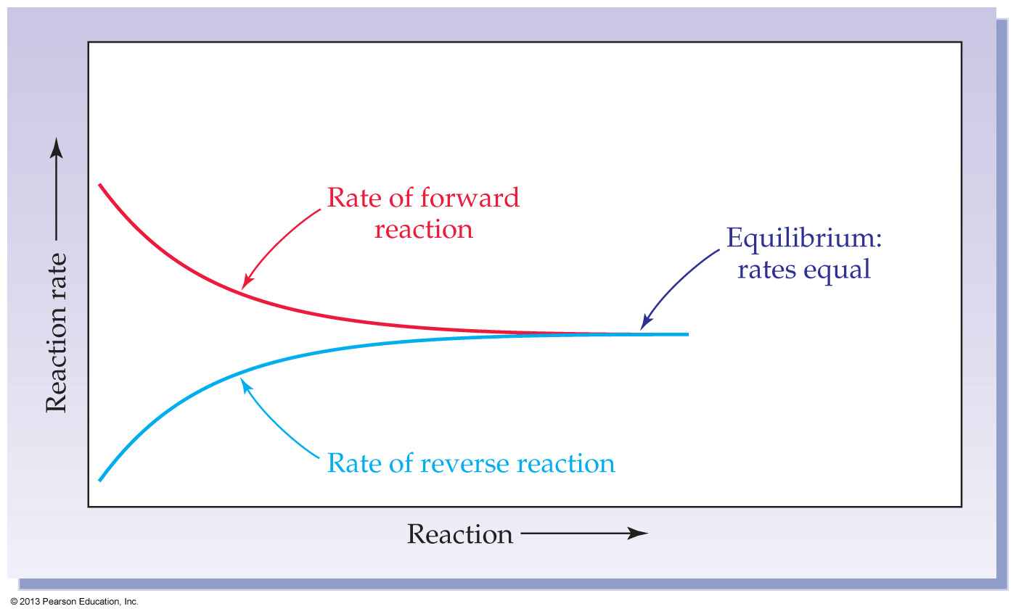
Dynamic chemical equilibrium

Slide 119
fyi
The forward reaction always takes place rapidly at the beginning, then slows down as reactant concentrations decrease
The reverse reaction takes place slowly at the beginning but then speeds up as product concentrations increase
Ultimately, the forward and reverse rates become equal

Slide 120
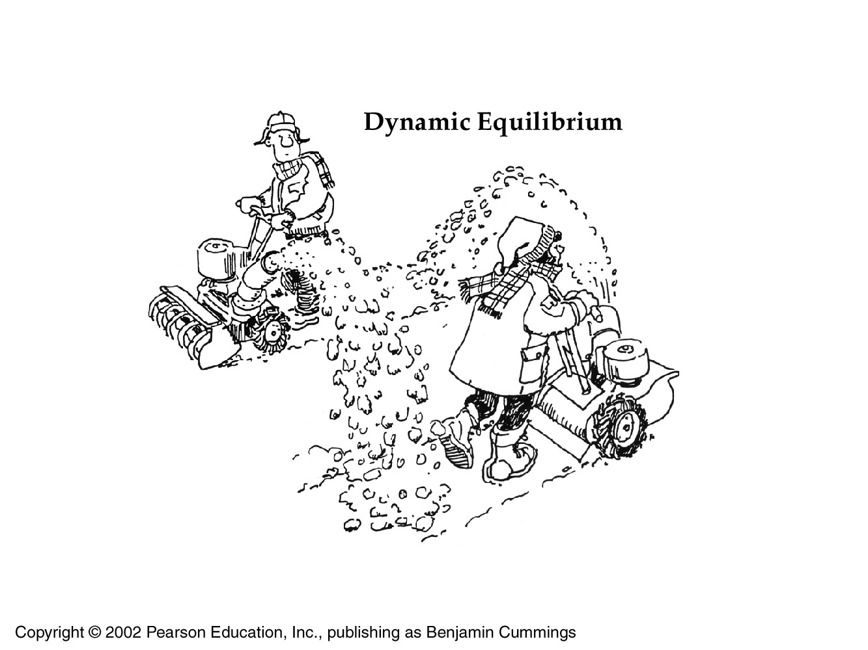
Chemical equilibrium
is an active, dynamic condition

Slide 121
All substances present at equilibrium are being made and unmade at the same rate
so the calculated concentrations are constant
This does not mean that concentrations of reactants and products ever become equal
The extent to which the forward or reverse is favored … is a characteristic property of a reaction under given conditions – next section

Slide 123
Is it possible to predict what the equilibrium positions will be for any given reaction?
Yes

Slide 124
aA + bB +… D mM + nN +…
For the above generalized equation
A and B are reactants, M and N are products, and a, b, m, and n are coefficients
Once equilibrium is reached
the composition of the reaction mixture obeys the equilibrium equation
where K is the equilibrium constant
[] = concentration

Slide 125
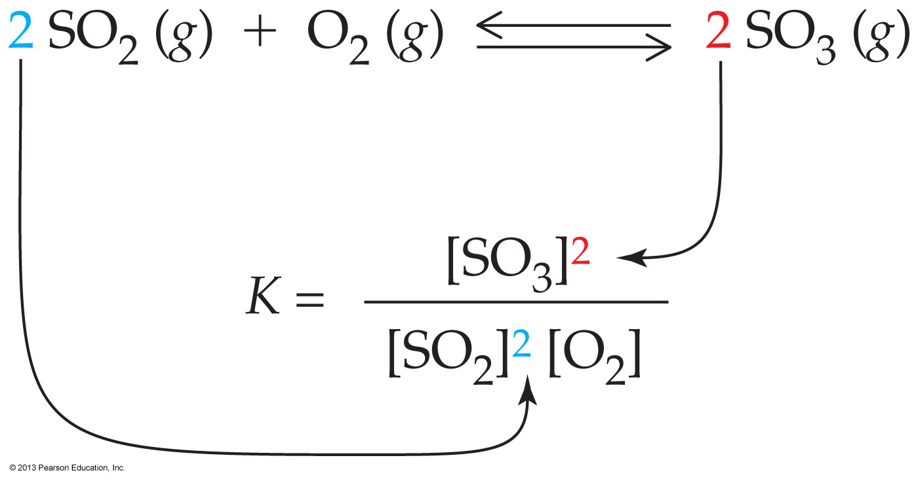
Before equilibrium, forward and reverse rates change with changing concentrations
next slide
But at equilibrium K is a constant—never changes!
and can be calculated

Slide 126
Before equilibrium, forward and reverse
reaction rates differ

Slide 127
And etc
The value of K does vary with temperature
25 °C is assumed unless specified
For reactions that involve pure solids
The concentration of pure solids are omitted when writing the equilibrium constant expression
If there is no coefficient for a reactant or product in the reaction equation
it is assumed to be 1
Units are usually omitted

Slide 128
Worked example 7.8
CO (g) + 3H₂ (g) CH₄ (g) + H₂O (g)
Hydrogen can be combined with carbon monoxide to give methane and water. Write the equilibrium equation for the reaction.

Slide 129
Worked example 7.8
CO (g) + 3H₂ (g) CH₄ (g) + H₂O (g)
Hydrogen can be combined with carbon monoxide to give methane and water. Write the equilibrium equation for the reaction.

Slide 130
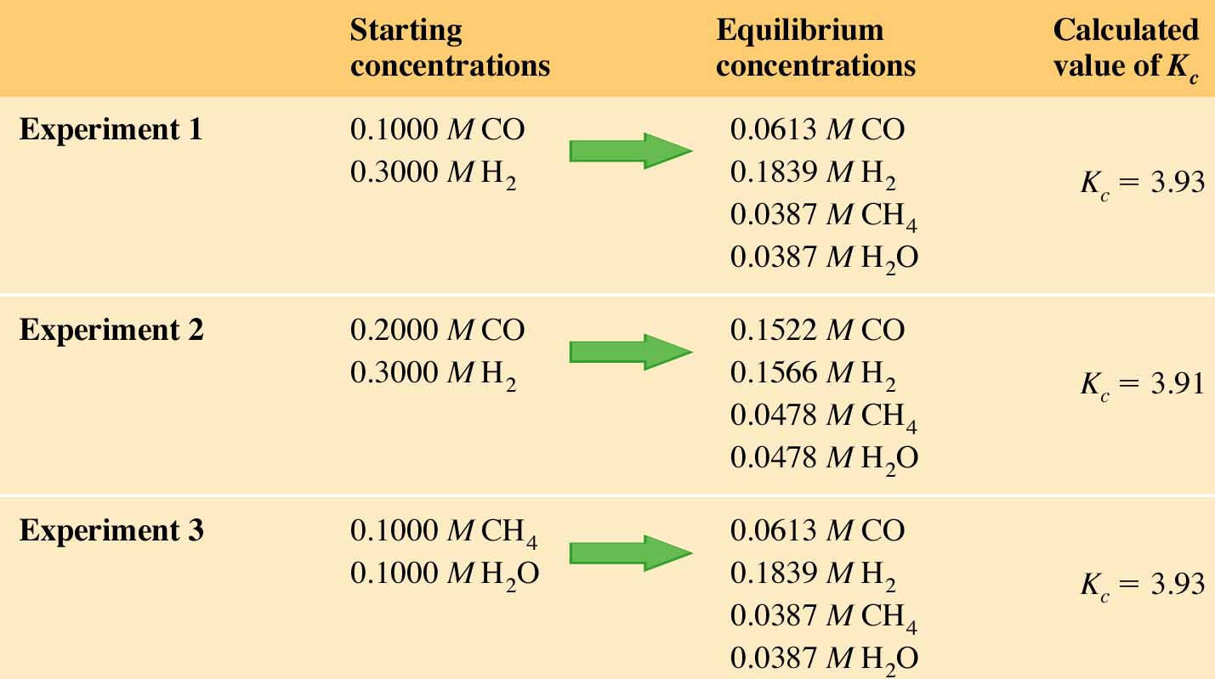
data: equilibrium compositions for the worked example

Slide 131
So if
for
What does K for the following reaction equal
CH₄ (g) + H₂O (g) CO (g) + 3H₂ (g)
= ?
CO (g) + 3H₂ (g) CH₄ (g) + H₂O (g)

Slide 132
Before equilibrium, forward and reverse
reaction rates differ

Slide 133
The value of the equilibrium constant indicates the position of a reaction at equilibrium
K much smaller than 0.001: Only reactants are present at equilibrium; essentially no reaction occurs.
K between 0.001 and 1: More reactants than products are present at equilibrium.
K between 1 and 1000: More products than reactants are present at equilibrium.
K much larger than 1000: Only products are present at equilibrium; reaction goes essentially to completion.

Slide 134
Which of the following statements about the equilibrium constant (K) is false?
When K is much smaller than 0.001, there is virtually no product formed in a reaction.
When K is much smaller than 0.001, there is mostly product present at equilibrium.
When K is much larger than 1000, there is mostly product present at equilibrium.
When K is between 1 and 1000, there are more products than reactants at equilibrium.

Slide 135
Worked example 7.9: Calculating K
In the reaction of Cl₂ with PCl₃, the concentrations of reactants and products were measured at equilibrium and found to be 7.2 mol/L for PCl₃, 7.2 mol/L for Cl₂, and 0.050 mol/L for PCl₅
Write the equilibrium equation, and calculate the equilibrium constant for the reaction. Which reaction is favored, the forward one or the reverse one?

Slide 136
Worked example 7.9: Calculating K
In the reaction of Cl₂ with PCl₃, the concentrations of reactants and products were measured at equilibrium and found to be 7.2 mol/L for PCl₃, 7.2 mol/L for Cl₂, and 0.050 mol/L for PCl₅

Slide 137
Worked example 7.9: Calculating K
In the reaction of Cl₂ with PCl₃, the concentrations of reactants and products were measured at equilibrium and found to be 7.2 mol/L for PCl₃, 7.2 mol/L for Cl₂, and 0.050 mol/L for PCl₅
K is less than 1, so the reverse reaction is favored

Slide 138
7.9 Le Châtelier’s Principle: The Effect of Changing Conditions on Equilibria

Slide 139
Le Châtelier’s principle—When a stress is applied to a system at equilibrium, the equilibrium shifts to relieve the stress
Common ‘stressers’ are: changes in concentration, pressure, and temperature
but addition of a catalyst does not affect the equilibrium
a catalyst affects only the time it takes to reach equilibrium

Slide 140
Effect of Changes in Concentration: Adding more reactant
Once equilibrium is reached
the concentrations of reactants and products are constant
the forward and reverse reaction rates are equal (next slide)
If the concentration of a reactant is suddenly increased
the rate of the forward reaction must increase
so the equilibrium is “pushed” to the right
ie, ‘equilibrium’ is suspended temporarily

Slide 141
Before equilibrium is re-established,
forward and reverse reaction rates differ

Slide 142
Effect of Changes in Concentration: Adding more reactant
But ultimately, the forward and reverse reaction rates adjust until they are again equal, and the old equilibrium is reestablished
The value of K at equilibrium never changes when only concentrations are altered

Slide 143
Remember this?

Slide 144
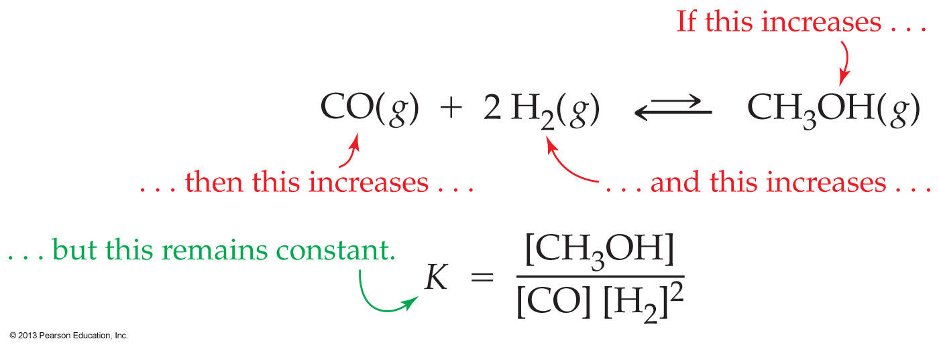
Effect of Changes in Concentration: Adding more product
So what happens if we add more product to a reaction that has already reached equilibrium?
If more product is added to the reaction at equilibrium
the rate of the reverse reaction will increase until equilibrium is reestablished

Slide 145
If a reactant is continuously supplied or a product is continuously removed
then equilibrium can never be reached
Metabolic reactions sometimes take advantage of this effect, with one reaction prevented from reaching equilibrium by the continuous consumption of its product in a further reaction

Slide 146
‘Adding’ pressure and temperature
to a reaction already at equilibrium

Slide 147
It is easy to visualize what happens when a physical stressor (reactant / product) is added to a reaction already at equilibrium
We move now to ‘adding’ non physical stressors
pressure and temperature
Many students find the impact of changing pressure or temperature more difficult to visualize

Slide 148
Our next examples (changing pressure and temperature) obey the same logic as does the addition of physical stressors to a reaction already at equilibrium
But the examples are more difficult to visualize because temperature and pressure are not physical ‘things’

Slide 149
Pressure and Temperature
Metaphorically we may say: Pressure is a reactant (in the direction the reaction is written)
Bottom line: you have to completely understand the previous slides before you can hope to understand where we are going

Slide 150
Changes in Pressure on equilibrium

Slide 151
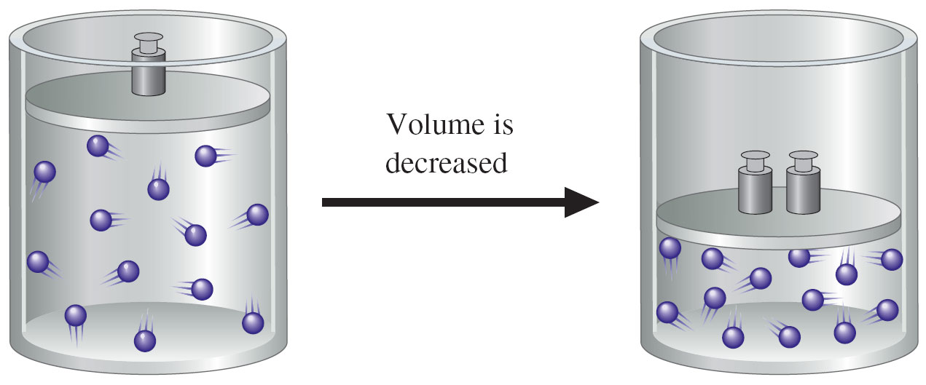
Changes in Pressure on equilibrium
Pressure influences an equilibrium only if one or more of the substances involved is a gas
pressure has no effect on liquids or solids because they are already fully condensed!

Slide 152
Changes in Pressure on equilibrium
Notice that an increase in pressure has the effect of increasing concentration for the gas
So logically, a change in pressure also has no effect on the final equilibrium constant K

Slide 153
Changes in Pressure on equilibrium
Increasing the pressure shifts the equilibrium in the direction that decreases the number of molecules in the gas phase – until equilibrium is reestablished

Slide 154
So pressure is a reactant in the direction toward fewer moles of gas
Because going from 4 moles of gas to 2 moles of gas relieves pressure in a fixed container

Slide 155
Changes in Temperature on equilibrium

Slide 156
Changes in Temperature on equilibrium
Unlike changes in concentration and pressure, a change in temperature DOES permanently change the value for the equilibrium constant K

Slide 157
Changes in Temperature on equilibrium
Note this reaction is exothermic to the right and endothermic to the left
So we say that
heat is a product in the exothermic direction
heat is a reactant in the endothermic direction

Slide 158
Changes in Temperature on equilibrium
Equilibrium reactions are therefore always
exothermic in one direction
and endothermic in the other
An increase in temperature will cause an equilibrium to permanently shift in favor of the endothermic reaction so the additional heat can be continually absorbed

Slide 159
Changes in Temperature on equilibrium
A decrease in temperature will cause an equilibrium to shift in favor of the exothermic reaction, so additional heat is released
Try to think of heat as a reactant or product
Heat as reactant => means heat is being applied
Heat as product => means heat is being given off

Slide 160
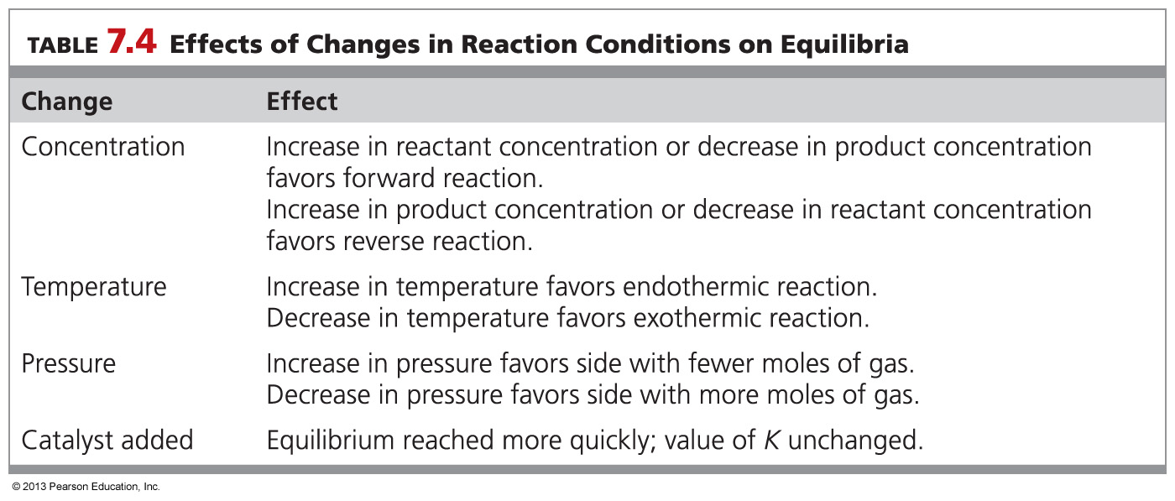

Slide 161
What effects will (1) increasing the temperature and (2) decreasing the pressure have on the concentration of water formed in this reaction at equilibrium? 2 H₂(g) + O₂(g) → 2 H₂O(g) ΔH = –58 kcal/mol
(1) decrease, (2) increase
(1) increase, (2) decrease
(1) decrease, (2) decrease
(1) increase, (2) increase

Slide 162
What effects will (1) adding more H₂ and (2) decreasing the volume have on the concentration of water formed in this reaction at equilibrium? 2 H₂(g) + O₂(g) → 2 H₂O(g) ΔH = –58 kcal/mol
(1) decrease, (2) increase
(1) increase, (2) decrease
(1) decrease, (2) decrease
(1) increase, (2) increase

Slide 163
Summary
Equilibria are affected by changes in:
Temperature (changes K)
Concentration (no effect on K)
Pressure (no effect on K)
But equilibria are not affected at all by:
Presence of a catalyst
A catalyst simply reduce the time it takes to reach equilibrium
because it speeds up both the forward and reverse reactions equally

Slide 164
Worked Example 7.10 Le Châtelier’s Principle and Equilibrium Mixtures
Nitrogen reacts with oxygen to give NO:
Explain the effects of the following changes on reactant and product concentrations:
(a) Increasing temperature (b) Increasing the concentration of NO
(c) Adding a catalyst

Slide 165
Worked Example 7.10 Le Châtelier’s Principle and Equilibrium Mixtures
Nitrogen reacts with oxygen to give NO:
Explain the effects of the following changes on reactant and product concentrations:
(a) Increasing temperature (b) Increasing the concentration of NO
(c) Adding a catalyst
Solution
(a) The reaction is endothermic (positive ), so increasing the temperature favors the forward reaction. The
concentration of NO will be higher at equilibrium.
(b) Increasing the concentration of NO, a product, favors the reverse reaction. At equilibrium, the concentrations of
both and , as well as that of NO, will be higher.
(c) A catalyst accelerates the rate at which equilibrium is reached, but the concentrations at equilibrium do not change.

Slide 166
fyi
Coupled Reactions
Coupling of reactions is a common strategy in both biochemical and industrial applications.
An endergonic reaction will not proceed spontaneously, but can be coupled to an exergonic reaction so that it will proceed.
An important example of coupled reactions in biochemistry is the endergonic phosphorylation of glucose, which is combined with the hydrolysis of adenosine triphosphate (ATP) to form adenosine diphosphate (ADP), an exergonic process.
Heat generated by the coupled reactions can be used to maintain body temperature.

Slide 167
Chapter Summary

Slide 168
What energy changes take place during reactions?
The strength of a covalent bond is measured by its bond dissociation energy, the amount of energy that must be supplied to break the bond in an isolated gaseous molecule.
For any reaction, the heat released or absorbed by changes in bonding is called the heat of reaction, or enthalpy change.
If the total strength of the bonds formed in a reaction is greater than the total strength of the bonds broken, then heat is released and the reaction is said to be exothermic.
If the total strength of the bonds formed in a reaction is less than the total strength of the bonds broken, then heat is absorbed and the reaction is said to be endothermic.

Slide 169
What is “free energy,” and what is the criterion for spontaneity in chemistry?
Spontaneous reactions are those that, once started, continue without external influence.
Nonspontaneous reactions require a continuous external influence.
Spontaneity depends on the amount of heat absorbed or released in a reaction (ΔH) and the entropy change (ΔS), which measures the change in molecular disorder in a reaction.
Spontaneous reactions are favored by a release of heat (negative ΔH) and an increase in disorder (positive ΔS).
The free-energy change ΔG takes both factors into account, according to the equation ΔG = ΔH − TΔS.
A negative value for ΔG indicates spontaneity, and a positive value for ΔG indicates nonspontaneity.

Slide 170
What determines the rate of a chemical reaction?
A chemical reaction occurs when reactant particles collide with proper orientation and sufficient energy.
The exact amount of collision energy necessary is called the activation energy.
A high activation energy results in a slow reaction because few collisions occur with sufficient force, whereas a low activation energy results in a fast reaction.
Reaction rates can be increased by raising the temperature, by raising the concentrations of reactants, or by adding a catalyst, which accelerates a reaction without itself undergoing any change.

Slide 171
What is chemical equilibrium?
A reaction that can occur in either the forward or reverse direction is reversible and will ultimately reach a state of chemical equilibrium.
At equilibrium, the forward and reverse reactions occur at the same rate, and the concentrations of reactants and products are constant.
Every reversible reaction has a characteristic equilibrium constant (K), given by an equilibrium equation.

Slide 172
What is Le Châtelier’s principle?
Le Châtelier’s principle states that when a stress is applied to a system in equilibrium, the equilibrium shifts so that the stress is relieved.
Applying this principle allows prediction of the effects of changes in temperature, pressure, and concentration.

