Slide 1
to do
my students need to partner up
put chapter self tests on website
copy 6 lab reports

Slide 2
http://www.laney.edu/wp/vsmall/

Slide 3
vsmall
WAjzgMBltbiu

Slide 4
Added to website [http://www.laney.edu/wp/vsmall/]
Self Test ch 1
Due today: none
Ch 1 homework due: Thursday, 4 sep

Slide 5
Today’s Lecture
Ch 2: Atoms and the Periodic Table
2.1 Atomic Theory
2.2 Elements and Atomic Number
2.3 Isotopes and Atomic Weight
2.4 The Periodic Table
2.5 Some Characteristics of Different Groups
Today’s Lab:
Exp 1: Metric Measurements
Remember to print out each Lab Report before class

Slide 6
Next Lecture
Ch 2: Atoms and the Periodic Table
2.6 Electronic Structure of Atoms
2.7 Electron Configurations
2.8 Electron Configurations and the Periodic Table
2.9 Electron-Dot Symbols
Next Lab
Exp 4: Graph (shorten)

Slide 7
Coming soon
Schedule change:

Slide 8
General Issues
This is a “Last Name First” class
Put last name first on all assignments, quizzes, exams, Scantrons, etc
Points will be taken off
I frequently call on students in the during lecture. Please let me know if you prefer not being called on.
Chemistry Tutors:
Tutoring program in Student Center (Lisa Cook)
Always have a (simple) scientific calculator with you in class
especially for quizzes and exams
Homework always due 1 week after chapter finished

Slide 9
Tutoring is being set up for chemistry

Slide 10
Lab Report Form Etiquette
Put lab instructor’s name on the top of everything you hand in
Do not staple multiple labs together (-5 points)

Slide 11
Web site
http://www.laney.edu/wp/vsmall/
On this web site I will post
Syllabus package
Current lecture PowerPoint's (by chapter)
Useful handouts (by chapter)
Lab reports

Slide 12
We will communicate by email:
chemsmall789@gmail.com
Please email me at this address with the email address you want me to be using for the course (Roster to come)
I will copy and paste your email address

Slide 13
Scott’s email
scott.beaver17@yahoo.com

Slide 14
Office hours
Dr Small, CHEM 30A (40573 Lecture )
Mon / Wed: 12:30 – 1:00 pm
Where: Rm A239 (right here)

Slide 16
Important dates for Chem 30A
2 Sep Census date
8 Sep Last day for Pass/No pass option
15 Nov Last day to withdraw with a ‘W’
10 Dec Noon – 2 pm, Tue, here or in lab

Slide 17
regarding roster slides
If there is a ‘V’ to the left of your name, you are in my lab (Dr. Small)
Otherwise, you’re in Scott’s lab.
Please check for mistakes
Also check email

Slide 18
Check
your
email
addresses

Slide 19
Check
your
email
addresses

Slide 20
Start lecture

Slide 21
Today’s lab
Help me remember to hand back corrected labs

Slide 22
Today’s lab
Exp 1: Metric Measurements
Use metric balances – not beam balances
Record all digits from the metric balance
they are all significant
Do not drop your metal piece directly into a glass graduated cylinder -- it will break
Skip parts 7 & 8
No chemicals today!

Slide 23
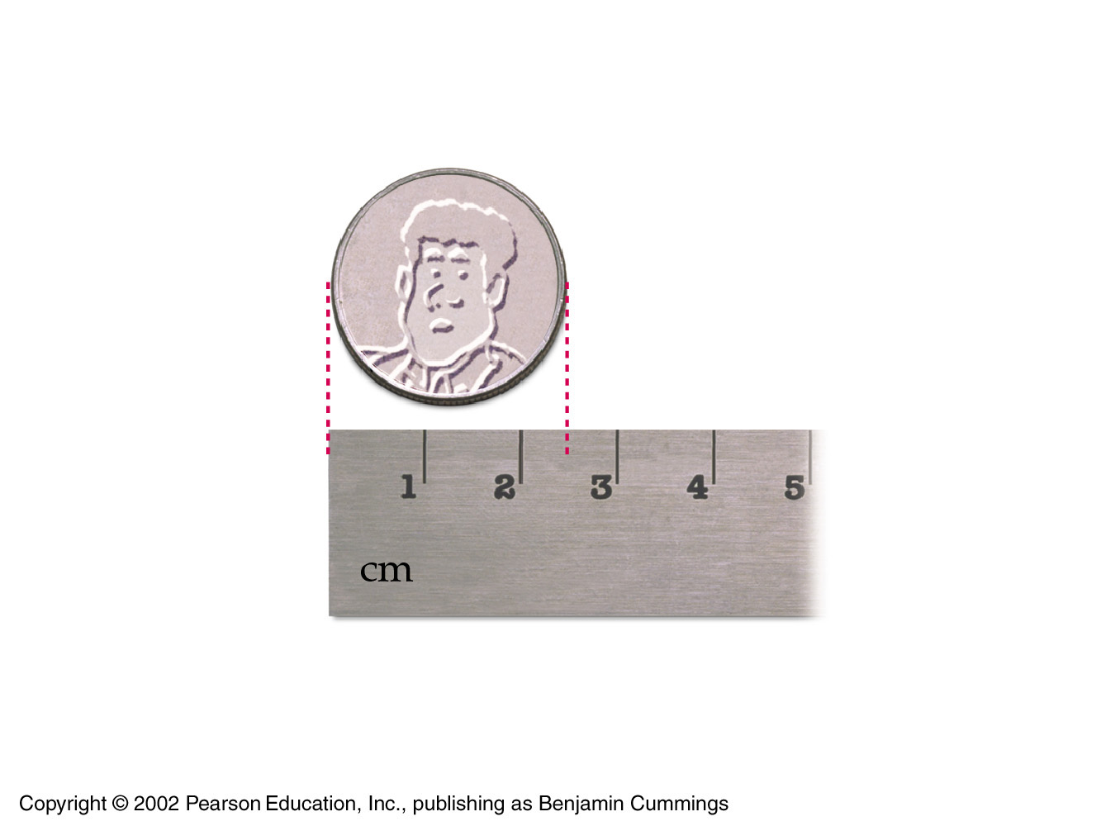
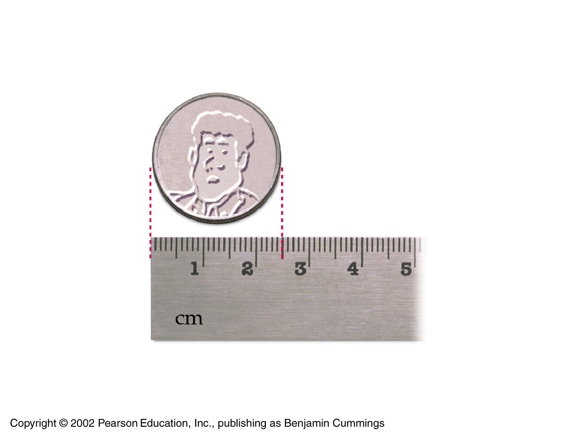
We will interpolate today!
How many sig figs on top?
How many sig figs on bottom?
23

Slide 24
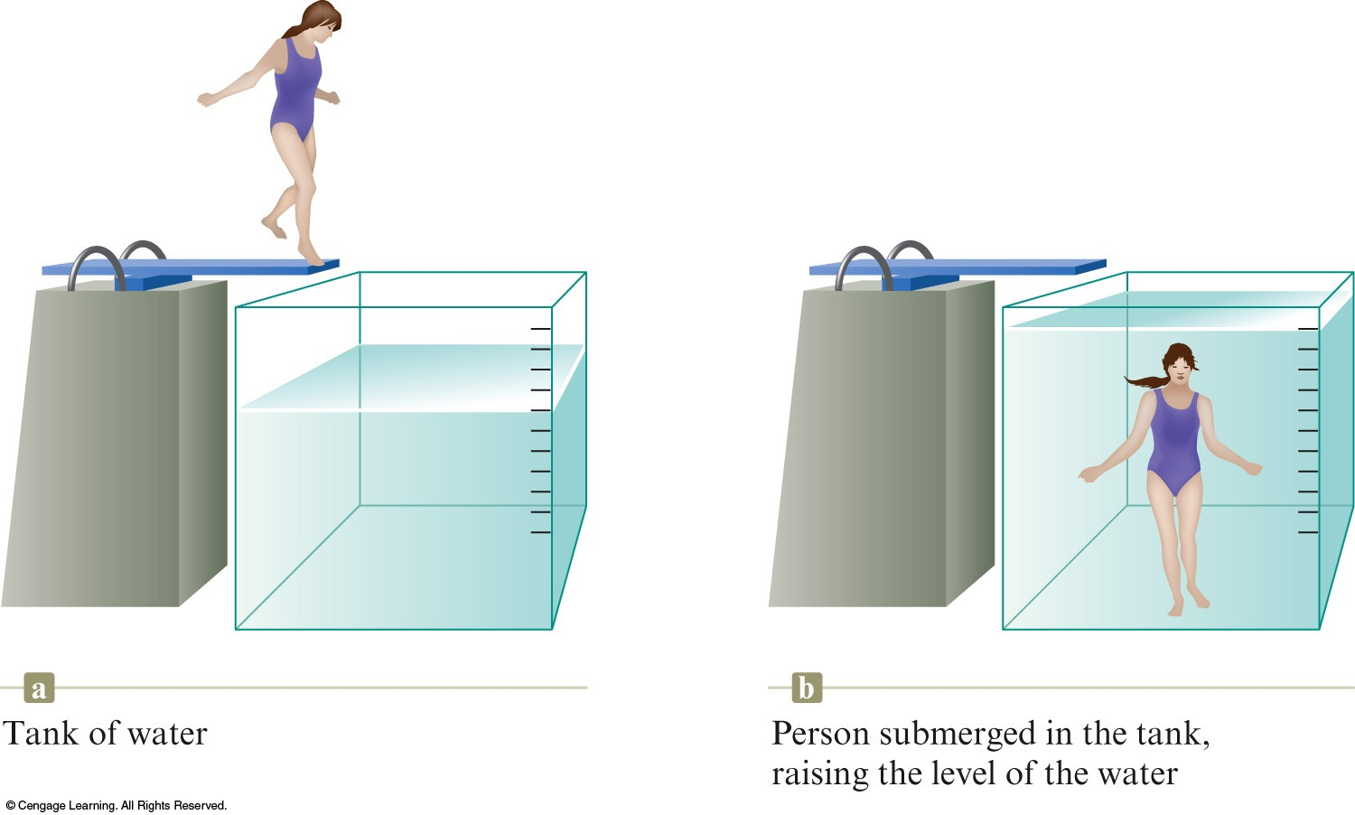
Measuring the Volume of a Solid Object by Water Displacement

Slide 25
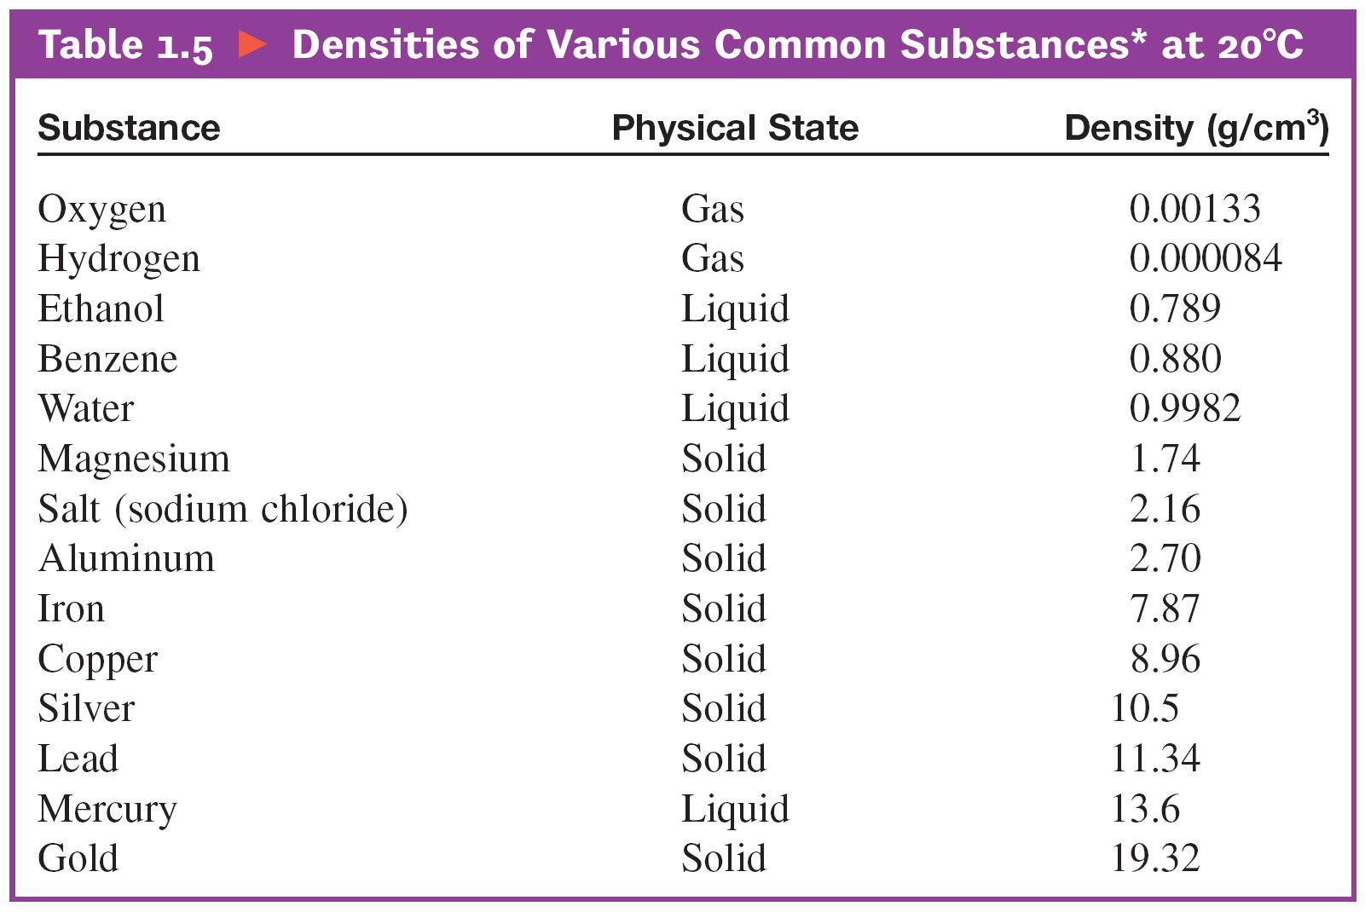
A piece of metal (mass = 47.5432 g) is placed in 10.1 mL of chloroform (d = 1.498 g/mL) in a 25 mL graduated cylinder. The chloroform level increases to 15.46 mL. The best value for density of this metal from these data is
A) 3.4 g/mL.
B) 1.20 g/mL.
C) 8.9 g/mL.
D) 5.17 g/mL.
E) 8.87 g/mL.
Ans: C
what element might it be?

Slide 26
Lab Dress Codes
If you are not dressed properly, you will have to miss the lab
don’t miss over 3 labs
Covered foot wear
lab glasses
etc
See the movie

Slide 27
Lab Issues
Broken glassware costs money
Until you pay your bill
you won’t get any grades from Peralta
you won’t be able to register at Peralta
Hand-backs: quizzes, exams, labs, homework, etc
Will take place mostly during lab
Please email me concerning any class you will be missing
This will help your lab partner

