Slide 1
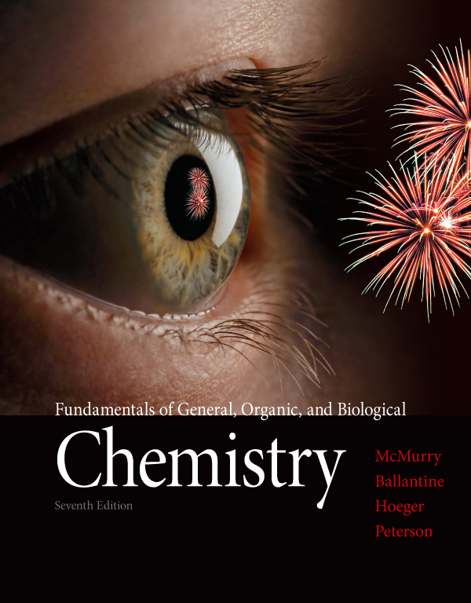
Chapter Ten
Chapter 10 Lecture
Fundamentals of General, Organic, and Biological Chemistry
7th Edition
McMurry, Ballantine, Hoeger, Peterson
Acids and Bases
Julie Klare
Gwinnett Technical College
© 2013 Pearson Education, Inc.

Slide 2
Outline
10.1 Acids and Bases in Aqueous Solutions
10.2 Some Common Acids and Bases
10.3 The Brønsted–Lowry Definition of Acids and Bases
10.4 Acid and Base Strength [definition of strong & weak only]
10.5 Acid Dissociation Constants [lightly]
10.6 Water as Both an Acid and a Base
10.7 Measuring Acidity in an Aqueous Solution: pH
10.8 Working with pH
10.9 Laboratory Determination of Acidity
10.10 Buffer Solutions
10.11 Acid and Base Equivalents
10.12 Some Common Acid-Base Reactions
10.13 Titration
10.14 Acidity and Basicity of Salt Solutions [skip]

Slide 3
go to slide 62

Slide 4
Goals
What are acids and bases?
Be able to recognize acids and bases and write equations for common acid–base reactions.
What effect does the strength of acids and bases have on their reactions?
Be able to interpret acid strength using acid dissociation constants K_{a} and predict the favored direction of acid–base equilibria.
What is the ion-product constant for water?
Be able to write the equation for this constant and use it to find the concentration of H⁺ or OH–.
4. What is the pH scale for measuring acidity?
Be able to explain the pH scale and find pH from the H₃O⁺ concentration.
5. What a buffer?
Be able to explain how a buffer maintains pH and how the bicarbonate buffer functions in the body.
6. How is the acid or base concentration of a solution determined?
Be able to explain how a titration procedure works and use the results of a titration to calculate acid or base concentration in a solution.

Slide 5
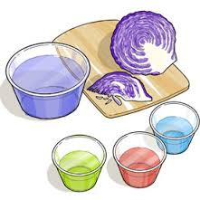
10.1 Acids and Bases in Aqueous Solution

Slide 6
Acids
Among the ancients, acids were perhaps the first substances conceptualized as “chemicals”
Taste sour
Turn water extracts red of certain lichens and cabbages
Later the alchemists discovered that ‘strong’ acids react with some metals to evolve a flammable gas (hydrogen)

Slide 7
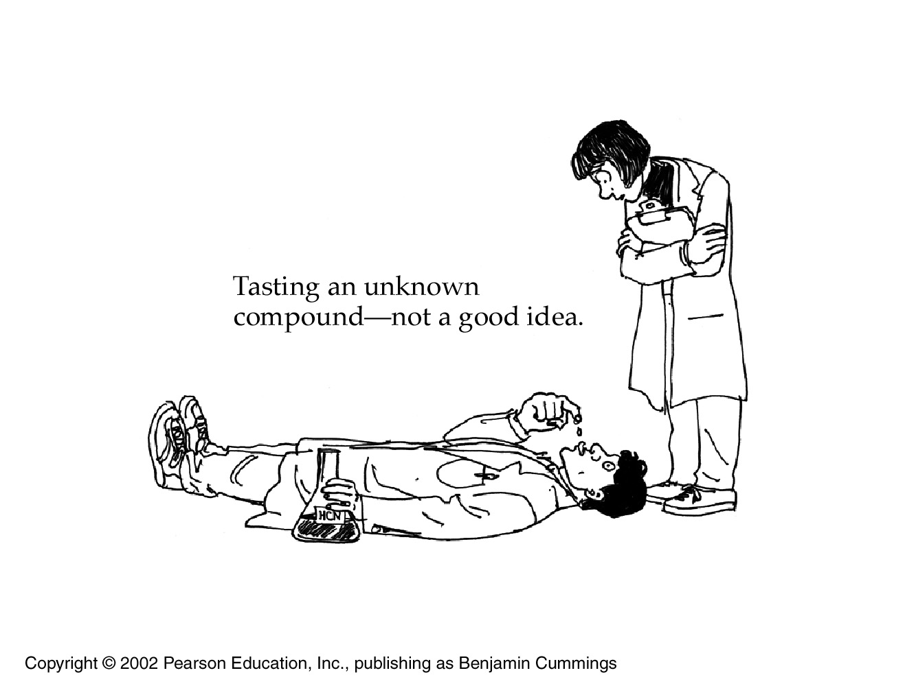
In Latin, the word acidus means sour

Slide 8
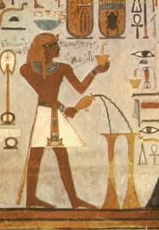
Making battery acid
FYI
Perhaps our oldest ‘chemical’ is sulfuric acid, prepared by heating vitriol, a pretty blue mineral found in the Egyptian desert
A very toxic gas (SO₃) is given off which is then bubbled through water

Slide 9
The ‘opposite’ of acids are… Bases
Among the ancients, bases were already thought of as “the opposite of acids”
Taste bitter
Turned an aqueous solution of litmus, blue
Produced aqueous solutions that felt slippery to the touch
Neutral substances are soluble chemicals (molecules or salts) which are neither acids nor bases
Salts are the neutralization product of acids and bases

Slide 10
The original Arrhenius theory (late 1880s)
An acid is a substance that releases hydrogen ions, H⁺, when dissolved in water
Chemist generally refer to H⁺ as a proton
A base is a substance that releases hydroxide ions, OH– when dissolved in water
The neutralization reaction of an acid (H⁺) with a base (OH–) yields water (H₂O) plus a salt
HCl(aq) + NaOH(aq) → H₂O(l) + NaCl(aq)

Slide 11
fyi
Acids have a magical chemistry because
If the proton were the size of a golf ball
Everything else in solution is the size of the astrodome

Slide 12
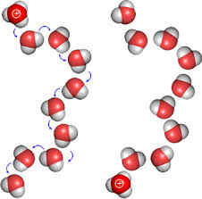
But we now know the H⁺ ion is so reactive that it never really exists in water as an isolated species
It reacts with H₂O to produce the hydronium ion, H₃O⁺
Unfortunately, the terms H₃O⁺(aq) and H⁺(aq) will often be used interchangeably
But Arrhenius was correct
about (strong) bases.
They do simply release
OH– into water.

Slide 13
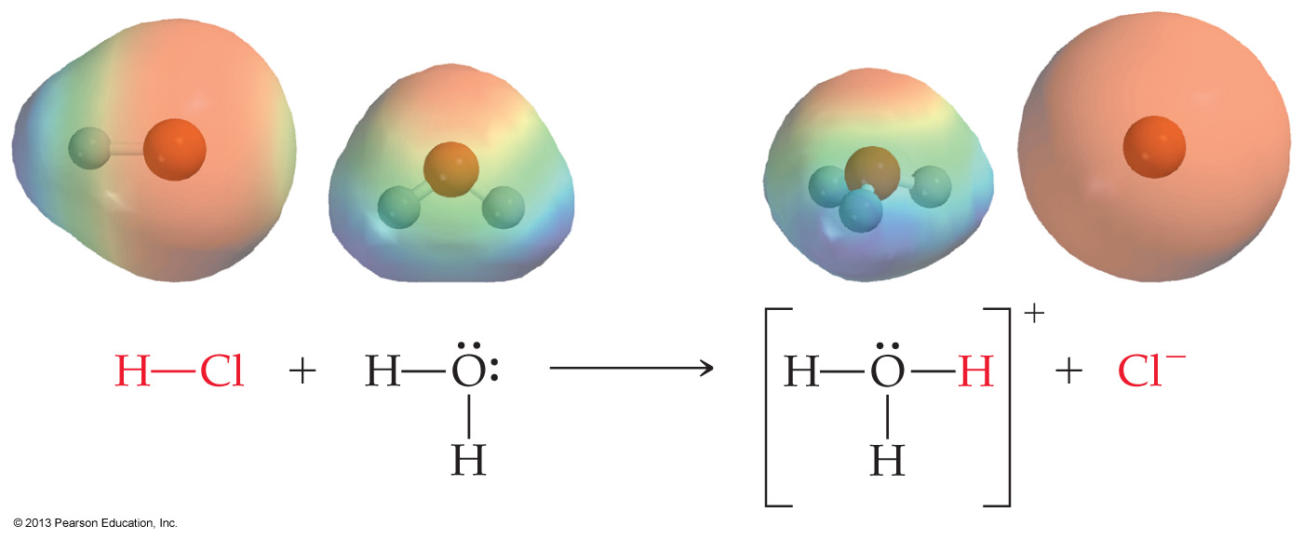
(Modified) Arrhenius Acid
When the gaseous molecule HCl dissolves in water
it instantly ionizes, then
H⁺ is released via dissociation, then
H⁺ instantly reacts with water to produce H₃O⁺

Slide 14
FYI
HBr, HI, H₂S and HCN are also gaseous molecules in the absence of water
Like HCl, bubbled into water they first must ionize and then dissociate
Water can accommodate up to 37 mass-% HCl
The mineral acid H₂SO₄ needs water to exist—it is a hydrate
In the presence of water, gaseous SO₃ hydrates to H₂SO₄ – a totally new substance
Any mineral acid is already ionic (H₂SO₄, HNO₃), so it can always dissociate – given enough ‘free’ water to donate a proton to
Mineral acids usually contain oxygen

Slide 15
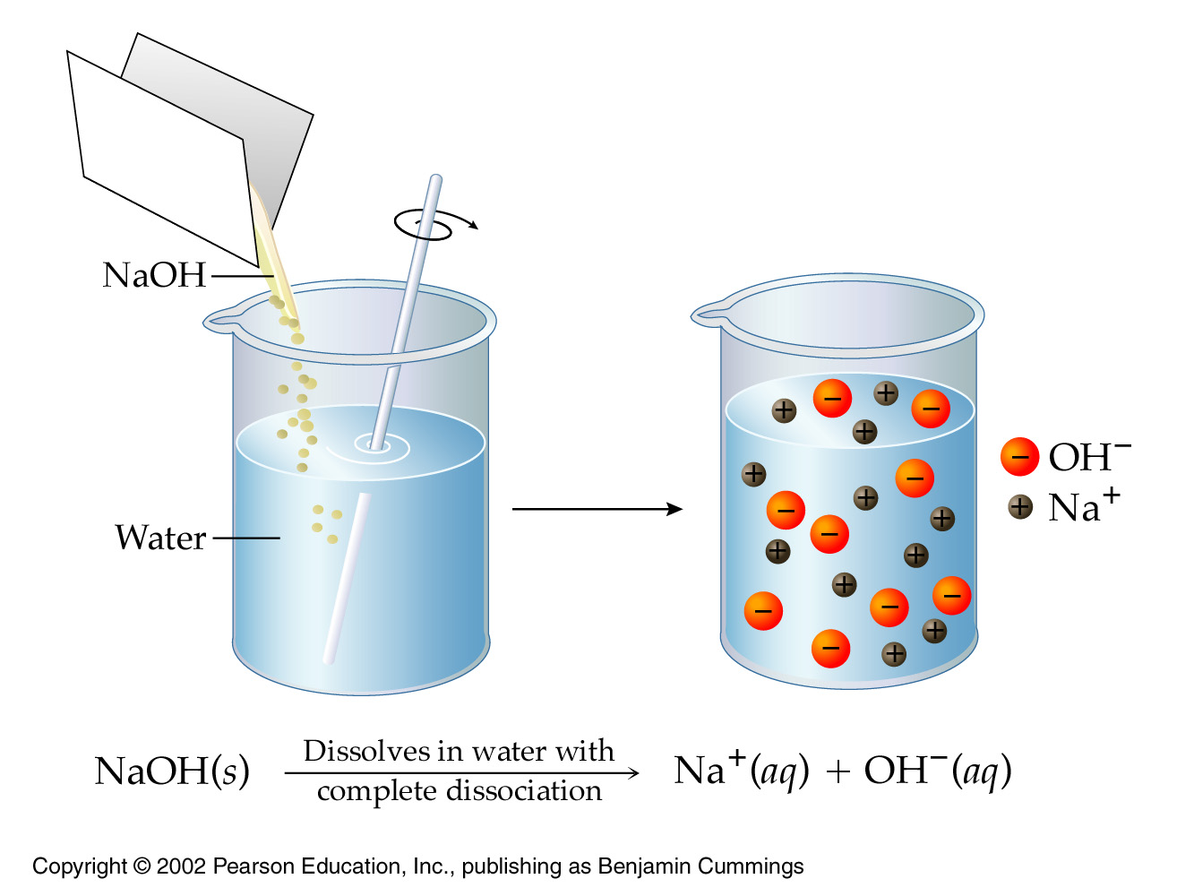
Arrhenius (strong) bases
A metal hydroxide such as NaOH directly releases the hydroxide ion (OH–) when dissolved in water
This is unchanged
from the original
Arrhenius theory

Slide 16
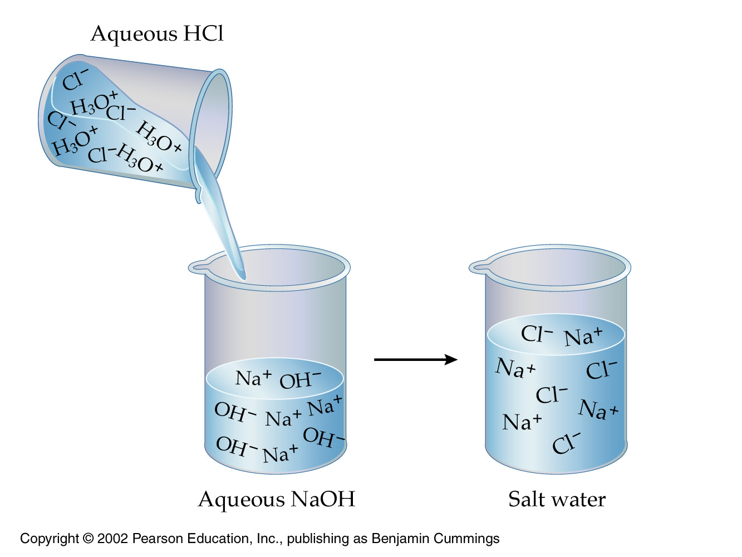
The neutralization reaction of an acid with a base yields water plus a salt

Slide 17
FYI
OH– ions come from two sources
Metal hydroxides are ionic compounds that release OH– ions when they dissolve in water
Some molecular compounds such as ammonia react with water to produce OH– ions in situ
So strictly, ammonia is not an Arrhenius base
© 2013 Pearson Education, Inc.

Slide 18
10.2 Some Common Acids and Bases
© 2013 Pearson Education, Inc.

Slide 19
Acids are present in many foods:
Lemons, oranges, and grapefruit contain citric acid, and sour milk contains lactic acid
Bases are present in many household cleaning agents
bar soap, ammonia-based window cleaners, drain openers
It is a good idea to learn the names and formulas of common acids and bases
© 2013 Pearson Education, Inc.

Slide 20
The remaining slides in this section
are left as an exercise for the student
Notice which polyatomics are involved

Slide 21
Sulfuric acid, H₂SO₄, (strong-mineral) is manufactured in greater quantity worldwide than any other industrial chemical
It is the acid found in automobile batteries
highly corrosive and can cause painful burns
Hydrochloric acid, HCl, (strong-molecular) or muriatic acid, has many industrial applications
Metal cleaning, the manufacture of high-fructose corn syrup
Aqueous HCl is stomach acid in the digestive system
© 2013 Pearson Education, Inc.

Slide 22
Nitric acid, HNO₃, (strong-mineral) is a strong oxidizing agent that is used for the manufacture of ammonium nitrate fertilizer and military explosives
When spilled on the skin, it leaves a characteristic yellow coloration because of its reaction with skin proteins
Phosphoric acid, H₃PO₄, (weak-mineral) is used in phosphate fertilizers, and as an additive in foods and toothpastes
The tart taste of many soft drinks is due to the presence of phosphoric acid
Acetic acid, CH₃CO₂H, (weak-organic molecular) is the primary constituent of vinegar
It occurs in all living cells and is used in the preparation of solvents, lacquers, and coatings
© 2013 Pearson Education, Inc.

Slide 23
Sodium hydroxide, NaOH, (strong-mineral) caustic soda or lye, is the most commonly used of all bases
It is used in the production of aluminum, glass, soap, and drain cleaners, and hair straightener (relaxer)
Concentrated solutions can cause severe burns
Calcium hydroxide, Ca(OH)₂, (moderate-mineral) or slaked lime, is made by treating lime (CaO) with water
It is used in mortars and cements
Aqueous Ca(OH)₂ is limewater
Magnesium hydroxide, Mg(OH)₂, (weak-mineral) or milk of magnesia, is an additive in foods, toothpaste, and over-the-counter medications.
Antacids contain magnesium hydroxide
Ammonia, NH₃, (weak-molecular) is used primarily as a fertilizer, but has industrial applications including pharmaceuticals and explosives
A dilute solution of ammonia is frequently used as a glass cleaner
© 2013 Pearson Education, Inc.

Slide 24
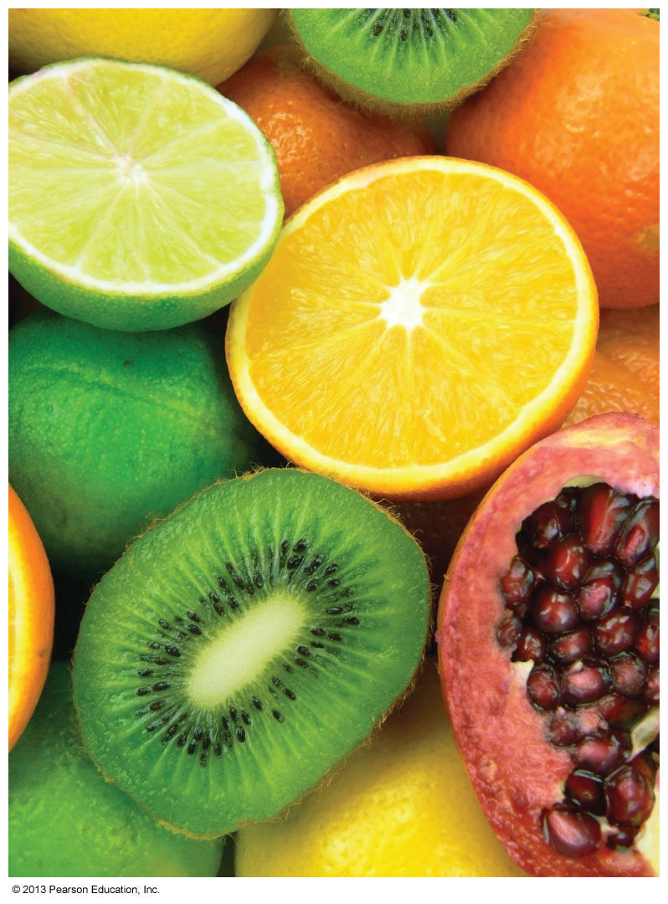
Which of the following statements is NOT true of an acid?
Many acids can be eaten.
Acids have a sour taste.
Acids are found in many household cleaning products like soap.
Acids can dissolve metals.

Slide 25
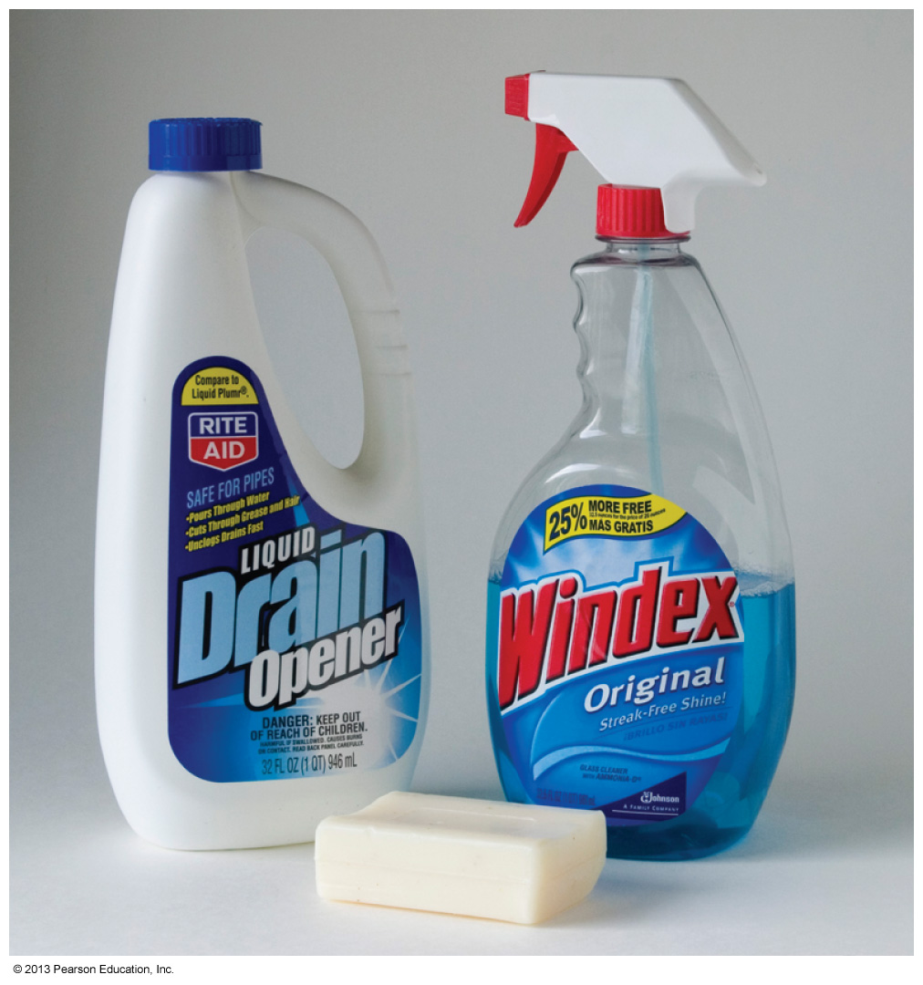
Which of the following statements is NOT true of bases?
Bases are found in many cleaning supplies.
Bases react with acids.
Bases are contained in antacids.
Bases have a sour taste.

Slide 26
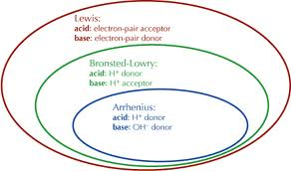
10.3 The Brønsted–Lowry Definition of Acids and Bases
© 2013 Pearson Education, Inc.

Slide 27
We have already been introduced to the original Arrhenius theory of acids and bases
recall it was limited to aqueous (water) solutions
A more general theory was proposed in 1923 by the Danish chemist Johannes Brønsted and the English chemist Thomas Lowry
Not limited to water solutions
However, in Intro Chem we will only investigate water solutions of acids and bases
© 2013 Pearson Education, Inc.

Slide 28
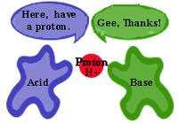
According to Brønsted and Lowry, an acid–base reaction is one in which only a proton is transferred
Acid—proton donor
Base—proton acceptor
Furthermore, an acid must coexist with a base
This was not true in the Arrhenius theory
© 2013 Pearson Education, Inc.

Slide 29
Brønsted–Lowry
According to Brønsted and Lowry, an acid must coexist with a base
Here, HCl is the acid (proton donor)
H₂O is the base (proton acceptor) forming H₃O⁺

Slide 30
According to Brønsted and Lowry, an acid–base reaction is one in which only a proton is transferred
Acid—proton donor
Base—proton acceptor
Clearly the behavior of an acid is opposite that of a base according to Brønsted and Lowry
© 2013 Pearson Education, Inc.

Slide 31
Acids can be ‘polyprotic’
Different acids can supply different numbers of H⁺ ions
Acids with one proton (eg, HCl) are monoprotic acids
H₂SO₄ is diprotic because it has two protons to donate
H₃PO₄ is triprotic because it has three protons to donate
Acidic H atoms must be bonded to electronegative atoms like oxygen and chlorine
© 2013 Pearson Education, Inc.

Slide 32
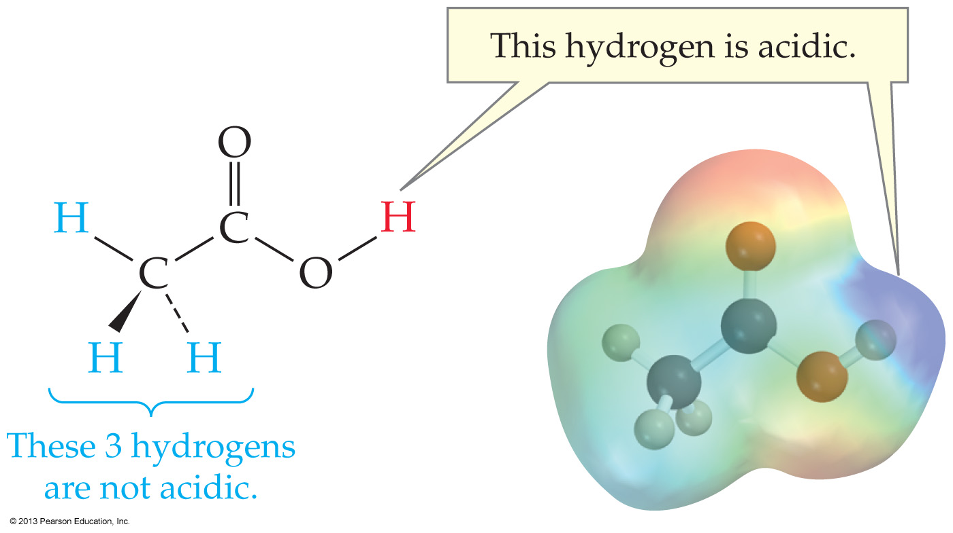
Acetic acid is a very important organic acid
In the presence of an acid, water acts as a base, but with acetic acid the products only occur at about 1%
Notes:
Chapter 10, Unnumbered Figure 2, Page 293

Slide 33
A Brønsted–Lowry base is a substance that accepts H⁺ from an acid
For example, the weak base ammonia accepts a proton from water to produce OH– ions
In the presence of a base, water acts as an acid but with ammonia the products only occur at about 4%
© 2013 Pearson Education, Inc.

Slide 34
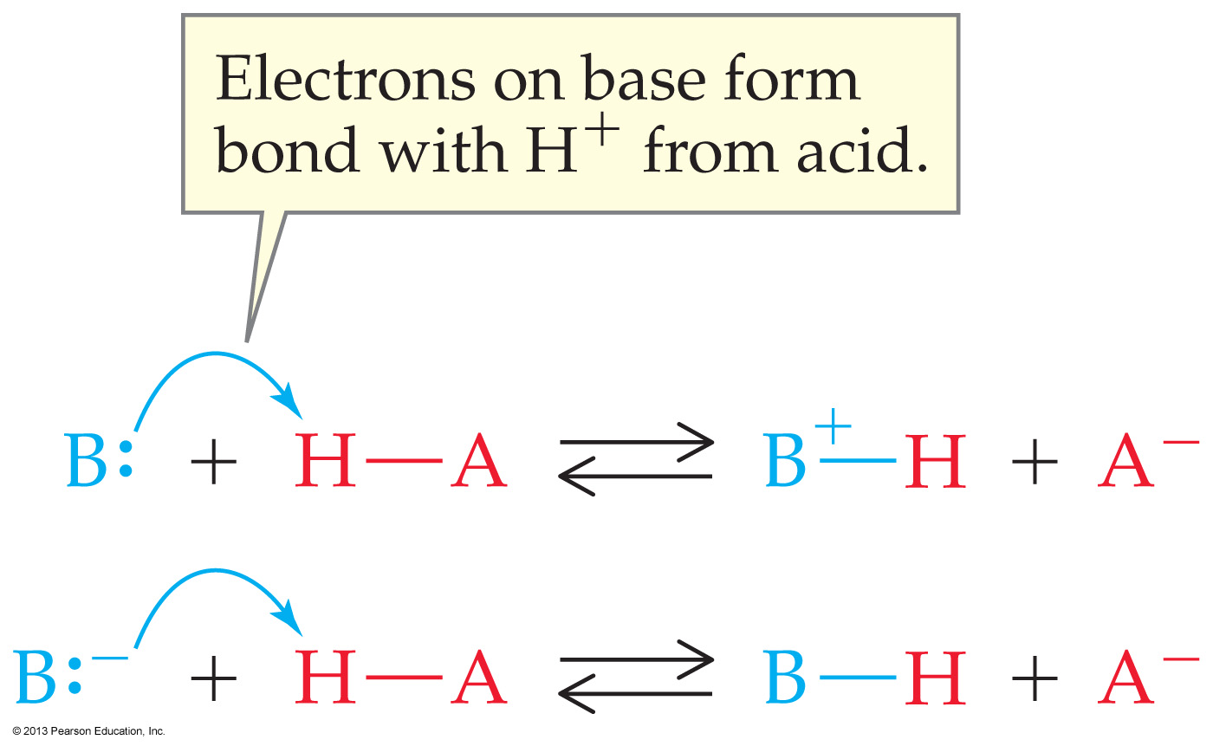
A Brønsted–Lowry base must have a lone pair of electrons to accept H⁺ from an acid
A base can be either neutral (B: eg, ammonia) or negatively charged (B:– hydroxide)
So if the base is neutral, the product has a positive charge after H⁺ is added
© 2013 Pearson Education, Inc.

Slide 35
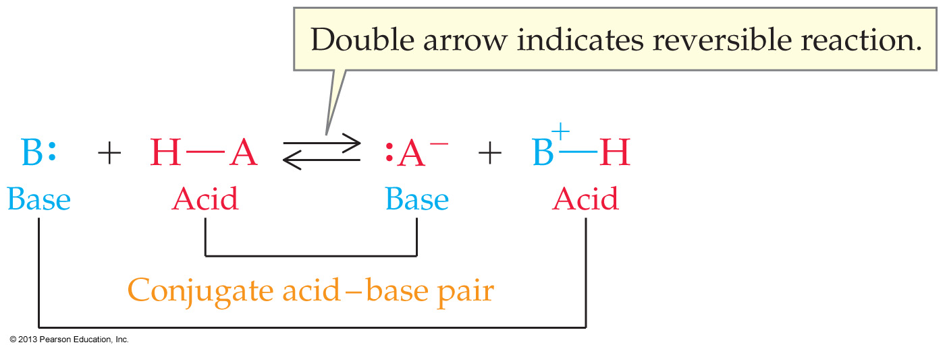
The products of an acid and base reaction are conjugate acids and conjugate bases … BUT…
only the conjugate base of a weak acid is appreciably basic (ie, accepts protons)
only the conjugate acid of a weak base is appreciably acidic (ie, donates protons)
© 2013 Pearson Education, Inc.

Slide 36
Here are some common conjugate acid–base pairs
They are found on opposite sides of a chemical reaction with formulas that differ by one H⁺ … and one H⁺ only
© 2013 Pearson Education, Inc.

Slide 37
Some weak acids and their conjugate bases
Acetic acid Acetate ion
CH₃COOH CH₃COO⁻
Carbonic acid Bicarbonate ion
H₂CO₃ HCO₃⁻
Hydrofluoric acid Fluoride ion
HF F⁻
Ammonium ion Ammonia
NH₄⁺ NH₃

Slide 38
Some weak bases and their conjugate acids
Acetate ion Acetic acid
CH₃COO⁻ CH₃COOH
Bicarbonate ion Carbonic acid
HCO₃⁻ H₂CO₃
Fluoride ion Hydrofluoric acid
F⁻ HF
Ammonia Ammonium ion
NH₃ NH₄⁺

Slide 39
Ways to Describe Acid Strength

Slide 40
Some strong acids and their conjugate ‘bases’
Hydrochloric acid Chloride
HCl Cl⁻
Nitric acid Nitrate
HNO₃ NO₃⁻
Note: the conjugate ‘base’ of a strong acid is always a weaker base than water
Meaning it does not accept a proton back in water solution

Slide 41
FYI
If Cl⁻ were appreciably basic, than a glass of salt water (NaCl) would be basic and bitter
If NO₃⁻ were basic, then hot dogs (containing NaNO₃⁻) would be bitter
CH₃COO⁻ is basic, so a glass of sodium acetate (CH₃COO⁻ Na⁺) does taste bitter

Slide 42
FYI ‘Some’ strong bases and conjugate acids
(Metal) Hydroxide Water
(Na⁺) OH⁻ H₂O
In water, OH⁻ is the only strong base possible
Its conjugate ‘acid,’ H₂O is neutral
The metal is simply a spectator. It could be any alkali or alkaline metal cation

Slide 43
Which of the following would you expect to be a Bronsted-Lowry acid?
Fe³⁺
H₂CrO₄
NH₃
NO₃–

Slide 44
Which of the following would you expect to be a Bronsted-Lowry base?
HNO₂
NH₄⁺
Ni²⁺
PO₄^{3–}

Slide 45
Worked Example 10.2 Acids and Bases: Identifying Conjugate Acid–Base Pairs
Write formulas for
(a) The conjugate acid of the cyanide ion, CN–
(b) The conjugate base of perchloric acid, HClO₄
A conjugate acid is formed by adding H⁺ to a base
A conjugate base is formed by removing H⁺ from an acid
(a) HCN is the conjugate acid of CN–
(b) ClO₄– is the conjugate base of HClO₄

Slide 46
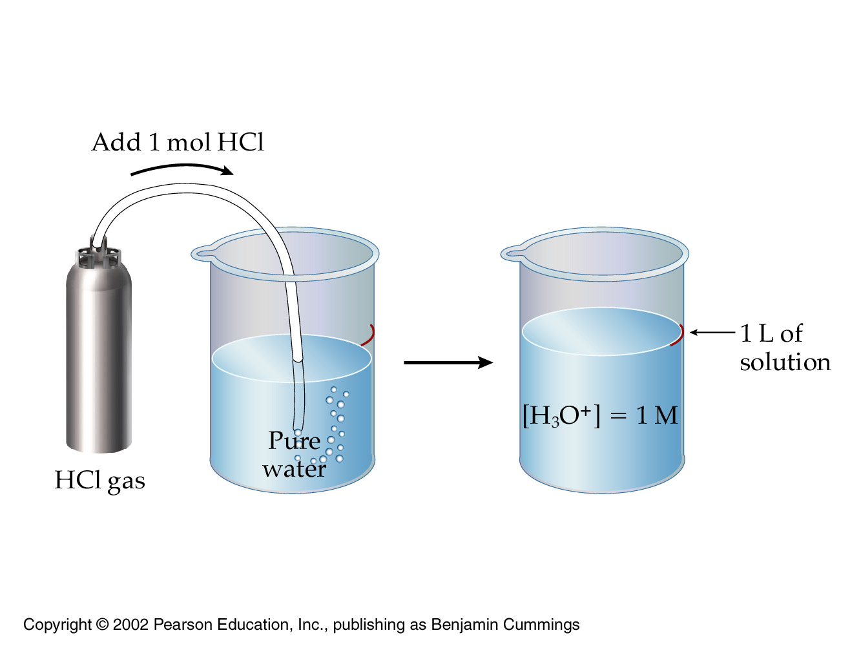
10.4 Acid and Base Strength [Cover definition of strong & weak only]
© 2013 Pearson Education, Inc.

Slide 47
Strong acids donate a proton easily
and are essentially 100% dissociated in water
Thus the concentration of H⁺ is the same as the concentration of the added strong acid
Weak acids donate a proton with difficulty
and are substantially less than 100% dissociated in water
Thus the concentration of the H⁺ is always considerably less than the concentration of the added weak acid
Strong bases hold a proton tightly
Weak bases hold a proton less tightly
© 2013 Pearson Education, Inc.

Slide 48
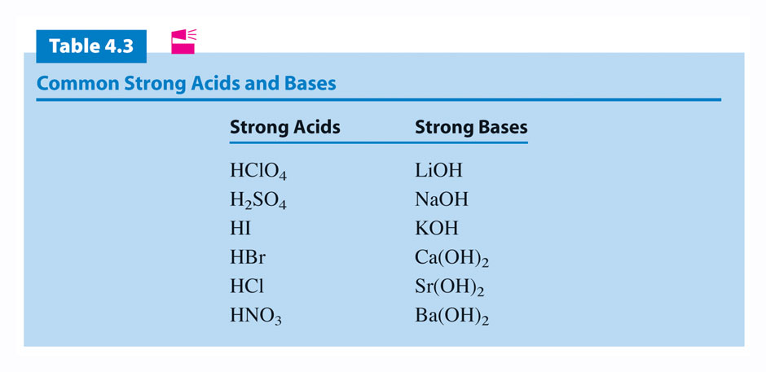
In Intro and Gen Chems:
If it isn’t on this list it isn’t strong

Slide 49
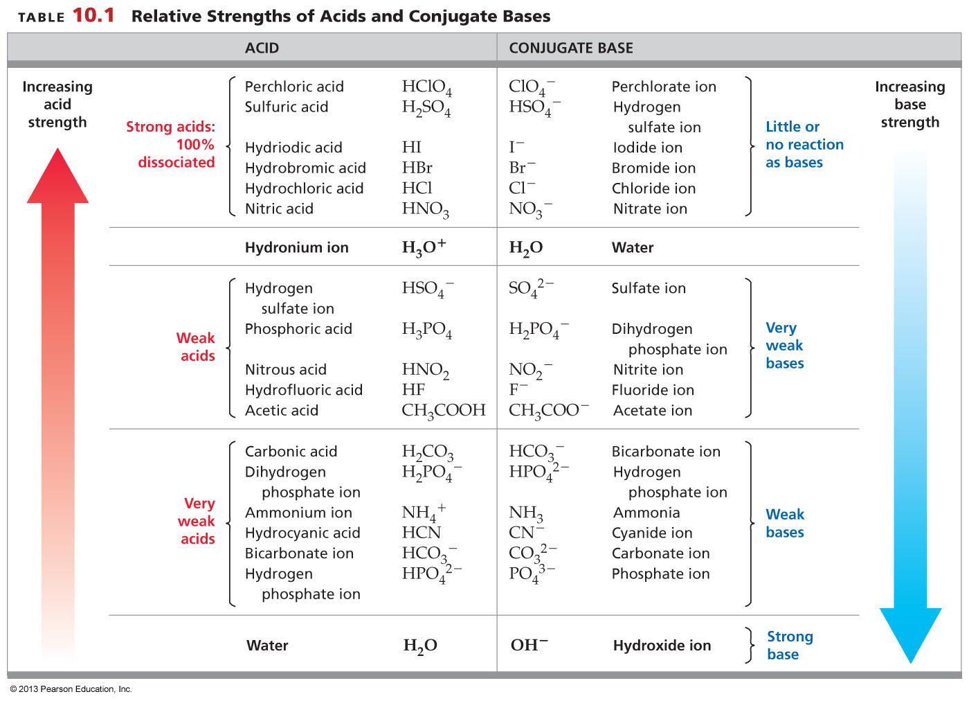
© 2013 Pearson Education, Inc.

Slide 50
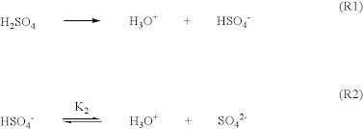
Polyprotic acids undergo stepwise dissociations in water
The first dissociation occurs to the extent of 100% when the acid is strong
The second dissociation takes place to a much lesser extent
because removal of a positively charged H⁺ from a negatively charged anion is difficult
© 2013 Pearson Education, Inc.

Slide 51
There is an inverse relationship between acid strength and base strength
The stronger the acid, the weaker its conjugate base
the weaker the acid, the stronger its conjugate base
Conjugate acid/base pairs
© 2013 Pearson Education, Inc.

Slide 52
Skip to the next section

Slide 53
There is an inverse relationship between acid strength and base strength
The stronger the acid, the weaker its conjugate base
the weaker the acid, the stronger its conjugate base
Knowing the relative strengths of acids makes it possible to predict proton-transfer reactions
An acid–base proton-transfer equilibrium always favors reaction of the stronger acid with the stronger base
and thereby, formation of the weaker acid and base
For example, if HCl is added to pure water
water must act as a base
If HCl is added to a solution containing water and NaOH
NaOH acts as the base
© 2013 Pearson Education, Inc.

Slide 54
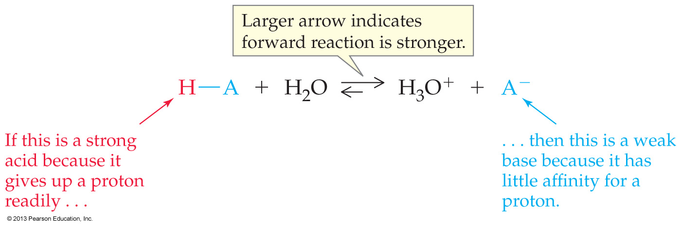

Slide 55
Notes:
Chapter 10, Unnumbered Figure 4, Page 298

Slide 56
BrØnsted-Lowry concept of conjugate acid base pairs
HA(aq) H₂O(l) H₃O⁺(aq) A^{ˉ}(aq)
acid base conjugate conjugate acid base

Slide 57
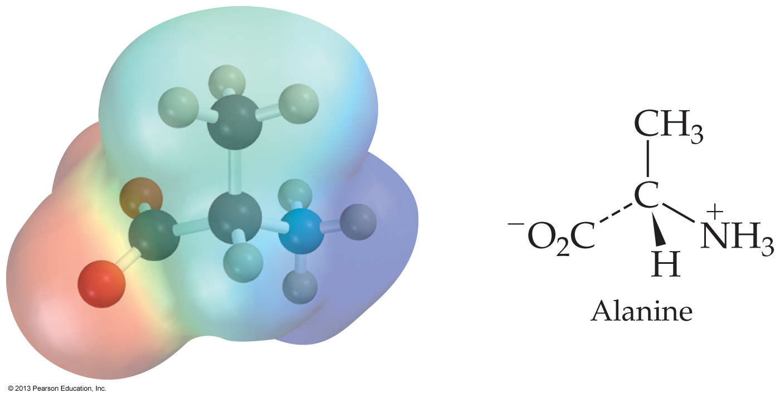
Shown below is the zwitterion of the amino acid alanine. The zwitterion can serve as _______.
both an acid and a base
only an acid
only a base
neither an acid not a base

Slide 58
Worked Example 10.3 Acid/Base Strength: Predicting Direction of H-transfer Reactions
Write a balanced equation for the proton-transfer reaction between phosphate ion (PO₄3–) and water, and determine in which direction the equilibrium is favored.
Analysis
Look in Table 10.1 to see the relative acid and base strengths of the species involved in the reaction. The acid–base proton-transfer equilibrium will favor reaction of the stronger acid and formation of the weaker acid.
Solution
Phosphate ion is the conjugate base of a weak acid (HPO₄^{2–}) and is therefore a relatively strong base. Table 10.1 shows that HPO₄^{2–} is a stronger acid than H₂O, and OH– is a stronger base than PO₄^{3–}, so the reaction is favored in the reverse direction:

Slide 59
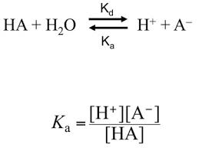
10.5 Acid Dissociation Constants
© 2013 Pearson Education, Inc.

Slide 60
The reaction of a weak acid with water, like any chemical equilibrium, can be described by an equilibrium equation
Recall the concentration of the solvent is never included
The K_{a} values for strong acids are huge (ie, off scale), and measurements are amazingly unrepeatable
However, for a weak acid, K_{a} is small, measurable, useful
© 2013 Pearson Education, Inc.

Slide 61
Know this stuff
Strong acids (would) have K_{a} values much greater than 1 because dissociation is favored (obviously)
Weak acids have K_{a} values much less than 1 because dissociation is not favored
Donation of each successive H⁺ from a polyprotic acid like H₂SO₄ is more difficult than the one before it, so K_{a} values become successively lower for polyprotics
Most organic acids, which contain the —COOH group, have K_{a} values near 10^{–5}
© 2013 Pearson Education, Inc.

Slide 62
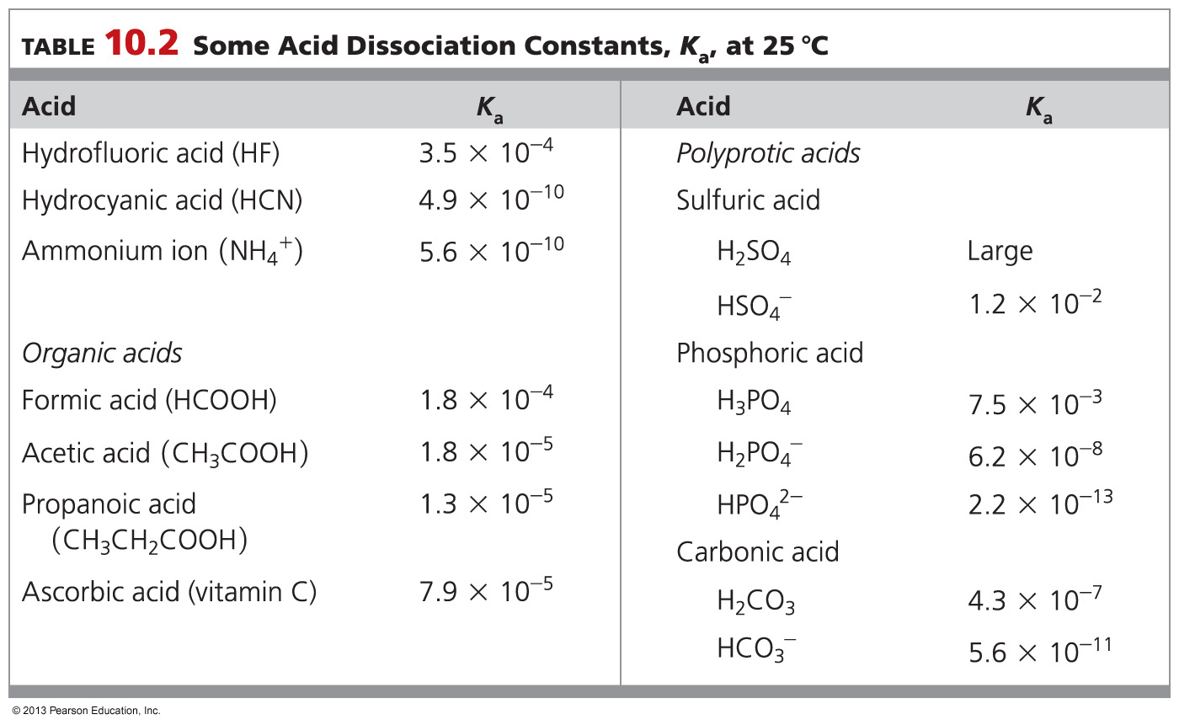
© 2013 Pearson Education, Inc.

Slide 63
Start

Slide 64
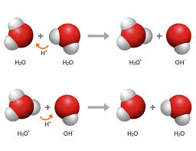
10.6 Water as Both an Acid and a Base
© 2013 Pearson Education, Inc.

Slide 65
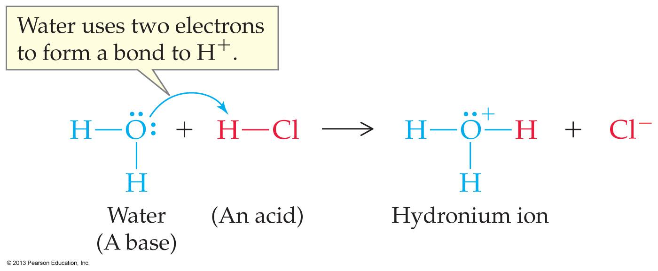
When in contact with a base, water donates a proton
When in contact with an acid, water accepts a proton
Substances which can react as either a Brönsted acid or base are called amphoteric
Water is
amphoteric
© 2013 Pearson Education, Inc.

Slide 66
K_{w} @ 25ºC
Pure water alone dissociates to form hydronium and hydroxide ions
But in pure neutral water, the concentrations of H⁺ and OH⁻ must be equal, since logically neither can dominate

Slide 67
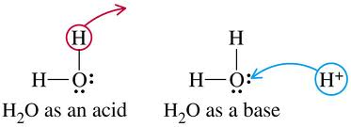
K_{w} @ 25ºC
Pure water alone dissociates to form hydronium and hydroxide ions
But in pure neutral water, the concentrations of H⁺ and OH⁻ must be equal, since logically neither can dominate

Slide 68
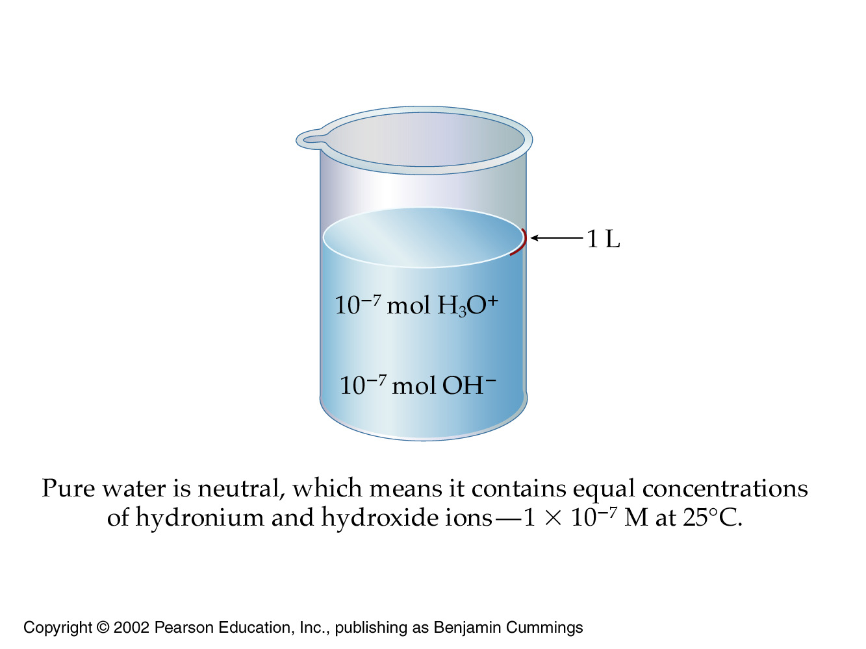
K_{w} @ 25ºC
Pure water alone dissociates to form hydronium and hydroxide ions
But in pure neutral water, the concentrations of H⁺ and OH⁻ must be equal since neither can dominate
[H⁺ ] = [OH⁻] = 1.00 × 10⁻⁷ M
© 2013 Pearson Education, Inc.

Slide 69
K_{w} @ 25ºC
So when no ‘outside’ proton source (acid) or proton acceptor (base) is added
the purified water sample is always neutral
meaning its hydronium and hydroxide concentrations must be equal
meaning: [H⁺ ] = [OH⁻] = 1.00 × 10⁻⁷ M

Slide 70
K_{w} @ 25ºC
The ion-product constant for water (K_{w})…
is the H⁺ concentration times the OH– concentration
so K_{w} = [H⁺ ][OH⁻] = 1.00 × 10^{–14} (no label)
(No denominator because it would be a solvent)
Amazingly, it turns out that
The product of [H⁺] and [OH⁻] is always 1.00 × 10^{–14}
In all aqueous solutions @25ºC, not just in pure, neutral water
© 2013 Pearson Education, Inc.

Slide 71
K_{w} @ 25ºC
Thus we can always determine the concentration of one species
if we know the concentration of the other
K_{w} = [H⁺ ][OH⁻] = 1.00 × 10^{–14}
© 2013 Pearson Education, Inc.

Slide 72
Solutions are identified as acidic, neutral, or basic (alkaline) according to the value of their H₃O⁺ and OH– concentrations
Acidic solution: [H₃O⁺] > 10^{–7} M => [OH–] < 10^{–7} M
Basic solution: [H₃O⁺] < 10^{–7} M => [OH–] > 10^{–7} M
Neutral solution: [H₃O⁺] = 10^{–7} M => [OH–] = 10^{–7} M
© 2013 Pearson Education, Inc.

Slide 73
For the next work problem
K_{w} = [H⁺ ][OH⁻] = 1.00 × 10^{–14}

Slide 74
Water Dissociation Constant: Using K_{w} to Calculate [OH–]
Milk has an H₃O⁺ concentration of 4.5 × 10^{–7} M
What is the value of [OH–]? Is milk acidic, neutral, or basic?
Since [H₃O⁺] at 4.5 × 10^{–7} M is larger than 10^{–7} M,
the solution is slightly acidic

Slide 75
10.7 Measuring acidity in aqueous solutions: pH
Love your calculator!
© 2013 Pearson Education, Inc.

Slide 76
The need for a pH scale
Slight changes in concentrations of hydronium or hydroxide ion can have enormous consequences
Biologically, changing hydronium ion concentration even slightly will result in death
Concentrations written in Molarity are inconvenient because the numbers are typically so small
pH provides a more convenient scale for working with acid and base concentrations

Slide 77
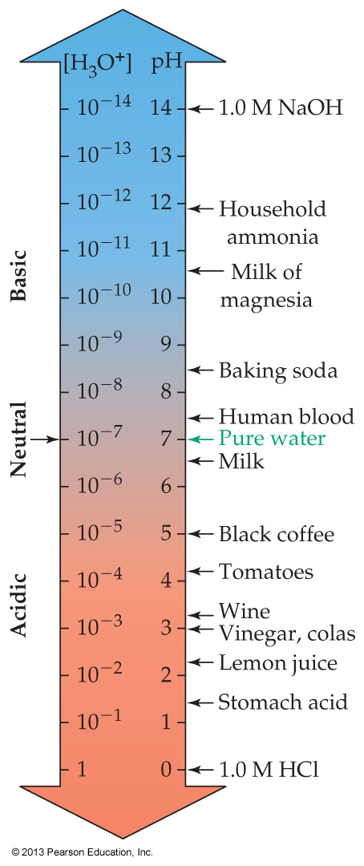
Know your calculator!!
The pH of an aqueous solution is a number, usually between 0 and 14
This number indicates the H₃O⁺ concentration of the solution
pH = –log[H₃O⁺]
A pH smaller than 7 corresponds to an acidic solution
A pH larger than 7 corresponds to a basic solution
A pH of exactly 7 corresponds to a neutral solution
© 2013 Pearson Education, Inc.

Slide 78
What is the pH of a 0.10 M HNO₃ solution?
0.010
0.10
1.0
10.
LOG: pH = – log[H₃O⁺]
ANTILOG: [H₃O⁺] = 10^{–pH}

Slide 79
Acidic solution: pH < 7 [H₃O⁺] > 10^{–7}
Basic solution: pH > 7 [H₃O⁺] < 10^{–7}
Neutral: pH = 7 [H₃O⁺] = 10^{–7}
The pH scale covers an enormous range of acidities because it is logarithmic
A change of 1 pH unit means a tenfold change in H₃O⁺
a change of 3 pH units represents a thousand fold change
Calculations can often be simplified by realizing that pH + pOH = 14
© 2013 Pearson Education, Inc.

Slide 80
What other scale is logarithmic?
earthquake scale

Slide 81
10.8 Working with pH
Calculators!
© 2013 Pearson Education, Inc.

Slide 82
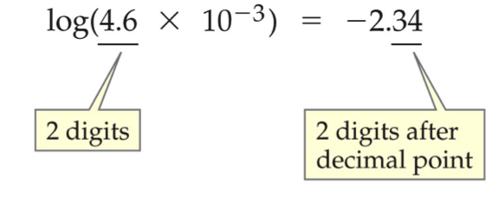
Converting from [H₃O⁺] to pH requires taking the negative of the logarithm of the molarity, M
This is done on most calculators with a log key
Consult your calculator instructions if you are not sure how to use these keys (bring your own calculator!!)
© 2013 Pearson Education, Inc.

Slide 83
Converting from [H₃O⁺] to pH requires taking the negative of the logarithm of the molarity, M
This is done on most calculators with a log key
Consult your calculator instructions if you are not sure how to use these keys (bring your own calculator!!)
Remember that the sign of the number given by the calculator will have to be changed to get the pH
pH = 2.34
© 2013 Pearson Education, Inc.

Slide 84
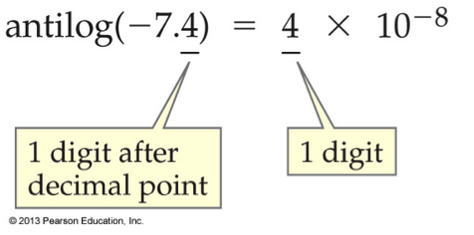
Converting from pH back to [H₃O⁺] requires finding the antilogarithm of the negative pH
This is done on many calculators with a 10^{x} or an INV plus the log key (but not on all calculators)
© 2013 Pearson Education, Inc.

Slide 85
Converting from pH back to [H₃O⁺] requires finding the antilogarithm of the negative pH
This is done on many calculators with a 10^{x} or an INV plus the log key (but not on all calculators)
Before pressing the antilog button you will also have to be able to convert a number to its negative or vice versa
Consult your calculator instructions if you are not sure how to use these keys (bring your own calculator!!)
© 2013 Pearson Education, Inc.

Slide 86
Sig Figs
The rule for keeping track of significant figures is very unusual using Logs
© 2013 Pearson Education, Inc.

Slide 87
Wine has a pH of 3.5. What is the hydronium concentration ([H₃O⁺]) of wine?
3 × 10⁻⁴ M
3.1 × 10⁻¹¹ M
10.5 M
3.5 × 10⁻² M

Slide 88
10.9 Laboratory Determination of pH
© 2013 Pearson Education, Inc.

Slide 89
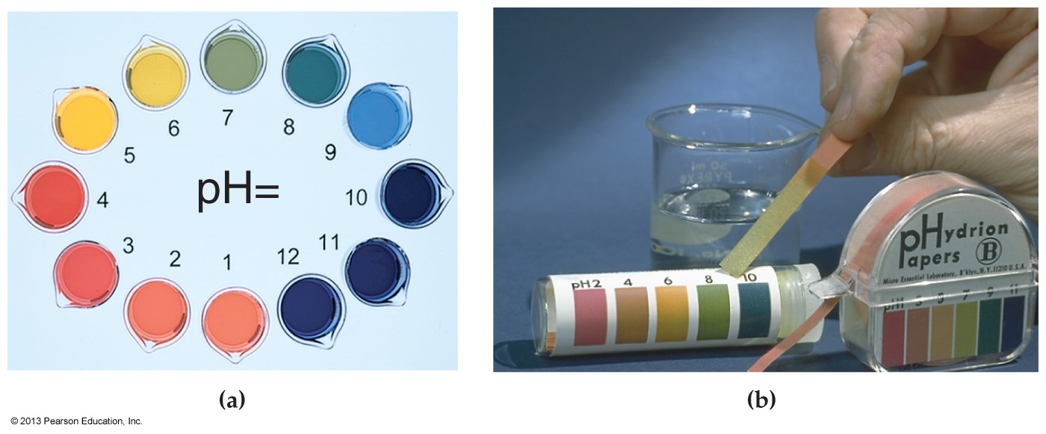
The simplest but least accurate method of pH determination is acid–base indicators
These change color depending on the pH of the solution
Test kits contain a mixture of indicators known as universal indicator that give approximate pH measurements in the range 2–10
© 2013 Pearson Education, Inc.

Slide 90
pH paper makes it possible to determine pH simply by putting a drop of solution on the paper and comparing the color that appears on the paper to the color on a calibration chart
© 2013 Pearson Education, Inc.

Slide 91
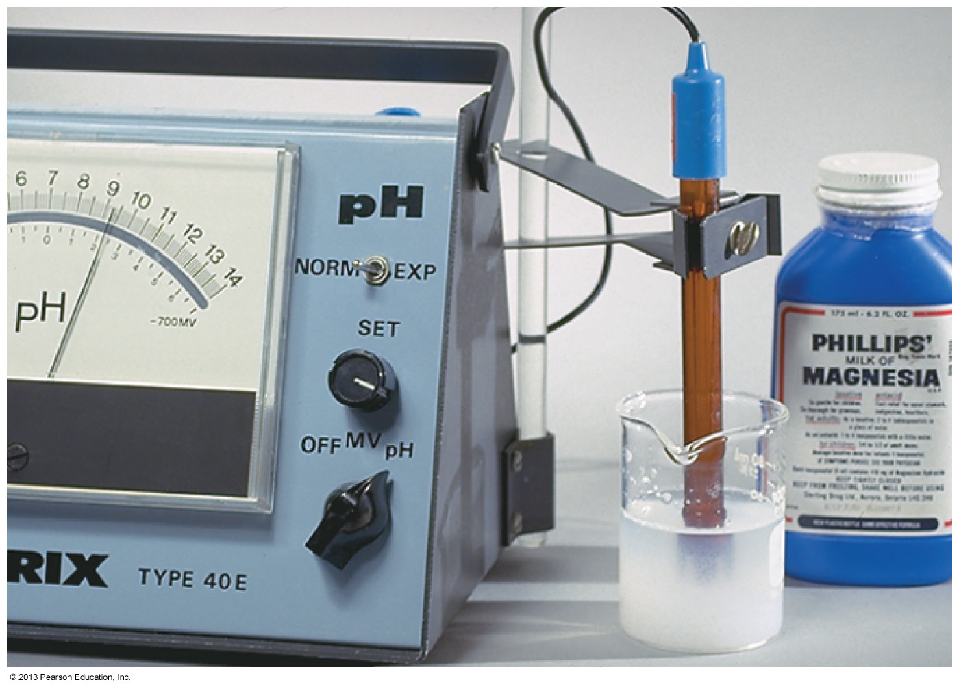
A much more accurate way to determine pH is an electronic pH meter. Electrodes are dipped into the solution, and the pH is read from the meter
© 2013 Pearson Education, Inc.

Slide 92
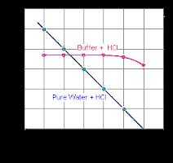
10.10 Buffer Solutions
Buffering protects solutions from large shifts in pH, upon
the addition of moderate amounts of strong acid or base
© 2013 Pearson Education, Inc.

Slide 93
A buffered solution – resists a change in its pH when either strong acid or a strong base has been added
The buffer works its magic via the combined presence of both a weak acid and its conjugate base…
Or the combined presence of a weak base and its conjugate acid

Slide 94
Commercial buffers are typically prepared by making solutions from equal concentrations of weak acids and their conjugate bases in purified water
Acetic acid Acetate ion
CH₃COOH (HAc) CH₃COO⁻ (Ac⁻)
Carbonic acid Bicarbonate ion
H₂CO₃ HCO₃⁻
Hydrofluoric acid Fluoride ion
HF F⁻
Ammonium ion Ammonia
NH₄⁺ NH₃

Slide 95
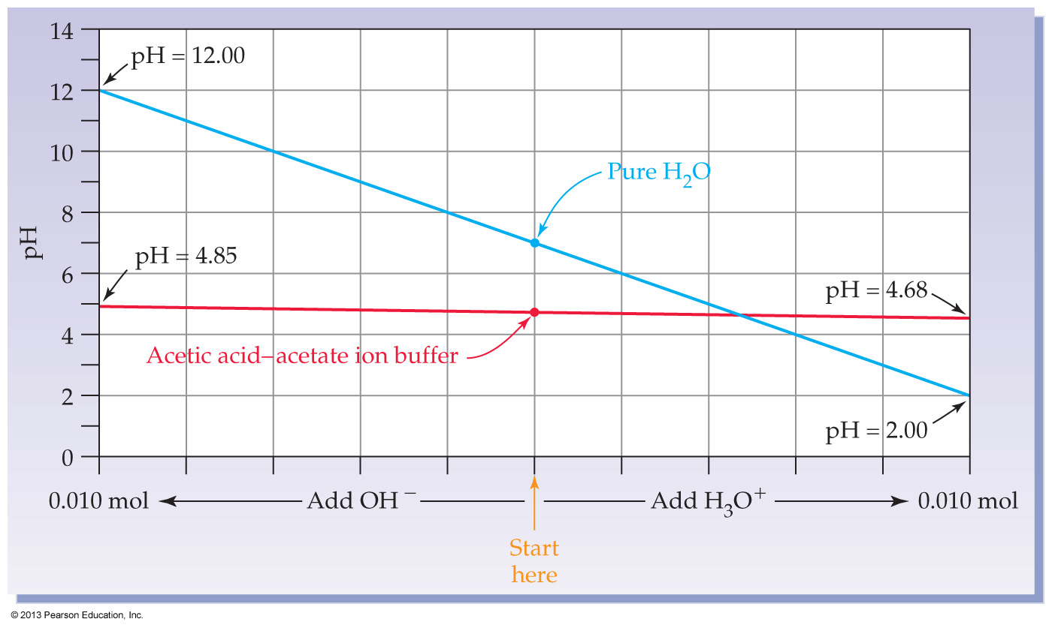
Consider the industrially important
acetic acid (0.1M)—acetate (0.1M) buffer
pH 0.1 M acetic ≈ 2.9
pH 0.1 M sodium acetate ≈ 8.9
pH of the buffer combo ≈ 4.7

Slide 96
CH₃CO₂H(aq) + H₂O(l) H₃O⁺(aq) + CH₃CO₂⁻(aq)
(0.10 mole in solution) (0.10 mole in solution)
Say we have a buffer solution where [HAc] = [Ac⁻]
it will have a pH of about 4.7
Say we now add enough strong acid (HCl) to convert 0.010 mole (10%) of the weakly basic Ac⁻ into weakly acidic HAc
the pH will only drop to about 4.6
Say instead we add enough strong base to eliminate a similar amount of HAc
the pH will only rise to about 4.8

Slide 97
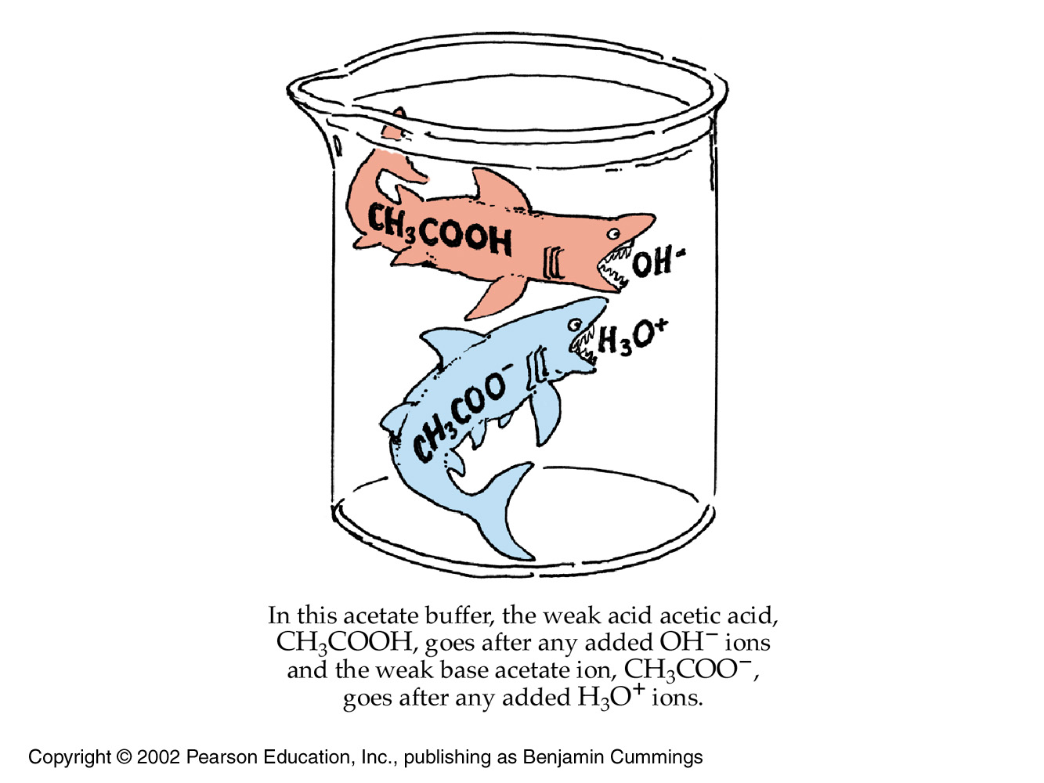

Slide 98
FYI
Buffer systems cannot be made with strong acids and their conjugate bases
Because the ‘conjugate base’ of a strong acid is actually neutral – not basic at all
The conjugate base of HCl is Cl⁻ (as in NaCl)
Adding NaCl to a solution of HCl will not stabilize the pH against the addition of more acid or base
Indeed, adding NaCl will not change the pH at all because Cl⁻ is utterly neutral!

Slide 99
pH 0.1 M acetic ≈ 2.9
pH 0.1 M sodium acetate ≈ 8.9
pH of the buffer combo ≈ 4.7

Slide 100
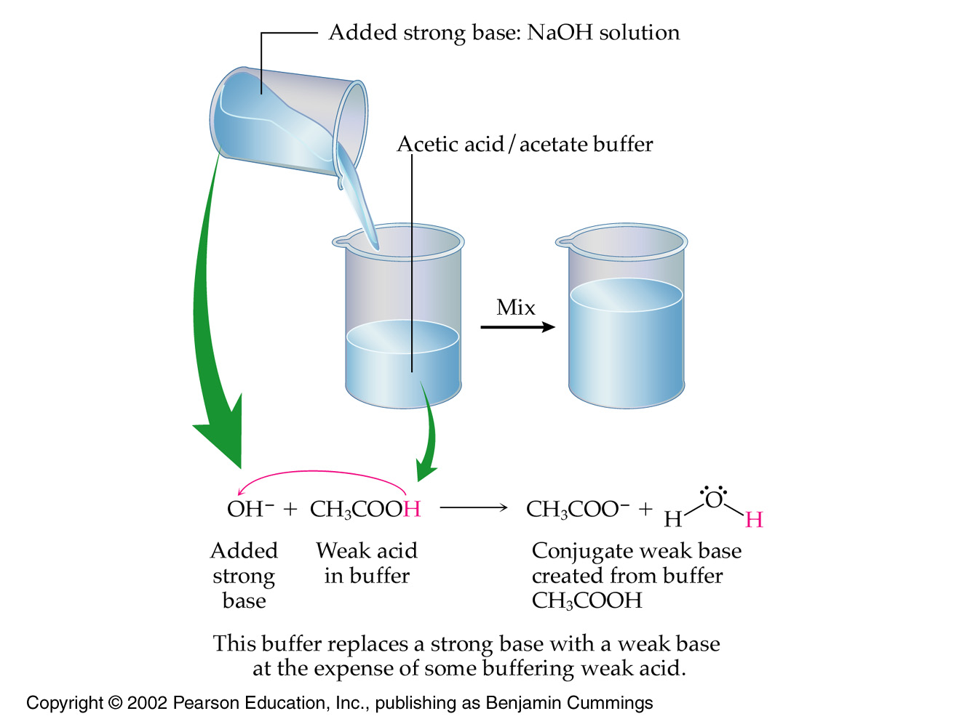

Slide 101
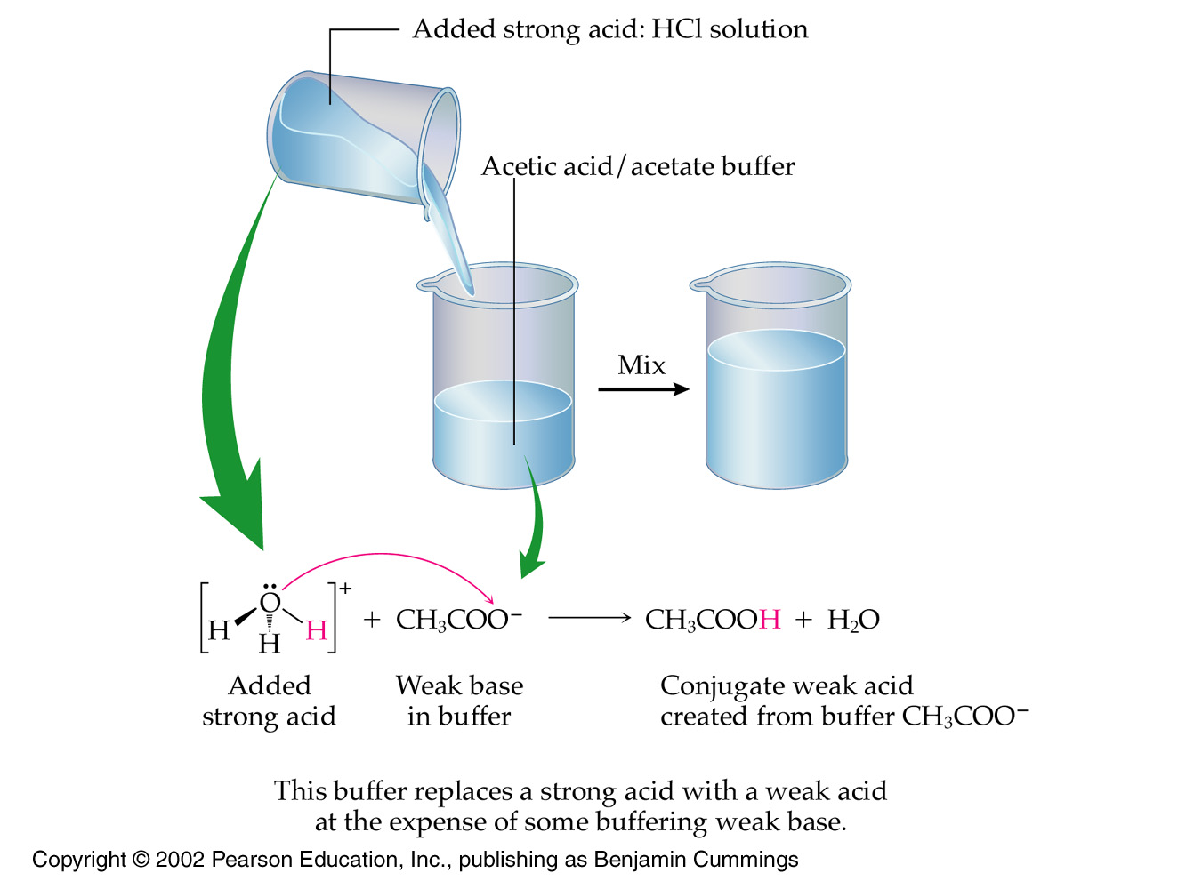

Slide 102
(Use for the next slide) Some weak bases and their conjugate acids
Acetate ion Acetic acid
CH₃COO⁻ CH₃COOH
Bicarbonate ion Carbonic acid
HCO₃⁻ H₂CO₃
Fluoride ion Hydrofluoric acid
F⁻ HF
Ammonia Ammonium ion
NH₃ NH₄⁺

Slide 103
Concept Check
If a solution is buffered with NH₃ to which has been added NH₄Cl, what reaction will occur if a strong base such as NaOH is added?
a) NaOH + NH₃ → NaNH₄O
b) NaOH + NH₄⁺ → Na⁺ + NH₃ + H₂O
c) NaOH + Cl– → NaCl + OH–
d) NaOH + H₂O → NaH₃O₂
Notes:
The correct answer is b. NH₄Cl is a strong electrolyte and dissolves to form NH₄⁺ and Cl–. NH₄⁺ is the conjugate acid of NH₃ and it will react with a strong base to form its conjugate base, NH₃ plus water.

Slide 104
FYI
Without buffering, the pH of our 5 liters of blood (7.4) would drop dramatically with even a tiny contamination from our own gastric juices (HCl – strong acid)
Even a mild ulcer would result in immediate death!
So organisms without buffering did not live long enough to reproduce

Slide 105
FYI
Maintaining a constant pH of blood and other bodily fluids within narrow limits is essential to homeostasis and is accomplished in nature through the use of natural buffers
The body uses a complicated 3-buffer system which is too complicated for Intro Chem
All simple buffer solutions are mixtures of a weak acid and its conjugate base
or a weak base and its conjugate acid
© 2013 Pearson Education, Inc.

Slide 106
start

Slide 107
Now for some mild-mannered math
The Henderson-Hasselbalch equation

Slide 108
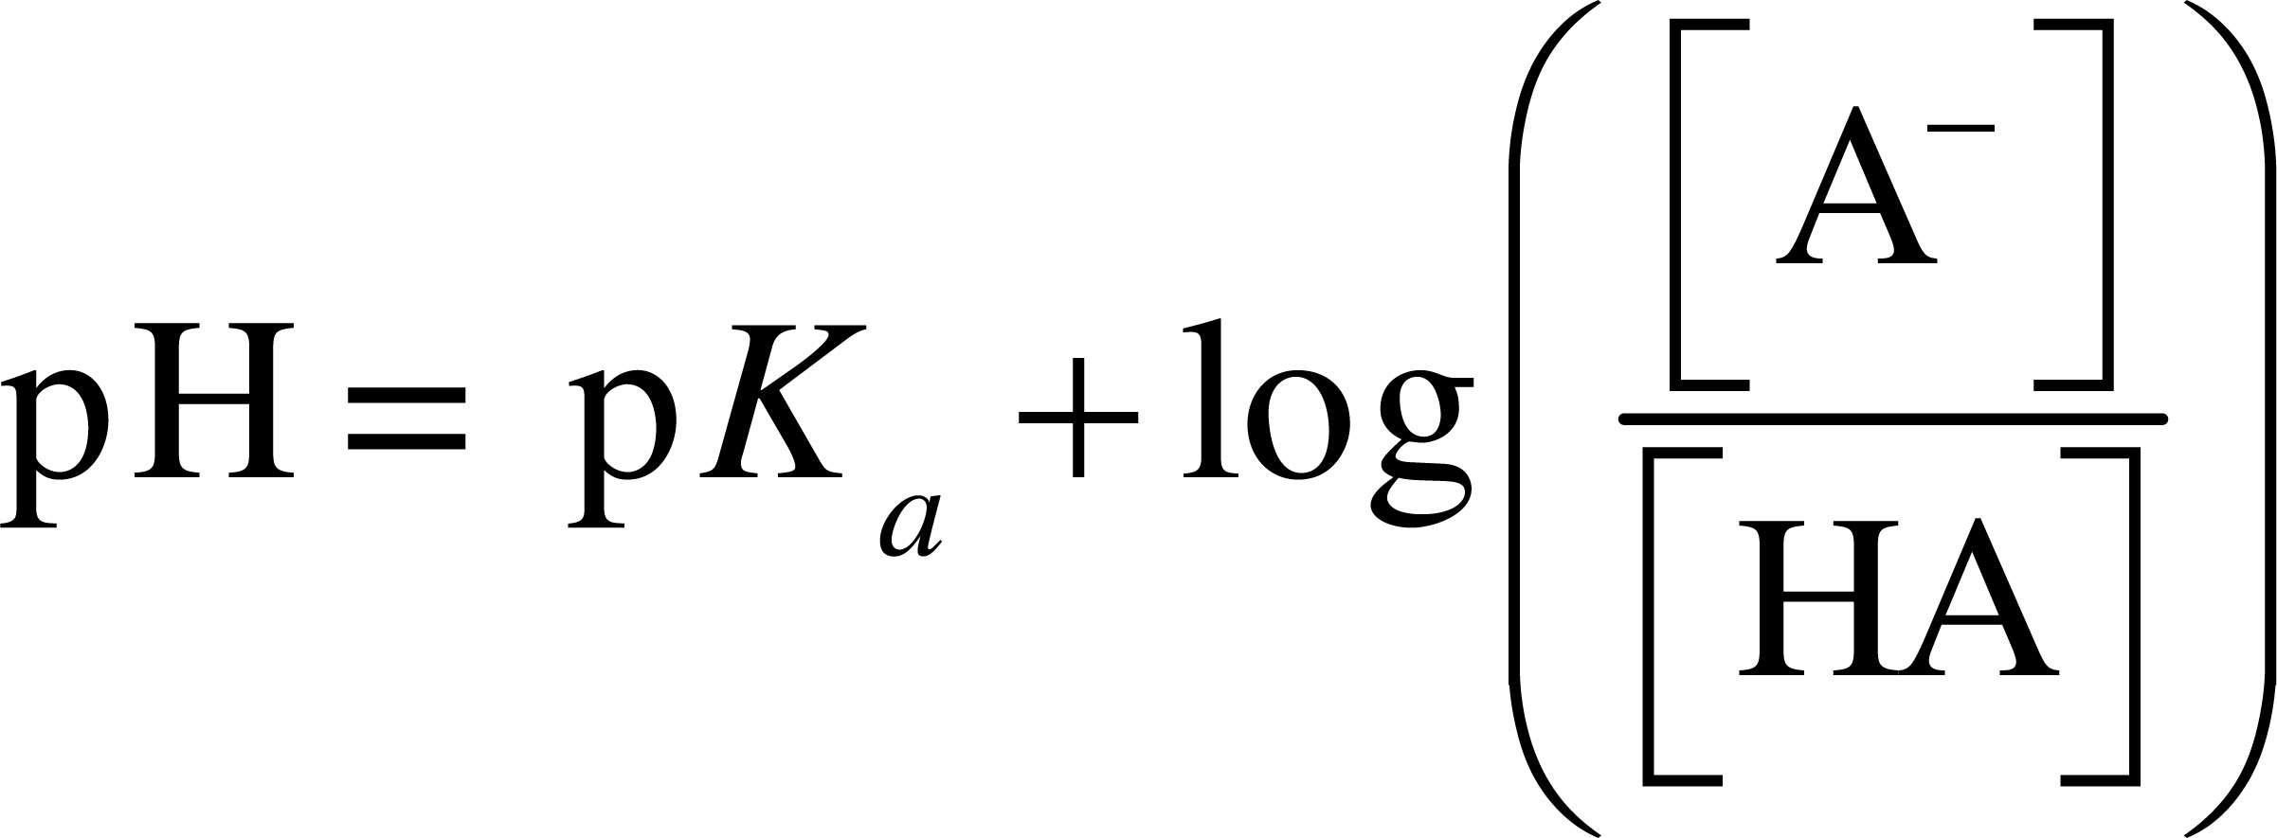
Henderson-Hasselbalch equation
The Henderson-Hasselbalch equation allows quick calculation of the pH of any buffer solution
Once the concentrations are plugged in

Slide 109
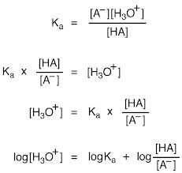
FYI: Henderson-Hasselbalch equation: Derivation
More rearrangements: H₂O + HA A⁻ + H₃O⁺
Now recall that pH = −log[H₃O⁺]
Similarly, pK_{a} = −logK_{a}

Slide 110
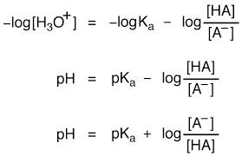
FYI: Henderson-Hasselbalch equation: Derivation
So multiplying through by (−) to give positive pH / pK_{a} values yields the famous Henderson-Hasselbalch equation
Note that the bottom two equations for the pH of a buffer are equivalent
via the rules of algebra

Slide 111
This is the form your book uses
Where HA is the weak acid and A– is the conjugate base
© 2013 Pearson Education, Inc.

Slide 112
Making buffer solutions

Slide 113
The effective pH range of a buffer depends on the pK_{a} of the acid plus the the log₁₀ of [HA] / [A⁻]
Equal concentrations of acid and conjugate base are normally employed to make fresh buffer
Thus the charge-ratio of [HA] to [A–] is 1 for a fresh buffer solution
this makes the log term equal to zero
Meaning pH = pK_{a} of the chosen acid in a fresh solution
For best results, a weak acid should be chosen that has a pK_{a} that is close to the desired pH of the buffer solution
© 2013 Pearson Education, Inc.

Slide 114
pH 0.1 M acetic ≈ 2.9
pH 0.1 M sodium acetate ≈ 8.9
pH of the buffer combo ≈ 4.7

Slide 115
CH₃CO₂H(aq) + H₂O(l) H₃O⁺(aq) + CH₃CO₂⁻(aq)
(0.10 mole in solution) (0.10 mole in solution)
Note that adding 0.010 moles of a strong acid (HCl) will remove 10% of the conjugate base A⁻ (CH₃CO₂⁻)
This shifts the equilibrium to the left
[HA] increases, [A⁻] decreases
But as long as changes to [A⁻]/[HA] are relatively moderate, there will be little change in calculated pH

Slide 116
A 0.10 M solution of ammonium ion, NH₄⁺, has a pH of 5.6. Ammonium ion is a
strong acid.
weak acid.
strong base.
weak base.

Slide 117
Some weak acids and their pK_{a} values are listed below. Which is the strongest acid?
Acetic acid, pK_{a} = 4.74
Ascorbic acid, pK_{a} = 4.10
Formic acid, pK_{a} = 3.74
Propanoic acid, pK_{a} = 4.89

Slide 118
Some weak acids and pK_{a} values are listed below. Which acid would be most appropriate to prepare a pH 4.50 buffer solution?
Acetic acid, pK_{a} = 4.74
Ascorbic acid, pK_{a} = 4.10
Formic acid, pK_{a} = 3.74
Propanoic acid, pK_{a} = 4.89

Slide 119
© 2013 Pearson Education, Inc.

Slide 120
Worked Example 10.13 Buffers: Calculating the pH of a Buffer Solution
What is the pH of a buffer solution that contains 0.100 M HF and 0.120 M NaF?
The K_{a} of HF is 3.5 × 10^{–4}
so pK_{a} = 3.46

Slide 121
FYI: Biological buffer systems
The pH of body fluids is maintained by three major buffer systems.
The carbonic acid–bicarbonate system and the dihydrogen phosphate–hydrogen phosphate system depend on weak acid–conjugate base interactions.
The third buffer system depends on the ability of proteins to act as either proton acceptors or proton donors at different pH values.
© 2013 Pearson Education, Inc.

Slide 122
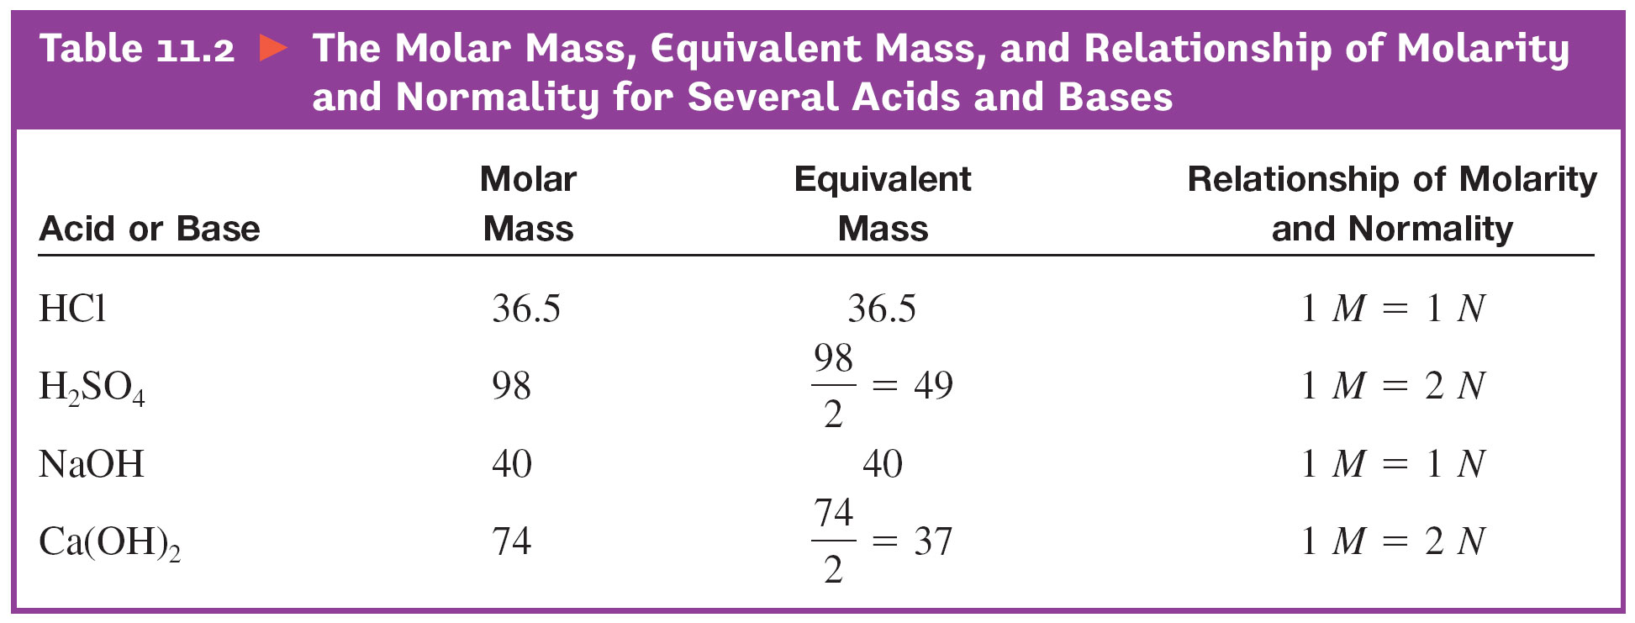
10.11 Acid and Base Equivalents
© 2013 Pearson Education, Inc.

Slide 123
Ch 9: We studied equivalents of biologically significant electrolytes
Na⁺, Ca²⁺, Cl⁻, SO₄²⁻, etc
Ch 10: We study equivalents of
H⁺ and OH⁻
© 2013 Pearson Education, Inc.

Slide 124
Vocabulary
The term ‘equivalents’ is only used for ionic species
You can have equivalents of acids, bases or ions
but you cannot have equivalents of a non-ionizable molecule like sugar
The term ‘normality’ (N) is reserved for acids and bases only

Slide 125
Equivalent: a unit of concentration
One equivalent of acid – an amount of acid that furnishes 1 mol of H⁺ ions
One equivalent of base – an amount of base that furnishes 1 mol of OH⁻ ions
We will discover that one equivalent of an acid neutralizes exactly one equivalent of a base

Slide 126
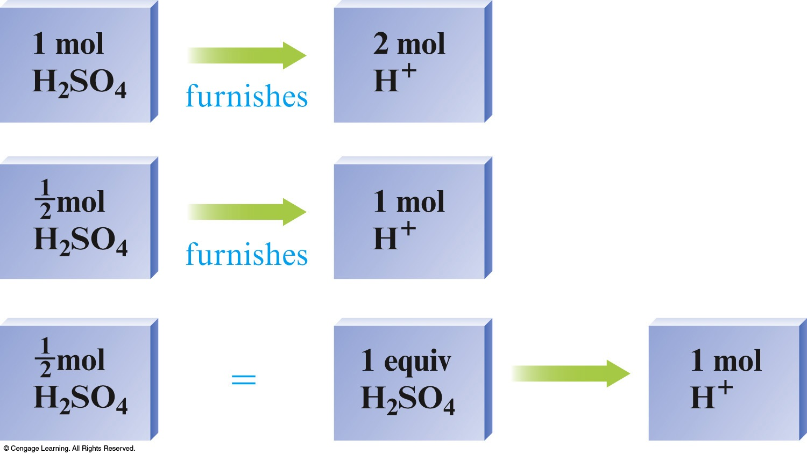

Slide 127
Reaction of Acids with Hydroxide Ion
So when a diprotic acid like sulfuric is used, we have to be careful in counting ‘equivalents’
We will get into the math of titration later
© 2013 Pearson Education, Inc.

Slide 128
Notice the columns for
‘Equivalent Mass,’ and
‘Relationship of Molarity and Normality’

Slide 129
Given Normality, N and volume, V
you can calculate the number of equivalents

Slide 130
How many equivalents of Ca(OH)₂ are in 2 liters of a 20N solution Ca(OH)₂?
40 eq

Slide 131
How many equivalents of base are there in 4 mol Ca(OH)₂?
a) 2
b) 4
c) 8
d) 16

Slide 132
Mass to Equivalent Conversion for Diprotic Acid
How many equivalents are in 3.1 g of the diprotic acid H₂S (34.0 g/mol)?
The number of acid or base equivalents is calculated by doing a gram to mole conversion using molar mass as the conversion factor and then multiplying by the number of H⁺ ions produced.

Slide 133
Why is the term ‘Equivalent’ useful
Because one equivalent of an acid neutralizes one equivalent of a base

Slide 134
Neutralization using normality

Slide 135
Considered as an ‘H⁺ delivery vehicle,’ sulfuric acid is twice as effective as hydrochloric acid
You would only have to weigh out half as many moles of sulfuric acid

Slide 136
49 grams of sulfuric acid neutralizes:
40 grams of sodium hydroxide, or
37 grams of calcium hydroxide

Slide 137
36.5 grams of hydrochloric acid neutralizes:
40 grams of sodium hydroxide, or
37 grams of calcium hydroxide

Slide 138
To get the Normality of an acid:
Multiply the Molarity (M) by the number of protons (H⁺) per acid formula unit
HCl = 1 proton ∴ 1M = 1N
H₂SO₄ = 2 protons ∴ 1M = 2N

Slide 139
Give the Normalities for 1M solutions of each of these acids in water

Slide 140
So the values of molarity (M) and normality (N) are the same for monoprotic acids, but are not the same for diprotic or triprotic acids
1 N HCl = 1 M HCl
1 N H₂SO₄ = 0.5 M H₂SO₄
1 N H₃PO₄ = 0.33 M H₃PO₄
© 2013 Pearson Education, Inc.

Slide 141
To get the Normality of a base:
Multiply the molarity (M) by the number of hydroxides (OH⁻) per base formula unit
NaOH = 1OH⁻ ∴ 1M = 1N
Ca(OH)₂ = 2OH⁻ ∴ 1M = 2N

Slide 142
What is the normality, N of a solution that contains 10 mol of Ca(OH)₂ in 1 liter ?
Let’s calculate its molarity M first
Then refer to the table below
20 N

Slide 143
Looking ahead
The concept of Normality vs Molarity allows us to use a modified version of the molarity dilution equation
This will greatly simplify titration calculations
M_{c} × V_{c} = M_{d} × V_{d}
from the dilution chapter evolves into:
N_{acid} × V_{acid} = N_{base} × V_{base}

Slide 144
10.12 Some Common Acid-Base Reactions (lightly)
© 2013 Pearson Education, Inc.

Slide 145
Reaction of Acids with Bicarbonate and Carbonate Ion
Bicarbonate ion reacts with acid by accepting H⁺ to yield carbonic acid, H₂CO₃
Carbonic acid decomposes to carbon dioxide gas and water
© 2013 Pearson Education, Inc.

Slide 146
Reaction of Acids with Bicarbonate and Carbonate Ion
Bicarbonate ion reacts with acid by accepting H⁺ to yield carbonic acid, H₂CO₃
Carbonic acid decomposes to carbon dioxide gas and water
© 2013 Pearson Education, Inc.

Slide 147
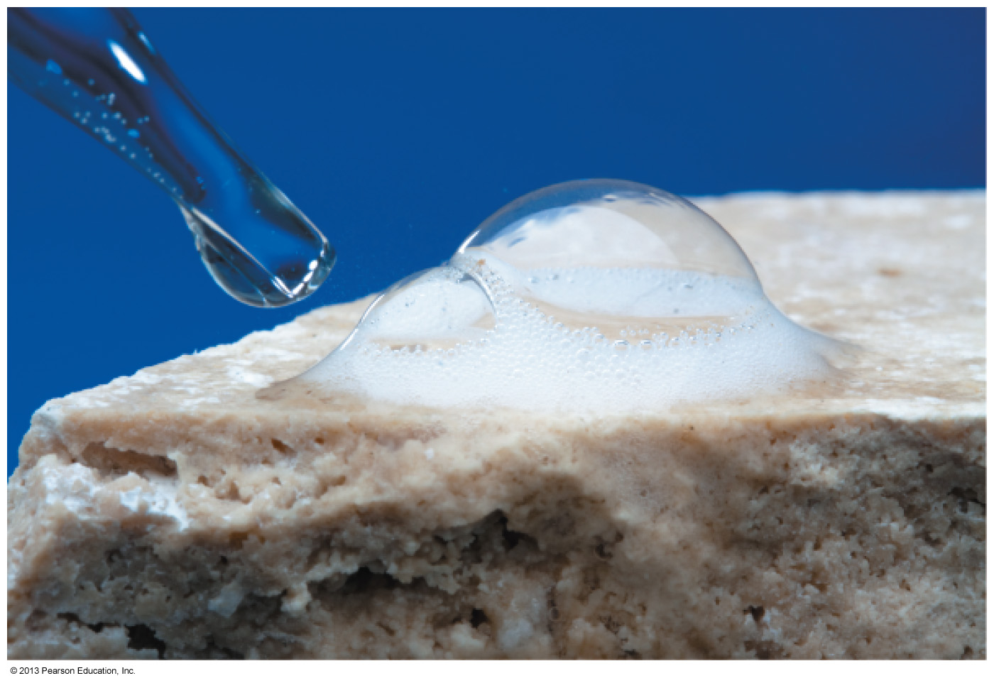
Reaction of Acids with Bicarbonate and Carbonate Ion
Most metal carbonates are insoluble in water but react easily with aqueous acid.
Geologists test for carbonate-bearing rocks by putting a few drops of aqueous HCl on the rock and watching to see if bubbles of CO₂ form.
Antacids that contain carbonates neutralize excess stomach acid.
© 2013 Pearson Education, Inc.

Slide 148
Reaction of Acids with Ammonia
Acids react with ammonia (weak base) to yield water-soluble ammonium salts
Living organisms contain amines
which contain nitrogen atoms bonded to carbon
Amines react with acids just as ammonia does
yielding water-soluble salts
found in
rotting fish
© 2013 Pearson Education, Inc.

Slide 149
10.13 Titration
Calculating total acid/base concentrations
© 2013 Pearson Education, Inc.

Slide 150
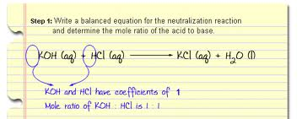
Reaction of Acids with Hydroxide Ion
Here, one equivalent (Eq) of an acidic proton completely ‘titrates’ one Eq of a basic hydroxide to yield water and a salt in a neutralization reaction
In neutralizations, the formation of water always goes to completion
© 2013 Pearson Education, Inc.

Slide 151
Neutralization of HCl with KOH
Formula equation:
HCl_{(aq)} + KOH_{(aq)} → KCl_{(aq)} + H₂O_{(l)}
Complete ionic equation
H⁺_{(aq)} + Cl⁻_{(aq)} + K⁺_{(aq)} + OH⁻_{(aq )} → K⁺_{(aq)} + Cl⁻_{(aq)} + H₂O_{(l)}
Net ionic equation
H⁺ _{(aq)} + OH⁻ _{(aq)} → H₂O_{(l)}
In acid base neutralizations, one Eq of positive charge
perfectly balances one Eq of negative charge

Slide 152
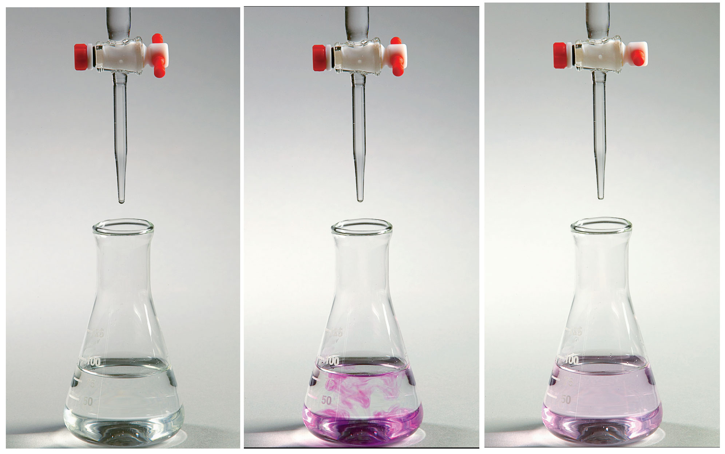
Titration of an acid solution of unknown concentration with a base solution of known concentration
© 2013 Pearson Education, Inc.

Slide 153
Titration of an acid solution of unknown concentration with a base solution of known concentration
A measured volume of acid solution is placed in the flask along with an indicator
A base of known concentration is added from a buret until the color change of the indicator shows that neutralization is complete
The end point
© 2013 Pearson Education, Inc.

Slide 154
Endpoint – the indicator changes color so you can tell the equivalence point has been reached
Note there is a difference in semantics between Equivalence point & Endpoint
The Endpoint is an approximation of the Equivalence point

Slide 155
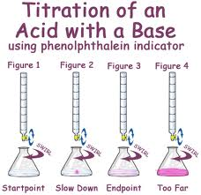

Slide 156
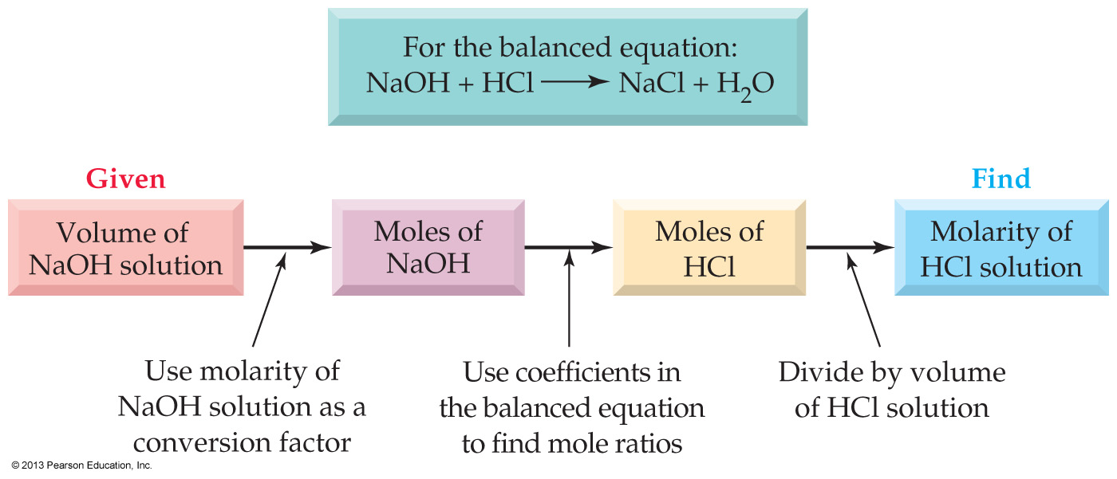
Titration of an acid solution of unknown concentration with a base solution of known concentration
© 2013 Pearson Education, Inc.

Slide 157
Titration of an acid solution of unknown concentration with a base solution of known concentration
Reading from the buret gives the volume of the NaOH solution that has reacted with the already known volume of HCl
© 2013 Pearson Education, Inc.

Slide 158
warning warning warning
All buret readings require two decimal points

Slide 159
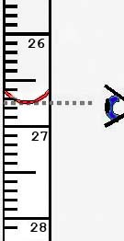
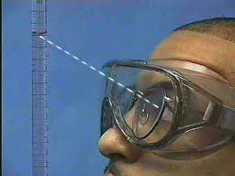
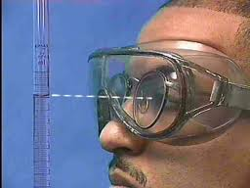
How to read a buret
Not like this
Like this

Slide 160
Reading from the buret gives the volume of the NaOH solution that has reacted with the already known volume of HCl
Knowing the concentration and volume of the NaOH solution allows calculation of the molar amount of NaOH
© 2013 Pearson Education, Inc.

Slide 161
The long, old way using moles

Slide 162
Reading from the buret gives the volume of the NaOH solution that has reacted with the known volume of HCl
Knowing the concentration and volume of the NaOH solution allows calculation of the molar amount of NaOH
The coefficients in the balanced equation allow us to find the molar amount of HCl that has been neutralized
Dividing the molar amount of HCl by the volume of the HCl solution gives the concentration
© 2013 Pearson Education, Inc.

Slide 163
The long way
0.50 L of 1.00 M NaOH was required to neutralize 2.00 L of HCl
How many moles of HCl was contained in the 2.00 L
What is the molarity of the HCl solution
Notes:
Figure 10.8 A flow diagram for an acid–base titration.

Slide 164
N_{acid} × V_{acid} = N_{base} × V_{base}
The shortcut
using equivalents

Slide 165
The concept of Normality vs Molarity allows us to use a modified version of the molarity dilution equation
This will greatly simplify titration calculations
M_{c} × V_{c} = M_{d} × V_{d}
from the dilution chapter evolves into:
N_{acid} × V_{acid} = N_{base} × V_{base}

Slide 166
In practice, all we have to do is multiply the molarity of:
an acid by the number of acidic protons
a base by the number of hydroxides
M_{c} × V_{c} = M_{d} × V_{d}
from the dilution chapter evolves into:
N_{acid} × V_{acid} = N_{base} × V_{base}

Slide 167
Titration with a diprotic acid
H₂SO₄(aq) + 2NaOH(aq) → Na₂SO₄(aq) + 2H₂O(l)
We will try to solve this first using M x V = M x V
Then we will solve correctly using N x V = N x V
Notes:
The balanced equation is: H₂SO₄ + 2NaOH → 2H₂O + Na₂SO₄. 0.500 moles of sulfuric acid is present to start. Due to the 1:2 ratio in the equation, 1.00 mol of NaOH would be required to exactly react with the sulfuric acid.
1.00 mol of sodium hydroxide would be required.

Slide 168
Titration with a diprotic acid
H₂SO₄(aq) + 2NaOH(aq) → Na₂SO₄(aq) + 2H₂O(l)
For the titration of sulfuric acid (H₂SO₄) with sodium hydroxide (NaOH), how many L of 0.200 M sodium hydroxide would be required to neutralize 1.00 L of 0.500 M sulfuric acid to reach the endpoint?
[5.00L NaOH]
Notes:
The balanced equation is: H₂SO₄ + 2NaOH → 2H₂O + Na₂SO₄. 0.500 moles of sulfuric acid is present to start. Due to the 1:2 ratio in the equation, 1.00 mol of NaOH would be required to exactly react with the sulfuric acid.
1.00 mol of sodium hydroxide would be required.

Slide 169
Concept check
For the titration of sulfuric acid (H₂SO₄) with sodium hydroxide (NaOH), how many moles of sodium hydroxide would be required to react with 1.00 L of 0.500 M sulfuric acid?
1.00 mol NaOH
Notes:
The balanced equation is: H₂SO₄ + 2NaOH → 2H₂O + Na₂SO₄. 0.500 moles of sulfuric acid is present to start. Due to the 1:2 ratio in the equation, 1.00 mol of NaOH would be required to exactly react with the sulfuric acid.
1.00 mol of sodium hydroxide would be required.

Slide 170
Measuring H⁺ concentration
of a weak acid by titration
The math for weak bases
is equal but opposite

Slide 171
Calculating total acid concentration
From pH we can calculate the H⁺ concentration, but not necessarily the total acid concentration
Because the H⁺ concentration only reflects the amount of acid that has dissociated into ions
Only with strong acids like HCl, does the H⁺ concentration equal the total acid (HCl) concentration

Slide 172
Pop quiz

Slide 173
A strong base will neutralize (titrate) all the weak acid molecules

Slide 174
0.10 M HCl has an H⁺ concentration of 0.10 M
pH = 1.00
0.10 M aqueous acetic acid has an H⁺ concentration of only 0.0013 M
pH = 2.89
But when a weak acid such as acetic is ‘titrated’ with a strong base such as NaOH, all acetic acid molecules are neutralized
not just those that would dissociate into ions in an aqueous solution

Slide 175
Remember
The hydroxide ion is such a strong base that for the purpose of stoichiometric calculations it can be assumed to react completely with any weak acid that we will encounter in Intro

Slide 176
Weak acid / strong base titration
Formula equation:
HAc_{(aq)} + NaOH_{(aq)} → NaAc_{(aq)} + H₂O_{(l)}
weak acid
Ionic Equation:
HAc_{(aq)} + Na⁺_{(aq)} + OH⁻_{(aq)} → Na⁺_{(aq)} + Ac⁻_{(aq)} + H₂O_{(l)}
Net ionic equation:
HAc_{(aq))} + OH⁻_{(aq)} → Ac⁻_{(aq)} + H₂O_{(l)}

Slide 177
Titrations: Calculating Total Acid Concentration
When a 5.00 mL sample of household vinegar is titrated
44.5 mL of 0.100 M NaOH solution is required
What is the acid concentration of the vinegar
equivalents per liter (N)
in moles per liter (M)

Slide 178
N_{a} × V_{a} = N_{b} × V_{b}
N_{a} = ?
V_{a} = 5.00 mL
N_{b} = 0.100 N
V_{b} = 45.0 mL
M_{a} = ?

Slide 179
10.14 Acidity and Basicity of Salt Solutions [Skip]
Not all salts are neutral!!!!
© 2013 Pearson Education, Inc.

Slide 180
Salt solutions can be neutral, acidic, or basic, depending on the ions present
Some ions react with water to produce H⁺ and some ions react with water to produce OH–
© 2013 Pearson Education, Inc.

Slide 181
Salt of Strong Acid + Weak Base = Acidic
A salt such as NH₄Cl which can be formed by reaction of a strong acid (HCl) with a weak base NH₃ yields an acidic solution
The Cl– ion does not react with water, but the NH₄⁺ ion is a weak acid that gives H⁺ ions
NH₄⁺ (aq) + H₂O (l) ⇆ NH₃ (aq) + H₃O⁺ (aq)
© 2013 Pearson Education, Inc.

Slide 182
Salt of Weak Acid + Strong Base = Basic
A salt such as sodium bicarbonate, which can be formed by reaction of a weak acid, H₂CO₃, with a strong base (NaOH)
yields a basic solution
The Na⁺ ion does not react with water, but the HCO₃– ion is a weak base that gives OH ions
HCO₃– (aq) + H₂O (l) ⇆ H₂CO₃ (aq) + OH–(aq)
© 2013 Pearson Education, Inc.

Slide 183
Salt of Strong Acid + Strong Base = Neutral
A salt such as NaCl, which can be formed by reaction of a strong acid (HCl) with a strong base (NaOH), yields a neutral solution
© 2013 Pearson Education, Inc.

Slide 184
Salt of Weak Acid + Weak Base = ?
Both cation and anion in this type of salt react with water
The ion that reacts to the greater extent will govern the pH
© 2013 Pearson Education, Inc.

Slide 185
Worked Example 10.18 Acidity and Basicity of Salt Solutions
Predict whether the following salts produce an acidic, basic, or neutral solution:
(a) BaCl₂ (b) NaCN (c) NH₄NO₃
Analysis
Look in Table 10.1 to see the classification of acids and bases as strong or weak.
Solution
(a) BaCl₂ gives a neutral solution because it is formed from a strong acid (HCl) and a strong base [Ba(OH)₂].
(b) NaCN gives a basic solution because it is formed from a weak acid (HCN) and a strong base (NaOH).
(c) NH₄NO₃ gives an acidic solution because it is formed from a strong acid (HNO₃) and a weak base (NH₃).

